Slide 1

Recap of survey for curved CCT former
Ernesto De Matteis
HITRIplus WP8, meeting 20
09/05/2023

Slide 2
Summary
Introduction to the design
AlBr former as possible solution (Motivations);
First construction procedure;
CERN’s list of companies – survey;
Several companies contacted;
Second construction procedure;

Slide 3
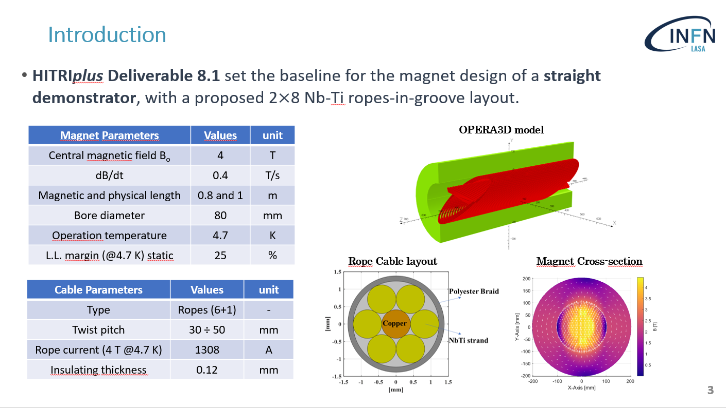
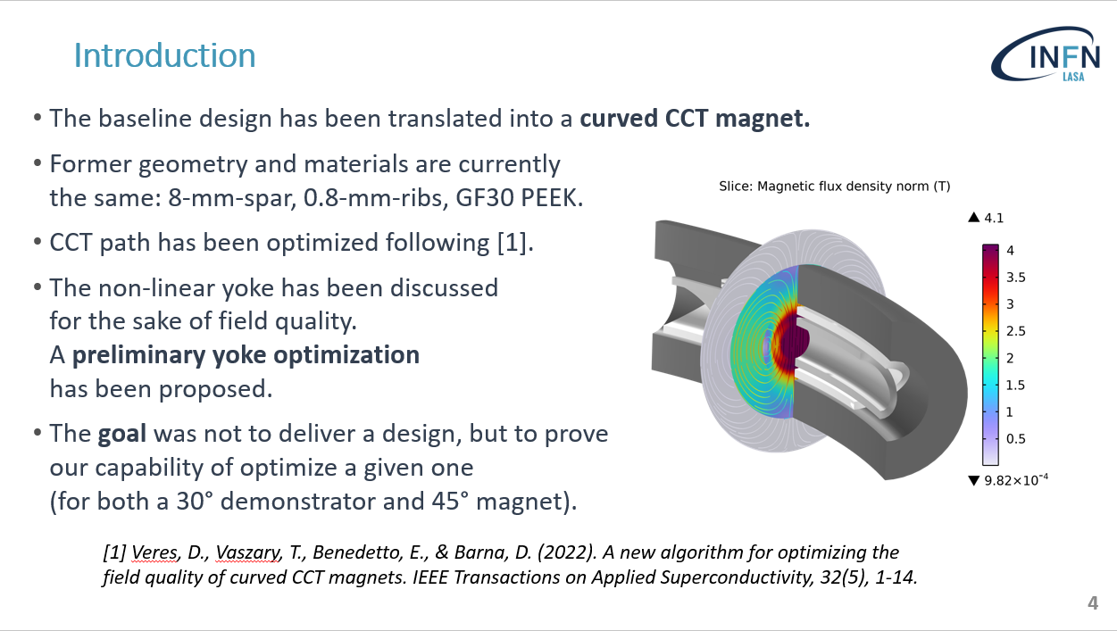
Introduction – Recap from previous Meetings

Slide 4
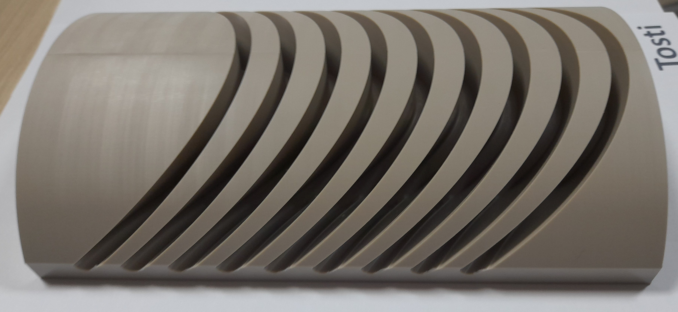
Motivations for an additional design
PEEK tests
Tests by Tosti s.r.l. promising but late in schedule. Missing full turns, gluing and cryogenic tests;
AluminiumBronze should be considered not only as a plan-B.
Mechanical tests
Minimum rib thickness of 0.7 mm realized with no issue, we can go for a “smart” 0.6 mm;
Lower rib thickness increases magnet efficiency, we may save current/ropes.
Courtesy of
Diego Perini (CERN)

Slide 5
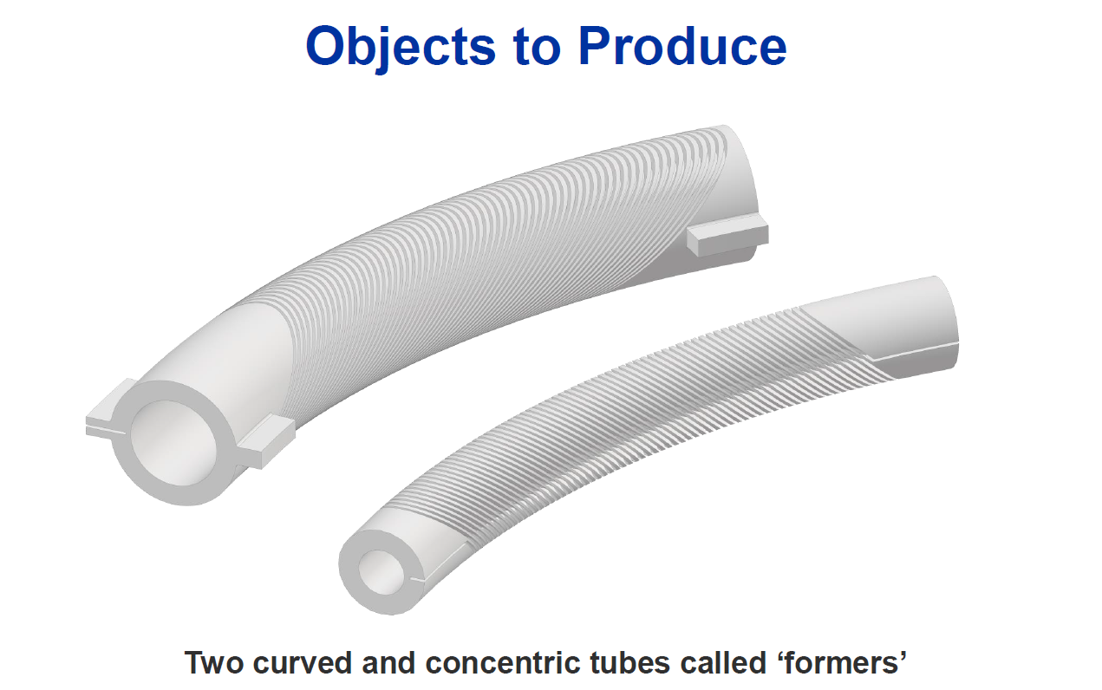
Curved AlBr former
AluminiumBronze should remain in game, guaranteeing the least delay possible;

Slide 6
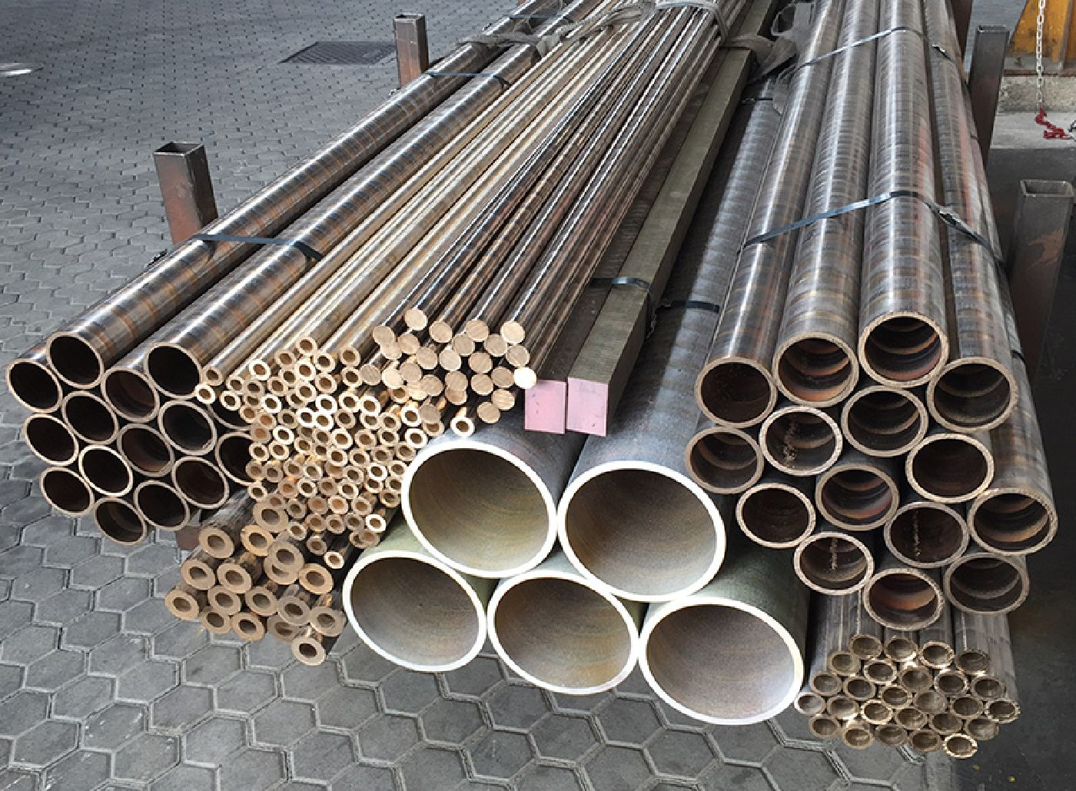
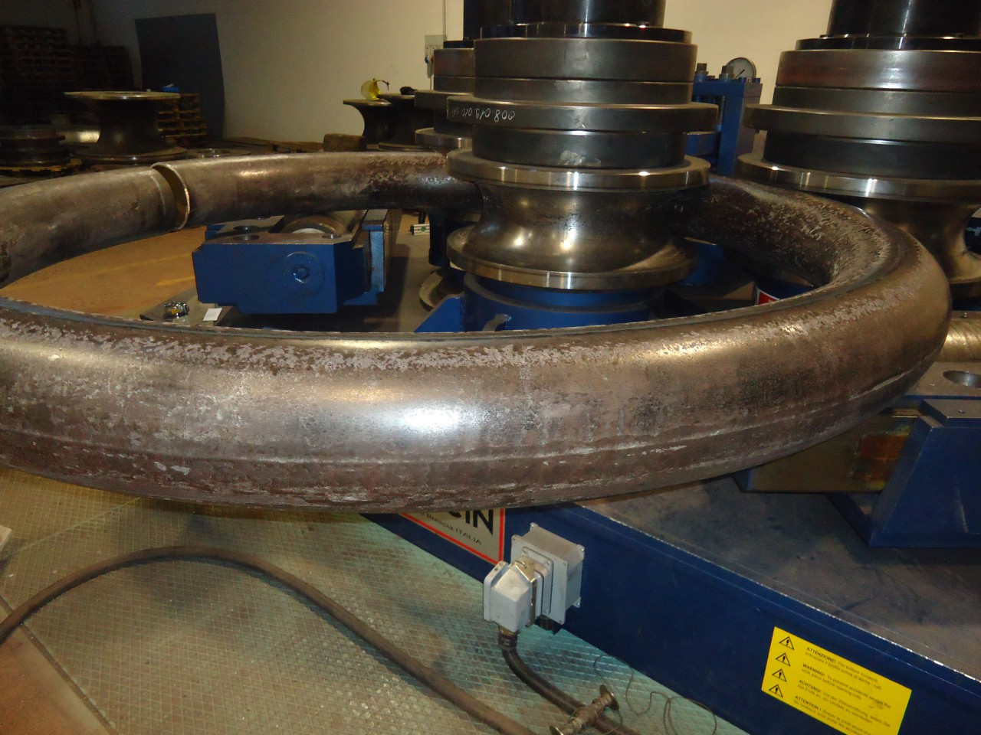
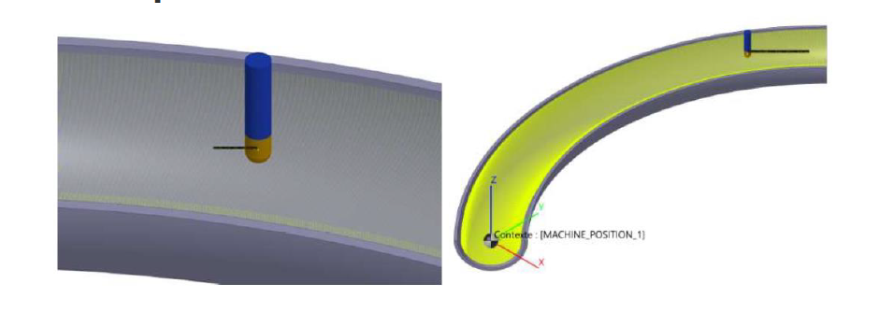
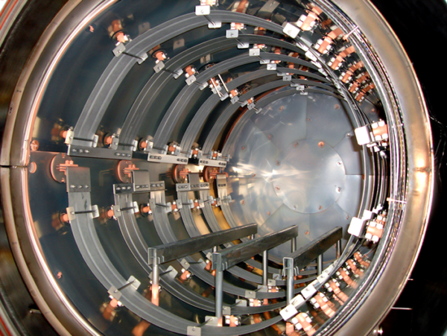
Procedural steps – #1 construction procedure
1
2
Supply of raw straight tubes of AlBr;
Bent tubes;
Split the bent tube along the longitudinal direction;
Machining of internal part;
Brazing of the two halves;
Machining of the formers’ groove;
3
4
5
6
One half of the curved tube with the milling tool (blue). The yellow indicates the machined area.

Slide 7
CERN’s list of companies
Company name | Country | Website / phone | Address | Reply | Comments
High Speed Machining AS | NO | https://hsm.as/ | Breivikvegen 16, 4120 Tau, NO | Yes | They give the availability for part of the work.
KORFIATIS ENGINEERING | GR | https://korfiatis.eu/?lang=en | 9 HAIDARIOU St, 18545 PIRAEUS, GR | No
MT SOLUTIONS AS | NO | +4791593503 | Forusbeeen 222, 4313 SANDNES, NO | No
SMP SPRL | BE | +32-43742068 | Rue de la Cale Seche 30, 4684 HACCOURT, BE | Yes | They show availability but then they disappeared.
VDL ETG | NL | +31402638777 | Hurksestraat, 5652 AH Eindhoven, NL | Yes | They can’t do it
ARGON SERVICES | UK | https://www.argonservices.co.uk | Unit 10 The Felbridge Centre Birches Industrial Estate, RH19 1XP EAST GRINSTEAD, GB | No
KANTER Mecanizados | ES | http://www.mecanizados-kanter.es/medios-productivos/centro-torneado-mazak-integrex-i300-1500-u/ | Poligono Egiburuberri Pabellon 9A ERRENTERIA 20100, ES | No
AlBr tube supplier
WISCO ESPANOLA | ES | https://www.wisco.es/en/ | Calle Mayor s/n BETELU, ES | No
HSM (Norway):
They cannot bend the AlBr tube → We should provide them the tube already bent;
They provide a quote just for the external part of the tubes (external surface + grooves)→ 42 keuros for both;
Very difficult to find a company for all the construction steps!!

Slide 8

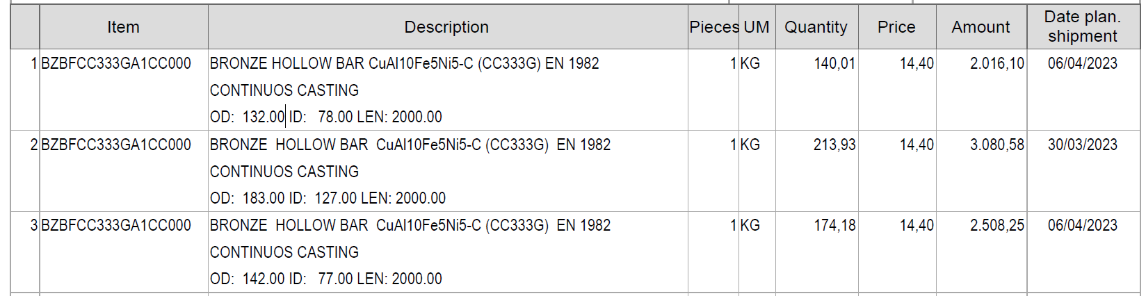

Suppliers of AlBr (CuAl10Fe5Ni5-C) tubes
Company | Reply | Comments
WISCO ESPANOLA (Spain) 'wisco@grupowisco.com' | NO
Musola Metalli (San Martino B.A. (VR), Italy) https://www.venditabronzo.it/tubi/tubi-di-bronzo-fusi.html | YES | I launched the order of three tubes (CuAl10Fe5Ni5-C) by CEA (Thibault Lecrevisse)
ORIC ITALIANA S.r.l. Castel San Giovanni (PC), Italy | YES | Prices for Kg almost double
Metalbarre, Cinisello Balsamo (MI), Italy | NO
Musola Metalli (San Martino B.A. (VR), Italy)
https://www.musolametalli.it/

Slide 9

Companies specialized in bending
Company | Reply | Comments
Farè & Spagarino (calandratura) Magnago (MI). italy | YES | They don't have the right equipment
FACS – Alba (CN), Italy | YES | They cancost for dedicated tools around 7000 euros
Tectubi Raccordi Carbonara Scrivia (Alessandria), Italy | YES | Never worked AlBr…may try
SVS srl, Schio (VI), Italy | YES | They have the right equipment and can do bend tests for 900 euros per tube – order completed for two tests
Via Lago di Levico, 3 - 36015 Schio (Vicenza)
https://www.calandraturasvs.com/
Order started in February before the CERN feedback on the Aluminium tube bending;
We can try to verify the precision of the bending for the AlBr tubes;

Slide 10

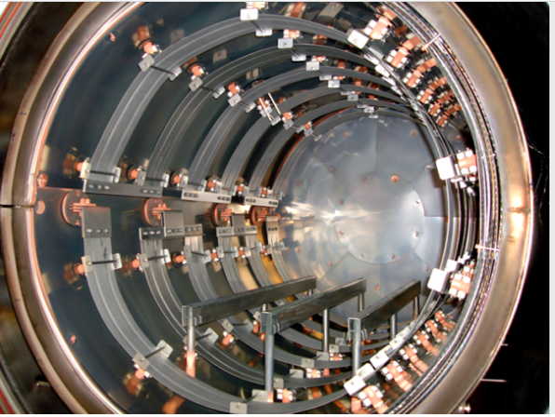
Company specialized in brazing and machining
Critical point of the first construction procedure;
Very rare capability of traditional industry (very difficult to find a company);
Found one of historical partner of CERN with a big oven for brazing
BRAZING VACUUM FURNACE
Via dell'Artigianato, 14-14/A
35010 Vigonza (Padova) - Italy
https://www.cinel.com/cinel/
They cannot bend the AlBr tube but they are very close to SVS Sandri srl;
I’m waiting for a technical and economical solution (internal and external surface machining of the two bent half tubes , brazing, and machining of the grooves);
They are also considering Stainless Steel (316L) solution;

Slide 11
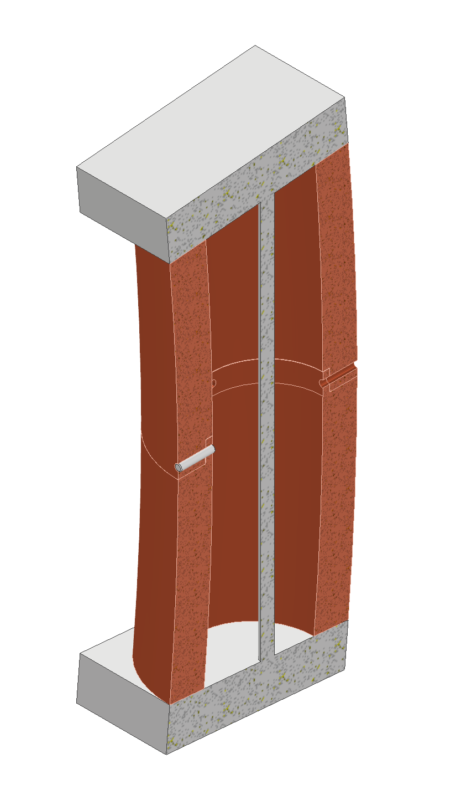
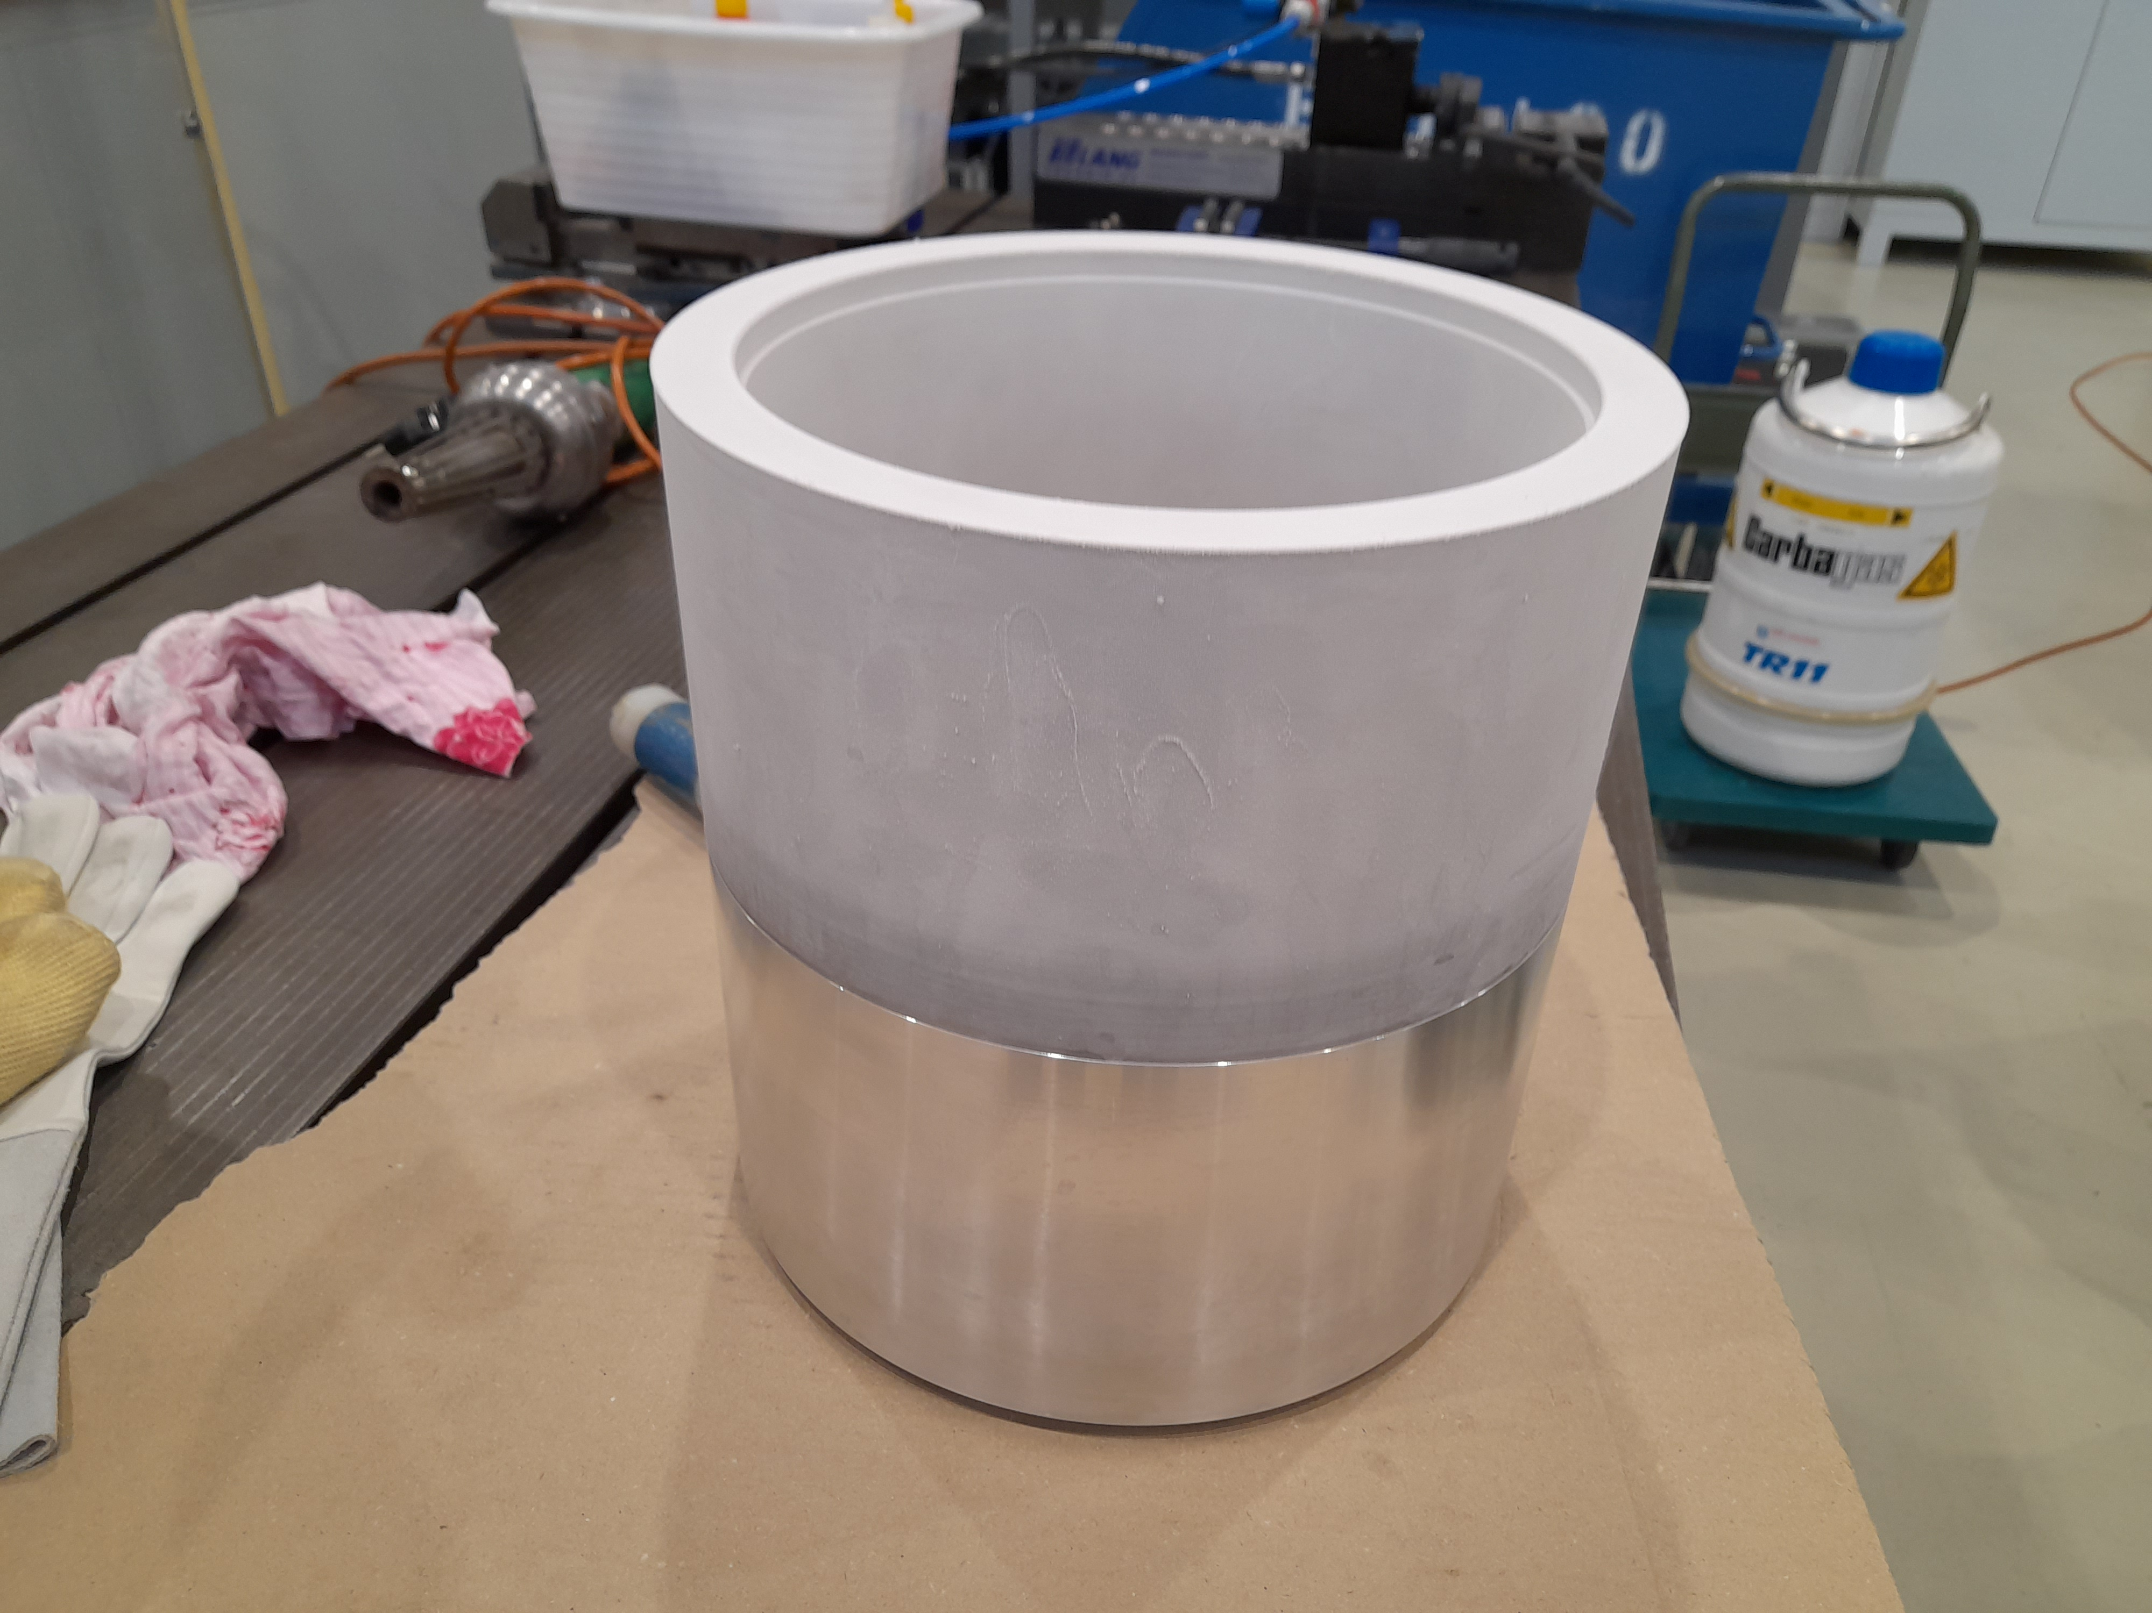
Second construction solution:
Noted the criticalities of the first solution;
  Difficulties to find a unique company able to do this kind of construction or a chain of companies capable of doing so;
We thought to follow the CERN approach with short curved tube sections;
We excluded the shrink-fitting (warm-cold) procedure, as CERN, because too risky for AlBr according to simulations (by Stefano);
We thought to join the subsections by slotted pins.
shrink-fitting (warm-cold) procedure
(courtesy of Glyn)

Slide 12
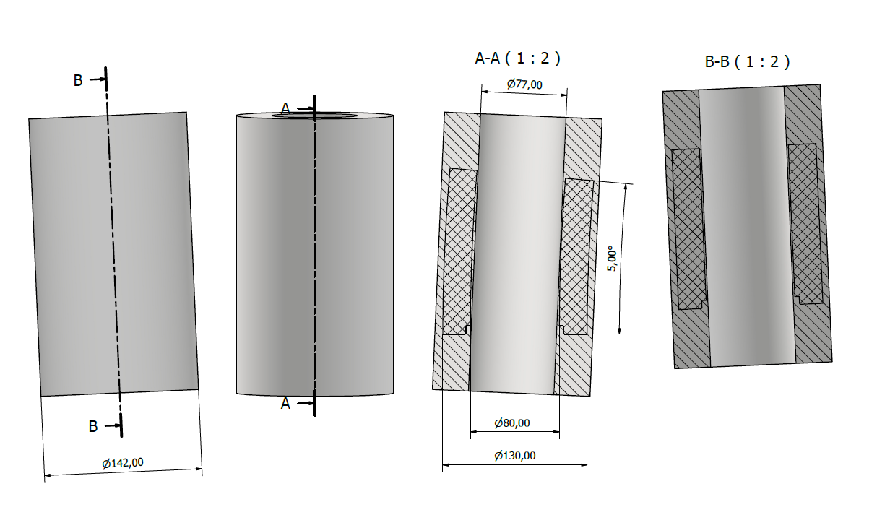
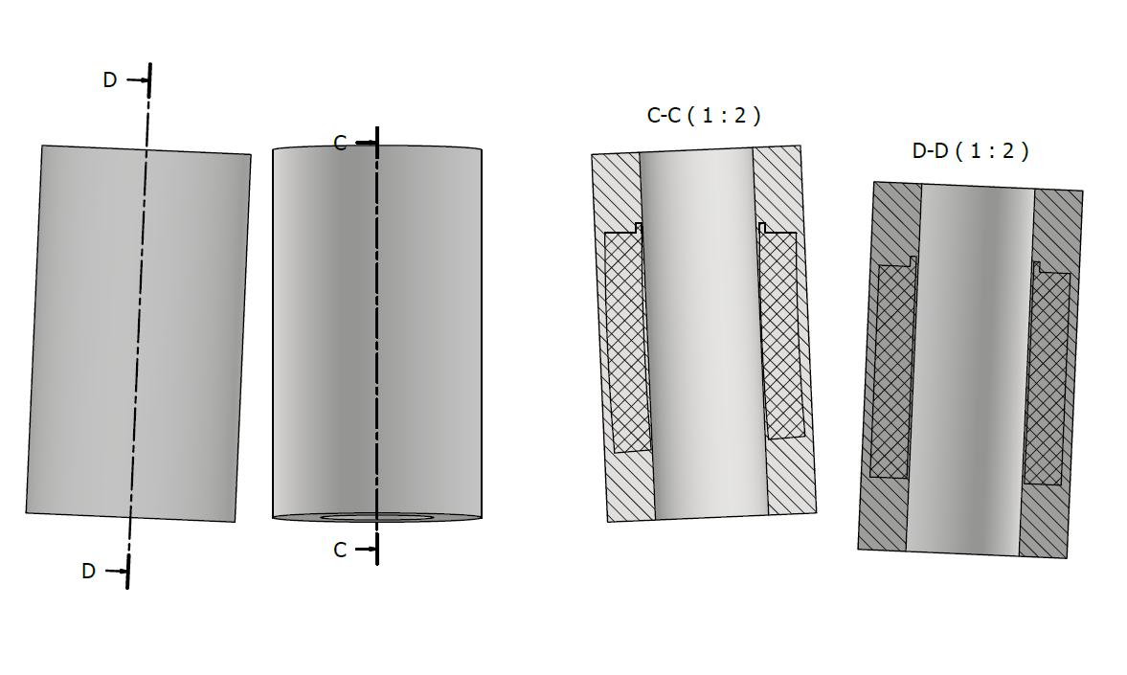
Second construction solution:
Build the curved tube subsections from a straight tube with extra wall material;
There is an ongoing order with Tosti srl for a test (join two subsections by 5 degrees of arc) → 4 keuros;
Tosti srl is specialized in the processing of glass fibers and polymers (as PEEK), but has acquired a company that is also specialized in metals;
Tosti already received the straight AlBr tube…they are ready to start the job.

