Slide 1
Visit to LBNL facilities
F. Toral, C. Martins
Hitri+ monthly meeting – May 9th 2023

Slide 2
Visit to LBNL
We had the opportunity to visit LBNL in April.
We thank them sincerely for sharing with us their know-how and progress on different projects. José Luis Rudeiros, Lucas Brouwer and Diego Arbeláez showed us their activities.
All the pictures in this presentation are property of LBNL.

Slide 3
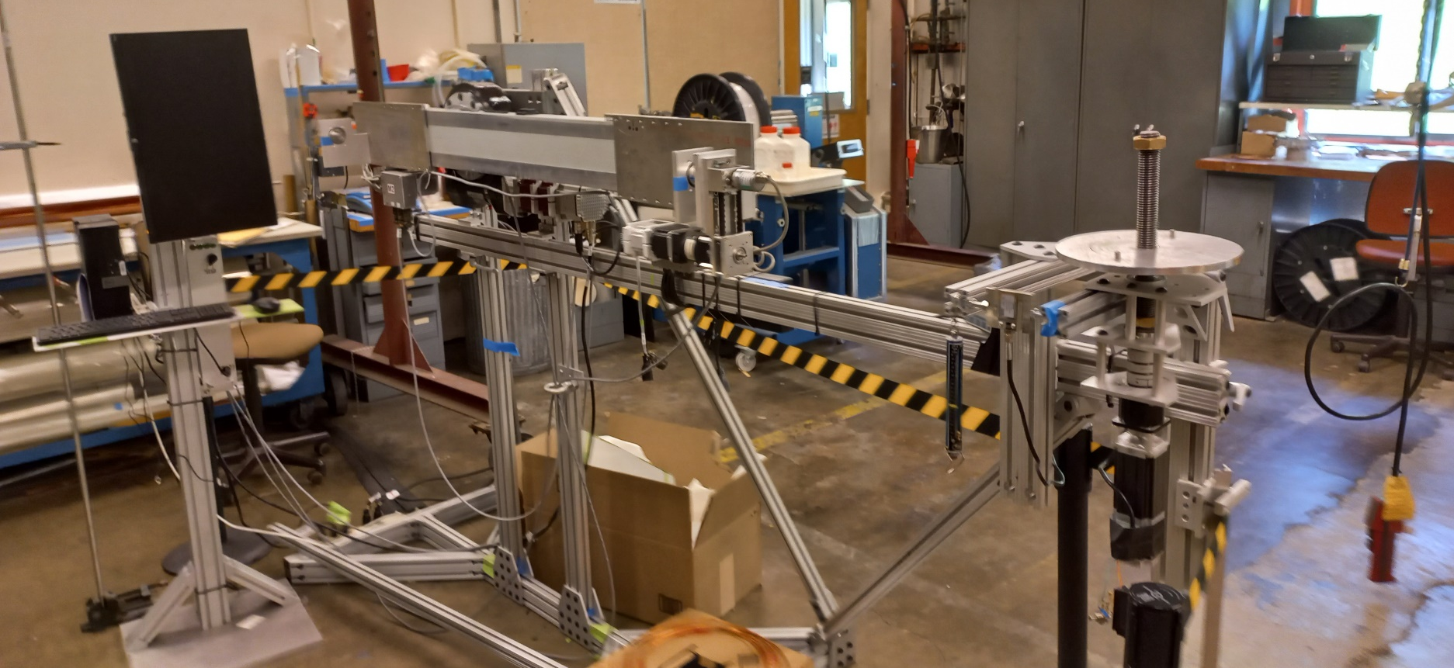
Winding machine (I)
Three automatized movements.
It is being used for HTS CORC cable to limit the bending radius during the winding.

Slide 4
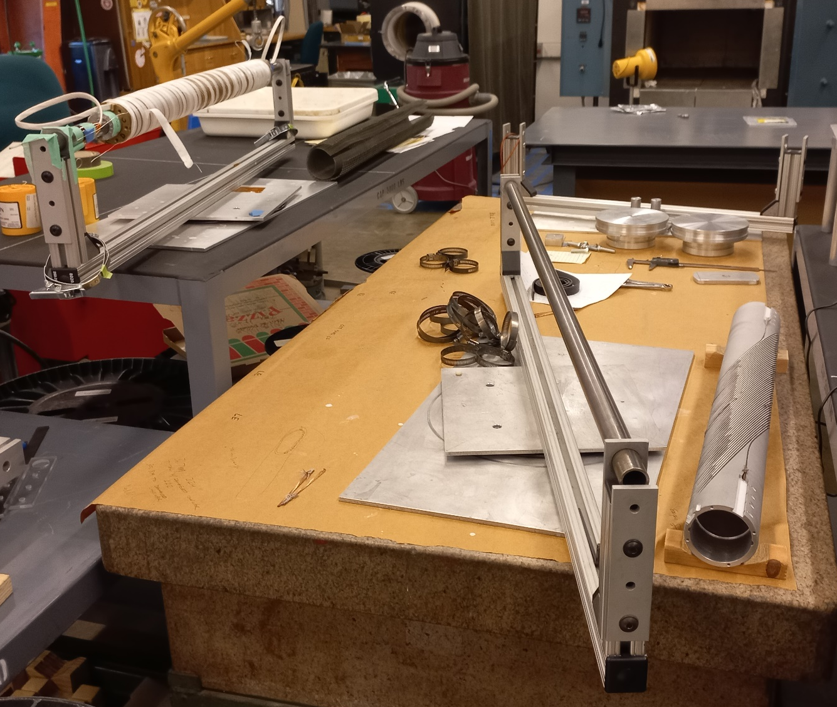
Winding machine (II)
Small straight CCTs are wound by hand.

Slide 5
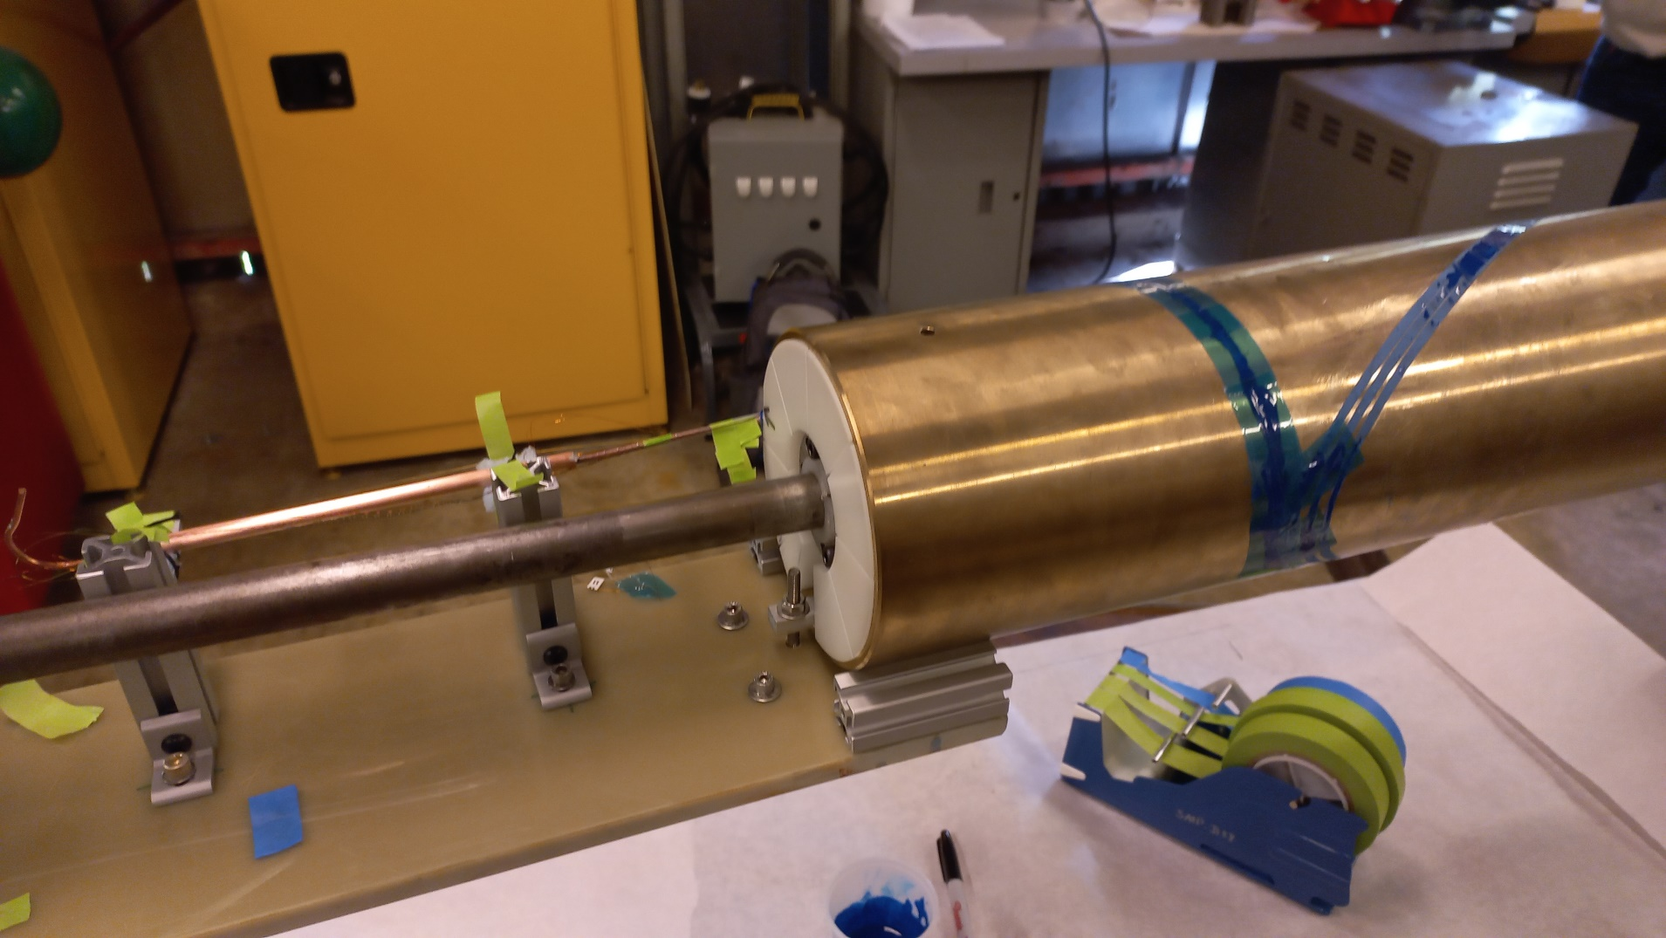
Impregnation with Stycast (CORC cable)

Slide 6
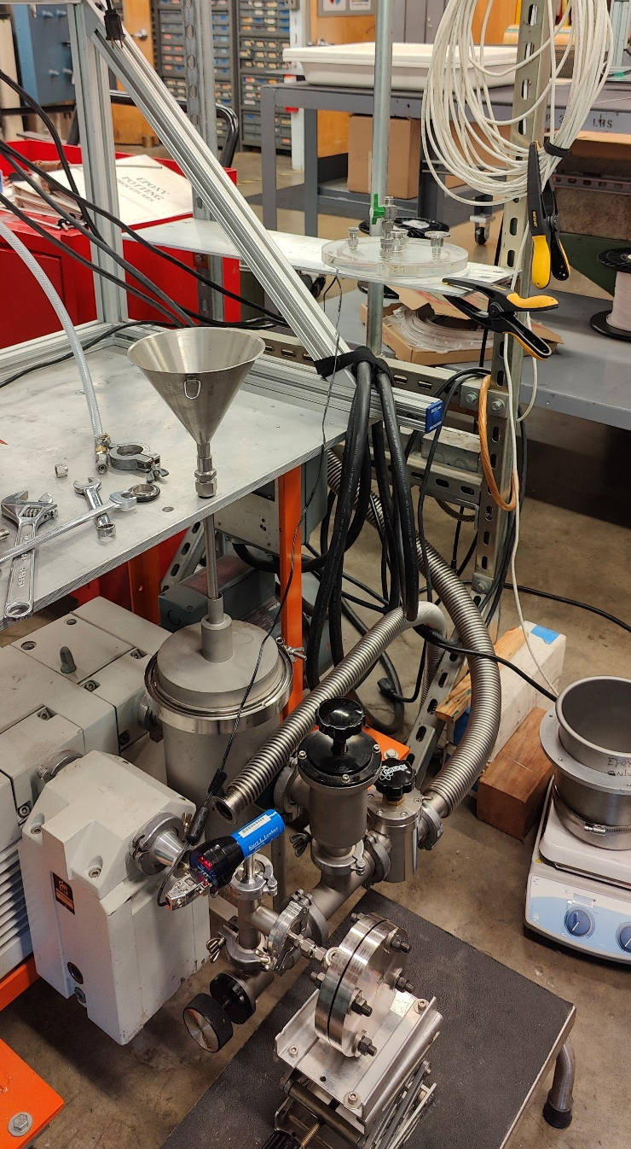
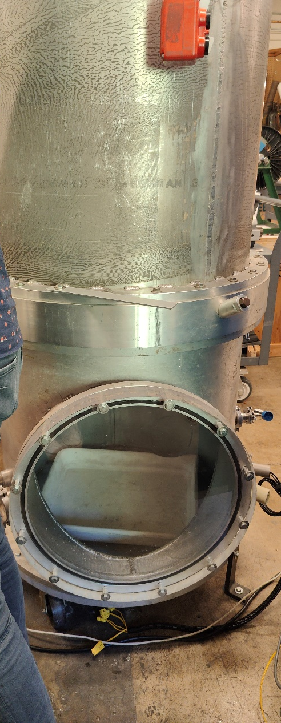
Impregnation with wax

Slide 7
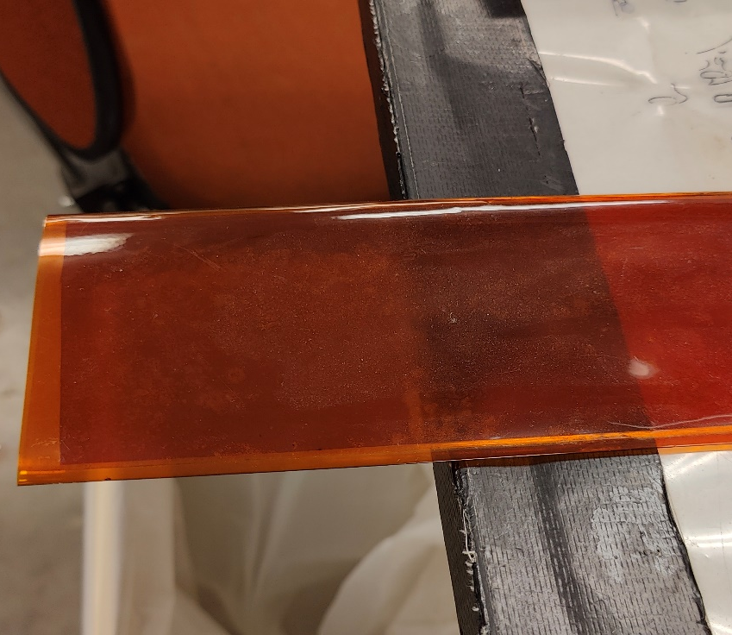
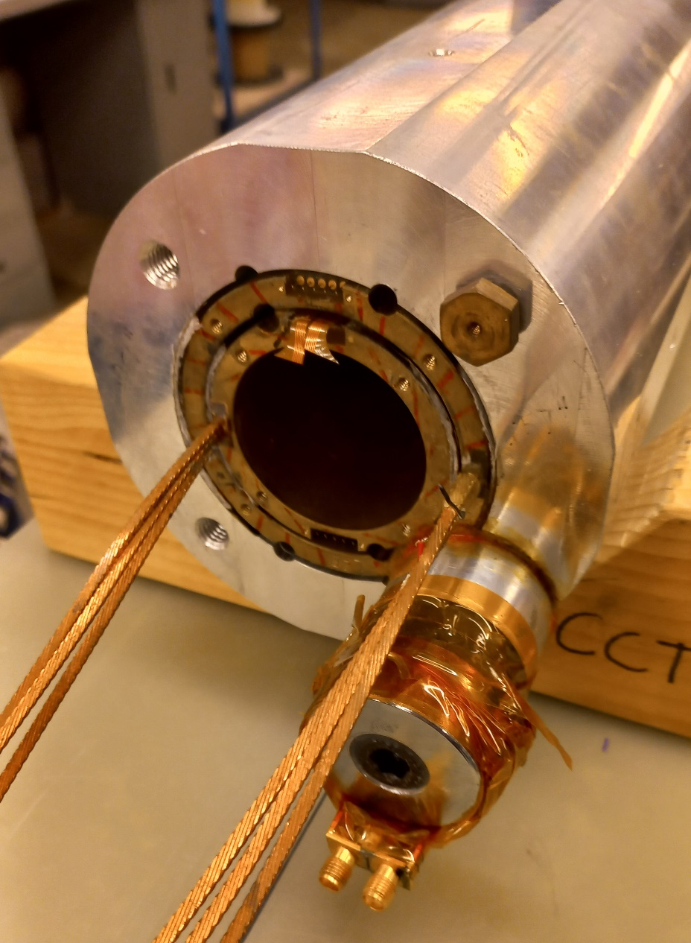
Epoxy filled bags
Hand made bags with folded polyimide and glue.
Assembly under vertical press.

Slide 8
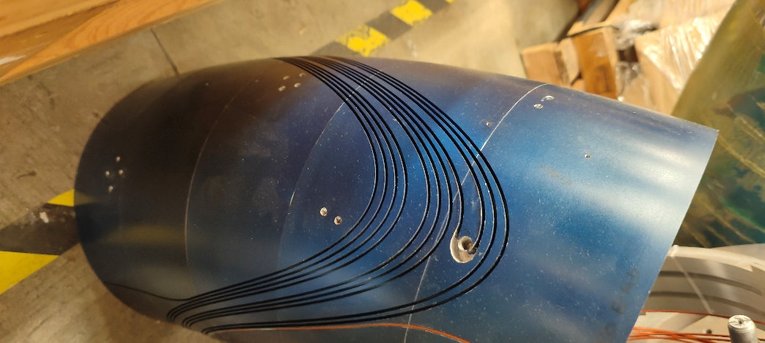
Curved CCT prototype: dummy former
Former made in aluminum parts fitted by shrinking with liquid nitrogen.

Slide 9
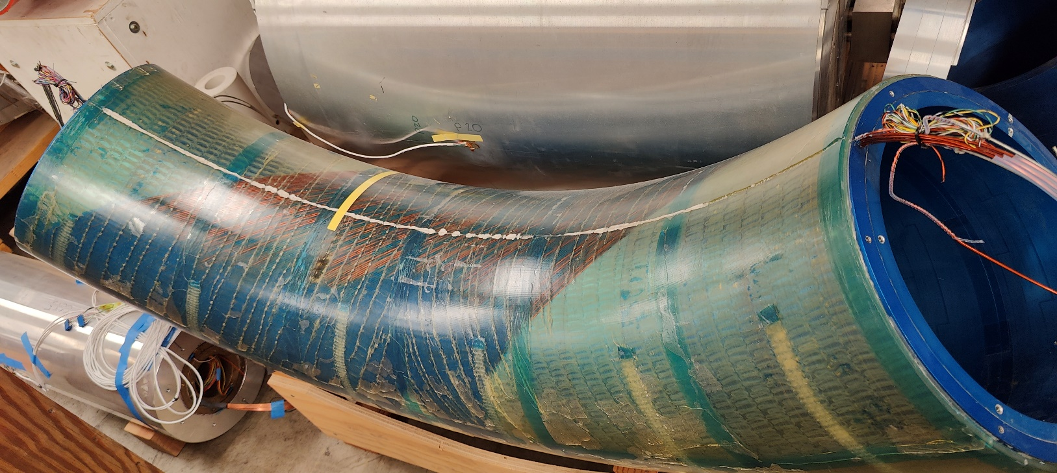
Curved CCT prototype
Impregnation mould in two halves (CTD-528 epoxy).

Slide 10
New gantry: concept
Based on fixed field SC magnets.

Slide 11
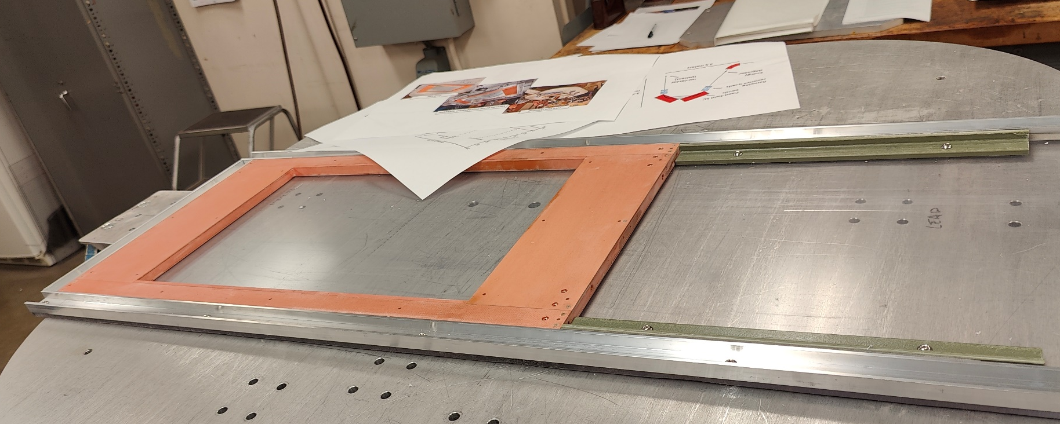
New gantry: Bi2223 coils
Conduction cooled flat coils. Vacuum impregnated.

Slide 12
Conclusions
Very valuable experience is available.
Epoxy filled bags are working well.
Cables are no jumping off the grooves.
No further developments on curved CCTs are foreseen in the near future.

Slide 13
Thank you very much for your attention

Slide 14
References
L. Brouwer et al., “Design and test of a curved superconducting dipole magnet for proton therapy”, Nuclear Inst. and Methods in Physics Research, A 957 (2020) 163414
L. Brouwer et al., “Design of an Achromatic Superconducting Magnet for a Proton Therapy Gantry”, DOI 10.1109/TASC.2016.2628305
L. Brouwer et al., “An achromatic gantry for proton therapy with fixed-field superconducting magnets”, International Journal of Modern Physics A Vol. 34, No. 36 (2019) 1942023 (13 pages) DOI: 10.1142/S0217751X19420235
J. L. Rudeiros et al., “Mechanical and Thermal Analysis of an HTS Superconducting Magnet for an Achromatic Gantry for Proton Therapy”, IEEE TRANSACTIONS ON APPLIED SUPERCONDUCTIVITY, VOL. 32, NO. 6, SEPTEMBER 2022, DOI 10.1109/TASC.2022.3158366

