Slide 1



RAL-LCG2
Network Outage October 2022
Alastair Dewhurst
Notes:
The abstract pattern can be removed or repositioned if required. Be careful to ‘Send to Back’ so that it does not obscure any important information.

Slide 2
Introduction
This report summarises the RAL-LCG2 Network outage which involved two outages and caused significant degradation to services for ~10 days.
Full SIR can be found here.

Slide 3
Legacy Network Meltdown
On Monday 17th October 2022 ~15:00 local time:
One of the two core Z9100 failed
One of the Facilities database server switches suffered a hardware failure
Took out RT ticketing system, FTS and GOCDB
One of the echo storage switches crashed
  Took out 25 storage nodes
Lots of spanning tree changes on management network
Rapid toplogy changes caused instability of MLAG & VRRP in core
Remaining core switches failed over to broadcast (i.e. hub) mode

Slide 4
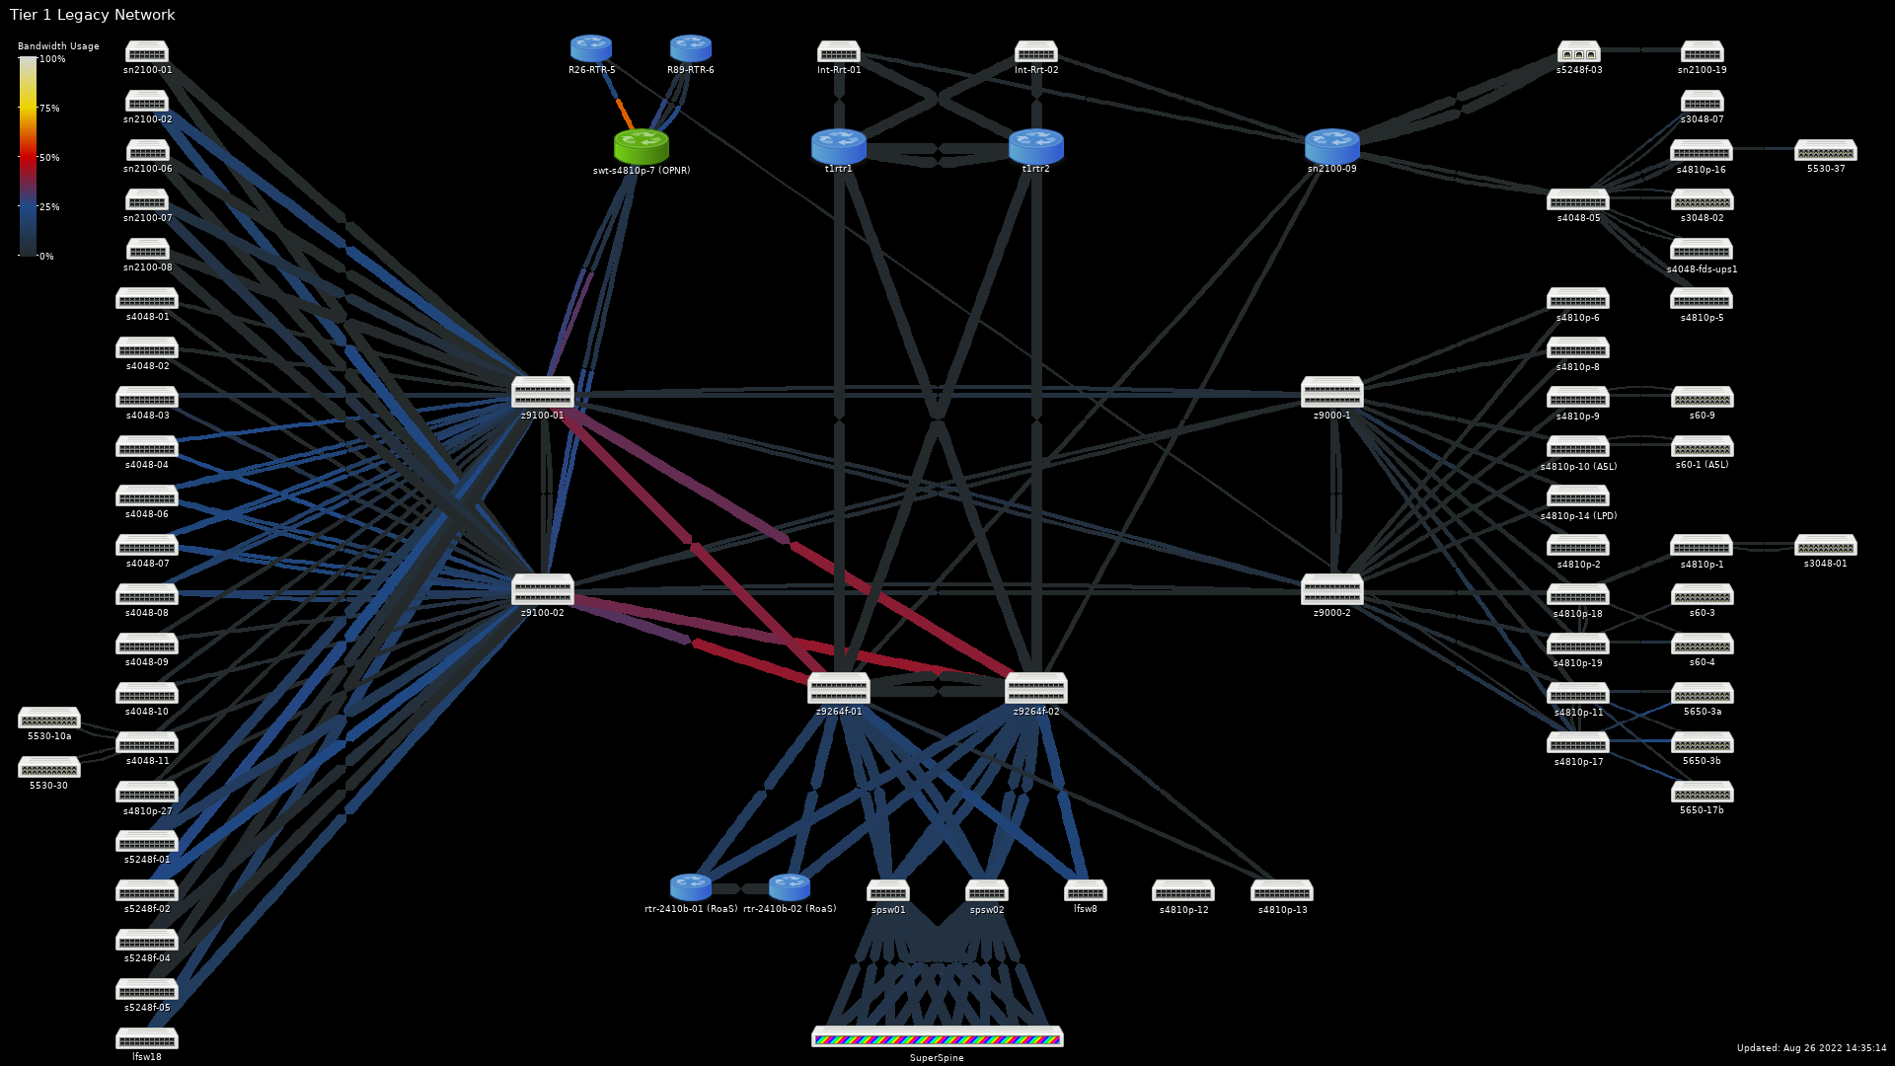

Slide 5
Legacy Network — October 2022
(Mixed 10/40/100Gbps)

Slide 6
Initial Response
Key staff away at HEPiX
Additional faults found when trying to restart
Restoring VLT crashed switches immediately
Fan and power supply failed
Z9000s & Z9100s out-of-maintenance
  No spare hardware
We were able to get the network functional by the end of the day (17th) and many services returned to production the following day.
However we had no resilience and batch and Echo needed to be limited.
One good thing: Plans had been made for migrating off them

Slide 7
Follow up response
Decided to make 12 months of planned changes in a single day
  Scheduled an intervention for 26th October.
  Moved 56 cables and config from four core switches
Not everything came back correctly so downtime had to be extended.
  It wasn’t bad for the complexity of the change and the time pressure.
Disabled management network entirely
  Designed an interim replacement architecture
  Replacement has been slow, but steady progress.

Slide 8
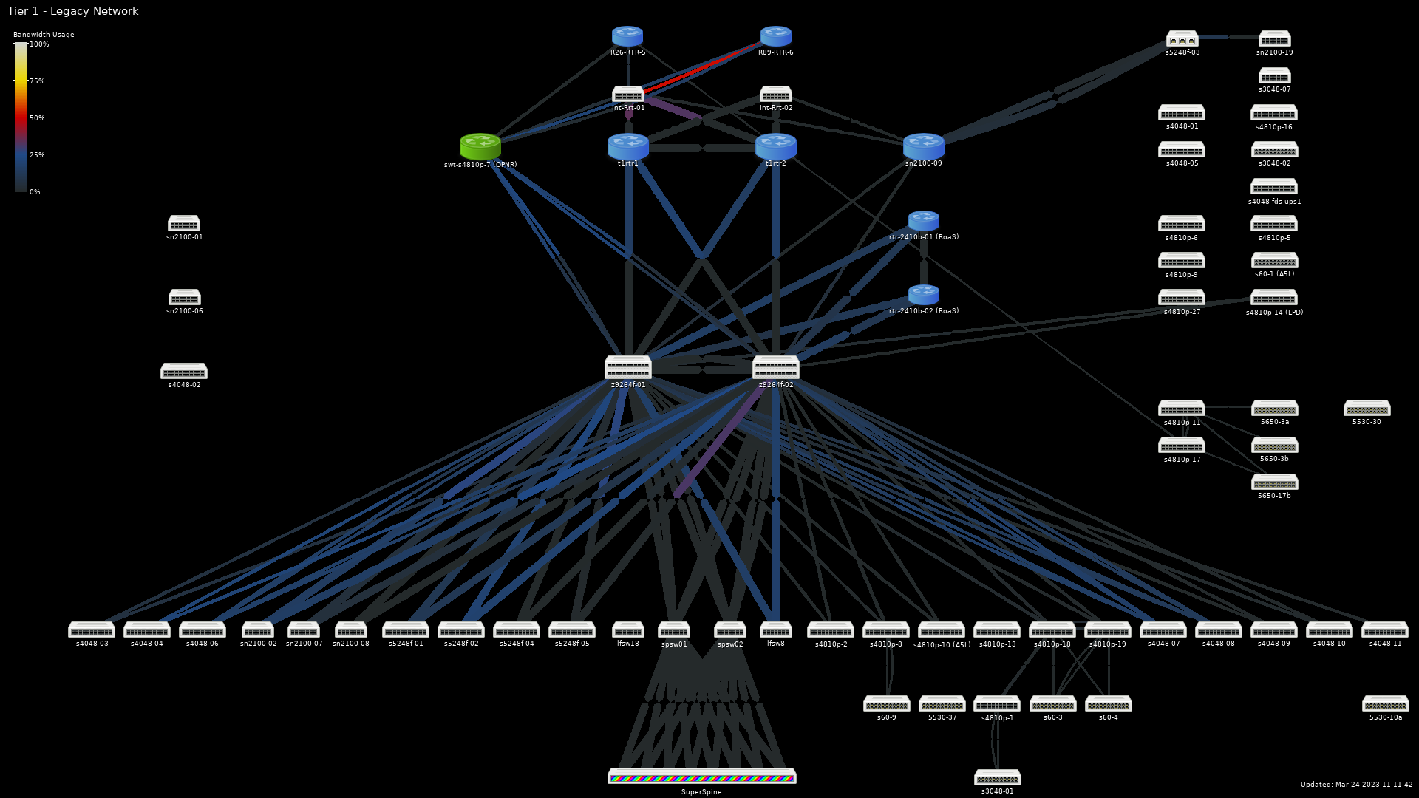
Legacy Network — March 2023
(Mixed 40/100Gbps)

Slide 9


Lessons learnt
Notes:
The abstract pattern can be removed or repositioned if required. Be careful to ‘Send to Back’ so that it does not obscure any important information.

Slide 10
Lesson learnt – legacy network
We weren’t surprised that the Legacy network failed.
  We have been working to replace it since 2020.
Between 2015 and 2018 there was no permanent RAL Tier-1 Manager
  Strategic decisions about the network weren’t made which delayed necessary upgrades and replacements.
The legacy network has been rebuilt simpler and with less ancient hardware and will be completely phased out by end of 2024.
The new network is starting to deliver significant benefits (e.g. LHCONE, multiple 100Gb/s OPN links)
The criticality of the network has been recognized and effort to support it is a core part of the GridPP7 funding bid.

Slide 11
Lesson learnt – operational
When RAL has a major outage it is likely to affect both the standard Tier-1 services and GOCDB.
  Better documentation has been put in place to ensure that more people know how to announce a downtime when you can’t use the GOCDB.
One Antares server (CTA-Frontend) was setup on the legacy Tier-1 network.
  This has now been moved to the correct location on the network.
The criticality of the management network for disaster recovery had been underestimated.
  We have invested £350k to purchase 110 new switches to modernize the hardware.
We were already in the process of moving our documentation and ticket system to Jira and Confluence in the Cloud.
  This should allow for more effective Disaster Recovery as it won’t be affected by an outage.

Slide 12
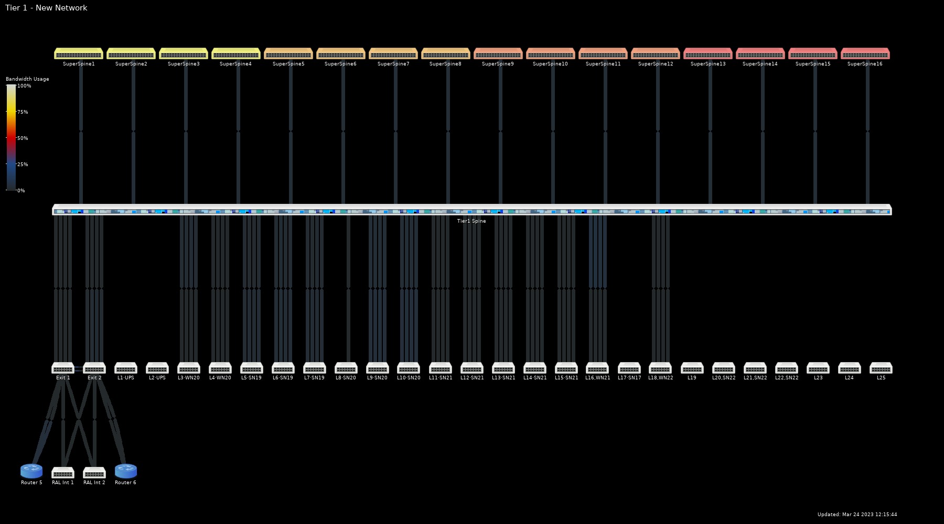
New Network — March 2023
(All links 100Gbps)

Slide 13

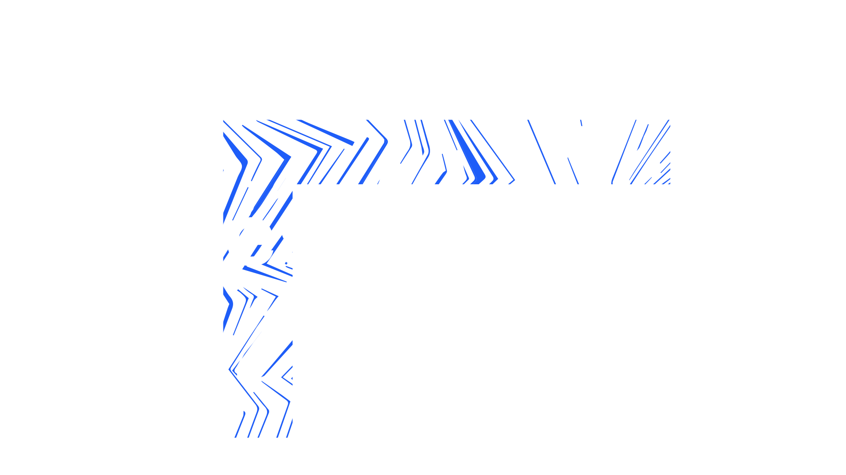

Notes:
The abstract pattern can be removed or repositioned if required. Be careful to ‘Send to Back’ so that it does not obscure any important information.

