Slide 1
Update on FCC with Local Chromatic Correction studies
May 4th, 2023
Pantaleo Raimondi
SLAC National Accelerator Laboratory

Slide 2
Outline
ARC cell
- doubled quadrupoles lengths
- improved transparency conditions for Z-lattice
FF optimization
- optimized DA with crab sextupoles ON
- flatten chromatic betas and tunes

Slide 3
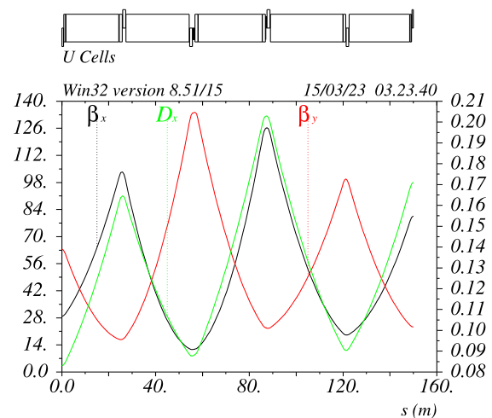
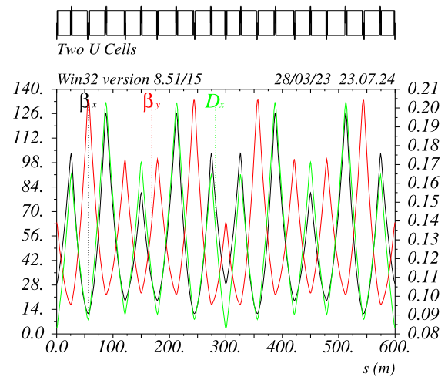
HFD lattice optimization: HFD~9090 for ttbar v_newFFb_12
The quadrupoles are effectively pairs about 1.2m long each
Sextupoles are 0.8/0.4m long (SD/SF)
In order to minimize synchrotron radiation, one of
the two quads is offset (~2-4mm) such as:
- the B-field of the QFs is about 0.60 the dipole field
- the B-field of the QDs is about 1.20 the dipole field
This combination makes Jx=1 @ttbar
U0 = 8.463GeV @ttbar (almost as with v_51b1)
For the Z lattice only the Ks of the not-offset quads are
changed (they become very weak).
The dispersion ratio across the QF/QD is different wrt to 9090,
this results in Jx=1.57 @Z
This could be very convenient because the emittance ratio Z/ttvar
is very similar to the betax* ratio, thus ensuring the same
stay clear across the FD area for both cases.
Energy spread @Z is nevertheless very similar to baseline.
Ring parameters with and without offset quads will be shown later
Half Cell
With HTS, the quads dipole field can be superimposed to all the ARC quads.
In this case the ARC dipole filling ratio will be > 0.99

Slide 4
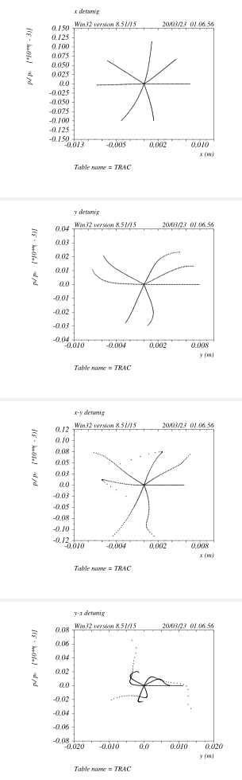
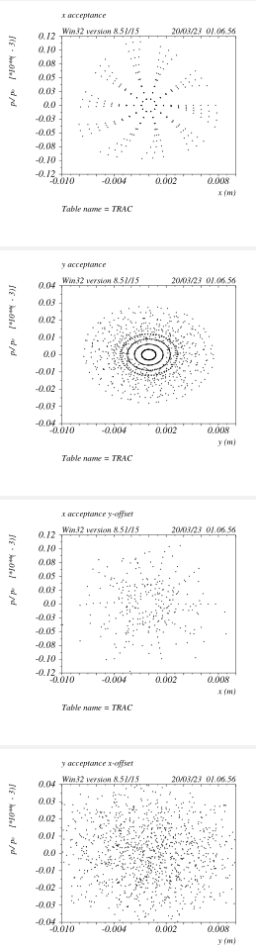
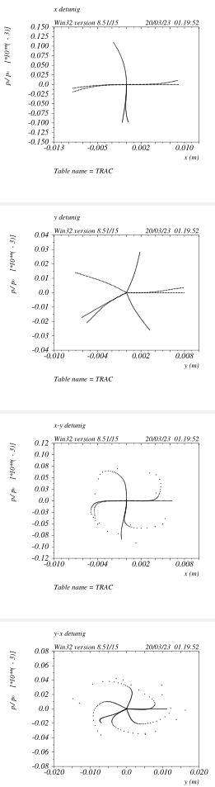
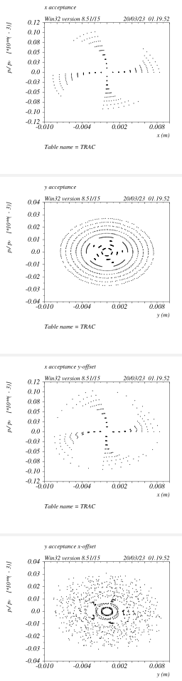
DA optimization with crab sextupoles
DA optimized with CS on
Main difference wrt to v_51a1 are:
- fine tuning of the R34s in the CCSy
- enforced TCs&@LSs for the Z-lattice
Reduction of DA still noticeable, largest
offender is the IP-phase SFM:
turning it off removes about 70% of the
CS DA shrinkage
V_51a1
V_newFF_12

Slide 5
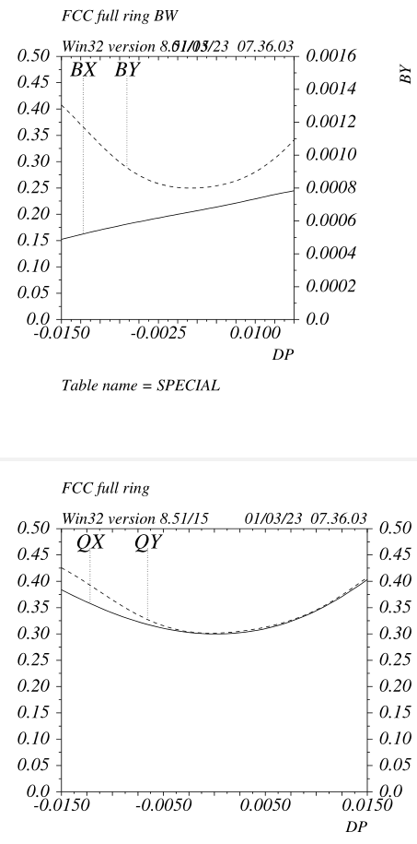
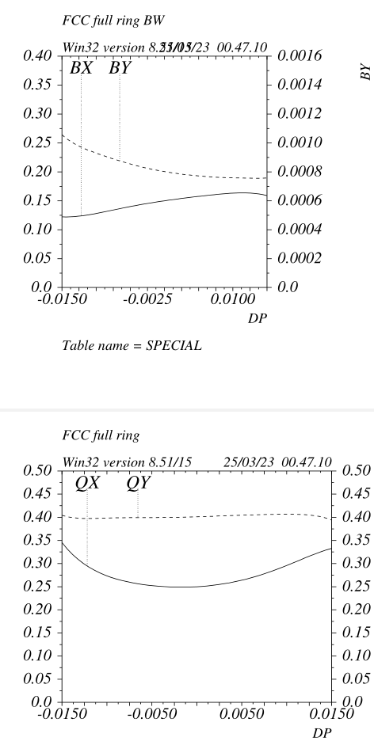
Full ring Bandwidth: Z case
Last two ARC cells sextupoles are adjusted
in order to restore the Ws&ddx in the ARCs and
improve the BW in general.
So far no optimization of the DA vs DE
with tracking has been made.
Unfortunately the latest version has a much poorer
behaviuor of x-DA vs DE => needs to be revisited!
Best approach would be to perform the same
sextupole optimization done for the baseline for the
HFD as well . Most likely just using the same sextupoles
that so far have been optimized “by hand”.
*the y-decapoles are effective for BW > 2%,
they are not really needed for the presently achieved BW
V_51a1
V_newFF_12a

Slide 6
Full ring general parameters
Z lattice:
Ex = 0.343nm
Jx = 1.54
Alphac = 2.37e-5
U0 = 33.06MeV
Sig_E = 4.29e-4
Betay*= 0.8mm
Betax*= 0.15m
Z lattice:
Ex = 0.528nm
Jx = 1.00
Alphac = 2.37e-5
U0 = 34.38MeV
Sig_E = 3.82e-4
Betay*= 0.8mm
Betax*= 0.15m
Without offset quads
ttbar lattice:
Ex = 2.03nm
Jx = 1.00
Alphac = 0.901e-5
U0 = 8.46GeV
Sig_E = 1.45e-3
Betay*= 1.6mm
Betax*= 1.0m
ttbar lattice:
Ex = 2.03nm
Jx = 1.00
Alphac = 0.901e-5
U0 = 8.78GeV
Sig_E = 1.50e-3
Betay*= 1.6mm
Betax*= 1.0m
Without offset quads

Slide 7
Arc lattice magnets
ARC quads are up to 1.2m long and Ks are set to about 0.02@ttbar (gradients around 12T/m @ttbar)
Quads are not paired between the two rings
Total number of ARC quads ~250*20=5000 per ring, ~10000 total
It would be interesting to see if it is possible to conceive a quad that needs 1-2Kw@ttbar
(ESRF HG-quad, 0.49m long, G=90T/m, bore radius~12.5mm, needs~1.5Kw, APS HG-quads are even more efficient)
ARC sextupoles at the moment have all the same strength, apart the “matching section” ones
SFs are 0.38m long Ks~0.146 @Z Ks~0.685 @ttbar
SDs are 0.77m long Ks~-0.125 Ks~-0.70
Total number of ARC sextupoles ~250*4=1000 per ring ~2000 total
Sextupoles total power consumption should rescale as Integrated_sexts_length/Integrated_quads_length
ARC looks very “LEP” like.
Alignment tolerances should be on the 50-100um level (if they scale with the sexts strength)
Possibly just 6 correctors pairs and 6BPMs per CELL could be needed (not needed to center the beam on both side of the sextupoles either)
Trimming skews&quads in the ARC sextupoles might not be needed, lattice correction can be performed just
applying proper offsets to the BPMs e.g. building the “golden orbit

Slide 8
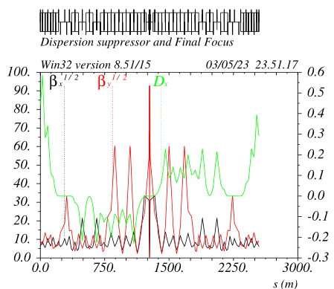
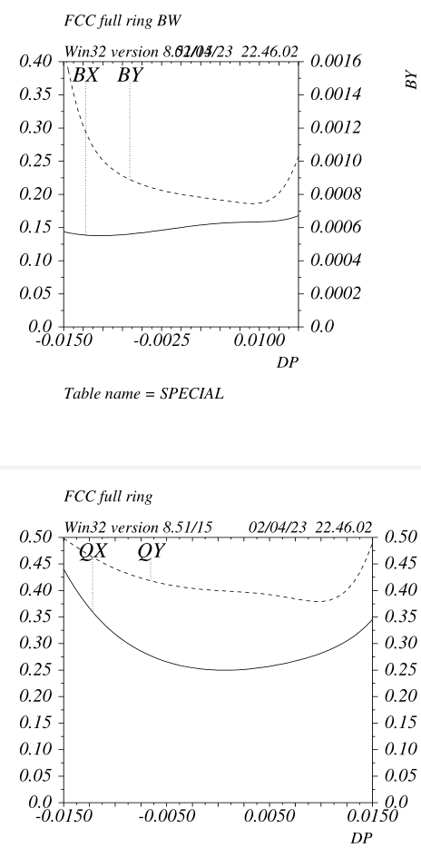
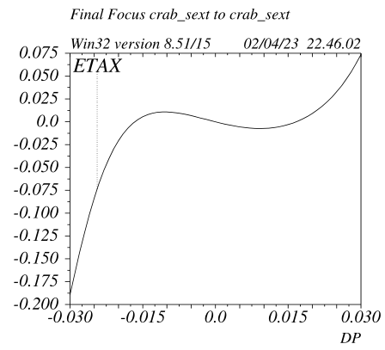
FF general layout options
A fully antisymmetric dogleg-like FF has performances very similar
in terms of DA/MA to the present ones.
Advantage is that the overall FF layout is virtually identical to
the one of a Long-Straight (the wider tunnel across the FF is still needed)
Disadvantages are:
- increased SR ~10%
- increased emittance ~20%
*The case with CCS/CCX opposite sign etas
has many problems, too many to be worth listing in this presentation

Slide 9
Back up

Slide 10
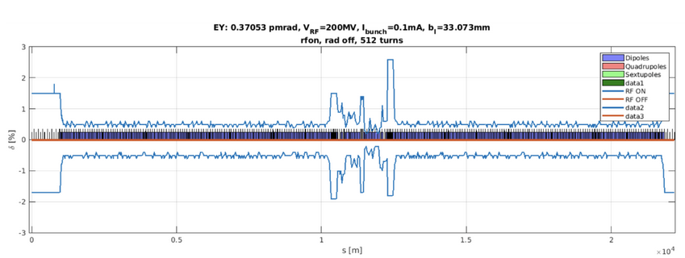
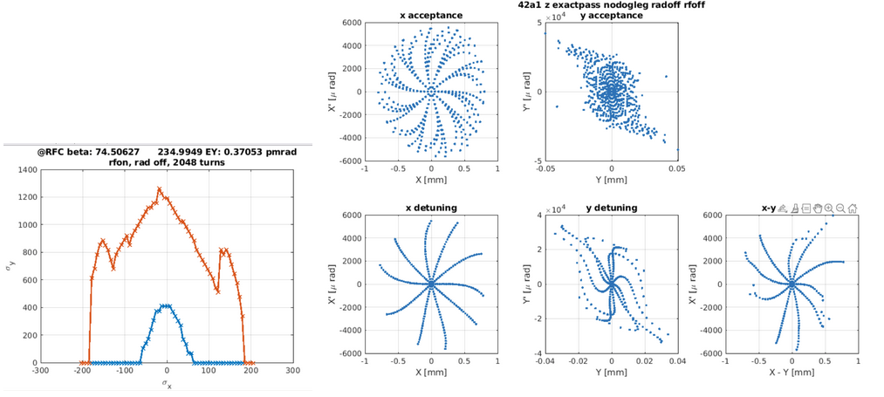
DA/MA check from S Liuzzo (earlier version with large path lengthening)

Slide 11
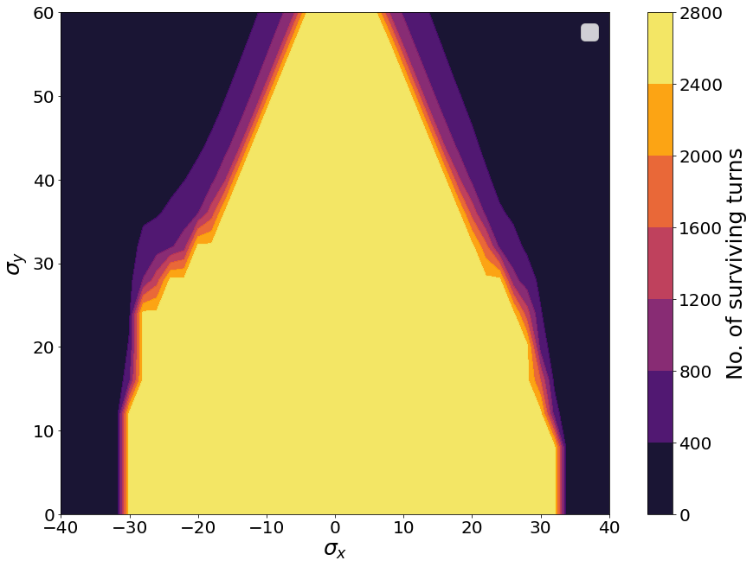
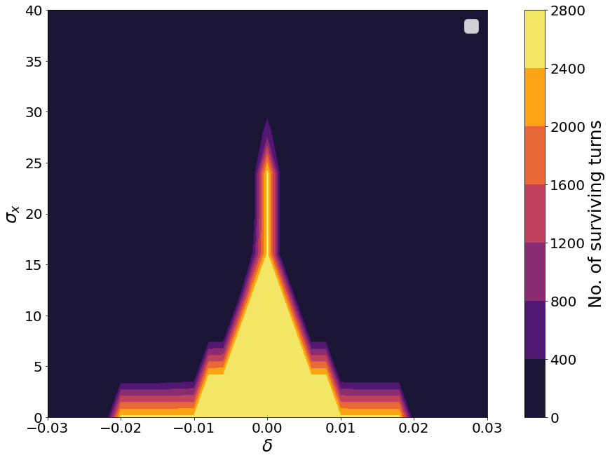
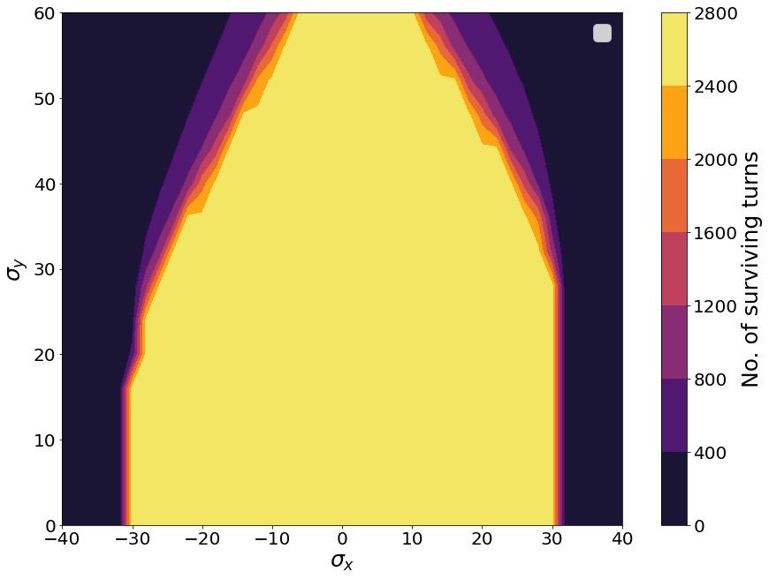
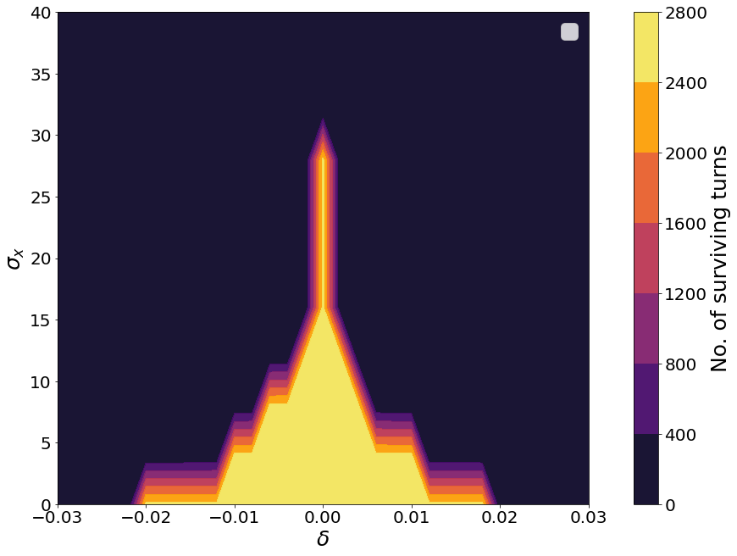
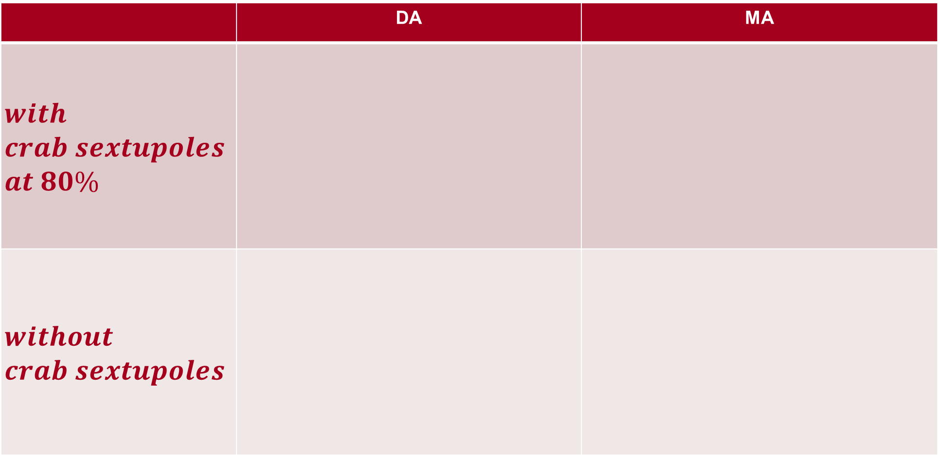
First DA/MA checks with SR at Z
 | DA | MA
$$with \\ crab sextupoles \\ at 80\%$$
$$without \\ crab sextupoles$$

