Slide 1
PS Booster magnets Task Force
Subtask-3
G. Favre 17 May 2023

Slide 2
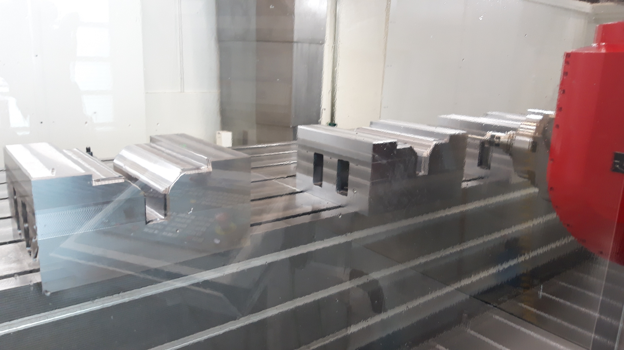
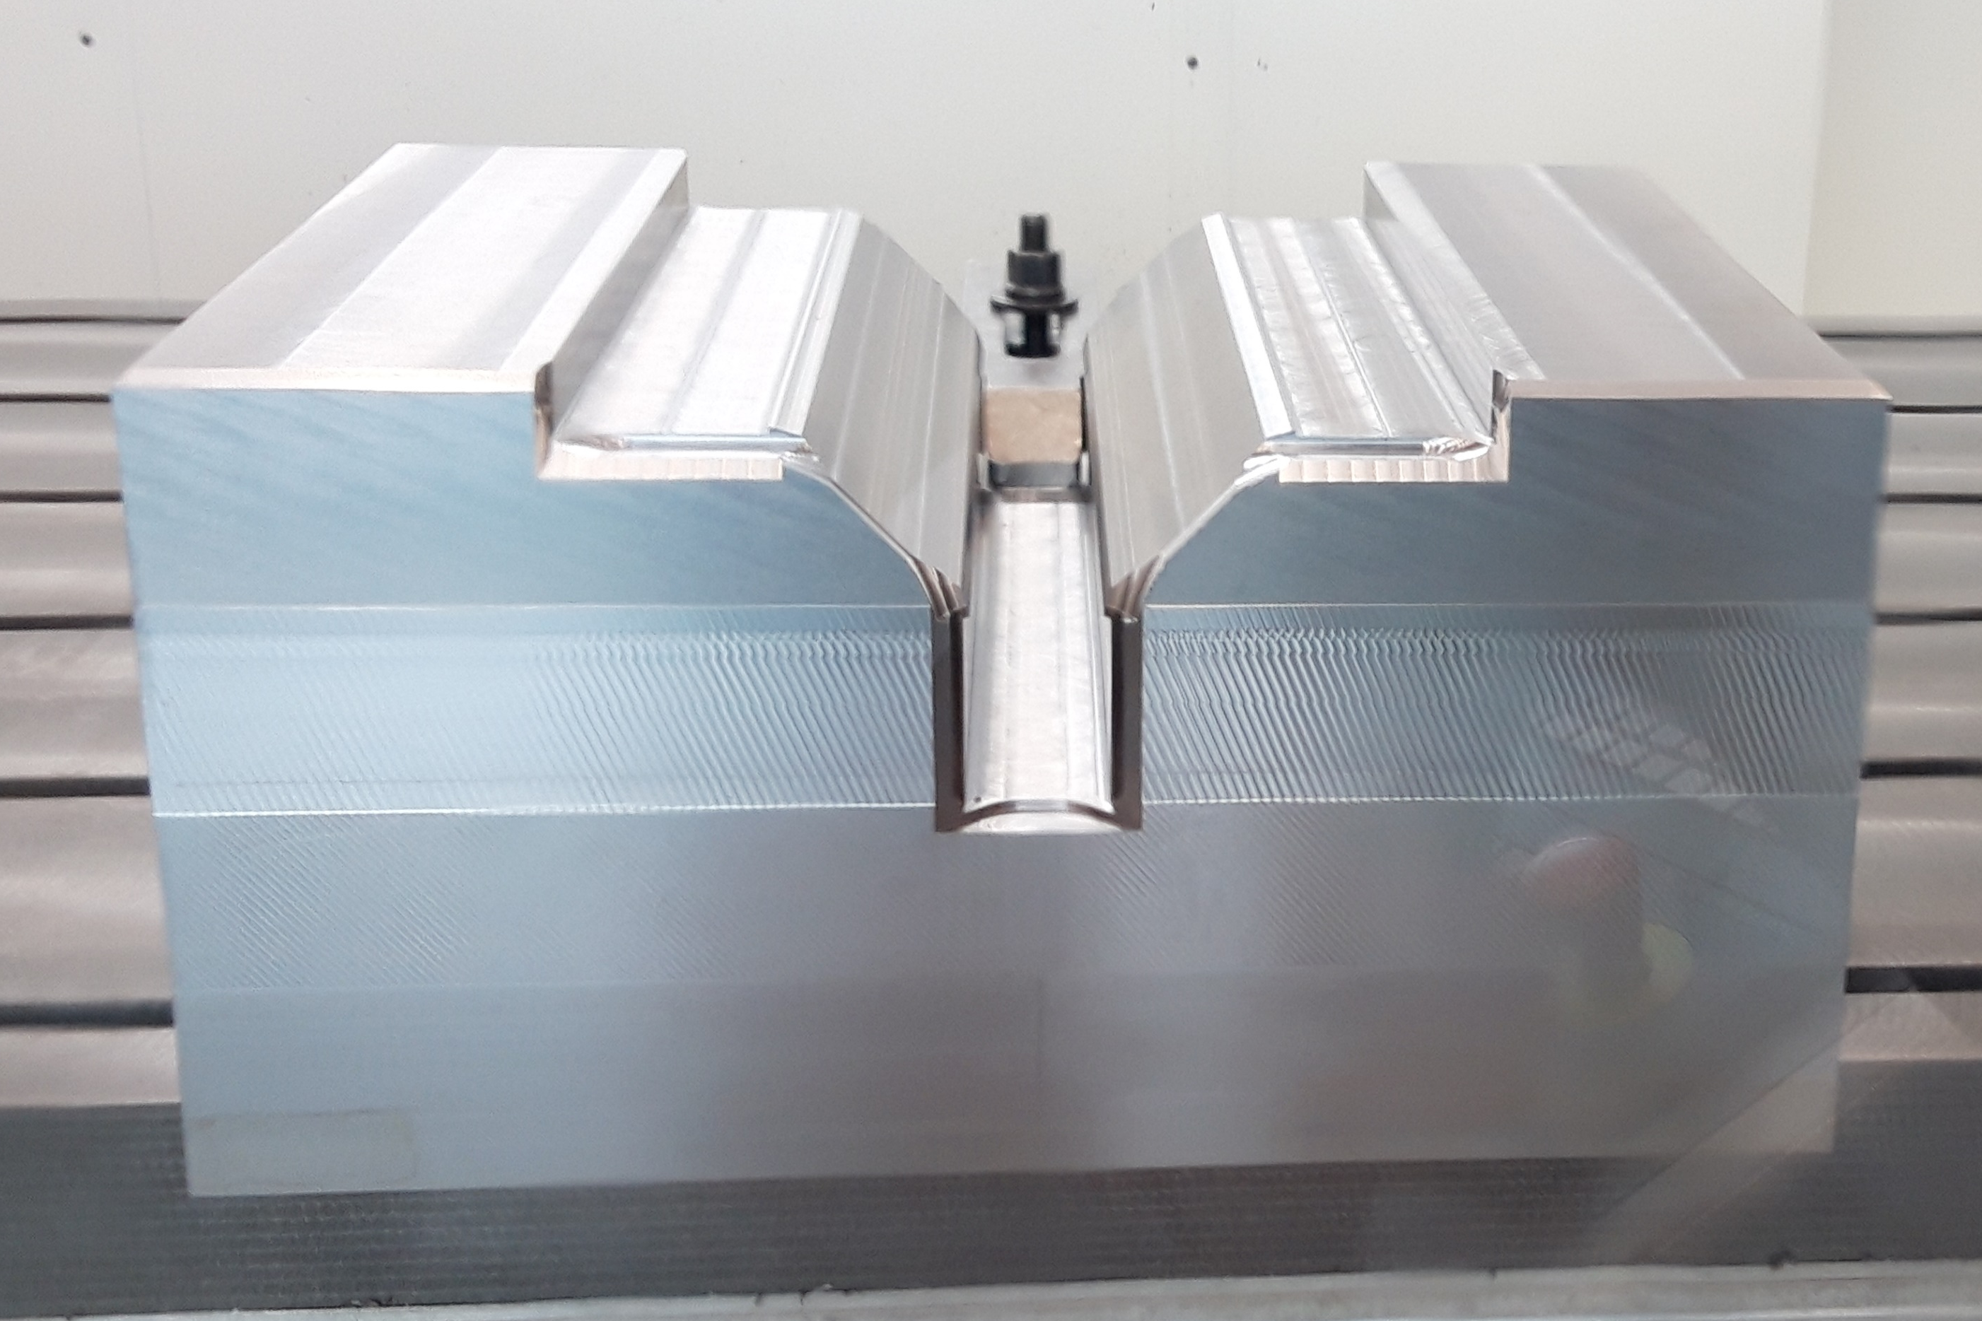
Ongoing tasks
Mock-up fabrication: machining should be finished at the end of week 21

Slide 3
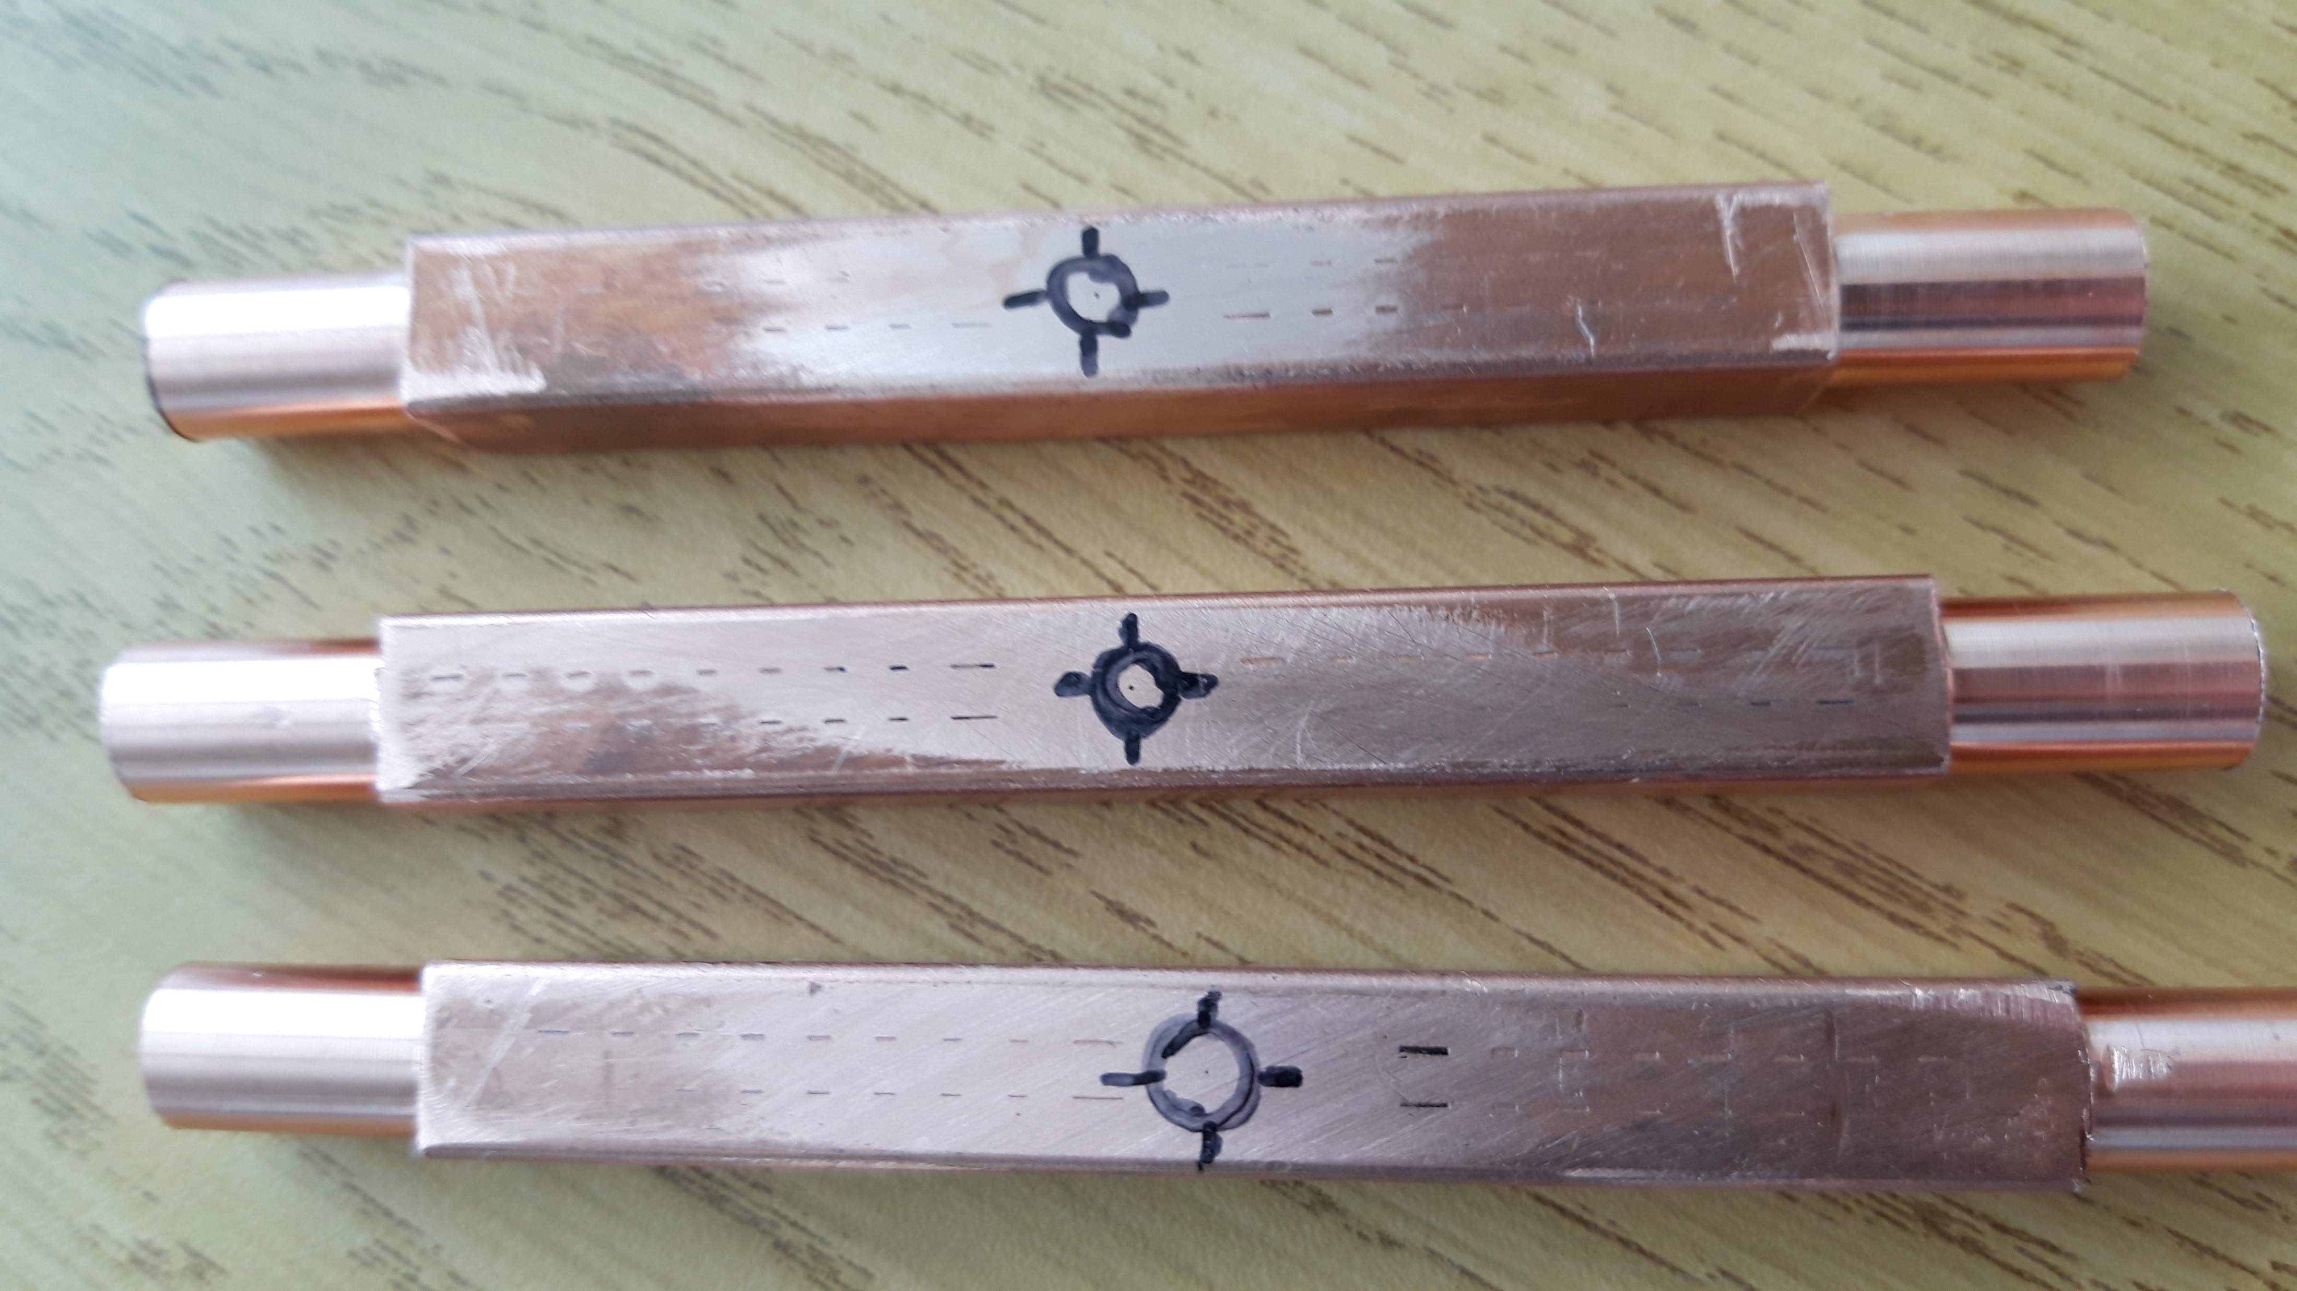
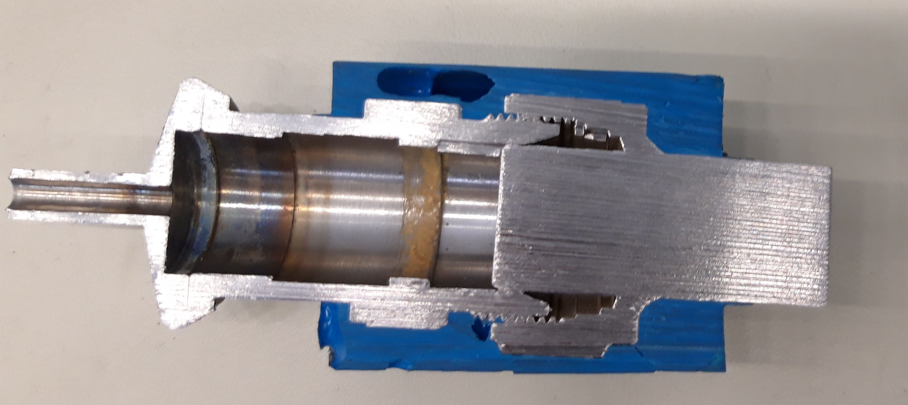
Ongoing tasks
Evaluate the possibility to fixe a leak using epoxy (ECCOBOND type)
  Fabrication of samples with calibrated leak (drilling of 0.2 mm hole)
  Injection of epoxy in the defect (hole) → leak test & pressure test
  Add of an external epoxy patch to reinforce the joint → leak test & pressure test
  Destructive examination of the joint
  Development carried out with Sebastien Clement, Antony Newborough & Didier Lombard
Test samples with 0.2 mm hole
Example of epoxy patch

Slide 4
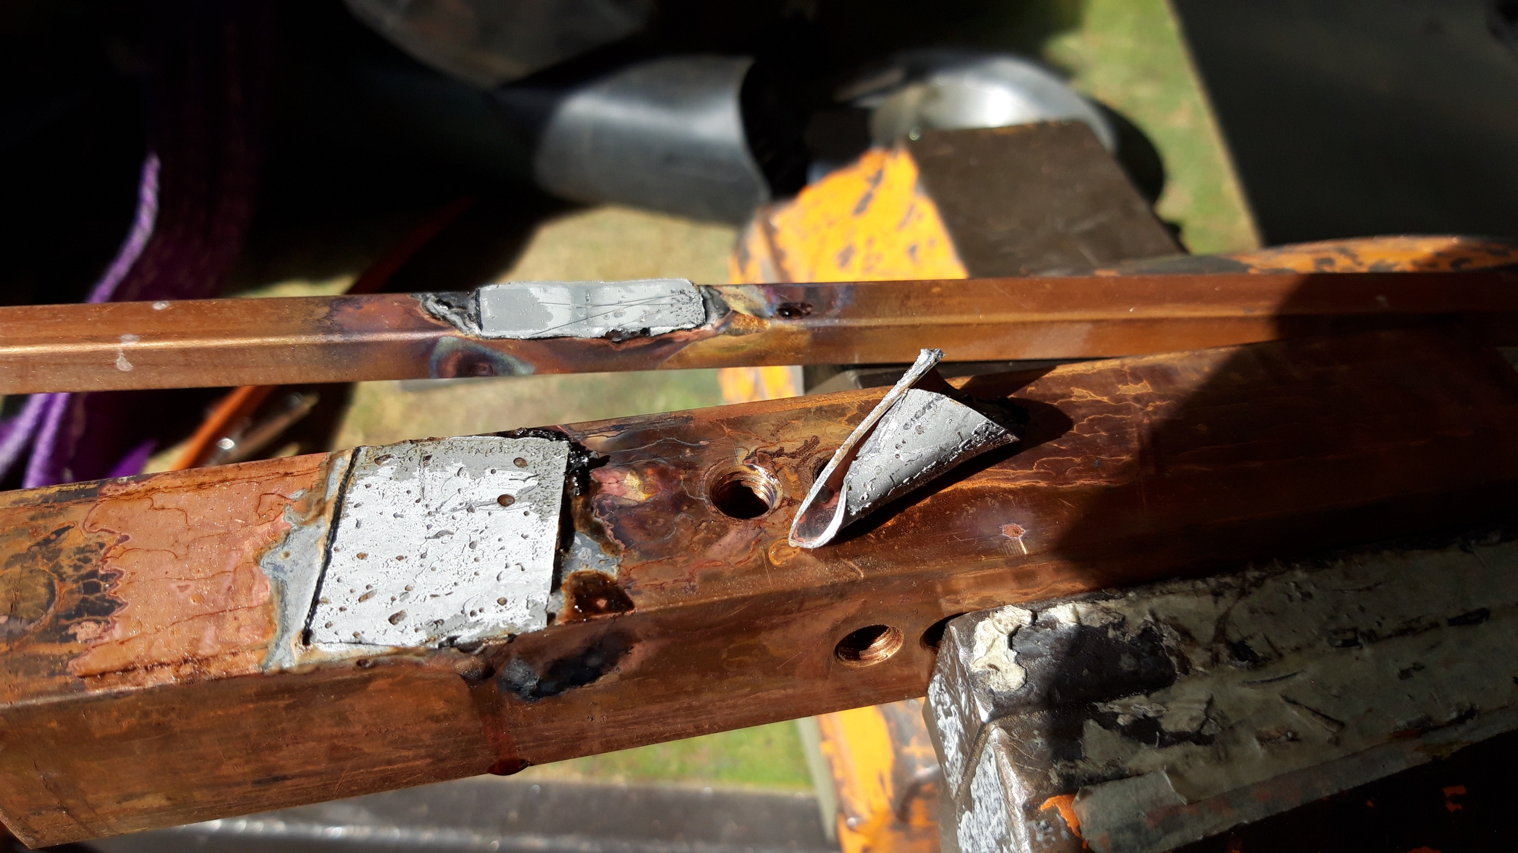
Ongoing tasks
Evaluate the possibility to fixe a leak using soft soldering (Sn-Ag type)
  Patch soldering using a “non corrosive” flux kester 135 (or MOB 39)
  Evaluate the possibility to use TIG as heat input

