Slide 1
Planning of BR.QFO11 exchange during run 2023
PSB Magnet Task Force Meeting - 31st May 2023

Slide 2
Context and assumptions
The following planning has been established as first iteration to show and quantify the various activities which are to be executed during a possible urgent replacement of the leaking BR.QFO11 triplet quadrupole during the run and not during the upcoming EYETS. Most of the task will have to be done independent of the intervention period, however some are very specific to an intervention during the run.
The planning is quite comfortable but remains realistic, however it is not optimized in any way to speed up the whole operation.
Assumptions:
Planning for success without any margin to accomodate unforeseen difficulties
All intervening teams only work during normal working hours
Coactivity is avoided as during any technical stop period (TS, YETS, LS)
Spare magnet is already available in building 361
Note: BR.QFO11 is one of the easier magnets to replace (no RP hot spot, individual vacuum chambers, individual displacement of magnet)

Slide 3
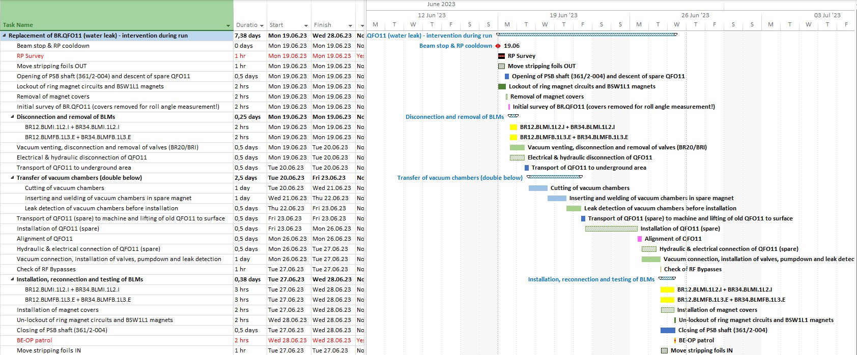
Preliminary planning for exchange of BR.QFO11

Slide 4
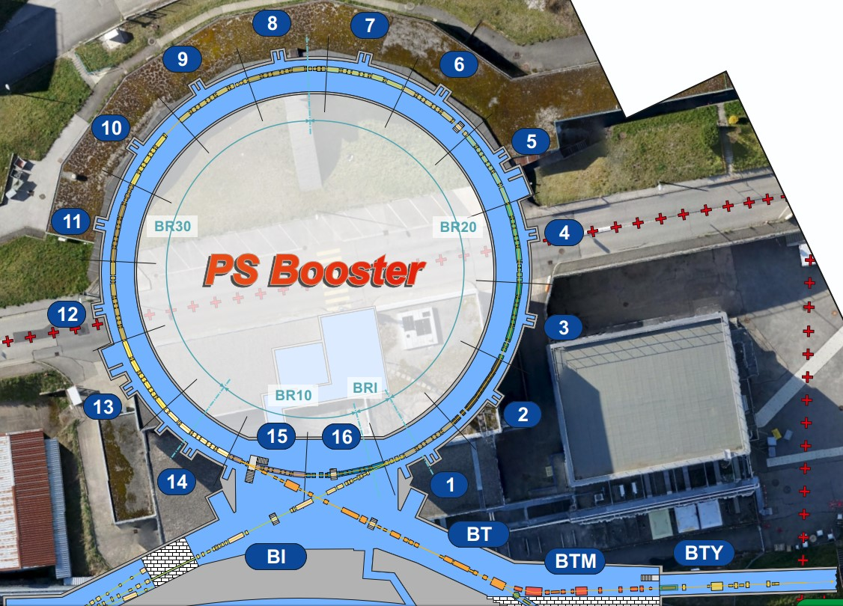
PS Booster – overview
Complex triplet locations in sectors 14/15/16:
Presence of extraction bumpers (need to be lifted together with downstream QFO)
first experience during last YETS (QFO142)
Higher activation around extraction area (ring hot spot)
Bakeout of BE.SMH15L1 required after opening of vacuum sector BR10 (~5 days)
Conditioning of extraction kicker BE.KFA14L1 required after opening of vacuum sector BR30 (~2 days)

