Slide 1
PSB cooling circuit: current knowledge on Sulphur content / origin & future measures
PS Booster magnets Task Force meeting – G. Petrika, S. Deleval
2023-05-31
Reference (EDMS, Indico…)

Slide 2
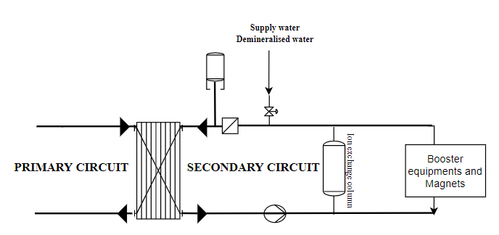
Supply water
31st of May 2023 – PS Booster magnets Task Force meeting

Slide 3
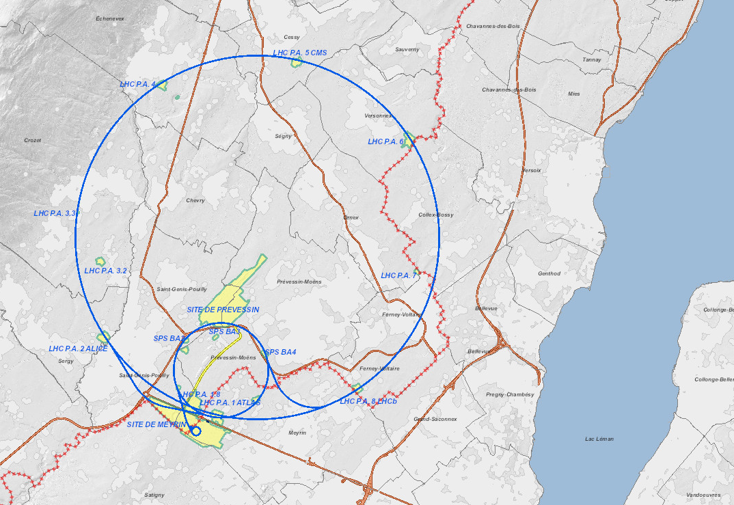
Origin of water
Tuileries
Filtration plant
Pumping
stations
La Berne
Tanks
Vengeron
Pumping station
31st of May 2023 – PS Booster magnets Task Force meeting

Slide 4
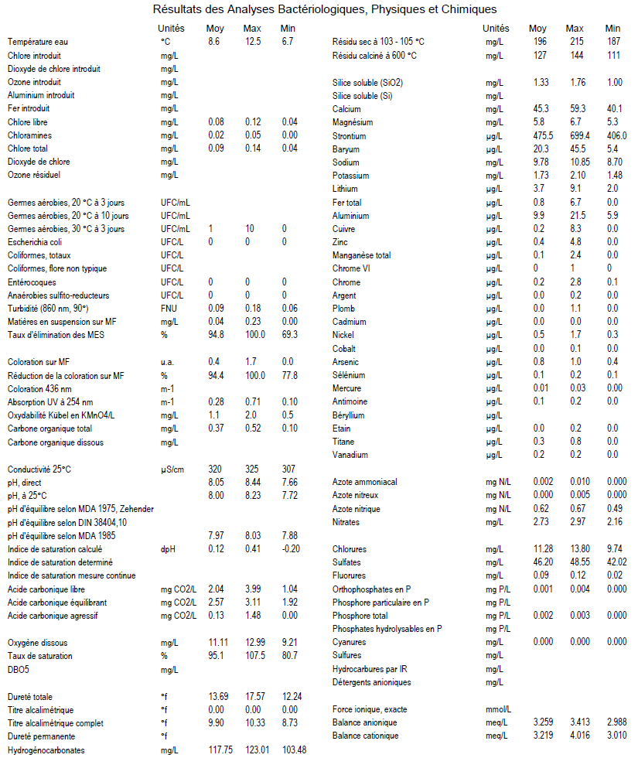
Water characteristics
Water analysed at every pumping and filtering stations
Water analysed on the CERN sites
Sulphur is not followed but according to SIG there is no need
31st of May 2023 – PS Booster magnets Task Force meeting

Slide 5
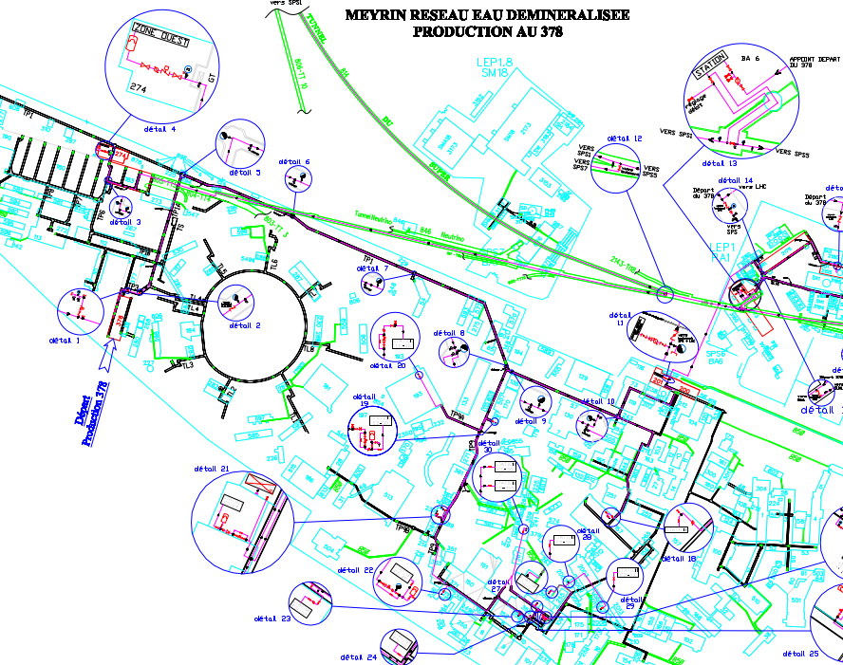
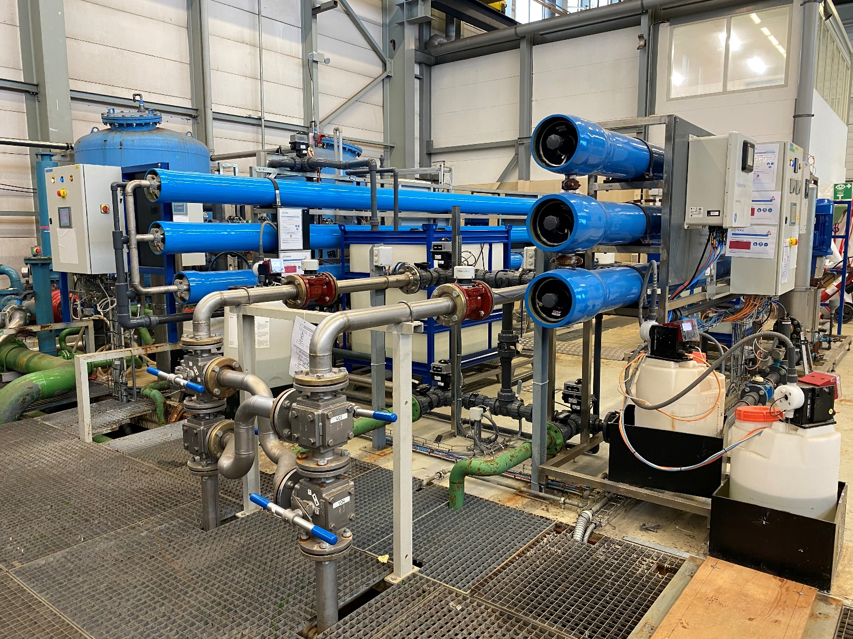
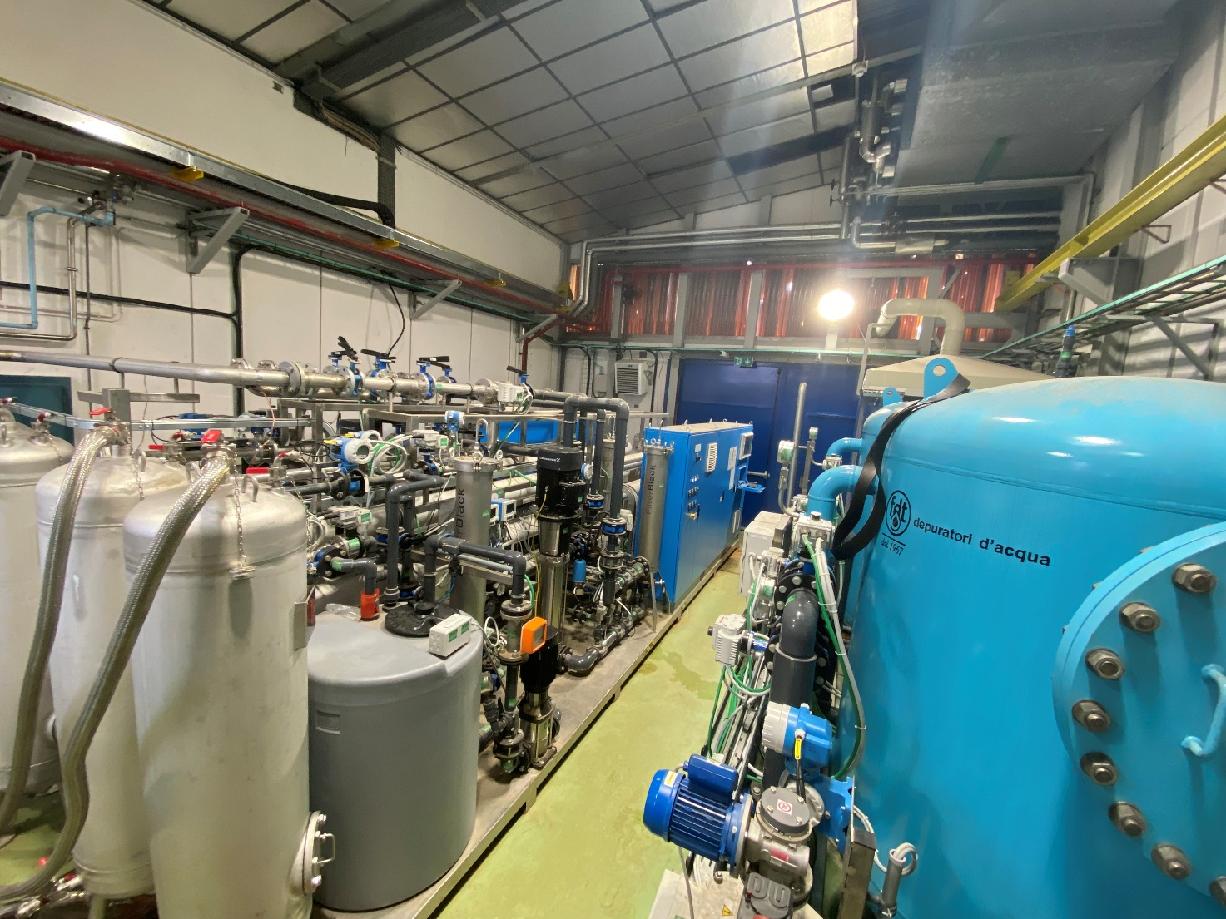
Supply of demineralised water
From drinking water network
From drinking water network
31st of May 2023 – PS Booster magnets Task Force meeting

Slide 6
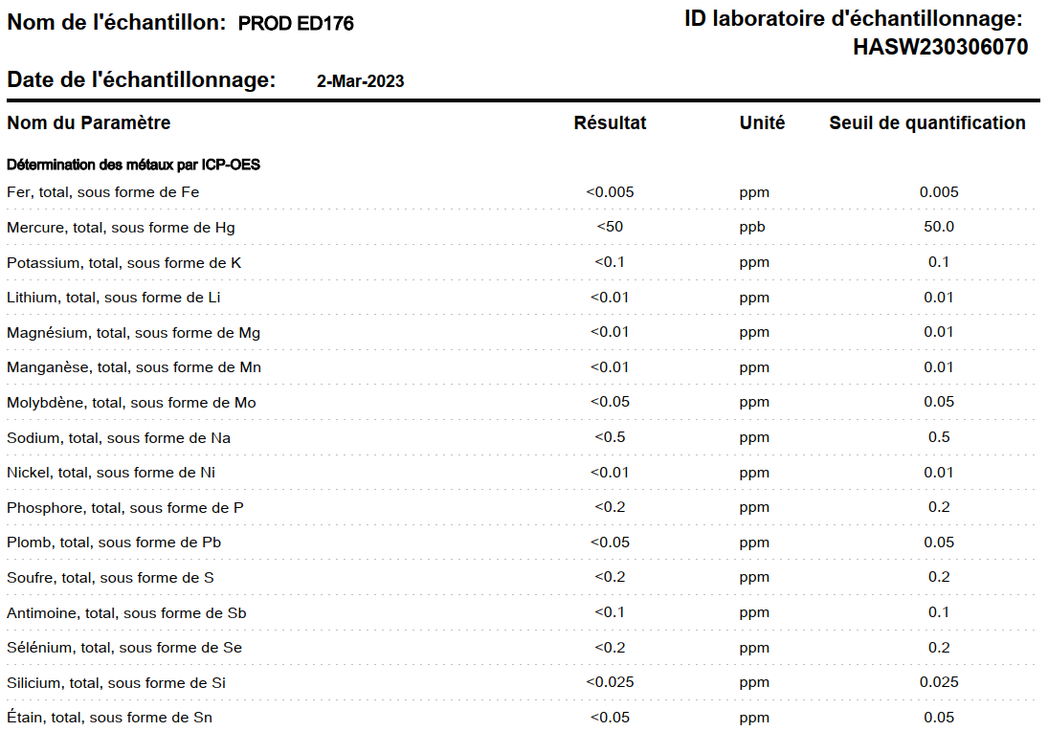
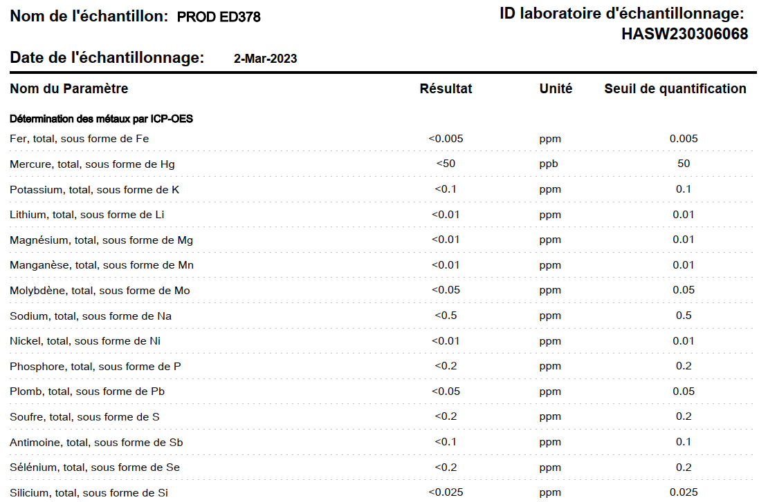
Demineralised water charactheristics
31st of May 2023 – PS Booster magnets Task Force meeting

Slide 7
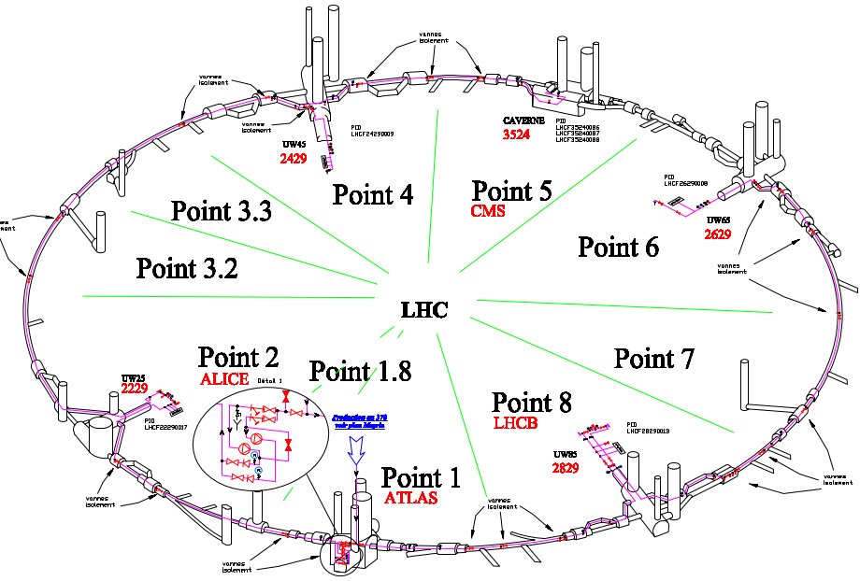
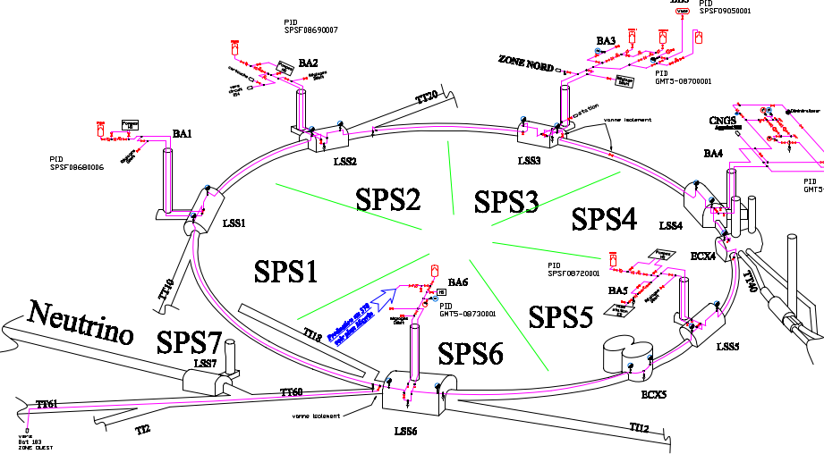
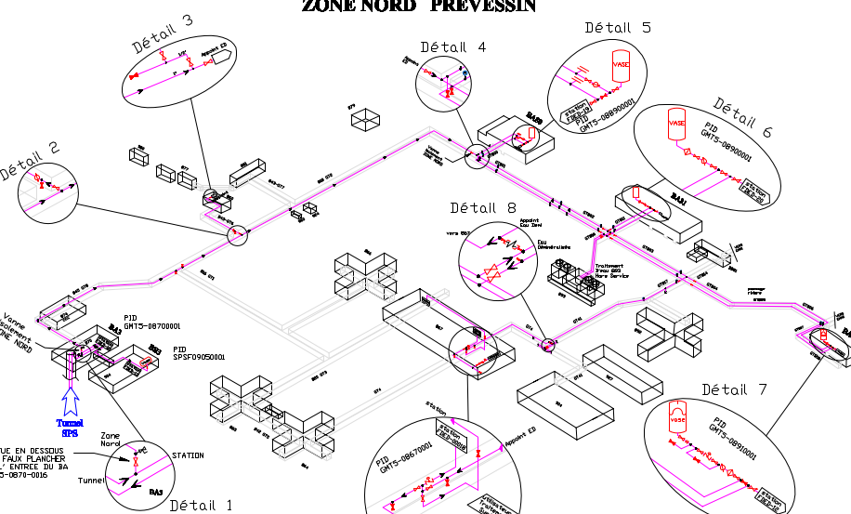
Distribution of demineralised water
31st of May 2023 – PS Booster magnets Task Force meeting

Slide 8
Conclusion for the supply water
The demineralised water is produced by two reverse osmosis plants from drinking water (from the same source)
The demineralised water produced has the same characteristics for all circuit at CERN
No sulphur (< 0,2ppm) was measured.
31st of May 2023 – PS Booster magnets Task Force meeting

Slide 9
Booster circuit water
31st of May 2023 – PS Booster magnets Task Force meeting

Slide 10
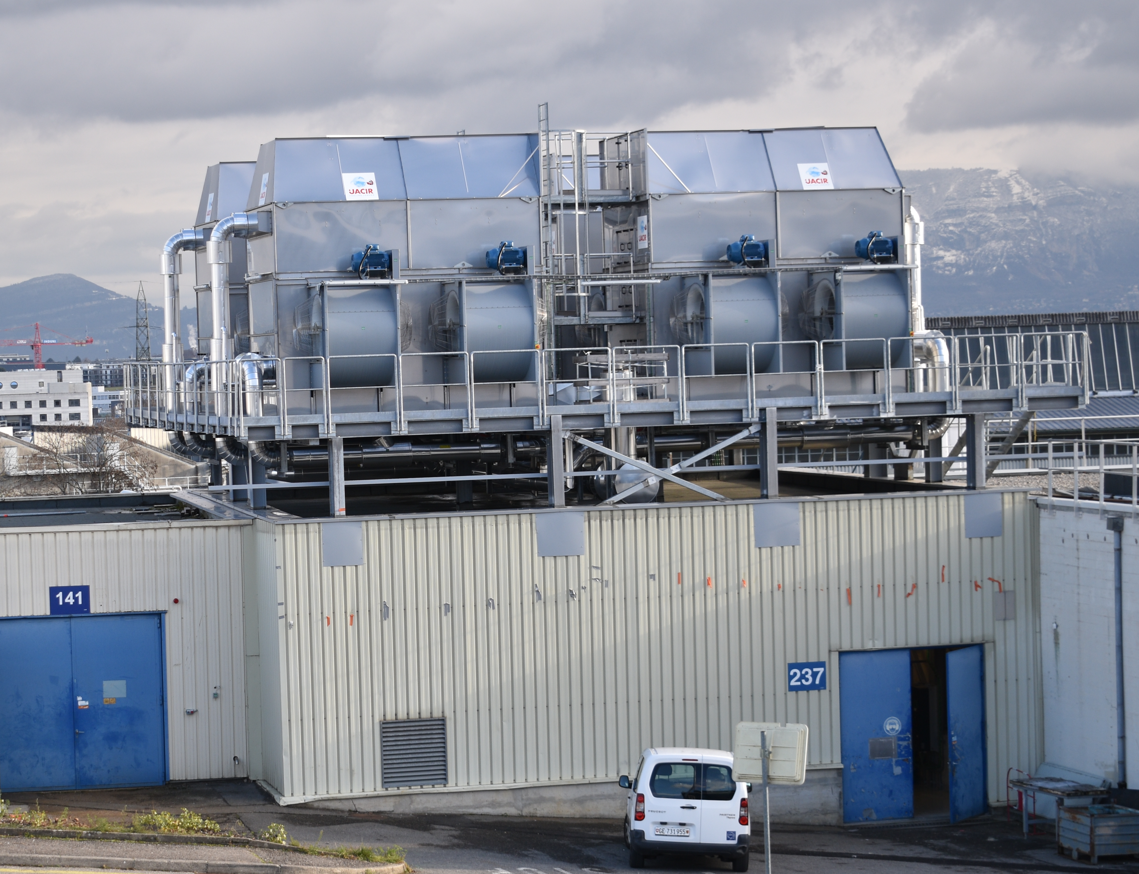
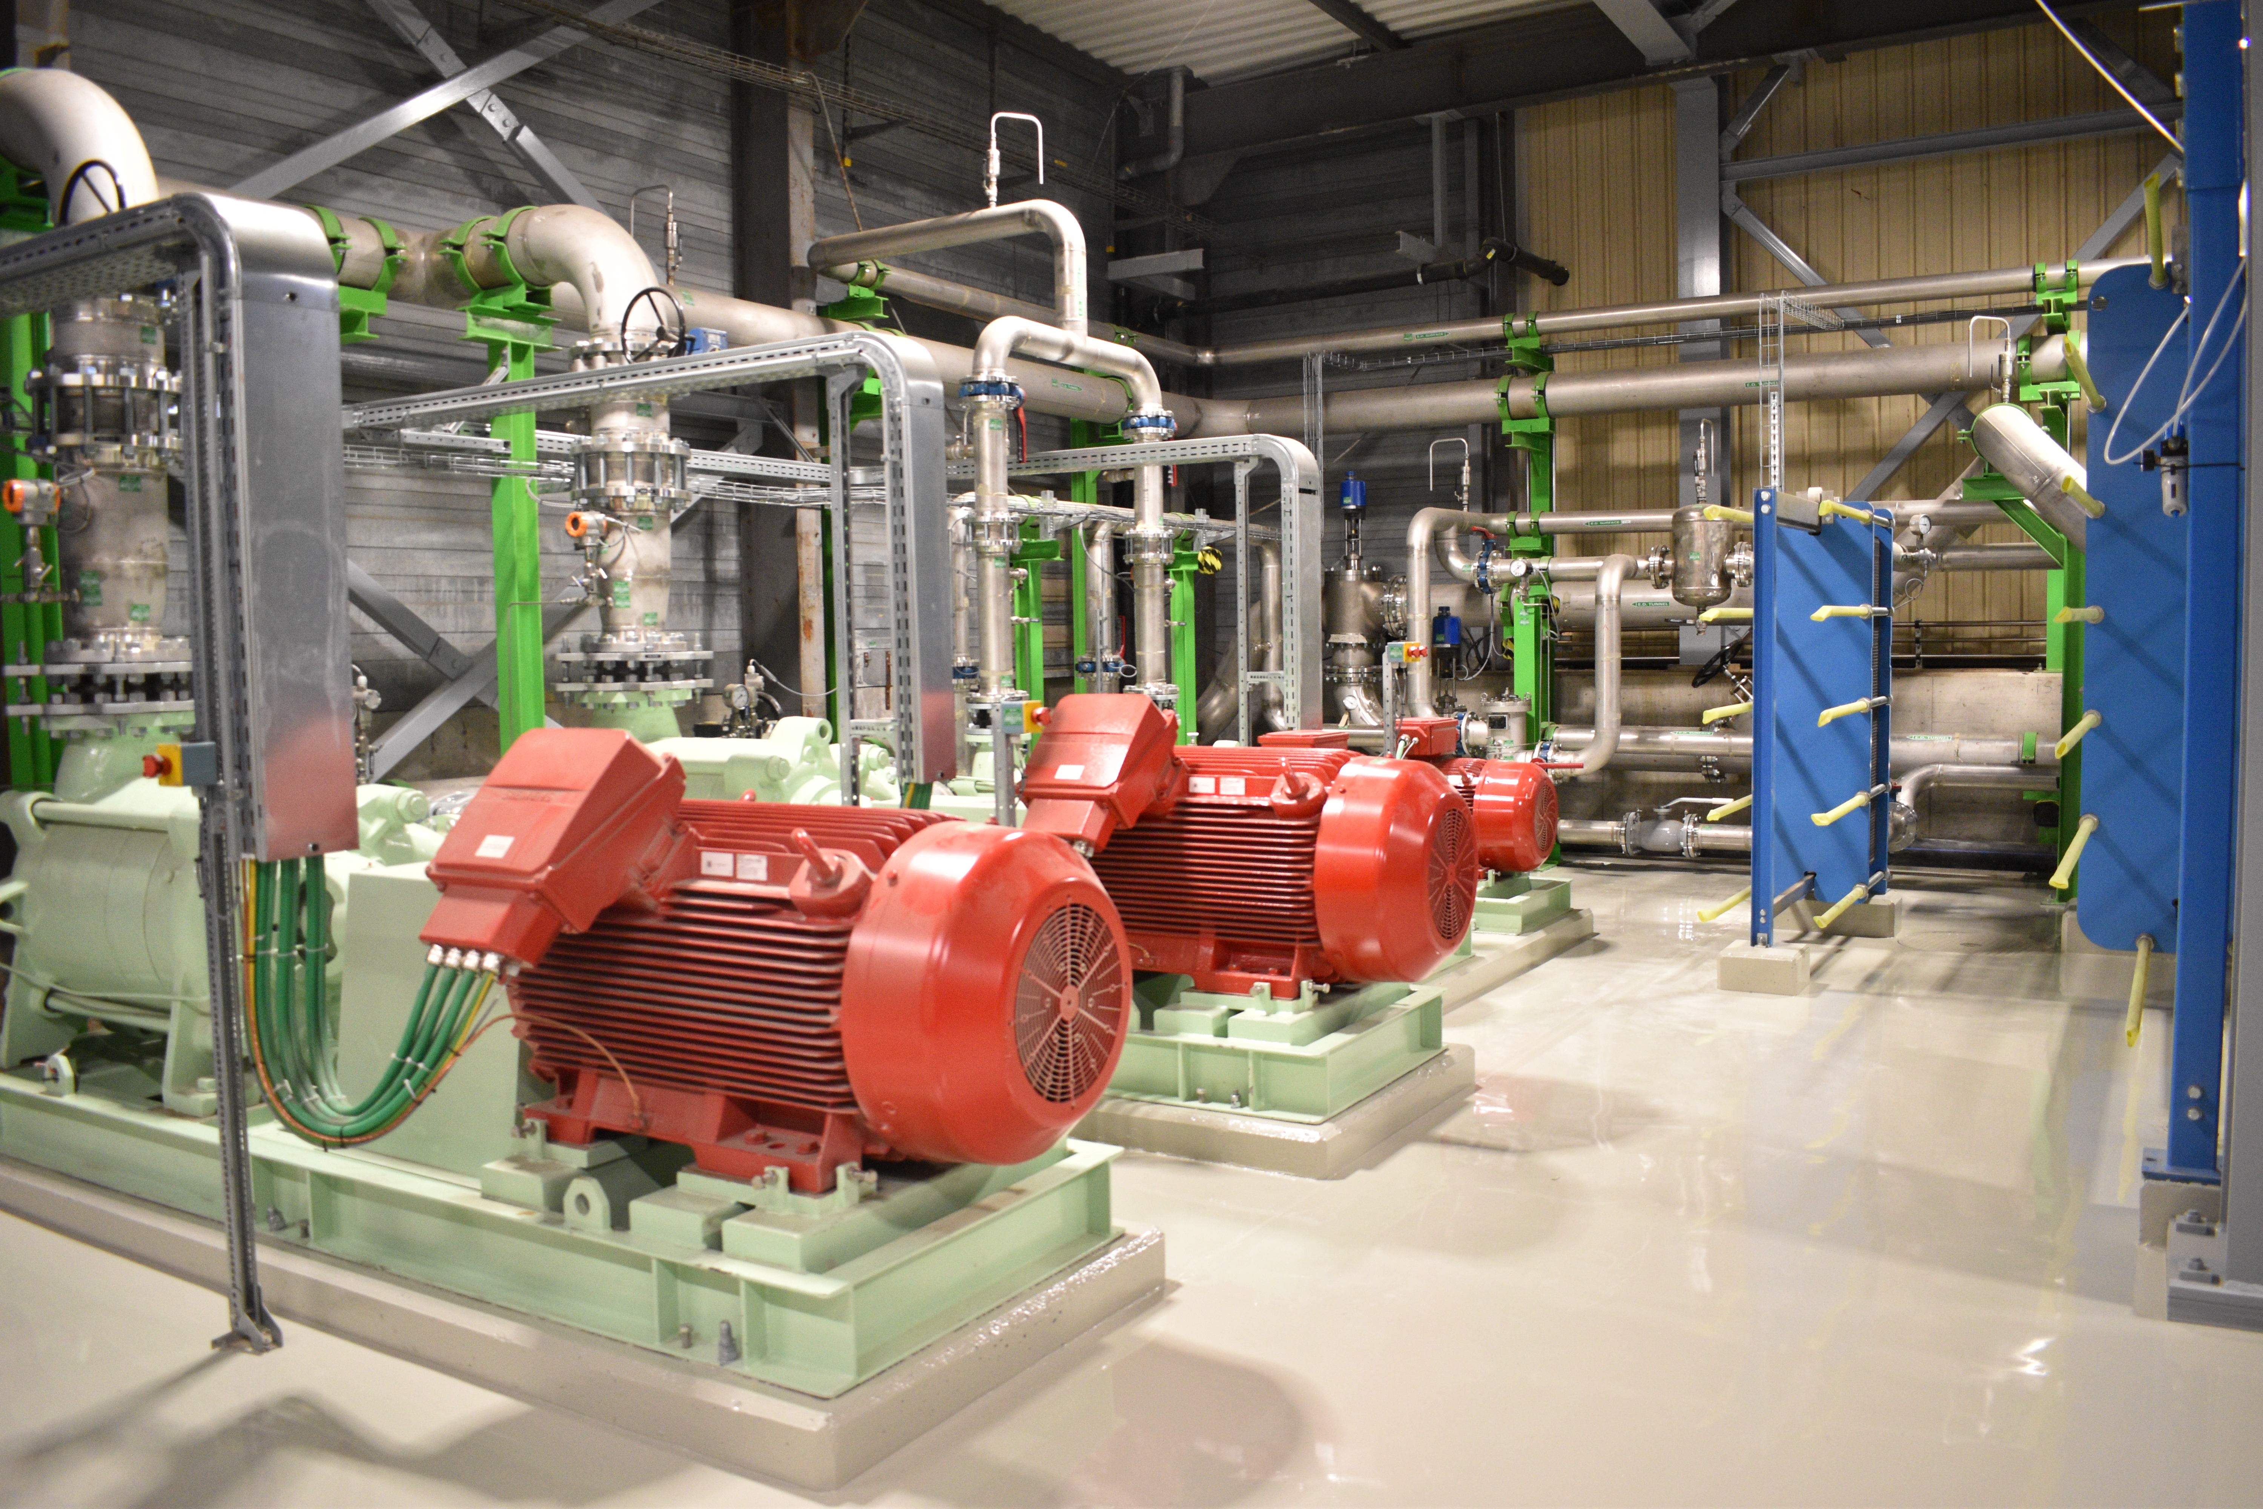
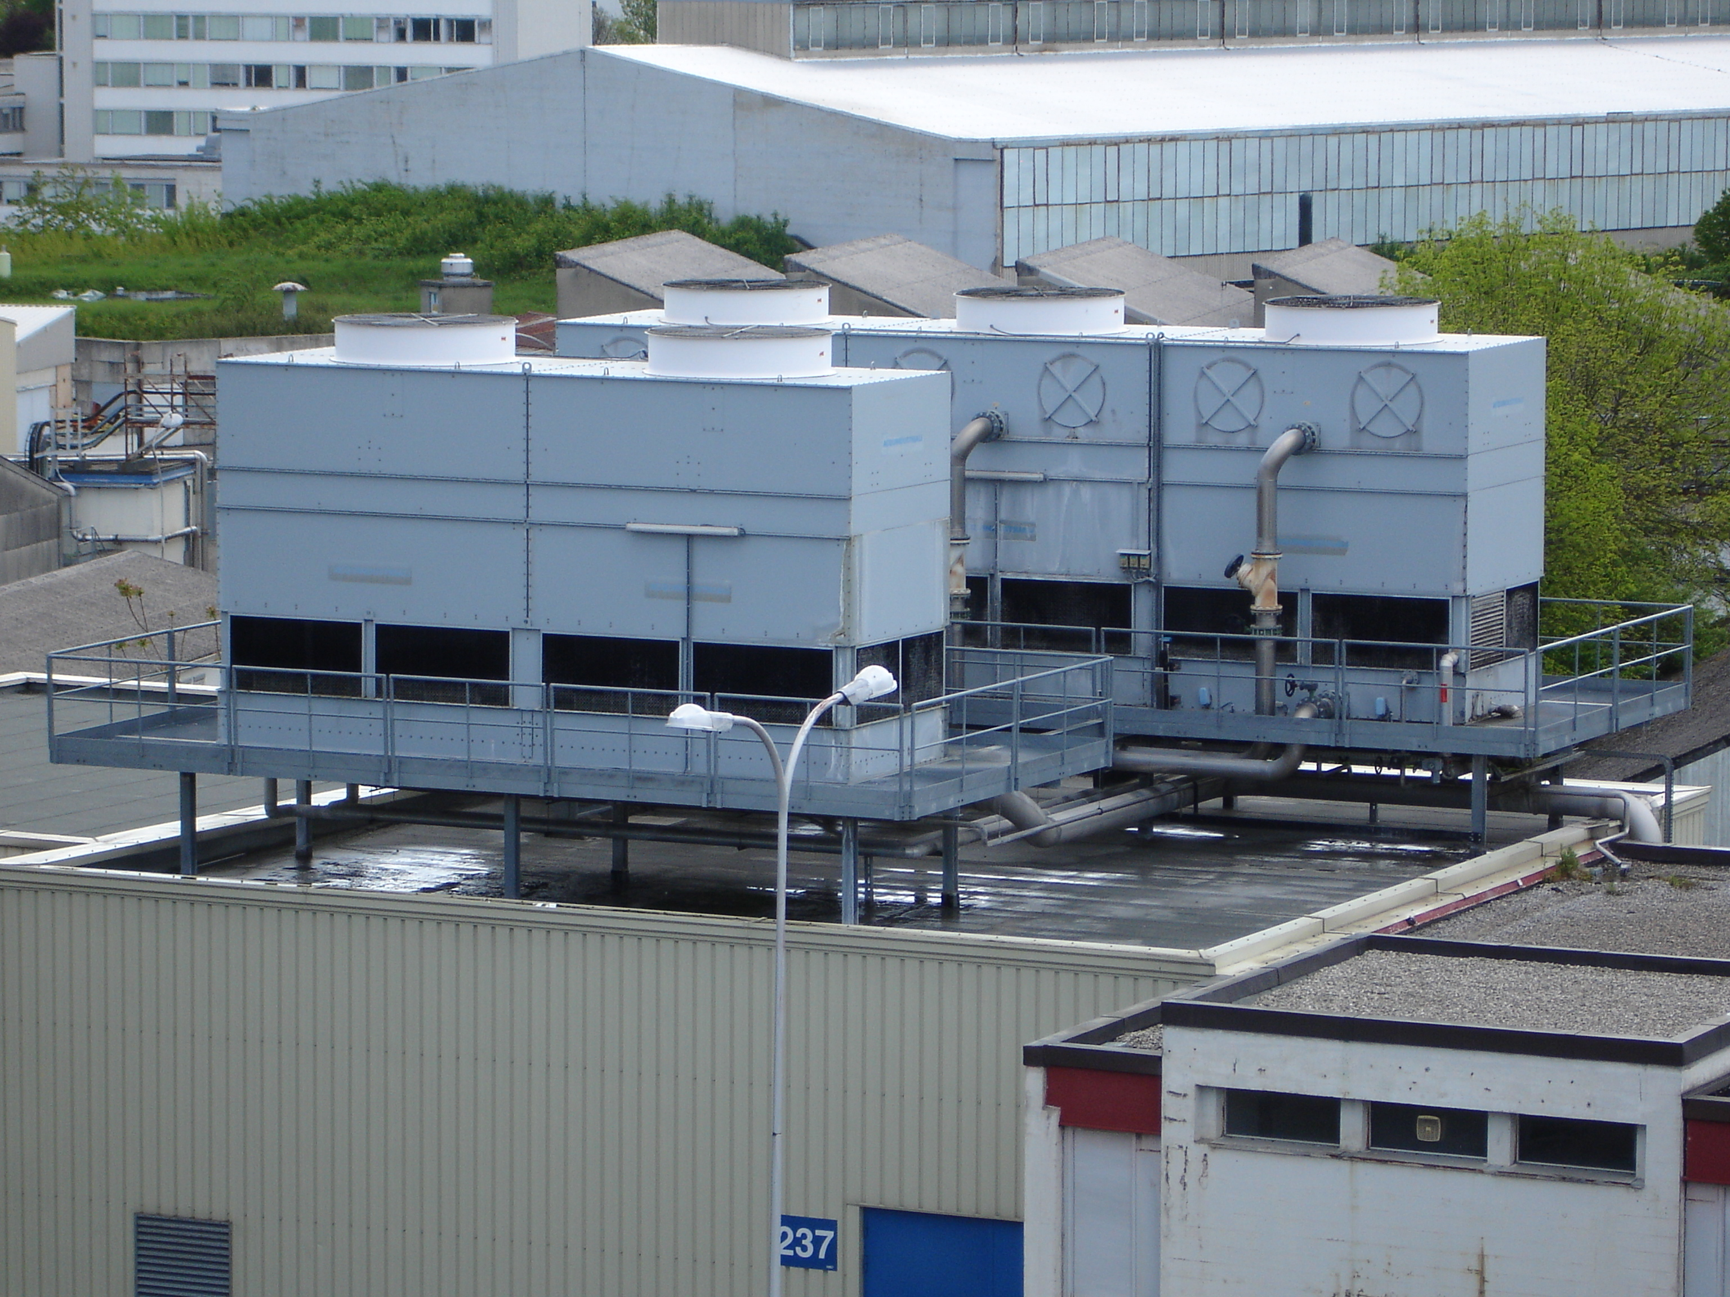
LS2 (1/2)
Major consolidation
Upgrade for LIU project
31st of May 2023 – PS Booster magnets Task Force meeting

Slide 11
LS2 (2/2)
Complete replacement of PS Booster cooling plant
Cooling plant made of stainless steel
Modification of the distribution circuit
Many beam equipments (new / modified or upgraded) were connected to the circuit during LS2
Slight modification of hydraulic characteristics (pressure, flow)
Despite intensive commissioning phase by rinsing and filtering (with additional filter) various impurities could remain in the circuit after LS2
31st of May 2023 – PS Booster magnets Task Force meeting

Slide 12
PSB Tunnel Circuit Pollution LS2
  Pollution detected : beginning of December 2019
  Description of the damage : Severely polluted distribution network
  Damaged equipment: PSB RF equipment
  Cause :
    Welding sponge, paper, grinding powder, metal dust and other material inside the pipeline.
    Decomposed organic parts and fibres of paper composed a sticky compound with fine metal spalls and grinding powder, spalls and grinding powder. This compound dispersed all over the hydraulic circuit including user equipment.
  Damage : direct damage 46 kCHF + long cleaning period (3W)

Slide 13
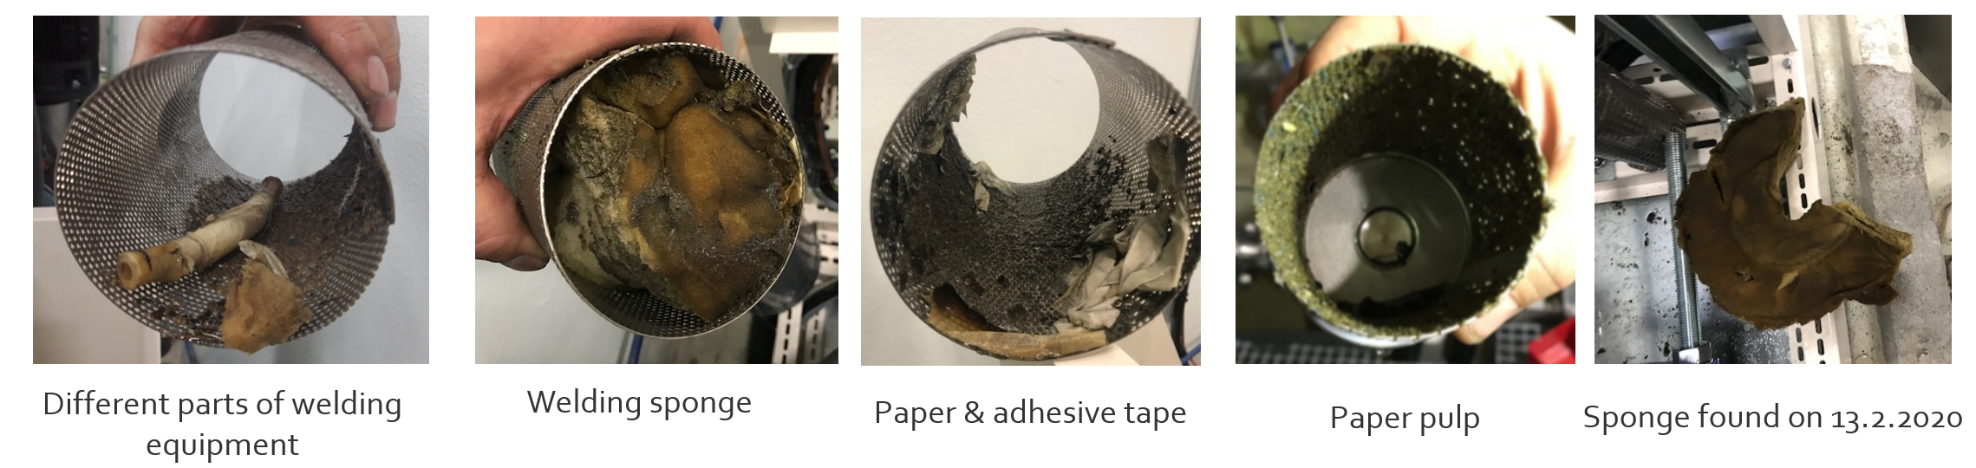
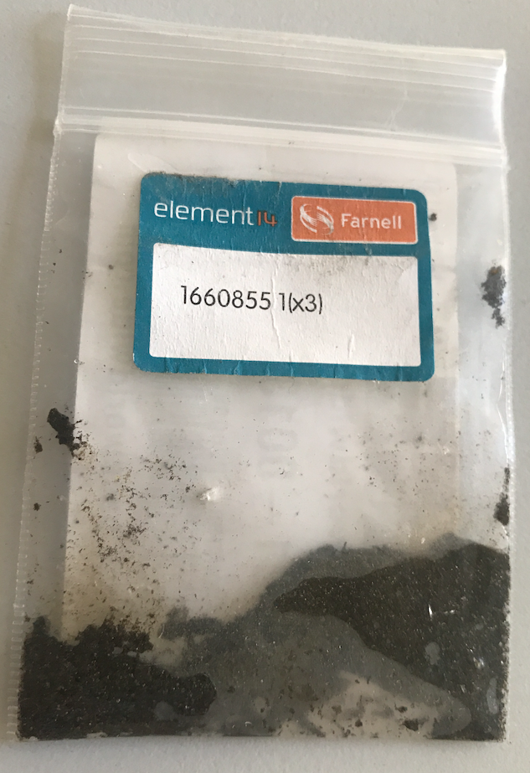
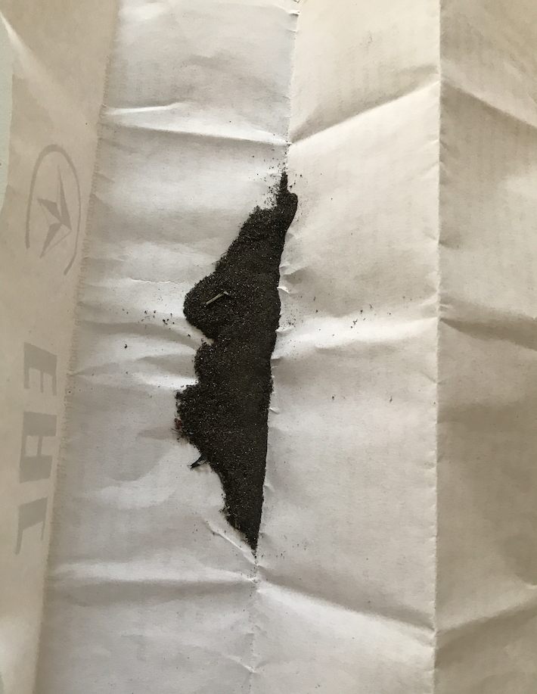
PSB Tunnel Circuit Pollution LS2
PSB Cooling
Sponge & paper
PSB Cooling
Grinding dust

Slide 14
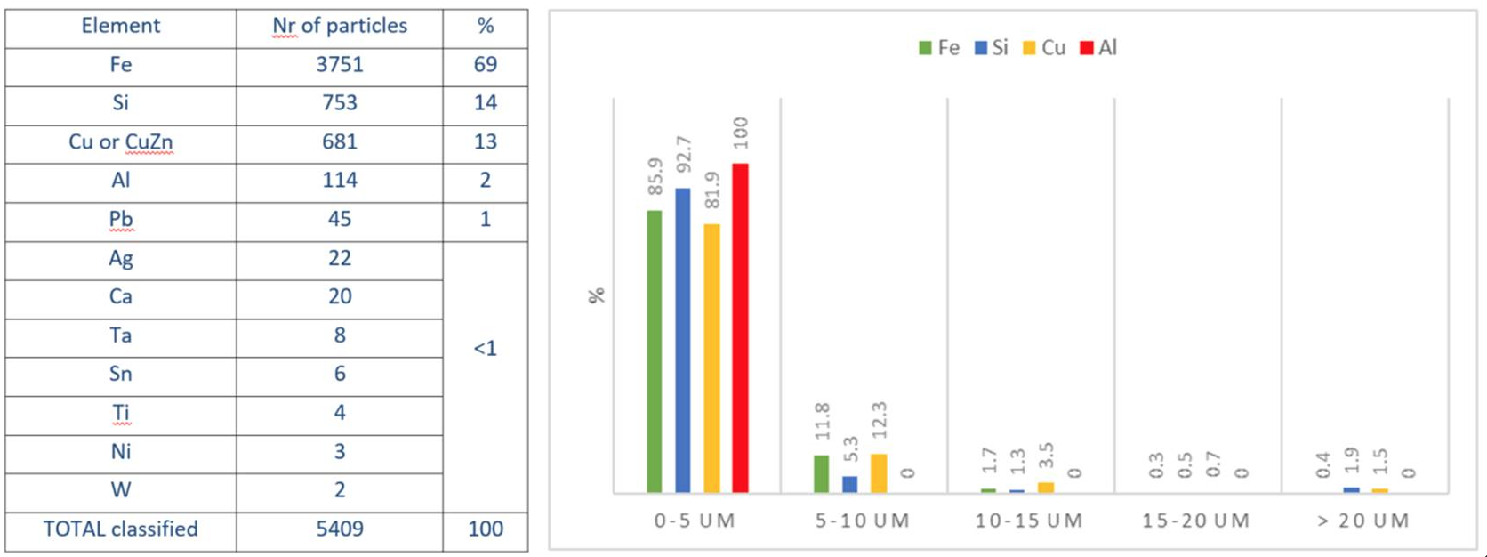
PSB Tunnel Circuit Pollution LS2 - Analyze
  Particle Analysis EN/MME
  Chemical analysis by SUEZ
    MES Particles in suspensions
    PSD particle size distribution
    Chemical analysis
  Conductivité : 13.3 µS/cm
  Fer total : 0.101 mg/L
  Fer soluble : 0.041 mg/L
  Cuivre total : 1.7 mg/L
  Cuivre soluble : 1.38 mg/L

Slide 15
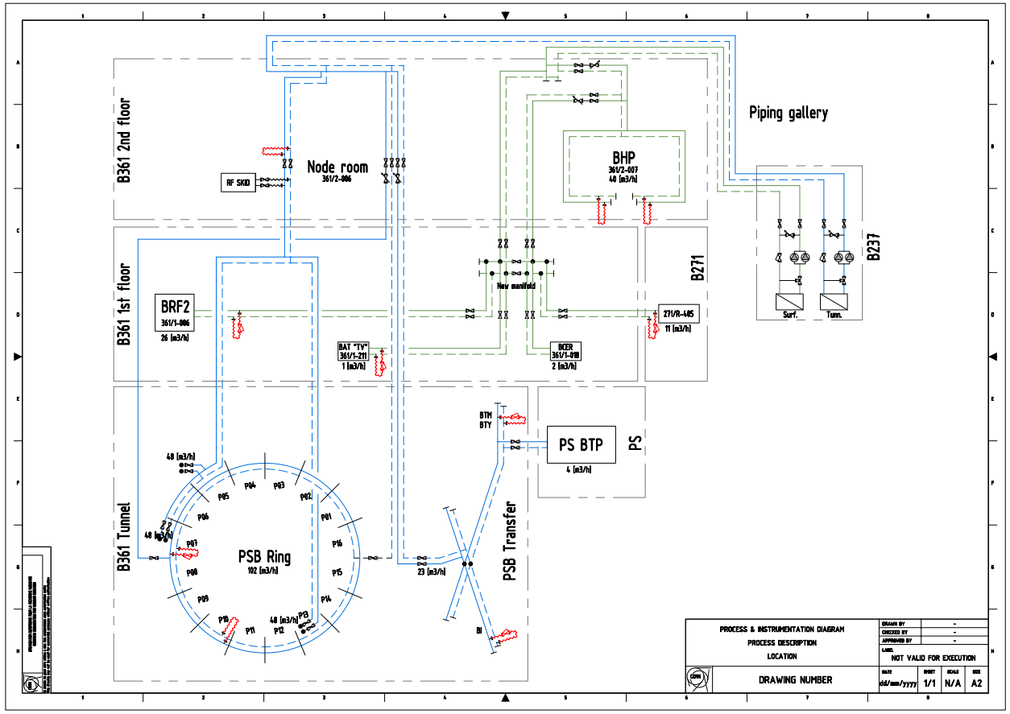
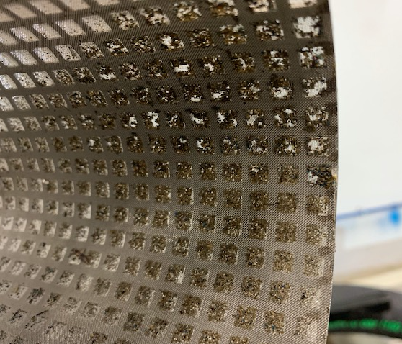
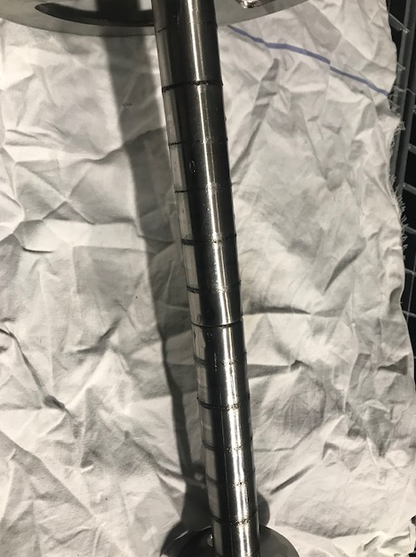
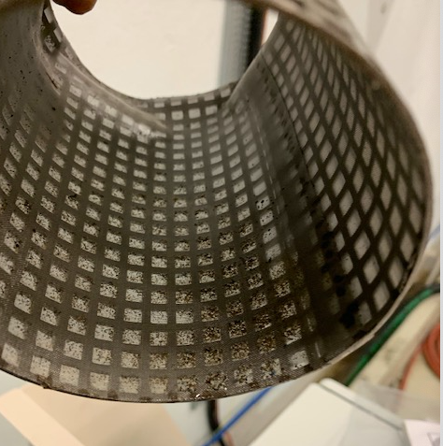
PSB Tunnel Circuit Pollution LS2 - Network cleaning
  Circuit flushing
    4 cartridge filters installed in the tunnel
    4 by-ball points > All user equipment closed
    3 weeks

Slide 16
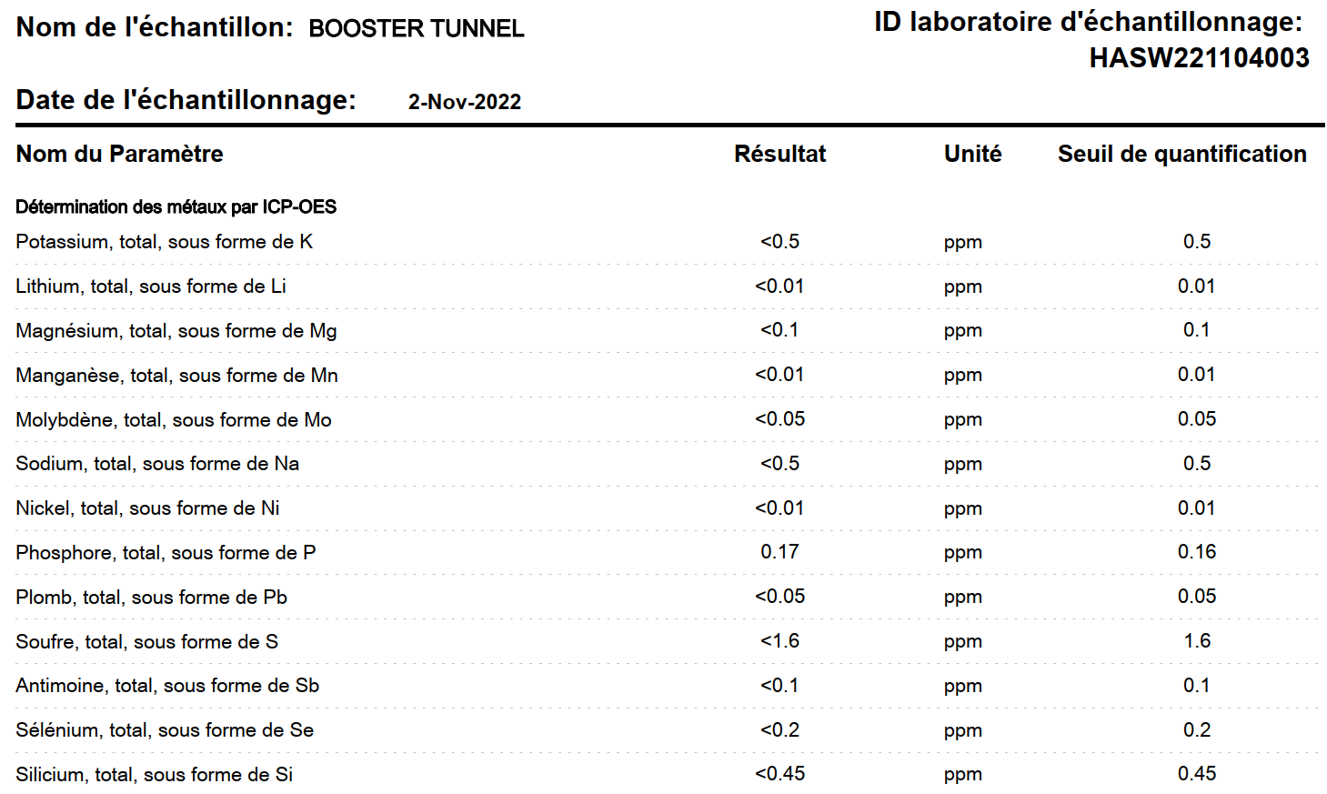
Booster circuit water analysis in 2022
31st of May 2023 – PS Booster magnets Task Force meeting

Slide 17
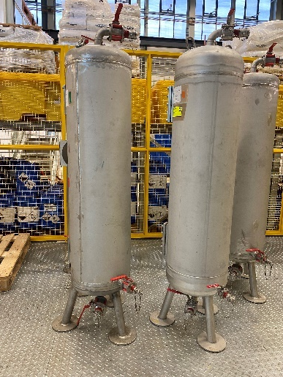
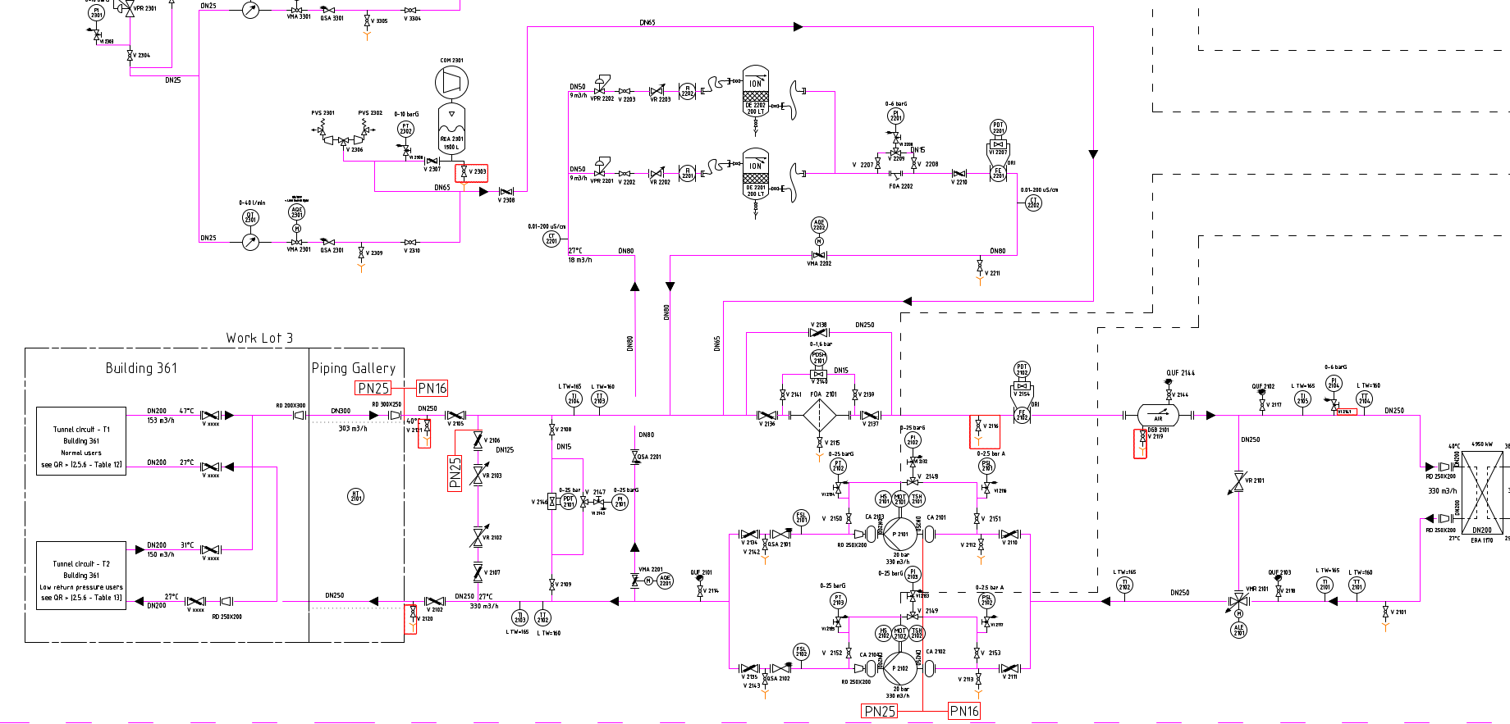
Ion exchange column
Cartridges in stainless steel
Resins (cation) = Amberlite 200C
Resins (anion) = Amberlite IRA 900
31st of May 2023 – PS Booster magnets Task Force meeting

Slide 18
Other circuits water analysis
Comparison with demineralised water of other circuits
Same characteristics.
Sulphur <1,6 ppm
31st of May 2023 – PS Booster magnets Task Force meeting

Slide 19
Conclusion
Water characteristics, material used, process and resins are the same for all Accelerators circuits.
Sulphur was not detected (< 1,6ppm) in the Booster and other circuits nor at the production of demineralised water (< 0,2ppm)
With the work performed during LS2, various impurities were integrated in the circuit.
Circuit was drained and rinsed many times during commissioning.
The water quality was then conform before providing water to the magnets.
31st of May 2023 – PS Booster magnets Task Force meeting

Slide 20
Possible actions
Perform repeated water analysis focusing on sulphur with a lower threshold.
Check and reduce on the magnets water speed preventively
31st of May 2023 – PS Booster magnets Task Force meeting

