Slide 1
SPS report
K. Li, F. Velotti for the SPS team

Slide 2
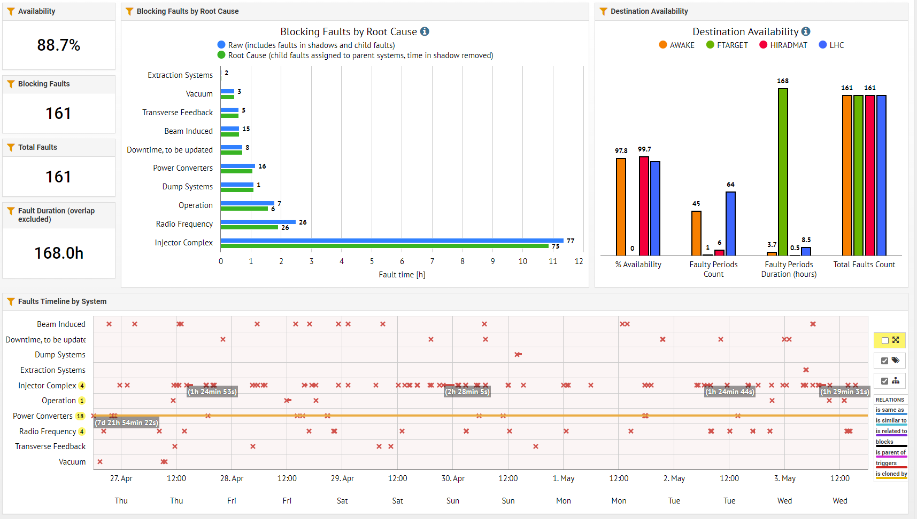

Slide 3
Users info and status
SFTPRO:
  Very good availability – no major issues
  Spill quality: small modifications done on the RF side to try to improve the quality of the spill
  10th May dedicated MD will need beam to P42 also if possible
  50 and 100 Hz automatic compensation on → still sometimes the algorithms hits boundaries and provokes shots with very large 50 and 100 Hz
AWAKE:
  Physics started on Monday – no major stops or issues until now
HiRadMat:
  1h of extractions provided Wednesday morning – everything looks rather as expected and not major issues seen in the profile measured (unfortunately very difficult to say more as on emittance measurement available in the SPS)

Slide 4
Upcoming events
Friday morning stop for about 1h for crab cavities DSO test
  Tentatively 10AM (it depends on the LHC)

