Slide 1
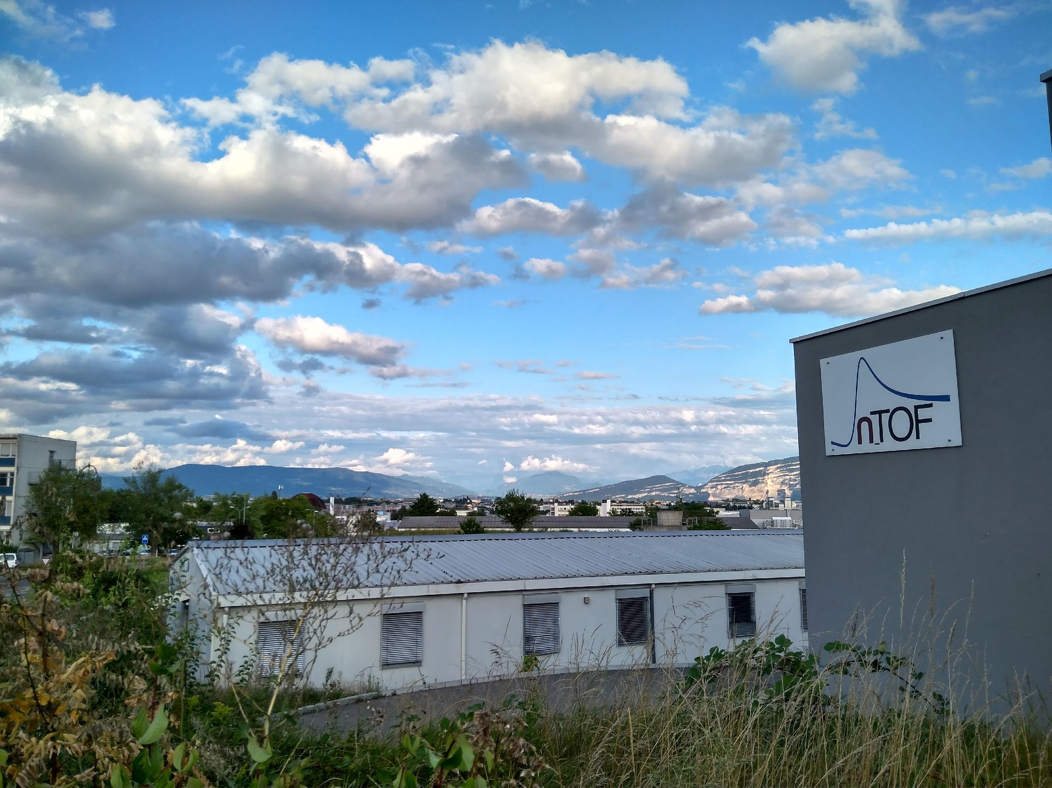



STATUS REPORT OF THE n_TOF FACILITY
Nikolas Patronis n_TOF Physics Coordinator CERN & Univ. of Ioannina | Michael Bacak n_TOF Run Coordinator CERN

Slide 2
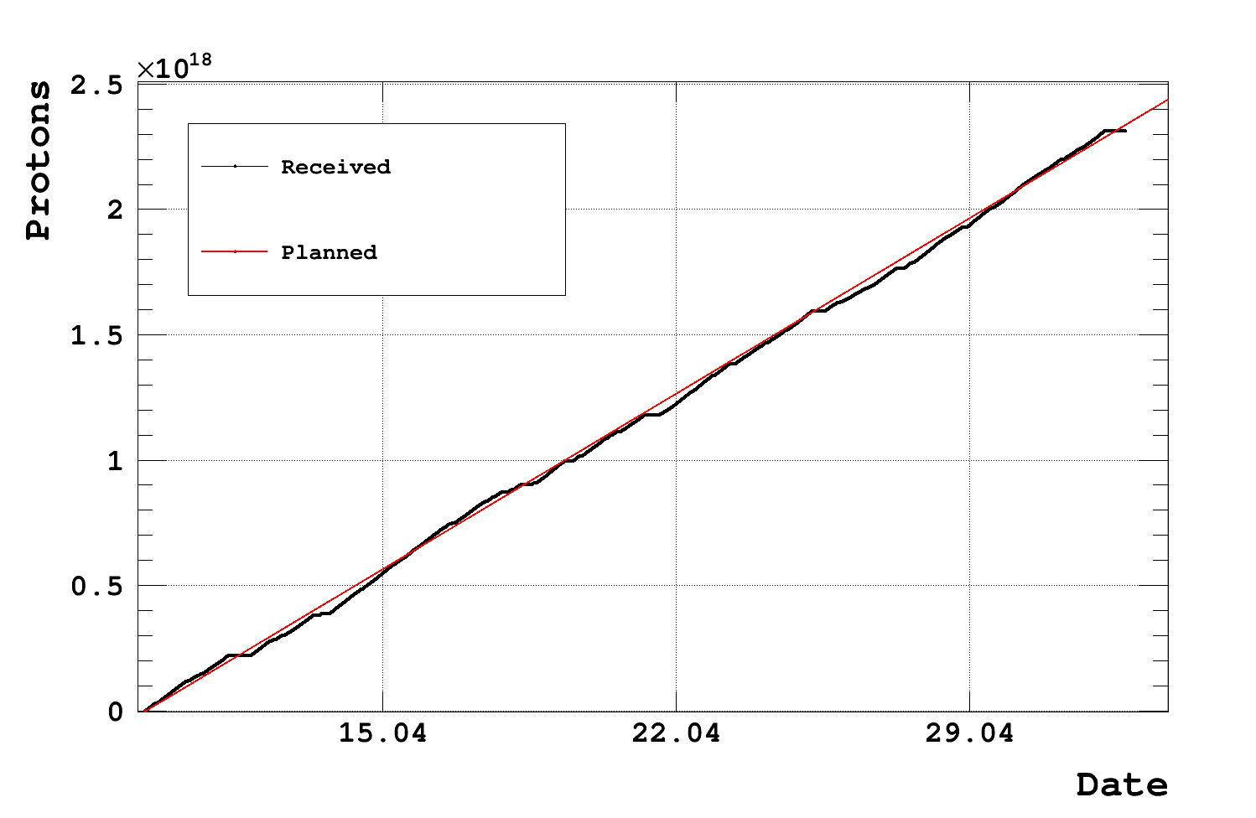
Week 18 Status
Total Physics PoT: 2.3E18

Slide 3
Week 18 Status
EAR1: The first n_TOF neutron inelastic measurement was successfully accomplished. First results are promising, and we are optimistic that (n,n’) reactions can be studied at n_TOF. On 03.05.2023 almost the full day was spent to change the setup from HPGe detector to capture setup (C6D6 and sTED) for the study of ¹⁸¹Ta(n,g) reaction.
EAR2: One more week of auxiliary capture setup measurements
NEAR: Change of irradiation configuration on 03.05.2023. Till 10.05.2023 (Wednesday) -> study of ⁹⁴Zr(n,g) using 15mm B4C filters
PoT: 2.3E18; back to normal pulse intensity
Many thanks to PS-teams for making their best to receive the scheduled ppd (despite the low intensity ppp request from our side)
Back to nominal intensity pulses for n_TOF
Scheduled beam-off Wednesday 10.05.2023 -> 09:00 - 14:00 (5h); change of NEAR irradiation setup to ⁹⁴Zr(n,g) with 20mm B4C filters

Slide 4
Thank you
iTED @ EAR1
sTED @ EAR2

