Slide 1
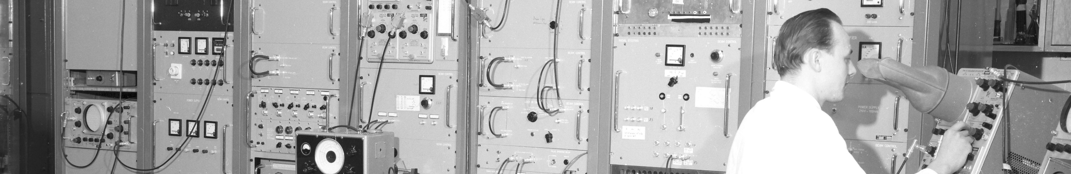
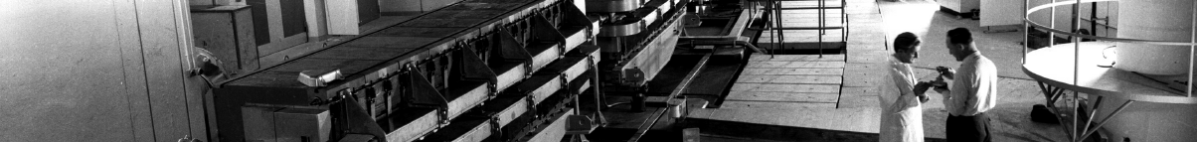
PS Report week 18
Many thanks
to the PS OP and coordination teams as well as all equipment experts and support teams!
D.Cotte BE-OP-PS

Slide 2
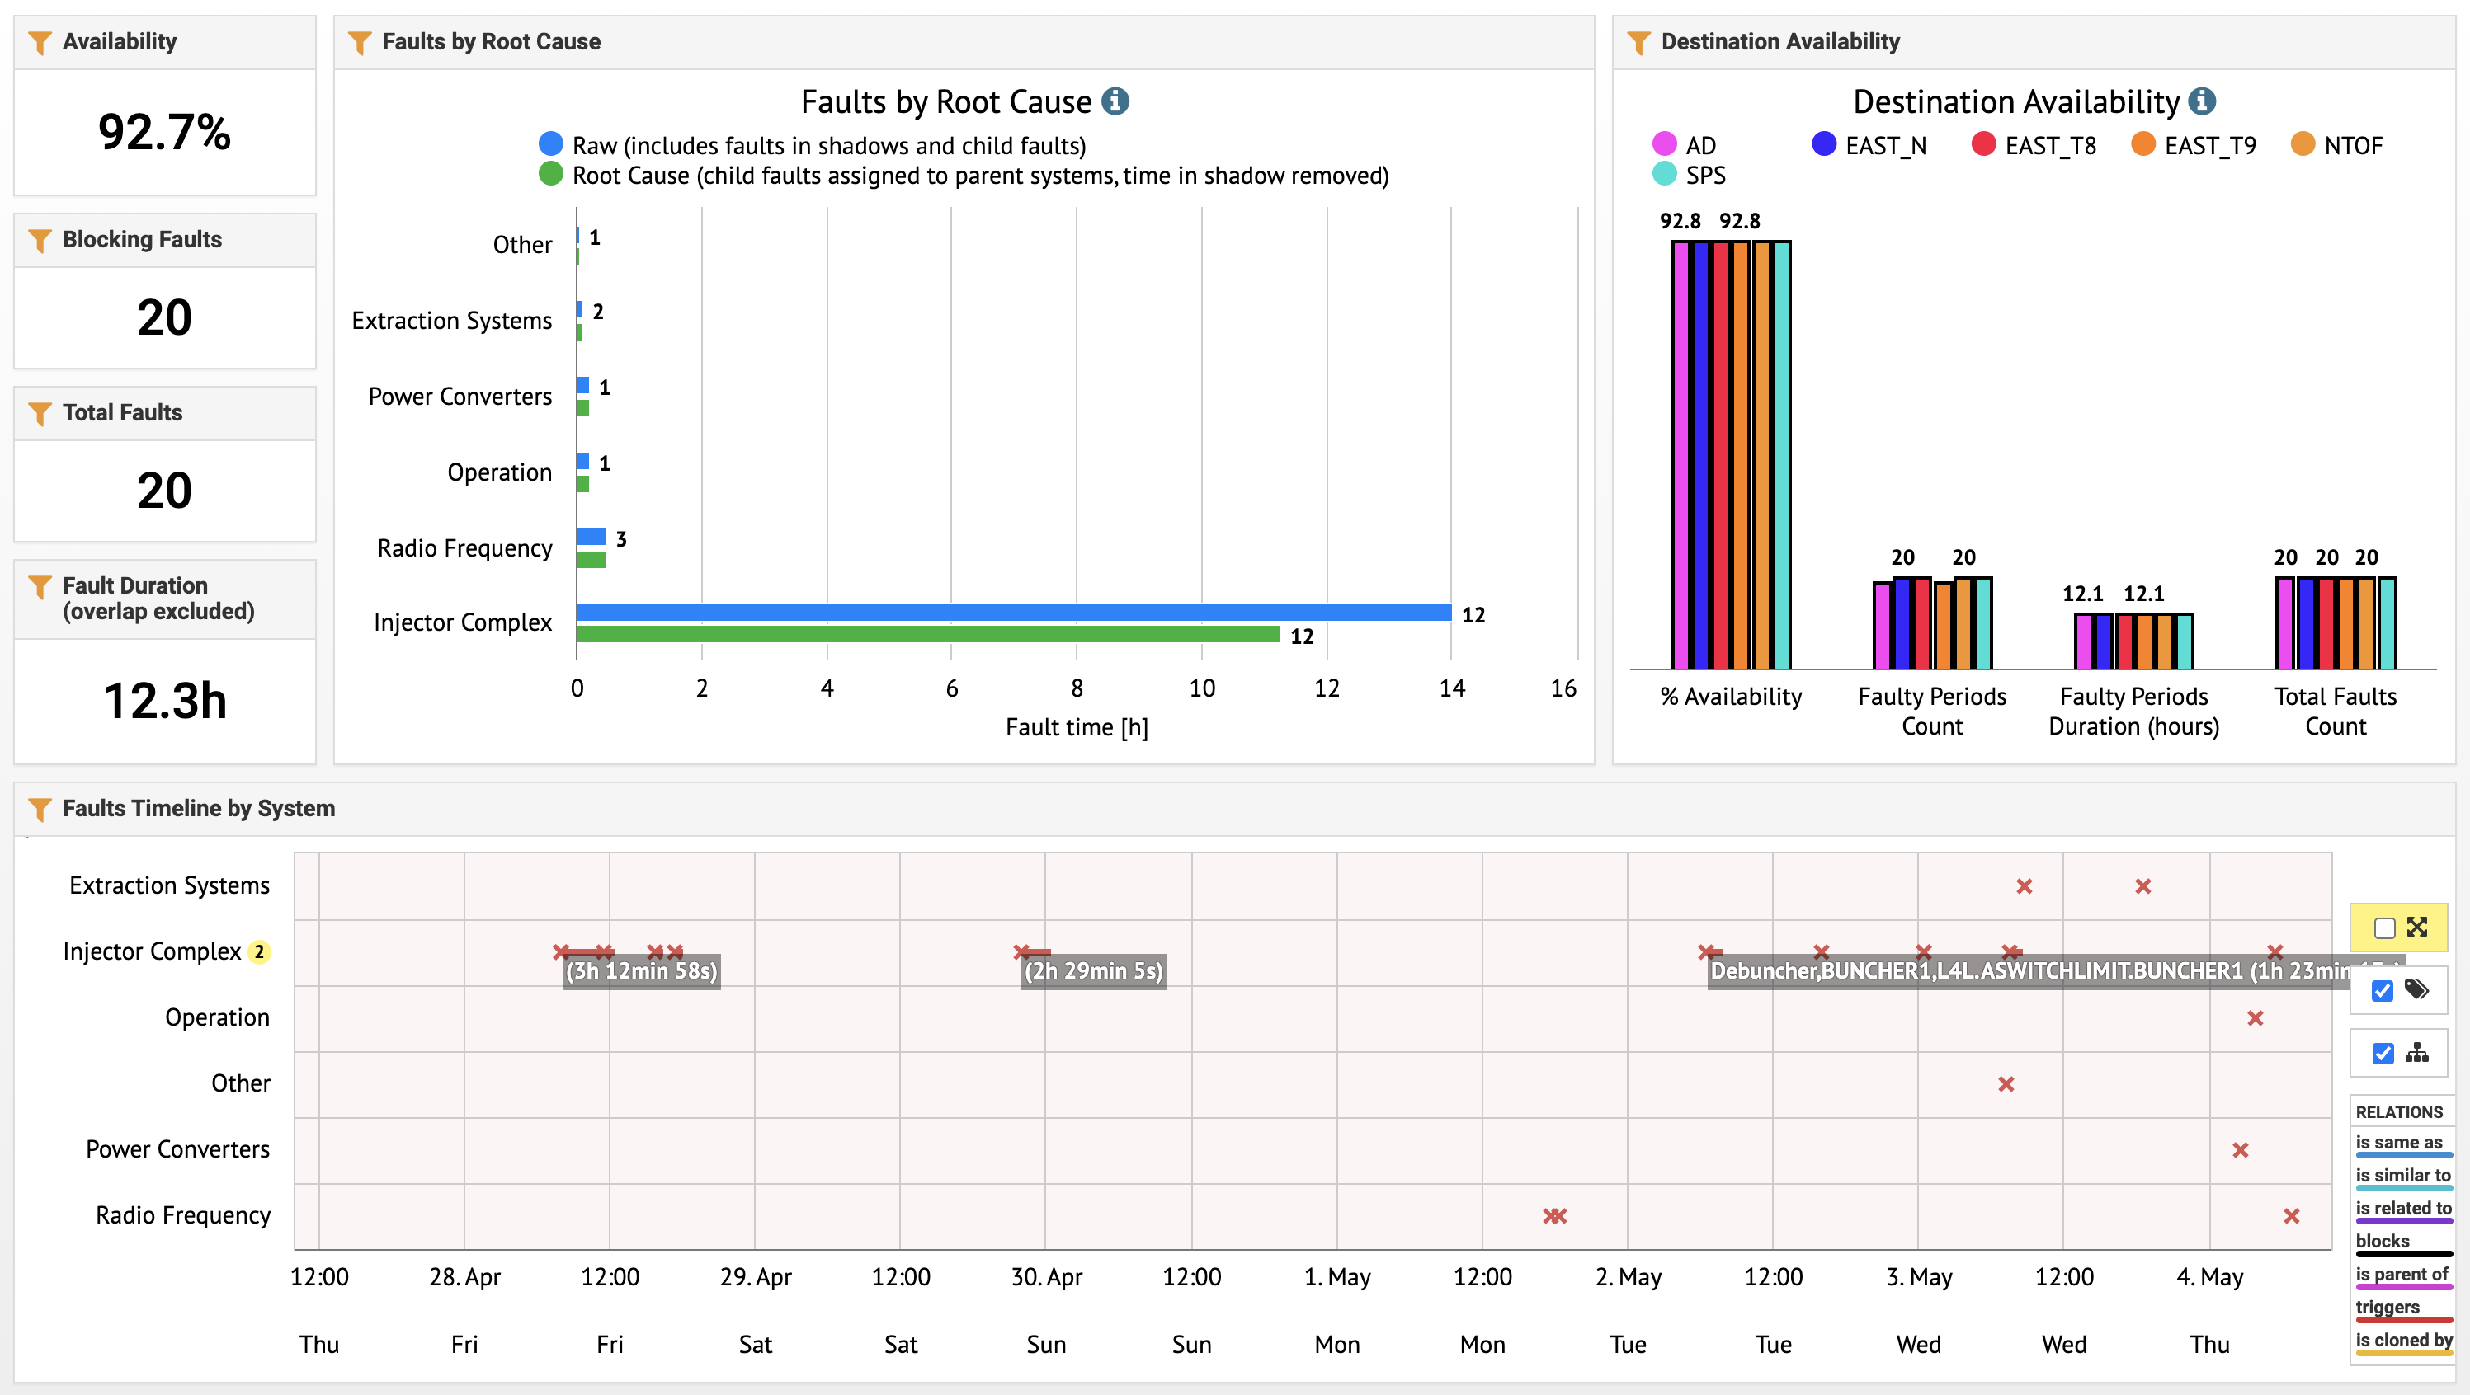
Beam availability W18
KFA71
BT4.SMV10
L4 source intervention
10Mhz cavities

Slide 3
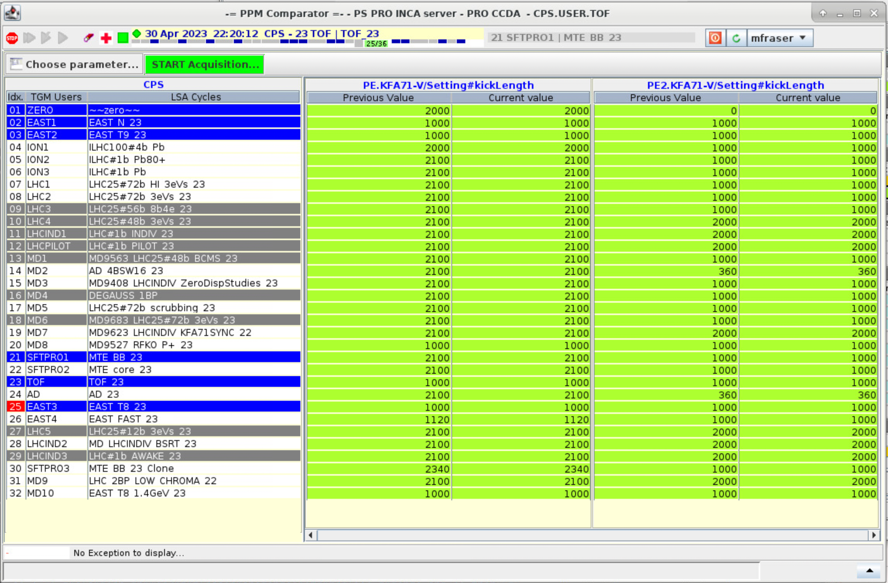
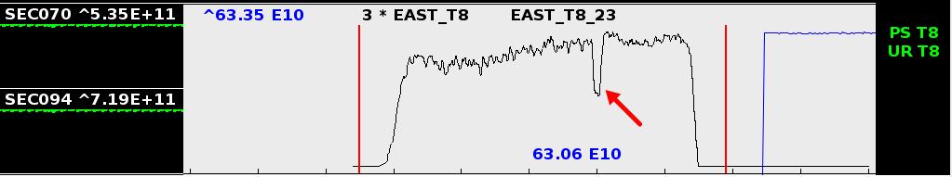
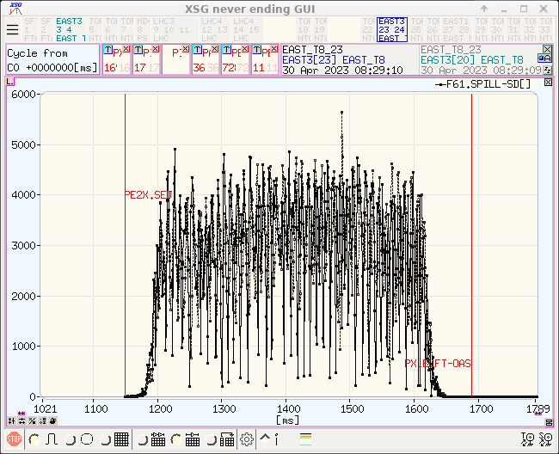
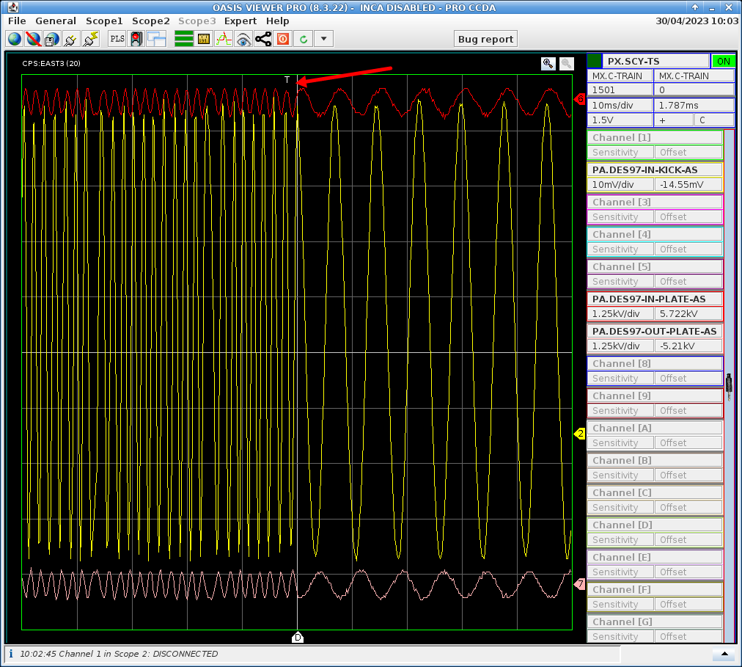
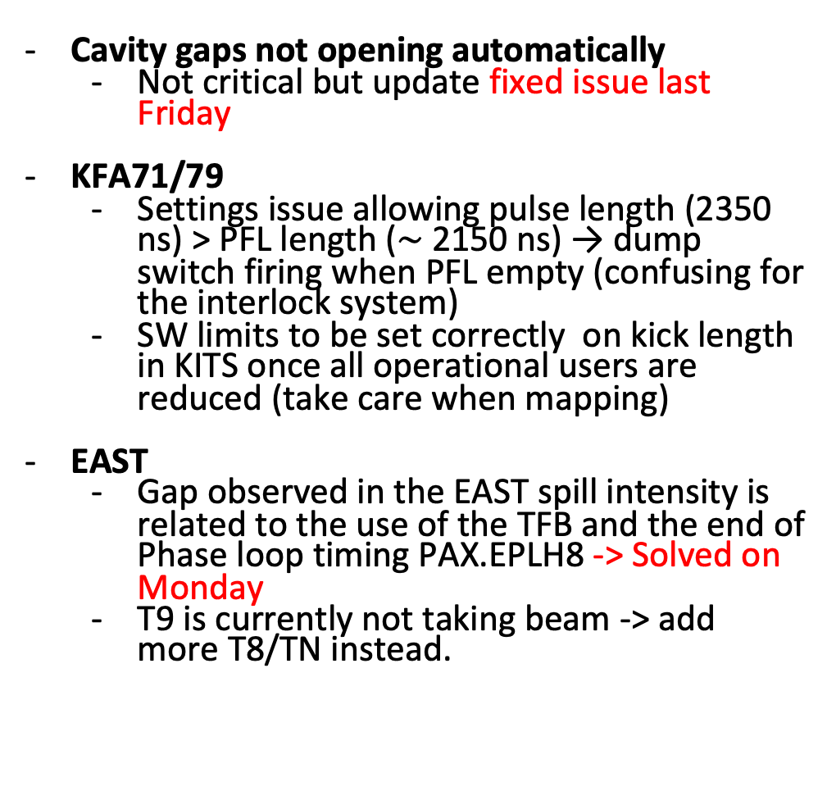
Main issues and activities
Cavity gaps not opening automatically
  Not critical but update fixed issue last Friday
KFA71/79
  Settings issue allowing pulse length (2350 ns) > PFL length ($\sim$2150 ns) → dump switch firing when PFL empty (confusing for the interlock system)
  SW limits to be set correctly on kick length in KITS once all operational users are reduced (take care when mapping)
EAST
  Gap observed in the EAST spill intensity is related to the use of the TFB and the end of Phase loop timing PAX.EPLH8 -> Solved on Monday
  T9 is currently not taking beam -> add more T8/TN instead.
M. Fraser SY-ABT-BTP

Slide 4
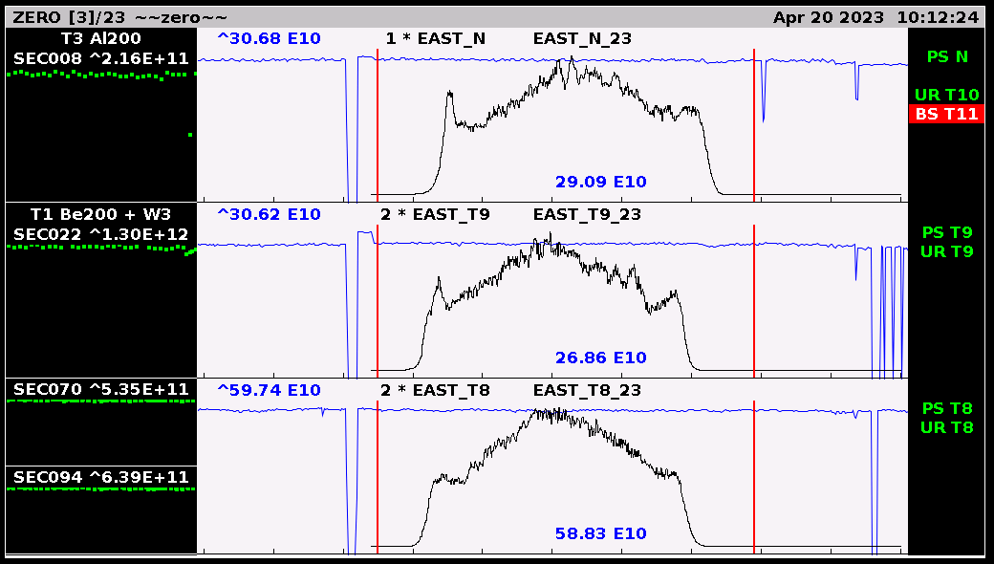
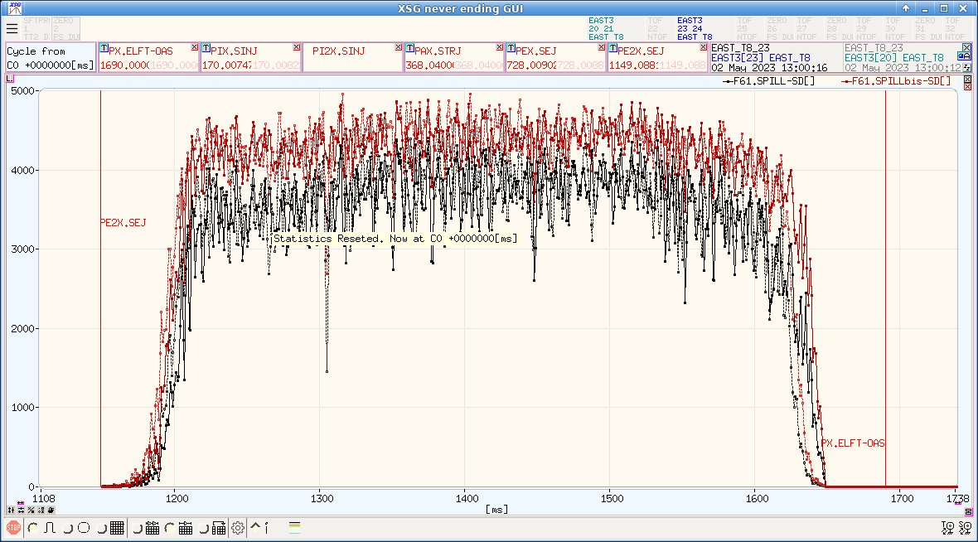
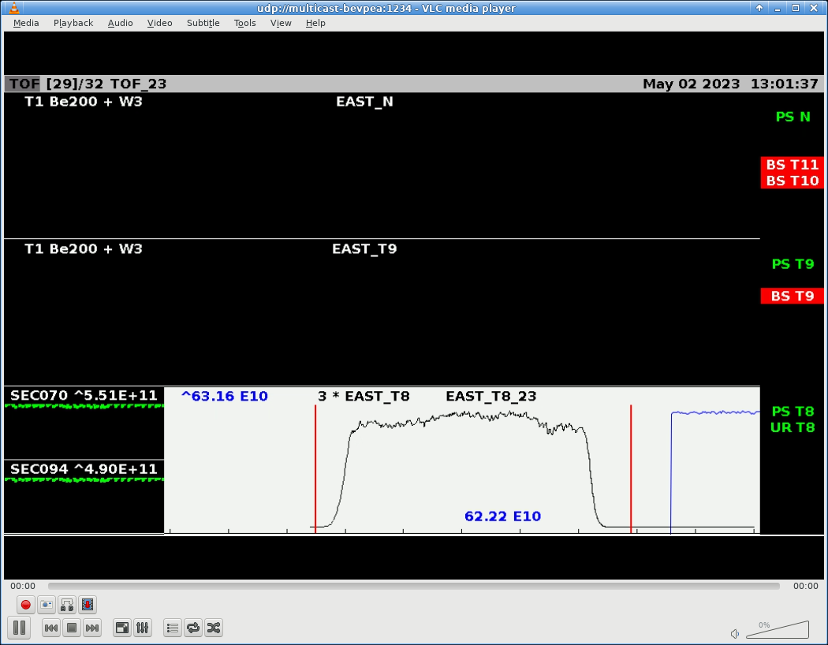
Main issues and activities
- EAST
  - Since Tuesday, very nice spill shape provided to EAST Area
TOF
  Back to nominal intensity.
  A new version with optimized working point and 4 extraction bumpers is available and ready to be tested (on Friday ?)
SFTPRO
  Intensity increased, now at 1150e10 ppp.

Slide 5
Status of operational beams
Fixed target beams | Status | Comment
SFTPRO (core only) | Operational | Sent to SPS at 50 ∙ 10¹⁰ p/p
SFTPRO (5 turn extraction) | Operational | Available up to 1.5 ∙ 10¹³ p/p
AD | Operational | Available up to 1.5 ∙ 10¹³ p/p ; FTA line commissioned
TOF | Operational | 850 ∙ 10¹⁰ p/p and (28-)40 ns bunch length at extraction
EAST | Operational | Beam slow extracted to T9, N targets and to IRRAD, Fast extraction and parasitic TOF
LHC-type beams | Status | Comment
LHCPILOT, LHCINDIV | Operational
LHC25 (3bp, 72b) | Operational | Sent to SPS at 2.4 ∙ 10¹¹ p/b; Pushed up to 2.6 ∙ 10¹¹ p/b
LHC25 (2bp, 12b to 48b) | Operational | Sent to SPS at 1.9 ∙ 10¹¹ p/b; Pushed up to 2.6 ∙ 10¹¹ p/b
LHC25 BCMS (48b) | On hold | OK at 1.4 ∙ 10¹¹ p/b; Pushed up to 2.3 ∙ 10¹¹ p/b
LHC25 8b4e (56b) | Operational | Pushed up to 2.1 ∙ 10¹¹ p/b
AWAKE | Operational
HiRadMat | Operational | Single bunch AWAKE-like prepared at 2um transverse emittance
ILHC (1b), ILHC (4b)

Slide 6

PS Coordinator for week 17 – Matthew Fraser
PS Coordinator for week 18 – Denis Cotte
Questions and Comments
9:00 live meeting at the CCC on Wednesday and Friday
Zoom link to follow the meeting on remote: https://cern.zoom.us/j/9372114100?pwd=L29BcmlHUENCdFBRSytXYVcrM1B4Zz09
Meeting ID : 937 211 4100
Passcode: 525463

