Slide 1
Quantum Computing and High Energy Physics [Report Number: FERMILAB-SLIDES-23-328-ETD]
Prasanth Shyamsundar, Fermilab Quantum Division
Top Quark Physics at the Precision Frontier, Purdue University
3 October 2023

Slide 2
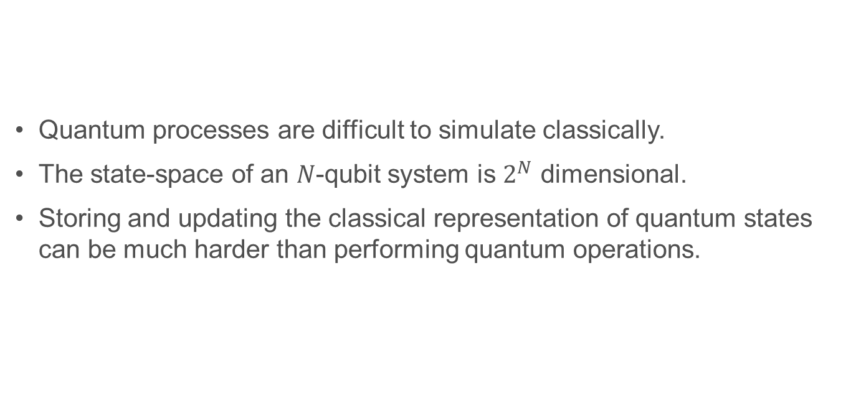
The Allure of Quantum Computing
Quantum processes are difficult to simulate classically.
The state-space of an $N$-qubit system is $2^{N}$ dimensional.
Storing and updating the classical representation of quantum states
can be much harder than performing quantum operations.

Slide 3
Some Difficulties in Quantum Computing…
The size (number of qubits) in current and near-term quantum computers in limited…
The quality of current and near-term quantum computers is limited…
Current quantum computers can’t run very large quantum circuits either…
How long until we can run quantum circuits
that can’t be classically simulated?

Slide 4
We’re already there!
We can already run circuits of sufficient size, depth, and entanglement (with reasonable accuracy),
that classically simulating them is prohibitively expensive.

Slide 5
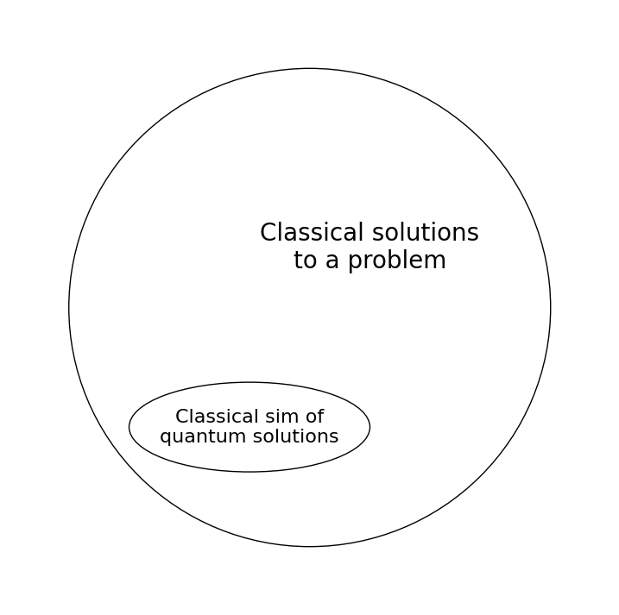
So, why do we still keep classical computers around?
Simulating quantum circuits is not the only way to solve problems with classical computers.
Quantum computers have an exponential advantage over classical simulations, not necessarily classical solutions…
Also, not all quantum circuits are hard to simulate… (Clifford circuits, low-entanglement circuits can be simulated relatively easily)

Slide 6
What about Shor’s algorithm?
There are known quantum algorithms with computational-complexity advantage over classical solutions.
Shor’s algorithm for factorizing numbers:
  Offers super-polynomial speedup ☺
  Highly sensitive to hardware noise ☹
  Current and near-term hardware is not good enough to solve large problems.

Slide 7
What about Grover’s algorithm?
Grover’s algorithm for unstructured search:
  Starting from a superposition of “records” classifiable as “good” and “bad”,
  this algorithm amplifies the amplitude of the good records.
  Offers quadratic speedup ☺ but also ☹
  Quantum advantage from Grover is expected to be available only in the long-term
  and only in a very narrow class of problems, due to a combination of
    hardware noise-levels, computational overheads
    a quantum-inspired classical algorithm (based on tensor-networks sims) [E. M. Stoudenmire, X. Waintal, 2023]
Non-Boolean Amplitude Amplification algorithm:
  Generalizes Grover’s algorithm to situations with a Non-Boolean grading scale.
Quantum Mean Estimation Algorithm: quadratic speedup
“Non-Boolean Quantum Amplitude Amplification and Quantum Mean Estimation,”
P. Shyamsundar, arXiv:2102.04975 [quant-ph])

Slide 8
Outlook for this talk…
We can run already quantum circuits that we cannot simulate classically.
The question is what useful problems can we solve on quantum computers
  In the near-future
  In the far-future
A few assorted themes for the rest of this talk…
What will quantum computing look like in the near-term?
Some HEP applications of Quantum Computing
HEP for Quantum Computing Hardware
Quantum Sensing

Slide 9
What will Quantum Computing Look Like in the Near-Term?

Slide 10
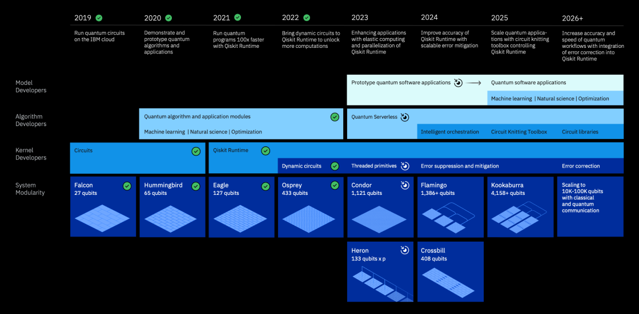
IBMs roadmap:
Circuits with order 1000 qubits, order 100 depth…
Error mitigation (until error correction becomes available)

Slide 11
Classical-Quantum Hybrid Approaches
These approaches use both quantum and classical computers
to perform different steps of an algorithm.
Accommodates the limitations for near-term hardware.
Example: Variational quantum algorithms (like VQE, QAOA)
  One creates a parameterized circuit to do some task
  (e.g., create the ground state of some Hamiltonian; similar to a variational ansatz)
  Measurements after performing the circuit inform how well the circuit does the task
  (how low the energy of the state is)
  Classical optimization is used to update the values of the circuit’s parameter.

Slide 12
Error Mitigation, Fidelity Estimation, etc.
Error mitigation will be an important aspect of near-term quantum computing.
Even if one is not directly involved in quantum hardware development, and just wants to run some circuits on available hardware, one will need to get involved in error mitigation strategies (some level of automation will become available with time).
Some questions of interest in this domain:
  Performing error mitigation (better)
  Modeling noise well, performing classical simulations of noisy circuits efficiently.
  Validating the results (estimate the fidelity) of quantum computations we cannot simulate?

Slide 13
Some Error Mitigation Techniques
Zero Noise Extrapolation:
  It may not be possible to reduce the noise in a hardware circuit,
  but one can algorithmically increase the noise.
  But evaluating the results at a few different noise levels,
  one can approximately estimate the result under zero noise.
Probabilistic Error Cancellation:
  The result of a noiseless computation is estimated as a linear
  combination (weighted average) of results of a several noisy computations.
  The noise in the circuit is learned using hardware experiments, and the ensemble of PEC circuits (and associate weights) is created to undo the effect of the noise on the result.
  Introduces a sampling overhead (somewhat similar to the sign problem in collider Monte Carlo).
  Related: “Reducing the Sampling Overhead in Quasiprobabilistic Decompositions Using Control variates,”
  P. Shyamsundar, W. Yeong, Upcoming paper.

Slide 14
Scaling Up Using Classical Post Processing
Circuit cutting techniques can be used to break larger circuits into
smaller sub-circuits, which can be run on available hardware.
The entanglement across the different circuits is mimicked by
classical communication and post-processing, with an exponential sampling overhead.
Great for weakly entangled circuits.
A take-home message:
  In the near-term, utilization of quantum computers will be relatively “low-level”.
  Less of research with quantum computers, and more of research in quantum computing.

Slide 15
Some HEP Applications of Quantum Computing

Slide 16
Simulations of Quantum Phenomena
Quantum Simulation for High Energy Physics, Snowmass whitepaper, arXiv:2204.03381 [quant-ph]
Quantum Computing for HEP: State of the Art and Challenges, Summary of the QC4HEP Working Group, arXiv:2307.03236 [quant-ph]
A very promising application of quantum computing is for the simulation of quantum phenomena.
Sidesteps the issue of classical approaches having alternative approaches,
when the task itself is in simulations…
Simulation of QFTs, Lattice Field Theories are great candidate use cases.
One needs to
  Find representations for the states in the field theory in terms of states of the quantum computing hardware.
  Implement the time evolution operators of the field theories using the operation-set of the quantum computing hardware
We have a several different candidate simulation tasks ranging from the classically tractable ones like (1+1)D lattice gauge theory simulation to classically intractable ones like ab-initio Hadron-Hadron scattering simulations.
Quantum simulation of (1+1)D system is under active research and (2+1)D systems are under consideration by various groups.

Slide 17
An Application of the Quantum Mean Estimation Algorithm
Quantum mean estimation algorithm has applications in Lattice Field Theory.
“Quantum mean estimation for lattice field theory,” E. J. Gustafson, H. Lamm, J. Unmuth-Yockey, arXiv:2303.00094 [hep-lat]
QME was used in a toy U(1) gauge theory model and the Ising model to estimate certain observables expressible as expectation values under these models.
Offers a theoretical quadratic advantage over classical MC techniques.
This speedup
  Persists in the presence of a sign problem
  Is insensitive to critical slowing down

Slide 18
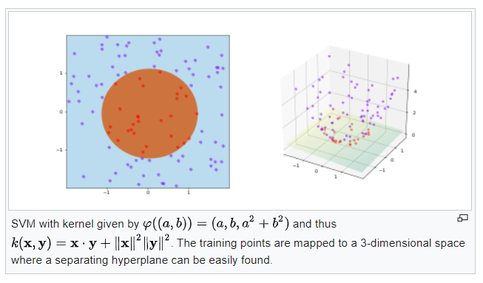
Quantum Data Analysis/Machine Learning
These are classical-quantum hybrid strategies.
Potential applications in collider experiments include jet reconstruction, anomaly detection, etc.
Techniques include Quantum Kernel Methods, QML, Quantum Annealing for optimization, QAOA for optimization, etc.
Quantum kernel Method:
  Use quantum circuits to create representations of classical data.
  Classical data analyses are performed on these quantum-created
  representations
  These representations are accessed using measurements of the
  quantum circuits. The quantum circuits can themselves be parametrized and trained.
  The goal is not be faster than classical techniques but be better than classical techniques.
  Requires quantum to offer a beneficial inductive bias unavailable to classical techniques.
Source: https://en.wikipedia.org/wiki/Kernel_method#/media/File:Kernel_trick_idea.svg,
by Shiyu Ji, Wikipedia contributor.

Slide 19
HEP for Quantum Computing Hardware

Slide 20
HEP for Quantum Hardware
Building state-of-the-art quantum computers is a massive engineering endeavor.
The technical and organizational expertise of the HEP community can play a significant role in advancing quantum hardware
  From developing high-quality quantum technologies
  To scaling them up to build larger, error-tolerant devices
Superconducting Quantum Materials and Systems (SQMS) center
  led by Fermilab
  uses Superconducting Radio-Frequency cavities technology used in particle accelerators as the quantum technology
  Builds next generation quantum computers geared towards generic and HEP-specific applications.
  Involved in co-development of science applications/drivers for quantum computing.

Slide 21


Quantum Sensing
Quantum Sensors have immediate applications, both in HEP and in real life.
Some examples include
  Dark photon search using SRF cavities at SQMS:
    Initial run already performed
  MAGIS 100:
    Dark matter and gravity waves detector, using single atoms
    which travel on a superposition of paths meters apart
    Will be the world’s largest cold atom interferometer
  Quantum sensors for axion dark matter detection

Slide 22
Acknowledgments
These slides have been authored by Fermi Research Alliance, LLC under Contract No. DE-AC02-07CH11359 with the U.S. Department of Energy, Office of Science, Office of High Energy Physics.
PS is supported by the U.S. Department of Energy, Office of Science, Office of High Energy Physics QuantISED program under the following grants:
  “HEP Machine Learning and Optimization Go Quantum”, Award Number 0000240323
  “DOE QuantiSED Consortium QCCFP-QMLQCF”, Award Number DE-SC0019219

