Slide 1




Sleep Spindles as a Driver of Low Latency, Low Power ML in HLS4ML
Hardware Development: Xiaohan Liu (Speaker), Atharva Mattam, Chi-Jui Chen, Lin-Chi Yang, Yan-Lun Huang, Elham E Khoda, Scott Hauck, Shih-Chieh Hsu, Bo-Cheng Lai
Neural Interfaces: Lauren Peterson, Leo Scholl, Amy Orsborn
Neural Processing Algorithms: Trung Le, Eli Shlizerman
07/10/2023
1
Notes:
Add name,
add taiwan team to the hardware development, logo of taiwan team (next to W)

Slide 2
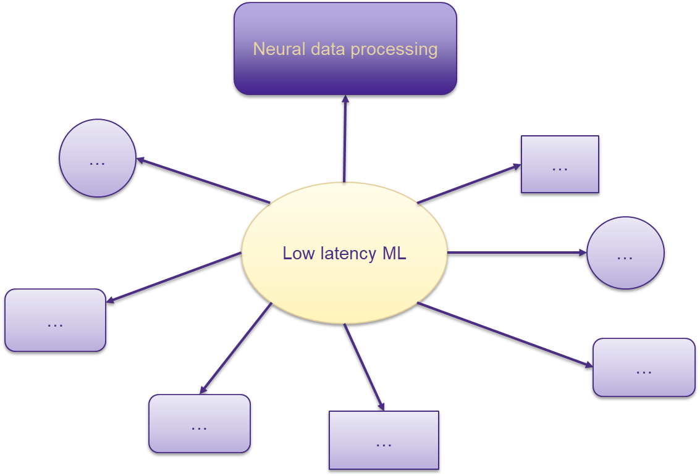
What We Do
2
Notes:
deploy a deep learning model that is used for processing neural data onto FPGA to help

Slide 3
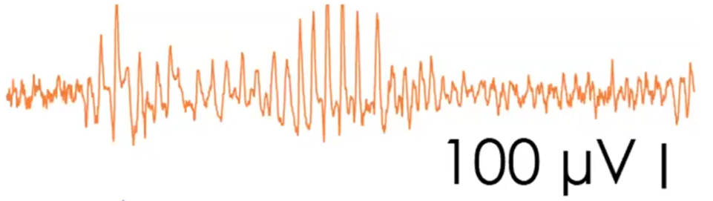

Sleep Spindles
Oscillating signals during sleep or rest
Believed to contribute to learn
Goal: Predict and disrupt spindles
Sleep Spindle
3
Orsborn A, Shlizerman E, Dadarlat M. (2021) “Understanding & Interfacing with the brain: challenges and opportunities”
Notes:
We will have controlled experiment. One with spindle, and one without spindle.
waive the click, no empty slides at the beginning. And only build when it’s necessary
font size 16 - 18

Slide 4
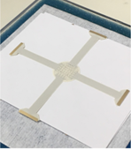
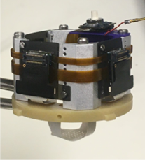
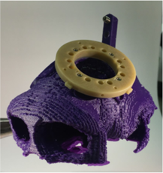


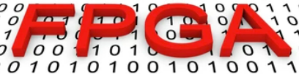
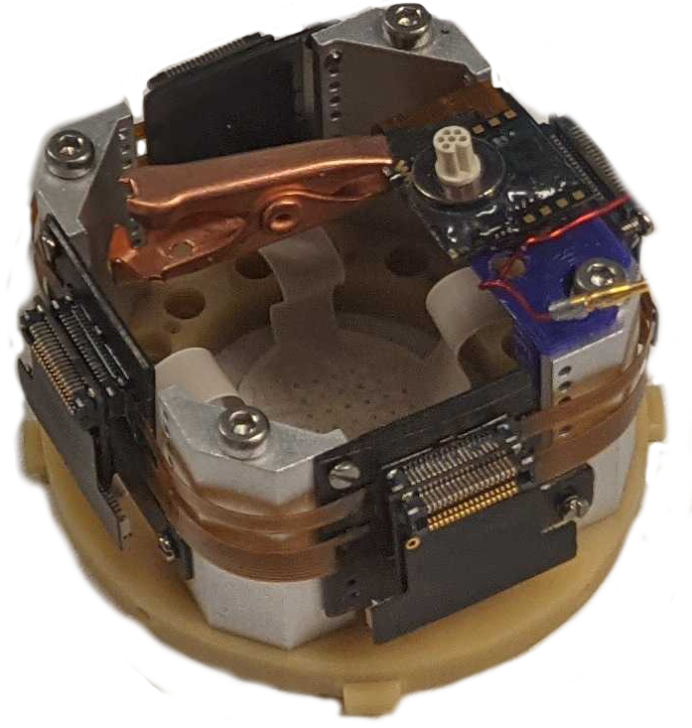

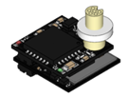
System Setup
Electrocorticography with 4 arms
+
+
Head-mounted device
subject’s skull
Amplifier
+
Arm adapter
+
Headstages
4
Notes:
System setup: a diagram shows the proposed system. FPGA and headstage on the subject (Monkey)

Slide 5
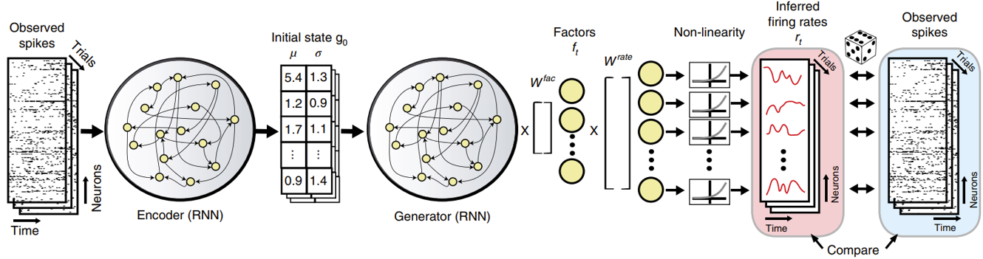
Latent Factor Analysis via Dynamical Systems (LFADs)
RNN Variational Autoencoder (RNN VAE)
Pandarinath, C., O’Shea, D. J., Collins, J., Jozefowicz, R., Stavisky, S. D., Kao, J. C., ... & Sussillo, D. (2018). Inferring single-trial neural population dynamics using sequential auto-encoders. Nature methods, 15(10), 805-815.
5
Notes:
Model used for detection: Mikes model (MRAE) will be used for the sleep spindle detection, and introduce the baseline model LFADs
cut the builds
Cut MRAE, keep only RNN VAE for LFADs

Slide 6
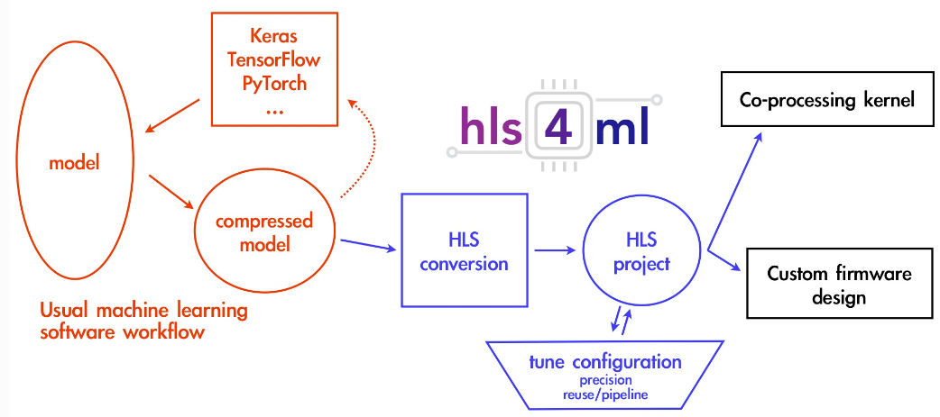
Tool – HLS4ML
6
Notes:
Briefly introduce HLS4ML
no bullets here

Slide 7
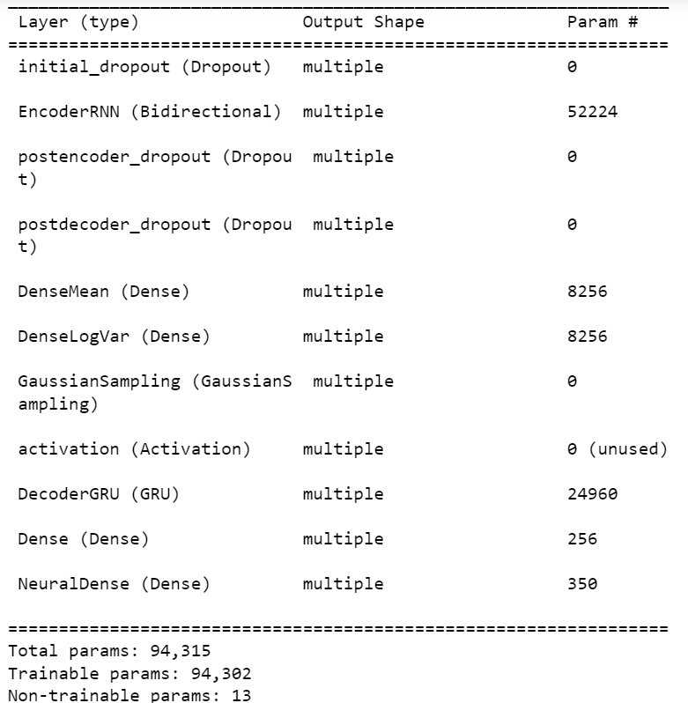
LFADs Architecture - Detail
LFADs architecture
  Custom model
One custom layer
  Gaussian sampling layer
One unsupported Keras layer
  Bidirectional
One unsupported arguments
  GRU initial_state
7
Notes:
Introduce LFADs architecture
no build

Slide 8
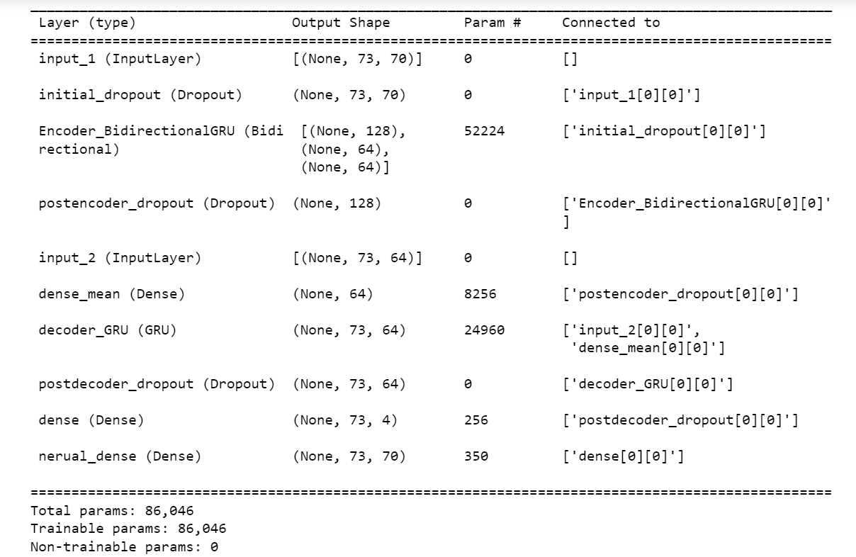
Current Model Architecture
Removed the gaussian: being developed in parallel
Recreated LFADs in Keras functional API
8
Notes:
reason and performance comparison. (with figure)
no builds

Slide 9
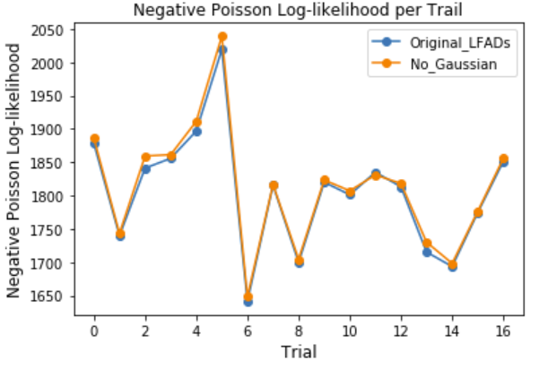
Performance Comparison
Dataset from
  Perich, M. G., Gallego, J. A., & Miller, L. E. (2018). A neural population mechanism for rapid learning. Neuron, 100(4), 964-976.
Evaluation metric - Negative poisson log-likelihood
9
Notes:
current model architecture (show model summary)
no gaussian
original LFADs

Slide 10
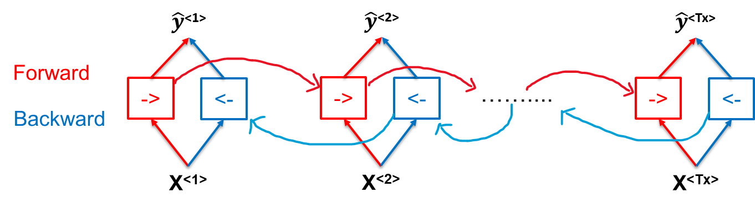
HLS4ML Implementation - Bidirectional
Implemented Bidirectional GRU layer
10
Notes:
cut the “a”
x, y in between the red and blue box; arrows on the transition

Slide 11
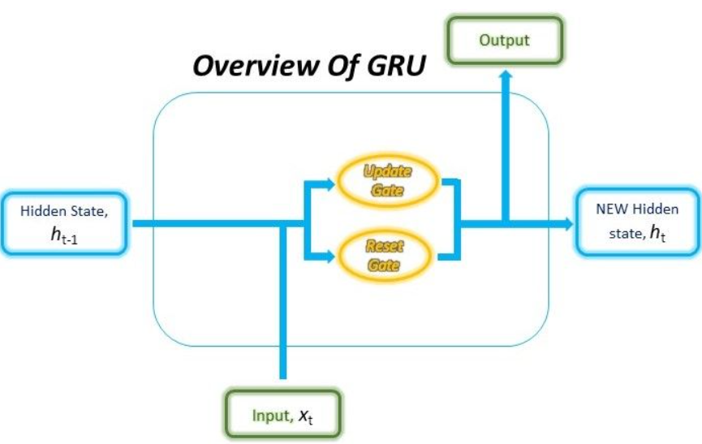
HLS4ML Implementation - GRU Initial State
Implemented initial_state
  Initial_state is hidden state of the unit
11
Image recourse: https://blog.floydhub.com
Notes:
Introduce the layer/args we’ve implemented in HLS4ML
GRU layer developed in UW

Slide 12
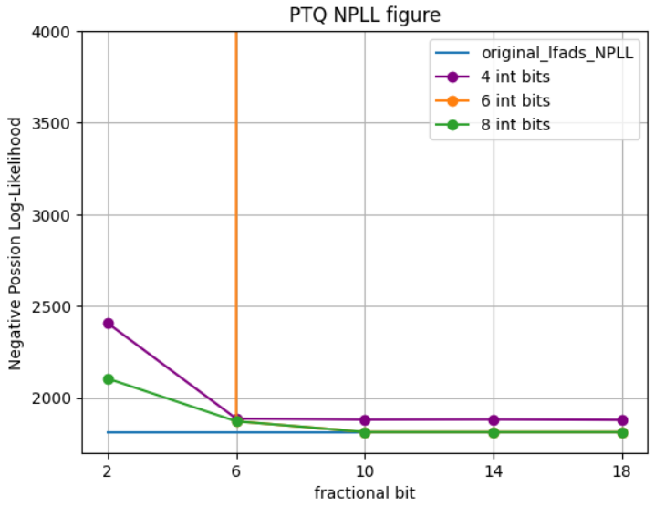
HLS (LFADs) Model Performance
Post training quantization (PTQ) with different precision
12
Notes:
Introduce the layer/args we’ve implemented in HLS4ML
cut the 10

Slide 13
FPGA Deployment Result
Current board: Xilinx U55C
Precision: ap_fixed<16,6>
Frequency: 200 MHz
Latency: 41.97 μs
V synthesis | U55C
HLS version | 2022
BRAM | 474 (23.51%)
DSP | 1,869 (20.71%)
FF | 150,882 (5.79%)
LUT | 164.726 (12.64%)
13
Notes:
Show the LFADs performance on FPGAs ( target board, latency, throughput, etc)

Slide 14
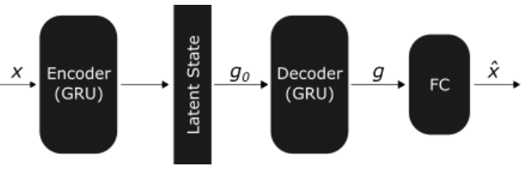
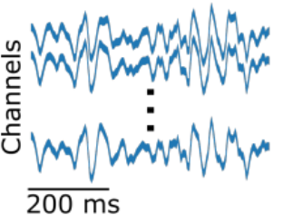
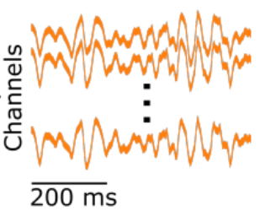

Multi-block RNN Autoencoders (MRAE)
Nolan, M., Pesaran, B., Shlizerman, E., & Orsborn, A. L. (2022). Multi-block RNN Autoencoders Enable Broadband ECoG Signal Reconstruction. bioRxiv, 2022-09.
Low pass Filter
Bandpass Filter
High pass Filter
14
Notes:
Introduce RAE: very similar to LFADs

Slide 15
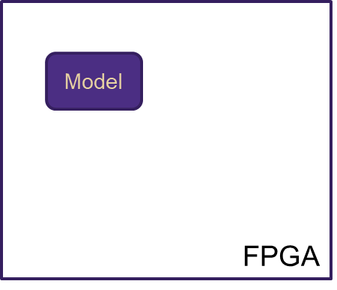
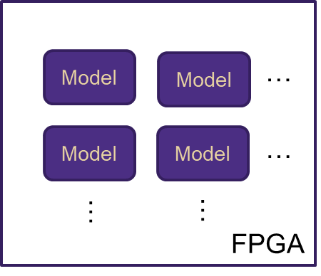
Multi-block RNN Autoencoders (MRAE)
Reduce FPGA resource utilization
Increase throughput
15
Notes:
The model we are going to deploy onto FPGA to detect spindle (MRAE)

Slide 16
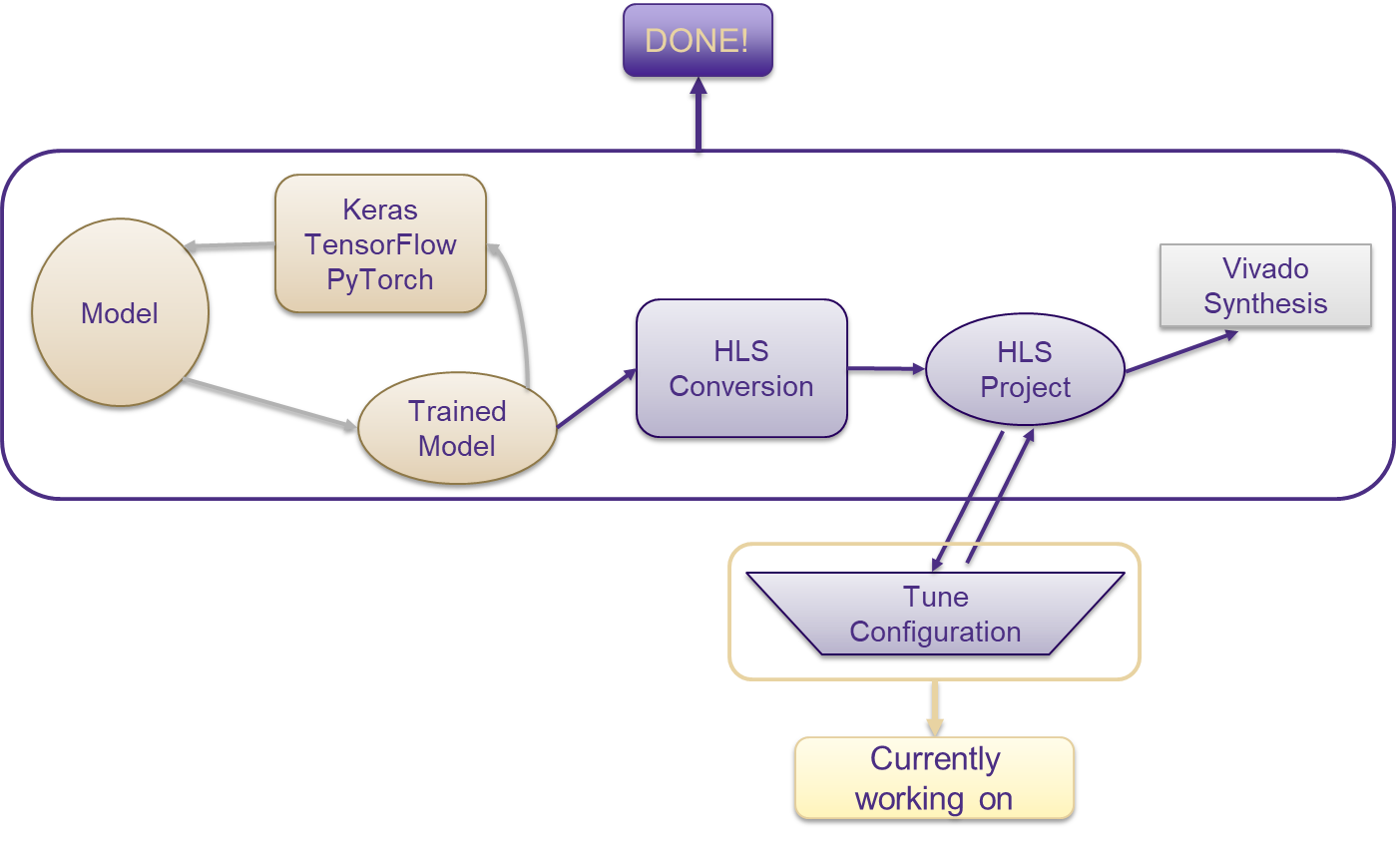
Current progress & future work
Add Gaussian Sampling layer back
Extend to MRAE
16
Notes:
one bullet: adding gaussian, extend to MRAE
combine “DONE”, looking to extend to MRAE

Slide 17
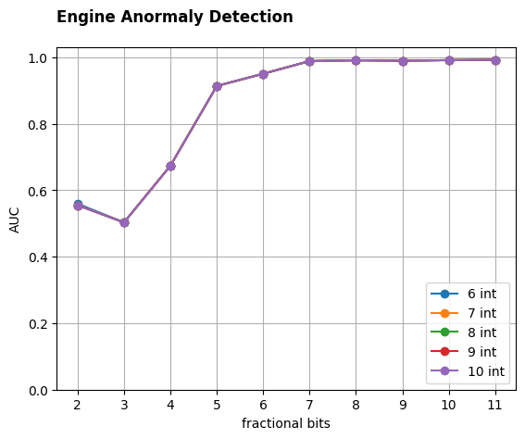
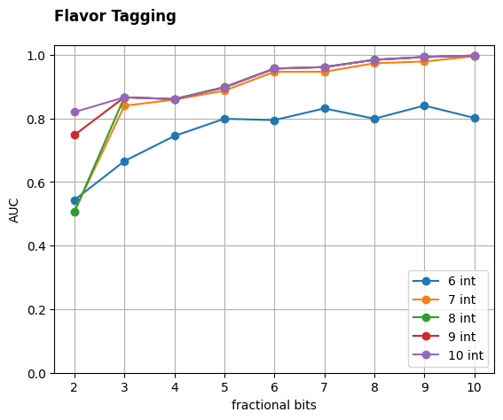
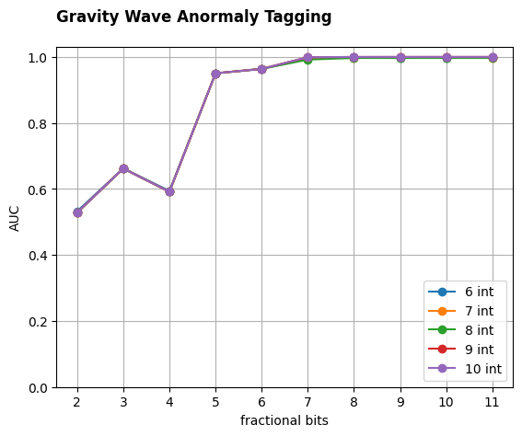
Projects Related to A3D3 in Our Group
Transformer model for Neural signals
  Trung Le, Ethan Jiang, Dennis Yin, Vidhi Desai, Elham E Khoda
  Model done; HLS4ML Transformer layer done
16
Notes:
one bullet: adding gaussian, extend to MRAE
combine “DONE”, looking to extend to MRAE

Slide 18
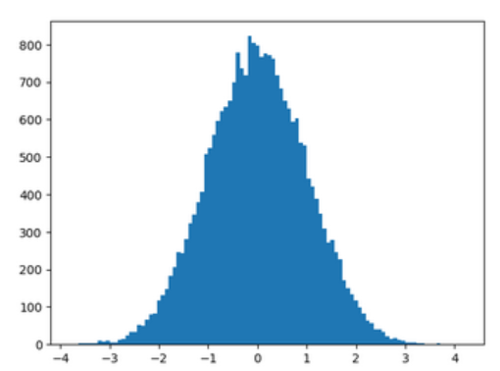
Projects related to A3D3 in Our Group
Gaussian sampling in HLS4ML
  Atharva Mattam
  HLS code done
  HLS4ML PR528
Benchmarking HLS4ML vs SystemVerilog
  Caroline Johnson & Waiz Khan
Algorithm Processing Unit (APU)
  Ethan Jiang, Bowen Zuo
16
Notes:
one bullet: adding gaussian, extend to MRAE
combine “DONE”, looking to extend to MRAE

Slide 19

Thank you for listening!
Questions?

