Slide 1

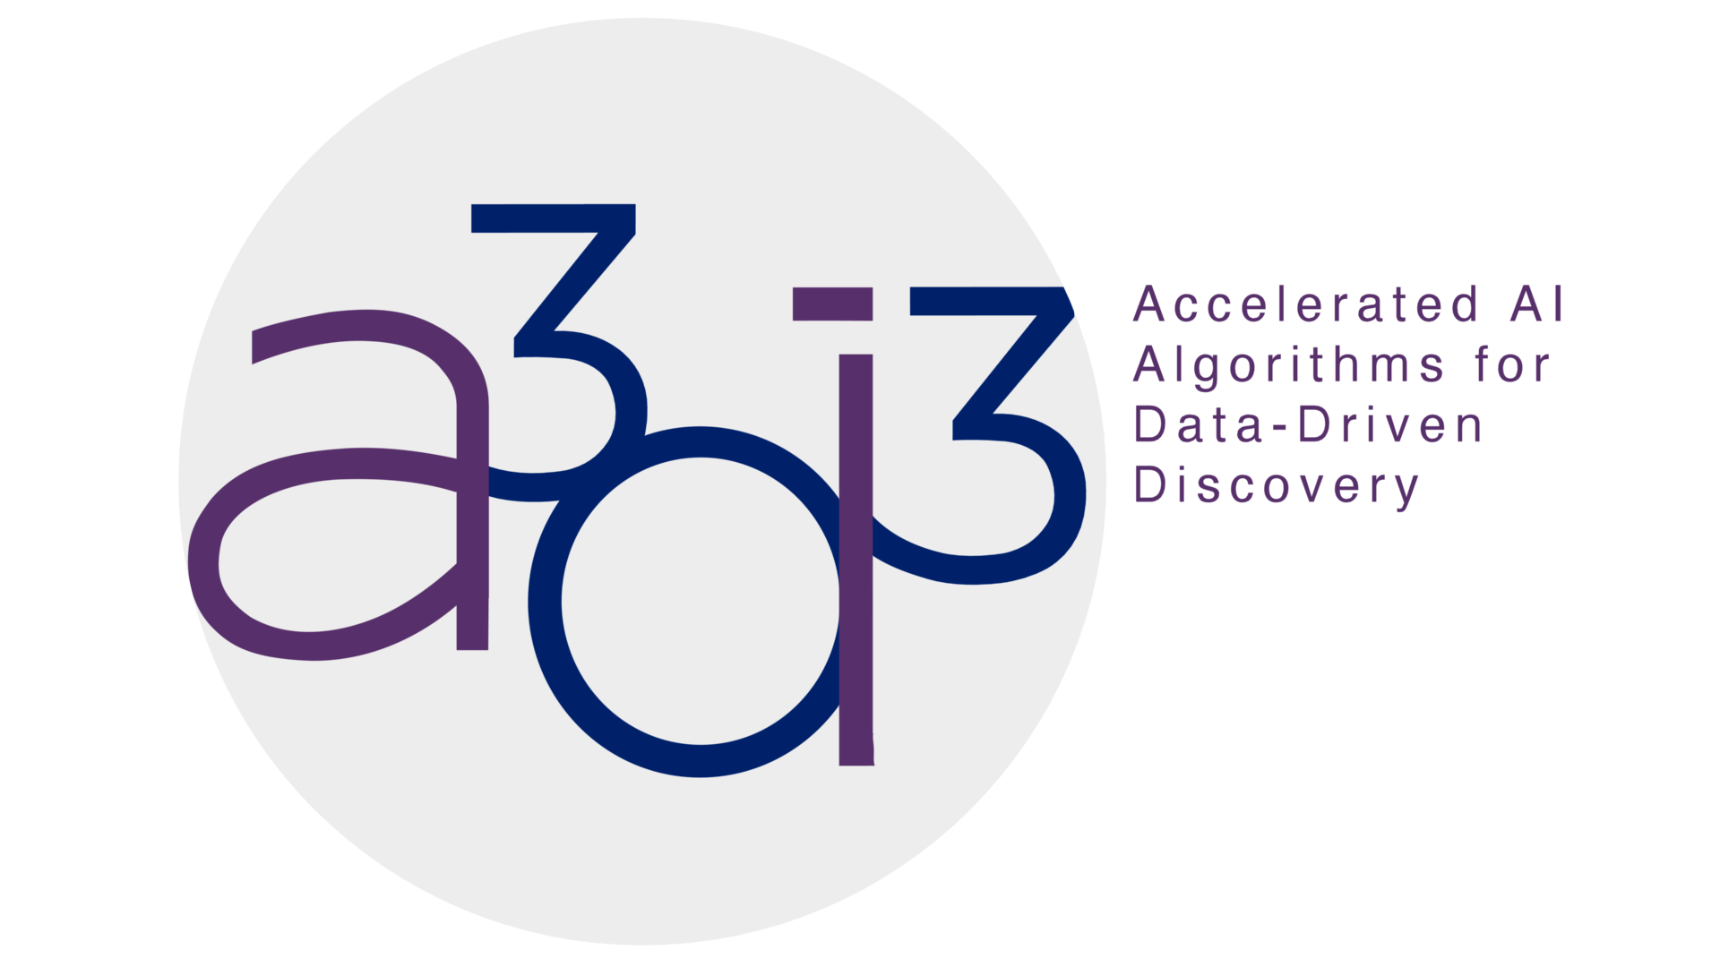
Effective Co-design for Data-Intensive Applications through Next-generation HLS Toolchains
ESCAD Group @ UIUC
PhD Students: Jialiang Zhang, Hanchen Ye
Advisor: Deming Chen
Collaborator: Sitao Huang, Vladimir Loncar
Supported by OAC-2117997 Grant from NSF

Slide 2
Presentation Outlines
- Our Group’s Goal
- HIDA: A Hierarchical Dataflow Compiler for High-Level Synthesis (ScaleHLS 2.0)
  Motivation
  Framework
  Benchmarking results
- PyLog2.0: Towards domain specific applications & finer-grained design space explorations
  Motivation
  Framework
  Integration with HLS4ML
  Benchmarking results
- Conclusion

Slide 3
Gap between Hardware and Software Abstraction Levels
Huge gap between hardware abstraction levels and software abstraction levels
Large number of applications/frameworks are developed with high-level languages
HIDA targets automated optimization towards ML model and unoptimized HLS designs
PyLog focuses on integrating Python language into the overall flow
Low-Level Abstraction
High-Level Abstraction
Circuit design
Netlists
Verilog/VHDL
Assembly
C/C++/OpenCL
Python
Haskell/Scala
Hardware Abstraction
Software Abstraction
Libraries/Frameworks created with Python
NumPy
Panda
scikit-learn
PyTorch
TensorFlow
…
PyLog/HIDA

Slide 4
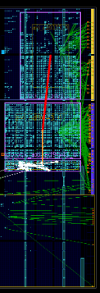
Our Goal: Hardware acceleration in a more efficient & productive way!
FPGA Programming is moving towards higher abstractions & finer-grained Optimizations
Algorithm Expressions , e.g.
(Python)
(Pytorch Models)
High-level synthesis (HLS) flow greatly improves design productivity:
Fewer lines of code (LOC)
Easier system integration (e.g. cloud/edge FPGAs)
Easier design space search, explore more alternative designs, achieve better QoR
Easier design migration
…
Benefits of using high-level abstraction (C language)
int accel(...) {
#pragma ...
}
Need high-level programming and synthesis flow!
PyLog!
PyLog Design Flow
High-Level Synthesis
HIDA Pytorch Design Flow
Some drawbacks:
Limitations in expressing concurrency with C semantics
Conservative compiler optimizations due to the lack of high-level computation pattern information
Highly performant code requires careful tuning and LOC increases quickly (e.g. 8,000 lines of HLS C code for optimized convolution kernel)
...
PyLog & HIDA targets different abstraction levels
Need languages with high-level operators (high-level languages)
HLS Design Flow
module accel(...);
...
endmodule
HIDA HLS Design Flow
Need finer-grained optimizations schemes and design space exploration!
Need powerful compiler optimizations
HIDA!
RTL Design Flow
Synthesis & Implementation
Easier to achieve with high-level languages

Slide 5
Motivation - Existing Works
HLS Languages
Dahlia
HeteroCL
TAPA
PyLog
Intel HLS
LegUp
Merlin
DaCe
XLS
Vitis HLS
ScaleHLS
Dynamatic
CIRCT
Spatial
COMBA
POLSCA
DASS
PipelineC
HPVM2FPGA
SODA
Hector
SOFF
TAPAS
Calyx
HLS Optimizers
HLS Schedulers
Existing HLS languages are orthogonal to HIDA and they can be integrated as front-ends of HIDA.
Existing HLS schedulers tackled the operator-level scheduling instead of the coarse-grained task-level scheduling.
Existing HLS optimizers cannot optimize hierarchical dataflow structure and generate efficient dataflow HLS design.
Notes:
HLS Language related – not in conflict; scheduler mainly on operator → hida focus on coarse grained task level

Slide 6
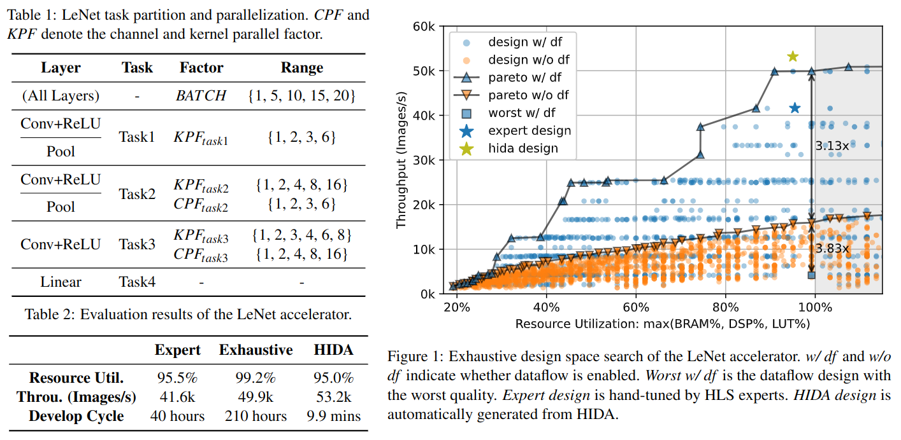
Motivation - A LeNet Example
Notes:
Exhaustive: heuristic pruned: 1)conv relu pool fused together 2)only extend kernel & channel dimension (only KPF & CPF) 3) Parallelization factor restricted to 1,2,4 etc.

Slide 7
Motivation - A LeNet Example (Cont’d)
Observations
Dataflow designs are Pareto-dominating. The best dataflow design achieves 3.13× higher throughput than the non-dataflow counterpart.
Dataflow cannot guarantee a good trade-off. The best non-dataflow design achieves 3.83× higher throughput than the worst dataflow design.
Dataflow design space is vast and difficult to comprehend. The design space contains more than 2.4×10⁴ points after heuristical pruning.
Automated tool outperforms exhaustive search. HIDA further improves the throughput of the exhaustive design by 1.06×.
Productivity - Performance - Scalability

Slide 8
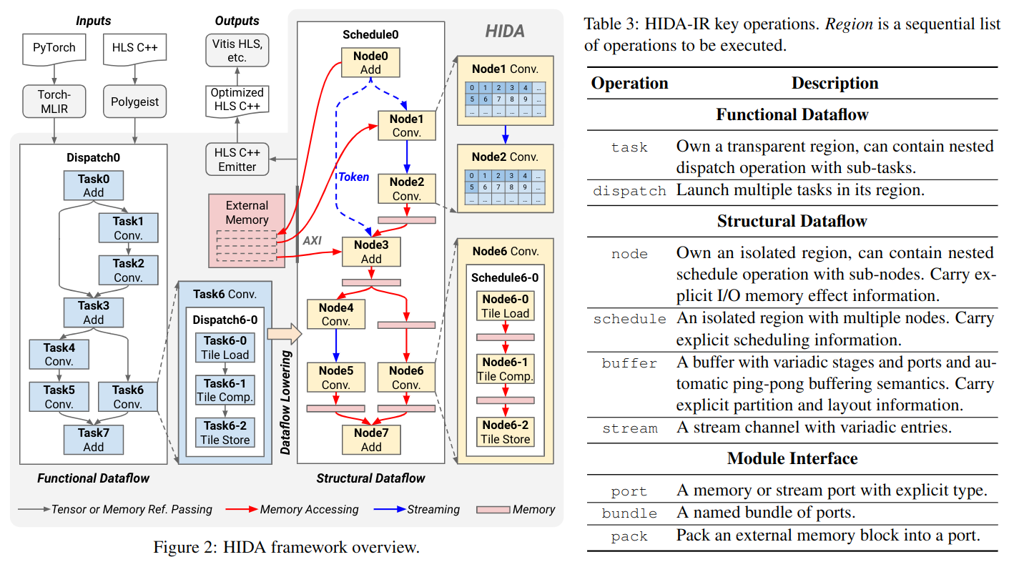
HIDA Framework
Notes:
Functional: focus on high-level characteristics and hierarchy of HLS design. It produce effective task partitioning toward load balancing and low communication cost
Structural: focus on lower-level microarchitecture optimizations to handle scheduling, parallelization and code gen.
→ structural level parallelization: Node connected through buffer
Pattern based: several fused pattern (e.g. conv+relu)
Task = node Dispatch = schedule
Token: Represent dependency involved with ex

Slide 9
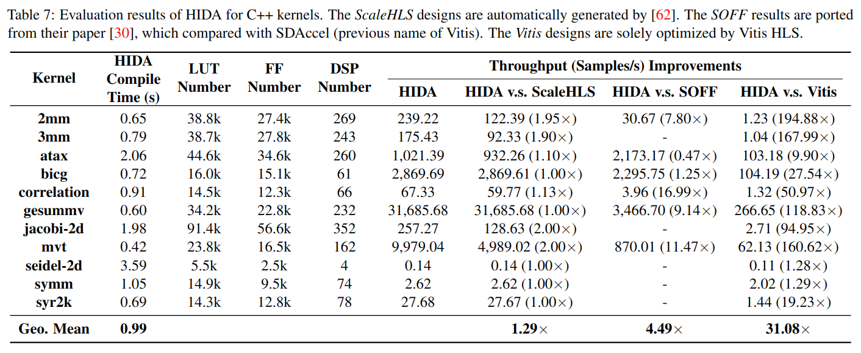
Evaluation Results on PolyBench

Slide 10
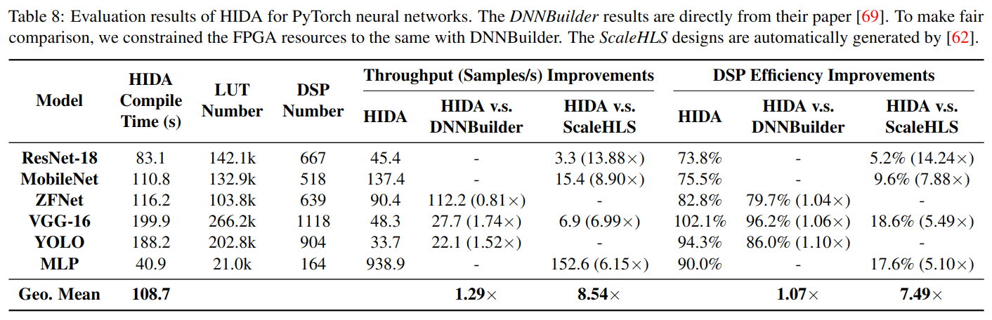
Evaluation Results on DNNs

Slide 11
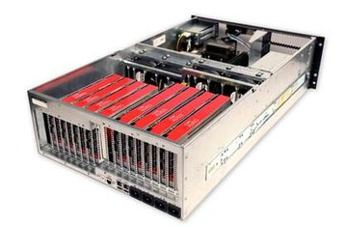

PyLog Flow Overview
PyLog Code
PyLog Code Generator
HLS C Code
Analysis
void accel(int32* a, int32* b, int32* c, int32* d, int32* e) {
for(int i = 0; i < 32; i++) {
for (ii...)
#pragma HLS ...
}
...
}
PyLog System Generator
import numpy as np
from pylog import *
@pylog
def add(a, b):
b = a + b
b = map(lambda x, y: x+y, a, b)
if __name__ == "__main__":
a = np.array([1, 3, ...])
b = np.array([8, 9, ...])
print(add(a, b))
Type Inference
Tcl Script Generation
Optimization
IP Generation
accelerator
Code Generation
System Integration
Design Generation
PyLog Runtime
FPGA
FPGA Programming
On-Chip MEM
host
Mem Allocation
Start Accelerator
DDR MEM
…
Collect Results
PE
PE
PE
vecadd.py
Target Systems
System Design
Deployment Flow
>>> python3 vecadd.py
[10, 15, ...]
>>>
Synthesis Flow
Execution Results
Notes:
PyLog flow takes high-level Python code as input, and generates optimized highly efficient FPGA designs. PyLog compiler compiles the decorated Python function, and generates optimized FPGA module. Which is then packed into complete FPGA design. PyLog runtime programs FPGA and runs accelerator. The running of underlying FPGA accelerator is hidden from users.

Slide 12
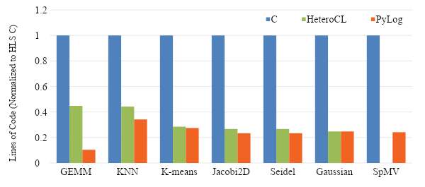
PyLog Evaluation: Expressiveness
Compare LoC (Lines of Code) of HLS C code vs HeteroCL* code vs PyLog code
  Normalized to HLS C LOC
  70% reduction compared to HLS C code
*Yi-Hsiang Lai, Yuze Chi, Yuwei Hu, Jie Wang, Cody Hao Yu, Yuan Zhou, Jason Cong, and Zhiru Zhang. HeteroCL: A Multi-Paradigm Programming Infrastructure for Software-Defined Reconfigurable Computing. FPGA 2019.
Notes:
Evaluation shows that PyLog can save 70% of code, compared to C-based HLS approaches. PyLog also uses less code when comparing with one recent high-level programming framework, HeteroCL.

Slide 13
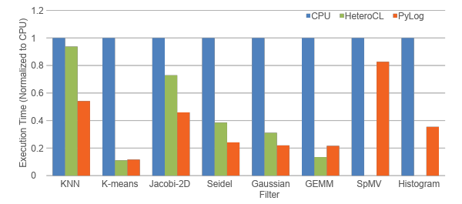
PyLog Evaluation: Accelerator Performance
Compare PyLog accelerator performance vs CPU (C++) performance and HeteroCL accelerator performance
Platform: Amazon AWS F1 instance (Xilinx Virtex UltraScale+ XCVU9P)
3.17x and 1.24x speedup than optimized CPU and FPGA accelerators
CPU: Optimized CPU code running on single thread on 8-core Intel Xeon E5-2686 v4 CPU
Notes:
When comparing accelerator performance, PyLog generated hardware achieves 3.17x speedup over optimized CPU code, and 1.24x speedup over manually optimized FPGA designs.

Slide 14
PyLog: Integrating with Existing Scientific Computing Tools
Motivation:
  Domain-specific scientists rely on Python for prototyping for its programmability & abstractions
HLS4ML: a template-based ML accelerating framework targeting FPGAs
Difficult to generate customized code
Takes effort to migrate to new models
Does not have design space exploration
Hand-tuned Template
Normal line: Automated
Dashed line: manual effort
Customized ML model
HLS4ML parser
HLS4ML IR
HLS code
Final model in HLS
Customized layer
PyLog
Compilation
Workflow
PyLog
IR & Optimizer
PyLog
Codegen
HLS code

Slide 15
HLS4ML and PyLog Automated Flow
Automatically connects HLS4ML’s hand-tuned templates and PyLog generated code in C
Can define customized layer through PyLog_layer class → Enjoy all benefits of PyLog
In the future, we plan to provide finer-grained DSE & optimizations through other backend tools
Hand-tuned Template
Purple DSE is from another backend tool for lower level (To be done)
Customized ML model
HLS4ML parser
HLS4ML IR
HLS code
Final model in HLS
Customized layer
DSE
PyLog_layer
PyLog
Compilation
Workflow
PyLog
IR & Optimizer
PyLog
Codegen
HLS code
DSE

Slide 16
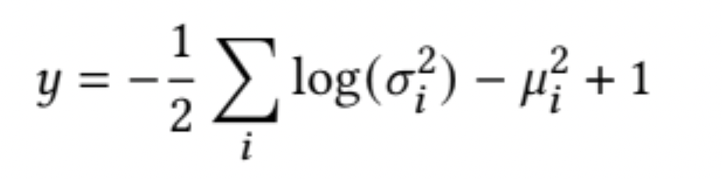
PyLog Evaluation: Comparison with Hand-tuned HLS code
HLS4ML Cannot fully customize design in Python
Original HLS C code version was carefully hand-tuned
PyLog version support fully unrolled loops and look up table method
Close latency performance (2 cycles VS 4 cycles)
Reduced lines of code by over 60%

Slide 17
PyLog Evaluation: Comparison with Hand-tuned HLS code (Cont’d)
Implemented another matrix vector multiplication example
Compared with a dense layer directly taken from HLS4ML’s Keras model layer
PyLog version can support all kinds of pragma, including initial interval
Close latency performance (2 cycles vs 4 cycles)
Reduced lines of code by over 75%

Slide 18
PyLog-HLS4ML Future: Towards higher performance and scalability
PyLog- HLS4ML
PyLog-HLS4ML serves as the front-end of a more powerful framework
(1) represents pathways with unstructured PyLog code
  Require automatic DSE & evaluation
(2) represents pathways with PyLog’s high level operators
  Require global optimizations
Evaluate models with both PyLog & HLS4ML layers
The code base will be released in 1-2 weeks on Github
(1)
(2)
Unstructured
Segments
(3)
High-level
Operators
Hand-tuned templates
Global Optimization
Optimized
Results
Two-level Fine-tuned Results

Slide 19
Conclusions
We presented HIDA:A Hierarchical Dataflow Compiler for High-Level Synthesis
  Can generate optimized hierarchical dataflow structure and efficient, scalable HLS design
  Tackled both the operator-level scheduling and the coarse-grained task-level scheduling
  Delivers 8.54x performance compared to ScaleHLS
We proposed PyLog-HLS4ML flow:
  Leverage higher-level abstraction for faster prototyping algorithms
  Integrated with current HLS4ML flow
  Delivers similar performance with hand-tuned template while significantly reduce the lines of code and development period
We hope to deliver efficient toolchains with high performance to the community, targeting data-intensive applications on heterogeneous platforms!

Slide 20
Q & A
Thanks!

