Slide 1
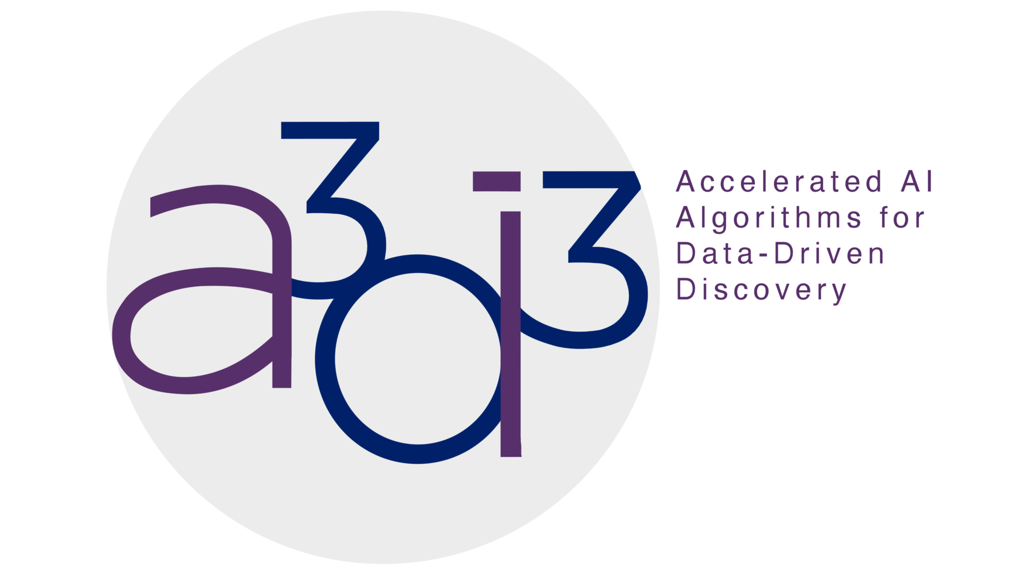
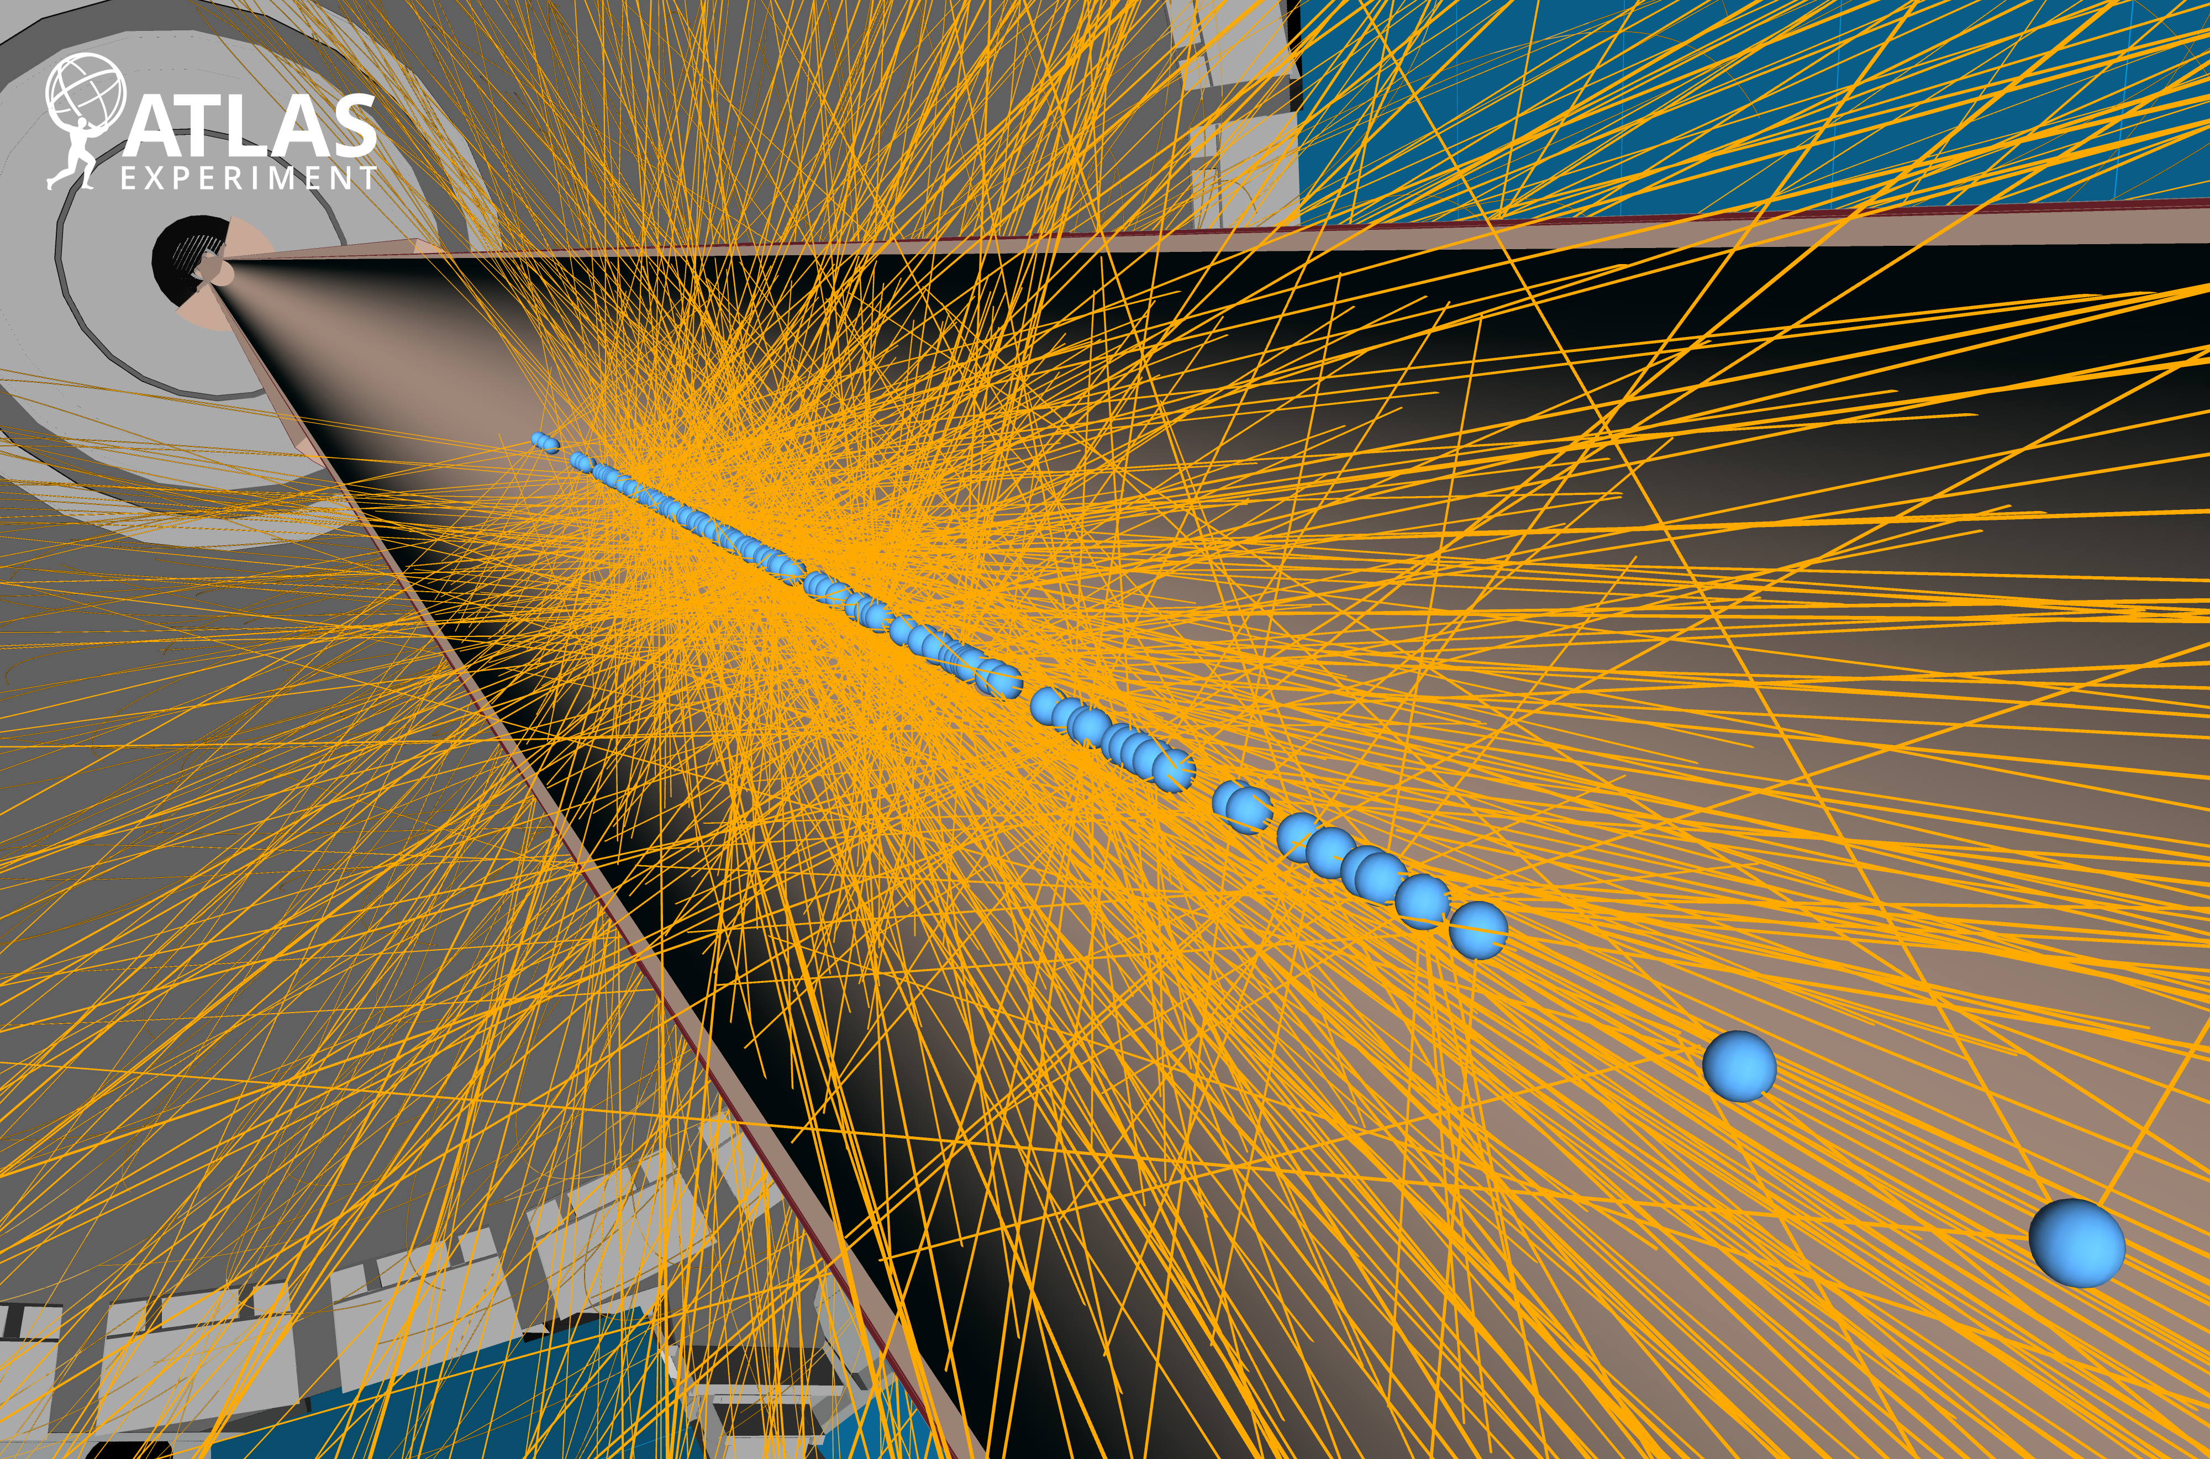
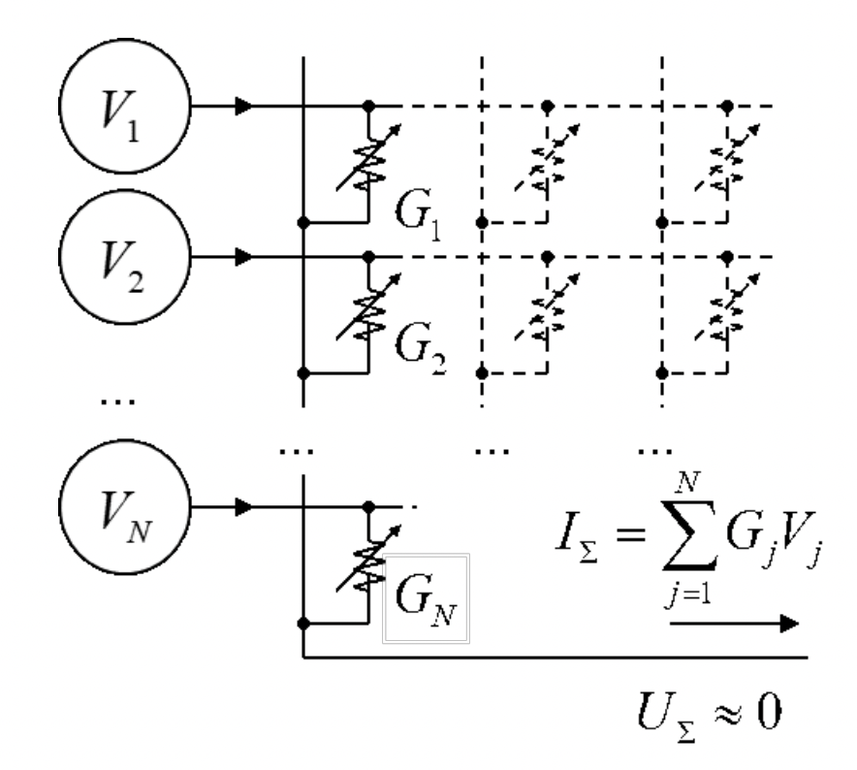

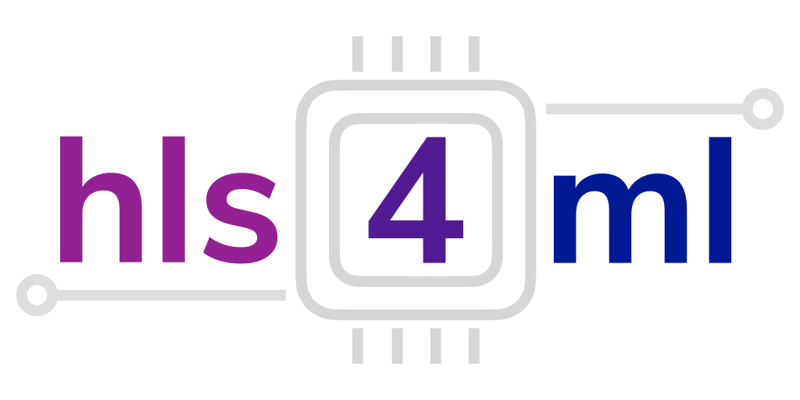
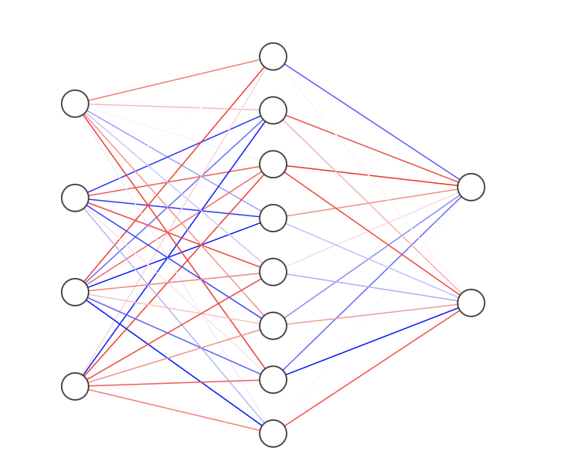
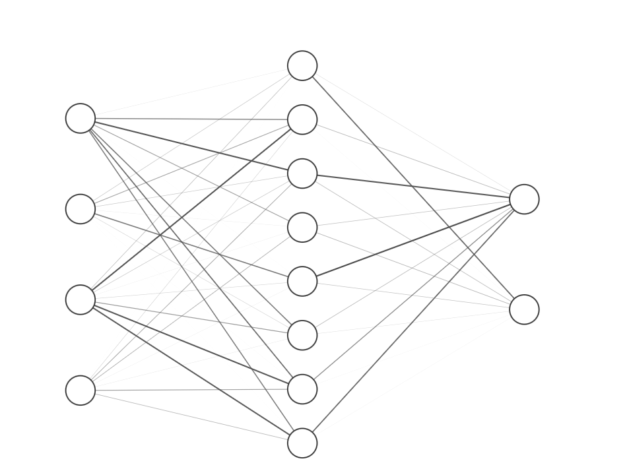
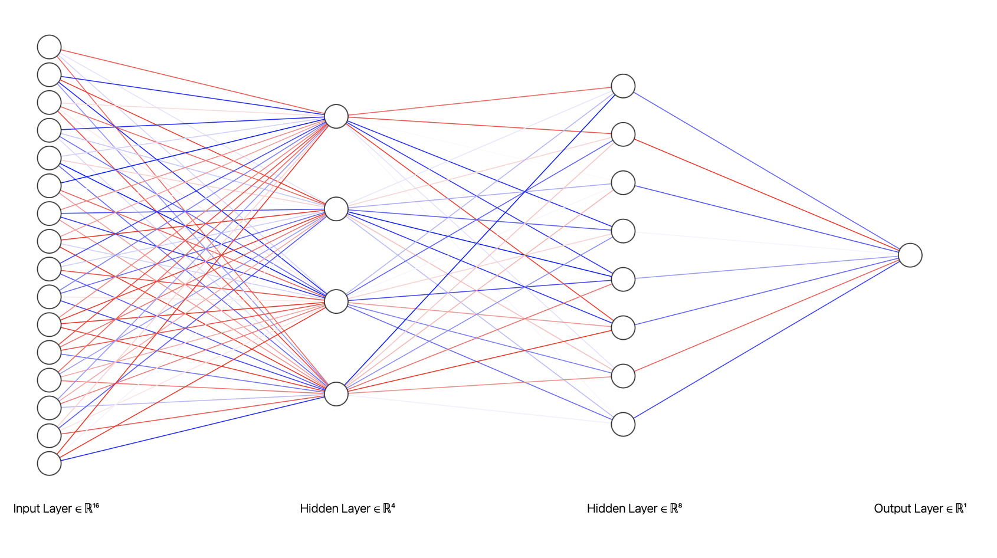
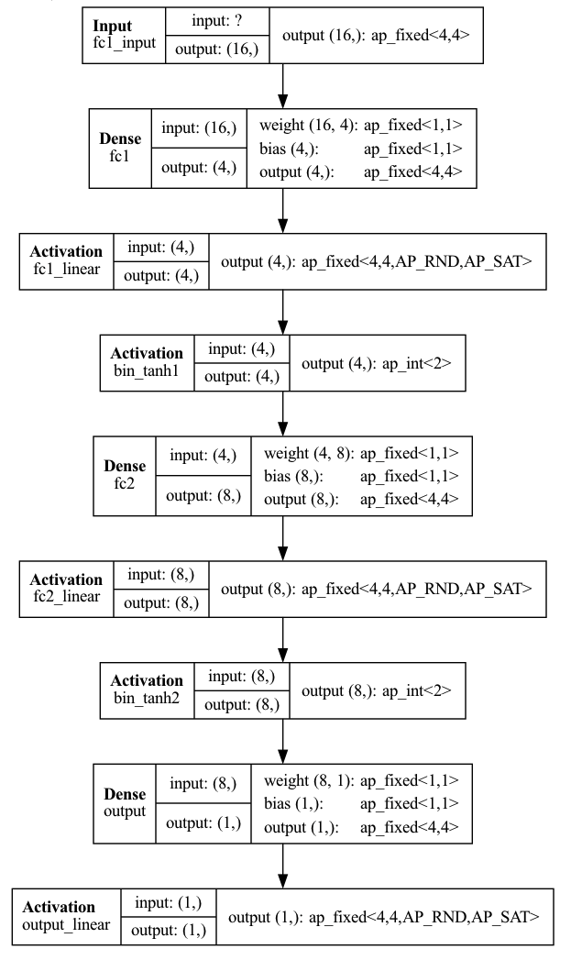
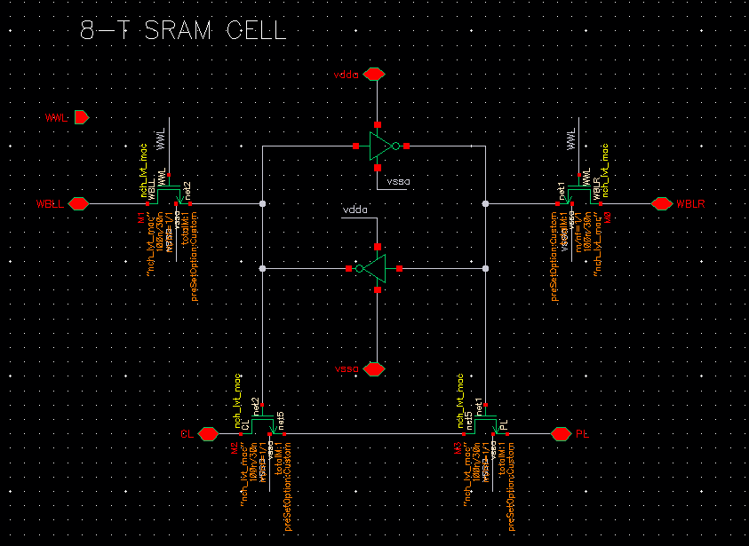
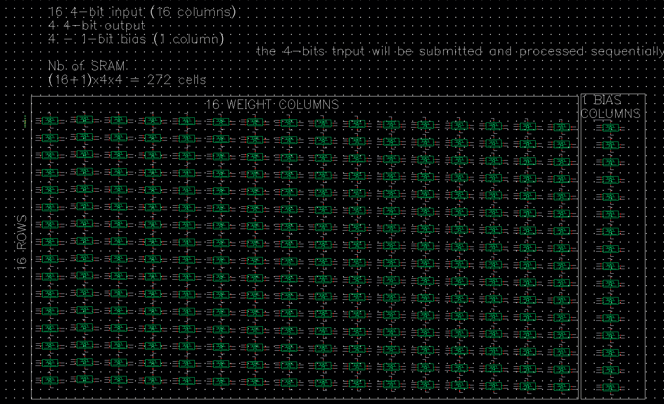
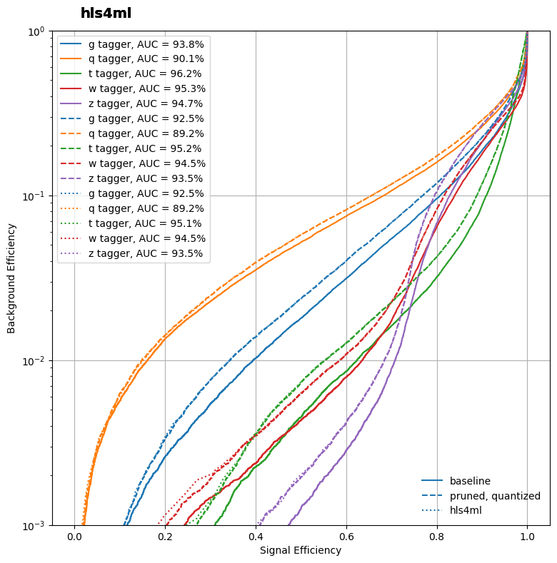

Analog-Domain Implementation of Neural Networks for Energy-Efficient High Energy Physics Applications
Author: Dewen Zhong¹,Mark Neubauer¹
Institutions: ¹University of Illinois at Urbana-Champaign
Computing Challenge @ HL-LHC
Analog AI
Efficient computational strategies are paramount for devices in resource-limited settings, particularly within high-energy physics experiments.
At HL-LHC, 10x more data per second than Run 1 & 2.
Application of analog computing techniques to perform artificial intelligence (AI) tasks.
Analog computing operates on continuous physical quantities, such as voltages or currents.
Inherent parallelism and efficiency of analog computations.
More energy-efficient, Better Latency to accelerate AI algorithm.
HLS4ML
Analog Path
hls4ml¹ is a firmware implementations of machine learning algorithms using high level synthesis language (HLS) in FPGAs with ultra low latency.
Simplify the hardware implementation process.
Support for popular machine learning libraries.
Compatibility with diverse hardware platforms such as FPGAs and ASICs.
Deploy models in real-time and embedded applications.
“Analog” Primitive:
a2d (N,precision)
d2a (N,precision)
Mat-Vec operation
Model training
hls4ml
Internal representations
Fab “Primitives”
TSMC Crossbar, 1-bit memristor
Sonos, Crossbar, 5-bit memristor
OTA
FPAA
28nm CMOS 1b SRAM “crossbar”
hls4ml
C code
Model design
Model pruning
Machine Learning architectures
SRAM-UNIT Cell
Based off design
Mf-net: Compute-in-memory sram for multibit precision inference using memory-immersed data conversion and multiplication-free operators
MC-CIM: Compute-in-Memory With Monte-Carlo Dropouts for Bayesian Edge Intelligence
Custom ANN model
First Layer Analog Representation
Expectation and Goal
Basic Matrix for fc1 layer:
16 4-bits input (16columns)
4 4-bits output
4 1-bit bias (1 bias column)
All production lines charged are accumulated and summed horizontally bit by bits.
Each bit needs to be binary weight.
Using hls4ml to generate analog AI models and implement analog models to ML-based jet Tagger.
Provide similar performances as digital hls4ml ML models.
Conclusion
References & Acknowledges
Investigate the analog path to produce analog AI model from custom ANN model via hls4ml
Simulate the first layer analog representation for ANN model.
Further Work
Complete the full analog representation for entire ANN model structure.
Tunning and Optimize the analog AI model performance for High Energy Physic models and beyond .
This project is funded by NSF OAC-2117997
[1] hls4ml: An Open-Source Codesign Workflow to Empower Scientific Low-Power Machine Learning Devices F. Fahim, B. Hawks, +27 authors Zhenbin Wu ,Computer Science, arXiv:2103.05579 2021

