Slide 1
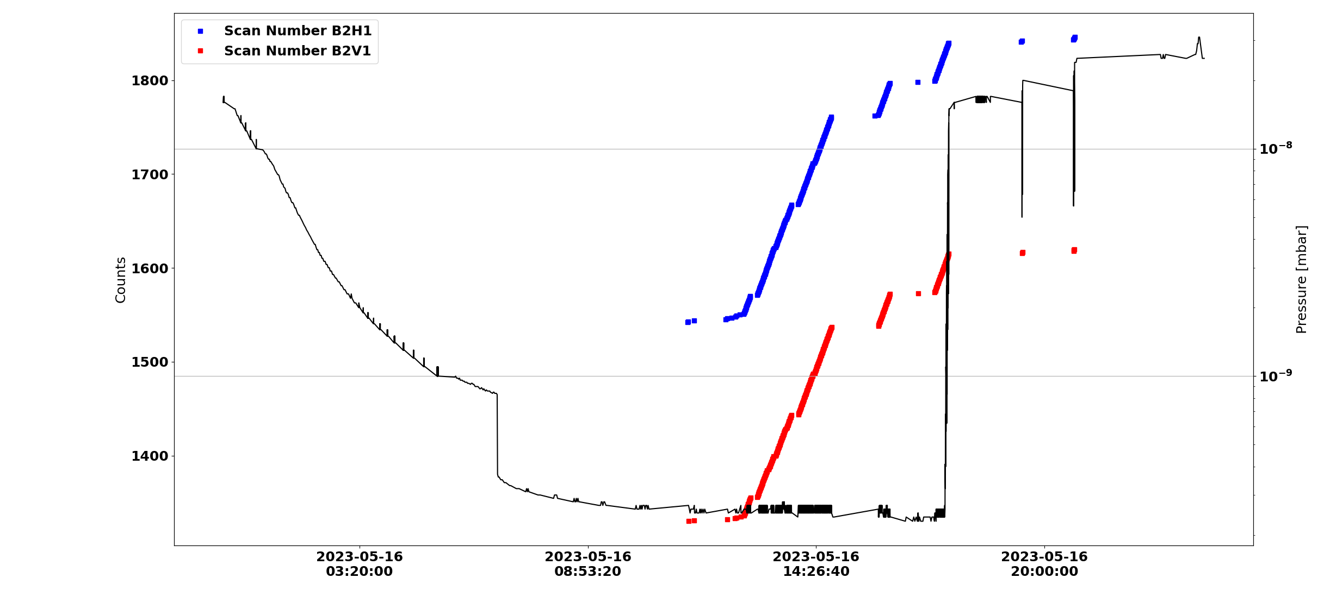
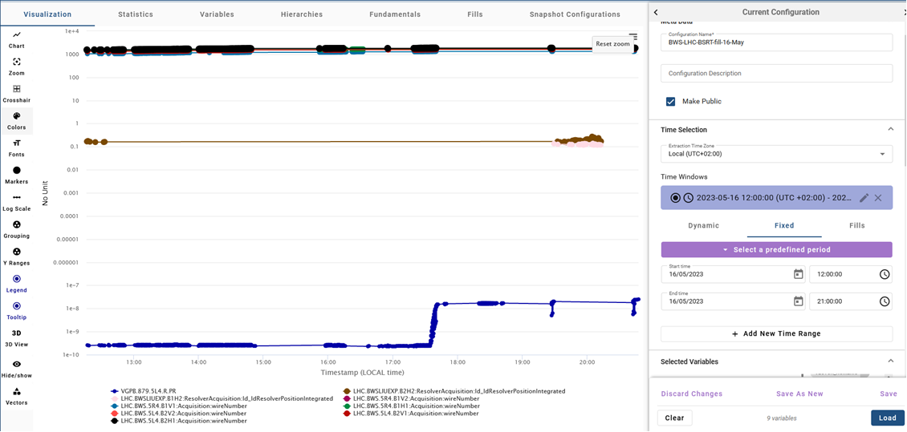
B1H2, B2H2
Hybrids tests
Courtesy of Georges Trad
Pressure rise

Slide 2
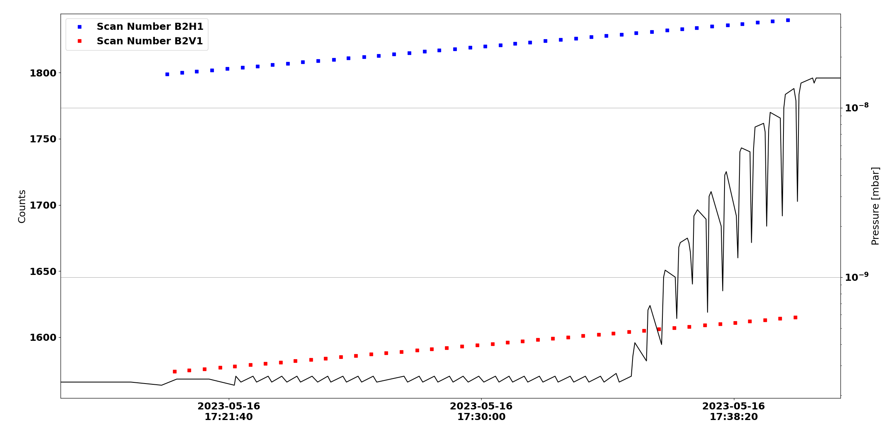
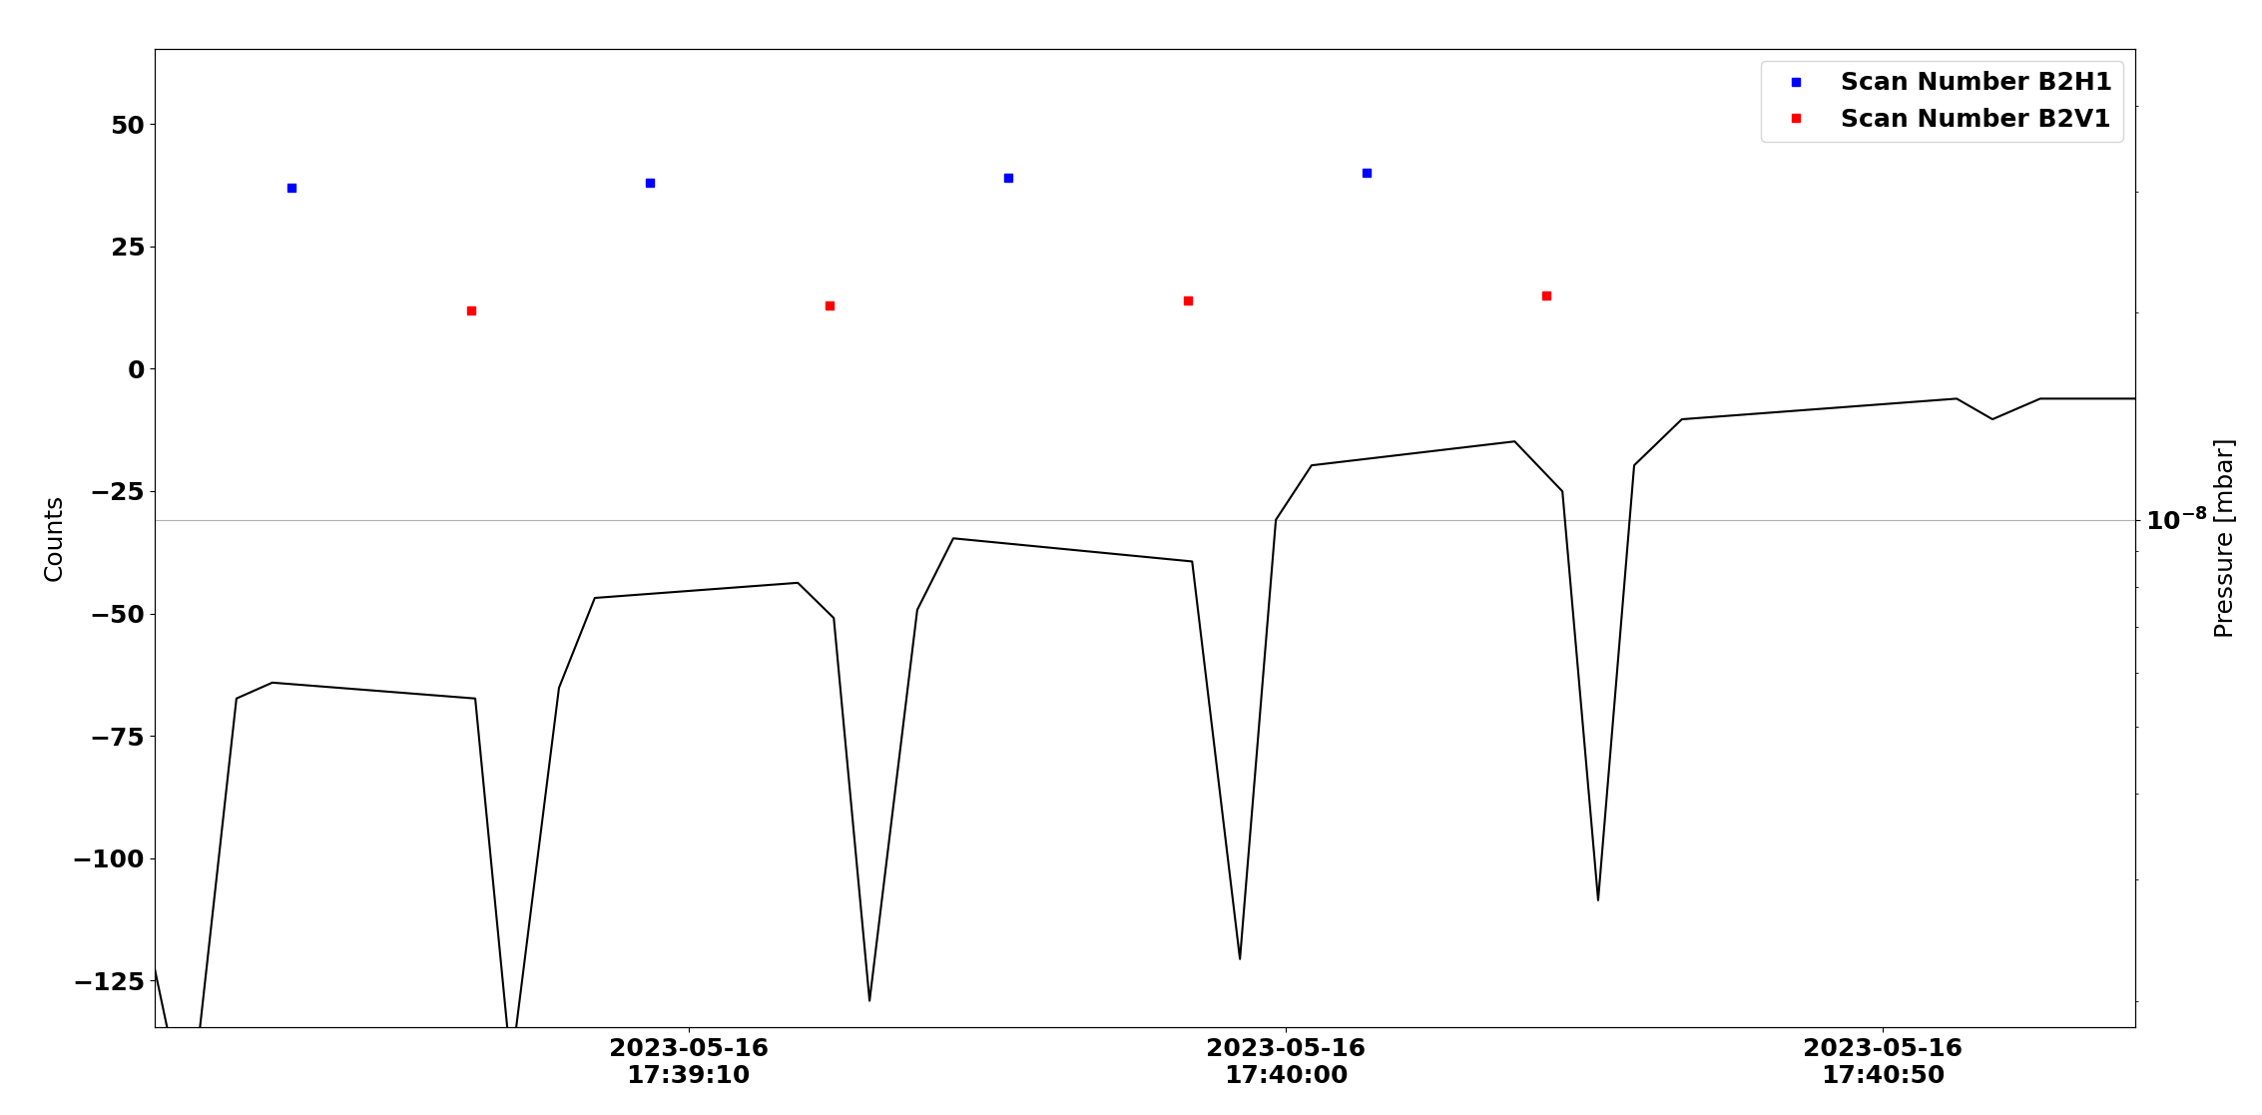
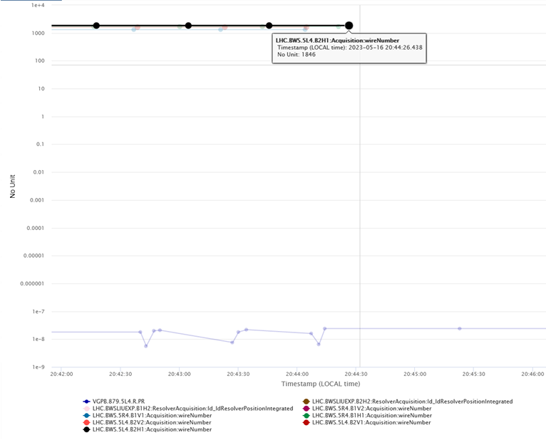
Courtesy of Georges Trad
Last scan by B2H1
did not provoke a vacuum spike

