Slide 1
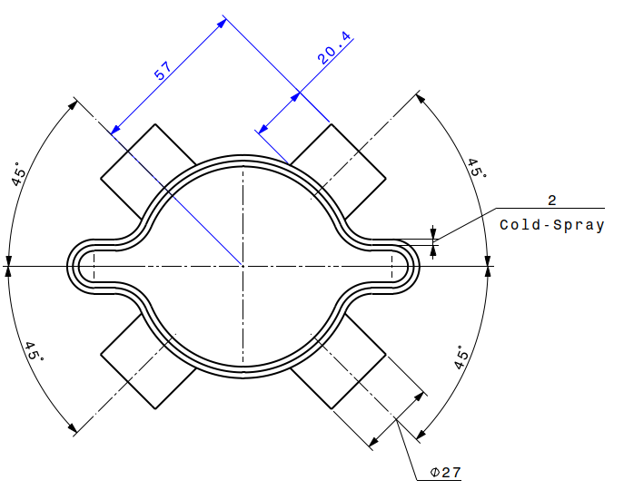
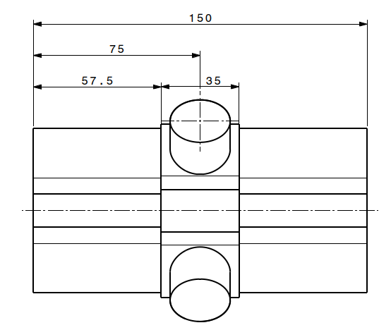
BPM Prototyping
Current status of BPM design from vacuum group
As sprayed (or ‘pre-machined’) prototype BPM dimensions
The scope of this prototyping is to:
Prove feasibility of cold-spraying a complex geometry;
Test machining / post-processing options of cold-sprayed copper;
Conduct UHV related tests (Leak testing);
Mechanical characterisations of copper cold-spray;
Test SMA connectors
Sam Rorison, TE-VSC-DLM, Arc Half Cell Mock-up Meeting - BPM and interfaces # 2 04-May-2023

Slide 2
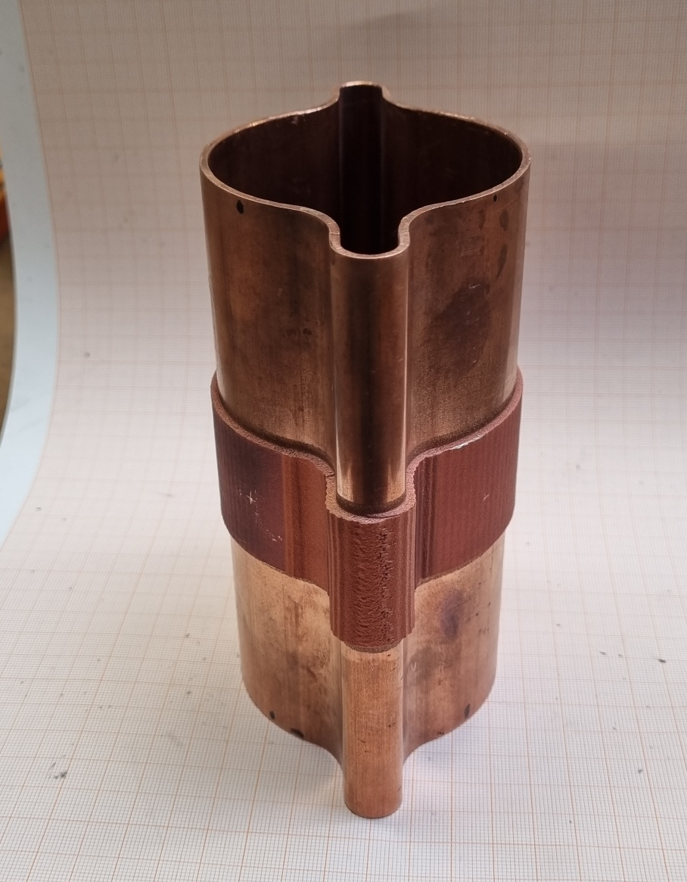
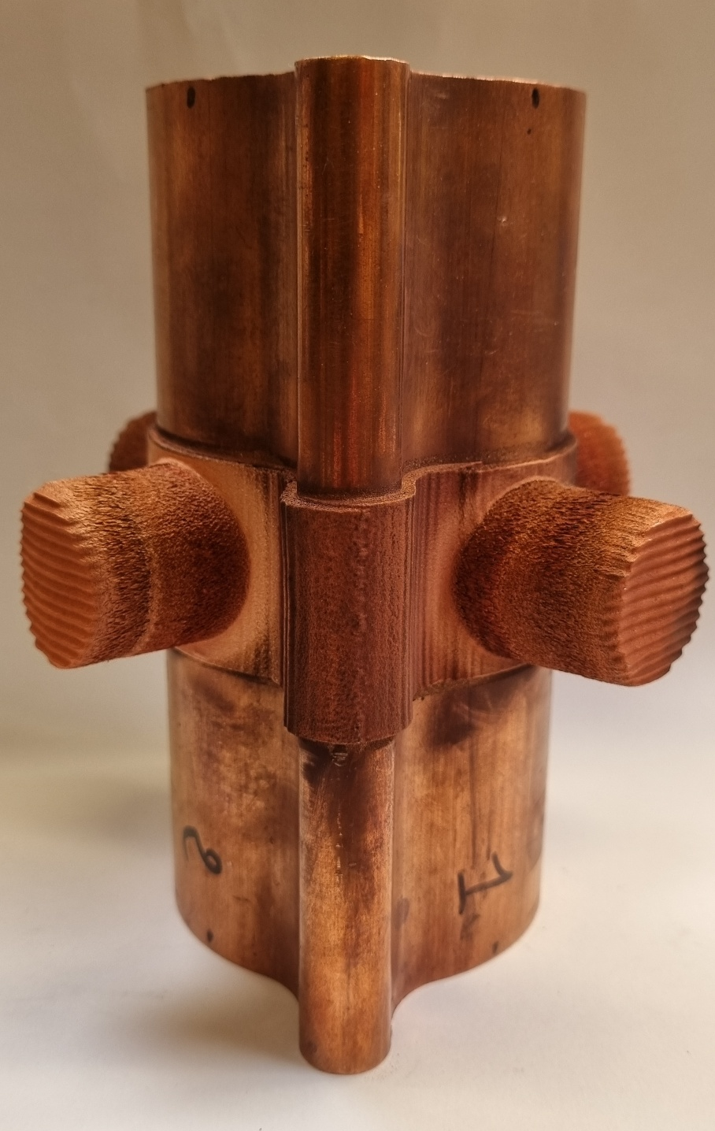
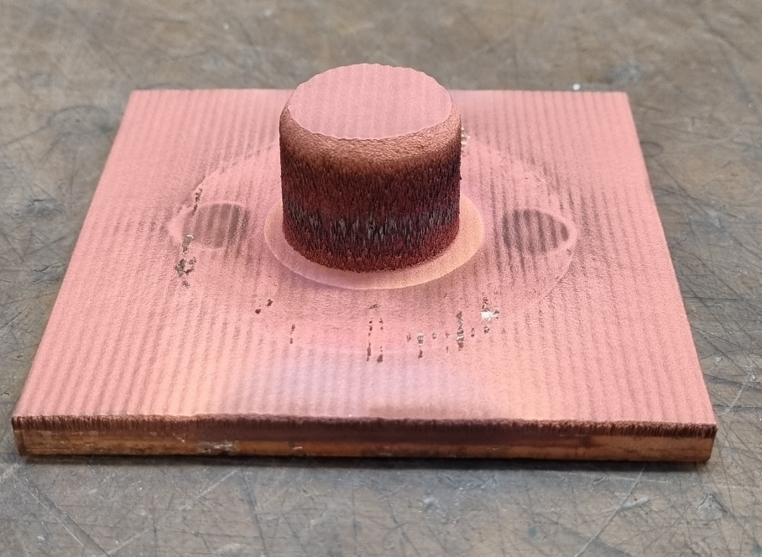
BPM Prototyping
First prototypes of complex cold-spray geometry applied to copper plate and FCC-ee vacuum chamber profile (cold-extrusion)
It is clear that optimisation and further study of the manufacturing process is required to enable this method for the scale required for FCC.
For example, using robotic spray setup to avoid de-bonding issues on bosses.
Chamber; 2mm layer sprayed all around
Chamber prototype with x4 bosses
Test-plate. Boss sprayed to same dimensions as chamber bosses (x4)
Sam Rorison, TE-VSC-DLM, Arc Half Cell Mock-up Meeting - BPM and interfaces # 2 04-May-2023

Slide 3
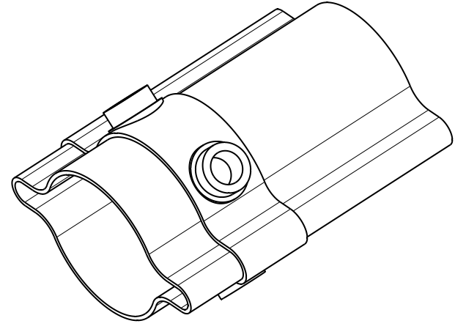
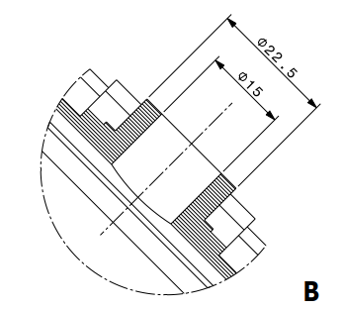
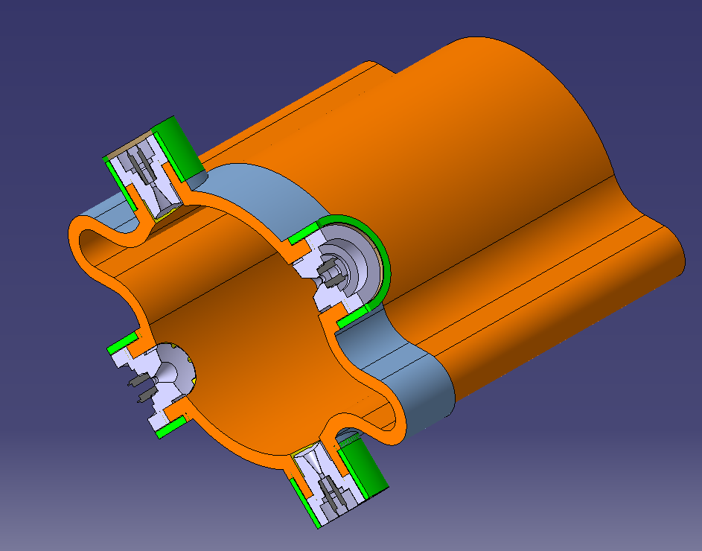
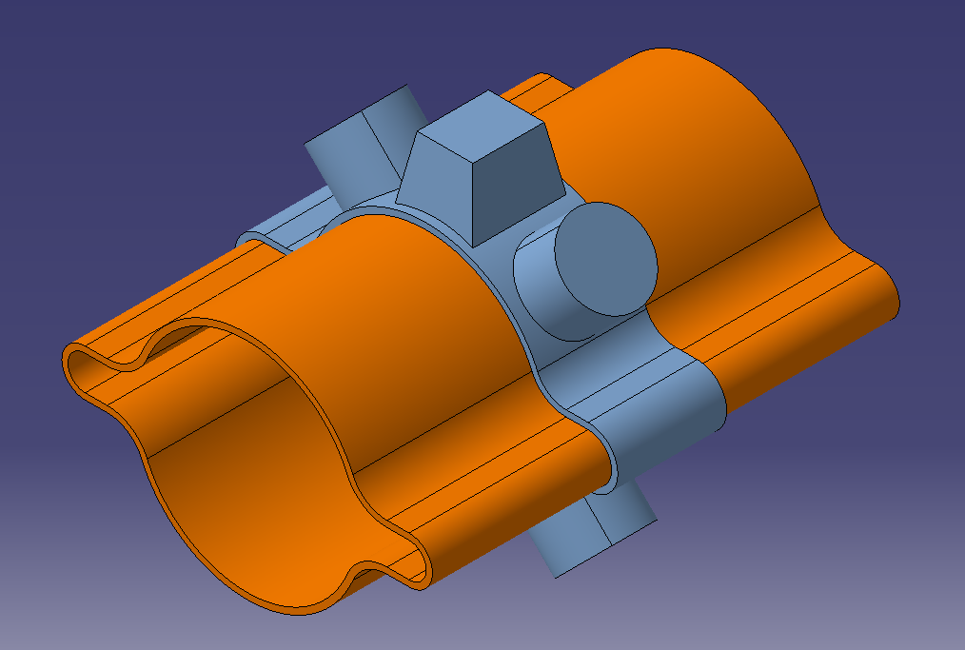
BPM Prototyping
Components provided by BPM team early 2022, Should therefore not be considered current while BPM design is on-going
For alignment with magnets / machine so the chamber is not ‘floating’ , vacuum group propose to spray another boss that could house alignment equipment
Sam Rorison, TE-VSC-DLM, Arc Half Cell Mock-up Meeting - BPM and interfaces # 2 04-May-2023

