Slide 1
Cable protection

Slide 2
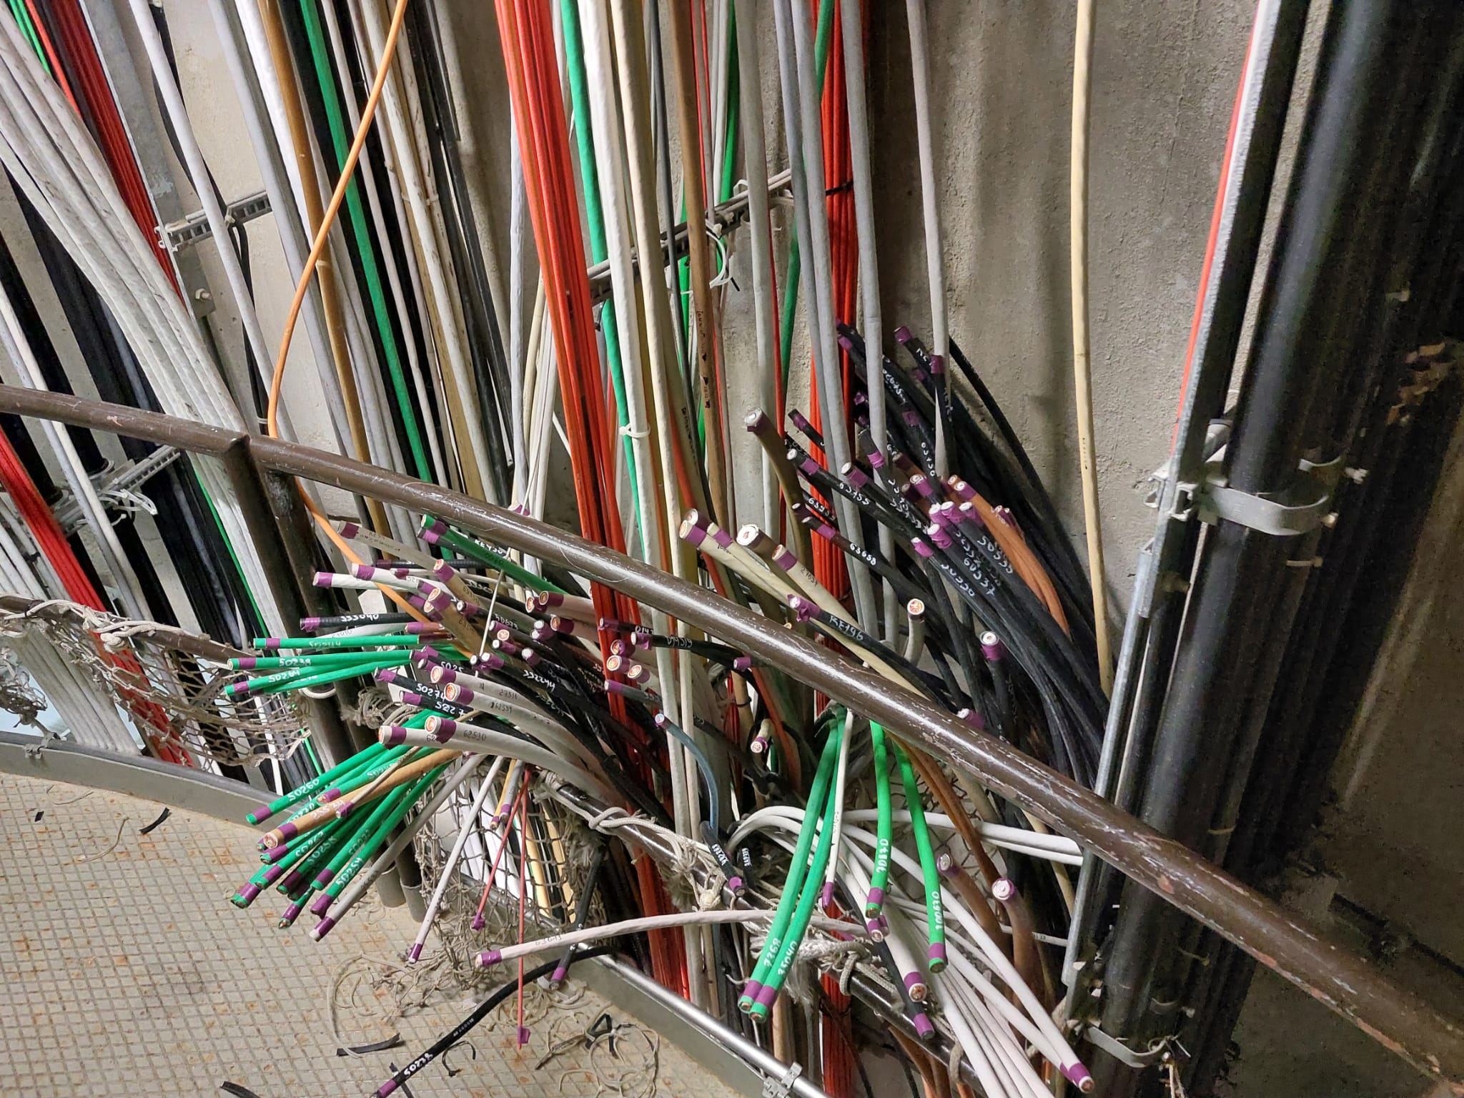
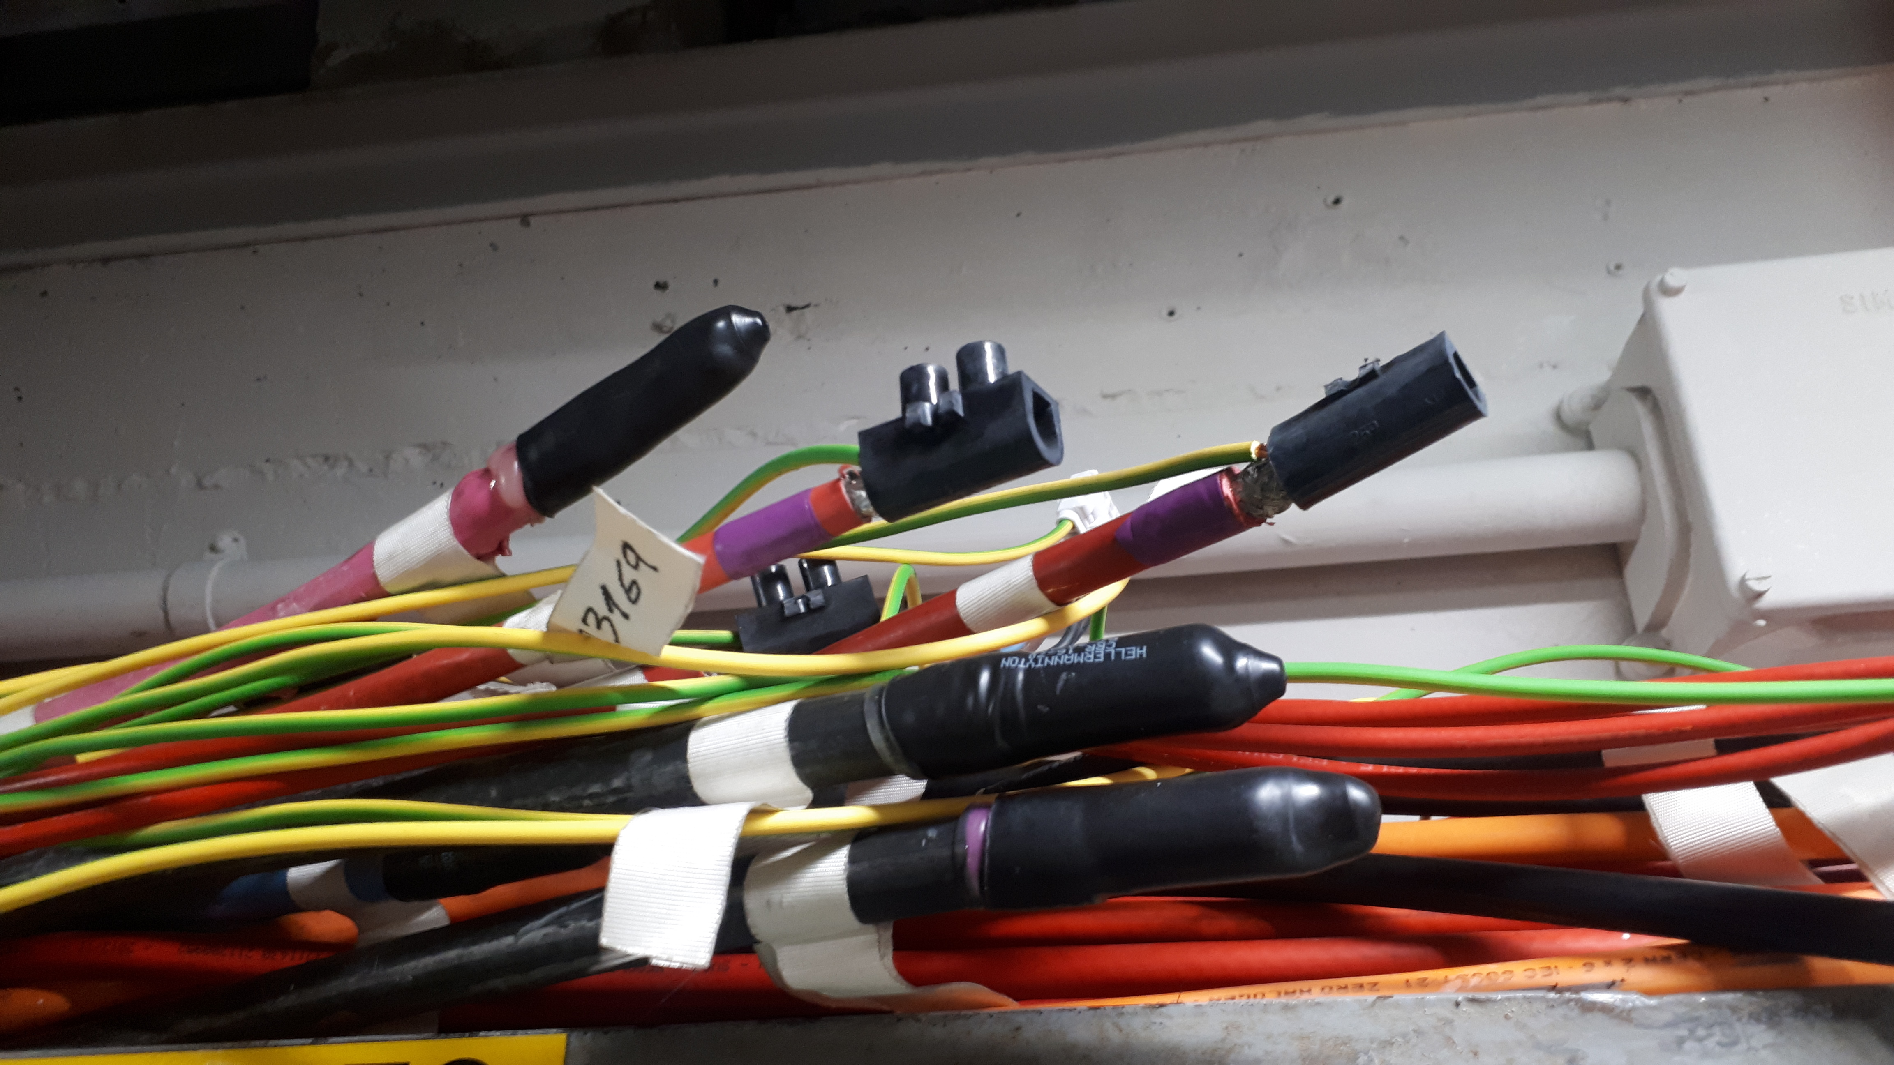
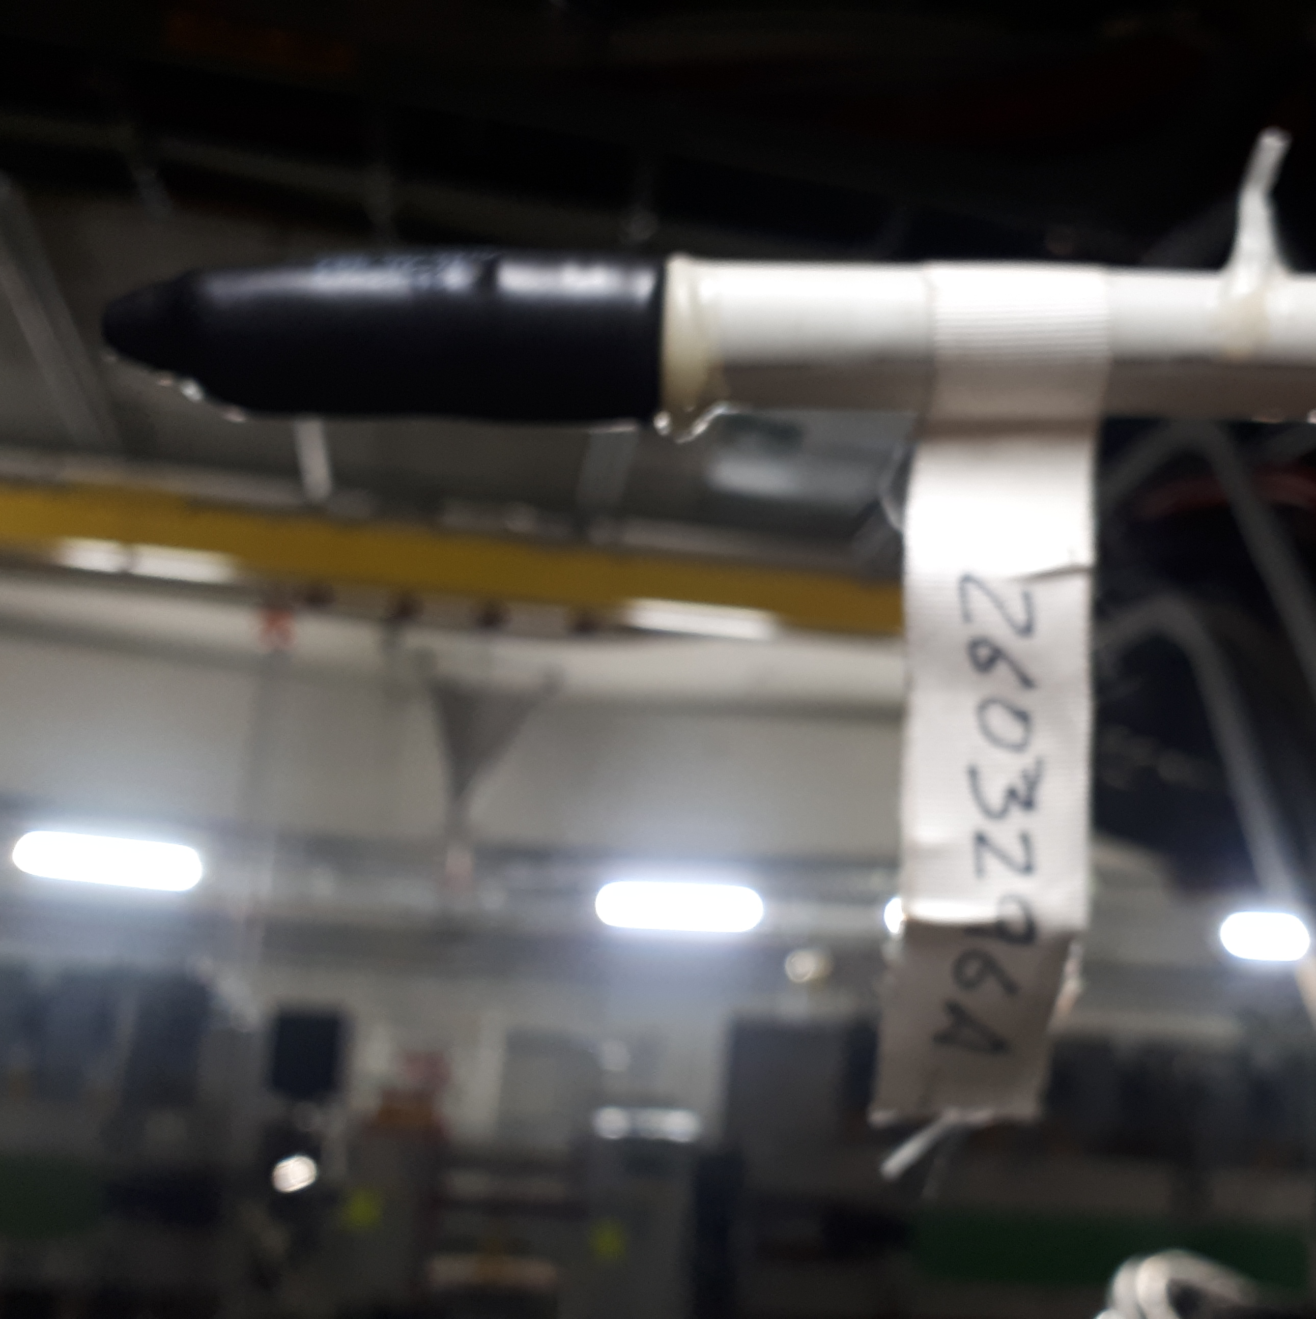
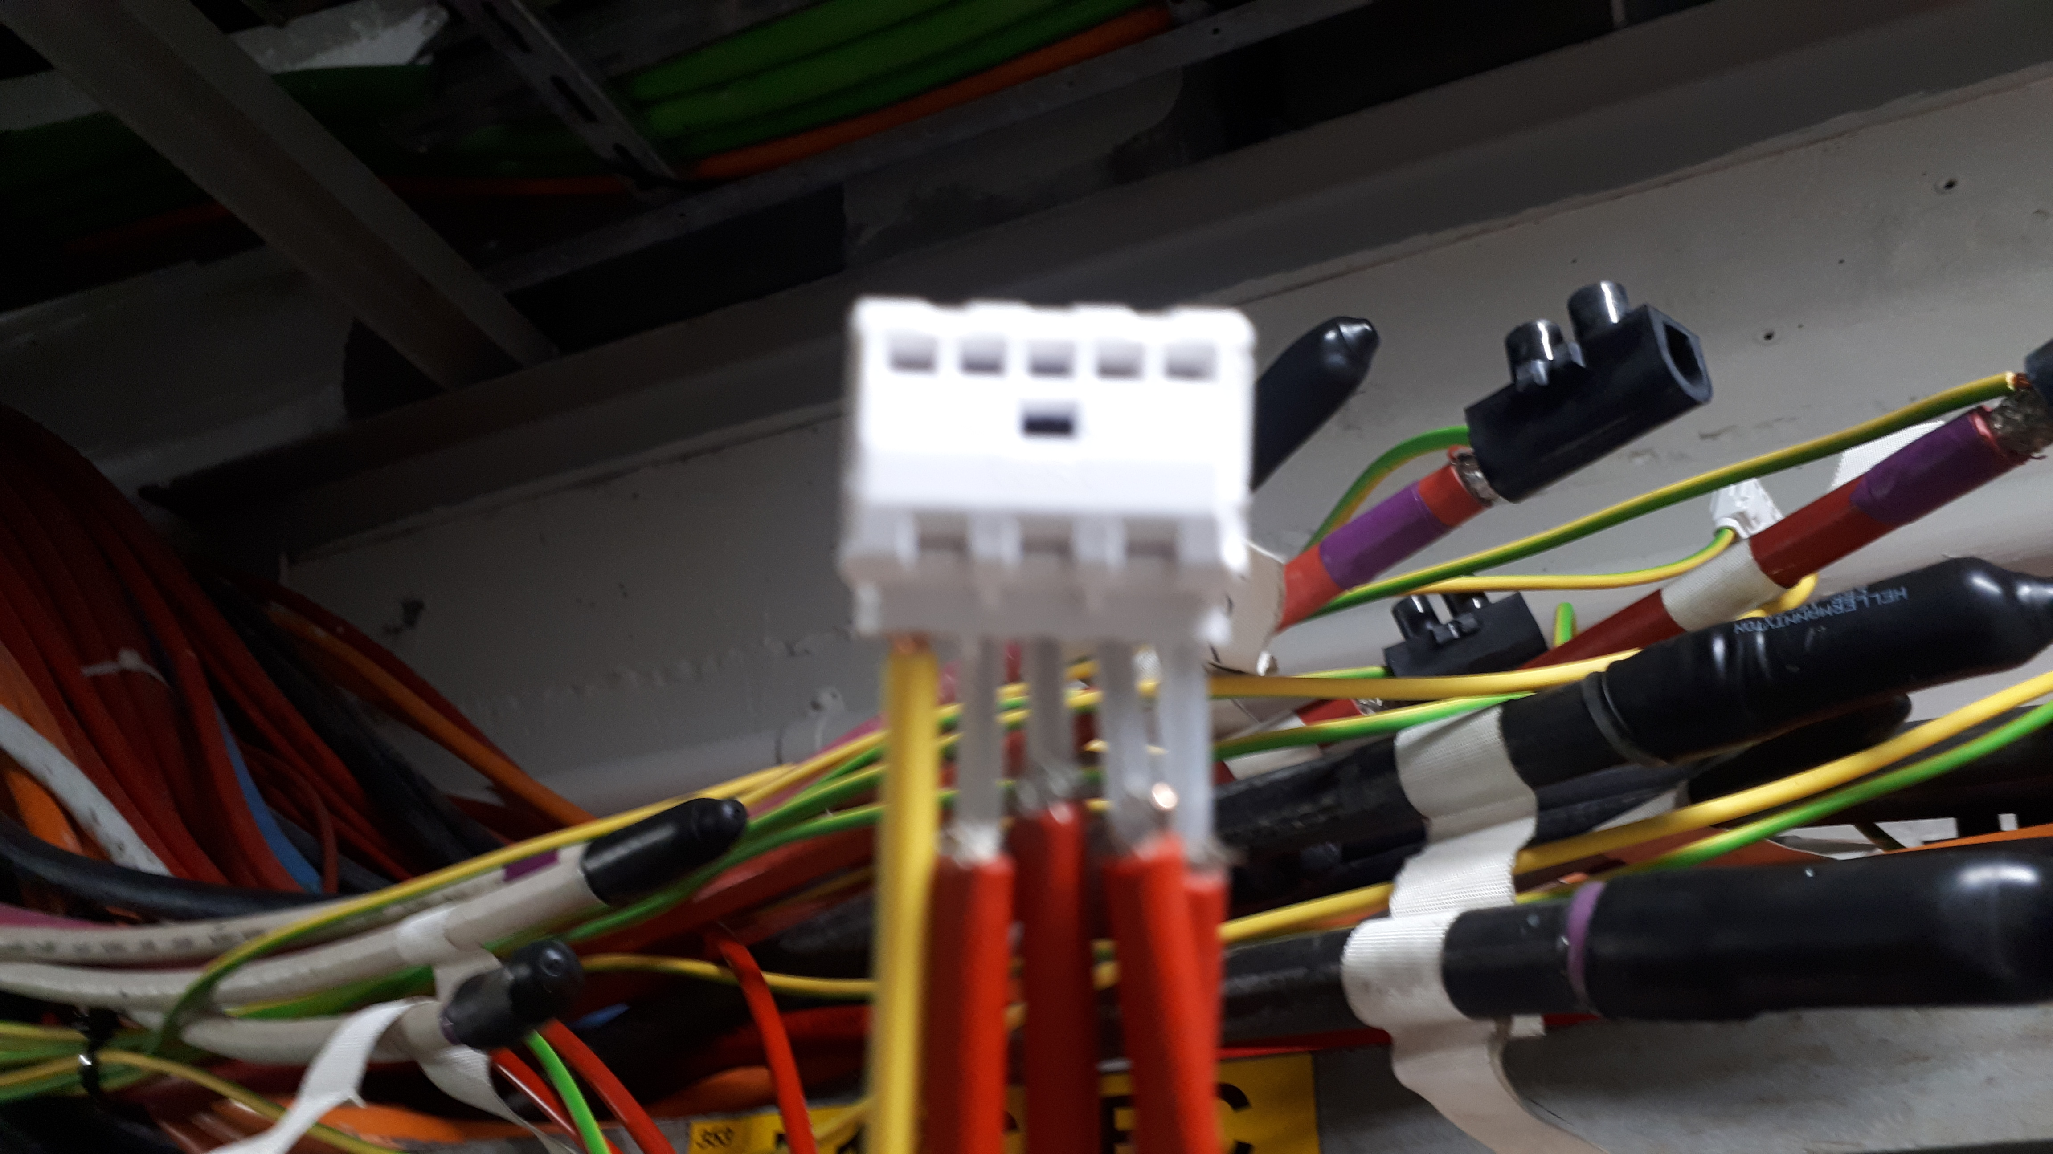
  Some installations are 60+ years old
  Cables as old as the installations
  Ongoing projects to removed obsolete cables
  Not all the cables are removed in one go
  Not all the cable length is removed in the same campaign
  Before starting removing a VAT (Absence of Tension Verification) must be performed individually on each cable

