Slide 1
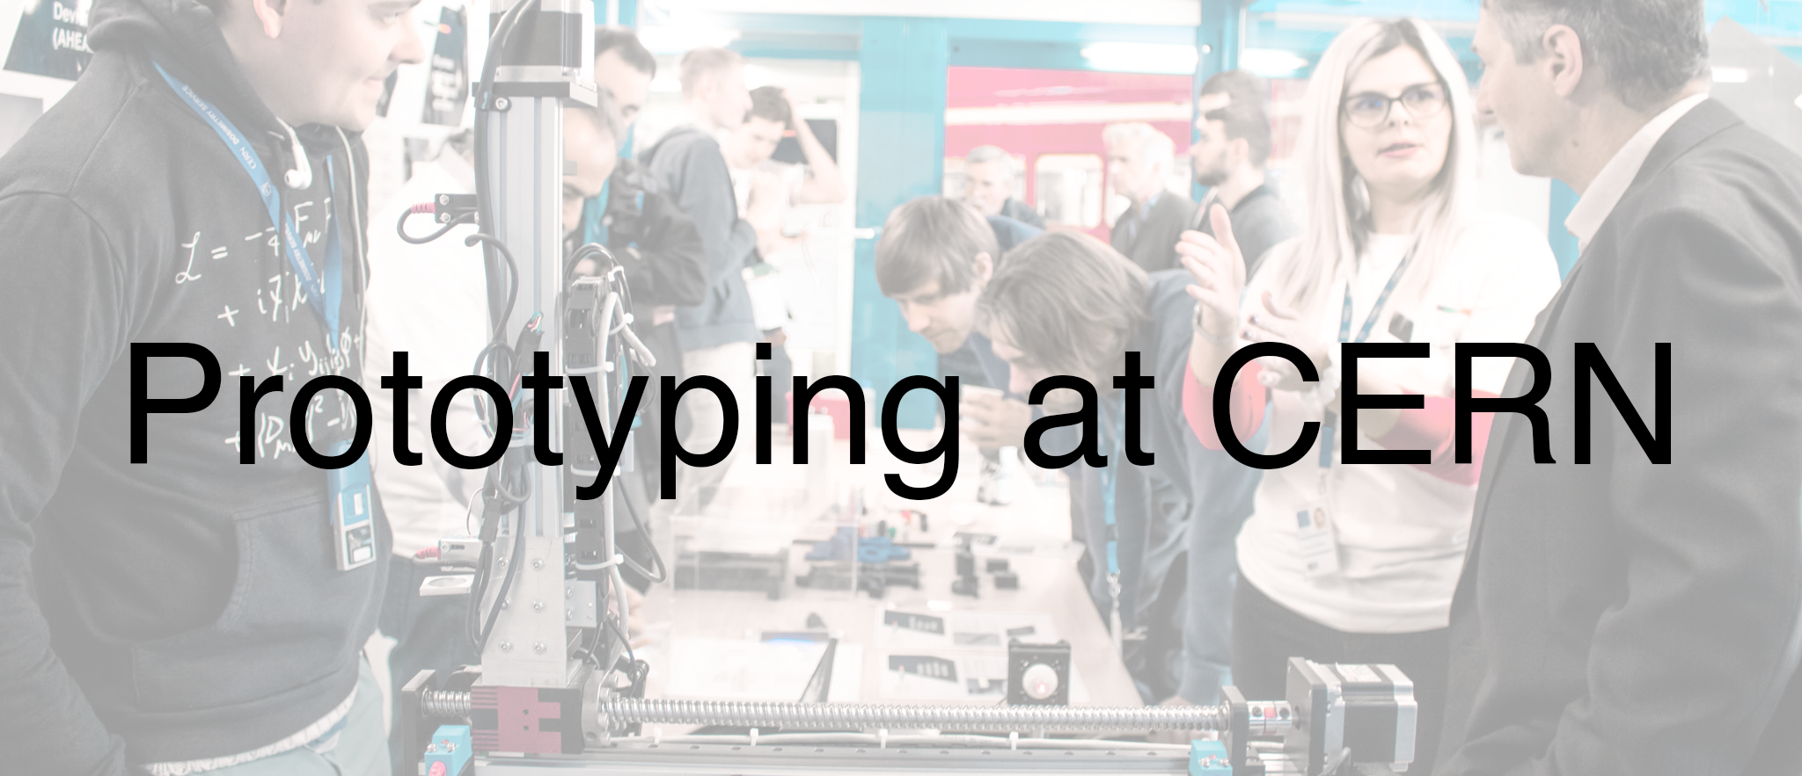

Slide 2
ideasquare.cern/prototyping

Slide 3
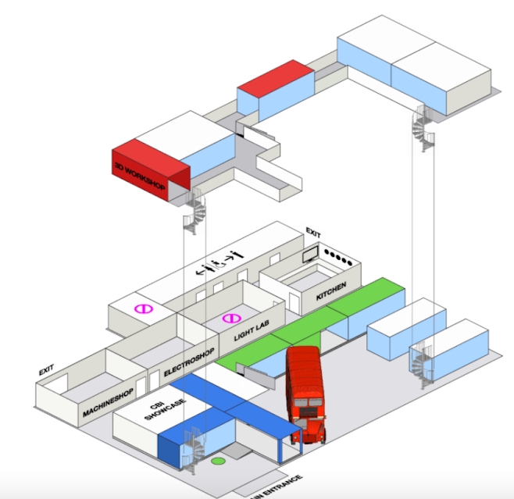
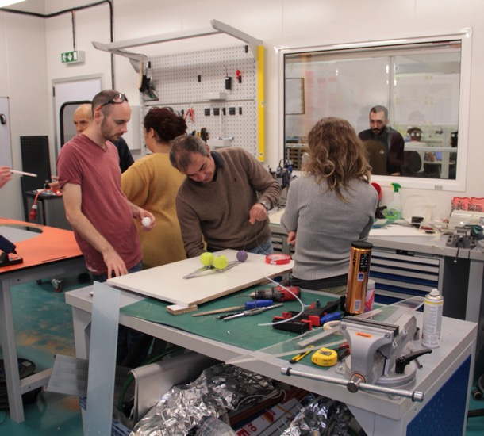
Intro Prototyping
The IdeaSquare space consists of 700m² flexible office space as well as 2 meeting rooms in our famous double-decker bus. Additionally, a total of 140m2 of prototyping facilities include:
- an open space for ideation and
- labs for 3D-printing, mechanical & electric work.
Over 200 CERN personnel use IdeaSquare’s spaces regularly for various prototypes: from working on improvements to their particle physics experiments to developing medical applications. We even created a reusable 3D printed mask during the CERN against Covid-19 initiative.
Notes:
Visual: overall space or drawing of building

Slide 4
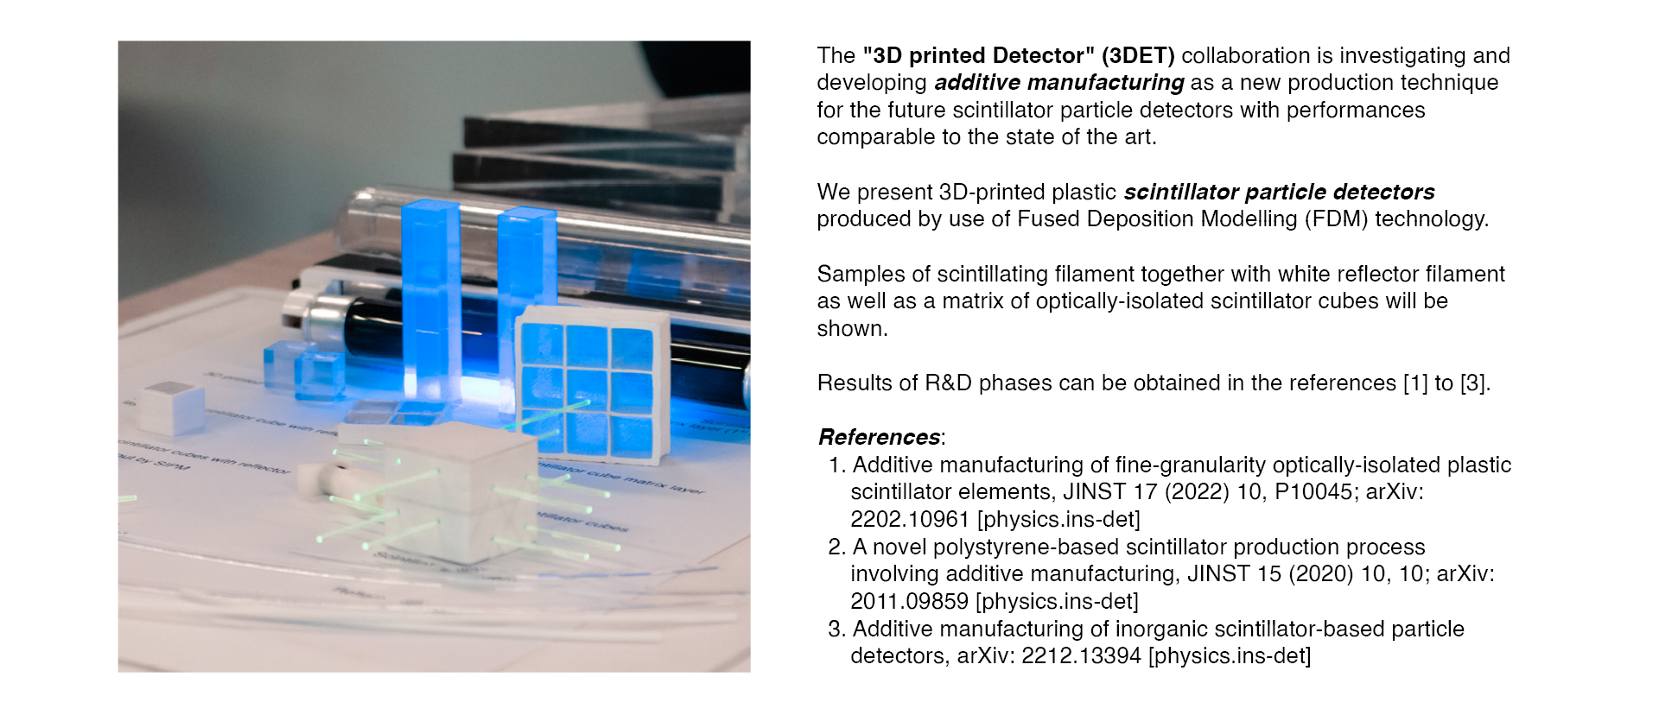


3D printing particle detector
CERN IdeaSquare

Slide 5
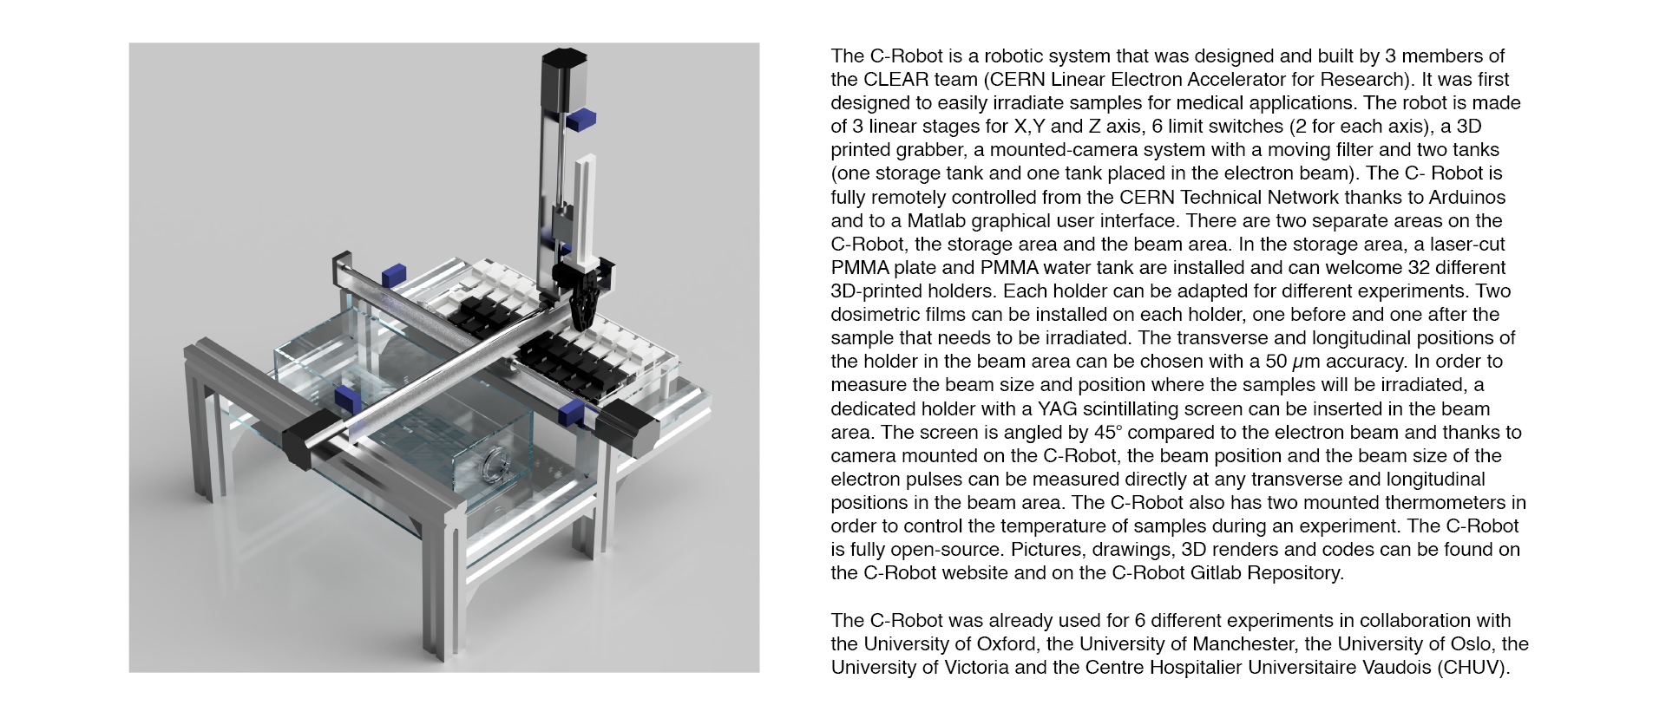
C-Robot
CERN IdeaSquare

Slide 6
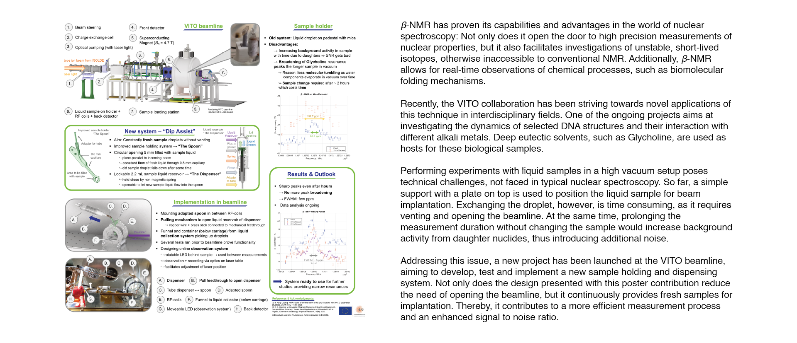
Liquid Sample Dispensing System for β-NMR Studies in Vacuum
CERN IdeaSquare

Slide 7
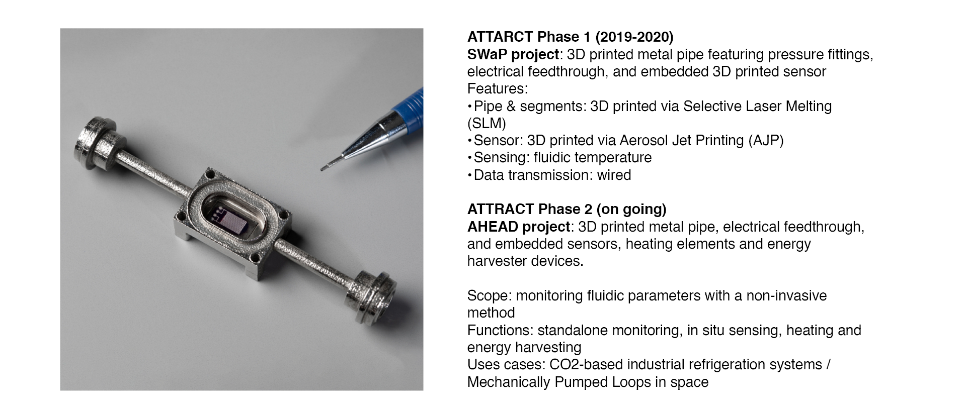
Venturi tube (AHEAD)
CERN IdeaSquare

Slide 8
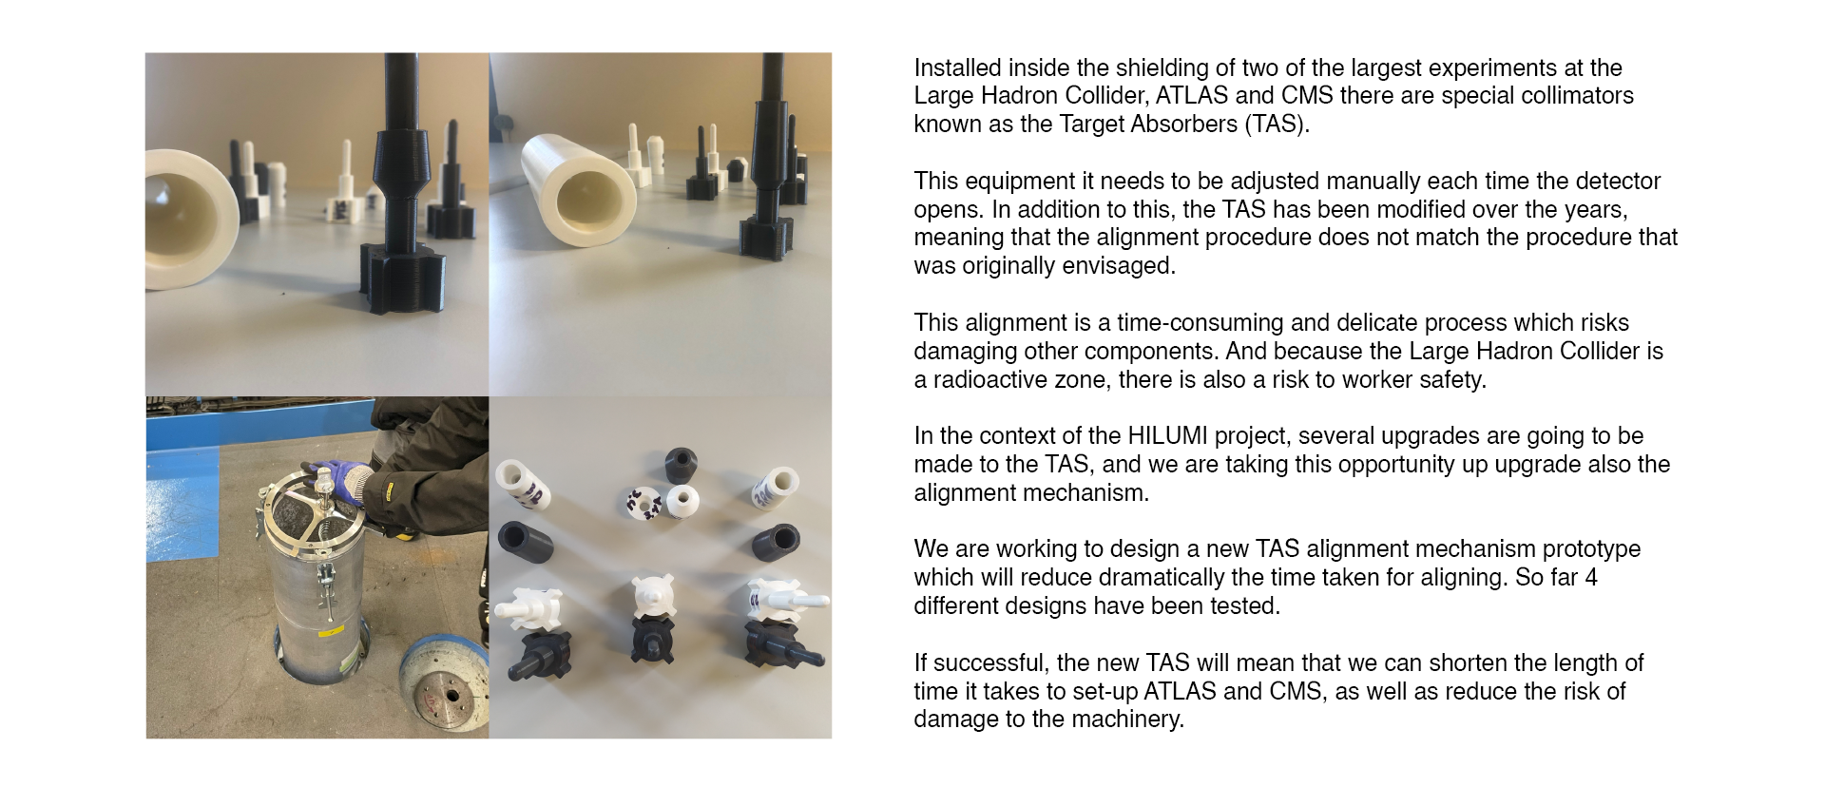
Alignment mechanism for ATLAS/CMS
CERN IdeaSquare

Slide 9
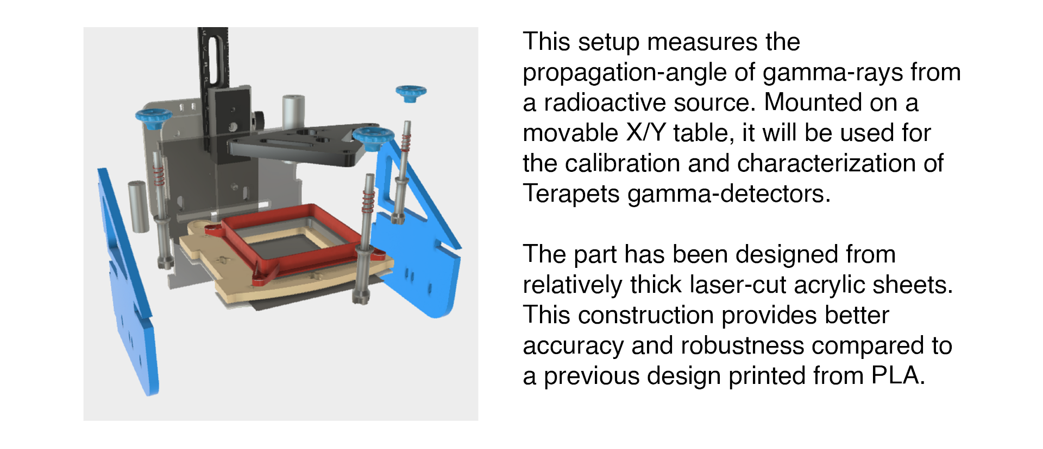
Calibration setup for gamma-ray
CERN IdeaSquare

Slide 10
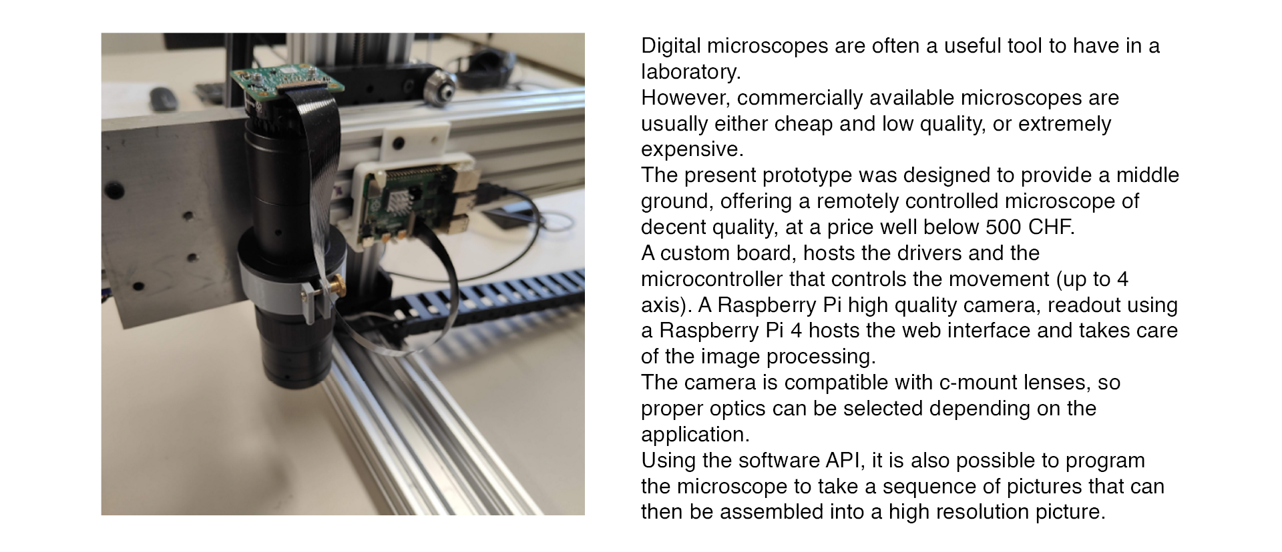
Affordable and customizable remote-controlled microscope
CERN IdeaSquare

