Slide 1
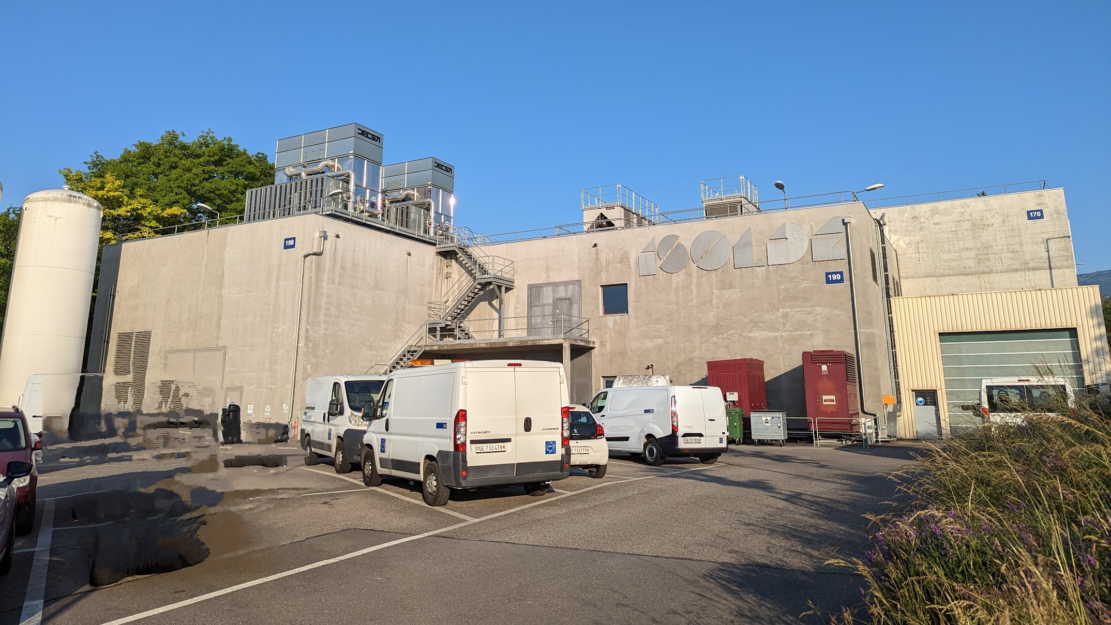
INTC 73: ISOLDE report
Karl Johnston, Joachim Vollaire, Erwin Siesling
Technical updates
Schedule for 2023
Feedback from runs so far
New setups

Slide 2
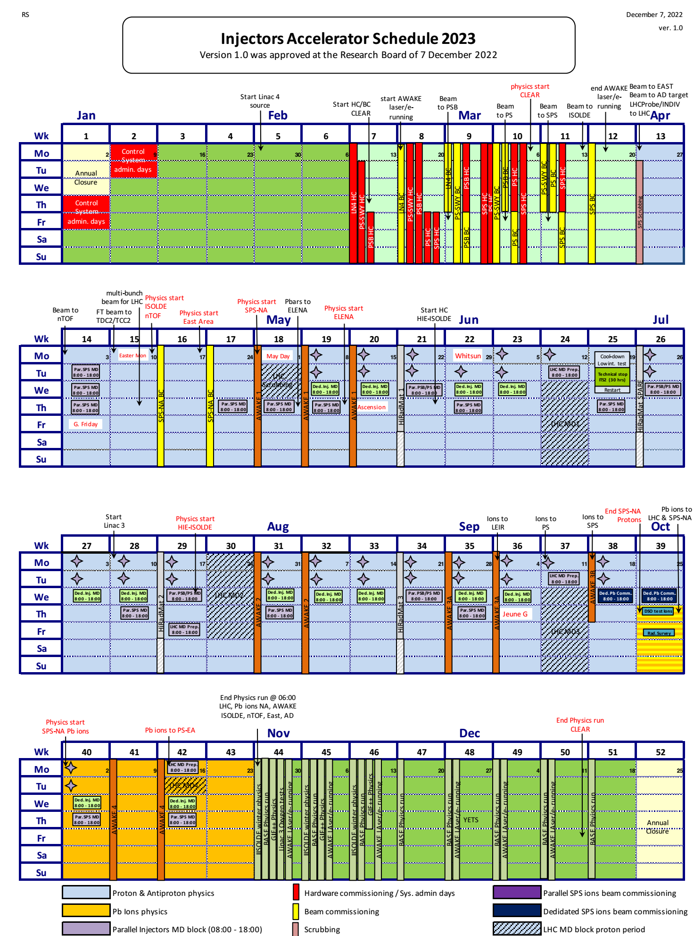
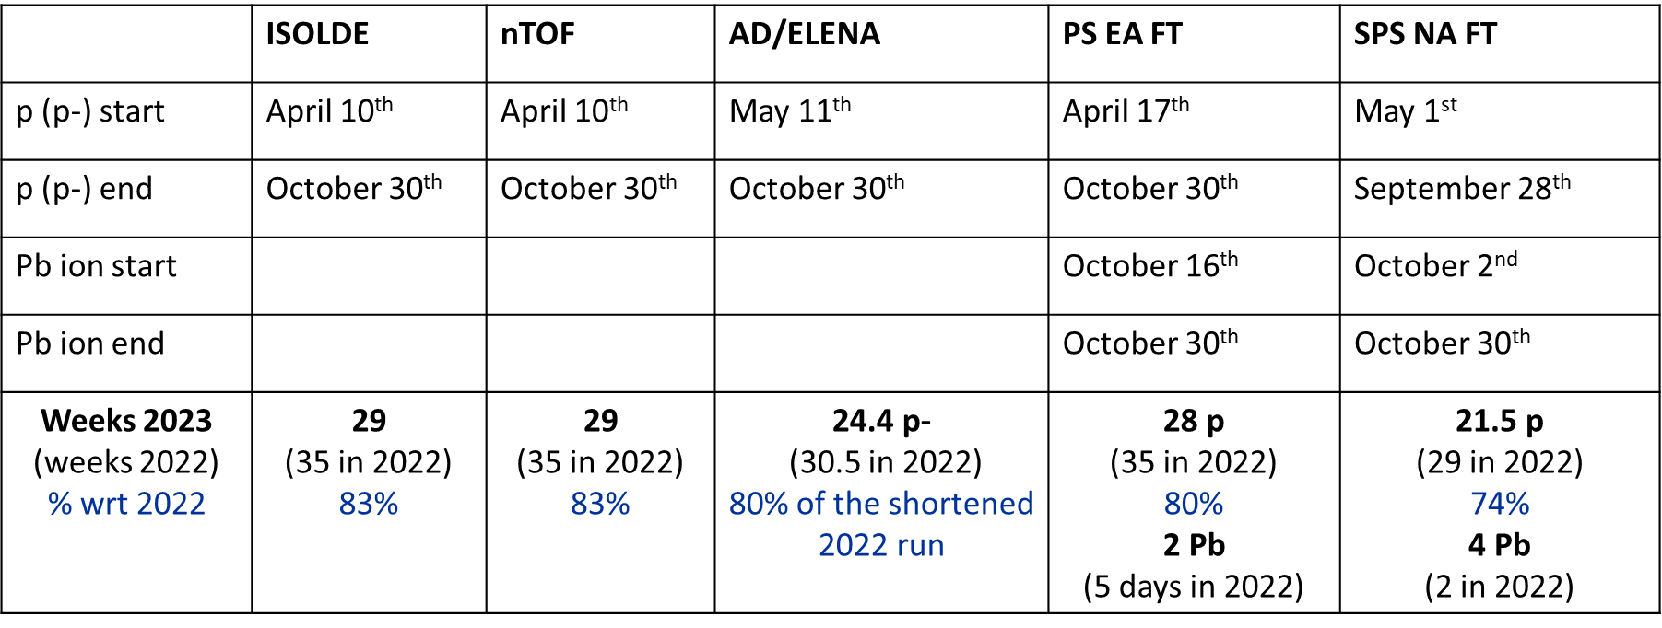
Key dates for 2023
Relatively short run with protons in 2023. Energy considerations mean all accelerators will run ~20% less than 2022.
Prolonged winter physics period from Oct 30th onwards. Now explicitly reserved in the master accelerator schedule.
Relatively short run for HIE ISOLDE in 2023.

Slide 3
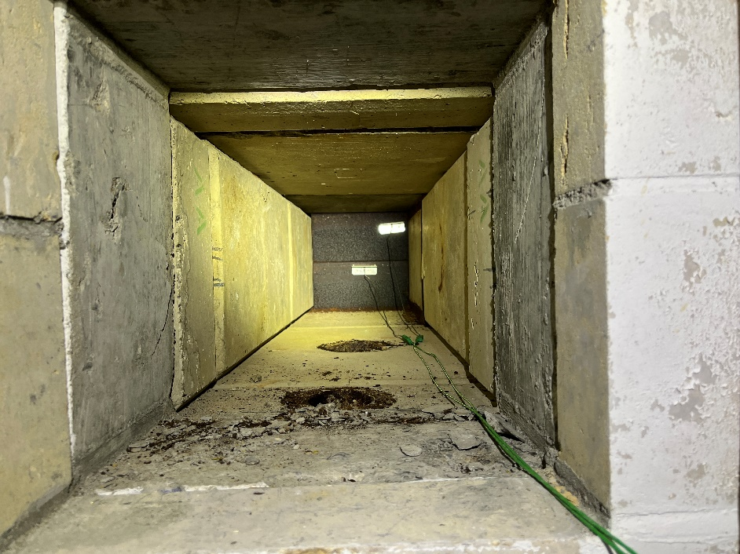
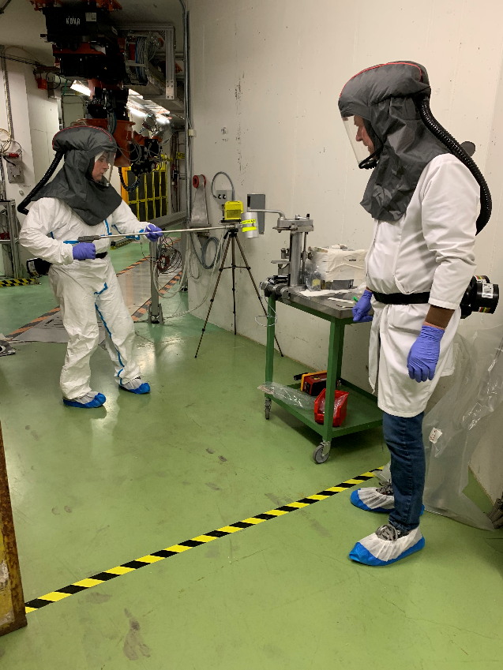
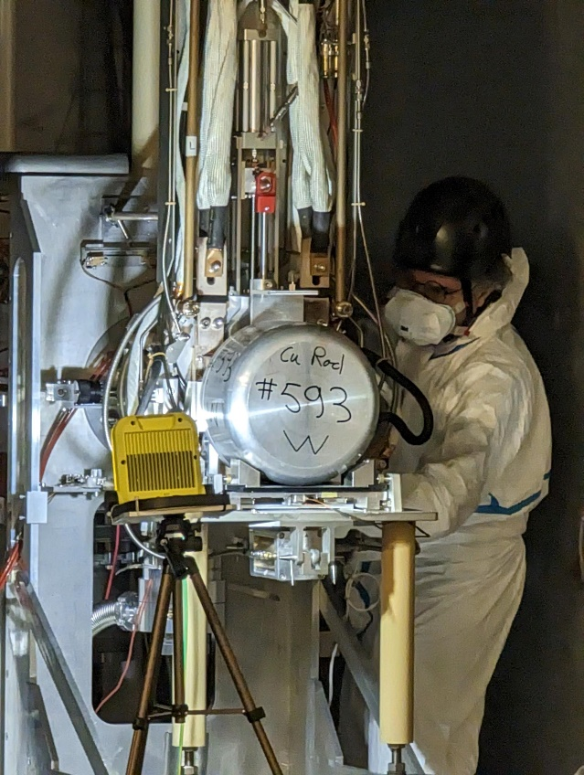
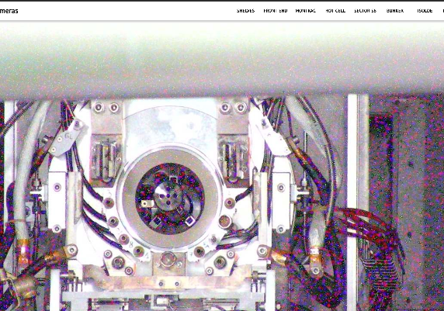
YETS activities for the primary areas (since last INTC)
After the completion of ventilation consolidation (power and control), YETS activities related to the primary areas were finalized to allow the recommissioning of the facility by the OP team
Installation of thermocouples on beam dumps
Exchange of extraction electrodes
Cleaning of insulators

Slide 4
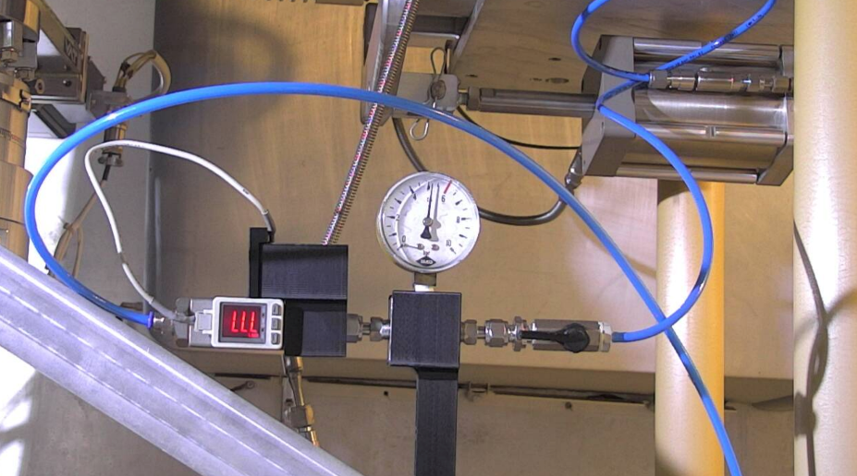
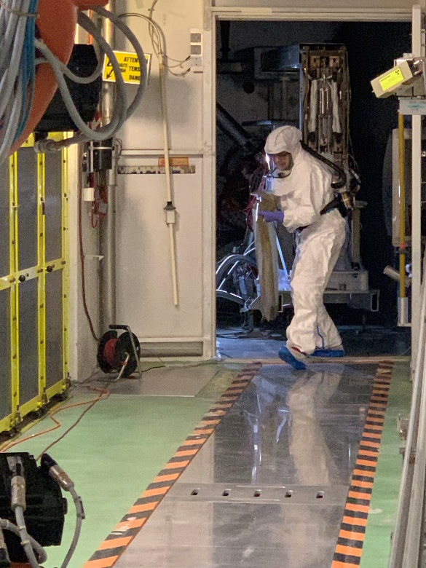
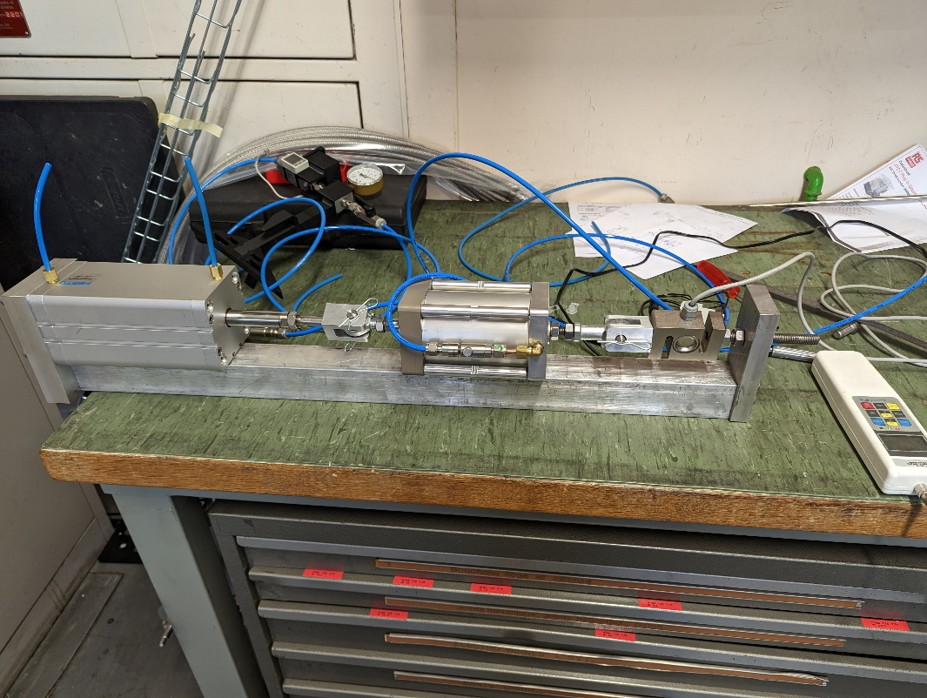
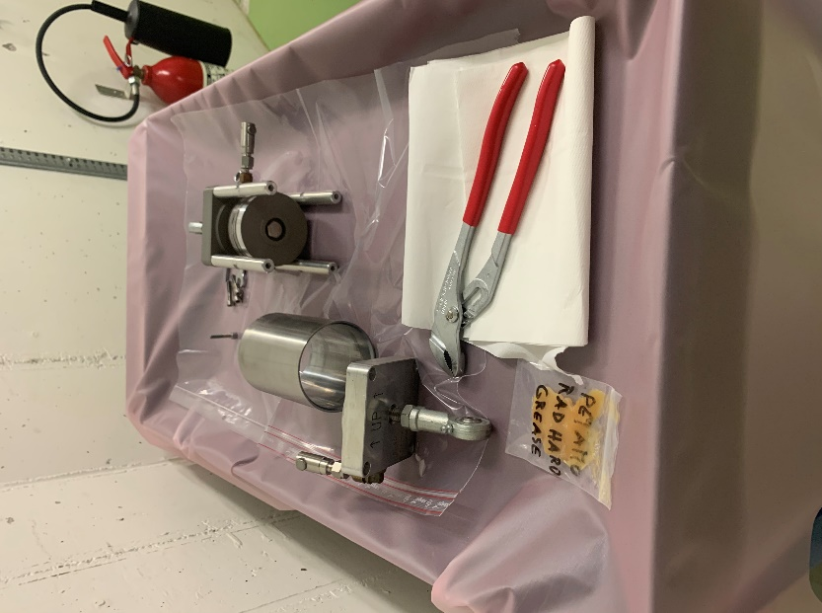
Coupling table piston
Target area – in-situ measurements
Removal
Test bench (new design)
Inspection

Slide 5
Yearly Technical Stop and restart:
PSB
ISOLDE Low E
HIE ISOLDE
  Key Dates:
    HIE-ISOLDE
      Hardware Commissioning from the 24/02/2023 to the 24/05/2023
      Beam Commissioning from the 24/05/2023 (SRF ready, HW commissioning completed) to the 19/07/2023 (with stable to the experiments as of 30/06/2023) (wk28 instead)
      Beam for HIE physics: 20/07/2023
  Key Dates:
    Low energy
      Hardware Commissioning from the 24/02/2023 to the 12/03/2023
      Beam Commissioning from the 13/03/2023 to the 09/04/2023
      Beam for ISOLDE physics: 10/04/2023
      With 1 week before for a Target and Ion Source Development LOI

Slide 6
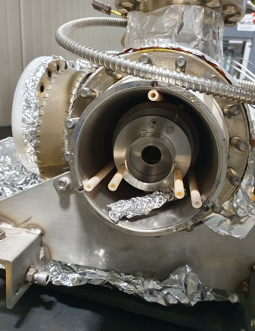
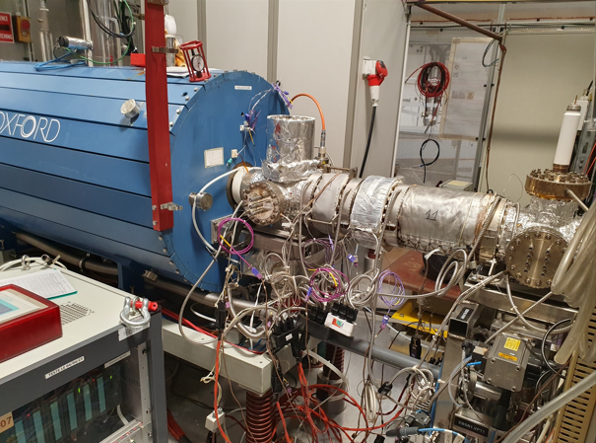
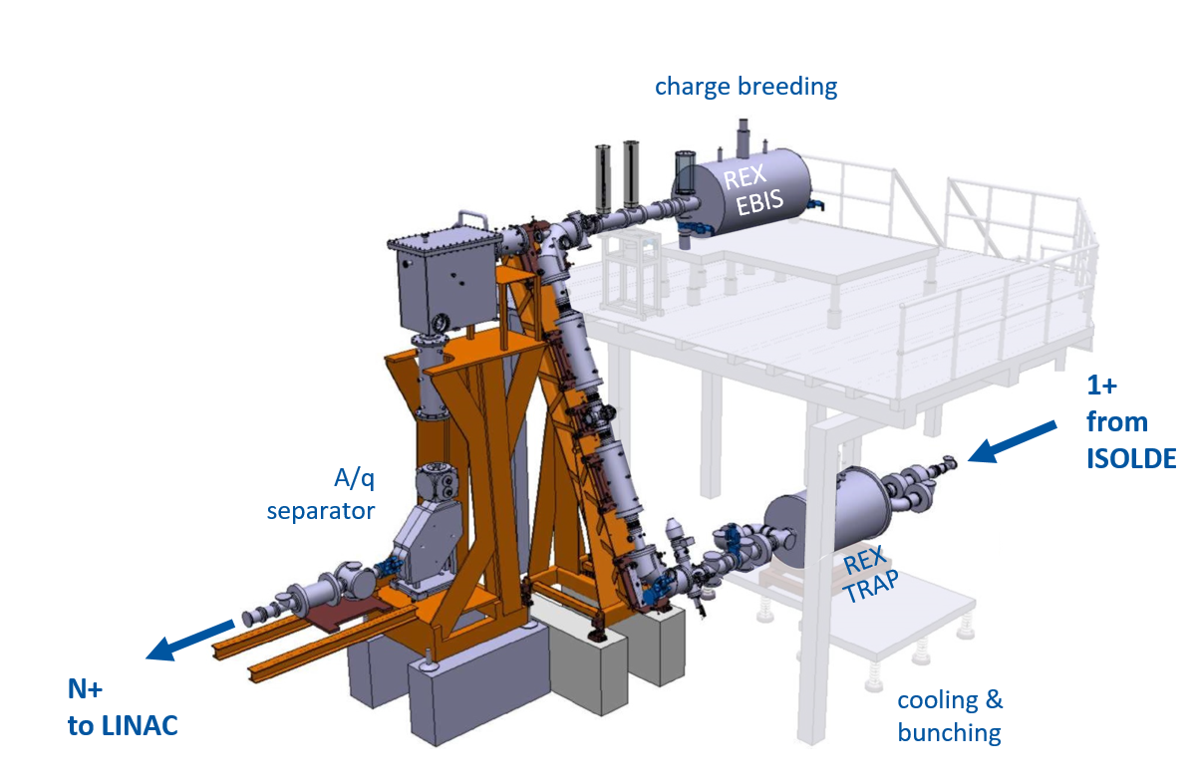
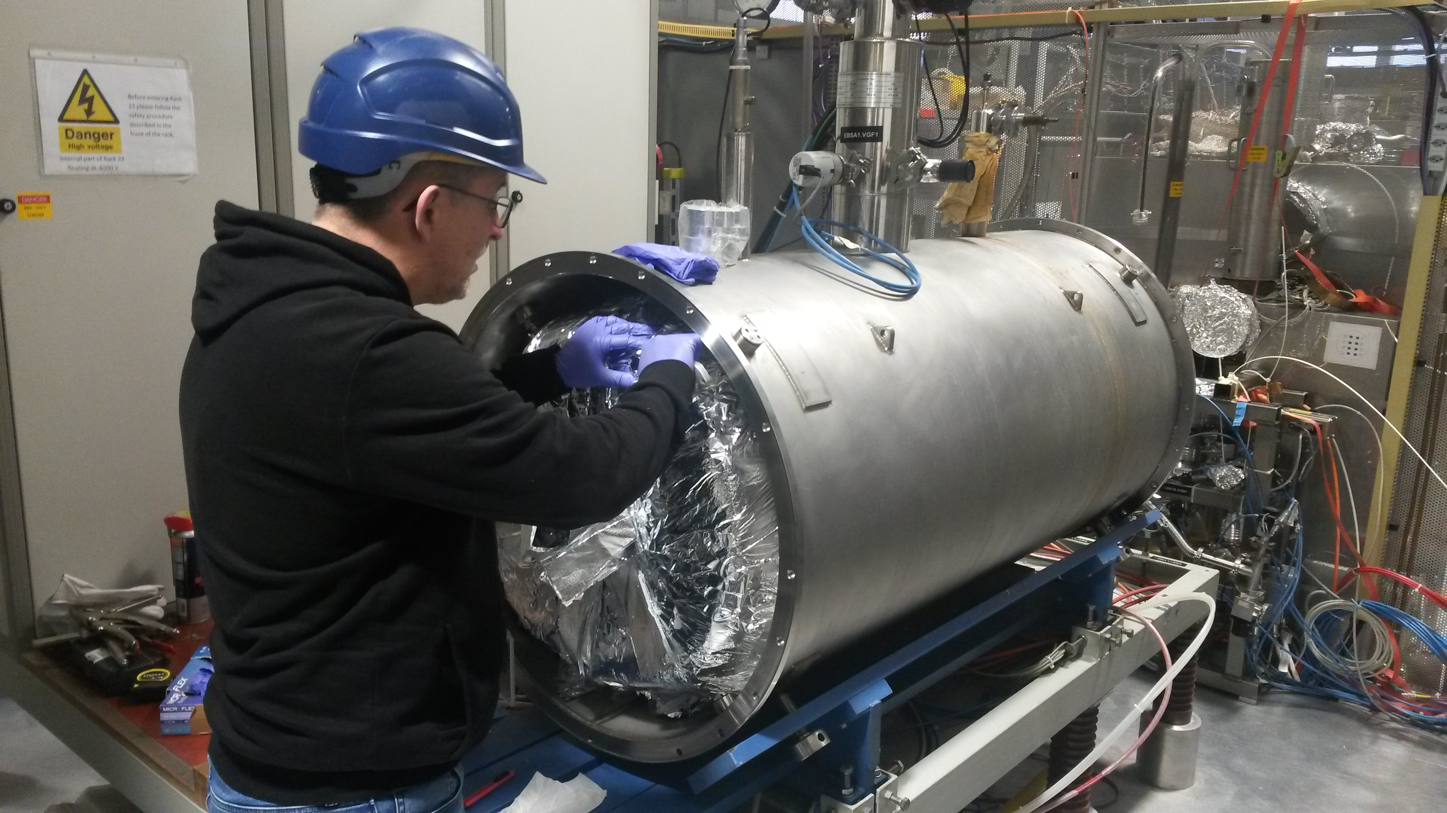
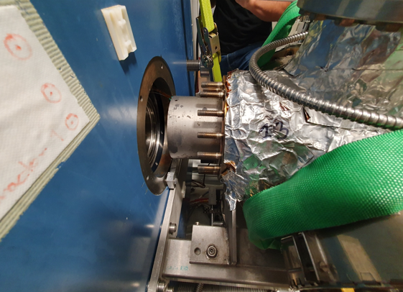
REX EBIS charge breeder:
REX EBIS solenoid experienced rapid LHe boil-off in July ‘22.
Numerous quenches in August ’22. Operation continued with the magnet at 1.5T instead of nominal 2T.
REX EBIS repair during the YETS 22-23: Succesful dis- and reassembly of the solenoid.
First tests in February were satisfactory – no need to exchange for the Twin EBIS (which would have had a serious impact on the start of HIE Physics)
Small delay accumulated (1 wk)
However.. In April during removal of the drift tube inside the solenoid for a modification on the gas injection line, the collector end cap came off. A crash repair was carried out, the parts reassembled, realigned and EBIS pumped and baked out.
Beam from EBIS expected this week!
Delay on EBIS beam commisioning ~2 wks
EBIS development
BE/ABP and TE/CRG are looking into the implementation of a cryo cooler on the EBIS to reduce the use of He and increase the reliability and lifetime of the machine (no more EBIS warm-up cycles). Foreseen for the YETS ‘23-’24
E. Siesling - HIE ISOLDE Physics Workshop, 24-26 May 2023, IOP, London, UK

Slide 7
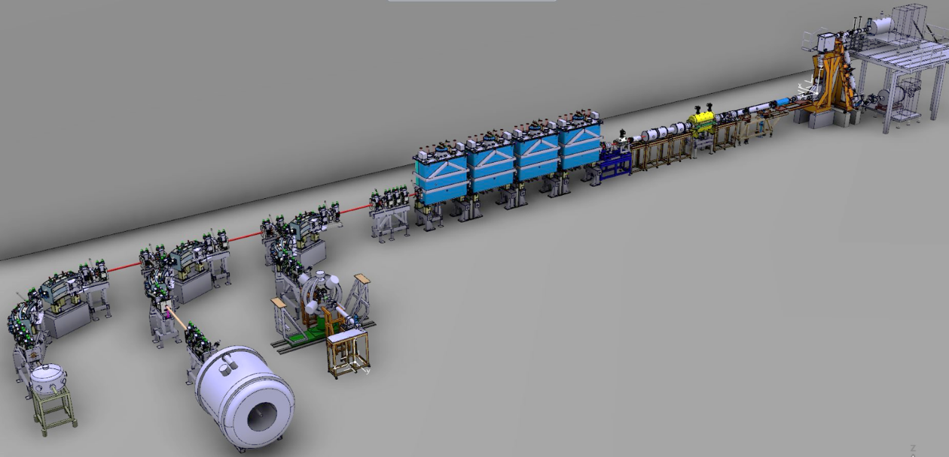
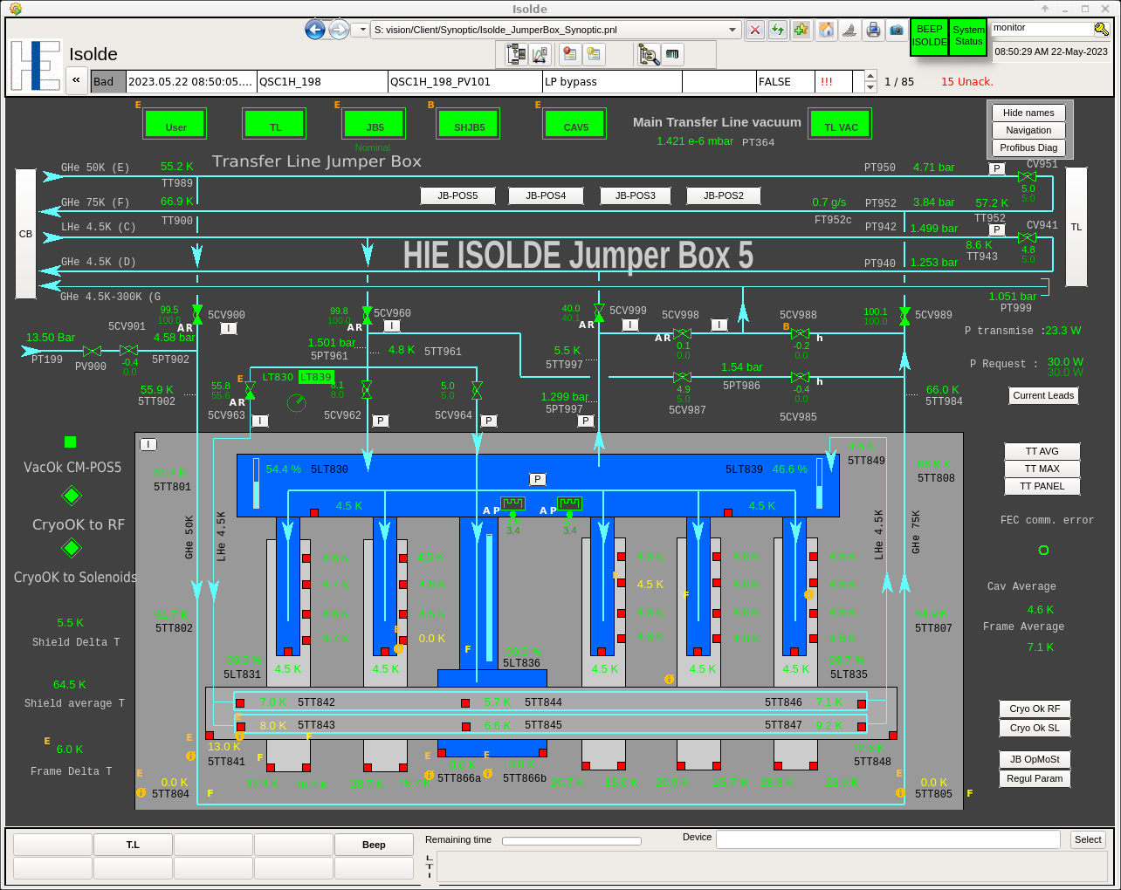
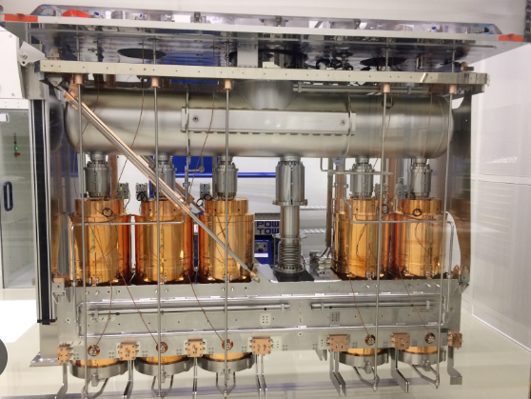
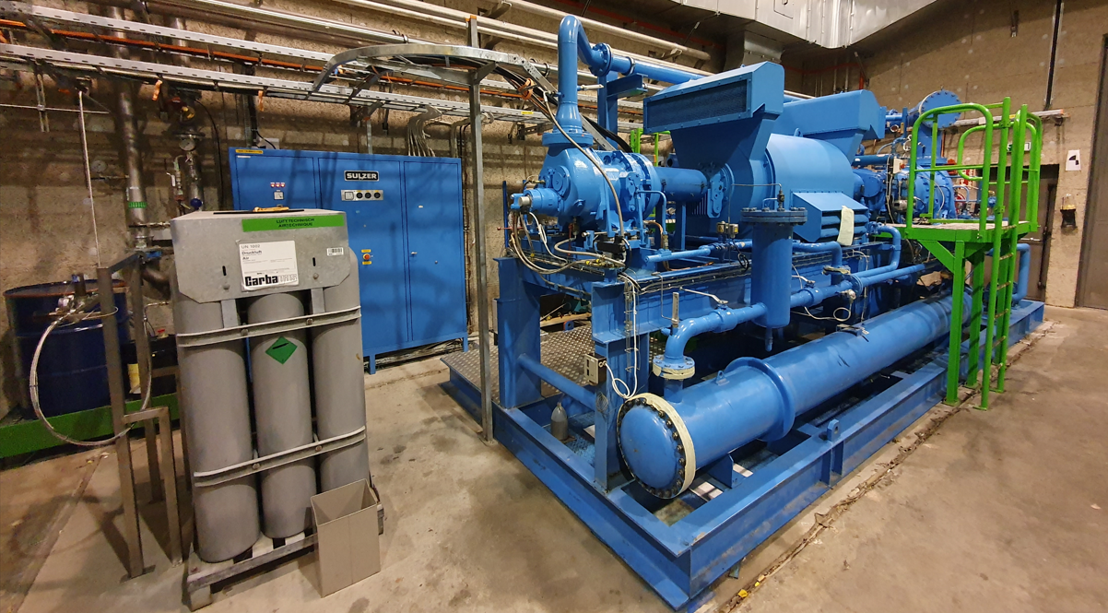
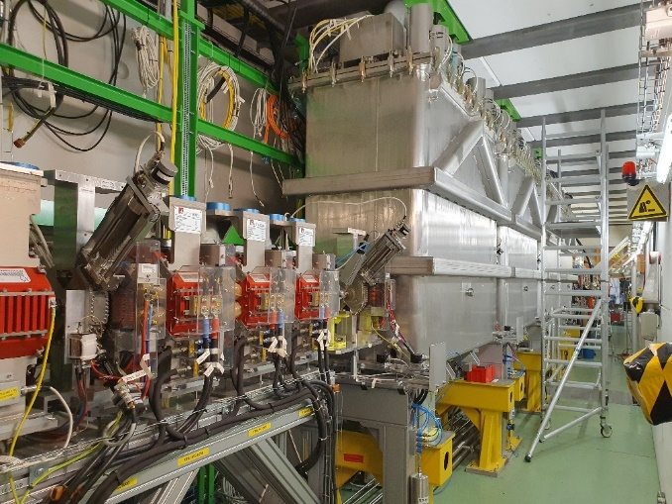
HIE ISOLDE LINAC 1/2:
The cooldown and filling with LHe of the Cryo Modules finished as per schedule at the end of April. Significant amount of improvements and actions realized by the Cryo group
HIE ISOLDE SC LINAC
  Total refurbishment of the Cryo Modules Process control
  Mirror tests in order to validate new process before loading into the PLC
  Commissioning to validate different modes: Precool down, Cooldown, Filling, Nominal, Stand by and Off
  Valves position checking in case of Cryoplant Failure
  Automatic reconnection after Cryoplant restarting
  Compressed Air back up system installed and tested during the maintenance period which guarantees an autonomy of 4 hours in case of CERN Compressed Air failure
HIE ISOLDE Cryo development
Tests were performed during the ‘22 warm-up phase with LHe at LN2 temperature circulating in the shields in the frame of a study to maintain GHe or LN2 circulation in the CM thermal shields keeping the CMs below 100K. During unexpected cryo plant stops as well as maintenance this would reduce the impact on the SRF cavities (possible gain for commissioning time, thermal stresses, long term machine performance….)
  The Cryo group will perform a pre-study if benefits are confirmed and probability that resources to implement the solution are available
4 HIE SRF Cryo Modules

Slide 8

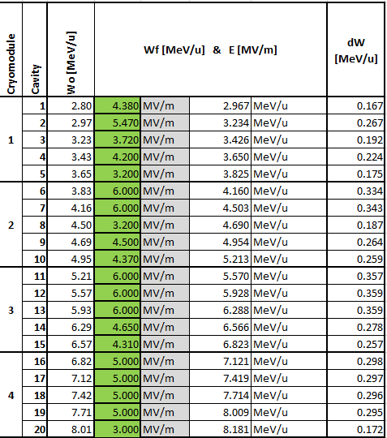
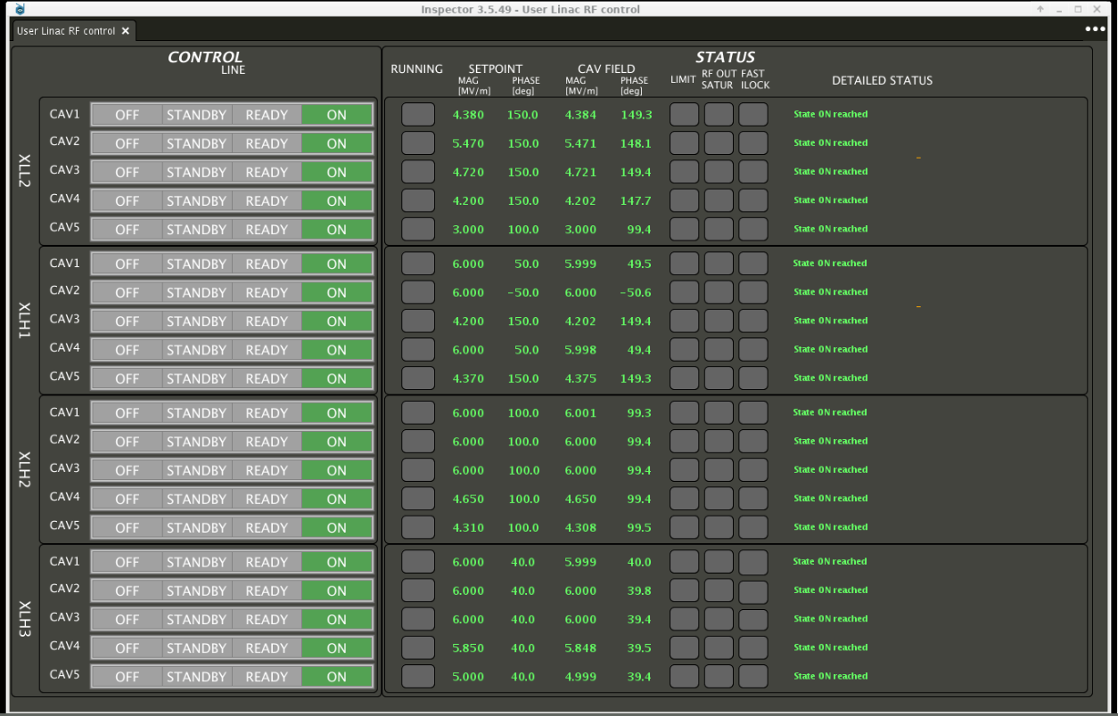
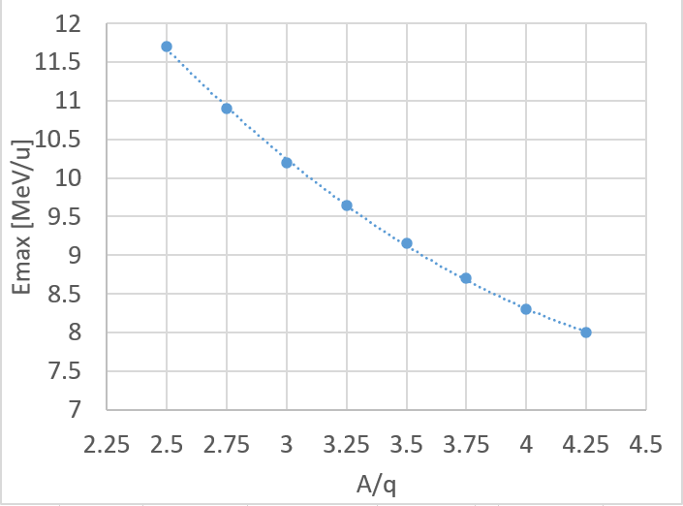
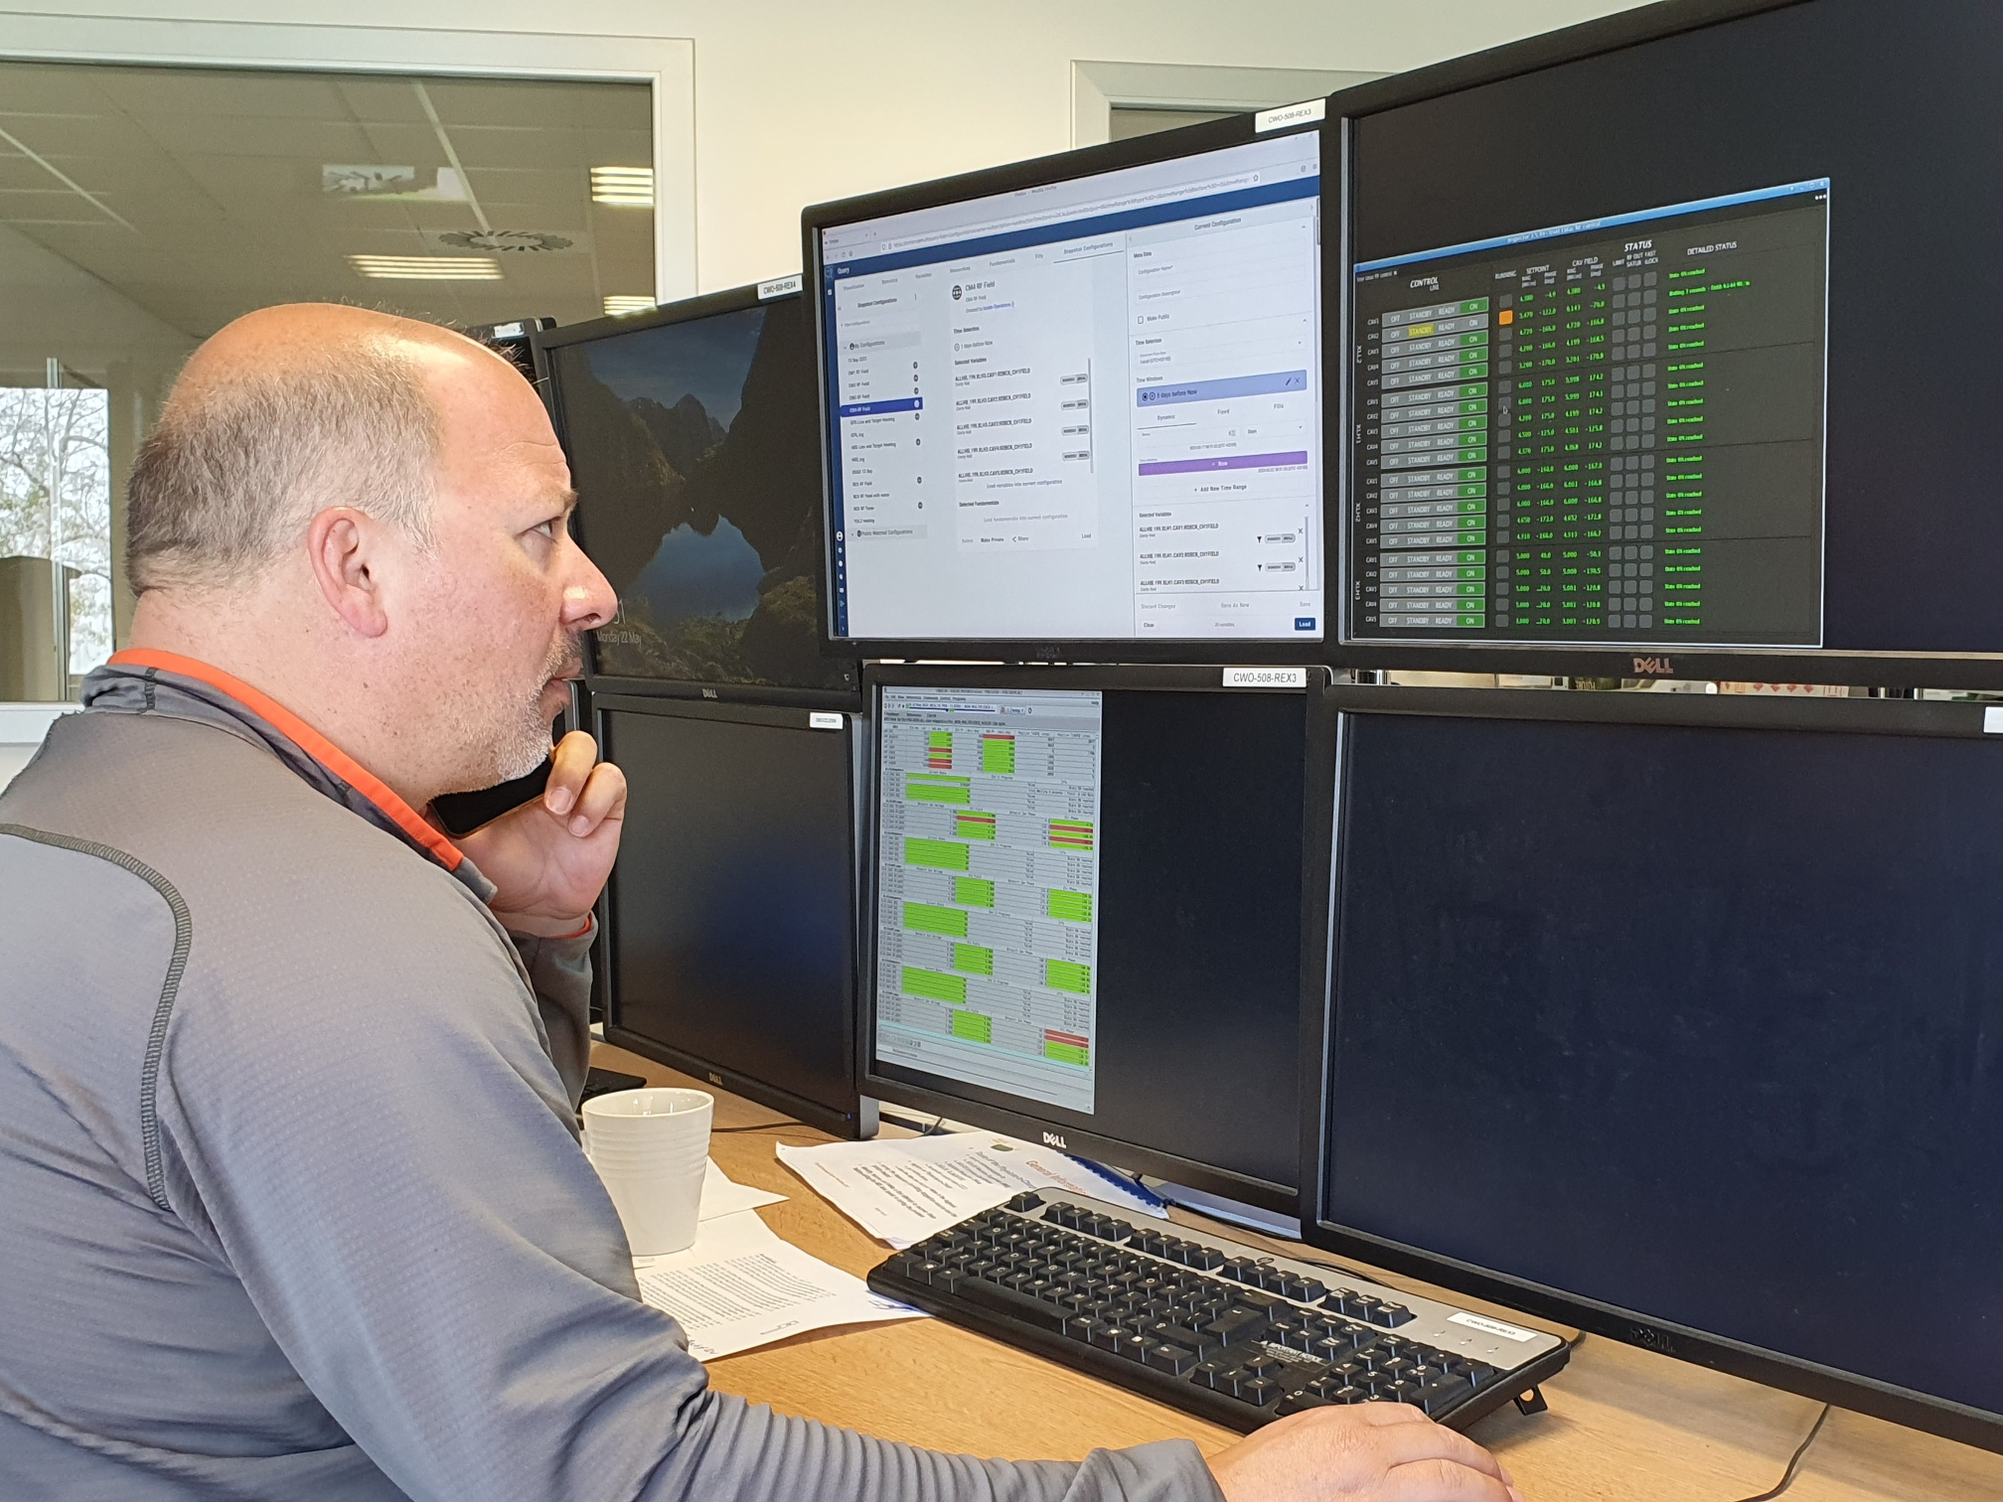
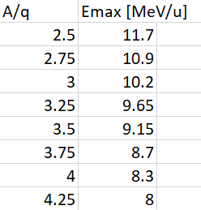
HIE ISOLDE LINAC 2/2:
Tweaking of their systems by the RF and Cryo experts during the reconditioning of the SRF cavities seem to have paid off.
A stable total gradient of the HIE SC LINAC of 79% (95 MV/m out of 120 MV/m) has been achieved
Last year the run started with 74% which degraded (loss of 2 cavities) to 69% towards the end of the run
A new version of the FESA class has been deployed allowing controlled automatic restart after a cavity trip. The latest version should be available for the run.
79%

Slide 9
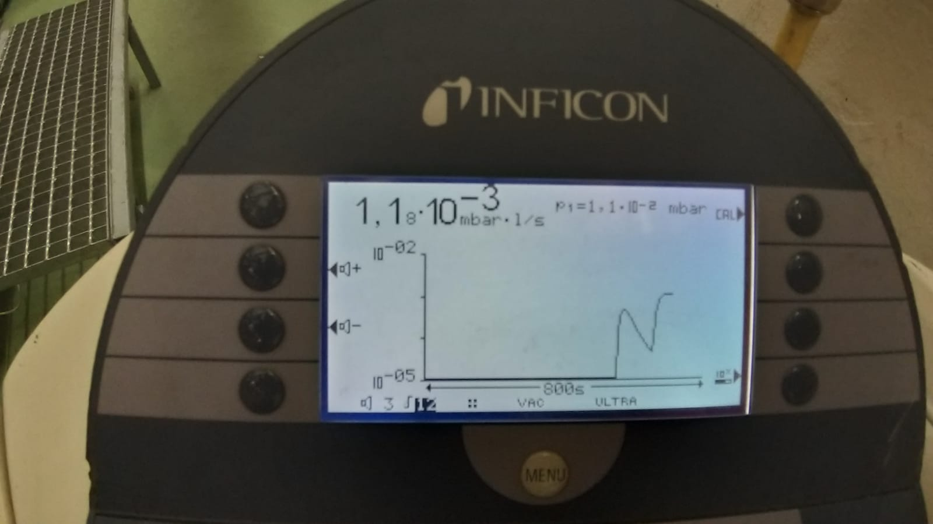
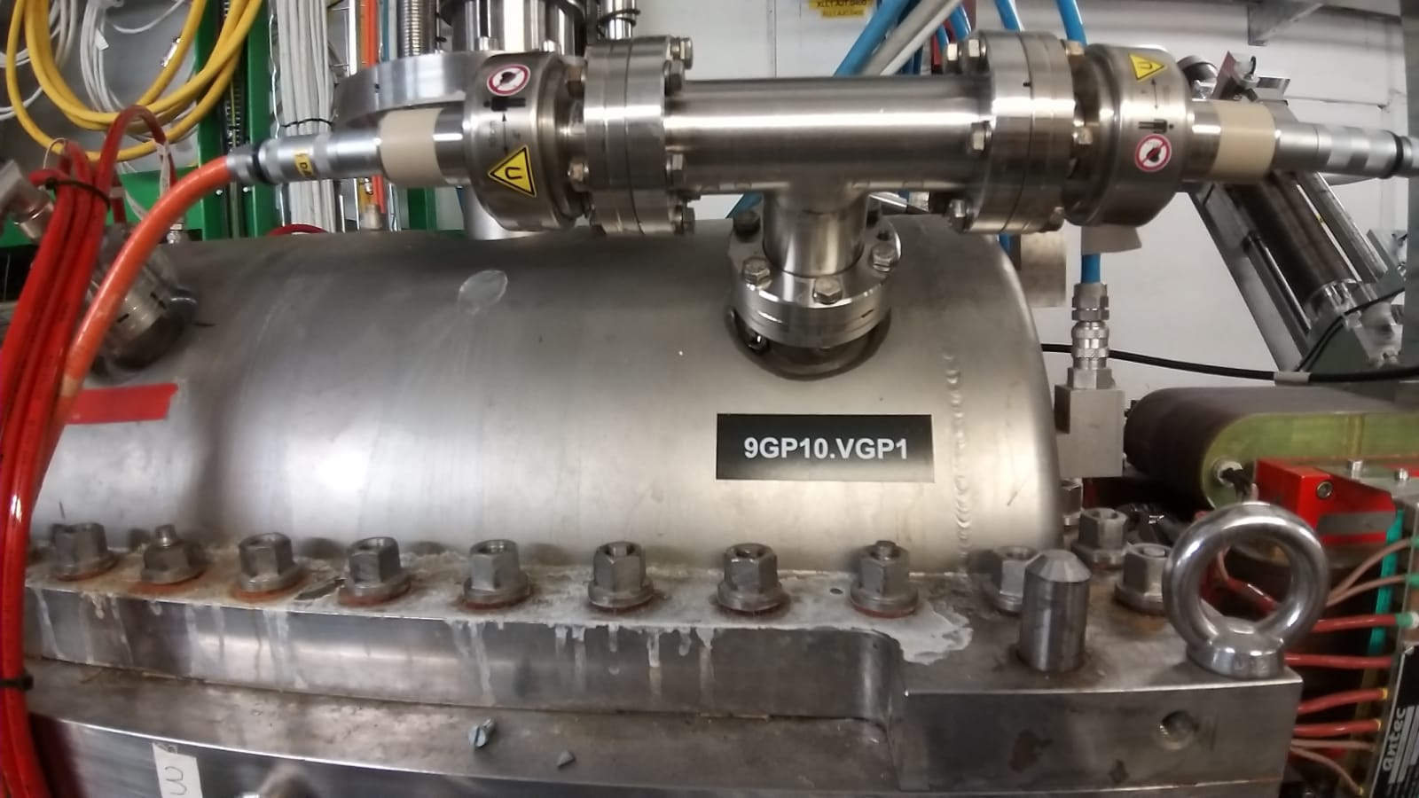
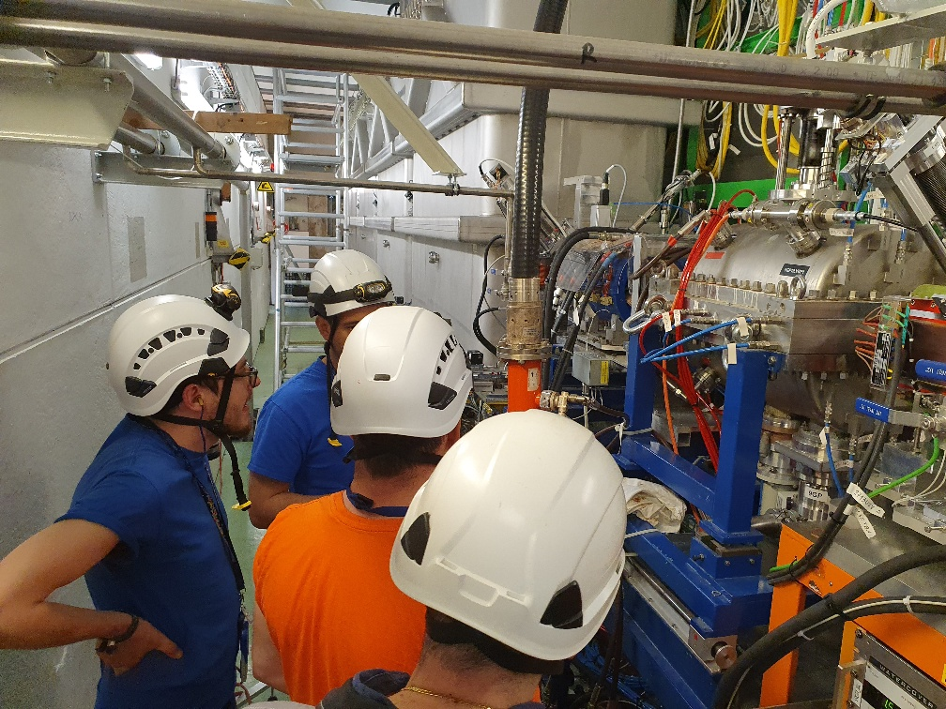
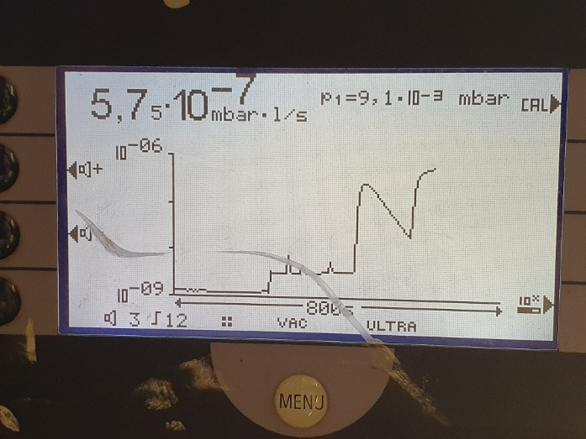
Vacuum issues REX 9-gap
Yesterday
Today
Leak now seems to be solved. But such inteventions eat into commissioning time…

Slide 10
Experimental shifts on the books
Beam requests received 2023
Row Labels | Sum of Requested shifts
1.7GeV | 12
Biophysics | 2.5
COLLAPS | 30
Collection | 45
Collection: PSI | 30
CRIS | 52.5
ECSLI | 14
Gandalph | 8
HIE | 375
IDS | 50
IDS | 15
IDS/TISD | 3
ISOLTRAP | 17
LA1 | 23
Medical | 5
MIRACLS | 17
Nuclear clock | 30
Online PAC | 5
SSP | 59
TAS | 41
TISD | 63
TISD/IDS | 12
VITO | 35
Wisard | 24
(blank)
Grand Total | 968

Slide 11
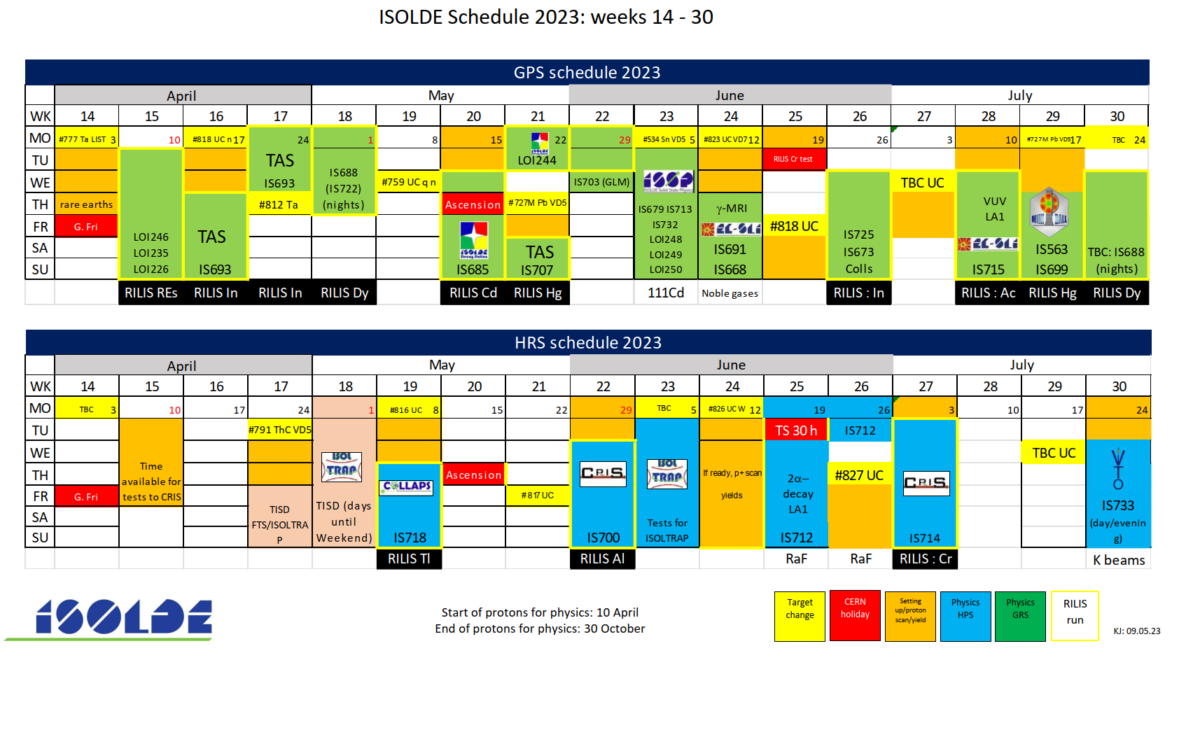
Mostly successful runs.
Numerous developmental runs at the beginning of the year
Non-standard e.g. LIST, q-line targets on GPS.
Best performing cooled q-line yet seen. Almost full suppression of contaminants for ~7 days.
Preliminary counting ~110 shifts delivered so far.

Slide 12
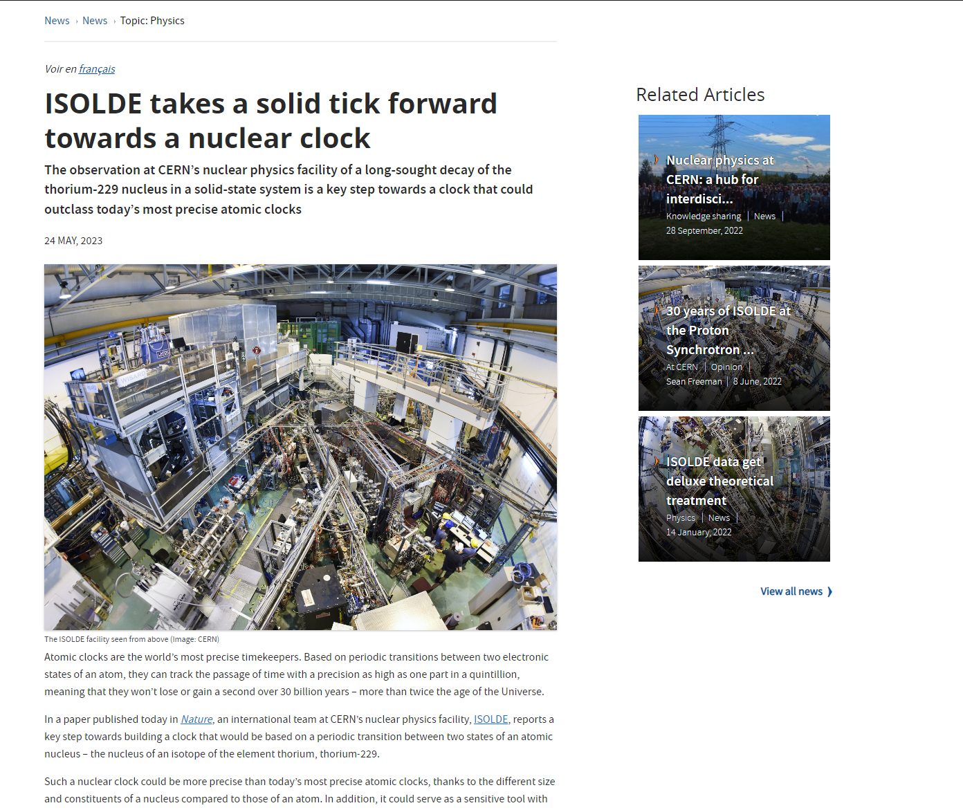
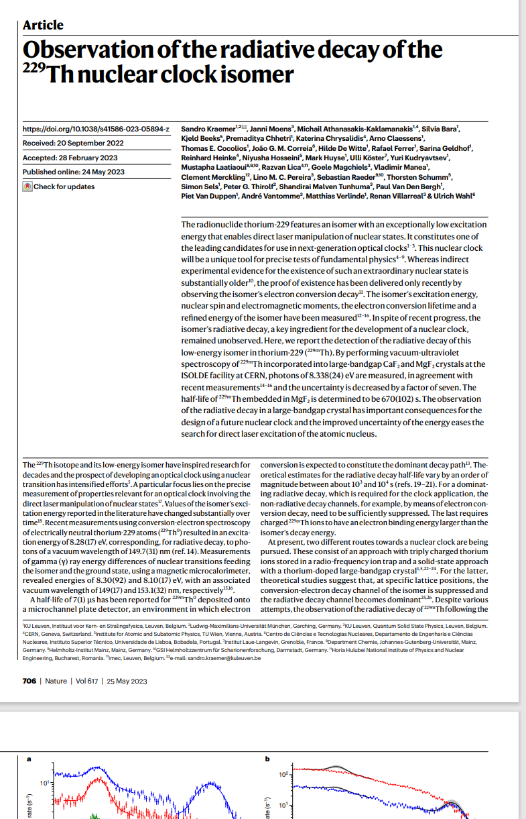

Slide 13
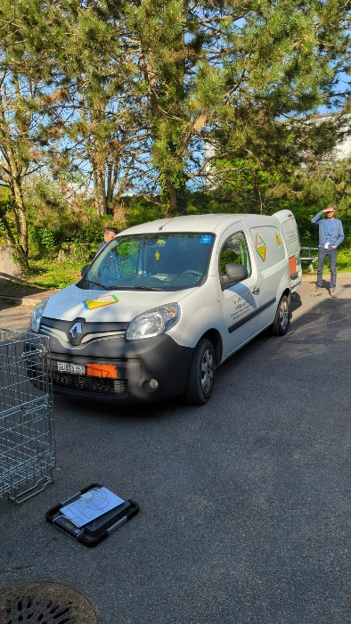
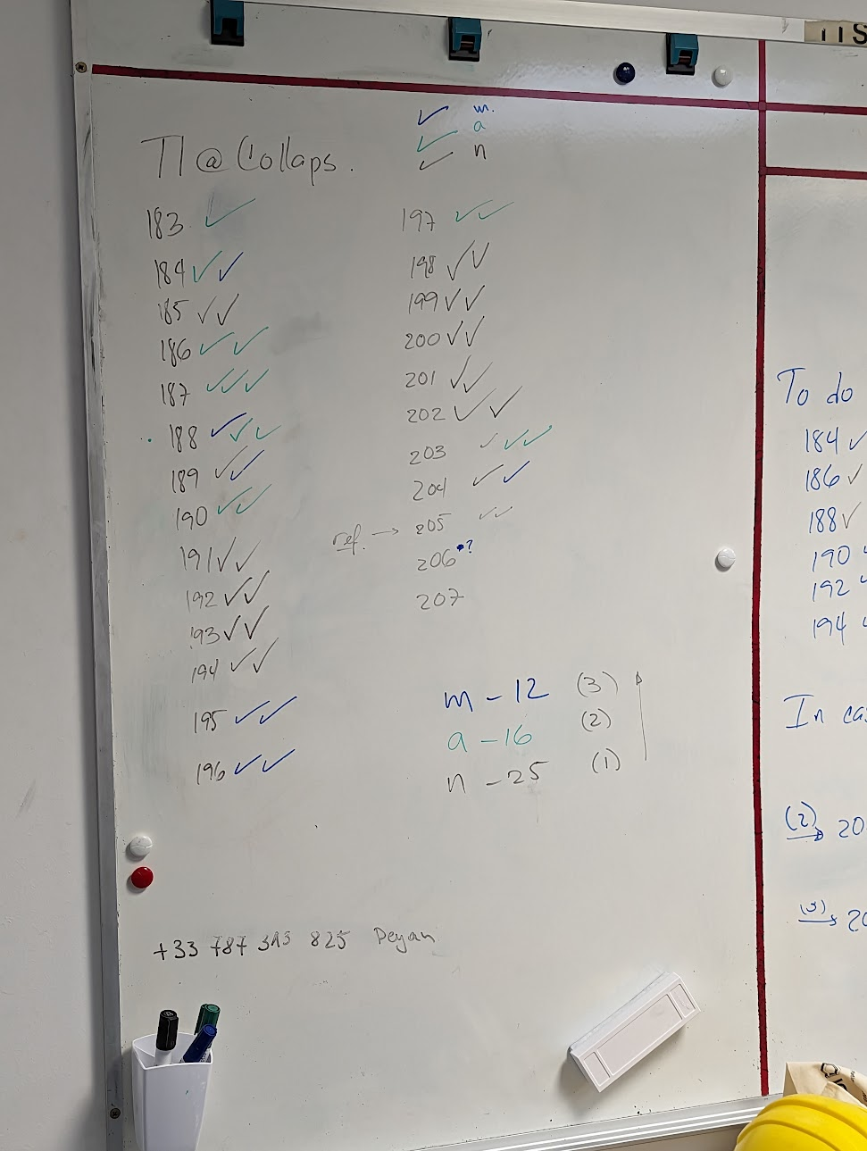
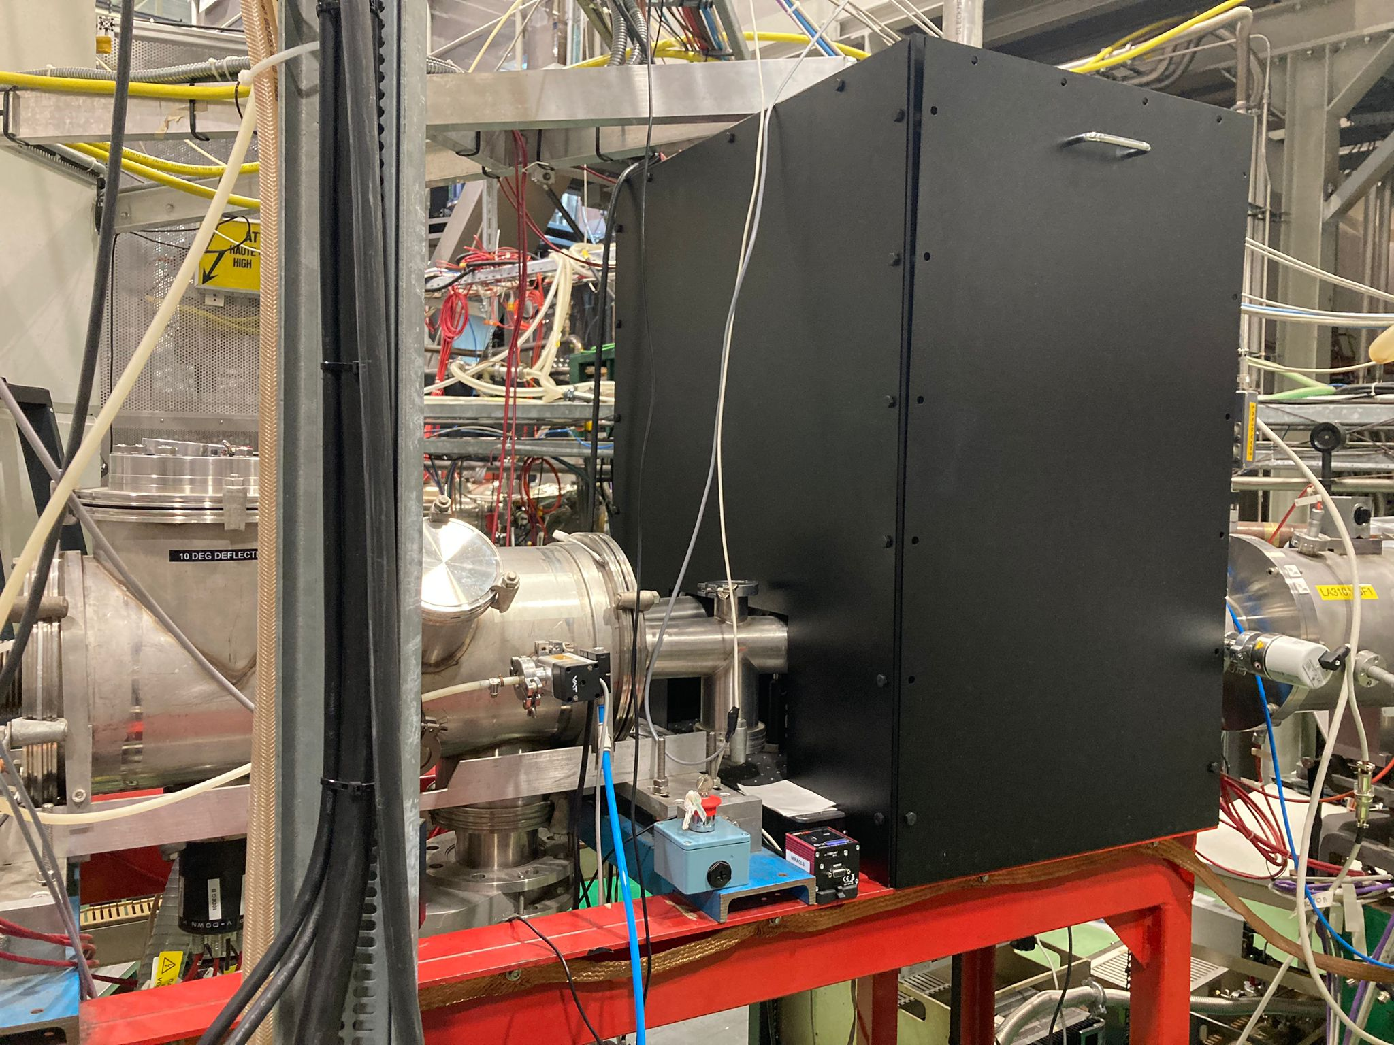
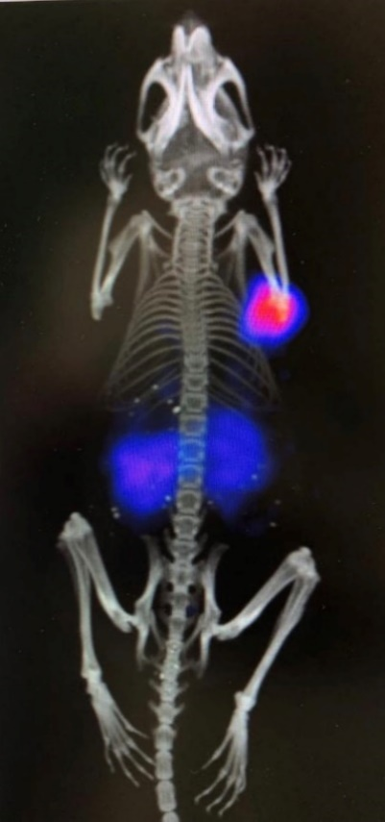
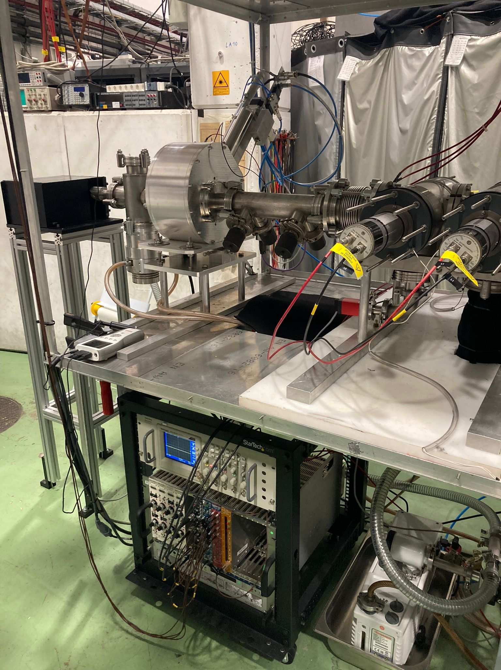
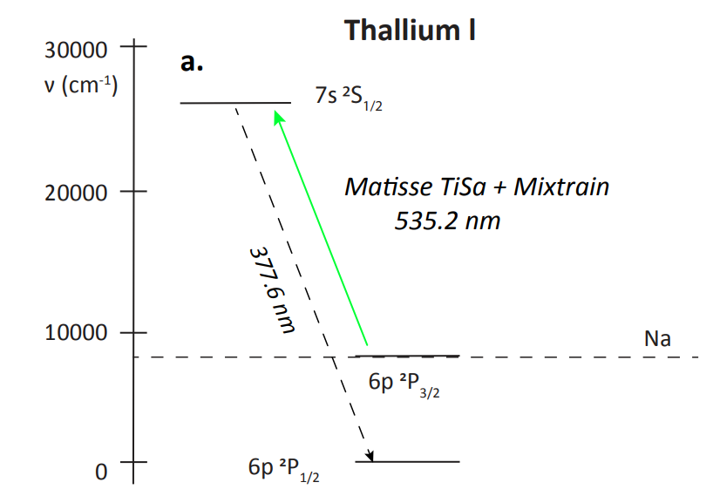
IS718: COLLAPS
IS688: Targeted alpha therapy
Record-breaking production of 149Tb.
New Ta target (perhaps partly due to improved line heating) produced most 149Tb yet seen at ISOLDE.
An average of ~250 MBq per collection was obtained after transport and chemical separation (approximately two half-lives), more than double the previous best.
50 MBq/nmol DOTA, anoher record-breaking result. The activity was used to study therapeutic efficacy.
An example of in vitro tumour uptake 2 h p.i. can be observed in the image.
New laser enclosure and completely new laser beam path
Two transitions to be used, and no “easy cases”
New wire scanner and FC at the end of the beamline

Slide 14
Week 31 | Monday | 31-Jul-23 | UC for Ca
 | Tuesday | 01-Aug-23
 | Wednesday | 02-Aug-23 | IS727 50Ca to ISS |  | Ca
 | Thursday | 03-Aug-23 | IS727 50Ca to ISS |  | Ca
 | Friday | 04-Aug-23 | IS727 50Ca to ISS |  | Ca
 | Saturday | 05-Aug-23 | IS727 50Ca to ISS |  | Ca
 | Sunday | 06-Aug-23 | IS727 50Ca to ISS |  | Ca
Week 32 | Monday | 07-Aug-23 |  |  | Ca
 | Tuesday | 08-Aug-23 |  |  | Ca
 | Wednesday | 09-Aug-23 | IS724 49Ca to ISS |  | Ca
 | Thursday | 10-Aug-23 | IS724 49Ca to ISS |  | Ca
 | Friday | 11-Aug-23 | IS724 49Ca to ISS |  | Ca
 | Saturday | 12-Aug-23 | IS724 49Ca to ISS |  | Ca
 | Sunday | 13-Aug-23 | IS724 49Ca to ISS |  | Ca
Week 33 | Monday | 14-Aug-23 |  | Prep
 | Tuesday | 15-Aug-23 |  | Prep
 | Wednesday | 16-Aug-23 | UC (new??) | LOI245 | Tm
 | Thursday | 17-Aug-23 |  | LOI245 | Tm
 | Friday | 18-Aug-23 | MIRACLS | TISD | Mg
 | Saturday | 19-Aug-23 | MIRACLS |  | Mg
 | Sunday | 20-Aug-23 | MIRACLS |  | Mg
Week 34 | Monday | 21-Aug-23 |  | UC q n
 | Tuesday | 22-Aug-23
 | Wednesday | 23-Aug-23 | UC q n | IS682 | Zn
 | Thursday | 24-Aug-23 | setting | IS682 | Zn
 | Friday | 25-Aug-23 |  | IS682 | Zn
 | Saturday | 26-Aug-23 |  | IS682 | Zn
 | Sunday | 27-Aug-23 |  | IS682 | Zn
Week 35 | Monday | 28-Aug-23 | setting | IS682 | Zn
 | Tuesday | 29-Aug-23 | setting |  | Zn
 | Wednesday | 30-Aug-23 | IS557 |  | Zn
 | Thursday | 31-Aug-23 | IS557 |  | Zn
 | Friday | 01-Sep-23 | IS557 |  | Zn
 | Saturday | 02-Sep-23 | IS557 |  | Zn
 | Sunday | 03-Sep-23 |  |  | Zn
Week 36 | Monday | 04-Sep-23 |  |  | Zn
 | Tuesday | 05-Sep-23 | Is646 |  | Zn
 | Wednesday | 06-Sep-23 | Is646 |  | Zn
 | Thursday | 07-Sep-23 | Is646 |  | Zn
 | Friday | 08-Sep-23 | Is646 | 7, 65, 195, 3, 8, 8, 195, 5 | Zn
 | Saturday | 09-Sep-23 | Is646 |  | Zn
 | Sunday | 10-Sep-23 | Is646 |  | Zn
Week 37 | Monday | 11-Sep-23 | Is646 | UC used for Cs | Zn
 | Tuesday | 12-Sep-23 | UC used
 | Wednesday | 13-Sep-23 | setting | setting
 | Thursday | 14-Sep-23 | Mossbauer | setting | Mn
 | Friday | 15-Sep-23 | 5, 65, 202, 3, 6, 8, 202, 5 Mossbauer | yield and | Mn
 | Saturday | 16-Sep-23 | Mossbauer | transmission | Mn
 | Sunday | 17-Sep-23 | Mossbauer |  | Mn
Week 38 | Monday | 18-Sep-23 |  | final checks | Mn
 | Tuesday | 19-Sep-23 | TBC | IS656
 | Wednesday | 20-Sep-23 |  | IS656 | Cs to HIE
 | Thursday | 21-Sep-23 |  | IS656
 | Friday | 22-Sep-23 |  | IS656
 | Saturday | 23-Sep-23 |  | IS656
 | Sunday | 24-Sep-23
Week 31 | Monday | 31-Jul-23 | UC for Ca
 | Tuesday | 01-Aug-23
 | Wednesday | 02-Aug-23 | IS727 50Ca to ISS |  | Ca
 | Thursday | 03-Aug-23 | IS727 50Ca to ISS |  | Ca
 | Friday | 04-Aug-23 | IS727 50Ca to ISS |  | Ca
 | Saturday | 05-Aug-23 | IS727 50Ca to ISS |  | Ca
 | Sunday | 06-Aug-23 | IS727 50Ca to ISS |  | Ca
Week 32 | Monday | 07-Aug-23 |  |  | Ca
 | Tuesday | 08-Aug-23 |  |  | Ca
 | Wednesday | 09-Aug-23 | IS724 49Ca to ISS |  | Ca
 | Thursday | 10-Aug-23 | IS724 49Ca to ISS |  | Ca
 | Friday | 11-Aug-23 | IS724 49Ca to ISS |  | Ca
 | Saturday | 12-Aug-23 | IS724 49Ca to ISS |  | Ca
 | Sunday | 13-Aug-23 | IS724 49Ca to ISS |  | Ca
Week 33 | Monday | 14-Aug-23 |  | Prep
 | Tuesday | 15-Aug-23 |  | Prep
 | Wednesday | 16-Aug-23 | UC (new??) | LOI245 | Tm
 | Thursday | 17-Aug-23 |  | LOI245 | Tm
 | Friday | 18-Aug-23 | MIRACLS | TISD | Mg
 | Saturday | 19-Aug-23 | MIRACLS |  | Mg
 | Sunday | 20-Aug-23 | MIRACLS |  | Mg
Week 34 | Monday | 21-Aug-23 |  | UC q n
 | Tuesday | 22-Aug-23
 | Wednesday | 23-Aug-23 | UC q n | IS682 | Zn
 | Thursday | 24-Aug-23 | setting | IS682 | Zn
 | Friday | 25-Aug-23 |  | IS682 | Zn
 | Saturday | 26-Aug-23 |  | IS682 | Zn
 | Sunday | 27-Aug-23 |  | IS682 | Zn
Week 35 | Monday | 28-Aug-23 | setting | IS682 | Zn
 | Tuesday | 29-Aug-23 | setting |  | Zn
 | Wednesday | 30-Aug-23 | IS557 |  | Zn
 | Thursday | 31-Aug-23 | IS557 |  | Zn
 | Friday | 01-Sep-23 | IS557 |  | Zn
 | Saturday | 02-Sep-23 | IS557 |  | Zn
 | Sunday | 03-Sep-23 |  |  | Zn
Week 36 | Monday | 04-Sep-23 |  |  | Zn
 | Tuesday | 05-Sep-23 | Is646 |  | Zn
 | Wednesday | 06-Sep-23 | Is646 |  | Zn
 | Thursday | 07-Sep-23 | Is646 |  | Zn
 | Friday | 08-Sep-23 | Is646 | 7, 65, 195, 3, 8, 8, 195, 5 | Zn
 | Saturday | 09-Sep-23 | Is646 |  | Zn
 | Sunday | 10-Sep-23 | Is646 |  | Zn
Week 37 | Monday | 11-Sep-23 | Is646 | UC used for Cs | Zn
 | Tuesday | 12-Sep-23 | UC used
 | Wednesday | 13-Sep-23 | setting | setting
 | Thursday | 14-Sep-23 | Mossbauer | setting | Mn
 | Friday | 15-Sep-23 | 5, 65, 202, 3, 6, 8, 202, 5 Mossbauer | yield and | Mn
 | Saturday | 16-Sep-23 | Mossbauer | transmission | Mn
 | Sunday | 17-Sep-23 | Mossbauer |  | Mn
Week 38 | Monday | 18-Sep-23 |  | final checks | Mn
 | Tuesday | 19-Sep-23 | TBC | IS656
 | Wednesday | 20-Sep-23 |  | IS656 | Cs to HIE
 | Thursday | 21-Sep-23 |  | IS656
 | Friday | 22-Sep-23 |  | IS656
 | Saturday | 23-Sep-23 |  | IS656
 | Sunday | 24-Sep-23
Draft schedule until almost end of September
(there could still be changes!!)
Priority to HIE ISOLDE physics, but aim to cater for low energy needs as well

Slide 15
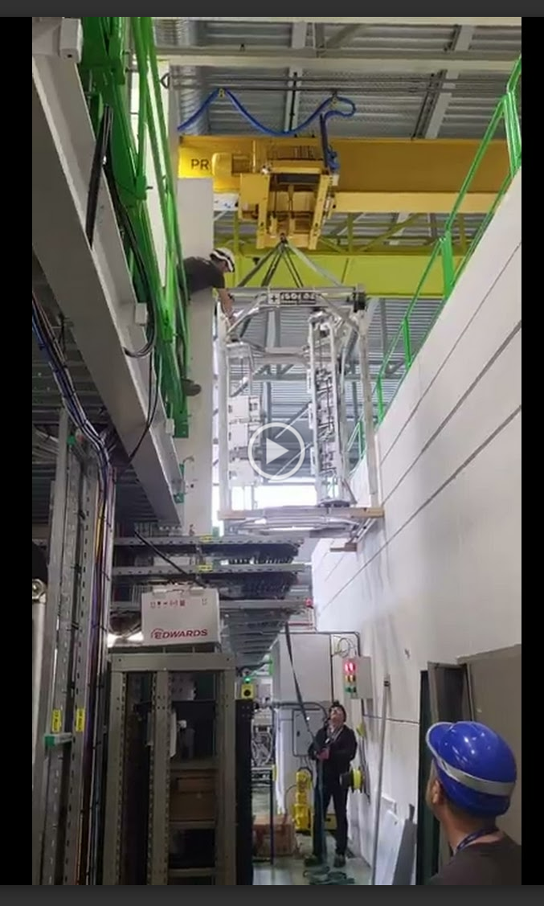
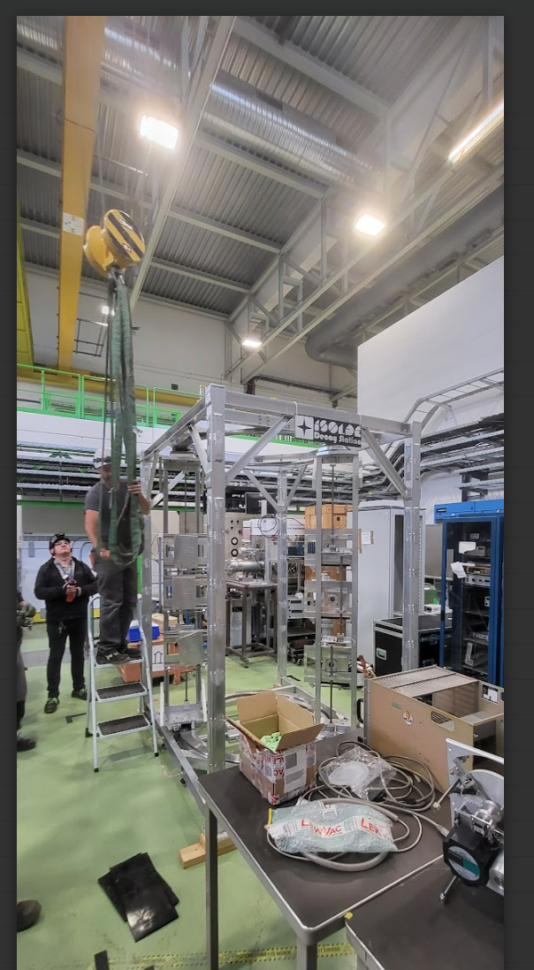
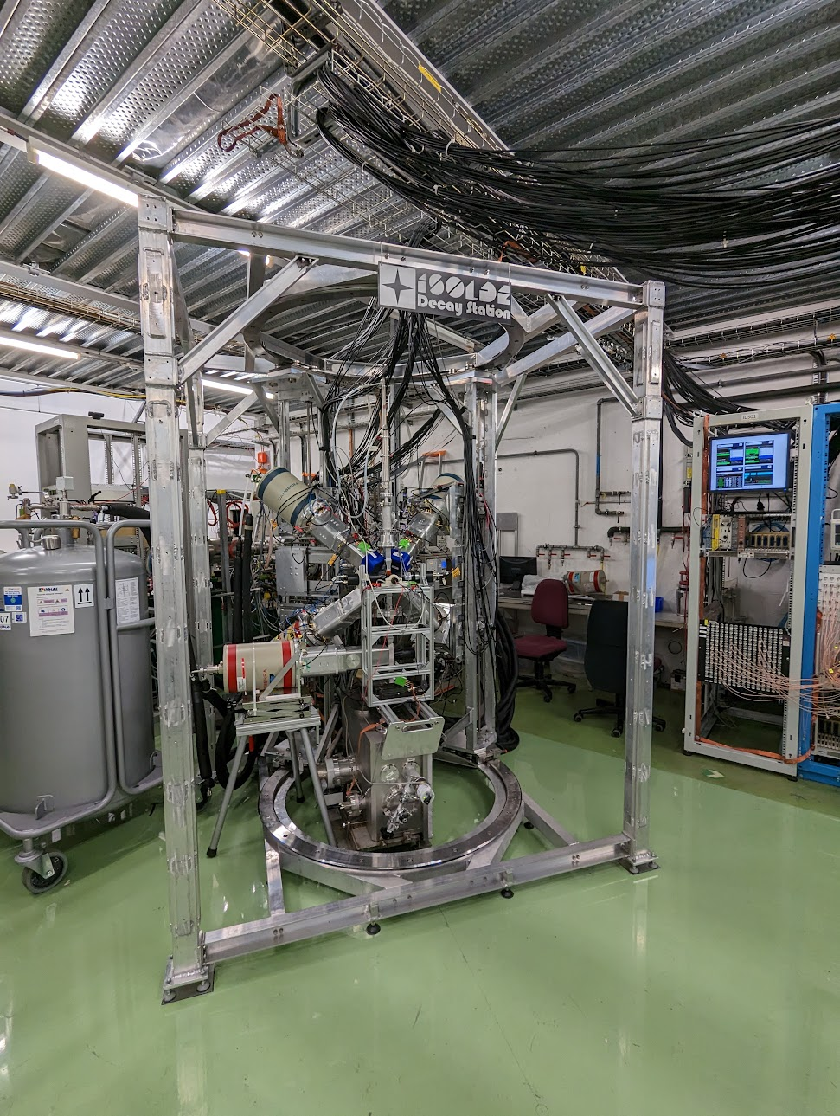
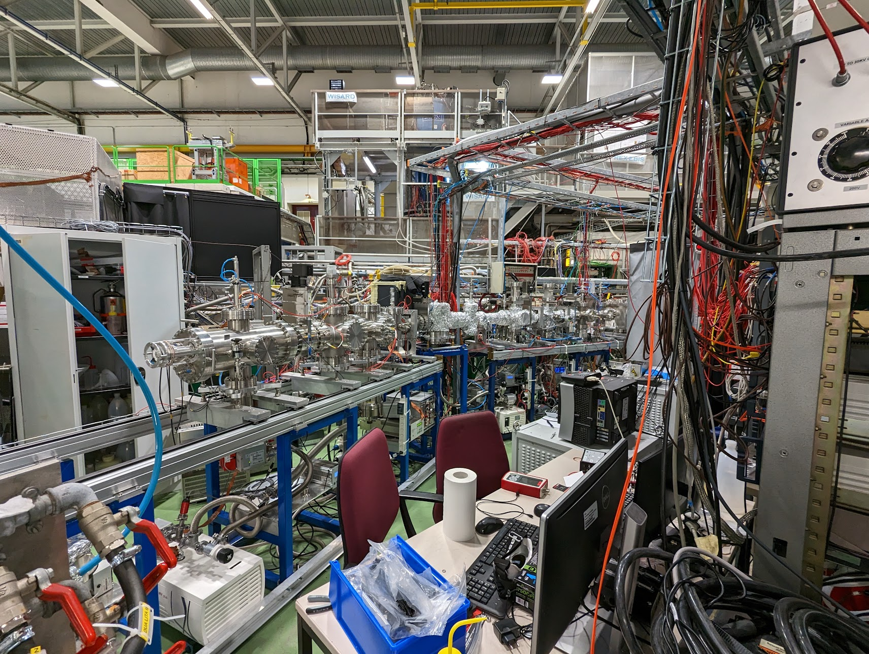
Starting tomorrow: CRIS upgraded beamline

Slide 16
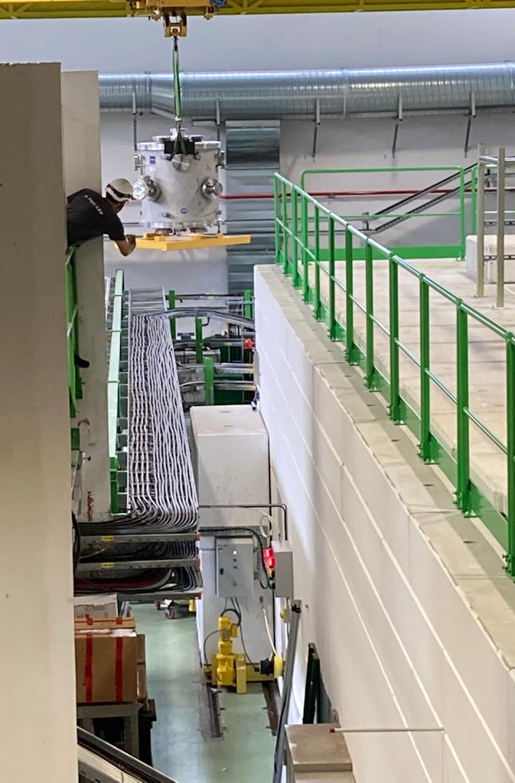
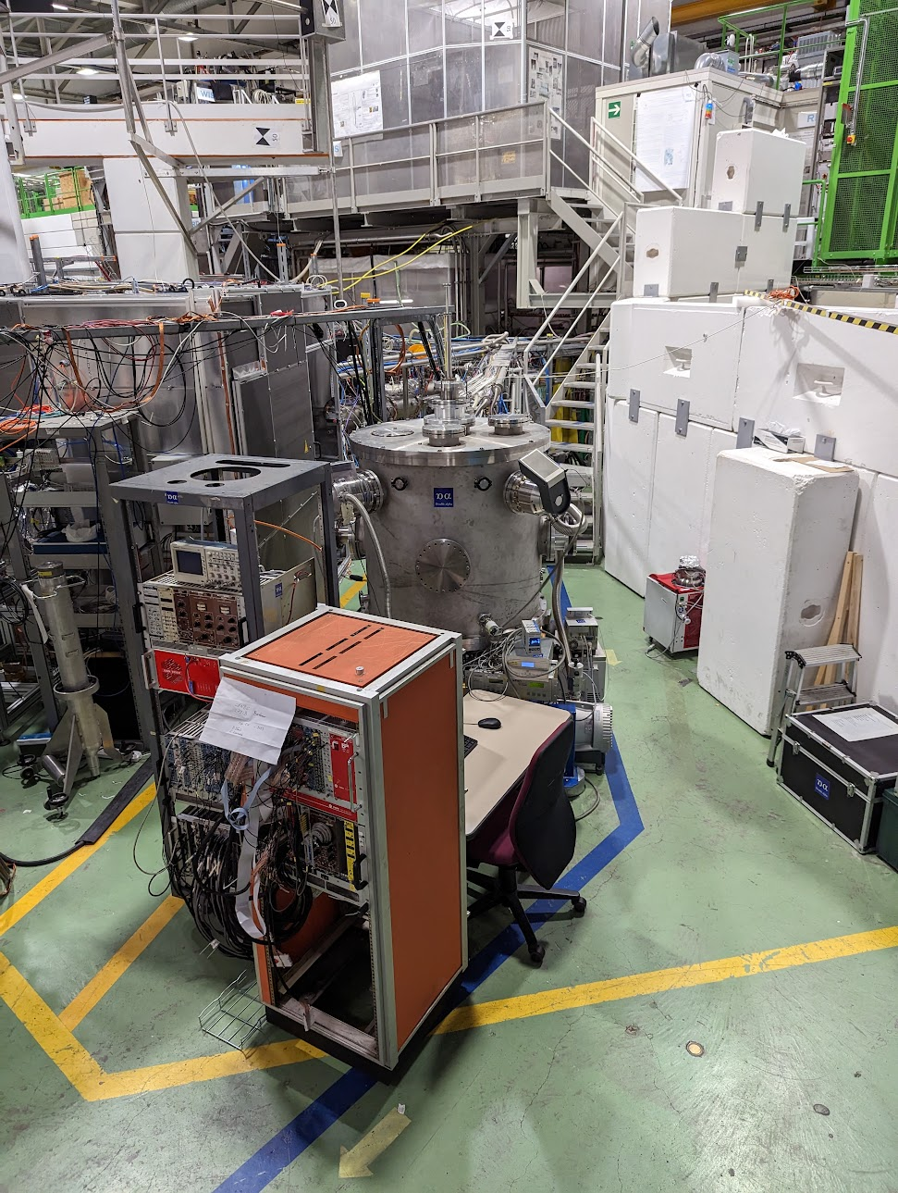
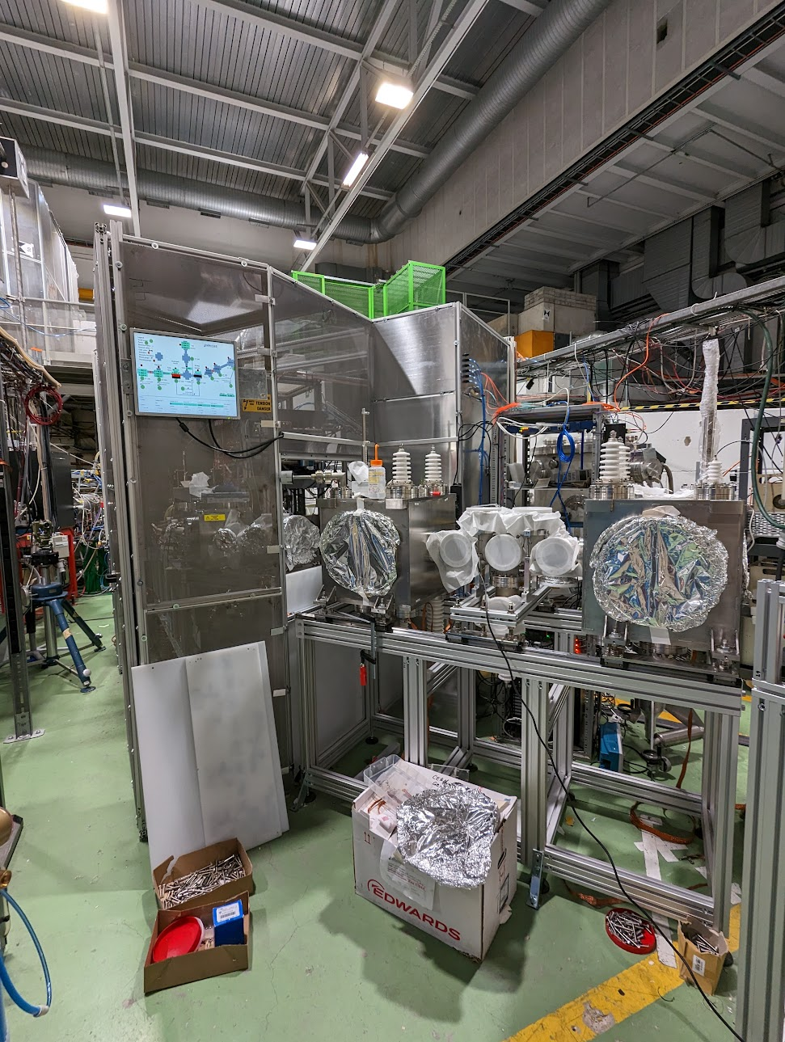
Week 25: 2-α decay…
TBC Week 33: Miracls

Slide 17
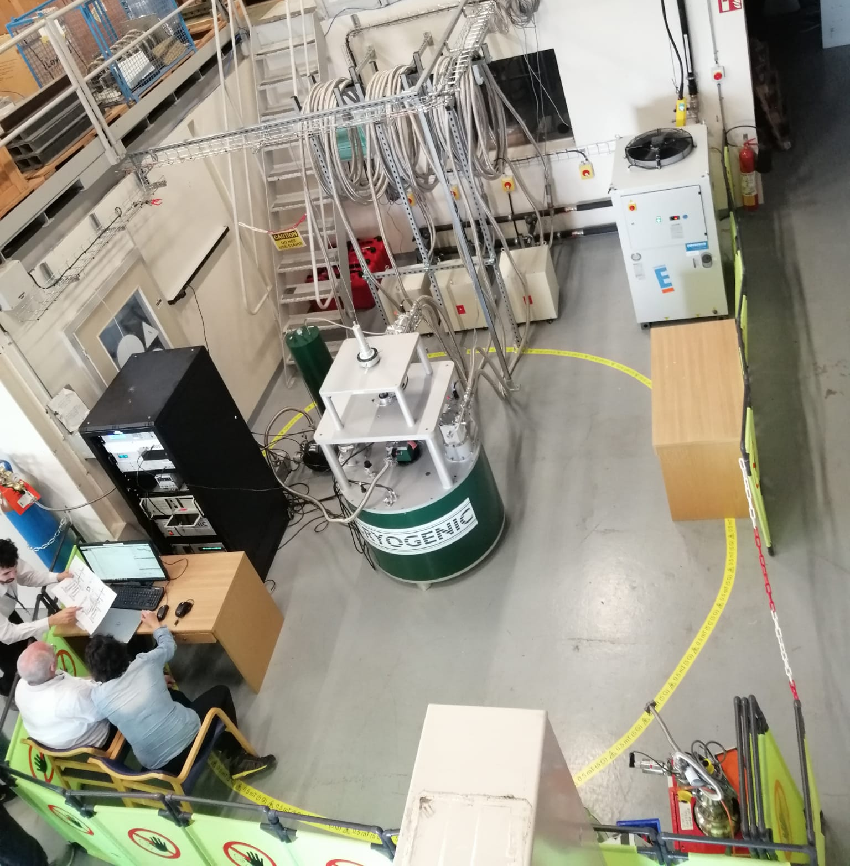
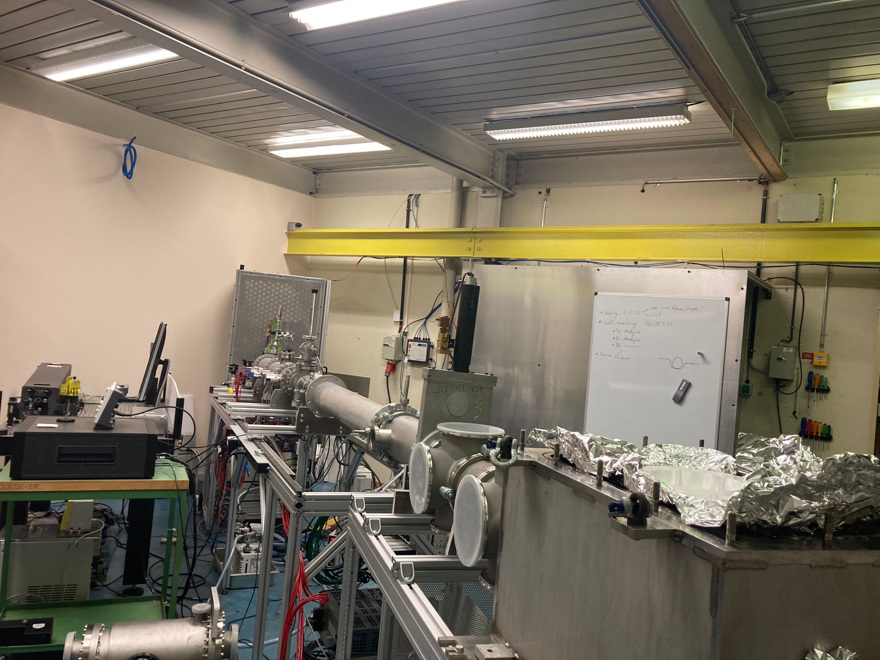
Multipac: commissioning in B275
IS529: ROC setup in B 275

Slide 18
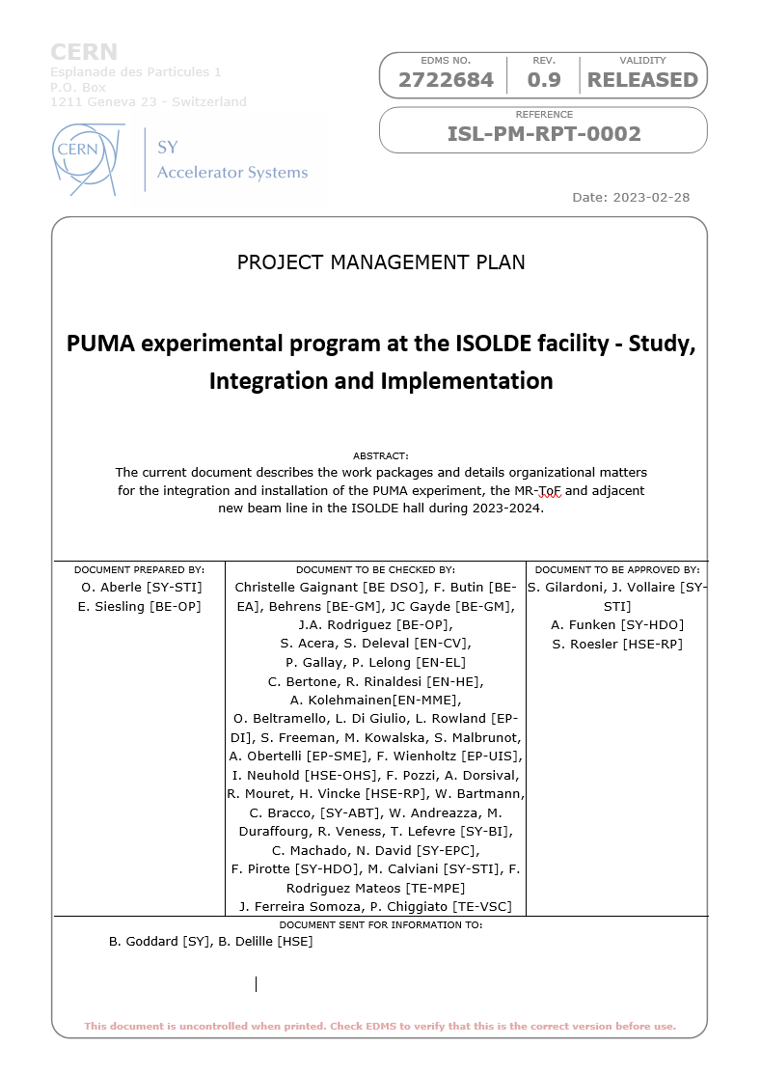
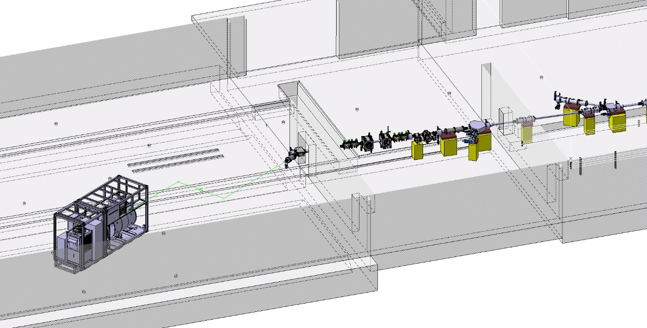

PUMA @ ISOLDE
My 23rd and final INTC meeting as INTC secretary.
Many thanks to the various chairs and committee members over the years and to Patricia and CSC team.

