Slide 1
Approved Experiment INTC-P-344:
Study of the di-nuclear system ^{A}Rb + ²⁰⁹Bi (Z₁ + Z₂ = 120)
Addendum to INTC-P-344:
Change of reaction system to ^{A}Ni + ²³⁸U (Z = 120)
SPOKESPERSONS:
Sophia Heinz
GSI Helmholtz Center, JLU Gießen, Philipps Universität Marburg, Germany
Emanuele Vardaci
INFN Naples, Italy

Slide 2
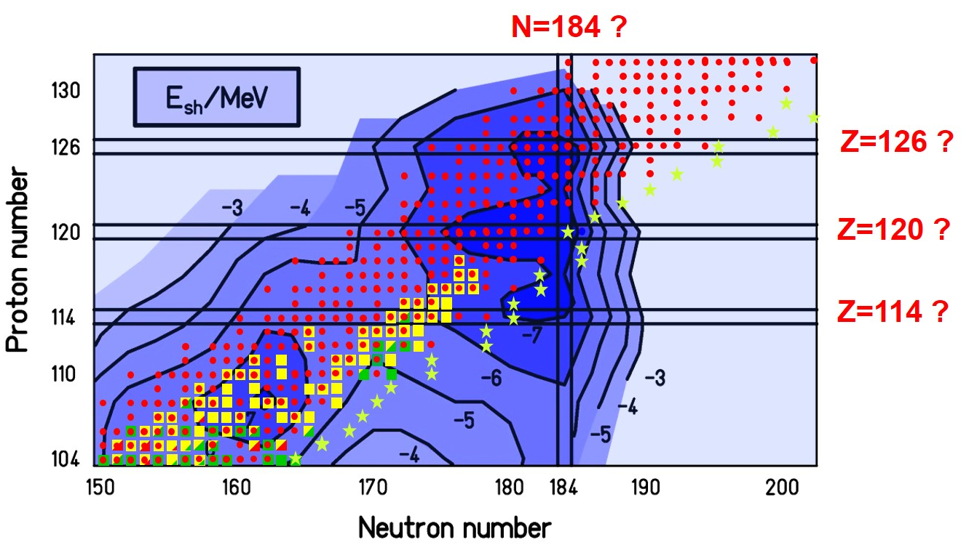
Magic numbers in superheavy nuclei ?
● fusion with stable projectiles
fusion with RIBs
Problem:
Nuclear systems with N = 184 could only be reached in fusion reactions with n-rich RIBs
but: RIB intensities are too small to observe fusion-evaporation residues (expected σ < 1 pb)
Approach:
Study of quasi-fission and fusion-fission reactions with n-rich RIBs

Slide 3
The fusion process in heavy systems
capture
FUSION
Compound
Nucleus (CN)
QUASI-FISSION
FUSION-FISSION
Fission
Fragments
Evaporation
Residue (ER)
Superheavy systems: σ_{ER} << σ_{capture}
→ σ_{capture} ≈ σ_{QF} + σ_{FF} ≈ 100 mb

Slide 4
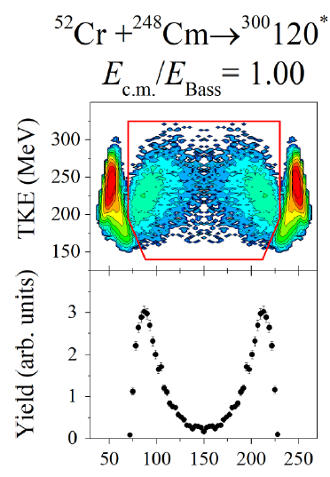
How to study shell effects in QF and FF reactions?
Experimental approach:
▪ Study of mass and energy distributions of QF and FF products
as a function of beam energy and projectile neutron number
▪ Shell effects are expected to be most
pronounced for symmetric fragment mass
distributions; those result from …
→ fusion-fission
→ quasi-fission of long-living nuclear systems
→ small excitaton energies
Fragment mass

Slide 5
Status of the Experiment
Re-evaluated and approved in 2018 : ^{A}Rb + ²⁰⁹Bi (Z = 120)
Remaining shifts: 12 / 12
Requested change to: ^{A}Ni + ²³⁸U (Z = 120)
Advantages of Ni + U:
smaller entrance channel Coulomb barrier (~20%)
→ larger σ_{CN} → larger σ_{FF}
beam intensity of ⁶⁶Ni is larger than ⁹⁵Rb:
⁶⁶Ni : 10⁸ (Yield / μC)
⁹⁵Rb : 10⁷ (Yield / μC)

Slide 6
Experimental Setup
original setup: ToF – E spectrometer CORSET (JINR Dubna)
new setup: ToF spectrometer TOSCA (INFN Naples, E. Vardaci et al.)
Time resolution | 60 ps
ToF base | 10-30 cm
ToF arm rotation range | 15°-165°
Solid angle | 100 -200 msr
Angular resolution | 0.3°
Mass resolution | (1 – 2) u
Energy resolution | 1%

Slide 7
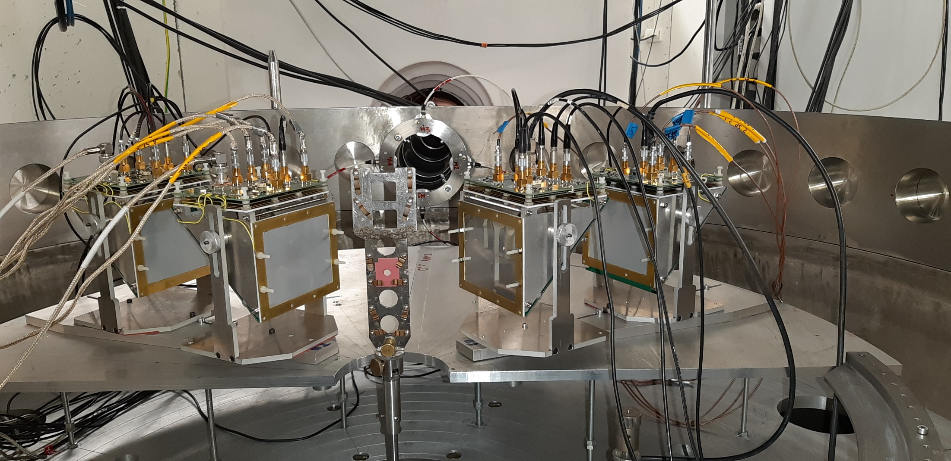
TOSCA at JYFL
February - March 2023

Slide 8
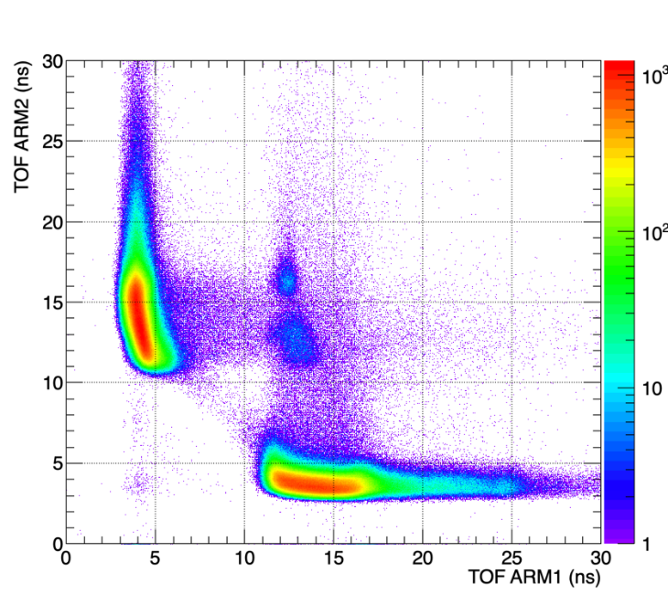
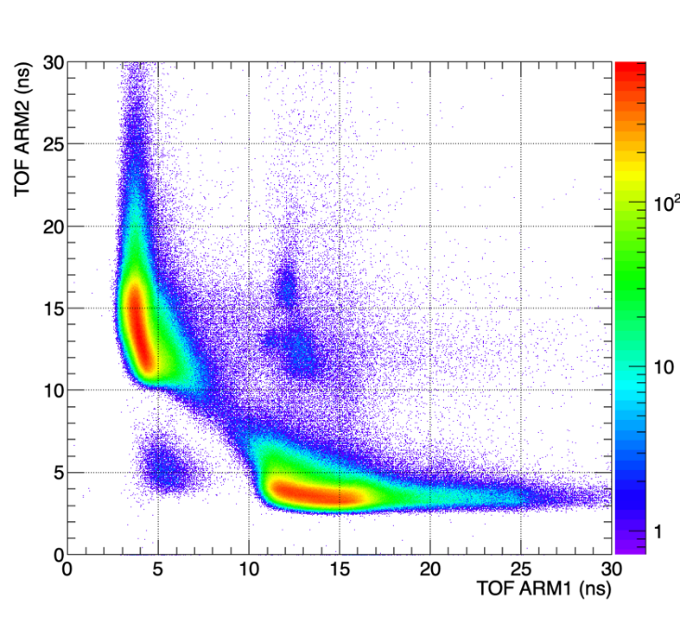
TOSCA at JYFL: ⁸⁸Sr + ²⁰⁸Pb → ²⁹⁶120*
preliminary results
E / E_{Bass} = 1.0
E / E_{Bass} = 1.08
with Ni + U we expect an enhancement of events in the framed area, given by the larger fusion probability

Slide 9
Event rate estimate
Cross section: 100mb
Beam Intensity: 10⁶ pps
Target Thickness: ~10¹⁸ atoms/cm²
exp. Efficiency ~ 0.1
#Events: 20000 /day

Slide 10
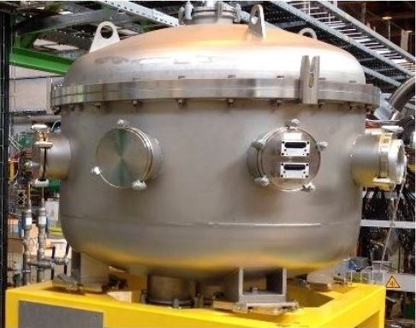
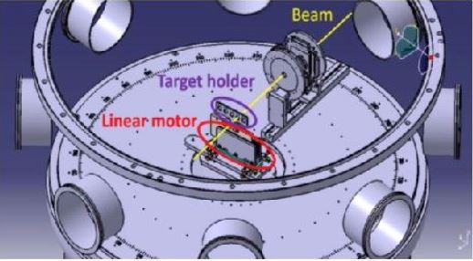
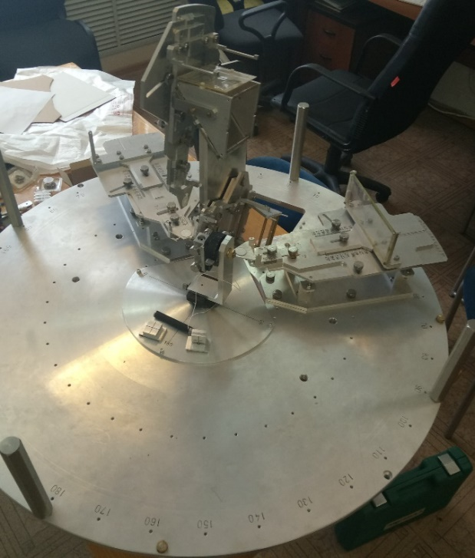
Scattering Experimental Chamber
S E C @ XT03 beamline of HIE-ISOLDE
Disc with suport
structure for the ToF
and DSSD
+ feedthrough for target stick

Slide 11
Approved Beamtime
Requested Beamtime (INTC, October 2012):
Projectile | ^{85,87}Rb (stable) | ^{A}Rb (neutron-rich)
beam energy | ~ 5 MeV/u | ~ (5 – 6) MeV/u
experiment | Tuning of the setup | Excitation functions for QF, FF
shifts | 6 | 3 x 12
Beamtime recommended by INTC: 12 shifts of n-rich Rb

