Slide 1



IS663: Rotational and Hyperfine Structure of RaF Molecules
M. Athanasakis-Kaklamanakis, M. Au, S. W. Bai, Y. Balasmeh, R. Berger,
A. A. Breier, K. Chrysalidis, T. E. Cocolios, C. M. Fajardo-Zambrano,
V. N. Fedoseev, K. T. Flanagan, S. Franchoo, R. F. Garcia Ruiz, T. F. Giesen,
D. Gonzalez-Acevedo, R. P. de Groote, D. Hanstorp, A. Koszorus, L. Lalanne,
P. Lassegues, Y. Liu, K. M. Lynch, B. A. Marsh, A. McGlone, W. C. Mei,
G. Neyens, L. Nies, F. C. Pastrana Cruz, J. R. Reilly, S. Rothe, M. R. Tarbutt,
J. Trujillo, S.-M. Udrescu, B. van den Borne, J. Warbinek, S. G. Wilkins, X. F. Yang
INTC-P-555-ADD-1
Request: 19 shifts with a pre-irradiated target
May 31, 2023 – 73rd INTC

Slide 2
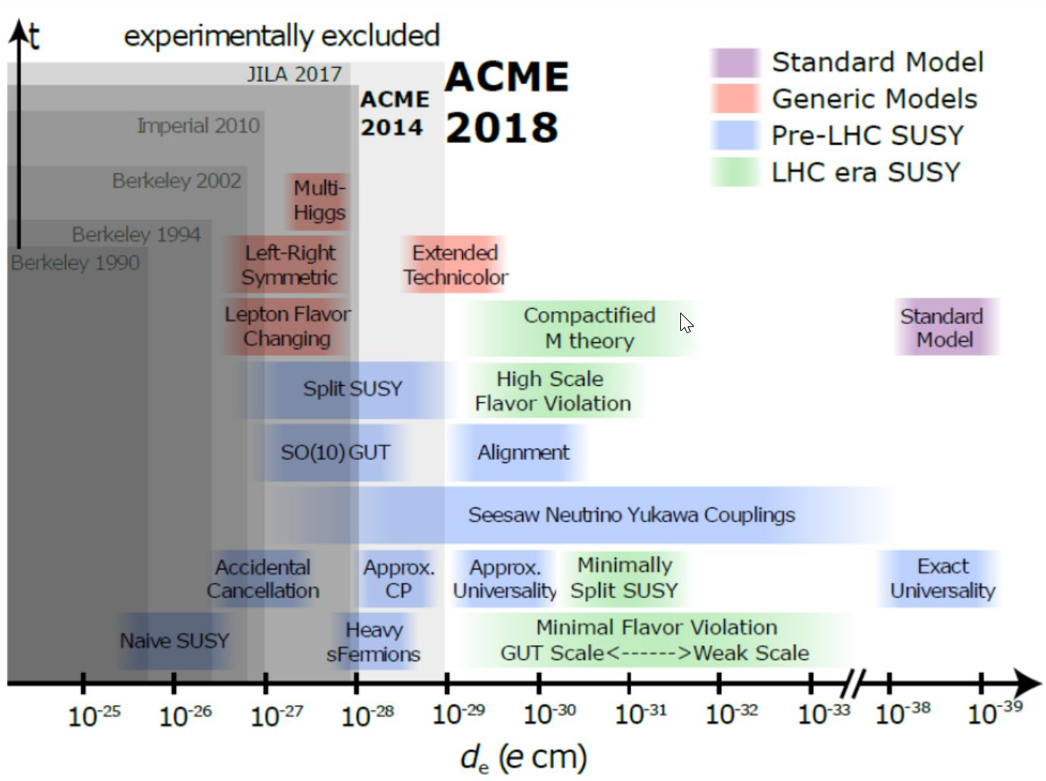
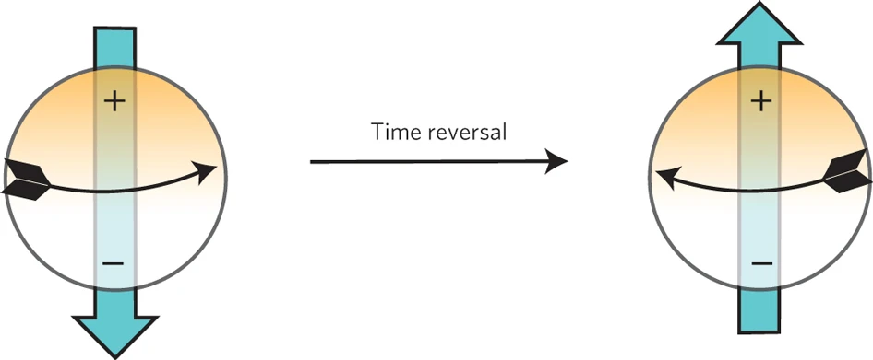
Symmetry-odd moments test the Standard Model
The Standard Model is incomplete
e.g. baryon asymmetry, strong CP problem
Use magnitudes of symmetry-violating moments
  Electric dipole moments (proton, neutron, electron)
  Nuclear Schiff, MQM moments
Benchmarks of Beyond-the-Standard-Model theories
with the electron EDM
Rushchanskii et al., Nature Materials 9, 649–654 (2010)
https://cfp.physics.northwestern.edu/gabrielse-group/acme-electron-edm.html

Slide 3
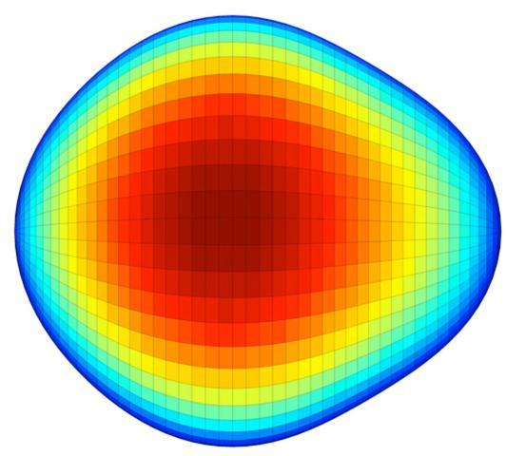


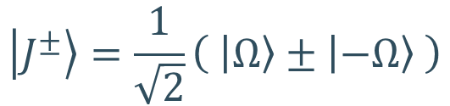
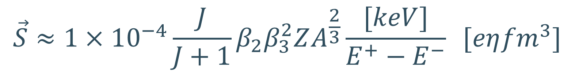

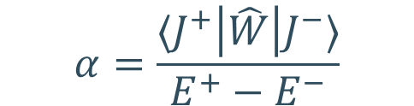
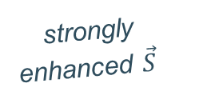
New physics is hidden in the nuclear Schiff moment
Octupole deformation
in Ra
Butler et al.,
PRL 124 (2020)
$$\vec{S}$$
Gaffney et al.,
Nature 497 (2013)
close-lying opposite-parity rotational doublet
$$\left|J^{±}\right\rangle =\frac{1}{\sqrt{2}}\left( \left|Ω\right\rangle ±\left|−Ω\right\rangle \right)$$
still unknown
P,T-odd nuclear forces
p⁺ EDM
n⁰ EDM
enhanced P,T-odd
interaction mixing
strongly
enhanced $\vec{S}$
$$α=\frac{⟨J^{+}\left|\hat{W}\right|J^{−}⟩}{E^{+}−E^{−}}$$
Flambaum & Dzuba, Phys. Rev. A 101 (2020)
$$\vec{S}≈1×{10}^{−4}\frac{J}{J+1}β_{2}β_{3}^{2}ZA^{\frac{2}{3}}\frac{[keV]}{E^{+}−E^{−}} [eη{fm}^{3}]$$
$\sim$keV
b

Slide 4
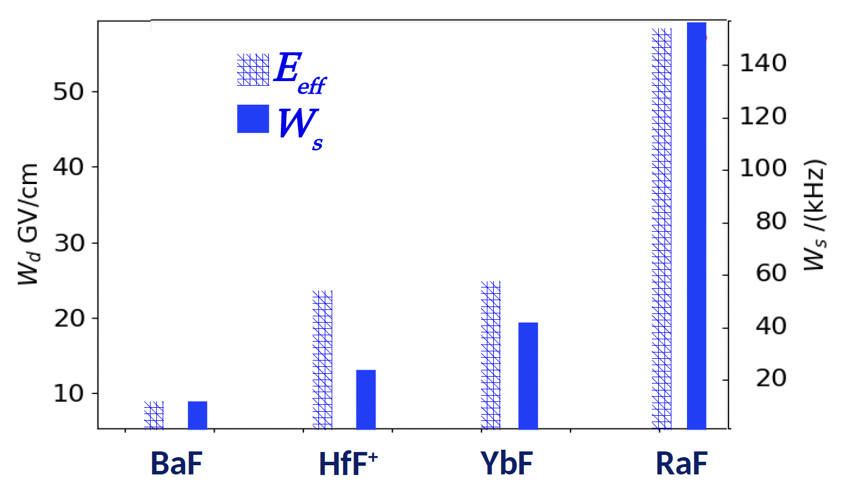
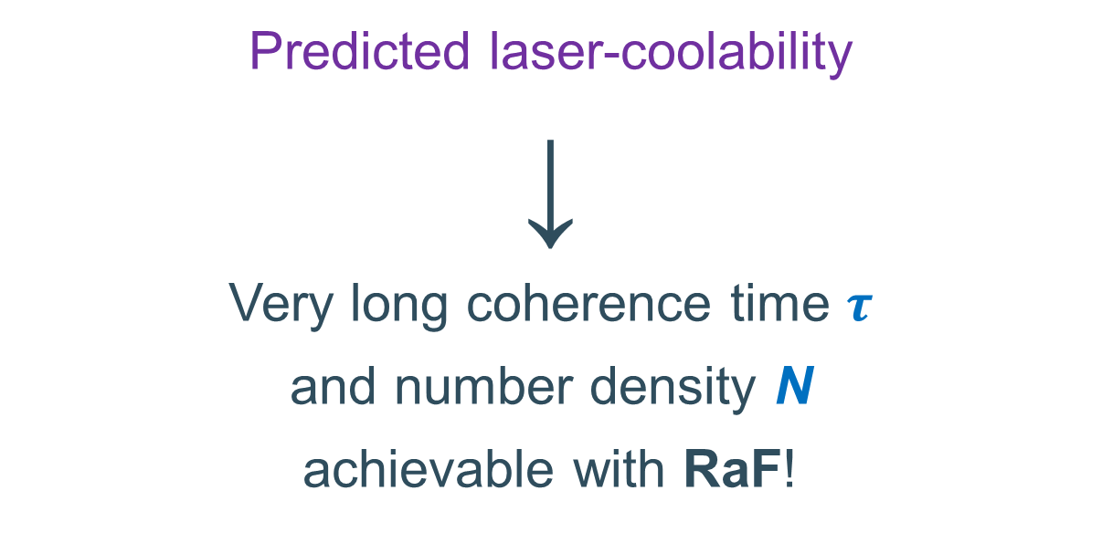

RaF is a highly promising system!
Predicted laser-coolability
↓
Very long coherence time $τ$
and number density N
achievable with RaF!
Plot courtesy of R. F. Garcia Ruiz and S. G. Wilkins (MIT)
Signatures of P,T-violating moments are
much stronger than in atoms!
Precision $∝τ E_{eff} √N$

Slide 5
Spectroscopy is necessary!
$${\hat{H}}^{RaF}={\hat{H}}_{el}+{\hat{H}}_{vib}+{\hat{H}}_{rot}+{\hat{H}}_{hfs}+…+{\hat{H}}_{P,T}$$
Experimental measurements needed to understand the structure of RaF!
Benchmark theory
Design experimental schemes

Slide 6
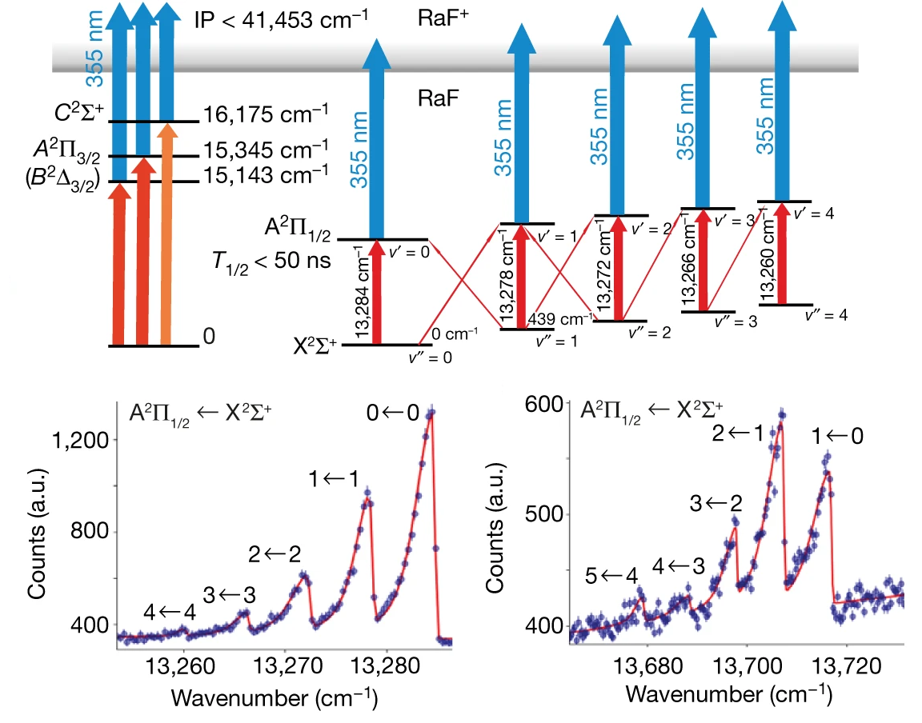
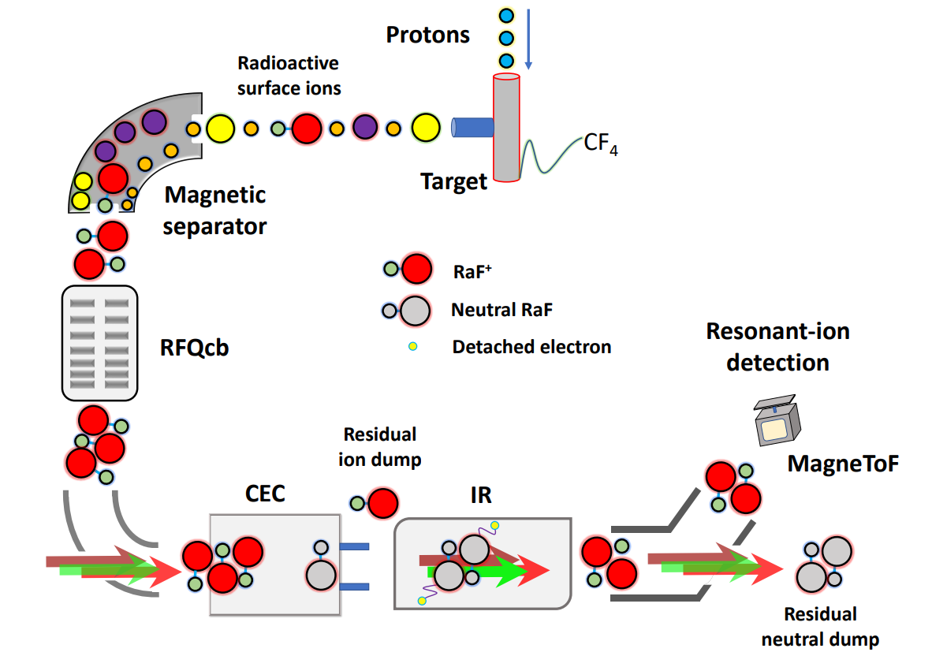
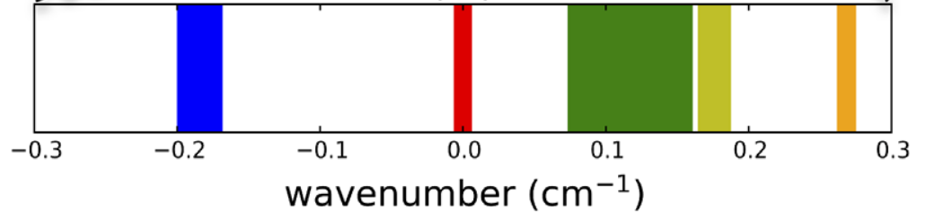
RaF at CRIS
RaF @ CRIS (2018)
Garcia Ruiz et al., Nature 581, 396-400 (2020)
²²⁶RaF
²²⁴RaF
²²⁸RaF
²²⁵RaF
²²³RaF
Udrescu et al., PRL 127(3), 033001 (2021)

Slide 7
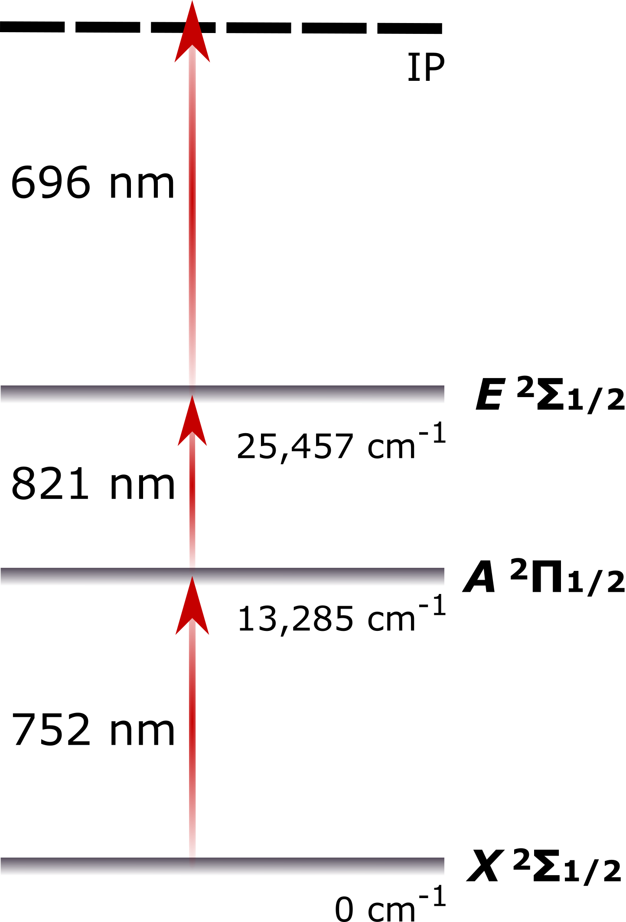
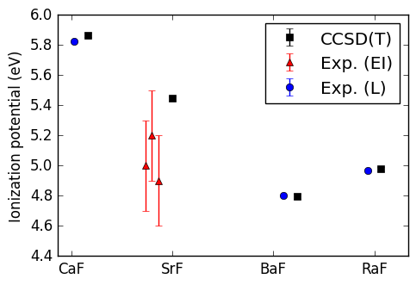
Ionization Potential
CRIS measurement
IP of RaF
S. G. Wilkins et al., In preparation (2023)

Slide 8
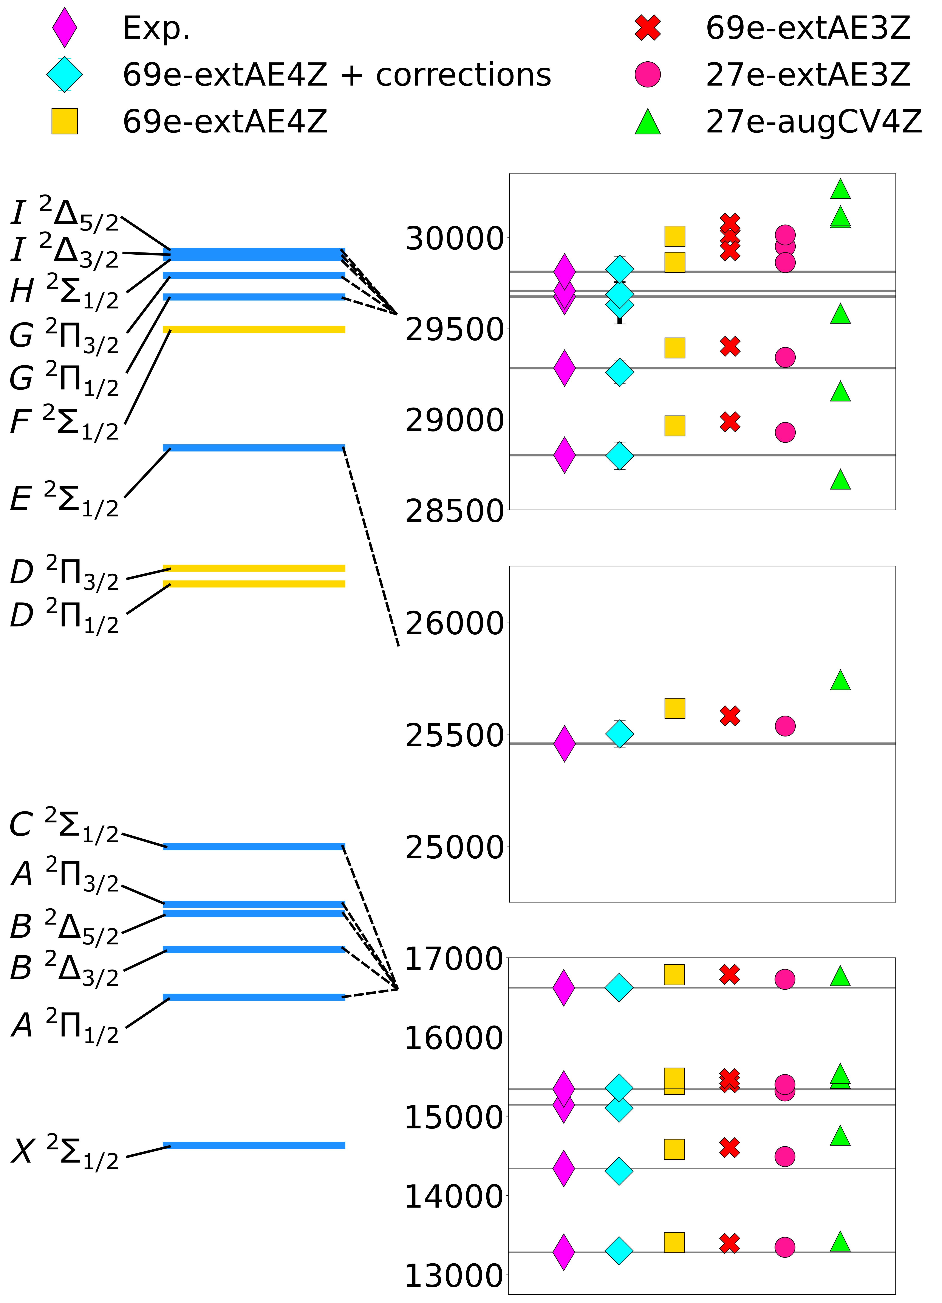
Excitation Energies
Fock-space relativistic coupled cluster theory reproduces all excitation energies with an accuracy of 99.7% or higher!
Also:
efficient and sensitive laser schemes
M. Athanasakis-Kaklamanakis, S.G. Wilkins, CRIS et al., In preparation (2023)

Slide 9
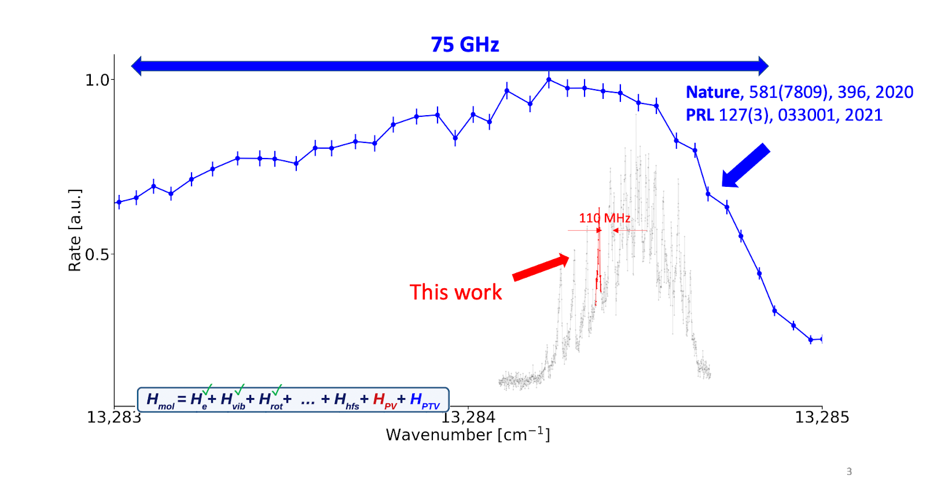
High-resolution spectroscopy: laser cooling
Rotational structure
High resolution
²²⁶RaF, no Ra spin!
Can we devise a laser-cooling scheme?
S.M. Udrescu, S.G. Wilkins, CRIS et al., Under review (2023)

Slide 10
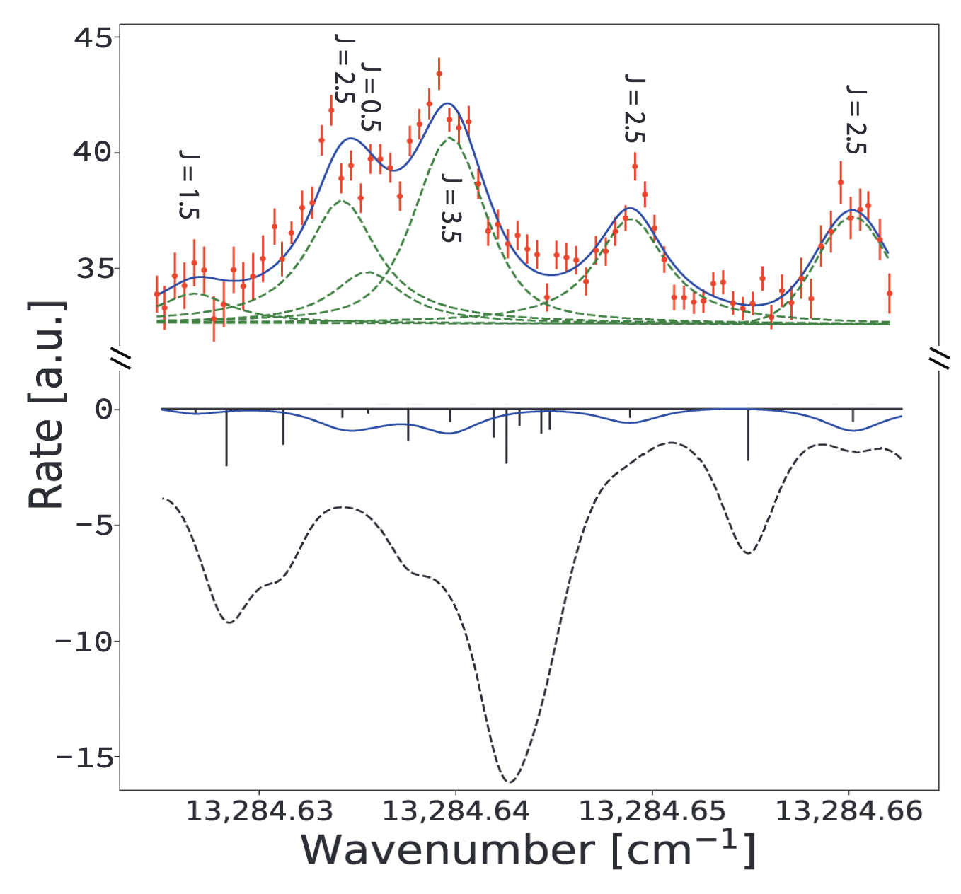
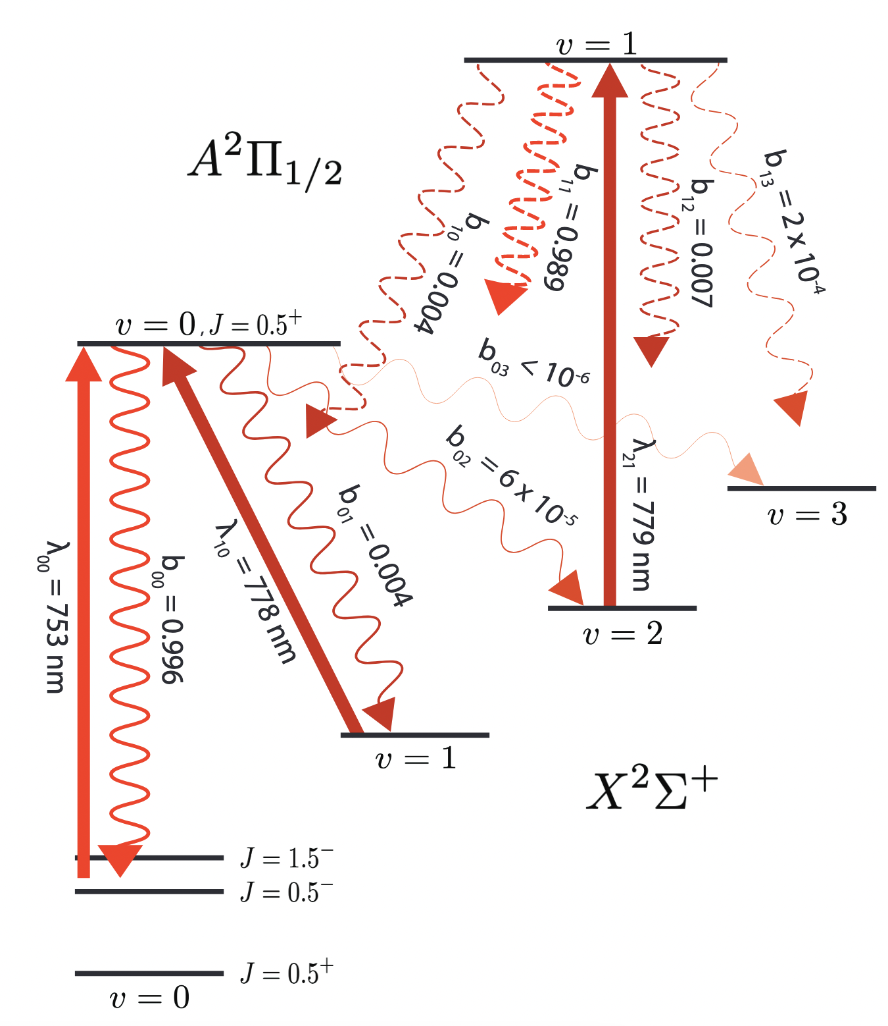
Laser-cooling scheme
S.M. Udrescu, S.G. Wilkins, CRIS et al., Under review (2023)
Need just 3 lasers!

Slide 11
Moving further down the Hamiltonian…
✓
✓
✓
$${\hat{H}}^{RaF}={\hat{H}}_{el}+{\hat{H}}_{vib}+{\hat{H}}_{rot}+{\hat{H}}_{hfs}+…+{\hat{H}}_{P,T}$$
A lot of progress!
So far, measurements without radium spin
Hyperfine structure needed to study electron-nucleus interactions!

Slide 12

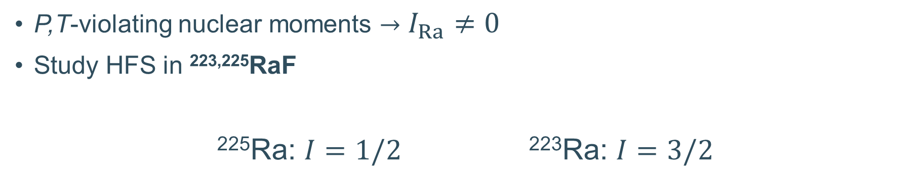
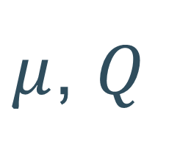
Hyperfine structure
P,T-violating nuclear moments $→$ $I_{Ra}≠0$
Study HFS in ^{223,225}RaF
²²⁵Ra: $I=1/2$ ²²³Ra: $I=3/2$
$$μ$$
$μ$, $Q$
Pin down dipole splitting
Move on to quadrupole splitting

Slide 13
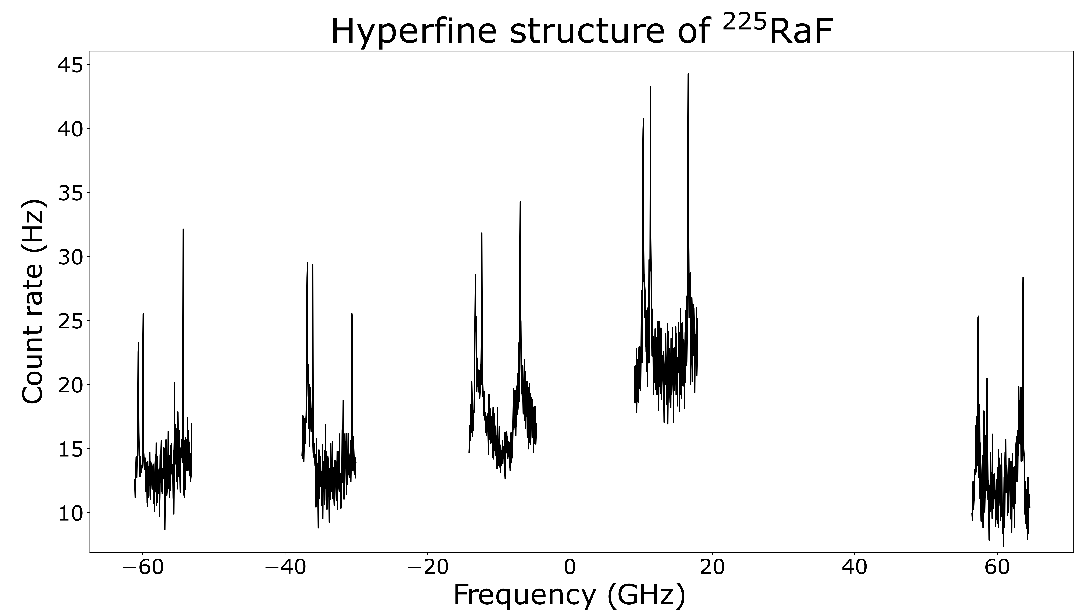
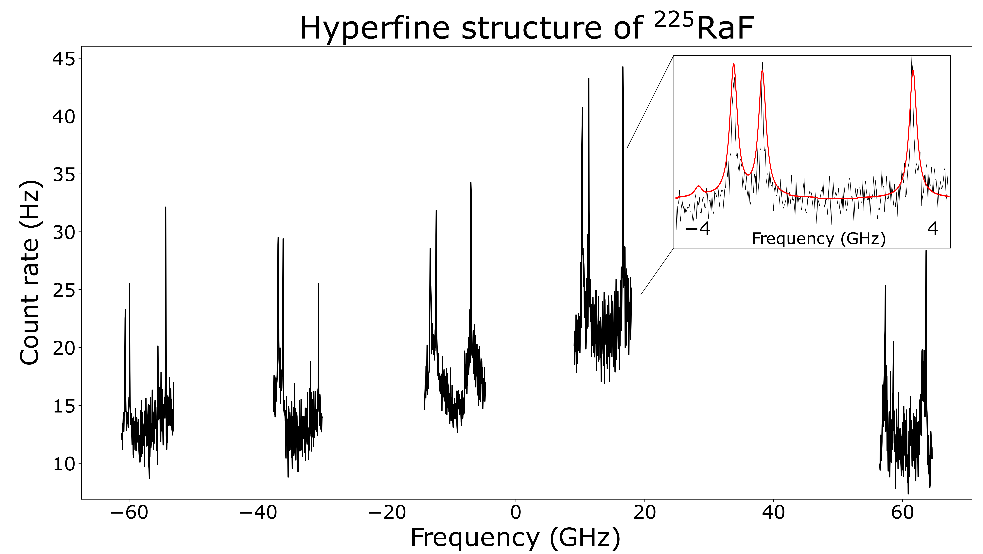
First measurements in ²²⁵RaF

Slide 14
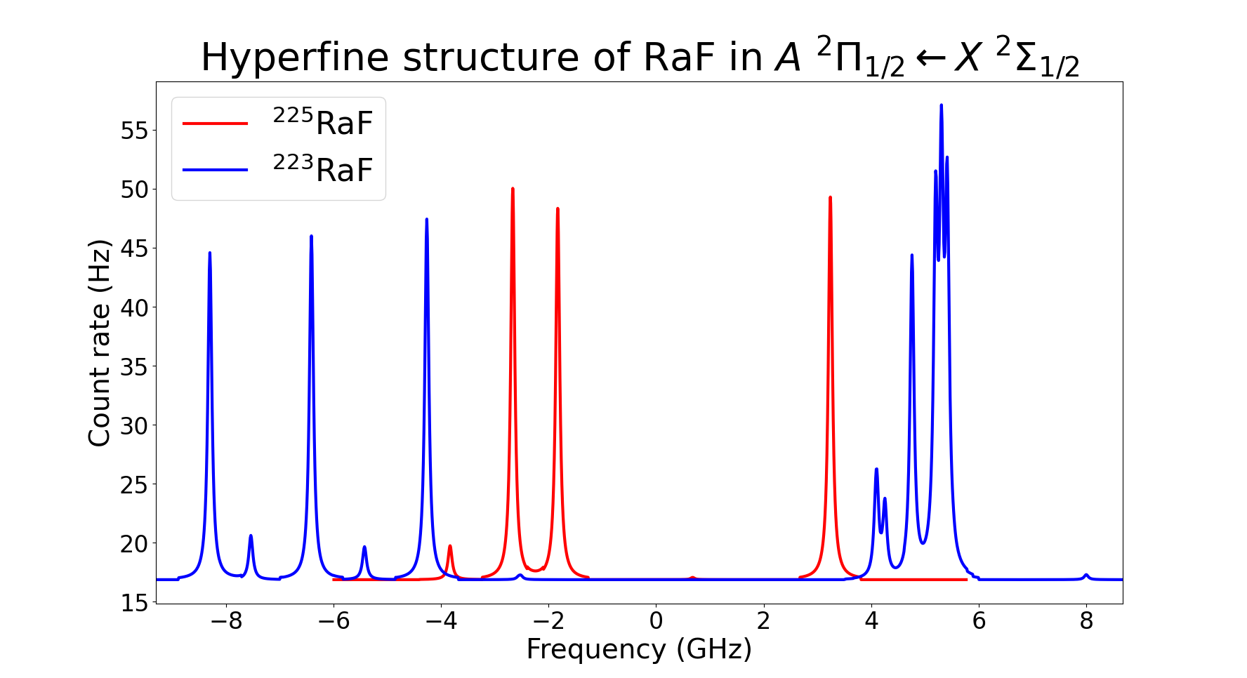
²²³RaF is more complex
Quadrupole splitting complicates the picture
Need to pin down dipole splitting in ²²⁵RaF

Slide 15
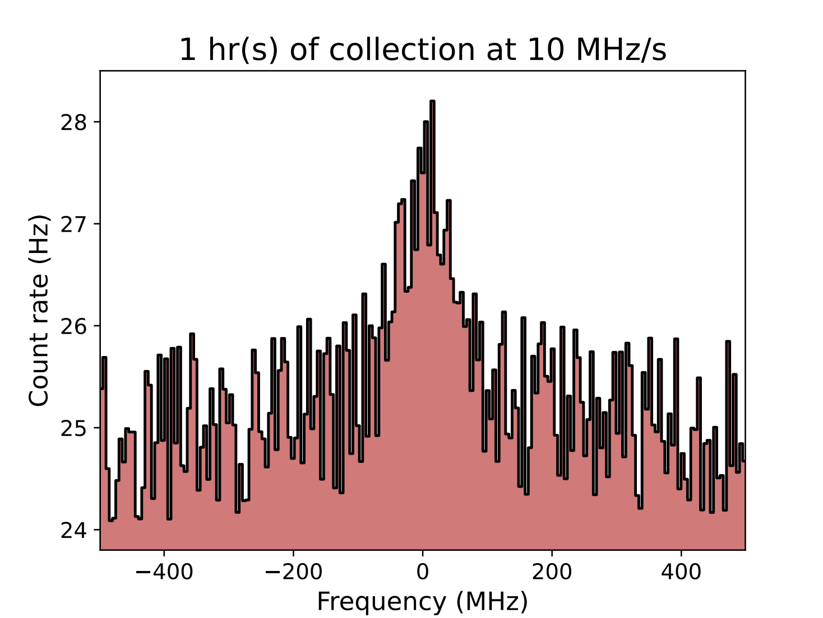
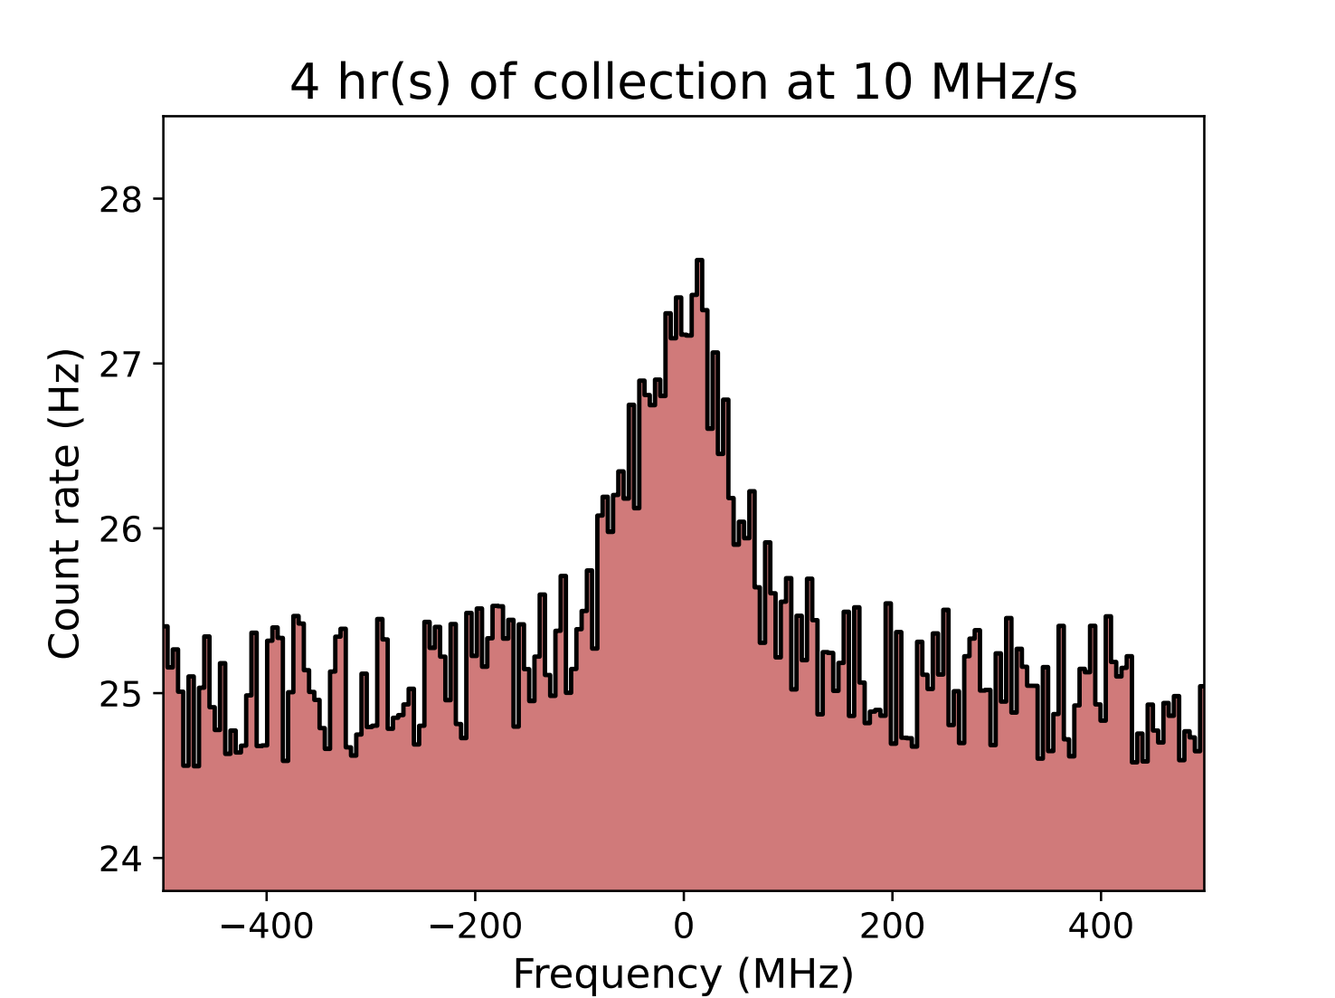
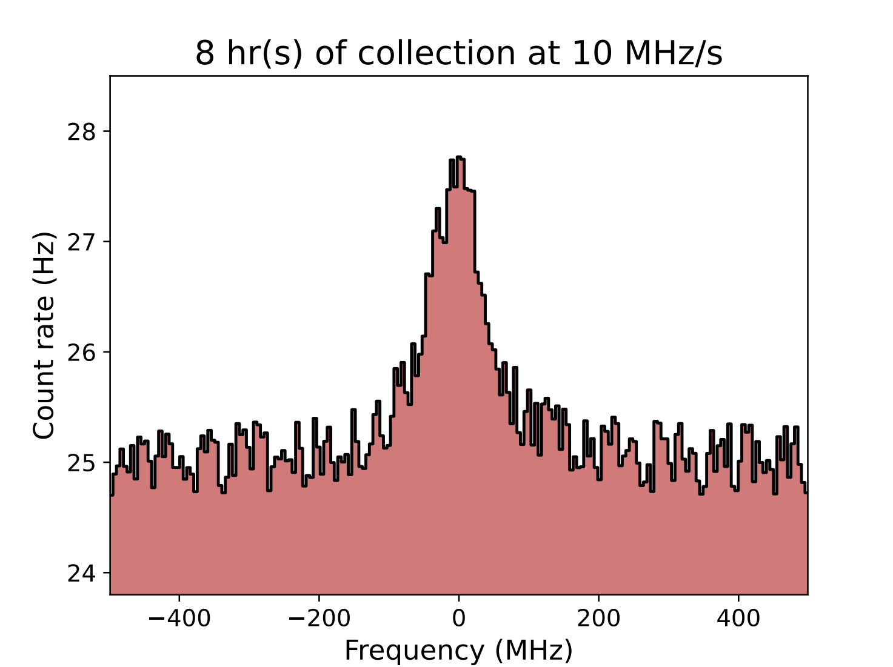
Simulated statistics: ²²⁵RaF
0.5 shift per peak is suitable
Scan range
1 GHz
7 rotational lines × 0.5 shift per peak = 3.5 shifts for measurement
+ 0.5 shift for re-measurement and safety margin
= 4 shifts in total for ²²⁵RaF

Slide 16
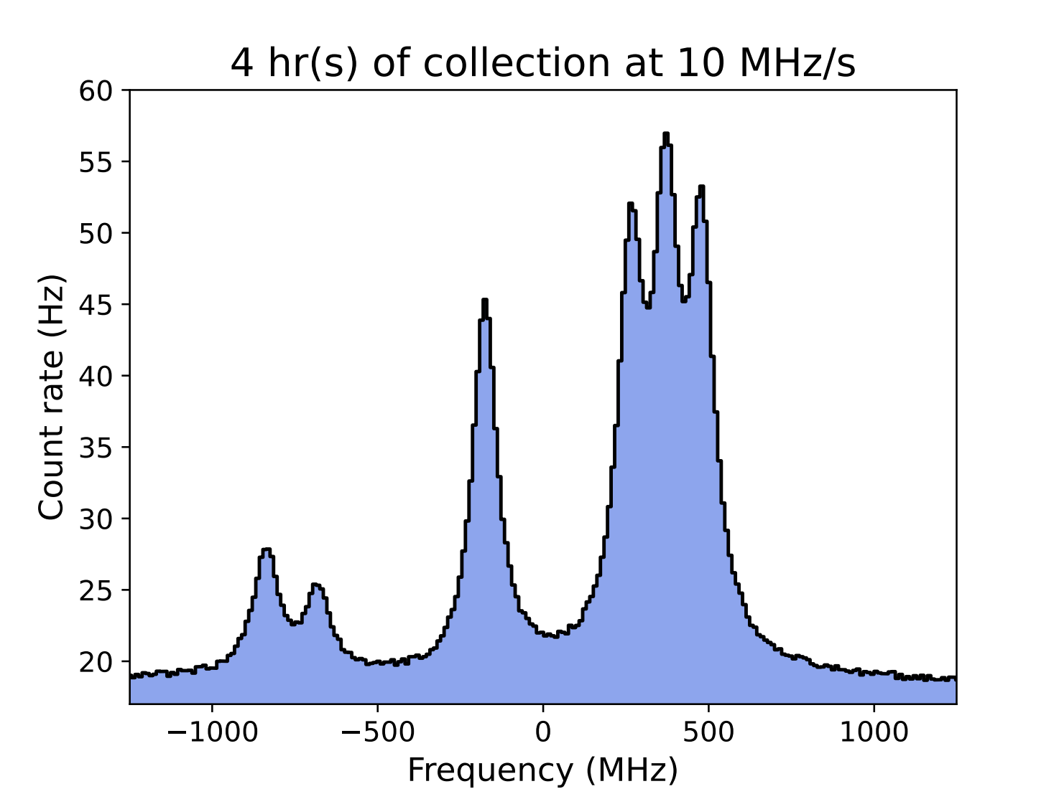
Simulated statistics: ²²³RaF
Scan range
2.5 GHz
7 rot. lines × 0.5 shift each = 3.5 shifts
>2 measurements per line preferrable
10 shifts requested in total
Quadrupole splitting constrained sufficiently with just right structure

Slide 17
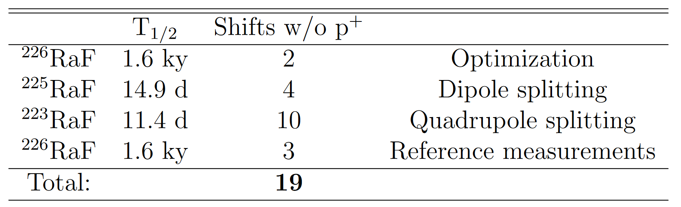
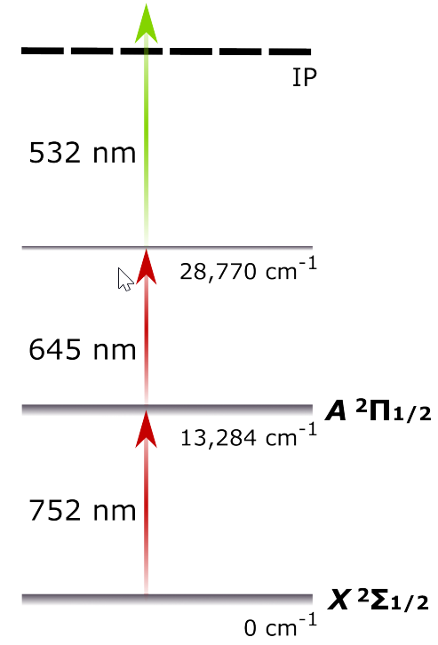
Request
Pre-irradiated UC_{x} target with CF₄ leak
Spectroscopy

Slide 18





Thank you!

Slide 19

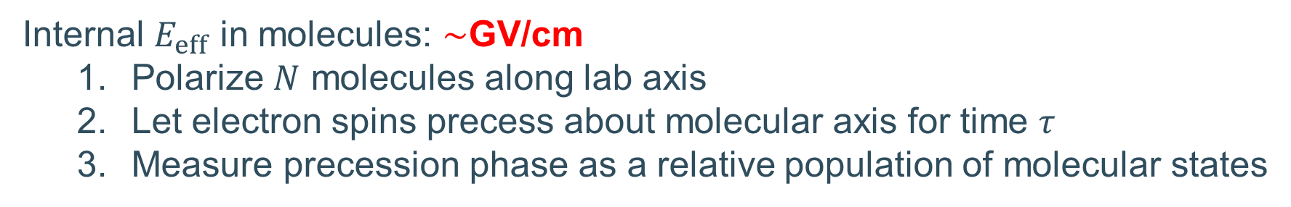
Exceptional sensitivity in molecules
Strong internal electric fields
Closely spaced opposite-parity electronic states
Example: eEDM
Internal $E_{eff}$ in molecules: $∼$GV/cm
  Polarize $N$ molecules along lab axis
  Let electron spins precess about molecular axis for time $τ$
  Measure precession phase as a relative population of molecular states
Precision $∝τ E_{eff} √N$

Slide 20

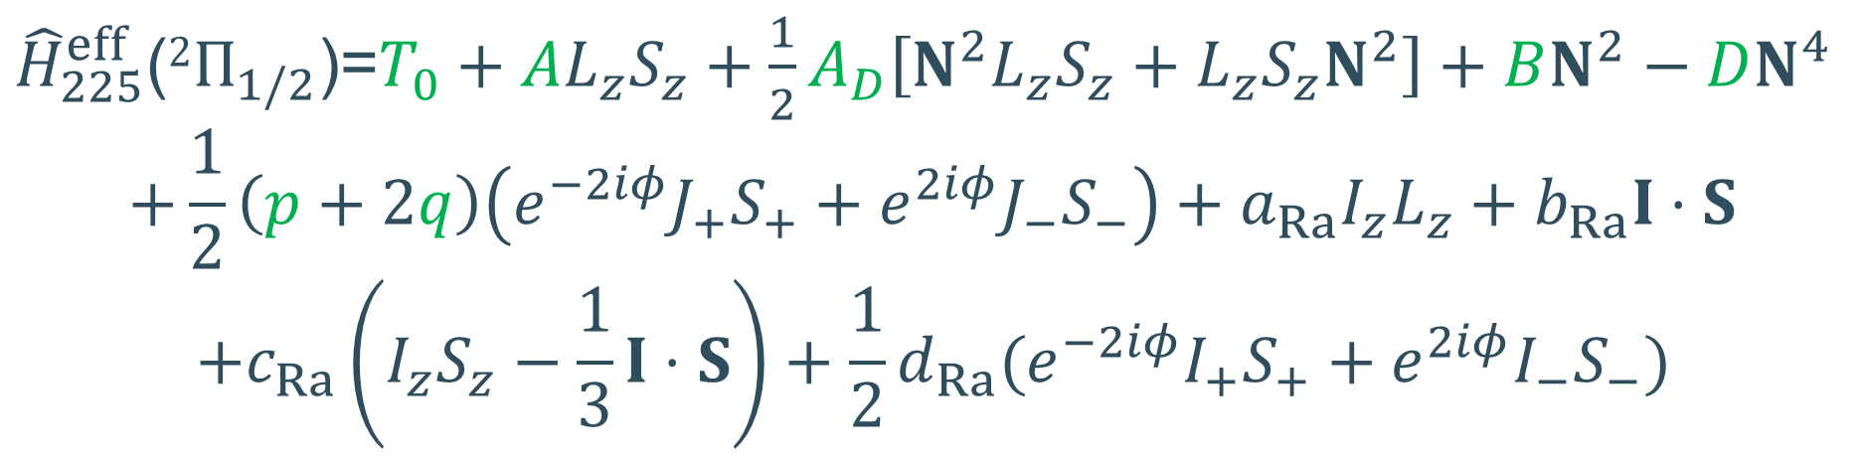

Hamiltonian in ²²⁵RaF
For the ground state ($X 2Σ_{1/2}$)
${\hat{H}}_{225}^{eff}$($2Σ_{1/2}$)=$B^{′′}N^{2}−D^{′′}N^{4}+γ^{′′}N⋅S+b_{Ra}^{′′}I⋅S+c_{Ra}^{′′}(I_{z}S_{z}−\frac{1}{3}I⋅S)$
Green: Nuclear-spin-independent
Scaled from ²²⁶RaF
For the upper state ($A 2Π_{1/2}$)
${\hat{H}}_{225}^{eff}$($2Π_{1/2}$)=$T_{0}+AL_{z}S_{z}+\frac{1}{2}A_{D}\left[N^{2}L_{z}S_{z}+L_{z}S_{z}N^{2}\right]+BN^{2}−DN^{4}$
$$+\frac{1}{2}\left(p+2q\right)\left(e^{−2iφ}J_{+}S_{+}+e^{2iφ}J_{−}S_{−}\right)+a_{Ra}I_{z}L_{z}+b_{Ra}I⋅S$$
$$+c_{Ra}\left(I_{z}S_{z}−\frac{1}{3}I⋅S\right)+\frac{1}{2}d_{Ra}(e^{−2iφ}I_{+}S_{+}+e^{2iφ}I_{−}S_{−})$$
Red: Magnetic dipole splitting
Measure in ²²⁵RaF

Slide 21
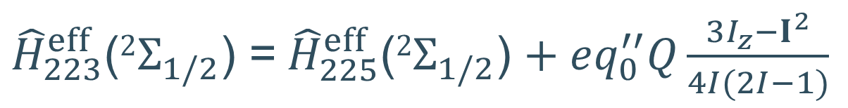

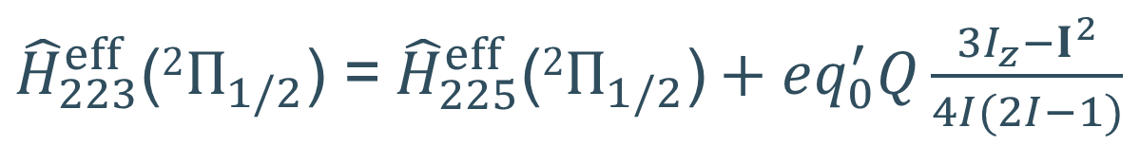

Hamiltonian in ²²³RaF
For the ground state ($X 2Σ_{1/2}$)
${\hat{H}}_{223}^{eff}$($2Σ_{1/2}$) =${\hat{H}}_{225}^{eff}\text{(}2Σ_{1/2}\text{)}$ $+ eq_{0}^{′′}Q\frac{3I_{z}−I^{2}}{4I(2I−1)}$
For the upper state ($A 2Π_{1/2}$)
${\hat{H}}_{223}^{eff}$($2Π_{1/2}$) =${\hat{H}}_{225}^{eff}\text{(}2Π_{1/2}\text{)}+eq_{0}^{′}Q\frac{3I_{z}−I^{2}}{4I(2I−1)}$
Blue: Electric quadrupole splitting
Measure in ²²³RaF

Slide 22
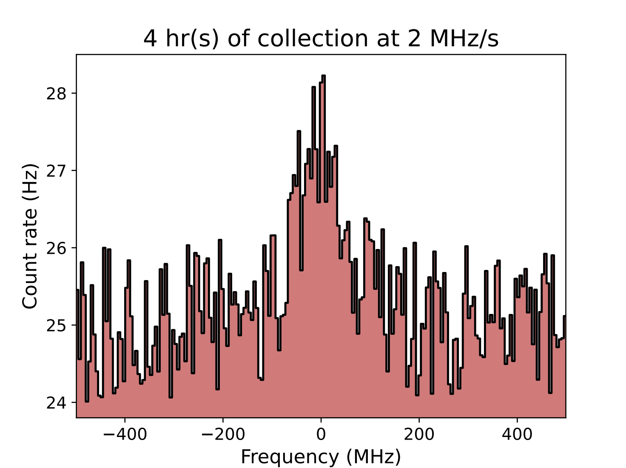
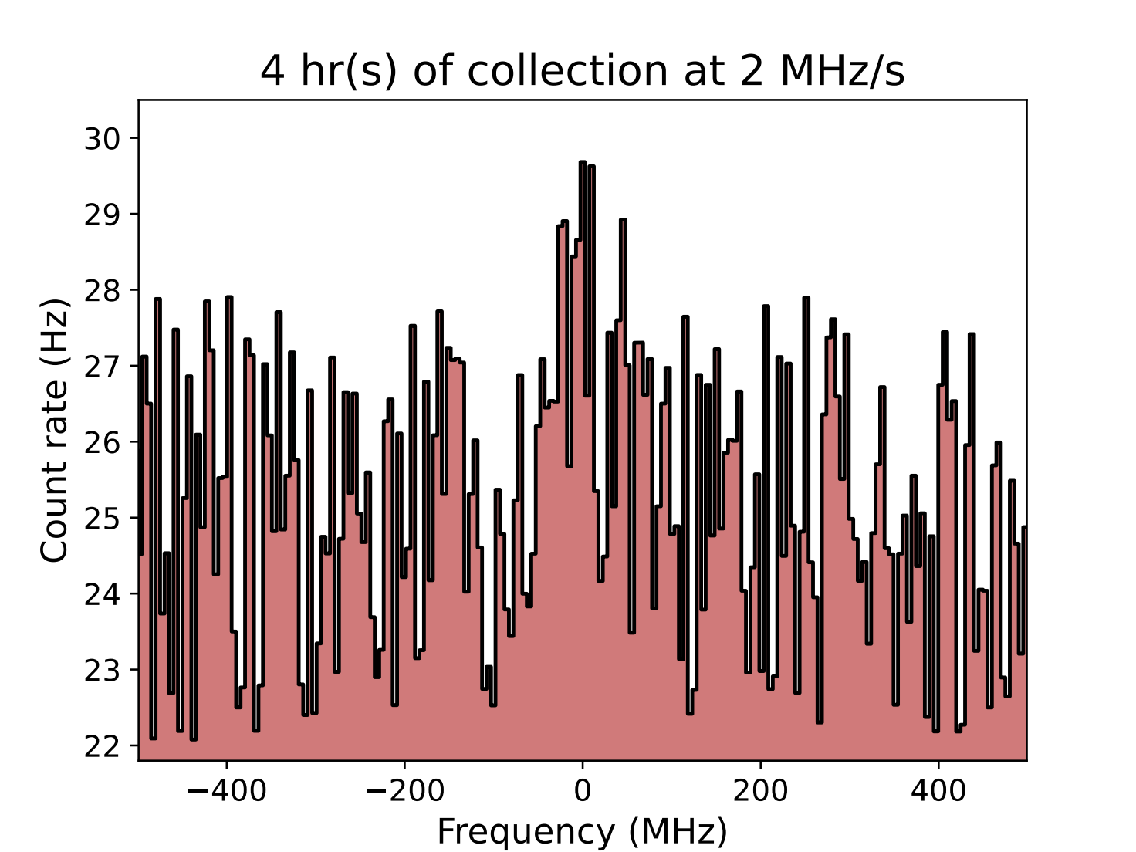
Simulation for frequency scanning: ²²⁵RaF
Scan range: 1000 MHz
Scan range: 8000 MHz

Slide 23
Simulation for frequency scanning: ²²⁵RaF
Voltage scanning
Range: 1000 MHz
Scan range: 1000 MHz
Scan range: 8000 MHz

Slide 24


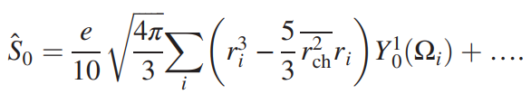
Nuclear Schiff moment
Dobaczewski et al., Phys. Rev. Lett. 121, 232501 (2018)

Slide 25
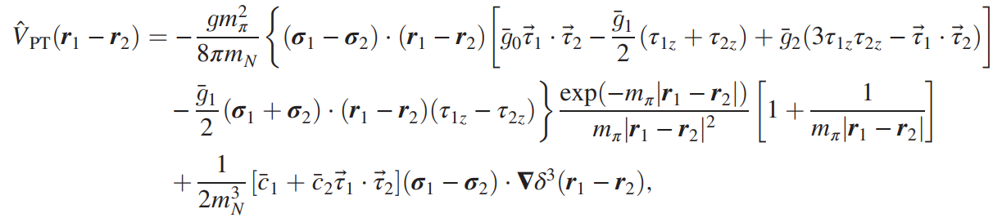

P,T-odd nuclear potential
Dobaczewski et al., Phys. Rev. Lett. 121, 232501 (2018)

Slide 26
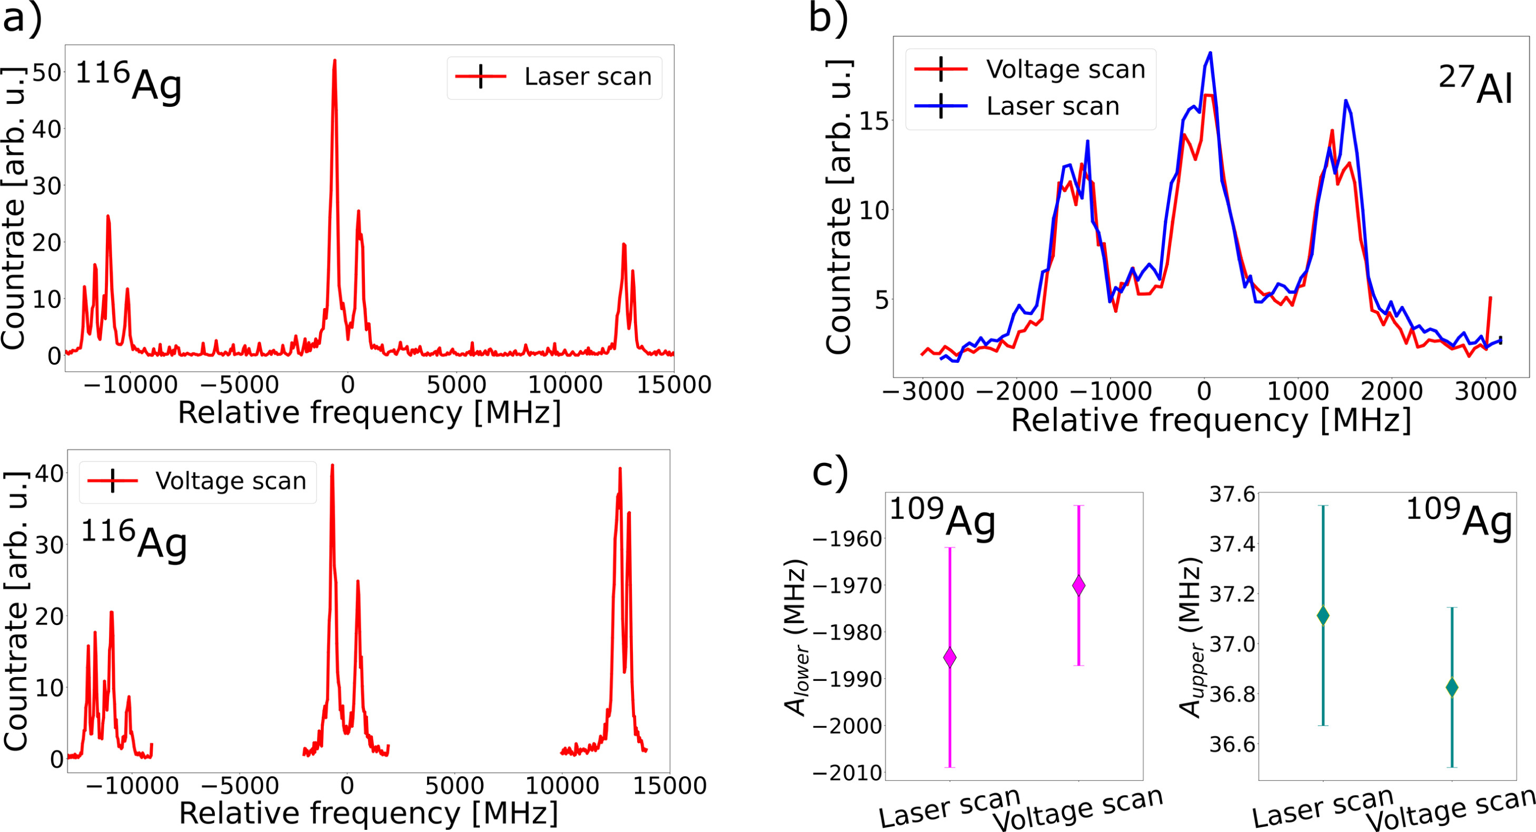
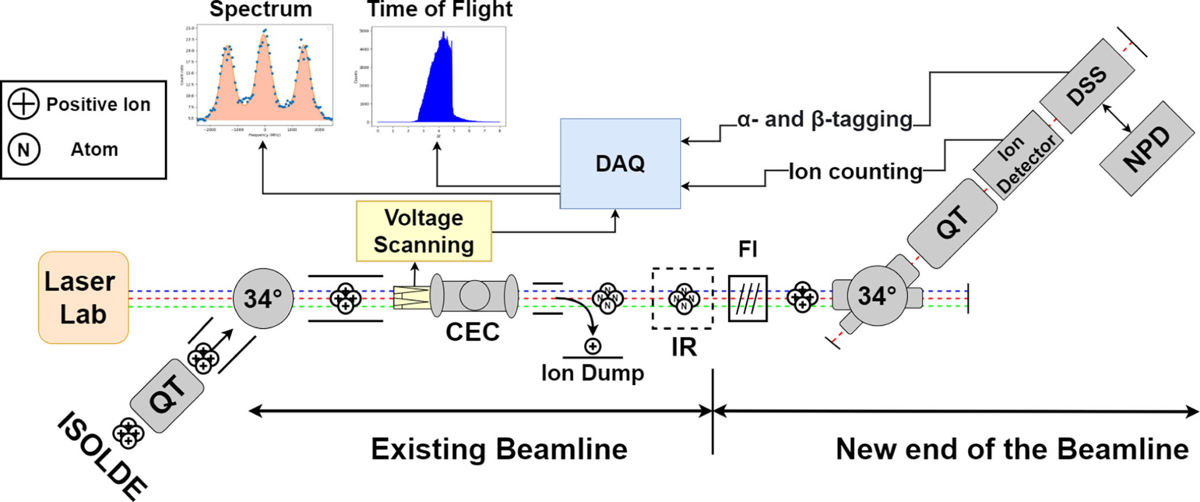
Voltage scanning
M.A.K., J. Reilly et al., NIM B 541, 86-89 (2023)

