Slide 1
SPS Wire Scanner
“Task Force”
Ray Veness

Slide 2
Contents
Introduction
  IEFC talk of Federico last Friday
    https://indico.cern.ch/event/1272497/
Scope of this Task Force
Membership
Preliminary list of work
Next meetings

Slide 3
2023 scrubbing – what happened
April 12: 4 out of 4 scanners found broken
  Looking at logging DB:
    no sign of breakage during last ‘good’ scan
    suspect: breakage happened in parking position
April 19: changed 2 systems in LSS4
April 21:
  Night: BWS41677 used during night – ok
  Morning: activated ‘wire signals’ measurements (check integrity and relative induced signal + resistance change=heating)
  Found BWS41677 broken
April 22:
  BWS41678 broke at 05h:43m:05s (local time), in the parking position
As of today:
could not find a failure cause
RF coupling suspected, not proved
Legacy linear BWS (not operational, similar to LHC ones) : NOT broken
Courtesy F.Roncarolo / IEFC / 28-4-23

Slide 4
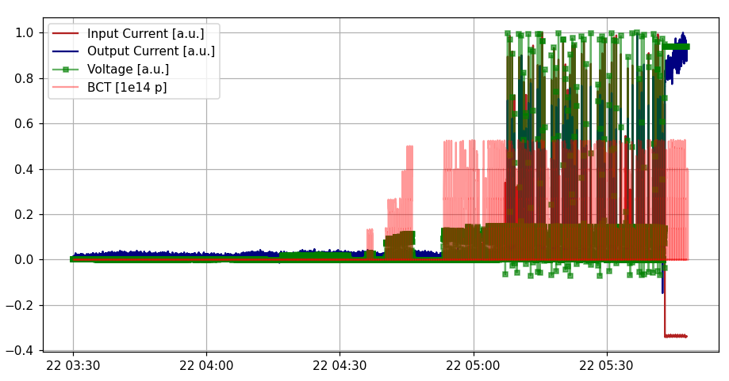
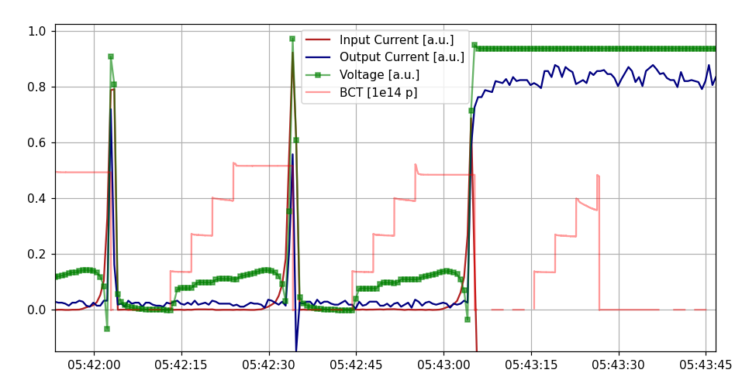
BWS 416678 - (second) breakage
Wire signals and beam intensity
ZOOM
Only ‘anomaly’ found so far:
this little spike in the measured current
Physical meaning of wire currents and voltage being analyzed
Electronics designed to check wire integrity and to keep such (small) control current constant by varying voltage
Also: bunch length evolution still to be checked in detail – few words in a couple of slides
Courtesy F.Roncarolo / IEFC / 28-4-23

Slide 5
Draft scope of the TF
Coordinate the studies and actions related to the recent wire breakages in the SPS rotary scanners
Prepare summaries, action plan, resource/cost estimate and timeline as well as mitigation measures such as degraded mode or operational limits
Report to the IEFC. Work closely with other groups, in particular the IWG and IPP
Time limited [initially target a possible intervention in TS1?]

Slide 6
Draft Membership
Core members:
  BI: William Andreazza, Jonathan Emery, Thibaut Lefevre, Federico Roncarolo, Ana Guerrero, Ray Veness,Tom Levens, Nabil El-Kassem
  RF: Michael Sullivan, Christine Vollinger, Ivan Karpov, Giulia Papotti
  ABP: Benoit Salvant, Carlo Zannini,
  ABT: Francesco Velotti
  OP: Kevin Li
  VSC: Jose Ferreira Somoza
  MME: TBC
For information:
  Brennan Goddard, IPP chairs, MPP chairs, Rende, Bettina, FOM chair

Slide 7
Preliminary list of tasks
Test bench and other laboratory measurements
  Christine/Michael/IWG with BI assistance (William)
HOM and beam induced heating measurements in the SPS WS tank
  Design of experiment and equipment
  Use of the existing HOM coupler port
  RF and BI (Christine)
Failure analysis of the scanners and wires
  Lessons learned from the access and intervention
  Ray/William/BI/MME/BI
Review of the causes of the failure
  Which beams, when, why, is this fatigue or one-off
  Carlo/Federico
Impedance simulations
  Christine/Michael/Carlo/Benoit/IWG
Mechanical and thermal simulations
  MME or BI (Name?)
SPS possible operating limits or mitigation measures
  (Federico/Carlo/Benoit/Giulia)
Wire scanner possible alternative operating modes and mitigation
  BI (Federico/Jonathan/Ana)
Possible wire scanner design modifications
  RF and BI (William)
Summaries, action plan, cost, timeline
  This TF/Ray

Slide 8
Future meetings/how to work
Plan for an active TF upto TS1 (20 June)
  Reserve a slot once per week. Friday morning at 9am?
Report back to IEFC
  Try to limit multiple presentations to different WGs
Plan to stop/re-evaluate this TF after the June TS
Agree a ‘rapporteur’ for each topic

Slide 9
Next meeting
Intensities and beams seen for the
First results from failure analysis
First results from simulations

