Slide 1
ENERGY SAVING: PLANS & ACHIEVEMENTS
Analysis of the energy consumption in CERN Sites & Future Perspectives
SCE-SAM-IN: HVAC, Sanitary and Electricity
Michela LAGIOIA
Guillaume ROUGE
30/05/2023
SCE – Site and Civil Engineering
Notes:
Energy savings plan and achievements

Slide 2
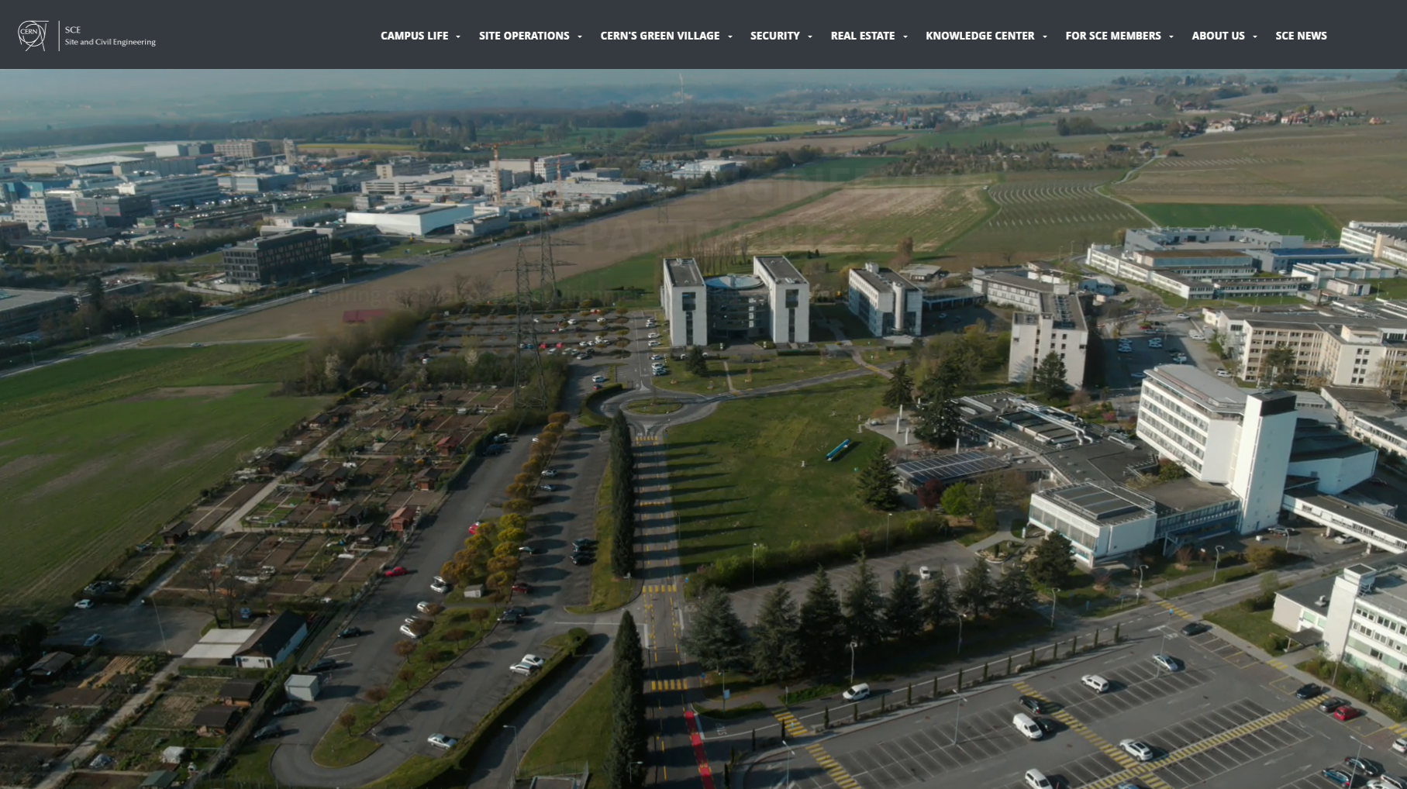

SCE-SAM-IN
SITE AND CIVIL ENGINEERING DEPARTMENT
Site Asset Management
[SAM group]
GL: Pierre Cardon
DGL: Michael Poehler
Admin support
Christine Alliod
The Infrastructure Section (IN), within the Site Asset Management (SAM) Group in the Site and Civil Engineering (SCE) Department, is in charge of the operation, maintenance, design, tendering and work phases of HVAC, Electrical and Sanitary installations for buildings in the CERN sites.
Infrastructure
[SAM-IN]
SL: Christophe Martel
DSL: Guillaume Rouge
Maintenance and Methods
Team referee:
Christophe Martel
Gabriel Genamy
Franck Moro
Yoann Obry
Delphine Viallet
Electrical
works
Team referee:
Fabien Vincent
Antoine Degeneve
Patrice Sajous
Oeyvind Vangen
HVAC and sanitary works
Team referee:
Guillaume Rouge
Thierry Duverger
Morgan Farre
Juan Gomez
Michela Lagioia
Denis Potard
+ support of Temps and Contractors

Slide 3






Summary
Introduction
PLAN
ACHIEVEMENT
FUTURE PERSPECTIVES
Solutions proposed in 2022: application in winter season 22-23
Led installation
Shutdown of public lights at nights
No electrical radiators
Optimization of the heating district
User awareness: good behaviour – HSE Campaign
Focus on electricity consumption
Focus on gas consumption
Sustainable heating plants
Cooling strategy
Conclusion
3

Slide 4


INTRODUCTION
Energy consumption at CERN in 2021
ELECTRICITY
GAS
Total annual electricity consumption at CERN:
990’895 MWh/year
[EN-EL Energy database]
Total annual gas consumption at CERN:
68’971.73 MWh/year
[SCE-SAM Gas invoices]
13’156.86 MWh/year
30’811 MWh/year
17’873 MWh/year
55’814.86 MWh/year
95 %
3 %
2 %
81 %
19 %
Tertiary Buildings (5%)
Impact per person (6500 users) = 7,5 MWh/year
Tertiary Buildings (100%)
Notes:
UPDATE WITH 2022

Slide 5










PLAN
Solutions proposed in September 2022
ELEC | HVAC & SAN | BEHAVIOUR | STRATEGY | MID/LONG-TERM
Led installation Public lighting No electrical radiators | Heating district Specific installations Washing hands | Communication with users | A/C for comfort | Smart working Old Barracks Renewable energy
MID/LONG-TERM
IMMEDIATE SOLUTIONS
5

Slide 6
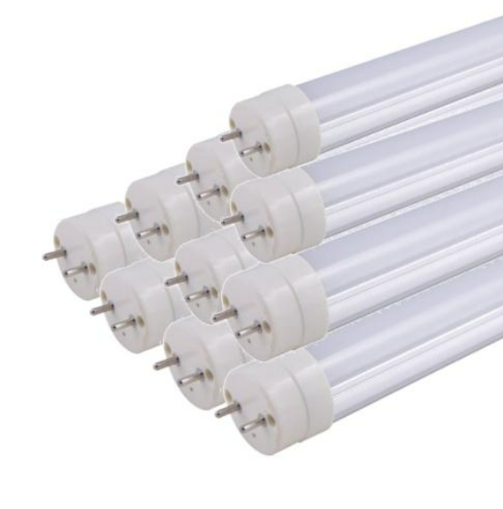
PLAN
Electricity
S1: LEDs INSTALLATION
Replacing immediately obsolete halogen lamps with LEDs reduces lighting electricity requirements by up to 65%.
Process ongoing, but far from being completed!
EXPECTATIONS: about 14’700 Led Tubes to be changed every year. Complete replacement at CERN to be completed in 8 years.
PROPOSAL: Increase in human resources to speed up the process, and to observe much more effectively the consequences of this replacement in all the buildings at CERN.
Energy involved | [Type] | Electricity
Investment costs | [CHF] | 280’000
Objective of reduction | [MWh/year] | 845
Energy savings costs | [CHF/year] | 46’000
Payback | [Years] | 6
Human resources | FTE | 2
Schedule | January 2023
Scale of application | 12% of total LED number in Meyrin and Prevessin
Impact on Users | None
N.B. The savings represent 0,09% of CERN’s Total Electricity consumption
[990’895 MWh/year]
SAVINGS:
1,74%
Notes:
Reduce text

Slide 7
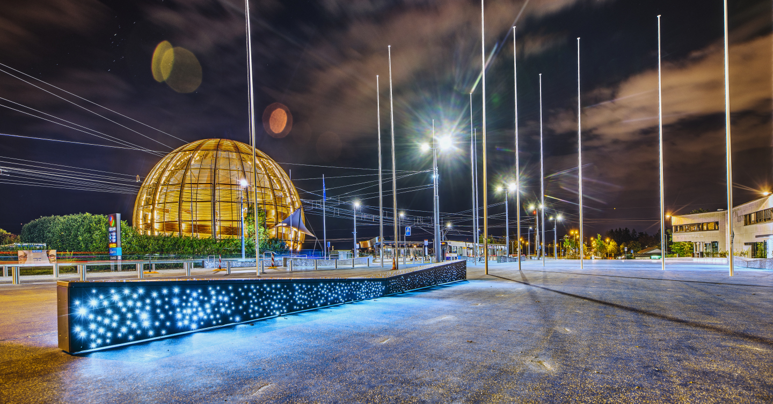
PLAN
Electricity
S2: PUBLIC LIGHTING SHUTDOWN
Many cities are currently shutting down the public lighting during the night, with the aim to save electricity while reducing CO₂ emissions and night-time pollution.
The target would be to shut down public lighting during non-operational hours, Specifically, the proposal is to shut it down from 11 p.m. to 5 a.m. in both Meryin and Prevessin sites.
Energy involved | [Type] | Electricity
Investment costs | [CHF] | 2’000
Objective of reduction | [MWh/year] | 260
Energy savings costs | [CHF/year] | 14’000
Payback | [years] | 0,14
Human resources | FTE | 0,04
Schedule | November 2022
Scale of application | CERN Site
Impact on Users | None
SAVINGS:
0,54%
N.B. The savings represent 0,03% of CERN’s Total Electricity consumption [990’895 MWh/year]
7

Slide 8
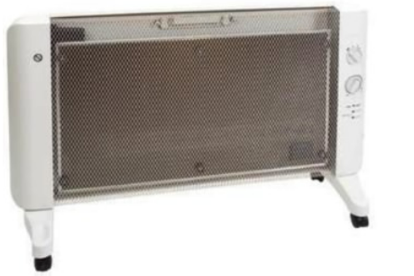
PLAN
Electricity
S3: REMOVE MOBILE ELECTRICAL RADIATORS
FROM CERN STORES CATALOGUE
On CERN Catalogue, there is the possibility for USERs to order independently mobile electrical radiators, as shown in the picture below. The proposal is to remove them from the catalogue in order to avoid the purchase of electricity consuming machines and to avoid their supply for comfort reasons.
An average of 50 units is sold every year from CERN Store.
CERN Stores Catalogue (19.09.60.E)
No-more available
Energy involved | [Type] | Electricity
Investment costs | [CHF] | 0
Objective of reduction | [MWh/year] | 60
Energy savings costs | [CHF/year] | 3’400
Payback | [years] | 0
Human resources | FTE | 0,01
Schedule | October 2023
Scale of application | Meyrin and Prevessin
Impact on Users | Moderate
N.B. The savings represent 0,01% of CERN’s Total Electricity consumption [990’895 MWh/year]
SAVINGS:
0,13%

Slide 9
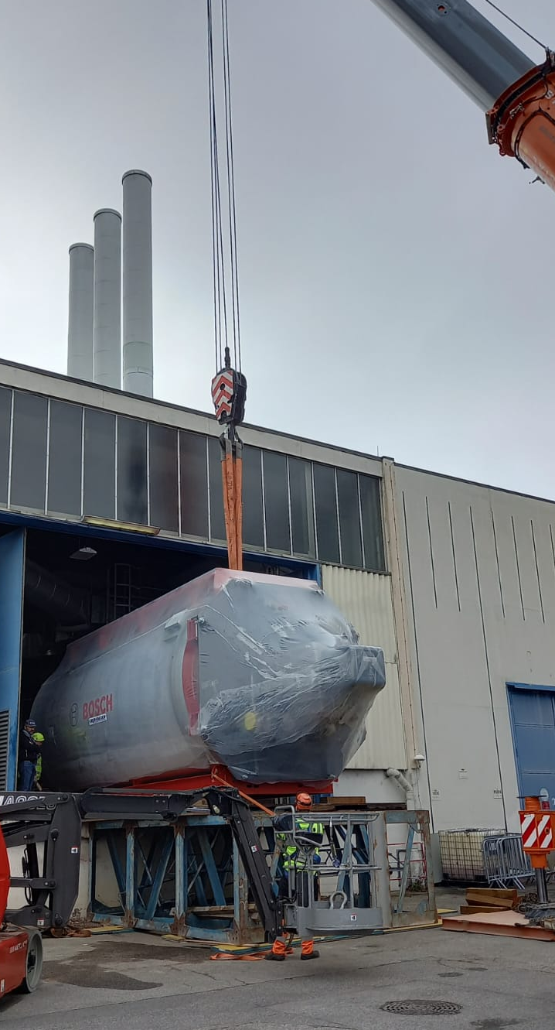
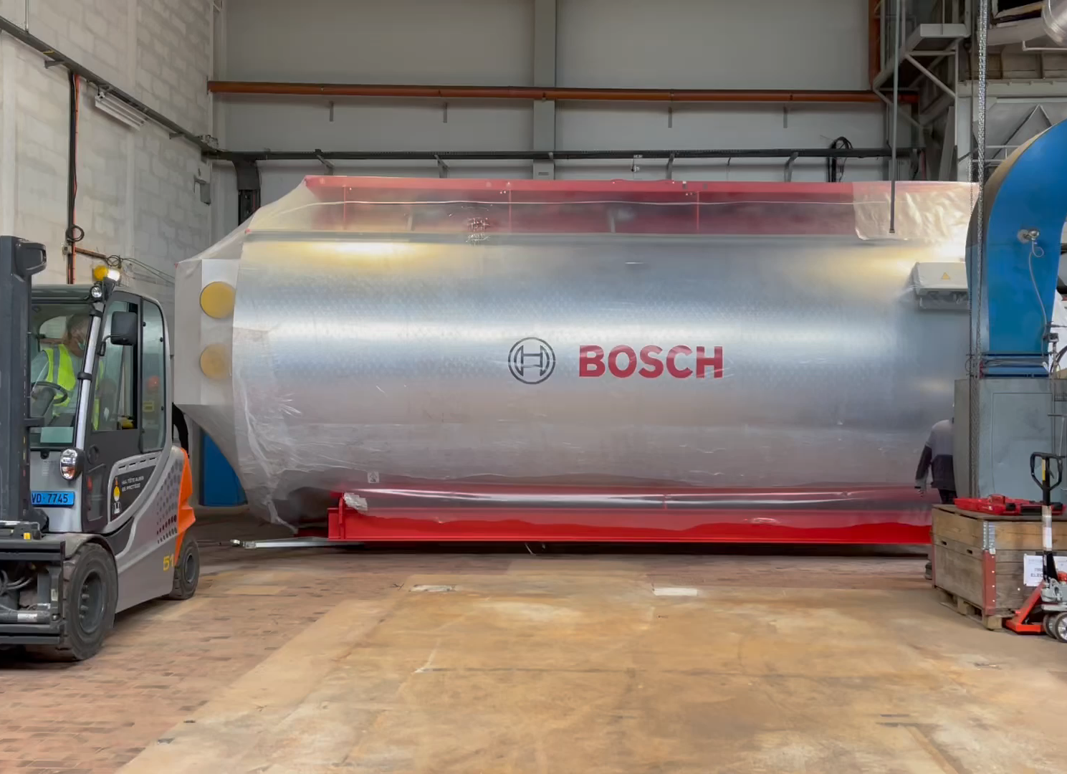

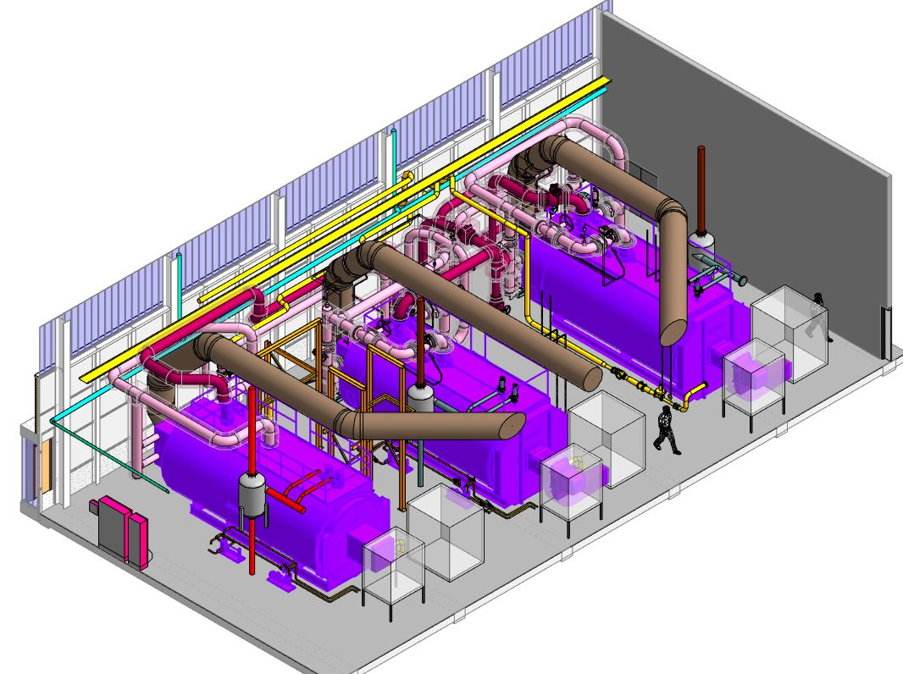
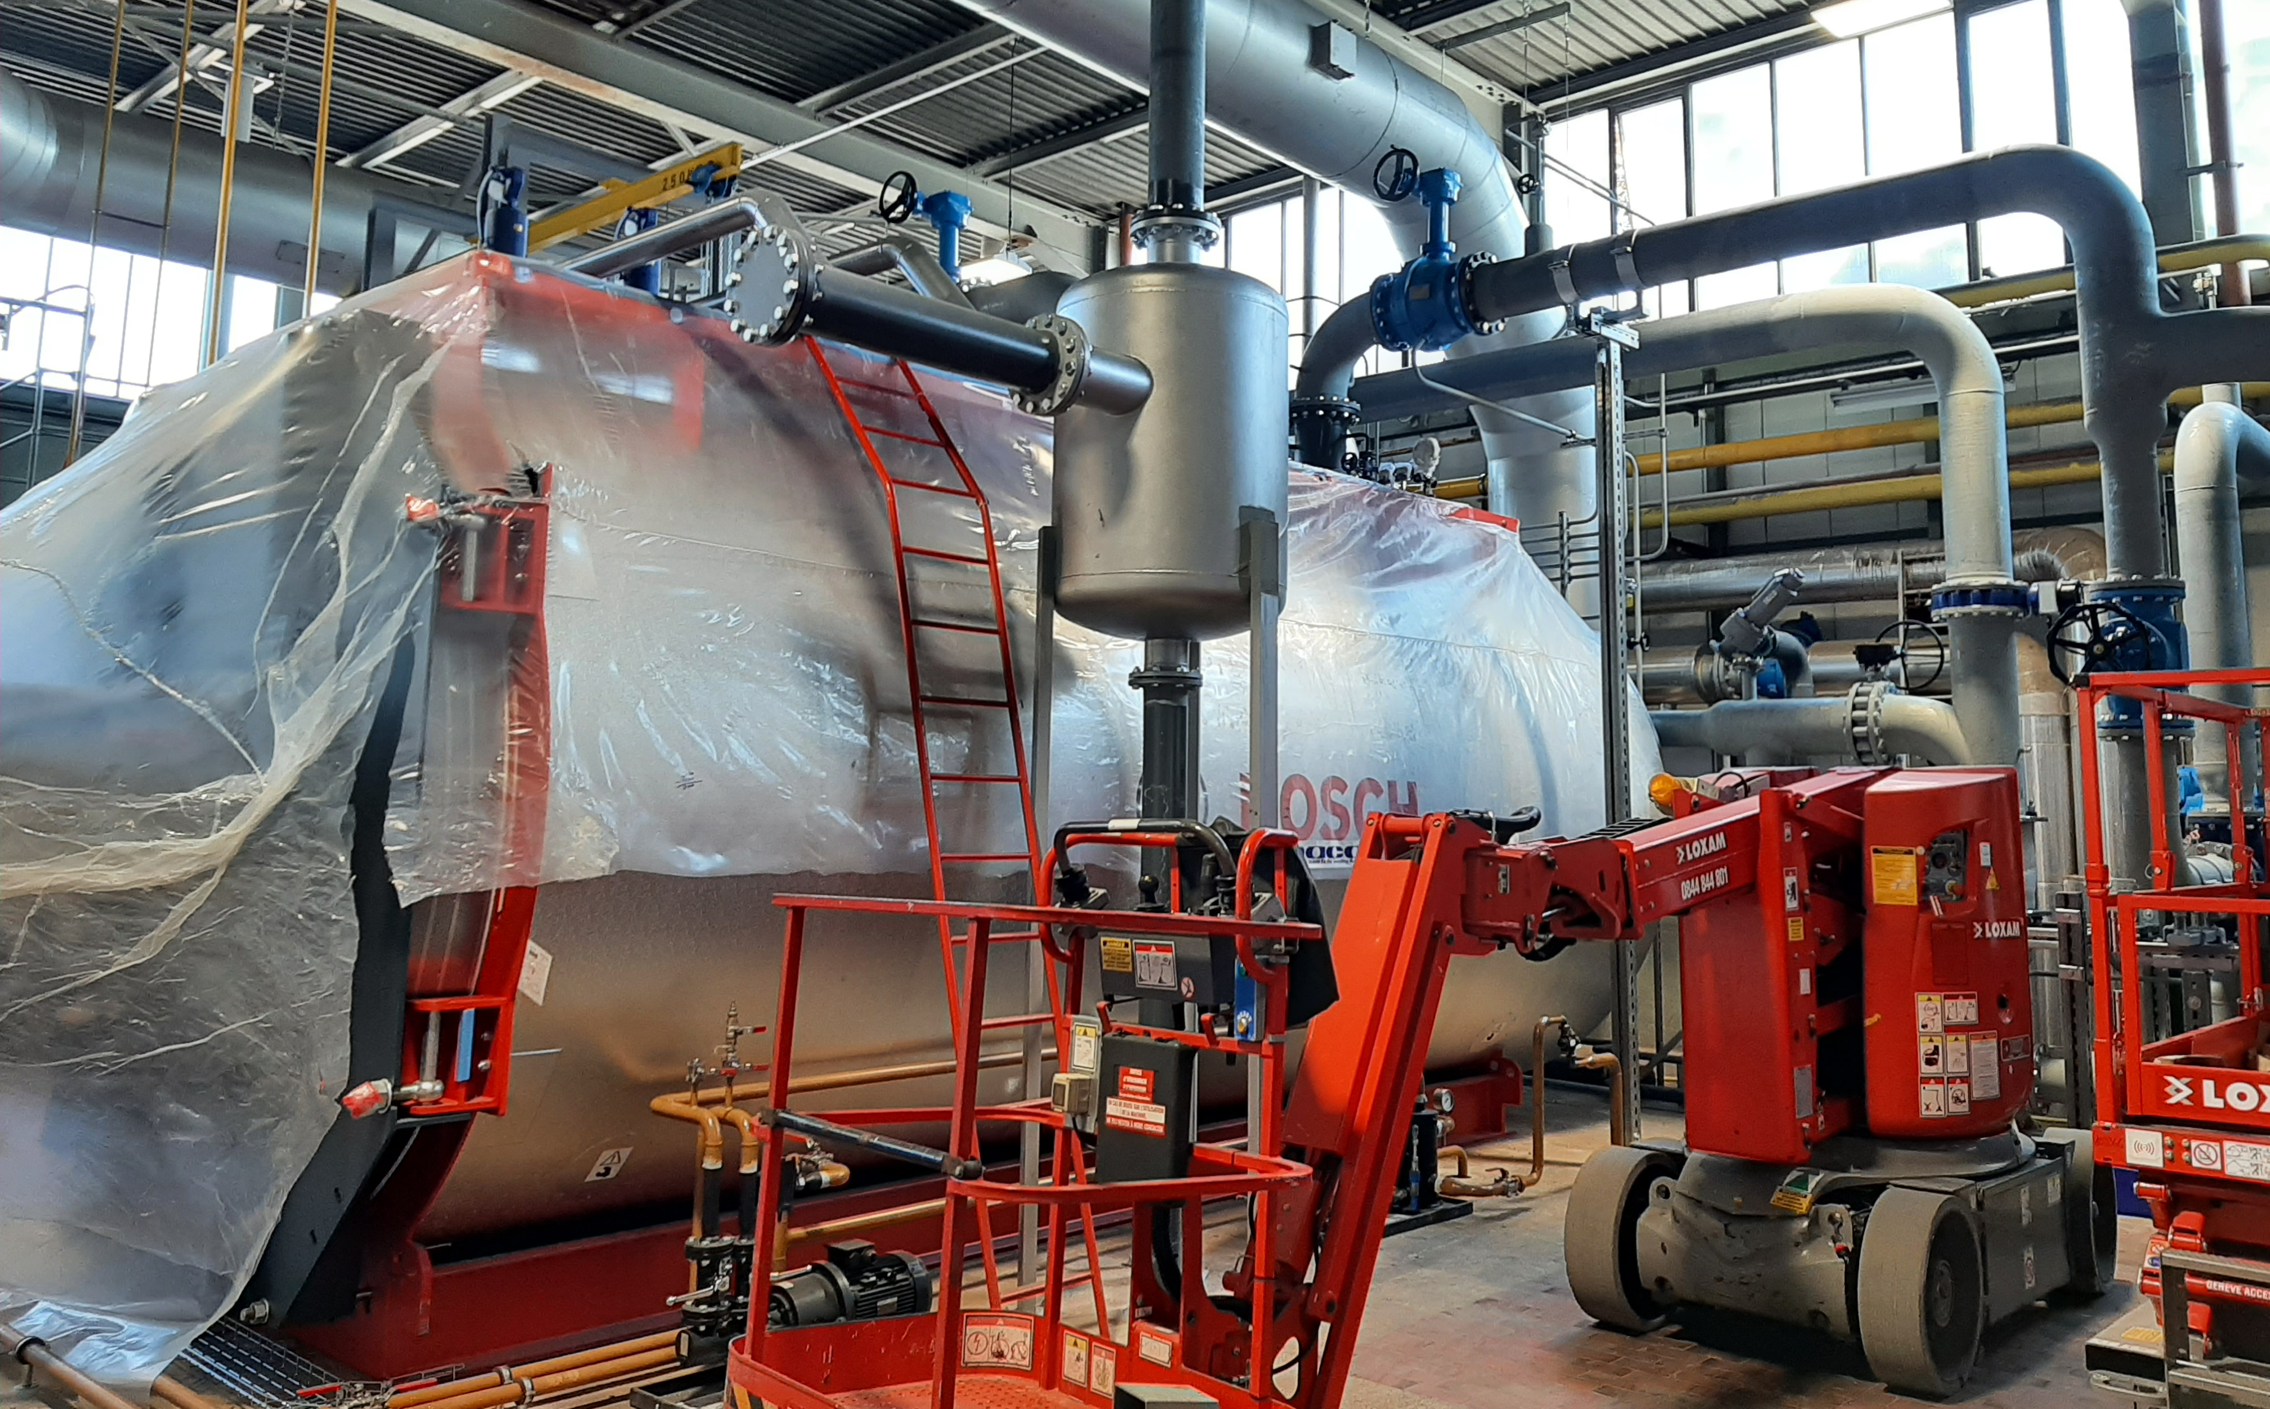
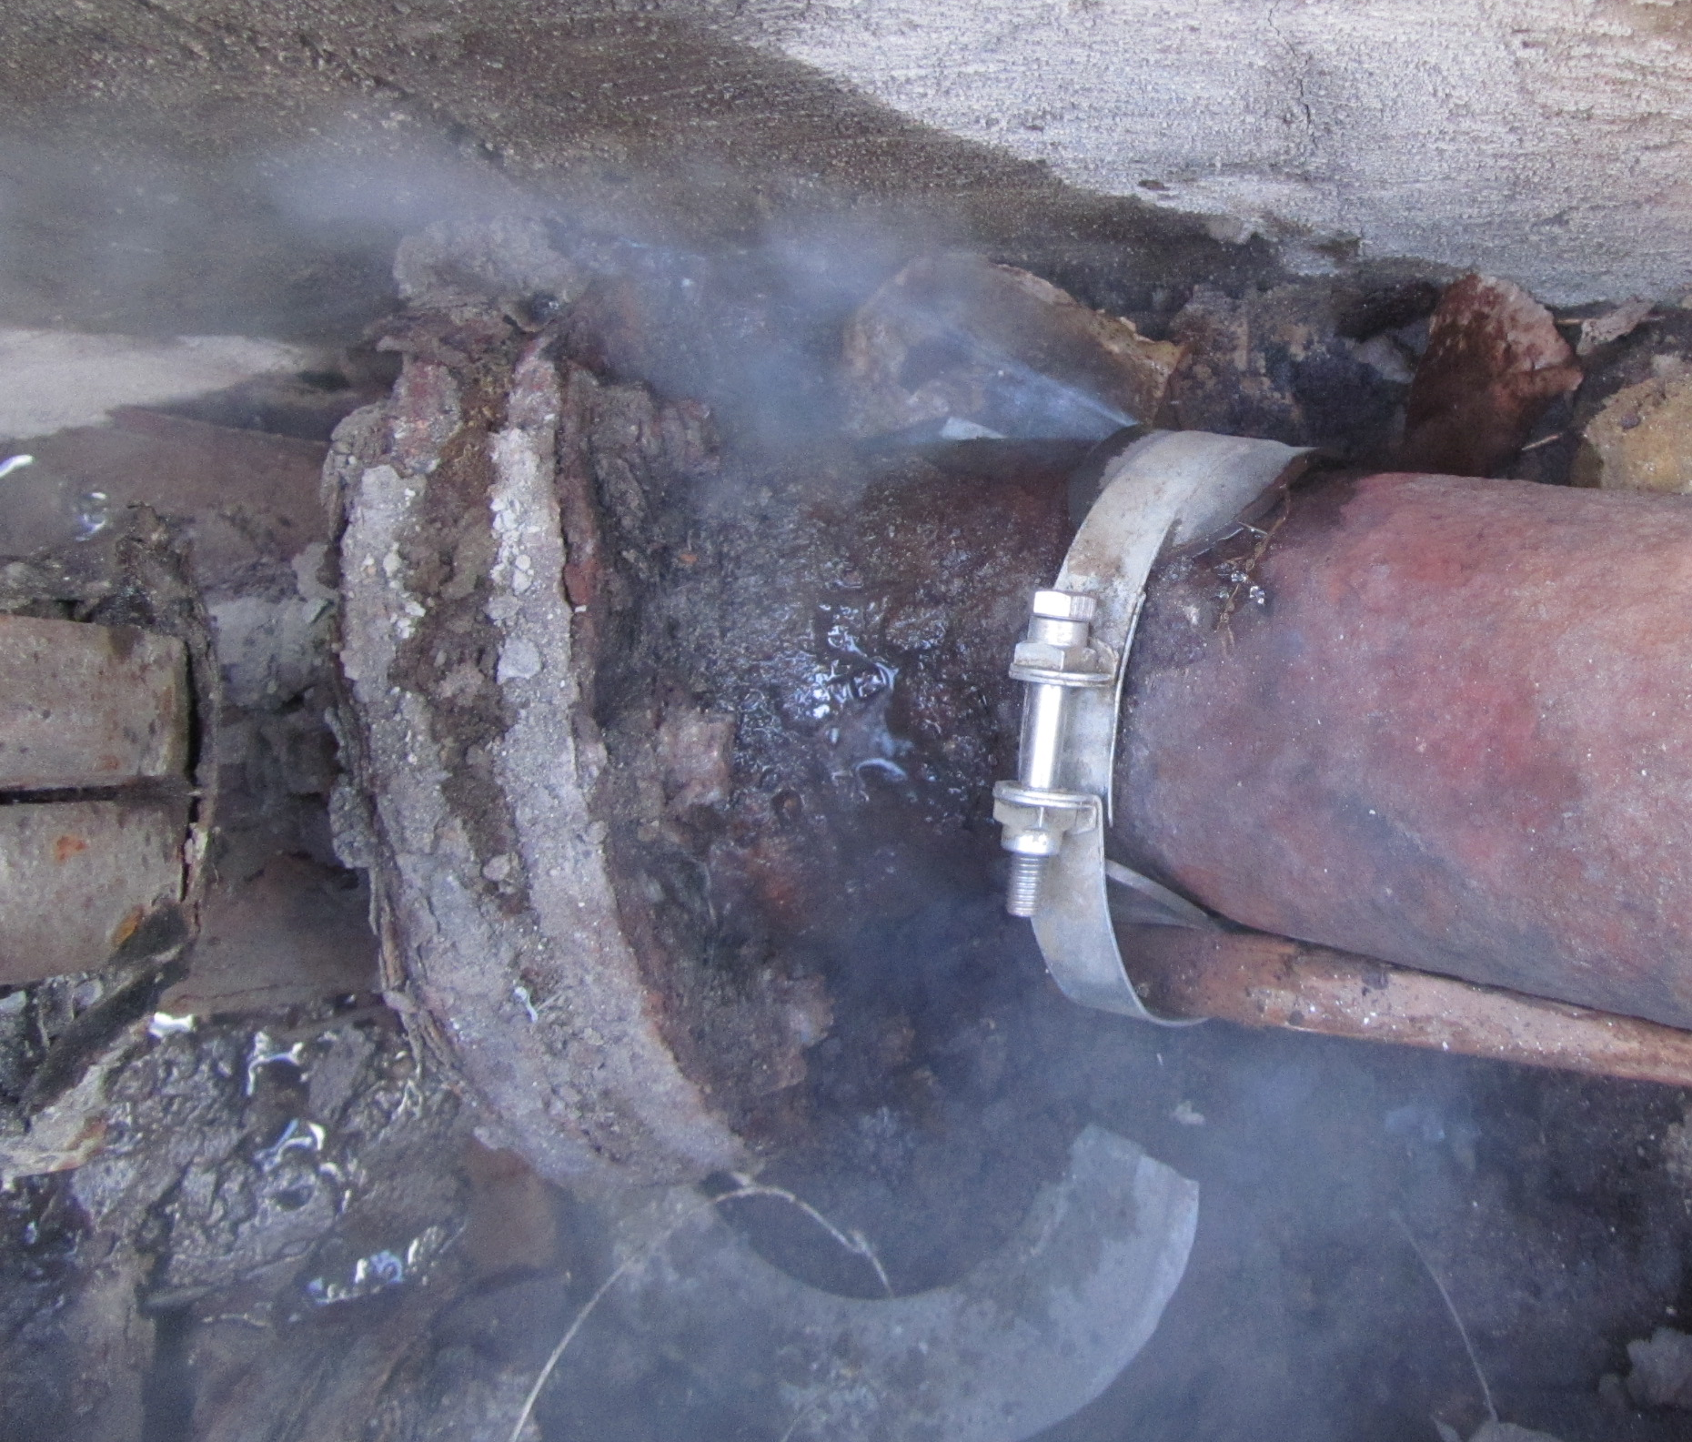
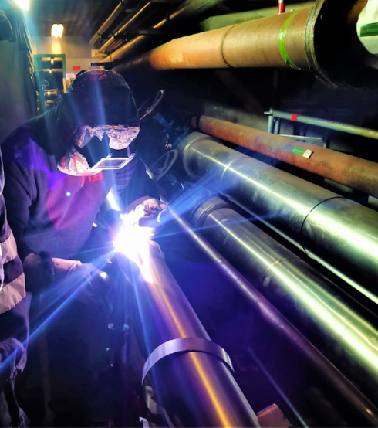
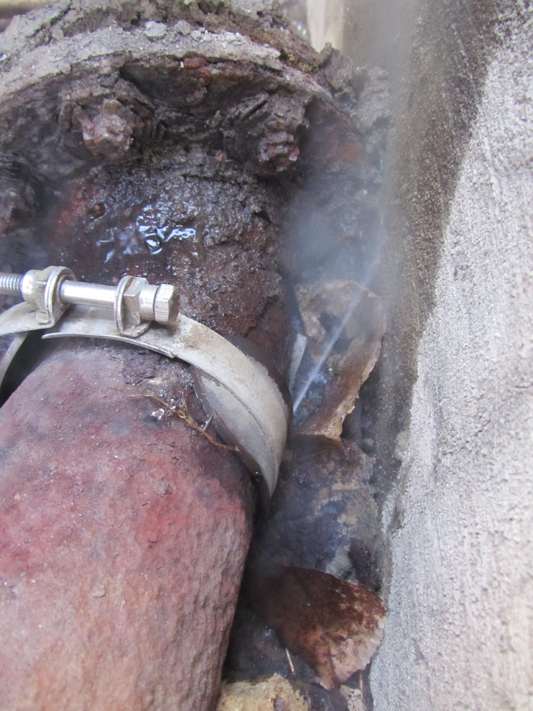
PLAN
GAS
BACKGROUND: OPTIMIZATION OF THE HEATING DISTRICT
Refurbishment of the heating plant in Meyrin & CERN’s Heating network
Installation of new boilers and new automation
Delivered in 2019
Delivered in 2017
Delivered in 2022
Leaks detection and repair in the distribution network;
Consolidation of heating substations
TG-CONS – Technical consolidations of the galleries
Notes:
100 heating substations
75 technical galleries
Pre-requisite for future optimization
(new automation system with PLC connected to network monitoring)

Slide 10
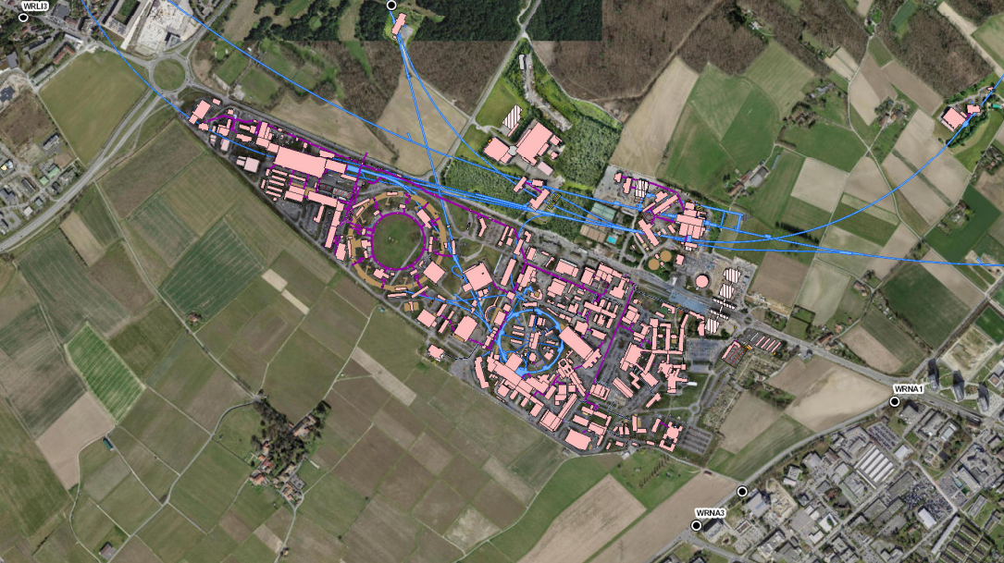
PLAN
GAS
S4: OPTIMIZATION OF THE HEATING DISTRICT
Decrease of the Temperature in the district and delay the start of the heating
The decrease of temperature in the heating district represents another possible solution to save energy: the proposal is to reduce the temperature at the delivery point of the boiler. Moreover, the starting day of the heating district is generally scheduled for the 1st of October: this date could be adjusted depending on the needs, according to the external temperature reached. In the estimation below, it has been considered a delay of 5 days.
PROPOSAL |  | -1°C IN THE DISTRICT | 5 DAYS DELAY
Energy involved | [Type] | GAS | GAS
Investment costs | [CHF] | 0 | 0
Objective of reduction | [MWh/year] | 930 | 750
Energy savings costs | [CHF/year] | 70’000 | 56’000
Human resources | FTE | 0 | 0
Schedule | October 2023
Scale of application | Meyrin and Prevessin
Impact on Users | None
1,5%
1,21%

Slide 11
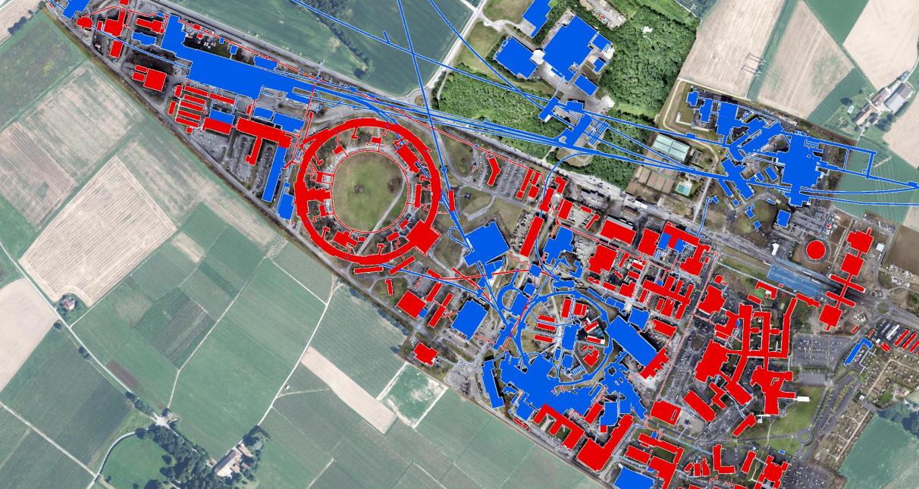



PLAN
GAS
OPTIMIZATION OF THE HEATING DISTRICT: Winter 22-23
SUBSTATIONS
Where?
Tertiary Buildings** in Meyrin and Prevessin
OPTIMIZATION OF THE HEATING CURVES:
Departure temperature based on the external temperature, to consider the influence of the climate and to avoid the waste of resources.
ECO-MODE
Additional adjustment provided to the setpoint during nighttime, during the weekend, and during holidays.
** In the following years the same optimization will be applied to the Machine Buildings
11
Notes:
100 heating substations
75 technical galleries
Dep temperature of secondary district after the heat exchanger for every building

Slide 12



PLAN
GAS
OPTIMIZATION OF THE HEATING DISTRICT: Winter 22-23
HEATING PLANTS
TEMPERATURE
Meyrin:
Optimization of the departure temperature from the boiler, which is also based on the air external temperature;
The number of boilers working simultaneously changes depending on the temperature range & power needs.
Prevessin:
The departure temperature from the boiler is fixed, and it does not vary according to the external temperature. Nevertheless, it has been optimized.
PRESSURE
Gradually decreased along the winter season in Meyrin:
November 2022: 10 bars
April 2023: 4 bars
Notes:
Old boiler needed high pressure.

Slide 13






PLAN
Electricity
& GAS
S9: GOOD BEHAVIOURS – MEMO BY HSE
Communication with users is crucial to raise awareness about the energy consumption strategy. Reminders from HSE about sensitive topics are essential to warn users about their impact on energy consumption and to guide them into changing their habits at CERN.
Switch off lights when you leave the room (office, labs, corridors and halls);
Turn off computers & screens when possible;
Remember to close windows and doors, especially when heating or air conditioning is on;
Reduce the valve of radiators when possible
Avoid using domestic hot water;
Reduce/Remove air conditioning when possible.
Close blinders during summer
Energy involved | [Type] | Electricity | Gas
Investment costs | [CHF] | 0 | 0
Objective of reduction | [MWh/year] | 2’400 | 3’100
Energy savings costs | [CHF/year] | 130’000 | 230’000
Payback | [years] | 0
Human Resources | FTE | 0
Schedule | October 2023
Scale of application | Meyrin and Prevessin
Impact on Users | Best effort
EXPECTED ENERGY SAVINGS – GOOD BEHAVIOURS
SAVINGS:
5%
SAVINGS:
5%
N.B. The savings in electricity represent 0,24% of CERN’s Total Electricity consumption [990’895 MWh/year]

Slide 14
Summary
Introduction
PLAN
ACHIEVEMENT
FUTURE PERSPECTIVES
Solutions proposed in 2022: application in winter season 22-23
Led installation
Shutdown of public lights at nights
No electrical radiators
Optimization of the heating district
User awareness: good behaviour – HSE Campaign
Focus on electricity consumption
Focus on gas consumption
Sustainable heating plants
Cooling strategy
Conclusion
14

Slide 15
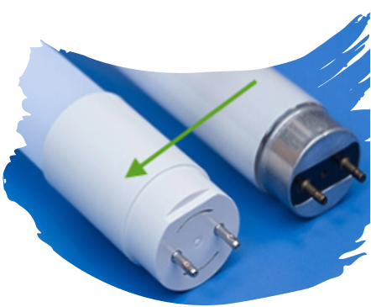

ACHIEVEMENTS
Electricity
LEDs INSTALLATION CAMPAIGN**
Starting date: 09/01/2023
TODAY:
Savings: 283 MWh
LED Installed: 10’260
EXPECTATIONS
DECEMBER 2023:
LED to be Installed: 28’000
After one year from the installation
Investment costs | [CHF] | 730’000
Objective of reduction | [MWh/year] | 1’992
Energy savings costs | [CHF/year] | 228’000
Scale of application | 23% of total LED number in Meyrin and Prevessin
Impact on Users | None
Manpower increased by 2 FTE in February 2022
**Please note that these data comes from a calculation, not from invoices
Notes:
4%

Slide 16
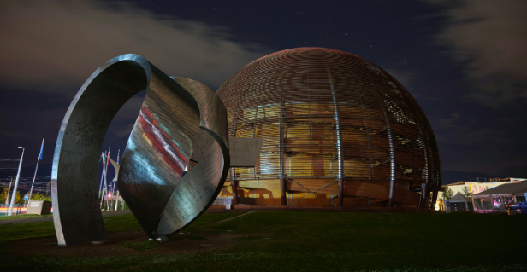

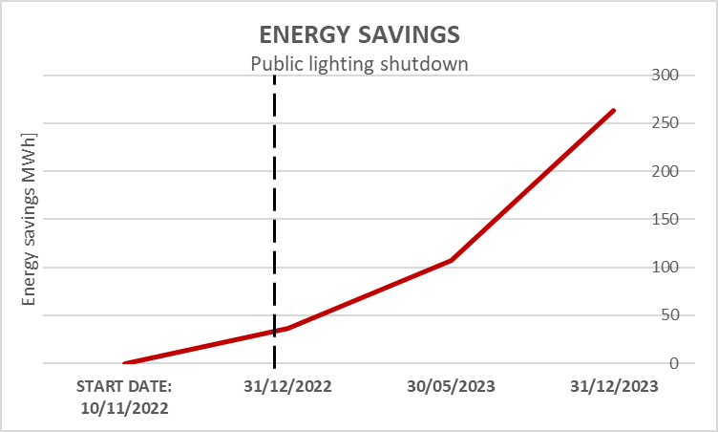
ACHIEVEMENTS
PUBLIC LIGHTING SHUTDOWN**
Electricity
The public light has been shutdown every night from 11 p.m. to 5 a.m.
Starting date: 11/10/2022
2022
2023
TODAY
IMPACT ON CERN’S ELECTRICITY CONSUMPTION:
Year 2022 (Oct.22 to Dec22): 36,7 MWh → 0,07 % Annual reduction
Year 2023 (Until Today) 106.56 MWh → 0,22 % Current Reduction
(Jan23 to Dec23) 262.8 MWh → 0,54 % Annual reduction
**Please note that these data comes from a calculation, not from invoices
16
Notes:
Waiting for more data - Nicolas Bellegarde

Slide 17
Summary
Introduction
PLAN
ACHIEVEMENT
FUTURE PERSPECTIVES
Solutions proposed in 2022: application in winter season 22-23
Led installation
Shutdown of public lights at nights
No electrical radiators
Optimization of the heating district
User awareness: good behaviour – HSE Campaign
Focus on electricity consumption
Focus on gas consumption
Sustainable heating plants
Cooling strategy
Conclusion
17

Slide 18
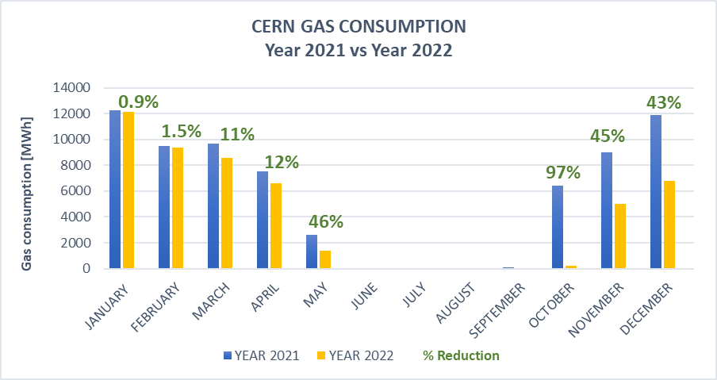
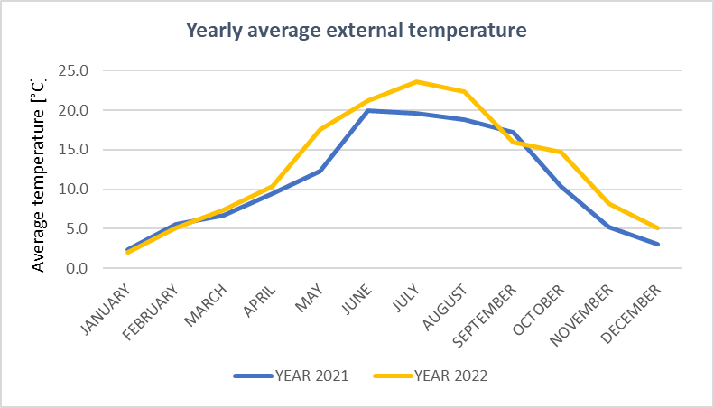
ACHIEVEMENTS
CERN Site
Comparison in gas consumption: 2021 vs. 2022
ENERGY SAVING POLICY 2022
Source: SCE-SAM Gas Invoices
YEAR 2021 [MWh] | 68,971.73
YEAR 2022 [MWh] | 50,048.92
Savings [MWh] | 18,922.81
% Reduction | 27%
BILL 2021 [CHF/year] | 2,73 Millions
BILL 2022 [CHF/year] | 2,65 Millions
Savings [CHF/year] | 0,08 Millions

Slide 19
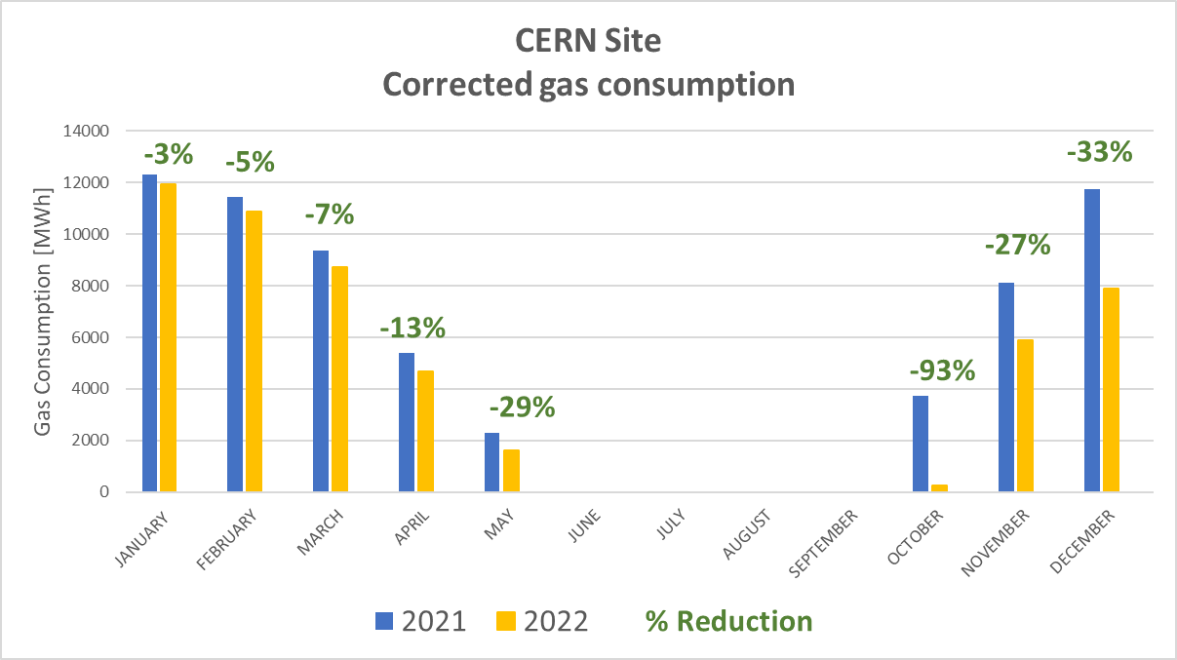

ACHIEVEMENTS
CERN Site
Corrected comparison in gas consumption: 2021 vs. 2022
DJ [DEGRÉ JOUR] = DJ make it possible to weight the energy consumption according to the climate. The climate correction consists of weighting the heating consumption on the annual climate data of the weather station. The goal is to make the years comparable with each other, regardless of the harshness of winter.
Without the influence of climate
Real consumption vs. Corrected consumption
YEAR 2021 [MWh] | 68,971.7
YEAR 2022 [MWh] | 50,048.9
Savings [MWh] | 18,922.8
% Reduction | 27%
YEAR 2021 [MWh] | 64,484.4
YEAR 2022 [MWh] | 51,917.7
Savings [MWh] | 12,550.8
% Reduction | 19%
SCE-SAM Gas invoices
Without the influence of the climate
Looking at the Corrected consumption, we can see that, erasing the climatic variable, CERN gas consumption in 2022 decreased.
The Reference DJ for the calculation comes from an average of 20 years of data (2000-2022), for a range of 12/18°C
Source: Office cantonal de l'énergie - OCEN
ENERGY SAVING POLICY 2022
Notes:
Hot wave in may
External temperature is less than 12°C
It is a difference between the external temp and a reference temp that allows the estimation of the energy consumption in the buildings.
So
Le degré jour unifié (DJU) est la différence entre la température extérieure et une température de référence qui permet de réaliser des estimations de consommations d'énergie thermique pour maintenir un bâtiment confortable en proportion de la rigueur de l'hiver ou de la chaleur de l’été
mma estesa a tutti i giorni della differenza positiva di temperatura tra una fissata (18) e la temp media esterna giornaliera

Slide 20

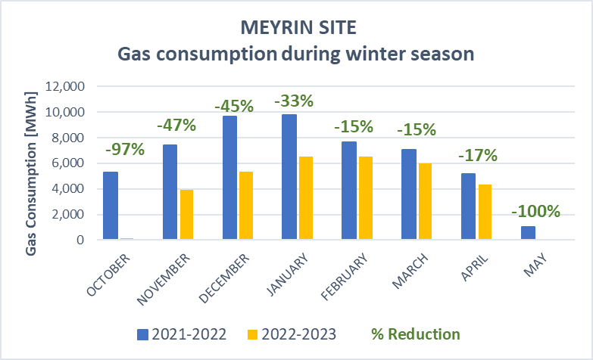
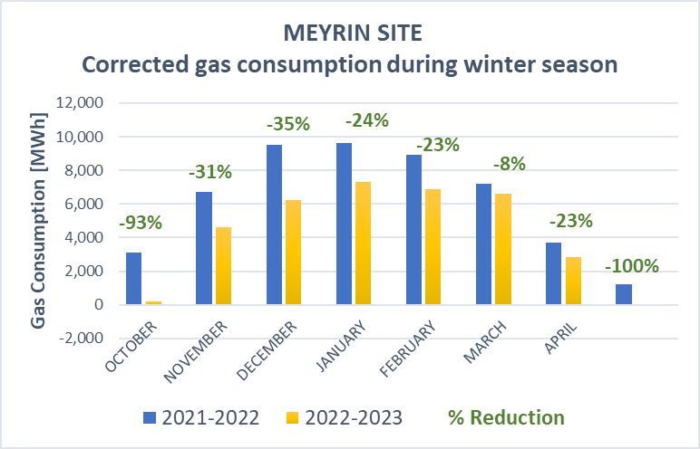

ACHIEVEMENTS
Meyrin Site
Comparison in gas consumption: winter seasons 21-22 vs 22-23
From SCE-SAM Gas Invoices:
Without the influence of climate
Gas consumption [MWh] |  |  | Saving
Month | 2021-2022 | 2022-2023 | MWh
October | 5,278.0 | 149.5 | 5,128.51
November | 7,422.3 | 3,906.4 | 3,515.85
December | 9,670.6 | 5,341.9 | 4,328.75
January | 9,751.8 | 6,516.4 | 3,235.39
February | 7,653.7 | 6,499.6 | 1,154.13
March | 7,062.0 | 5,975.2 | 1,086.82
April | 5,187.4 | 4,313.6 | 873.81
May | 1,042.0 | 0.0 | 1,042.02
TOTAL | 53,067.9 | 32,702.6 | 20,365.26
Reduction from winter 21-22 to winter 22-23: - 38%
Total corrected reduction from winter 21-22 to winter 22-23: -31%
Run of the Heating District:
Season 2021-22: October 2021 - May 2022
Season 2022-2023: November 2022 – April 2023

Slide 21
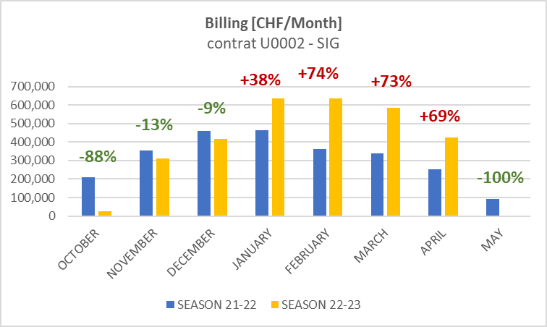
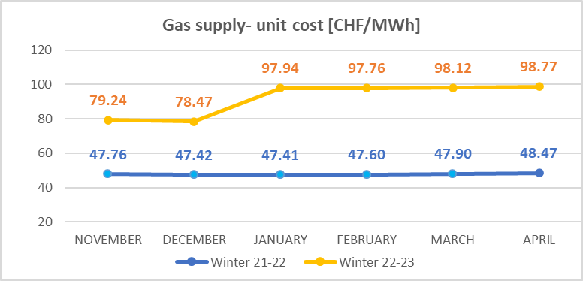
ACHIEVEMENTS
Meyrin Site
Consumption vs Expenses – winter seasons 21-22 vs 22-23
From SCE-SAM Gas Invoices:
Run of the Heating District:
Season 2021-22: October 2021 - May 2022
Season 2022-2023: November 2022 – April 2023
Despite the decrease in the consumption of GAS, the bills have significantly increased.
Notes:
Comparison 2 years gas consump

Slide 22
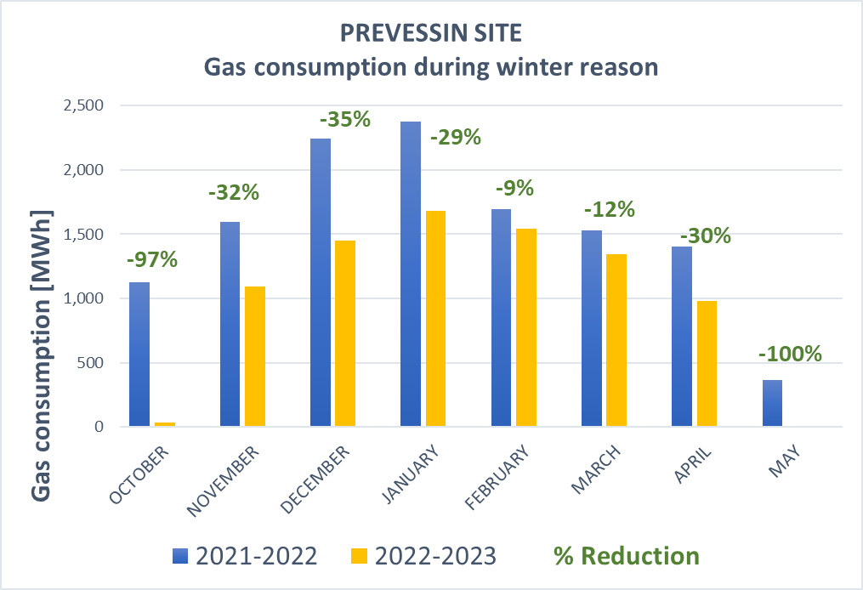
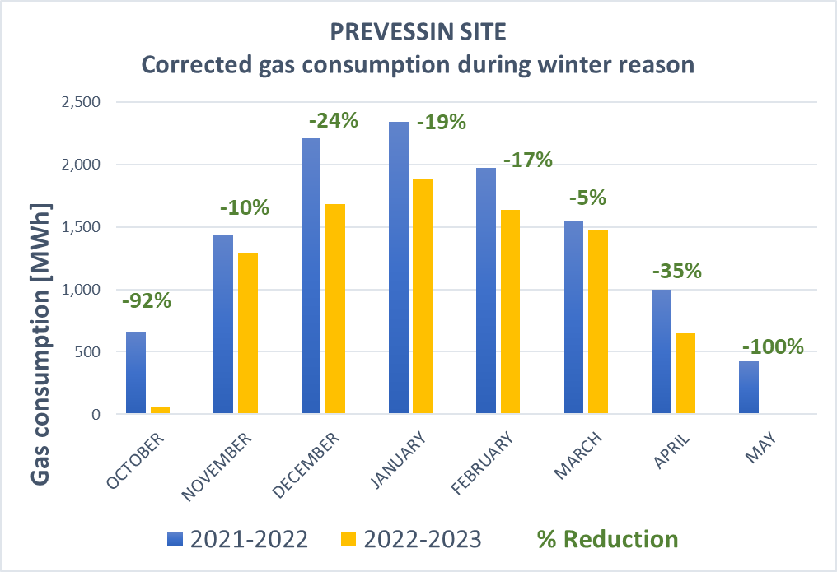
ACHIEVEMENTS
Prevessin Site
Comparison in gas consumption: winter seasons 21-22 vs 22-23
From SCE-SAM Gas Invoices:
Without the influence of climate
Gas consumption [MWh] |  |  | Saving [MWh]
Month | 2021-2022 | 2022-2023
October | 1,127.0 | 36.5 | 1,090.5
November | 1,596.4 | 1,093.2 | 503.1
December | 2,242.9 | 1,447.6 | 795.3
January | 2,378.2 | 1,684.0 | 694.1
February | 1,697.1 | 1,542.1 | 155.0
March | 1,525.4 | 1,341.3 | 184.1
April | 1,403.1 | 980.3 | 422.8
May | 367.3 | 0.0 | 367.3
TOTAL | 12,337.4 | 8,125.1 | 4,212.3
Reduction from winter 21-22 to winter 22-23: - 34%
Total corrected reduction from winter 21-22 to winter 22-23: -25%
Run of the Heating District:
Season 2021-22: October 2021 - May 2022
Season 2022-2023: November 2022 – April 2023

Slide 23
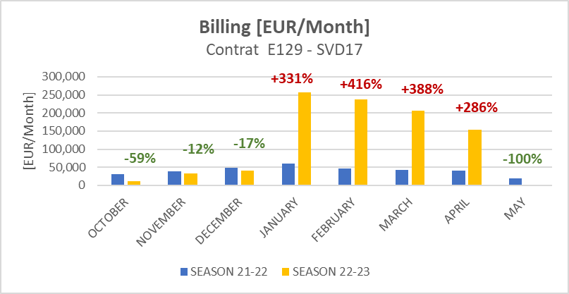
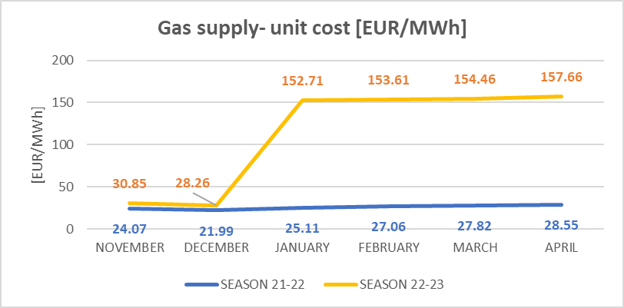
ACHIEVEMENTS
Prevessin Site
Consumption vs Expenses – Winter seasons 21-22 vs 22-23
From SCE-SAM Gas Invoices:
Run of the Heating District:
Season 2021-22: October 2021 - May 2022
Season 2022-2023: November 2022 – April 2023
Despite the decrease in the consumption of GAS, the bills have significantly increased.
Fixed future GAS Prices (Contract SDV17):
2024: 69.33 €/MWh
2025: 60.81 €/MWh

Slide 24
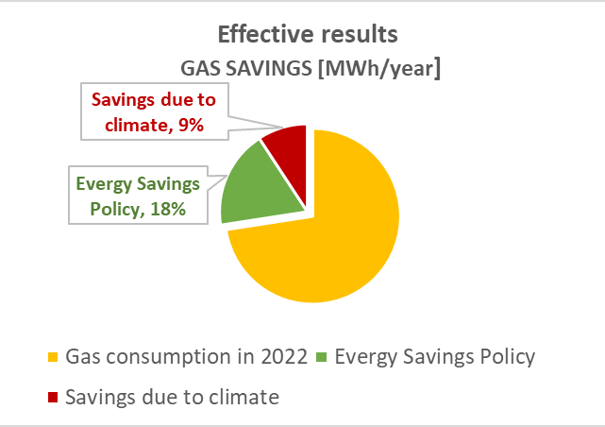

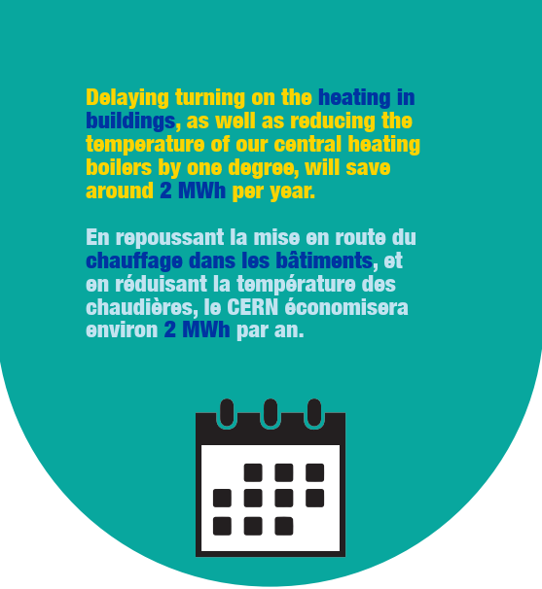



ACHIEVEMENTS
Expectations vs. Reality
BILL 2021 [CHF/year] | 2,73 Millions
BILL 2022 [CHF/year] | 2,65 Millions
Savings [CHF/year] | 0,08 Millions
MEMO BY HSE

Slide 25
Summary
Introduction
PLAN
ACHIEVEMENT
FUTURE PERSPECTIVES
Solutions proposed in 2022: application in winter season 22-23
Led installation
Shutdown of public lights at nights
No electrical radiators
Optimization of the heating district
User awareness: good behaviour – HSE Campaign
Focus on electricity consumption
Focus on gas consumption
Sustainable heating plants
Cooling strategy
Conclusion
25
Notes:
Meyrin: G:\Departments\SMB\Groups\SE\HE\HE HVAC\Batiments\200\2022_heating_plant_upgrade\DCE\Steering_board
Prevessin: G:\Departments\SMB\Groups\SE\HE\HE HVAC\Batiments\776 - Nouvelle chaufferie\02_DCE\Steering_board

Slide 26
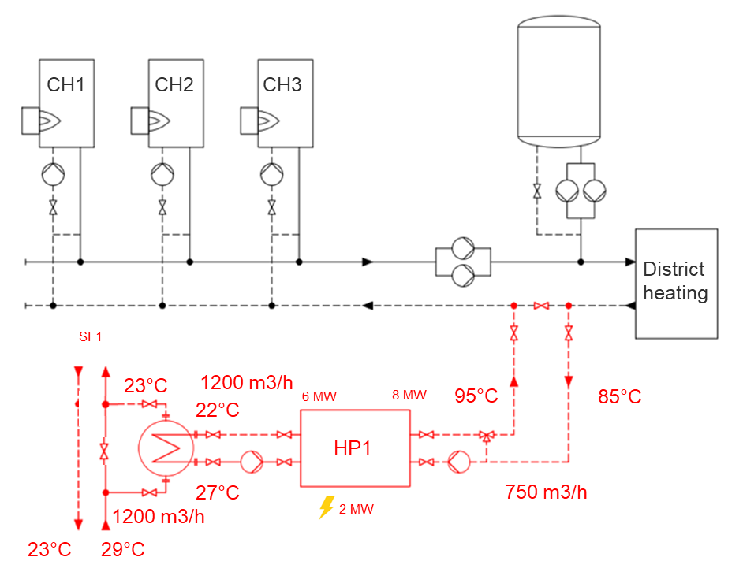
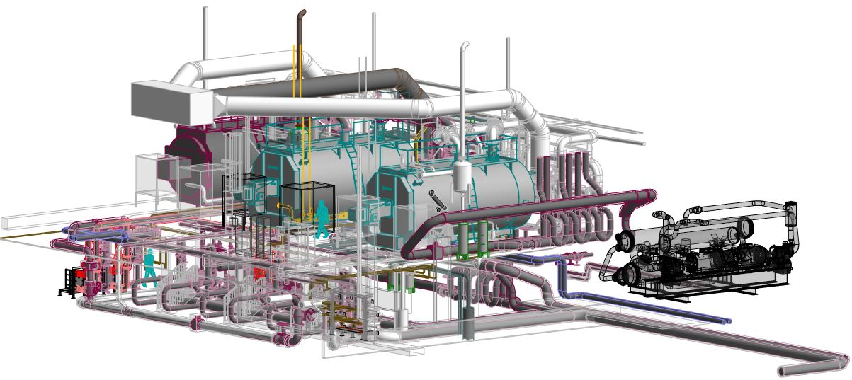

FUTURE PERSPECTIVES
SUSTAINABLE HEATING PLANT
Meyrin Heating Plant
Objectives:
Renovation of the heating distribution components in B200 & 201.
Arrangement of technical room in B200 for housing the heating pump.
Installation and connection of the heating pump.
Pipes connection from HP to PA1.
Delivery expected for hot season 2026-27
CURRENT CONFIGURATION (200 & 201)
3 boilers supplying the heating district in Meyrin Site
COOLING TOWER
PA1 LHC
SF1
PROJECT:
HEAT PUMP INSTALLATION
To recover energy from the cooling tower SF1, covering the main heating needs on the Meyrin site.
HEAT PUMP
Notes:
To achieve the goal of carbon neutrality in 2050, any upgrade or change of the heating plant has to consider both the cost and level of CO2 emissions of the future energy, its transport and infrastructure. Ideally, any heating network should be based on diverse energy sources, e.g. recovering heat produced on site and integrating renewable energy sources such as solar energy, geothermal, biomass, biodegradable waste, biogas, bio-oil, heat pumps, and electricity produced from renewable energy sources
Heat pump to be conn to accelerator cooling system to recover energy
PA1 Atlas
The proposed project will reuse the fatal energy from SF1 with heat pumps powered by electricity, resulting in a much-reduced carbon emission and a raise of the renewable energy rate, following the European and French directives about energy efficiency.
The new heating plant proposal ensures the main power via heat pumps, to cover the major part of the current heating needs on the Meyrin site, backed up by gas boilers which will also cover the power peaks in the coldest days. The energy source for the heat pumps is SF1
t P1

Slide 27
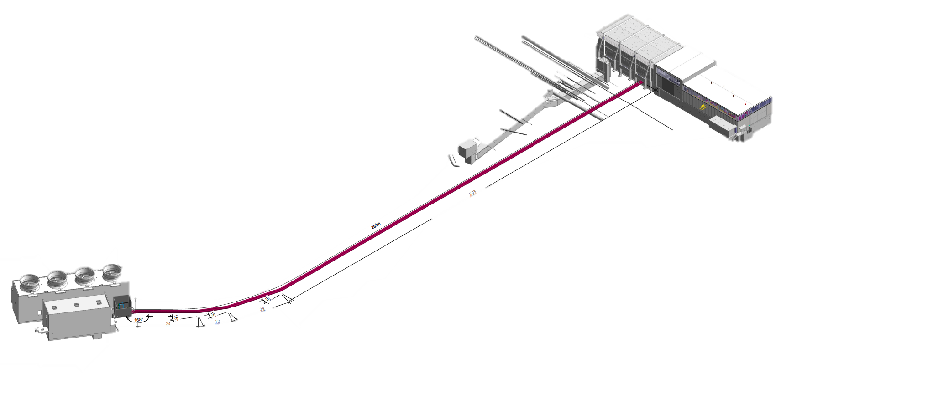
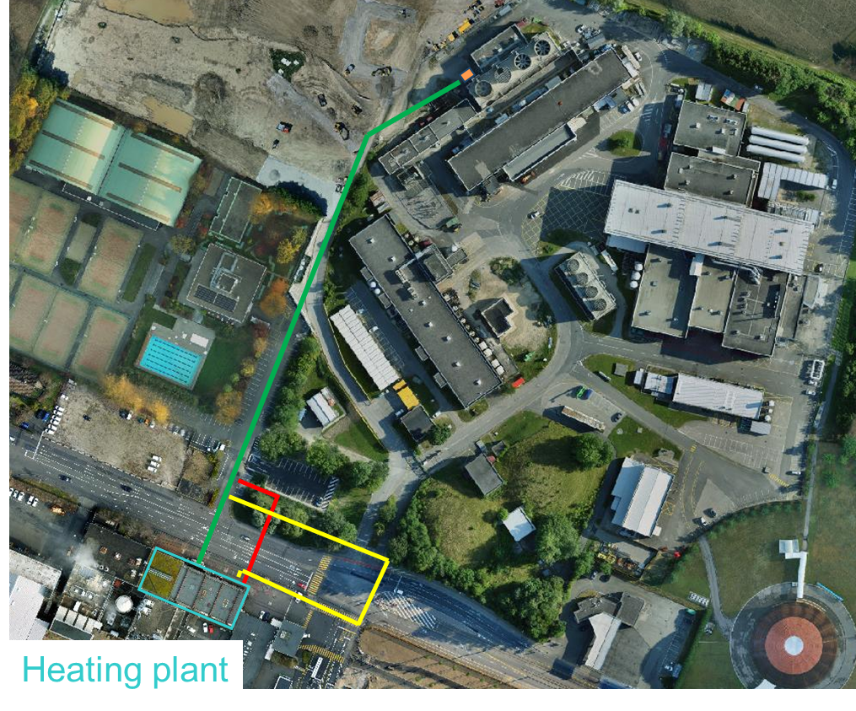
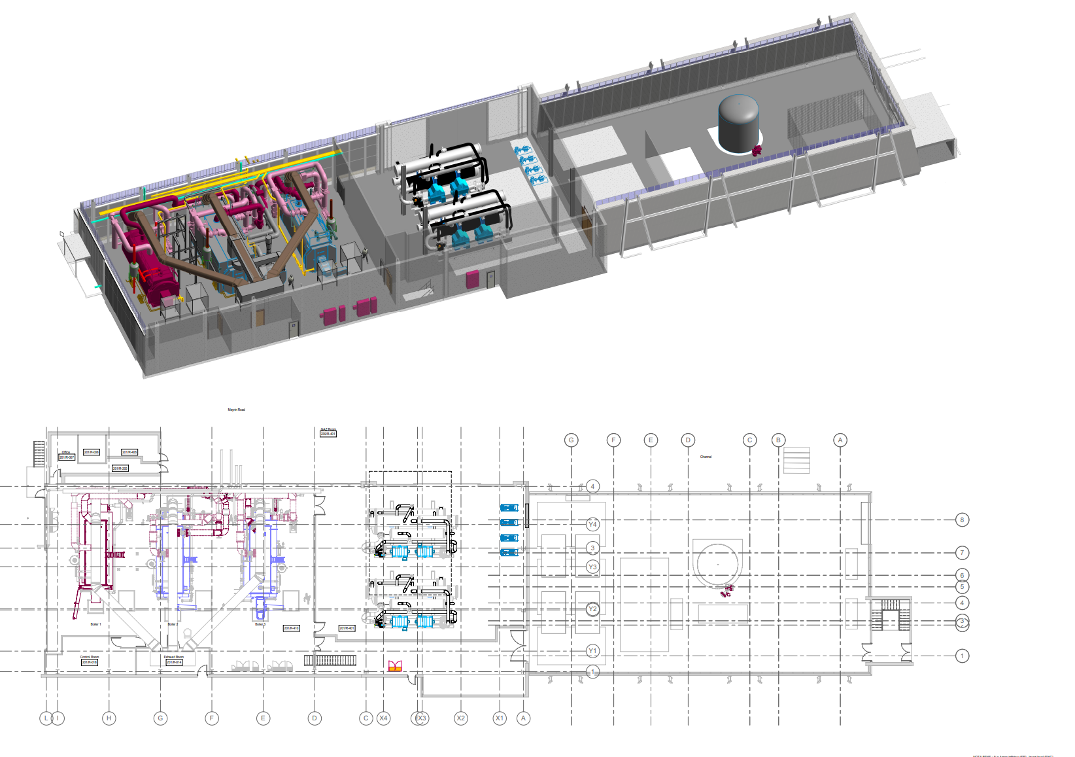
FUTURE PERSPECTIVES
SUSTAINABLE HEATING PLANT
Meyrin Heating Plant– Design overview
Heating Plant
3 boilers, 15 MW each (existing).
1 heat pump 8 MW
Available place for additional heat pump, if needed
PROJECT: HEAT PUMP INSTALLATION
To recover energy from the cooling tower SF1, covering the main heating needs on the Meyrin site.
SF1
SF1
New Heat Pump
200
201
Meyrin Site
Notes:
How much in terms of savings (gas and CO2) now vs future

Slide 28
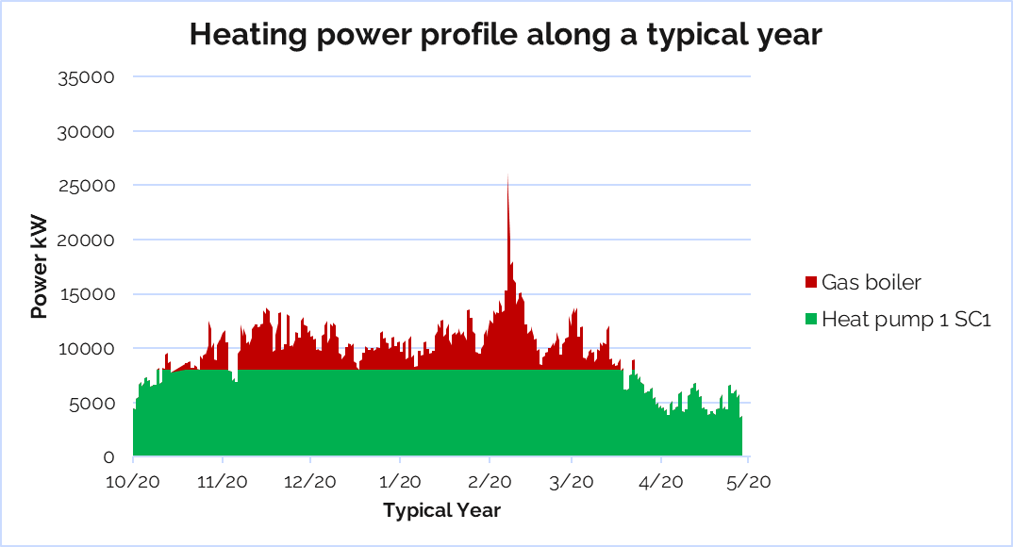
FUTURE PERSPECTIVES
SUSTAINABLE HEATING PLANT
Meyrin Heating Plant - Advantages
  Flexibility with gas boilers
The boilers will represent a backup for the HP, for the power peaks in the coldest days
  Compliance with European directives regarding the Carbon Neutrality goal by 2050: increase in renewable energy rate and reduction in CO2 emissions.
  N.B. The goal is to work on the decrease of the peaks of installing a bigger Heat Pump.
Notes:
How much in terms of savings (gas and CO2) now vs future
Goal: to decrease the peaks (energy needs) instead of installing a bigger HP to cover the whole need
Optimization heating district to minimize the peaks and to cover max power with heat pump

Slide 29
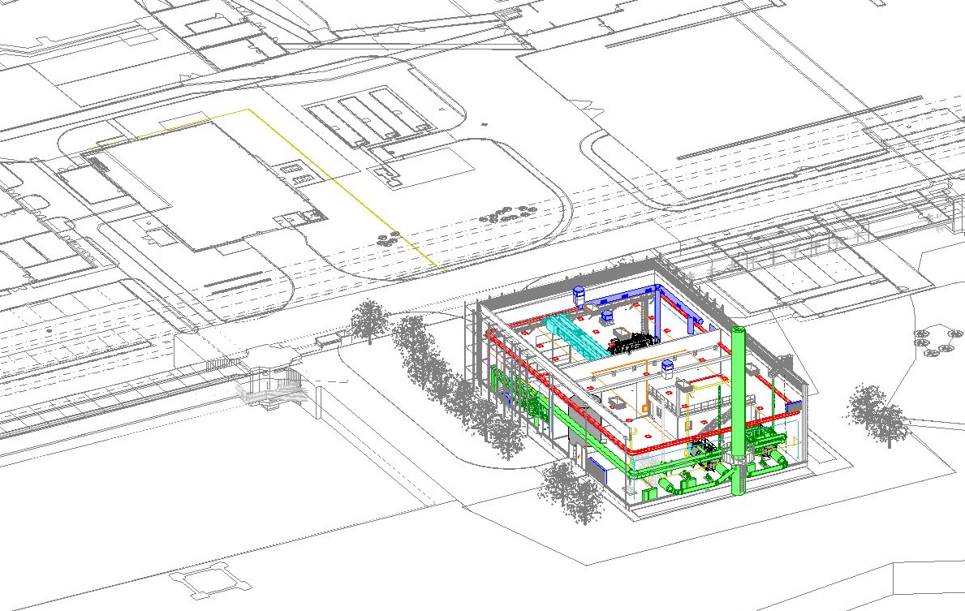
FUTURE PERSPECTIVES
SUSTAINABLE HEATING PLANT
Prevessin Heating Plant
Objectives:
New Building 776 for housing the heating plant;
Installation new heating plant with gas boilers and heat pump;
Dismantle the current heating installation in Building 860.
Delivery expected for hot season 2026-27
B.860
PCC, B.775
Building 776
New building, hosting the heating plant
Notes:
Meyrin: G:\Departments\SMB\Groups\SE\HE\HE HVAC\Batiments\200\2022_heating_plant_upgrade\DCE\Steering_board
Prevessin: G:\Departments\SMB\Groups\SE\HE\HE HVAC\Batiments\776 - Nouvelle chaufferie\02_DCE\Steering_board

Slide 30
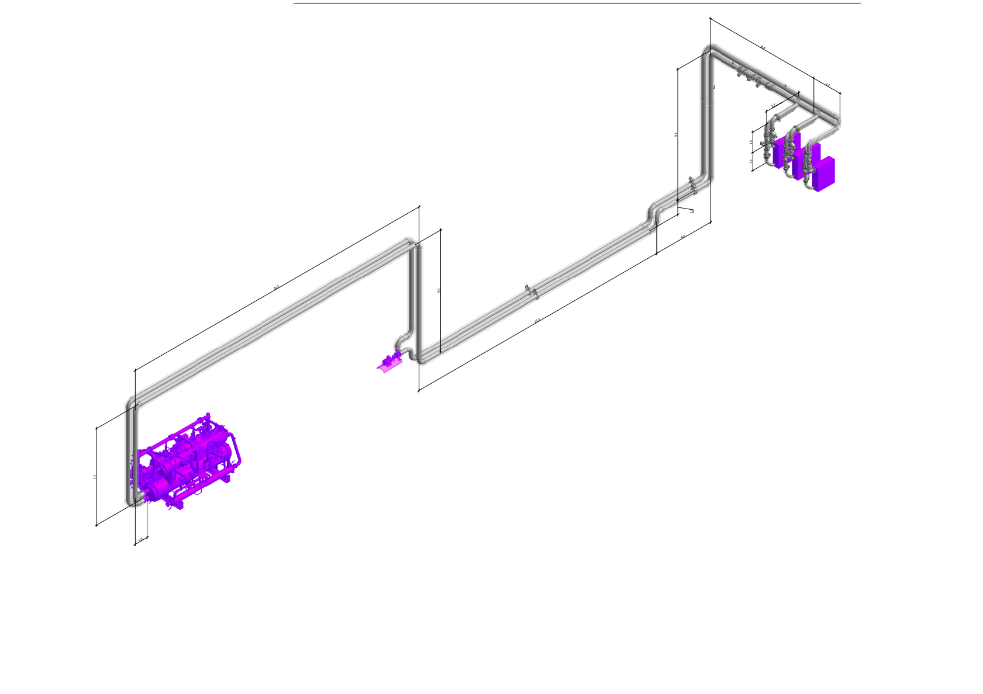
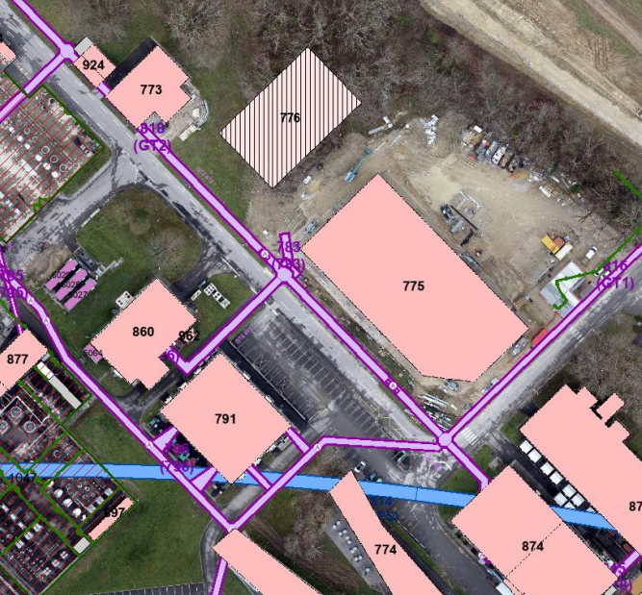
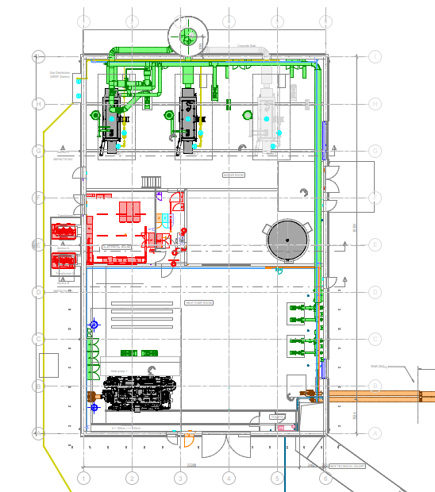
FUTURE PERSPECTIVES
SUSTAINABLE HEATING PLANT
Prevessin Heating Plant – Design overwiew
PCC Heat exchangers
Gallery 818
Networks to be connected
Building 776
New building, hosting the heating plant
775
New Heat Pump
776
Building 775
Hosting PCC, to be connected for the heat recovery
Heating plant configuration:
  2 boilers, 1-2MW & 1-4 MW
  1 heat pump 2.5 MW
  Available place for additional boiler & heat pump, if needed
Building 860
Hosting old heating plant, to be dismantled
Notes:
(1 of the boilers 4MW equipped for injector for Gas&Fuel, not only gas, in case of gas crisis

Slide 31
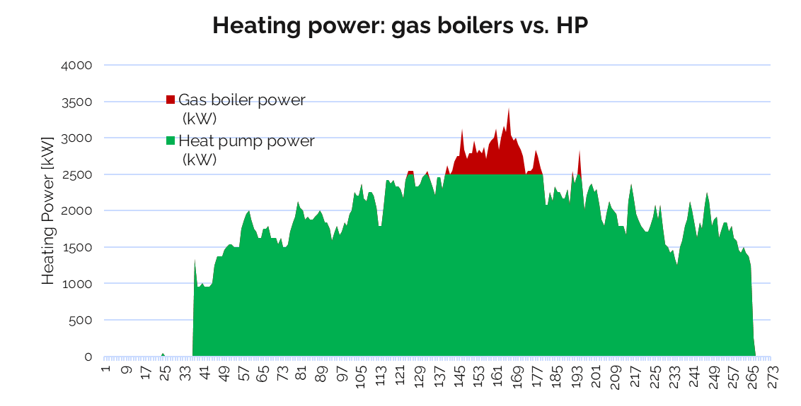
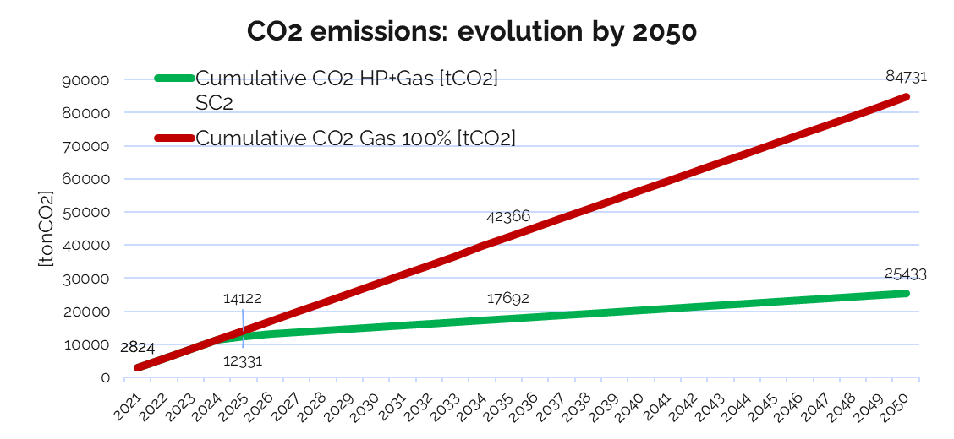
FUTURE PERSPECTIVES
SUSTAINABLE HEATING PLANT
Prevessin Heating Plant - Advantages
  Flexibility with gas boilers
  Compliance with European directives regarding the Carbon Neutrality goal by 2050: increase in renewable energy rate and reduction in CO2 emissions.
The boilers will represent a backup for the HP, for the power peaks in the coldest days
Heating power profile along a typical year
80% Heat pump
Heat pump = 80%
  N.B. The goal is to work on the decrease of the peaks of installing a bigger Heat Pump.
Notes:
Gas price in 2021 with increase rate 2.5 % every year
Meyrin old value before update heating
Goal: to decrease the peaks (energy needs) instead of installing a bigger HP to cover the whole need
Optimization heating district to minimize the peaks and to cover max power with heat pump

Slide 32
Summary
Introduction
PLAN
ACHIEVEMENT
FUTURE PERSPECTIVES
Solutions proposed in 2022: application in winter season 22-23
Led installation
Shutdown of public lights at nights
No electrical radiators
Optimization of the heating district
User awareness: good behaviour – HSE Campaign
Focus on electricity consumption
Focus on gas consumption
Sustainable heating plants
Cooling strategy
Conclusion
32

Slide 33
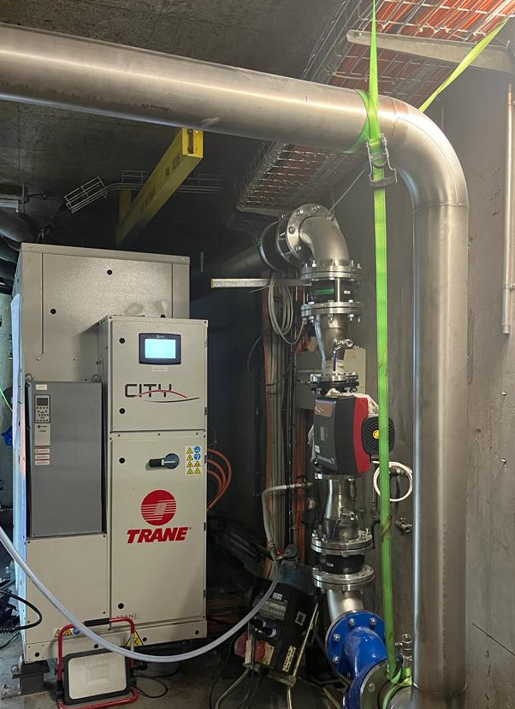
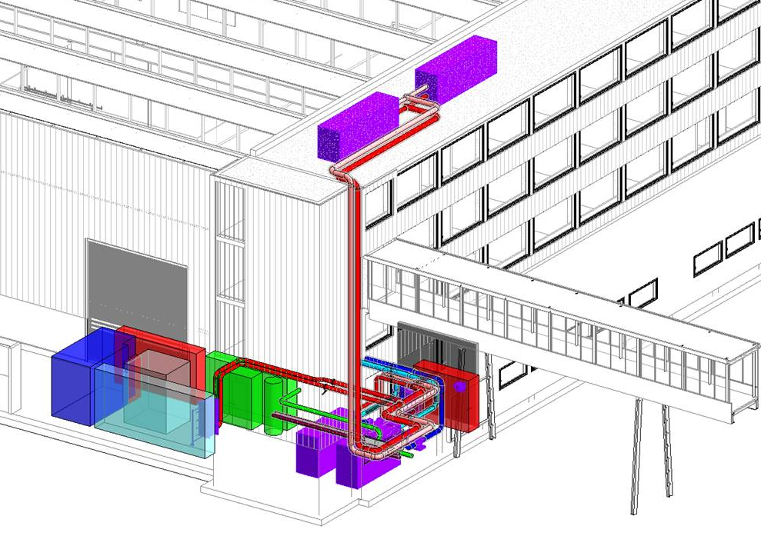
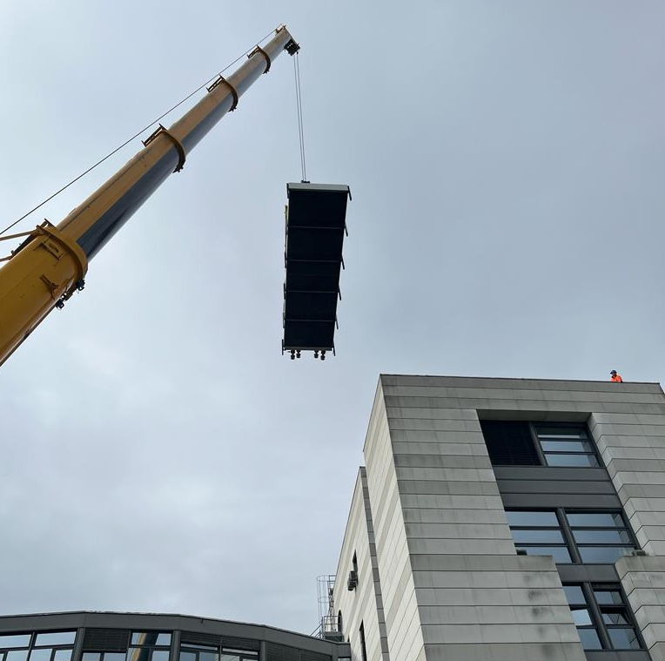
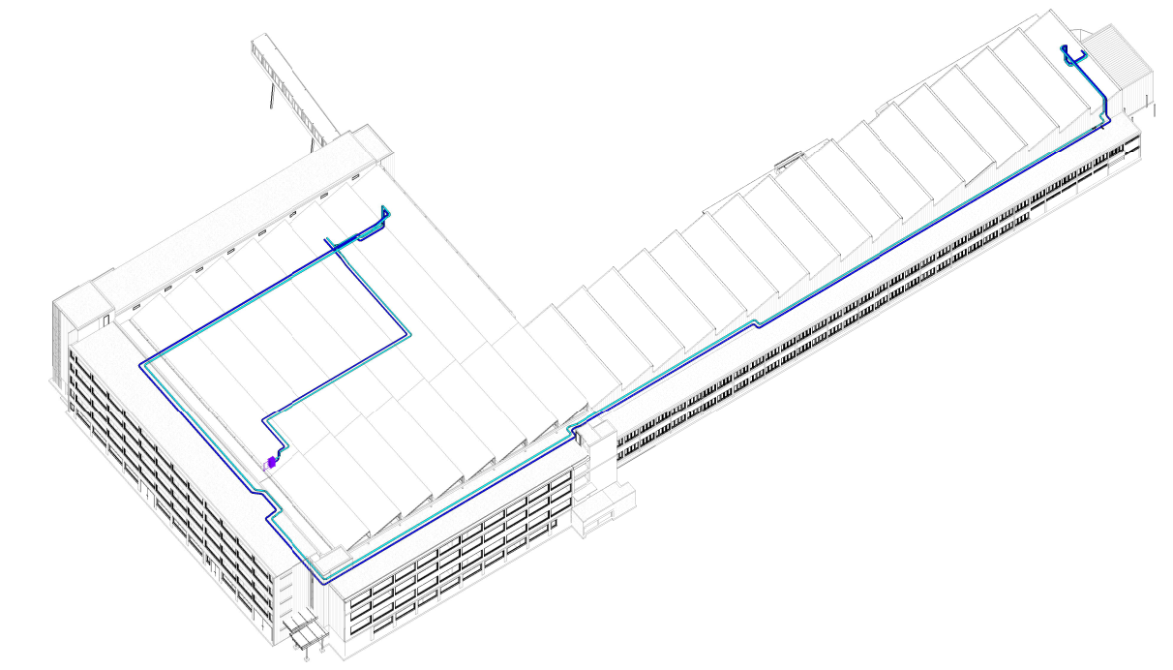
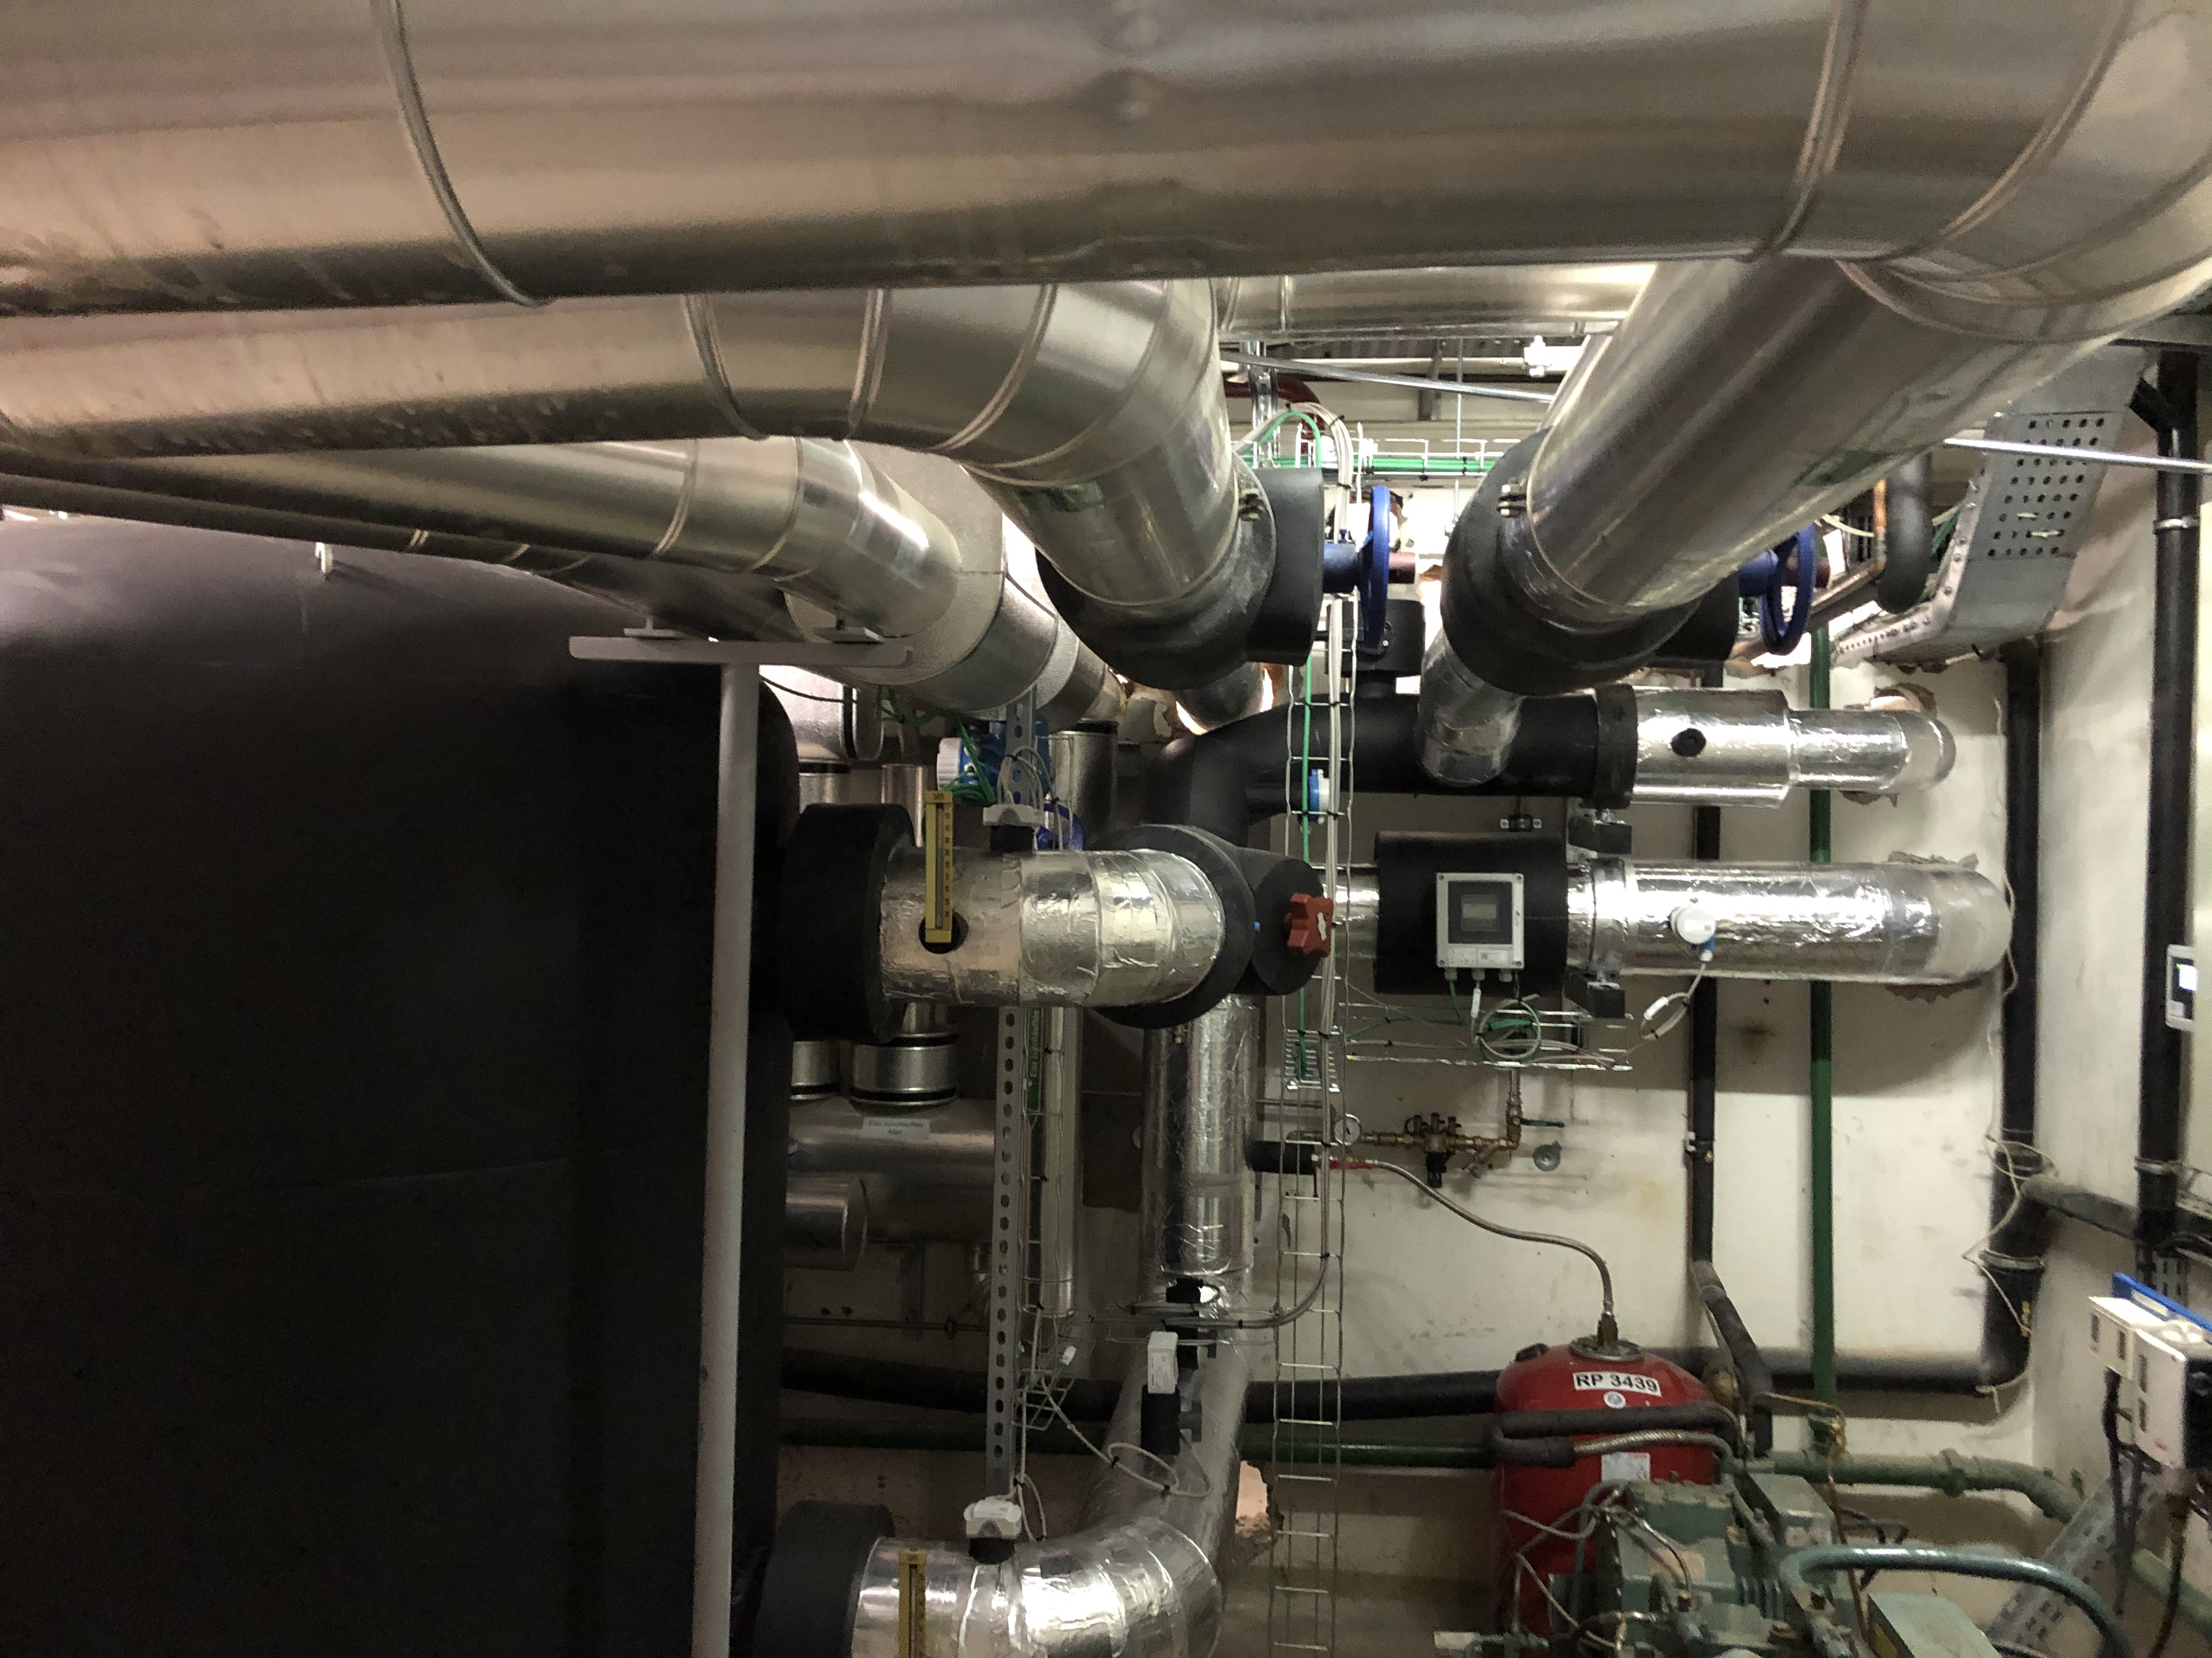
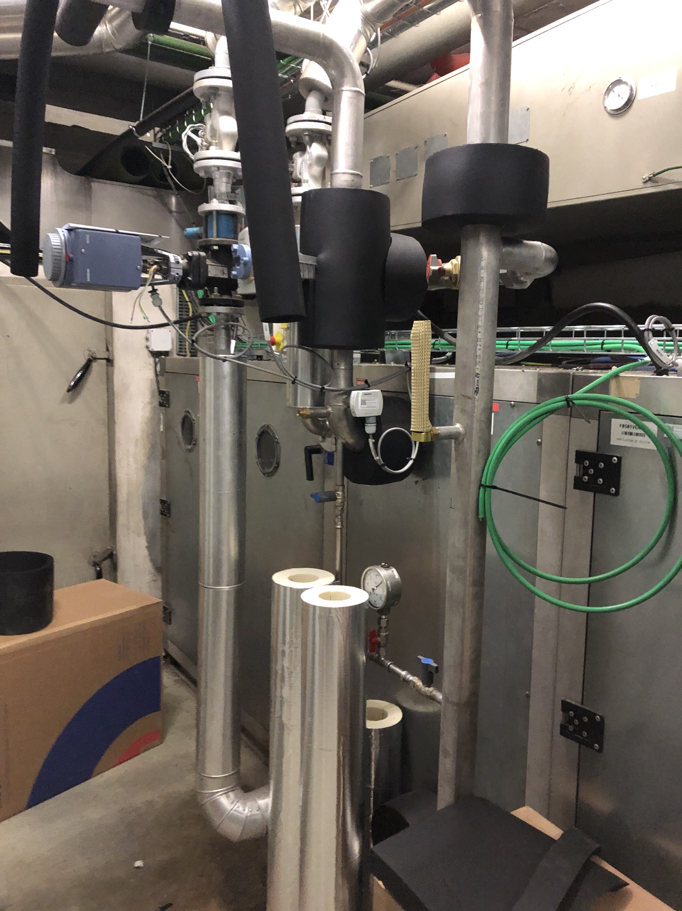
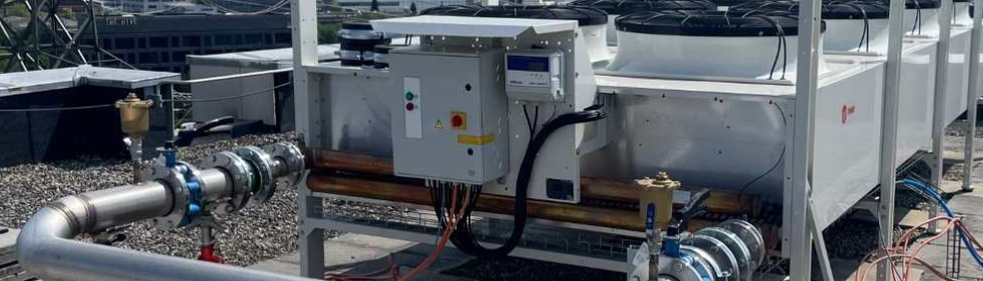
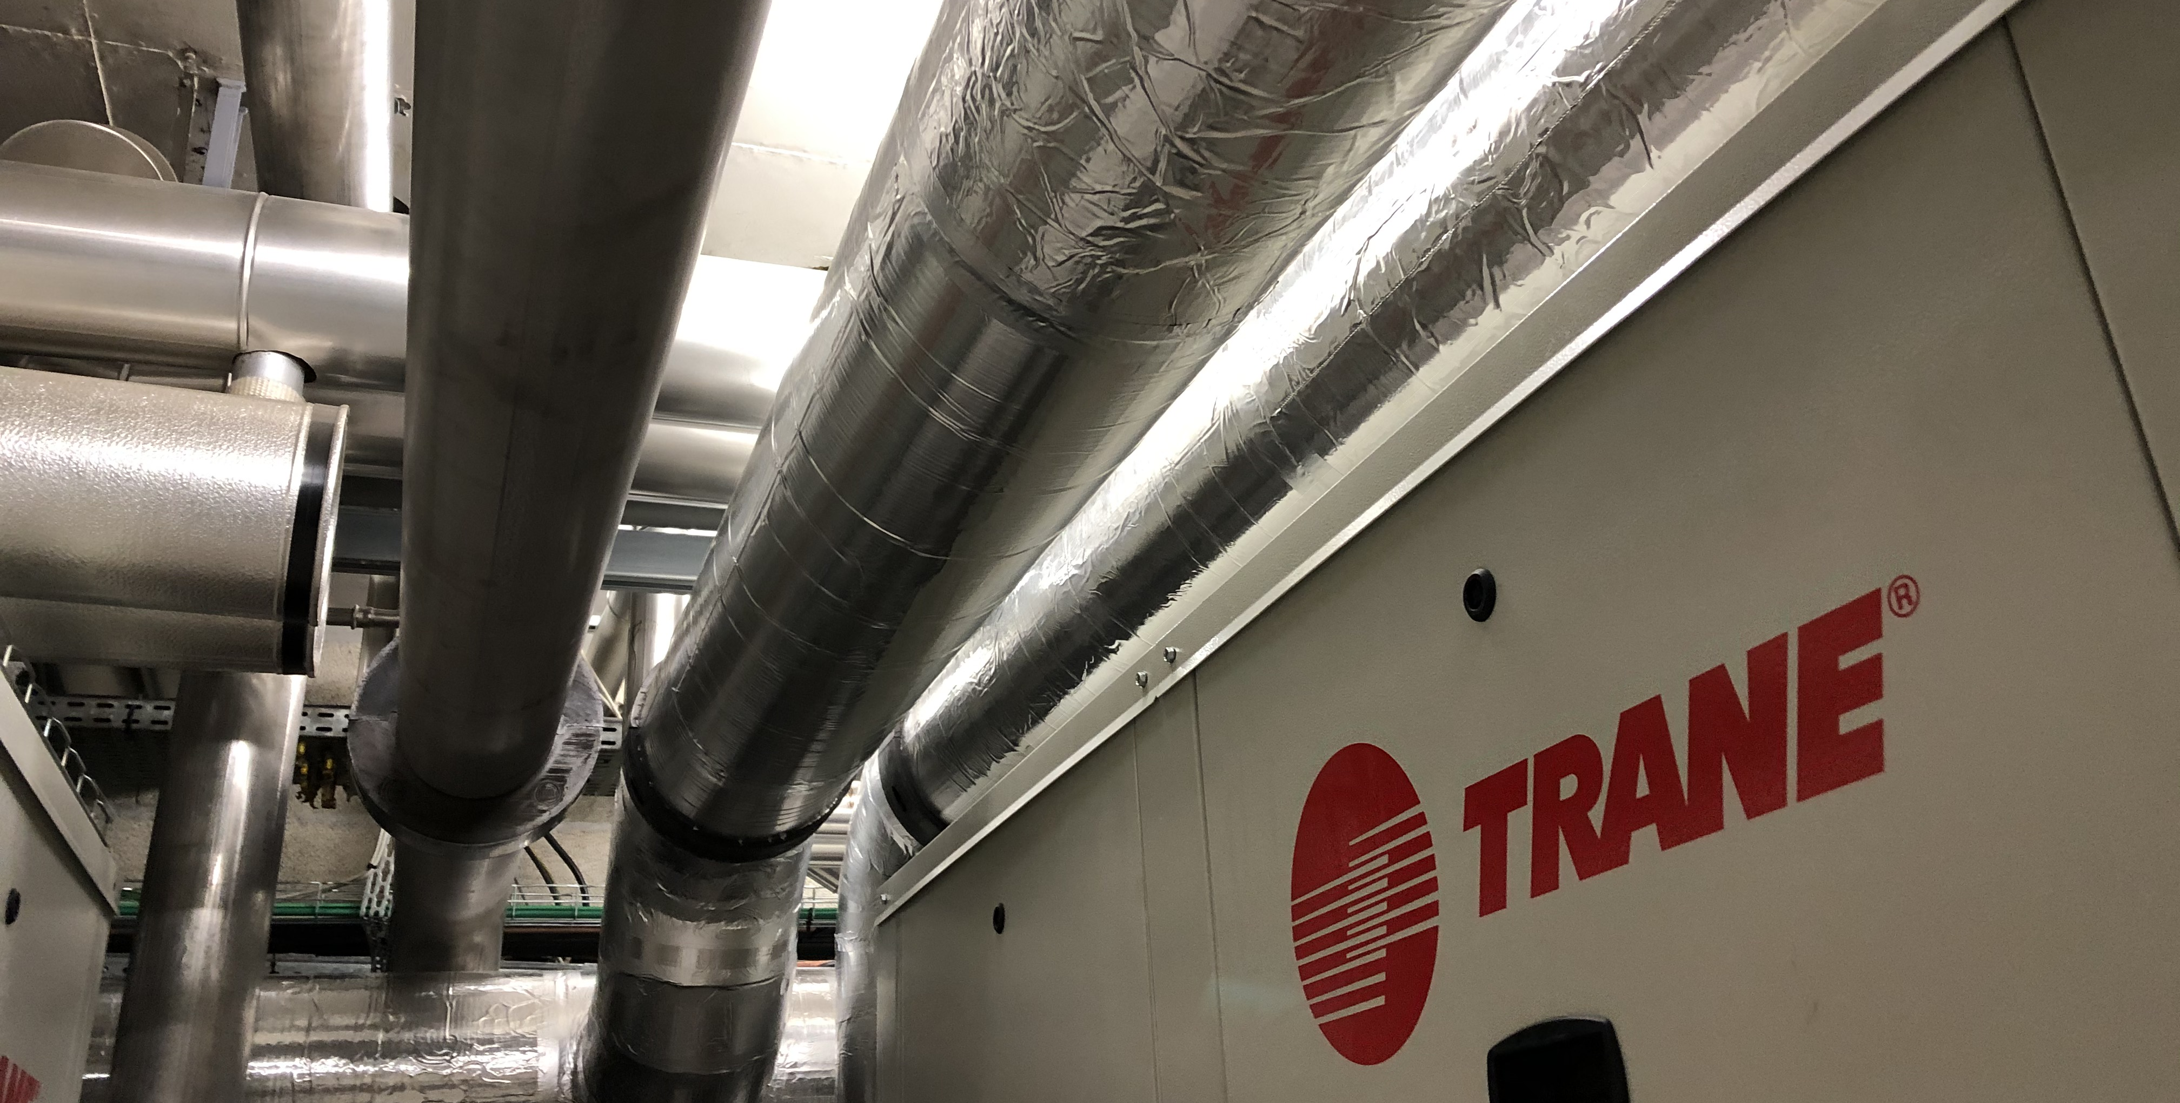
FUTURE PERSPECTIVES
COOLING – SCE Consolidation strategy
The goal is to replace obsolete chillers by new ones with low greenhouse effect gas, to increase efficiency and energy recovery potential.
Building 40 – In progress
Refurbishment of the chilled water production
153 Cluster – In progress
New CW production and distribution network
Building 501 – Completed
Refurbishment of chilled water production
  SCE Memorandum – EDMS: 2084349 v.2.4
Notes:
2084349 v.2.4

Slide 34




Conclusion
Significant reductions since September 2022: Introduction of Energy Saving Policy
Strong influence of the climate in the reduction of the gas consumption
Climate change: a sensitive topic worldwide
Challenge: to maintain the trend in the following years
ANY QUESTIONS?
34
Notes:
The reduction in the GAS consumption at CERN has been significant since the introduction of the Energy Saving Policy in September 2022. The optimization of the Heating District led to a big reduction in consumption, but it is important to consider that its functioning is strictly related to the temperature pattern, which could vary in the following years.
The benefits also come from a stronger awareness of the importance of energy savings. The topic has now become sensitive worldwide, but it was previously not valued enough.
Therefore, if this first attempts to decrease the consumption at CERN have been “easier” to accomplish, in the following years the challenge will be to search for new solutions to maintain the trend.

