Slide 1



CERN May 23, 2023
Istituto SPIN-CNR
Universita’ di Napoli Federico II
Dipartimento di Fisica “Ettore Pancini”
Ruggero Vaglio
Surface impedance of superconductors
in high magnetic fields, including nonlinear effects

Slide 2
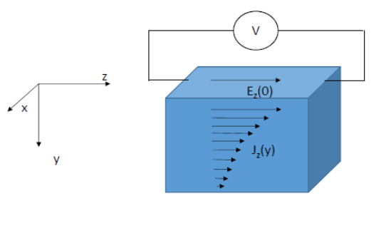
The concept of Surface Impedance for a conducting material
̃
d
d
(harmonic signal = plane wave)

Slide 3
The Surface Impedance in the local limit
Assuming :
(local, complex, constitutive relation)
considering and using Maxwell Equations,
«we get easily»:
For a thin film of thickness t it is :
For t 0

Slide 4
Surface Impedance of normal metals in the local limit
(the conductivity and the resistivity are real numbers)
i.e.
In this case we have:
( is called the penetration depth)
For a thin film of thickness t << δ it is:

Slide 5
Surface Impedance of normal metals in the «anomalous» limit
δ
In a normal metal the local limit fails if the mean
free path l exceeds the penetration depth δ (l > δ)
In this case the electrons traveling with direction normal to the external surface «see»
the electric field only for a small fraction of their motion between two relaxation events.
The rigrous, complete solution of the problems needs the solution of the full kinetic
equation for the electron motion. However an approximate solution, in the limit l >> δ,
can be found using the «ineffectiveness concept» :
l
Again, with this approximation, «we get easily»:
R_{n}
normal
skin effect
(independent of ρ_{n} )
anomalous
skin effect
ρ_{n}^{1/2}

Slide 6
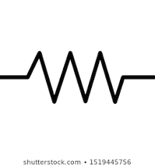

Surface Impedance of superconductors in the local limit
(two-fluid model)
n
s
( )

Slide 7
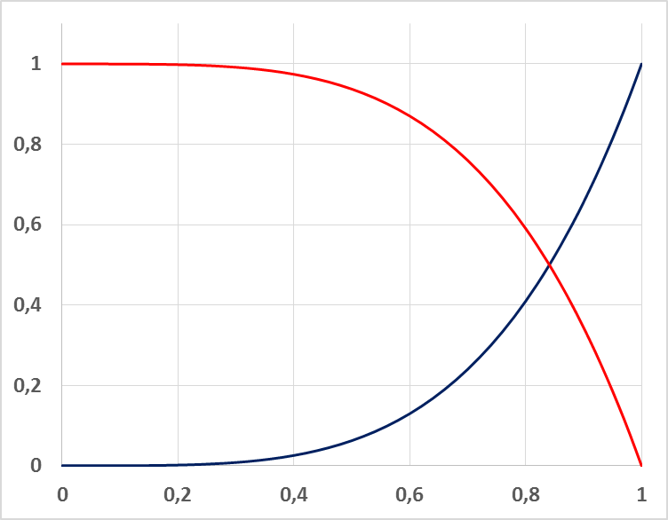
(frequency independent)

Slide 8
Surface Impedance of superconductors in the local limit
(two-fluid model)
from :
and:
Separating the real and imaginary parts, we get ( ) :
If :
In this case it is also:

Slide 9
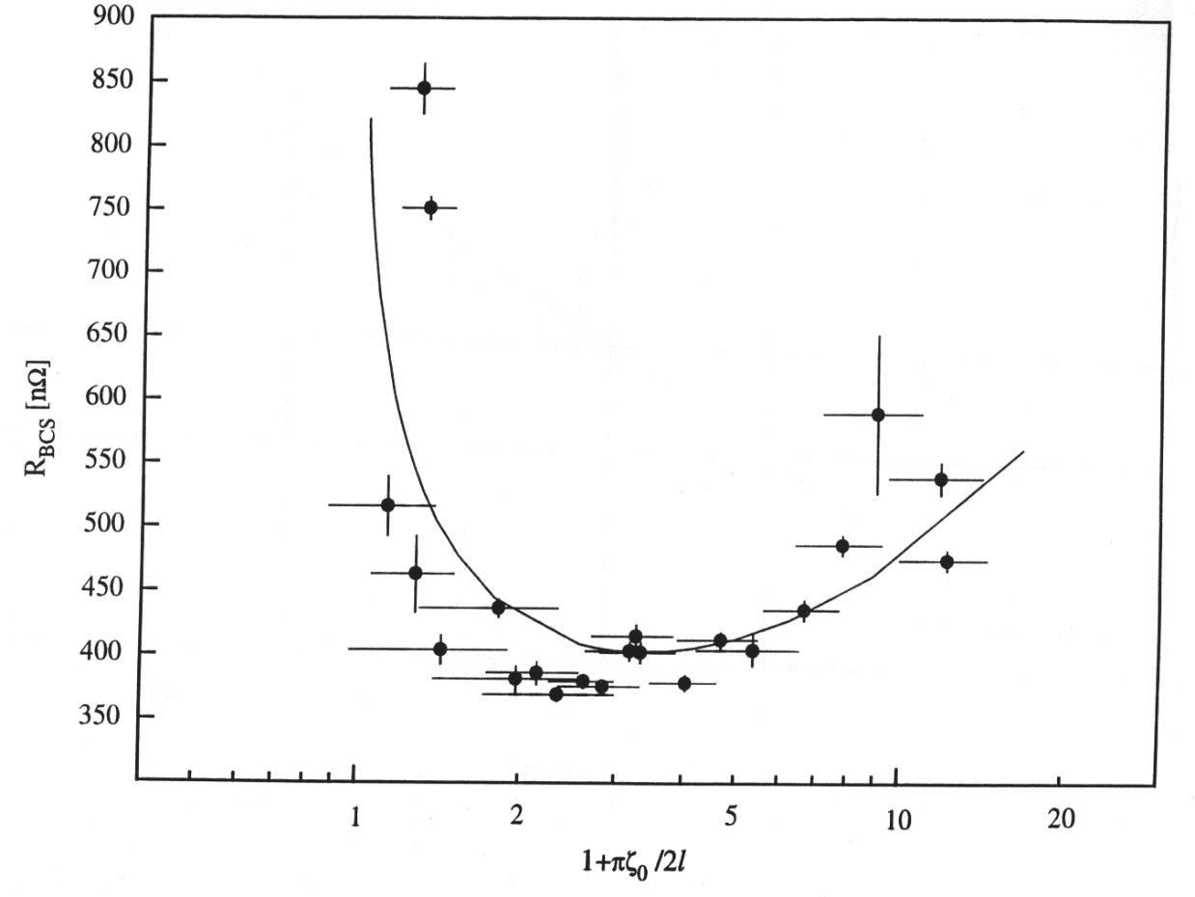
BCS (Matthis-Bardeen theory)
(Δ= Δ(T) is the «energy gap»)
The local limit always applies well superconducting compounds and alloys (l small compared to λ , «local dirthy limit)) and HTS (ξ small compared to λ , «local clean limit»), but not for high purity bulk Nb :
Full non-local
calculation
local limit validity zone
(l < ξ_{o} , RRR<20)
ξ

Slide 10
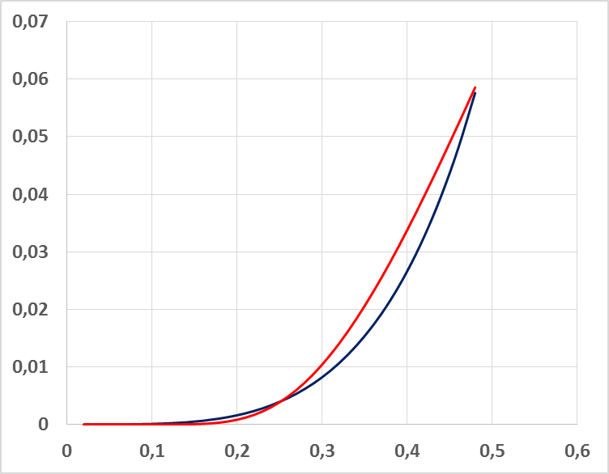
R_{s} (a.u.)
Two-fluid
HTS
BCS
Two fluid:
HTS:
BCS:

Slide 11
R_{s} frequency dependence
R_{s} ^{BCS}(Ω)
Normal metals :
10⁻¹
Superconductors :
10⁻²
Cu 77K
YBCO polycrystalline, measured values at 77k
BCS
10⁻³
two fluid and HTS
YBCO measured values at 77K
10⁻⁴
10⁻⁵
Nb, T=4.2K
Nb₃Sn, T=4.2K
10⁻⁶
0.1
1
10
100
f (GHz)

Slide 12
Measurements of the surface impedance temperature dependence
A.Andreone, A.Cassinese, A. Di Chiara, M.Salluzzo , R. Vaglio, JAP 78,1862 (1995)
Single frequency (here 3.5GHz) high Q resonator technique
(R_{s} is measured from the Q value ΔX_{s} from the frequency shift Δf/f )
V₃Si
BCS theory, local limit
BCS theory, local limit
R_{s}(μΩ)
X_{s}(T)/X_{s}(0)
R_{o}
T(K)
T(K)

Slide 13
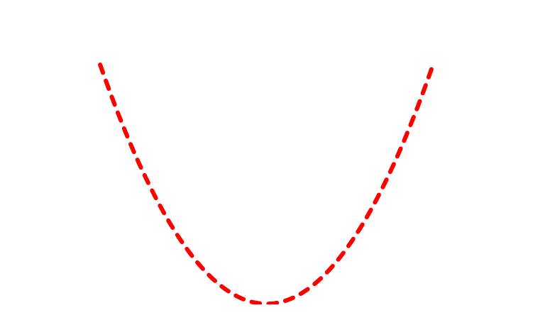
Superconductors in a magnetic field
z
x
y
y
x
Gittleman and Rosenblum,
Phys Rev. Lett. 16, 734 (1966)
̴
m : fluxon mass per unit lenght 0
fluxon viscosity per unit lenght
:
«depinning frequency»

Slide 14
Surface impedance of a superconductor in a magnetic field:
(rf current perpendicular to the field)
assuming
Surface resistance
Surface reactance
S. Calatroni, R.Vaglio : IEEE Trans. Superconductivity 2017
For a thin film :

Slide 15
For small fields, i.e. for a small number of trapped vortices
with

Slide 16
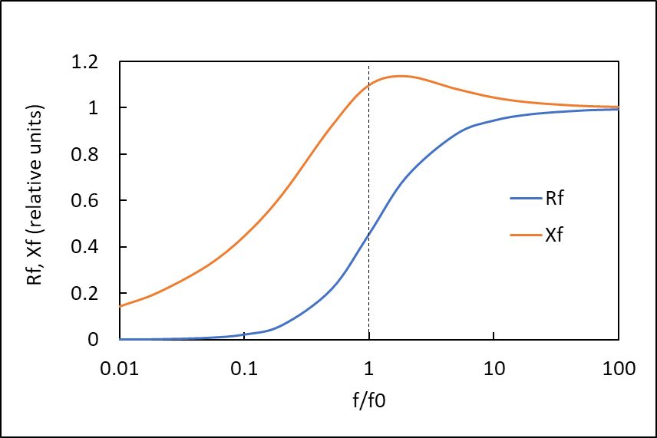
For high fields, i.e. for a large trapped flux ( vortex array)

Slide 17
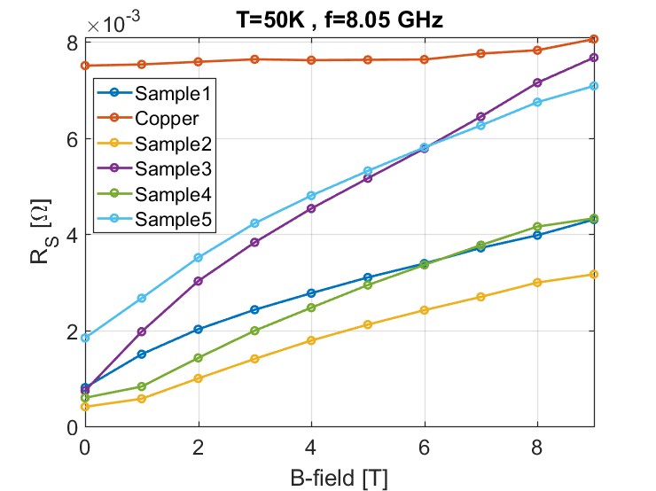


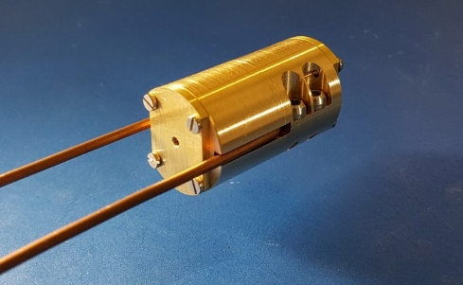
In the frame of the FCC-HTS beam screen coating project it was proved that this approach describes very well the experimental rf HTS results on YBCO tapes at T< 50K and B> 5T
T = 50K , ν= 8.05GHz
Copper
ν_{o}~ 25GHz
CC providers 1 – 5
R_{sf} (mΩ)
ν_{o}~ 40GHz

Slide 18
A recent new issue: superconductors are known to present nonlinear effects .
How this would be in high magnetic fields ?
How can high field nonlinearities come out:
a) The potential well for fluxons is non-parabolic
b) The viscous term can be not linearly dependent on fluxons velocity
a)
b) /
n=1: Calatroni & R.Vaglio, Physical Review Accelerators and Beams, 22, 022001, 2019
n=2: Calatroni & Vaglio IEEE Trans. Appl. Supercond. 31, 3500208, 2021

Slide 19
It is useful to introduce the following adimensional parameters:
,
,
,
,
,
is the depinning frequency
is the «nonlinearity parameter» (that can be dependent on the d.c. magnetic field B_{o} )
This nonlinear equation can be solved numerically.
Analitically solutions can be also obtained by simple perturbation methods possible
to obtaining a closed analytical expression for the nonlinear surface impedance Z(I_{rf} )
n=2
( , )

Slide 20
The nonlinearity produces a third harmonic (3ω) signal
The red line represents the time dependence of the first order perturbation analitical solution
The full numerical solution (that we also calculated) would not be distinguishable on this scale.
n=2
$$(E_{rf}=ωξB_{o}\dot{y}(τ) in the case of a thin film)$$

Slide 21
The surface impedance (both R_{s} and X_{s}) depend on the rf current
n=2

Slide 22

The nonlinear effects can be measured experimentally to determine characteristics
and «size» of nonlinear effects (i.e. evaluate n, a and its possible B_{o} dependence)
Preliminary measurements were already performed (Patrick Krkotic) on YBCO HTS samples
8GHz, 50K
n=1 ?

Slide 23
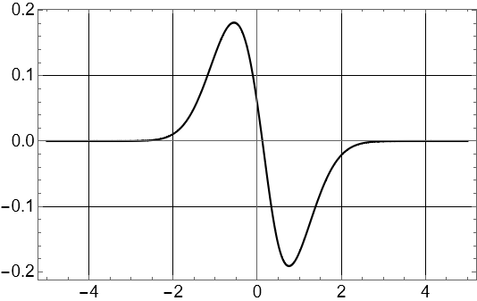
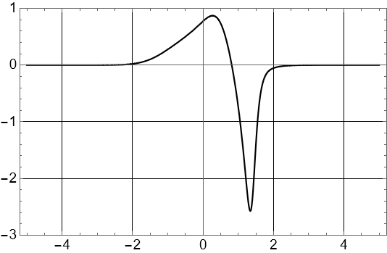
Problems related to the nonlinear response of superconductors in high magnetic fields (and high rf currents) can possibly occurr for the FCC beam screen coating with HTS
The black line represents the time dependence of the numerical solution for the fluxons velocity
(proportional to the electrical field)

Slide 24
Problems related to the nonlinear response of superconductors in high magnetic fields (and high rf currents) can possibly occurr for the FCC beam screen coating with HTS
for copper :
The black line represents the time dependence of the numerical solution for the fluxons velocity
(proportional to the electrical field)

Slide 25
Conclusions
- The surface impedance (resistance and reactance) is the main parameter characterizing the response of a metallic surface exposed to an rf electromagnetic field
- Superconductors are characterized by a low (but non-zero) surface resistance, and a much larger surface reactance (though still lower than normal metals)
- For any rf application of superconductors in high magnetic field (and sufficiently high rf currents) it is important to take into account nonlinear effects

