Slide 1



SNUG presentation
Laetitia Lejeune,
100 ACCU Meeting - CERN, 00 Month 2023
Eric LIENARD
CERN, October 2023

Slide 2
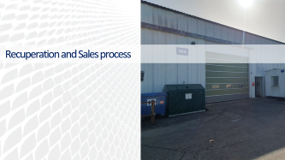


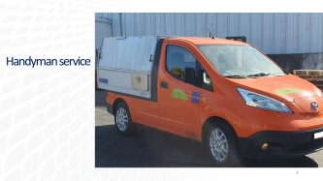


Agenda

Slide 3
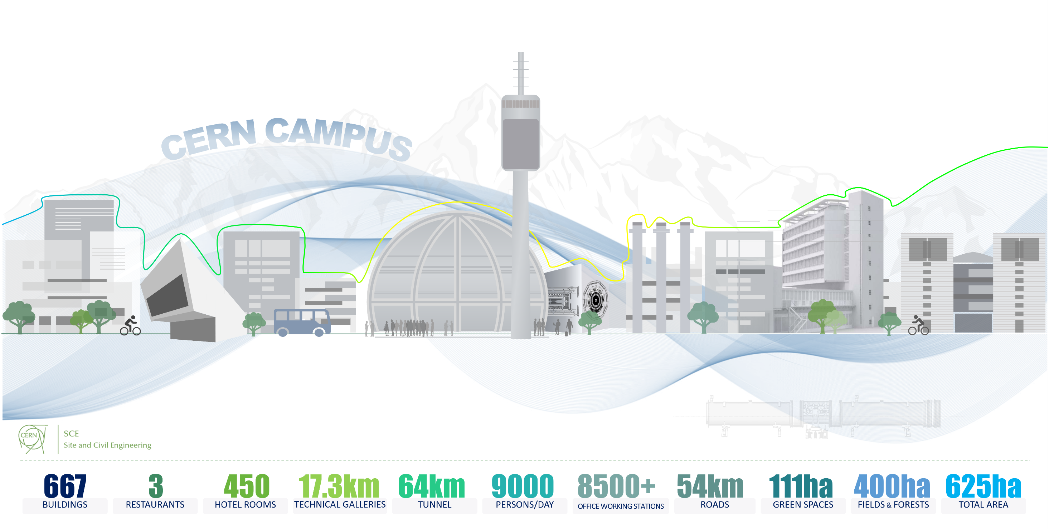
CERN, a real micro-society
Nothing to envy to a small city environment
Notes:
Half of the Geneva city surface
As many kilometers of roads as Gva to Lausanne
22 000 Declared vehicles
23 000 registered users

Slide 4
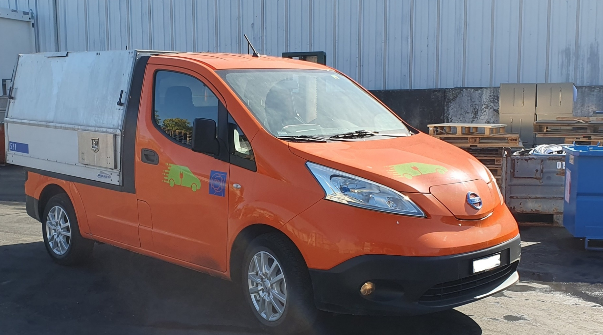
Handyman service

Slide 5
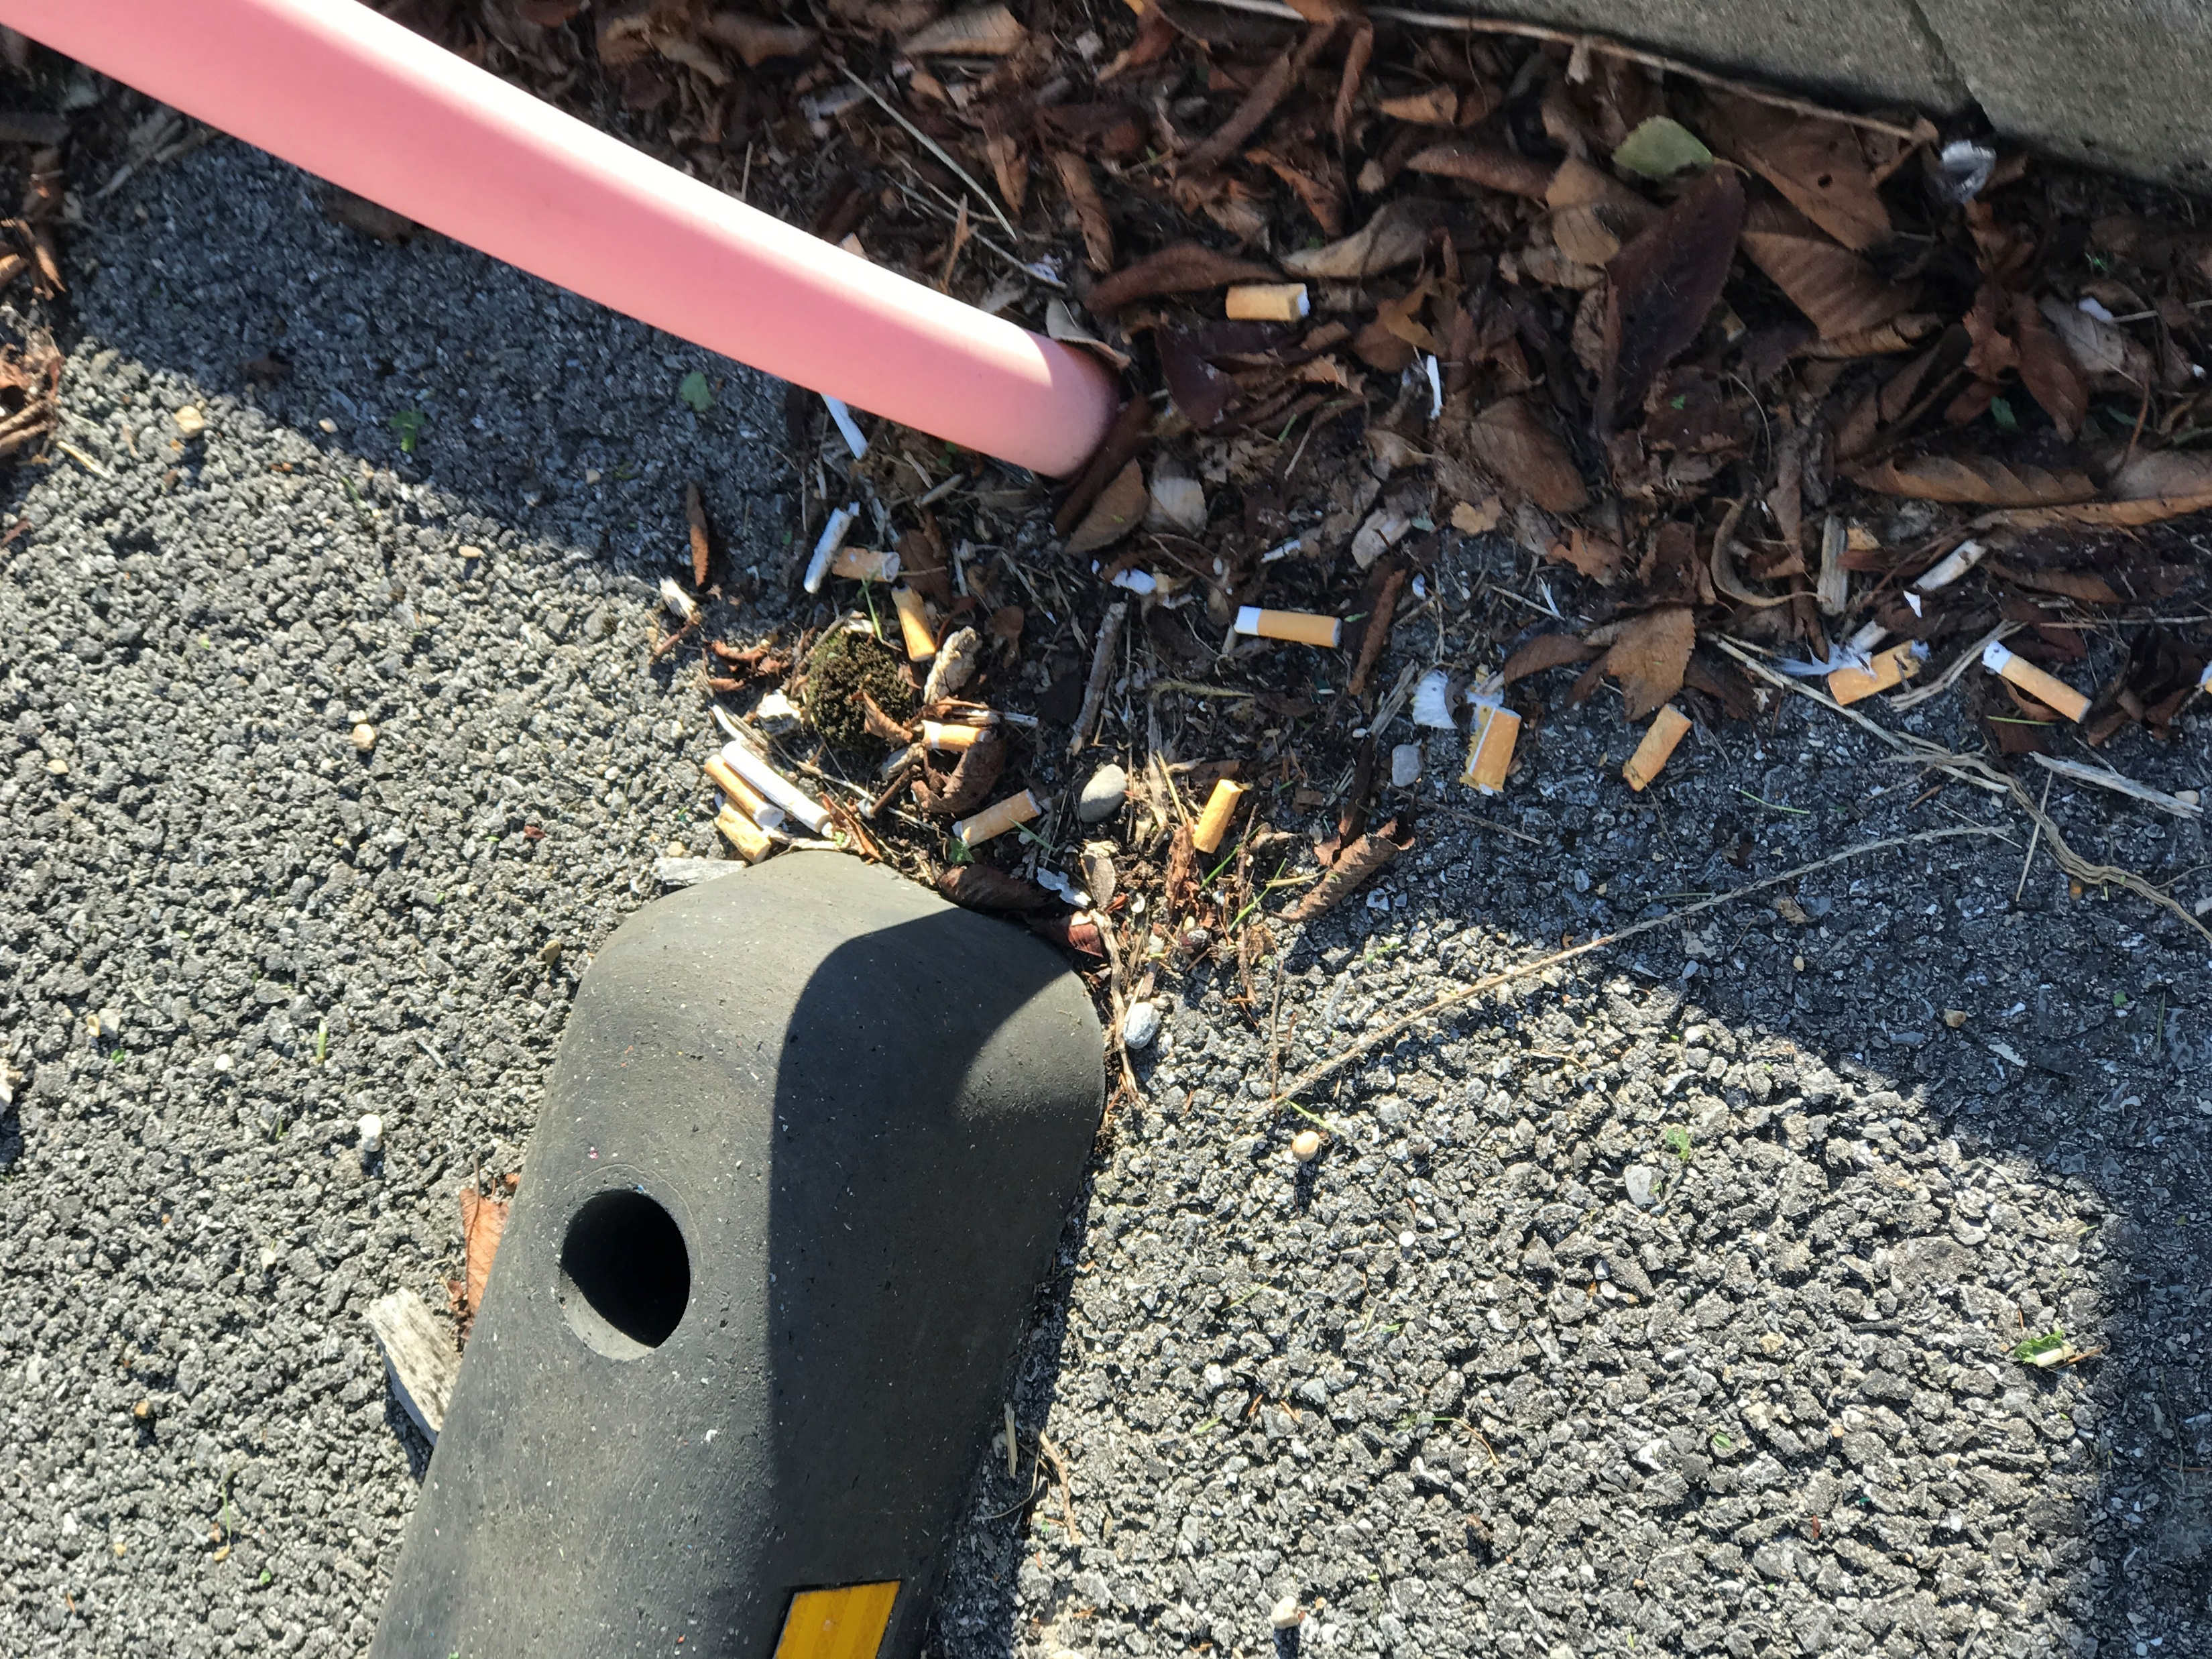
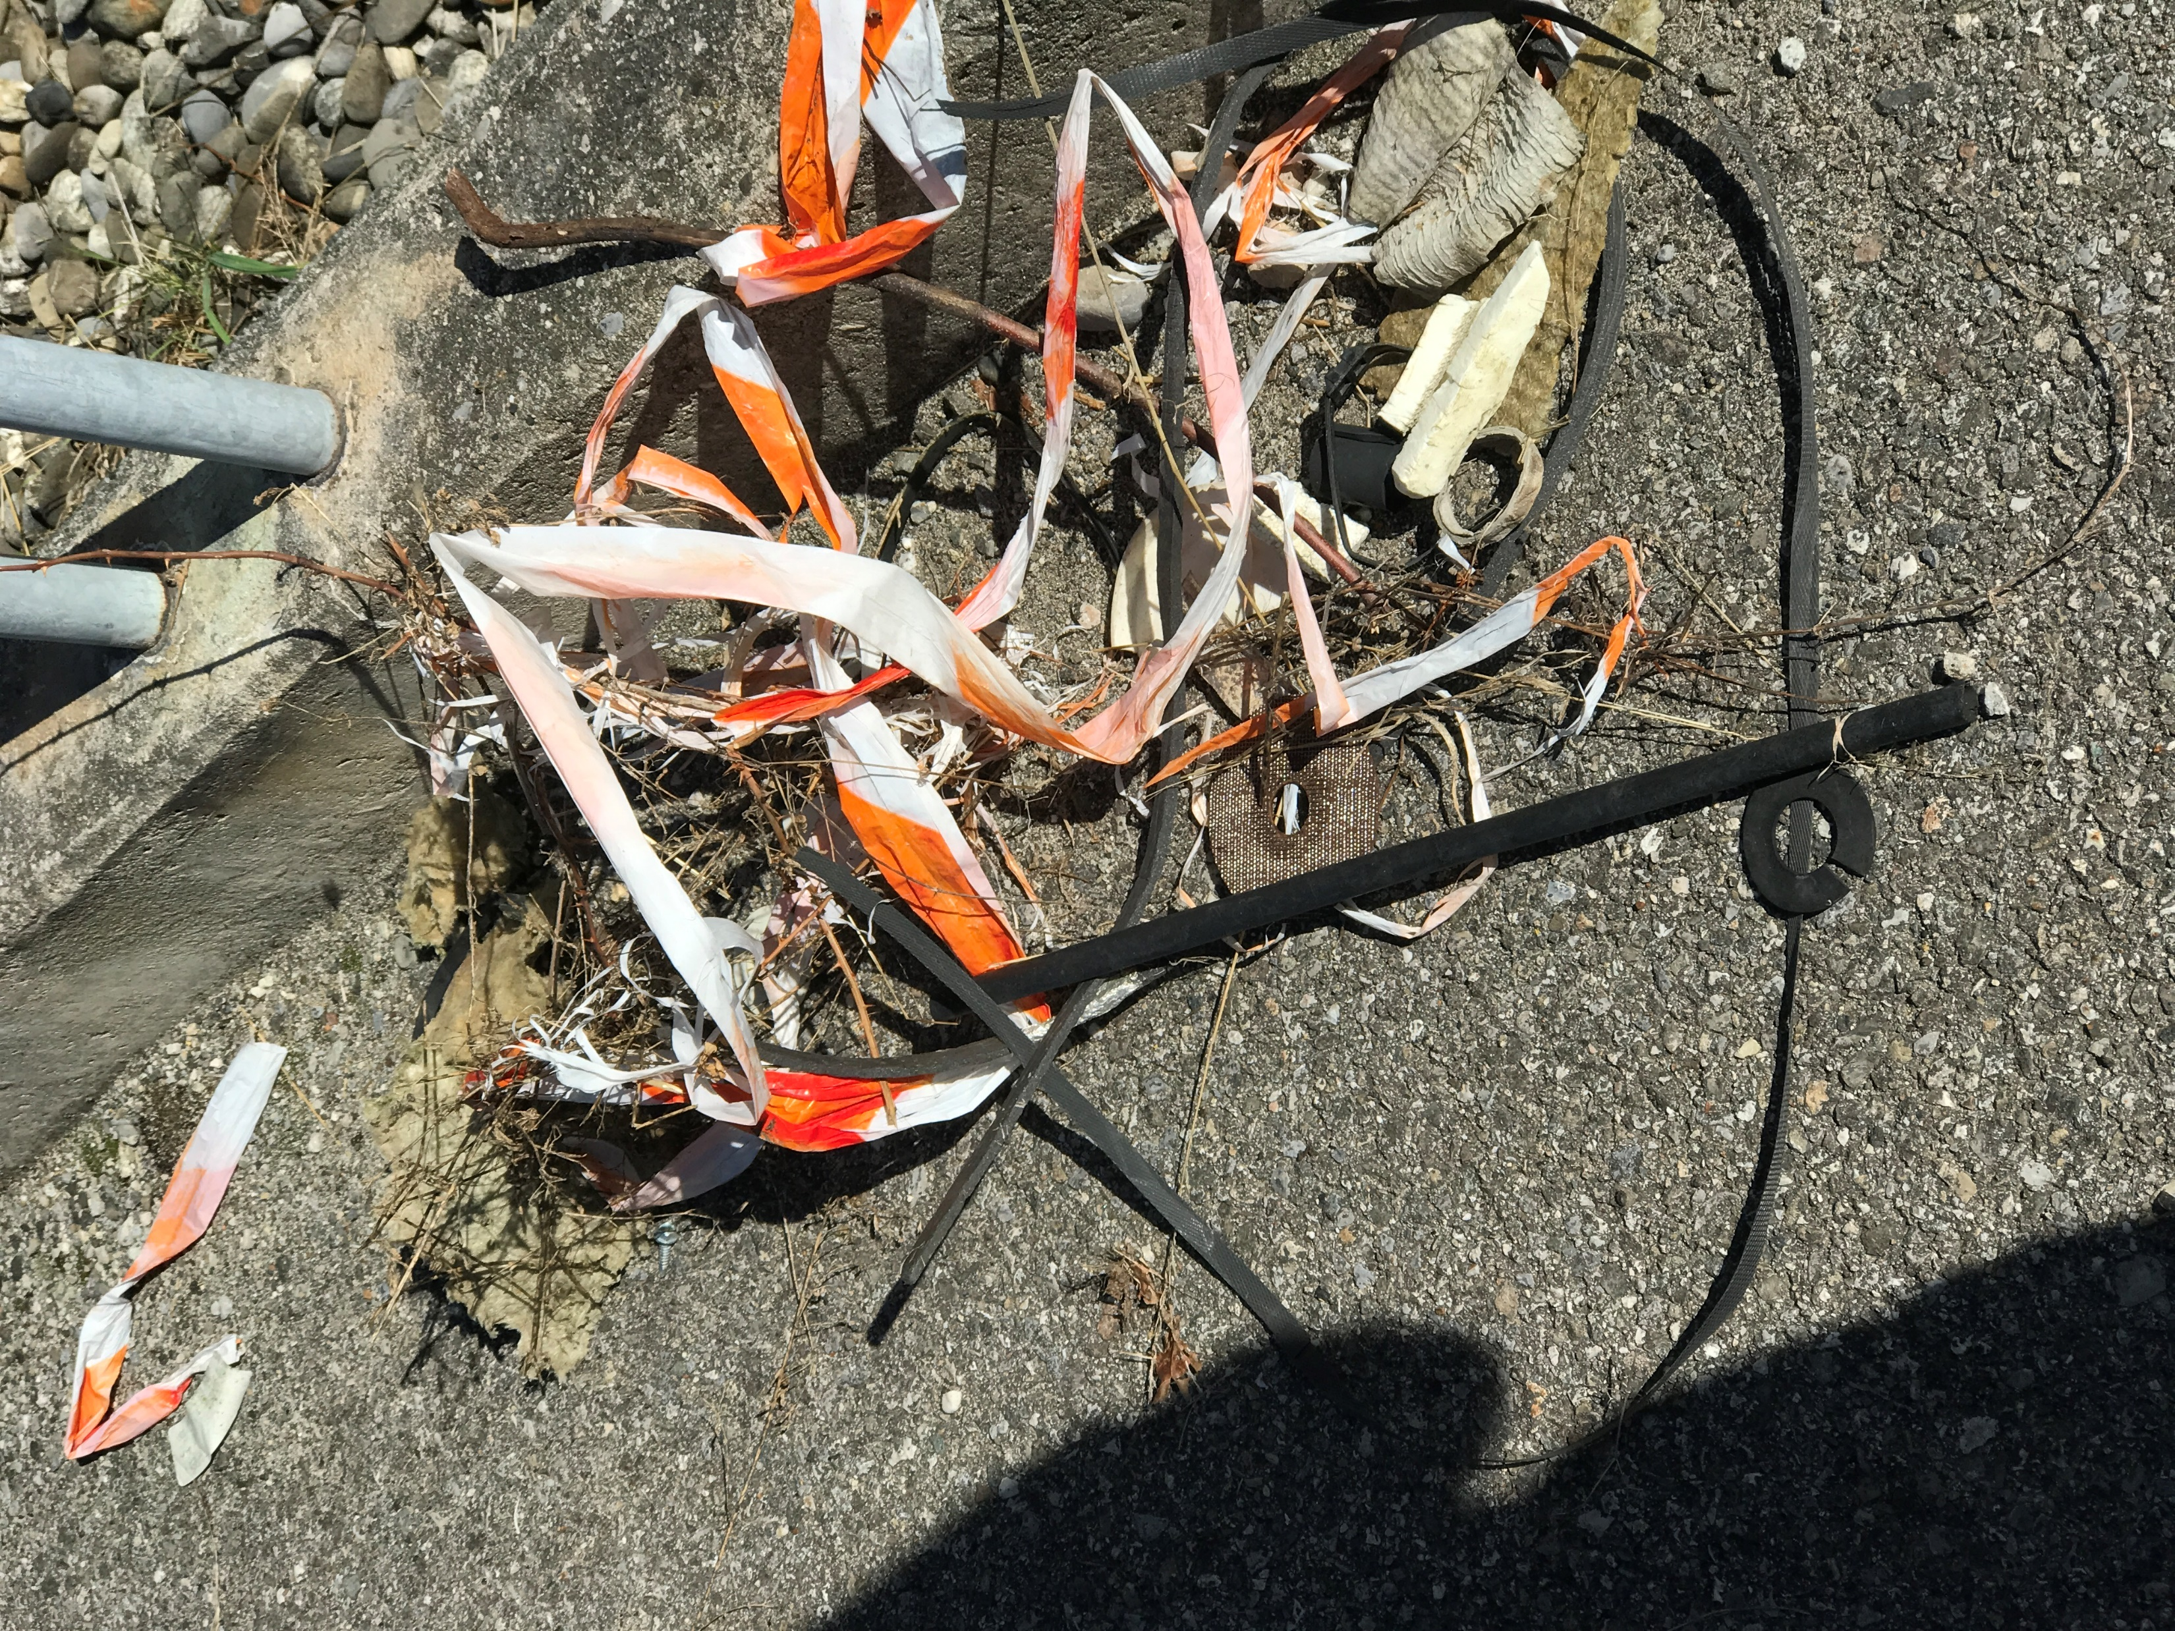
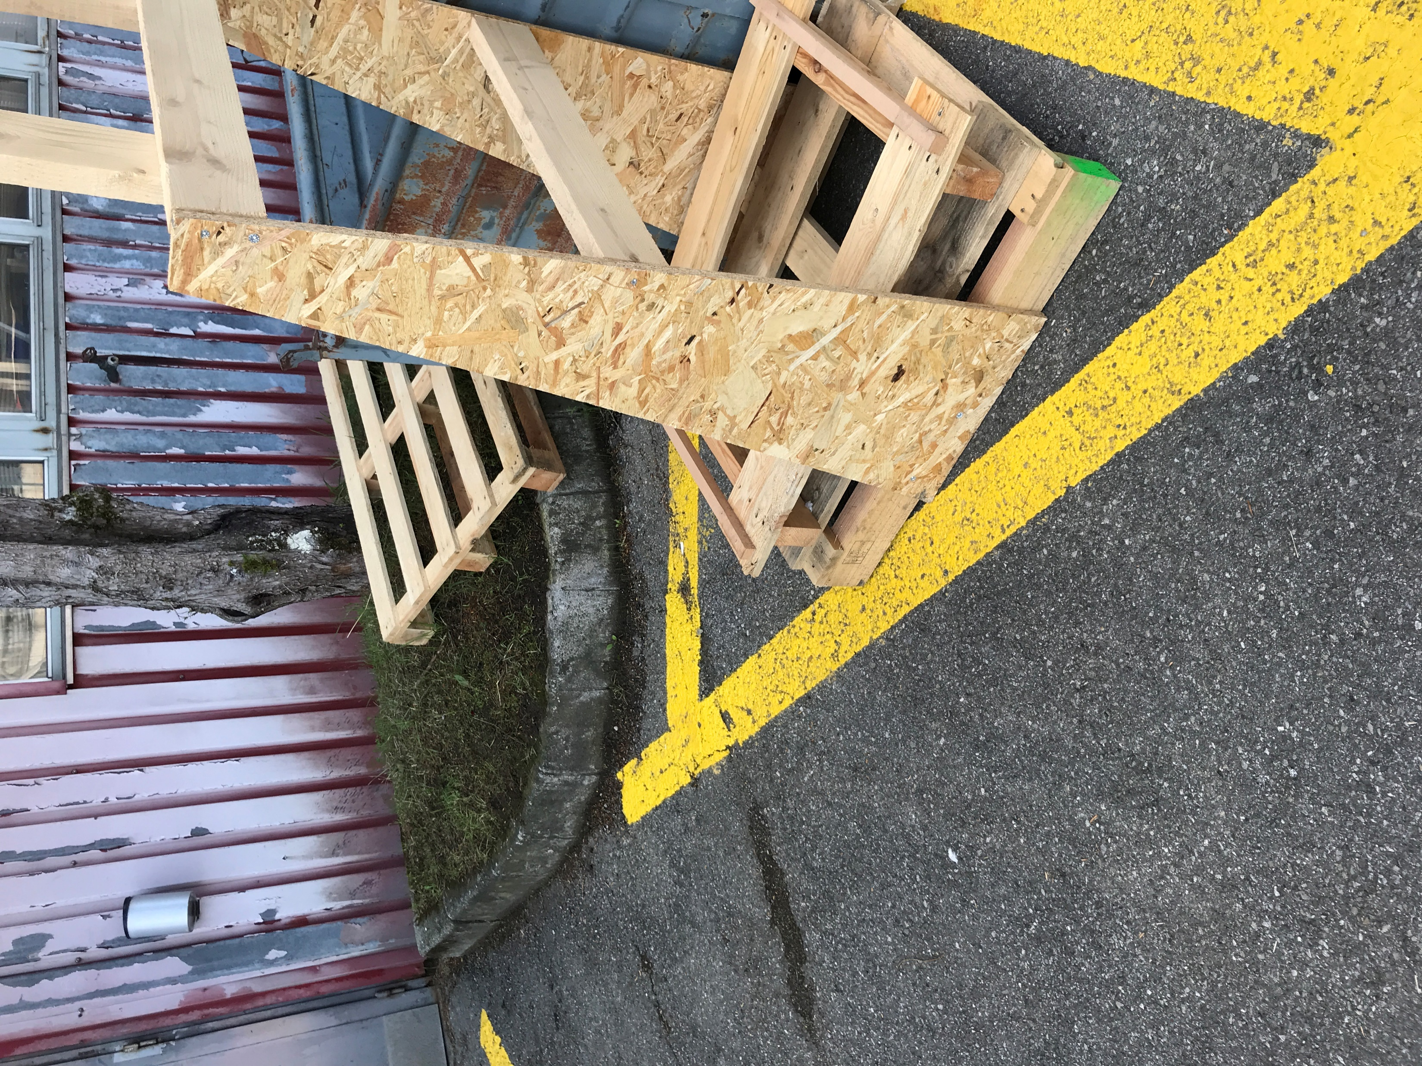
Key points
Presentation
SCE department has set up a handyman service. This polyvalent agent has a mission spread across all CERN sites, he is mostly on the move.
Objectives
maintain cleanliness along sites,
Respond to occasional request for clearance or cleaning,
Report weekly to department management.
Constraints
Gain acceptance of the use of an IT tool, not relevant for his job, by the agent,
Very small team (1 mobile, 2 dispatcher)
Never ending story

Slide 6


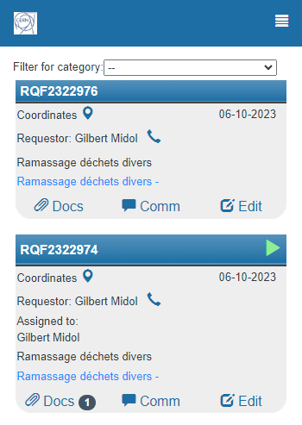
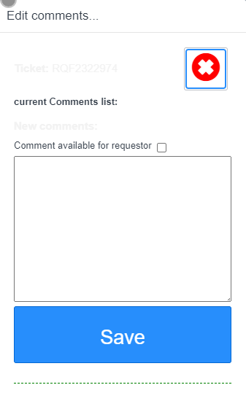
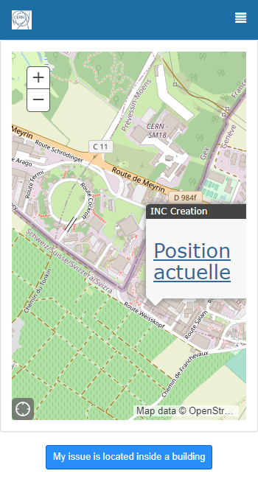
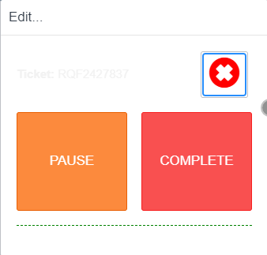
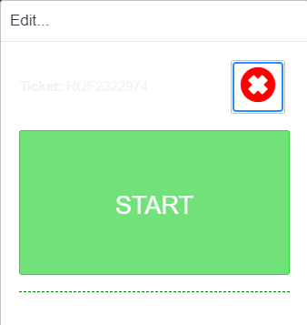
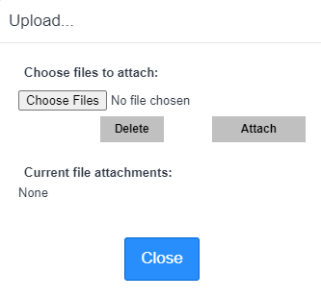
Objective: dispatch and report

Slide 7
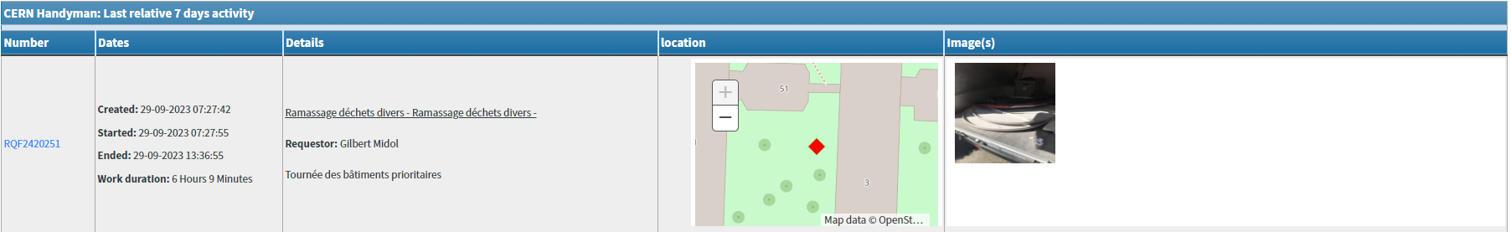
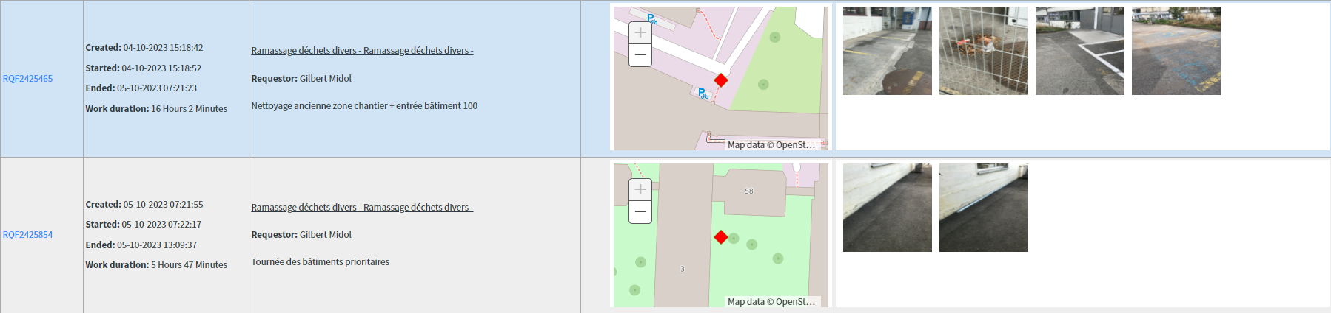
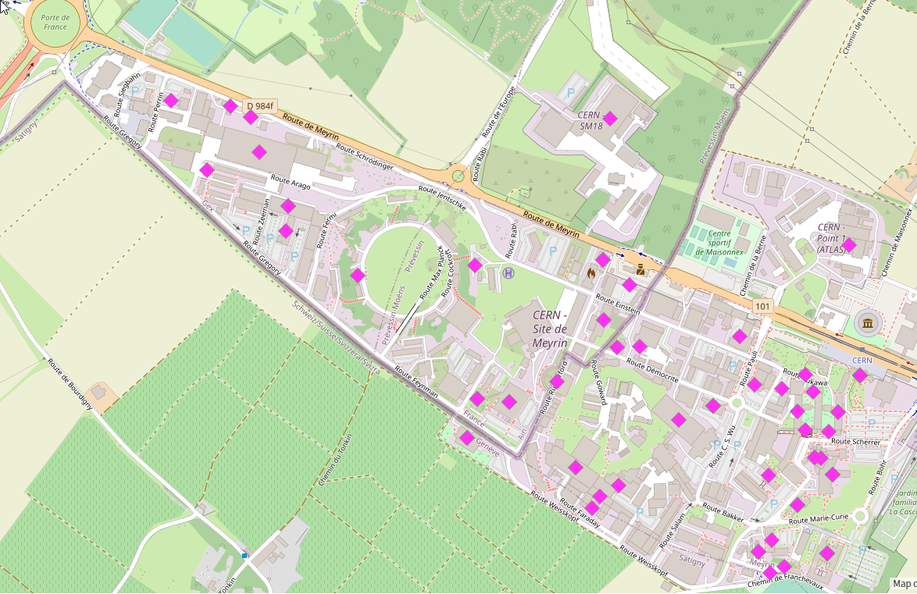
Reporting to management

Slide 8
Take away
Using the ServiceNow supporter interface would make no sense for one-time users
Interface should run on low-quality network,
Bottom–up considerations are key factors.
Results are very difficult to measure but, the return of the onsite situation is far better.
It gives clear indications on the distribution of problems and allow predictive circuit organisation.

Slide 9
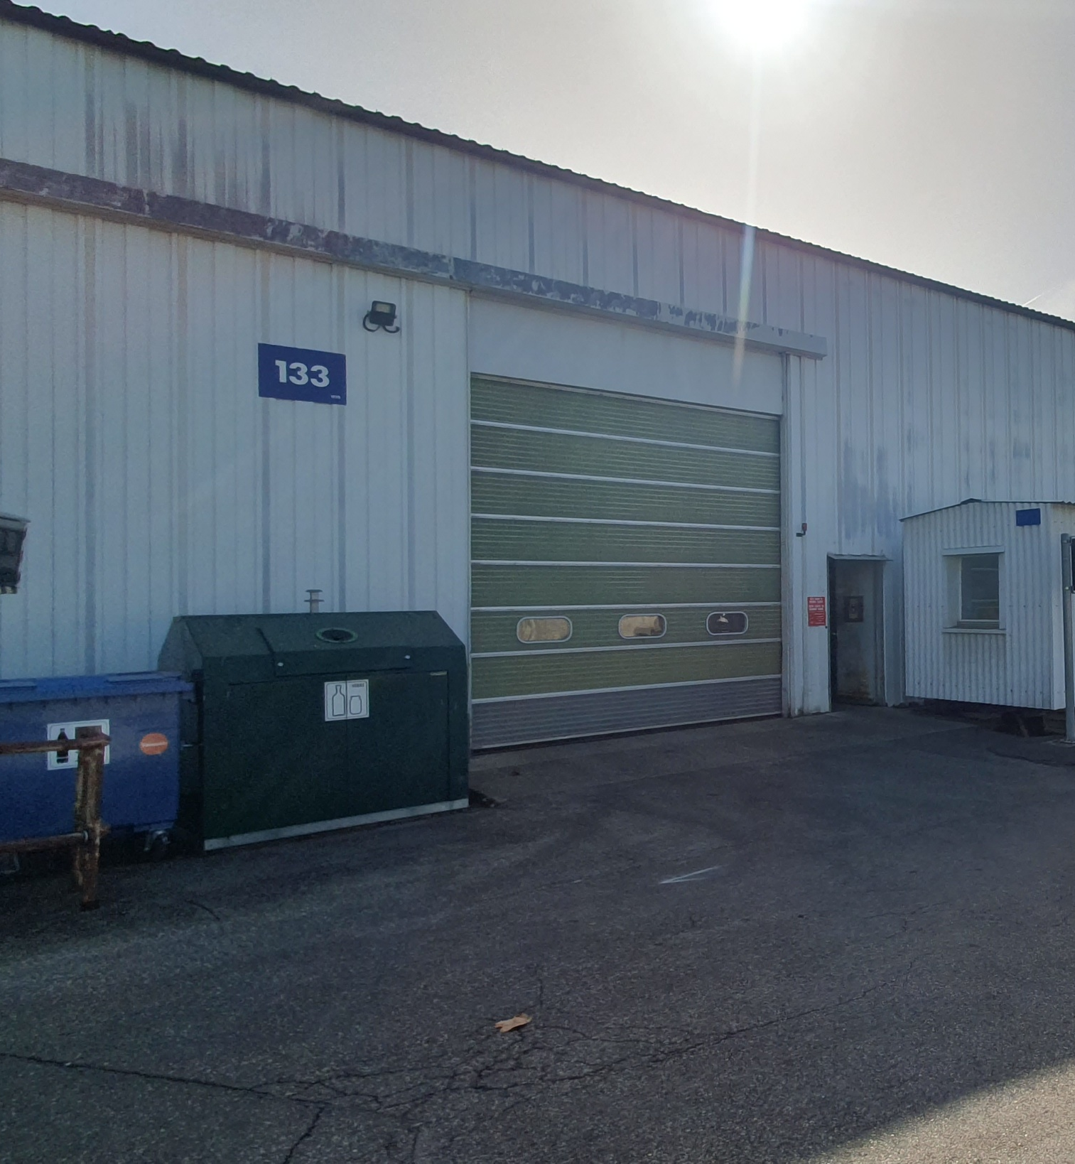
Recuperation and Sales process

Slide 10
Key points
Presentation
THE STORAGE, RECUPERATION AND SALES SERVICE, is responsible for storing, recycling and selling all CERN equipment and material which are no longer of use.
Objectives
Trying to give to a maximum of goods, a second life at CERN or for a public usage,
Providing a simple tool for maintenance workers,
Display all available items to a public community and this, in real time
Constraints
Gain acceptance of the use of IT tools by the team of maintenance workers,
Deploy a tool from scratch in a very short term,
Involving supporters' team to keep all stocks and new arrivals updated.

Slide 11
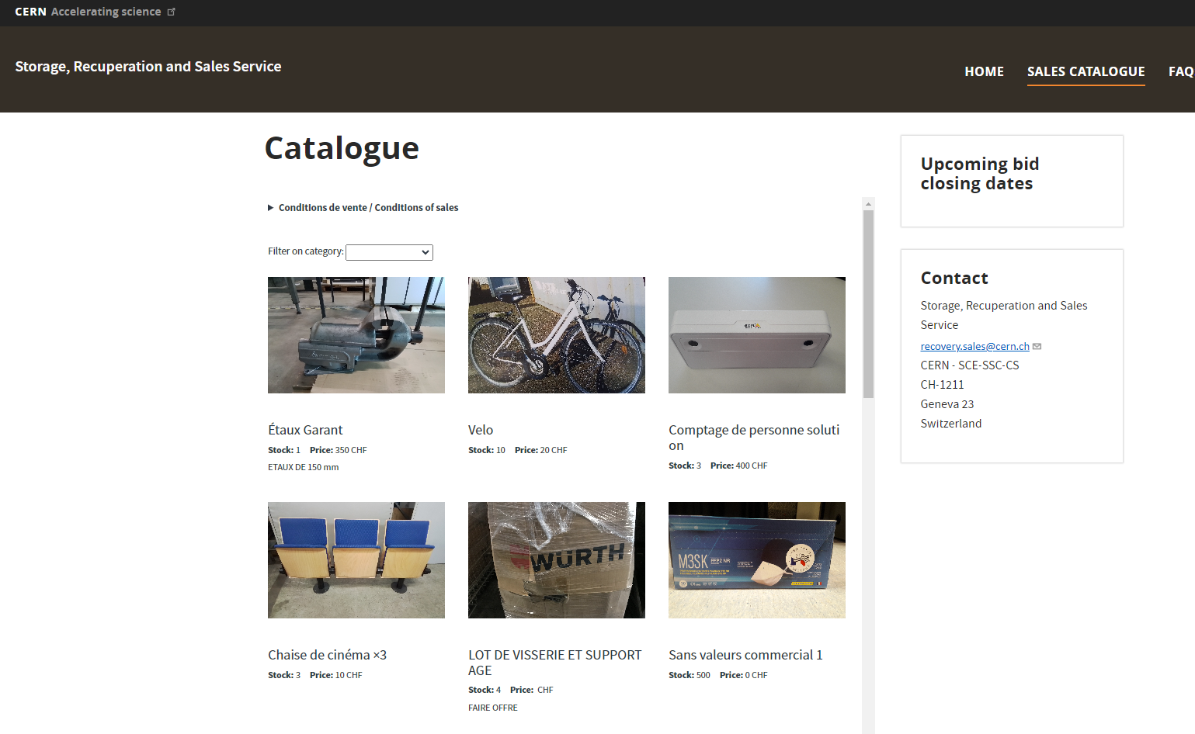


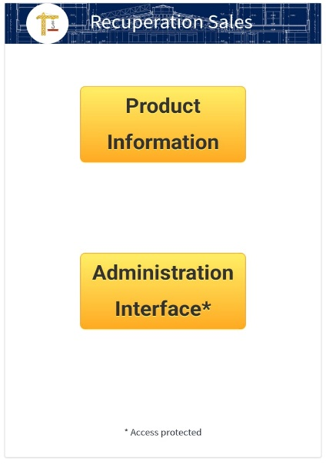
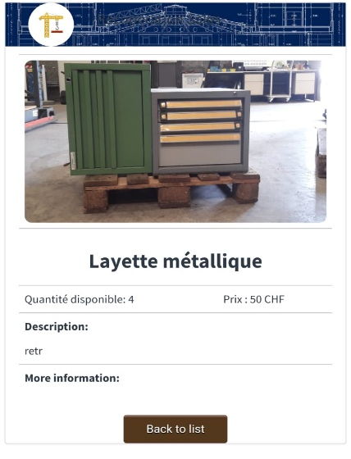
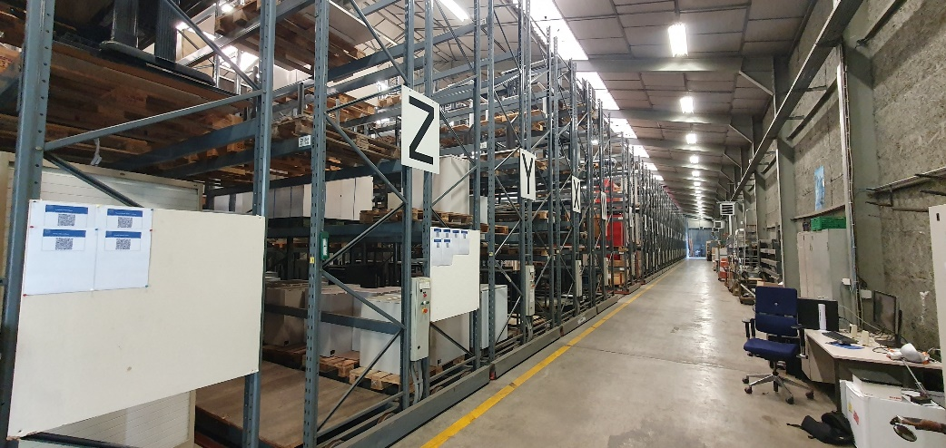
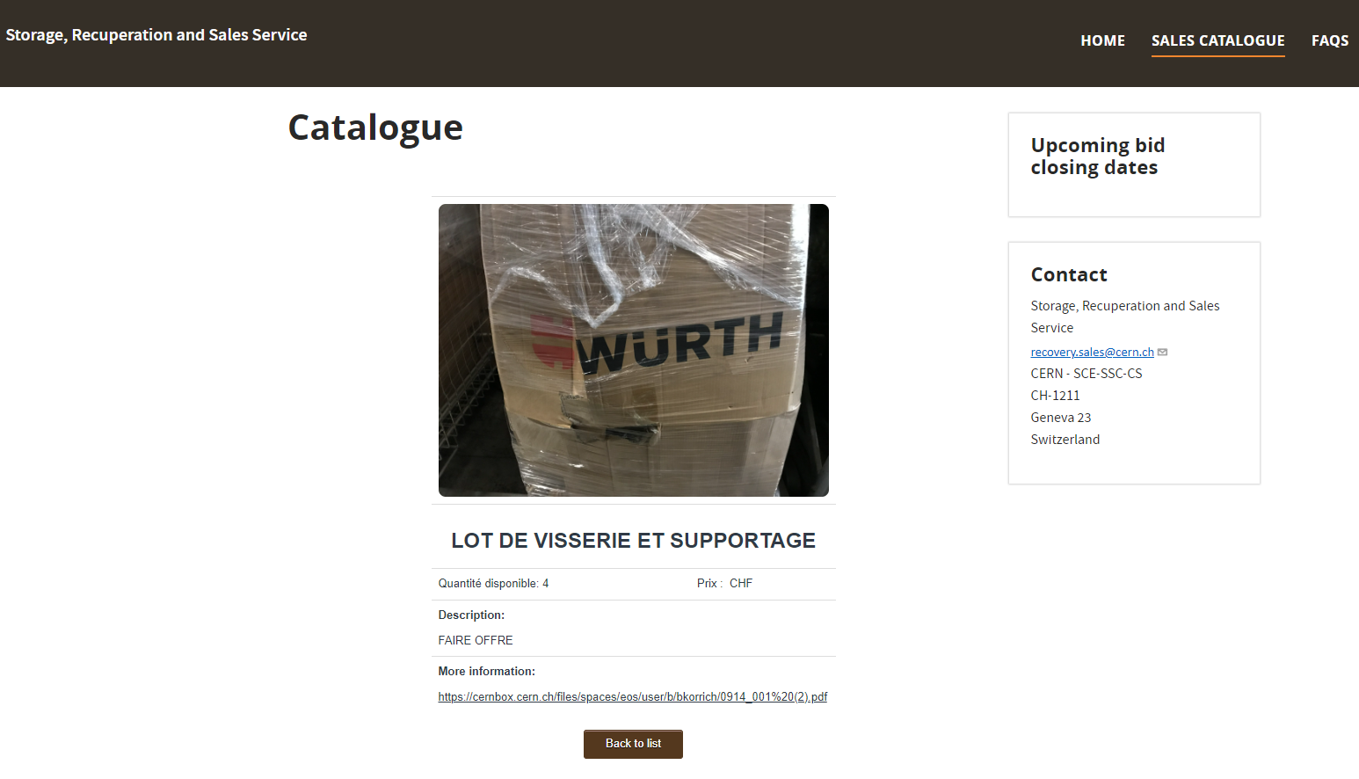
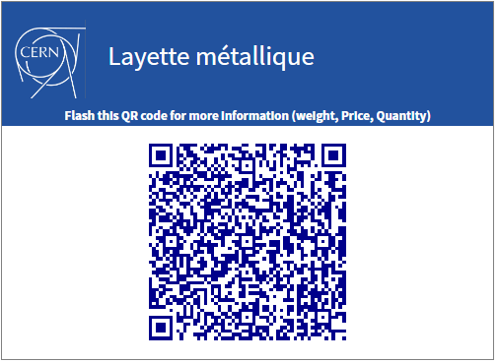
Client’s side
From the public website
Directly on site
https://recuperation-sales.web.cern.ch/catalogue

Slide 12
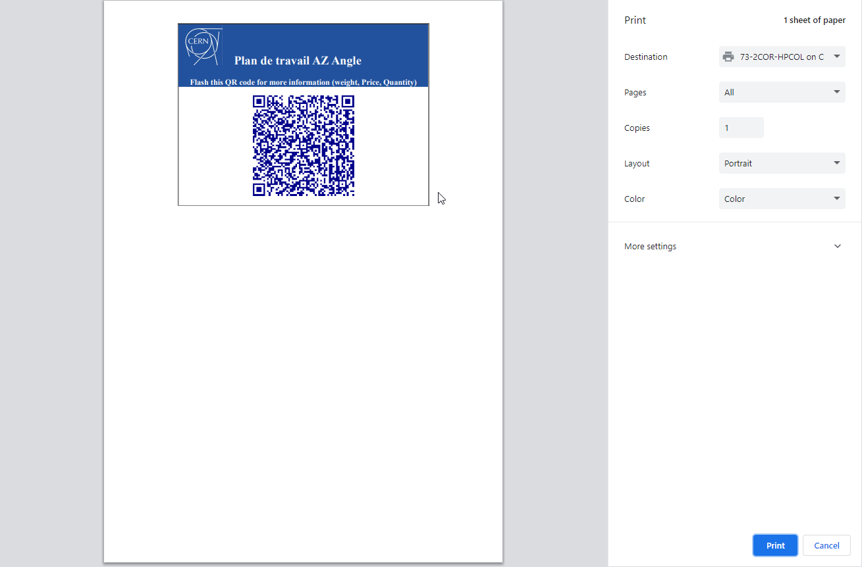
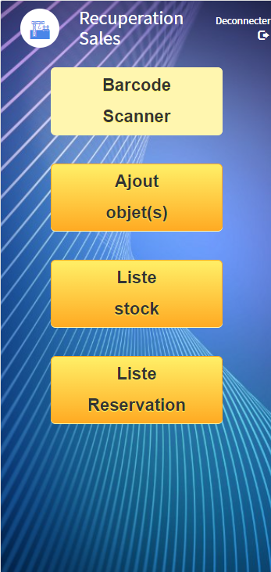

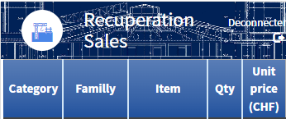
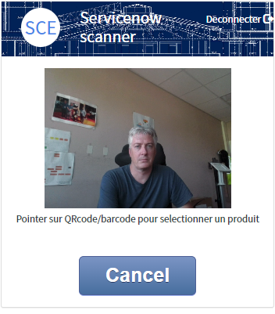
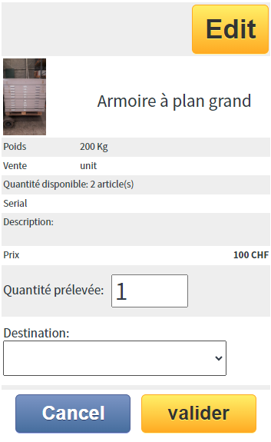
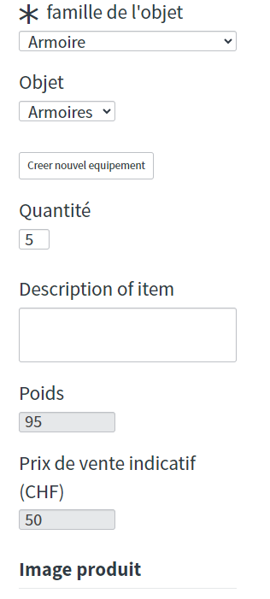
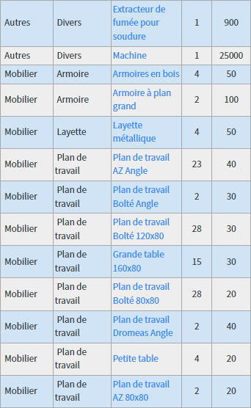

Supporter’s side

Slide 13
Take away
From scratch,
WE as a team (maintenance workers, site responsible) have built a whole second-hand asset management shop.
From NO IT to 100% online solution,
Bottom – up considerations are keys factors.
CERN recuperation website has recorded more than a thousand access during the first month.

Slide 14
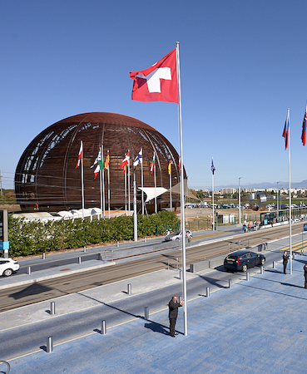
Automation in VIP visit organisation

Slide 15
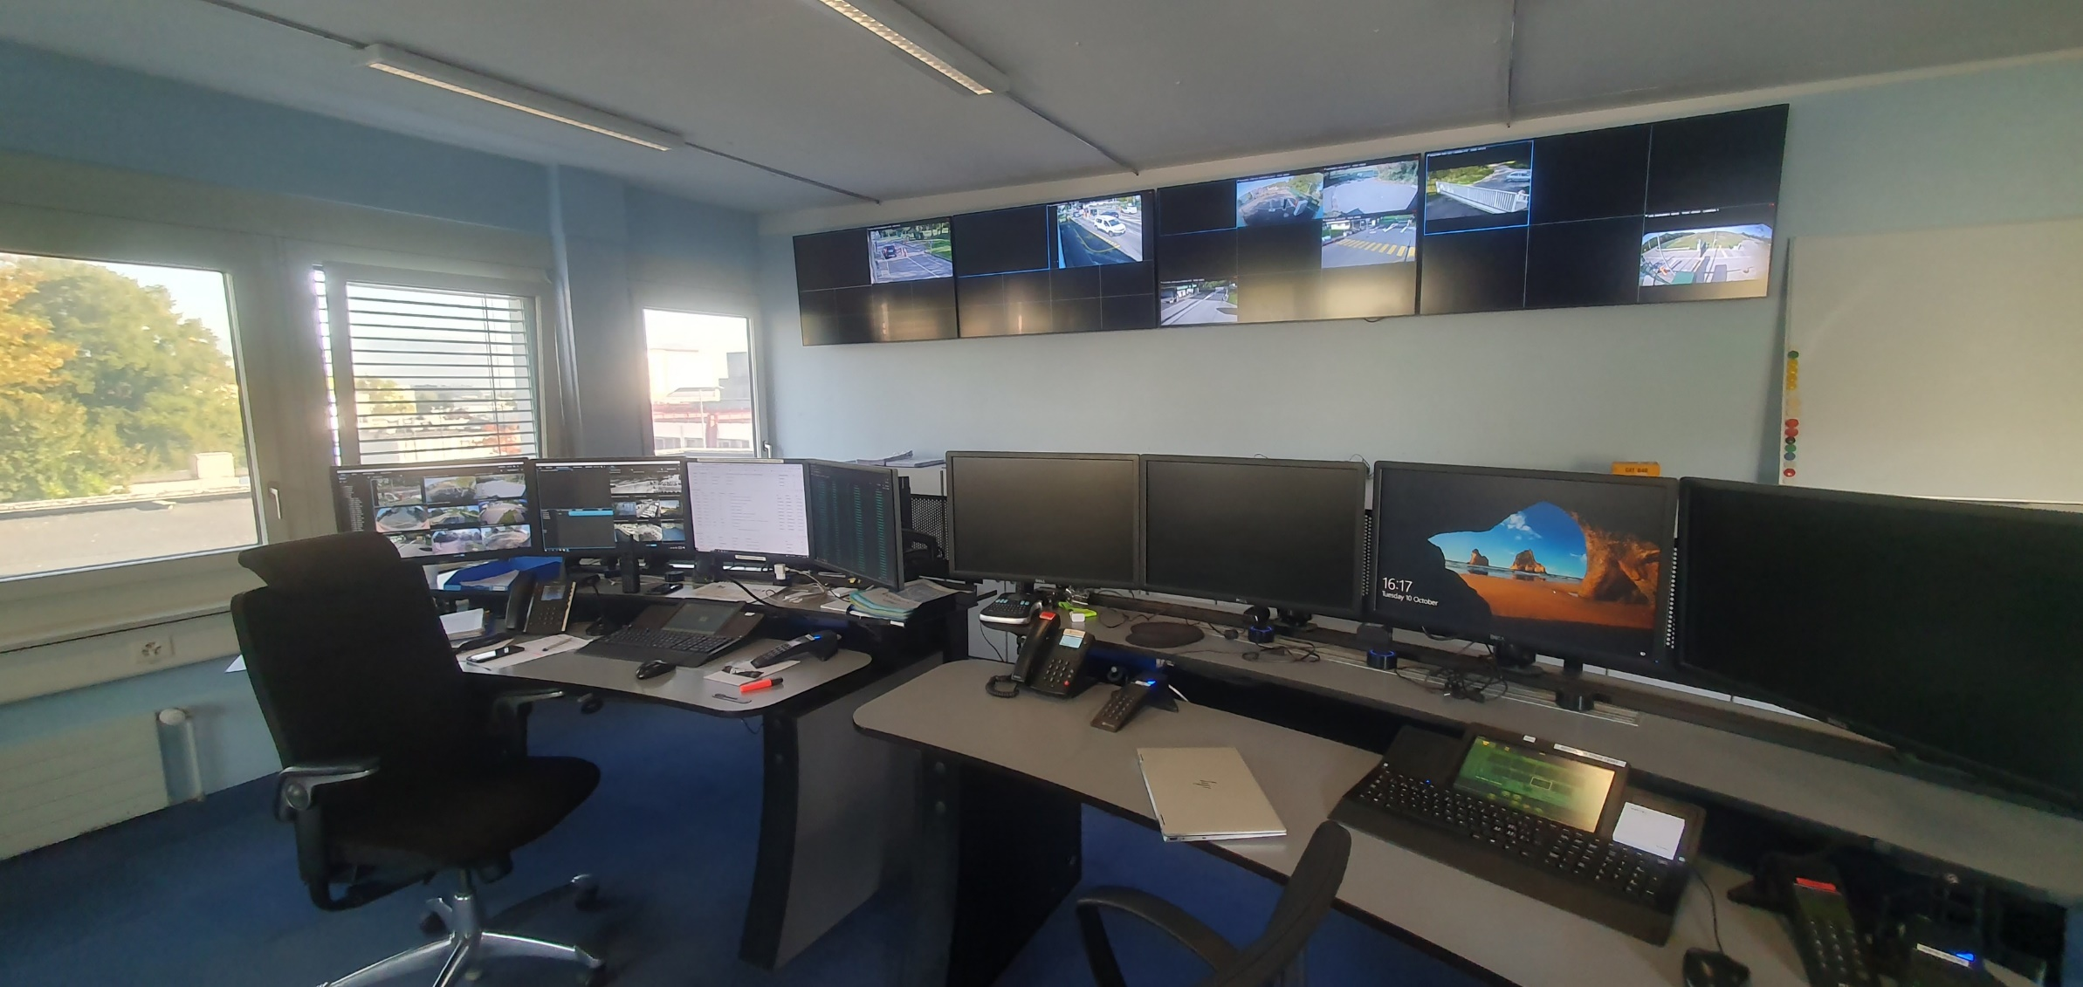
Key points
Presentation
CERN is also a magnet for international political figures. Indeed, protocol visits are made regularly, and require careful preparation.
Objectives
Ensure that visits run smoothly,
simplify the creation of necessary operations.
Providing a simple tool to dispatch and display organisation,
Constraints
The tool must be simpler than the manual procedure,
Incoming flow quality is difficult to modulate.

Slide 16


End user process view vs reality
CERN
Site security
Protocol service
Adjust the calendar
Gates opening
Parking lot reservation
Markup
Follow me cars
Police relationship
End visit process removal
One
Coordinator
for 3 hours

Slide 17
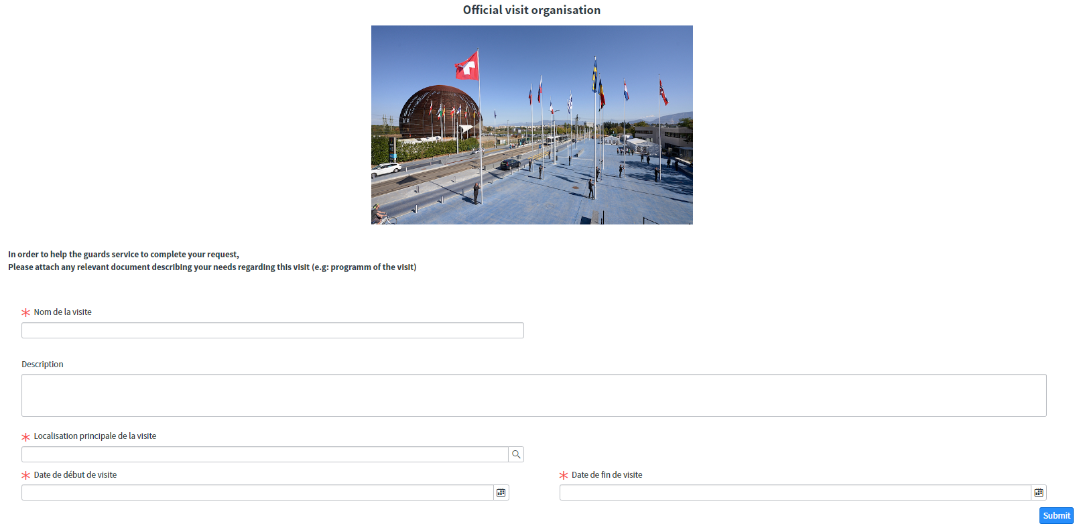
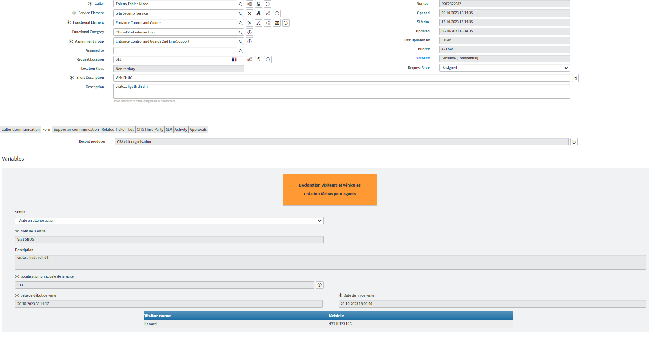
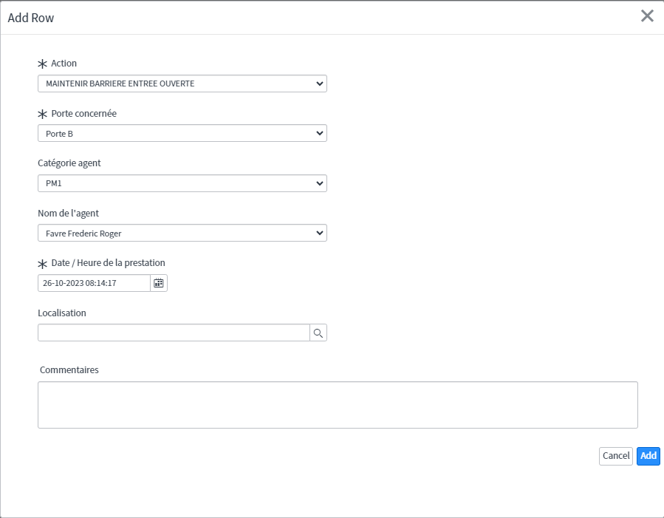
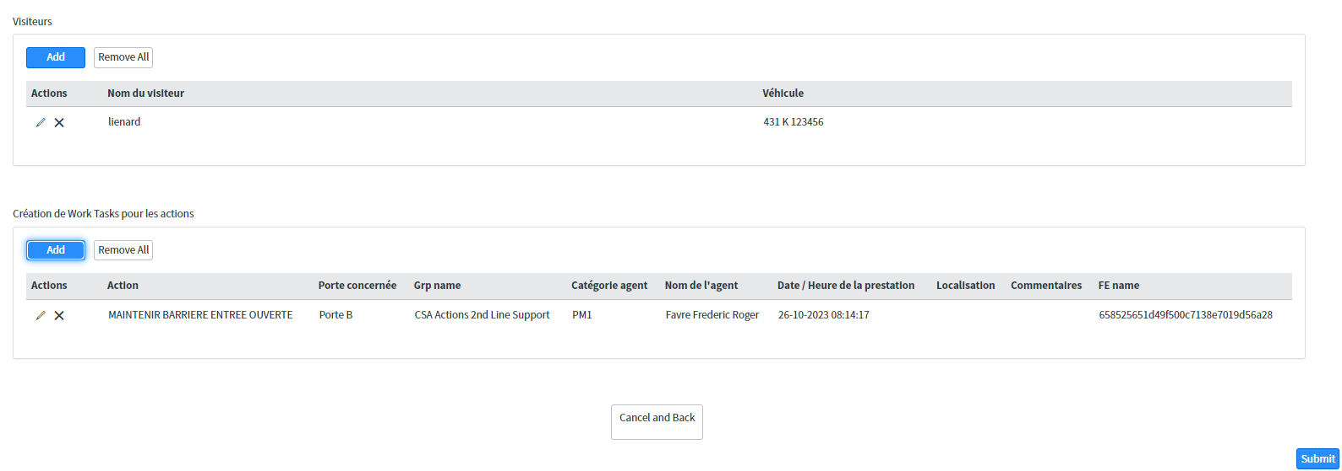
Supporter’s side

Slide 18

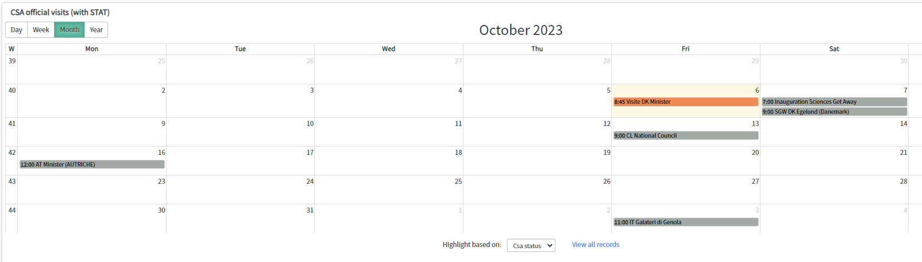
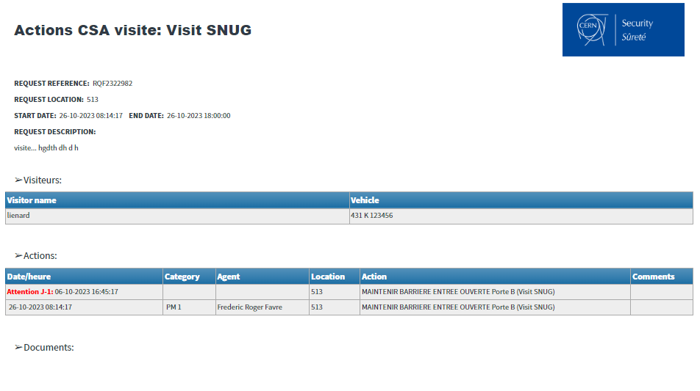
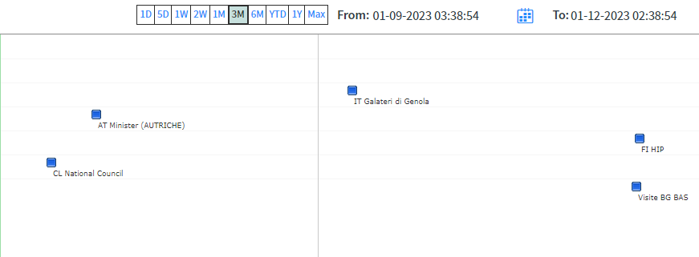
Supporter’s side
All visits with their respective status are visible in a glance to organize resources
Direct display for filed agents

Slide 19
Take away
By using most of standard out of the box features
Organisation time has decreased from 3 hours to 30 minutes!
Planification can be create by an agent, not only by manager,
Each visit is feeding the AI (limited) database for action declaration,
Bottom – up considerations are keys factors.

Slide 20
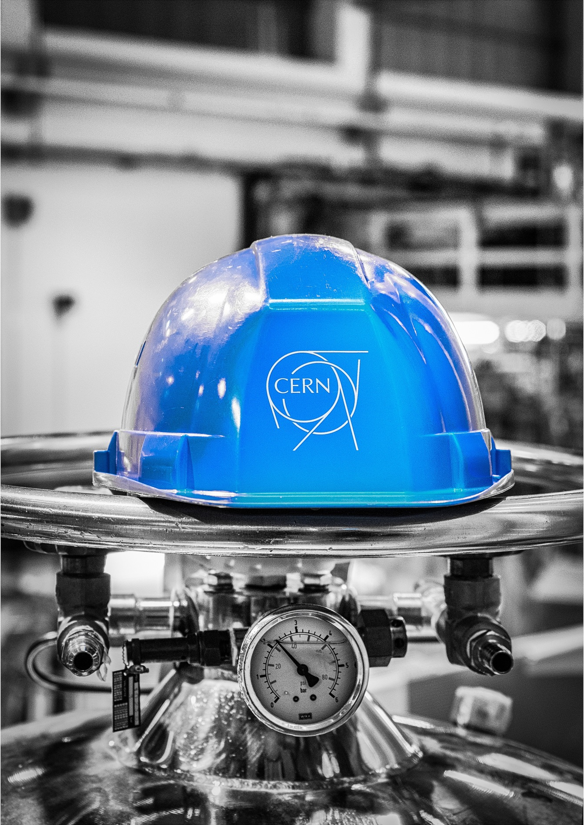


Questions & maybe…Answers

