Slide 1
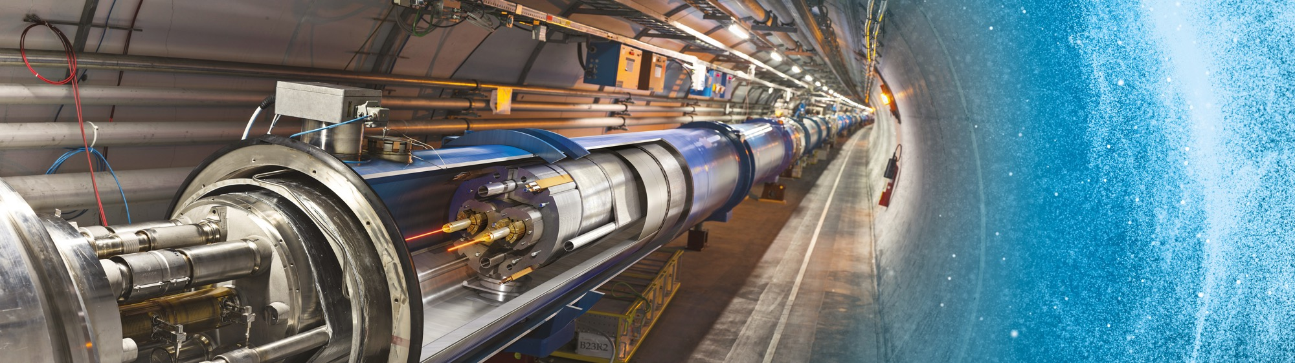
Doing Business with CERN
LHCP Meeting - 22 May 2023
CERN-Serbia: Industry and innovations forum
Dr.-Ing. Daniel Schoerling – IPT/PI

Slide 2
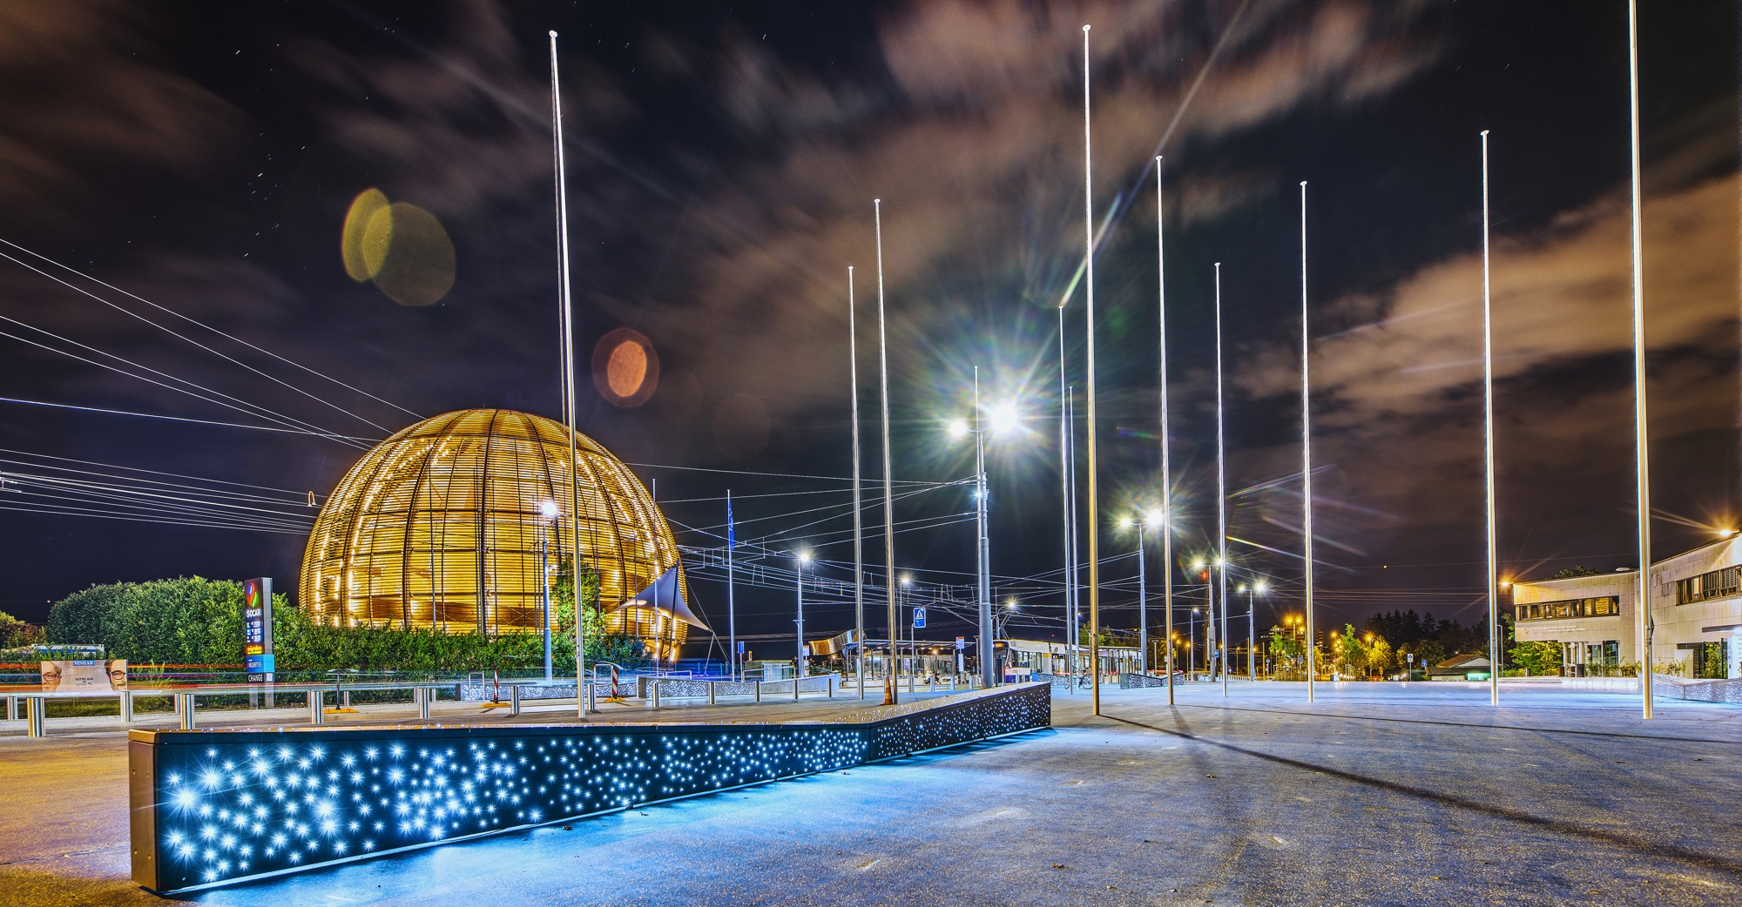
AGENDA
Introduction
    Legal Framework
    Budget
    What we buy
Procurement @ CERN
    Procurement Service
    Principles
    Procedures
    Collaboration agreeements
Procurement website

Slide 3

INTRODUCTION

Slide 4
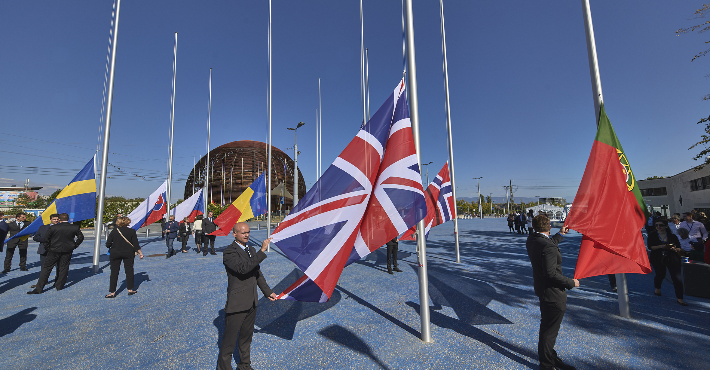
Legal Framework
CERN, an Intergovernmental Organization, was established in July 1953, by the “Convention for the establishment of a European Organization for Nuclear Research”;
As an Intergovernmental Organization, CERN is not a legal entity under national law but governed by public international law;
CERN is therefore entitled to establish its own internal rules necessary for its proper functioning, such as the rules under which it purchases equipment and services.

Slide 5

In 1954 CERN had 12 Member States
Today CERN has 23 Member States
23 Member States
3 Associate Member States in the pre-stage to membership
7 Associate Member States
6 Observers
Geographical & cultural diversity :
110 nationalities, from 77 countries
19.4% Women
2676 Staff members
1556 Contractors’ employees
11175 Physicists /Users
Yearly budget ~ 1200 MCHF
Notes:
The speaker can highlight CERN’s second mission as stated when it was established: to foster peaceful collaborations between nations that had recently been at war.
This slide will have information on the country of the visiting delegation:
Location on the world map
Date of accession (if Member State or Associate Member State)
For information:
Member States – Austria, Belgium, Bulgaria, Czech Republic, Denmark, Finland, France, Germany, Greece, Hungary, Israel, Italy, Netherlands, Norway, Poland, Portugal, Romania, Slovak Republic, Spain, Sweden, Switzerland, United Kingdom
Associate Member States in the pre-stage to membership – Cyprus, Serbia, Slovenia
Associate Member States – India, Lithuania, Pakistan, Turkey, Ukraine
Observers – USA, Russia, Japan, (EU, JINR, UNESCO)

Slide 6
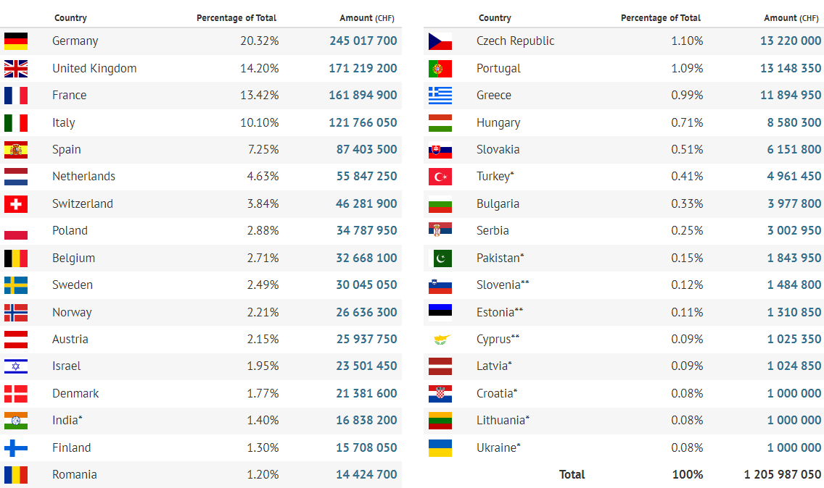
Yearly Budget (contributions 2022)

Slide 7

What we buy
Recurrent supplies & services
Accelerator technologies required for consolidation projects and new developments

Slide 8
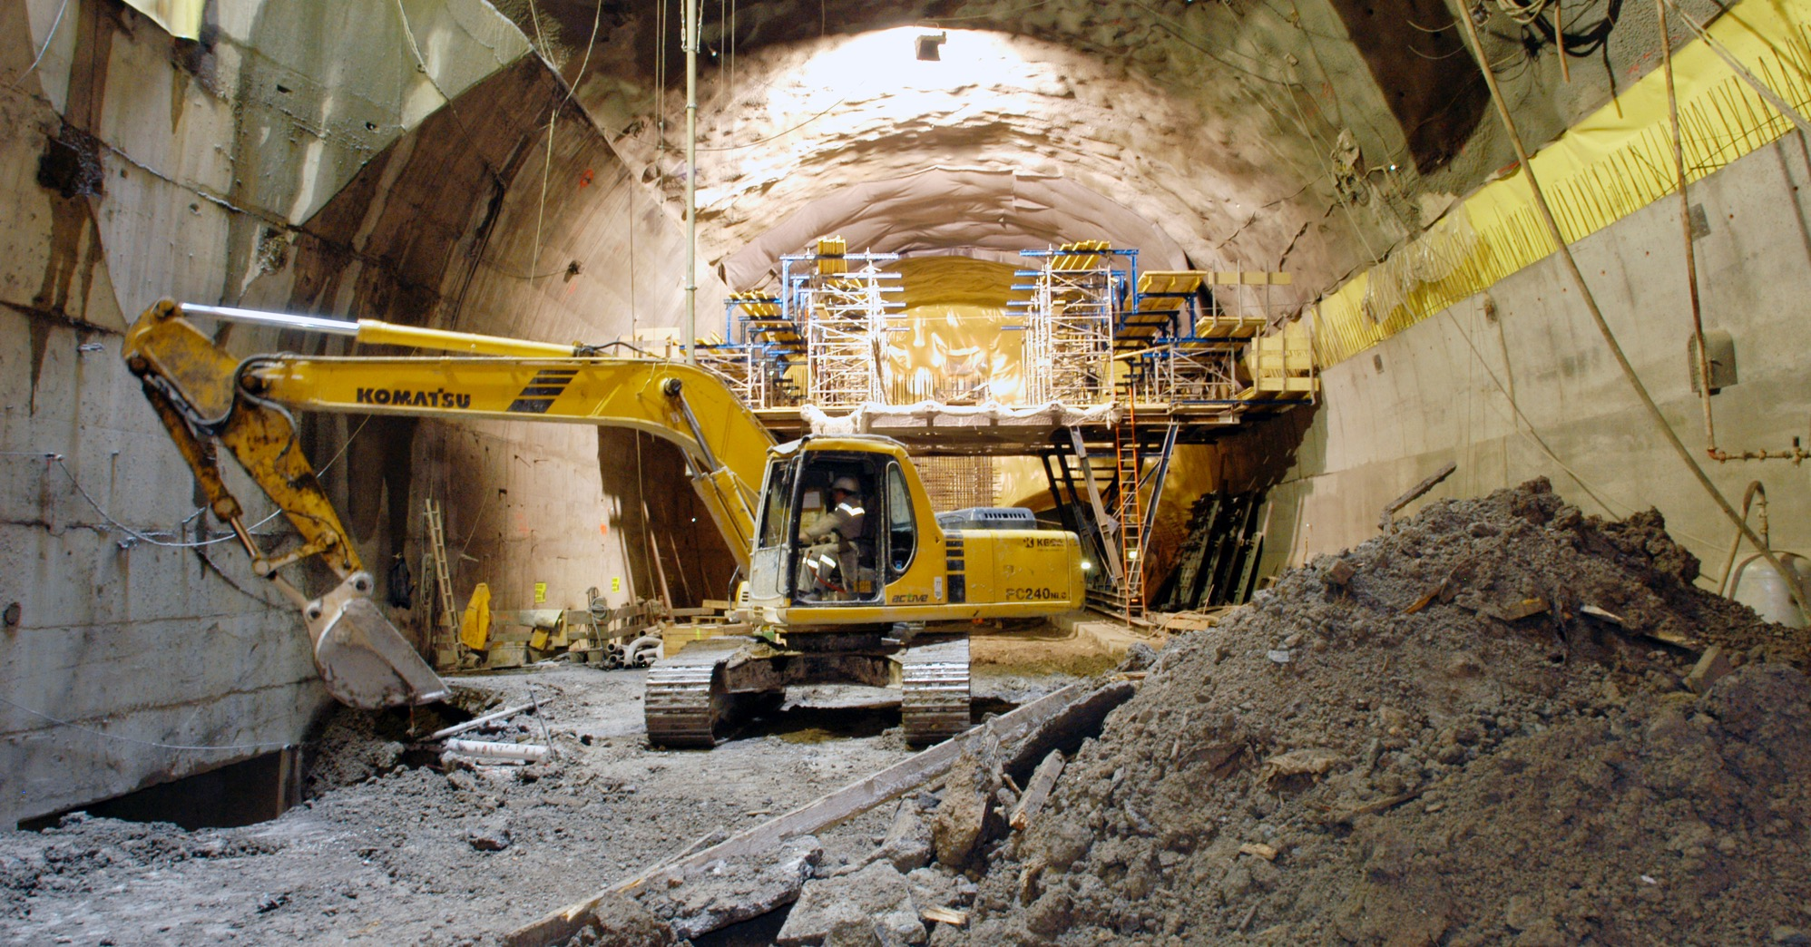
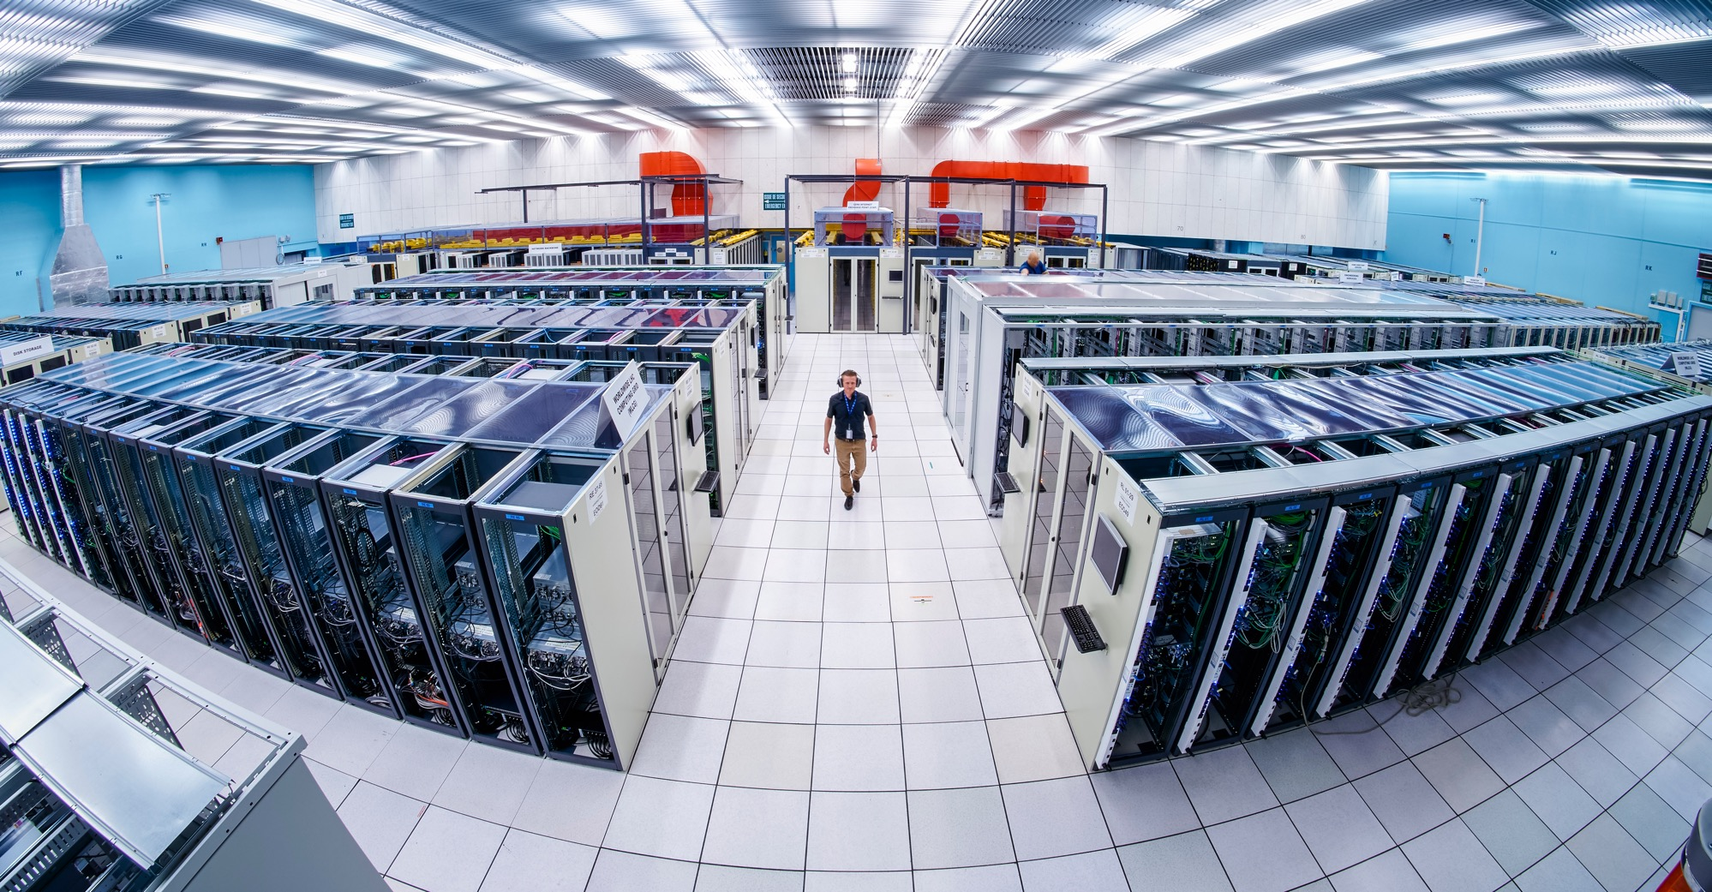
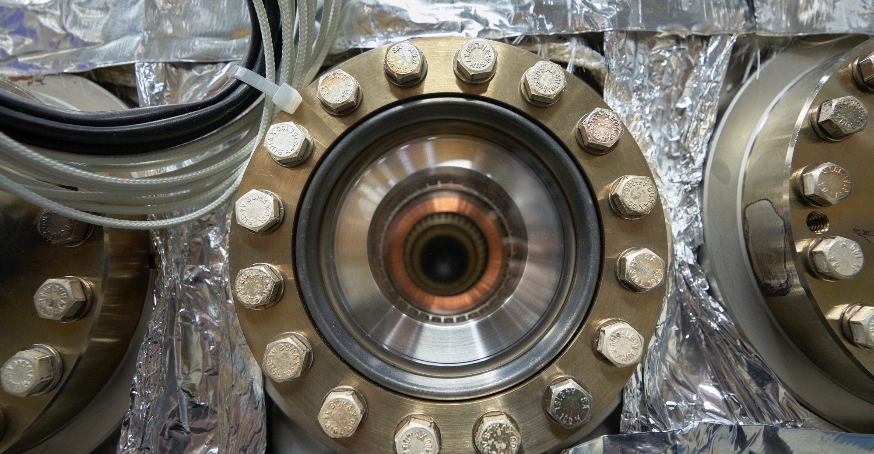
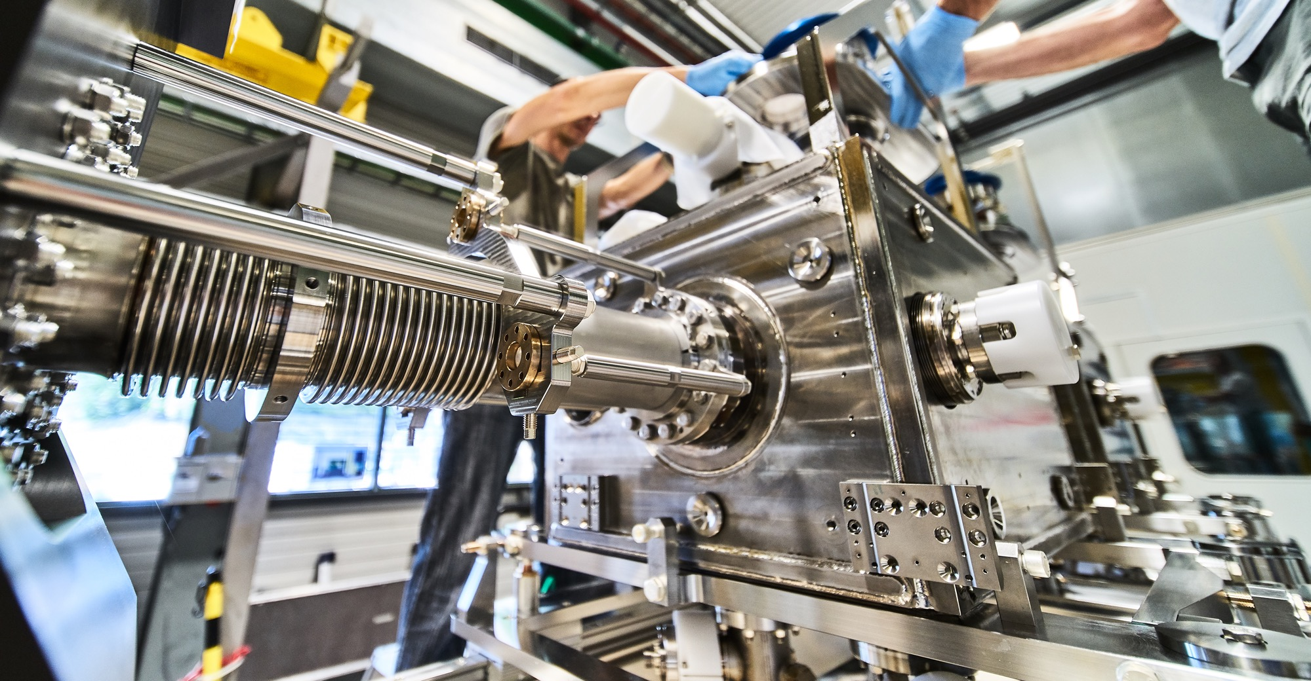
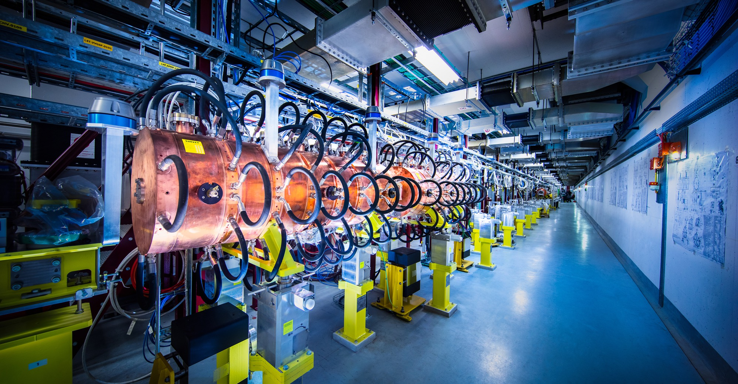
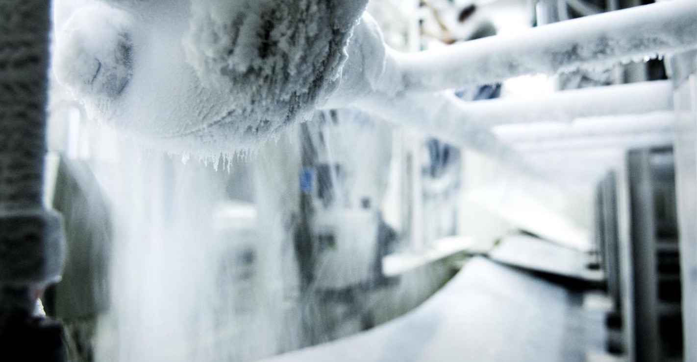
What we buy
Civil engineering
Cooling and ventilation
Electrical engineering and magnets
Information Technology
Mechanical engineering and raw materials
Electronics and radiofrequency
  Cryogenic and vacuum equipment
  Health and safety equipment,
  Transport and handling equipment
  Office supply, furniture
  Industrial services on the CERN site

Slide 9
Procurement Expenditure

Slide 10

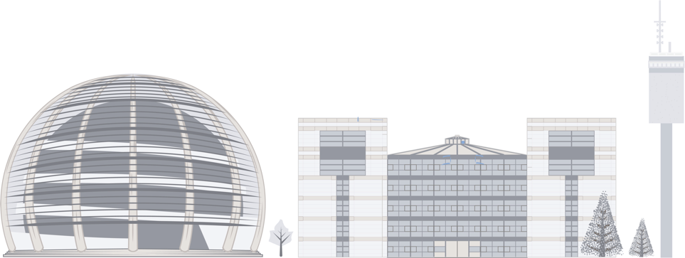
PROCUREMENT @CERN

Slide 11
The Procurement Service
The mission of the Procurement Service is to procure all supplies and services for CERN
Meeting all requirements:
specified and contractual technical, delivery
and performance requirements
At the lowest possible overall cost
While :
Achieving balanced industrial return for CERN Member States
Respecting CERN Procurement Rules

Slide 12
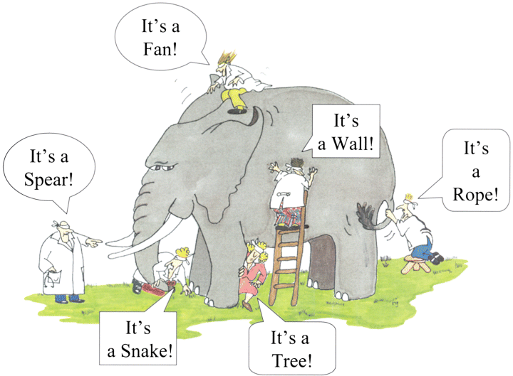
How do we buy ?
  Off-the shelf or non-standard products which can be produced with existing manufacturing techniques or technologies:
  => Functional specification
  Non-standard products where industry has neither the required know-how nor the interest to develop and design the products:
  => Build-to-Print specification
Prototypes and or Pre-series might be required

Slide 13
Country of Origin
SUPPLIES
“Country(ies) where the supplies (including their components and sub-assemblies) are manufactured or undergo the last major transformation by the contractor or its sub-contractor”
If at least 60% of the total amount of the bid comes from a poorly balanced MS, then the whole bid will be treated as that from a bidder in a poorly balanced MS.
SERVICES
“Country(ies) in which the bidder is established.”
If at least 40% of the total amount of the bid comes from a poorly balanced MS, then the whole bid will be treated as that from a bidder in a poorly balanced MS.

Slide 14

Industrial Return Coefficient
The Industrial Return Coefficient (IRC) of a Member State is defined as the ratio between that Member State's percentage share of the value of all Supply contracts and that Member State's percentage contribution to the CERN Budget over the same period.
Well balanced Member States: IRC ≥ 1
Poorly balanced Member States: 0.40 ≤ IRC < 1
Very Poorly balanced Members States : IRC < 0.40

Slide 15
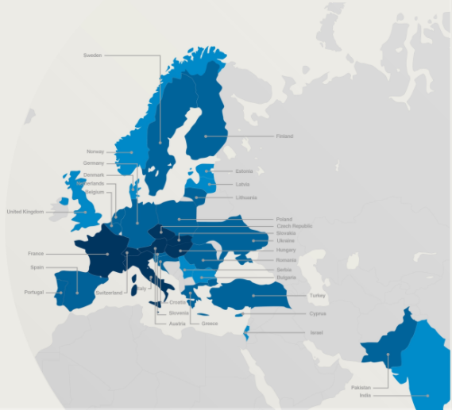
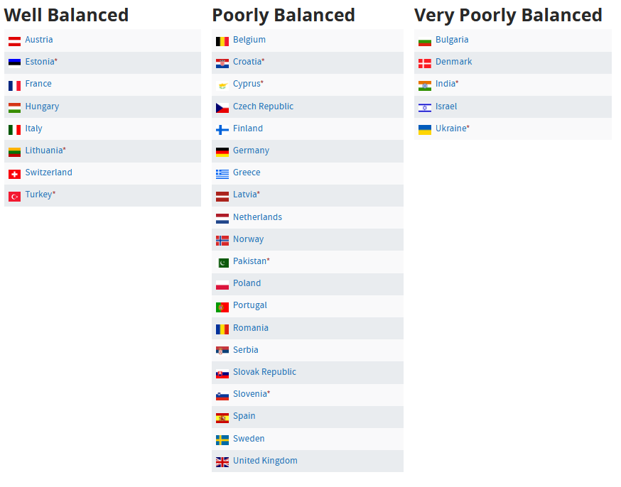

Member States Classification (Supplies)
(1st March 2023 – 29 February 2024, based on the previous 4 calendar years):

Slide 16

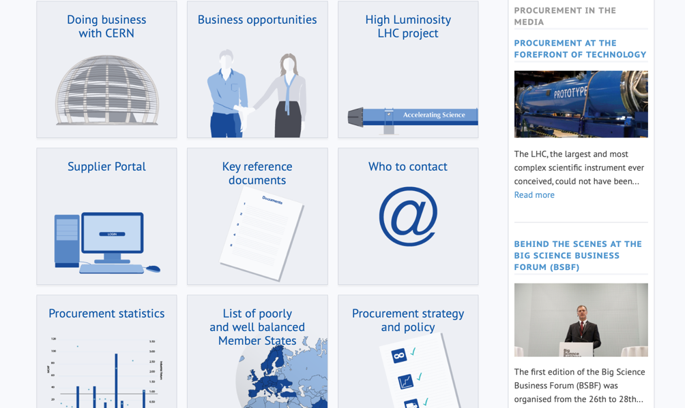
PROCUREMENT WEBSITE

Slide 17

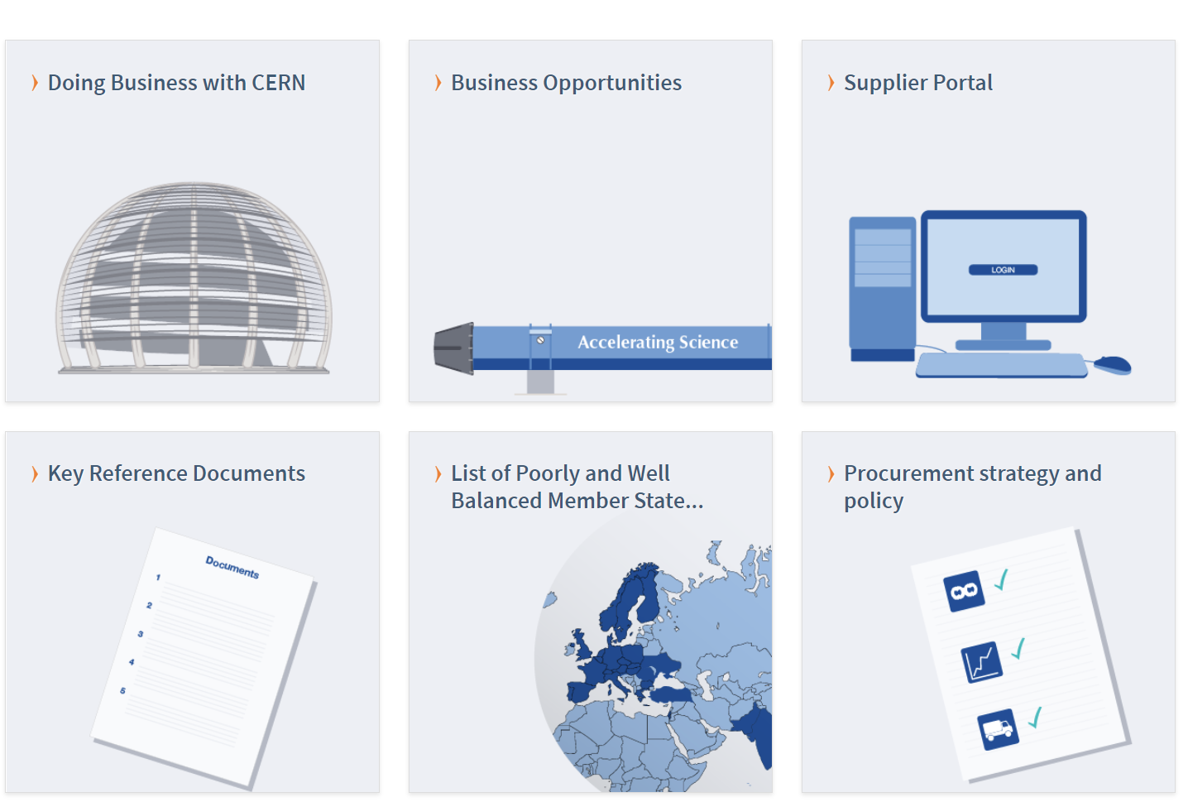
Procurement Website
http://procurement.web.cern.ch

Slide 18
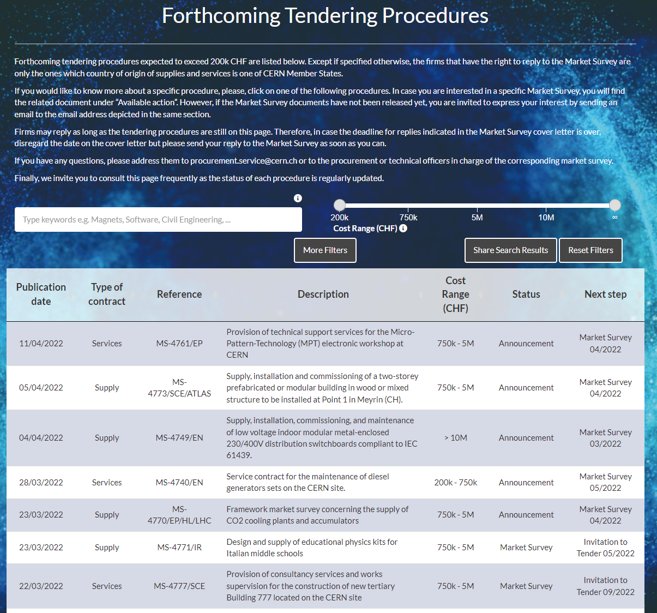
CERN Shopping List
https://forthcoming-ms.app.cern.ch/#!/

Slide 19
Procurement Website
http://procurement.web.cern.ch

Slide 20
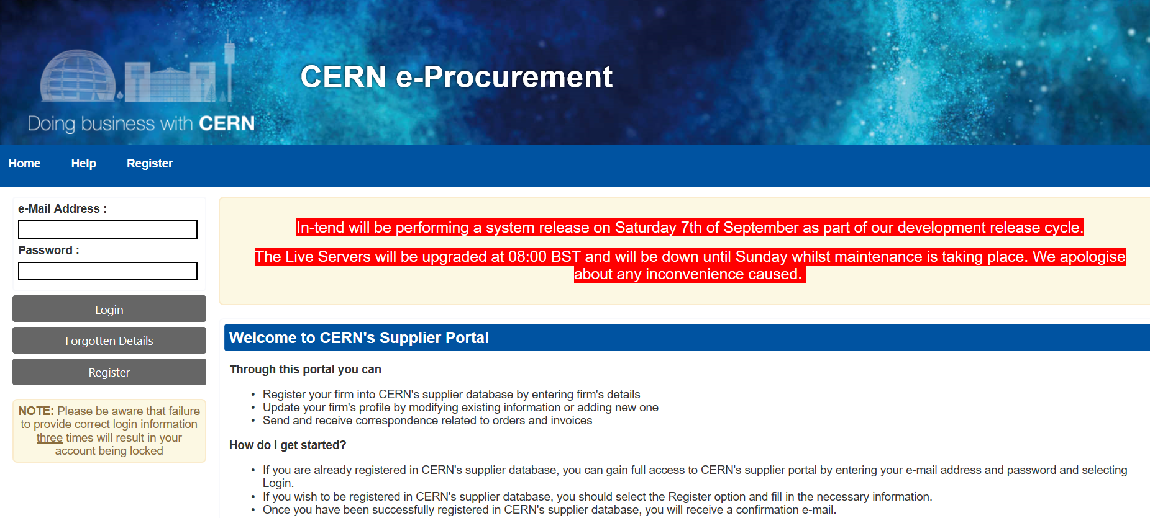
Suppliers Database Registration

Slide 21
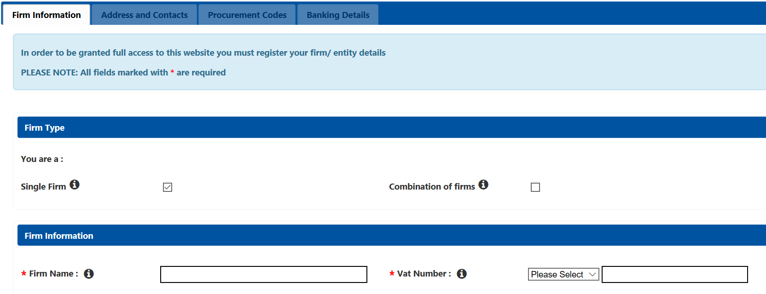
Suppliers Database Registration

Slide 22
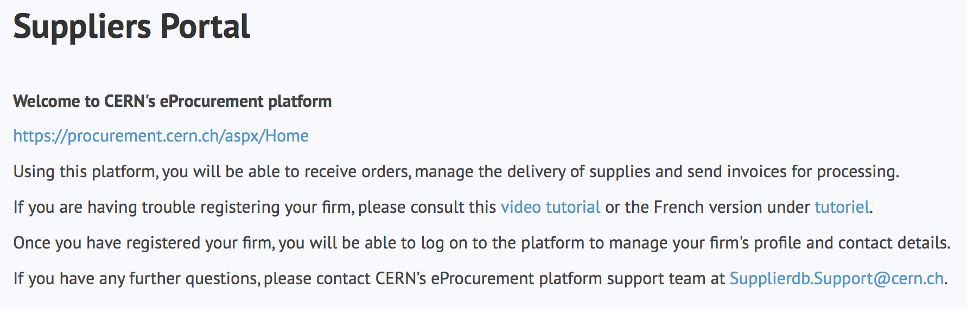
Suppliers must register in the Suppliers Portal
for all exchanges with CERN, in particular to:
Be visible for future opportunities
(with the procurement codes you have indicated),
Receive and follow-up orders,
Send invoices.
MANDATORY
Supplierdb.Support@cern.ch.

Slide 23
Procurement Website
http://procurement.web.cern.ch

Slide 24
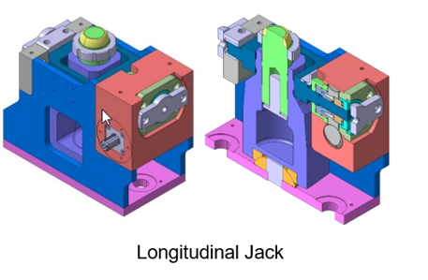
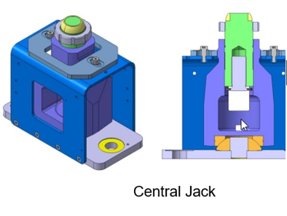
Jacks for FRAS
Description & Specific Condition :
FRAS will allow for remote and simultaneous alignment of Magnets, cryostats, crab cavities, cryomodules, and TAXN
The jacks consist of two different types
  Longitudinal jacks (130)
  Central jacks (10)
High precision machining and assembly are
required for this production
Cost Range : 750 k CHF ⬄ 5 M CHF
Planning: MS: Q3-2023 - IT: Q4-2024
Contact: Delio.Ramos@cern.ch

Slide 25
R&D collaboration agreements: Why?
CERN concludes collaboration agreements with institutes in Member States and AMS in order to fulfil a requirement which cannot be procured for a reasonable cost on a lowest compliant bid basis following CERN procurement rules. The activity shall not be in competition with industry in CERN Member States.
The requirement (design, manufacture and/or test of equipment) must be driven by a need for a CERN project or study. The project or study co-funds the requested activity.
The activity shall be of mutual interest and benefit for the partner institute and CERN.

Slide 26
What CERN provides?
The cost structure of any R&D activity comprises typically the following:
  Manpower cost at CERN and at the partner institute: CERN is covering 100% of its own personnel cost and up to 50% of the partner institute personnel cost (see next slide on details);
  Material cost: Up to 100% of material can be paid by CERN. However, material paid by CERN, shall be procured by and respecting CERN procurement rules, and provided to the partner institute upon delivery of a certificate of property;
  Operation cost (for example liquid helium for testing, electricity costs, consumables, etc.): Can be paid partly by CERN based on an upfront agreed lump sum; CERN shall not pay more than 75% of the overall operation costs;
  Infrastructure cost shall be borne fully by each party for their own infrastructure;
  Travel costs and any other administrative costs shall be covered fully by each party for their own activities.
  CERN looks for collaboration partners for its studies, in particular for the High-Field Magnet Program (Contact: Germana Riddone (HFM project office): Germana.Riddone@cern.ch)

Slide 27
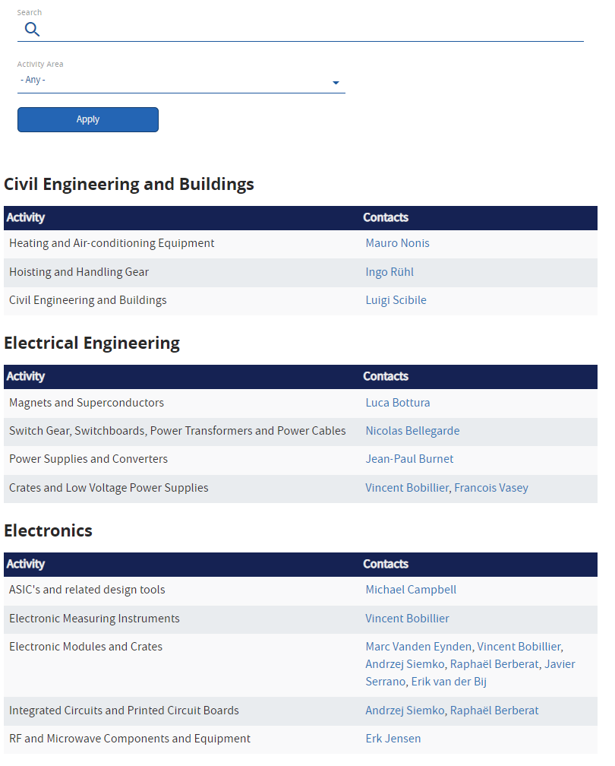
Contacts
CERN Procurement
CERN Technical Contacts
Please contact for all commercial inquiries:
procurement.service@cern.ch
https://procurement.web.cern.ch/contact/who-contact-cern

Slide 28
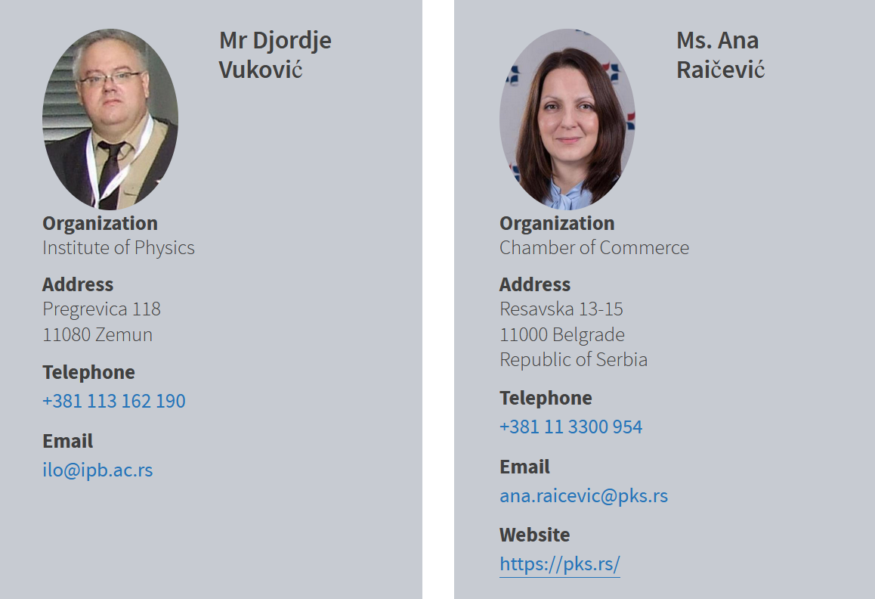
Contact for Serbia
ILO: Industrial Liaison Officer
Who to contact in your Country
    Industrial Liaison Officers (ILO's) are appointed by CERN's Member States to facilitate the flow of communication between CERN and its suppliers. ILO's can provide advice on the opportunities available for doing business with CERN and the support available to firms in their local regions.

Slide 29
Thank you

Slide 30
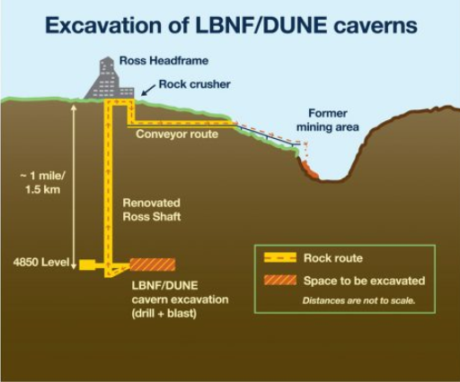
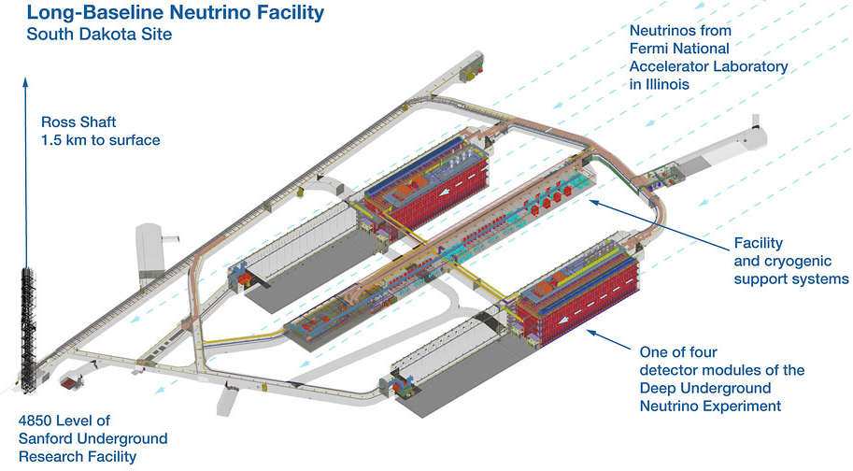
DUNE - Assembly
Description & Specific Condition :
Deep Underground Neutrino Experiment (DUNE), hosted at Sanford Underground Research Facility (SURF) in Lead, South Dakota (US).
Assembly of the structure according to drawings
Logistics (1500 meters underground)
Each structure : 65 m (length) x 19 m (width) x 18 m (height)
Each structure : 2300 tonnes.
Interested firms shall have proven experience in metallic structures manufacturing and erection
Cost Range : 5 M CHF ⬄ 10 M CHF
Planning: MS: Q1-2023 - IT: Q2-2023
Contact: Lluis.Miralles.Verge@cern.ch

Slide 31
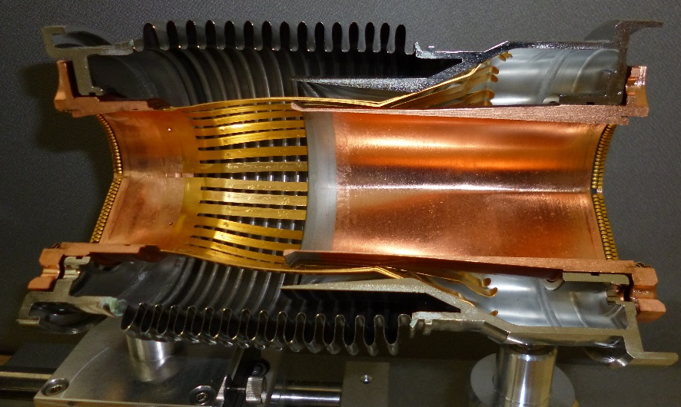
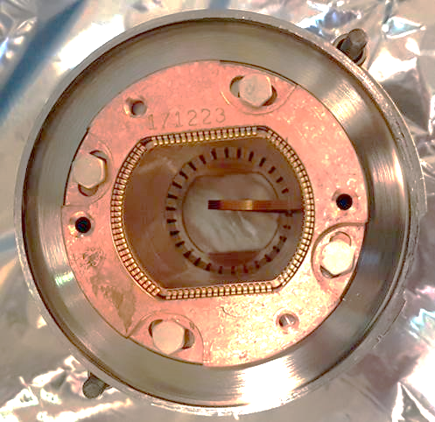
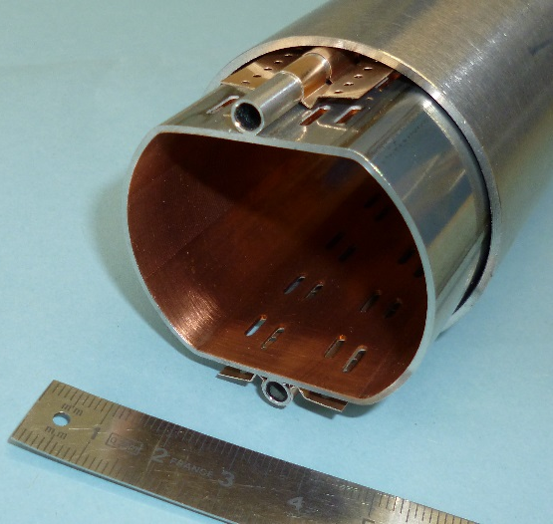
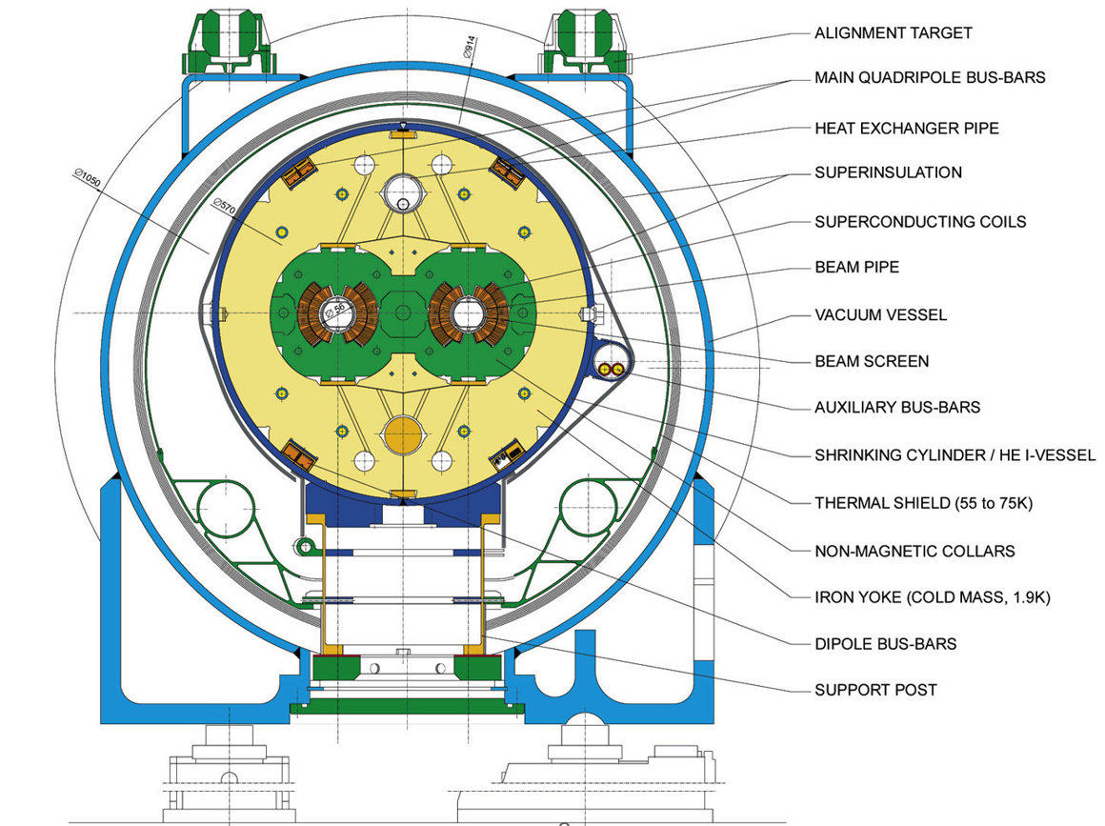
Inspection Tooling for LHC Vacuum Beam Screen
Description & Specific Condition :
  2 Systems
  Volumetric object to be detected : 30 mm2 (Correspond to 1 cm of one RF finger bent toward the centre of the beam screen)
Must inspect 2.8 km total length (Beam Screen: 15.5 meters long & Plug-in-Module every 14 meters)
  Front high resolution camera & video data recording
  Battery driven & autonomy of 6 km
  Prototype validation (FAT + SAT)
Cost Range : ≤ 750 k CHF
Planning: MS: Q3-2023 - IT: Q3-2024
Contact: Giuseppe Bregliozzi@cern.ch

Slide 32
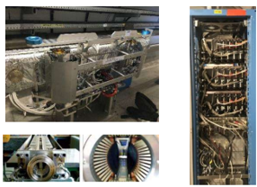
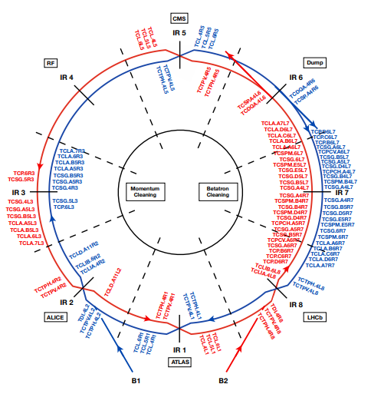
LHC Collimator Control System Upgrade
Description & Specific Condition :
Collimation control system allows for remote control and diagnostics of collimator parameters, for all specific sequences associated to LHC operational cycle.
Tenders will be subdivided into :
Stepping Motors Drivers
FMC Cards for Motion Control
PXI-e COMe Adapter
COMe CPU
PXIe Carrier
Cost Range : 750 k CHF ⬄ 5 M CHF
Planning: MS: Q3-2023 - IT: Q4-2024
Contact: Mario.di.Castro@cern.ch

Slide 33
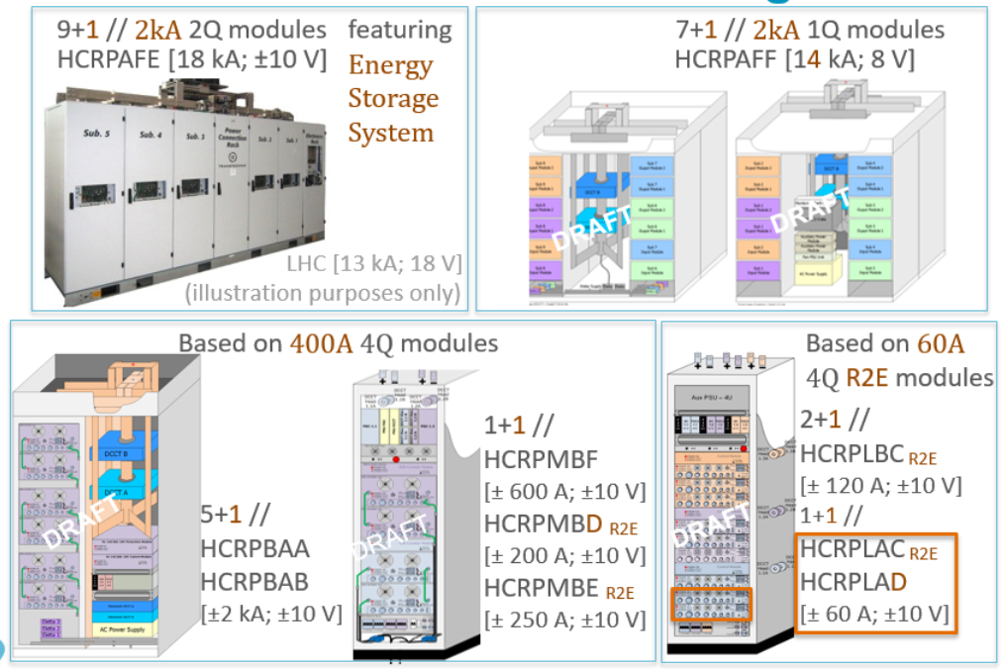
Power Modules for HL-LHC
Description & Specific Condition :
All HL-LHC Power Converters required for the HL-LHC Project will be Low Voltage Power Converters
Designed by CERN => Built to print & Manufacturing file provided by CERN
Production and Testing of power converters
Medium current: HL-LHC600A-10V : 26 units
Low current: R2E-HL-LHC120A-10V : 136 units
R2E-HL-LHC60A-10V : 442 units
Cost Range : 750 k CHF ⬄ 5 M CHF
Planning: MS: Q3-2023 - IT: Q3-2024
Contact: Serge.Pittet@cern.ch

Slide 34
Jacks for FRAS
Description & Specific Condition :
FRAS will allow for remote and simultaneous alignment of Magnets, cryostats, crab cavities, cryomodules, and TAXN
The jacks consist of two different types
  Longitudinal jacks (130)
  Central jacks (10)
High precision machining and assembly are
required for this production
Cost Range : 750 k CHF ⬄ 5 M CHF
Planning: MS: Q3-2023 - IT: Q4-2024
Contact: Delio.Ramos@cern.ch

Slide 35
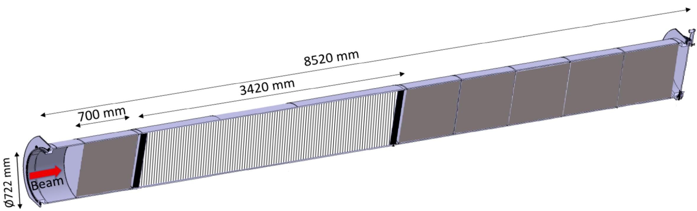
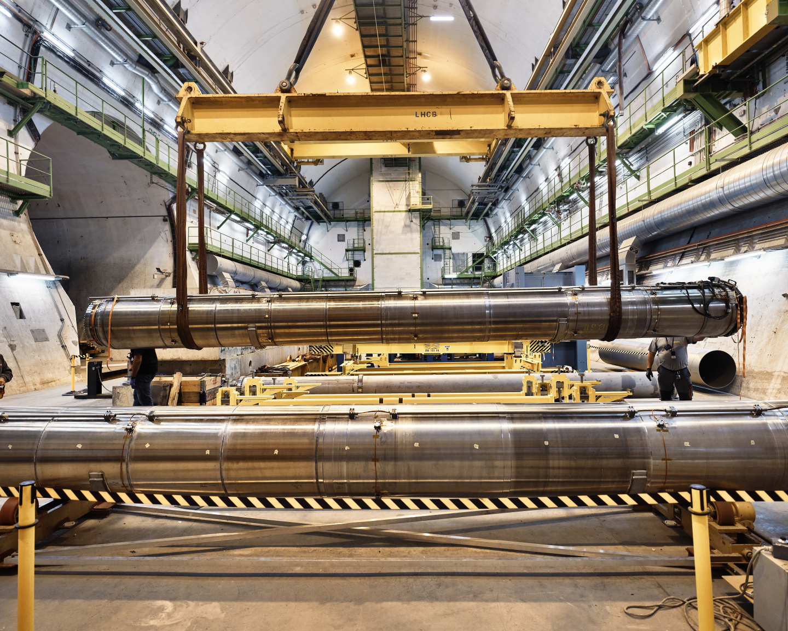
Graphitic materials for HL-LHC TDE dumps
Description & Specific Condition :
LHC3 & LHC 7
Graphitic materials - Isostatic Grade – CFC - Flexible Graphite
Production of carbon-fiber-reinforced-carbon composite material including material certificates
Testing and characterisation of carbon-fiber-reinforced-carbon composite materials
Chemical composition analysis
Application of heat treatments on carbon-based materials
Machining of these materials to strict dimensional tolerances (0.2 mm over 700 mm)
Cost Range : 750 k CHF ⬄ 5 M CHF
Planning: MS: Q2-2023 - IT: Q4-2024
Contact: Nicola.Solieri@cern.ch

Slide 36
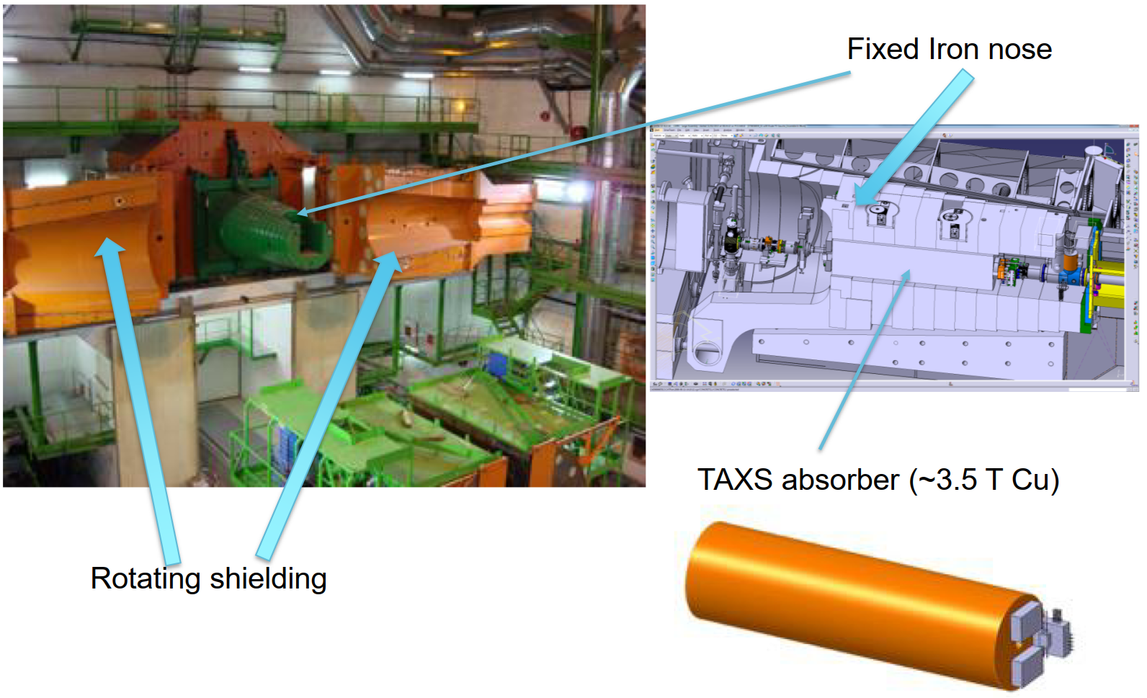
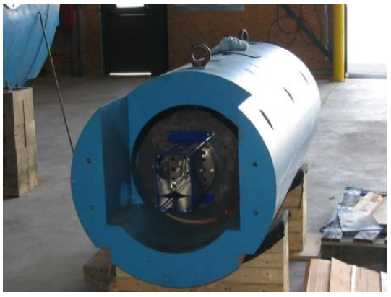
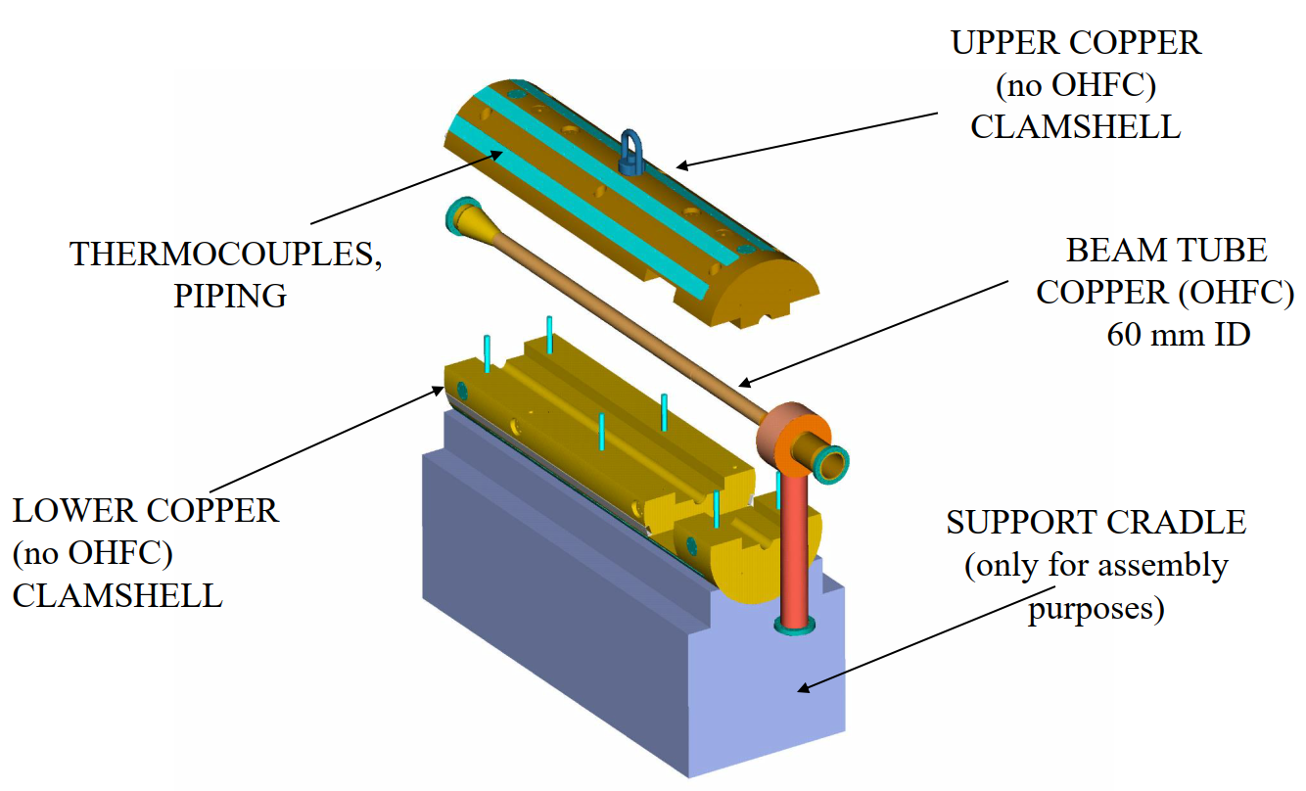
TAXS Absorbers (Target Absorbers for Secondary)
Description & Specific Condition :
TAXS absorbers are embedded in the forward shielding at the limit of the experimental cavern and the LHC tunnel, and are used to protect the inner triplets and dipoles from the collision debris generated at the interaction point
Built to print – 4 units
Absorber made of casted ETP Cu
Shielding made of casted steel
Cost Range : ≤ 750 k CHF
Planning: MS: Q4-2023 - IT: Q4-2024
Contact: Francisco.Sanchez.Galan@cern.ch

Slide 37
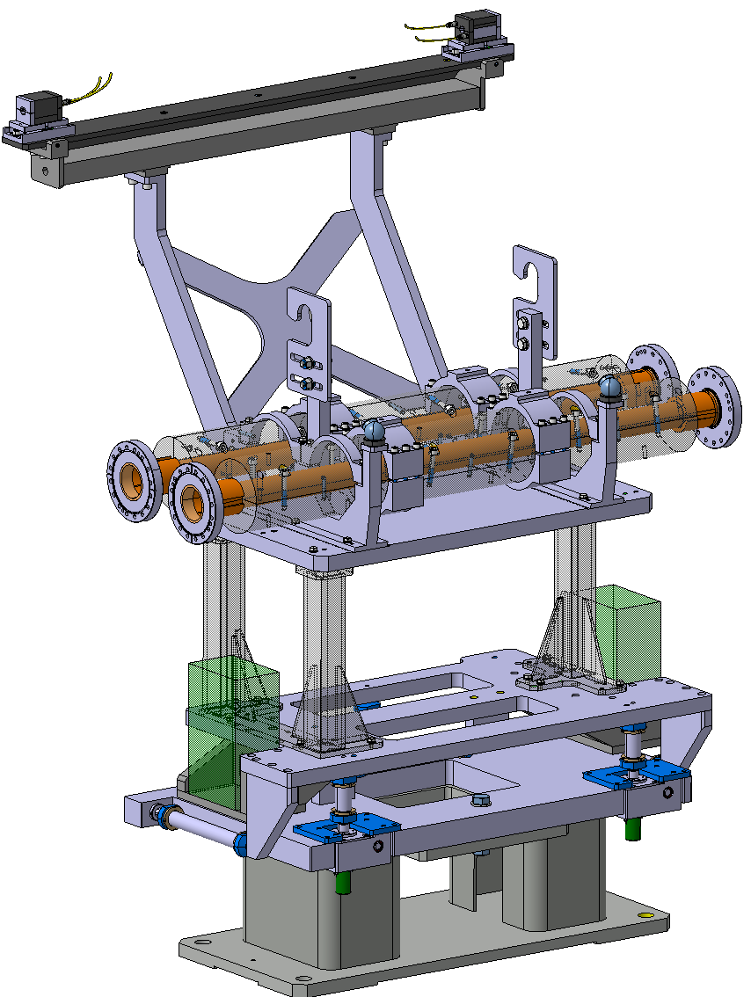
Supply of masks
Description & Specific Condition :
15 Masks for Vacuum chamber protection
Passive collimator – Protection for the magnets
Machined Tungsten blocs provided by CERN
Tolerances, Brazing
Copper, Inconel
Cost Range : ≤ 750 k CHF
Planning: MS: Q3-2023 - IT: Q1-2024
Contact: Francois-Xavier.Nuiry@cern.ch

Slide 38
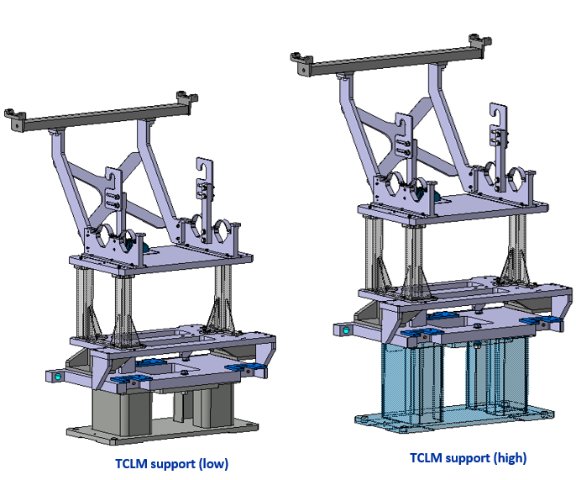
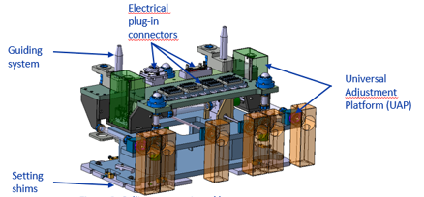
Supports for Collimator Masks
Description & Specific Condition :
Procurement of raw material and components
Machining of all components
Assembly, welding
Quality controls and metrology for every unit produced
All interfaces components (water connections, 50 pins connectors, connectors, BPM connectors) will be assembled at CERN after FAT
Cost Range : 750 k CHF ⬄ 5 M CHF
Planning: MS: Q4-2023 - IT: Q4-2024
Contact: Francois-Xavier.Nuiry@cern.ch

Slide 39
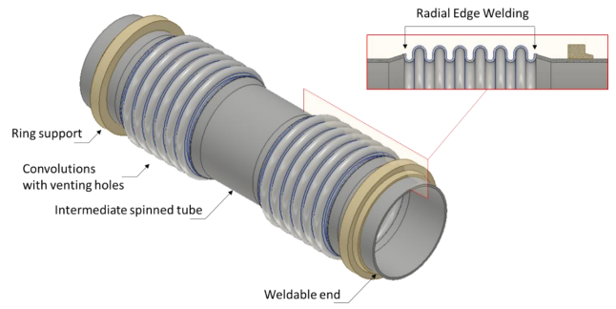
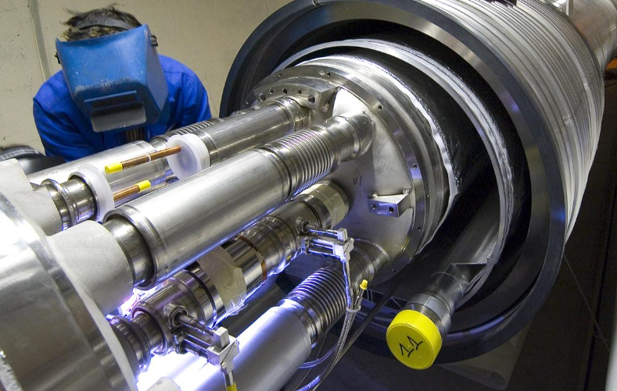
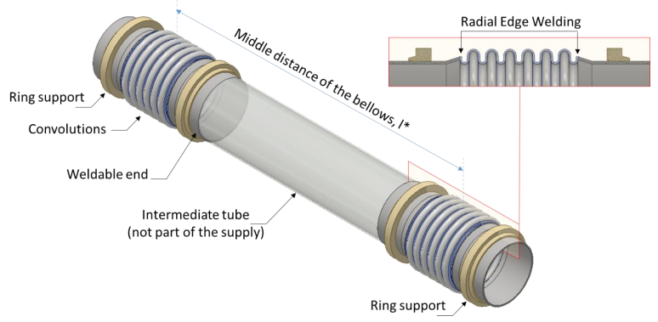
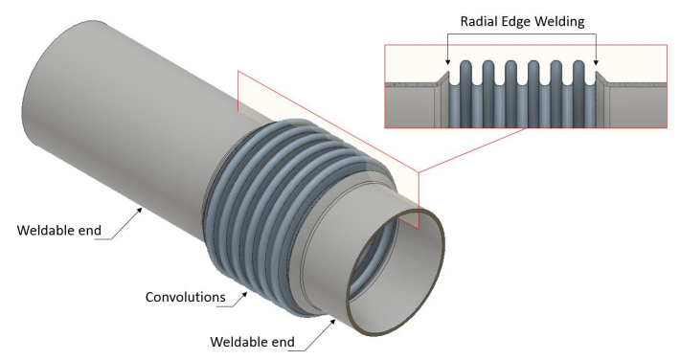
Metal Bellows Expansion Joints
Description & Specific Condition :
Supply of 300 metal bellows expansion joints for connecting the hydraulic circuits of the High Luminosity LHC superconducting magnets
Design, Procurement of raw material, production, QA, Cleaning and Testing
Six different types
Internal diameters between 50 mm and 100 mm
Installed in vacuum and contain superfluid helium at 1.9 K
Cost Range : ≤ 750 k CHF
Planning: MS: Q3-2023 - IT: Q4-2024
Contact: Delio.Ramos@cern.ch

Slide 40
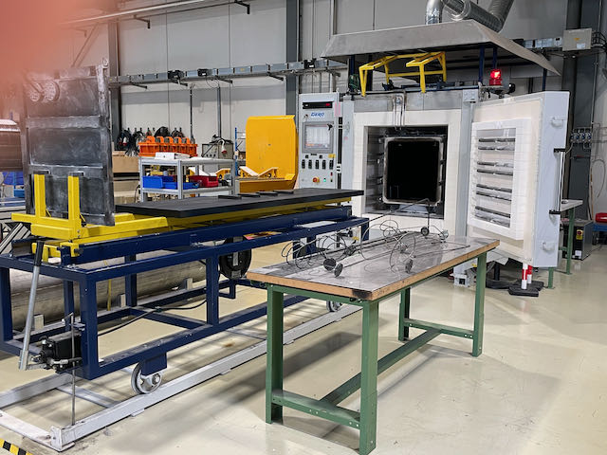
Supply of reaction Furnace
Description & Specific Condition :
Reaction furnace for heat treatment in inert gas atmosphere for Nb3Sn superconductor long coils (2.5M).
Design, manufacturing, testing and training
Temperature ranging from 200 ⁰C to 900 °C
Stability and uniformity of T °C is critical
Leak rate less very low ≤ 10⁻³ mbar l/s
Interested firms shall have a proven experience in the manufacture of furnaces of similar size and complexity
Cost Range : ≤ 750 k CHF
Planning: MS: Q2-2023 - IT: Q4-2023
Contact: Juan.Carlos.Perez@cern.ch

Slide 41
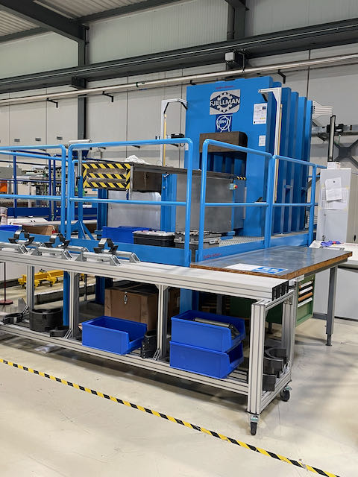
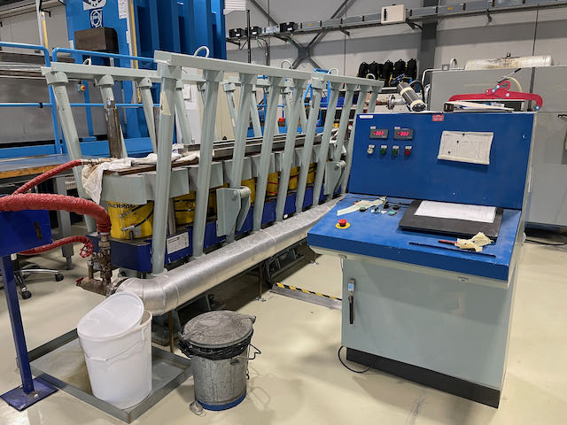
Supply of Collaring and curing press
Description & Specific Condition :
Hydraulic press of a length of 2.5 m
Total force of 14.8 kN
Uniformity of the force over the length is critical
Interested firms shall have a proven experience in the manufacture of press of similar size and complexity
Design, manufacturing, testing and training
Cost Range : ≤ 750 k CHF
Planning: MS: Q2-2023 - IT: Q4-2023
Contact: Juan.Carlos.Perez@cern.ch

Slide 42
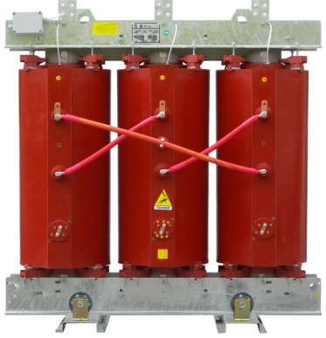
Cast –resin Dry-type Power Transformers
Description & Specific Condition :
B Contract over 5 years
Supply of 110 cast-resin dry-type power transformers:
  18/0.4 kV, 18/3.3 kV and 3.3/0.4 kV
  Rated power between 50 kVA and 12 MVA
Interested firms shall:
  have the proposed transformers in current production for at least two years
  be part of a standard range of products
Cost Range : 5 M CHF ⬄ 10 M CHF
Planning: MS: Q1-2023 - IT: Q4-2023
Contact: Stefano.Bertolasi@cern.ch

Slide 43
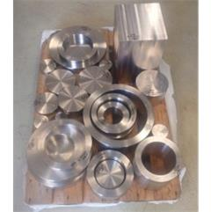
Stainless steel forged blanks for UHV applications
Description & Specific Condition :
B Contract over 5 years
Supply of 15000 pieces (about 45 tons)
EN 1.4429 AISI 316 LN
Interested firms shall have a proven experience and competence in metallurgy, manufacturing process, forging and testing
Cost Range : 750 k CHF ⬄ 5 M CHF
Planning: MS: Q3-2023 - IT: Q4-2024
Contact: Leila.Akhouay@cern.ch

Slide 44


Power Modules for HL-LHC & RF3kA Projects
Description & Specific Condition :
Designed by CERN => Built to print & Manufacturing file provided by CERN
Framework Market Survey => 2 X ITs
Production and Testing of power converters
Supply of 474 Power modules
18kA / 10Vdc => 90 Modules
3kA / 25Vdc => 168 Modules
14kA / 8V dc => 216 Modules
Cost Range : 750 k CHF ⬄ 5 M CHF
Planning: MS: Q1-2023 - IT: Q4-2023
Contact: Serge.Pittet@cern.ch
1st IT
2nd IT

Slide 45


Sensors for alignment
Description & Specific Condition :
Alignment system consists of :
  Wire Positioning Sensors (WPS)
  Hydrostatic Levelling Sensors (HLS)
  Frequency Scanning interferometry (FSI) to determine the position of components
  Adjustable platforms
  Motorisation for Jacks
  (Hi-Rad)
Cost Range : ≤ 750 k CHF
Planning: MS: Q3-2023 - IT: Q2-2024
Contact: Helene.Mainaud.Durand@cern.ch

Slide 46
Graphitic materials for HL-LHC TDE dumps
Description & Specific Condition :
LHC3 & LHC 7
Vacuum vessels : 318 LN vs Titanium
Windows
Cost Range : 750 k CHF ⬄ 5 M CHF
Planning: MS: Q3-2023 - IT: Q4-2024
Contact: Nicola.Solieri@cern.ch

Slide 47



TAXN Absorbers (Target Absorbers for Neutrals)
Description & Specific Condition :
TAXN will be used to protect the dipoles from the collision debris generated at the interaction point
TAXN consists of 2 major assemblies :
  Absorber box
  Steel shielding
Built to print
Absorber made of casted ETP Cu
Shielding of casted steel
Marble
Cost Range : ≤ 750 k CHF
Planning: MS: Q3-2023 - IT: Q4-2024
Contact: Francisco.Sanchez.Galan@cern.ch

