Slide 1
BI Documentation
BI TB, 15 June 2023, S. Jensen

Slide 2

Motivation
IT announced DFS end of life in ’21, promoting EOS as replacement
+
A lot of BI documentation on DFS - some obsolete, some less organized
+
Some BI documentation is located outside DFS (EDMS, Indico, Websites, CCDE, …)
Move all DFS documentation to EOS while discarding and organizing
+
Facilitate access to documentation via “System portal” wiki pages
+
Documentation is useless if you cannot find it…
Reorganize EDMS

Slide 3
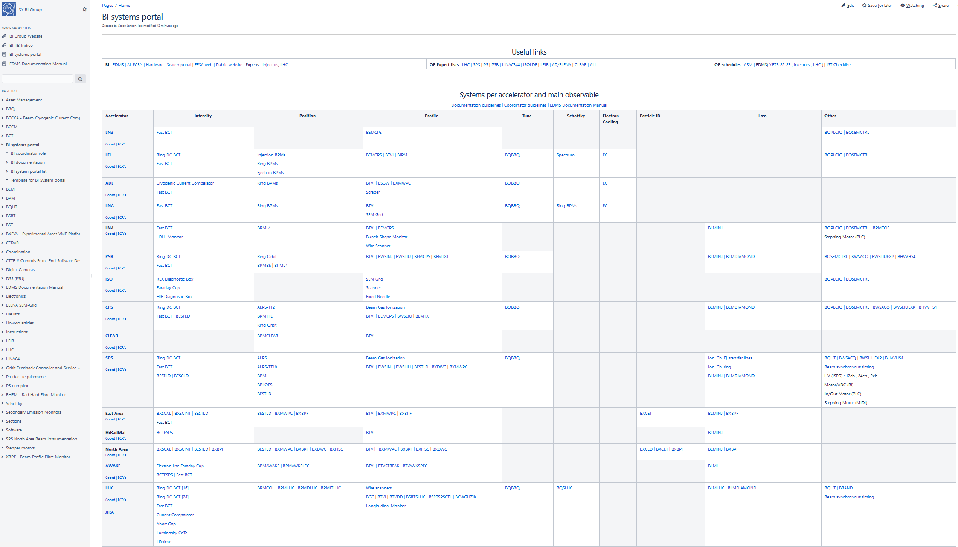
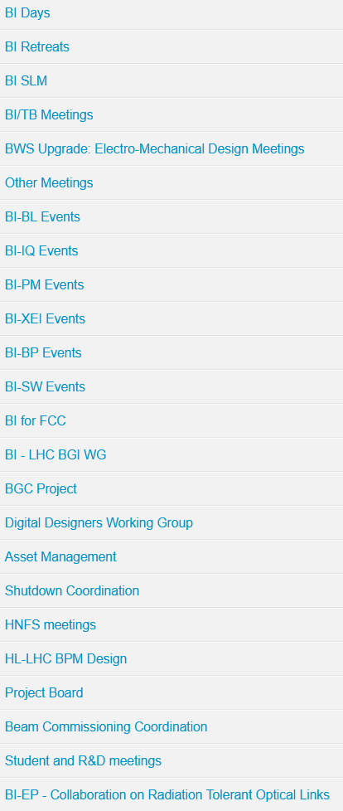
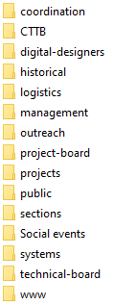
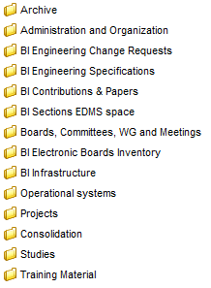
BI documentation platforms
SY-BI
BI systems portal @ Wiki
BI @ Indico
bi-group @ EOS
BI @ EDMS
Table with links to all BI system portals,
organized by observable and accelerator
“Daily-work” documents
“Formal” documents
Meetings, minutes
(Pointers to) presentations
https://wikis.cern.ch/display/BEBI/BI+systems+portal
https://edms.cern.ch/ui/#!master/navigator/project?P:1751860852:1751860852:subDocs
Web: https://cernbox.cern.ch/files/spaces/eos/project/b/bi-group
Linux VM: /eos/project-b/bi-group
Windows: \\eosproject-smb\eos\project\b\bi-group
https://indico.cern.ch/category/12866/

Slide 4
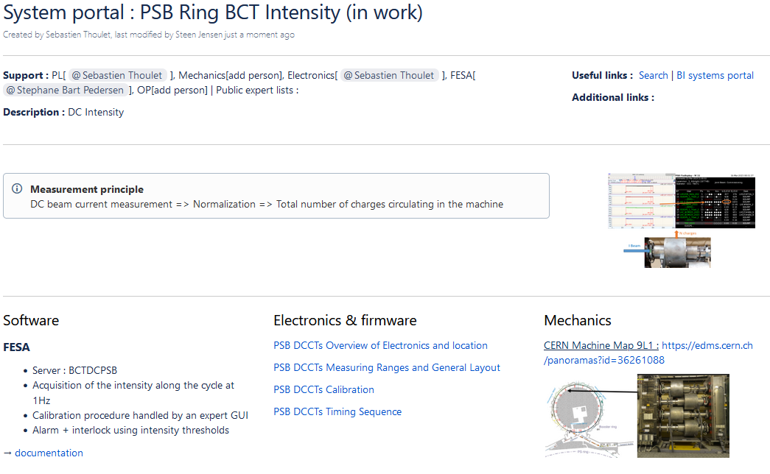
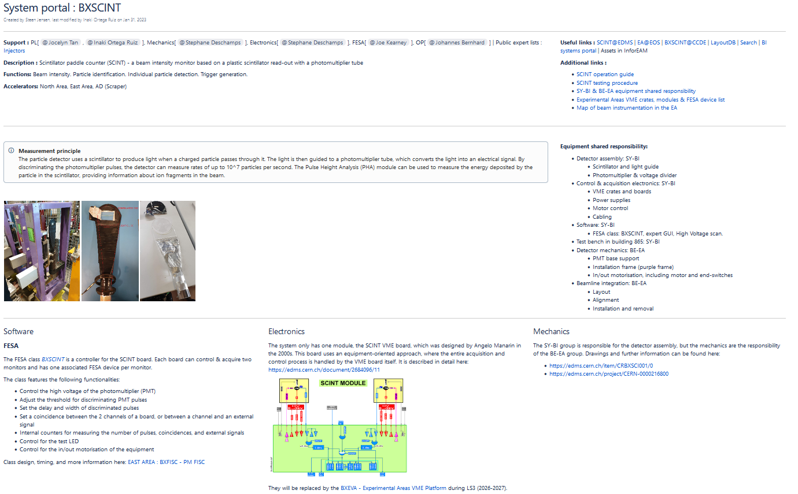
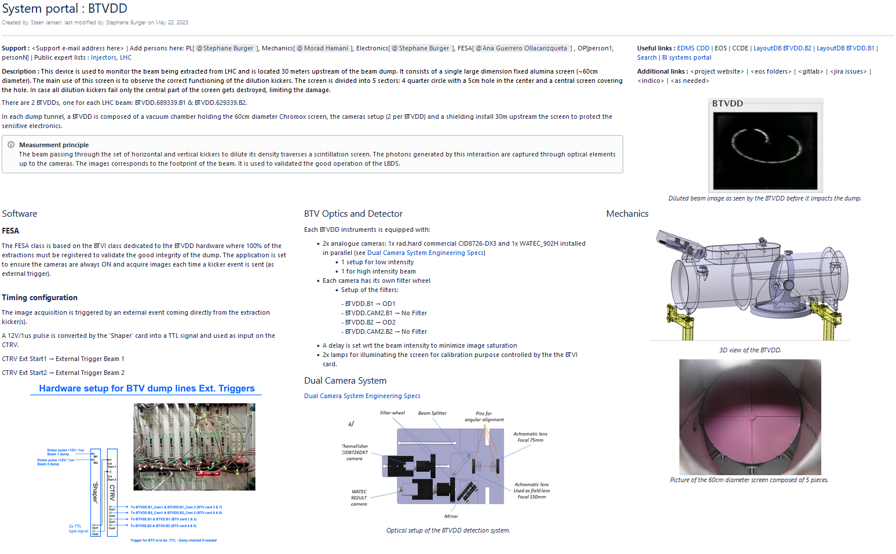
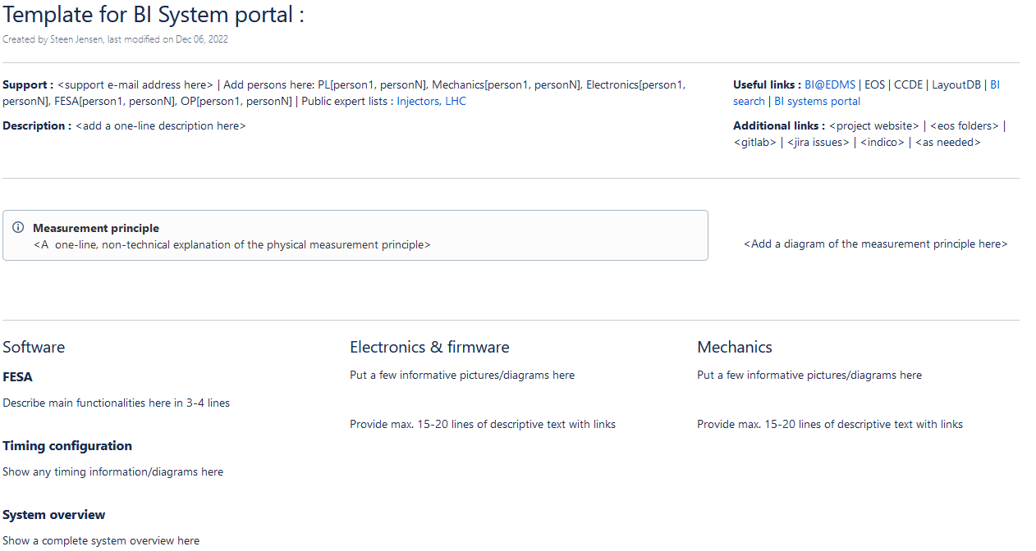
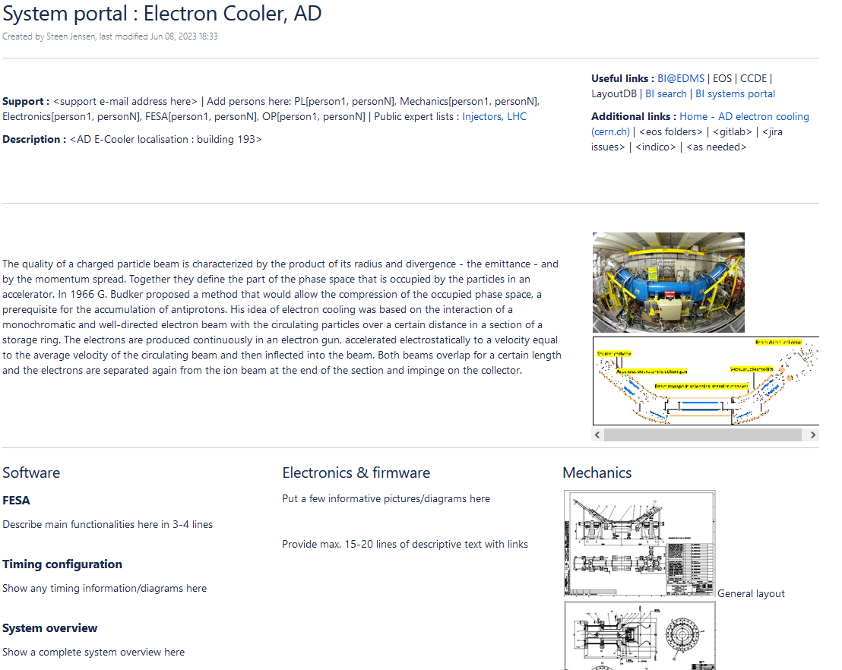
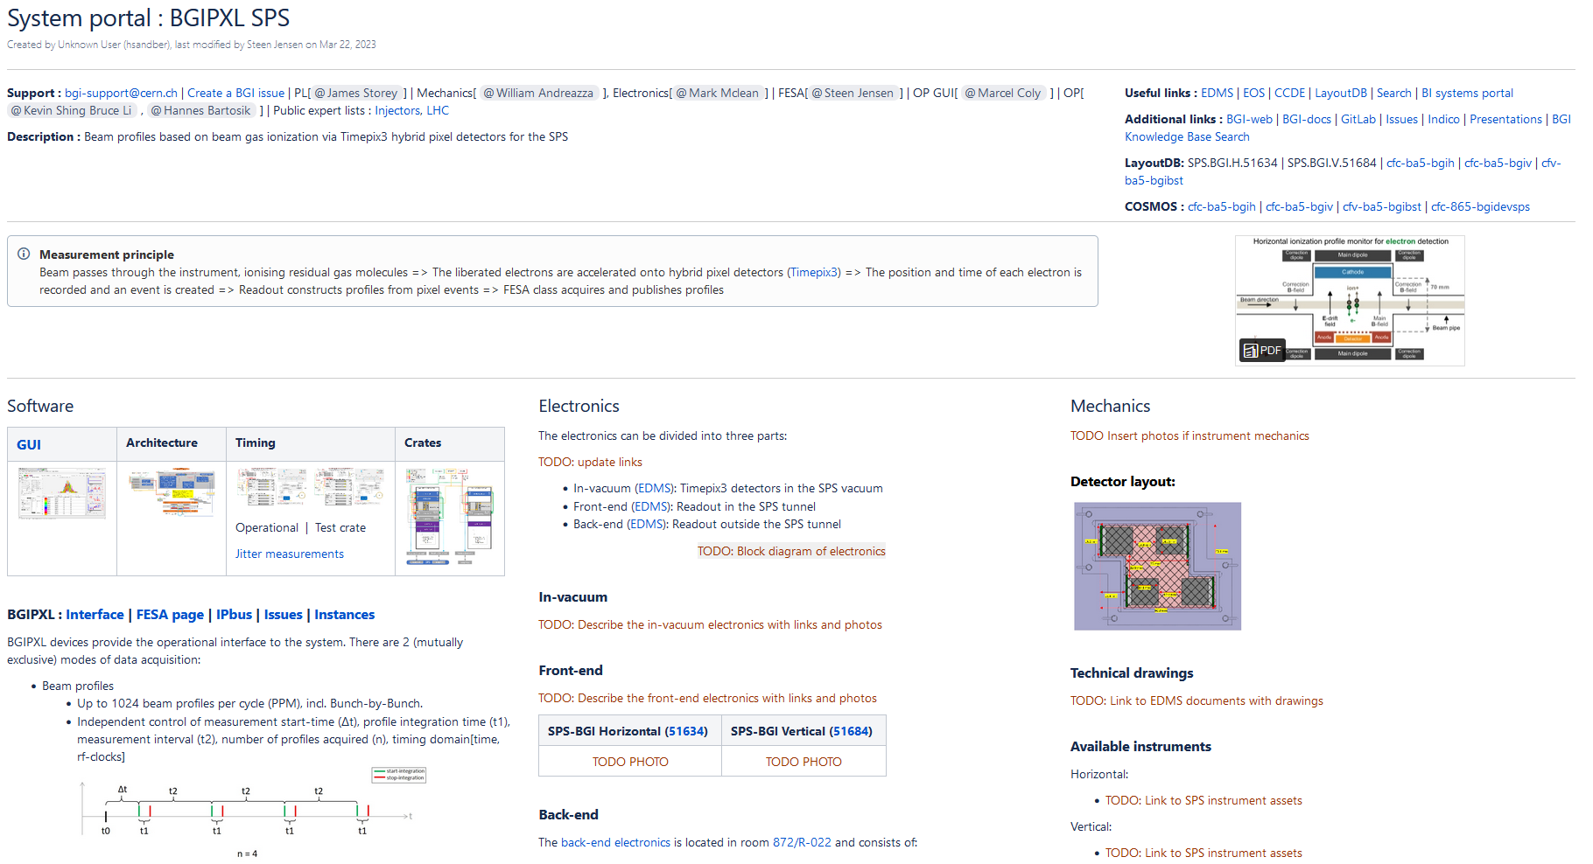
System portals
https://wikis.cern.ch/display/BEBI/BI+systems+portal
PSB BCT
BXSCINT
If you know a system with no portal, copy to template or ask me to do it
BTVDD
Introductions, diagrams, overviews
Pointers to documents
Template
AD e-cooler
BGIPXL
Fill in the part(s) you are responsible for:
“Software”, “Electronics&Firmware” and/or “Mechanics”

Slide 5

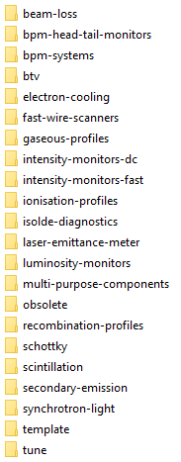


“bi-group” @ EOS
Linux VM: /eos/project-b/bi-group
Windows: \\eosproject-smb\eos\project\b\bi-group
Sections are responsible for populating “systems” folder, including naming convention
/eos/projects/b/bi-group/
bi-group/systems/
bi-group/systems/template
bi-group/systems/template/psb
2) Add/delete folders as needed for the system
1) For new system, copy “template” folder then rename

Slide 6
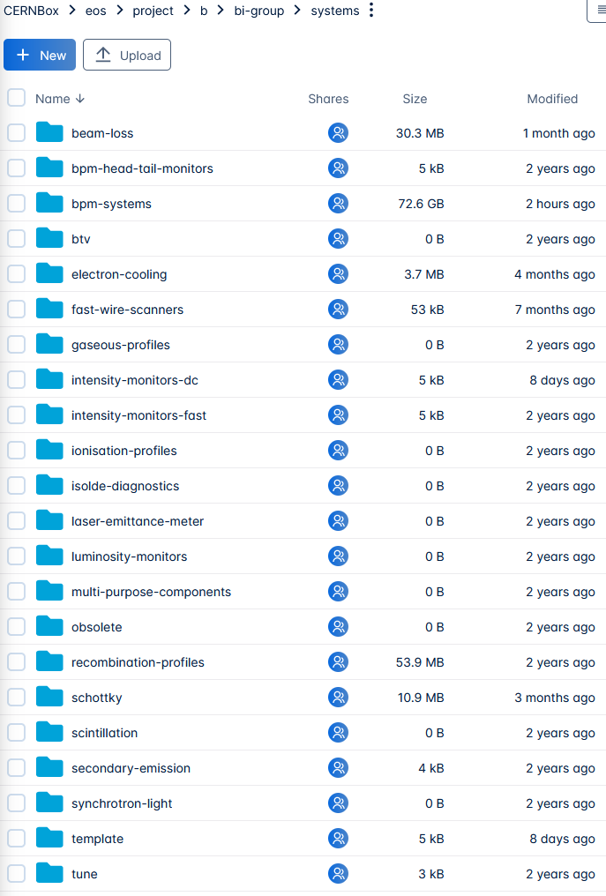


Status
BI systems portal
  103 system-portal-pages created and added to table
  63 pages have expert-names (sw, electronics, hw, op) filled in
  35 system portals ~complete
  => A good start, but some way to go still
EOS “bi-group”
  “systems” folder : Almost no activity in 2 years
  ~10 Other BI related spaces on EOS are in active use:
    100’s of Gb and accessed within past few days/weeks
  => Not a good uptake – why ?
    “Insufficient access control”
    “Accidental deletion”
    “No pressure from above”
    “DFS still available + department stays on DFS”

Slide 7
Comments from EOS team
Access control
  New feature available : Deny access (for admins only) – cannot be overridden further down the tree
  Permission to re-share being considered
Restoring deleted files
  Can be done for up to 6 months after deletion
Synchronization
  Can only be done at folder level, not individual files => organize accordingly
Notification mechanisms
  Being implemented
DFS
  Still available, but being replaced
  Solution in addition to EOS (which aims at handling big data with less focus on “DFS-like” features)
  Survey ongoing – no indication about dates yet

Slide 8
Conclusions
System portals
  The completed ones are very informative and look great !
  After 2 years, more should have been done
EOS
  Rather disappointing – especially since:
    No “real” technical reason
    No-one has reported problems or asked questions
    Other BI-related EOS projects are actively used
    => Primarily a question of habit and/or unawareness ?
Proposal:
  Additional SLM discussion(s)
    Presentation from EOS team – also about DFS replacement
    Re-evaluate our strategy
    Real commitment to outcome
  Each section appoints a person to drive work on documentation, reporting to SL
  Regular progress reports at SLM

Slide 9
Thank you

