Slide 1
Analysis of FBCT behaviour with respect to the bunch position in trains
Nathan Meagher, Manuel Gonzalez Berges, Tom Levens, Diogo L. Alves

Slide 2
Intro
Fast Beam Current Transformer overview
  System overview
  Data processing
  Integration of the bunch beam signal
  Contributing factors to the bunch position behaviour
BSRL overview
Previous analysis by Marcus Palm
Analysis of 2022 fills
Analysis of 2023 fills
Summary

Slide 3
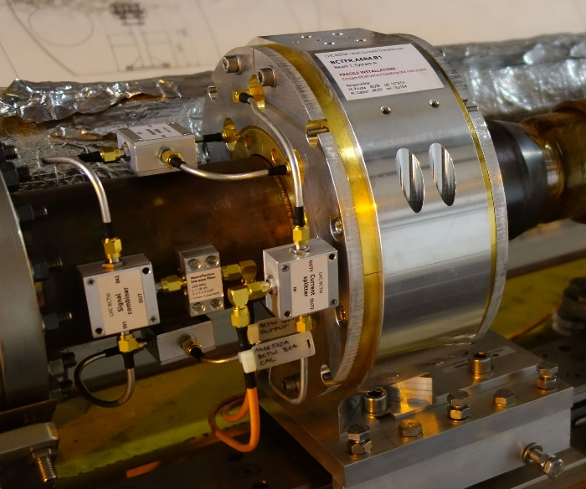
FBCT System Overview
LHC equipped with 2x Wall Current Transformer (BCTW) per ring to measure the bunch-by-bunch beam current (intensity)
Historical limitations observed:
  Bunch intensity is affected by bunch position in the train (seen as over estimation in the 1st bunch)
LHC Run 2022
BCTW + analogue electronics + digital integration
System A → Electronics as before LS2
System B → New electronics test bed
BCTW installed in LHC 2017

Slide 4
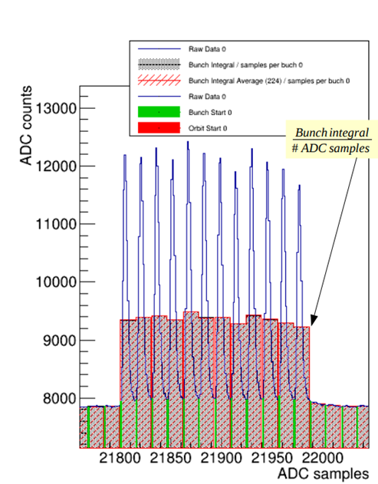
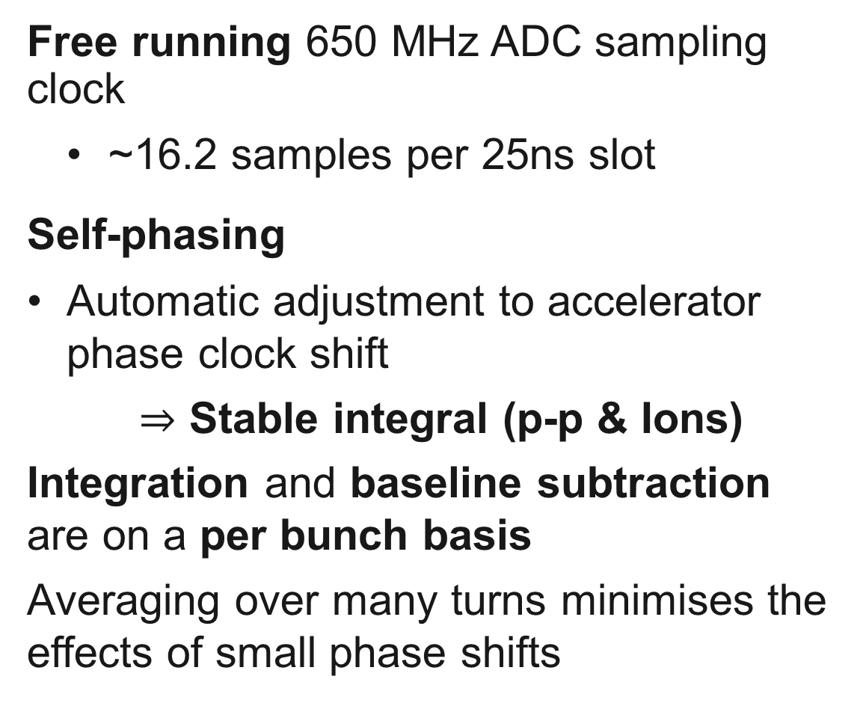
Data processing in the firmware
Free running 650 MHz ADC sampling clock
  ~16.2 samples per 25ns slot
Self-phasing
  Automatic adjustment to accelerator phase clock shift
  $⇒$ Stable integral (p-p & Ions)
  Integration and baseline subtraction are on a per bunch basis
  Averaging over many turns minimises the effects of small phase shifts
[*J. Kral, ”A new Acquisition System for the SPS and LHC Fast BCTs”]

Slide 5
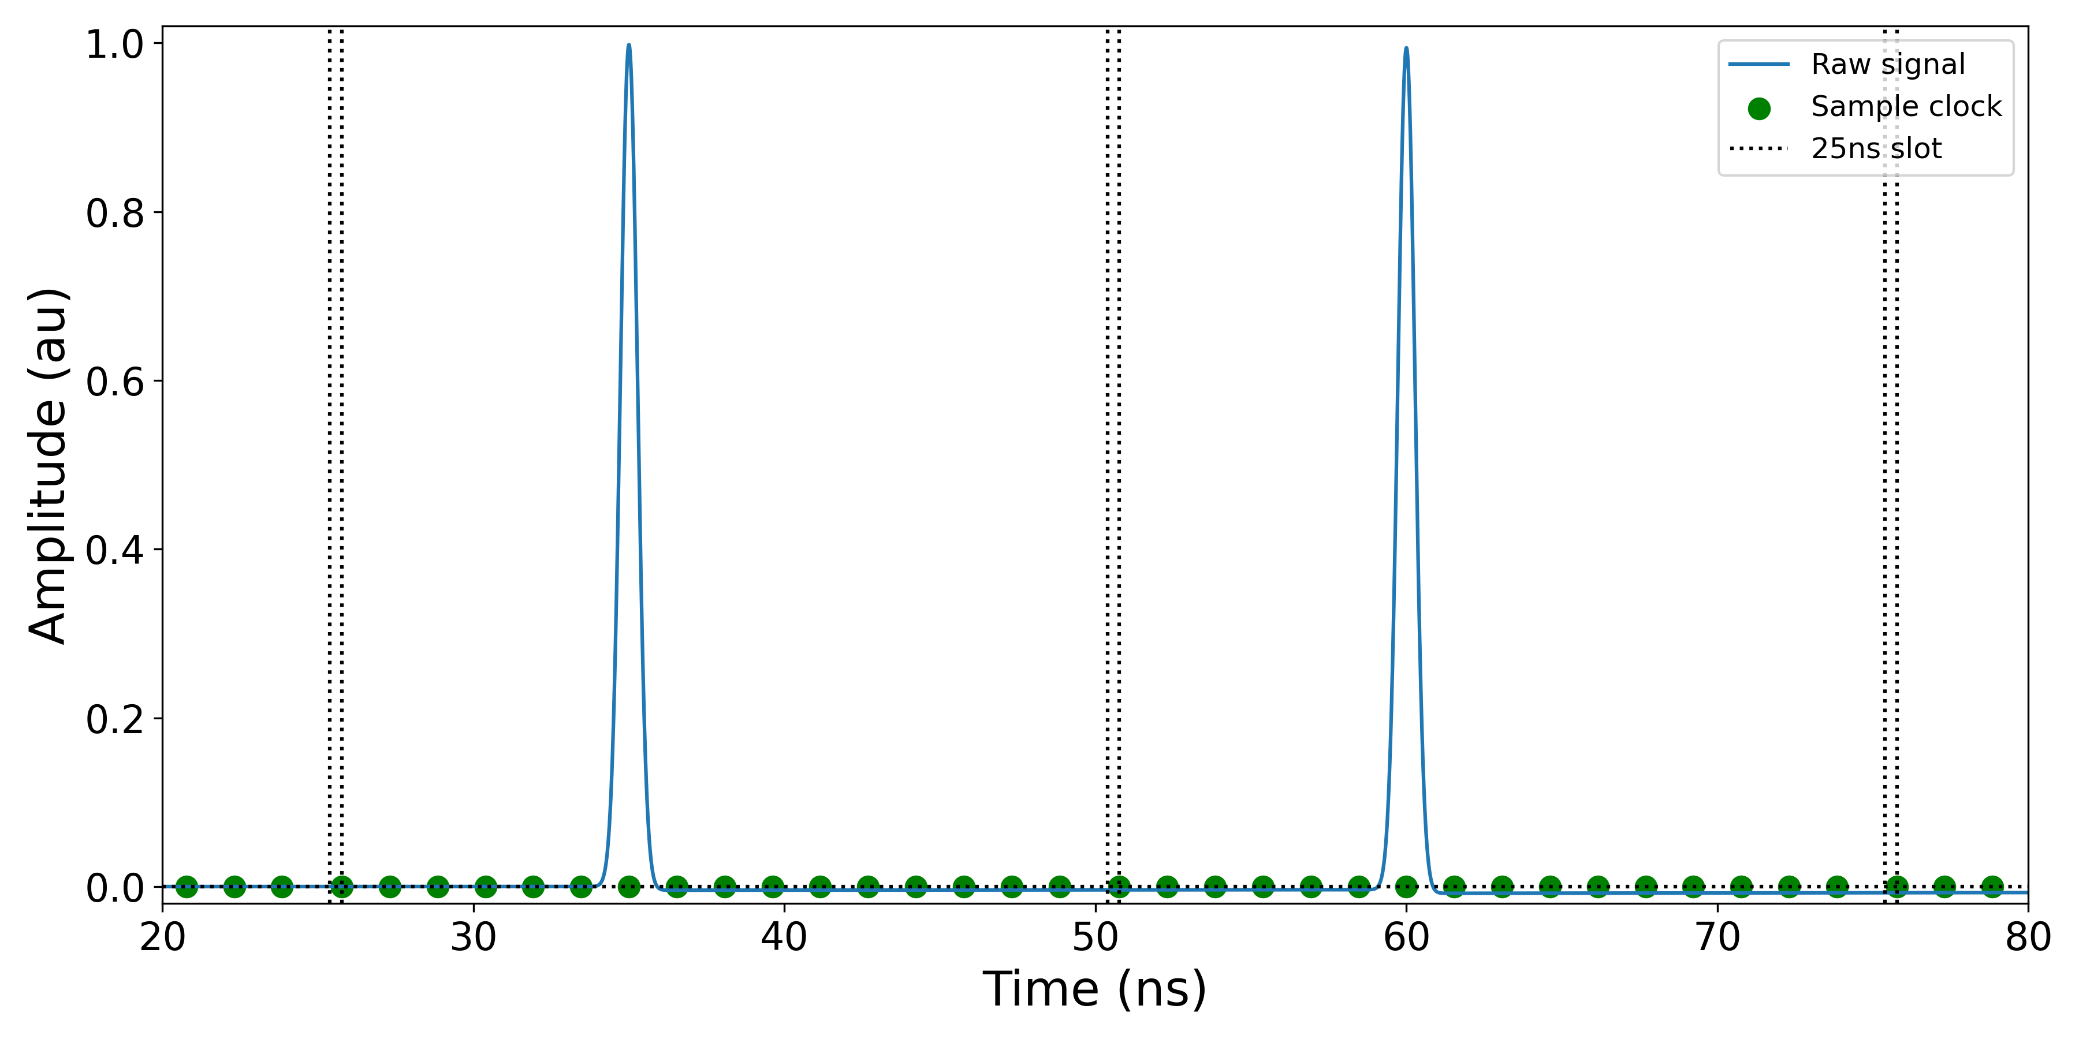
Details of digital integration…
25ns slot start
25ns slot end
raw FBCT signal
1-2 points per bunch
~16 samples
ADC sampling at 650 MHz (1.54ns) ➔ few points per bunch

Slide 6
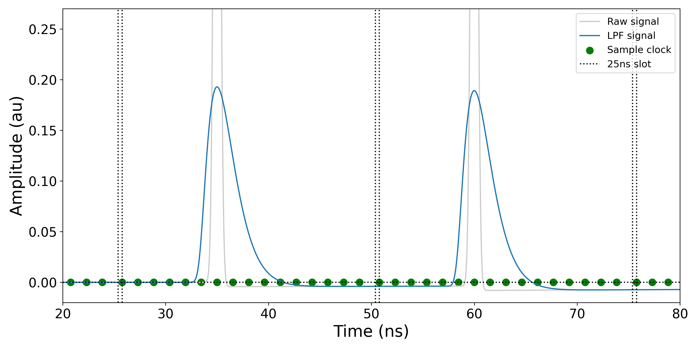
Details of digital integration…
raw FBCT signal
Low pass filtered signal
25ns slot start
25ns slot end
More samples
Signal is low pass filtered to give more sampling points ➔ integral conserved

Slide 7
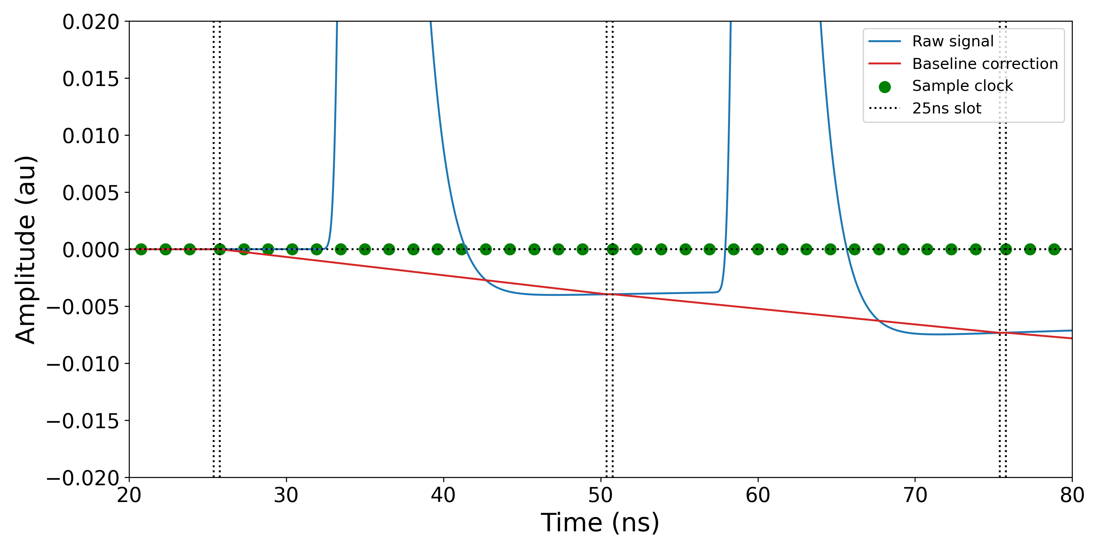
Baseline reconstruction
Linear baseline calculated between start/end of slot

Slide 8
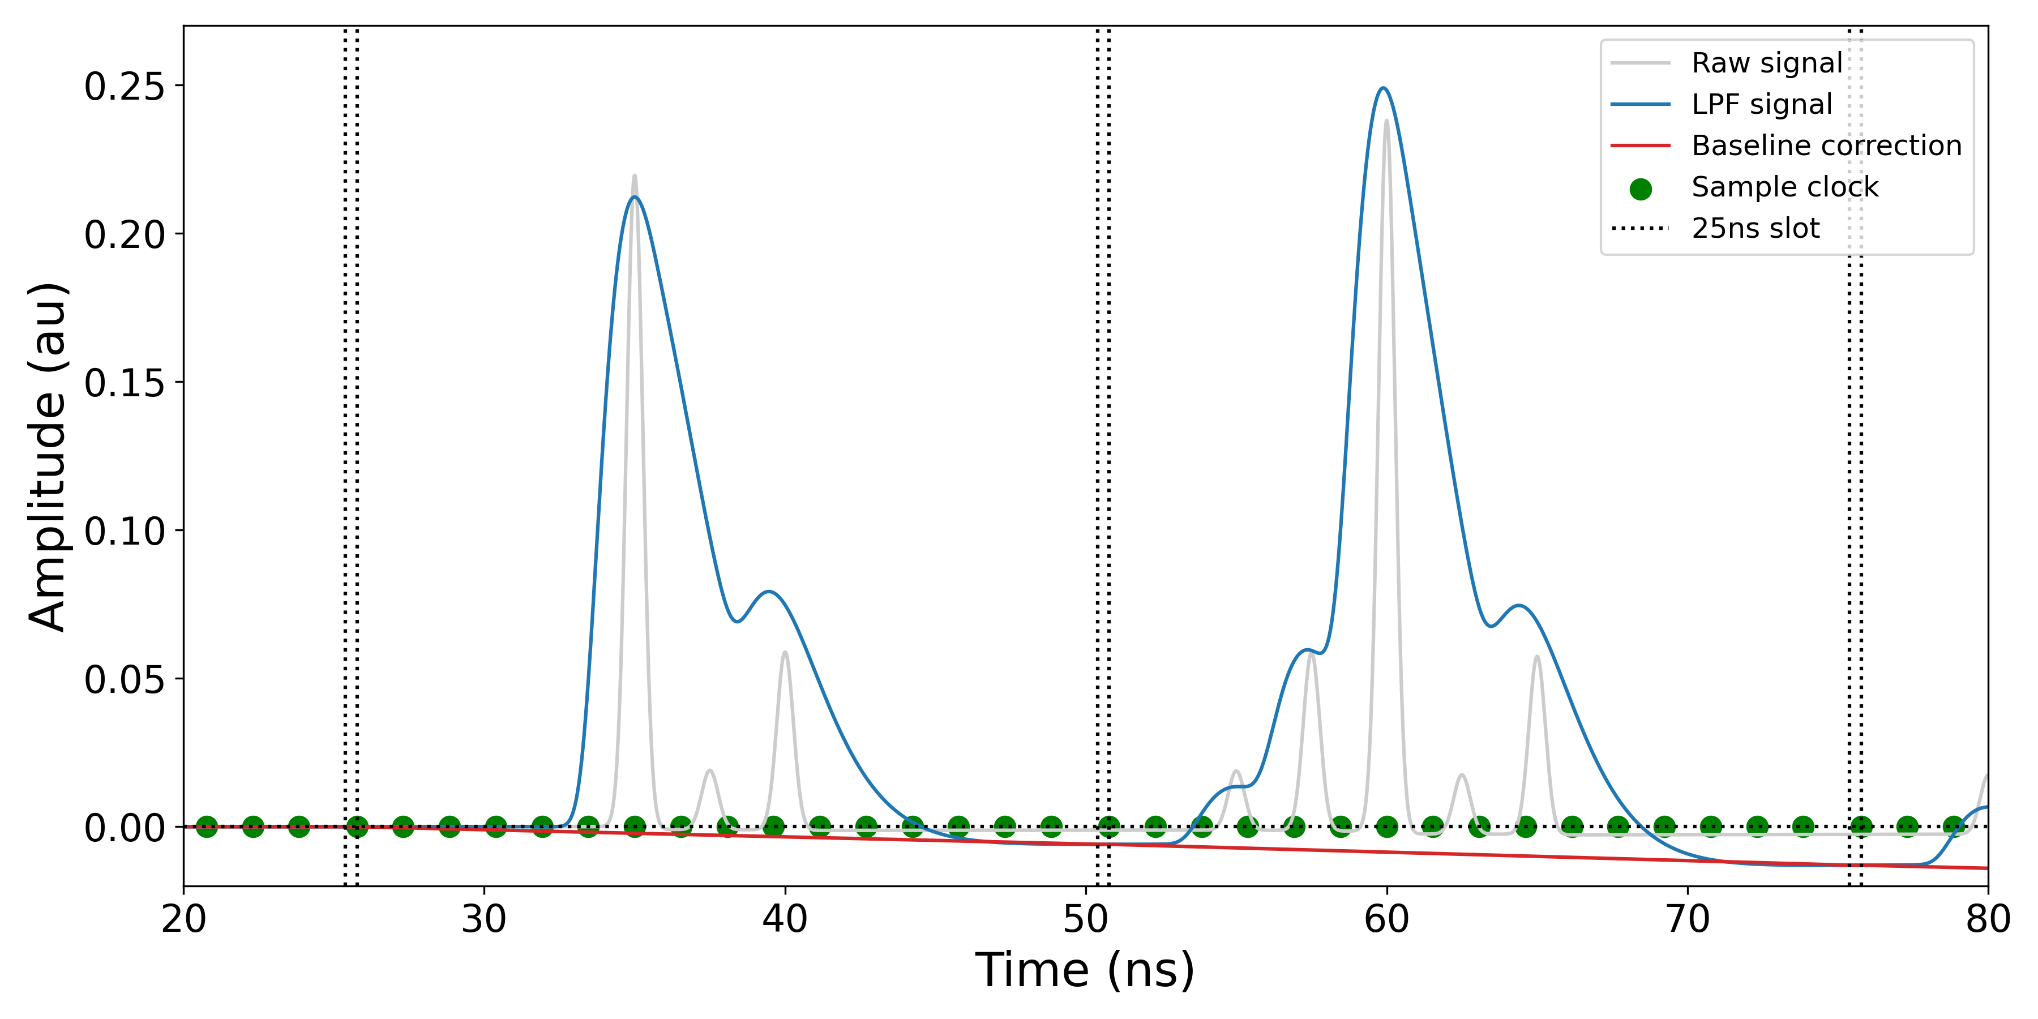
Effect of Ghost & Satellite bunches
N.B. Ghost charges not shown
Bunch
Satellite charges
Ghost & Satellites close to the main bunch are integrated ➔ increase bunch integral

Slide 9
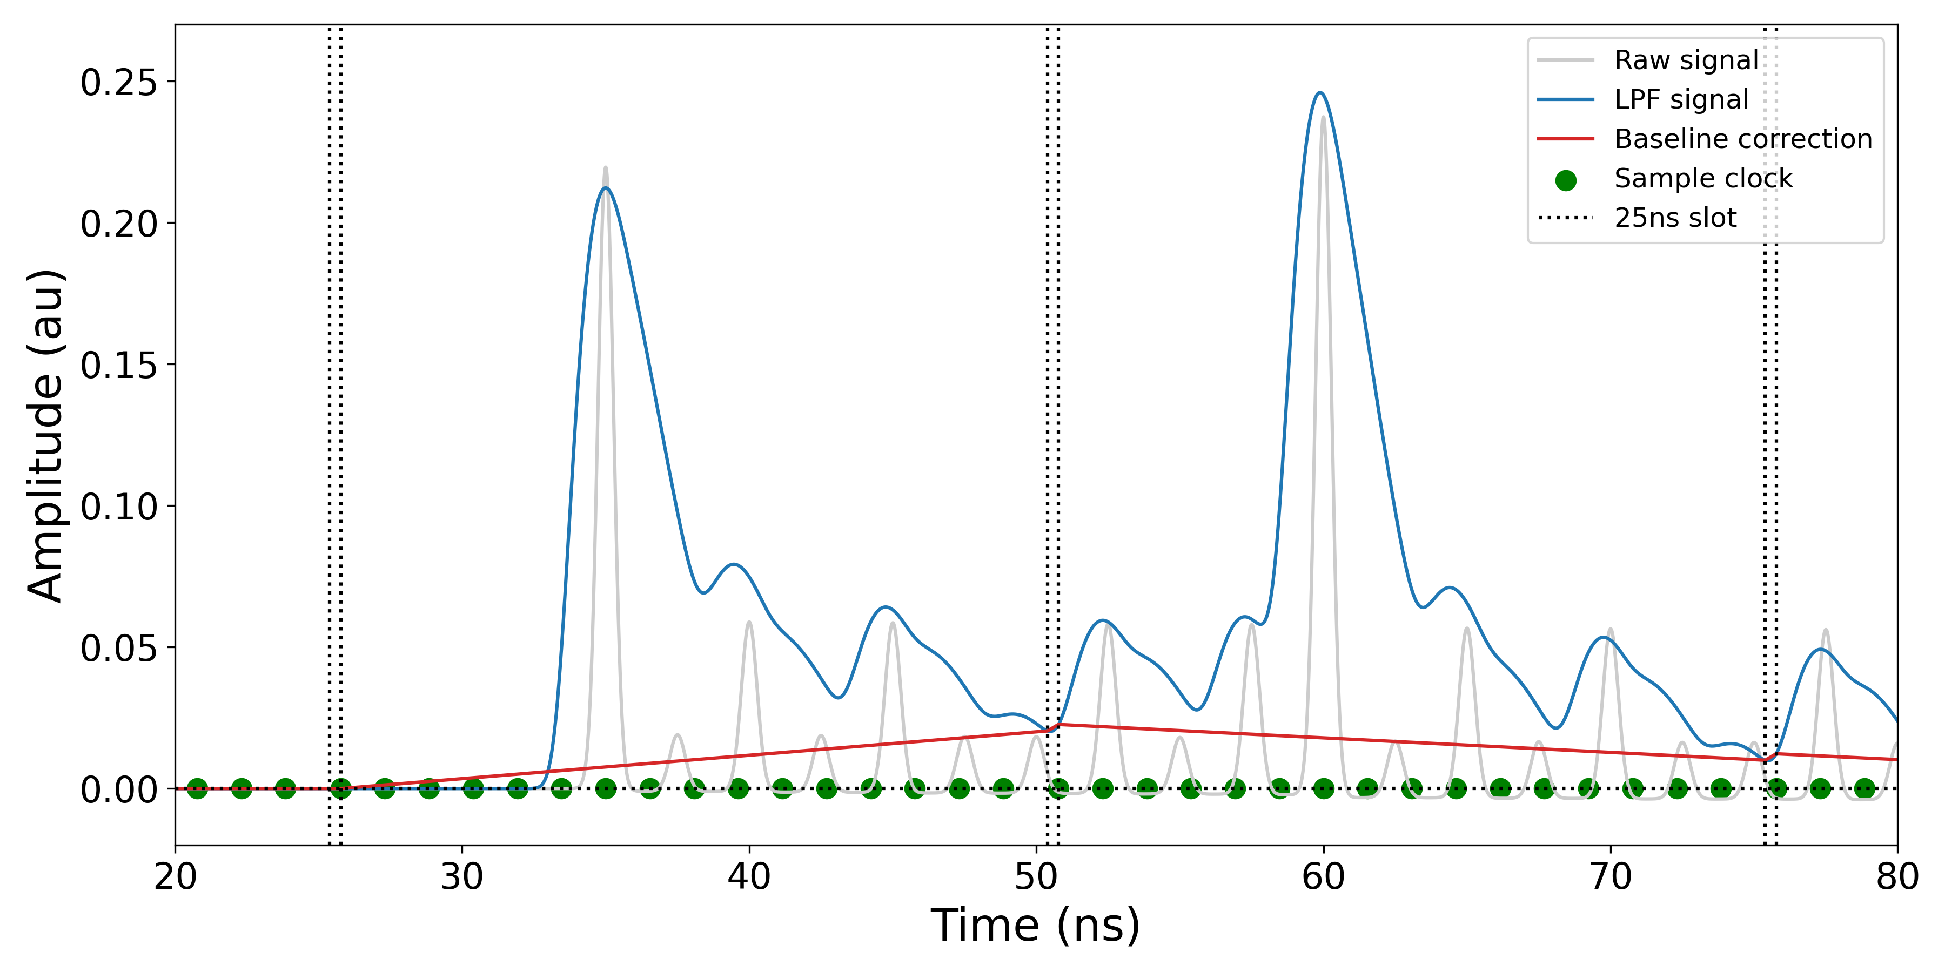
Effect of Ghost & Satellite bunches
25ns slot boundary
Satellite charges
G&S close to the bunch boundary raise the baseline ➔ decrease bunch integral

Slide 10
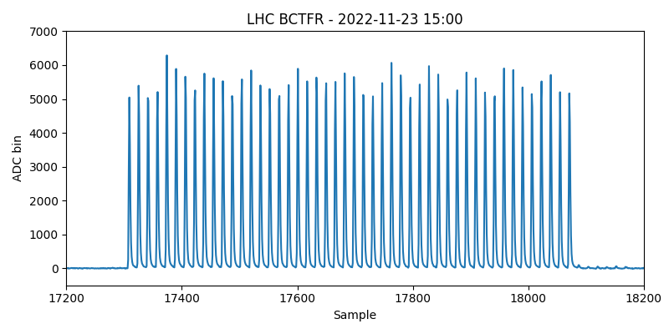
The reality…
48 bunch train
25ns spacing
p⁺ beam
Ghost charges

Slide 11
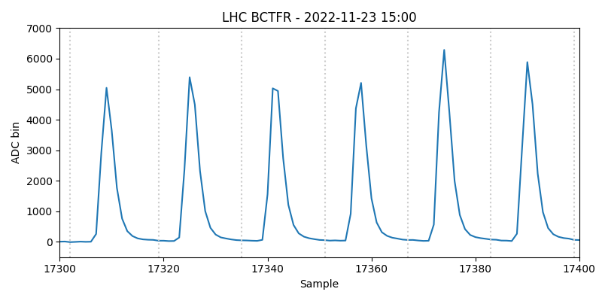
The reality…

Slide 12
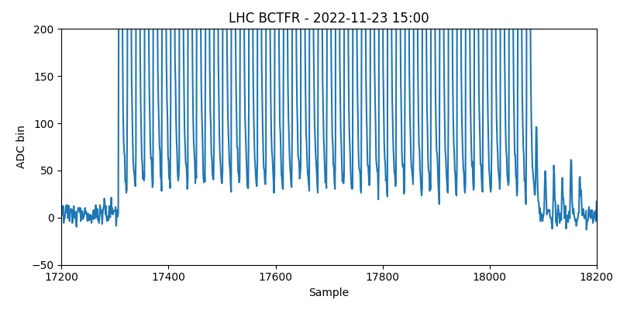
The reality… zoom on baseline

Slide 13
Summary of effects
The following effects all contribute to the overestimation of the first bunch:
  Low pass filter + dispersion in cables → leakage into next slot
  A/C coupling → droop after signal
  Ghost and satellite charge influence → raise/lower integral
  Baseline correction attempts to compensate for effects → raises/lowers the integral

Slide 14
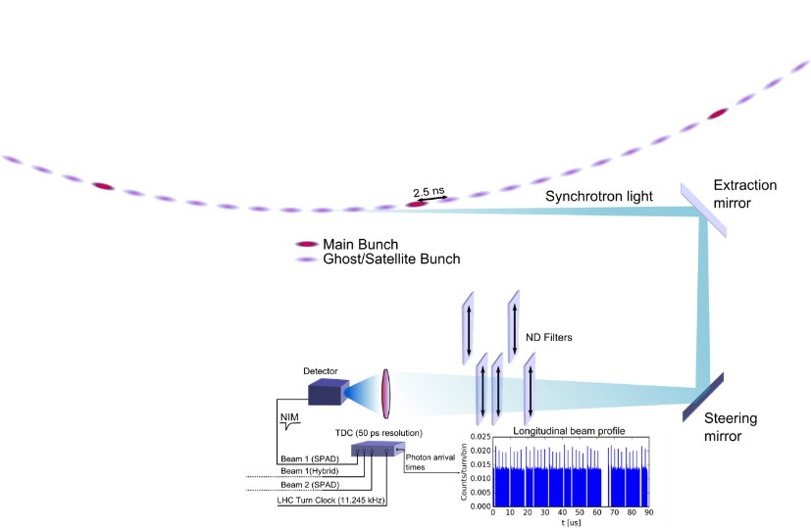
BSRL: Overview
Main Purpose
Longitudinal beam profile monitoring of LHC beams
Measure relative population of Main and Ghost/Satellite bunches
High dynamic range!
Principle
Time-correlated single photon counting of synchrotron light from LHC beams
Lens focuses light on sensor
ND-filters to control amount of light on sensor
TDC generates histogram of photon arrival times ⬄ Beam profile
Source: Stefano Mazzoni, https://indico.cern.ch/event/1206149/contributions/5072735/attachments/2525391/4343451/2022.10.10_LLCMWG.pdf

Slide 15
FBCT overestimation of the first bunch
Historically the FBCTs have overestimated the 1st bunch intensity measurement of each train.
Analysis performed by Marcus Palm confirmed this in 2017/18 ^{[1]}
Marcus confirms over estimation is not only caused from ghost charges
Signal leakage between bunch slots due to bandwidth limitations
  Raises baseline of subsequent bunches
  Decreases integral
  [1] - Palm M. 2018, BSRL Analysis

Slide 16
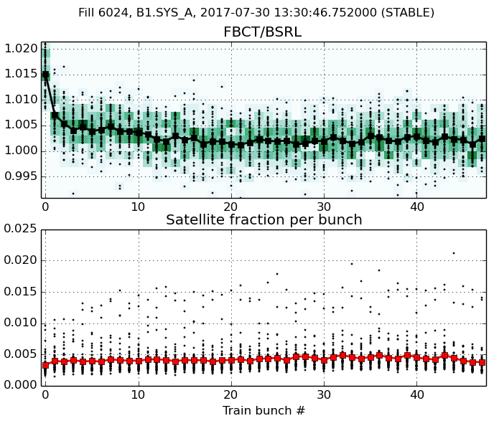
FBCT/BSRL ratio along train
Example, Fill 6024
48b trains
FBCT/BSRL ratio: First bunch of each train consistently higher than second
Not explained by satellites
In the following: compare only first and second bunch
Black line: mean of all trains
Black dots: individual bunches
Colormap: distribution
Compare ratio of these two points
Accompanying satellites per bunch along train
Palm M. 2018, BSRL Analysis

Slide 17
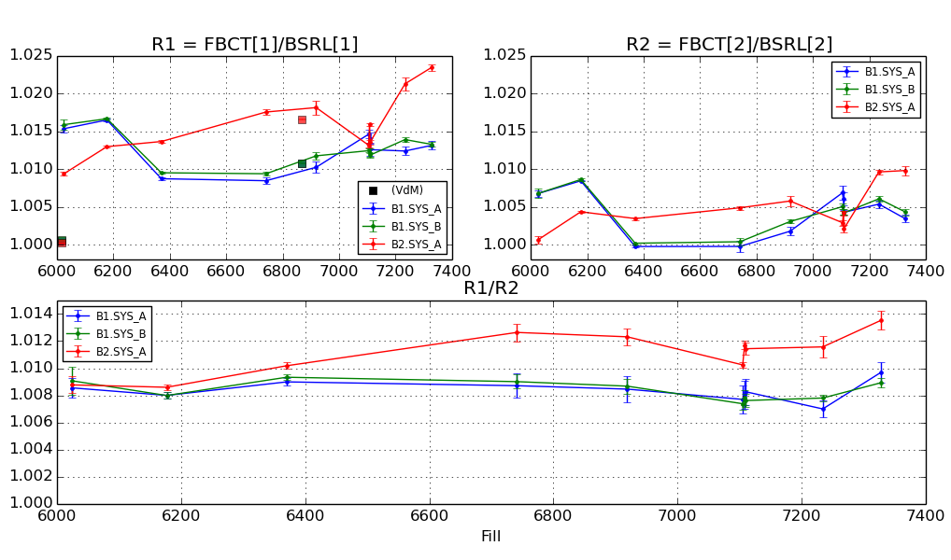
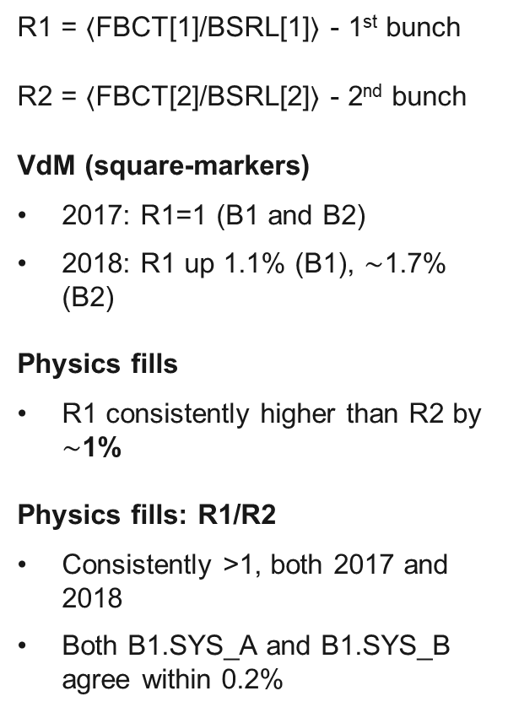
FBCT/BSRL overview: 2017-2018
R1 = $〈$FBCT[1]/BSRL[1]$〉$ - 1st bunch
R2 = $〈$FBCT[2]/BSRL[2]$〉$ - 2nd bunch
VdM (square-markers)
  2017: R1=1 (B1 and B2)
  2018: R1 up 1.1% (B1), $\sim$1.7% (B2)
Physics fills
  R1 consistently higher than R2 by $∼$1%
Physics fills: R1/R2
  Consistently >1, both 2017 and 2018
  Both B1.SYS_A and B1.SYS_B agree within 0.2%
2017
2018
2017
2018
2017
2018
Source: Marcus Palm, link

Slide 18
FBCT/BSRL Analysis for 2022

Slide 19
Data selection of analysis
We run our analysis on a 2022 LHC fills that fit the following criteria:
  Fills with multi bunch trains
  Stable beams condition lasts for a length longer than 10 minutes

Slide 20
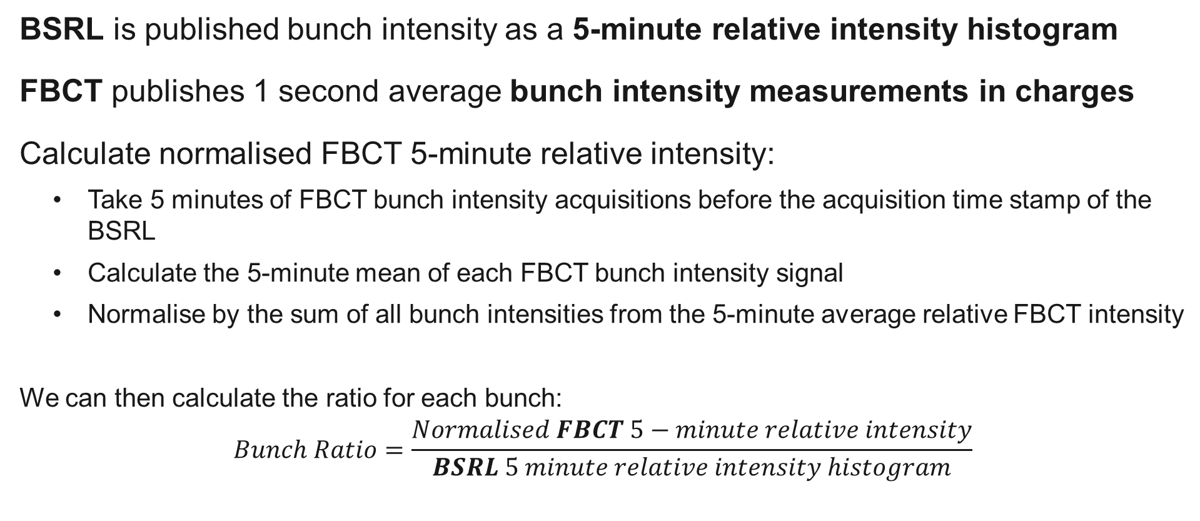
Relative intensity of the FBCT
BSRL is published bunch intensity as a 5-minute relative intensity histogram
FBCT publishes 1 second average bunch intensity measurements in charges
Calculate normalised FBCT 5-minute relative intensity:
  Take 5 minutes of FBCT bunch intensity acquisitions before the acquisition time stamp of the BSRL
  Calculate the 5-minute mean of each FBCT bunch intensity signal
  Normalise by the sum of all bunch intensities from the 5-minute average relative FBCT intensity
  We can then calculate the ratio for each bunch:
  $$Bunch Ratio=\frac{Normalised FBCT 5−minute relative intensity}{BSRL 5 minute relative intensity histogram}$$

Slide 21
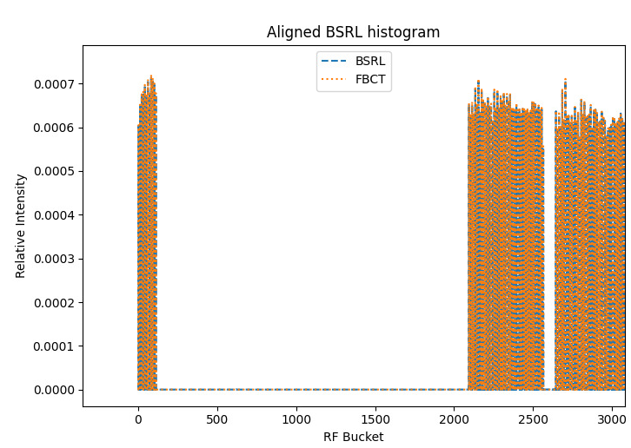
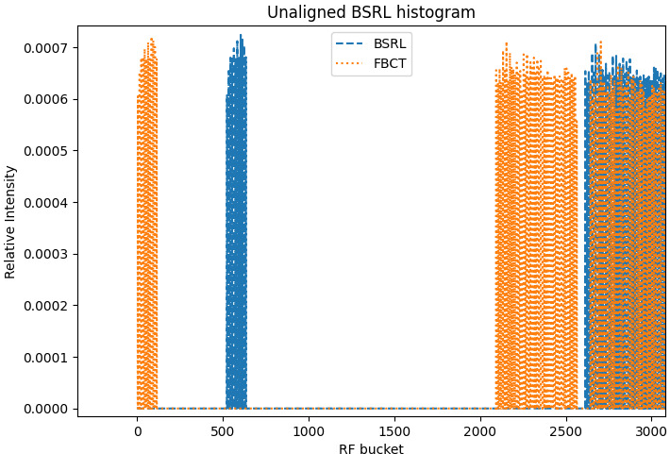
BSRL bunch intensity integration
Integrating BSRL data
  Expand FBCT data
  Align BSRL to the FBCT
  Integrate every 10 slots

Slide 22
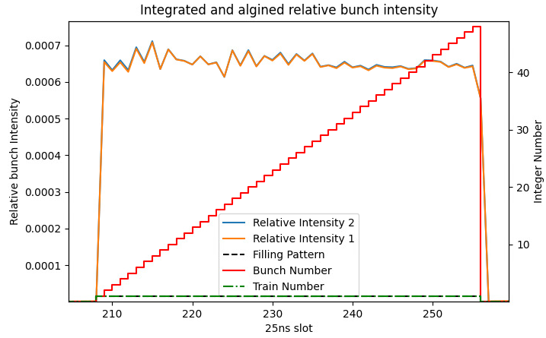
Identifying bunches and trains
FBCT bunch fill pattern used to identify trains
New train 5*25ns bunch gap

Slide 23
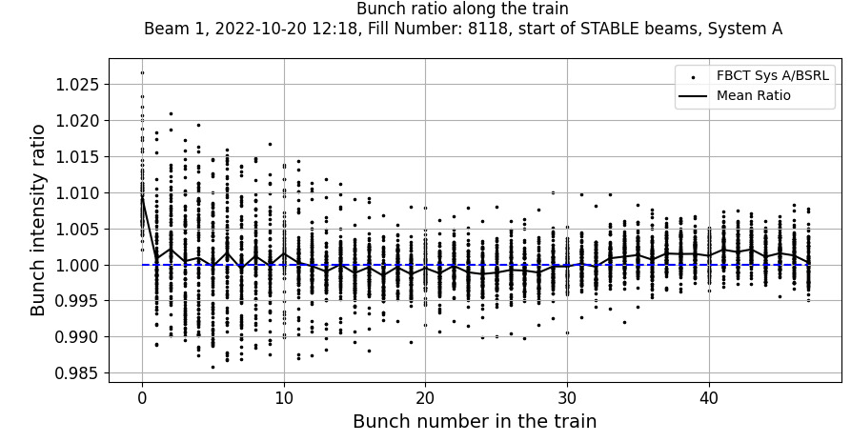
FBCT/BSRL Ratio along the train
Beam 1 System A
(same set up as analysis in 2017/18)
Example, Fill 8147
48b train
FBCT/BSRL ratio: First bunch of each train consistently higher than second
All other bunch intensity measurements are consistent with BSRL 0.5%
This behaviour is seen across most many fills

Slide 24
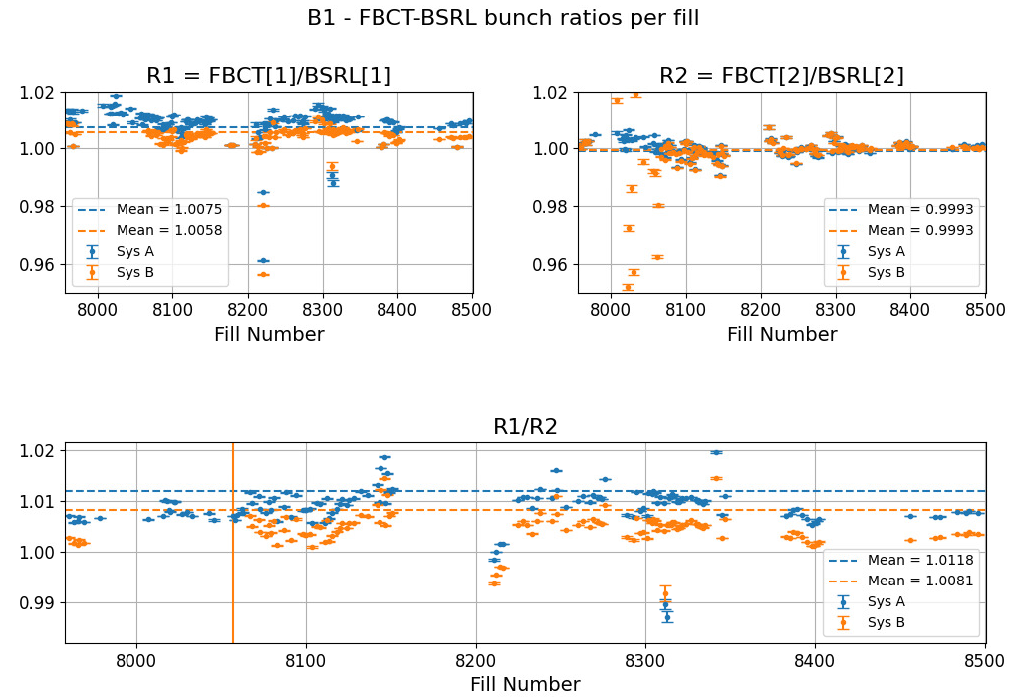
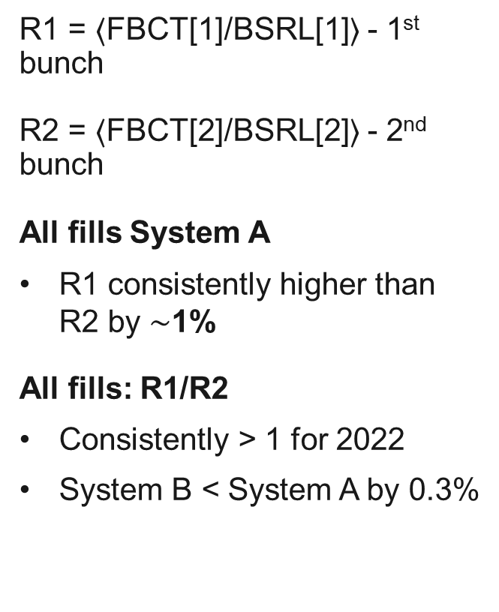
LHC 2022 Fills overview - Beam 1
Start of stable beams
R1 = $〈$FBCT[1]/BSRL[1]$〉$ - 1st bunch
R2 = $〈$FBCT[2]/BSRL[2]$〉$ - 2nd bunch
All fills System A
  R1 consistently higher than R2 by $∼$1%
All fills: R1/R2
  Consistently > 1 for 2022
  System B < System A by 0.3%

Slide 25
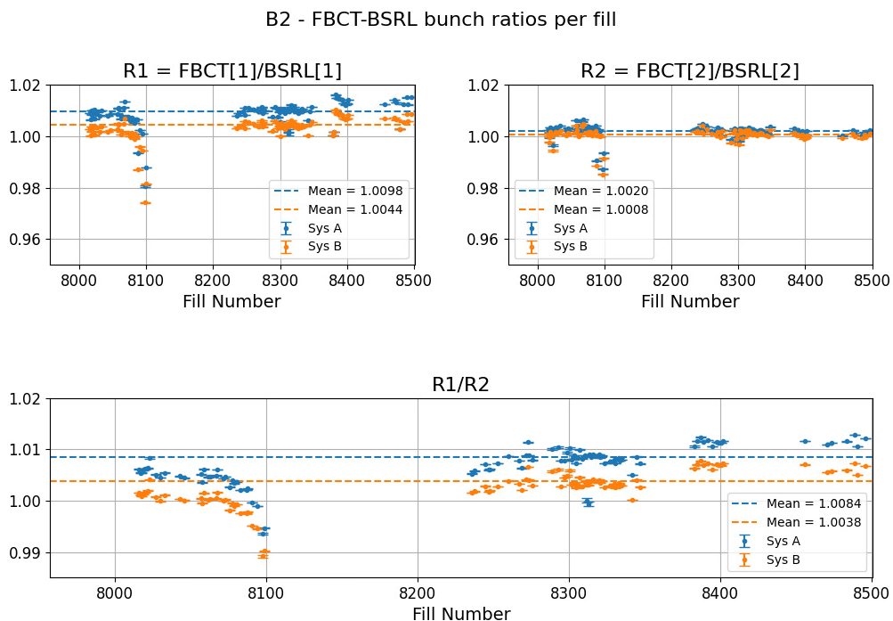
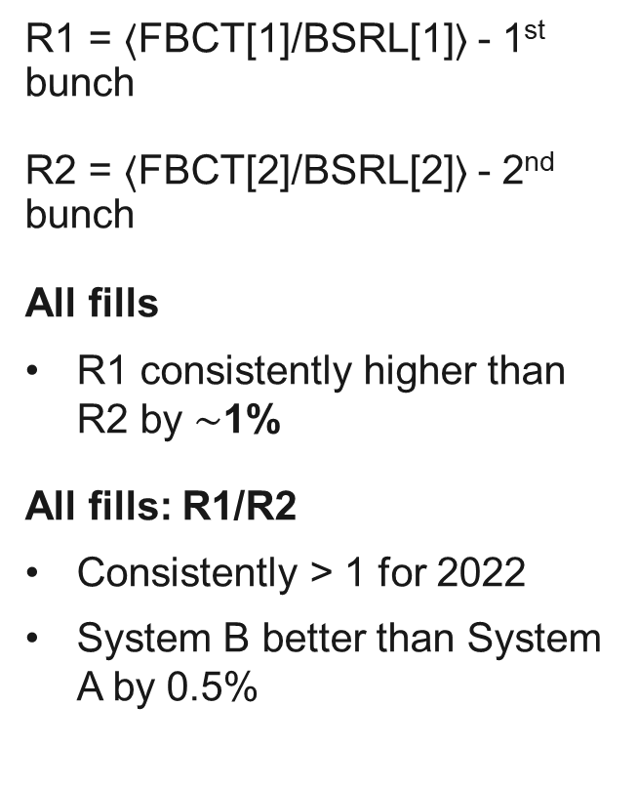
LHC 2022 Fills overview - Beam 2
Start of stable beams
R1 = $〈$FBCT[1]/BSRL[1]$〉$ - 1st bunch
R2 = $〈$FBCT[2]/BSRL[2]$〉$ - 2nd bunch
All fills
  R1 consistently higher than R2 by $∼$1%
All fills: R1/R2
  Consistently > 1 for 2022
  System B better than System A by 0.5%

Slide 26
FBCT/BSRL Analysis for 2023

Slide 27
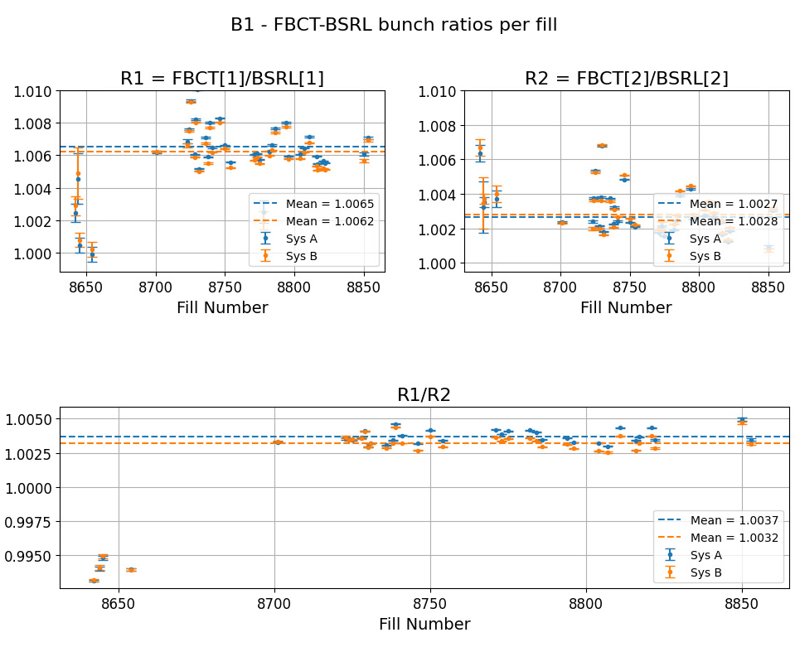
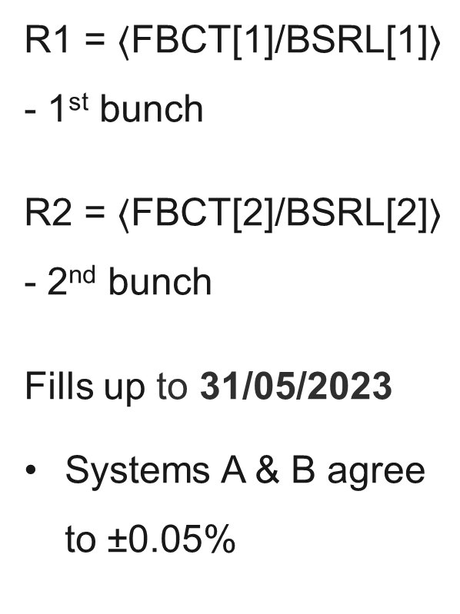
LHC 2023 Fills overview - Beam 1
Start of stable beams
R1 = $〈$FBCT[1]/BSRL[1]$〉$ - 1st bunch
R2 = $〈$FBCT[2]/BSRL[2]$〉$ - 2nd bunch
Fills up to 31/05/2023
  Systems A & B agree to ±0.05%

Slide 28
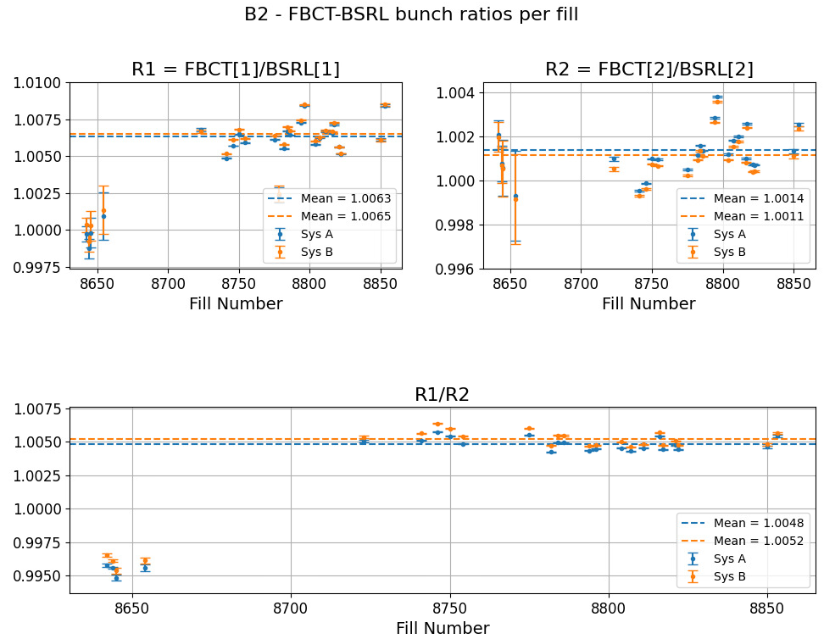
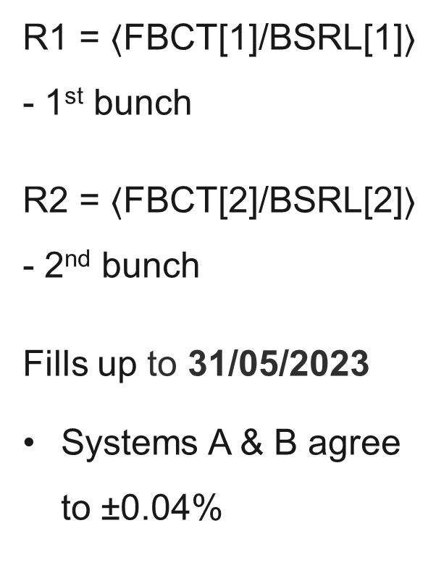
LHC 2023 Fills overview - Beam 2
Start of stable beams
R1 = $〈$FBCT[1]/BSRL[1]$〉$ - 1st bunch
R2 = $〈$FBCT[2]/BSRL[2]$〉$ - 2nd bunch
Fills up to 31/05/2023
  Systems A & B agree to ±0.04%

Slide 29
Summary of findings
1st Bunch overestimation with respect to the BSRL [%] | 1st Bunch overestimation
 | Beam 1 |  | Beam 2
 | System A | System B | System A | System B
Run 2 | >1 | >1 | >1 | -
2022 fills✝ | 1.1 | 0.84 | 0.84 | 0.38
2023 fills✝* | 0.37 | 0.32 | 0.48 | 0.52
✝ Includes fills of varying; intensities, train lengths, ghost and satellite charges
Outlook from 2023
  YETS 2022/23 – FBCT System A updated to use the 2022 system B acquisition electronics.
* Up to 31/05/2023

Slide 31
Additional Slides

Slide 32
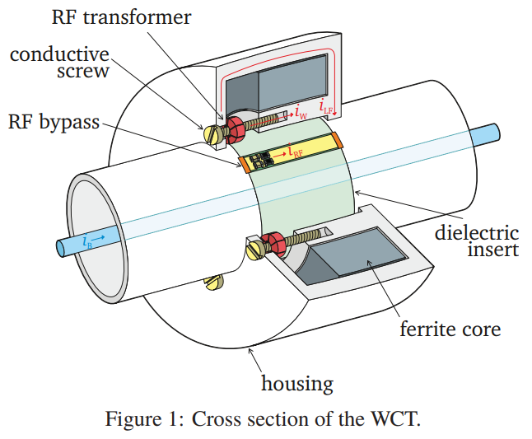

Wall Current Transformer WCT
Vacuum chamber/Beam Pipe
Principle
Measures the induced image current in the walls of the beam pipe
Wall current passes through conductive screw
$$I_{Beam}=N_{turns}I_{measured}$$
Particle Beam
Mihal Krupa, et al.

Slide 33
Timber variables used in the analysis
Timber variable | description
BSRL.POSTPROCESSING.B1:ProcessedData_aged:Q_BUNCHED | BSRL beam 1 relative intensity 5 minute aged histogram
LHC.BCTFR.A6R4.B1:BUNCH_INTENSITY | FBCT Bunch Intensity Beam 1 System A
LHC.BCTFR.A6R4.B1:BUNCH_FILL_PATTERN | Bunch pattern for FBCT B1 System A - True if bunch intensity above threshold of 8e8 charges
LHC.BCTFR.B6R4.B1:BUNCH_INTENSITY | FBCT Bunch Intensity Beam 1 System B
LHC.BCTFR.B6R4.B1:BUNCH_FILL_PATTERN | Bunch pattern for FBCT B1 System B - True if bunch intensity above threshold of 8e8 charges
BSRL.POSTPROCESSING.B2:ProcessedData_aged:Q_BUNCHED | BSRL beam 2 relative intensity 5 minute aged histogram
LHC.BCTFR.A6R4.B2:BUNCH_INTENSITY | FBCT Bunch Intensity Beam 2 System A
LHC.BCTFR.A6R4.B2:BUNCH_FILL_PATTERN | Bunch pattern for FBCT B2 System A - True if bunch intensity above threshold of 8e8 charges
LHC.BCTFR.B6R4.B2:BUNCH_INTENSITY | FBCT Bunch Intensity Beam 2 System B
LHC.BCTFR.B6R4.B2:BUNCH_FILL_PATTERN | Bunch pattern for FBCT B2 System B - True if bunch intensity above threshold of 8e8 charges

Slide 34
List of LHC fills used for the analysis
2022
Fills were selected if there was stable beams for longer than 10 minutes and more than 2 circulating bunches.
7662, 7663, 7670, 7692, 7694, 7696, 7697, 7702, 7703, 7733, 7822, 7876, 7895, 7916, 7920, 7921, 7923, 7960, 7963, 7965, 7966, 7967, 7969, 7978, 8007, 8016, 8017, 8018, 8019, 8020, 8022, 8023, 8027, 8030, 8033, 8043, 8046, 8057, 8058, 8059, 8062, 8063, 8067, 8068, 8072, 8073, 8076, 8078, 8079, 8081, 8083, 8087, 8088, 8091, 8094, 8098, 8099, 8100, 8102, 8103, 8106, 8108, 8111, 8112, 8113, 8115, 8118, 8120, 8121, 8124, 8125, 8128, 8132, 8136, 8142, 8143, 8144, 8146, 8147, 8148, 8149, 8151, 8177, 8178, 8181, 8184, 8210, 8211, 8212, 8214, 8216, 8220, 8221, 8222, 8223, 8225, 8226, 8228, 8230, 8232, 8233, 8236, 8238, 8245, 8247, 8248, 8253, 8260, 8263, 8267, 8269, 8272, 8273, 8274, 8276, 8289, 8293, 8295, 8297, 8299, 8301, 8302, 8304, 8305, 8306, 8307, 8309, 8311, 8312, 8313, 8314, 8315, 8316, 8317, 8319, 8320, 8321, 8322, 8324, 8327, 8330, 8331, 8333, 8334, 8335, 8342, 8345, 8347, 8379, 8381, 8383, 8385, 8387, 8389, 8392, 8395, 8398, 8399, 8401, 8402, 8412, 8413, 8456, 8471, 8474, 8479, 8484, 8489, 8491, 8496.

Slide 35
List of LHC fills used for the analysis
2023
Fills were selected if there was stable beams for longer than 10 minutes and more than 2 circulating bunches.
8642,8644,8645,8654,8675,8685,8686,8690,8691,8692,8695,8696,8701,8723,8724,8725,8728,8729,8730,8731,8736,8738,8739,8741,8746,8750,8754,8771,8773,8775,8778,8782,8784,8786,8794,8796,8804,8807,8811,8816,8817,8821,8822,8850,8853.

