Slide 1
BI documentation in EDMS
Eva Calvo (CERN, BI-BL)

Slide 2
Outline
Why EDMS ?
Examples of EDMS integration with other CERN platforms
Proposed structure for BI systems/equipment documentation
Brief presentation of other types project nodes in the structure
Conclusions
2 / 13

Slide 3
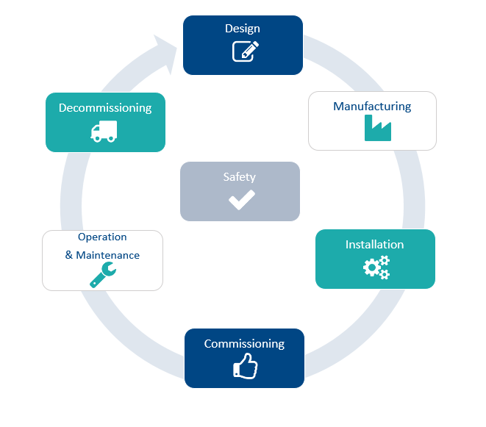








Why EDMS ?
Longevity and stability :
  CERN project lifecycles can last between 25 and 40 years.
    Very often, the engineers/scientist who design a system are not the same to the ones that will maintain/upgrade/decommission it.
    Documentation should remain retrievable on long-term basis
  EDMS was stablished at CERN in the 90’s, and it is still being the recommended and official platform to store and organize engineering information. Intensively used in new projects (e.g. HL-LHC).
  In my humble opinion, websites often do not life for so long
Integration
Version control
Access (inside and outside CERN)
Permissions
Approval procedures
3 / 13

Slide 4
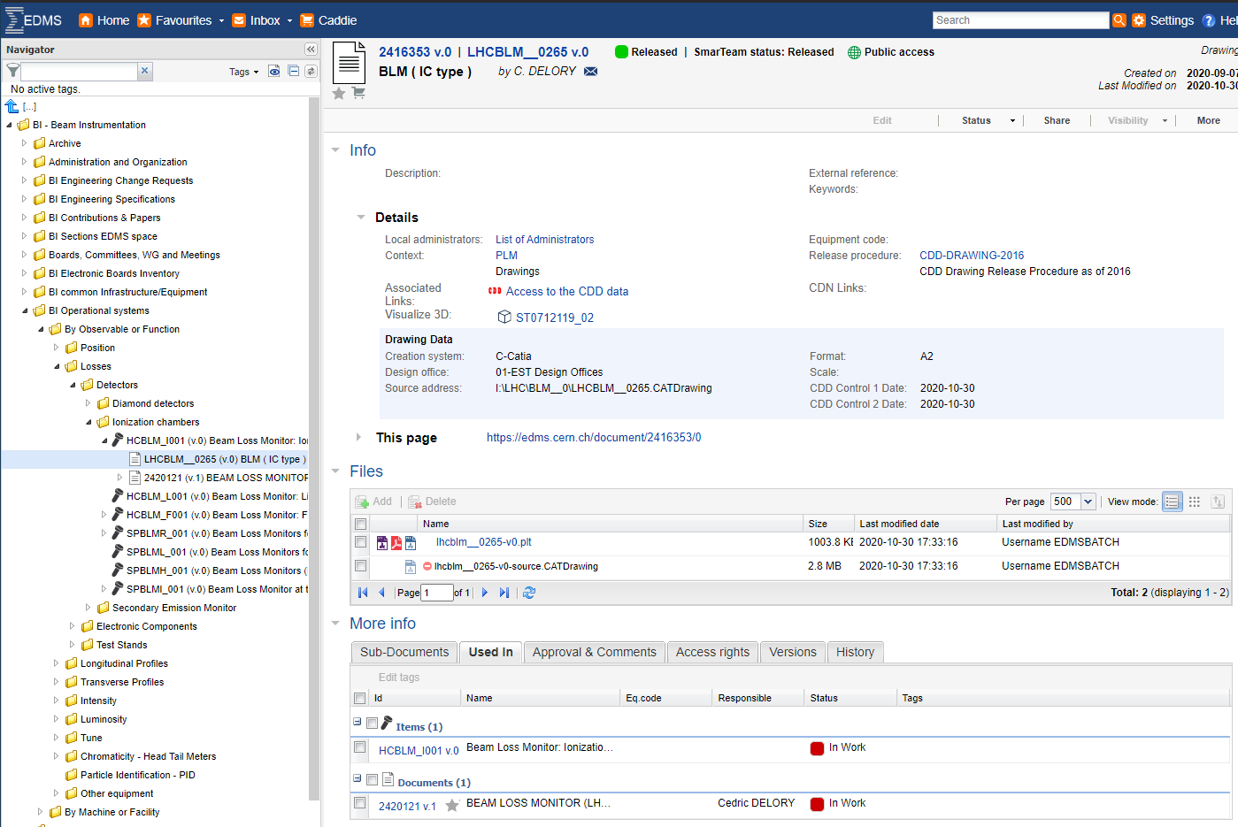
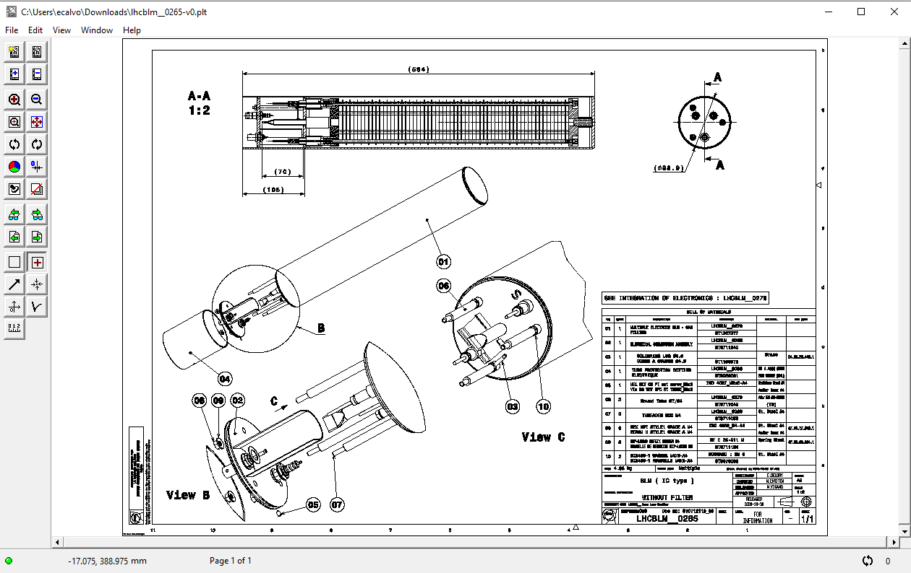
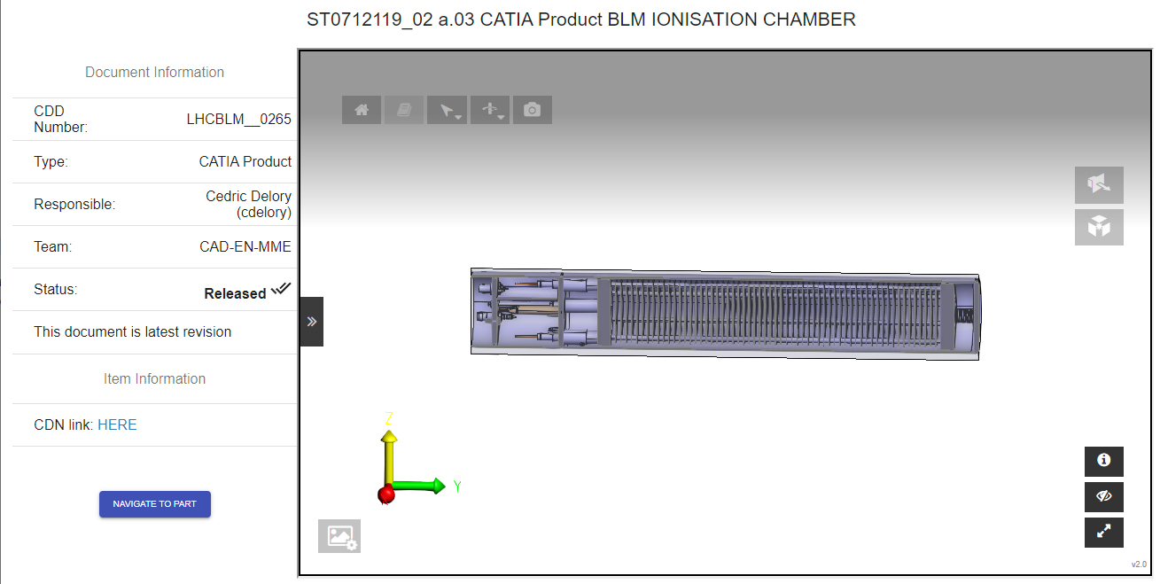
Ex: Links between items and CDD and 3D models
Links to CDD and 3D models
Ex: Link: https://edms.cern.ch/document/2416353/0
4 / 13

Slide 5
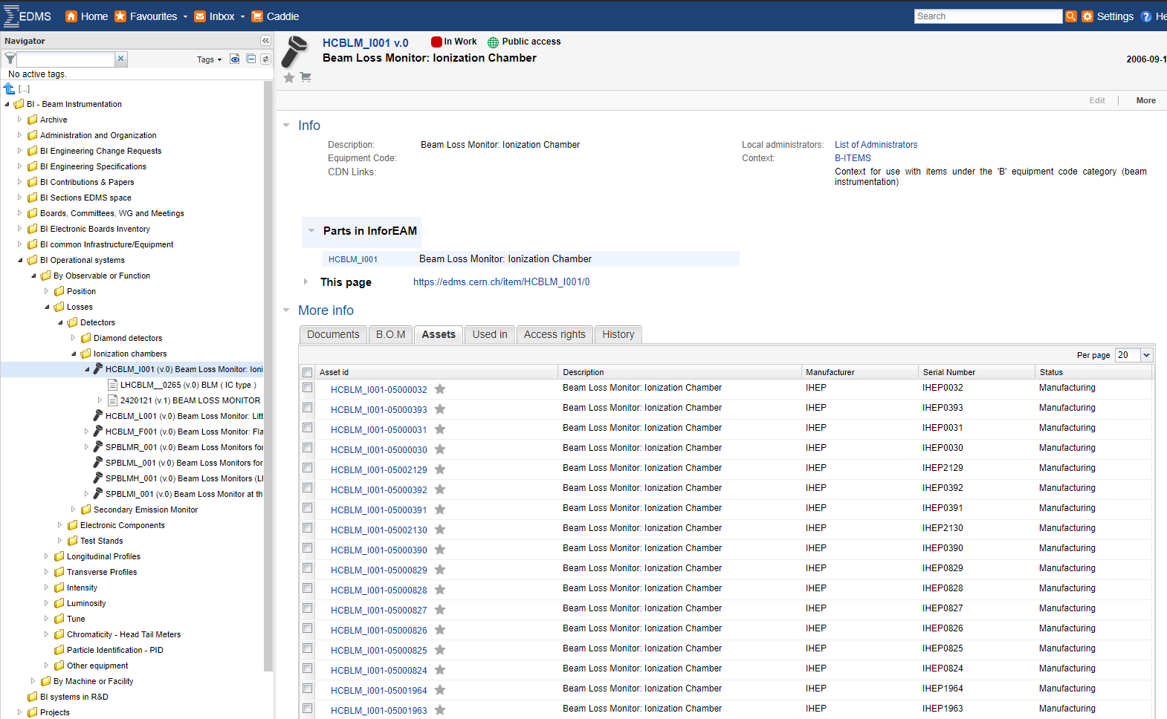
Ex: Links between items and Infor EAM assets
Links to assets
5 / 13

Slide 6
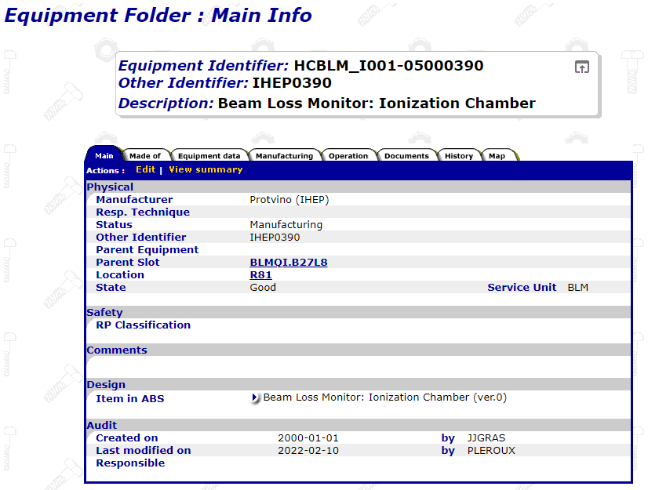
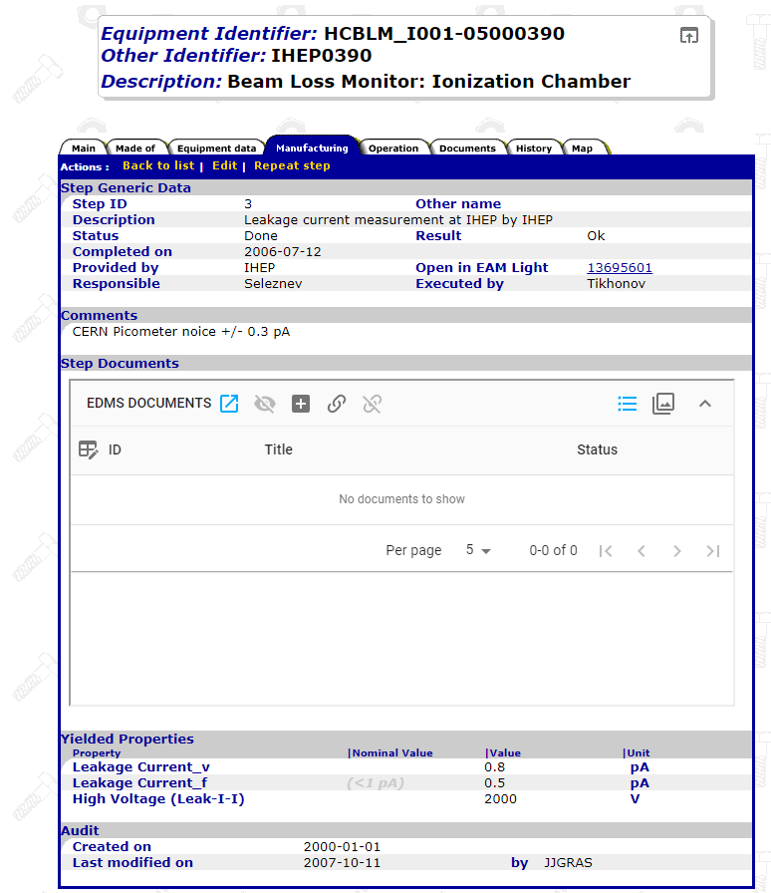
Ex: Links between items and Infor EAM assets (II)
Where it is installed
Results of validation tests
6 / 13

Slide 7
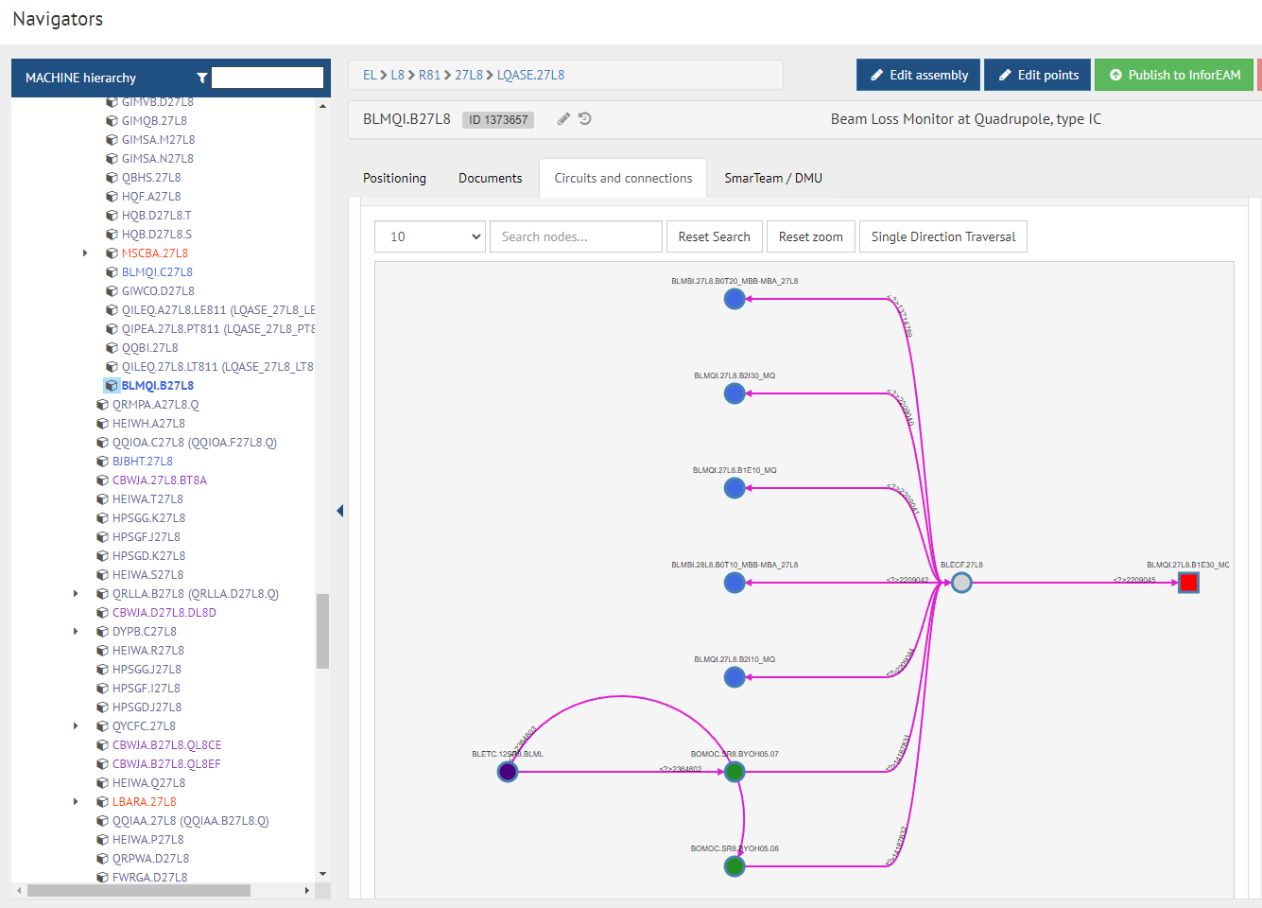
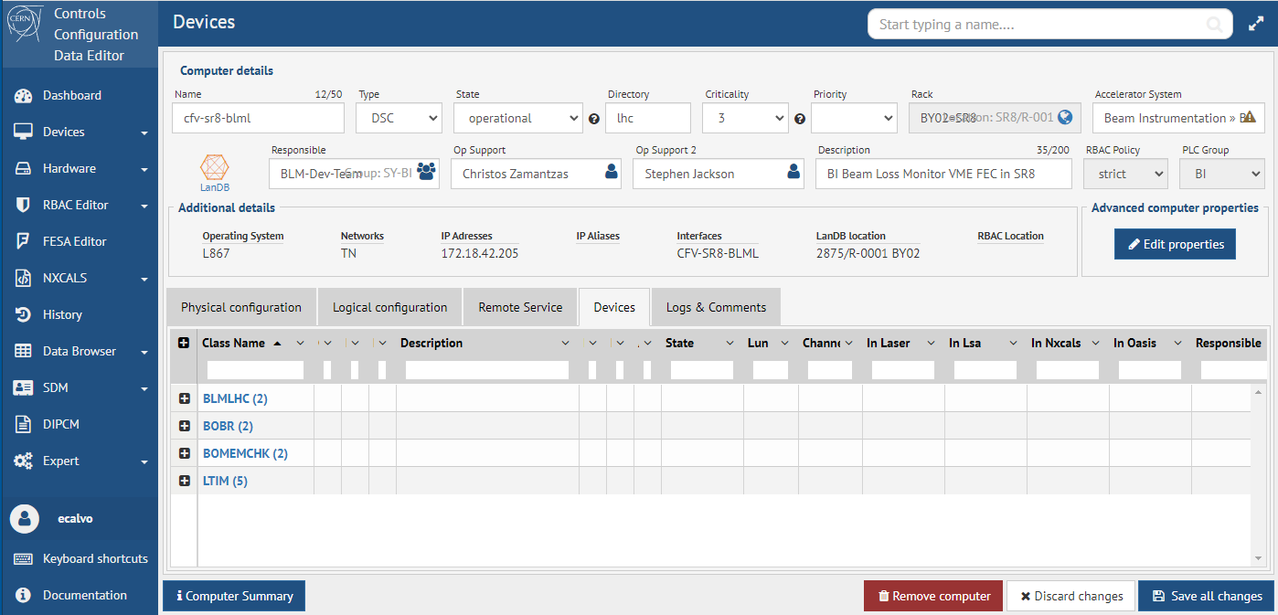
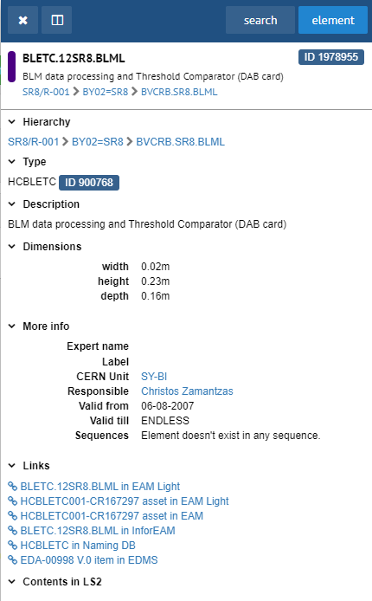
Ex: Additional info thanks to layout links
Which tunnel card is connected to it, and where
Surface crate where it is installed
Additional links to CCDE and network database
Which surface card is connected to it, and where
Surface optical connector
Card serial number with eventual validation tests or cal. procedures
Schematics and PCB layout of the electronic card !
7 / 13

Slide 8
Information structure
Because of Windows(/Linux) habitudes, we tend to organize information using a tree structure.
But things can not always be classified this way. That paradigm is a bit obsolete. Information connections need something like:
Topic 2
Topic 1
Topic 2
Topic 3
Topic 1
Topic 5
Sub-topic 1.1
Sub-topic 2.1
Sub-topic 2.2
Topic 8
Topic 4
Topic 6
Sub-topic 3.1
Sub-topic 3.2
Sub-topic 3.2
Topic 3
Topic 7
Do not think in folders. Think in terms tags / symbolink links / etc.
File systems (EOS, etc) are not very convenient for this structure. Websites and relational databases more convenient.
8 / 13

Slide 9
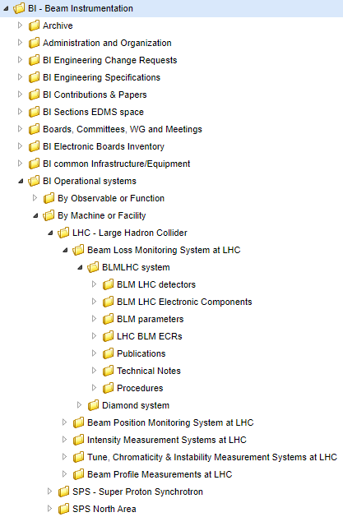
EDMS structure : By machine & Facility
Links to detectors info
CDD drawings
Manufacturing info
Maintenance/Cal. Procedures
EDA documents (schematics,
PCB layout, etc)
Maintenance/Cal. Procedures
Manuals, photos, etc
Machine
or Facility
Observable
(/Function)
System
Links to electron. info
Losses
Position
Intensity
Profiles, etc
ECR, Specifications
Presentations
System descriptions
Notes, reports, MDs, etc
Student thesis
Other info
Remember that it is a database: objects (items, documents or projects) can be linked to more than one project
This allows to model many possible scenarios:
  Same processing card with different detectors
  Different detectors using the same card
  Same presentation/document for different systems/machines
  etc
https://edms.cern.ch/project/CERN-0000223744
9 / 13

Slide 10
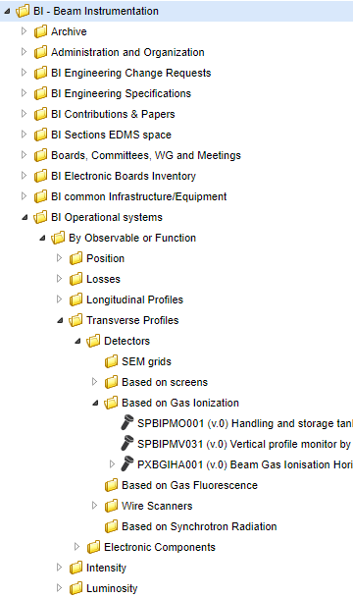
EDMS structure: by observable or function
Links to detectors info
CDD drawings
Manufacturing info
Maintenance/Cal. Procedures
EDA documents (schematics,
PCB layout, etc)
Maintenance/Cal. Procedures
Manuals, photos, etc
Observable
(/Function)
Links to electron. info
Test stands, test benches or other equipment related to an equipment but not necessarily installed in a machine
Other info
Remember documents are not duplicated, just presented with a different perspective
This strategy allows to create the different combinations presented before
within the machines projects
  Same processing card with different detectors
  Different detectors using the same card
  etc
10 / 13

Slide 11
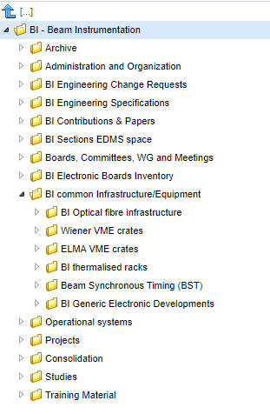
EDMS structure: Common equipment/infrastructure
Documentation related to infrastructure
or equipment which is common to different systems
11 / 13

Slide 12
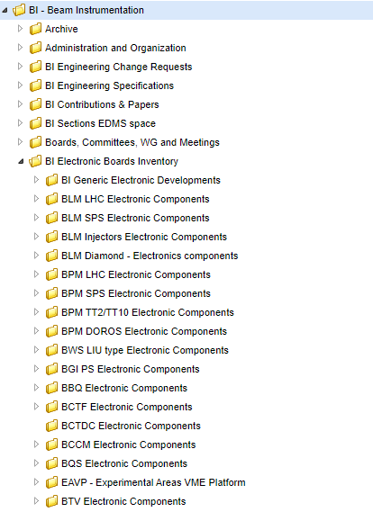
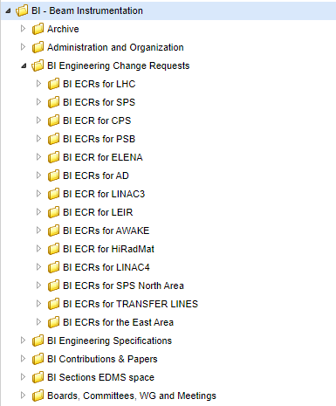
EDMS structure: Others
Collection of ECRs per machine
and instrument
Catalogue of electronics equipment (control, readout, power supplies, etc)
Classified by system where it is used
12 / 13

Slide 13

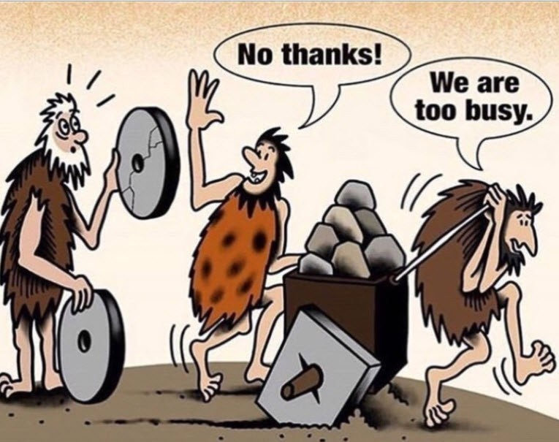
BI EDMS structure : conclusions
A structure has been put in place
It allows to retrieve the information through different
perspectives (without duplicating the information)
Projects can be renamed/attached/detached without
having to change the links that point to them
Proposals to add/modify will be warmly welcome
Please notify eventual incorrect contexts or permissions
Your contribution
is needed
Now the ball is in your court !
13 / 13

