Slide 1

Arc Half-Cell Mock-Up Meeting #7
Status on vibration and dynamic stability studies
Lucie Baudin, Audrey Piccini
Thursday 11th May 2023
Notes:
In the context of the mock-up study, we worked on vibrations and dynamic stability analyses, in particular on the collider supports, i.e. the girder and the booster support.

Slide 2
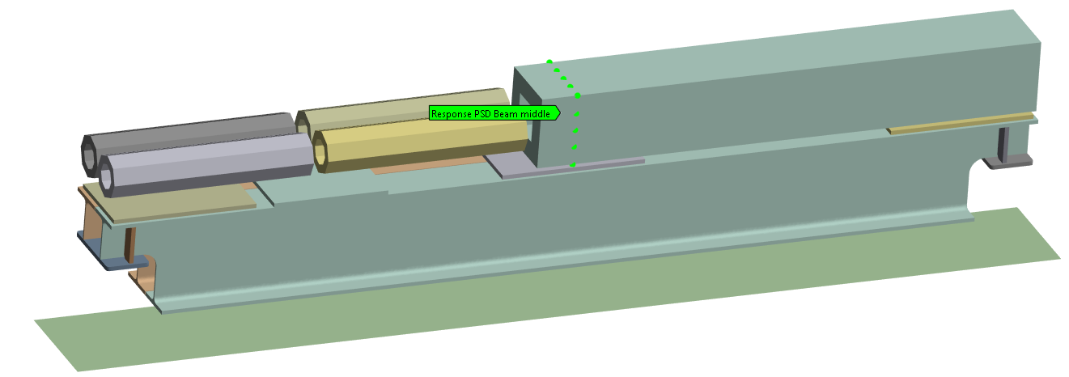
1. Girder stability – methodology
Magnets modeled by beams
Contacts between magnets and the girder → Fixed
Quadrupole:
Mass = 5300kg
Envelop = 500x500mm
Length = 3500mm
Sextupoles
Mass = 500kg
Envelop = Ø300mm
Length = 1400mm
Contacts between the girder and the ground → Springs with stiffness equivalent to jacks
Assumptions:
→ Beams model magnets of equivalent mass → J. Bauche
→ Connection between girder and magnets → Alignment strategy to be defined (shimming) (H. Mainaud Durand)
→ Value of the stiffness of the jacks → M. Sozin, M. Noir
→ Damping of material = 2% → To be checked with a suitable mock-up

Slide 3
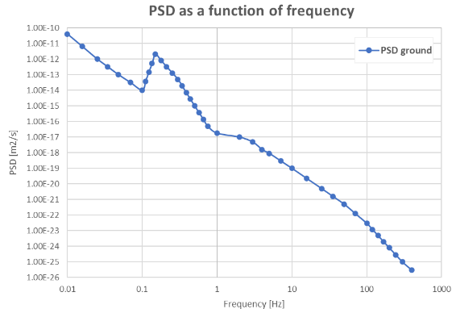
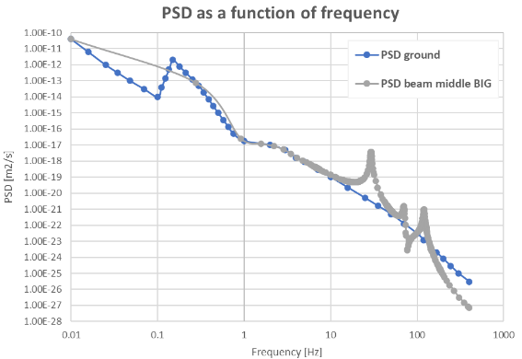
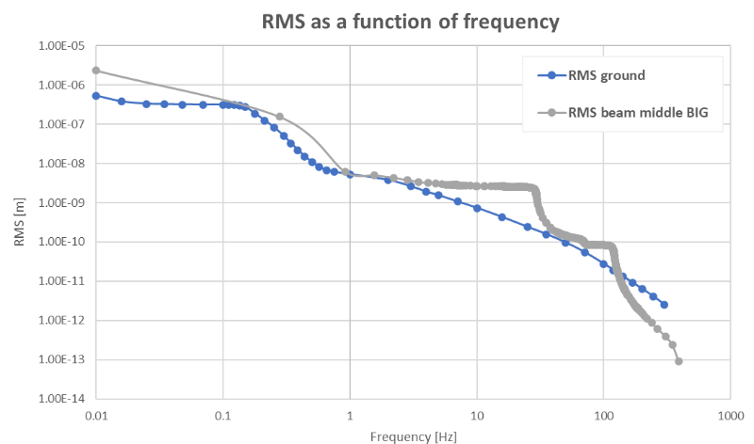
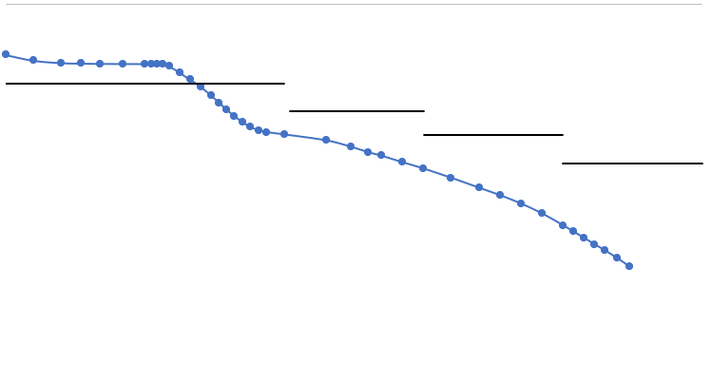
1. Girder stability – methodology
PSD of the ground motion
PSD at the level of the beamline
Assumptions:
→ Beams model magnets
→ Connection between girder and magnets
→ Value of the stiffness of the jacks
→ Damping of material = 2%
→ PSD input = envelop of measurement graphs
(LHC tunnel measurements)
RMS of the ground and the beam
Specifications:
Frequencies | Tolerance
1 > f > 0.01 Hz | 100 nm
10 > f > 1 Hz | 20 nm
100 > f > 10 Hz | 5 nm
f > 100 Hz | 1 nm
PSD = Power Spectral Density
RMS = Root Mean Squared
Given by T. Raubenheimer at FCCIS workshop

Slide 4
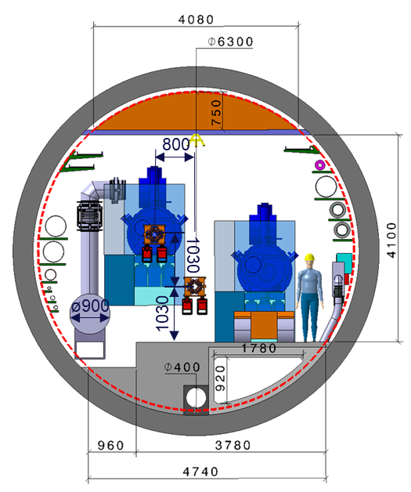
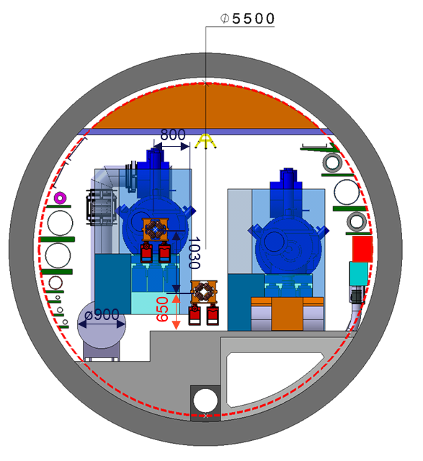


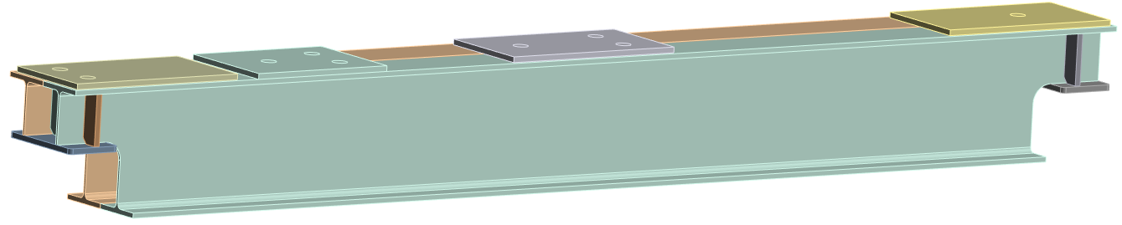
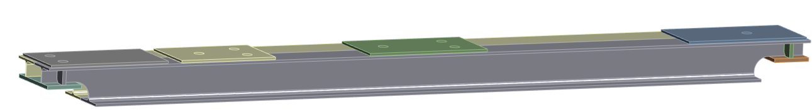

1. Girder stability – impact of lowering the beamline
Integration issues at the level of the RF sections
The idea → lower the beamline of the collider from 1030 to 650 mm
What is the impact on the girder supporting the collider?
Geometry of the girder
Stiffness of the jacks supporting the girder
What is the impact on the booster’s support?
Collider beamline = 1030mm
Collider beamline = 650mm
Height of the girder | 720mm
Height of jacks | 360mm
Stiffness of jacks | 800kN/mm (vert.) 40kN/mm (long. and trans.)
Height of the girder | 340mm
Height of jacks | 150mm
Stiffness of jacks | 1600kN/mm (vert.) 320kN/mm (long. and trans.)

Slide 5
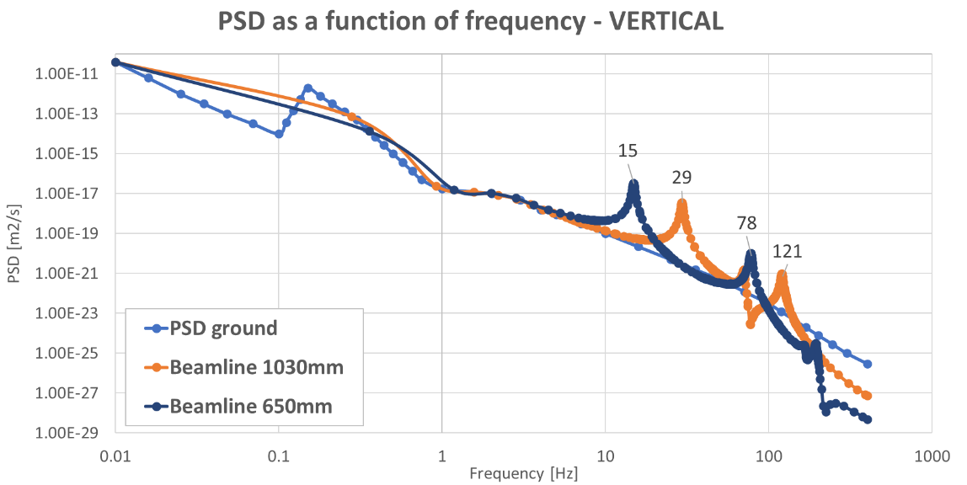
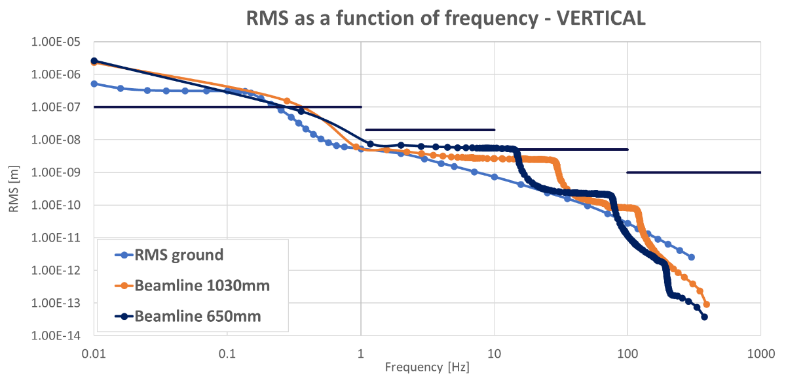
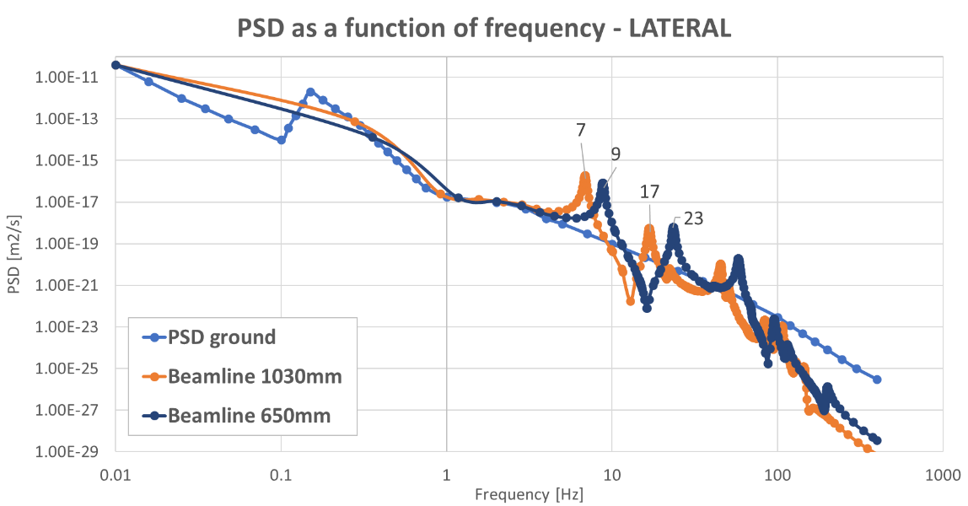
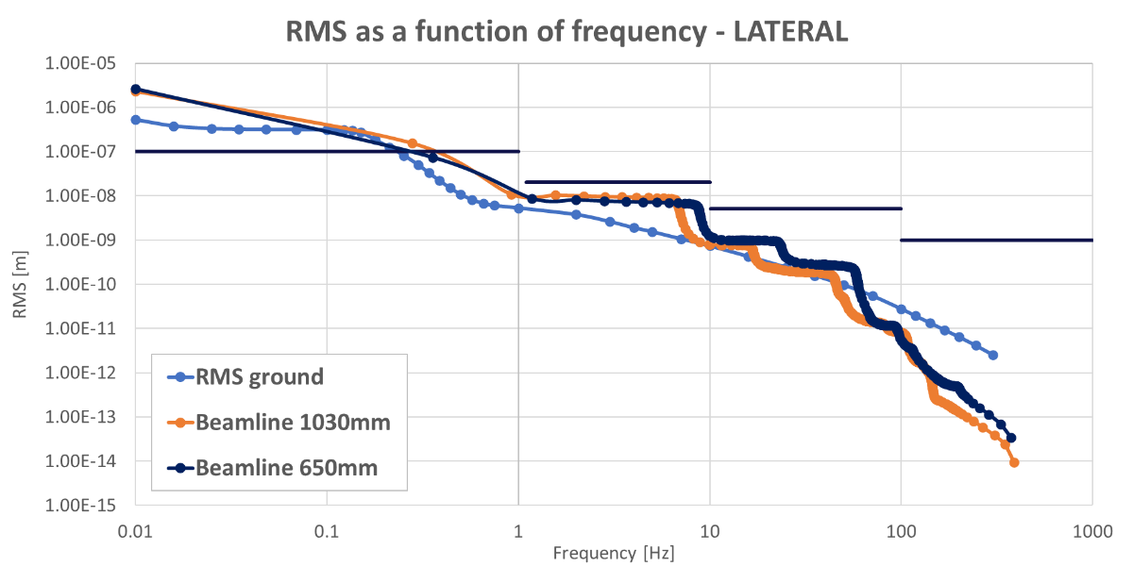
1. Girder stability – results
→ Diminution in modes when the beamline is lowered
→ Increase of the RMS when the beamline is lowered
Specifications
→ Increase in modes when the beamline is lowered
→ Decrease of the RMS when the beamline is lowered
Specifications

Slide 6
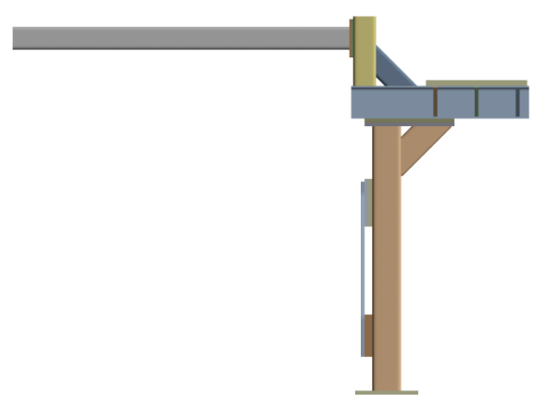
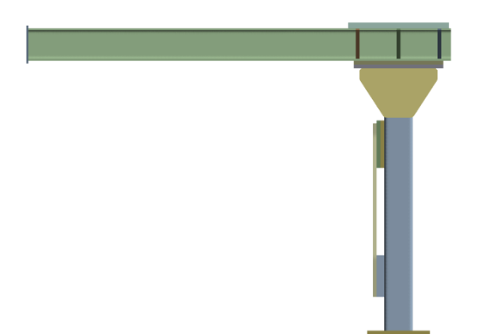

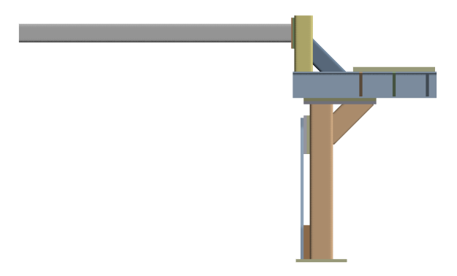
2. Booster support stability – methodology
→ There are two discussions, two points to be determined:
1. Type of geometry
Shifted geometry
Centered geometry
2. Height of the booster beamline
Beamline of the booster = 2060mm
Beamline of the booster = 1680mm
BIG – Shifted
SMALL – Shifted
≈1800mm
Beamline of the collider 1030mm
≈1400mm
Beamline of the collider 650mm

Slide 7
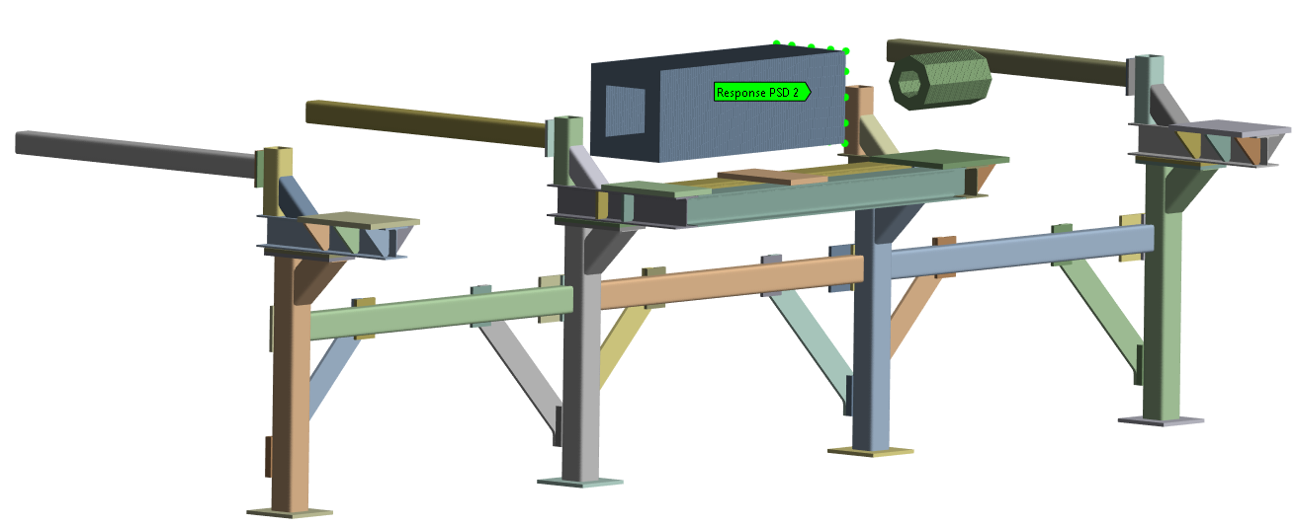

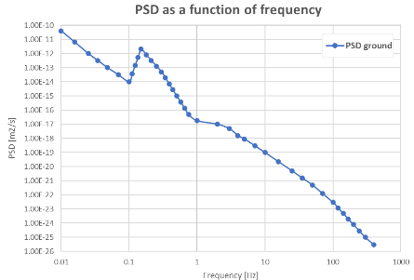

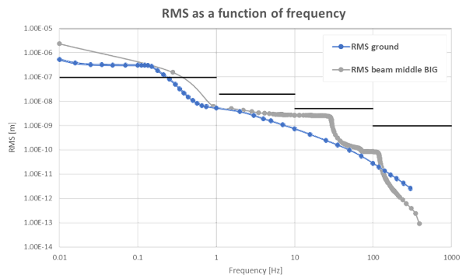
2. Booster support stability – methodology
Quadrupole:
Mass = 2000kg
Envelop = 500x500mm
Length = 1500mm
Sextupole
Mass = 200kg
Envelop = Ø300mm
Length = 500mm
Magnets modeled by beams and point mass
½ Dipoles
Mass = 500kg
PSD of the ground
PSD at the level of the beamline
Contacts between magnets and the girder → Fixed
RMS of the ground and the beam
Assumptions:
→ Beams model magnets
→ Connection between girder and magnets
→ Damping of material = 1%
→ PSD input = envelop of measurement graphs
(LHC tunnel measurements)

Slide 8
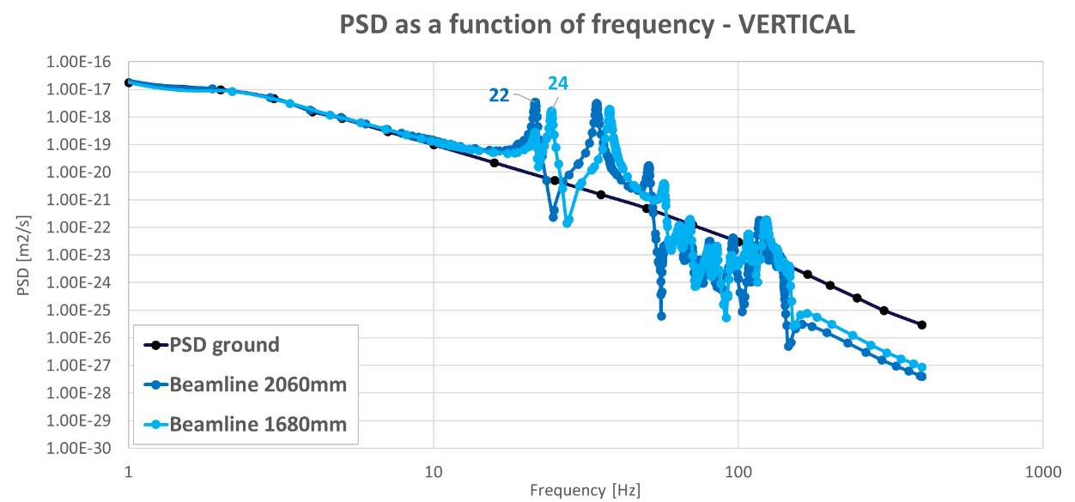
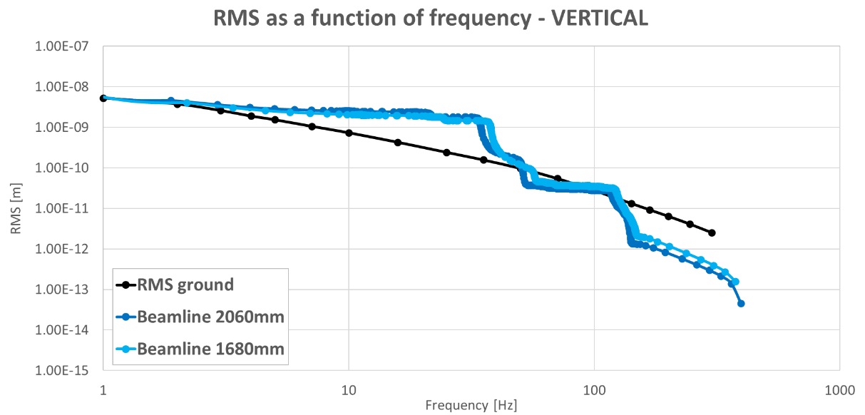
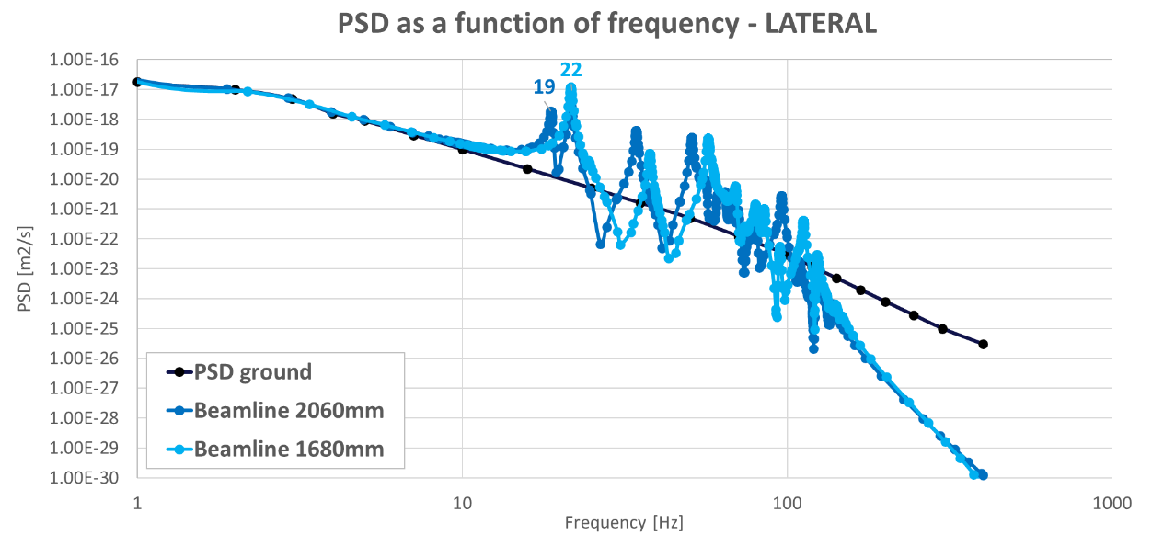
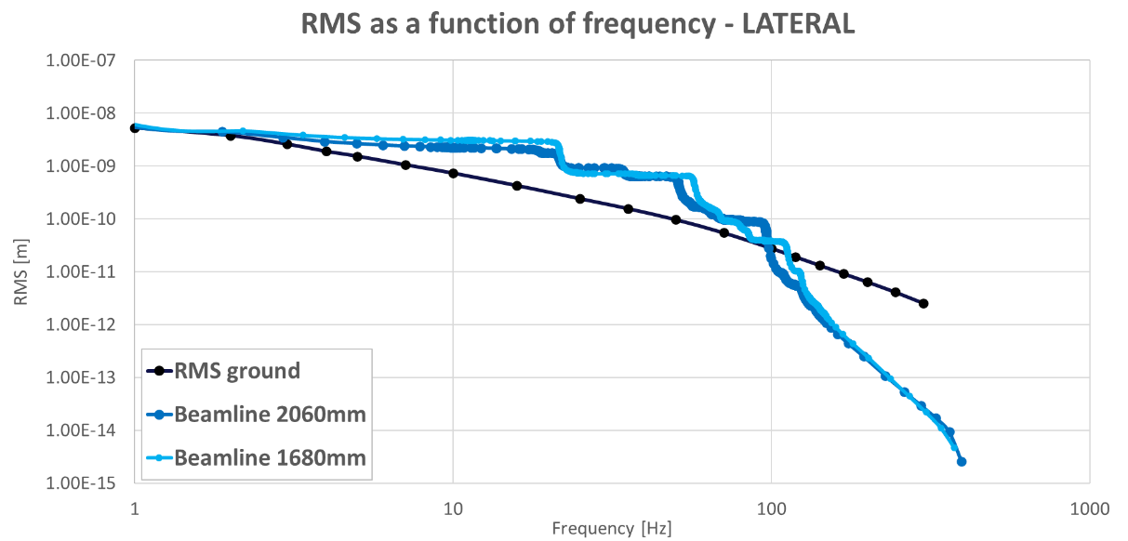
2. Booster support stability – results

Slide 9
3. Conclusions
The methodology for assessing the dynamic stability of the collider and booster support systems has been established.
It allows to compute an RMS at the beamline which can be compared to specifications
According to the first results calculated, the specifications are in general met (/!\ many assumptions have been made)
The position of the high and low beamline is manageable in terms of stability
BUT these results were obtained by making several assumptions
The assumptions can then be refined
→ NEXT STEPS: study crosstalk between booster and collider

Slide 10
Thank you for your attention

Slide 11
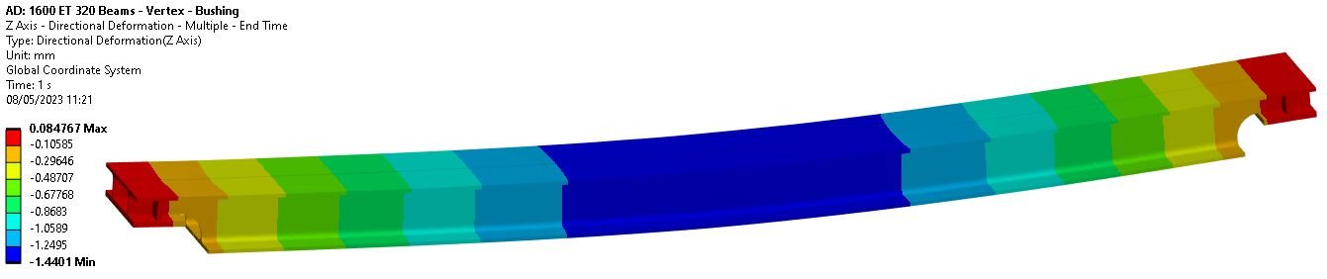
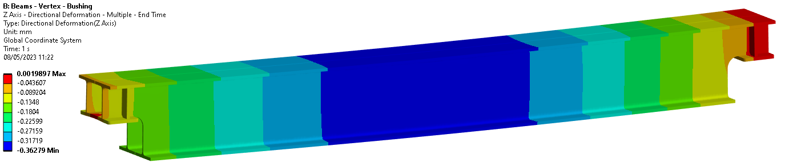
Deflection of the girder
Max deflection = 1.45mm
Max deflection = 0.37mm

Slide 12
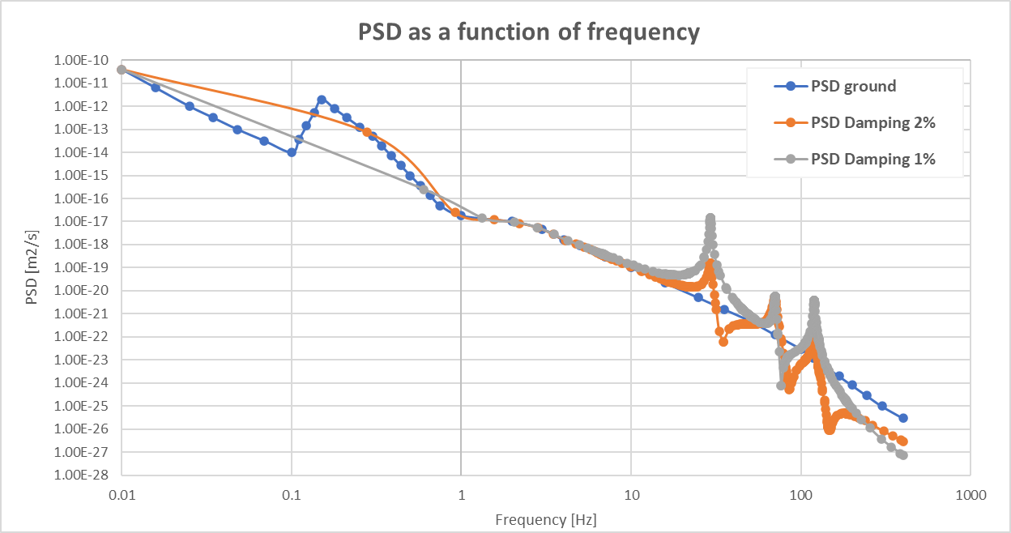
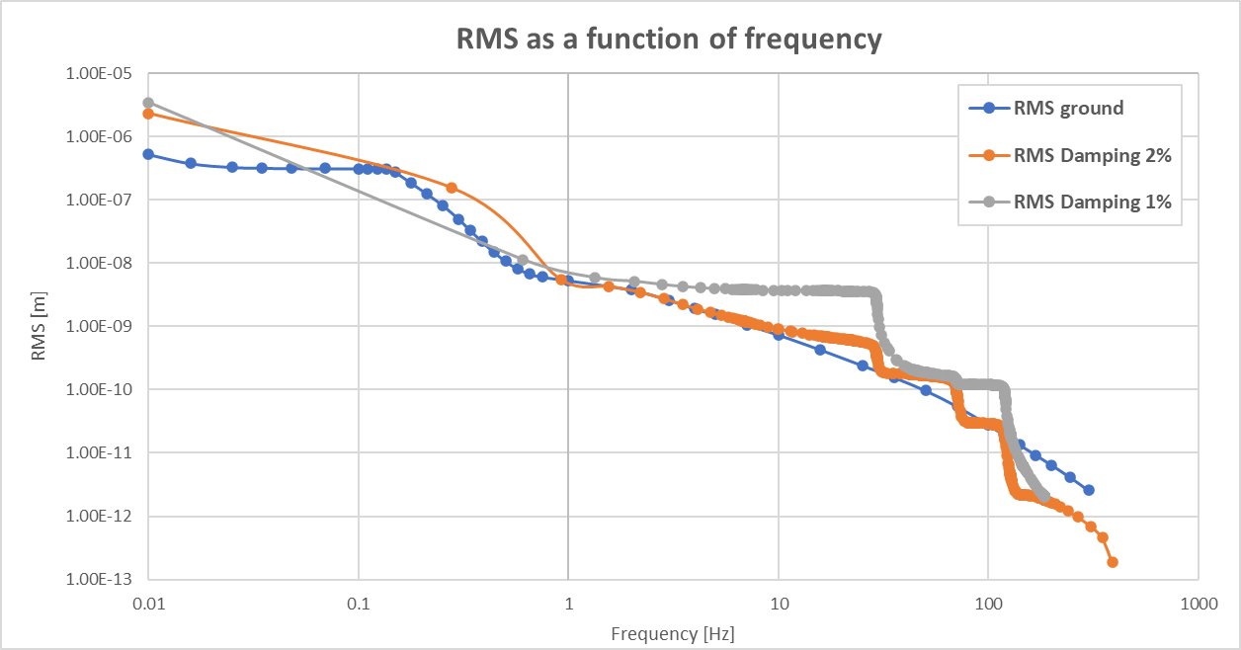
Simulations assumptions – DAMPING
RMS ANSYS from 400Hz to 1Hz (Middle)
1% | 6.3853E-09 | m
2% | 5.8250E-09 | m
RMS ANSYS from 400Hz to 10Hz (Middle)
1% | 3.72E-09 | m
2% | 2.68E-09 | m

Slide 13
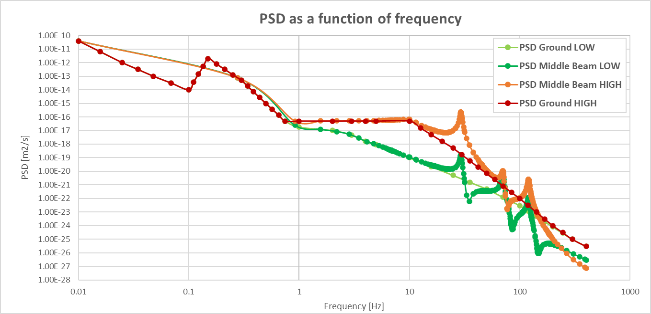
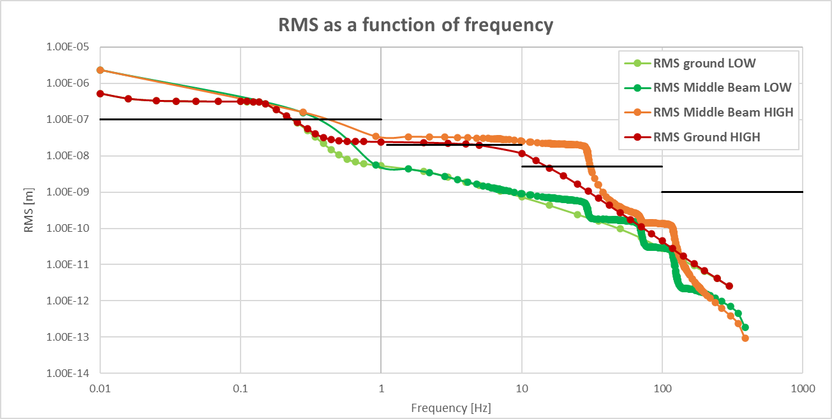
Simulations assumptions – PSD INPUT
RMS ANSYS from 400Hz to 1Hz (Middle)
LOW | 5.8250E-09 | m
HIGH | 3.3993E-08 | m
RMS ANSYS from 400Hz to 10Hz (Middle)
LOW | 2.680E-09 | m
HIGH | 2.544E-08 | m

Slide 14
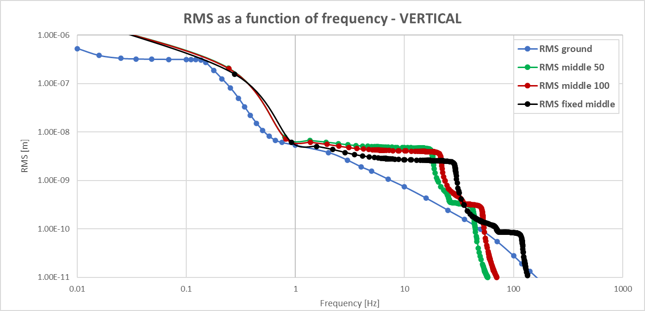
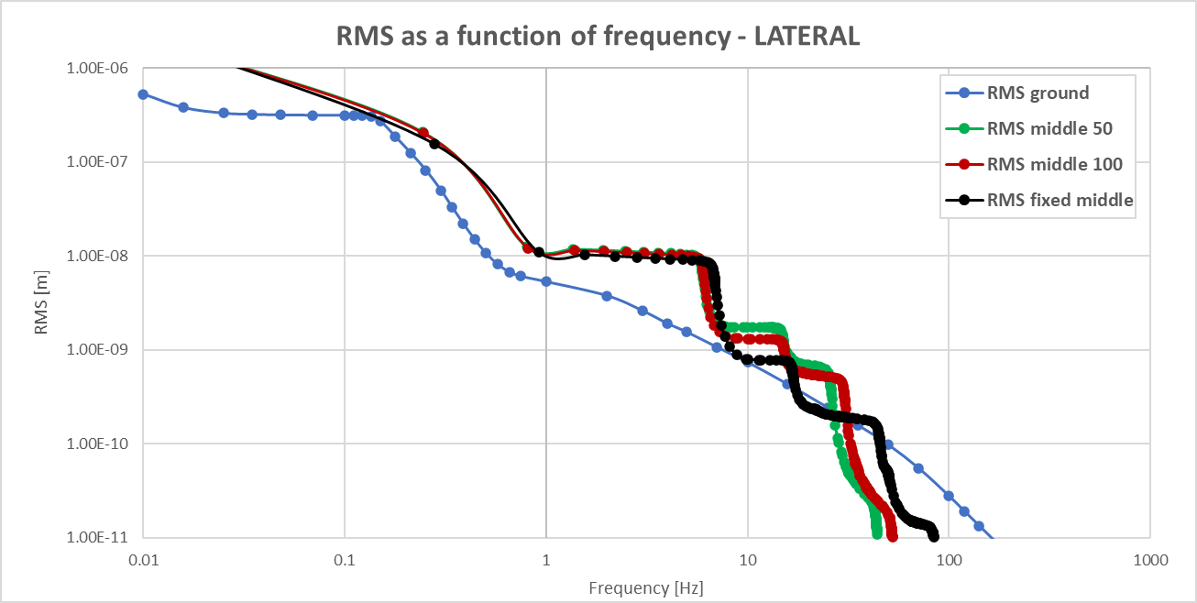
Simulations assumptions – CONTACT MAGNETS
Black → The contacts between magnets and girder are fixed
Green → The contacts between magnets and girder are modelled by springs with a stiffness equal to 100kN/mm
Red → The contacts between magnets and girder are modelled by springs with a stiffness equal to 50kN/mm

