Slide 1
05.06.2023 / FCC Week
F. Valchkova-Georgieva
  Integration news
  Topics:
  FCC-ee Underground Structure Overview
  FCC-ee Machine tunnel Layout

Slide 2
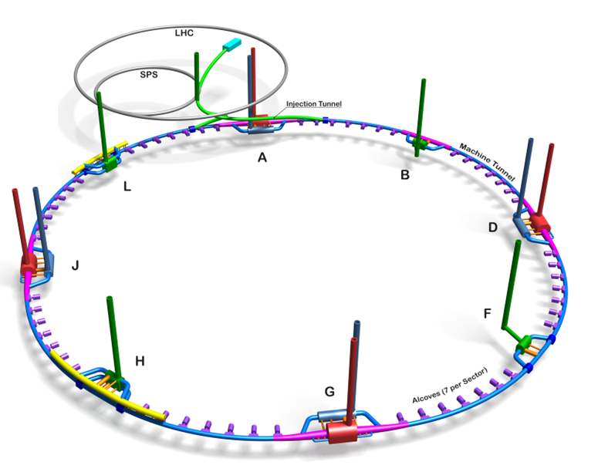
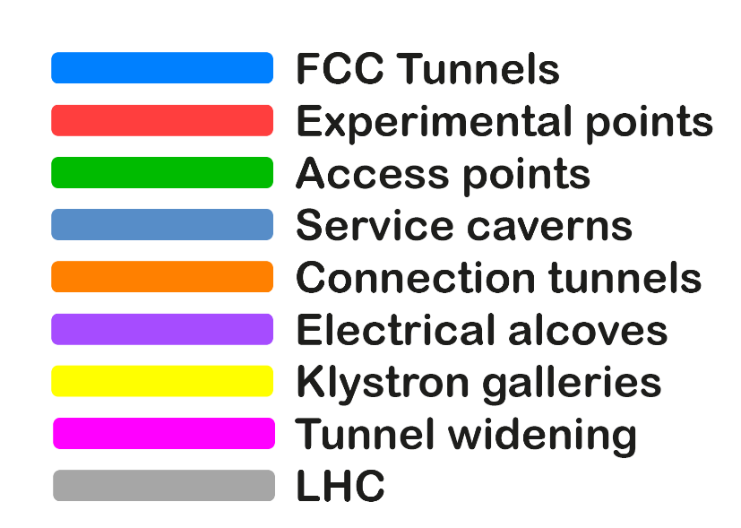
05.06.2023 / FCC Week
F. Valchkova-Georgieva
Only schematic, and not to scale.
  FCC-ee Underground Structure Overview
Courtesy A. Navascues Cornago

Slide 3
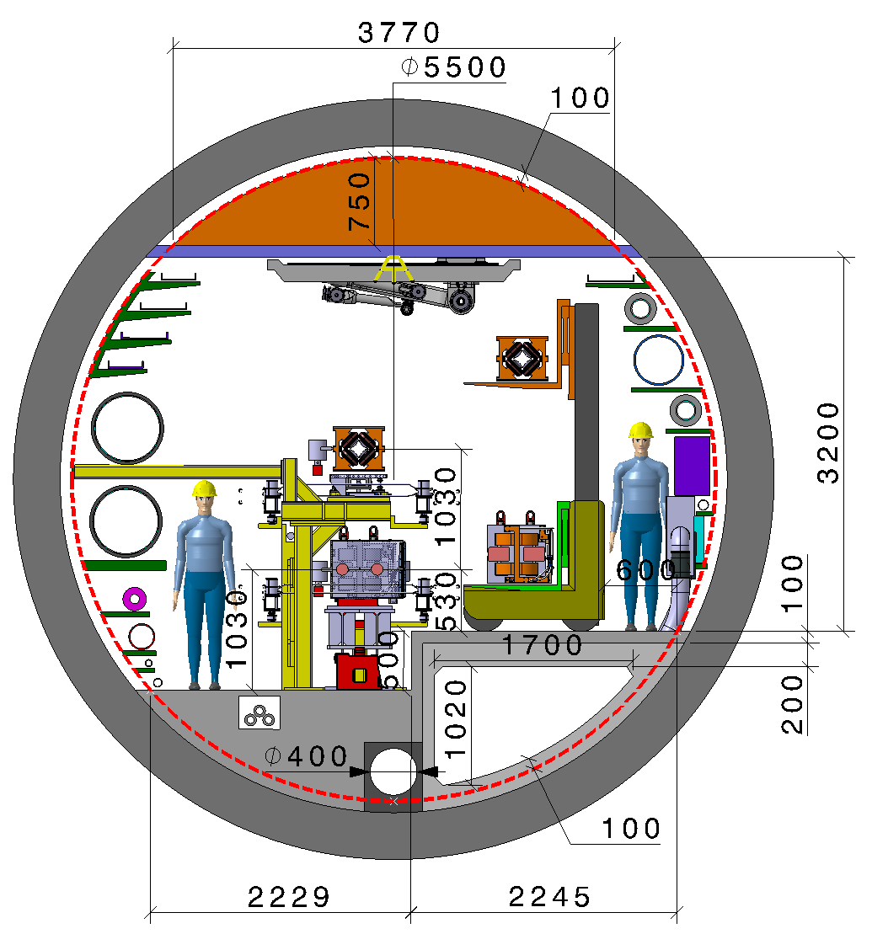
05.06.2023 / FCC Week
F. Valchkova-Georgieva
  Integration of FCC-ee machine elements (regular arc)
Machine tunnel 5.5m in diameter
Smoke/He extraction
Booster ring
Cable trays:
Fibre optic
LV distribution
Control cables
Cable tray:
MV distribution
Chilled water DN150
Demineralized water DN600
Firefighting/Row water DN400
Leaky feed
Alignment space occupation
Warm He recovery DN200
Compressed air DN80
He DN50
Fresh air diffused
Demineralized water felling DN65
Collider ring
Electrical HV
power transmission
Fresh air duct
Main cross section as for FCC-hh
Main ring below of booster ring
Main ring and booster ring 1.3 m distant
Drain
Collider Center

