Slide 1


INTERNATIONAL DUAL CAREER NETWORK
26 September 2023
IDCN LAKE GENEVA
CERN

Slide 2
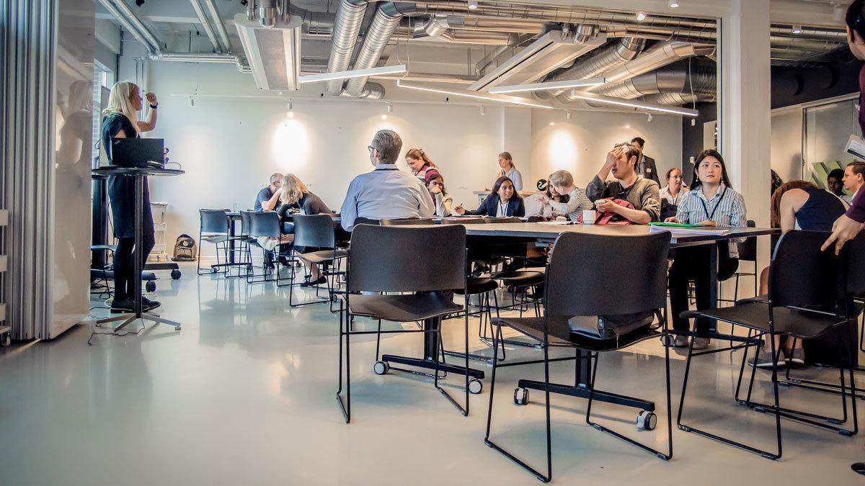
What is IDCN?
An association of international organizations
and corporations facilitating the integration
of mobile employee partners through
awareness, guidance, and professional
networking.

Slide 3
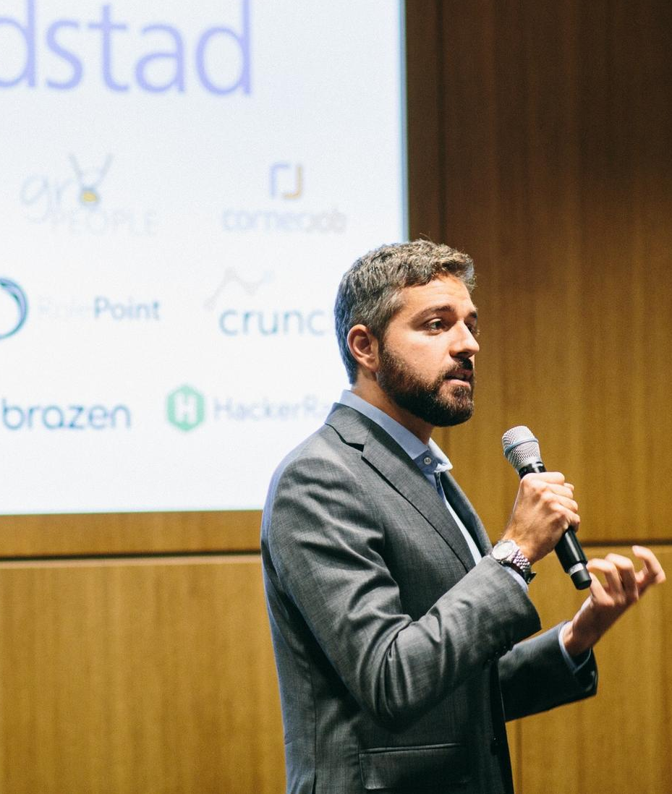
OUR
MISSION
IDCN is an association of multinational and local organizations that aim to support the professional integration of employee partners and spouses by hosting a variety of professional and social networking events, both locally and globally.
By leveraging the talent available through dual-career partners and spouses, the IDCN emphasizes the importance of fulfilling organizational responsibilities towards inclusion, diversity, corporate social responsibility, environmental, social, and governance (ESG) standards, as well as sustainability initiatives.
IDCN helps to make dual career assignments a success.
HOW ?
By providing:
Corporate Events
Career Mornings, Workshops

Slide 4
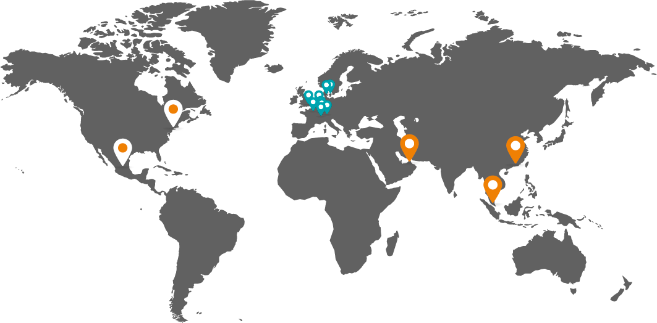














ABOUT IDCN
14 locations worldwide
Americas
Mexico City
New York
Asia
Dubai
Hong Kong
Singapore
Europe
Lake Geneva
Basel-Zurich
Brussels
Copenhagen
Jutland-Funen (DK)
London
Luxembourg
Munich
Paris

Slide 5


Slide 6
IDCN, Lake Geneva Organization Chart
President Office
IDCN LAKE GENEVA PRESIDENT – Pragya Bhatnagar
IDCN LAKE GENEVA VICE-PRESIDENT - Joanna Książek
Ahmet Kaya
MEASUREMENT
Track key performance metrics that drive overall strategy
MEMBERSHIP
Enhance the overall membership experience
EVENTS
Coordinate & Facilitate networking events
COMMUNICATION
Facilitate internal & external communication
TEAM LEAD
Devi Handriyani
TEAM LEAD
Joanna Książek
TEAM LEAD
Ahmet Kaya
TEAM LEAD
Bethany Higgin
VOLUNTEER MANAGER
Dipanwita Dash
Giulia Marzari
Jozi Rachman
Joreen Mufwaya
Glenn Borso-Tan
3 vacancies
NEWSLETTER MANAGER
Ahmet Kaya
EVENTS TEAM
MEASUREMENTS BACKUP
Vacant
VOLUNTEER COORDINATOR
Vacant
LINKEDIN MANAGER
Ahmet Kaya
MEMBERSHIP MANAGER
Devi Handriyani
CREATIVE DESIGNER
Jonas Reker
MEMBERSHIP BACKUP
Vacant
PHOTOGRAPHER
Diarmid Farquhar

Slide 7












IDCN Events Calendar 2023
2023
Jan
Feb
Mar
Apr
May
Jun
Jul
Aug
Sep
Oct
Nov
Dec
Career
Mornings
Summer
break
The power of Networking
24 Feb
How to prepare for a job interview
3 May
WEBINAR
Date: TBD
21- November
Topic; TBD
TBD
29 June
Learn about CERN
opportunities,
tips and tricks on how to build your CV
Marketing yourself in Switzerland
&
Bridging academia and career
28 Apr
5- Sept:
Learn about to integrate with the new environment as part of relocation and how to set up new business in Switzerland
Corporate
Events
Business Creation in Switzerland
30 Mar
PMI
H1 All Corporate Member Meeting
31 May
New IDCN Partner Members Welcome Event
planned
MASTERCLASS:
17 Jan
Volunteer meet-up
planned
MASTERCLASS
24 Feb
All Volunteer &
Partner Member Picnic
25 May
New IDCN Partner Members Welcome Event
13 Mar
Volunteer Christmas Lunch planned 1st half Dec
IDCN
Events

Slide 8
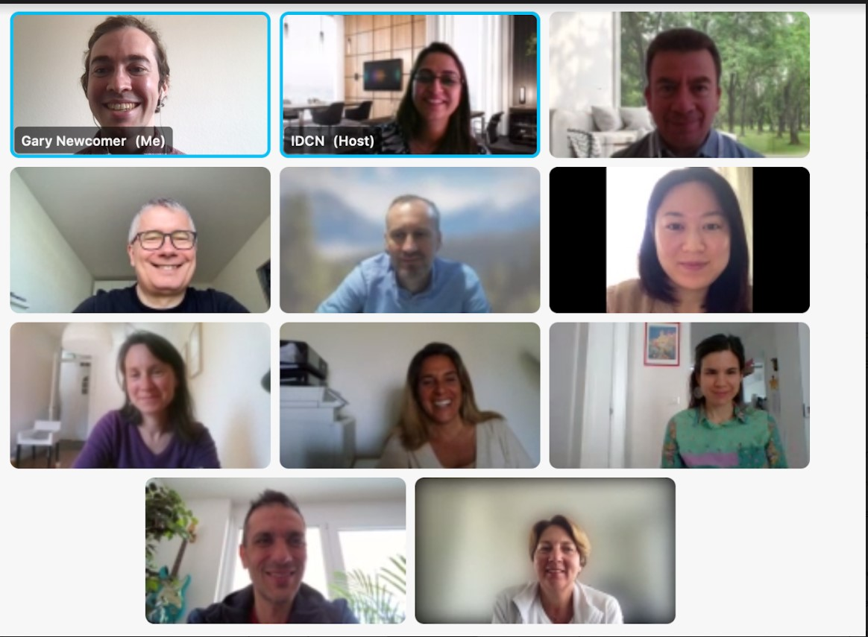
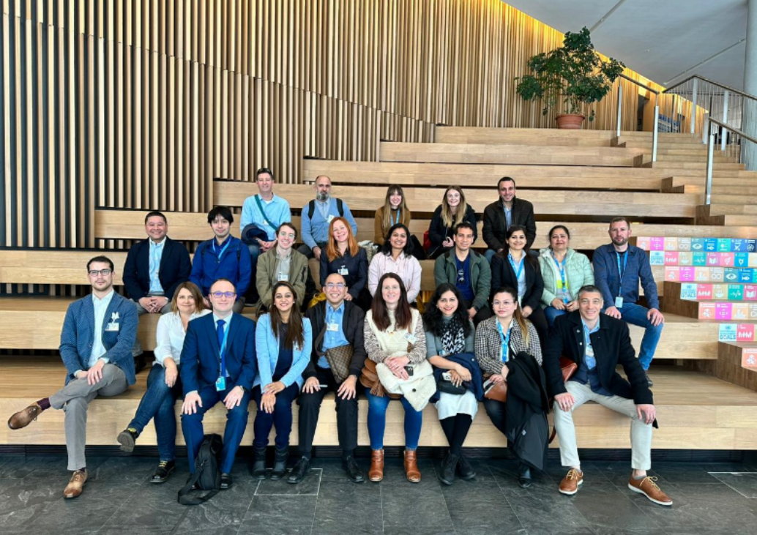
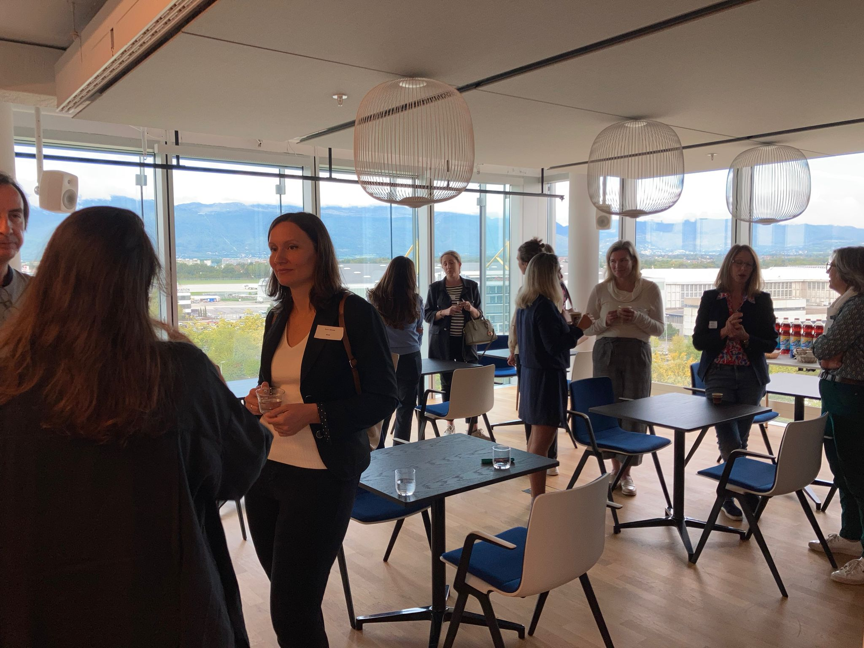
New Partner Members’ Welcome Event!
Started as online webinars, now on-site
Twice or three times a year
Objective: a warm welcome in a form of informative and fun session, also to maintain pipeline of the prospect volunteers:
  Presentation of IDCN by volunteers from
  the 4 teams who speak about their work
  Interactive Ice breaker: know your neighbor/peer/partner
  A fun quiz about IDCN and Switzerland

Slide 9
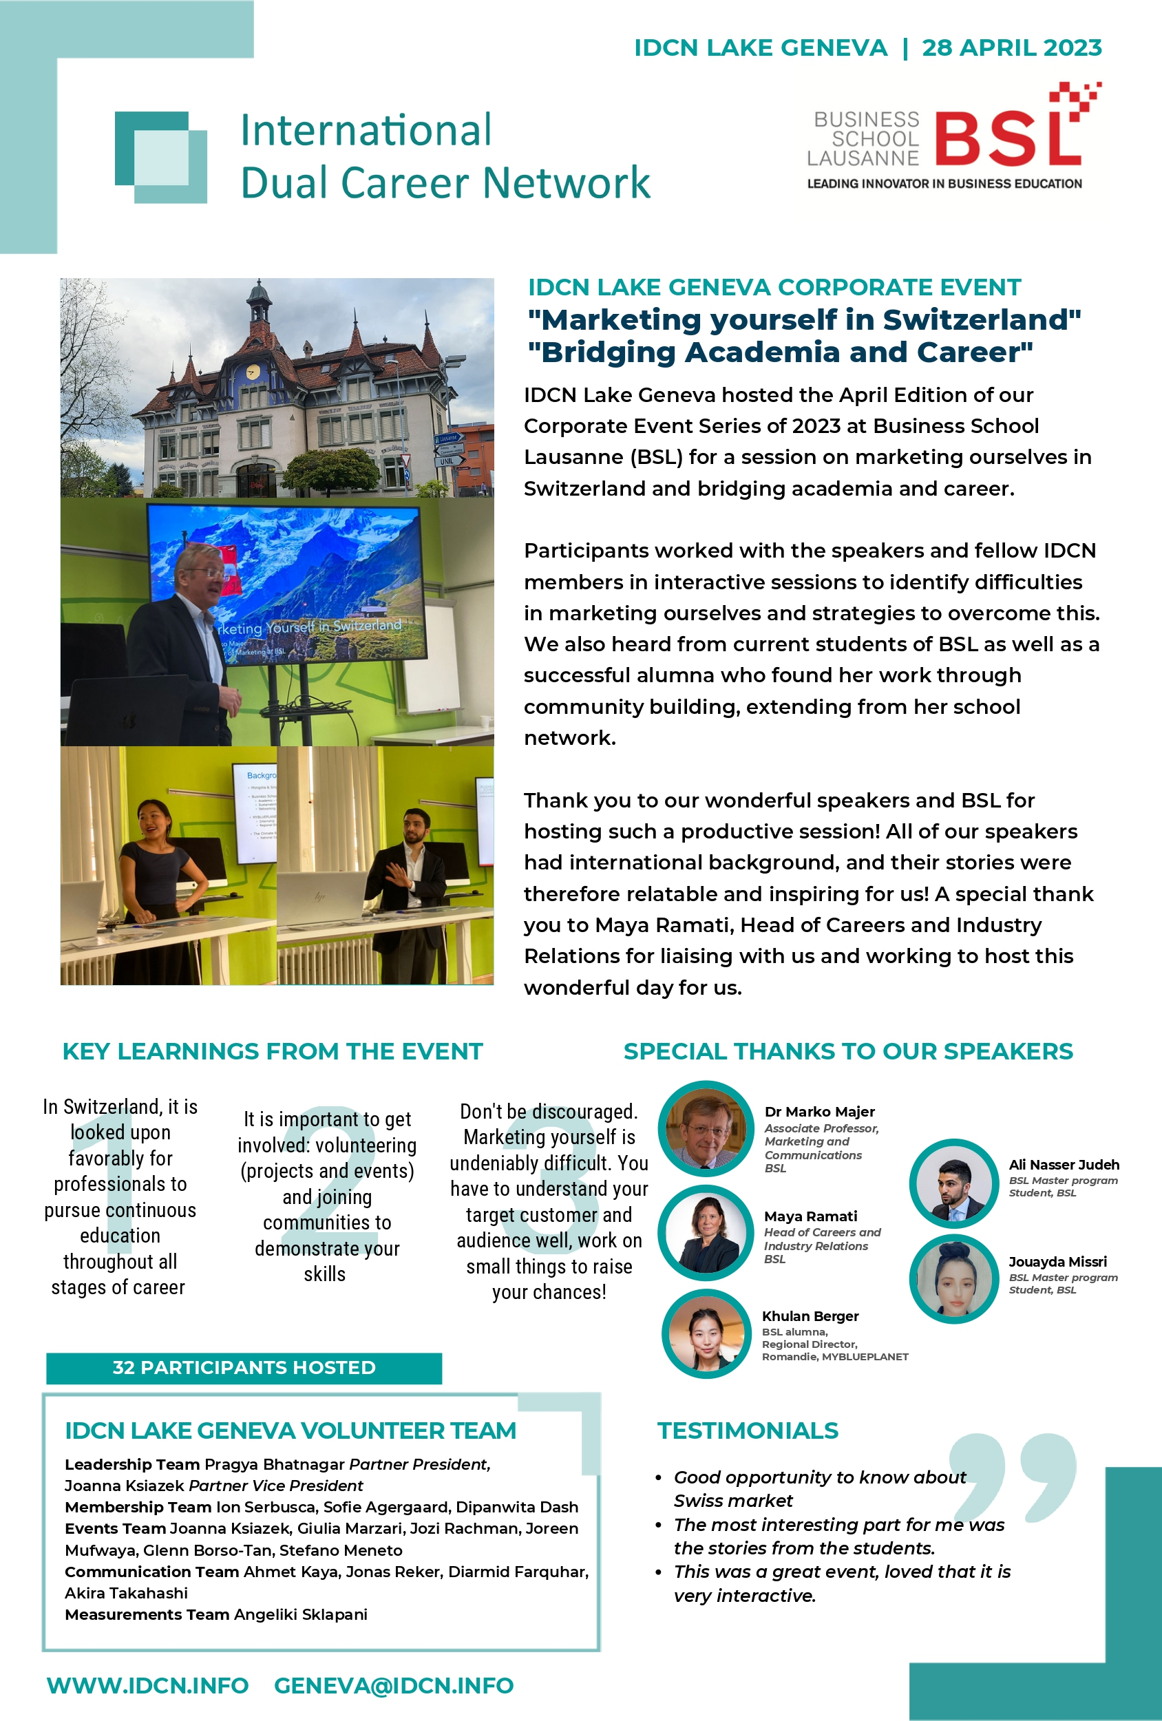

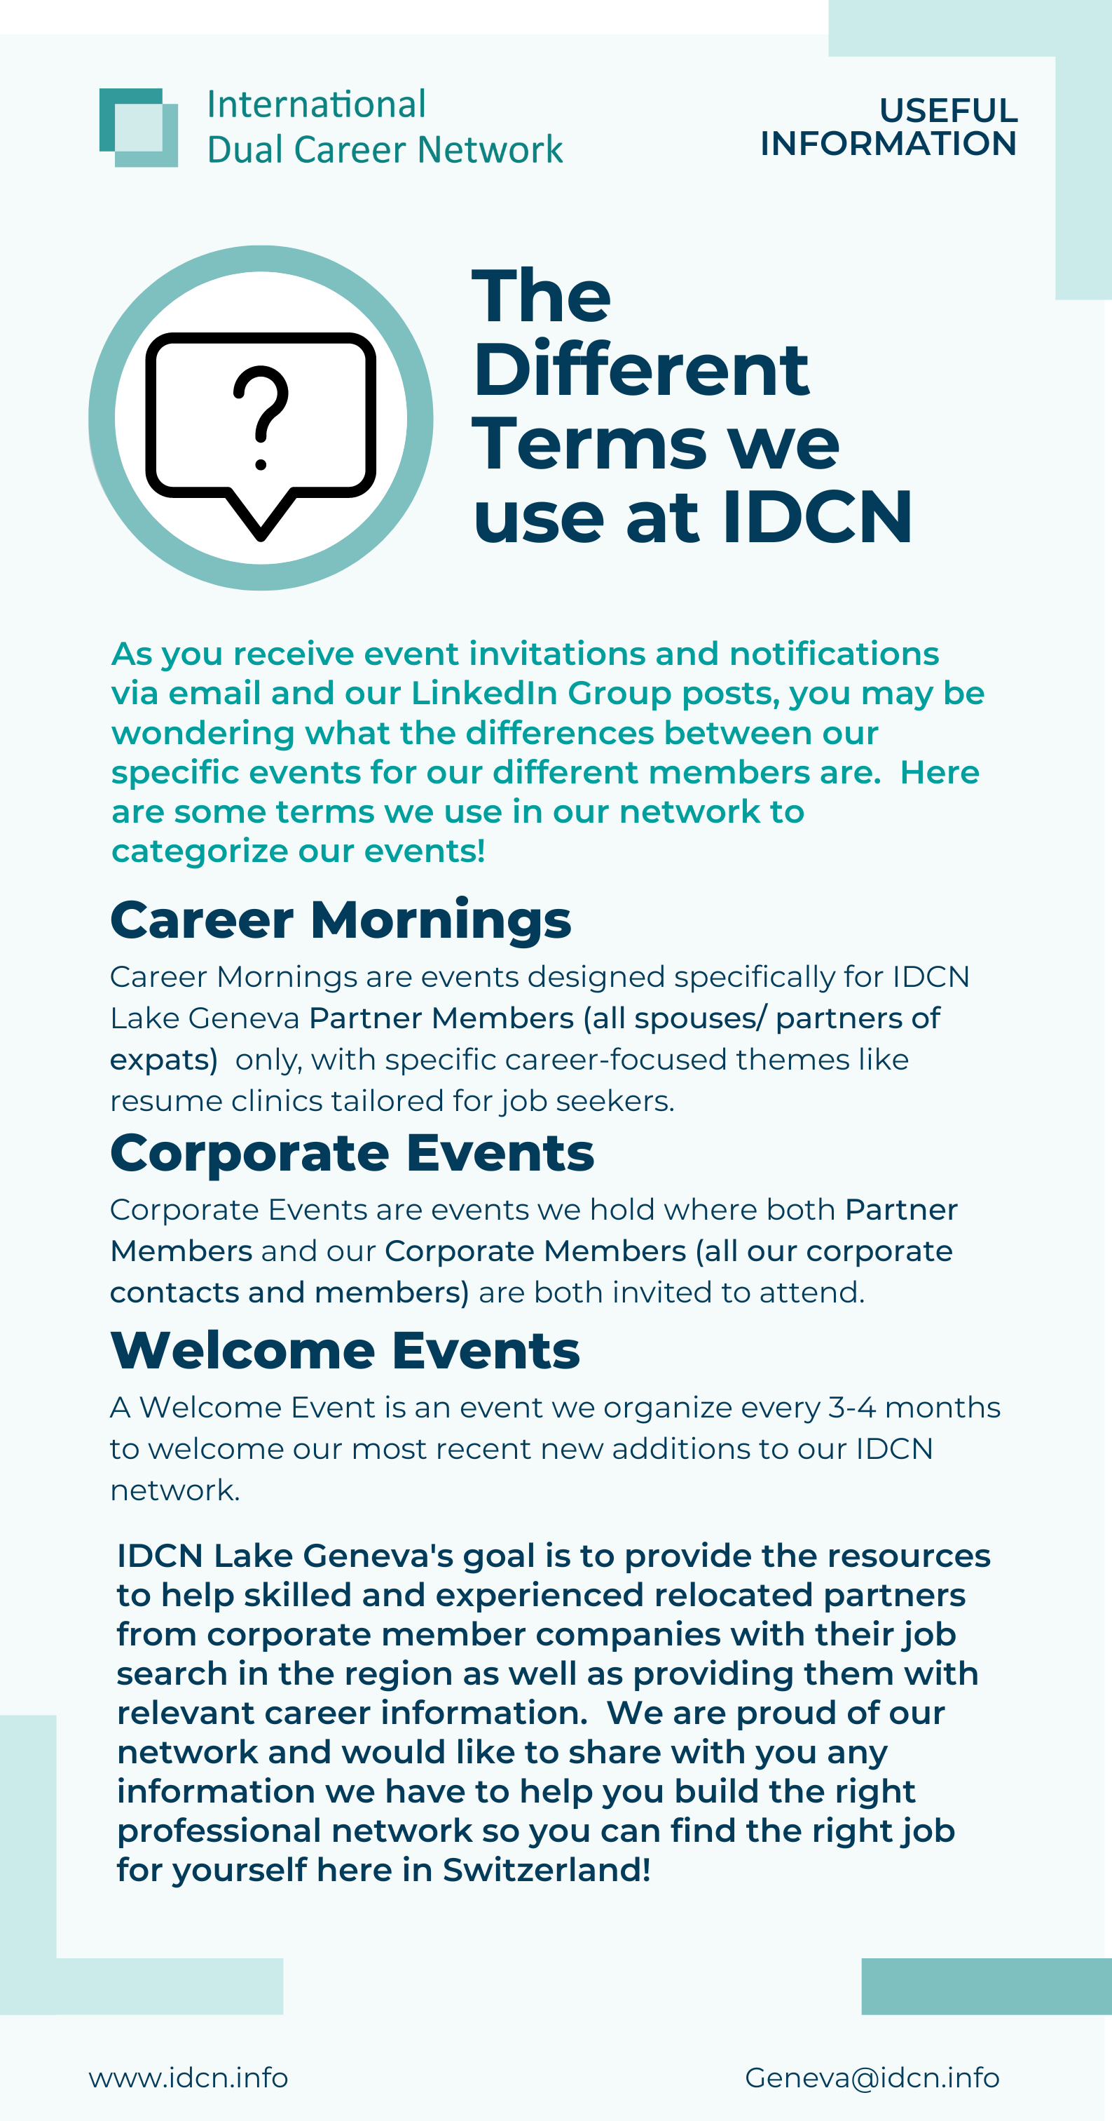
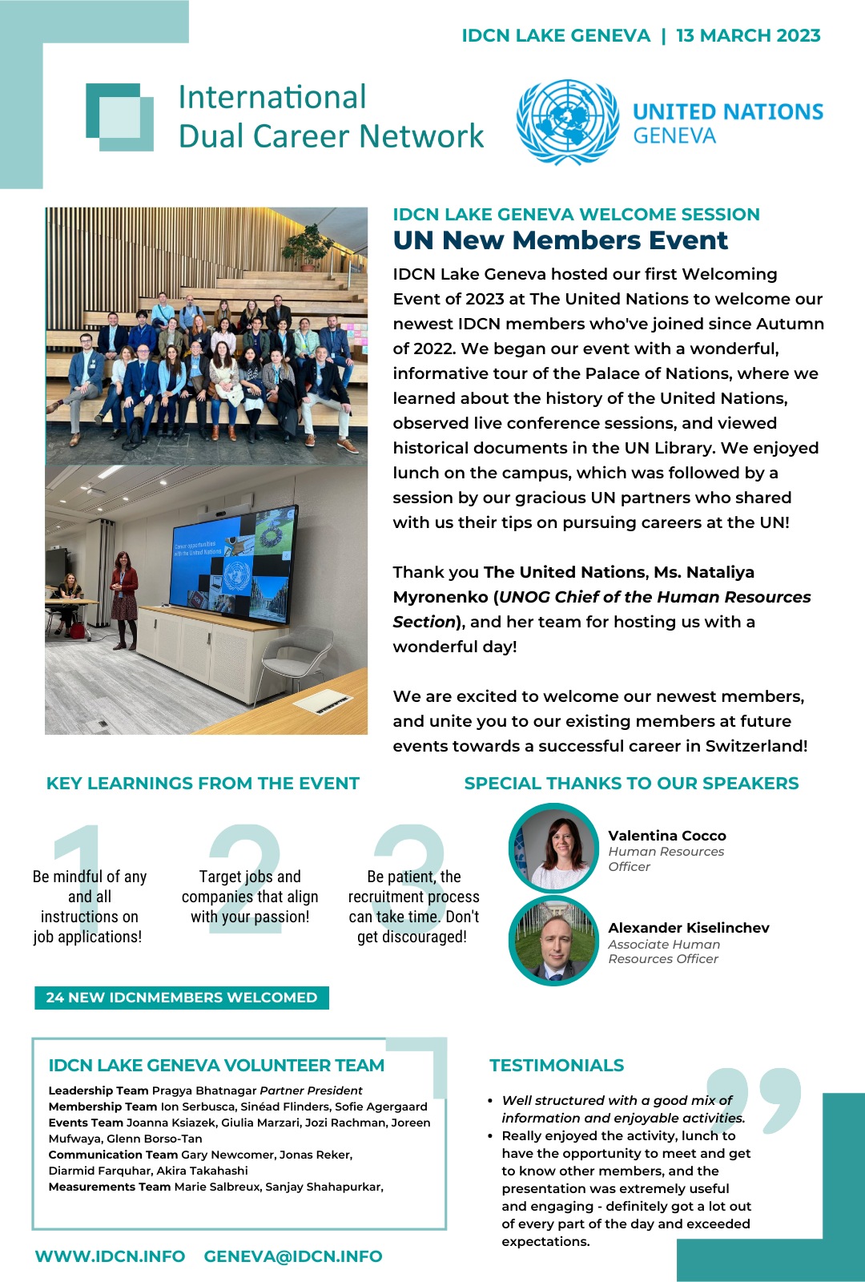
Newsletters, Posters, Success Stories
bi-annual report
success story
published newsletters
volunteer
profiles

Slide 10
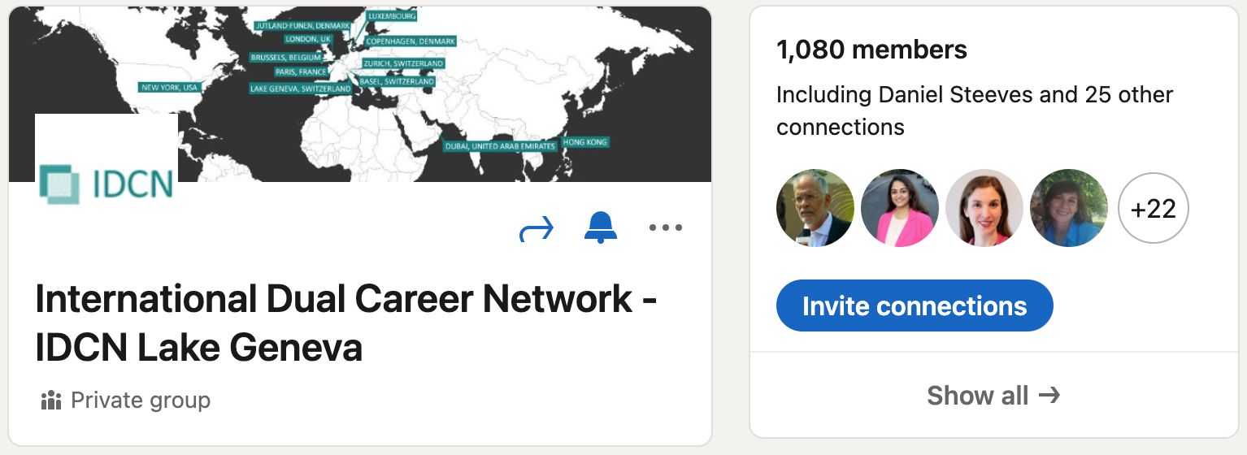



Impact on LinkedIn: Continued Growth
28
1080
7006
Posts
Members
Unique Views

Slide 11
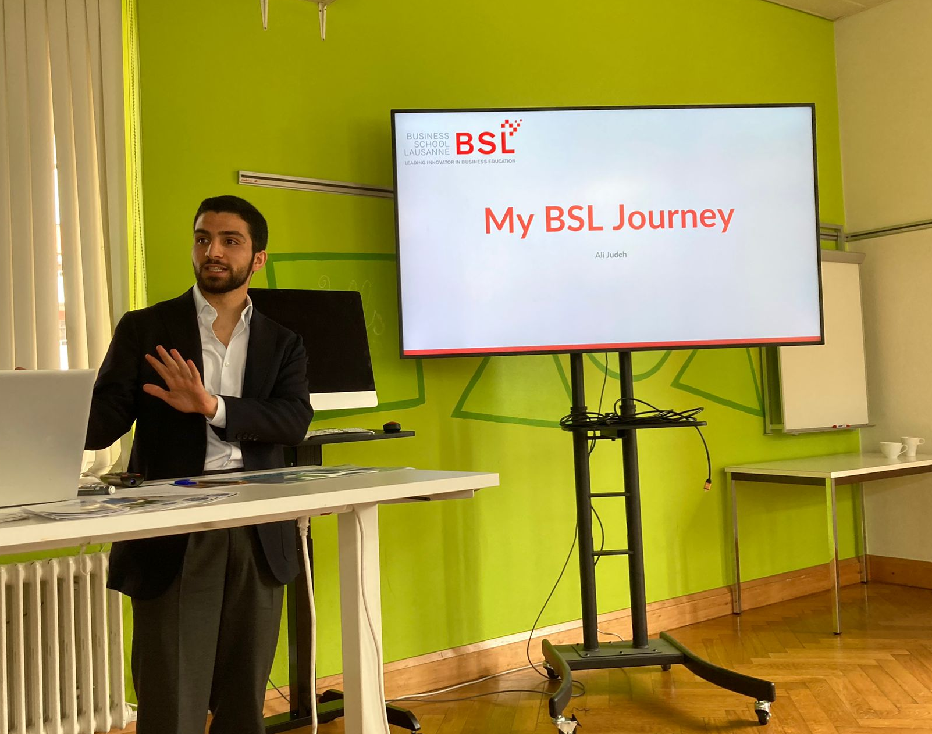
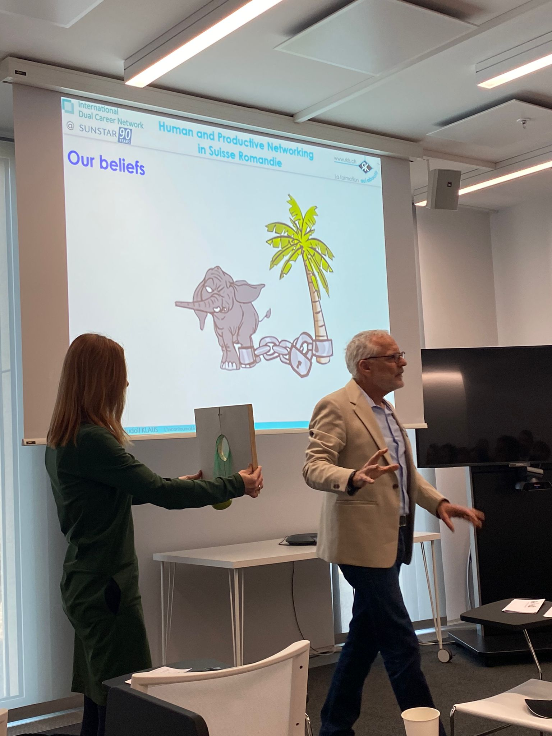
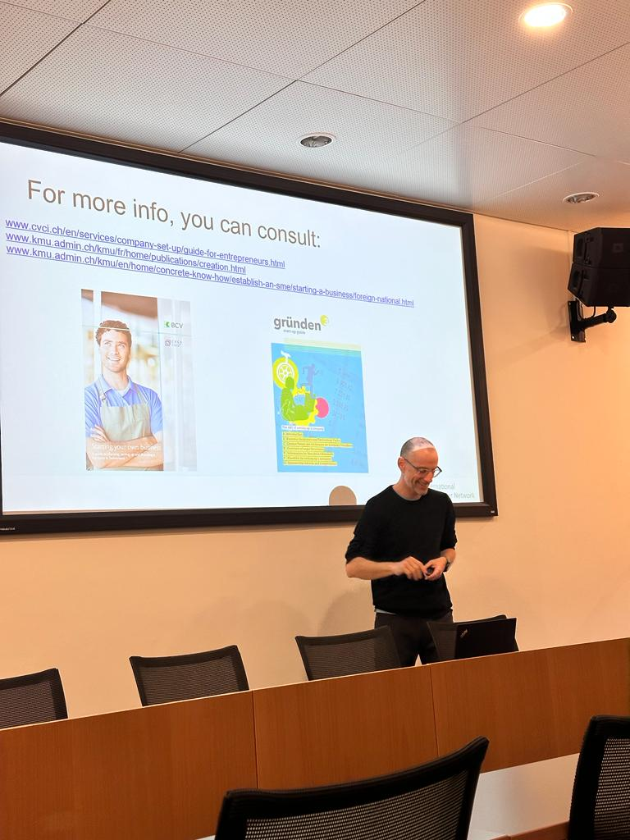
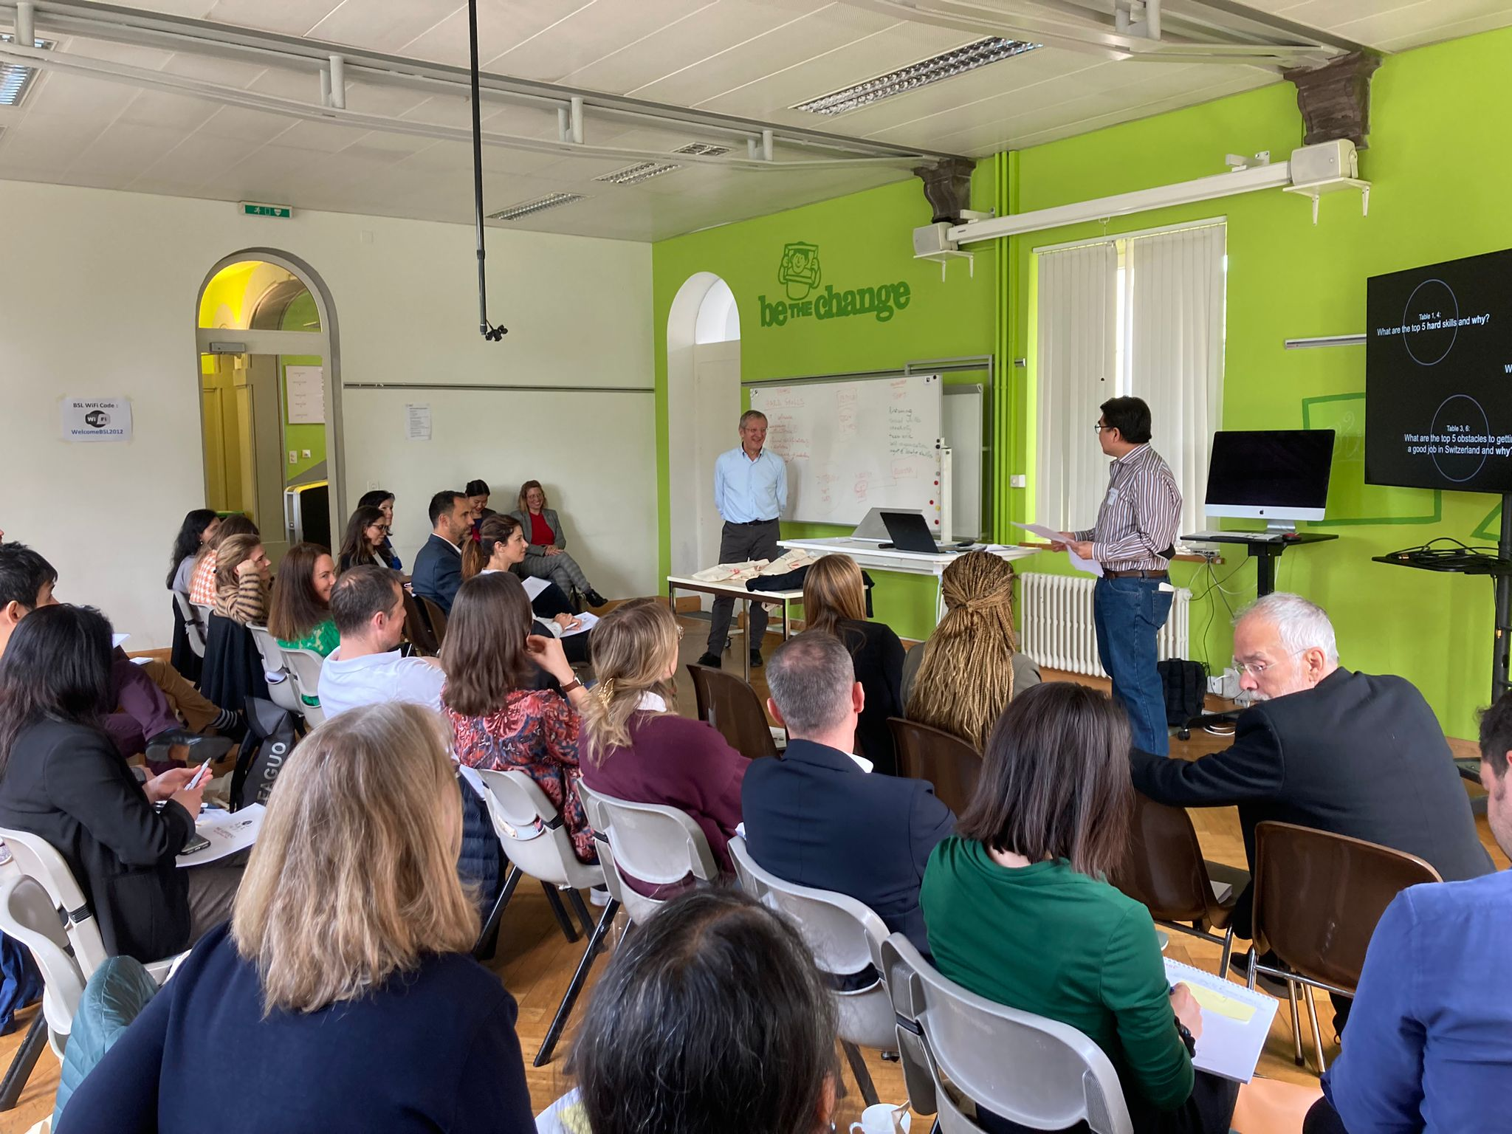
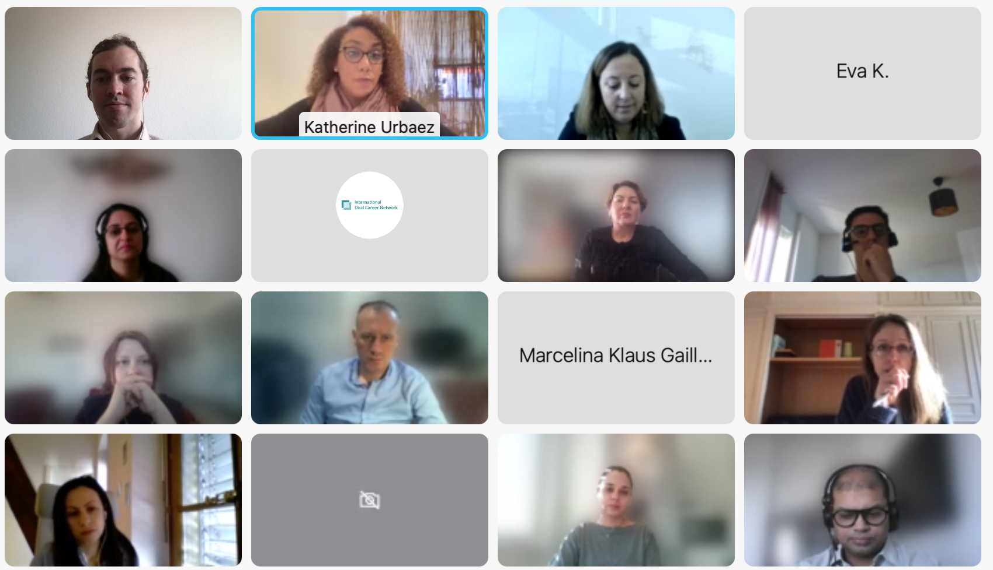
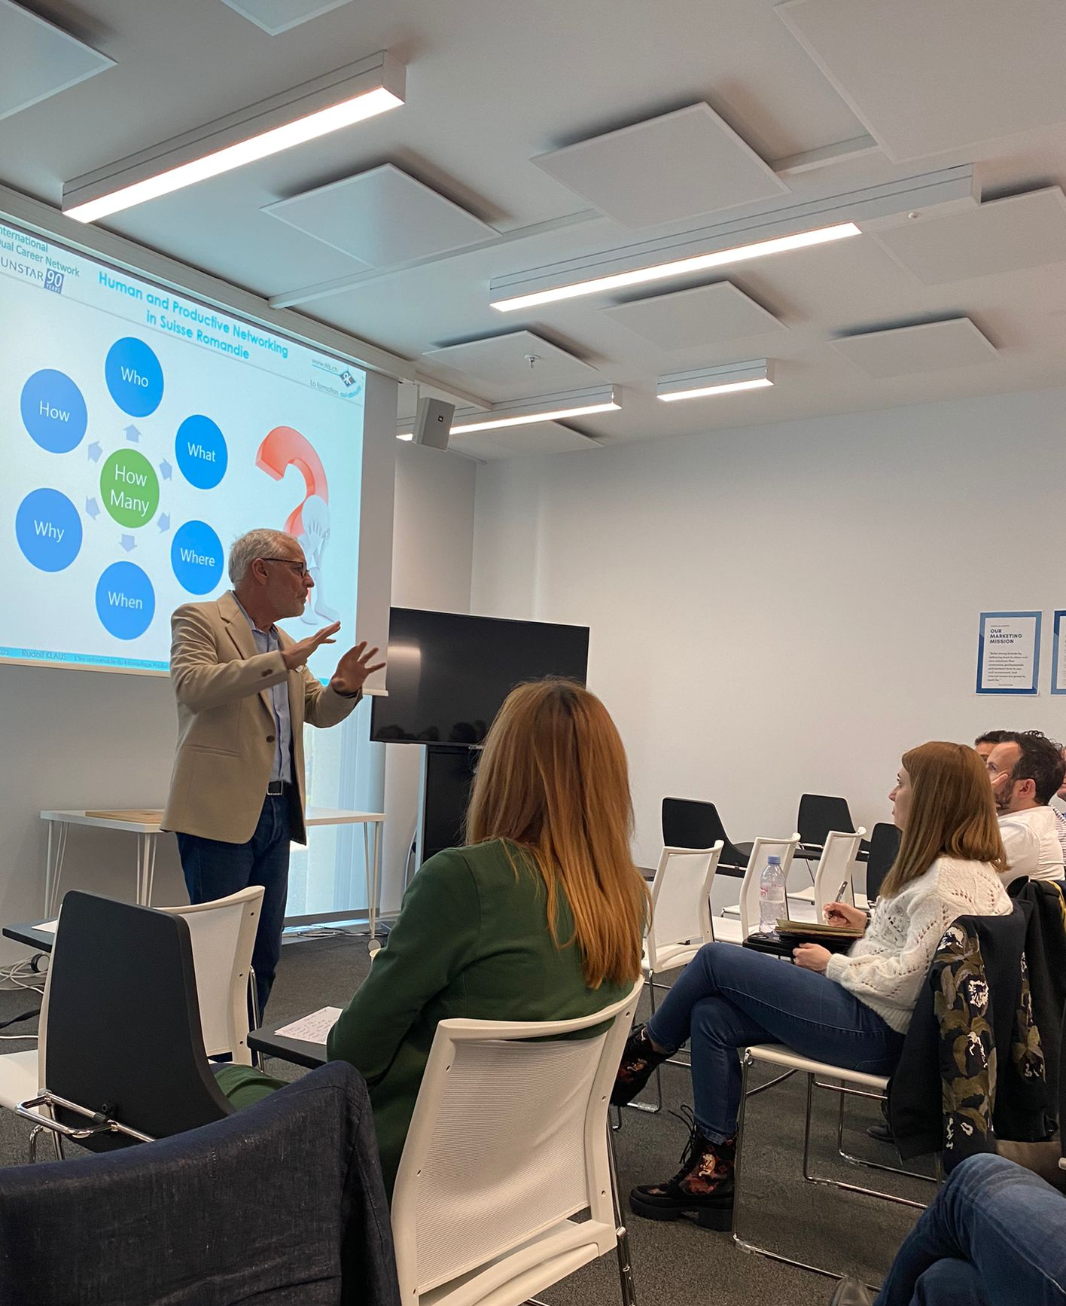
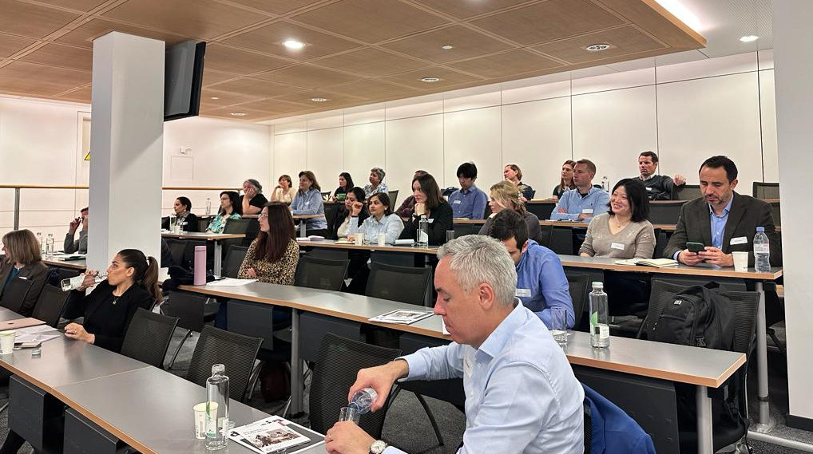
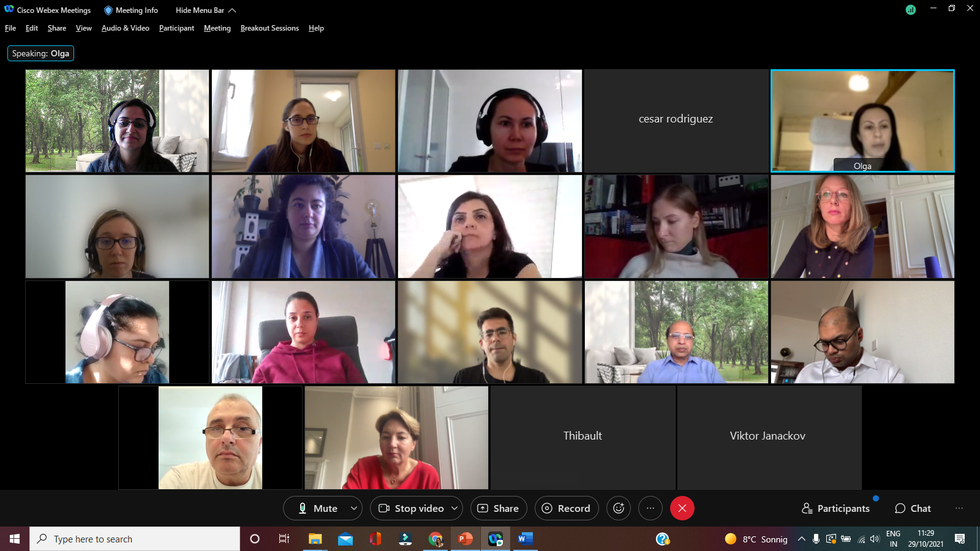
IDCN, Lake Geneva Activities H1 2023
External Events:
Face to Face and few virtual
    Corporate Events
    Career Mornings
    Global Webinars

Slide 12
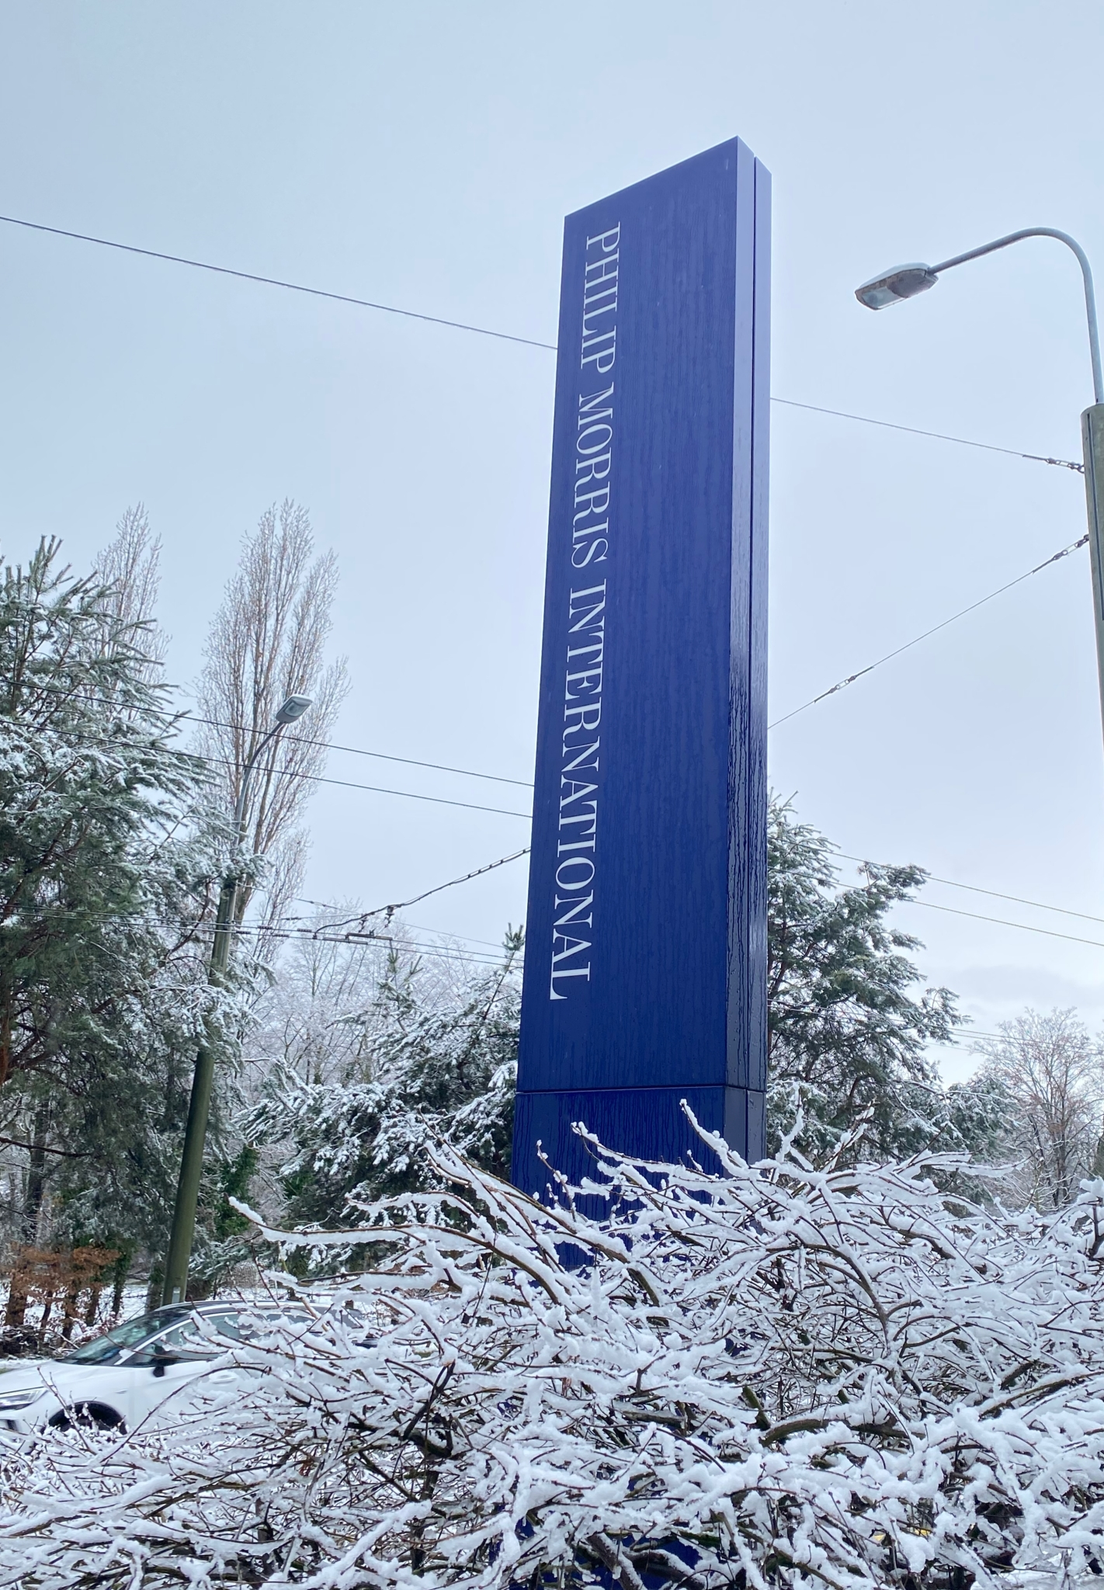
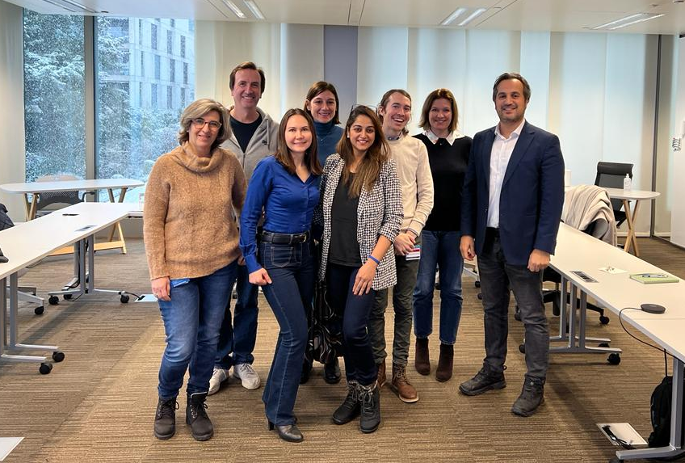

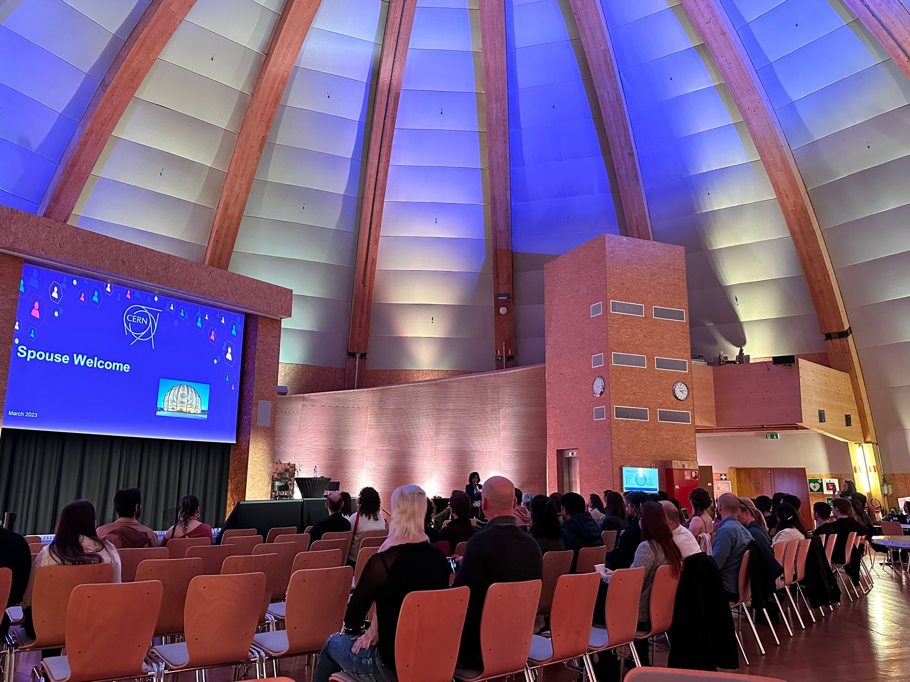
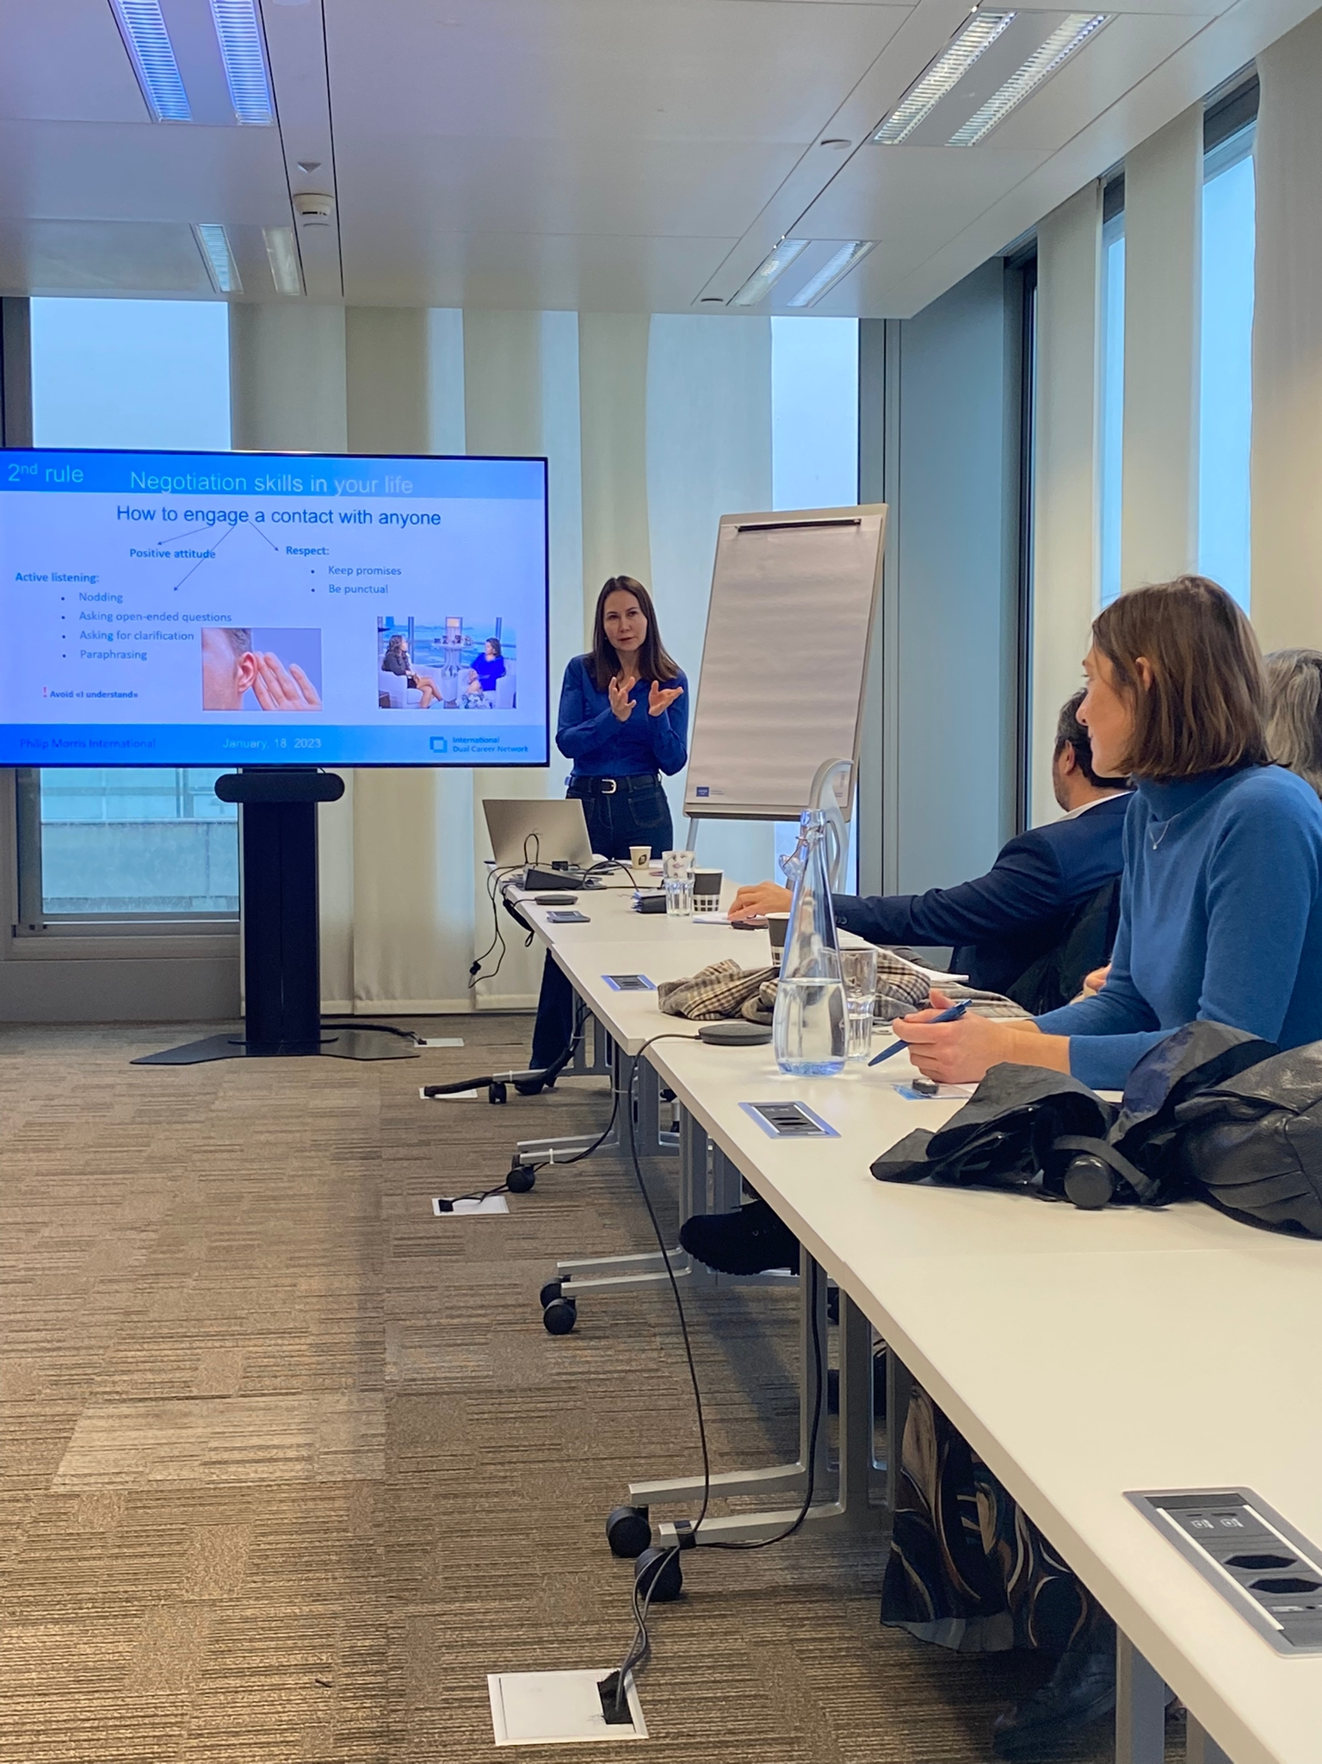
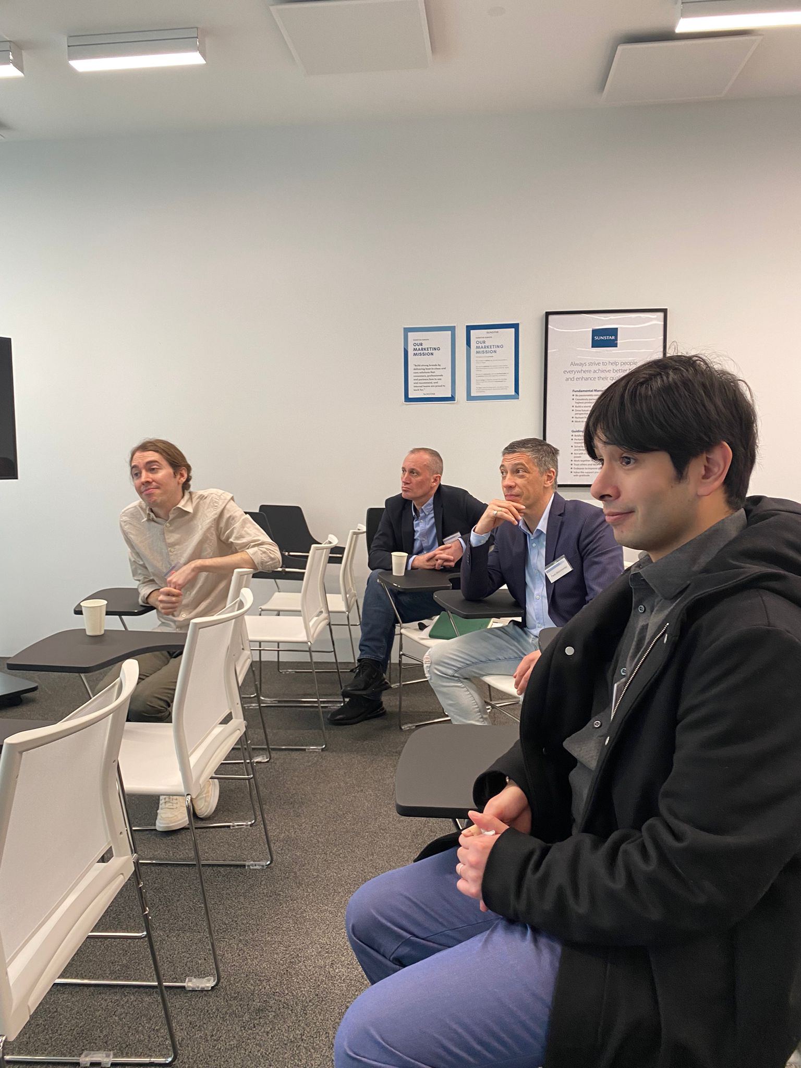
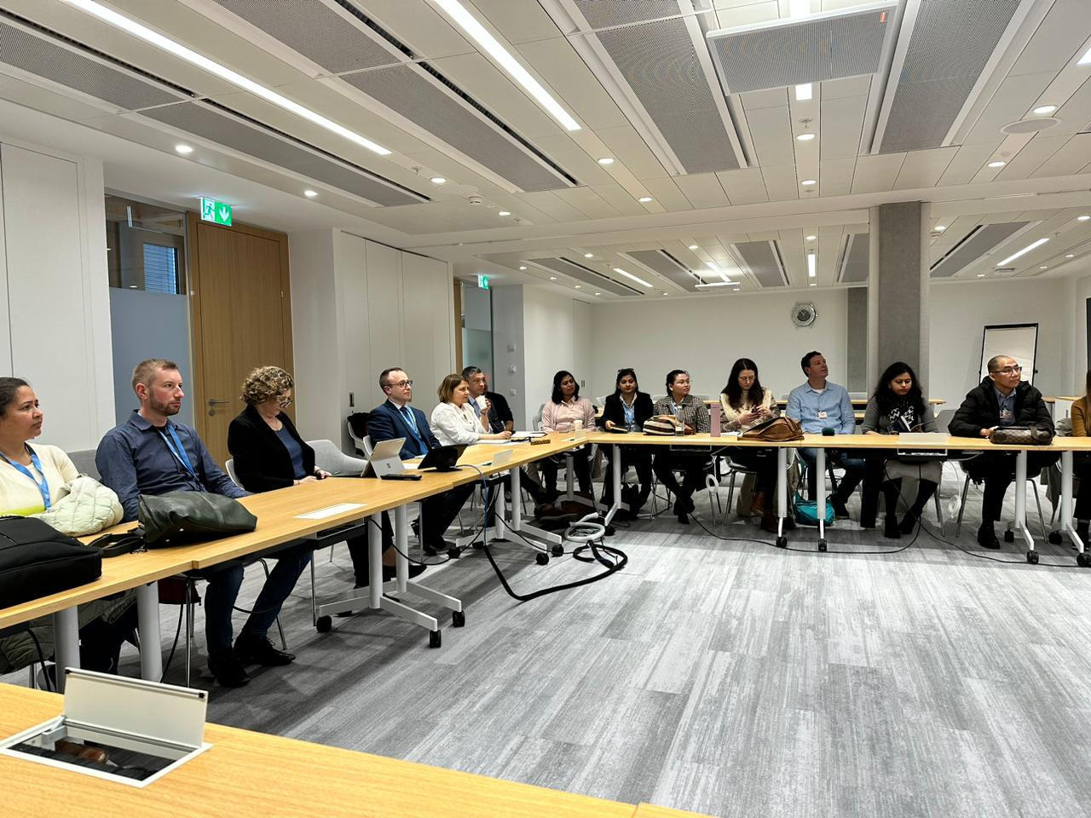
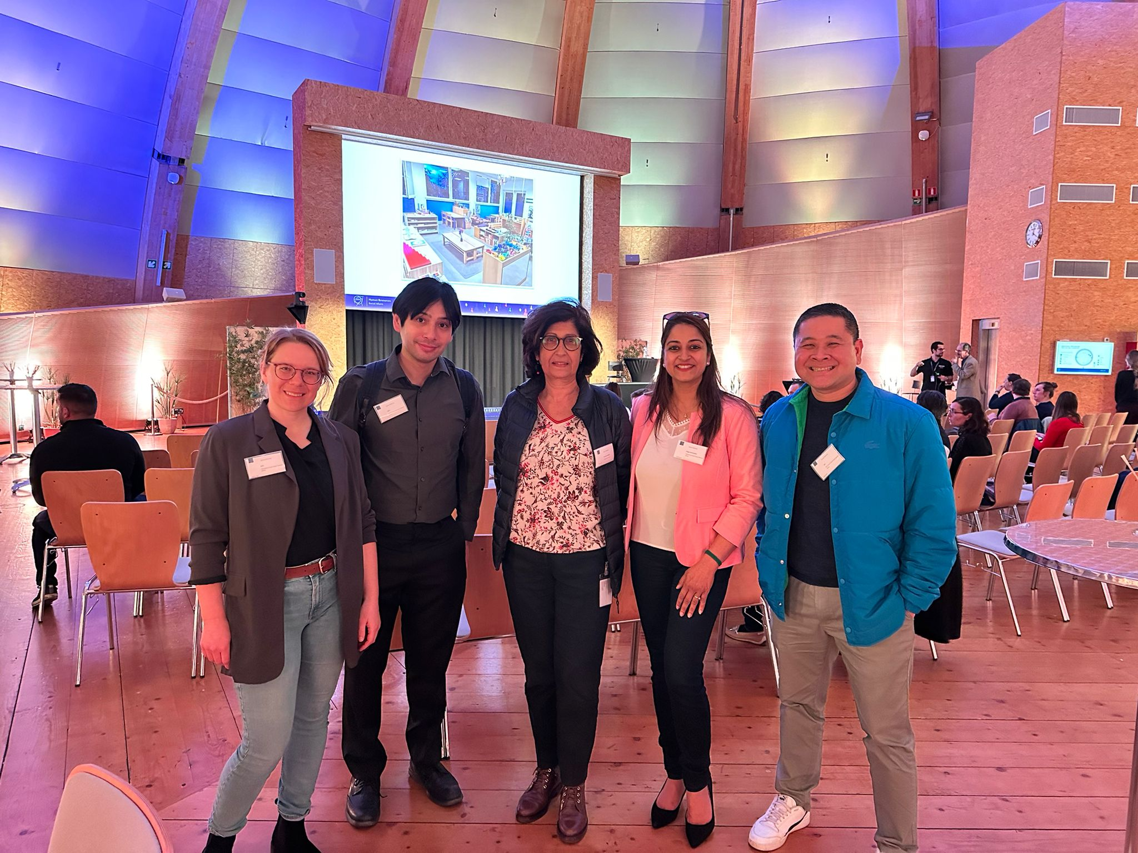
IDCN, Lake Geneva Activities H1 2023
Internal Events & Other Events:
                Welcome Events : New Members : United Nations
                Masterclass Initiative : Sunstar, PMI
                Spouse Welcome Program: CERN

Slide 13
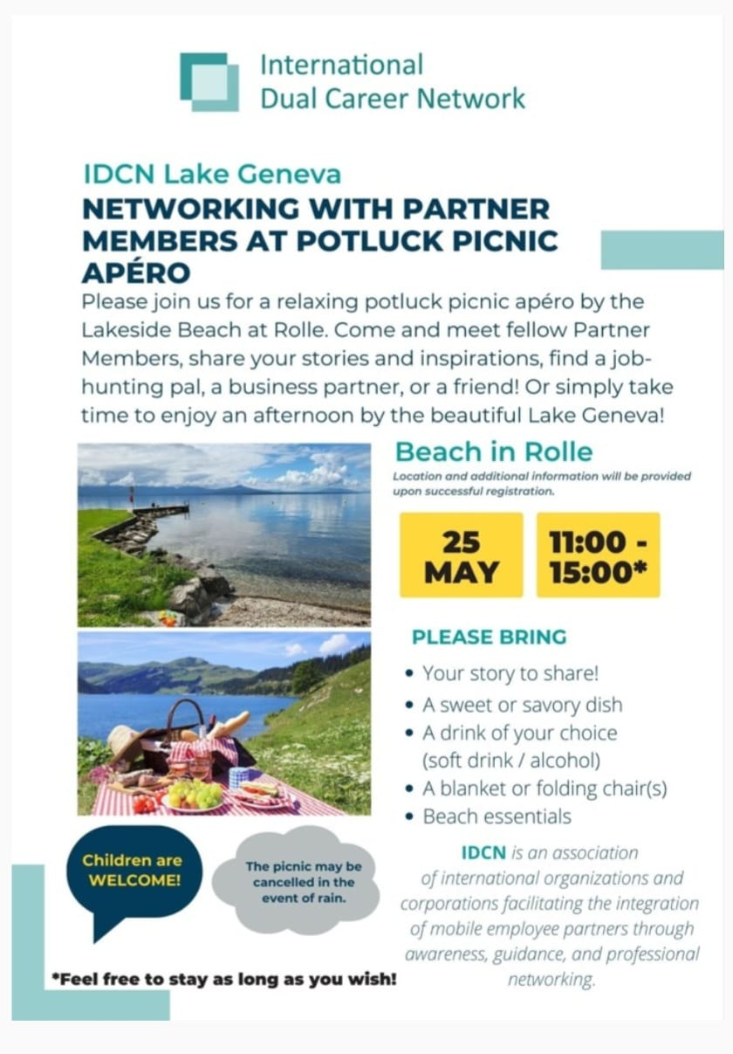
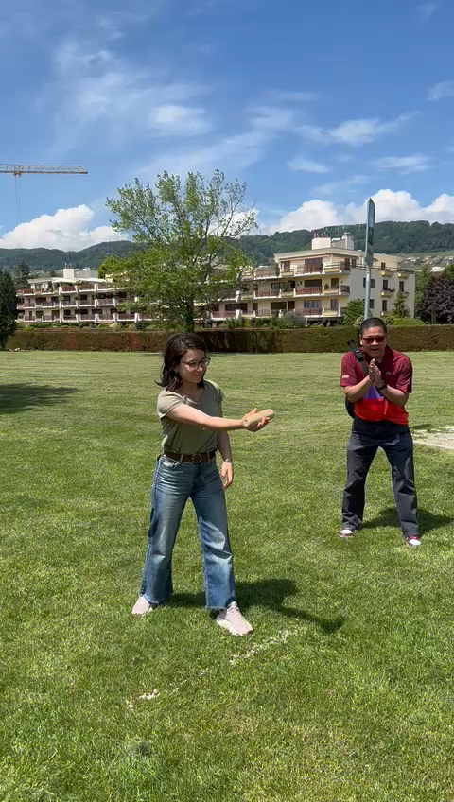
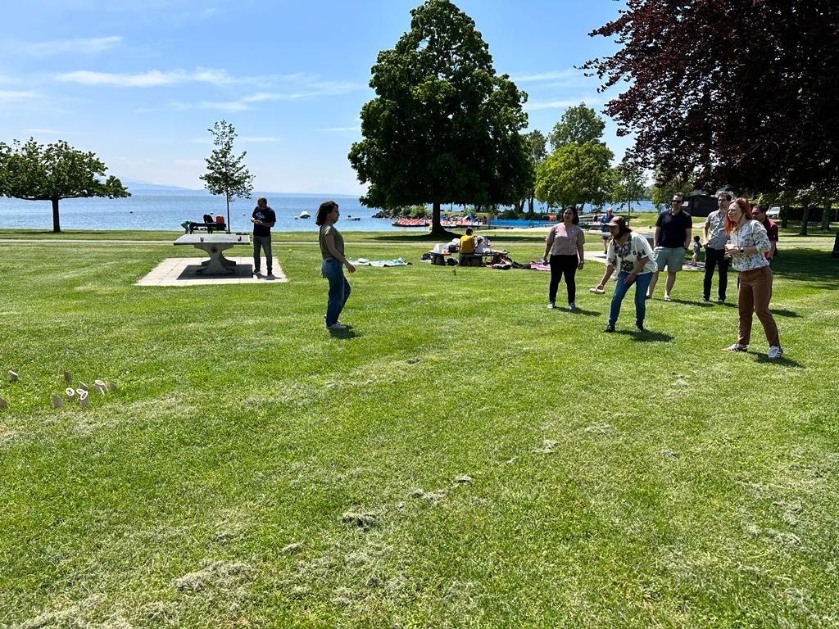
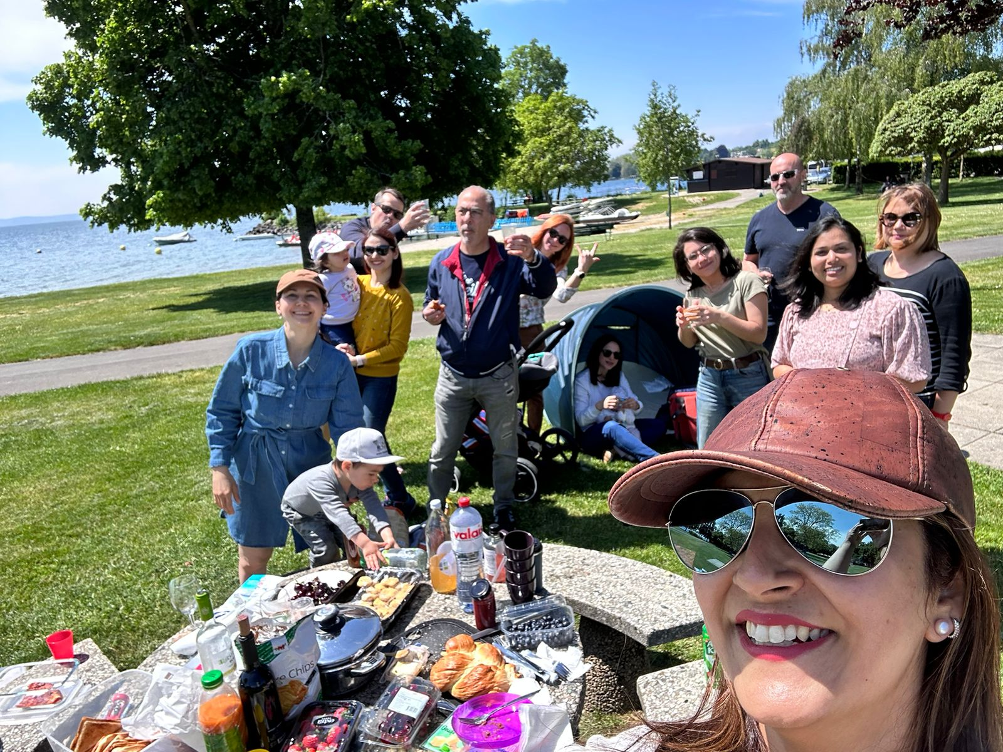
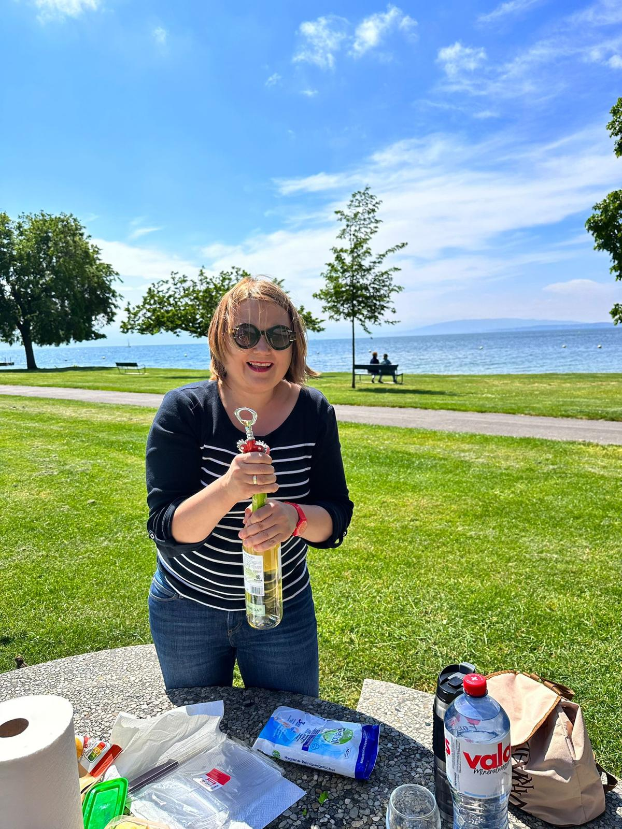
IDCN, Lake Geneva Activities H1 2023
IDCN Social Event: All Member Team Picnic:

Slide 14
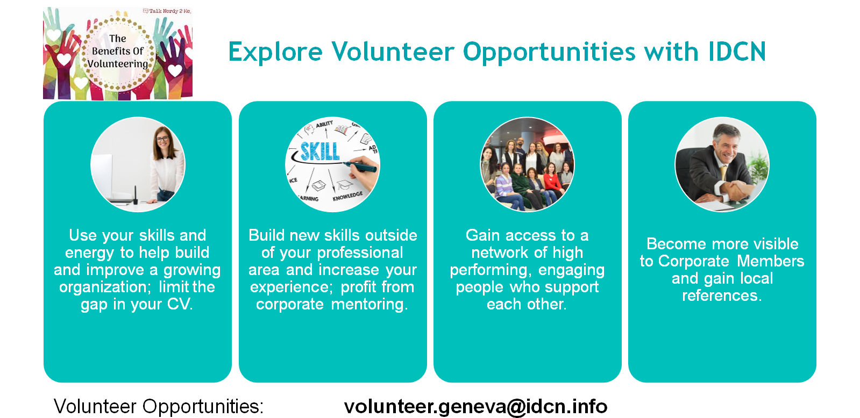

Slide 15
Thank you!

