Slide 1
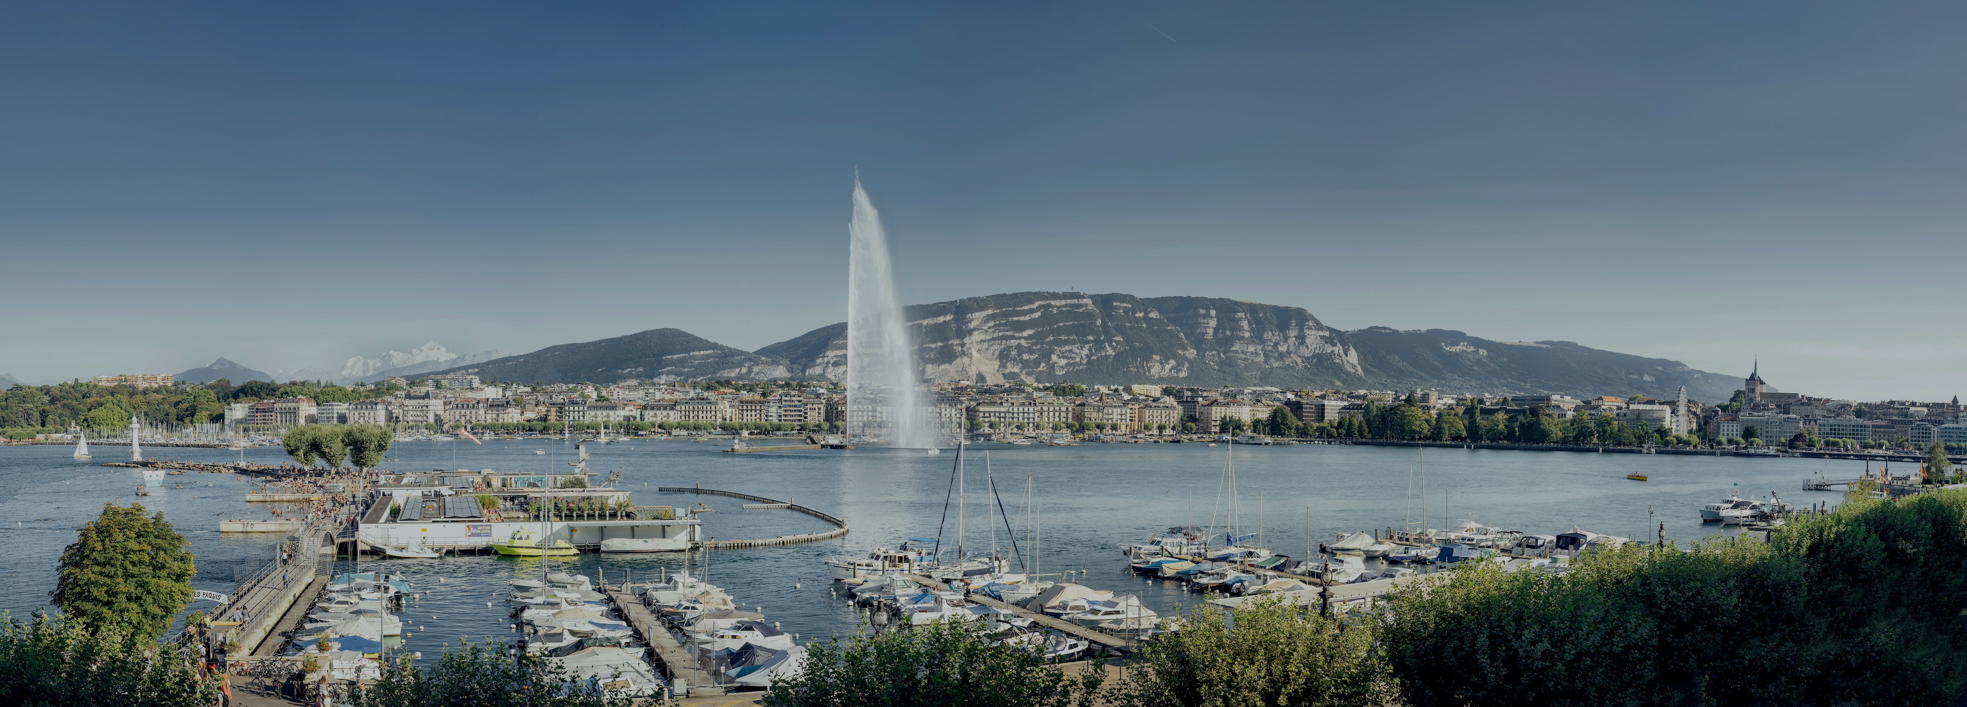

INTERNATIONAL GENEVA
WELCOME CENTRE

Slide 2
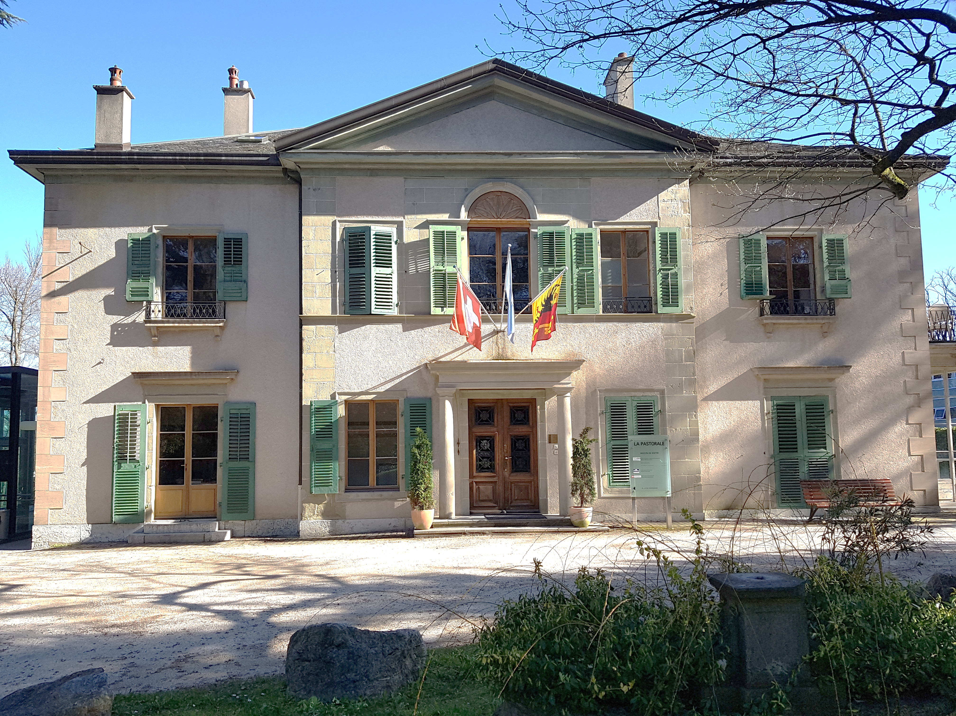
WHO ARE WE ?
A non-profit organisation, founded in 1996 by the Swiss Confederation and the Republic and canton of Geneva.
The 'one stop shop' facilitating the settlement and the integration of employees of International Geneva and their family members.
Assistance to NGOs and support to delegates attending conferences in Geneva.
Thanks to the support of public and private entities, CAGI’s services are free of charge.

Slide 3







































OUR MEMBERS
Founding members
Associate members
Supporting members

Slide 4
CAGI'S SUPPORT AND SERVICES
WELCOME SERVICE
            - Housing & Information
                - Welcome Programme
- Practical Geneva
EMPLOYMENT FOR INTERNATIONALS
- CAGI Recruitment Platform
- Private Household Employees platform
- How to assist spouses/partners
CULTURAL KIOSK AT UN GENEVA AND CERN
- Ticket sales, special offers/recommendations
CIVIL SOCIETY SERVICE
- Services for NGOs
                - Accommodation for Visiting Delegates
                - Delegates Information Desk
                SPACES FOR RENT
                - CAGI's meeting spaces
                - FIPOI Auditorium & other spaces

Slide 5
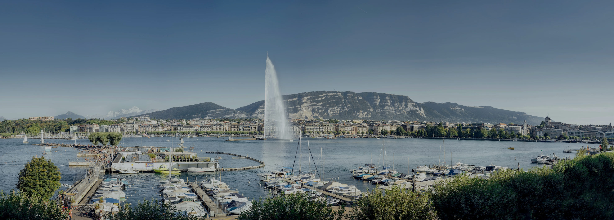
WELCOME SERVICE

Slide 6

HOUSING & INFORMATION
Support finding accommodation through an online housing platform
Housing offer primarily for internationals
VIP Service for Permanent Representatives, Heads of IOs and their Deputies
Settling-in & departure support
Proofreading of rental contracts and tenancy law advice
Support Permanent Missions and NGOs in their search for office space
Contact
 +41 22 546 14 17
welcome.cagi@etat.ge.ch

Slide 7


WELCOME PROGRAMME
If you have been in Geneva for less than a year and are eligible, sign up for the Programme and stay informed of the next event!
Download the Programme's brochure

Slide 8
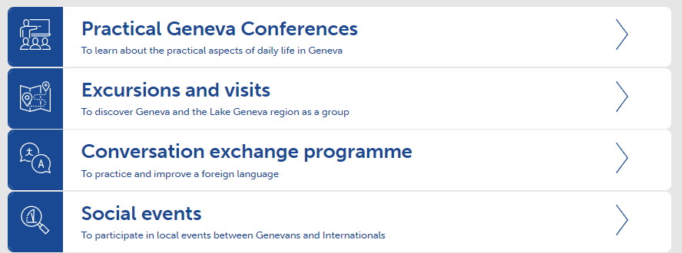
WELCOME PROGRAMME
If you have been in Geneva for less than a year and are eligible, sign up for the Programme and stay informed of the next event!
1
2
3
4
Download the Programme's brochure

Slide 9
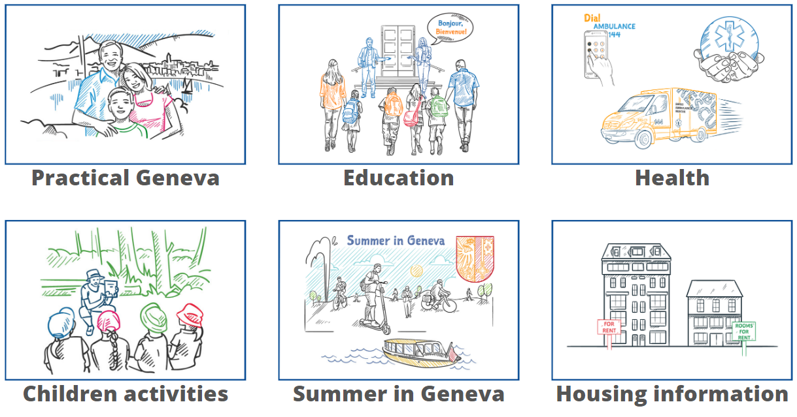
1. CONFERENCES
Information sessions on various thematic to facilitate your stay in Geneva

Slide 10
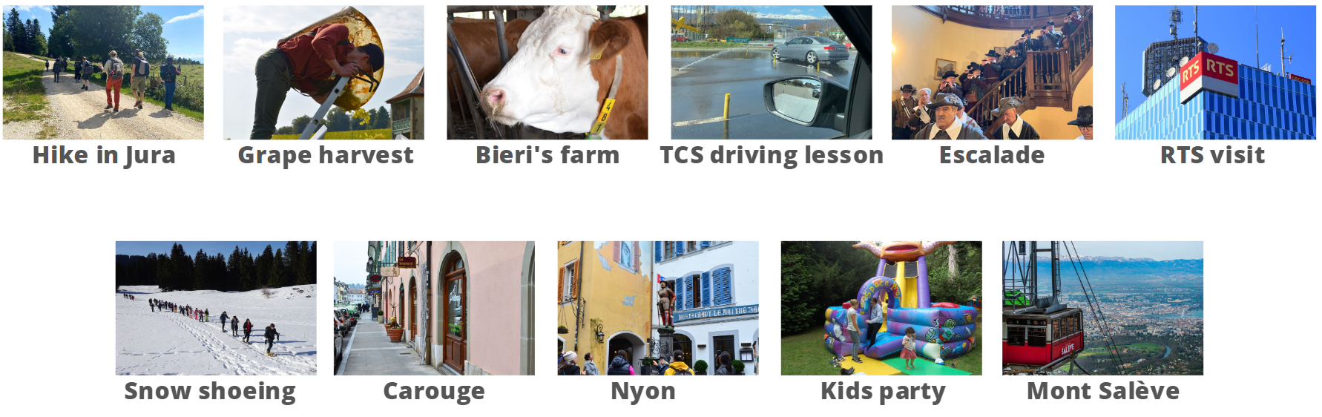
2. EXCURSIONS
A programme of excursions and visits for international newcomers (valid one year)

Slide 11

3. SOCIAL EVENTS
Discover local events happening in Geneva

Slide 12

4. "BEL"
BEL : Bourse d'Echanges Linguistiques or Conversation Exchange Programme

Slide 13
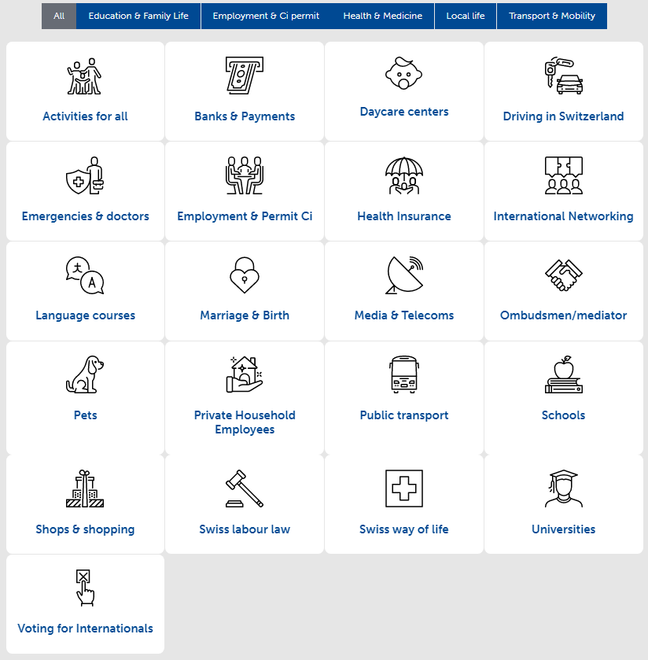

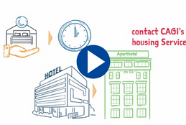
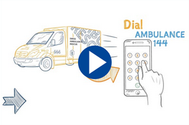


PRACTICAL GENEVA
Informing employees and their family members before their arrival
How to reach incoming employees of International Geneva?
Housing & Insurances
Health & Medical
Education & Family life
Transport & Mobility
Booklet
Videos
Web Information

Slide 14
EMPLOYMENT FOR INTERNATIONALS

Slide 15

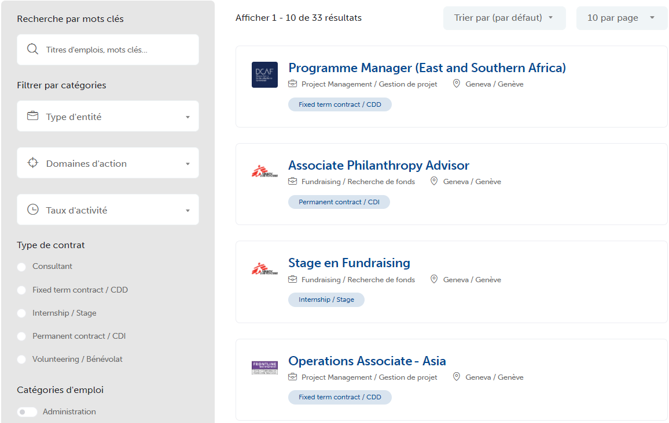
CAGI RECRUITMENT PLATFORM
➲ Access the platform

Slide 16
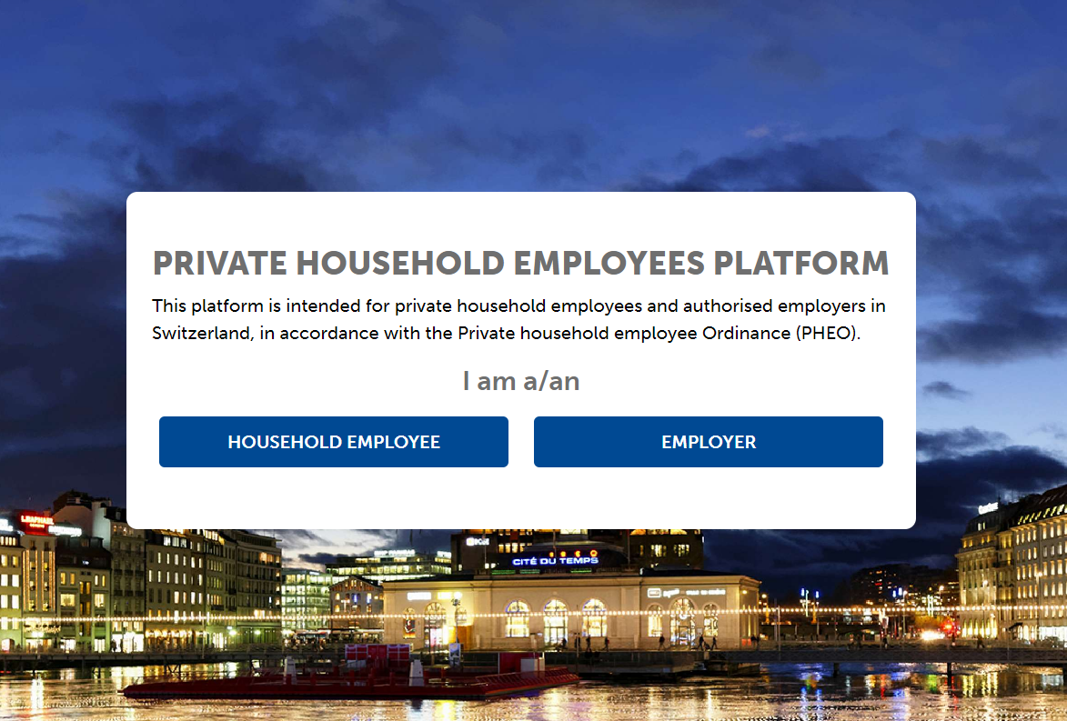
PRIVATE HOUSEHOLD EMPLOYEES PLATFORM
A platform dedicated to members of the staff of:
diplomatic missions
permanent missions
consulates
international organizations
People looking for a job and those looking for a domestic employee must register online by creating a profile on the platform

Slide 17

SPOUSES / PARTNERS
Event/conference - Twice a year in collaboration with the Swiss Permanent Mission, UN Geneva and Michael Page:
"Spouses/partners of employees of International Geneva – How to succeed with your job search"
CAGI's Recruitment Platform
International Dual Career Network: IDCN
Association découvrir – assists qualified migrant women
UNIGE: Horizon académique - Integration in Higher education institutions

Slide 18
CULTURAL KIOSK
AT UN GENEVA & CERN

Slide 19
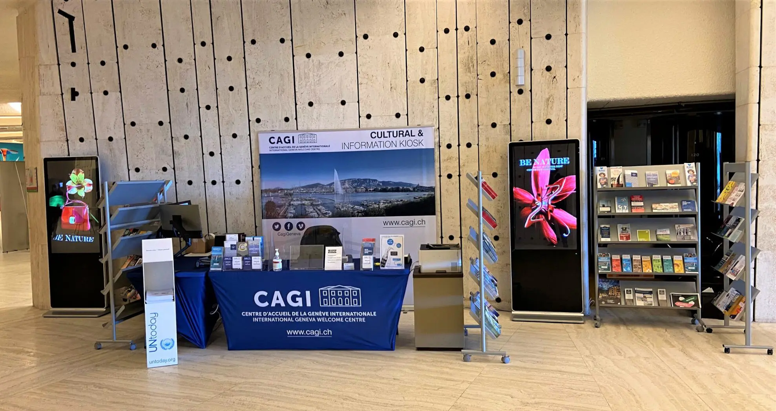
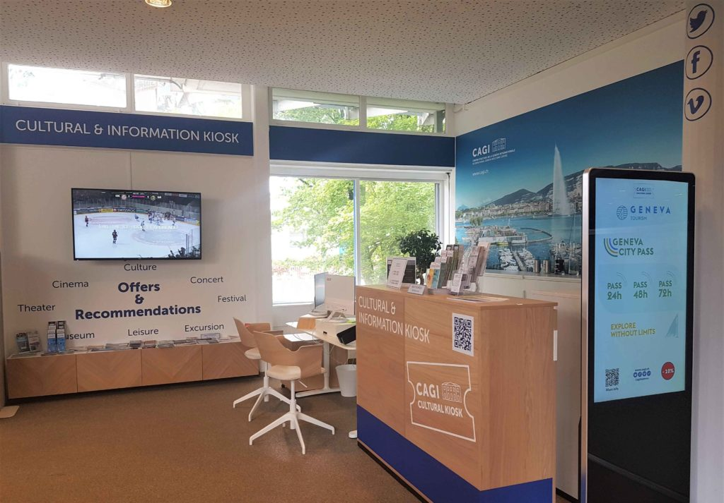

CULTURAL KIOSK : UN Geneva / CERN
One-stop-shop point of information and ticketing for entertainment, shows and cultural activities
Preferential rates on a variety of tickets
Recommendation of tourist and leisure activities in Geneva and Switzerland
Kiosque Culturel ONU Genève
 +41 22 917 11 11
info@kiosqueonu.ch
Kiosque Culturel CERN
 +41 22 766 94 76
info@kiosquecern.ch

Slide 20

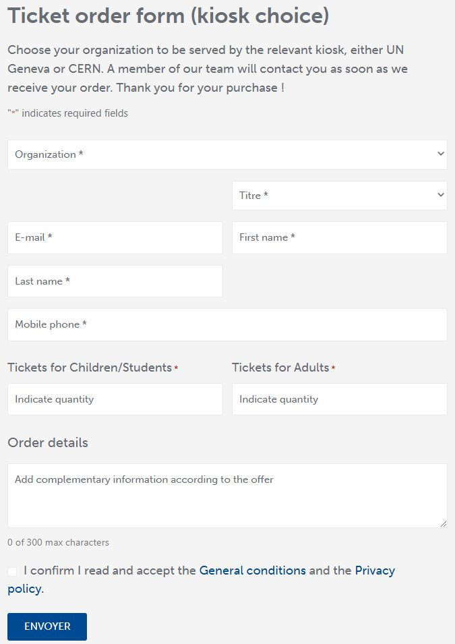



HOW TO PURCHASE TICKETS
DIRECTLY
UN or CERN badge or pass required
Payment by card only
REMOTELY
Online ticket order form
Payment link by email, sms

Slide 21





























































CULTURAL KIOSK PARTNERS

Slide 22

INFORMATION FROM CULTURAL KIOSK
HOW TO STAY INFORMED ?
on current offers
on cultural recommendations
on information about Geneva

Slide 23

AGENDA
https://www.cagi.ch/en/cultural-kiosk-agenda/

Slide 24

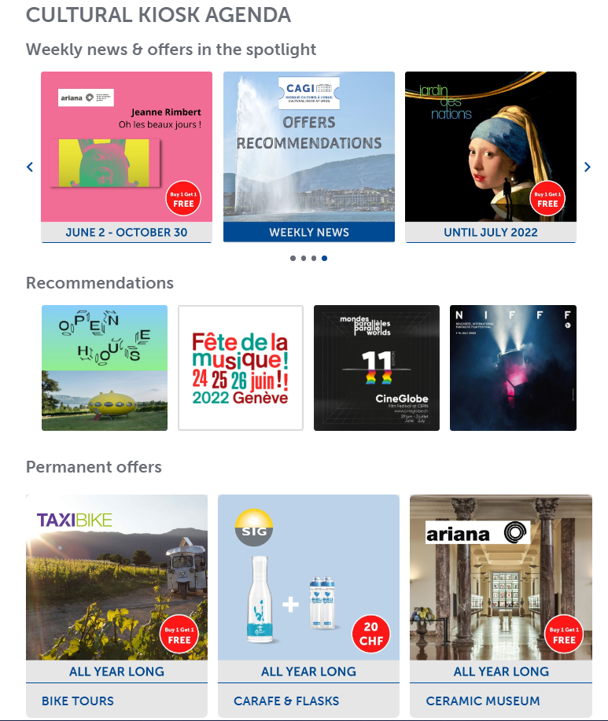

OFFERS & RECOMMENDATIONS

Slide 25



WEEKLY NEWSLETTER
IO, PM, NGOs, multinationals, HUG/UNIGE and international employees (on demand)
+ Broadcast UN Geneva "What's New" + "Le bulletin"
Notes:
+ Broadcast UN Geneva "What's New" & CERN Bulletin

Slide 26
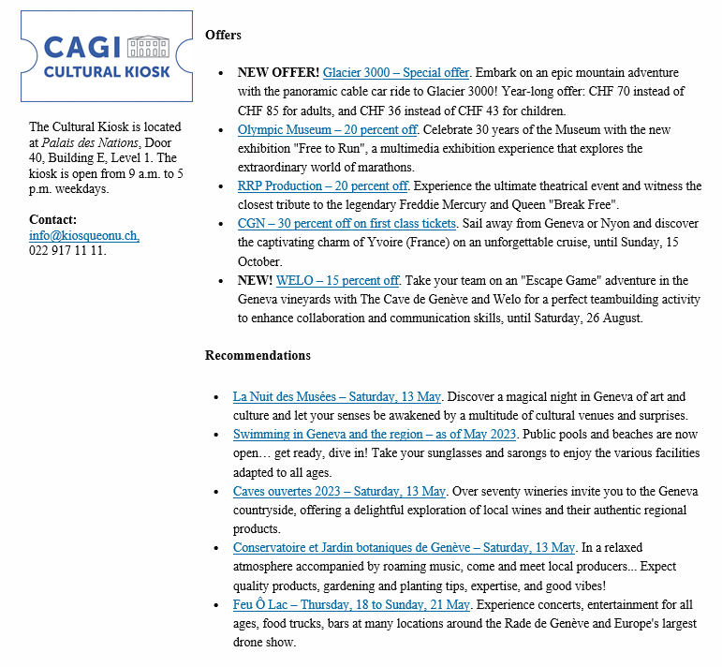

BROADCAST UN Geneva "What's new"

Slide 27

UN TODAY
untoday.org

Slide 28


SOCIALS
Special
offers
@cagi.geneva
Weekend
ideas &
inspiration
Cultural
recommendations
Practical
Geneva
Information
@CagiGeneva

Slide 29
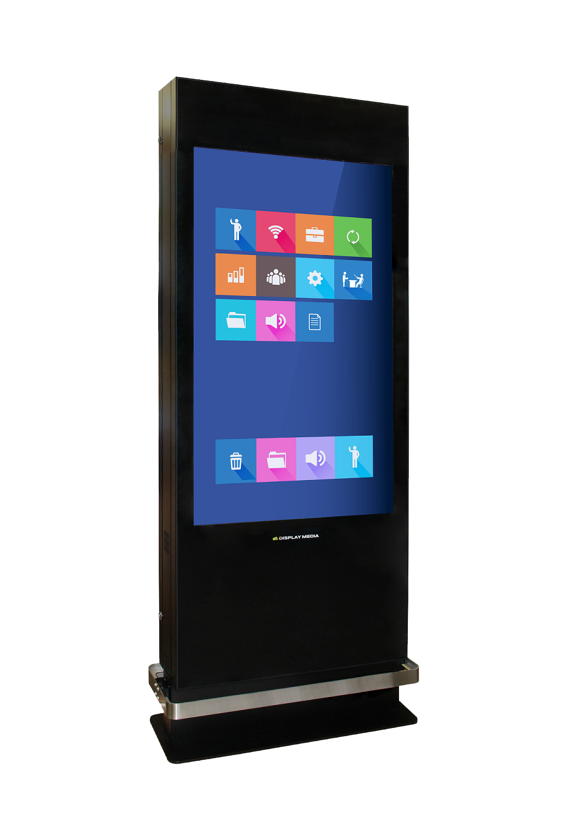
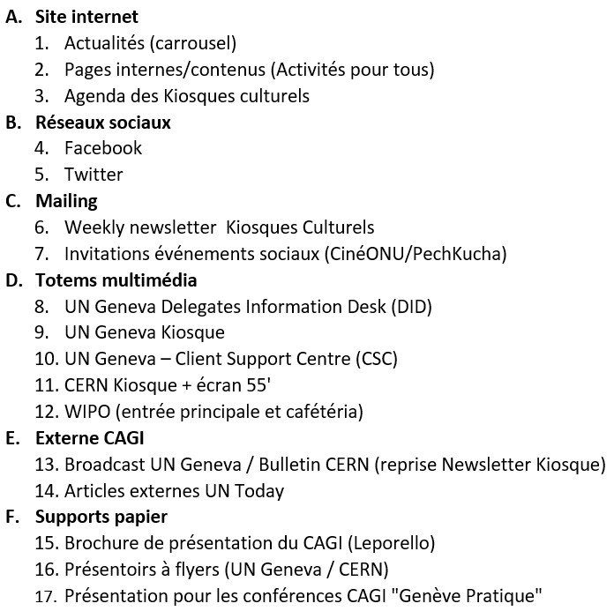






MARKETING & COMMUNICATIONS PACKAGE
NEWSLETTER
@
@
TOTEMS MULTIMEDIA: CERN KIOSK,
UN GENEVA - DID, KIOSK, CSC
WIPO 2x
TV SCREEN: CERN KIOSK

Slide 30
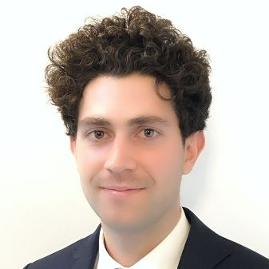
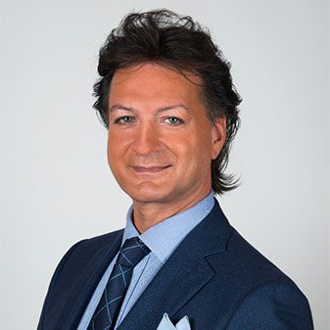
CONTACTS
Michael COCHET
Head of Communications
Cultural Kiosks at UN Geneva & CERN
Delegates Information Desk
022 546 14 07
André SALEM
Coordinator
Cultural Kiosks at UN Geneva & CERN
Delegates Information Desk
022 546 23 06
michael.cochet@etat.ge.ch
andre.salem@etat.ge.ch
communication.cagi@etat.ge.ch

Slide 31
CIVIL SOCIETY SERVICE

Slide 32

SERVICES FOR NGOs
Assistance and support to non governmental organisations (NGO), whether already based in, or interested in establishing an office in Geneva :
Information on the local conditions for NGO activities
Interface between NGO and public authorities
Practical services at facilating day-to-day operations
Contact
 +41 22 546 14 00
welcome.cagi@etat.ge.ch

Slide 33

VISITING DELEGATES
A support to delegates attending conferences within the framework of International Geneva :
Pratical and personalised information
Potential subsidy for accommodation (delegates of states and NGOs from developping countries)
Contribution to the development of synergies between delegates and local actors
Contact
 +41 22 546 23 00
delegates.cagi@etat.ge.ch

Slide 34
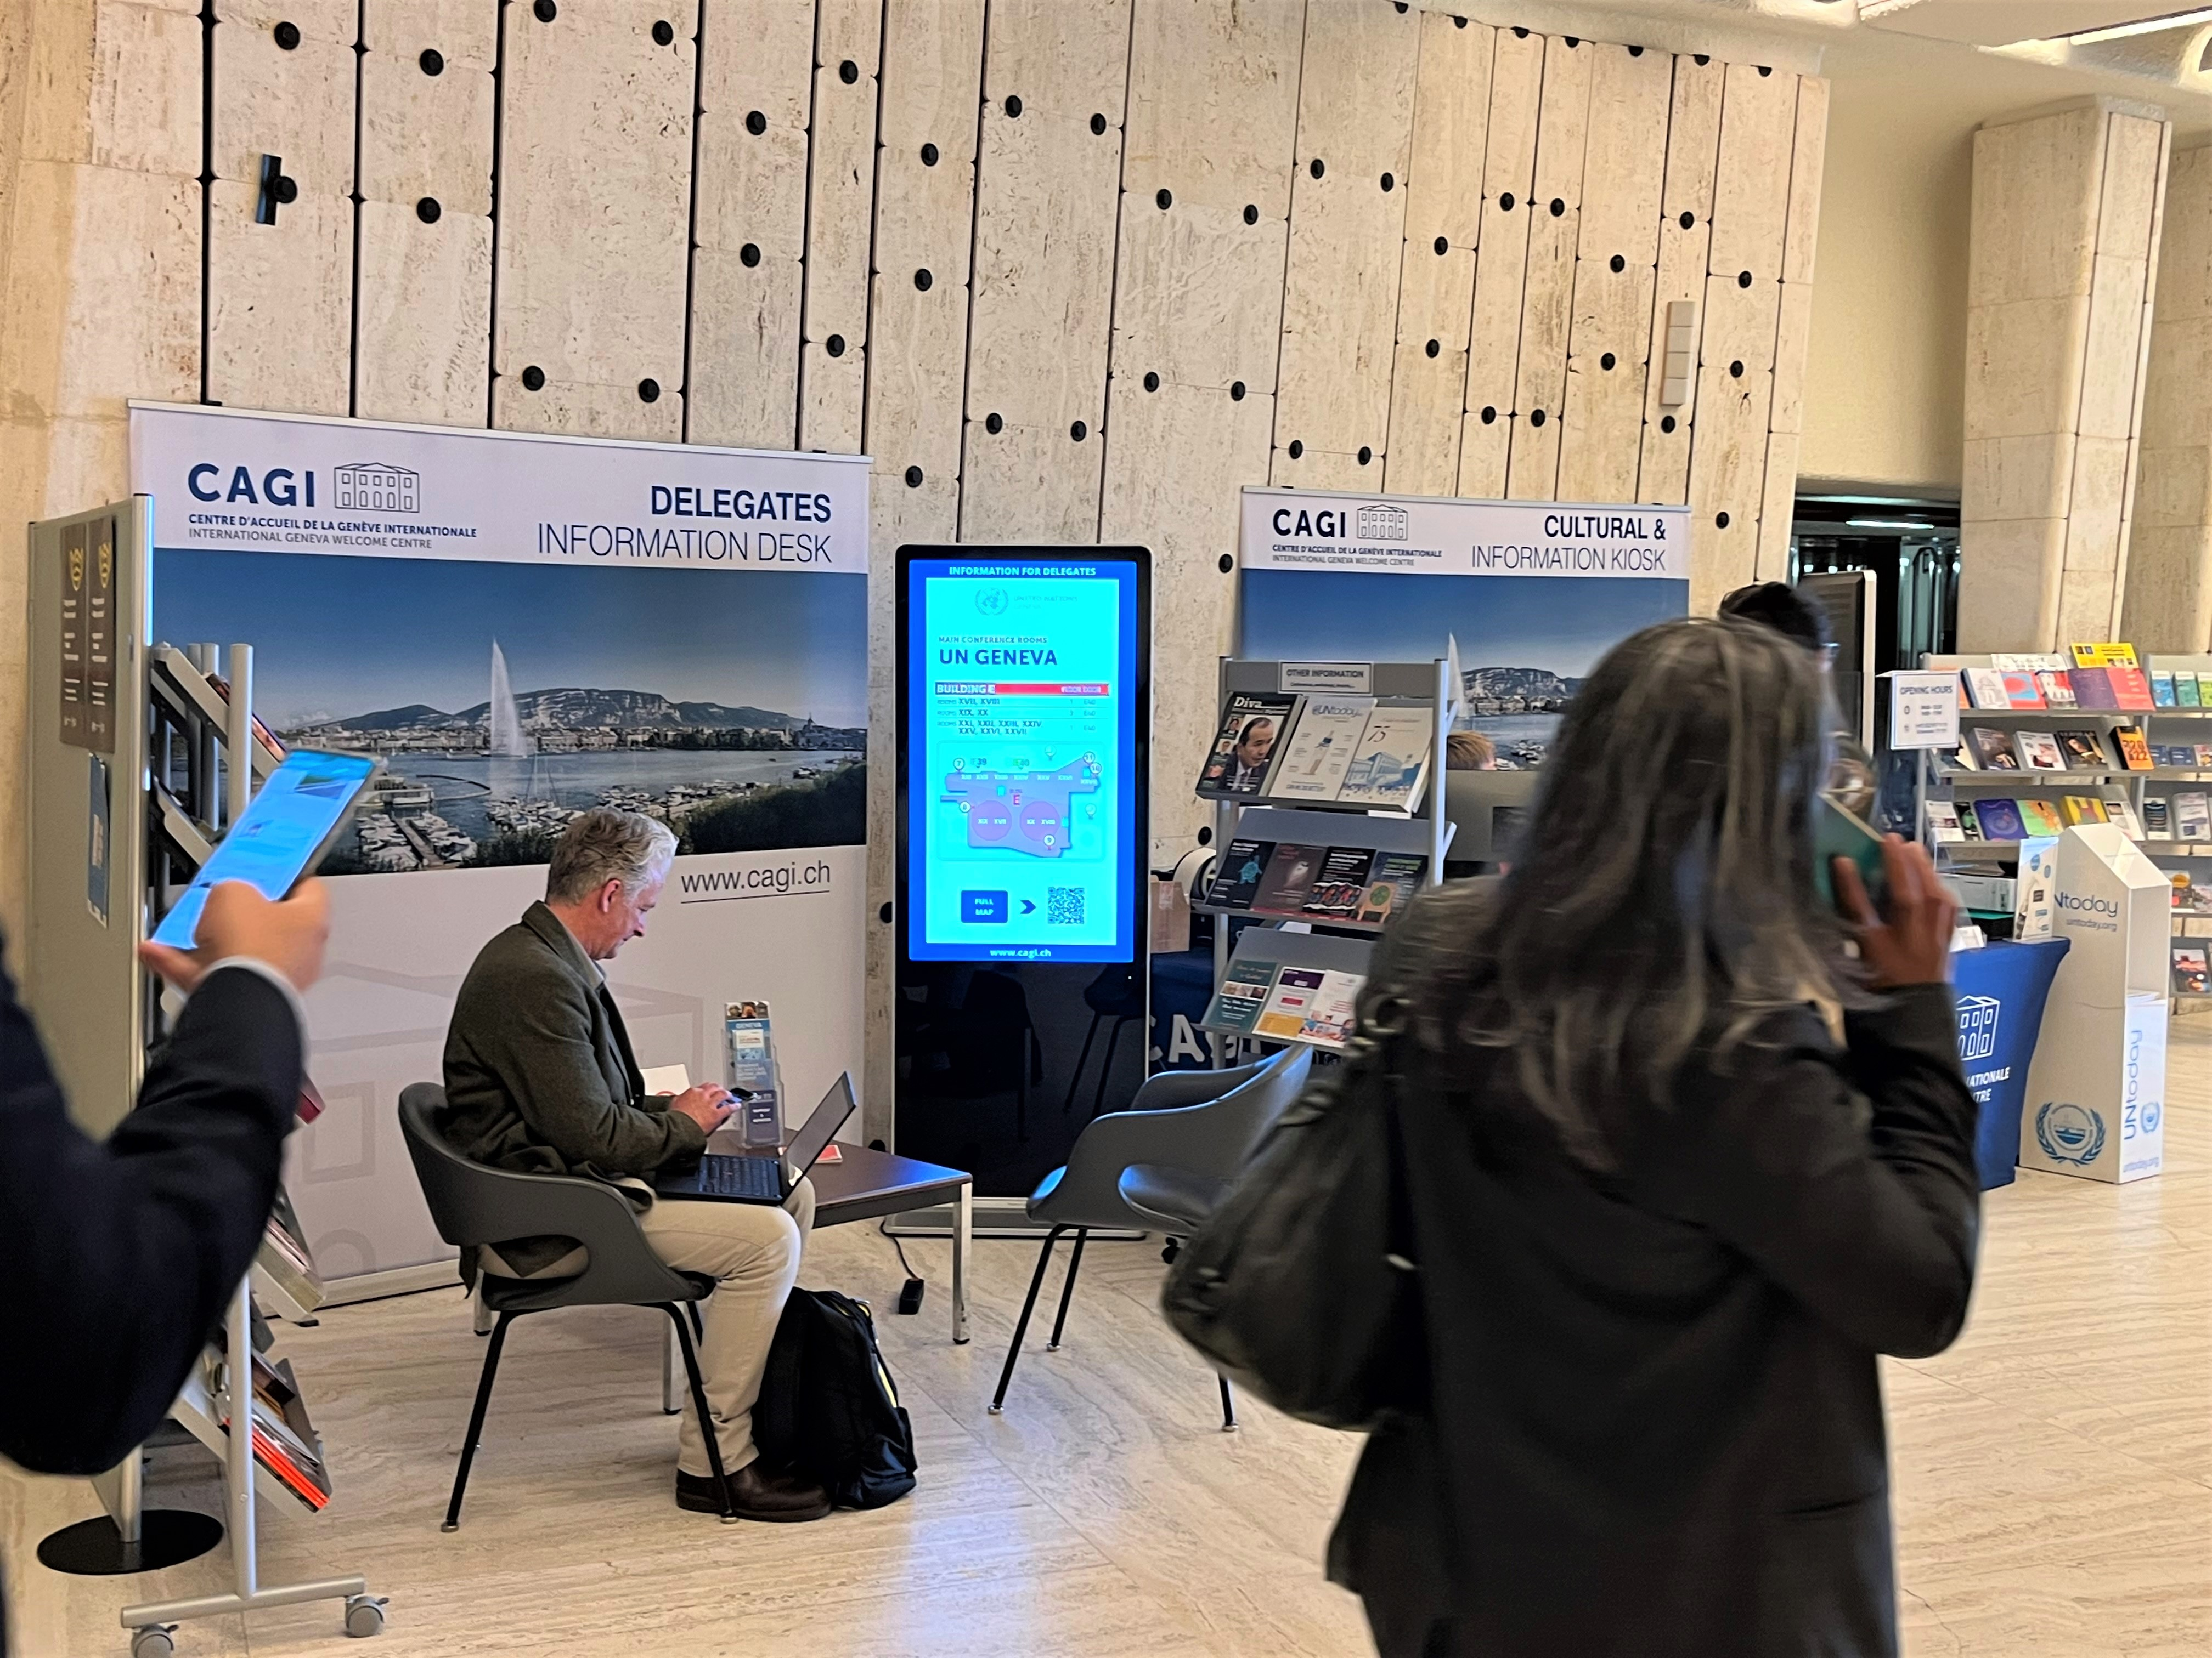
DELEGATES INFORMATION DESK
Welcome desk offering information and support to delegates at the venue of international conferences and meetings (upon request) :
An easy-to-install desk within the international organizations
Information on various services and support on site
Practical information about Geneva
Cultural and tourist recommendations during the stay
Contact
 +41 22 546 14 00
info@delegates.ch

Slide 35
SPACES FOR RENT

Slide 36
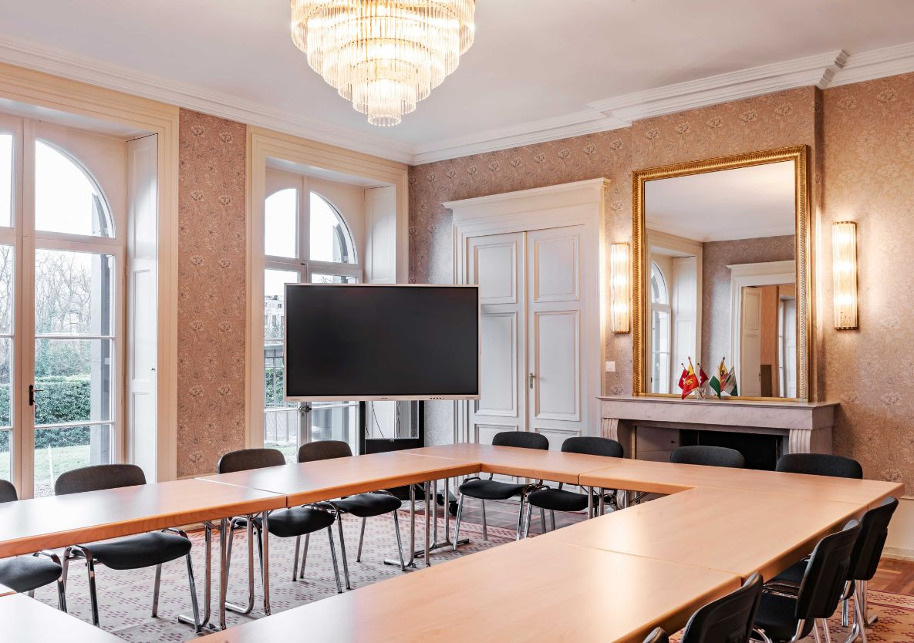
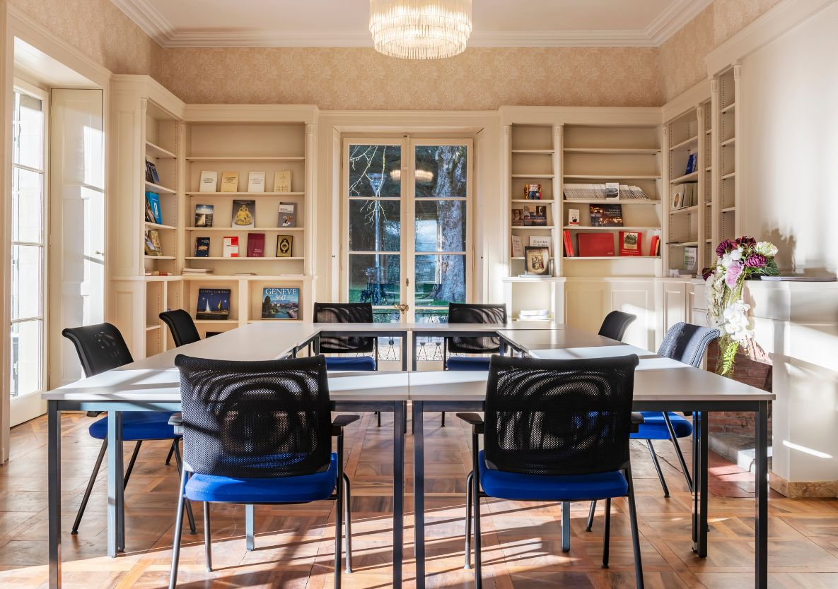
CAGI'S MEETING SPACES
Spaces available for rent in the heart of International Geneva, for your business meetings.
Receptions are permitted if they follow work meetings. Public events are excluded.
Two spaces may be rented individually or jointly.
Grand Salon
Library
From 10 to 40 pers.
For 10 pers.

Slide 37
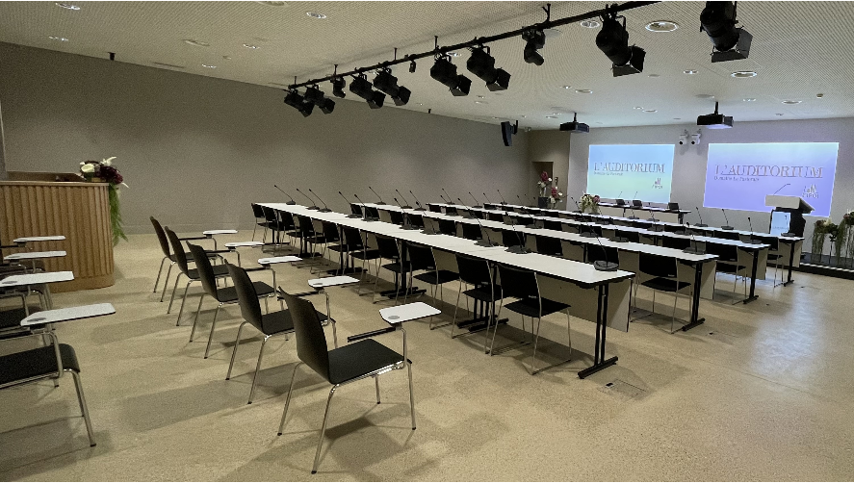

FIPOI AUDITORIUM & OTHER SPACES
Space available for rent at La Pastorale
Auditorium
Other spaces in Geneva
Conference Meeting Reception
From 36 to 140 places

Slide 38




CONTACT
La Pastorale, Maison de Maître
Route de Ferney 106
Genève
Mo-Fr : 9 a.m. – 4:30 p.m.
www.cagi.ch
@CagiGeneva
+41 (0)22 546 14 00
welcome.cagi@etat.ge.ch

Slide 39
PRACTICAL GENEVA
Housing & Insurances
Health & Medical
Informing employees and their family members before their arrival
How to reach incoming employees of International Geneva?
Education & Family life
Transport & Mobility

Slide 40
PRACTICAL GENEVA
Booklet
Web Information

