Slide 1
WP7 HFM task 1
Gijs de Rijk & Francois Kircher
22nd March 2011
Genève

Slide 2
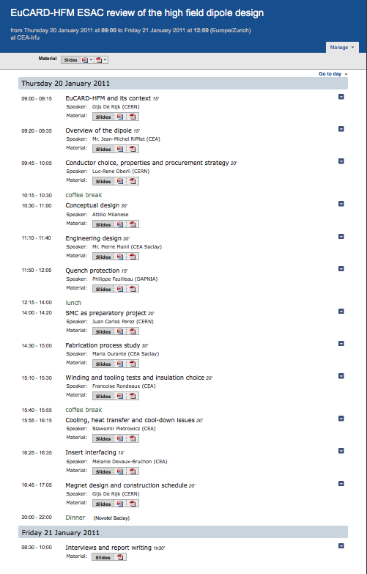
Task 1 Activities in the last 6 months
ESAC Dipole design review 21-22 Jan at CEA
Collaboration meeting preparation

Slide 3
Task 1 Activities for the near future
Prepare annual meeting (Talks: status report, 2 highlight talks: Amalia on the link and Pierre on the dipole)
Define what to do for the mid term review
  Planning for each task
  Deliverables: confirmation or justification
  Design for: Dipole, Insert, Undulator, Irradiation setup
task 3 reviews forecast:
  1) April-May 2011: conductor progress review
  2) July-2011: SMC performance review
  3) July-Aug 2011: Magnet structure and assembly review
  4) Oct-Nov 2011: Tooling design review
  5) Dec-2011: Coil manufacturing readiness review
  6) April-2012: First coil manufacturing review
  7) End 2012: coil manufacturing and quality review
  8) mid 2013 ?: Magnet assembly readiness review
  9) End 2013 ?: First magnet test review

Slide 4
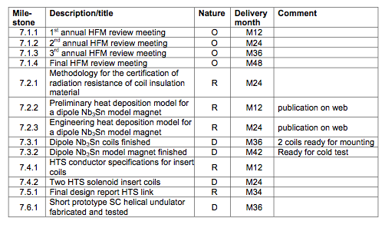
Deliverables
4

