Slide 1
Status SMC models
Gijs de Rijk for Juan-Carlos Perez
22nd March 2011
Genève

Slide 2
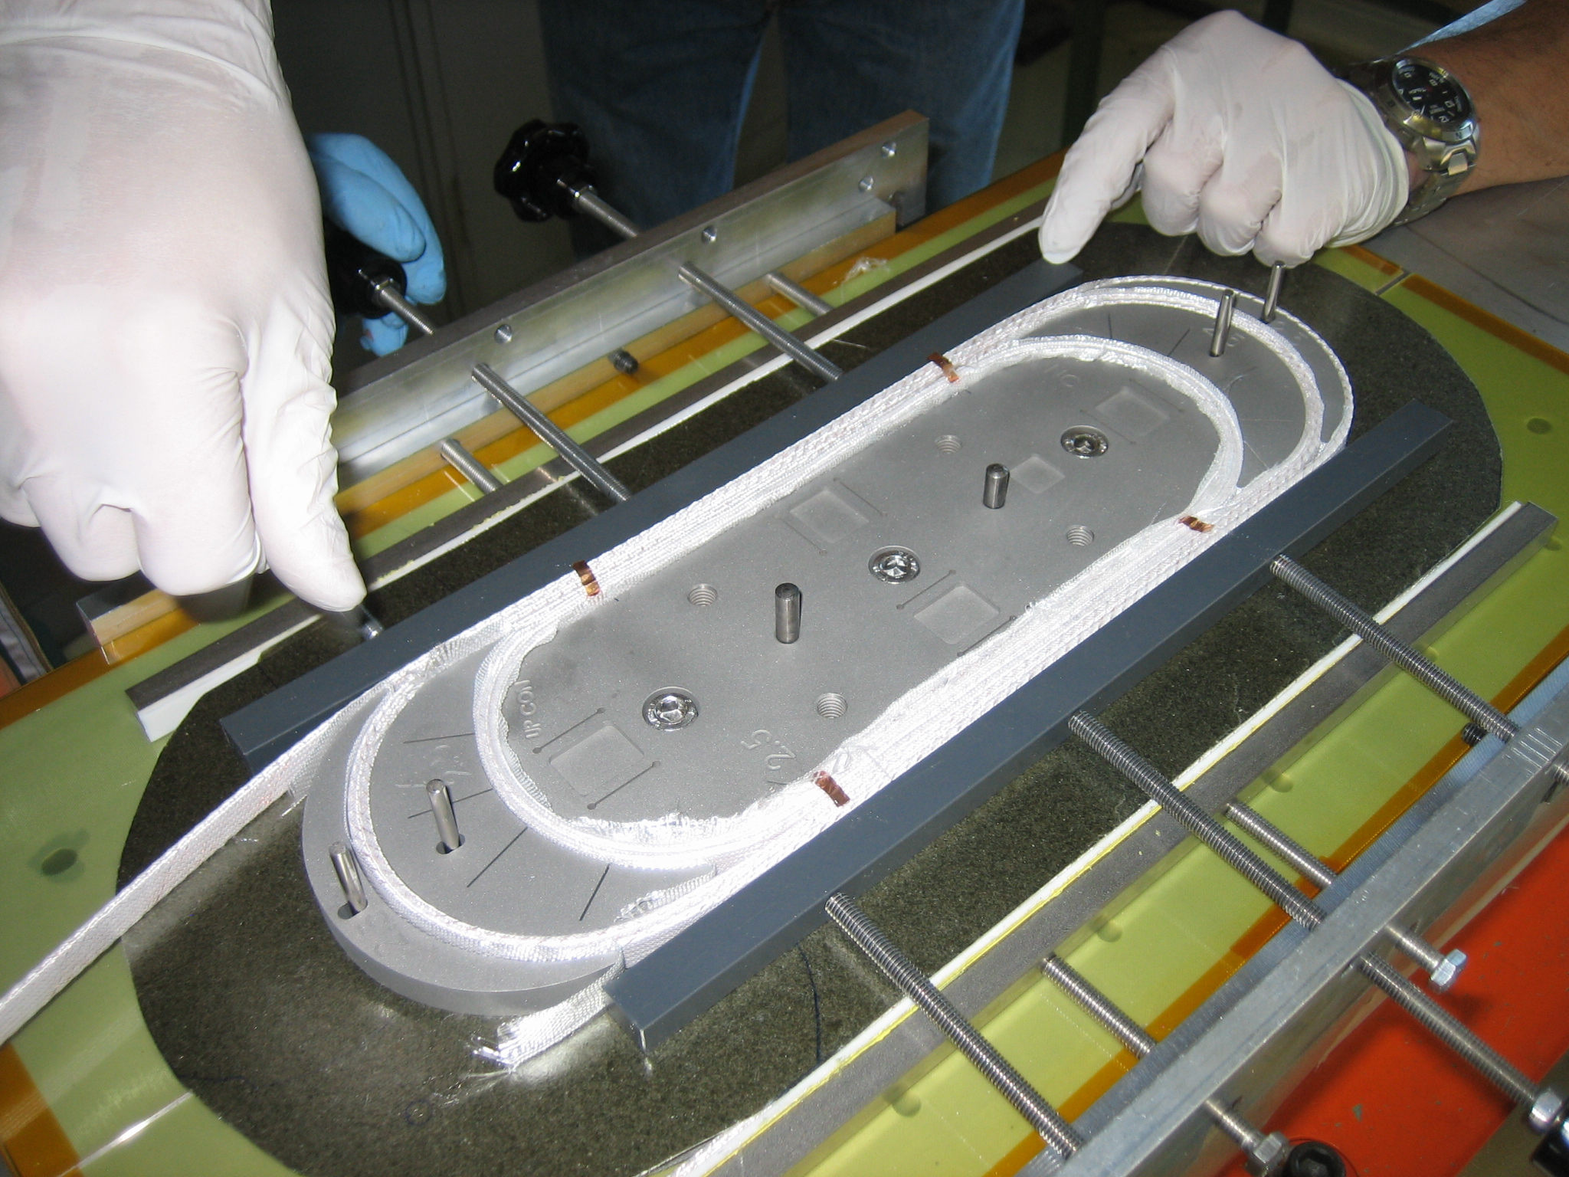
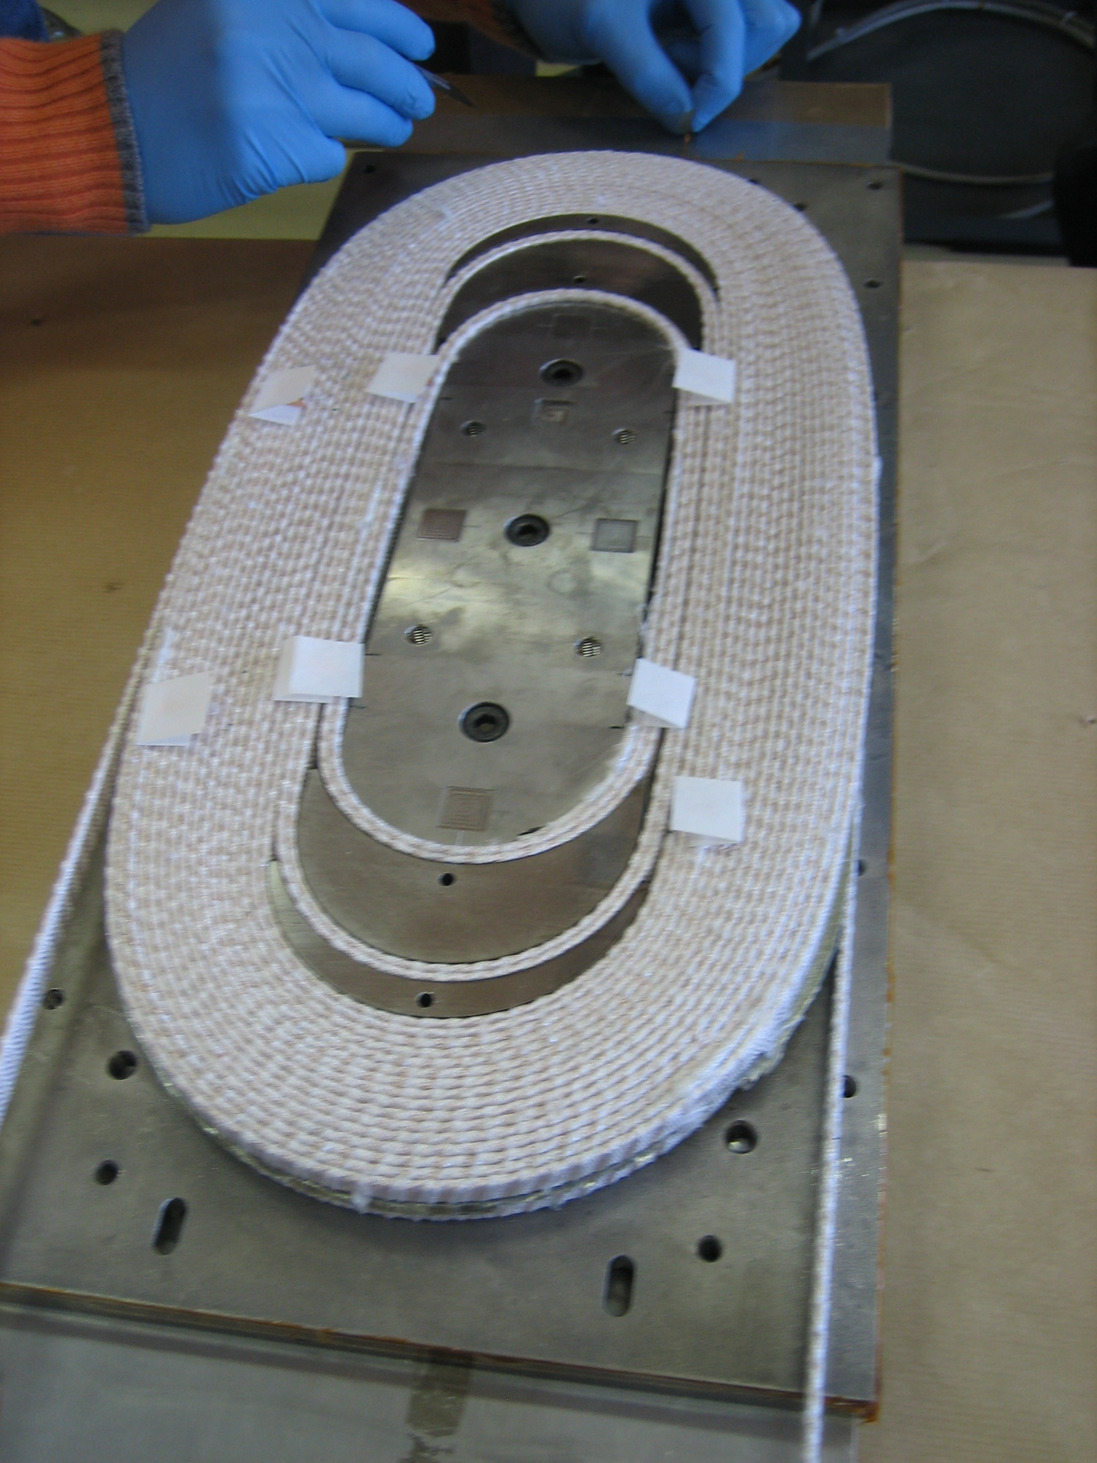
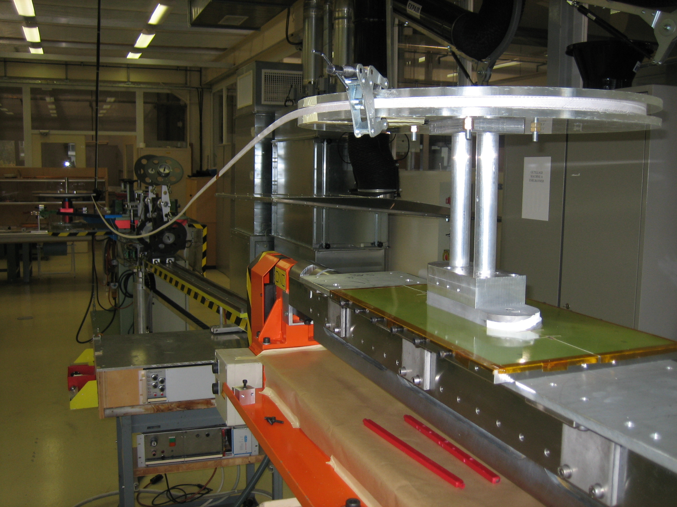
SMC3
1.25 mm diameter PIT
14 strand cable at CEA
2 double pancakes, 21 turns per layer
TQ type sock glass-fibre insulation

Slide 3
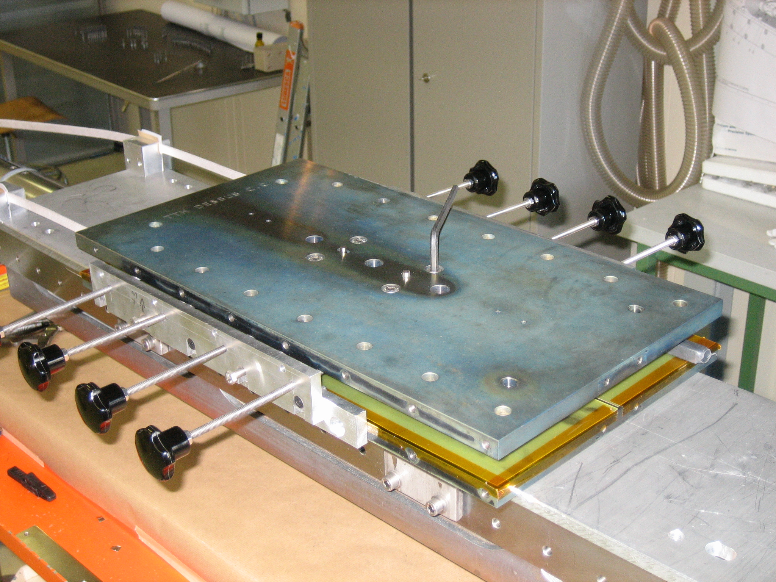
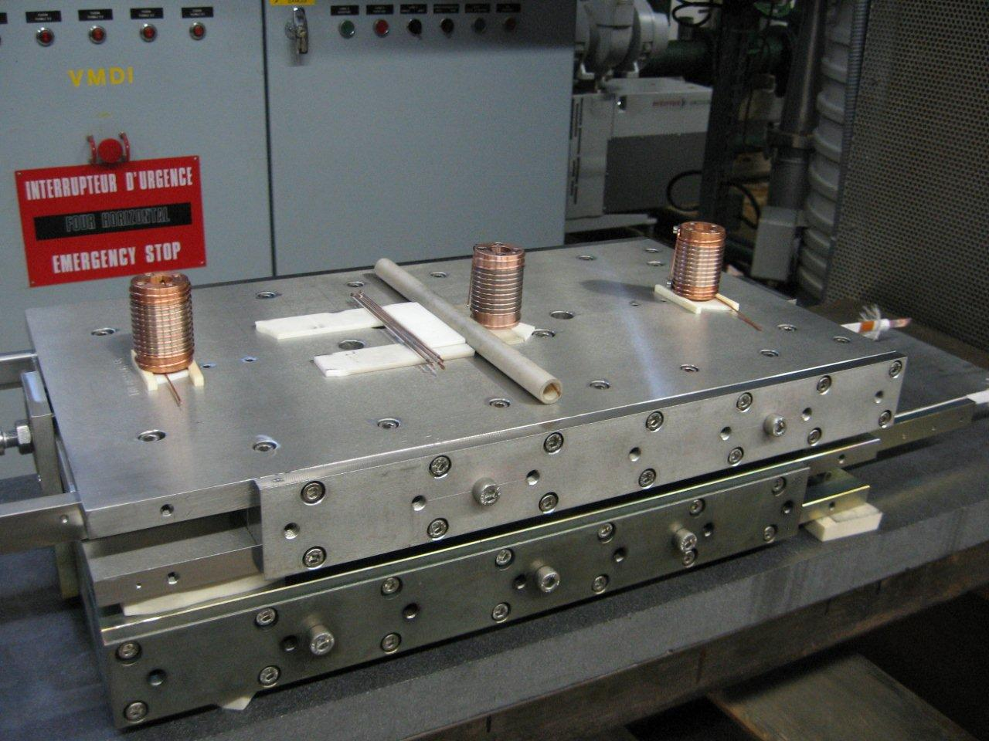
reaction

Slide 4
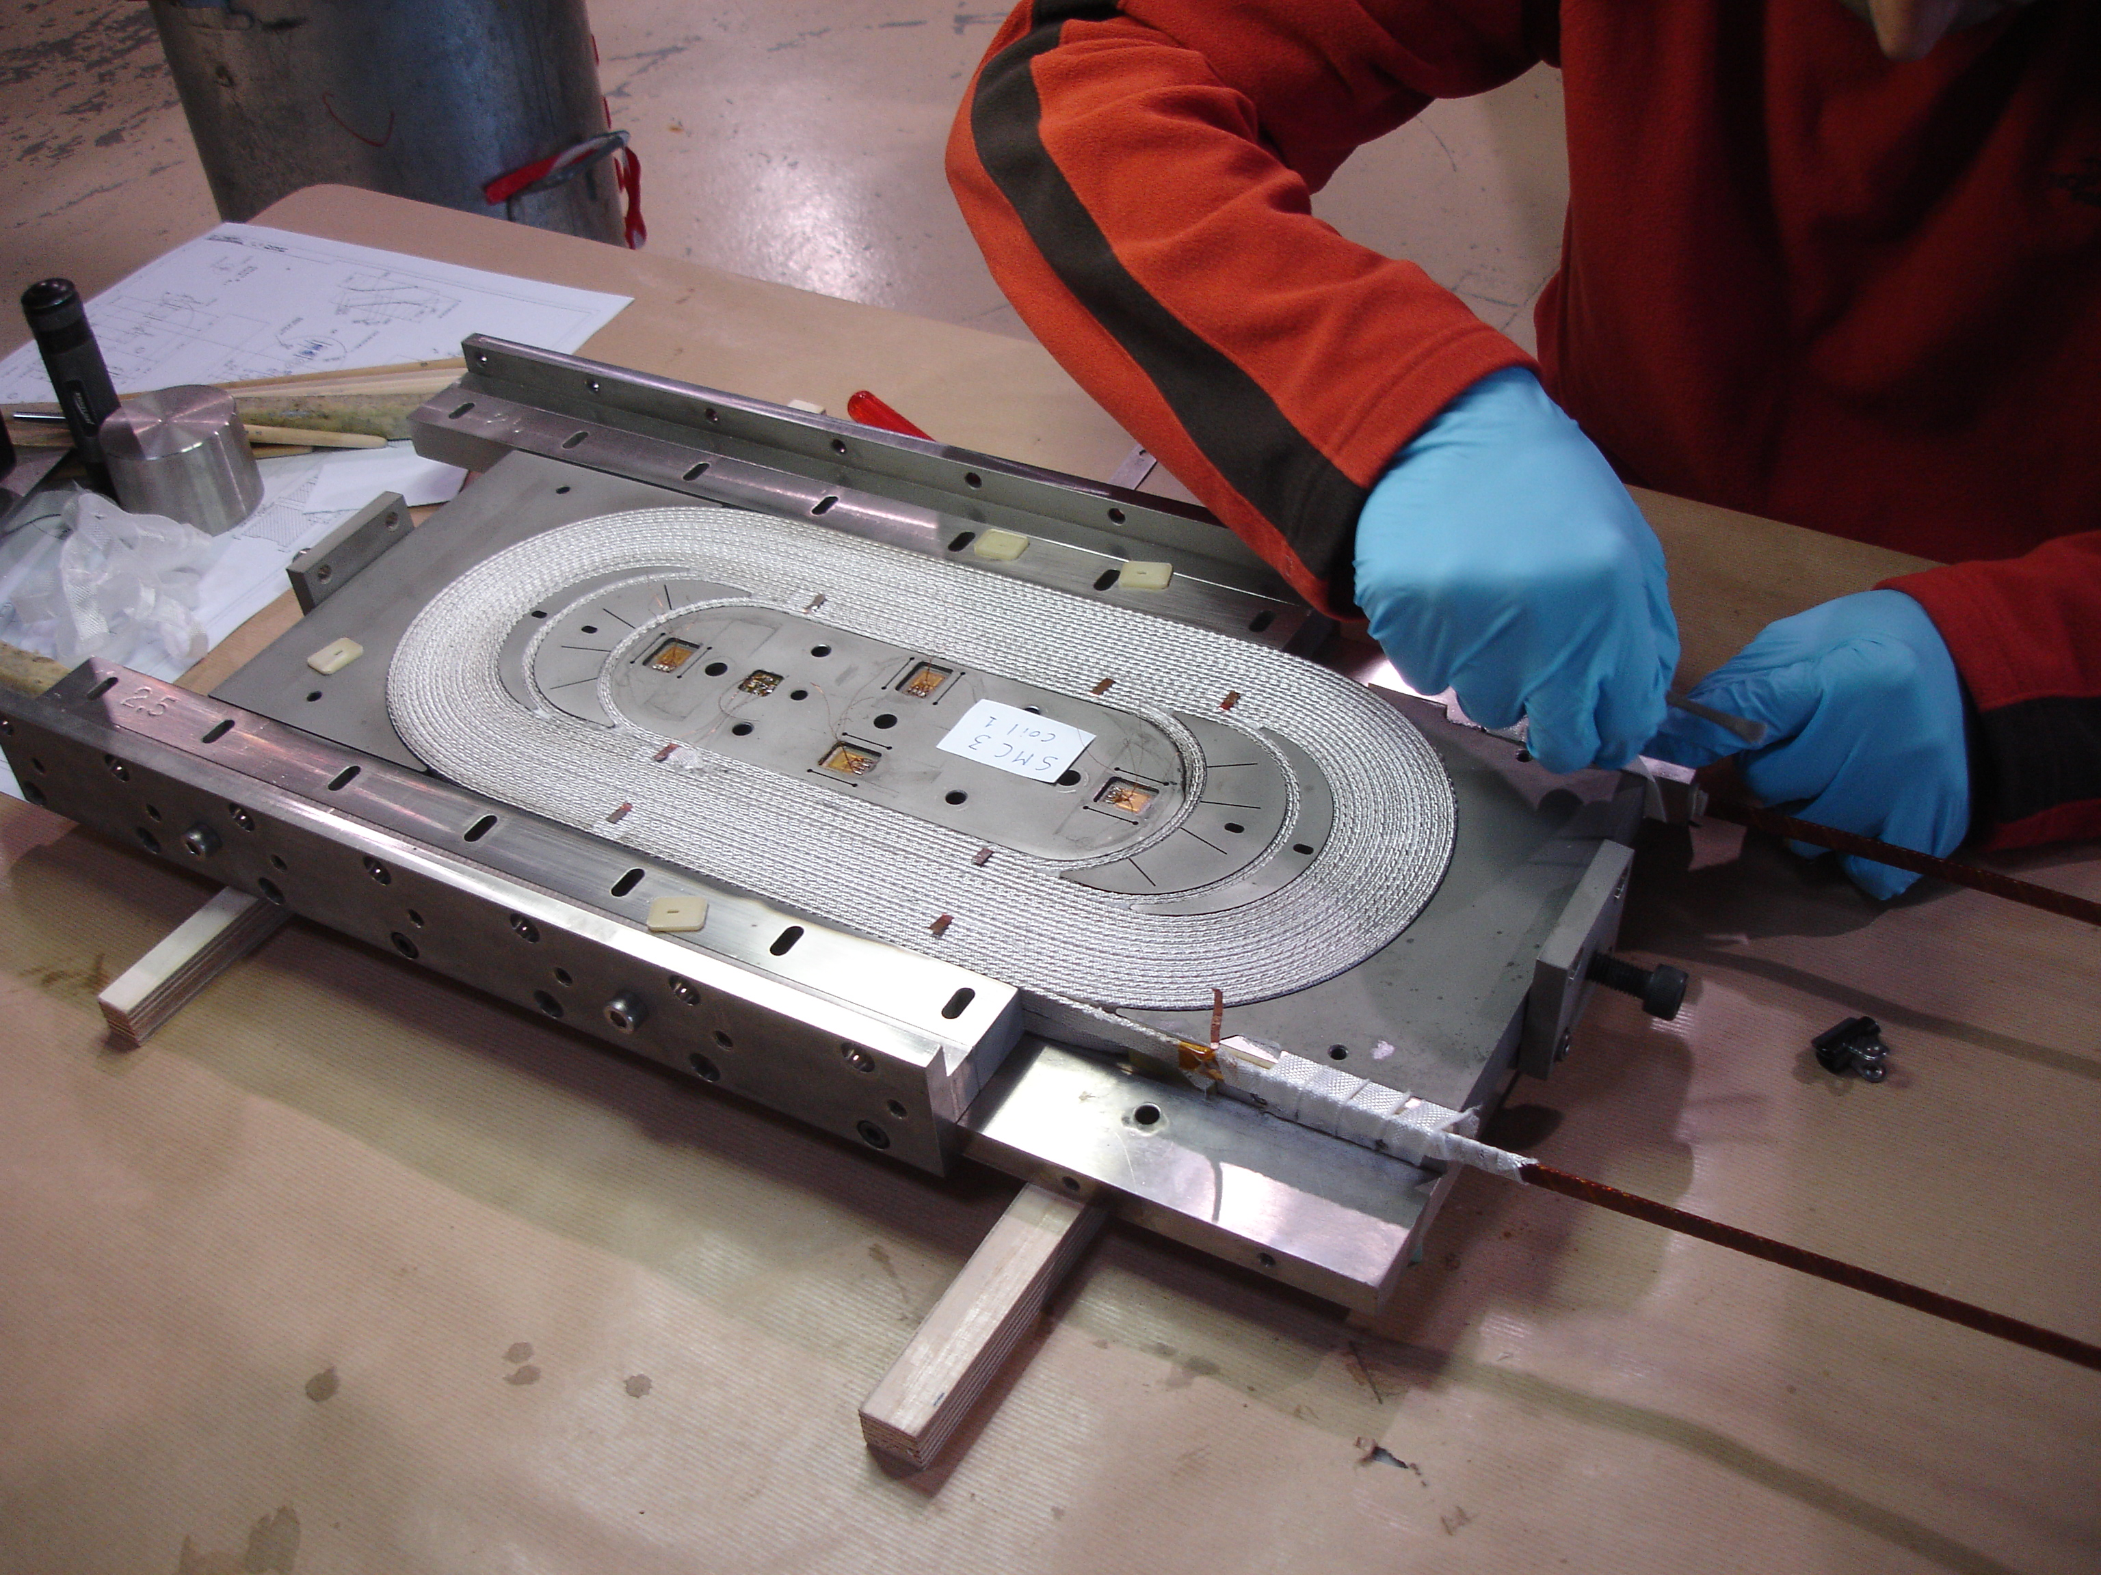
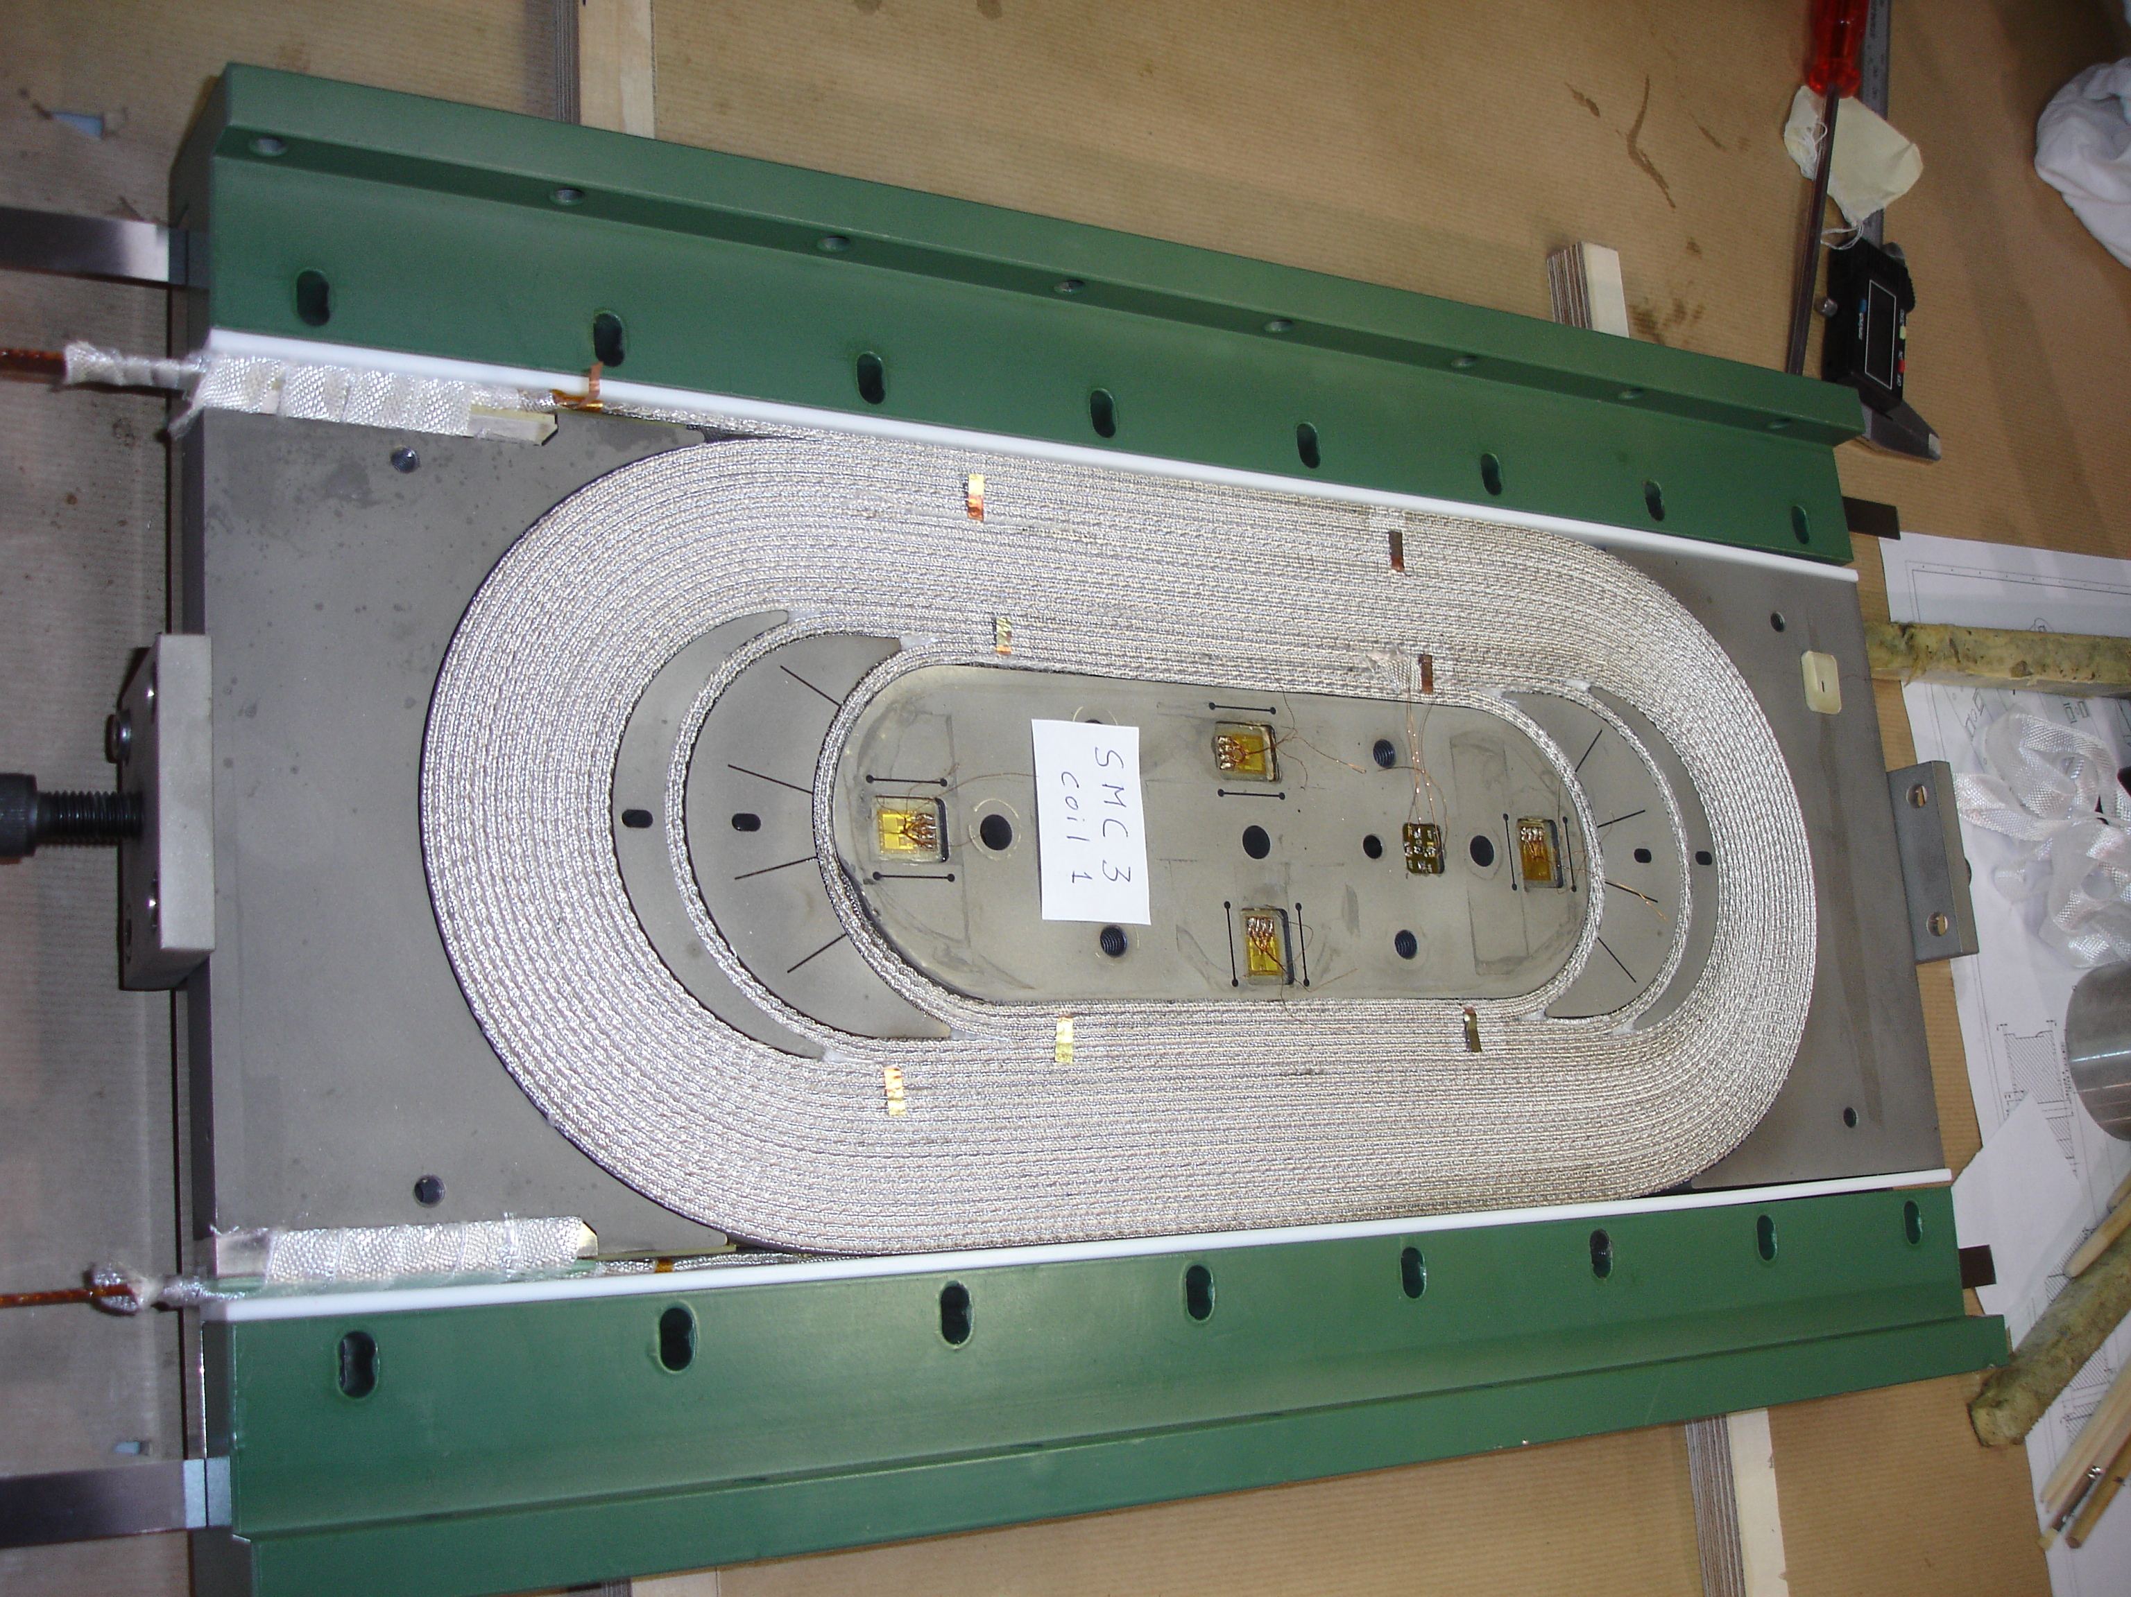
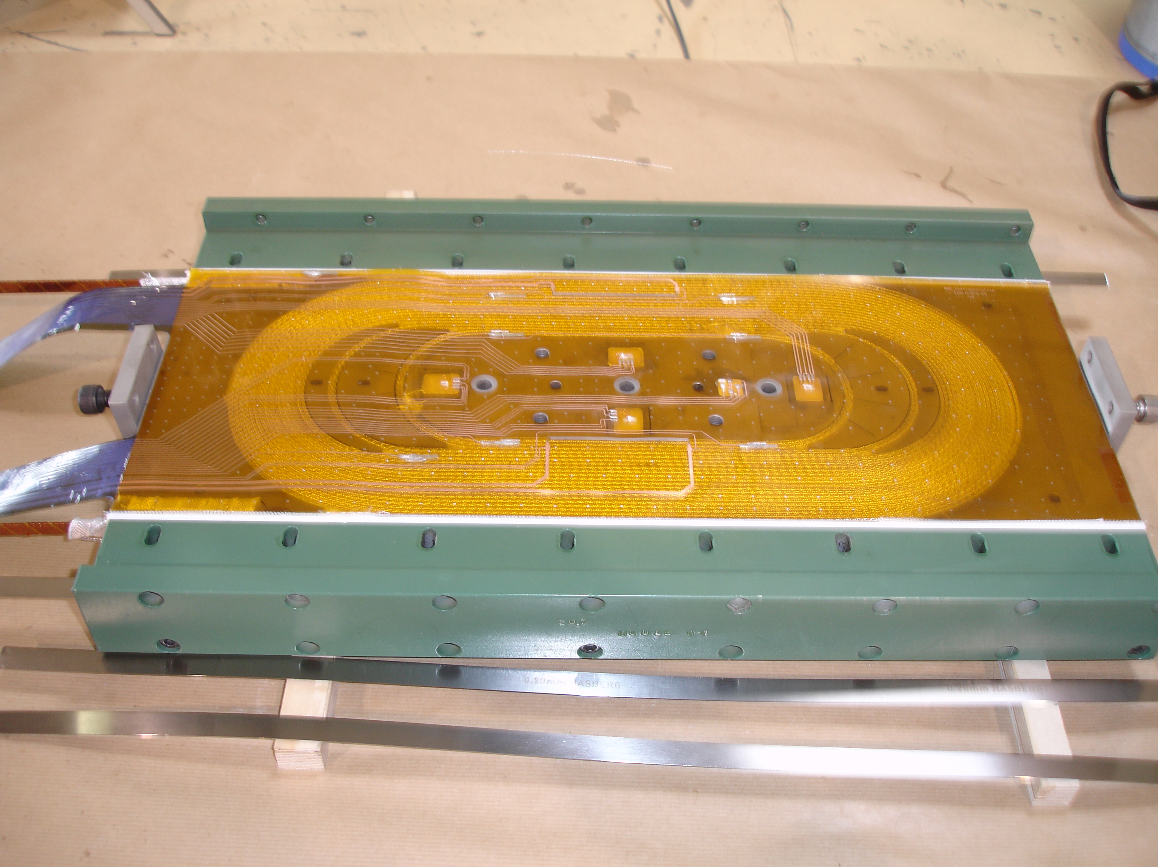
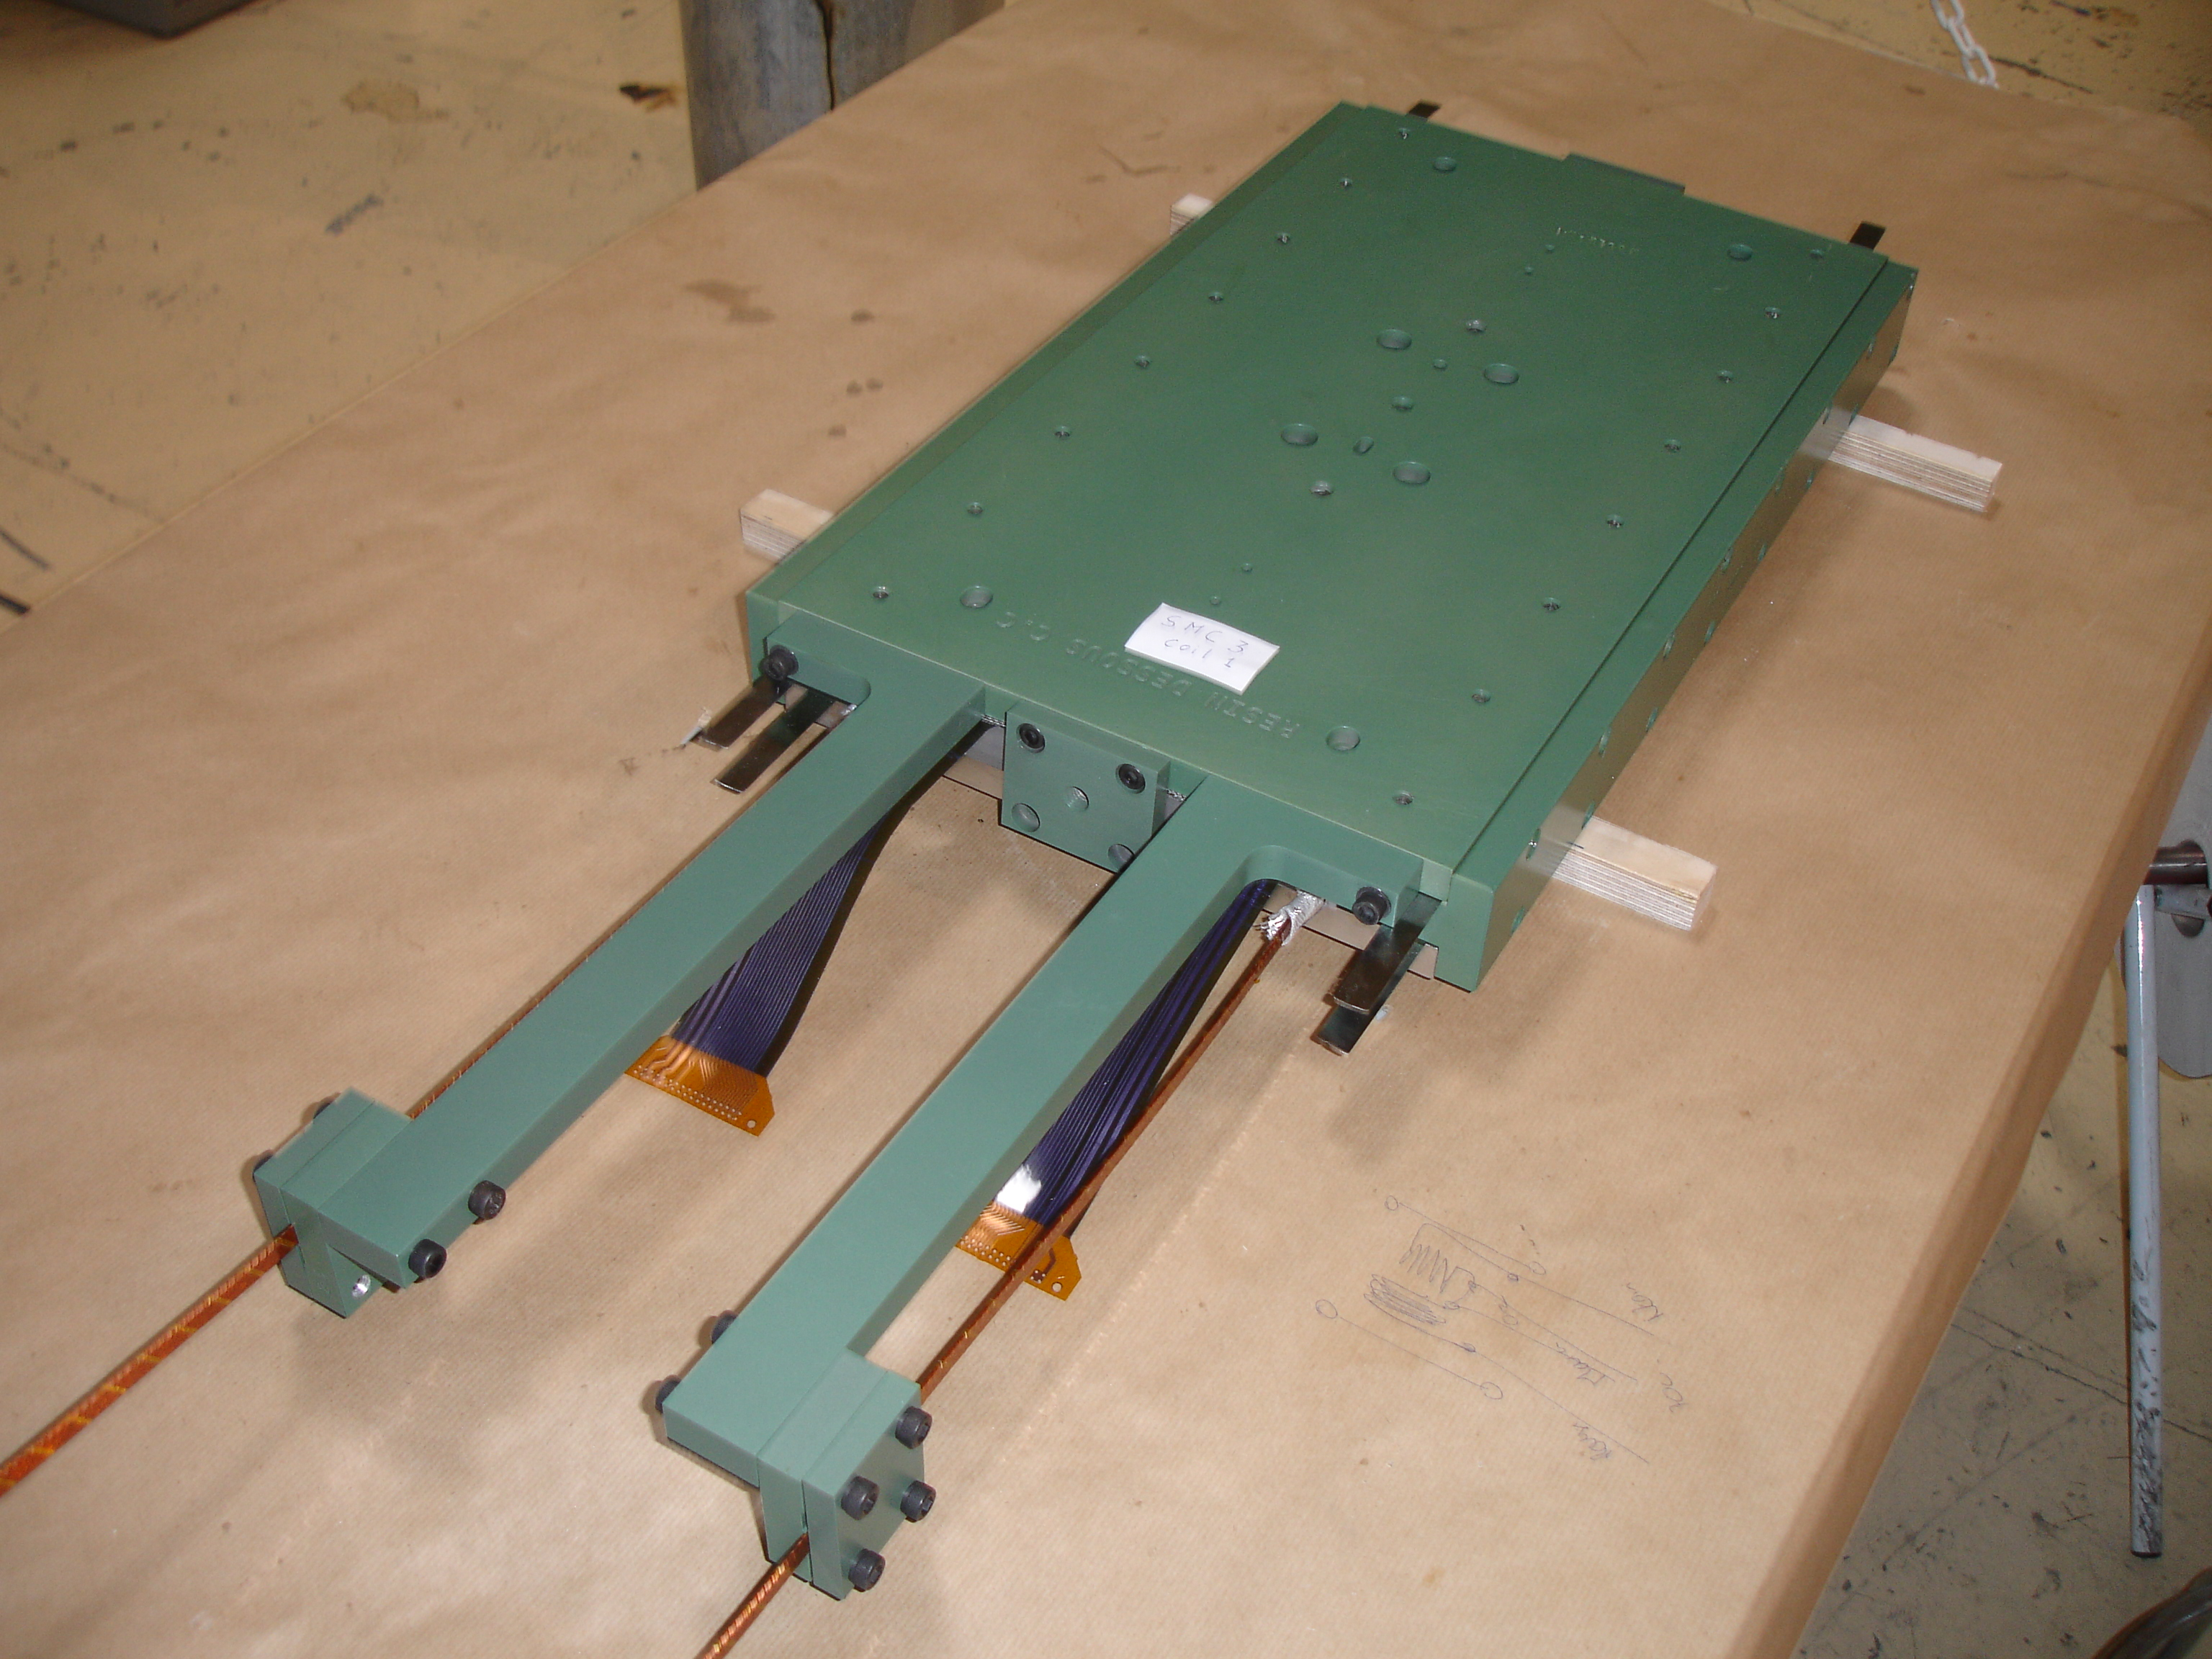
instrumentation
4

Slide 5
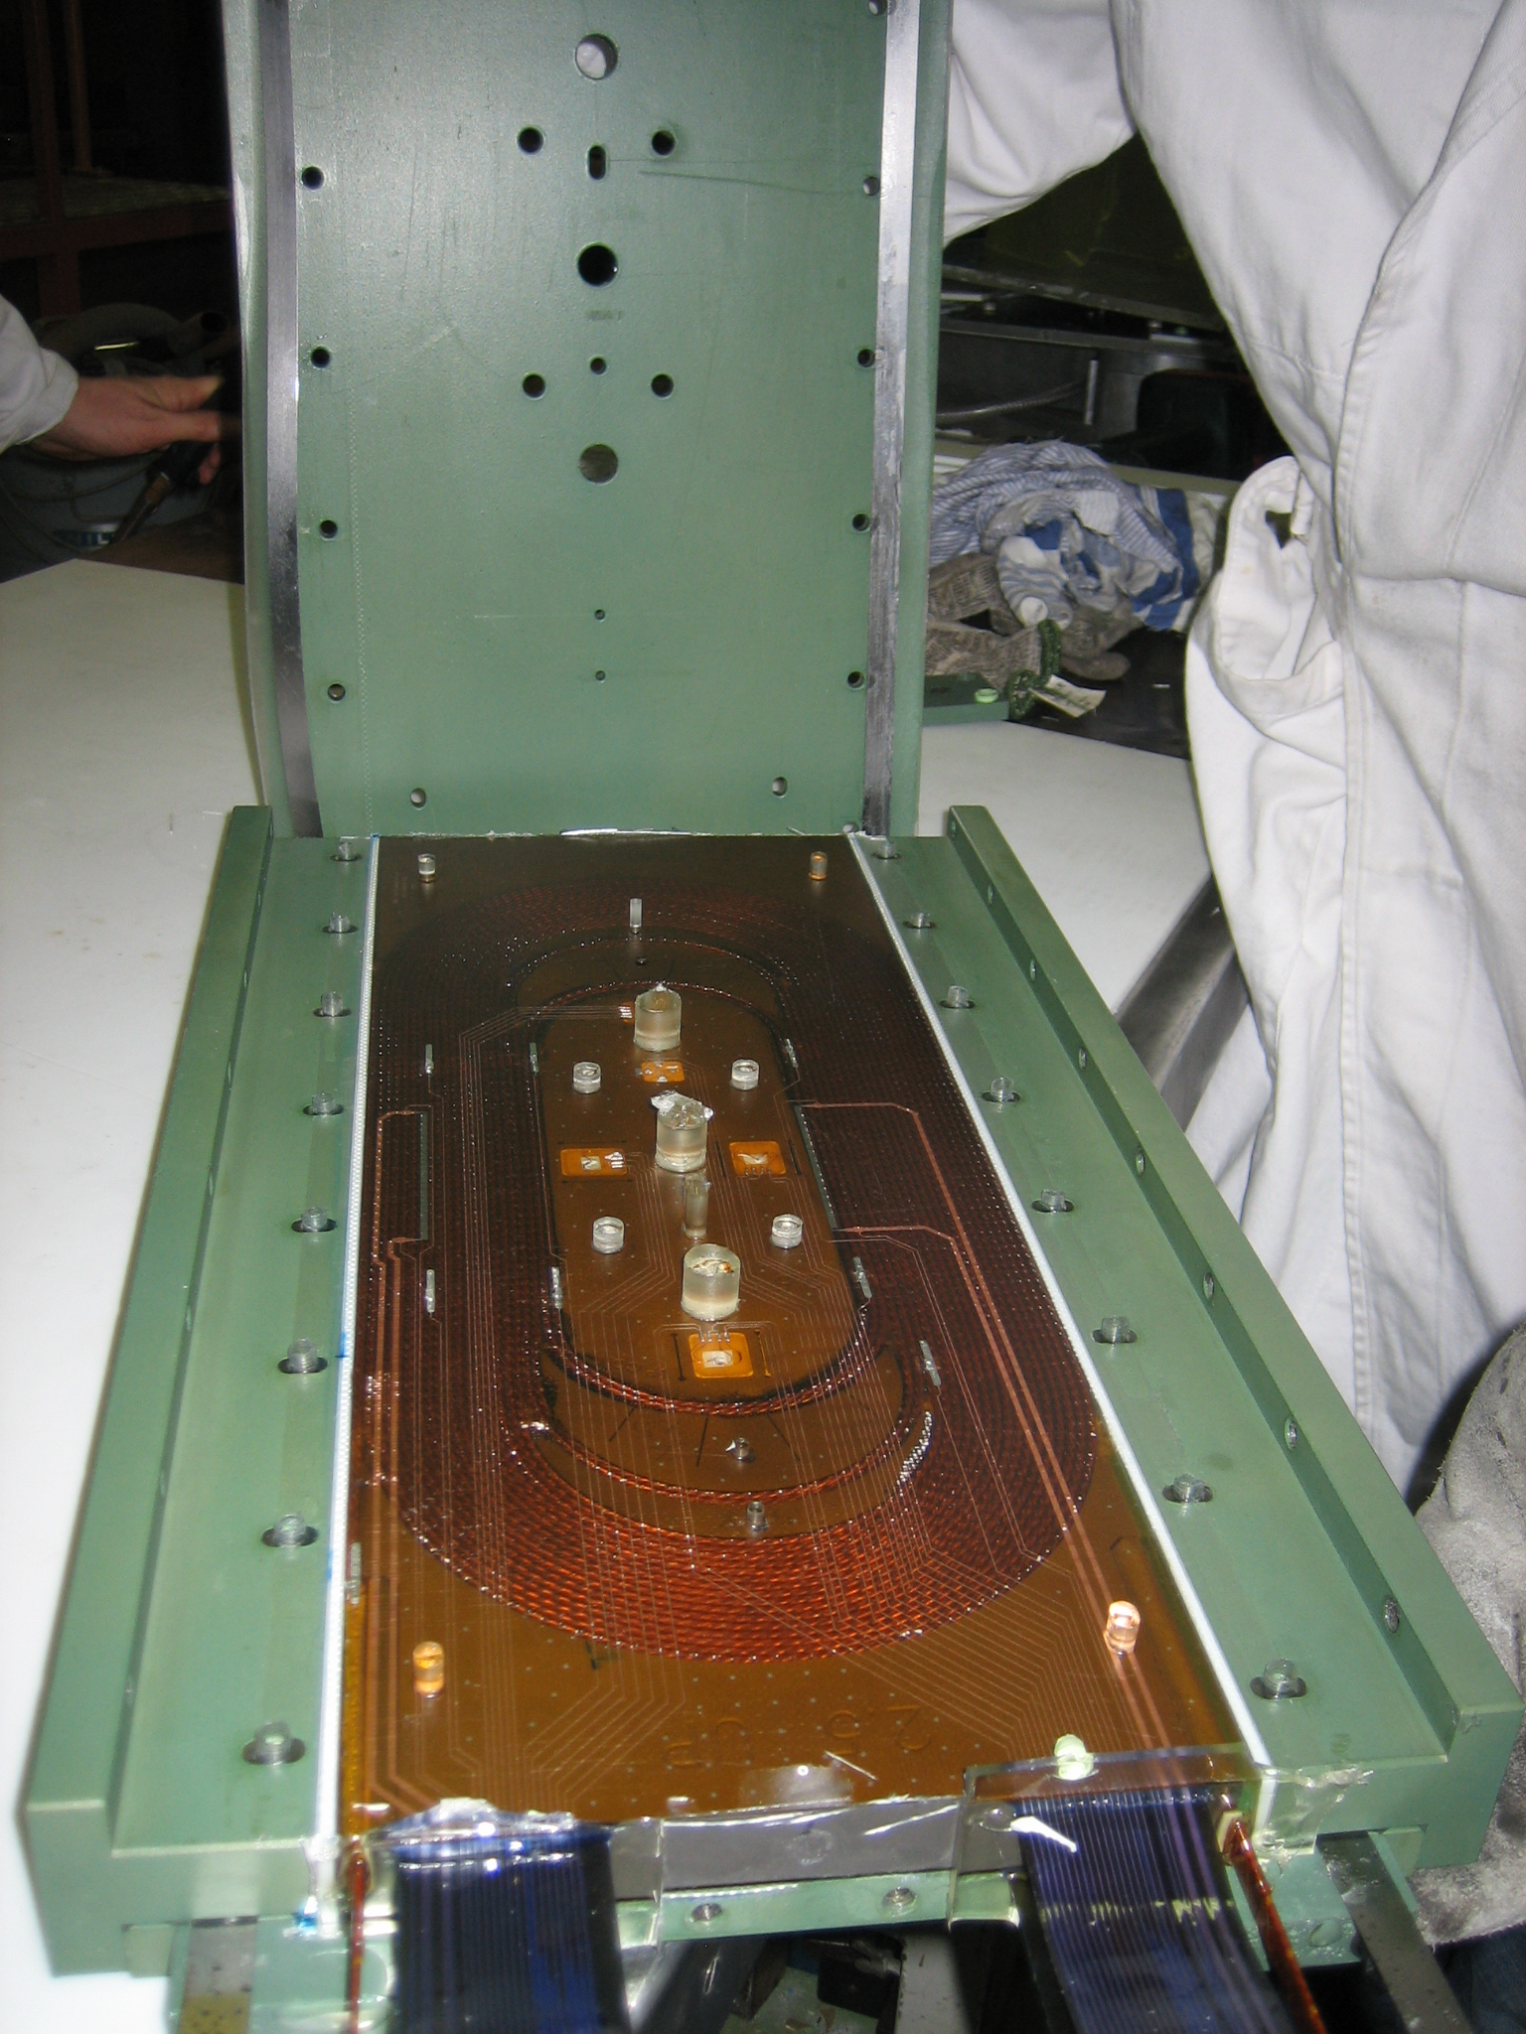
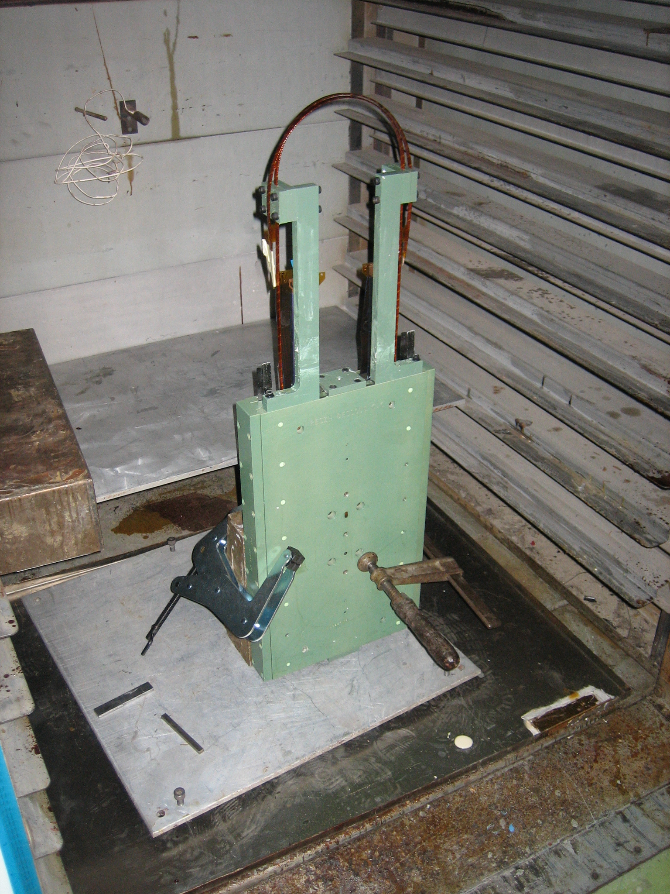
Impregnation

Slide 6
plans
SMC3a
  Calibrate sensors
  Assemble in structure
  Test in SM18 in May
SMC3b
  Make 2 more coils (start in April)
    implement what we have learned in SMC3a

