Slide 1


EuCARD-WP7-HFM meeting
22 March 2011
Baseline conceptual design: the magnet we will build
Attilio Milanese
Acknowledgements:
MPWG members, S. Caspi, P. Ferracin, ESAC reviewers

Slide 2
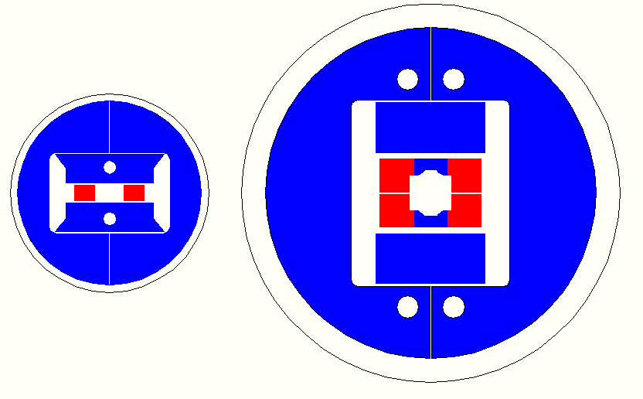


Magnetic cross section
SMC
no bore, O.D. 540 mm
4412 mm² of cable, L_{shell} = 0.5 m
≈ 13 T coil field at s.s.
FRESCA2
100 mm bore, O.D. 1030 mm
30199 mm² of cable, L_{shell} = 1.6 m
13 T nominal field in the bore

Slide 3
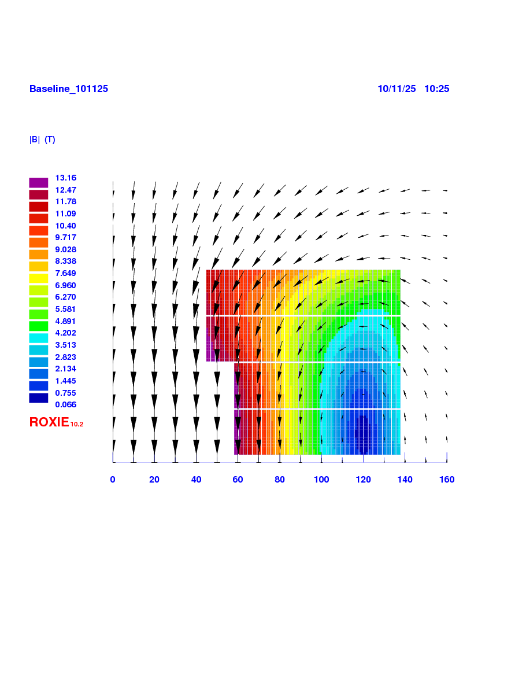
Coil and field in the cross section
156 turns per pole
(2 x 36 + 2 x 42)
B_{center} = 13.0 T
I_{13T} = 10.7 kA
B_{peak} = 13.2 T
E = 3.6 MJ/m
L = 47 mH/m

Slide 4
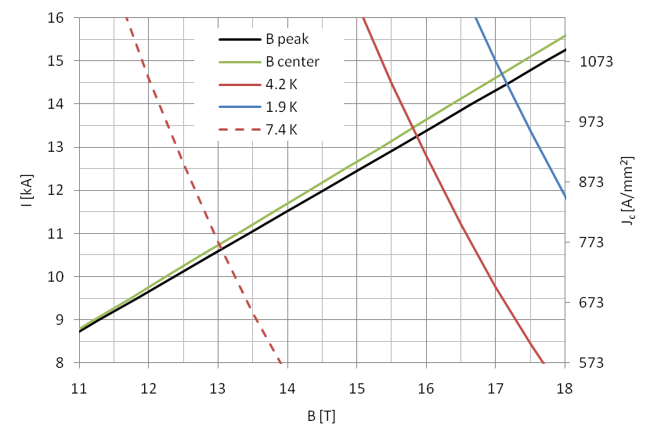
Load line and margins
13 T imply 83% @ 4.2 K, 76% @ 1.9 K along the load line
[15 T correspond to 88% along the load line @ 1.9 K]

Slide 5
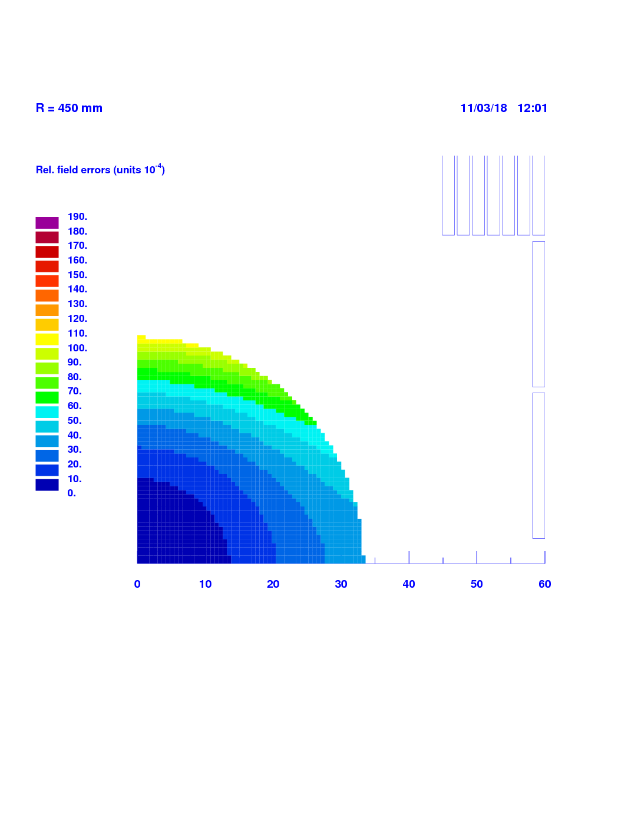
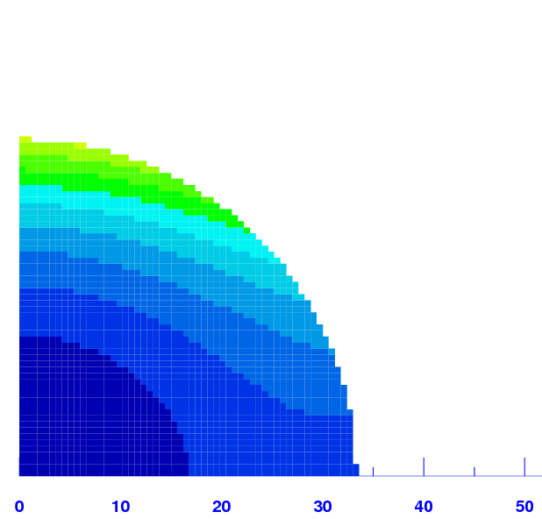

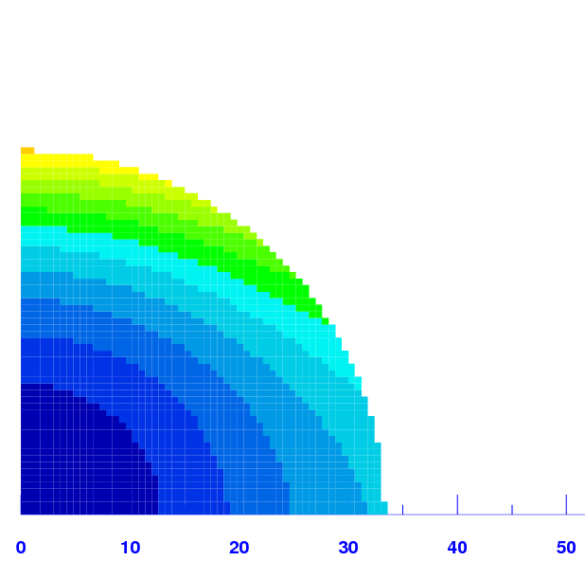
Field homogeneity in the cross section
B_{center} = 10 T
b₃ = 49.2
b₅ = −35.1
b₇ = 4.4
B_{center} = 11 T
b₃ = 58.3
b₅ = −37.5
b₇ = 5.1
B_{center} = 12 T
b₃ = 66.0
b₅ = −36.2
b₇ = 4.7
B_{center} = 13 T
b₃ = 72.8
b₅ = −35.1
b₇ = 4.4

Slide 6
Field homogeneity along the axis in 3d
limit of the straight section

Slide 7
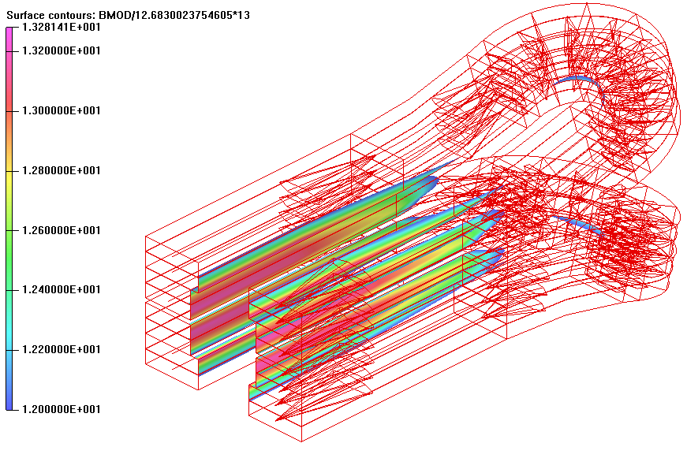
Field on the coil in 3D
The peak field is in the straight section.
Flared ends
α_{ramp} = 17°
R_{min, HW} = 700 mm
R_{min, EW} = 44.7 mm
yoke extruded all the way
vertical pad extruded over
the straight section
top central post all in iron

Slide 8
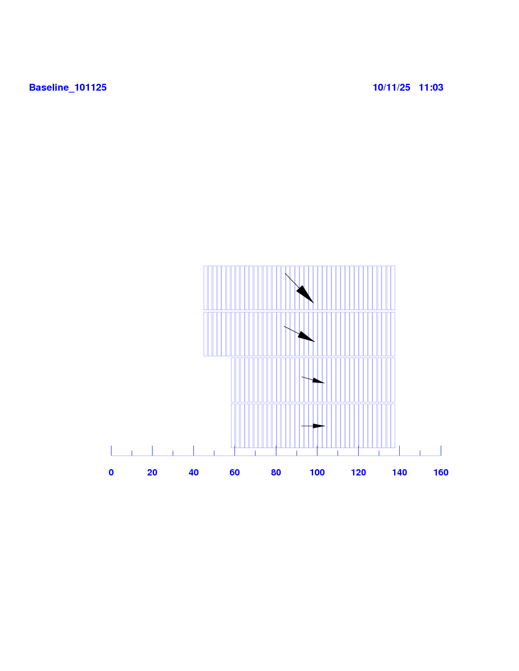
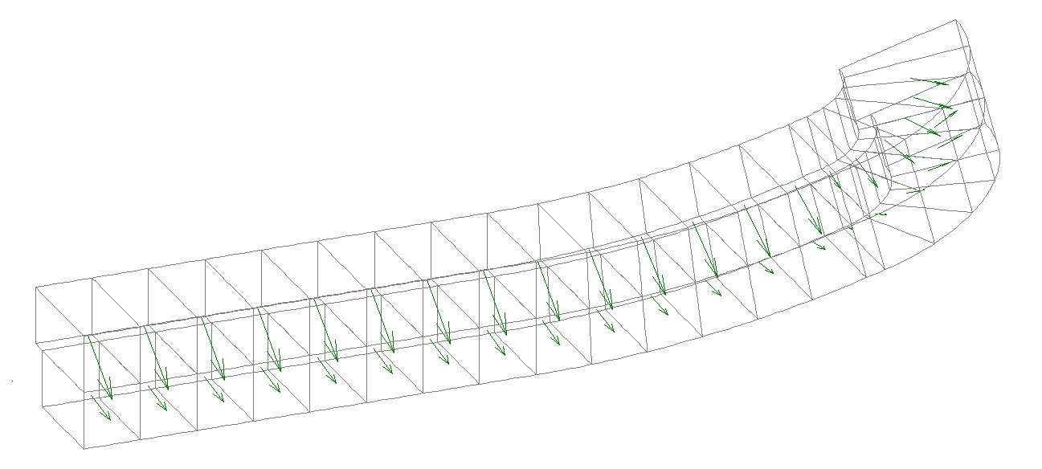
Lorentz forces in 2D and 3D, at 13 T
In 2D:
ΣF_{x} = 7.5 MN/m
ΣF_{y} = −3.9 MN/m
(per quadrant)
In 3D:
ΣF_{x} = 4.95 MN
ΣF_{y} = −1.97 MN
ΣF_{z} = 0.52 MN
(per octant)

Slide 9
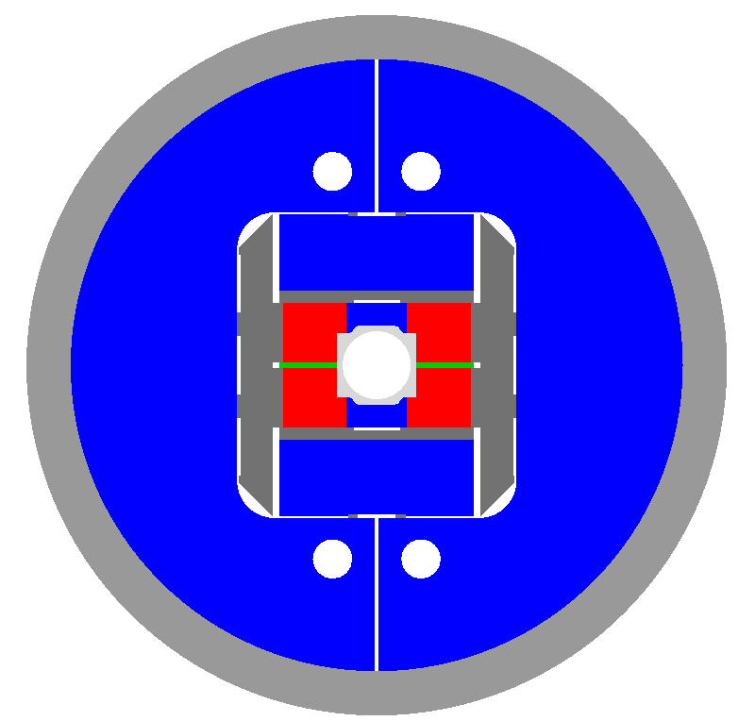
Structure
Same bladders and keys principle of previous meeting.
The geometry has been slightly modified:
no central tube
central posts
outer radius of yoke
thickness of shell
See Pierre’s (Françoise’s) presentation next for engineering details and last version.

Slide 10
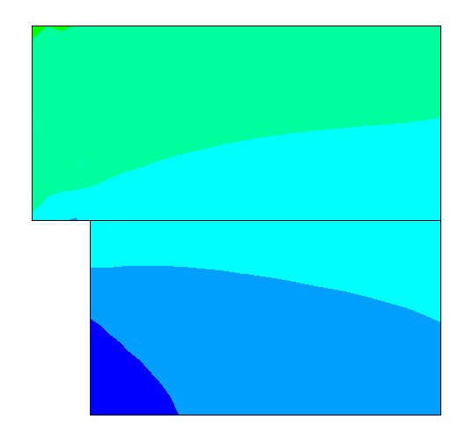
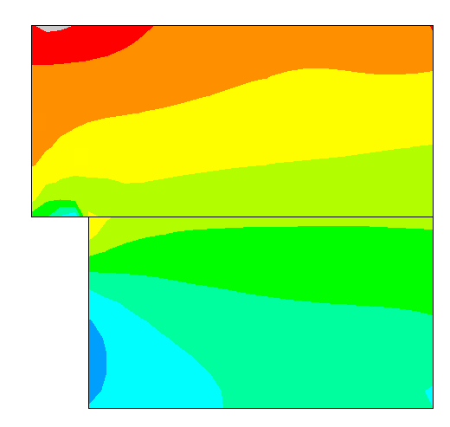
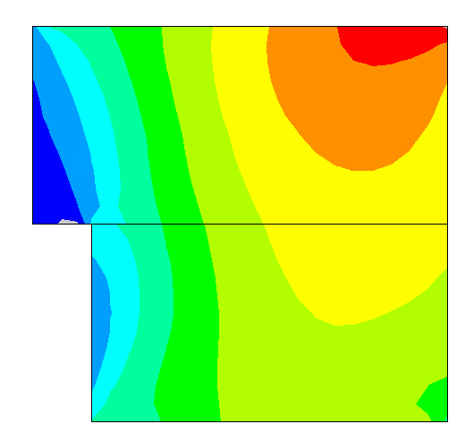
Stresses on the coil, 13 T
The coil does not go above 150 MPa, the Nb₃Sn “comfort zone”
The high field and high stress regions do not overlap
2d plane stress analysis confirmed by 3d one in the straight parts
warm
cold
13 T
σ_{x}

Slide 11
Conclusion
The conceptual design can be considered finished.
We are now in a new phase, where the magnetic and mechanical modeling is there to support the engineering design for “details”, like end plate geometry, tie rods, wedge, proper prestress of easy way part, field in the splice region, …
Consequently:
MPWG: Magnet Predesign Working Group
MDWG: Magnet Design Working Group

Slide 12
Thank you.

