Slide 1
Task 5: High-Tc Superconducting Link
Status Report
Eucard - WP7 Collaboration Meeting, CERN
A. Ballarino, J. Fleiter, T. Miani, G. Hurte, G. Willering (CERN)
S. Berta, G. Grasso (Columbus)
C. Beduz, Y. Yang (Univ. Southampton)
A. Aubele, A. Hallbauer (Bruker HTS)
Grenoble, 21st March 2011

Slide 2
Outline
Deliverable(s) and schedule
Contributions from individual partners
  Plan for future activities
  Conclusions

Slide 3
Deliverable
Deliverable, as described in the Eucard Grant Agreement:
Design and assembly of a superconducting link, 20 m long, containing
26 pairs of 600 A HTS cables. The test of the link is not included in
the Task.
The activity of Task 5 started on 1st September 2009 (6 months after the other tasks in the HFM Work-package).

Slide 4
CERN activity
Conceptual study and design of superconducting cables made from MgB₂, YBCO and BSCCO tape (twisted-pair cables) – completed
Assembly of short (~2 m length) prototype cables – completed
Test of prototype cables (MgB₂, YBCO and BSCCO) at 4.2 K and at LHe temperature (Ic~2×3500 A at 4.2 and in self-field) – completed
Procurement of conductor for 20 m long prototype link – completed
Design and assembly of cabling machine for the production of long-length cable– on going. Planned to be completed by end of Summer 2011
Design and assembly of a test station for the test of the prototype link in nominal
operating conditions – on going. Planned to be completed by September 2011
+
-

Slide 5
SOTON activity
Design and assembly of a test station to be used for the characterization of
cables in a variable temperature range:
  Cryostat: 2.6 metre inner height, 250mm inner bore cryostat
  Helium gas generated at 6 K – 50 K for the cooling of the cable
  2000 A Current Leads
The test station has been commissioned in February 2011.
A first YBCO twisted-pair cable assembled at CERN is being characterized

Slide 6
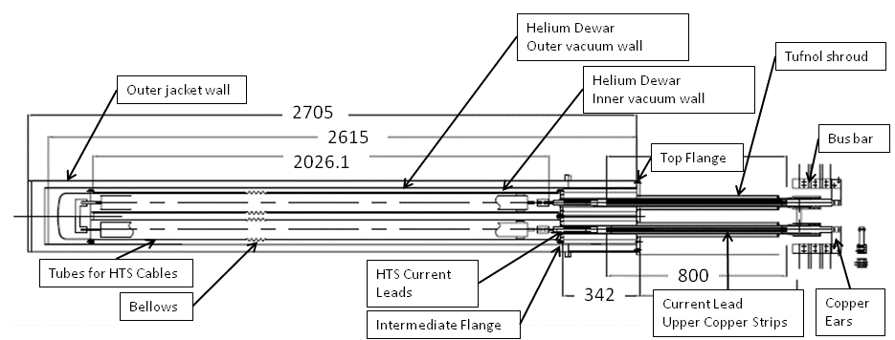
SOTON activity
Test station at Southampton University
Presentation of C. Beduz at the Task 5 meeting, Genova, August 2010

Slide 7
BHTS activity
Measurement of performance of Bi-2223 and Y-123 CC BHTS wires (Ic-B-T data)
Measurement and optimization of electrical joints (Bi-2223 and Y-123 conductors).
Use of different solders and different fluxes are being investigated. Verification
of mechanical strength of soldered joint (measurement of Ic after bending).
Development of optimized procedures for joining techniques.
Production of 120 m of Bi-2223 tape already delivered to CERN for the assembly
of the 600 A cables

Slide 8
Columbus activity
Conceptual design of a test station for the continuous Ic measurement of MgB₂
conductor. Task: definition of QC processes for long lengths
Measurement of performance of MgB₂ tape (Ic-B-T data)
Performance and optimization of electrical joints
Production of 1200 m of MgB₂ tape delivered to CERN in August 2010 for the
assembly of the 600 A cables

Slide 9



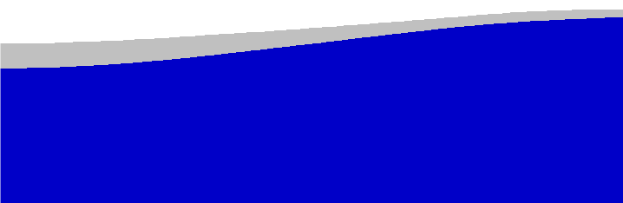
Columbus activity
Problems…
600 µm
300 µm
Current transfers from one tape to the other one flowing through the nickel matrix.
As a first approximation, electrical resistance for a 10 cm long splice @ 40K ≈ 4 ⋅ 10⁻⁸ Ω. We’ve considered RRR(Ni)=3. Doubling the splice length, R is only halved.
Even worse in the case of a Monel external sheath !!!
S. Berta
HOW to optimize the splice ???...
Long lengths Ic measurements
Splices between tapes
EuCARD Project: Task 7.5 meeting

Slide 10
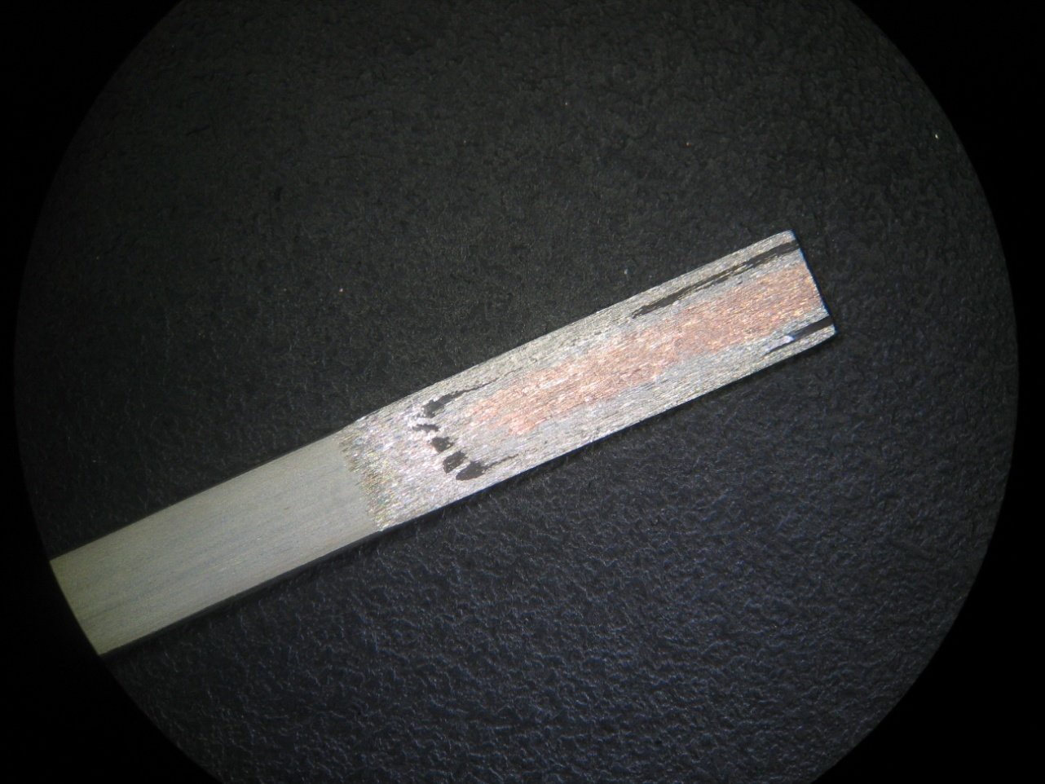
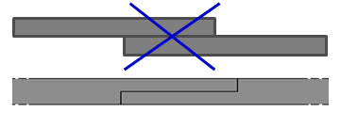
Optimized tape-to-tape splice
IDEA: we’re trying to remove part of the Ni matrix from that side of the tape which is welded.
Soldering optimization and testing in progress…
S. Berta
Long lengths Ic measurements
Splices between tapes
EuCARD Project: Task 7.5 meeting

Slide 11
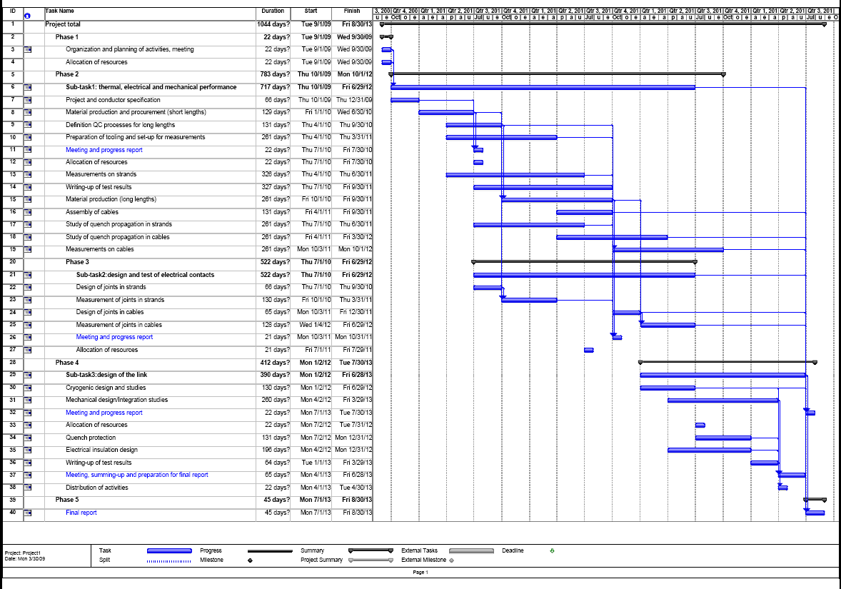
Are we on schedule ? Yes
Measurement of short prototype cables: planned to start in Oct 2011 – activity started in 2010 and is on-going
Procurement of conductors for prototype link: planned to be start in Oct 2010 – activity started on time and will be completed by mid 2011
Assembly of prototype link: planned to be completed in 2013. Activity is advancing according to schedule – presently ahead of schedule

Slide 12
Thanks for your attention !

