Slide 1
RFQ2 Action Discussion
L. Millar, A. Grudiev
CERN, SY-RF-MKS Section
08/05/2023

Slide 2


Summary
In short:
Q factor of the first RFQ was 6772.
The Q factor of the new RFQ (RFQ2) seems to be ~5200.
The following slides list several options for investigating the source of the losses, both with and without disassembling the cavity and measurement setup. The RFQ1 measurements are also provided for discussion.

Slide 3
RFQ1 Q₀ Measurements

Slide 4
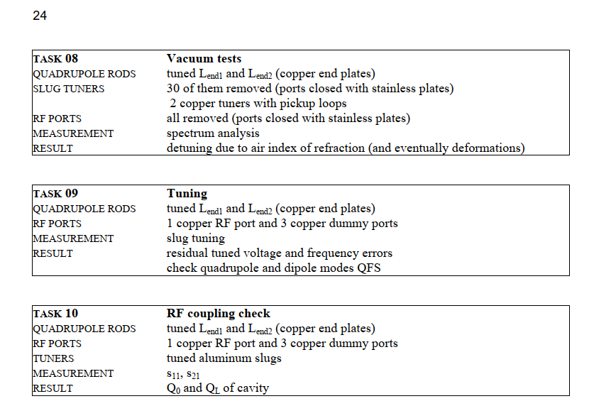
RFQ1 Q₀ Measurements
Results are taken from the RFQ1 fabrication report.
Doc No: L4-ACRFQ-EN-0001 rev.1.0
EDMS No:1469409
Tables on pages 22-24 show what was installed for each measurement.
Notes:
**This test occurred prior to capacitance analysis of §12.8.1: all aluminum adjustable tuners are removed; RF dummy ports are left
in electrically neutral position. Tuner ports are closed with stainless steel plates. Note that cut-off
frequency of cylindrical tuner bores is much higher than 352 MHz; RF field is expected to be close to
zero on steel plates with negligible losses. One tuner port is left open, and VNA is coupled to RFQ
using two small loop probes. Measured loaded quality factor is found to be QL ~ 7 900, close to the
theoretical Q0 = 8000 derived from Comsol and HFSS simulations (note that this value is higher than
the theoretical Q0 = 7 200 (Table 76, §11.2.6) of a closed RFQ with copper tuners and RF ports). By
the way this shows that surface resistivity is much higher for aluminum of adjustable tuners than for
standard aluminum (possibly a consequence of Alodine surface processing).

Slide 5
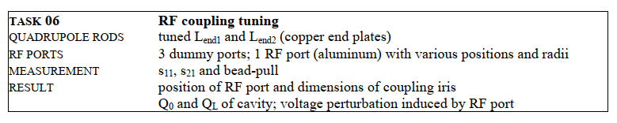
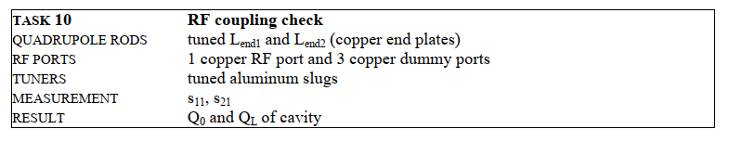
Overview of RFQ1 Q₀ Measurements
How as Q₀ affected by the aluminum dummy coupler?
Notes:
**This test occurred prior to capacitance analysis of §12.8.1: all aluminum adjustable tuners are removed; RF dummy ports are left
in electrically neutral position. Tuner ports are closed with stainless steel plates. Note that cut-off
frequency of cylindrical tuner bores is much higher than 352 MHz; RF field is expected to be close to
zero on steel plates with negligible losses. One tuner port is left open, and VNA is coupled to RFQ
using two small loop probes. Measured loaded quality factor is found to be QL ~ 7 900, close to the
theoretical Q0 = 8000 derived from Comsol and HFSS simulations (note that this value is higher than
the theoretical Q0 = 7 200 (Table 76, §11.2.6) of a closed RFQ with copper tuners and RF ports). By
the way this shows that surface resistivity is much higher for aluminum of adjustable tuners than for
standard aluminum (possibly a consequence of Alodine surface processing).

Slide 6
Overview of RFQ1 Q₀ Measurements
In Task 06, the WG transition was initially designed for 400 MHz.
In Task 09, three copper dummy RF ports and a copper iris were added. Tuners were still aluminium.
In task 11, the tuned aluminium slugs were installed. They seem to have affected Q₀ the most.
Task # | Condition | Q₀
Task 06 (page 105) | 3 dummy ports; 1 RF port (aluminum, WRONG WG TRANSITION | 4246 - 4630
Task 06 Update (page 144) | setup, with aluminum adjustable tuners. New WG transition. | 4575 - 4805
Task 10 (page 191) | 1 copper RF port, 3 copper dummy ports | 5001-5096
Task 12 (page 200) | Tuned copper slugs inserted. | 6772
Notes:
**This test occurred prior to capacitance analysis of §12.8.1: all aluminum adjustable tuners are removed; RF dummy ports are left
in electrically neutral position. Tuner ports are closed with stainless steel plates. Note that cut-off
frequency of cylindrical tuner bores is much higher than 352 MHz; RF field is expected to be close to
zero on steel plates with negligible losses. One tuner port is left open, and VNA is coupled to RFQ
using two small loop probes. Measured loaded quality factor is found to be QL ~ 7 900, close to the
theoretical Q0 = 8000 derived from Comsol and HFSS simulations (note that this value is higher than
the theoretical Q0 = 7 200 (Table 76, §11.2.6) of a closed RFQ with copper tuners and RF ports). By
the way this shows that surface resistivity is much higher for aluminum of adjustable tuners than for
standard aluminum (possibly a consequence of Alodine surface processing).

Slide 7
Possible Actions:
No Disassembly

Slide 8
Options - No Disassembly Required
The following actions could be taken without disassembling the RFQ or bead pull rig:
Investigate surface roughness (1-2 days, sims can run parallel to practical work):
  Simulate the RFQ with different surface roughness values (e.g. nominal up to 1mm).
  Ask Karol for a summary of the measured values.
Tuner position vs Q₀ scan (1-2 days for measurement):
  Measure Q₀ with tuners fully inserted (flange to flange), with a small (~1mm) gap, and at different positions until fully retracted.
  Simulate cavity with tuners in different positions and monitor Q₀.

Slide 9
Options - No Disassembly Required
Measure effect of individual tuners on Q₀ (~1 week to perform measurement):
  Individually retract/insert tuners and measure (can be done while making the matrix we need to tune!)
  Pre-tuning can the be performed.

Slide 10
Options - No Disassembly Required
First results for option 1:
~373 MHz Mode:
Flange to flange: Q₀=2200, β=1.58
1mm retraction: Q₀=2320, β=1.61
~385 MHz Mode:
Flange to flange: Q₀=2325, β=1.03
1mm retraction: Q₀=2450, β=1.05

Slide 11
Possible Actions: Disassembly Required

Slide 12
Options – (Some) Disassembly Required
Investigate the endplates/RF springs:
  Remove plates at cavity extremities to check RF springs. Traces should be visible on copper. Preferable to do this without removing the wire if possible.
Other options to be discussed….

