Slide 1
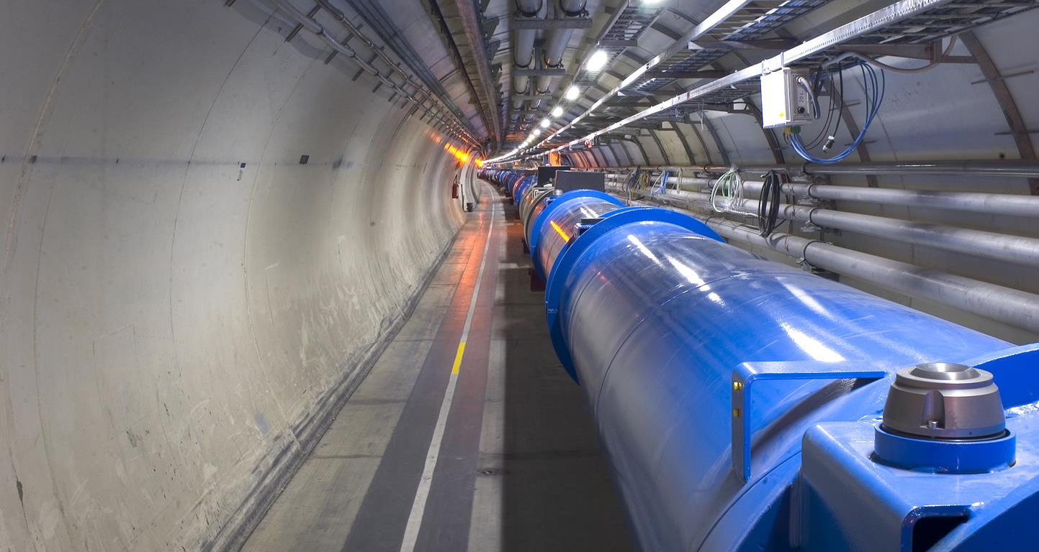
LHC Status Report
Tobias Persson
on behalf of the LHC operations team

Slide 2
Outline
Machine checkout
Beam commissioning
First stable beams in 2023
Intensity ramp up and crossing angle adjustment
Highlights in luminosity production
4L1 event and recovery
Outlook

Slide 3
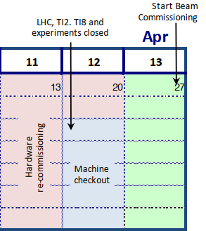
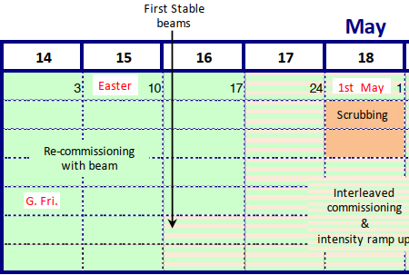
Machine checkout
Many checks of different system during the machine checkout:
Injection kickers
Vacuum interlocks
Interlocks and signal exchange with experiments.
Beam instrumentation (Beam position monitors, Beam Loss Monitors, Tune measurements system).
RF Low-level setup, Transverse damper
Controls and sequences
Collimators
Checkout
+
Intervention
point 7
A problem with a crystal collimator, was found and an intervention was needed. This delayed the startup with a few days.

Slide 4
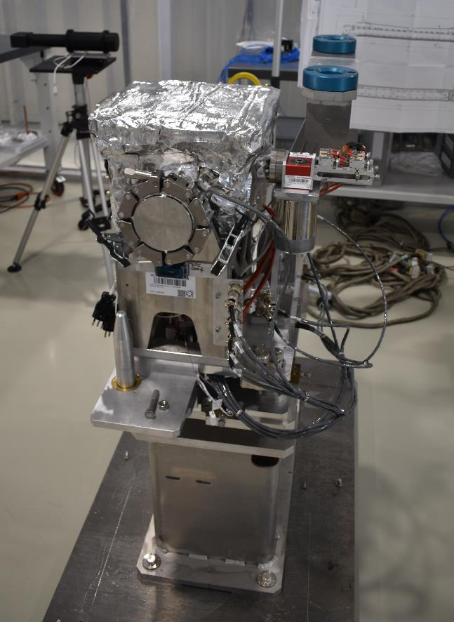
Crystal collimator
Installed in Feb 2023
Baked and commissioned
Motor lost steps during hardware commissioning (failure mode)
  Crystal halfway in, could not be moved from outside
  Intervention was needed and a replacement chamber was installed
    Will be installed in TS1
  Baseline for collimation in the Ion Run
    Without it we can’t reach the same nominal intensity for the ions

Slide 5
Beam commissioning

Slide 6
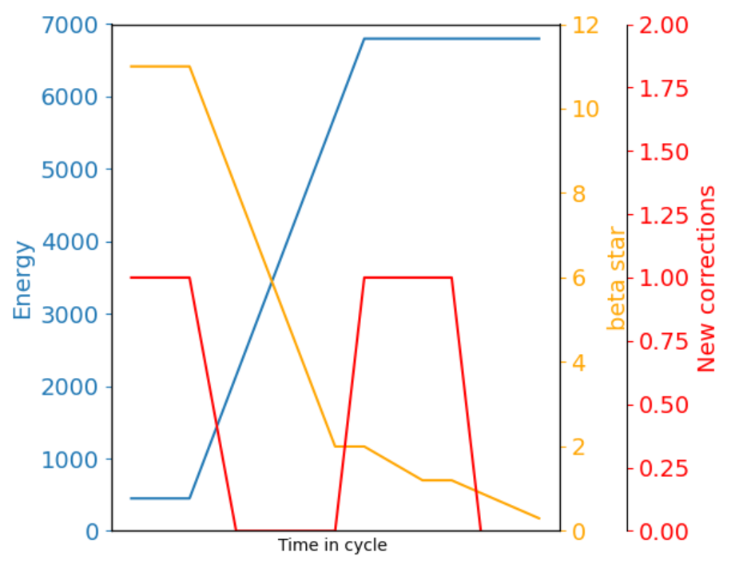
Why was the commissioning so short this year?
Beam commissioning started Tuesday March 28th
21 days for beam commissioning until first stable beam at 6.8 TeV in nominal cycle
  Helped by a very high availability of ~90%.
    Including the 4 lost days → 72%
      Rapture disc
      Switch to high-heat load configuration for cryo
The new cycle was already extensively tested during MDs in 2022
  Part of the cycle has also stayed the same
Increased understanding and experience from 2022

Slide 7
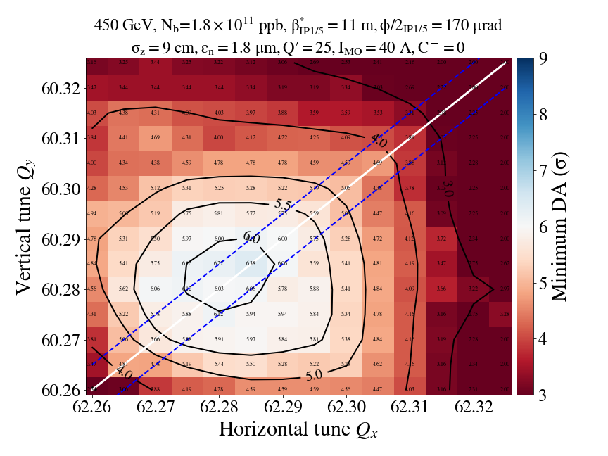
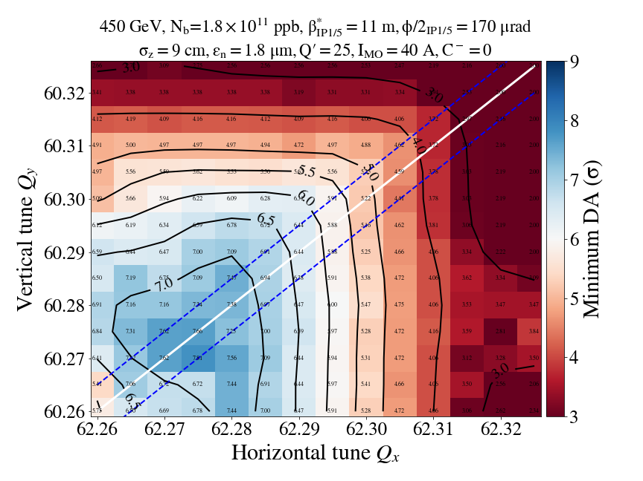
Injection, what is different this year?
New setting of the trim quadrupoles to change the phase advance to reduce the negative impact of the strong octupoles at injection needed to stabilize the beam
Preliminary analysis show an improvement of life time at injection
Dynamic aperture simulation
Nominal
New knob

Slide 8
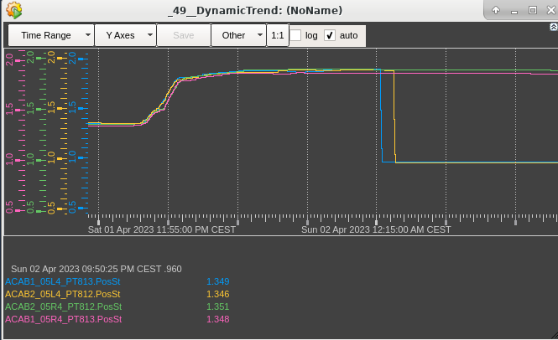
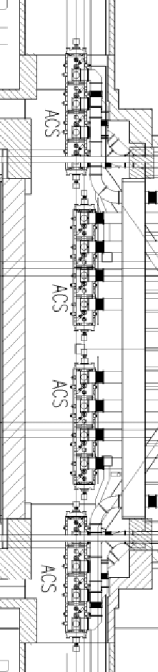
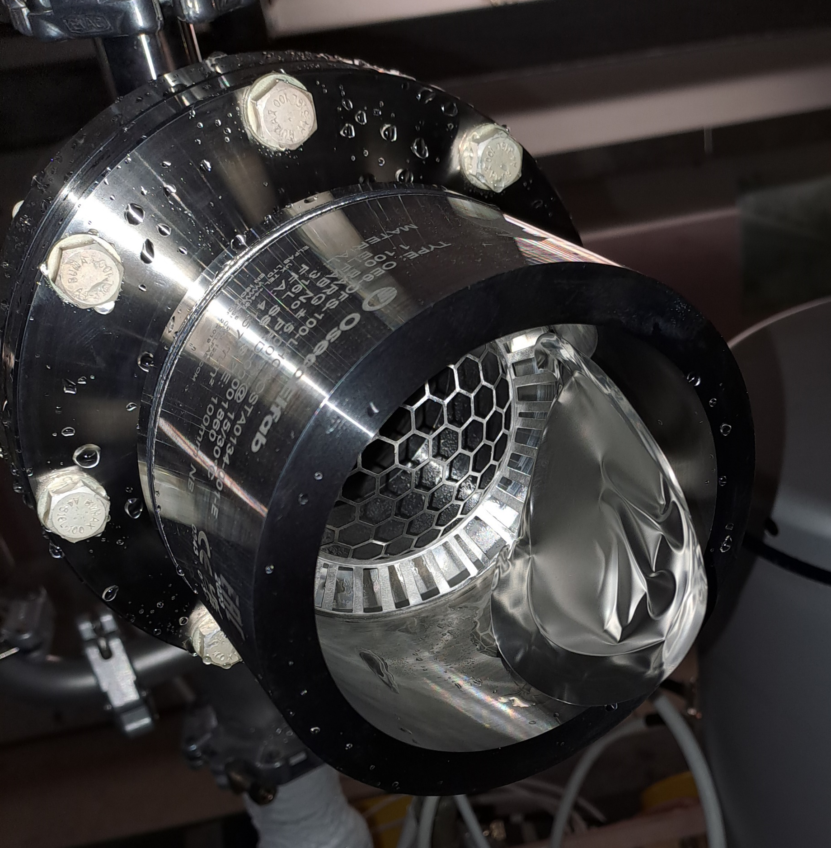
Rupture disc burst 2nd of April 2023
Following a power cut in IP4:
  2 rapture discs burst
    The rapture discs are crucial for certain failure scenarios
Replaced only 4 hours later
  Thanks to the fast intervention and reactions from everyone involved we were able to have back the RF conditions already on ~2.5 days after the incident
Cryomodule
He pressures
Rupture discs opened on C2B1 and C5B2

Slide 9
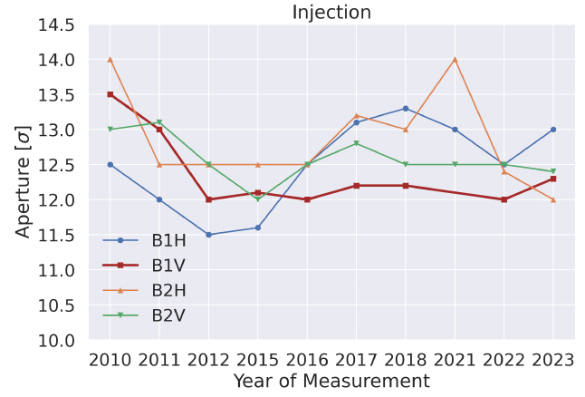
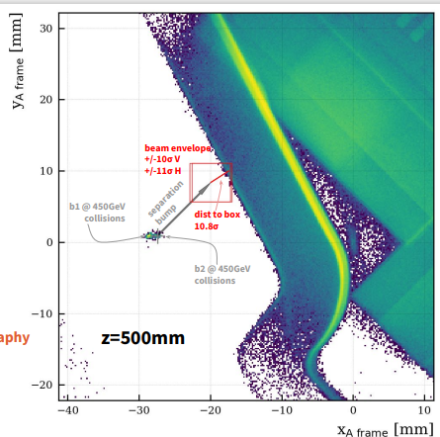
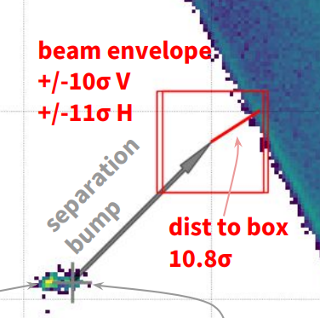
Aperture
Good aperture, as in previous years
Sufficient aperture & protection by collimation system throughout cycle
Injection: LHCb VELO is not the bottleneck
  Confirmed by tomography and by local aperture measurements
Probe the VELO with local bumps
Results consistent with tomography

Slide 10
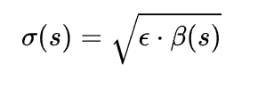
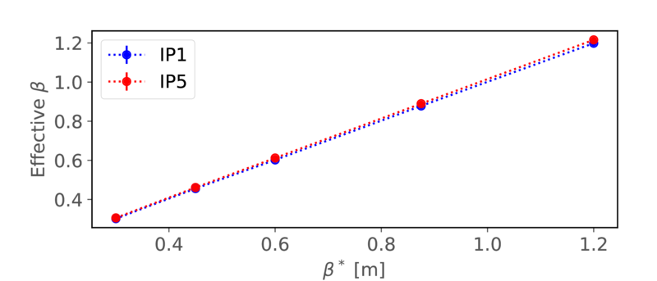
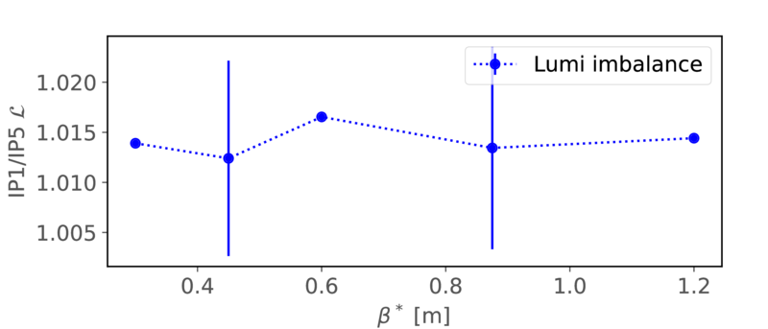
β* and luminosity
The β-beat was measured and corrected throughout the cycle
The β* was measured from 1.2m down to 30 cm using k-modulation
  3 times larger β* levelling range compared to 2022!
Analysis indicates a ~1.5% higher luminosity from β* for ATLAS
  To reduce error bar more measurement would be needed
LNO section meeting, F. Carlier

Slide 11

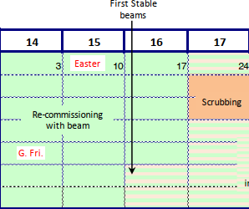
Ion commissioning already started!
IP1/2/8 are squeeze to 50 cm already in the ramp
Optics corrections already calculated
To do:
  Switch on separation and crossing schemes.
  Collimation setup
  Inject Pb ions…
After corrections | B1x | B1y | B2x | B2y | β* effective | Lumi relative to IP2
IP1 | 0.52 | 0.53 | 0.49 | 0.51 | 0.51 | 0.985
IP2 | 0.50 | 0.50 | 0.52 | 0.50 | 0.505 | 1
IP5 | 0.48 | 0.50 | 0.51 | 0.51 | 0.5 | 1.01

Slide 12
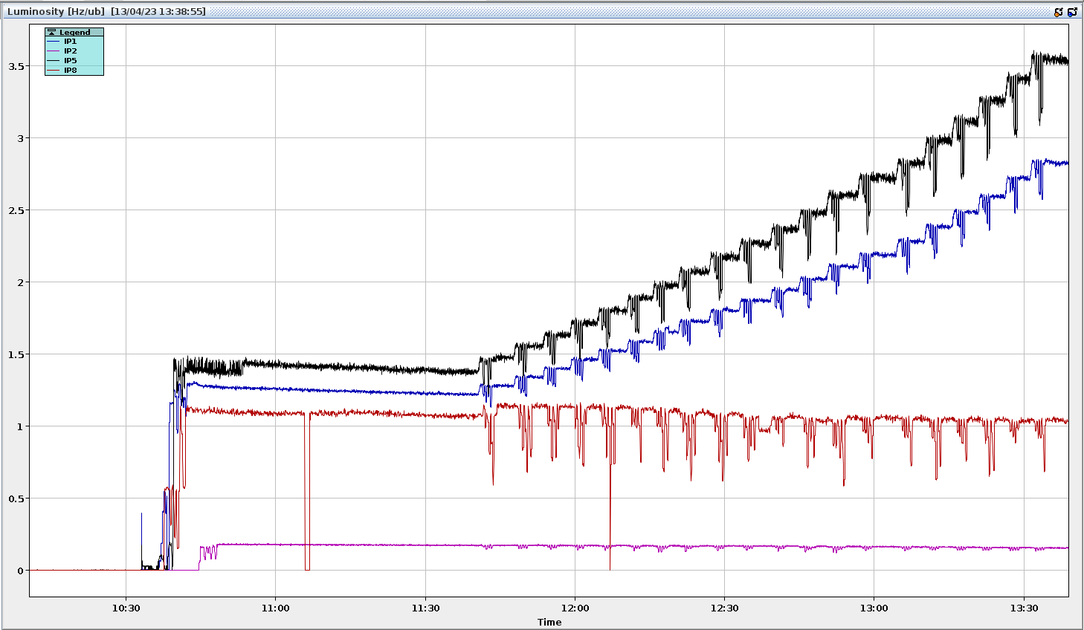
Collisions at 6.8 TeV
The vdm cycle was quickly recommissioned to establish first collisions at 6.8 TeV on Easter Monday
  Based on correction for tune, chroma and β-beat from 2022
First low β collisions at 1.2 m took place 3 days later, immediately followed by β* levelling to 30 cm
First β* levelling 120 cm to 30 cm

Slide 13
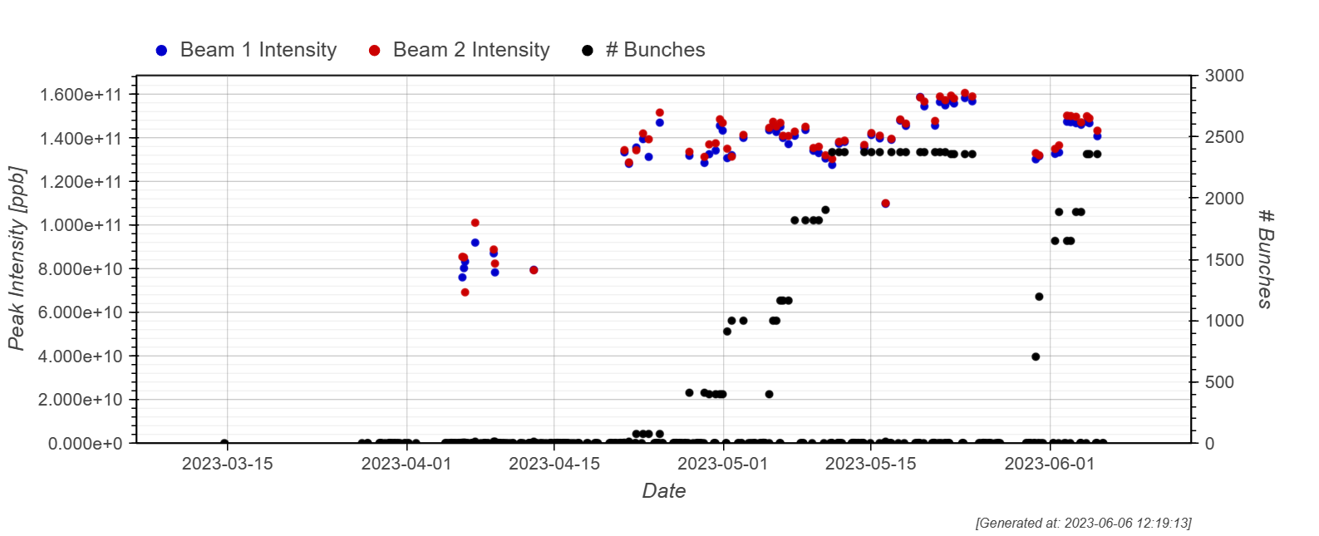
Intensity ramp up

Slide 14
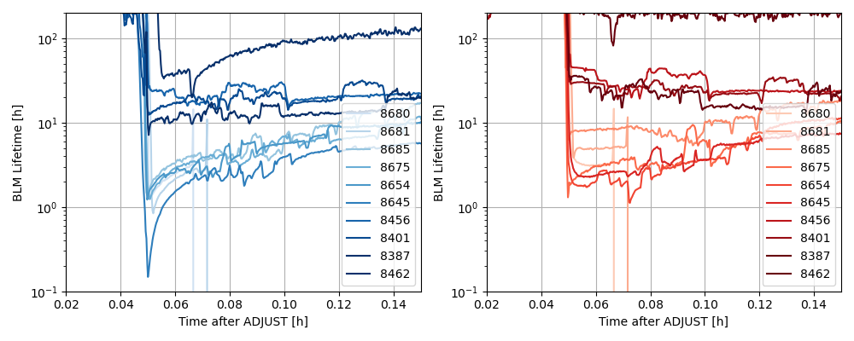
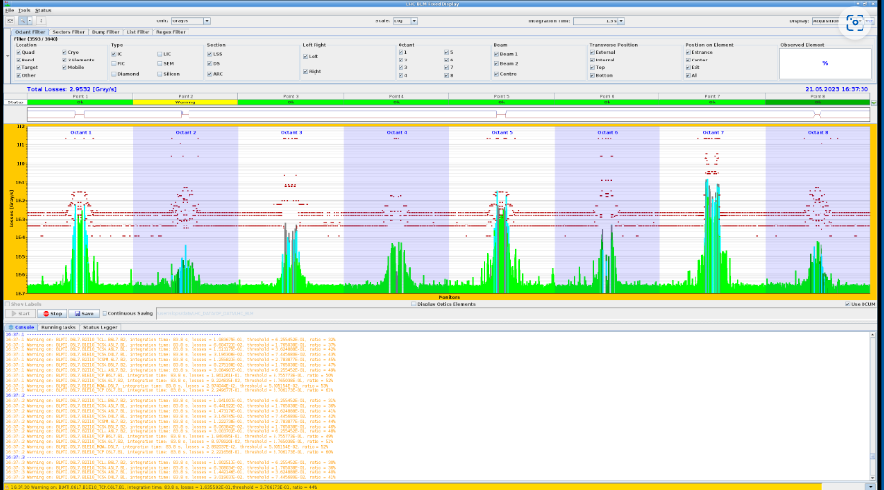
Intensity ramp up
During the intensity ramp up we got dumped due to losses when we went into collision
  Collimator with an angle was retracted which fixed the issues with the dumps coming from high losses going in collisions
Investigation ongoing to understand the worse lifetime when going to collisions
  Not blocking any intensity increase
2022
2023

Slide 15
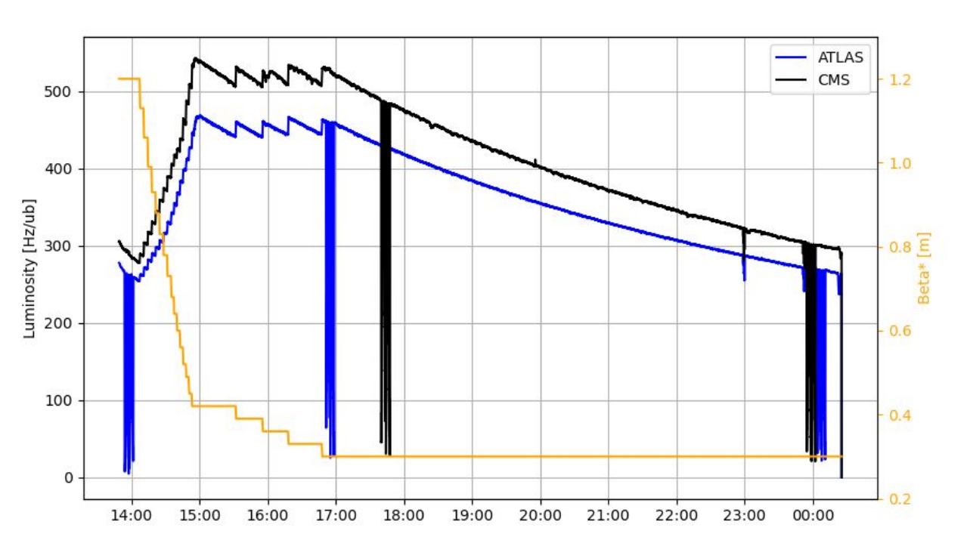
Luminosity in the early fills
Significant difference between ATLAS and CMS
At 30 cm the relative difference decreased
  Sign that part of difference was due to crossing angle
  Two independent beam position monitoring system also showed crossing angle was larger in ATLAS

Slide 16
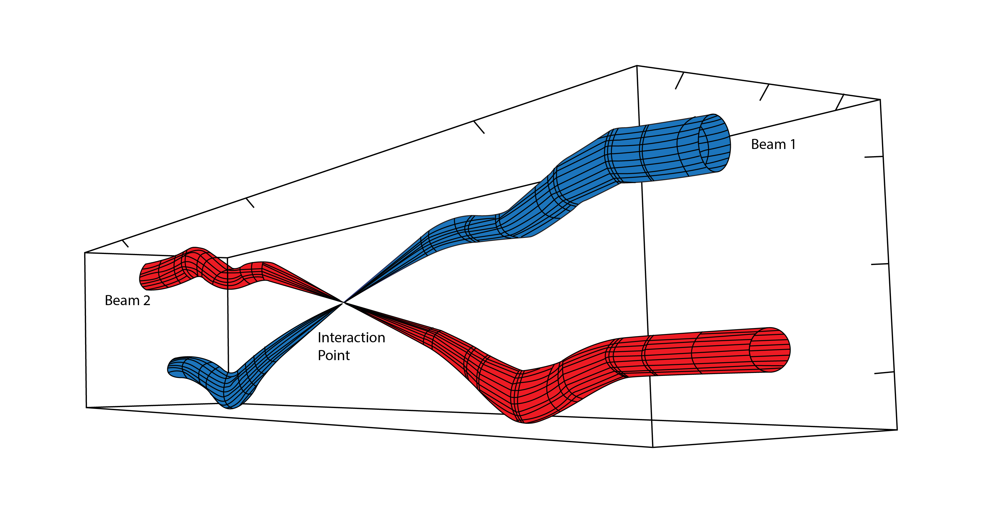
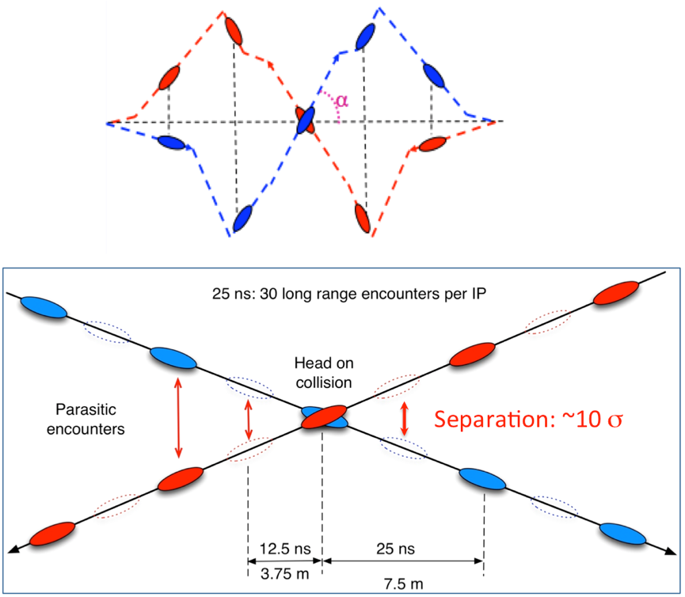
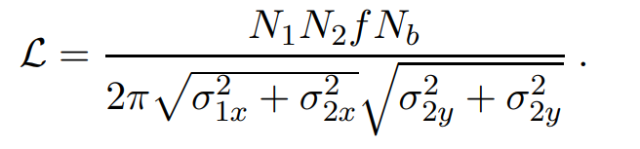
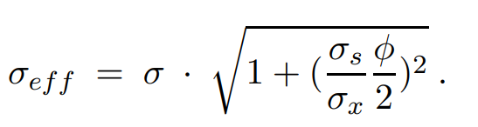
Crossing angle
We need the crossing angle to reduce the parasitic encounters
Has an impact on the luminosity
  Larger crossing angle -> Less luminosity
We just adjusted down the crossing angle for ATLAS by 10u rad and now the measured luminosity is much closer between ATLAS and CMS
  Done at the same time as retracting the collimator
  Saved time in terms of validation needed
In case of a crossing angle one can calculate an approximative effective beam size following this formula

Slide 17
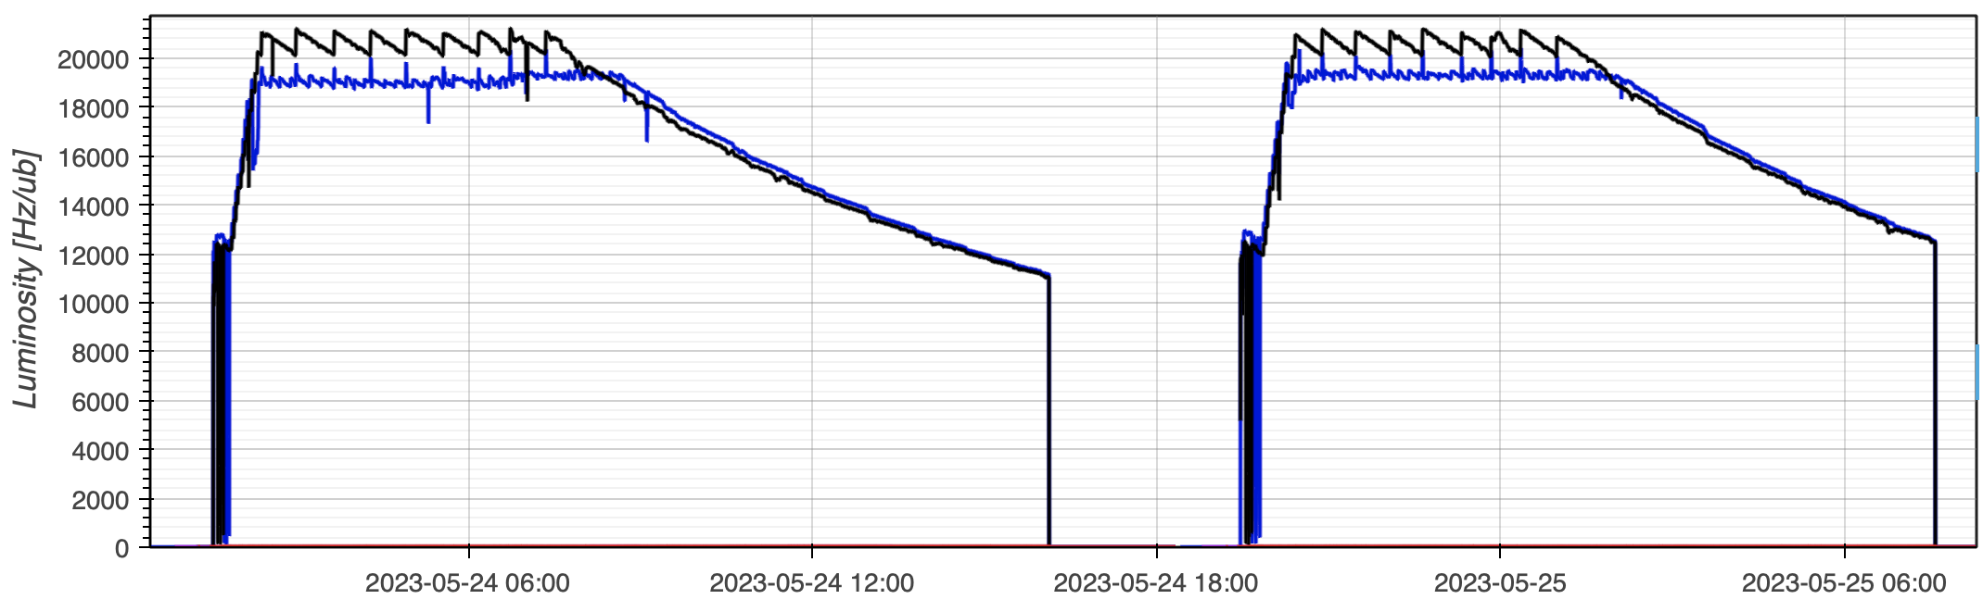
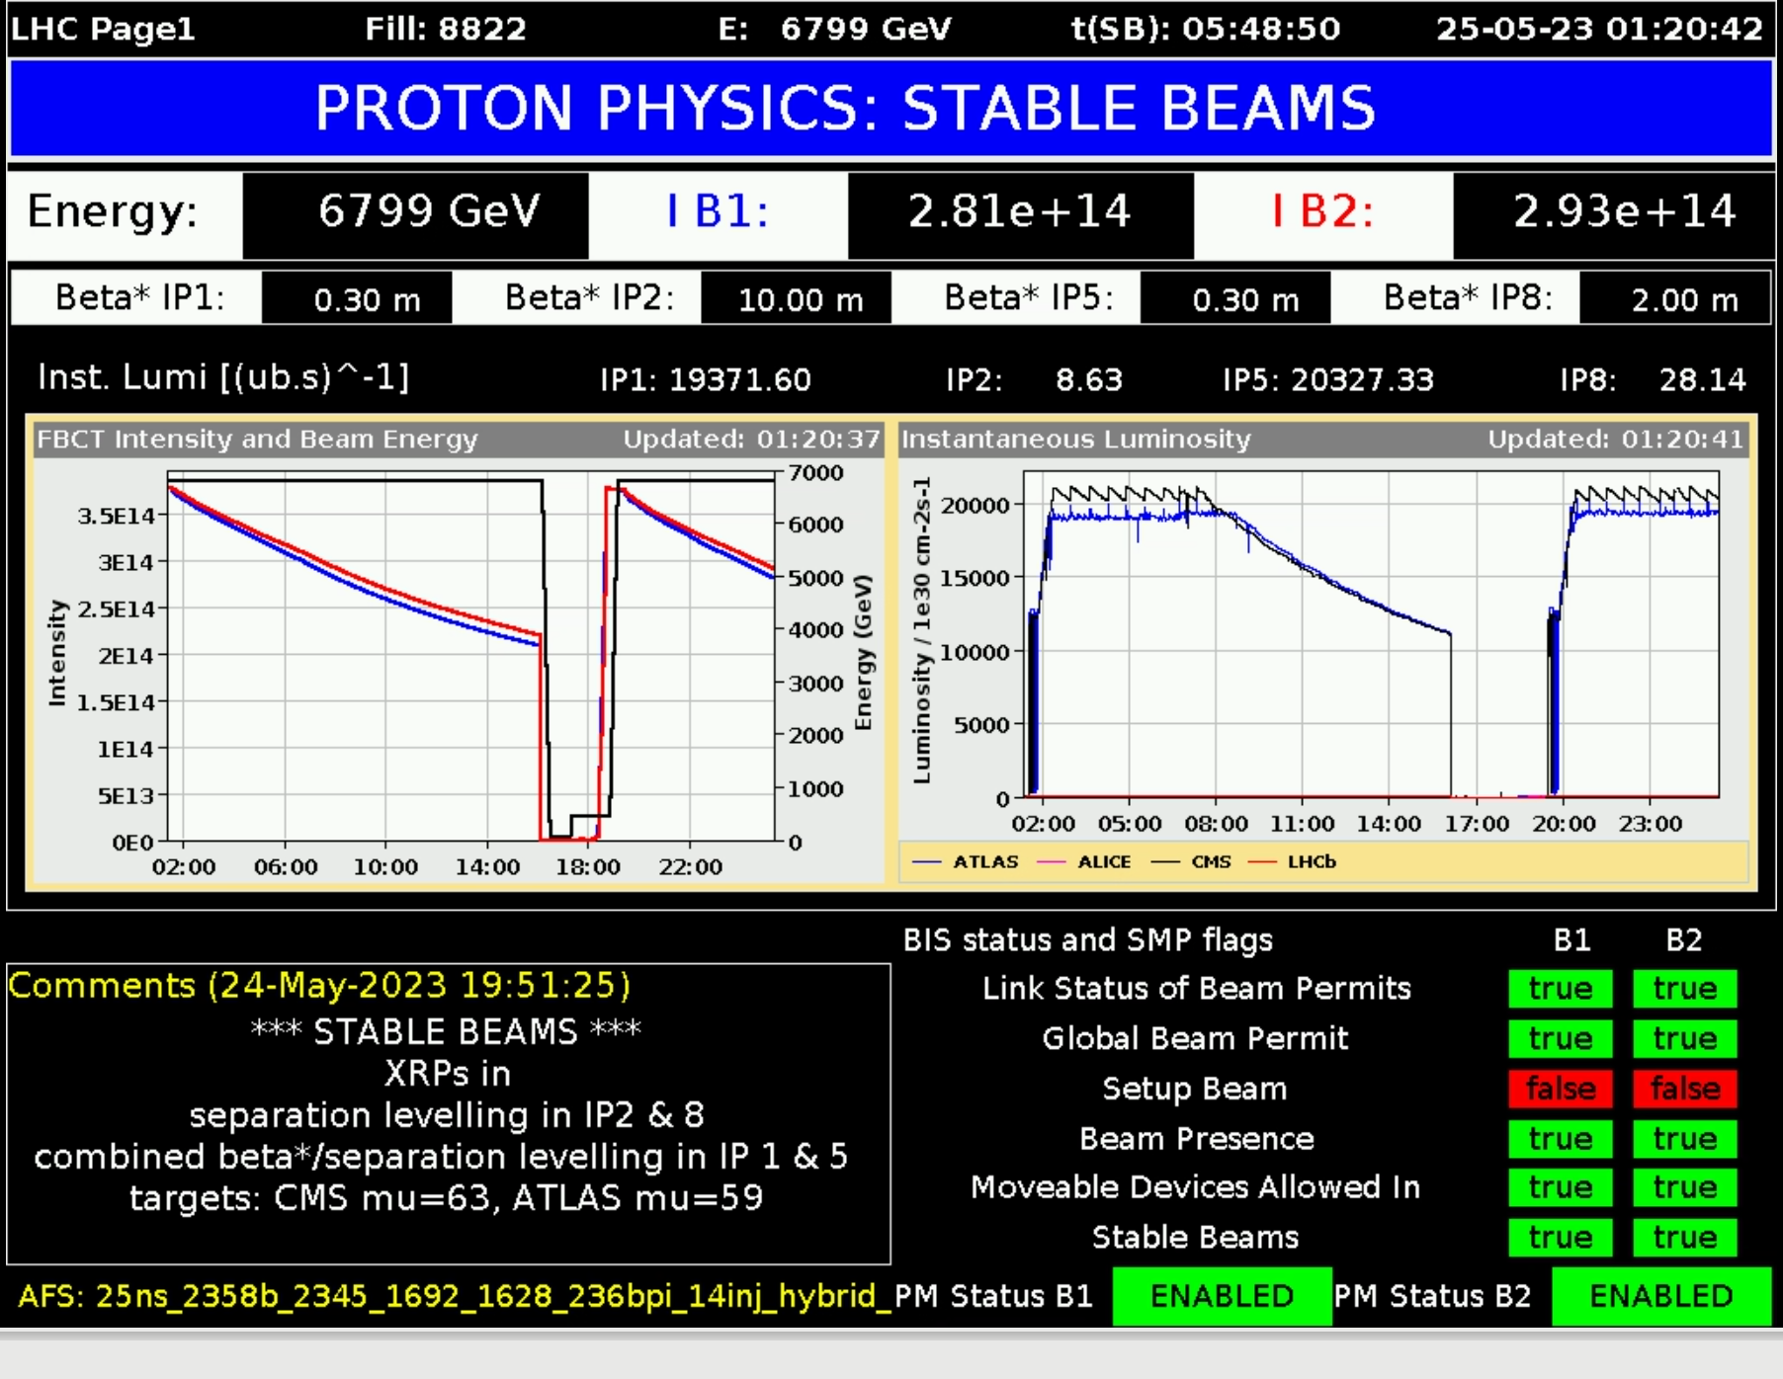
Physics fills performance end of May
New record: Integrated luminosity: ~1.2 fb⁻¹ in 24h !
Peak levelling just above 2.0 x 10³⁴cm⁻²s⁻¹
Pileup targets ATLAS/CMS = 63 / 59
  Thanks to combined separation β* levelling and separation levelling we can deliver different pile up to ATLAS and CMS!
Luminosity difference also reduce due to updated calibration factors
Max at start of stable beams: 409 MJ
1.59 x 10¹¹ p/b (Injected: 1.61)
24th to 25th of May 2023

Slide 18
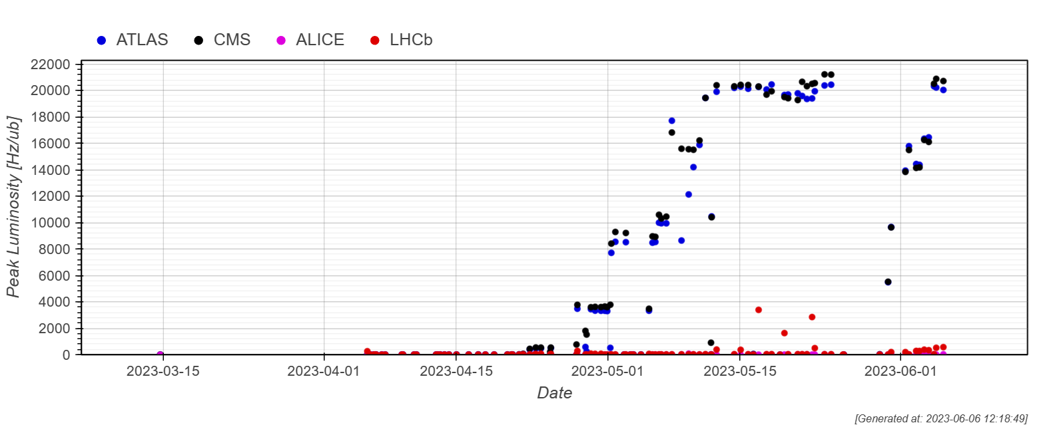
Peak luminosity evolution
The pileup is limiting the peak luminosity at the moment, but we are also close to the cryogenic limit for the inner triplets
  2.2*10³⁴cm⁻²s⁻¹ is currently the maximum operational limit

Slide 19
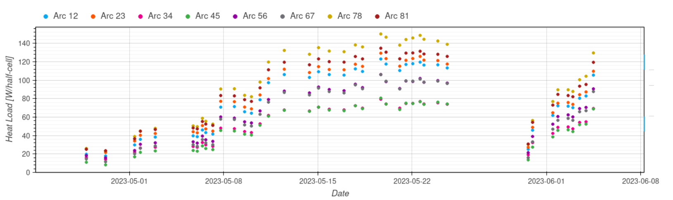
Heat Load
The heat load is under control even for the highest intensity fill we are below 150W/half cell
  Up to 183W/half-cell in 2022 even though the total intensity was very similar
Thanks to hybrid filling scheme (mixture of 8b4e and 36 bunch train)
  First time we use in normal operation
  Significant effort from the injectors to make this happen!

Slide 20
4L1 event

Slide 21
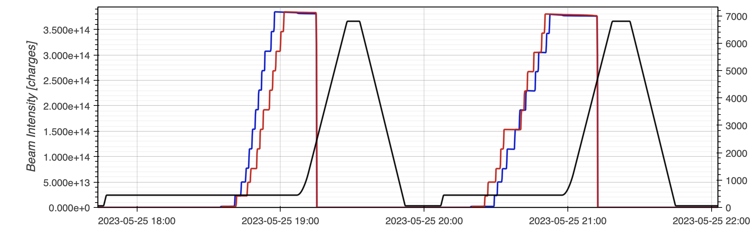
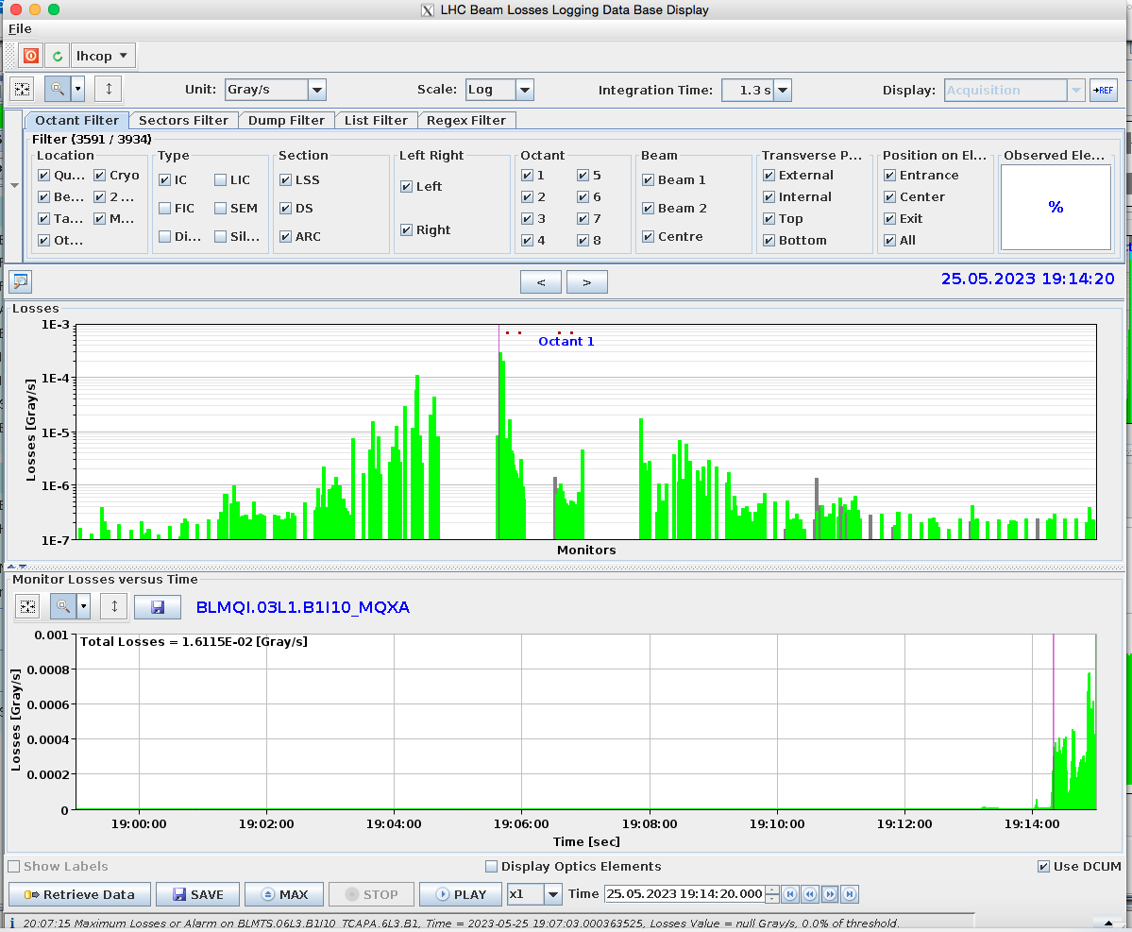
4L1 event
Evening of the 25th of May the beam was dumped during the ramp due to losses
  The highest losses were at Q3.L1
BLMQI.03L1.B1
QX.L
QX.R
IP1
21

Slide 22
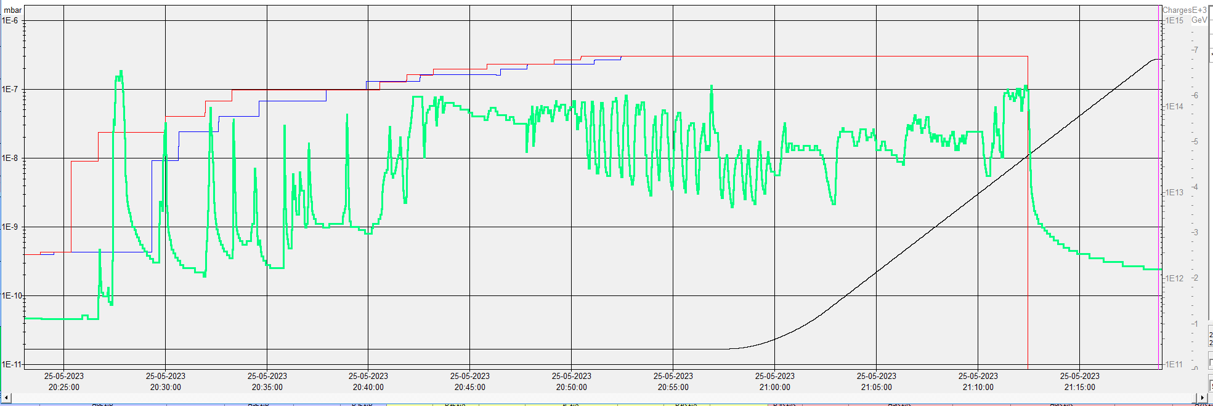
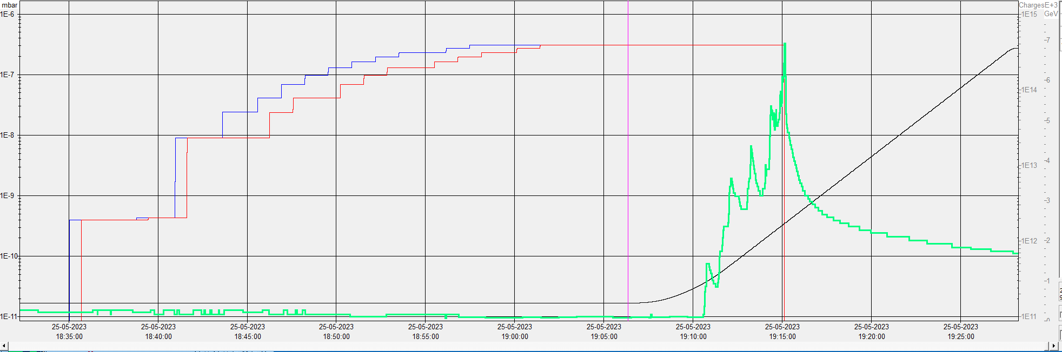
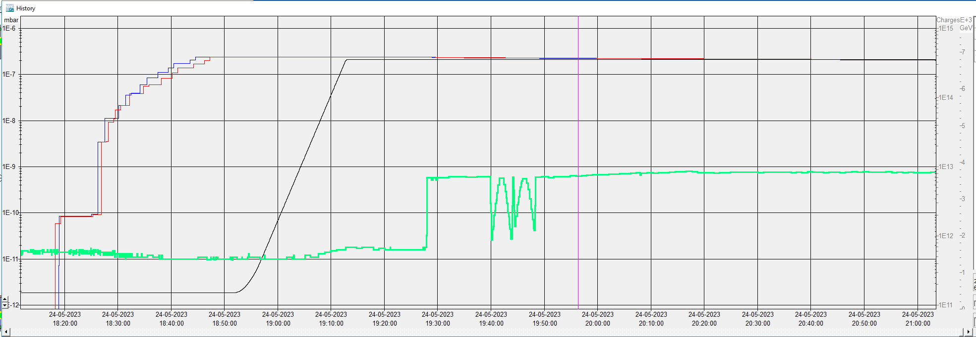
4L1 issue
Already issues at injection with the vacuum
High intensity operation was stopped after this!
The issue was not present the day before
Day before
First ramp that dumped

Slide 23
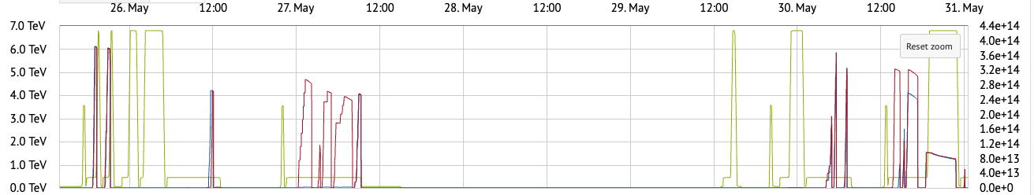
Intervention on 1L4
Many thanks to all the people involved, in particular VSC, MME, RP, CEM, BI and may other
After the high intensity was stopped a validation that there were no aperture restrictions done
  Loss maps
  Aperture measurements
X-ray campaign was launched to find the source day after
  The source was found to be “module 5” located left of IP1
Intervention to exchange was started ~2 days after the issue was first and vacuum pumping started as soon as it was finished
Issue found
Check location with beam & intensity scaling
Collimation losses & apert. Checks
Stoking filler: coupling/K-mod
First X-ray campaign
Machine full, 450GeV
Recovery: pilot cycle
Stable Beams
X-rays
Intervention and vacuum recovery

Slide 24
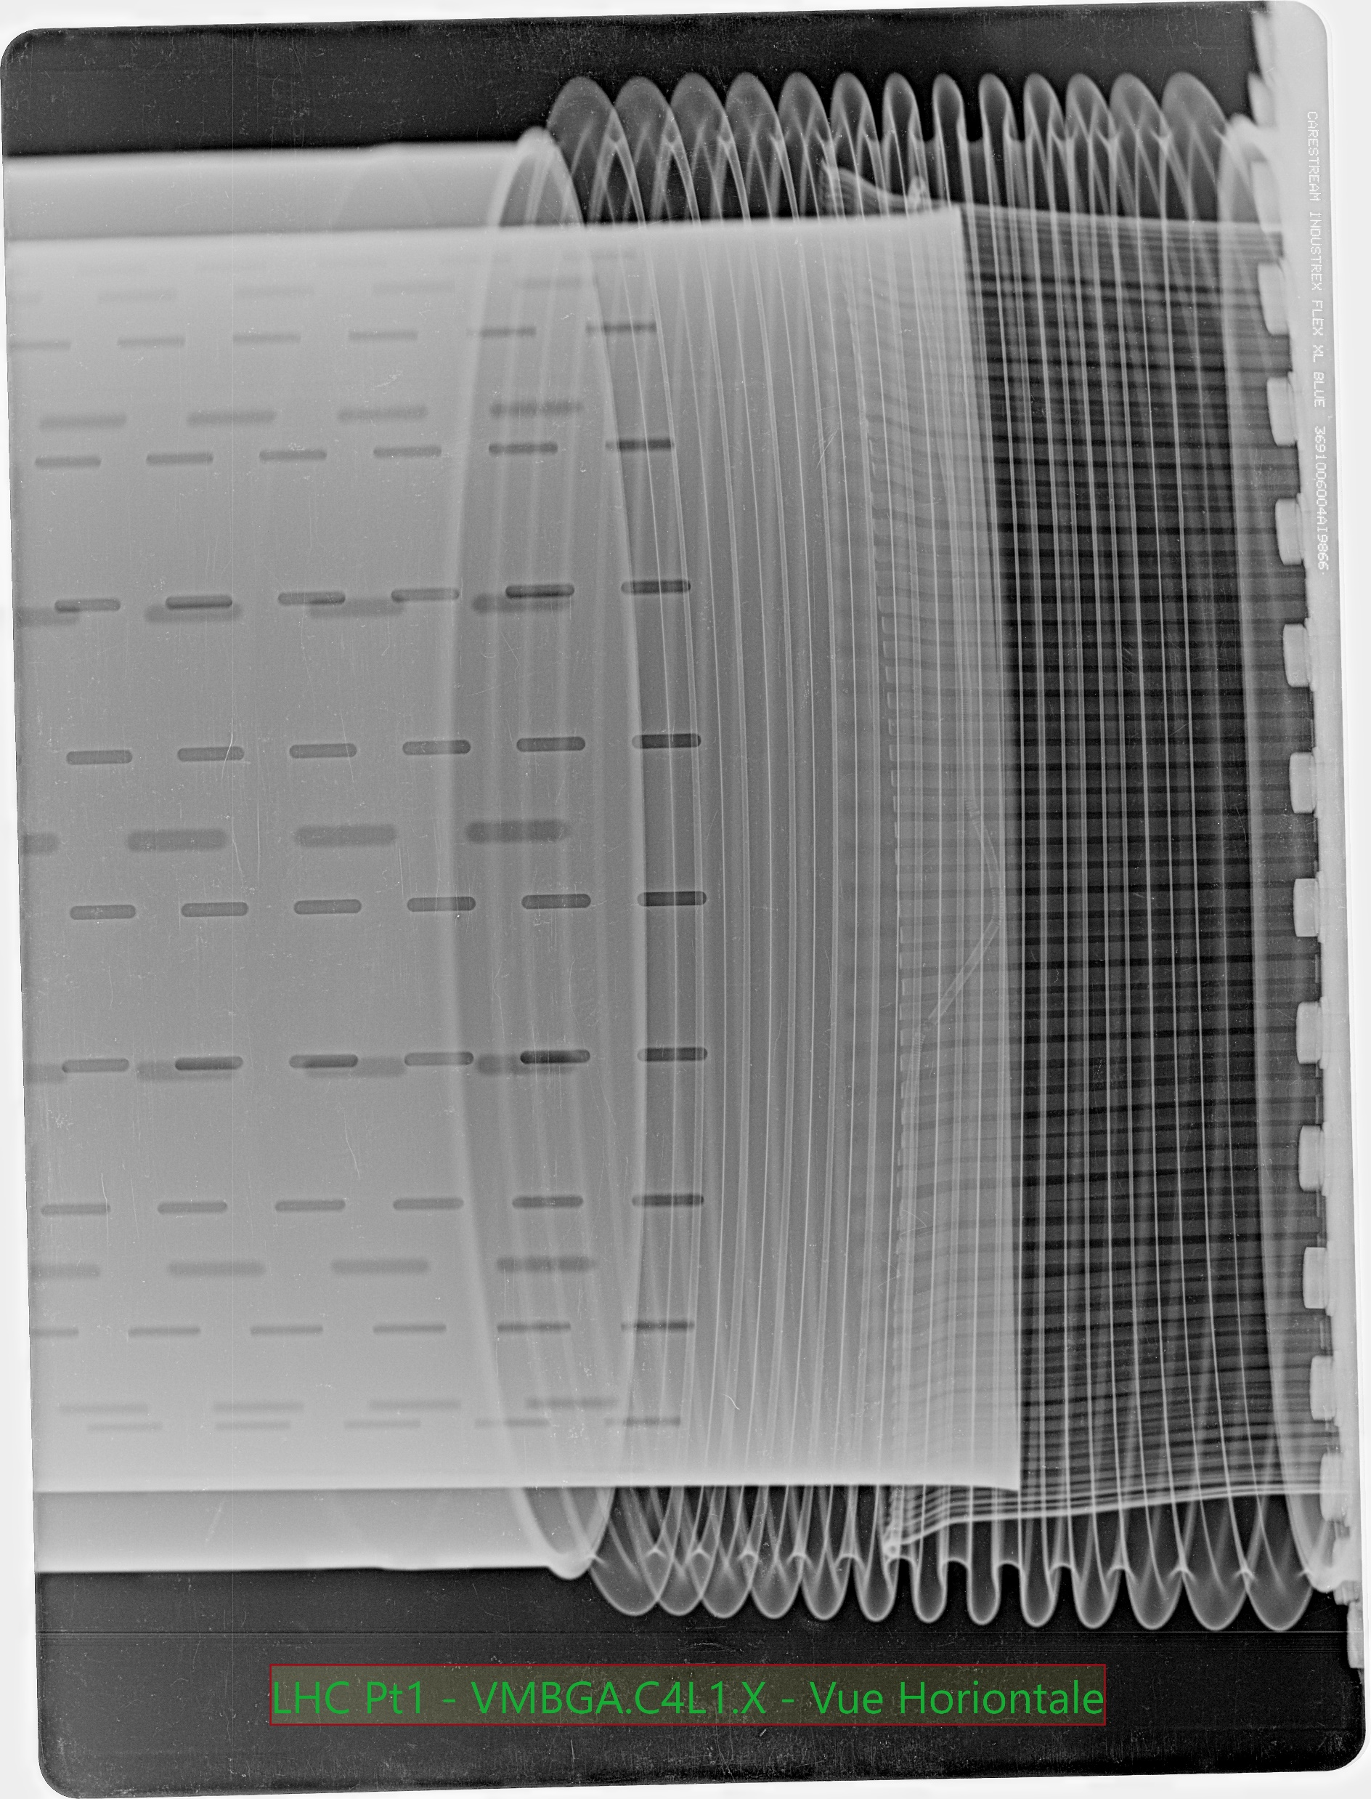
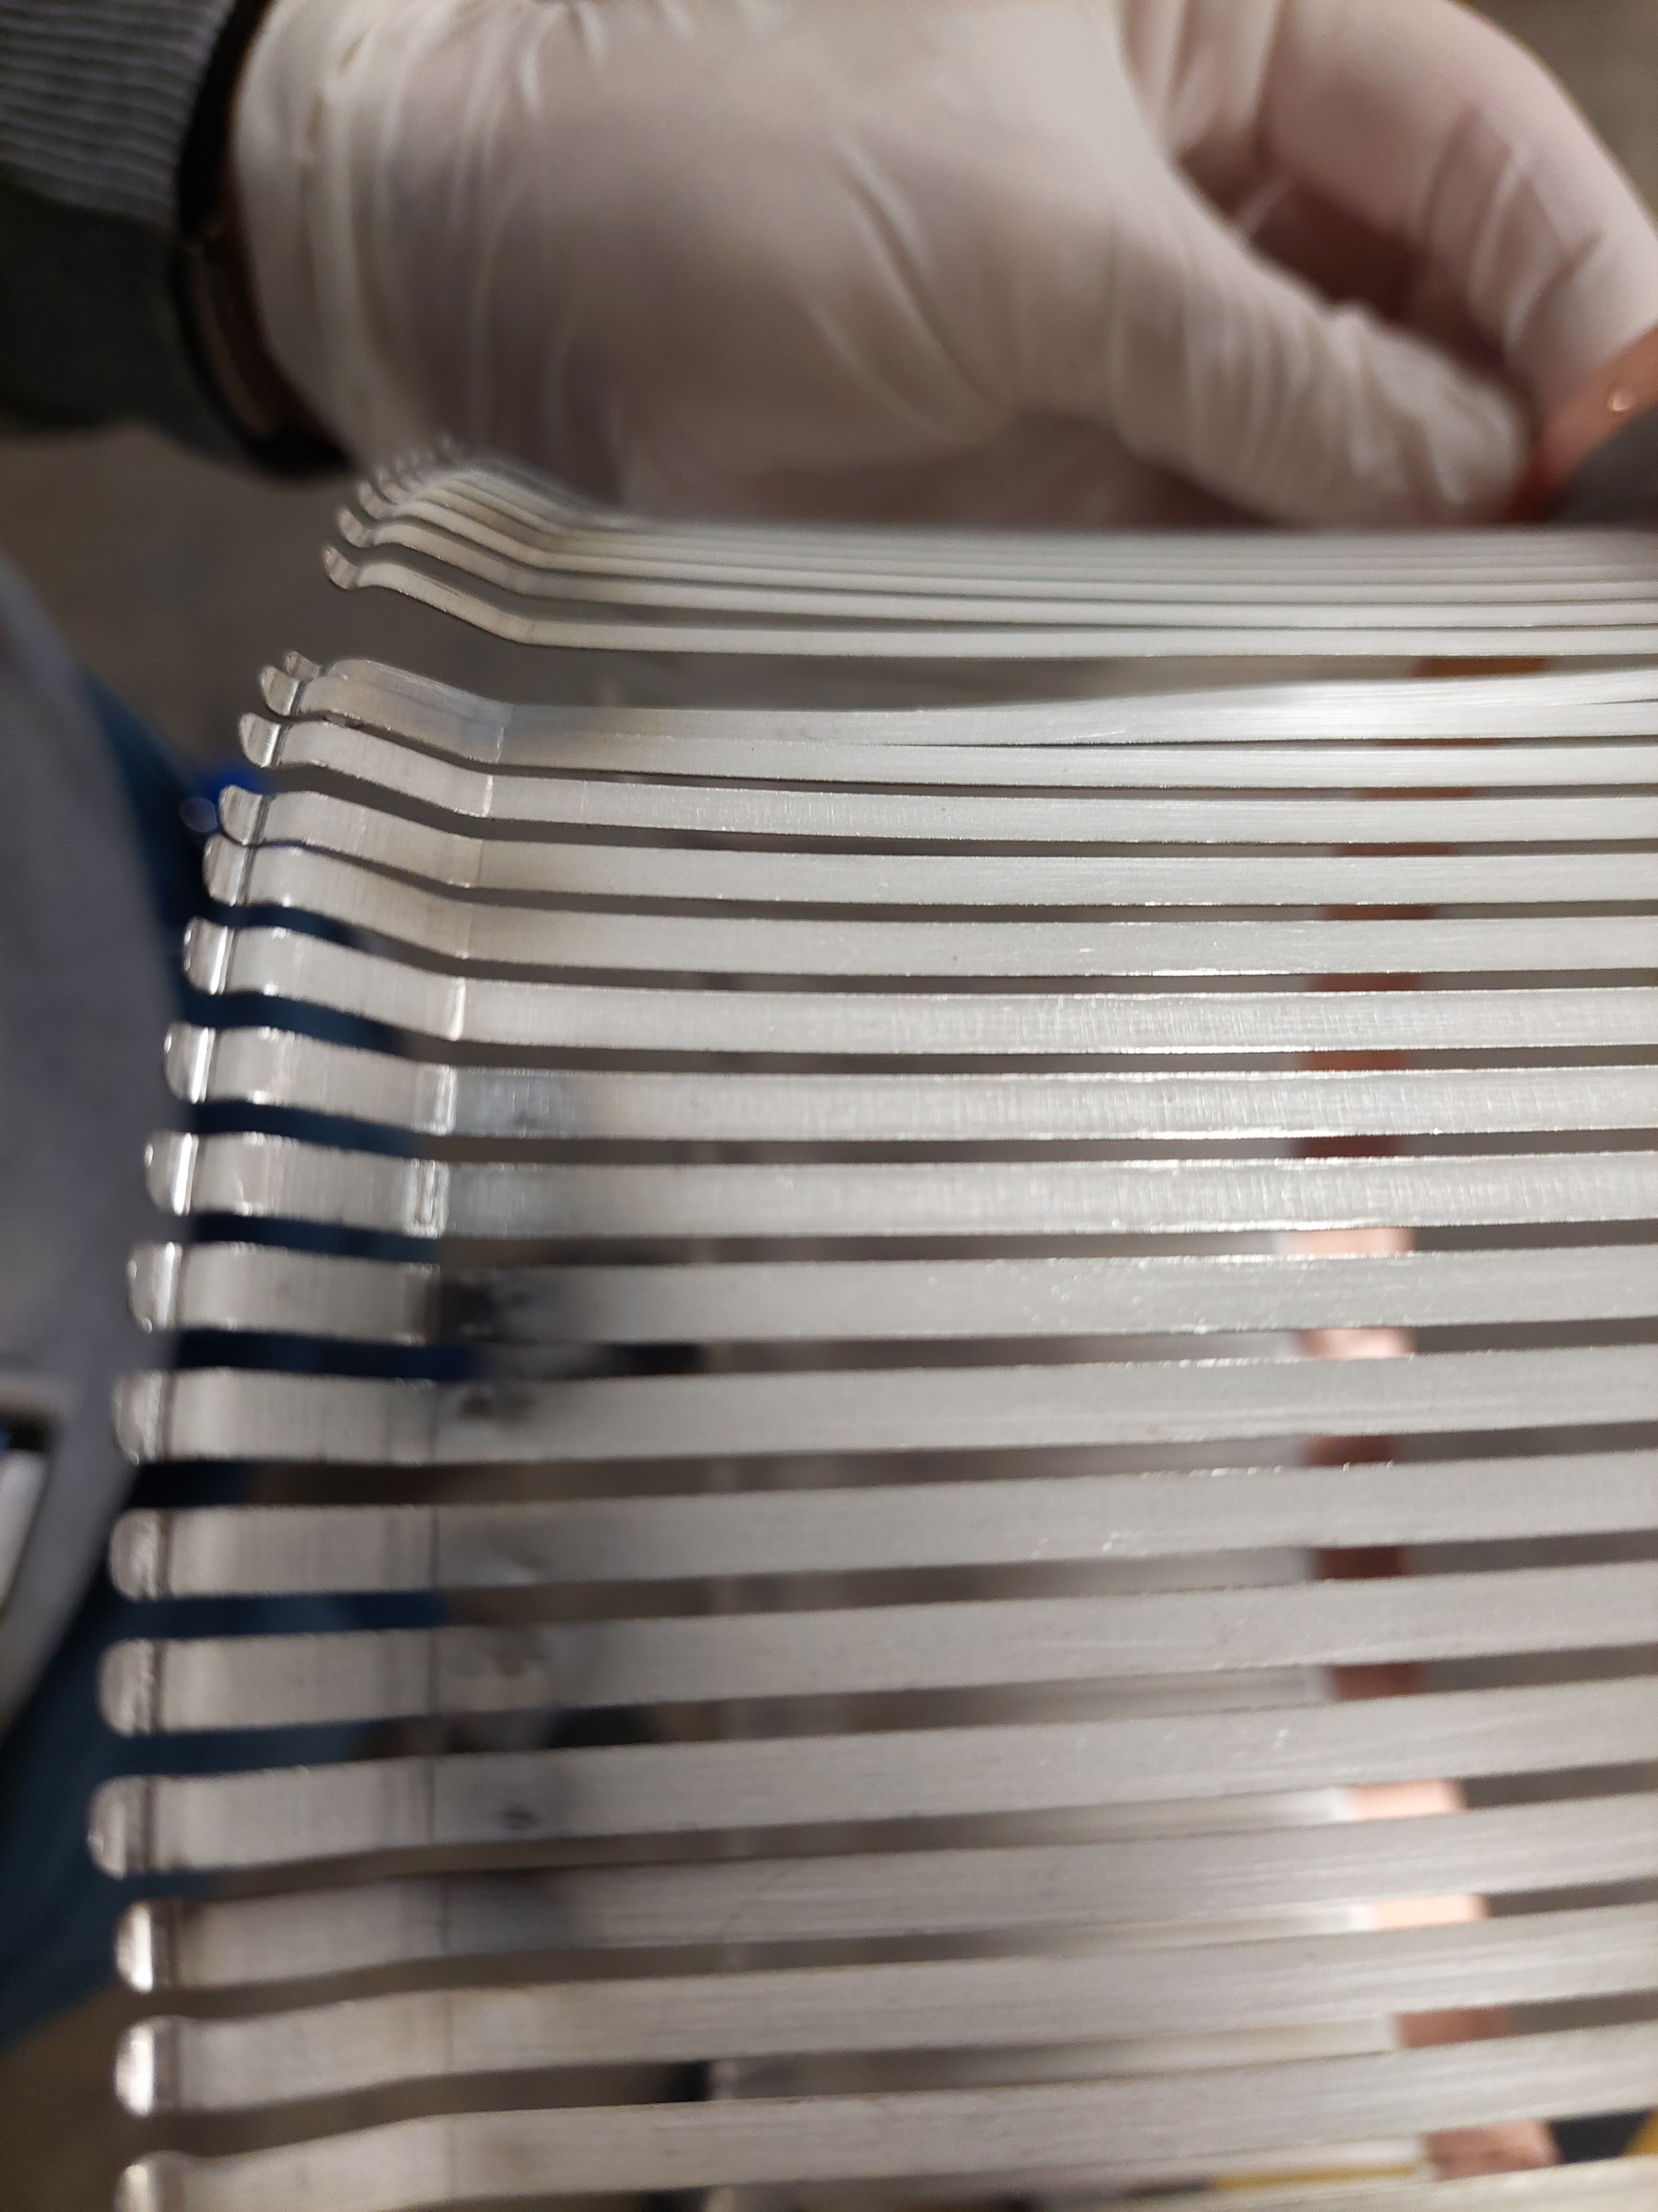
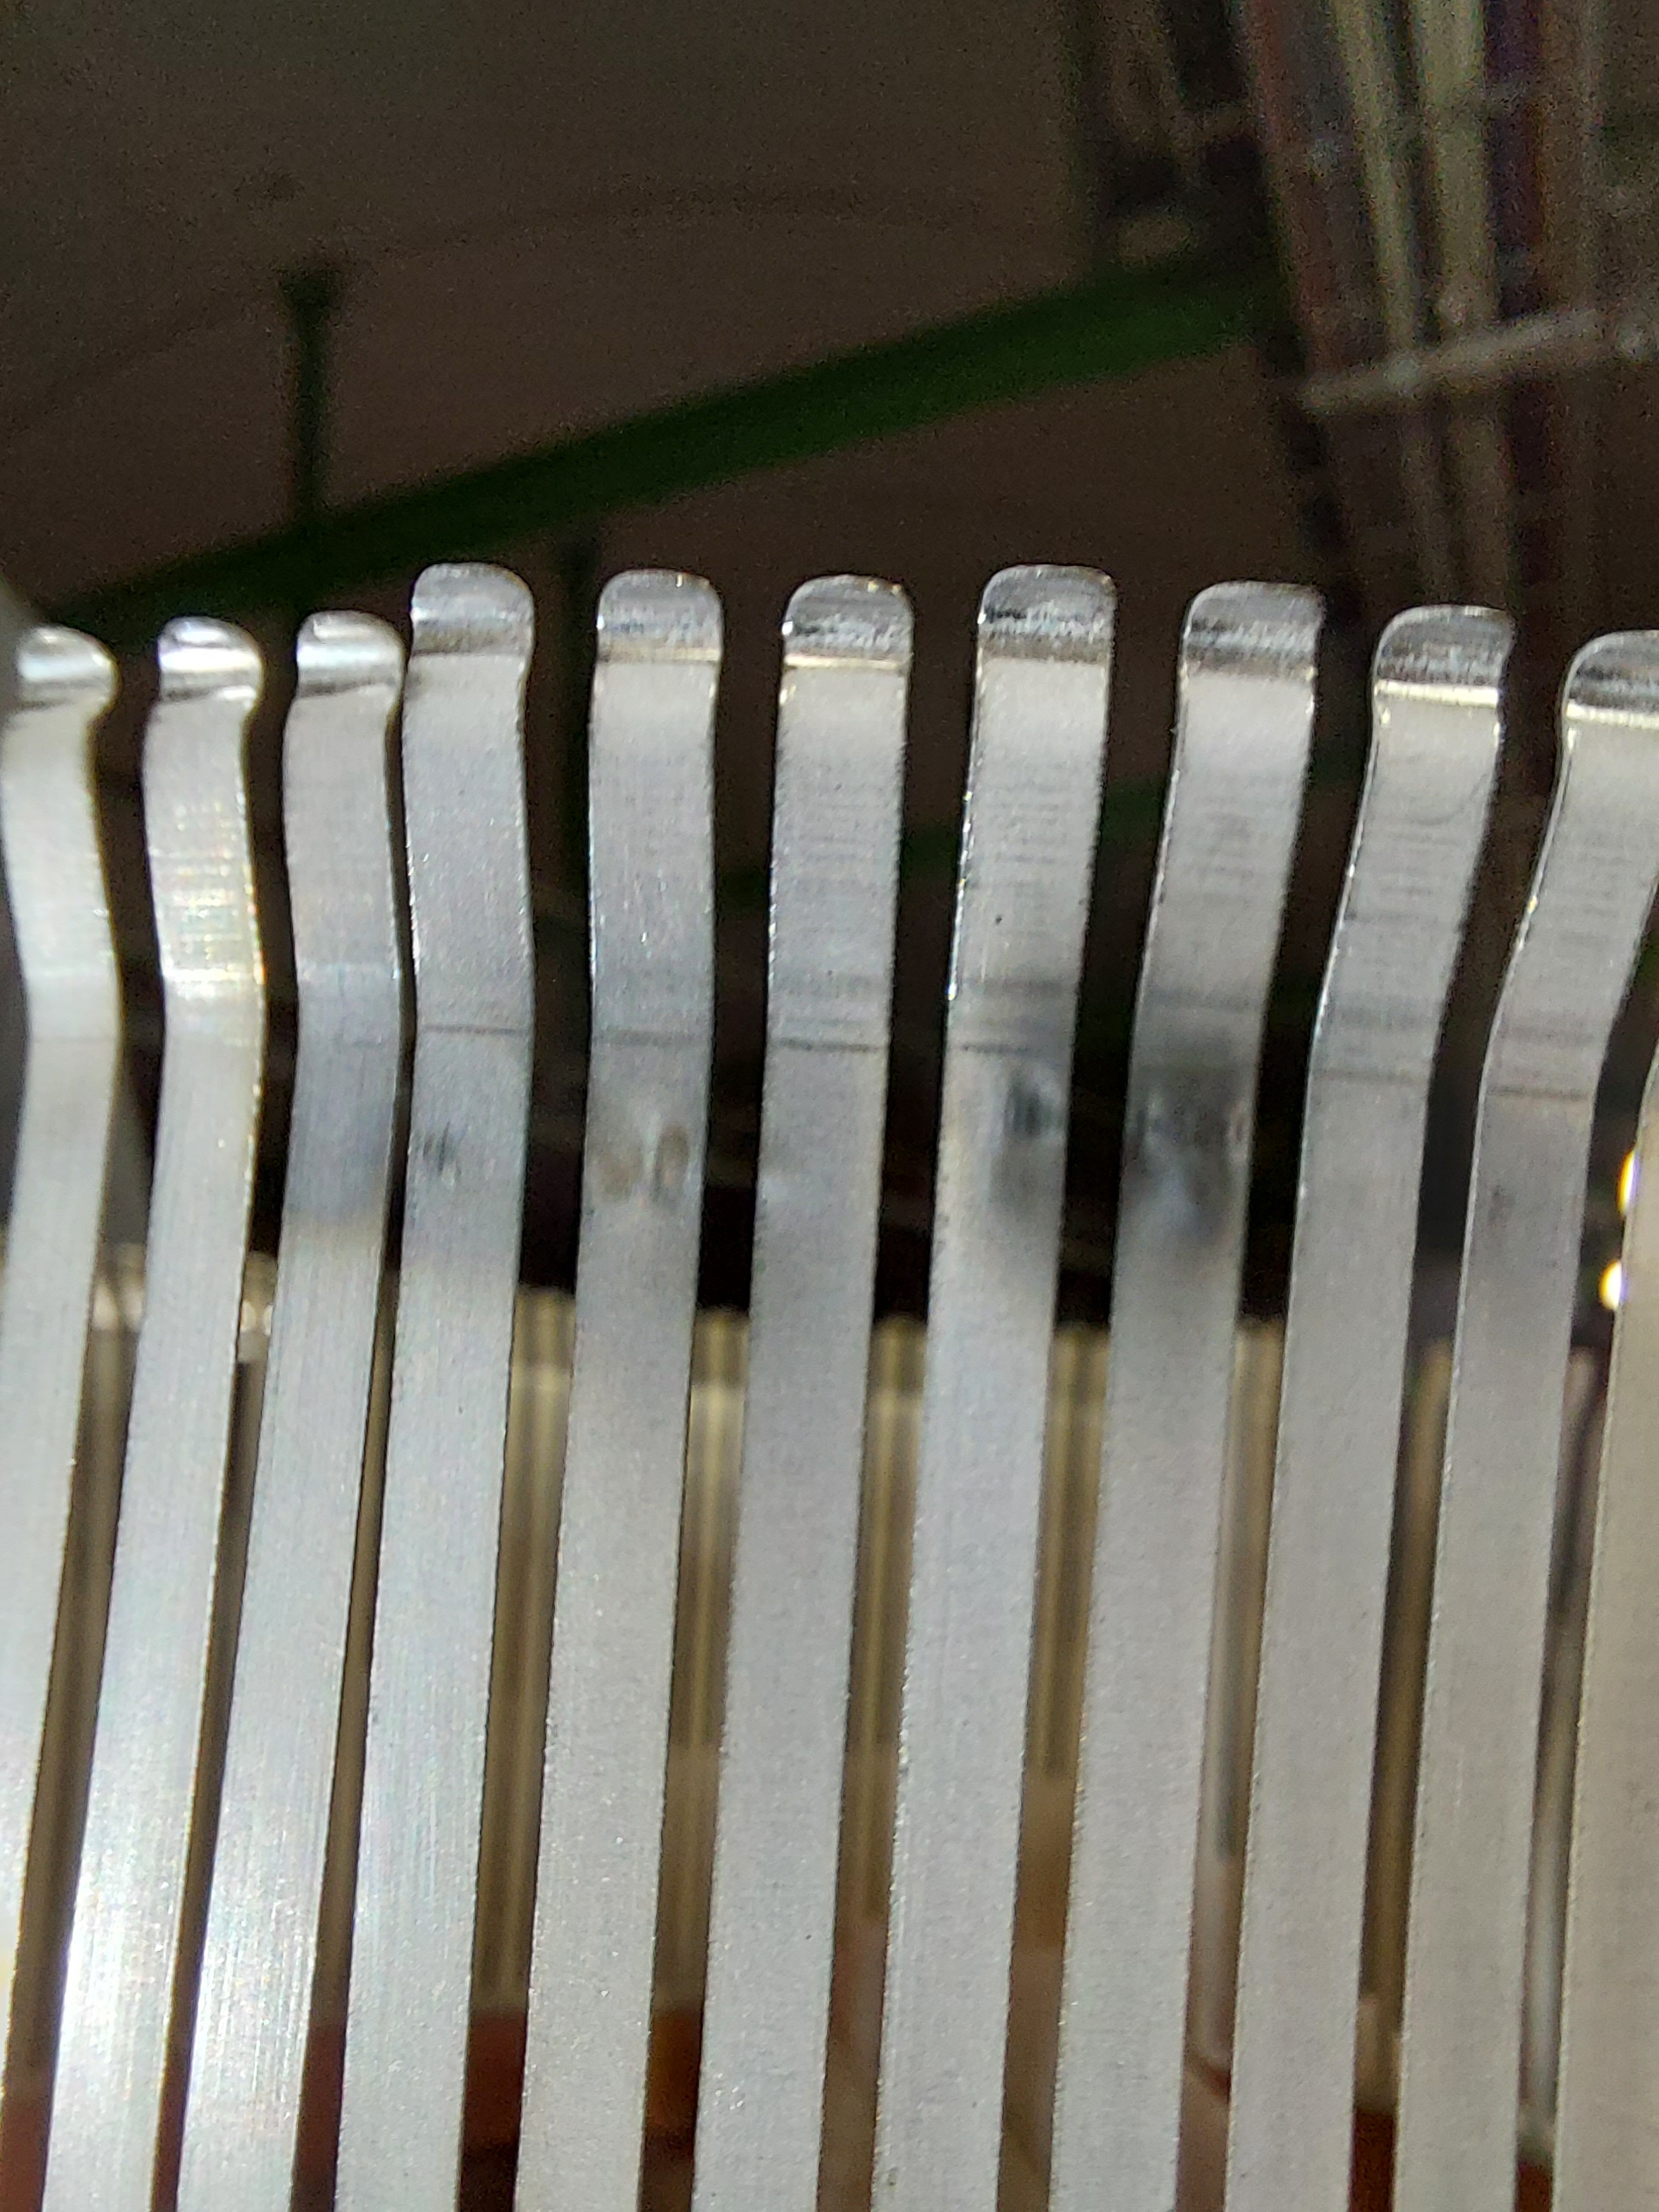
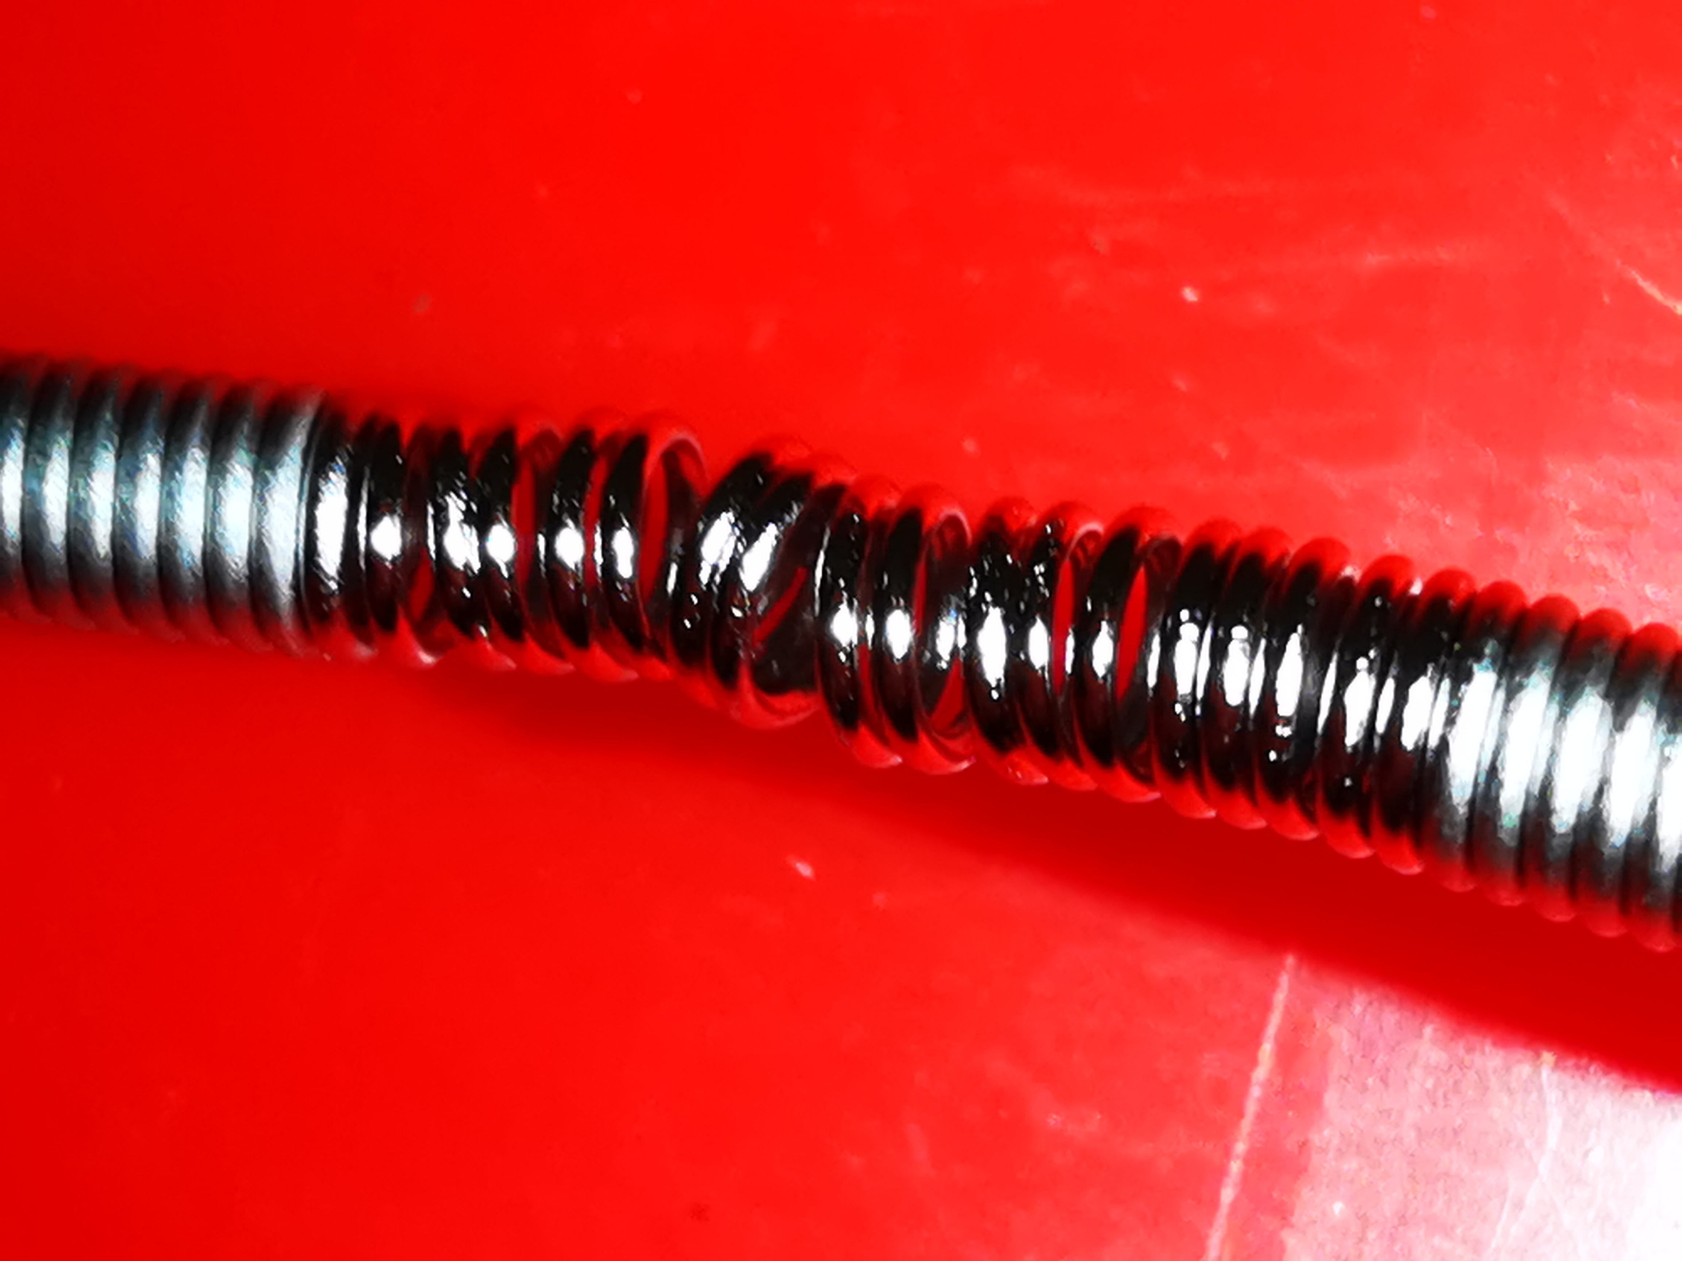
Module 5 X-ray and photos after opening
Clear sign of the spring heating, possibly this is the source of the problem
Horizontal
Preliminary, analysis ongoing!

Slide 25
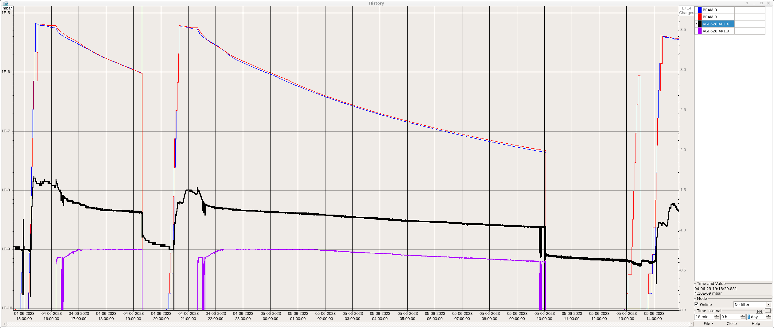
Recovery after intervention 4L1
Intensity
Priority was to get the machine back to physics
Vacuum conditioning with beam -> lower intensity for the first fills after intervention
Vacuum still not as good as before but no longer limiting us to reach previous intensity

Slide 26
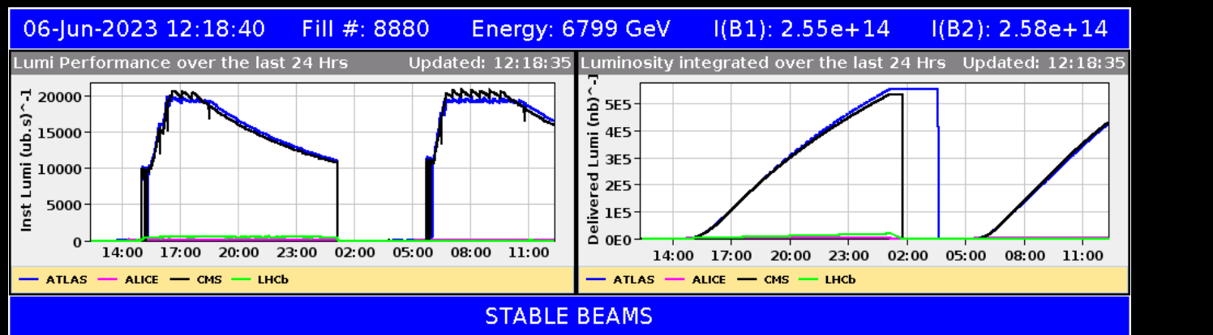
Almost back in the conditions before 4L1
Even with these issue we are back to significant luminosity production!
  Some difficulties to inject (not related to the event)
    Significant scraping of the beam is needed in SPS
  We will consolidate with bunch intensity below 1.6*10¹¹ while we better understand the 4L1 event and why the large scraping in SPS is needed

Slide 27
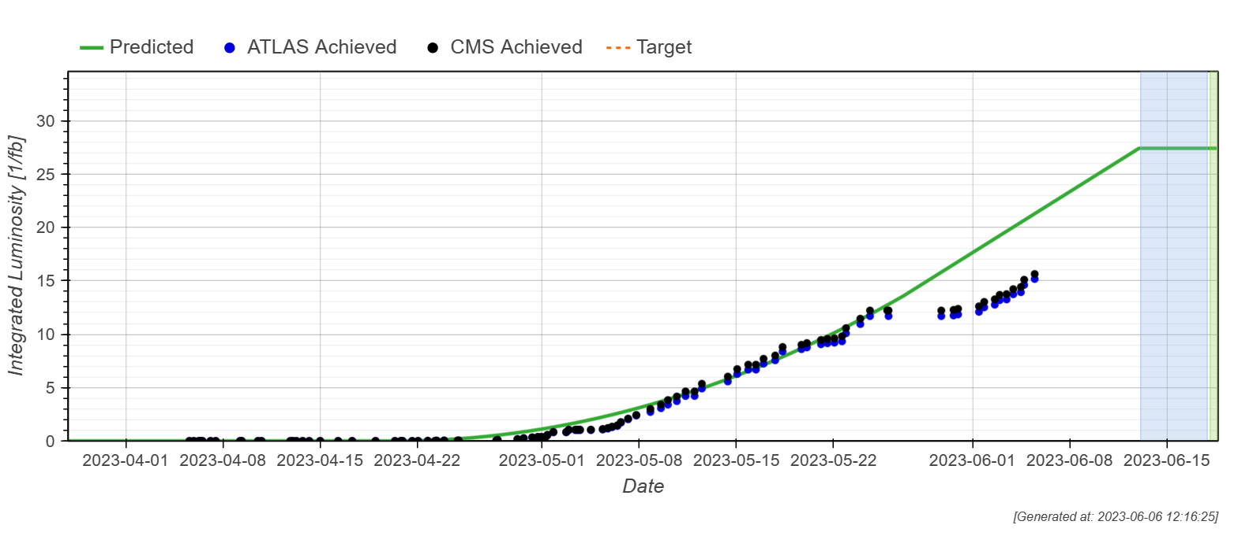
Luminosity production
We were following the prediction closely before the 4L1 even
Challenging “catch up”
  Mainly determined by the number of faults we have

Slide 28
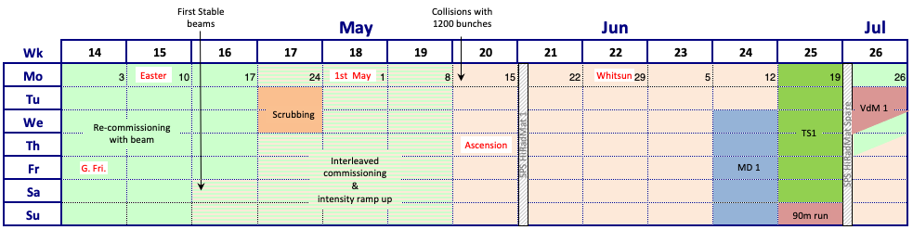
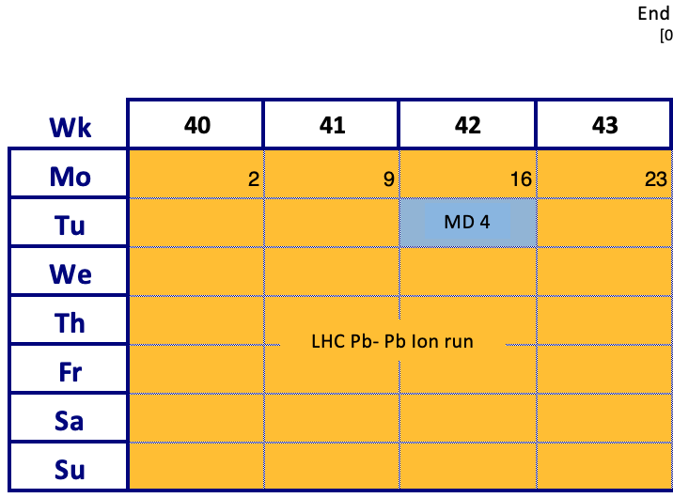
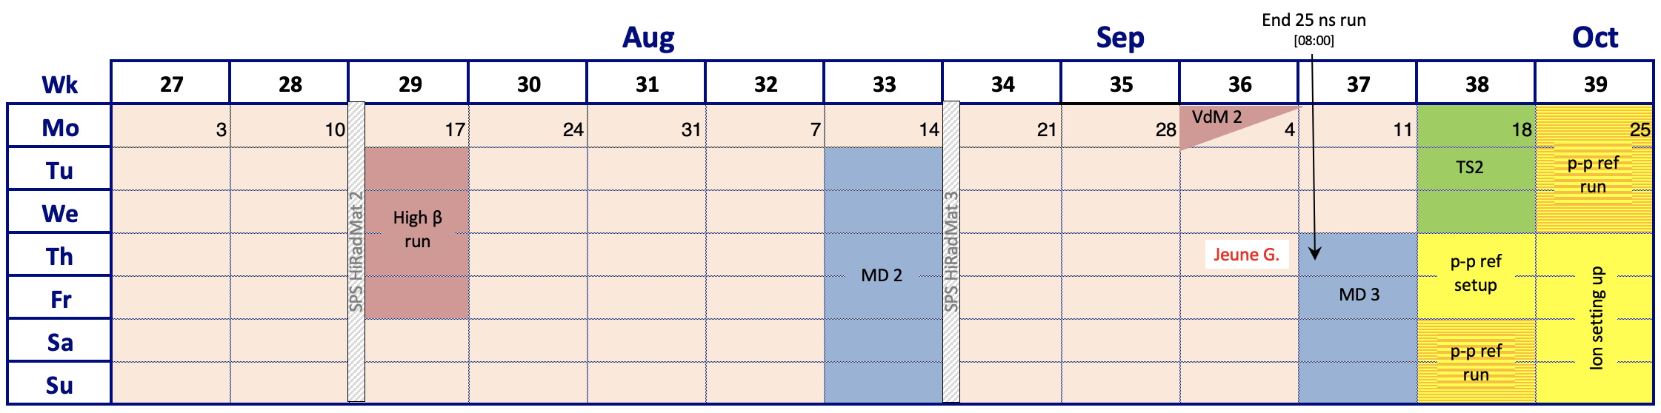
What is next?
MD period starting next week followed by a technical stop
Many interesting other runs ahead, e.g., high-β and ion run!
The target is still to reach the 1.8*10¹¹ for the nominal cycle this year
  Will be in β* levelling for most of the fill!

Slide 29
Conclusion
A very efficient commissioning thanks to all the effort of all the teams involved
  Profited from this period to anticipate activities, e.g., the ion commissioning
After the adjustment of the crossing angles and updated calibration factors the luminosity is now very close between IP1 and IP5
  Combined β* and separation levelling enable to operate at different pile up for ATLAS and CMS
The hybrid bunch scheme enables us to go for even higher intensities without being limited by the heat load
The issue in 4L1 is fixed and we are almost back to situation before the stop in terms of luminosity production!

Slide 30
Backup

Slide 31
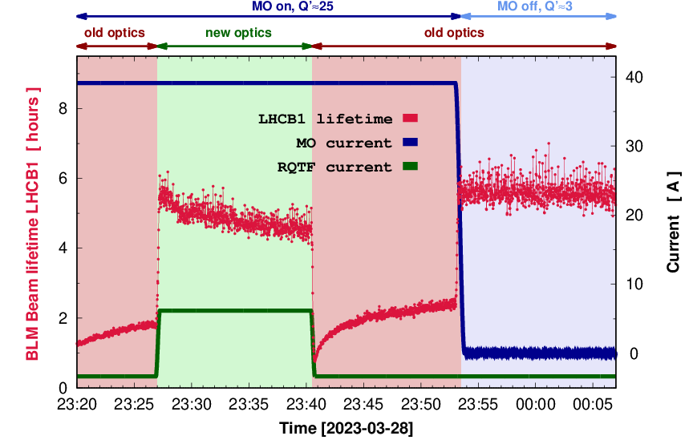
Clear improvement on lifetime with new optics
Test was done with blown-up single pilots (low intensity bunches)
  Different from normal configuration
Not so easy to compare to 2022 for nominal configuration due to the fact that we use mixed (36b and 8b4e) filling scheme this year.
Stay tuned for the results from the MD in the coming weeks when we will try to make a direct comparison!

Slide 32
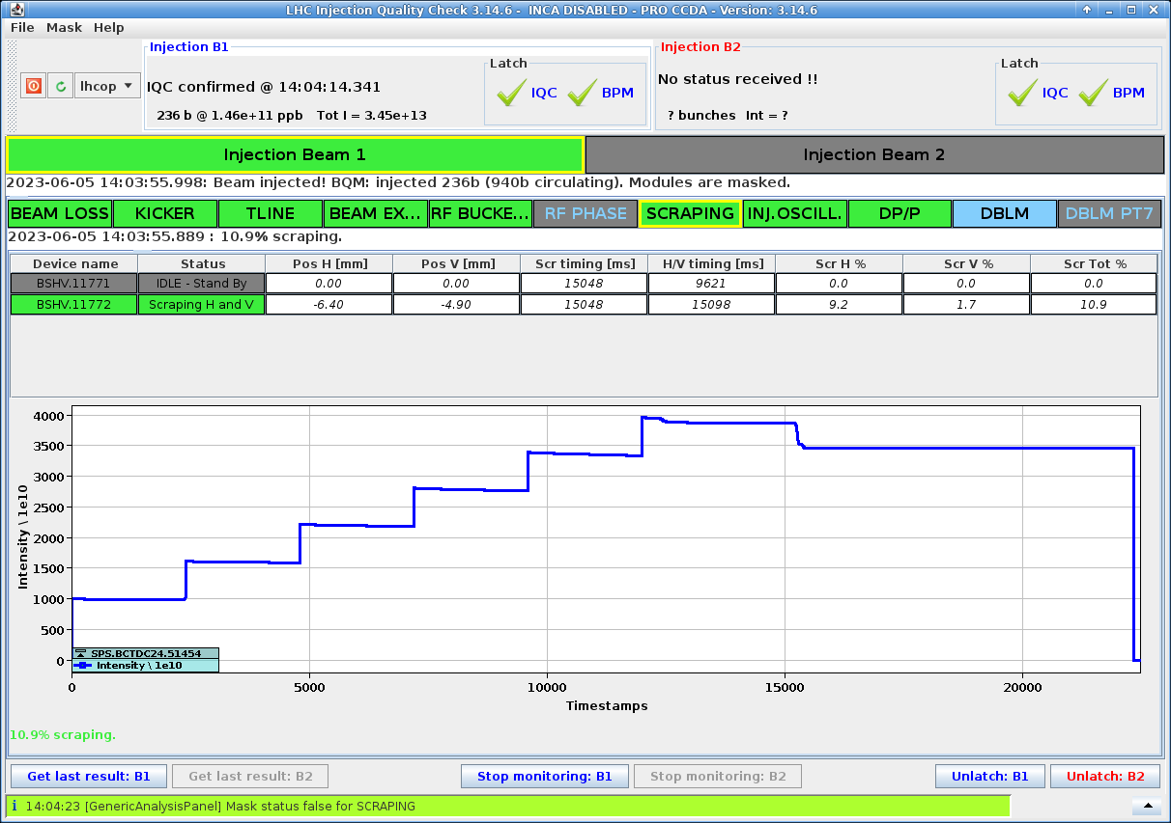
Issues at injection
Significant scraping of the beam needed in SPS to inject Beam 1
  Much less is needed for Beam 2
The temperature at the injection collimator for beam 2 (TDIS) close to threshold
-> Pause injection and move out injection protection to cool down

Slide 33
Recovery after intervention 4L1
In the end the measured losses at injection were the best proxy for a successful ramp.
the CCC adjusted machine filling to achieve <8E⁻⁶ Gy/s before ramping
Below is an indication of how the conditioning evolved over the weekend
Day | Fill # | # bunches | ppb | % RS12 threshold (3L1) | %RS7 TCTPH.4L1.B1 in collisions
Friday 2/6 | 8863 | 1650 | 1.5E11 | 87%
Saturday 3/6 | 8865 | 1650 | 1.5E11 | 60%
Saturday 3/6 | 8866 | 1886 | 1.5E11 | 55%
Sunday 4/6 | 8870 | 1886 (2358b scheme) | 1.5E11 | 72% | 56%
Sunday 4/6 | 8872 | 2358 | 1.5E11 | 70% | 56%
Sunday 4/6 | 8873 | 2358 | 1.5E11 | 56% | 60%

Slide 34
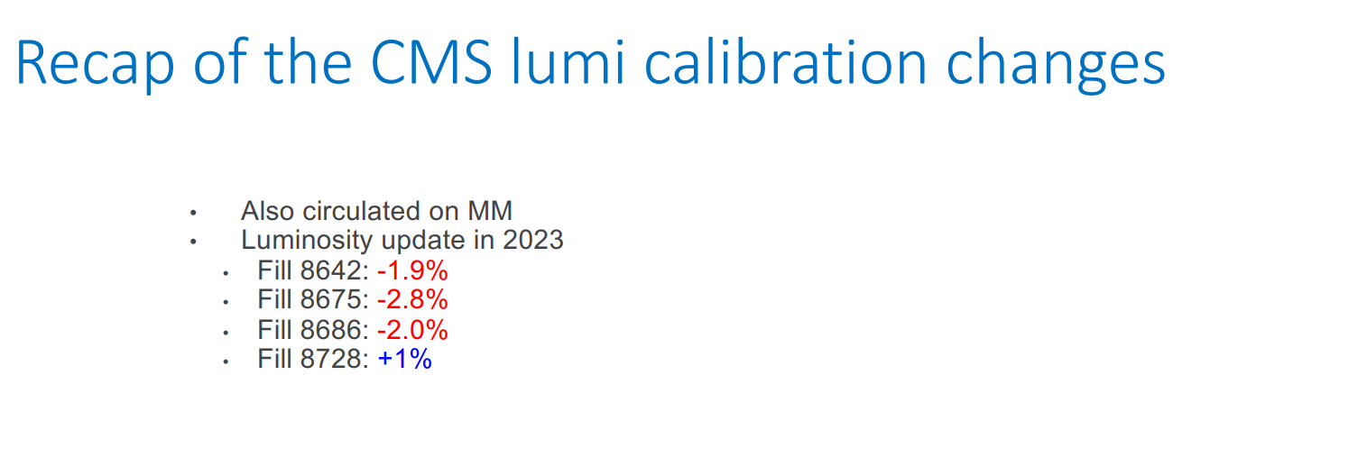

Slide 35
Collimator and xing angle “retouche”
Updated settings for TCSPM.E5R7.B1 (dumps going in collisions)
  Moved the TCSPM.E5R7.B1 to 8.2 sigma
Also applied a crossing angle correction at IP1 of 10urad (down)(IP1/5 imbalance)
  Luminosities at IP1 and IP5 now well correlated
Validation of the new settings agreed with Machine Protection Panel
Two validation fills for loss maps
  subset of βtron loss maps from flat top to 30 cm, off momentum loss maps at 30cm and asynch dump at 120cm and 30cm with roman pots in and the wires powered (only at 30cm).
Step down in intensity to 400b (with ~1.5e11 ppb) for one fill
Followed by a final 999b fill (also with 1.5e11ppb), before stepping to 1200b

Slide 36
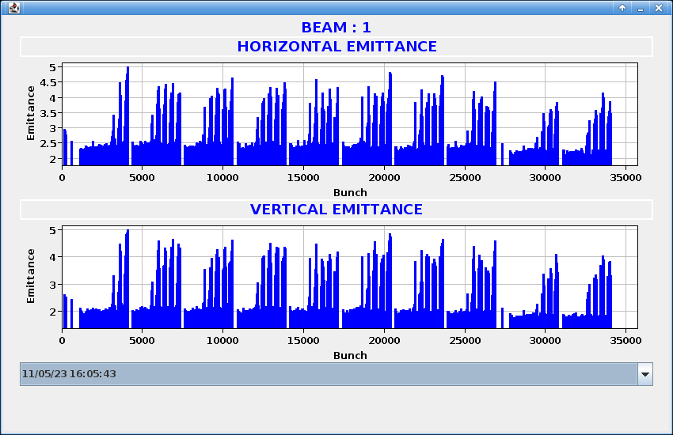
Emittance blowup in B1 at 1.1 TeV
Emittance blowup at 1.1TeV on B1
In the fist two fills with 200ns spacing clear signs of e-cloud increase (1900b and 2400b)
Sudden blowup of B1 around 1.1 TeV
Increase of Q’ did not help
Disappeared by itself due to conditioning
Investigation lead to finding bug in FF of coupling correction

Slide 37

Beam measurements and intervention
Slide from LMC, S. Redaelli
  Friday: Beam checks: loss maps, “collimation losses” and aperture at 450GeV → Ok
  Access: first X-ray campaign, installation of BatMon and prep. for new BLMs → Ok
  Suspicious spring layout for “Module 5”. Cross checked with beam measurements.
  Sat.: X-ray of Module 5 from side → Confirmed issue. Started intervention to replace M5.
  Initial pumping; leak detection; continued pumping.
  Sun.: Given the good progress of pumping, could already launch the partial bake out!
  Mon.: Good progress. Access to remove equipment and opened valves → Ok for beam
  Over night: (1) full cycle with 3b; (2) filling the machine at 450GeV (three fills)
Many thanks to all the people involved, in particular VSC, MME, RP, CEM, BI and may other

Slide 38



Module 5: Transition tube
Sign of sparking or heating on the outside of the transition tube

Slide 39


Slide 40







Additional observations
Beam 2
S. Danzeca
New BLM layout also deployed by BI: 3 new BLMs per side available and configured on Tue.

Slide 41


Module 5: RF Fingers
However, there is clear sign of sparking or heating on the outside of the RF fingers
Clear sign of the spring heating, possibly this is the source of the problem
Clear sign of the spring heating, possibly this is the source of the problem

Slide 42




Module 5: Spring
Completely plasticized spring (T > 500°C)
Sign of melting and evaporation

Slide 43


Collisions at injection
Four fills of stable beams were delivered at injection with nominal crossing scheme (+ 1 fill of setting up).
  First fill with 3 bunches, other fills with 12 bunches per beam.

Slide 44




Losses going in collisions
B1
8b4e almost unaffected
Center of 36b batch most affected
Losses last few seconds
Dump on long RS (80s)
Much more pronounced on B1
B2

Slide 45

LPC on 27th February 2023
CONFIRMED
LHCC open session - 8th March 2023

Slide 46
Observation on TCPCH.A4L7.B1
(HCTCPC_002-CR000004)
Situation today:
  Motor, interferometry system, LVDT, switches and external linear motion functioning ok
  Replacement chamber in OUT position
  Internal linear stage is blocked at an intermediate position (32 mm, hard point)
  Rotational stage still operating
  Linear movement interrupted (link between external and internal stages appears to be lost)

Slide 47
Recovery
Monday morning: Cryo conditions re-established for RF
  Conditioning procedure launched to check cavity performance
  Conditioning @ injection (20k) and flat-top (60k) coupler settings
  Single and double RF frequency modulations
  No significant degradation was observed, and the full conditioning cycle was completed in 24h
Tue 09:00: RF ready for beam
Injection, single FM
☑
Injection, second FM
☑
Q_{ext} = 20000
Injection, CW max power for 10 hrs
☑
Flat top, single FM
☑
Flat top, second FM
☑
Q_{ext} = 60000
Flat top, cavity up to 2.2 MV CW
☑
Flat top, 1.75 MV CW for 14 hrs
☑
Conditioning procedure

Slide 48



Rupture discs
2 batches of discs were purchased during YETS:
  18 stainless steel forward-acting discs (ELFAB)
  18 stainless steel reverse buckling discs (Paliwoda)
Both types are specified as 1.10 barg +/- 5% rupture pressure
  Certified minimum rupture pressure 1.045 barg
The first batch (ELFAB) was individually tested up to 0.85 barg
  16 discs installed in LHC + 2 spares
  2 of these burst this weekend at 0.9 barg
  The 2 spares were installed to replace the 2 burst discs
The second batch (Paliwoda) is at CERN awaiting testing
  Will be tested at higher pressure (maximum allowed working pressure, 0.99 barg)
Forward-acting disc (ELFAB)
Reverse buckling disc (Paliwoda/Rembe)

Slide 49

Comparison X rays in 2014 vs 2023

Slide 50

Confirmation of location with BatMons
Ib=1.5x10¹¹p/b
Ib=1.2x10¹¹p/b
Ib=1.1x10¹¹p/b
Measurements with one beam at a time indicated that the vacuum activity in the common region is triggered primarily by the Beam 2.

Slide 51



New Warm Module Type VMB & VAM
Without Spring
With Spring

Slide 52

LPC @Chamonix

