Slide 1
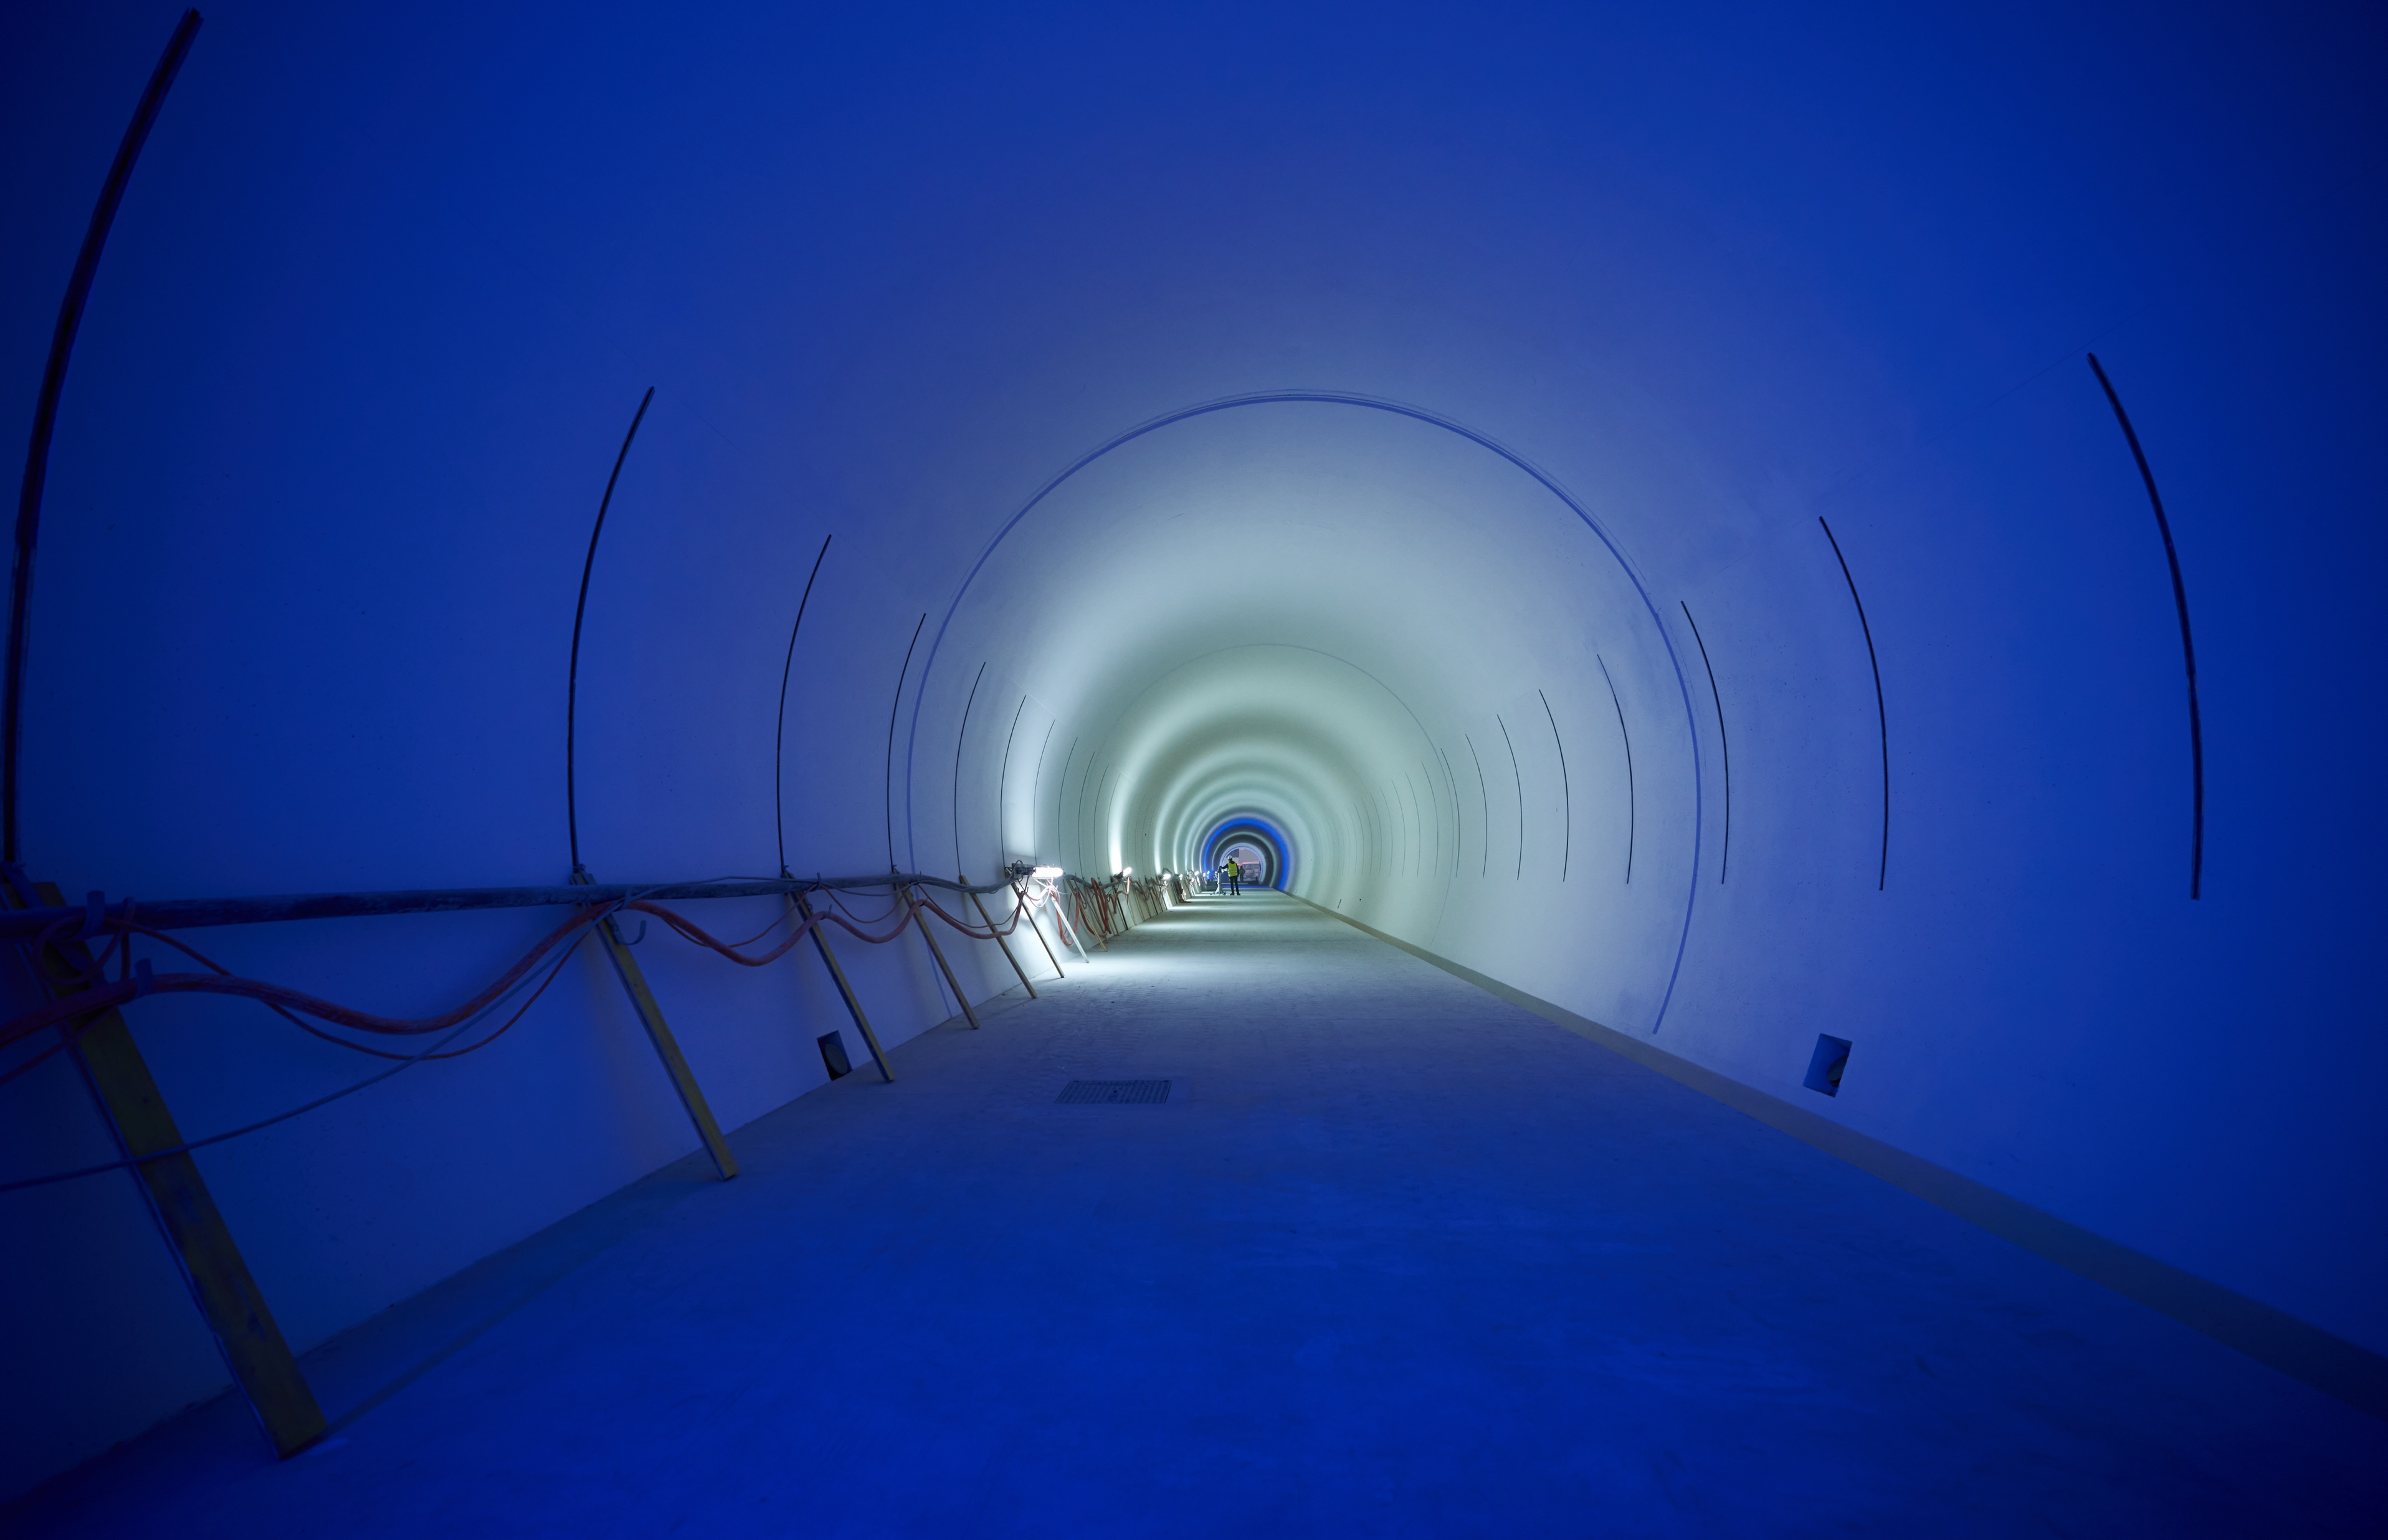
Overall status of the HL-LHC project
O. Brüning
CERN, Geneva, Switzerland

Slide 2

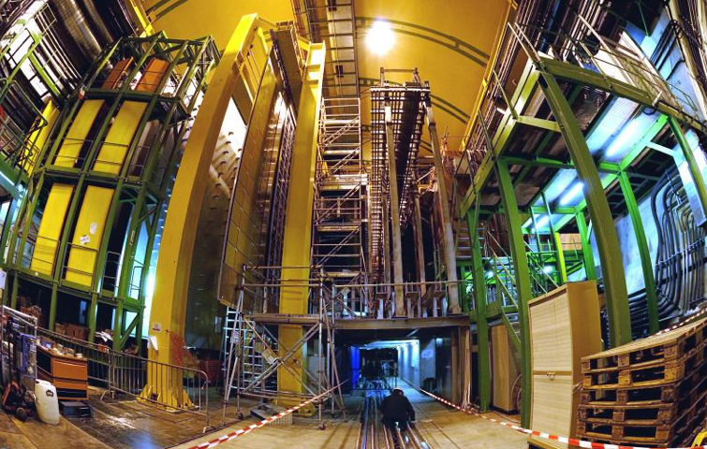


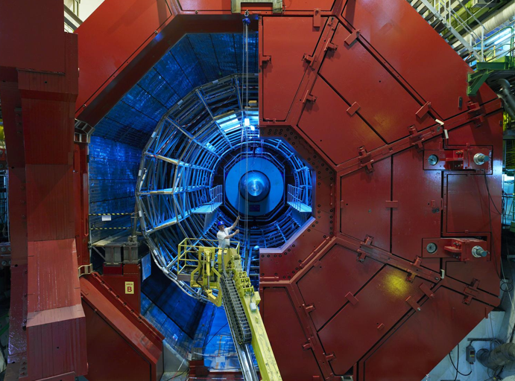

LHC in the Geneva Basin and its Experiments
LHCb
ATLAS
CMS
Features proton-proton and Lead-Lead and Lead-proton collisions!
LHC ring:
27 km circumference
ALICE
Super-Conducting Dipole
Magnets along the 8 symmetric
Arcs [22km]
Notes:
Specialized and Multi-Purpose

Slide 3
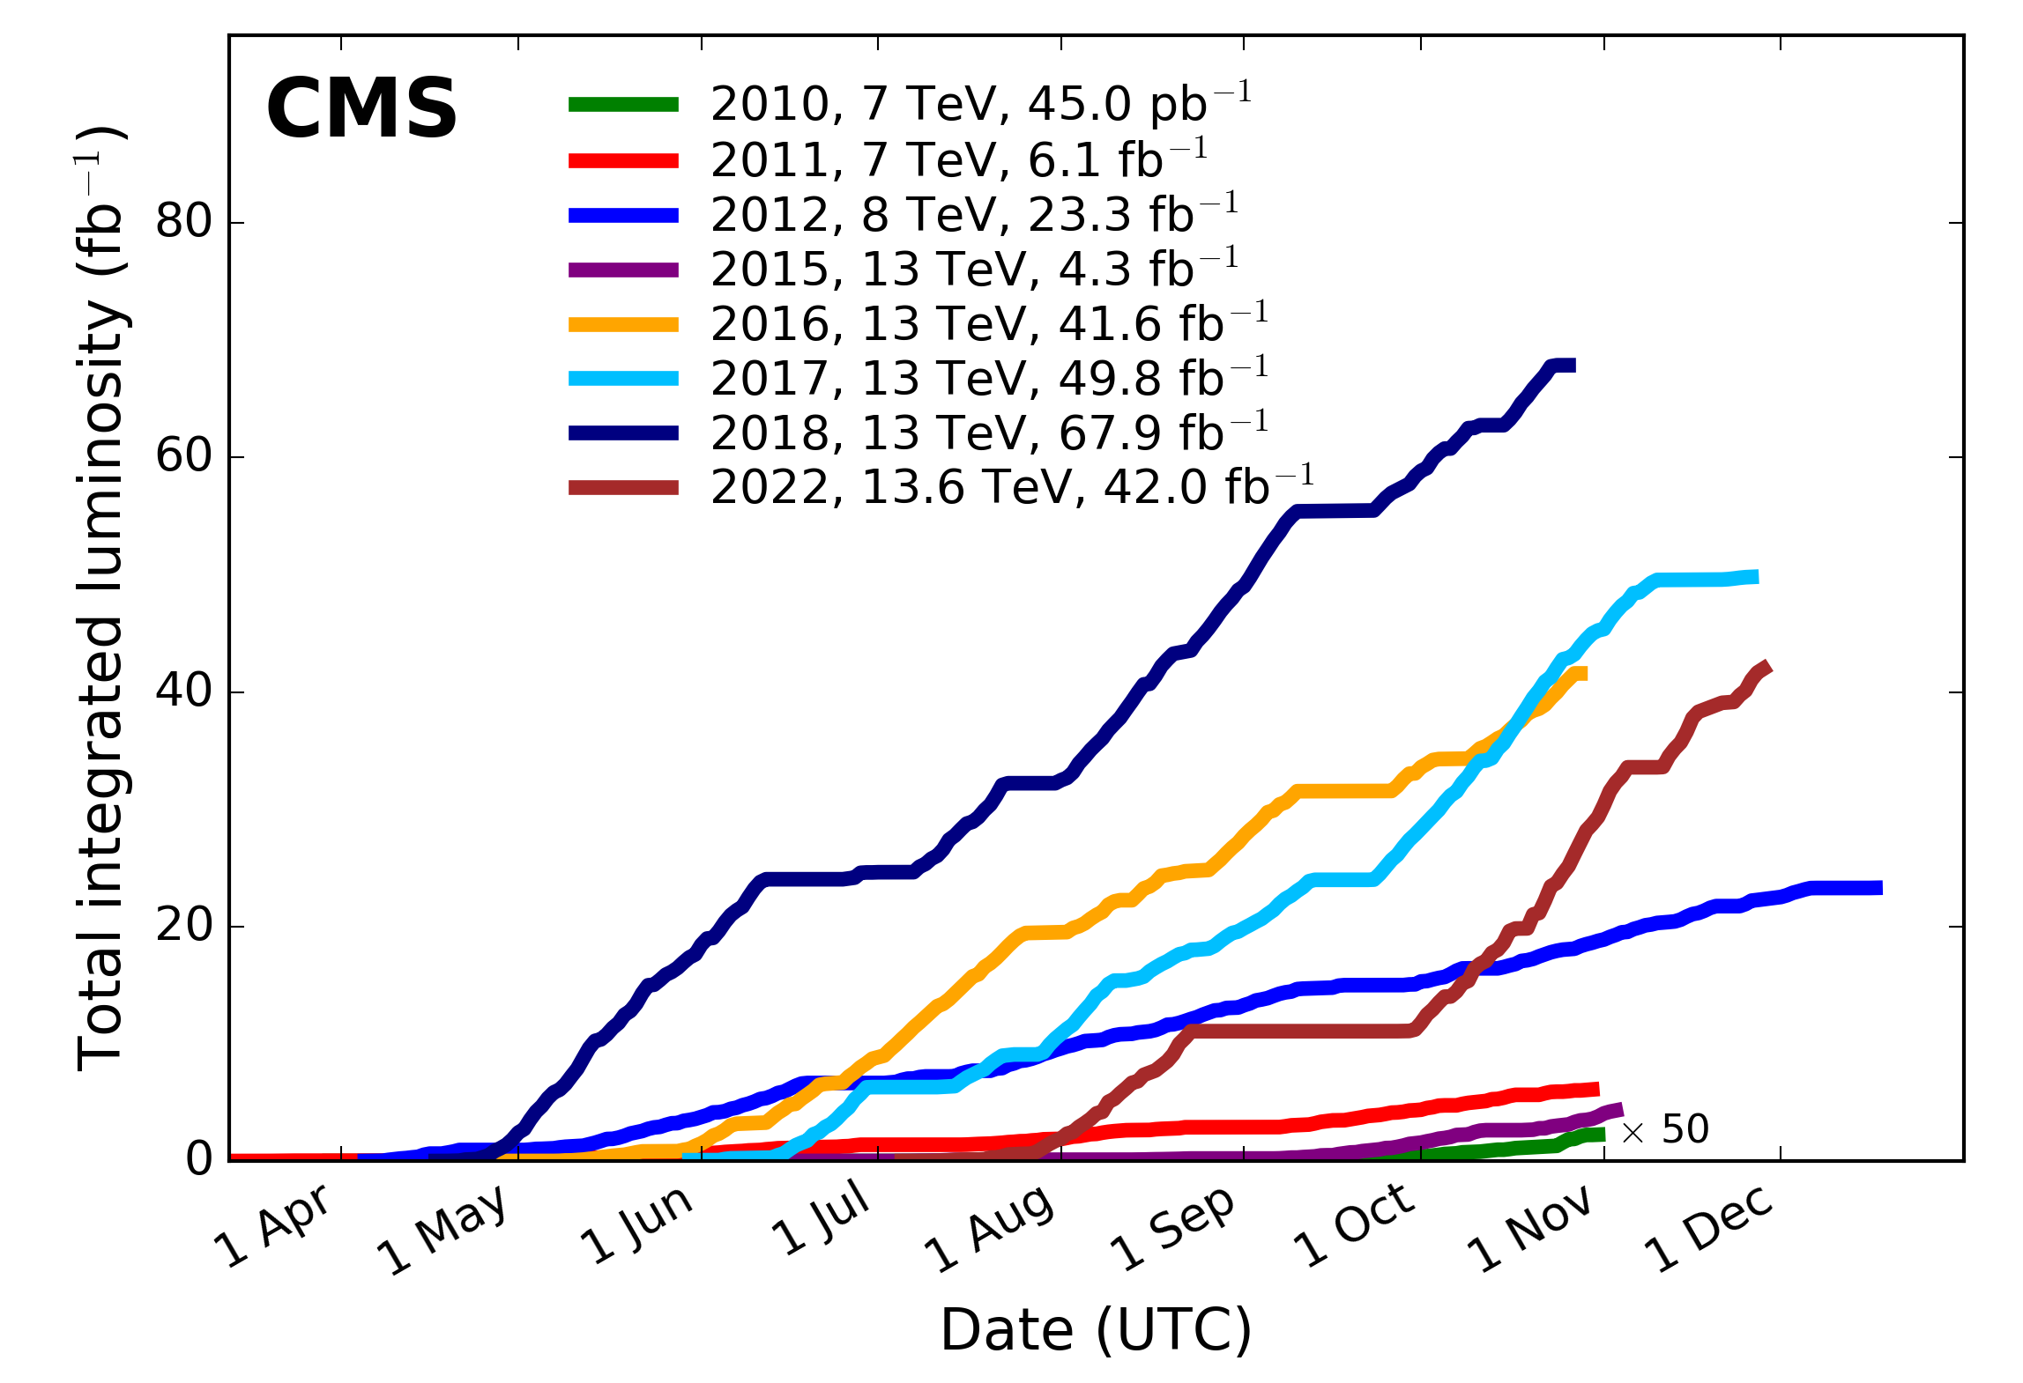
HL-LHC Goals in a nutshell:
Extend the LHC lifetime by 15+ years
Prepare the machine for producing in that period
10 times more data as compared to the nominal LHC operation period
Need to overcome several technological challenges! [not just in the machine but also in the detectors!]
HL-LHC is a technology driver in many areas
Higgs discovery in 2012! ➔ But many questions remain and the search continues!!!
Higgs properties [coupling]
More than one Higgs?
BSM Physics? Dark Matter & Dark Energy?
Need for more Data and Statistics!!
Over 160 fb⁻¹ at 13 TeV during Run1 & Run2
Higgs Discovery in 2012!
ca. 70 fb⁻¹ / year at hand!!!
➔ over 400 fb⁻¹ by the end of LHC Run3 by end 2025!!!
So Why do we need an Upgrade?
Doubling the accuracy for the experiments implies 4 times the data volume!!!
➔ over 20 Years of operation with current peak performance after end of Run 3 (after 2025)!

Slide 4
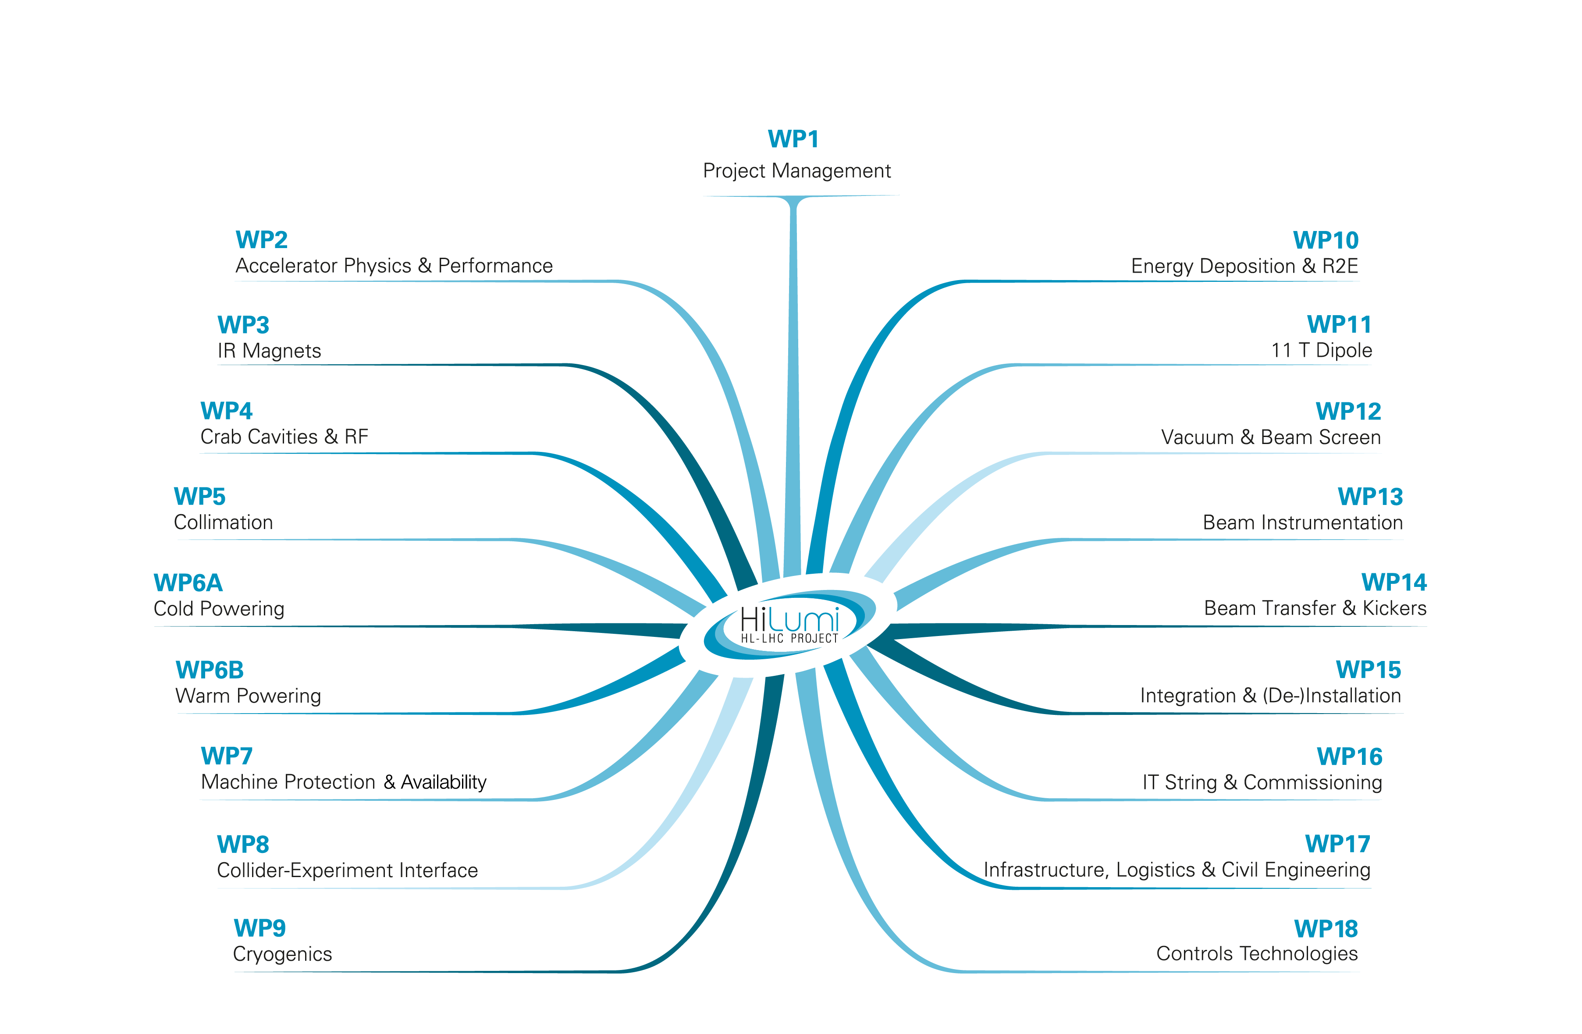
Organized into 19 Technical Work Packages
Impossible to be exhaustive in this presentation!
More information under:
HL-LHC News: https://hilumilhc.web.cern.ch/news
HL-LHC Newsletter: https://hlcb-newsletter.web.cern.ch

Slide 5
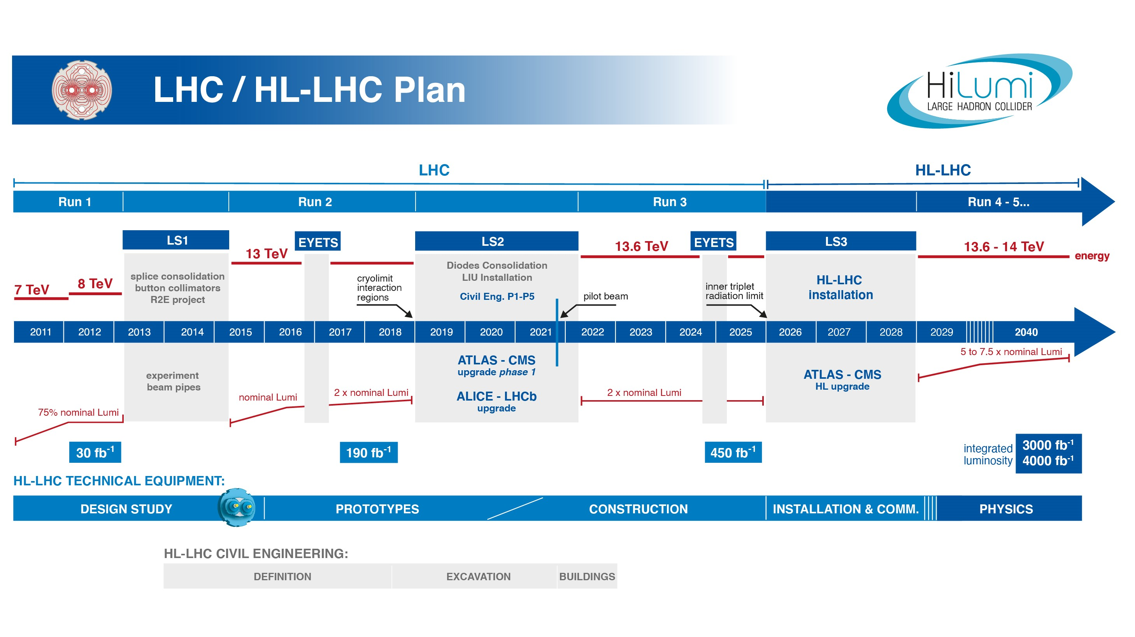
EU funded HiLumi
Design Study
Approval of
HL-LHC Project
We are here
HL-LHC Operation
Run3 operation
Over Half Way!
7 years since project approval
Less than 6 years until start Run4
Series production is well underway - or ready to be launched - for all components!
Ca. 1.1BCHF
Ca. 75% committed
Notes:
5

Slide 6
HL-LHC Technical Challenge 1: Triplet Magnets
Epoxy and most insulation materials
will become brittle at these radiation levels and loose their mechanical integrity!!!
– essential for the coil production of
superconducting magnets! –
Operation beyond 2025:
Requires replacement of LHC Triplet magnets
10 x the luminosity ➔ Requires new, more radiation resistant triplet magnets
Cold bore insulation
≈ 35 MGy
Q2
27 MGy
MCBX3 20 MGy
ATLAS
CMS
6

Slide 7
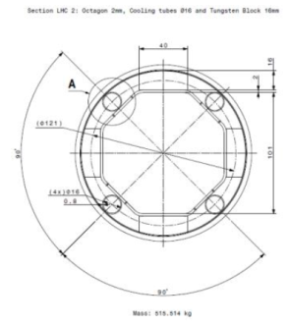
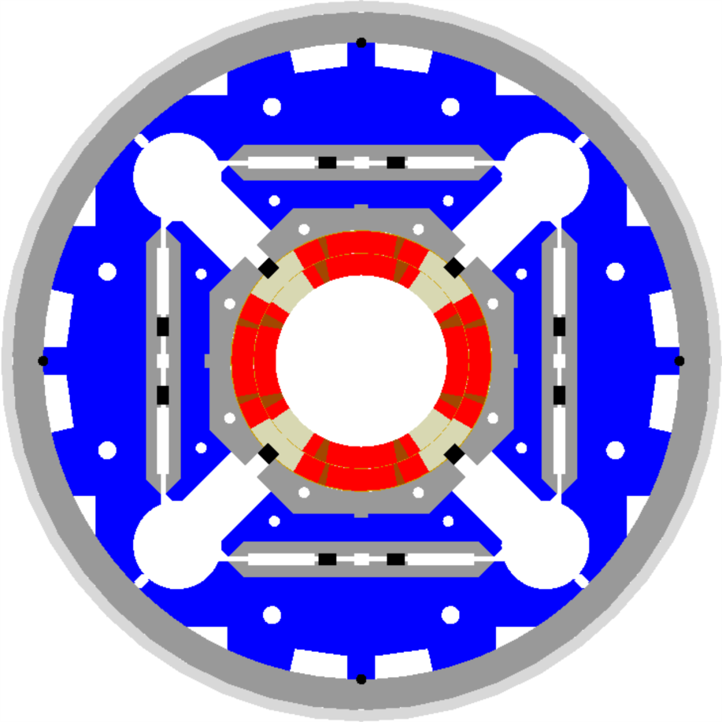
HL-LHC technical Challenge:
Radiation Hard Triplet Magnets
G. Apollinari - MOPL040
A. Milanese - WEPM060
Need to replace existing triplet magnets with radiation hard system such that the new magnet coils receive a similar radiation dose @ 10 times higher integrated luminosity!!!!! ➔ Shielding!
Tungsten blocks
US-LARP MQXF magnet design
Based on Nb₃Sn
technology
Requires larger aperture!
LHC: 70mm ➔ HL-LHC: 150mm diameter
➔ New, brittle superconductor!
➔ New magnet technology!
Capillaries
@ 210 T/m
@ 140 T/m
Longer magnets
8T peak field at coils
Incompatible with Nb-Ti
➔ 12T field at coils!!!
[at the limit of Nb-Ti technology]
Nb₃Sn technology
Notes:
10

Slide 8
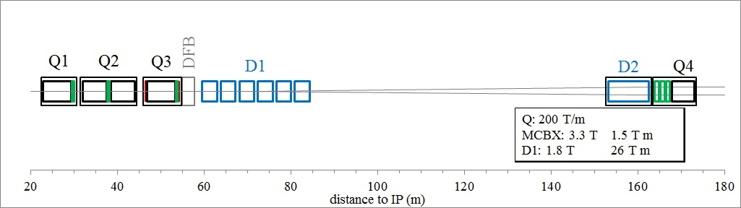
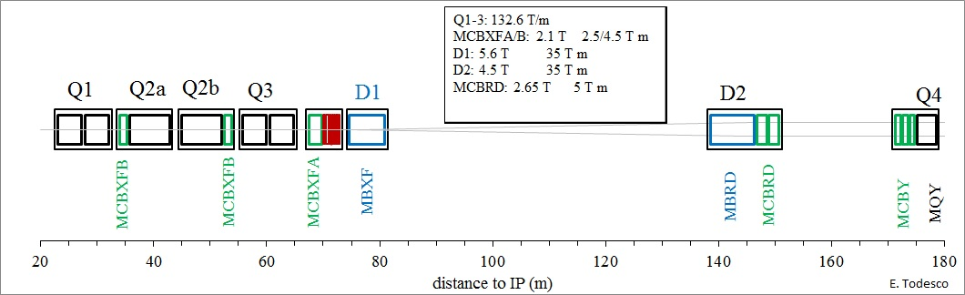
New HL-LHC Triplet Lay-out:
Longer Triplet assembly implies longer distance over which the 2 LHC beams share the same path!
ca. 40 unwanted [parasitic] collision points
Crossing angle & Crab Cavities
ATLAS
CMS

Slide 9
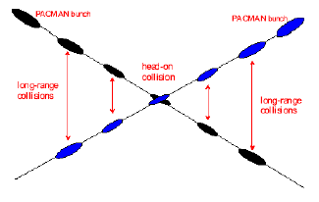
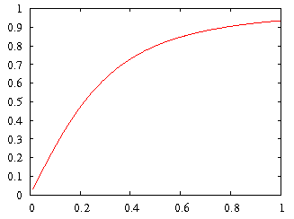
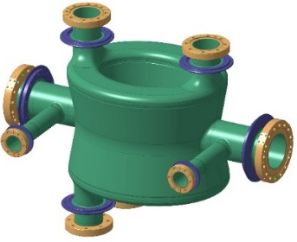
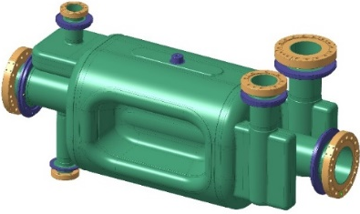
HL-LHC Technical Challenge 2: Crab Cavities
Geometric Luminosity Reduction Factor:
Crab Cavities:
Full Crossing angle:
285μrad LHC TDR
329μrad in LHC op
500μrad HL TDR
DQW
RF-Dipole
effective cross section
Challenging space constraints – 194mm separation between the 2 beams
➔ requires compact cavity design

Slide 10
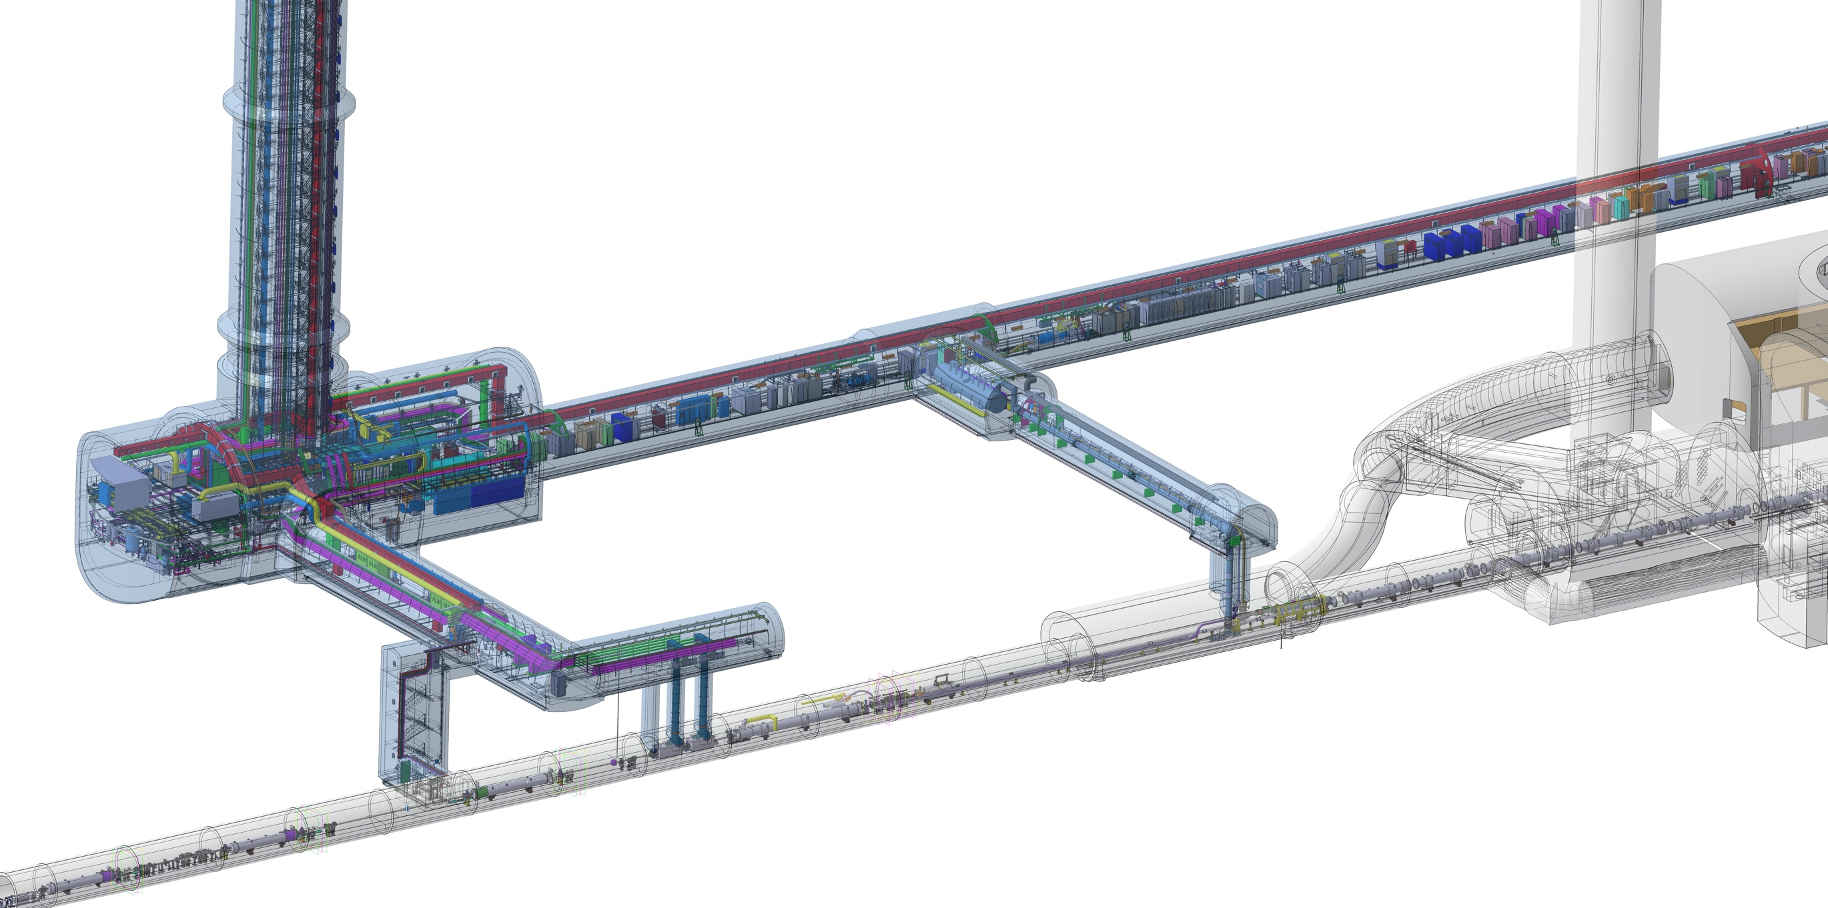
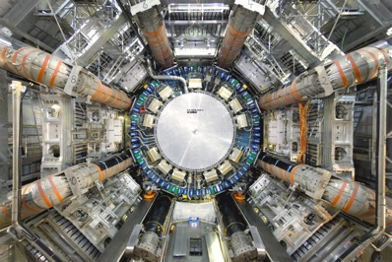
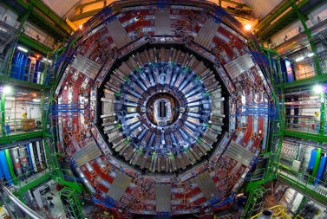
HL-LHC Challenge 3: Machine Efficiency
QDS
UR55
Warm Diodes
CLIQ
PIC,BIS
CDBs
OC EE
Valve box
DFHX
D2 OC PCs
DFHM
US57
D2 PC
D1 PC
OC PCs
UW57
PC IT
PCs IT Trims
CDBs
DSHX
D2 OC EE
UL57
Cold box
DSHM
UA57
D1
CP
Q3
Q2B
Q2A
Q1
RF Powering
DFM
DCM
Cooling and Ventilation
DFX
UPR57
Cold Diodes
TAXN
D2
DQHDS
Crab
Cavities
➔ Low radiation areas for electronics
Accessibility of equipment!
But up to 100m between PC and magnets!
Q4
Q5
Q6

Slide 11
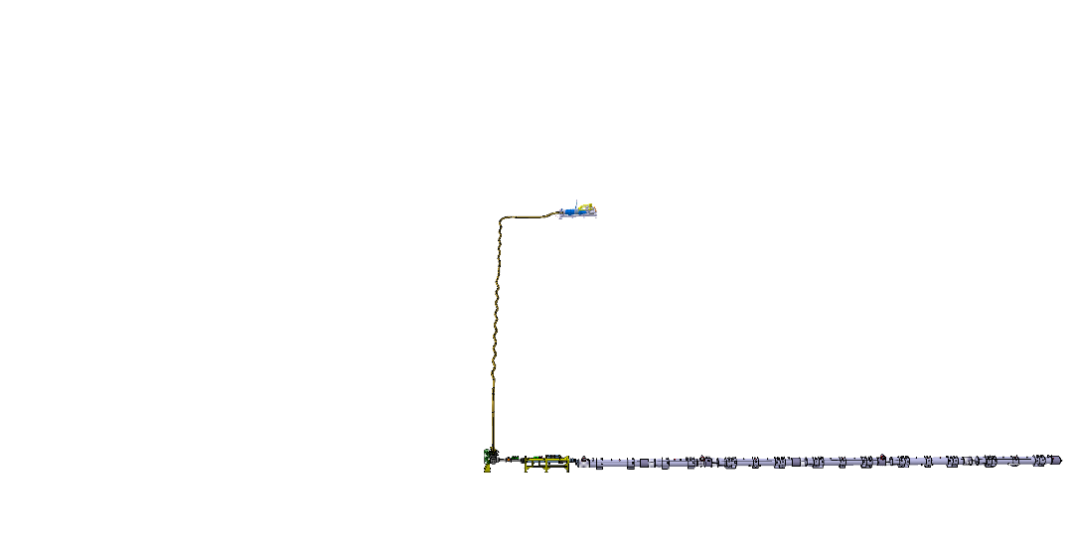
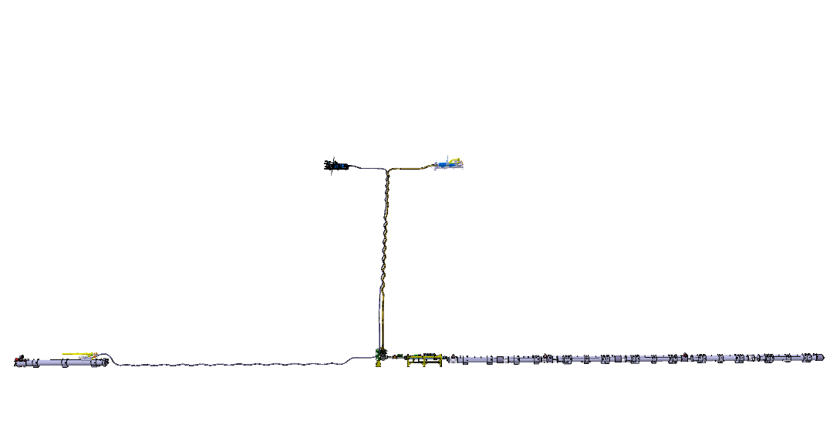
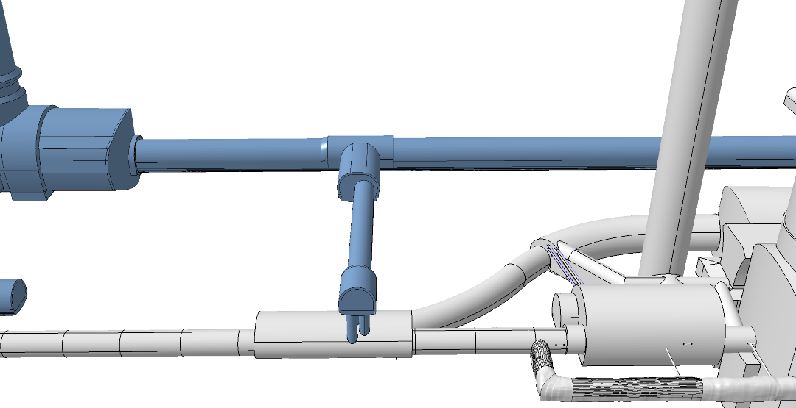


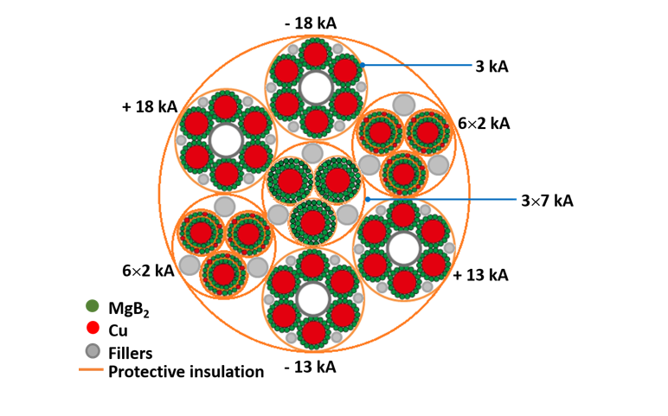
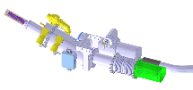
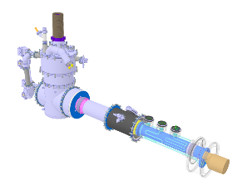
HL-LHC Technical Challenge 4:
Superconducting Link based on HT MgB₂
Superconductor
DFHM
DFHX
DSHM
DSHX
D2
DCM
D1
CP
Q3
Q2B
Q2A
Q1
DFM
DFX
Diam ca. 90mm
> 100kA @ 25K

Slide 12
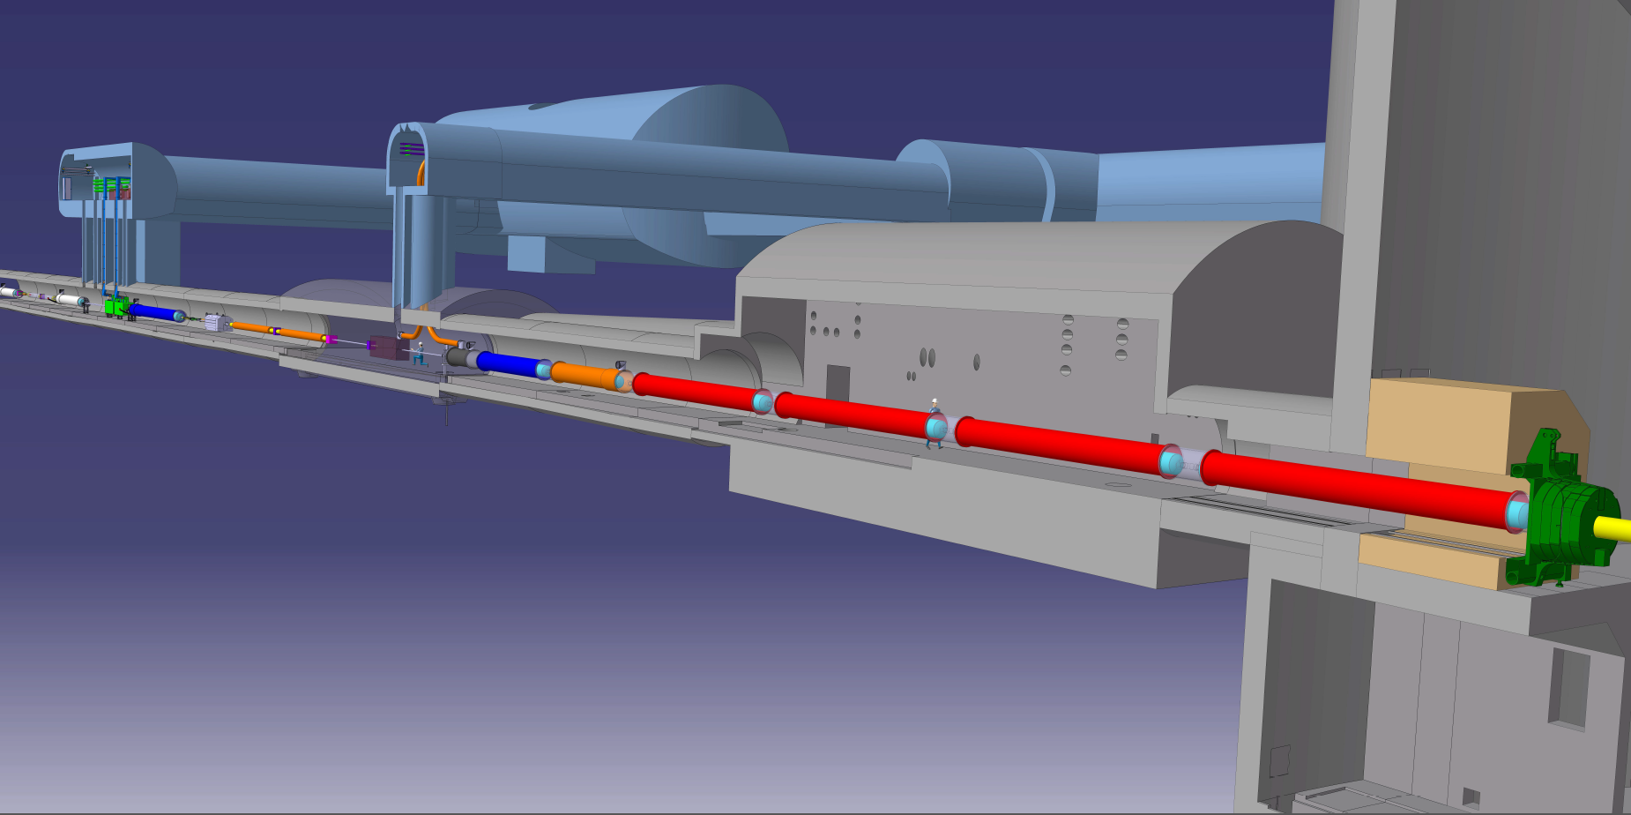






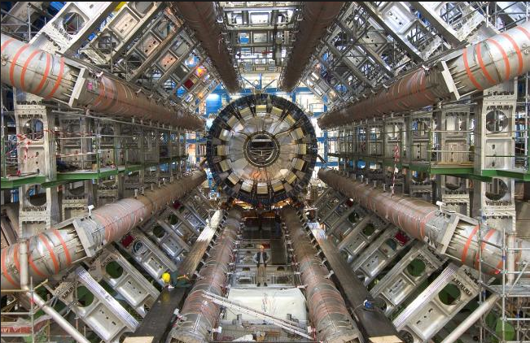


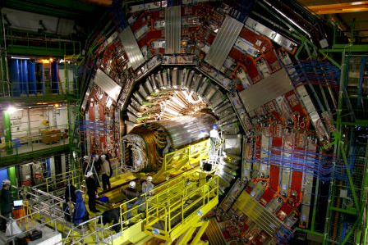
HL-LHC is a truly International Collaboration
Connection to LHC (UL)
Service gallery (UR)
UA Gallery
Service cavern
DFHX
DFHM
Q4
Collimators
SC Links
D2
Crab cavities
D1
CP
Q3
TAXN
DFM
DFX
Q2b
Q2a
Q1
TAXS
Notes:
17

Slide 13
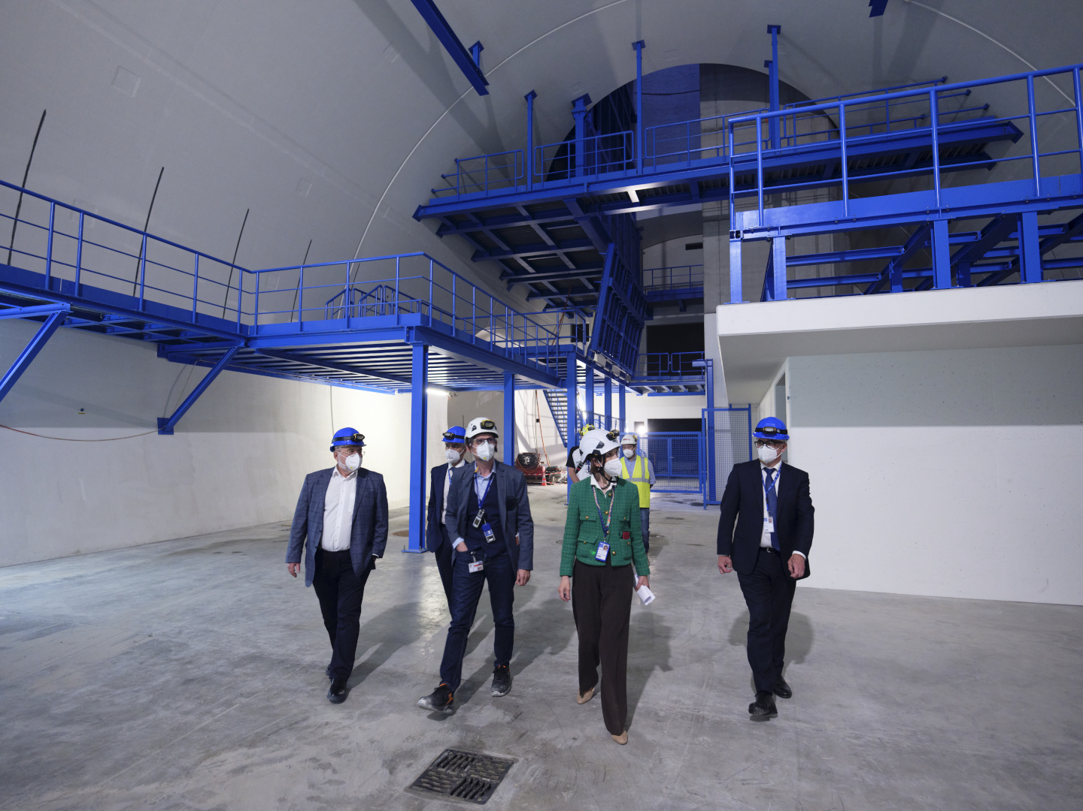
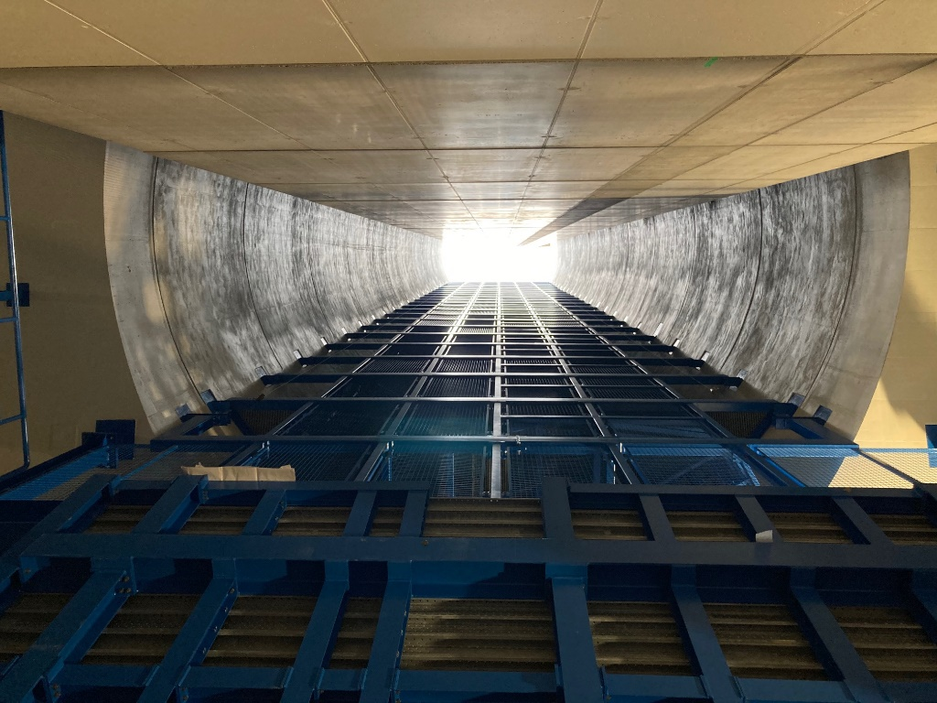
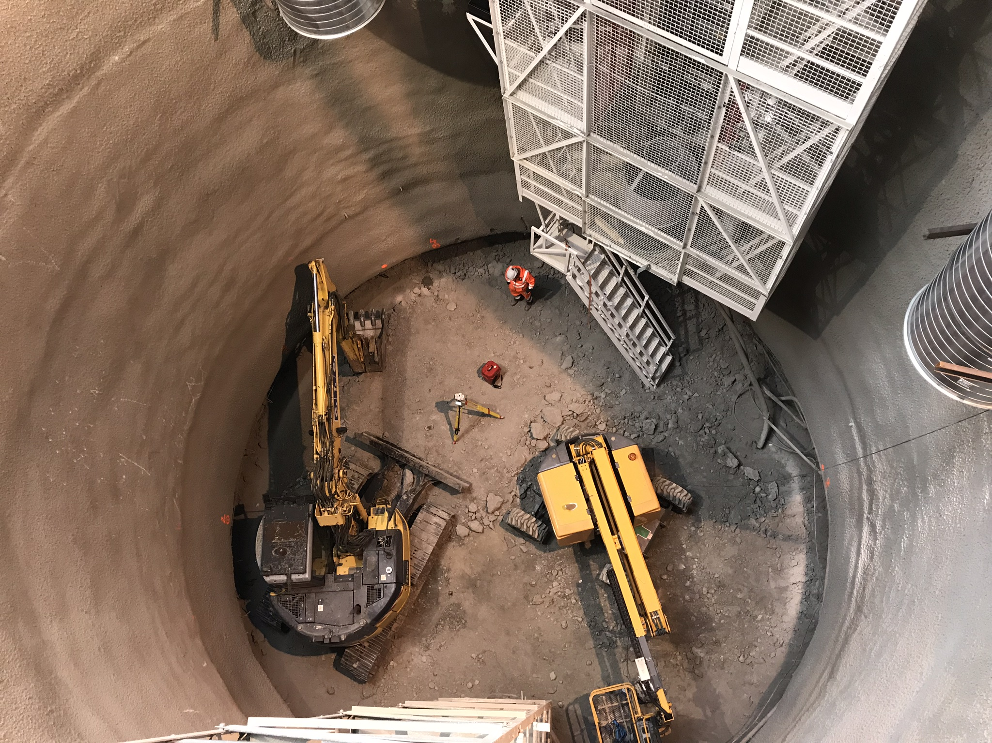
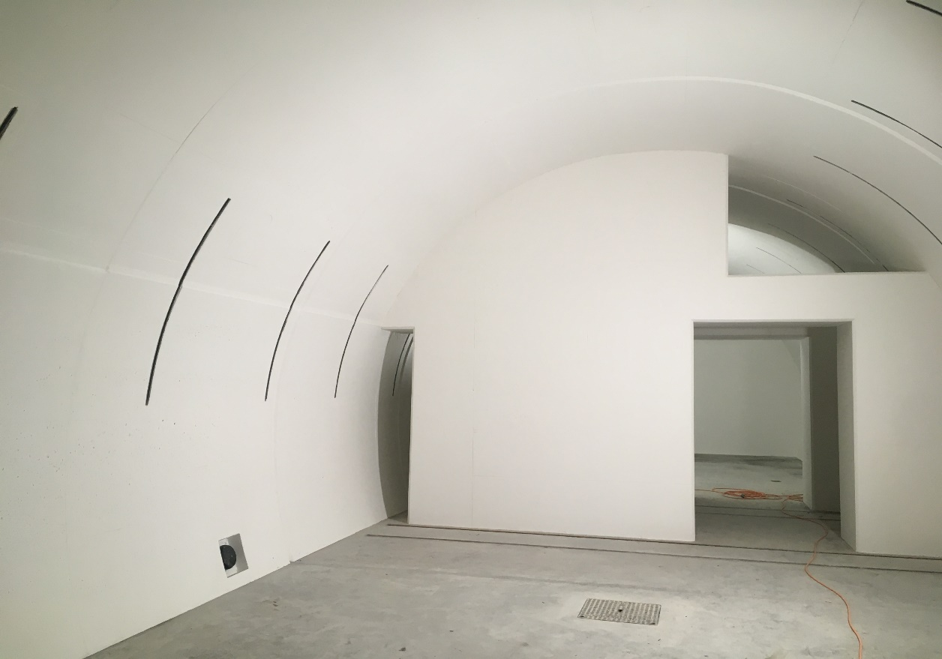
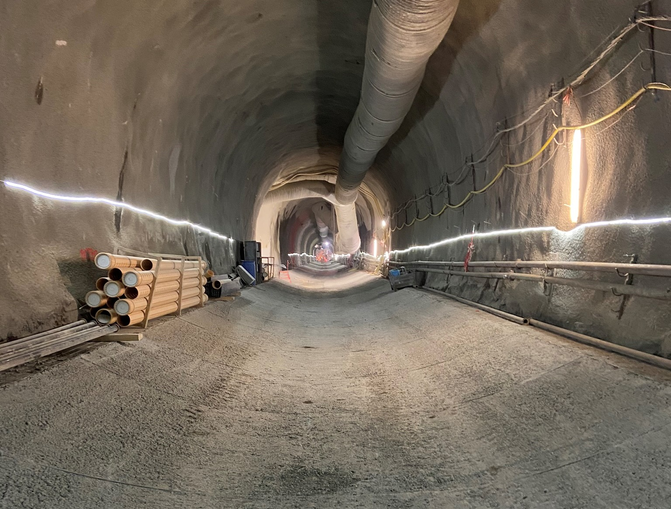
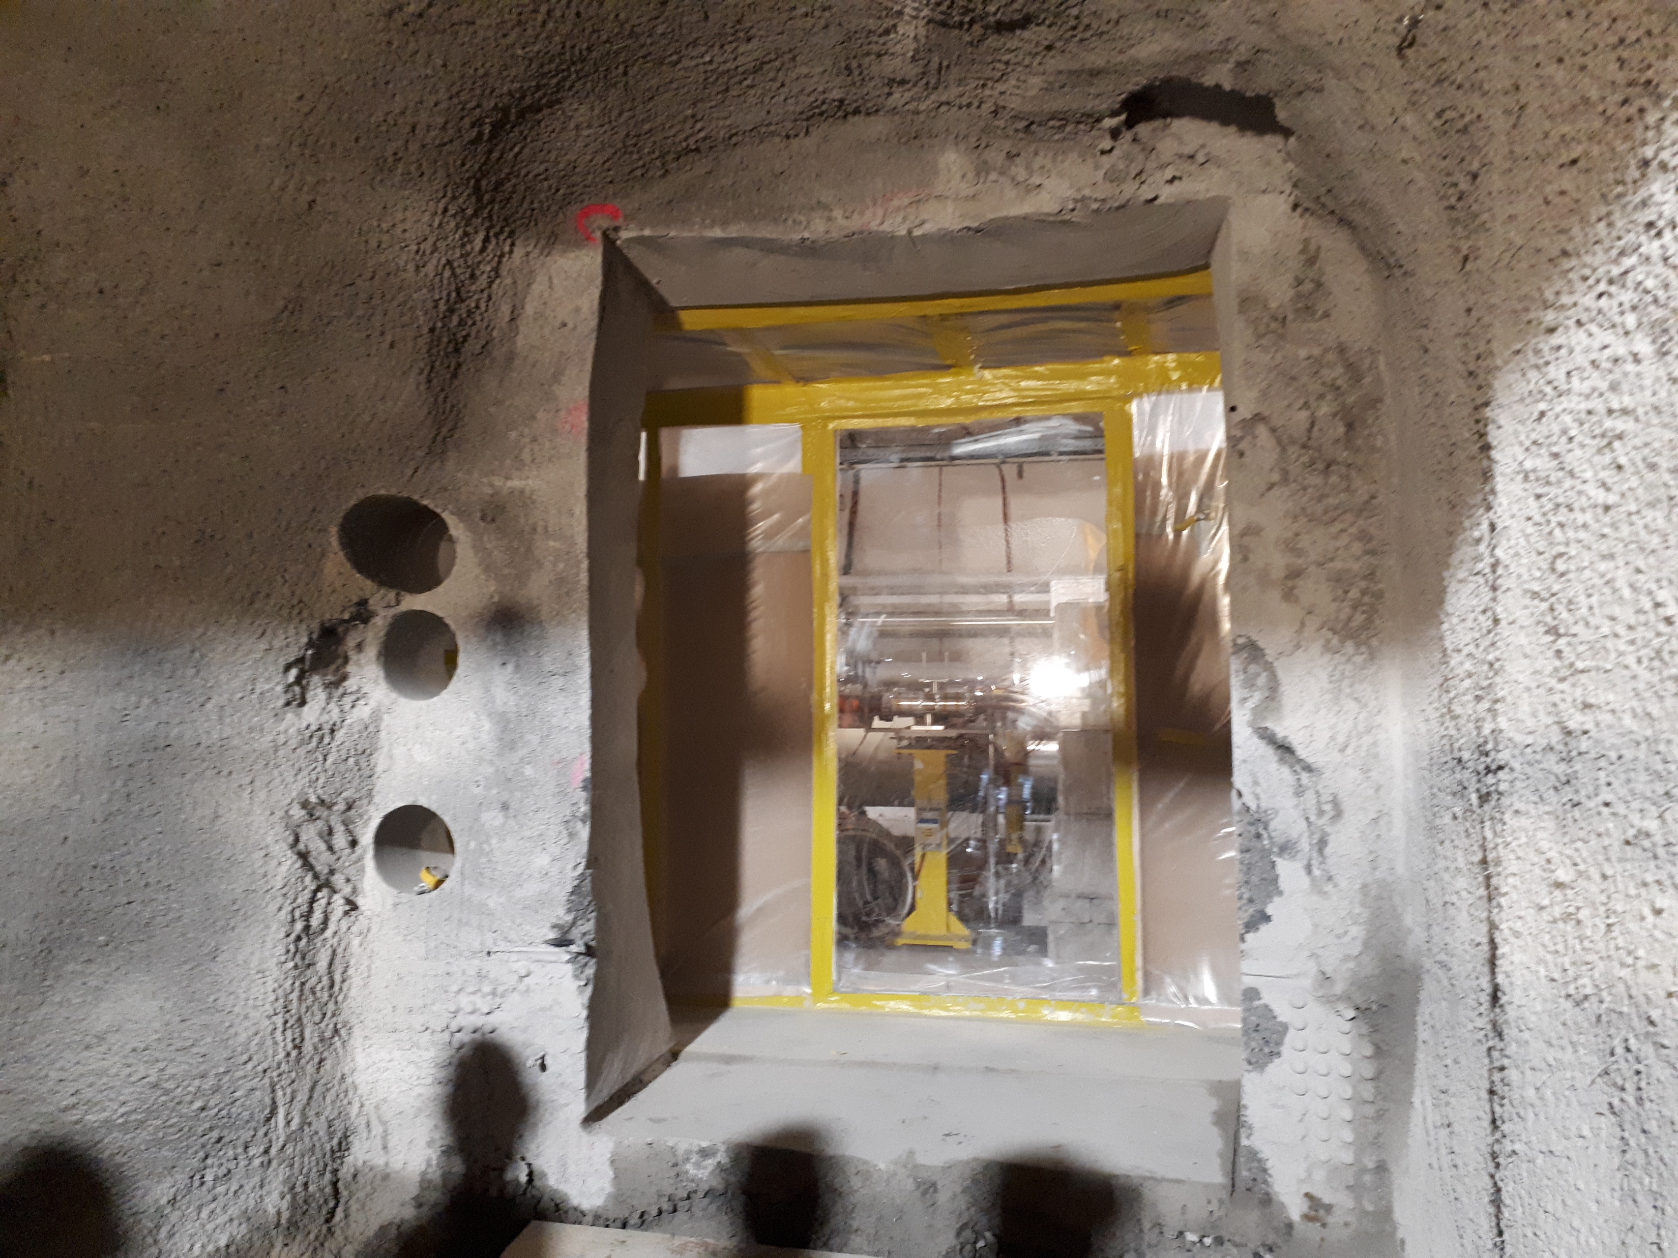
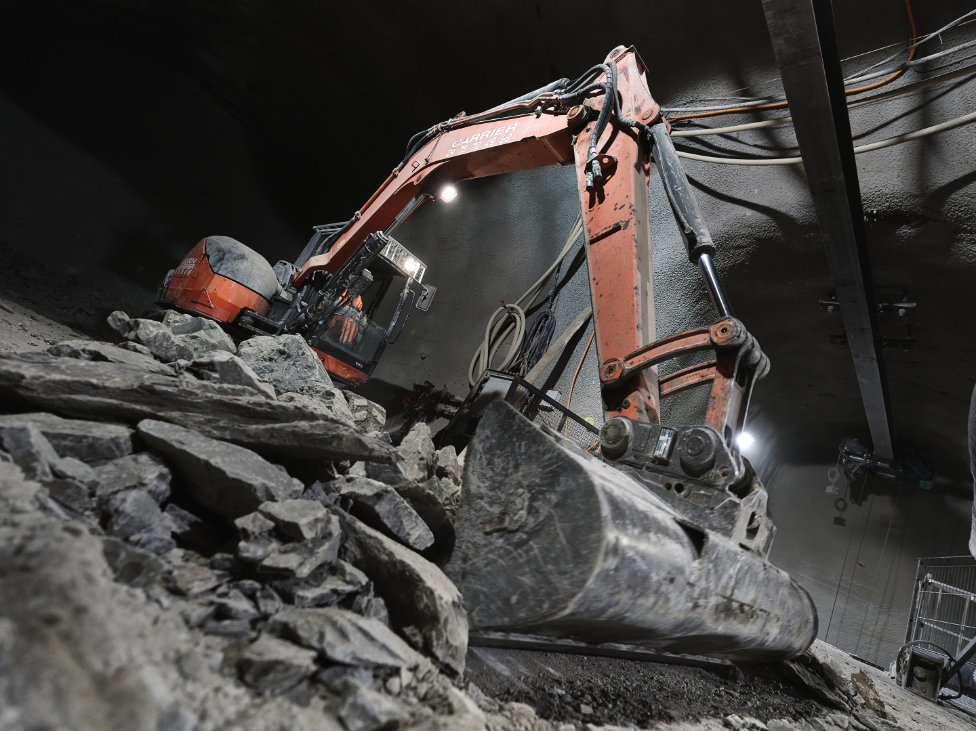
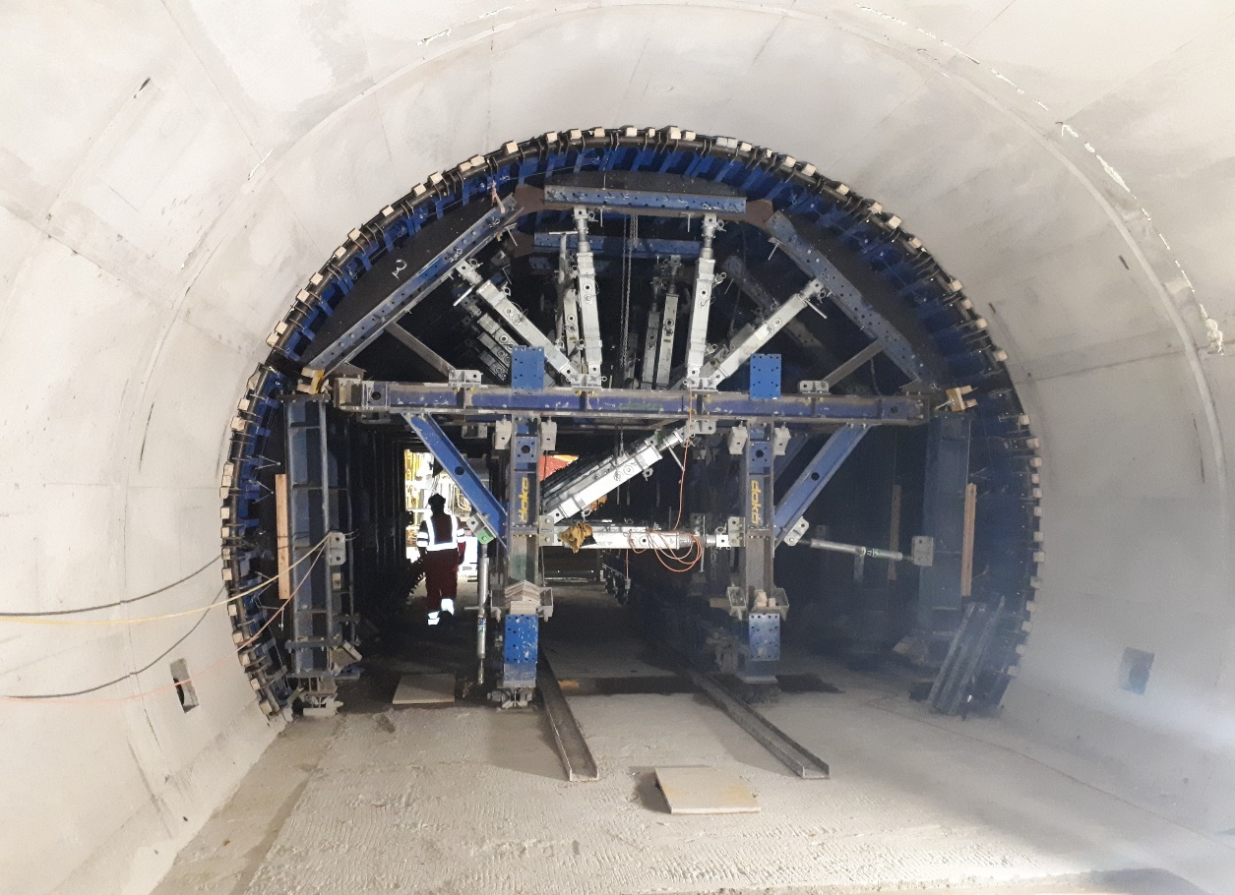
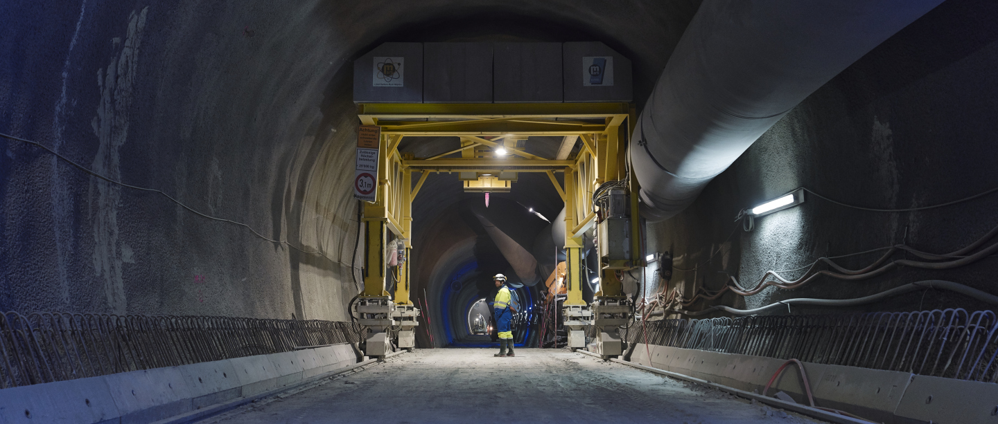
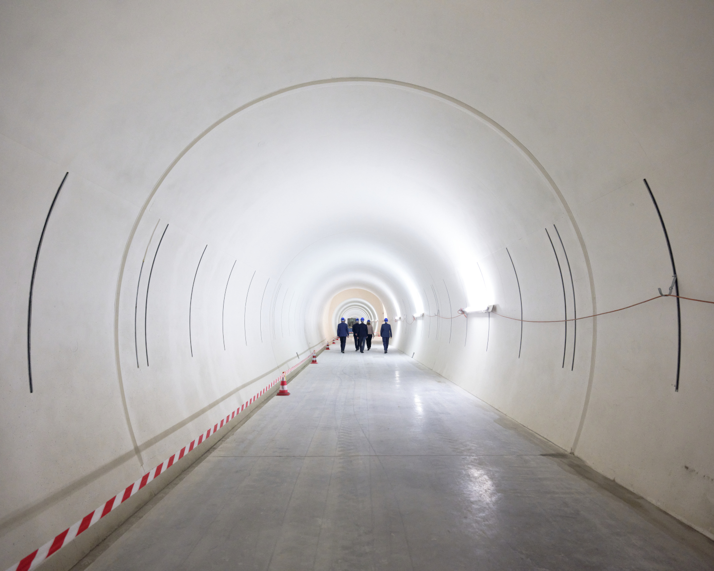
IR1 & IR5 Underground Civil Engineering: completed in 2022!
Construction Finished End 2022
Work started at End Run1 during 2018
Most of the work was conducted during LS2 ➔ vibration impact
Transition to LHC tunnel
13
Notes:
18

Slide 14
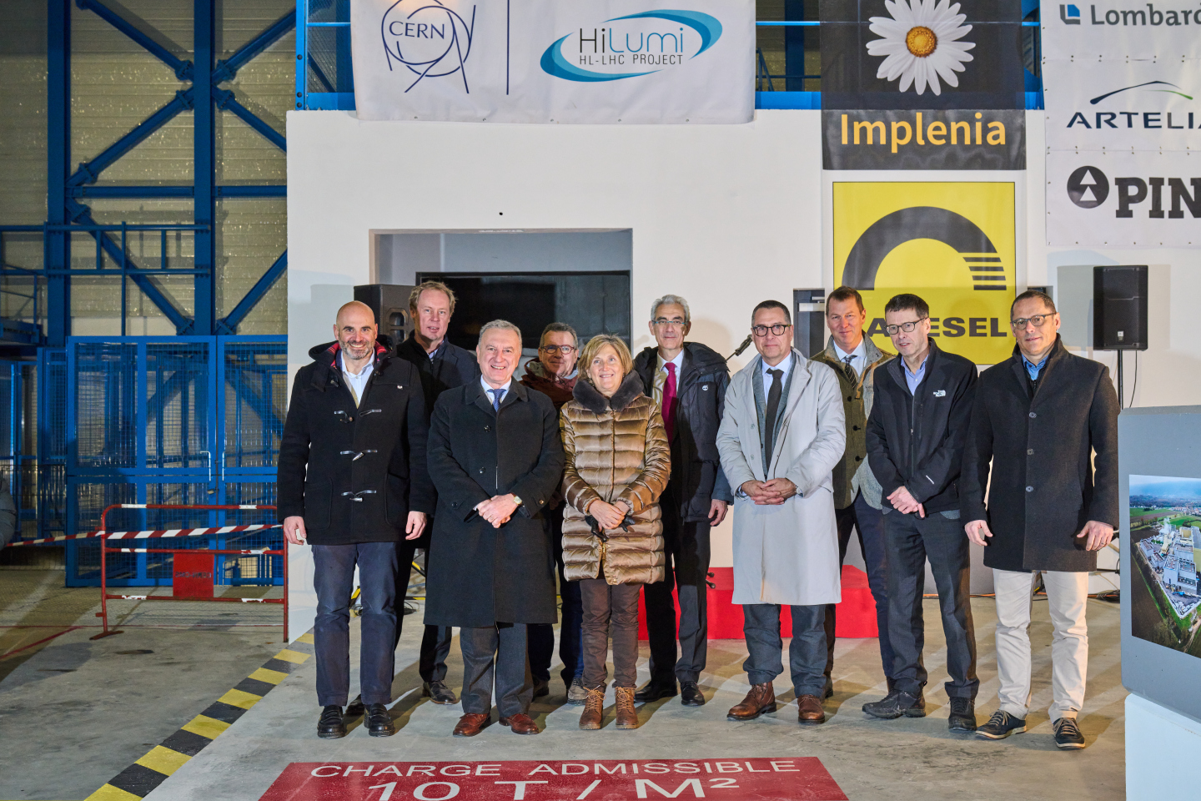
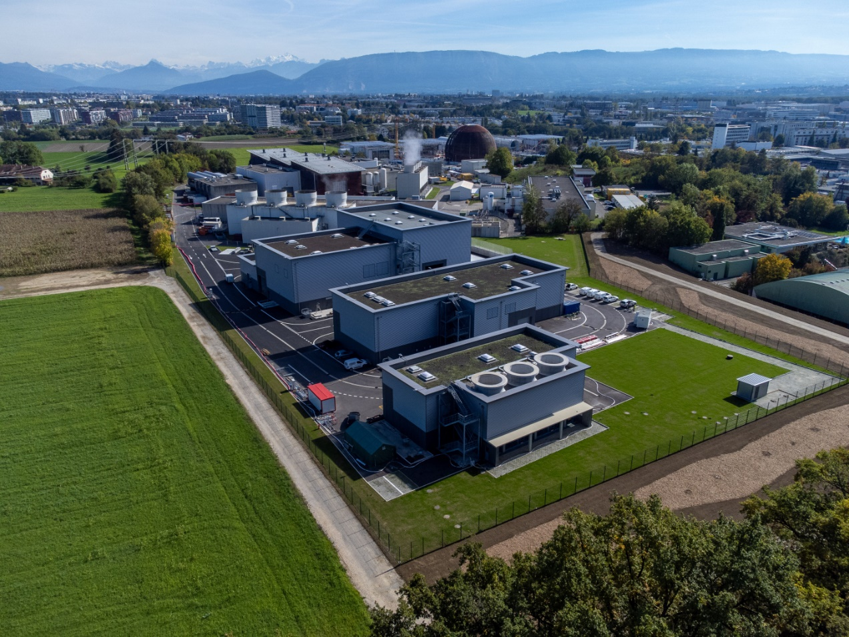
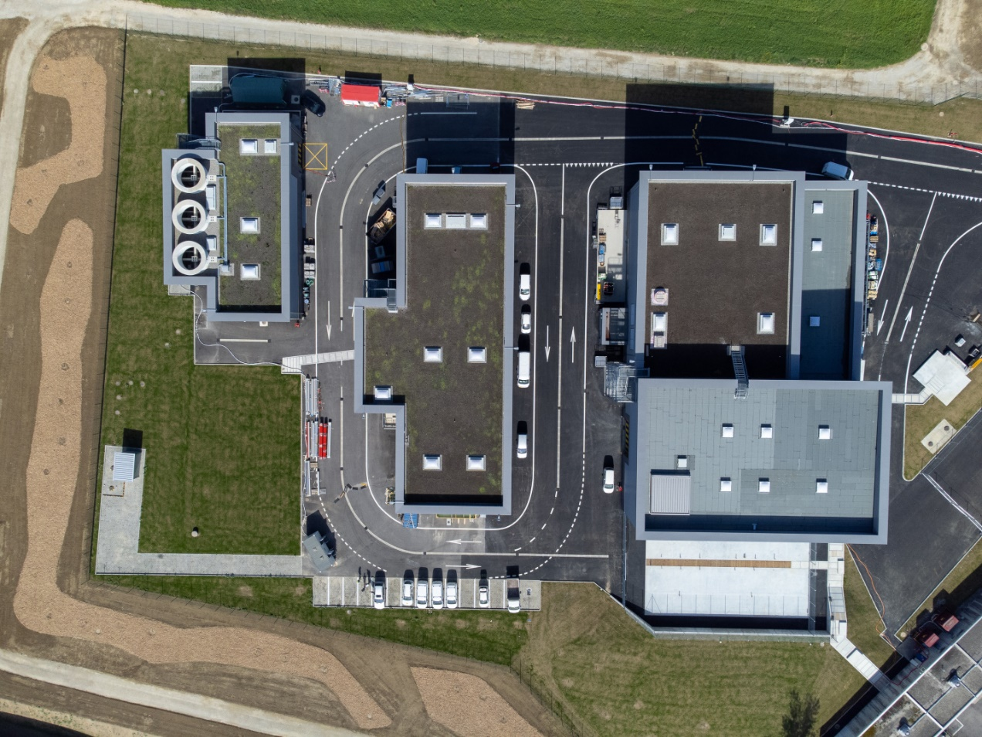
Completion of the Surface Buildings in 2023
Work Ended Spring 2023
SF17
SU17
SE17
SHM17
SD17
Example Point 1
20th January 2023
Celebration Ceremony: Point 5

Slide 15
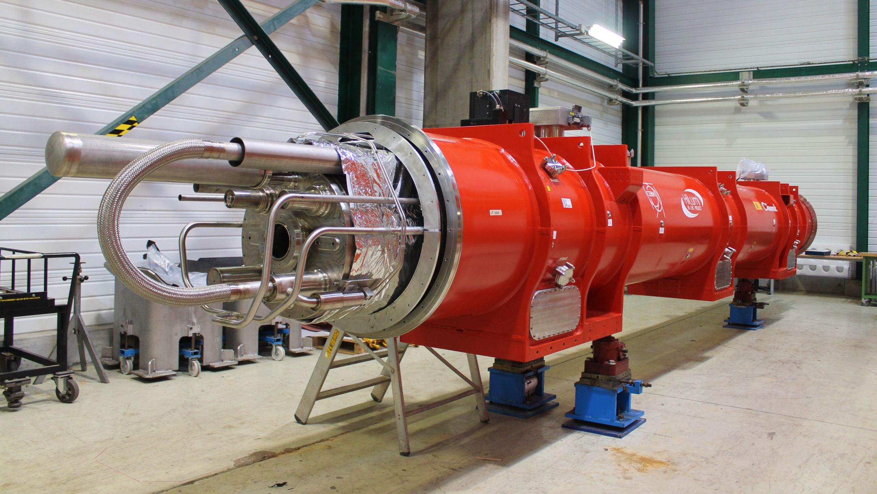
Status of the HL-LHC Triplet Magnets
IPAC 2023, Venice May 9th 2023 Oliver Brüning
Notes:
Centre piece

Slide 16
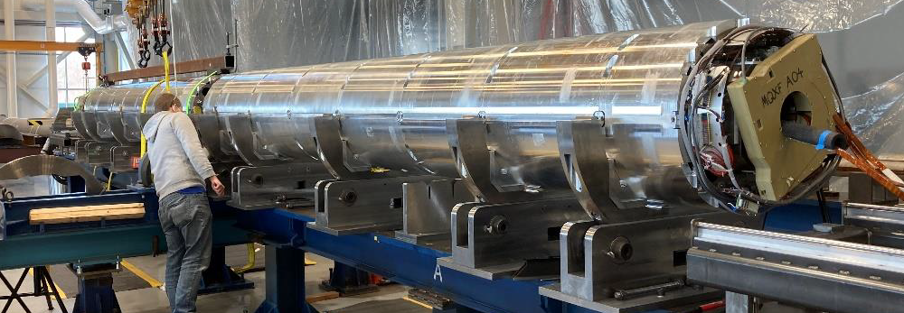
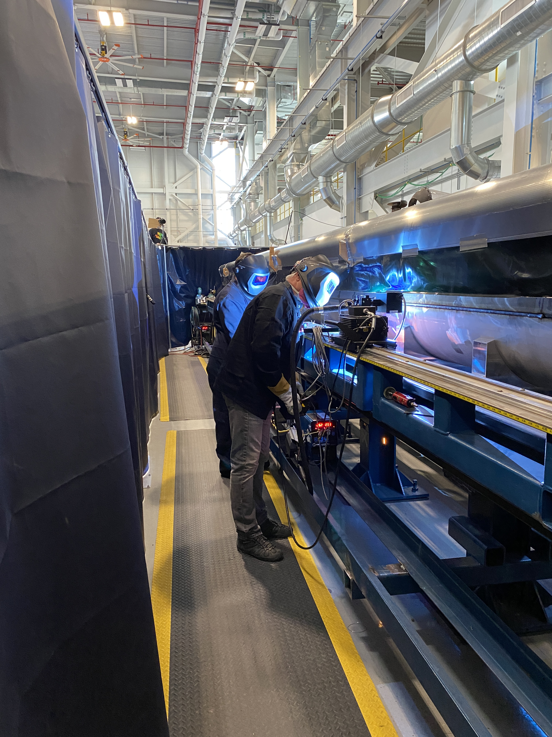
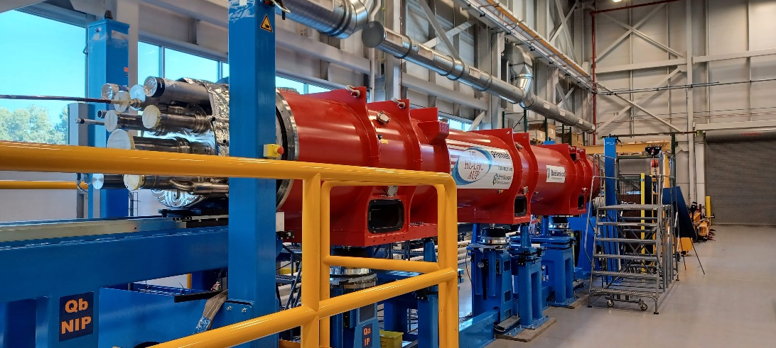
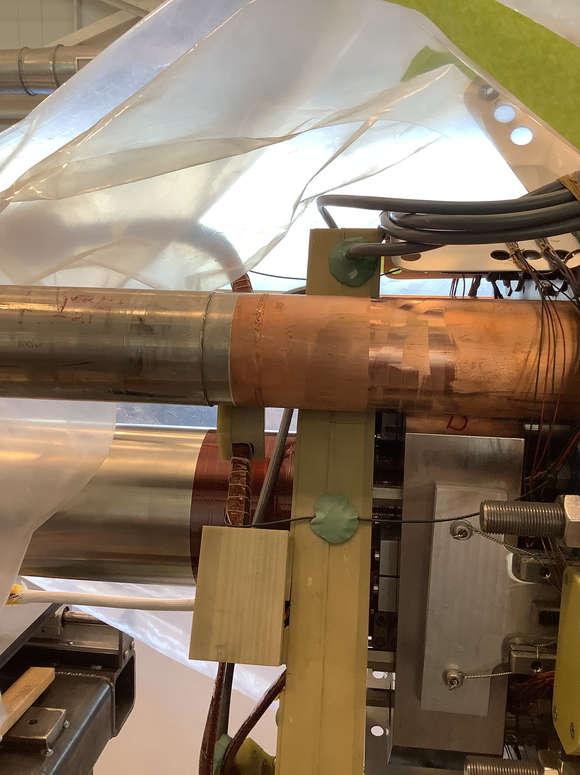
Update on MQXFA – Q1 & Q3: Cryo-Module Assembly in the USA
7 magnets constructed and validated ➔ Started Coldmass construction [2 / Coldmass]! ✓
May 2022: Endurance Test on MQXFA05: 50 quenches, 5 TC ➔ magnet remains @ nominal! ✓
Magnet Pair Alignment
Cryostated Assembly LMQXFA-01
Shell Longitudinal Seam Welding
G. Apollinari - MOPL040
Heat Exchanger Installation
Cryostated Assembly @ FNAL
  First AUP horizontal test: LQXFA01 reached nominal +300A @1.9K & @4.5K last weekend!
  ➔ tests are ongoing

Slide 17
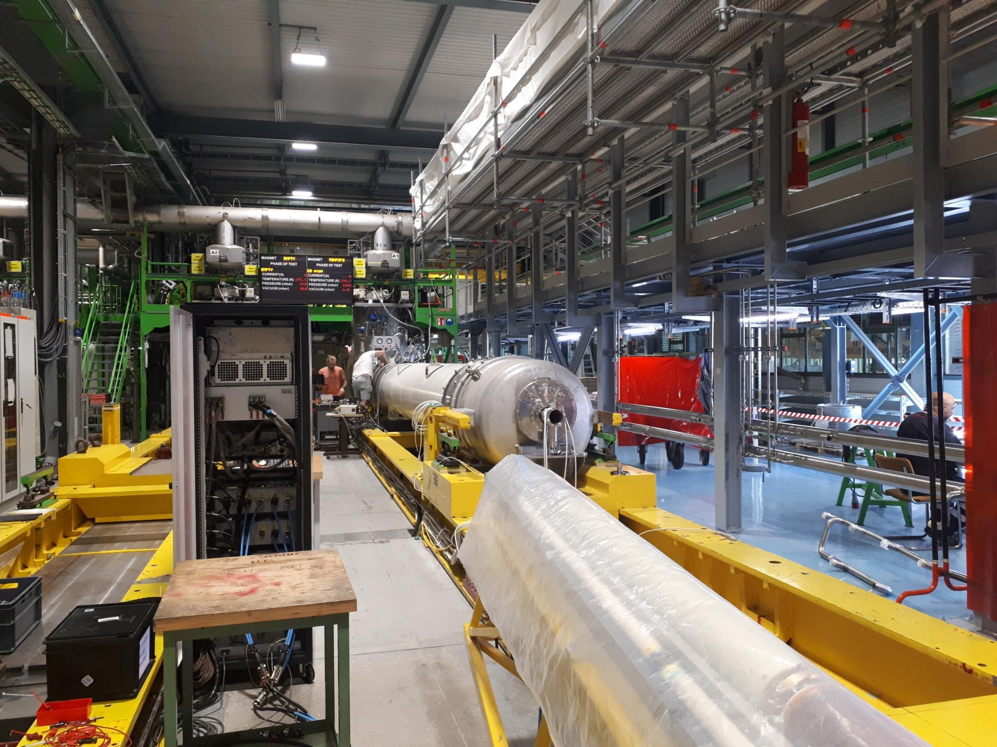
Update on MQXFB – Q2: Cryo-Module Assembly at CERN
[Both tests conducted in temporary cryostat]
  MQXFBP3 test at CERN ➔ nominal +300A @ 1.9K and TC ✓
  MQXFB02 test at CERN ➔ nominal +300A @ 1.9K and TC ✓
A. Milanese - WEPM060
P3 and MQXFB02 satisfy the CERN acceptance criteria ✓
Limitation @ 4.5K, but Temperature margins compatible with ultimate operation energy:
P3 & 02 reached nominal +300A @ 1.9K,
P3 and 02 went through
3 TC
without degradation!
On Track for Series Production of Nb₃Sn
HL-LHC Triplet Quadrupole Magnets!

Slide 18
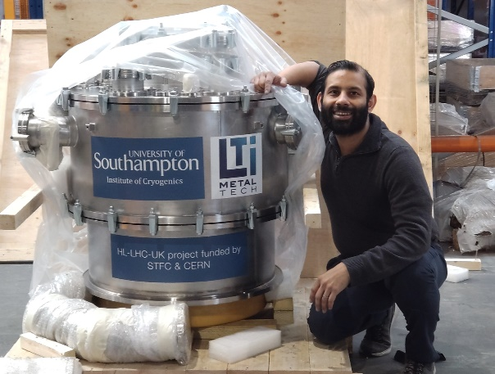
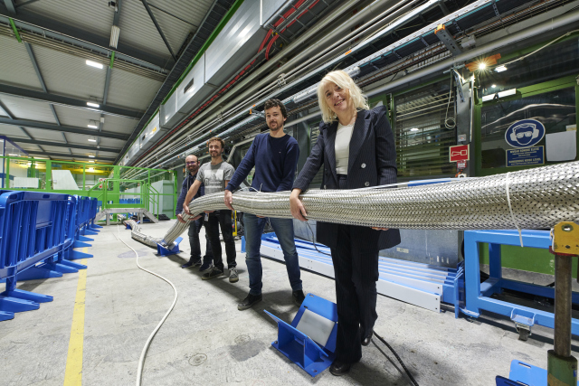
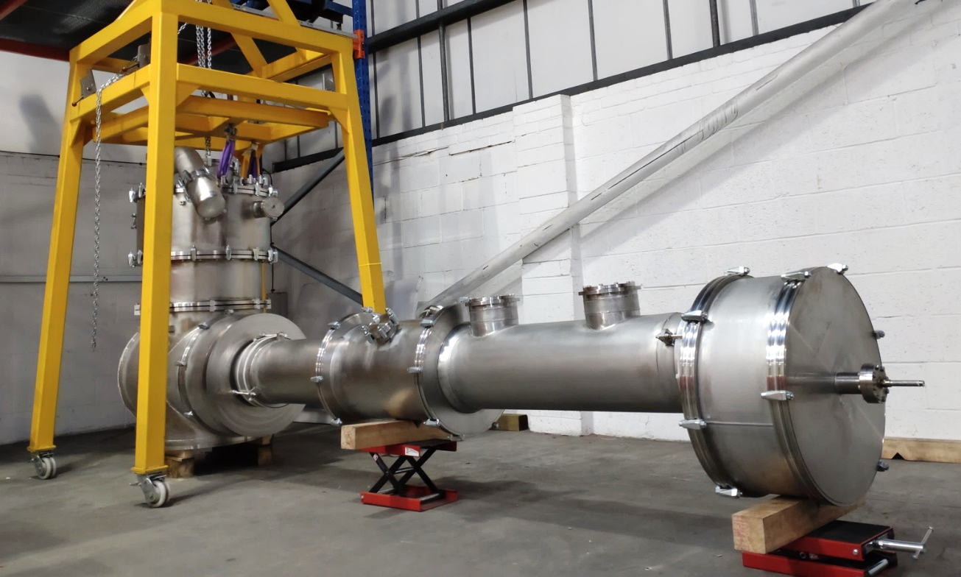
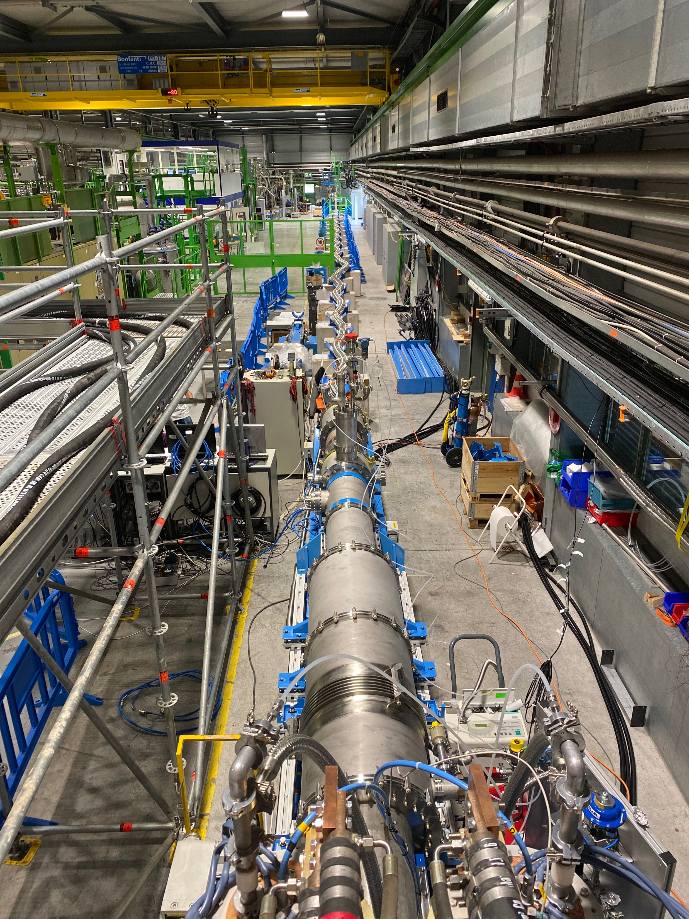
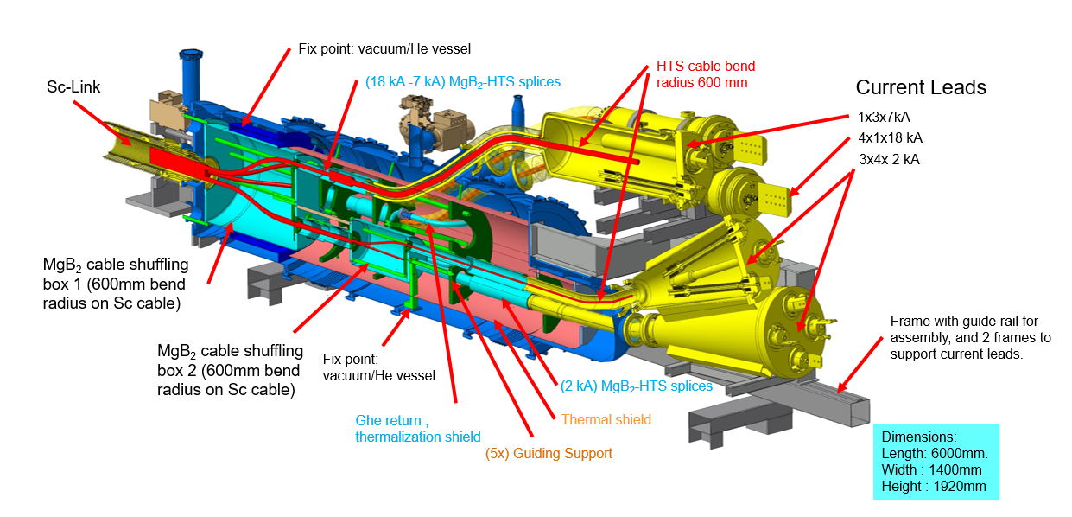
Status of the Superconducting Link
International Collaboration for the Feedboxes: with UK Southampton and Sweden Uppsala University
Successfully Demonstrated
Concept between 2020 / 22
with > 120kA @ 30K
Cable production complete
Assembly of the first complete
system incl. flexible cryostats
is ongoing
DFHM
DFHX
DSHM
DSHX
D2
DCM
D1
CP
Q3
Q2B
Q2A
Q1
DFM
DFX
Demo-3 in SM18
Diam ca. 90mm
> 100kA @ 25K

Slide 19






Status Crab Cavities
DQW Cavity – RI pre-series
RF-Dipole Cavity – US & Canada
Beam measurement in the SPS of the bunch deflection
RF-Dipole
2-Cavity
String
assembly
and
Cryostat
assembly
DQW Crab Cavity Prototype Cryostat in the SPS

Slide 20



HL-LHC IT STRING a reproduction of HL-LHC P5L
P4
P5
P5
P3
P2
HL-LHC
P6
P5R
SPS
P7
P1
P5L
P8
➔
Notes:
23

Slide 21

HL-LHC IT STRING in a surface building @ SM18
STRING area
Horizontal benches for cryomagnets
Magnet test cryostats
SC link system test bench
Cryogenic infrastructure
RF test zone

Slide 22






IT-String Status in pictures
PC and Energy Extraction racks installed on the metallic structure
Cryo Distribution
On top of the empty metallic structure
Under the metallic structure
June 2024
Sept 2024
Aug 2025
Jan 2026

Slide 23

Summary:
Civil Engineering Work Completed
Nb₃Sn Technology validated
Repaired
MB Dipole
Some HL-LHC related contributions at this conference:
Project management: WEPM124; TUPA154; TUPA155
Configuration: MOPL001; MOPL034; WEPL102; WEPA091
Triplet Magnets: MOPL040; WEPM057; WEPM060;
Crab Cavities & RF: WEPA149; WEPL119; TUPA160;
Collimation, Beam Dump and Machine Protection:
MOPL017; MOPL036; MOPA126; MOPL022; MOPA101; MOPL023; MOPA100; MOPL036; WEPM058; WEPM109; WEPA022; WEPA148; TUPM122
Superconducting Link demonstrated
MQXFBP3
Crab Cavity Operation and Production demonstrated
MQXFB02
D1
proto
CP
The project is on Track for installation
during LS3 starting in 2026
Stay Tuned for completion of the IT-String installation in 2023/24 and operation in 2025!
1st Part of Collimation Upgrade completed
All magnet productions on good track!
➔

Slide 24




Status Collimation
S. Redaelli - MOPL017
The ALICE HL-LHC running period started in Run3 – thanks to the LIU upgrade
New Dispersion Suppressor Collimators for Pb⁺⁸² operation installed @ ALICE
LIU: M. Meddahi - MOXD1
HL-LHC will almost double the proton current [ca. 1A] – thanks to the LIU upgrade
HL-LHC features new, low impedance collimators ➔ ca ½ already installed for Run3!
HL-LHC features crystal collimators for Pb ion beam cleaning; ready for Run3!
HL-LHC features new, physics debris collimators next to the experiments
➔ In preparation for installation during LS3

Slide 25
Thank you for your attention

Slide 26
Significant Progress on many fronts!

Slide 27
Summary
Nb₃Sn Technology validated
Some HL-LHC related contributions at this conference:
Project management: WEPM124; TUPA154; TUPA155
Configuration: MOPL001; MOPL034; WEPL102; WEPA091
Triplet Magnets: MOPL040; WEPM057; WEPM060;
Crab Cavities & RF: WEPA149; WEPL119; TUPA160;
Collimation, Beam Dump and Machine Protection:
MOPL017; MOPL036; MOPA126; MOPL022; MOPA101; MOPL023; MOPA100; MOPL036; WEPM058; WEPM109; WEPA022; WEPA148; TUPM122
Superconducting Link demonstrated
Crab Cavity Operation and Production demonstrated
Civil Engineering Work Completed
The project is on Track for installation
during LS3 starting in 2026
1st Part of Collimation Upgrade completed
Stay Tuned for completion of the IT-String installation in 2023/24 and operation in 2025!
All magnet production on good track!
IPAC 2023, Venice May 9th 2023 Oliver Brüning

Slide 28




Technology
Landmarks
Separation / Recombination
dipole magnets: D1 & D2
Non-Linear Corrector magnets
Hollow Electron Lens installation delayed until after LS3 ➔ no longer part of the HL-LHC baseline

Slide 29
LHC (Large Hadron Collider): Magnet Technology
1983 1991 2000 2010
The LHC dipole magnets mark the
culmination of 30 years of superconducting
NbTi magnet technology development!
➔ Requiring 1.9K [-271 degrees Celsius] operating temperature
A 27 km circumference collider…
29

Slide 30

SC Magnet
Technology
source:
D. C. Larbalestier @ Researchgate
Nb₃Sn
HL-LHC with 11-12T
16 T for HEP?
Almost a commodity!
  15-20 t per year for MRI
  ITER needs 500 t
ca 5 times cost of LHC Nb-Ti
Brittle material
HTS (needed → 20 T)
➔ on going R&D!
Bi-2212: cost today 2-5 x Nb₃Sn
YBCO: cost today 10 x Nb₃Sn
More SC
for the
same field
➔ Cost!
30

Slide 31


Luminosity optimization:
Luminosity Levelling at the luminosity frontier:
To cope with the total number of events per time interval and the
event pileup in the detector
➔ Design for highest possible virtual luminosity, but keep the luminosity artificially lower during operation!!
All levelling methods have been successfully demonstrated in
Machine Studies in the LHC!!!
Lifetime proportional to total particles:
$$τ_{eff}=\frac{N_{tot}}{n_{IP}∙σ_{tot}∙L_{leveled}}$$
➔ Maximize the number of particles in the storage ring and the number of bunches!
➔ Injector Complex Upgrade - LIU
➔ Stored Beam Power in the LHC!
31

Slide 32

The LHC is NOT a Standalone Machine
The LHC performance fully relies on the performance of its injector complex
By itself one of the largest accelerator facility in the world with its own diverse and, for many aspects, unique physics program
LHC : 2x(0.45 – 7) TeV
SPS : 26 – 450 GeV
PS : 1.4 - 26 GeV
PSB : 0.05 -1.4 GeV
Linac 2: 0-50 MeV
LHC : 2x(0.45 – 7) TeV
SPS : 26 – 450 GeV
PS : 2 - 26 GeV
PSB : 0.16 -2 GeV
Linac 4: 0-160 MeV H⁻
LHC Injector Upgrade Project
Installation finished in LS2
➔ Now being commissioned!
Notes:
Maybe skip?

Slide 33
Machine Efficiency
This becomes more challenging with increased Collider size and Requires even more powerful injector complex!!!!
Minimum of 2h between end of one, and start of the next fill
Average LHC Turnaround time of 4-5h!!!!
Average LHC fill length of 8h ➔ 65% of scheduled physics time!!!
ca. 50% in LHC operation including faults at best conditions!
33

Slide 34



Energy management challenges: Example LHC
Energy stored in the LHC magnet system [8.3T]: ∼10 GJoule
Worry about beam losses:
Failure Scenarios ➔ Local beam Impact
➔ Equipment damage
Lifetime & Loss Spikes ➔ Distributed losses
➔ Magnet Quench & QPS
➔ Machine efficiency
e.g. Cryo Sectors: 95% availability requires 99% with 8 sectors
8 Sectors ➔ [12 Sectors ➔ 20 Sectors]
10 GJoule ≅ flying 700 km/h
10 GJoule ≅ 55 km/h
Sectorization!!
Tracking
[ppm]!!!
560 tons
88’000 tons
Energy stored in the two beams: 720 MJ [ 6 10¹⁴ protons (1 ng of H+) at 7 TeV ]
700 MJ melt one ton of copper
700 MJoule dissipated in 88 μs
⎝ 8 TW
Installed World Electrical Capacity:
3.8 TW
Beam Dump robustness [core and windows]
Kicker reliability ➔ many kicker elements
➔ Failure likelihood & reliability
1 electron volt = 1,602× 10⁻¹⁹ joule
Notes:
34
Aircraft carrier

Slide 35






Nb₃Sn quadrupole: Transition from Prototype to Series production
Second short (1.5 m) under preparation for test at CERN
Insertion of coil package inside mechanical structure of the first IT quad prototypes (4.2 m long) in LBNL-USA
35

Slide 36

Crossing Angle & Parasitic Collisions
Insertion Layout:
ca.130m ➔ 150m
ca.50m
Parasitic bunch encounters:
Operation with ca. 2800 bunches @ 25ns spacing ➔ approximately 50 unwanted collision per
Interaction Region (IR).
➔ Operation requires crossing angle
non-linear fields from long-range beam-beam interaction:
efficient operation requires large beam separation at unwanted collision points ➔ Separation of 10 -12 σ ➔ large triplet apertures for HL-LHC!!

Slide 37



HL-LHC cavity designs
2 Designs with
Different Coupler concepts and
Deflection planes
RF Dipole: Waveguide or
waveguide-coax couplers
Double ¼-wave: Coaxial couplers with
hook-type antenna
DQW crab-cavity
Cryomodule for
SPS tests
Present baseline: 4 cavities / IP / side ➔ 16 total

Slide 38






Crab cavity cryo-module for installation in the SPS
38

