Slide 1
MCBXFB02 and MCBXFB02b test results
Gerard Willering, TE-MSC-TM
17 May 2023 – WP3 meeting
With thanks to the test team including Franco Mangiarotti, Jerome Feuvrier, Jean-Luc Guyon, Patrick Viret, Yannick Thuau, Frederic Rougemont, Filip Kosowski
Test report in EDMS 2897254

Slide 2
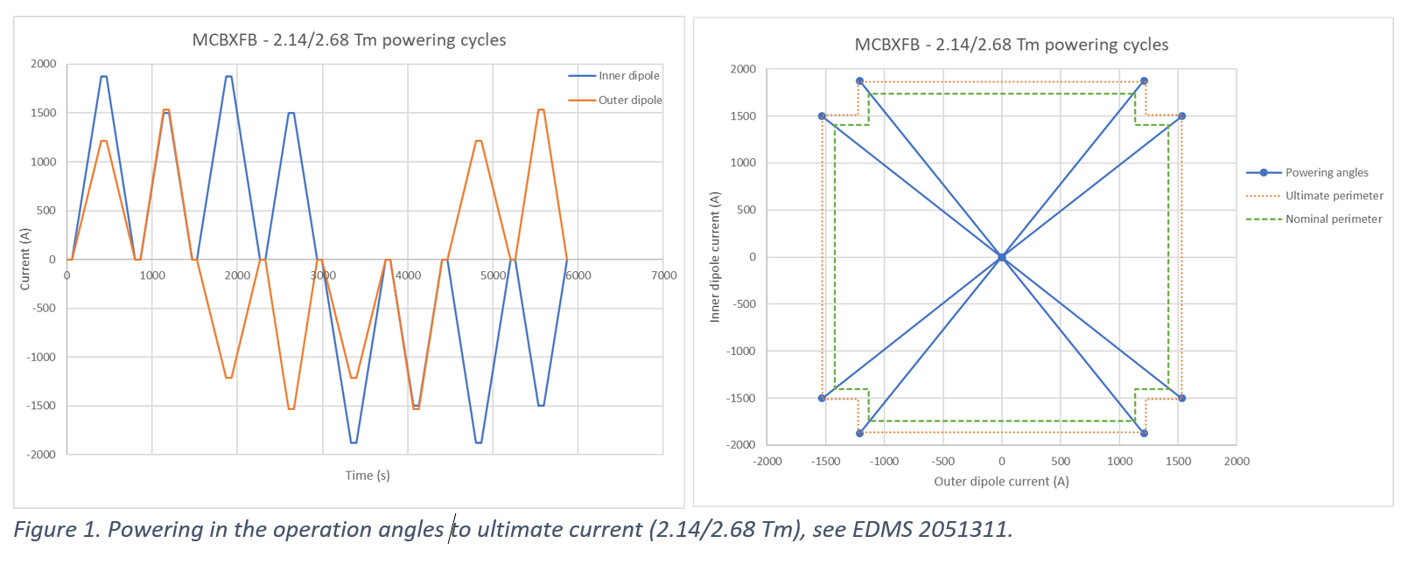
Recall test plan
Standard test in operational angles to ultimate (2.14/2.68 Tm).

Slide 3
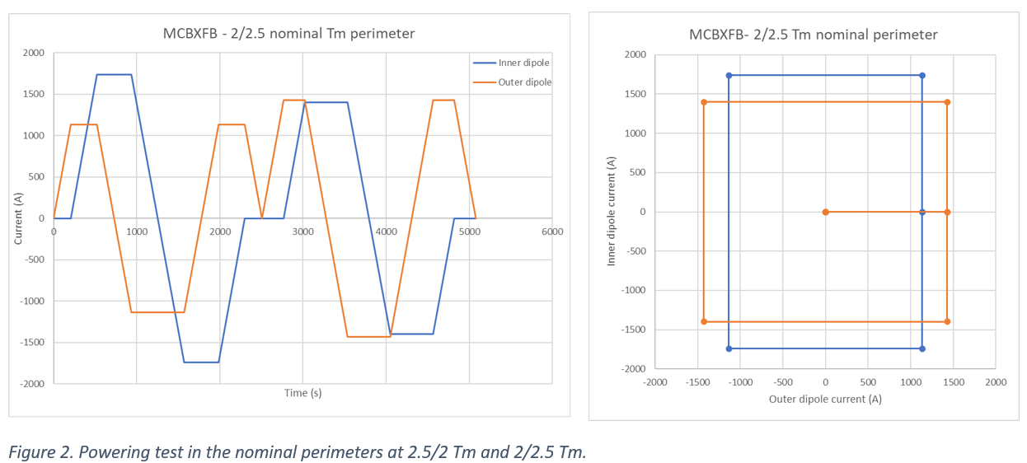
Recall test plan
Standard test following the ‘nominal perimeter’ in two rectangular cycles (2/2.5 Tm)
Added to the test plan only after CD2 of this magnet.

Slide 4
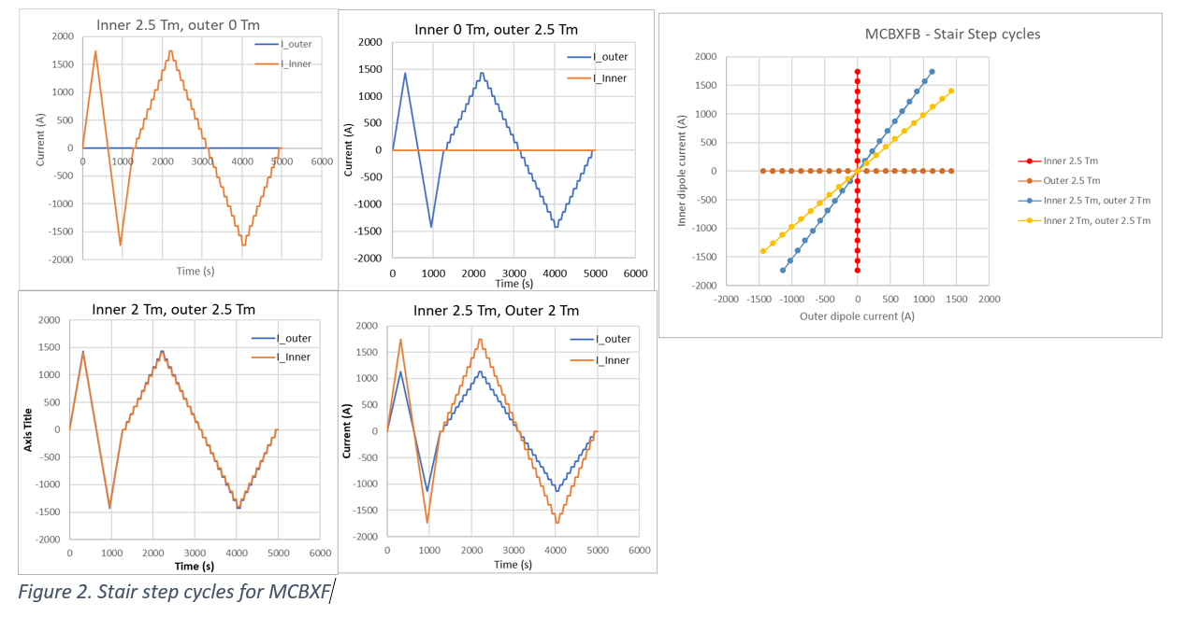
Recall test plan
Standard magnetic measurement cycles to 2.5 Tm individual and in the nominal operation angles to 2/2.5 Tm

Slide 5
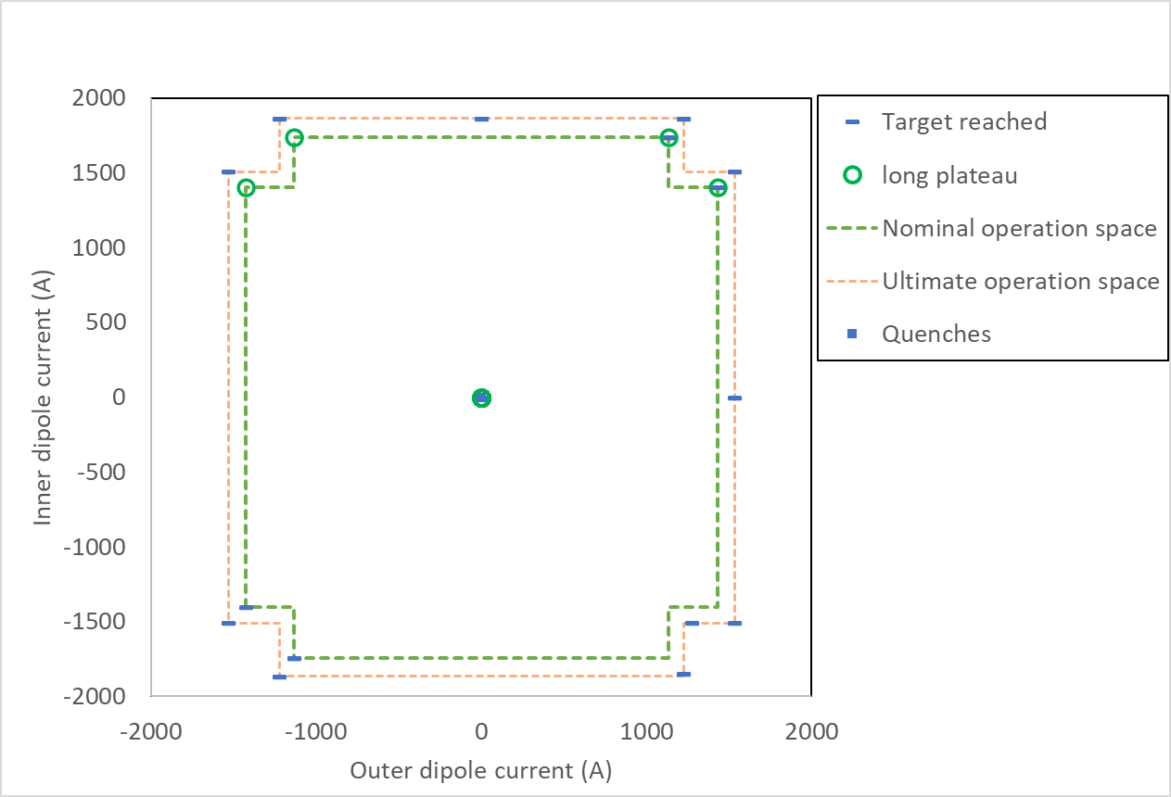
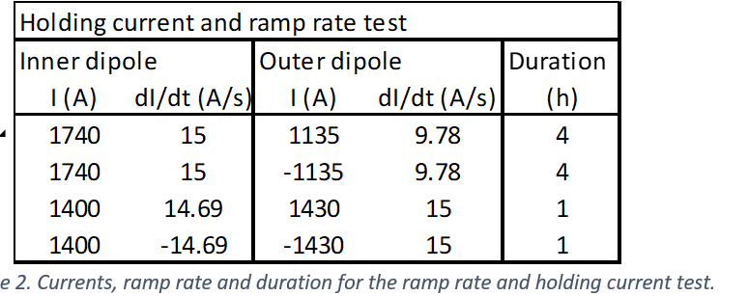
Recall test plan
Standard holding current tests at nominal 2/2.5 Tm in 4 angles for 1 to 4 hours.
1h
4h
4h
1h

Slide 6
MCBXFB02 and MCBXFB02b - info
Magnet details:
Magnet MTF name | HCMCBXFB012-E5000001
Inner coil | ICBS04
Inner coil | ICBS07
Outer coil | OCBS04
Outer coil | OCBS07
MCBXFB02 - Cool down 1: October 2022
MCBXFB02 - Cool down 2: October 2022
Then it was sent to Elytt for reassembly/repair of outer dipole, which had an insulation non-conformity. After reassembly the magnet was renamed MCBXFB02b, still using the same MTF name.
MCBXFB02b - Cool down 1: February 2023
MCBXFB02b - Cool down 2: April 2023

Slide 7
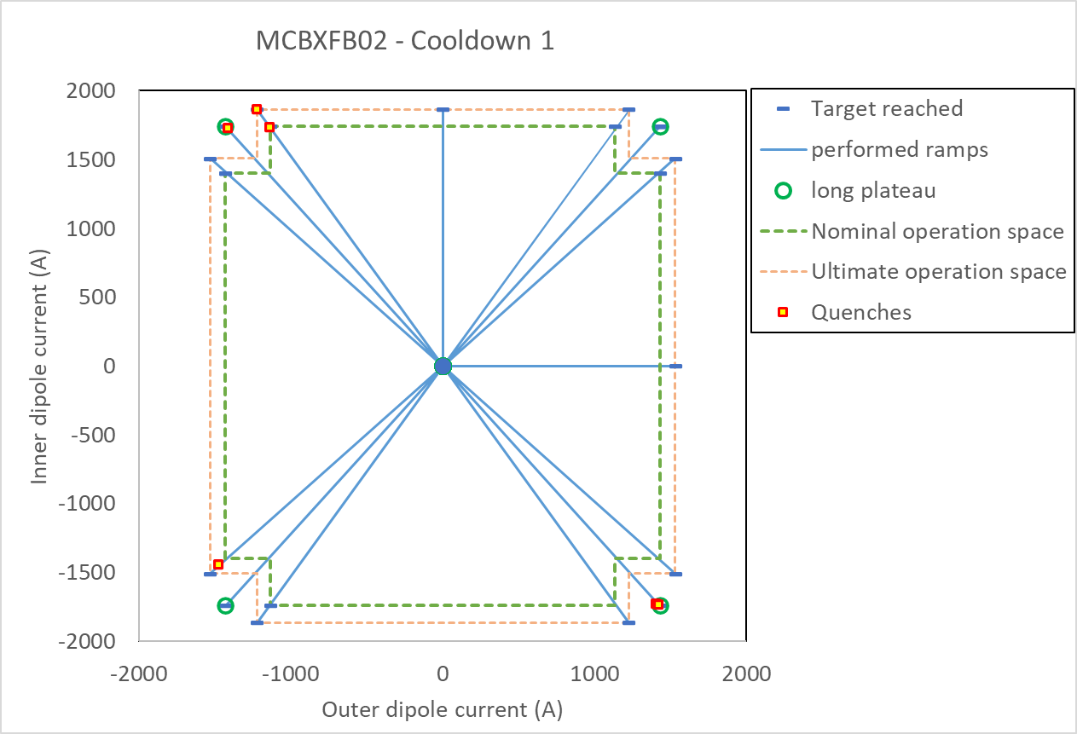
MCBXFB02 – Cool Down 1 - summary
Powering
1 quench in nominal operation space
2 quenches in ultimate operation space
2 quenches beyond ultimate operation space
Different compared to current test plan:
Diagonals up to 2.5/2.5 Tm were tested for comparison with earlier prototypes as additional test.
“rectangular” powering not performed.
Holding current tests at 2.5/2.5 Tm

Slide 8
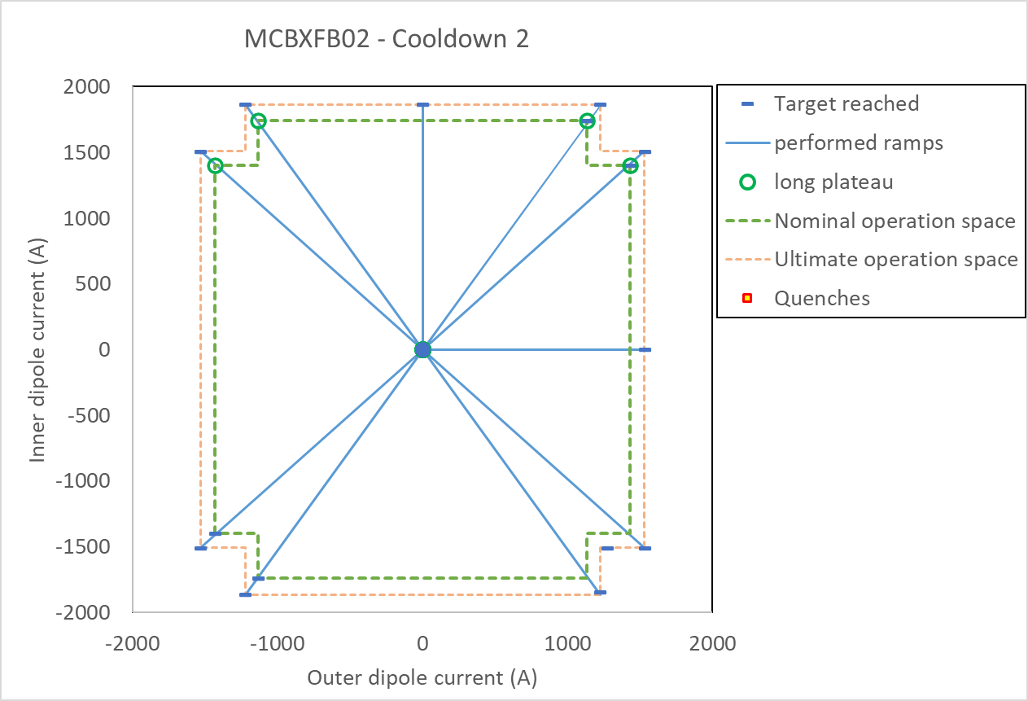
MCBXFB02 – Cool Down 2 - summary
Powering
0 quench in nominal operation space
0 quenches in ultimate operation space
Compared to current test plan:
“rectangular” powering not performed.

Slide 9
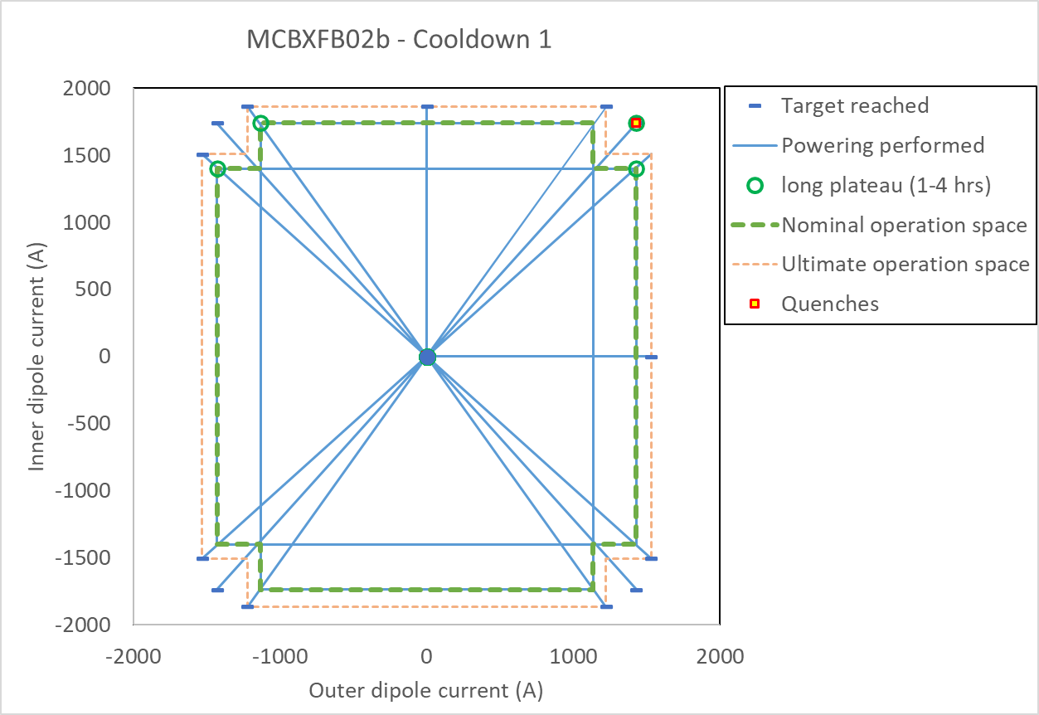
MCBXFB02b – Cool Down 1 - summary
Note that between MCBXFB02 and MCBXFB02b the outer dipole was modified and the magnet reassembled with the same coils.
Powering
0 quench in nominal operation space
0 quenches in ultimate operation space
1 quench beyond ultimate operation space.
Compared to current test plan:
Diagonals tested up to 2.5/2.5 Tm for comparison with CD1 and prototypes.

Slide 10
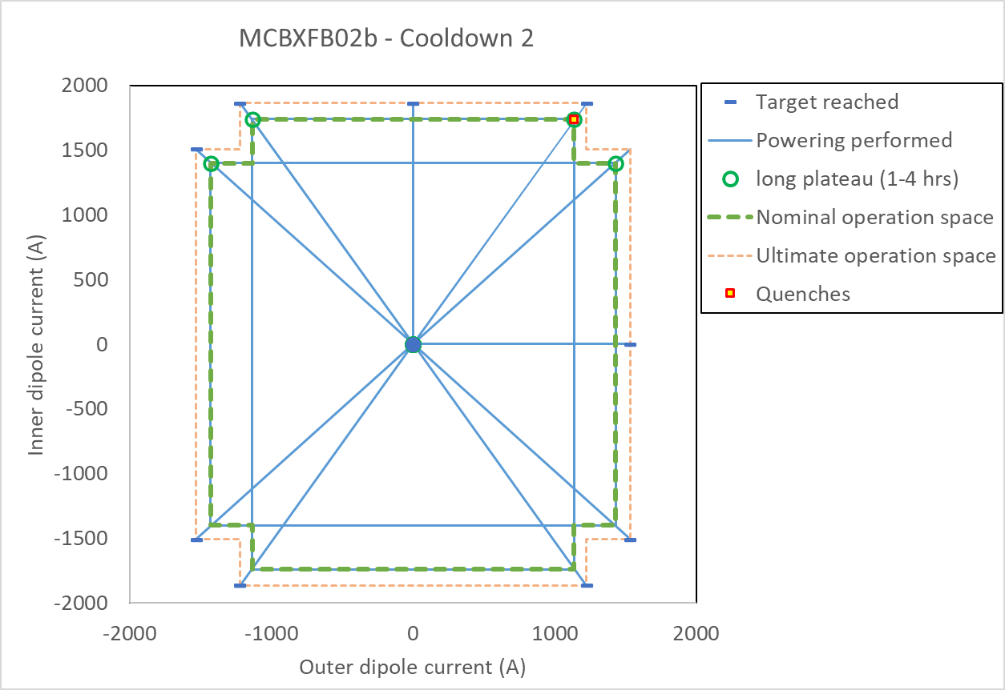
MCBXFB02b – Cool Down 2 - summary
Note that the outer dipole was modified and the magnet reassembled after CD 2.
Powering standard test
0 quench in nominal operation space
0 quenches in ultimate operation space
Additional tests:
2000 cycles in 4 angles up to 2/2.5 Tm, see next slide. 1 quench after 630 cycles, then no more quench in the 1370 additional cycles.
Ultimate current in the 8 ‘operation angles’ reverified (0 quench) after the 2000 cycles.

Slide 11
MCBXFB02 – Cool Down 4 – Cycling tests
2000 cycles were requested.
100 cycles in angle 1 up to 2.5/2 Tm
100 cycles in angle 2 up to 2.5/-2 Tm
100 cycles in angle 3 up to 2/2.5 Tm
100 cycles in angle 4 up to -2/2.5 Tm
Cycling done at 15 A/s to gain time (3 times more than the nominal 5.5 A/s)
Total cycling time about 120 hours (13 working days or 5 days with continous cycling).
For each block of 100 cycles the force directions changed (20 force direction changes)
4
3
Repeated 5 times
2
1
Result:
One quench after 670 cycles (angle 3) at the nominal level of 2.5/2 Tm. Then no more quenches up to 2000 cycles.
Ultimate powering after cycling OK without quench.

Slide 12
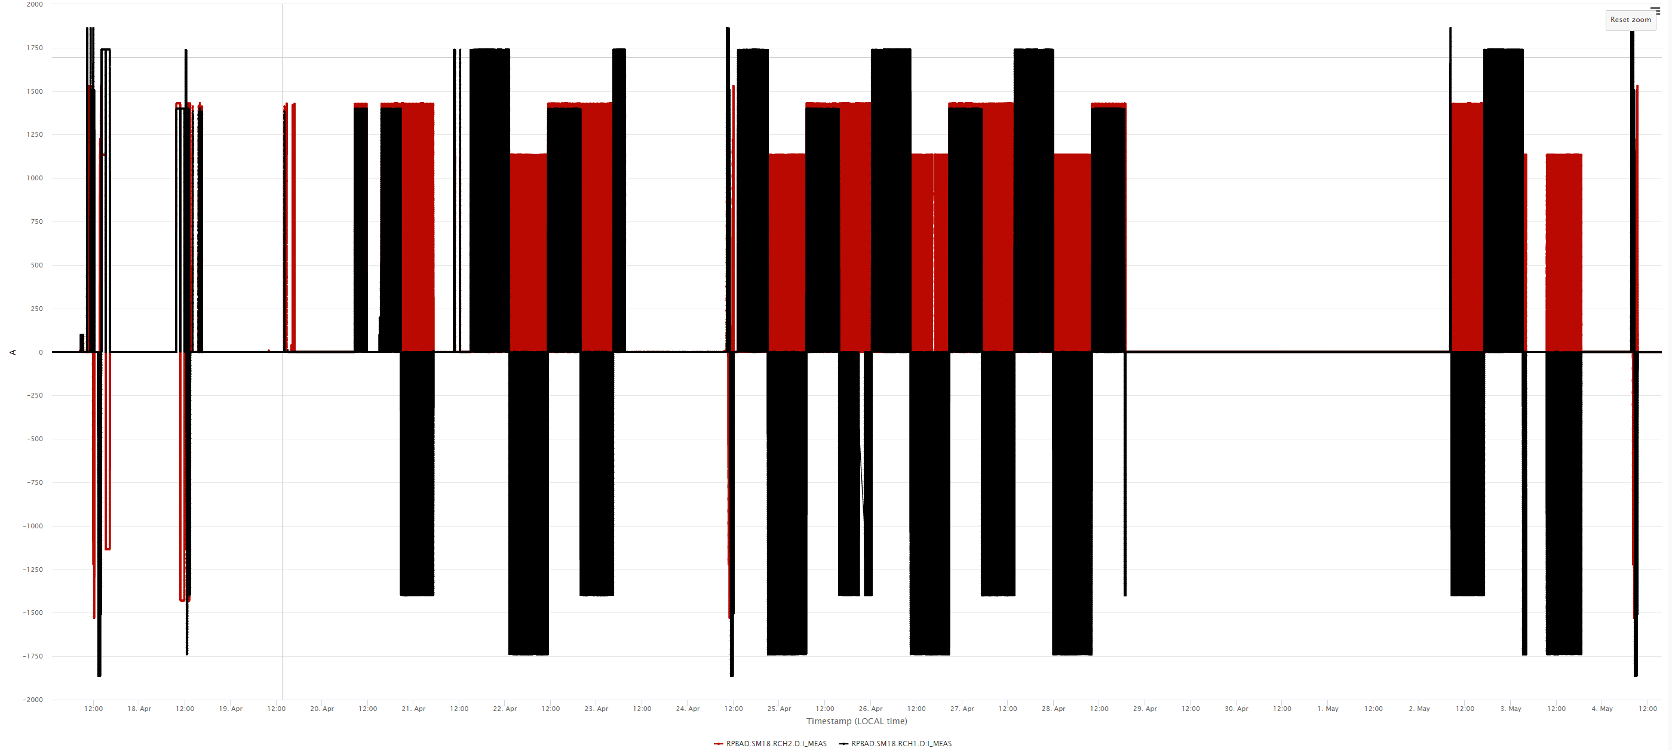
MCBXFB02b – CD2 – full powering overview
Red lines: current in outer dipole
Black lines: current in inner dipole
2kA
Ultimate current tests
630 powering cycles
Quench
~1070 powering cycles
~300 powering cycles
Ultimate current verifications
Magnet current
Trip
-2kA
18 April
4 May

Slide 13
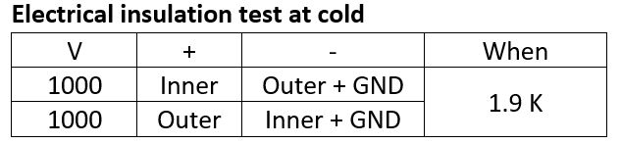
MCBXFB02 and MCBXFB02b – Insulation test
MCBXFB02 - CD1 and CD2
HV test breakdown occurred at around 700 V for the outer dipole to ground. See non-conformity report in https://edms.cern.ch/document/2799619/0.1
MCBXFB02b – CD1 and CD2:
After reassembly and repair in the first and second cool down, all HV insulation tests were within specifications up to 1 kV between coil and ground.

Slide 14
MCBXFB02 and MCBXFB02b – summary
Powering performance very good, also after reassembly.
2000 powering cycles OK, 1 quench recorded.
Insulation OK after successful repair.
 | # quench in nominal operation space | # quench in ultimate operation space | # quench beyond ultimate operation space | Insulation test Inner/Outer
MCBXFB02 - CD1 | 1 | 2 | 2 | OK/Fail
MCBXFB02 - CD2 | 0 | 0 | NA | OK/Fail
MCBXFB02b – CD1 | 0 | 0 | 1 | OK/OK
MCBXFB02b – CD2 | 1 | 0 | NA | OK/OK

