Slide 1
Magnetic Measurements on MCBXFB02
Piotr Rogacki
Lucio Fiscarelli
Matthias Bonora
Agnieszka Chmielinska
and other colleagues of the TM section
EDMSID: 2826024

Slide 2
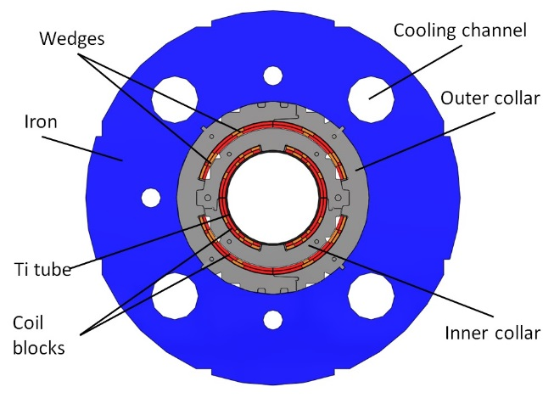
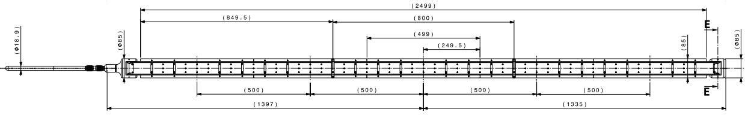
Introduction
Vertical field from the inner coils:
- main field B₁ (normal)
- first allowed b₃
Horizontal field from the outer coils:
- main field A₁ (skew)
- first allowed a₃
Reference radius 50 mm
Rotating-coil in the helium bath of vertical cryostat ClusterD in SM18
  5 segments (500 mm each, 2.5 m total)
    Centered around Segment 3
2

Slide 3
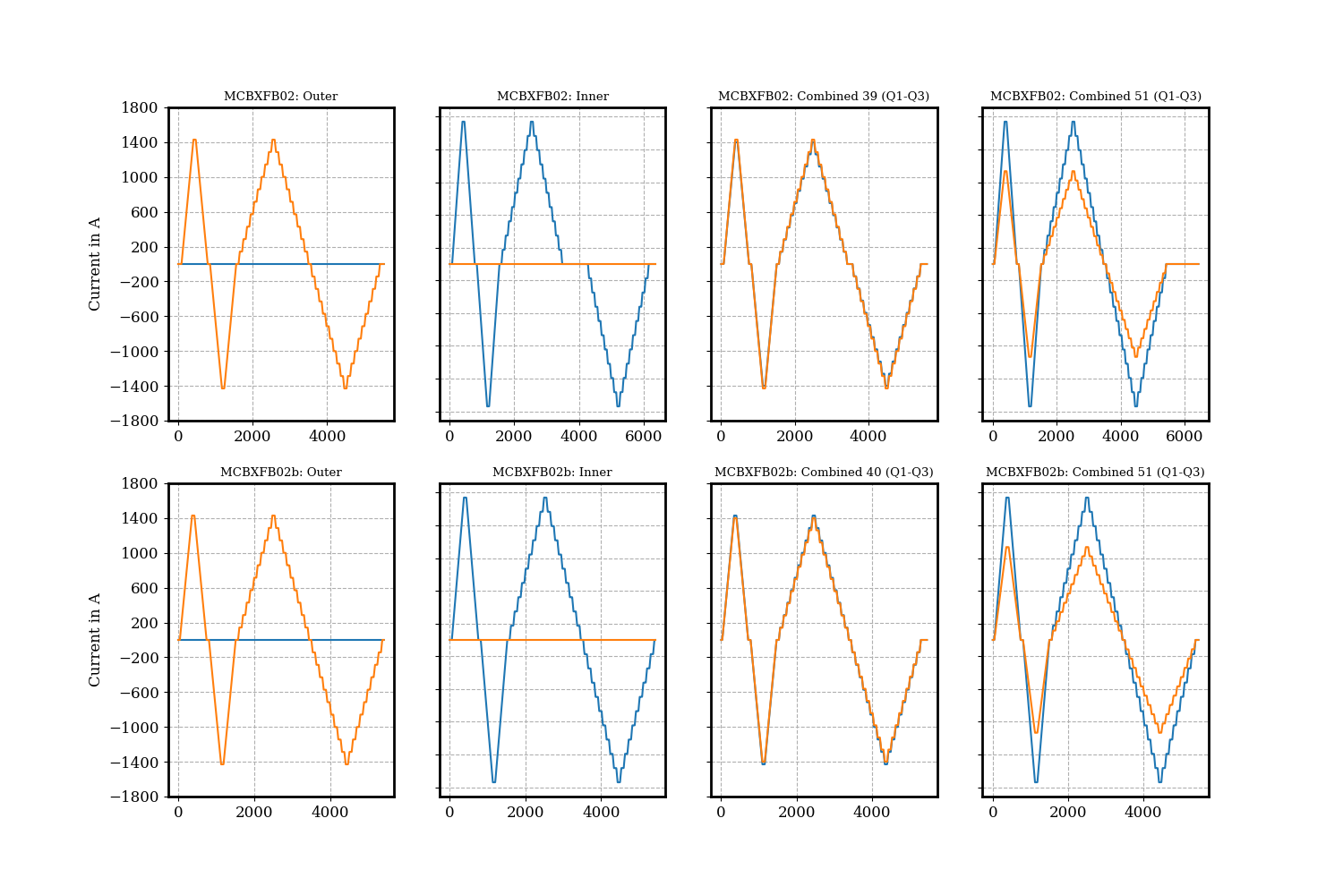
Powering cycles
First test
Second test
Inverted

Slide 4
Standard Cycles
Integrated Field Strength
  Inner Plane at 1740 A
    Individual Powering: 2.549 Tm (First meas.: 2.550 Tm)
    Combined powering: 2.506 Tm (First meas.: 2.505 Tm)
    Previous magnet MCBXFBP2c:
      2.563 Tm (individual at 1755 A)
  Outer Plane at 1430 A
    Individual Powering: 2.549 Tm (First meas.: 2.548 Tm)
    Combined Powering: 2.516 Tm
    Previous magnet MCBXFBP2c:
      2.563 Tm (individual at 1435 A)
4

Slide 5
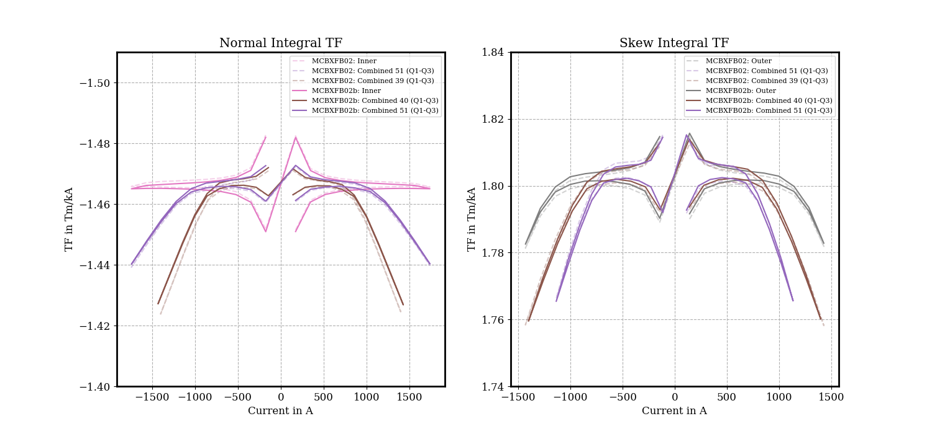
Transfer function
1.4%
1.1%
      Individual powering:
      Saturation on outer plane -1.1%
      Combined 39/51°:
      Saturation on inner plane: -1.9% (51°) / -3.0% (39°)
      Saturation on outer plane: -2.1% (51°) / -2.4% (39°)

Slide 6
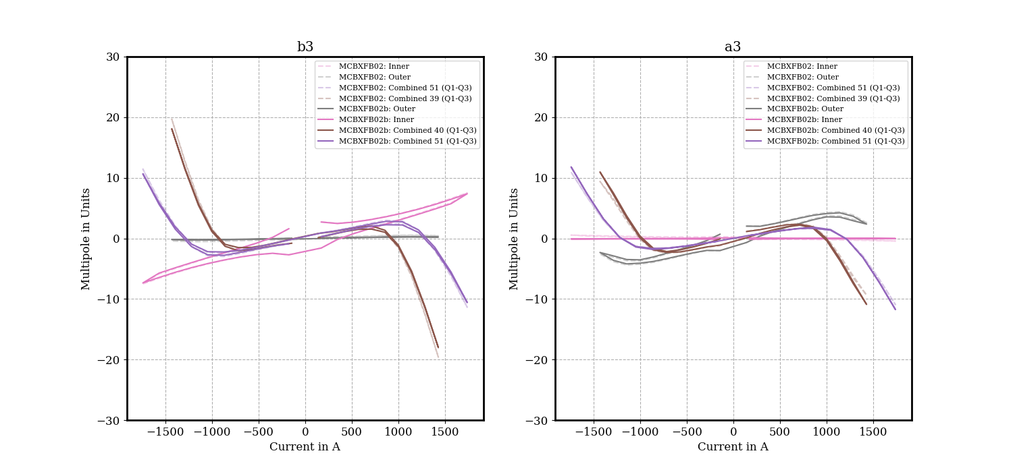




On Multipole Normalization
bn and an normalized to the nominal field:
2.5 Tm (MCBXFB) or 4.5 Tm (MCBXFA)
$$b_{n}=\frac{B_{n}}{2.5}∗10000$$
$$a_{n}=\frac{A_{n}}{2.5}∗10000$$
E.g., for a diagonal powering (2.5 T in both inner and outer planes) at nominal current:
$$b_{1}=10000$$
Proposal together with WP2
$$a_{1}=10000$$

Slide 7
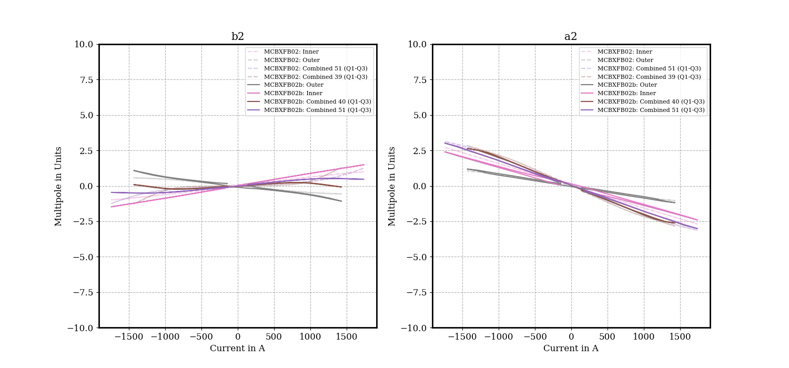
Multipoles b2/a2

Slide 8
Multipoles b3/a3

Slide 9
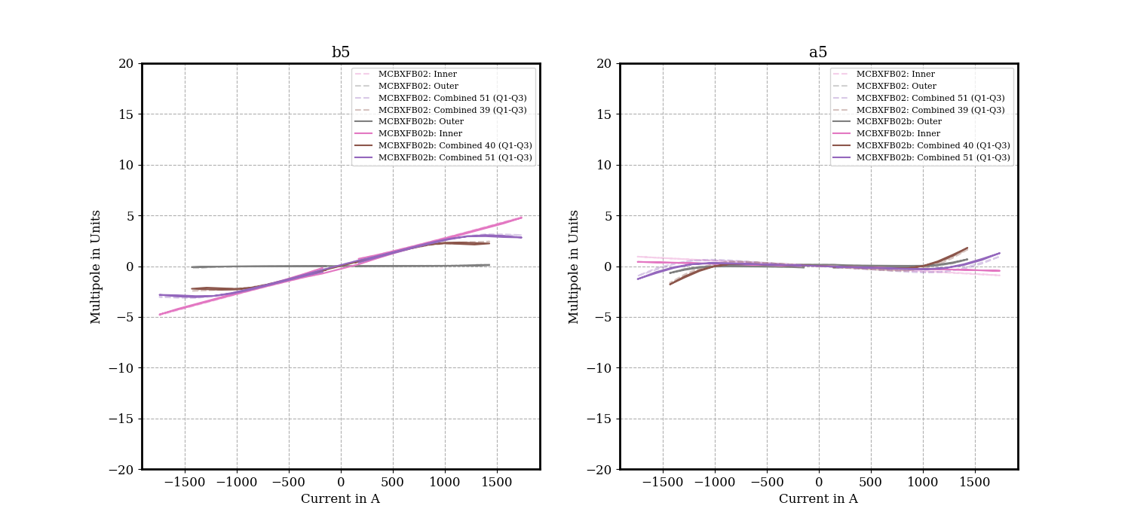
Multipoles b5/a5

Slide 10
Integral field-quality table
INNER at 1740A OUTER at 0A |  |  | INNER at 0A OUTER at 1430A |  |  | INNER at 1740A OUTER at 1135A |  |  | INNER at 1400A OUTER at 1430A
 | Unit | Value |  | Unit | Value |  | Unit | Value |  | Unit | Value
Norm. TF | Tm/kA | -1.465 | Norm. TF | Tm/kA | - | Norm. TF | Tm/kA | -1.44 | Norm. TF | Tm/kA | -1.425
Norm. Int. Field | Tm | -2.549 | Norm. Int. Field | Tm | 0 | Norm. Int. Field | Tm | -2.506 | Norm. Int. Field | Tm | -1.994
Skew TF | Tm/kA | - | Skew TF | Tm/kA | 1.783 | Skew TF | Tm/kA | 1.766 | Skew TF | Tm/kA | 1.758
Skew Int. Field | Tm | 0.001 | Skew Int. Field | Tm | 2.549 | Skew Int. Field | Tm | 2.004 | Skew Int. Field | Tm | 2.514
n | bn | an | n | bn | an | n | bn | an | n | bn | an
2 | 1.49 | -2.41 | 2 | -1.08 | -1.19 | 2 | 0.46 | -3.02 | 2 | 1.28 | -2.84
3 | 7.37 | -0.03 | 3 | 0.21 | 2.35 | 3 | -10.6 | -11.76 | 3 | -19.62 | -9.37
4 | 0.24 | -0.11 | 4 | -0.01 | -0.29 | 4 | 0.33 | -0.09 | 4 | -0.47 | -0.14
5 | 4.77 | -0.46 | 5 | 0.1 | 0.68 | 5 | 2.82 | 1.29 | 5 | 2.43 | 1.63
6 | 0.13 | -0.3 | 6 | -0.21 | 0.08 | 6 | -0.13 | -0.32 | 6 | -0.02 | 0.43
7 | 3.23 | -0.36 | 7 | -0.4 | -2.53 | 7 | 3 | -2.7 | 7 | 1.83 | -3.38
8 | 0 | -0.08 | 8 | 0 | 0.02 | 8 | -0.1 | 0.06 | 8 | 0.5 | -0.52
9 | -0.05 | -0.14 | 9 | -0.49 | 0.03 | 9 | -0.54 | -0.14 | 9 | -0.23 | -0.21
10 | 0.12 | 0.24 | 10 | 0.02 | -0.01 | 10 | 0.06 | 0.25 | 10 | 0.18 | -0.15
11 | -1.81 | 0.5 | 11 | 0.02 | 0.02 | 11 | -1.83 | 0.43 | 11 | -1.33 | 0.72
12 | -0.11 | -0.32 | 12 | -0.02 | 0.02 | 12 | -0.05 | -0.18 | 12 | -0.09 | 0.39
13 | 1.5 | -0.44 | 13 | 0.01 | -0.04 | 13 | 1.57 | -0.41 | 13 | 0.99 | -0.73
14 | -0.03 | -0.03 | 14 | 0 | 0 | 14 | -0.01 | 0.03 | 14 | -0.02 | -0.08
15 | -0.11 | 0.07 | 15 | 0.05 | 0 | 15 | -0.2 | 0.05 | 15 | -0.09 | -0.04
+30 units with previous
-22 units with previous

Slide 11
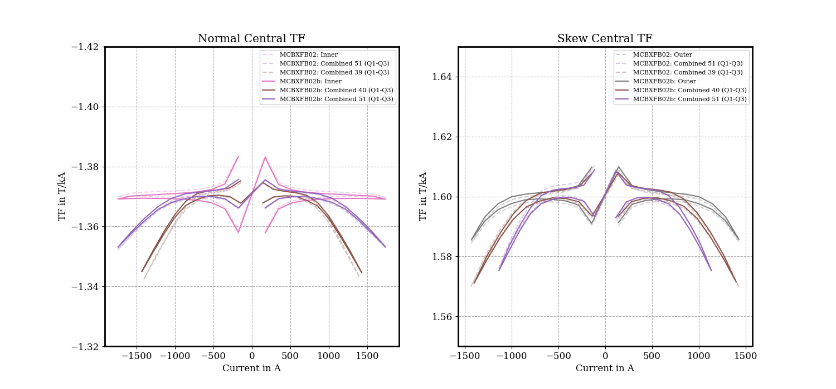
Central transfer function
1.5%
1.2%
      Individual powering:
      Saturation on outer plane -0.9%
      Combined 39/51°:
      Saturation on inner plane: -1.3% (51°) / -2.0% (39°)
      Saturation on outer plane: -1.6% (51°) / -1.9% (39°)

Slide 12
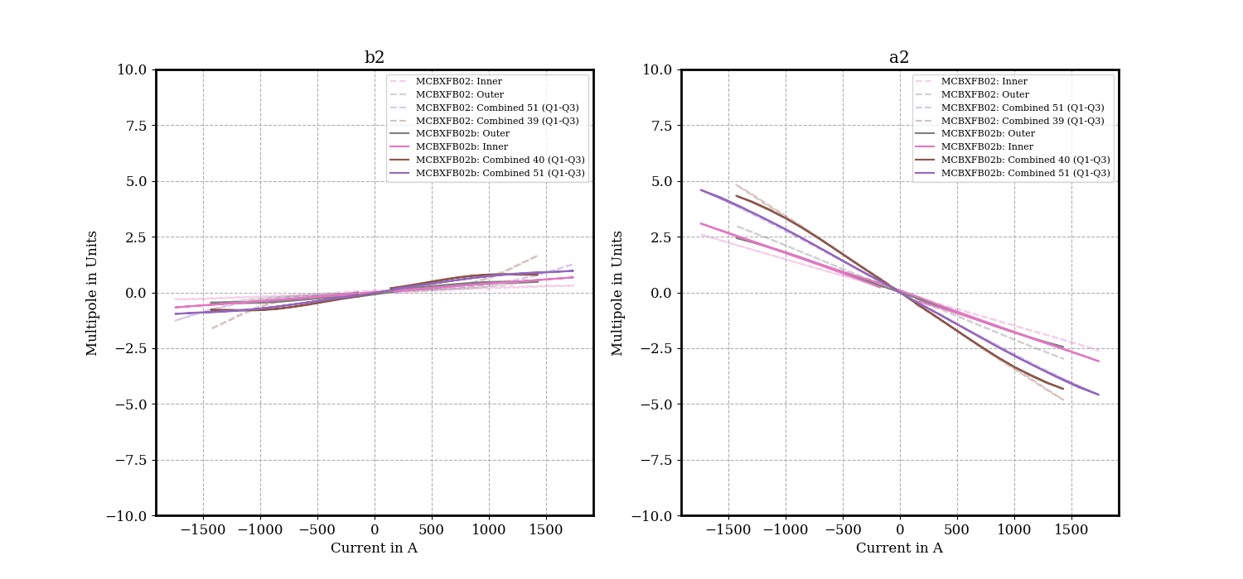
Central multipoles b2/a2

Slide 13
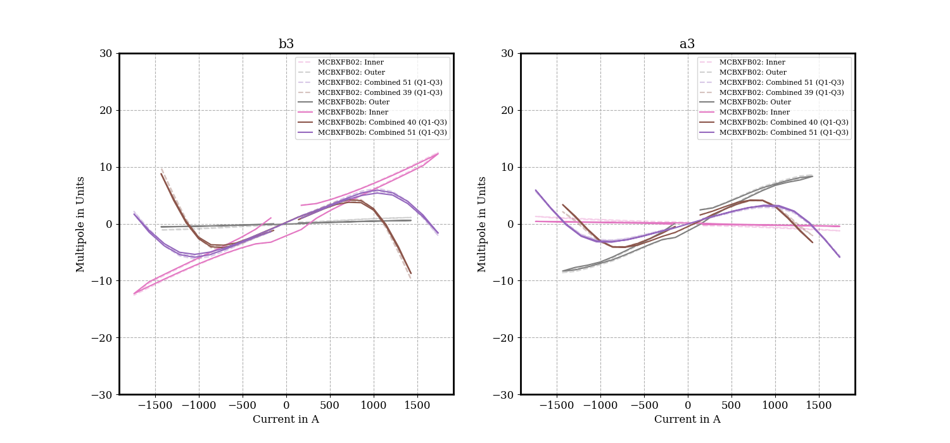
Central multipoles b3/a3

Slide 14

Central multipoles b5/a5

Slide 15
Central field-quality table
INNER at 1740A OUTER at 0A |  |  | INNER at 0A OUTER at 1430A |  |  | INNER at 1740A OUTER at 1135A |  |  | INNER at 1400A OUTER at 1430A
 | Unit | Value |  | Unit | Value |  | Unit | Value |  | Unit | Value
Norm. TF | T/kA | -1.369 | Norm. TF | T/kA | - | Norm. TF | T/kA | -1.353 | Norm. TF | T/kA | -1.343
Norm. Field | T | -2.382 | Norm. Field | T | 0 | Norm. Field | T | -2.354 | Norm. Field | T | -1.880
0Skew TF | T/kA | - | Skew TF | T/kA | 1.586 | Skew TF | T/kA | 1.575 | Skew TF | T/kA | 1.570
Skew Field | T | 0.001 | Skew Field | T | 2.267 | Skew Field | T | 1.788 | Skew Field | T | 2.245
n | bn | an | n | bn | an | n | bn | an | n | bn | an
2 | 0.67 | -3.09 | 2 | 0.47 | -2.45 | 2 | 0.97 | -4.59 | 2 | 1.65 | -4.82
3 | 12.31 | -0.46 | 3 | 0.58 | 8.33 | 3 | -1.66 | -5.90 | 3 | -9.79 | -2.09
4 | 0.06 | -0.01 | 4 | -0.08 | 0.03 | 4 | 0.15 | 0.32 | 4 | -0.22 | 0.53
5 | 4.88 | -0.63 | 5 | 0.07 | 0.34 | 5 | 3.05 | 0.82 | 5 | 2.56 | 0.86
6 | 0.14 | 0.28 | 6 | -0.28 | 0.11 | 6 | -0.18 | 0.32 | 6 | 0.41 | 0.43
7 | -0.79 | 0.19 | 7 | -0.47 | -3.21 | 7 | -1.09 | -2.58 | 7 | -1.63 | -2.95
8 | 0.77 | 1.22 | 8 | -0.02 | 0.06 | 8 | 0.69 | 1.33 | 8 | 0.39 | -0.20
9 | 0.05 | -0.01 | 9 | -0.64 | 0.04 | 9 | -0.70 | 0.04 | 9 | -1.18 | -1.02
10 | 0.20 | 0.46 | 10 | -0.01 | -0.03 | 10 | 0.16 | 0.43 | 10 | 0.30 | -0.21
11 | -2.81 | 0.77 | 11 | -0.01 | 0.00 | 11 | -2.77 | 0.65 | 11 | -1.99 | 1.18
12 | -0.10 | -0.38 | 12 | -0.07 | 0.01 | 12 | -0.06 | -0.27 | 12 | -0.11 | 0.37
13 | 1.58 | -0.46 | 13 | 0.00 | -0.06 | 13 | 1.58 | -0.49 | 13 | 1.05 | -0.82
14 | -0.04 | -0.01 | 14 | -0.01 | 0.01 | 14 | -0.02 | 0.01 | 14 | 0.01 | -0.15
15 | -0.20 | 0.07 | 15 | -0.01 | -0.01 | 15 | -0.28 | 0.05 | 15 | -0.14 | 0.03
+6 units with previous
+10 units with previous

Slide 16
Conclusions
  Transfer function at nominal level
    Individual powering
      Inner plane: -2.549 Tm, Outer Plane: 2.549 Tm
      Saturation on outer plane -1.1% with individual powering
    Combined powering 51°/39°
      Inner plane: -2.506 Tm, Outer Plane: 2.516 Tm
      Saturation: -1.9% on inner plane, -2.4% on outer plane
  Field quality at nominal level
    Inner plane
      b3 of 7.4 units (individual), -10.6 units (combined powering 51°)
      b5 of 4.8 units (individual), 2.8 units (combined powering 51°)
    Outer plane
      a3 of 2.4 units (individual), -9.4 units (combined powering 39°)
      a5 of 0.7 units (individual), 1.6 units (combined powering 39°)
      Noticeable a2 in combined powering (up to 3 units in case of 51°)
  Measured values within magnet specification
16

Slide 17
Field-quality table (1st measurement)
INNER at 1740A OUTER at 0A |  |  | INNER at 0A OUTER at 1430A |  |  | INNER at 1740A OUTER at 1135A |  |  | INNER at 1400A OUTER at 1430A
 | Unit | Value |  | Unit | Value |  | Unit | Value |  | Unit | Value
Norm. TF | Tm/kA | -1.466 | Norm. TF | Tm/kA | - | Norm. TF | Tm/kA | -1.440 | Norm. TF | Tm/kA | -1.425
Norm. Int. Field | Tm | -2.550 | Norm. Int. Field | Tm | 0.005 | Norm. Int. Field | Tm | -2.505 | Norm. Int. Field | Tm | -1.994
Skew TF | Tm/kA | - | Skew TF | Tm/kA | 1.782 | Skew TF | Tm/kA | 1.766 | Skew TF | Tm/kA | 1.758
Skew Int. Field | Tm | 0 | Skew Int. Field | Tm | 2.548 | Skew Int. Field | Tm | 2.004 | Skew Int. Field | Tm | 2.514
n | bn | an | n | bn | an | n | bn | an | n | bn | an
2 | 0.99 | -2.7 | 2 | -0.57 | -1.04 | 2 | 1.25 | -3.14 | 2 | 1.28 | -2.84
3 | 7.52 | -0.43 | 3 | 0.41 | 2.59 | 3 | -11.38 | -10.95 | 3 | -19.62 | -9.37
4 | -0.1 | 0.14 | 4 | 0 | -0.33 | 4 | -0.35 | -0.07 | 4 | -0.47 | -0.14
5 | 4.84 | -0.91 | 5 | 0.18 | 0.64 | 5 | 3.06 | 0.95 | 5 | 2.43 | 1.63
6 | -0.09 | 0 | 6 | 0.17 | 0.31 | 6 | -0.12 | 0.35 | 6 | -0.02 | 0.43
7 | 3.28 | -0.79 | 7 | -0.74 | -2.49 | 7 | 2.57 | -3.13 | 7 | 1.83 | -3.38
8 | 0.28 | -0.05 | 8 | 0.16 | -0.44 | 8 | 0.49 | -0.43 | 8 | 0.5 | -0.52
9 | 0.04 | -0.05 | 9 | -0.32 | -0.1 | 9 | -0.19 | -0.2 | 9 | -0.23 | -0.21
10 | 0.16 | -0.3 | 10 | 0.03 | 0.01 | 10 | 0.21 | -0.24 | 10 | 0.18 | -0.15
11 | -1.63 | 0.96 | 11 | 0.06 | -0.08 | 11 | -1.62 | 0.92 | 11 | -1.33 | 0.72
12 | -0.36 | 0.34 | 12 | 0.09 | 0.03 | 12 | -0.2 | 0.38 | 12 | -0.09 | 0.39
13 | 1.4 | -0.86 | 13 | -0.05 | 0.02 | 13 | 1.32 | -0.92 | 13 | 0.99 | -0.73
14 | 0.12 | -0.17 | 14 | -0.05 | -0.02 | 14 | -0.03 | -0.19 | 14 | -0.02 | -0.08
15 | -0.04 | 0.01 | 15 | -0.11 | 0.03 | 15 | -0.19 | 0.1 | 15 | -0.09 | -0.04

Slide 18
Field-quality table (2nd measurement)
INNER at 1740A OUTER at 0A |  |  | INNER at 0A OUTER at 1430A |  |  | INNER at 1740A OUTER at 1135A |  |  | INNER at 1430A OUTER at 1400A
 | Unit | Value |  | Unit | Value |  | Unit | Value |  | Unit | Value
Norm. TF | Tm/kA | -1.465 | Norm. TF | Tm/kA | - | Norm. TF | Tm/kA | -1.44 | Norm. TF | Tm/kA | -1.427
Norm. Int. Field | Tm | -2.549 | Norm. Int. Field | Tm | 0 | Norm. Int. Field | Tm | -2.506 | Norm. Int. Field | Tm | -2.040
Skew TF | Tm/kA | - | Skew TF | Tm/kA | 1.783 | Skew TF | Tm/kA | 1.766 | Skew TF | Tm/kA | 1.760
Skew Int. Field | Tm | 0.001 | Skew Int. Field | Tm | 2.549 | Skew Int. Field | Tm | 2.004 | Skew Int. Field | Tm | 2.464
n | bn | an | n | bn | an | n | bn | an | n | bn | an
2 | 1.49 | -2.41 | 2 | -1.08 | -1.19 | 2 | 0.46 | -3.02 | 2 | -0.08 | -2.62
3 | 7.37 | -0.03 | 3 | 0.21 | 2.35 | 3 | -10.6 | -11.76 | 3 | -18.04 | -10.91
4 | 0.24 | -0.11 | 4 | -0.01 | -0.29 | 4 | 0.33 | -0.09 | 4 | 0.32 | -0.16
5 | 4.77 | -0.46 | 5 | 0.1 | 0.68 | 5 | 2.82 | 1.29 | 5 | 2.23 | 1.81
6 | 0.13 | -0.3 | 6 | -0.21 | 0.08 | 6 | -0.13 | -0.32 | 6 | -0.17 | -0.2
7 | 3.23 | -0.36 | 7 | -0.4 | -2.53 | 7 | 3 | -2.7 | 7 | 2.43 | -2.96
8 | 0 | -0.08 | 8 | 0 | 0.02 | 8 | -0.1 | 0.06 | 8 | -0.02 | 0.12
9 | -0.05 | -0.14 | 9 | -0.49 | 0.03 | 9 | -0.54 | -0.14 | 9 | -0.6 | -0.09
10 | 0.12 | 0.24 | 10 | 0.02 | -0.01 | 10 | 0.06 | 0.25 | 10 | 0.06 | 0.17
11 | -1.81 | 0.5 | 11 | 0.02 | 0.02 | 11 | -1.83 | 0.43 | 11 | -1.43 | 0.41
12 | -0.11 | -0.32 | 12 | -0.02 | 0.02 | 12 | -0.05 | -0.18 | 12 | -0.13 | -0.15
13 | 1.5 | -0.44 | 13 | 0.01 | -0.04 | 13 | 1.57 | -0.41 | 13 | 1.26 | -0.46
14 | -0.03 | -0.03 | 14 | 0 | 0 | 14 | -0.01 | 0.03 | 14 | 0.08 | 0.02
15 | -0.11 | 0.07 | 15 | 0.05 | 0 | 15 | -0.2 | 0.05 | 15 | -0.09 | 0.03

Slide 19
Central field-quality table (1st meas.)
INNER at 1740A OUTER at 0A |  |  | INNER at 0A OUTER at 1430A |  |  | INNER at 1740A OUTER at 1135A |  |  | INNER at 1400A OUTER at 1430A
 | Unit | Value |  | Unit | Value |  | Unit | Value |  | Unit | Value
Norm. TF | T/kA | -1.37 | Norm. TF | T/kA | - | Norm. TF | T/kA | -1.353 | Norm. TF | T/kA | -1.343
Norm. Field | T | -2.383 | Norm. Field | T | 0.004 | Norm. Field | T | -2.354 | Norm. Field | T | -1.88
Skew TF | T/kA | - | Skew TF | T/kA | 1.585 | Skew TF | T/kA | 1.575 | Skew TF | T/kA | 1.57
Skew Field | T | 0 | Skew Field | T | 2.266 | Skew Field | T | 1.788 | Skew Field | T | 2.245
n | bn | an | n | bn | an | n | bn | an | n | bn | an
2 | 0.30 | -2.60 | 2 | 0.50 | -2.98 | 2 | 1.27 | -4.59 | 2 | 1.65 | -4.82
3 | 12.54 | -1.24 | 3 | 1.09 | 8.62 | 3 | -2.11 | -5.69 | 3 | -9.79 | -2.09
4 | 0.05 | 0.35 | 4 | 0.07 | 0.19 | 4 | -0.11 | 0.53 | 4 | -0.22 | 0.53
5 | 4.86 | -1.25 | 5 | 0.10 | 0.30 | 5 | 3.17 | 0.32 | 5 | 2.56 | 0.86
6 | 0.32 | -0.01 | 6 | 0.22 | 0.34 | 6 | 0.37 | 0.35 | 6 | 0.41 | 0.43
7 | -0.77 | 0.34 | 7 | -0.96 | -3.20 | 7 | -1.59 | -2.32 | 7 | -1.63 | -2.95
8 | 0.11 | 0.71 | 8 | 0.22 | -0.57 | 8 | 0.35 | 0.01 | 8 | 0.39 | -0.20
9 | -1.00 | -0.98 | 9 | -0.30 | -0.08 | 9 | -1.29 | -1.21 | 9 | -1.18 | -1.02
10 | 0.32 | -0.35 | 10 | 0.05 | 0.04 | 10 | 0.38 | -0.30 | 10 | 0.30 | -0.21
11 | -2.62 | 1.44 | 11 | -0.02 | 0.03 | 11 | -2.49 | 1.47 | 11 | -1.99 | 1.18
12 | -0.35 | 0.44 | 12 | -0.03 | 0.02 | 12 | -0.22 | 0.43 | 12 | -0.11 | 0.37
13 | 1.49 | -0.96 | 13 | -0.21 | 0.10 | 13 | 1.33 | -1.06 | 13 | 1.05 | -0.82
14 | 0.12 | -0.16 | 14 | -0.16 | -0.08 | 14 | 0.03 | -0.21 | 14 | 0.01 | -0.15
15 | -0.12 | 0.08 | 15 | -0.07 | -0.02 | 15 | -0.28 | 0.12 | 15 | -0.14 | 0.03

Slide 20
Central field-quality table (2nd meas.)
INNER at 1740A OUTER at 0A |  |  | INNER at 0A OUTER at 1430A |  |  | INNER at 1740A OUTER at 1135A |  |  | INNER at 1430A OUTER at 1400A
 | Unit | Value |  | Unit | Value |  | Unit | Value |  | Unit | Value
Norm. TF | T/kA | -1.369 | Norm. TF | T/kA | - | Norm. TF | T/kA | -1.353 | Norm. TF | T/kA | -1.345
Norm. Field | T | -2.382 | Norm. Field | T | 0 | Norm. Field | T | -2.354 | Norm. Field | T | -1.923
Skew TF | T/kA | - | Skew TF | T/kA | 1.586 | Skew TF | T/kA | 1.575 | Skew TF | T/kA | 1.571
Skew Field | T | 0.001 | Skew Field | T | 2.267 | Skew Field | T | 1.788 | Skew Field | T | 2.200
n | bn | an | n | bn | an | n | bn | an | n | bn | an
2 | 0.67 | -3.09 | 2 | 0.47 | -2.45 | 2 | 0.97 | -4.59 | 2 | 0.79 | -4.33
3 | 12.31 | -0.46 | 3 | 0.58 | 8.33 | 3 | -1.66 | -5.90 | 3 | -8.76 | -3.33
4 | 0.06 | -0.01 | 4 | -0.08 | 0.03 | 4 | 0.15 | 0.32 | 4 | 0.13 | 0.28
5 | 4.88 | -0.63 | 5 | 0.07 | 0.34 | 5 | 3.05 | 0.82 | 5 | 2.46 | 1.19
6 | 0.14 | 0.28 | 6 | -0.28 | 0.11 | 6 | -0.18 | 0.32 | 6 | -0.23 | 0.30
7 | -0.79 | 0.19 | 7 | -0.47 | -3.21 | 7 | -1.09 | -2.58 | 7 | -1.00 | -3.11
8 | 0.77 | 1.22 | 8 | -0.02 | 0.06 | 8 | 0.69 | 1.33 | 8 | 0.61 | 1.16
9 | 0.05 | -0.01 | 9 | -0.64 | 0.04 | 9 | -0.70 | 0.04 | 9 | -0.77 | 0.05
10 | 0.20 | 0.46 | 10 | -0.01 | -0.03 | 10 | 0.16 | 0.43 | 10 | 0.14 | 0.34
11 | -2.81 | 0.77 | 11 | -0.01 | 0.00 | 11 | -2.77 | 0.65 | 11 | -2.23 | 0.59
12 | -0.10 | -0.38 | 12 | -0.07 | 0.01 | 12 | -0.06 | -0.27 | 12 | -0.09 | -0.22
13 | 1.58 | -0.46 | 13 | 0.00 | -0.06 | 13 | 1.58 | -0.49 | 13 | 1.25 | -0.48
14 | -0.04 | -0.01 | 14 | -0.01 | 0.01 | 14 | -0.02 | 0.01 | 14 | 0.03 | -0.01
15 | -0.20 | 0.07 | 15 | -0.01 | -0.01 | 15 | -0.28 | 0.05 | 15 | -0.17 | 0.09

Slide 21
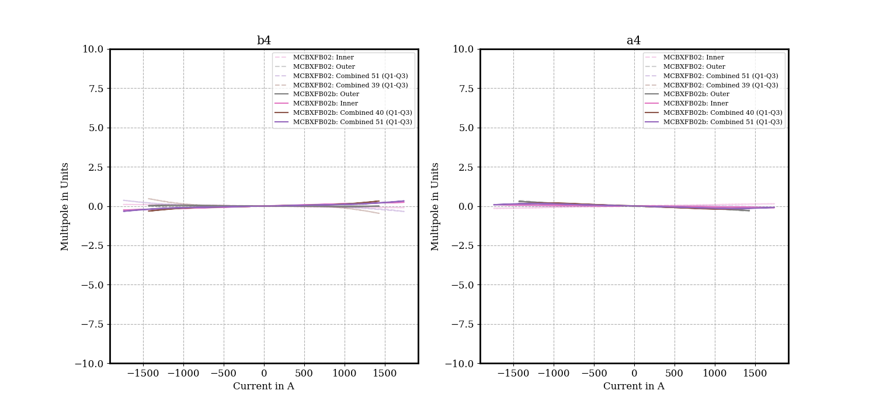
Multipoles b4/a4

Slide 22
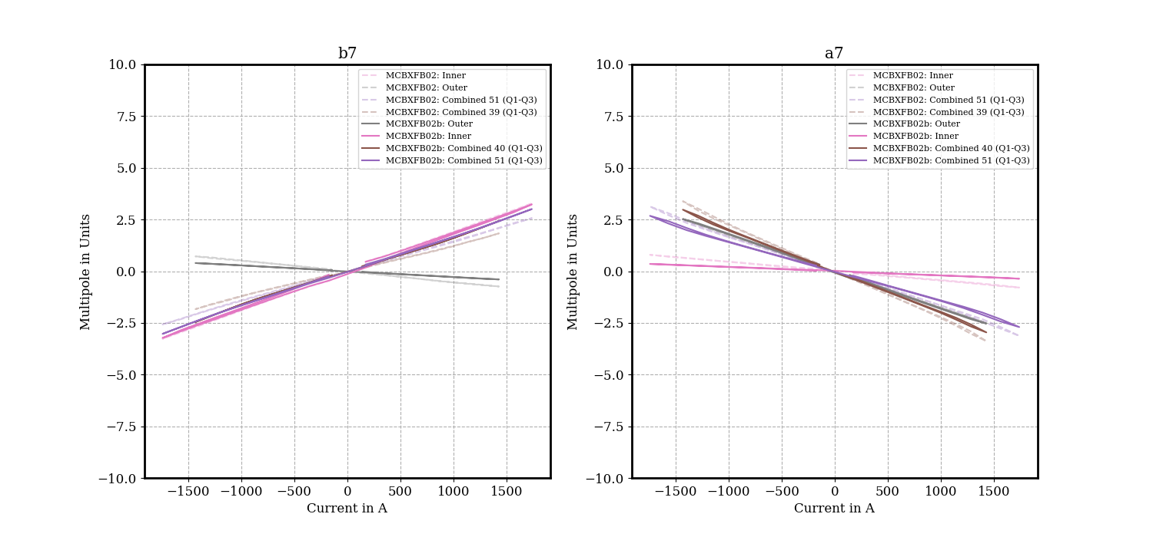
Multipoles b7/a7

Slide 23
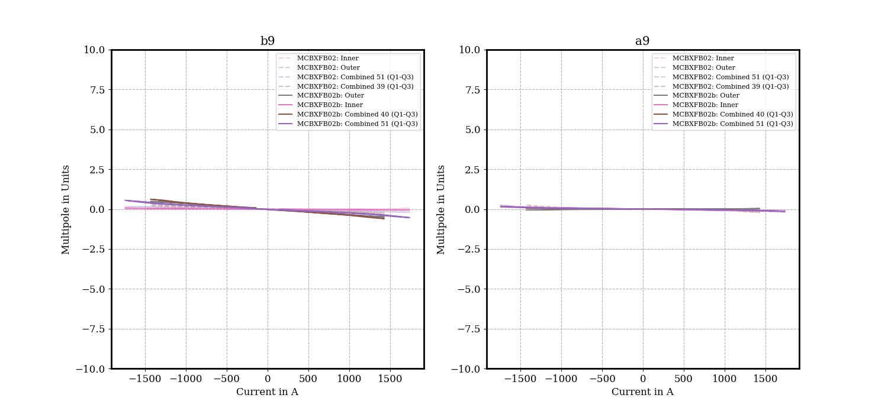
Multipoles b9/a9

Slide 24
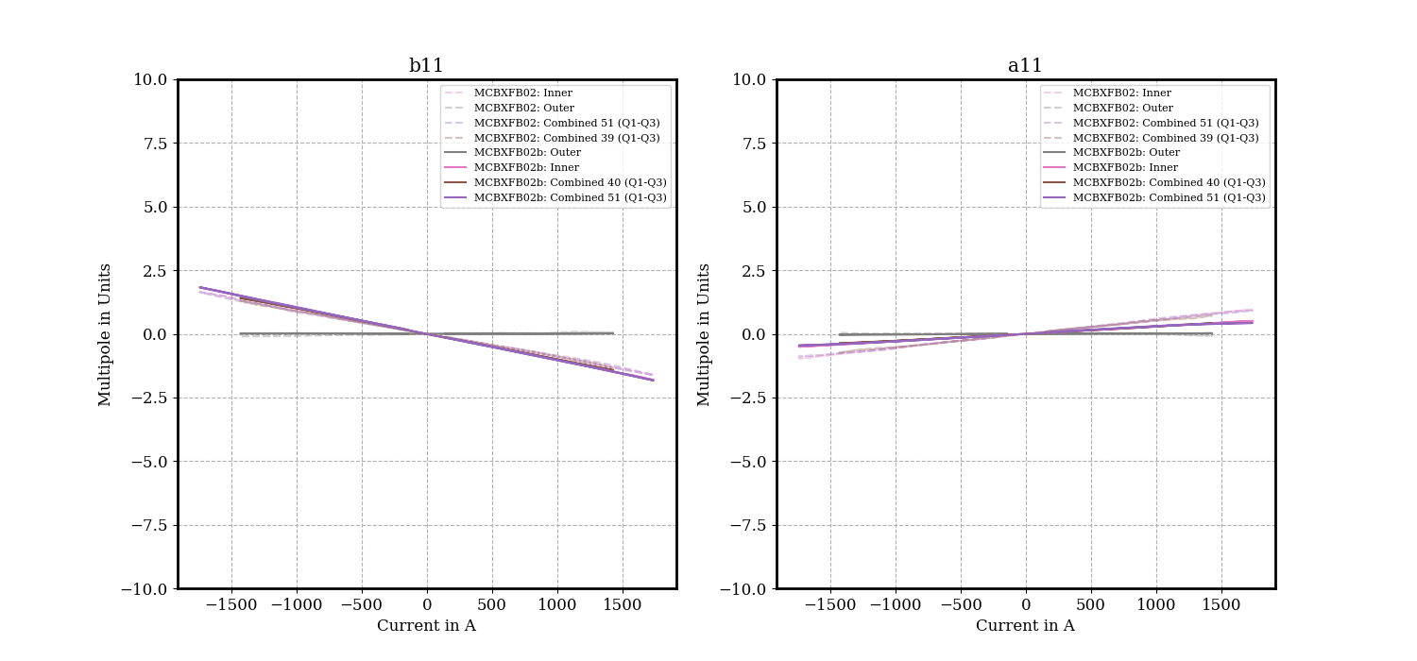
Multipoles b11/a11

Slide 25
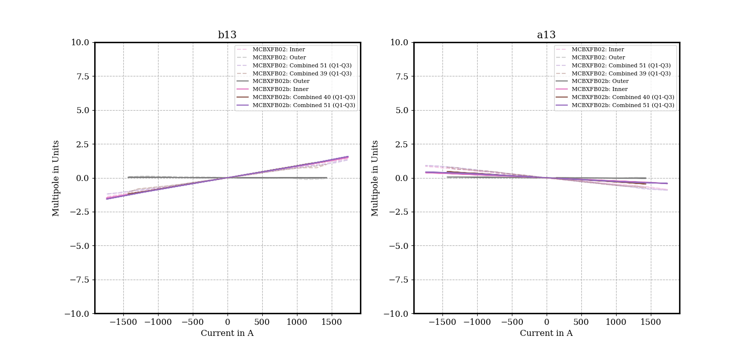
Multipoles b13/a13

Slide 26
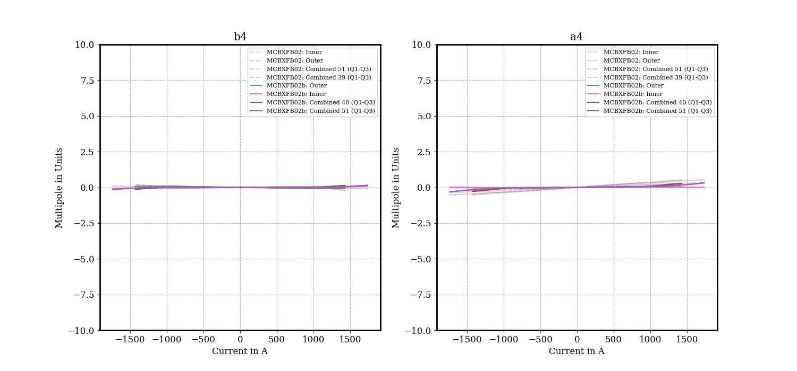
Central multipoles b4/a4

Slide 27
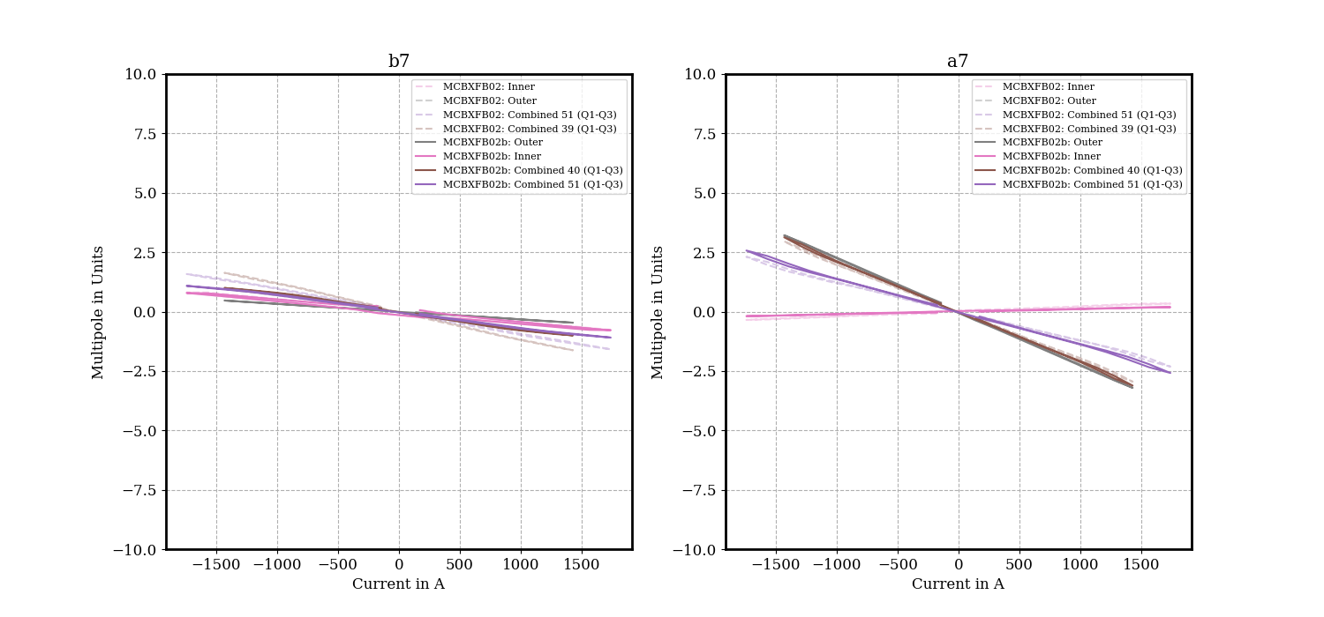
Central multipoles b7/a7

Slide 28
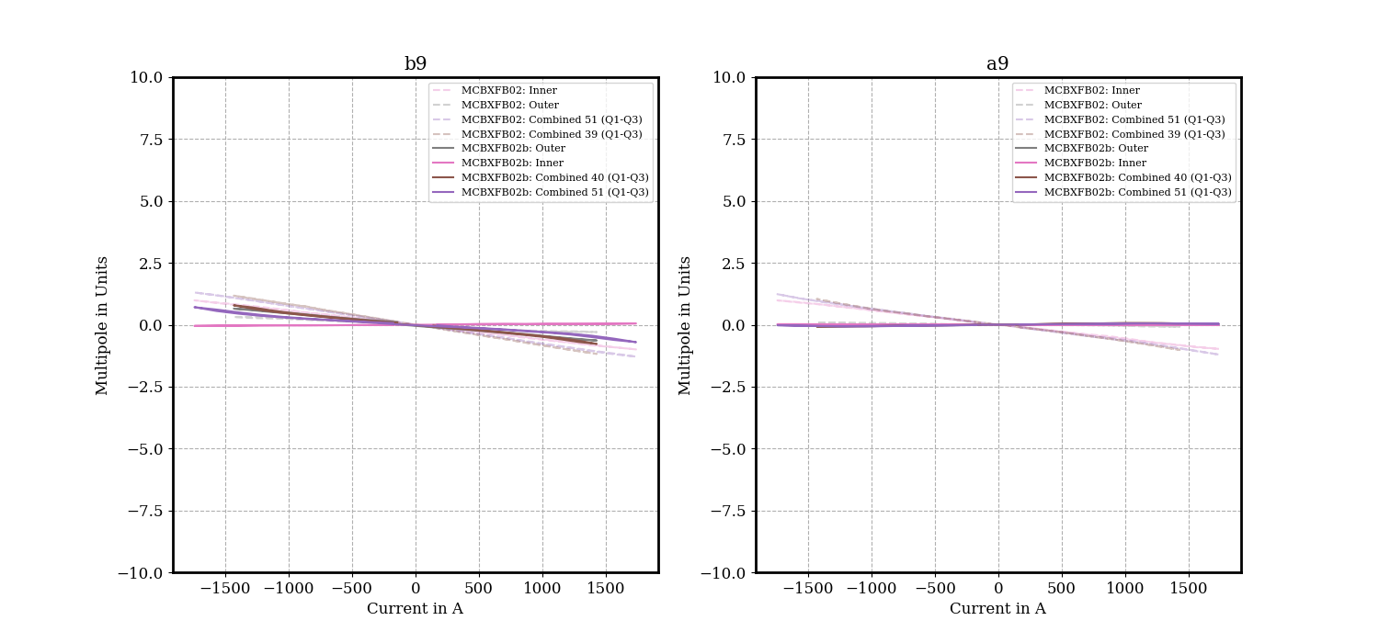
Central multipoles b9/a9

Slide 29
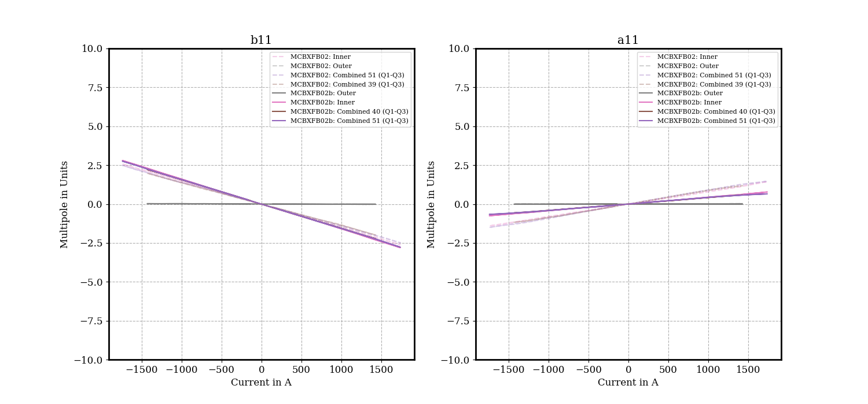
Central multipoles b11/a11

Slide 30
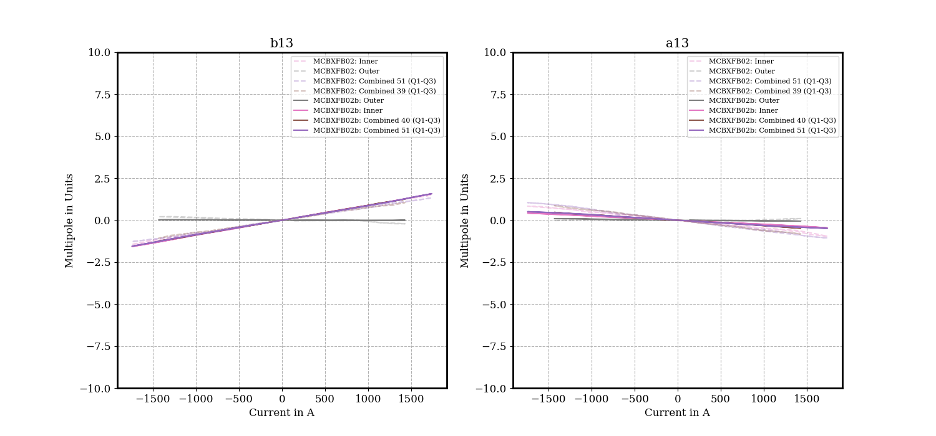
Central multipoles b13/a13

