Slide 1
Introduction to CERN & BE-GM
P. Bestmann for BE-GM-ASG
Mai 2023

Slide 2

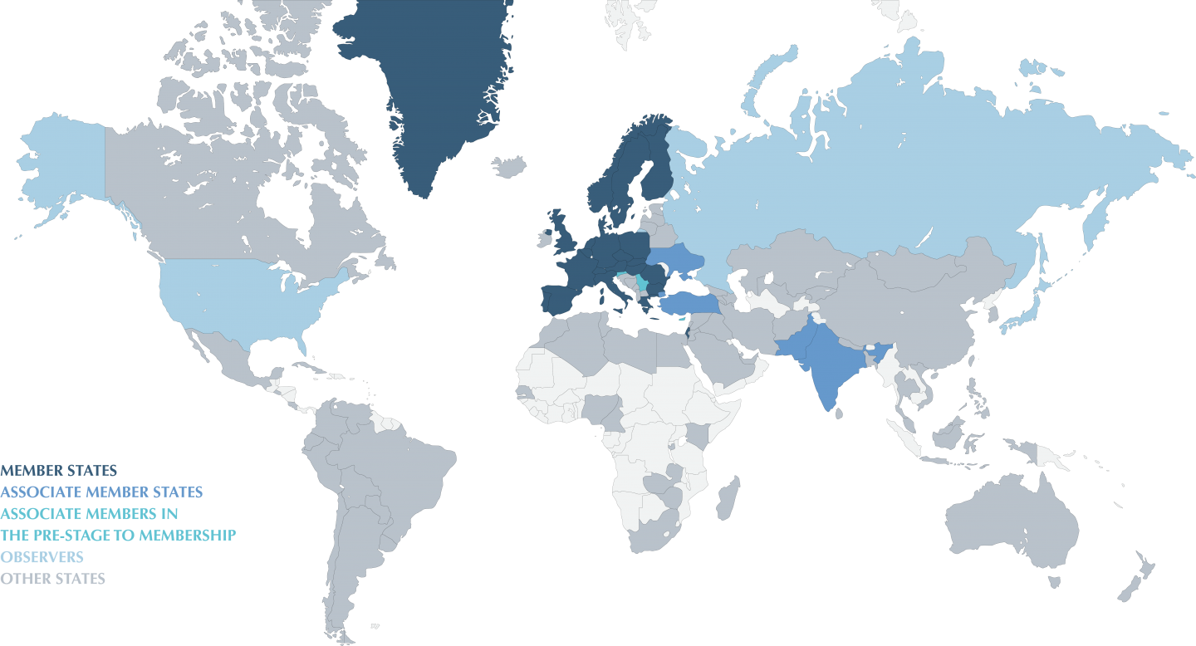
CERN
CERN stands for Conseil Européen pour la Recherche Nucléaire
  created in 1954
  First accelerator in 1959
  in 1985 : Laboratoire Europeen pour la Physique des Particles
  23 Members States
  Thousands of users from all over the world

Slide 3
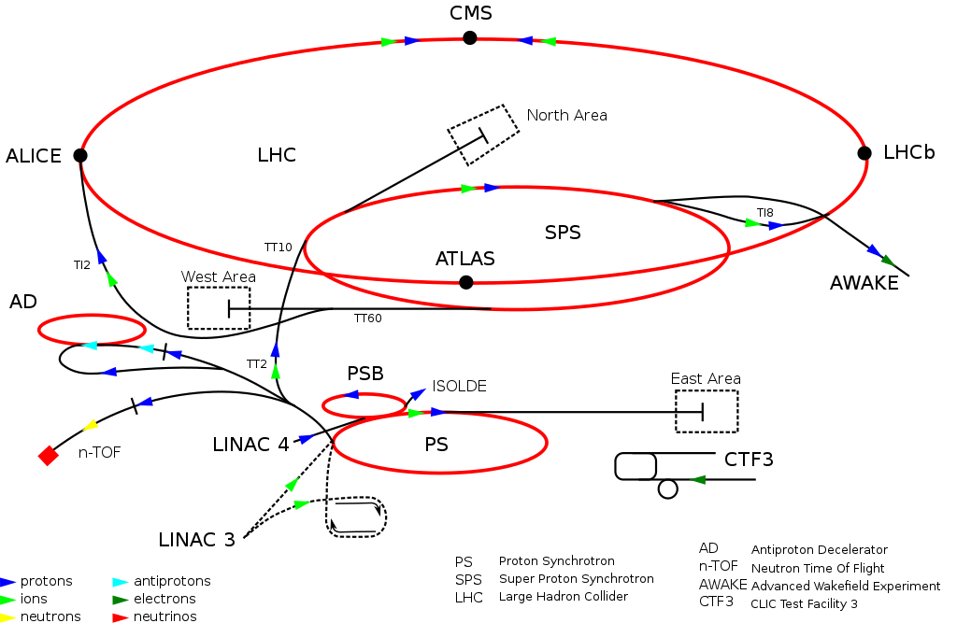
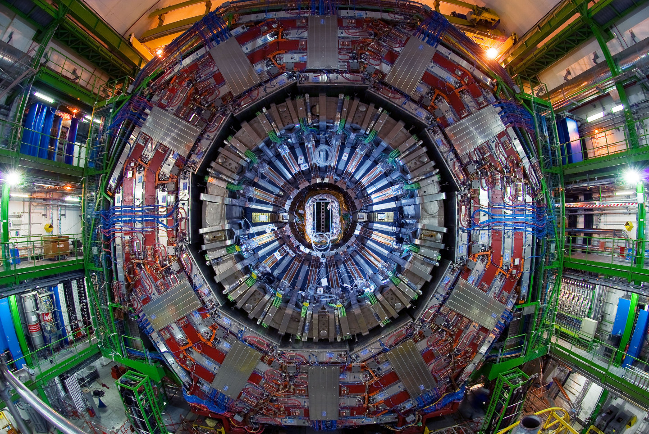
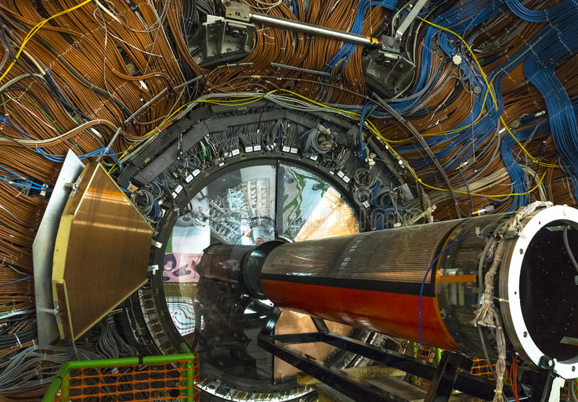
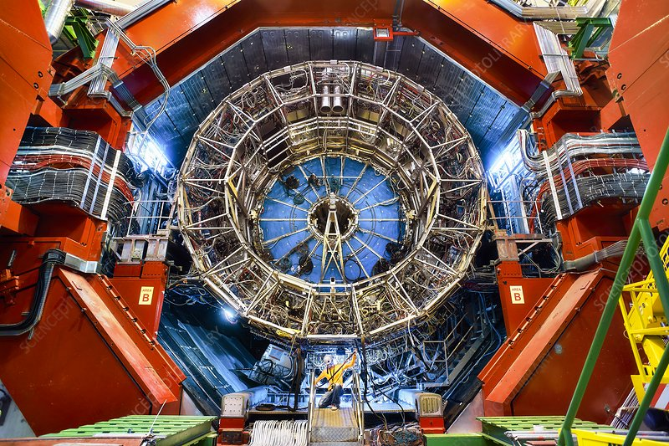
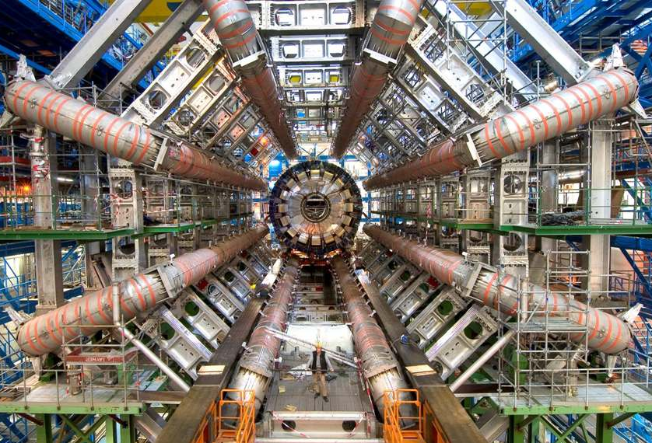
CERN
… what makes our Universe, where it comes from, where it is going to …
Our tools…
Accelerators and Experiments

Slide 4
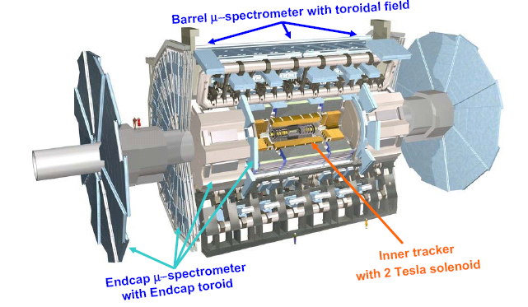
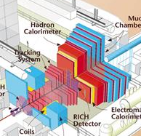
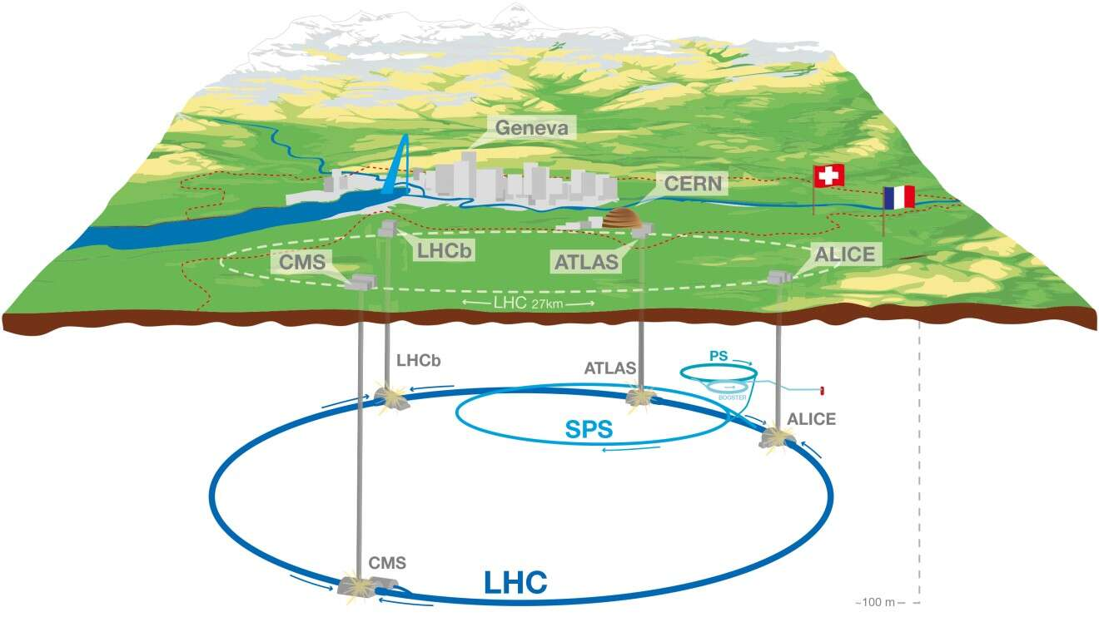
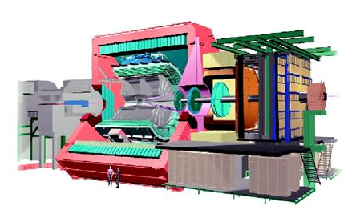
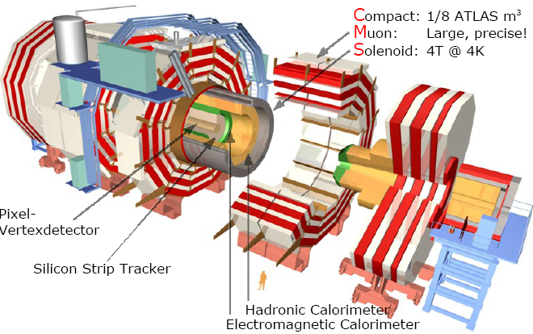
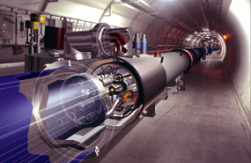
LHC
ATLAS: 42 m long
LHCb
ALICE
CMS: 14 000 tons
LHC machine

Slide 5
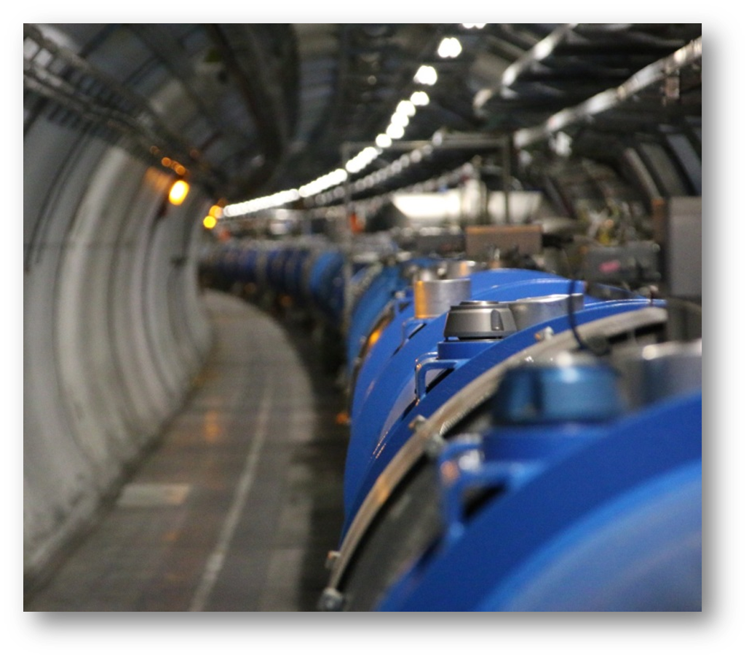
BE-GM Group
The Geodetic Metrology Group within the Beams Department (BE-GM) provides metrology and alignment for components installed in the accelerators, their beam transfer lines and the physics experiments throughout the CERN complex. It also handles the geodetic aspects of the CERN reference systems.
More than 70km of beamlines
More than 1800 Cryomagnets in the LHC
Thousands of other warm magnets and components

Slide 6
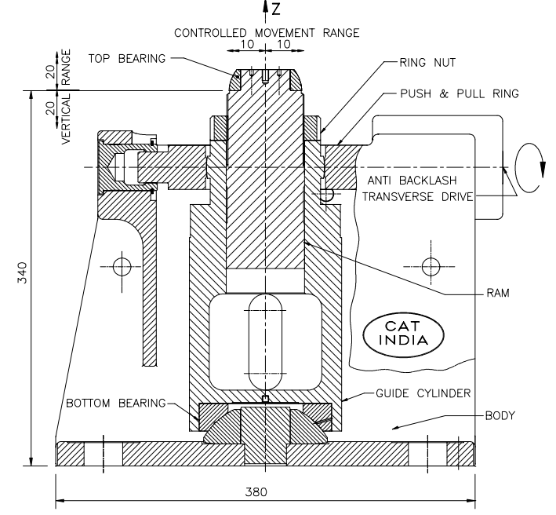
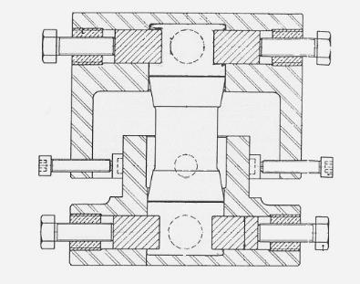
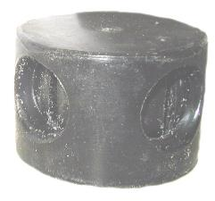
Magnets supports
The magnets are supported by jacks of different types
  Depending on installation date, machine, load, stroke, etc…
  The majority is supported by mechanical jacks
  The PU Jacks have a several advantages
    Very compact and smart system
    Easy & precise alignment
    Cheap, easy maintenance
    Only issue is the reliability now

Slide 7
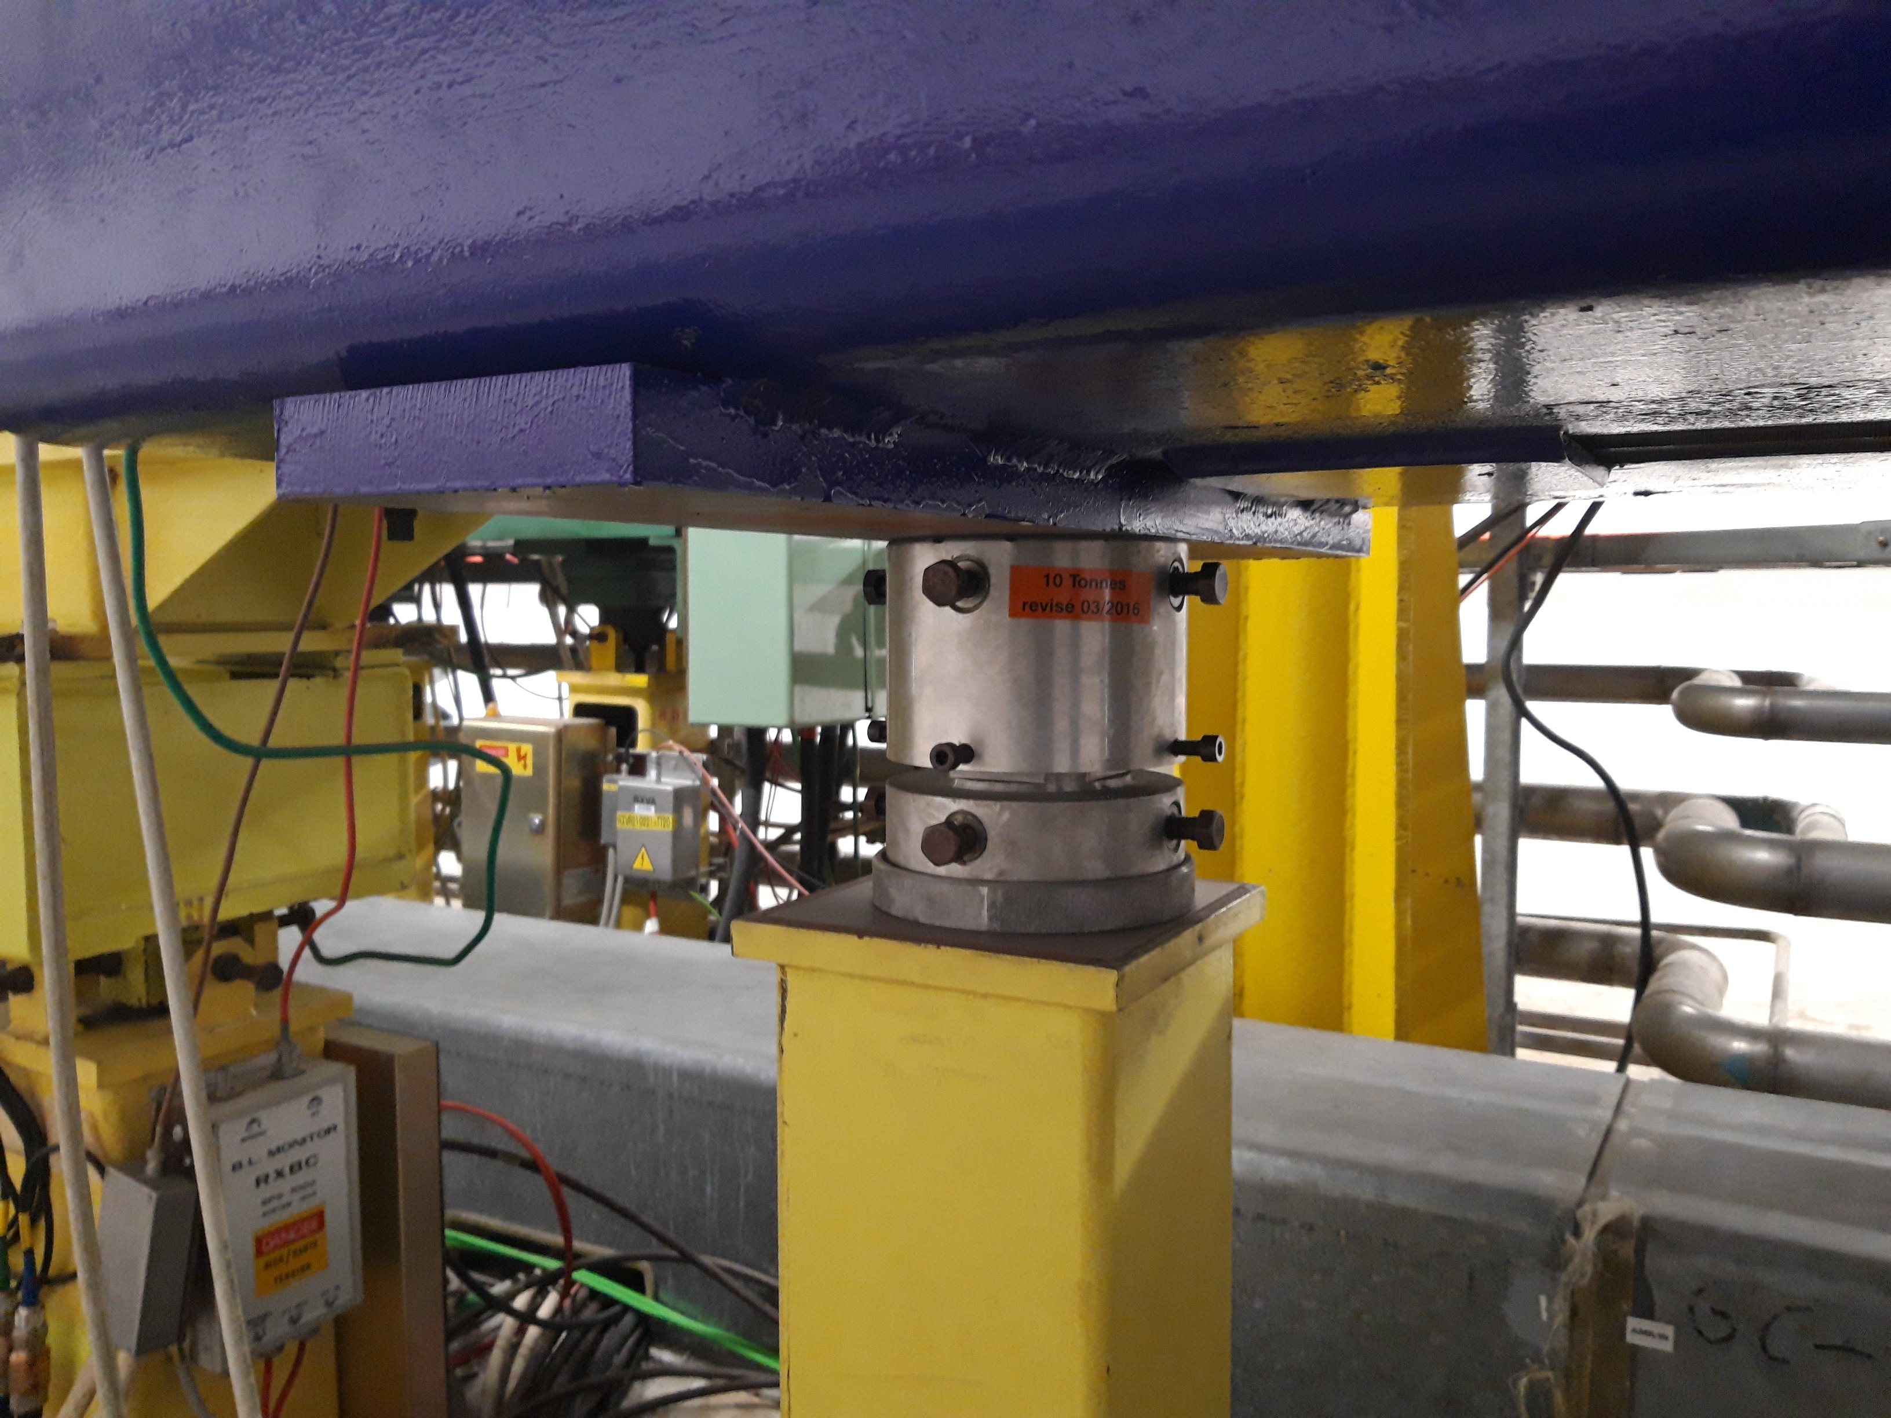
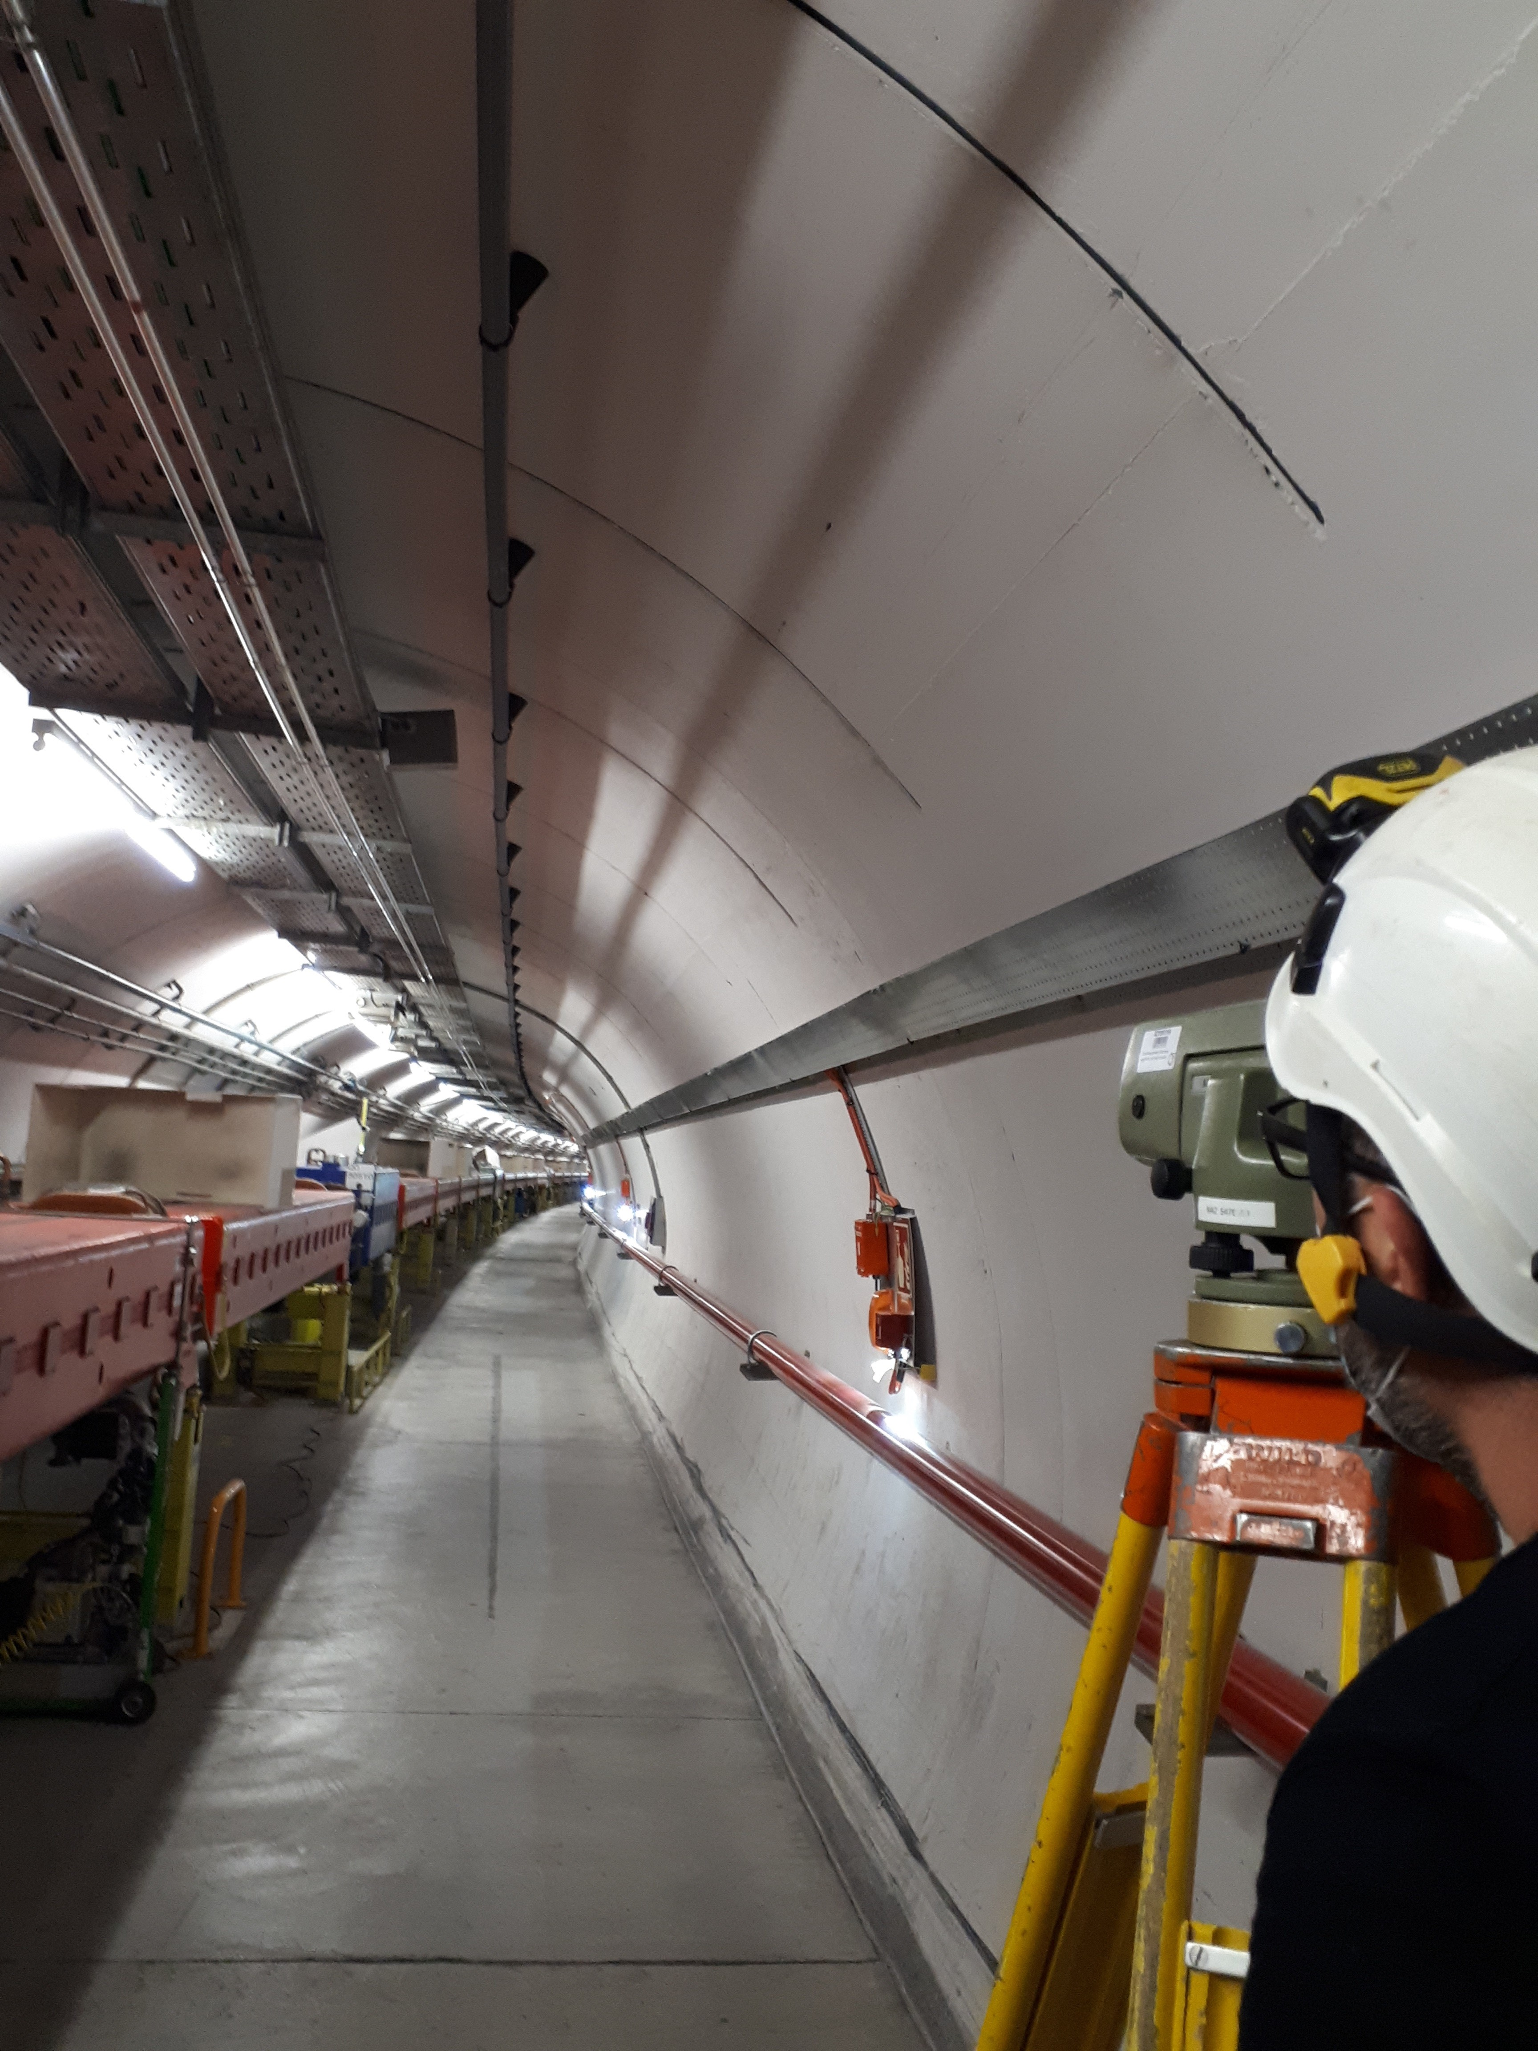
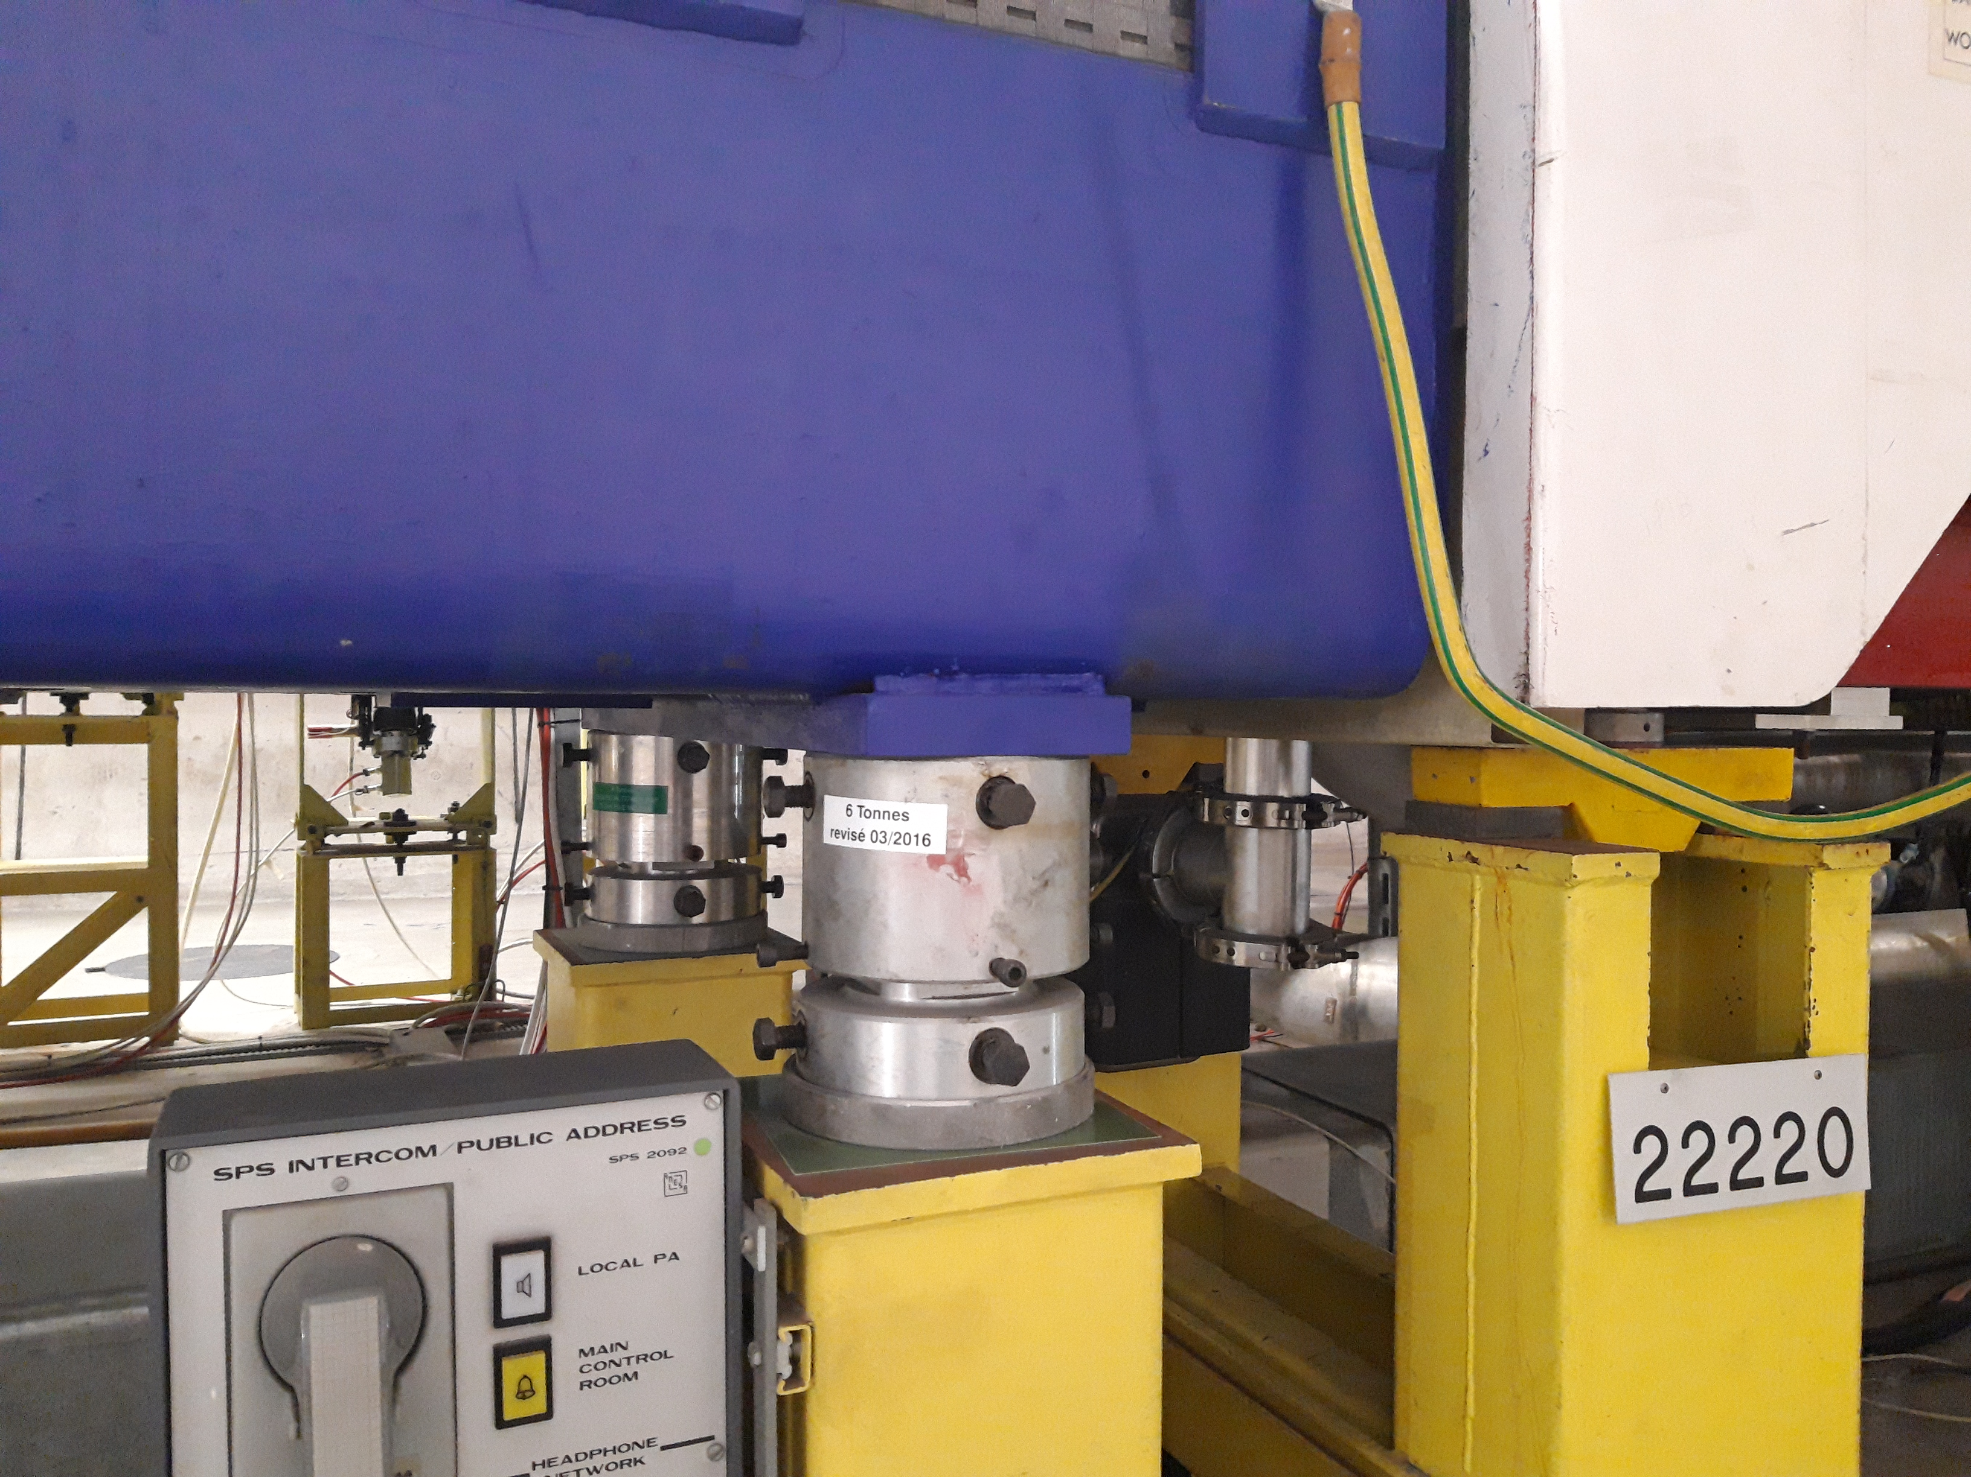
Magnets supports
Single Jack
10T 90ShA
Double Jack
6T 75ShA

Slide 8
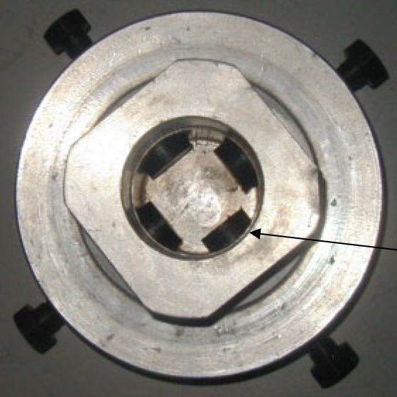
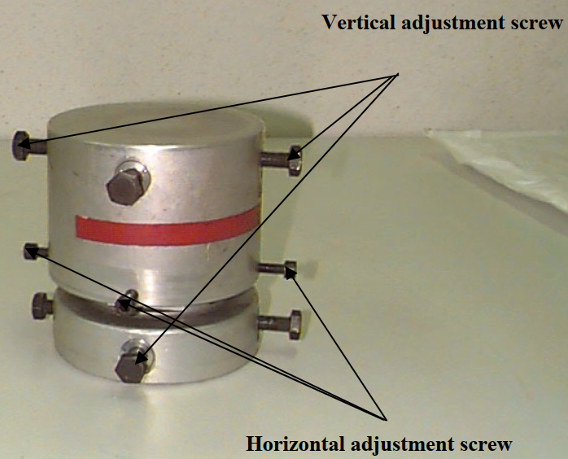
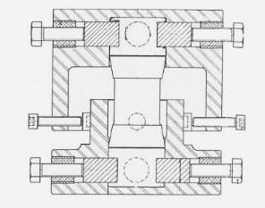
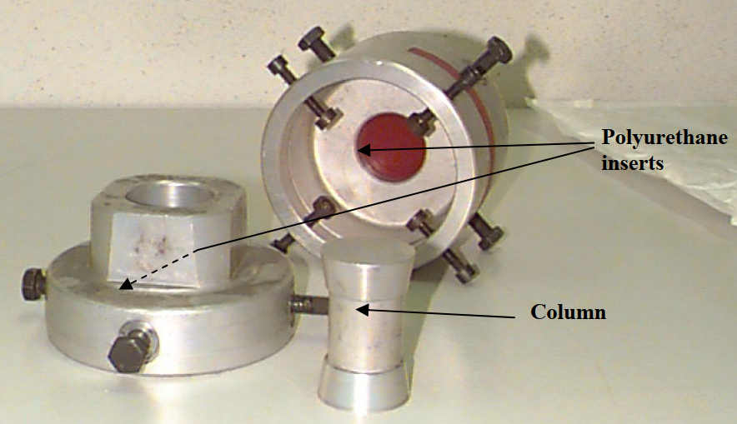
SPS Jack
216 SPS quadrupoles installed on three alignment jacks which can adjust vertical position by compressing polyurethane pads
- Admissible load: 6 tons (PU pads 75 Shore A) / 10 tons (PU pads 90 Shore A)
- Range: ±10 mm vertical / ±8 (4) mm horizontal

Slide 9
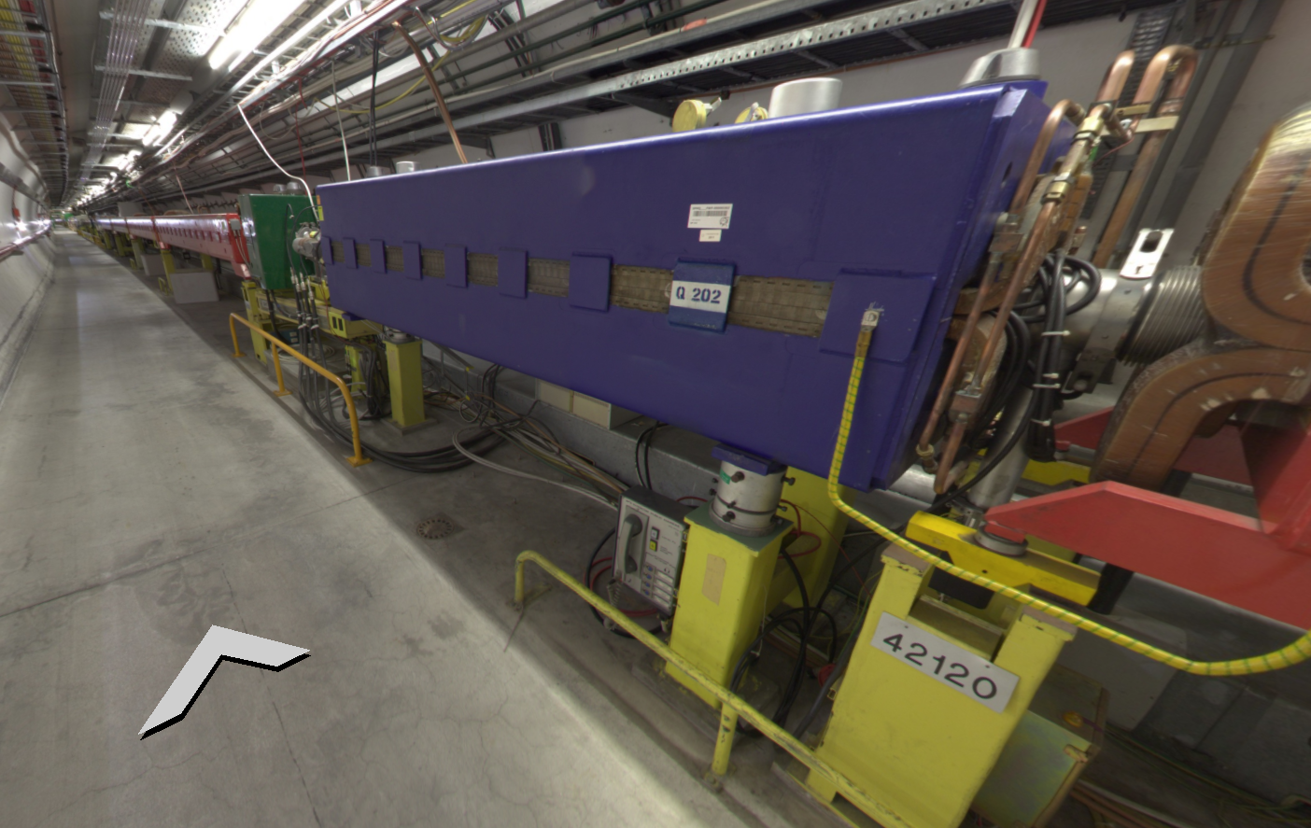
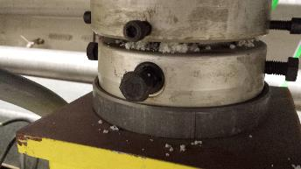
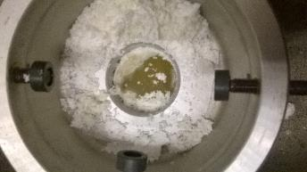
SPS Jack
First jack failed during Operation in August 2016
4mm vertical movement of single jack

Slide 10
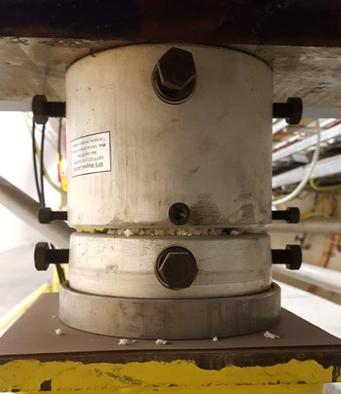
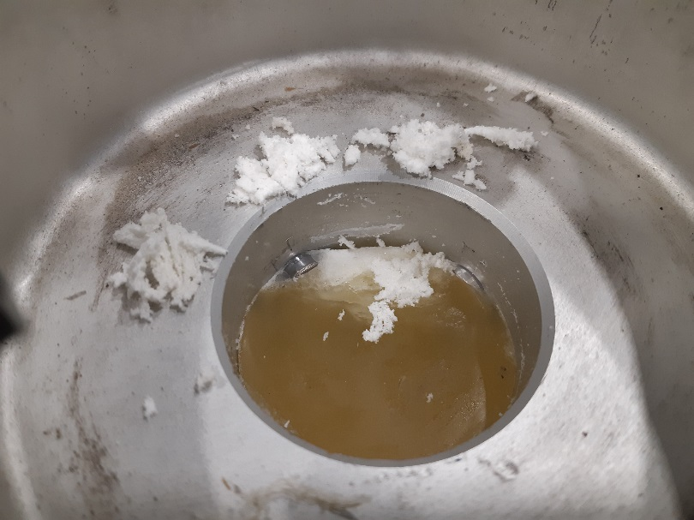
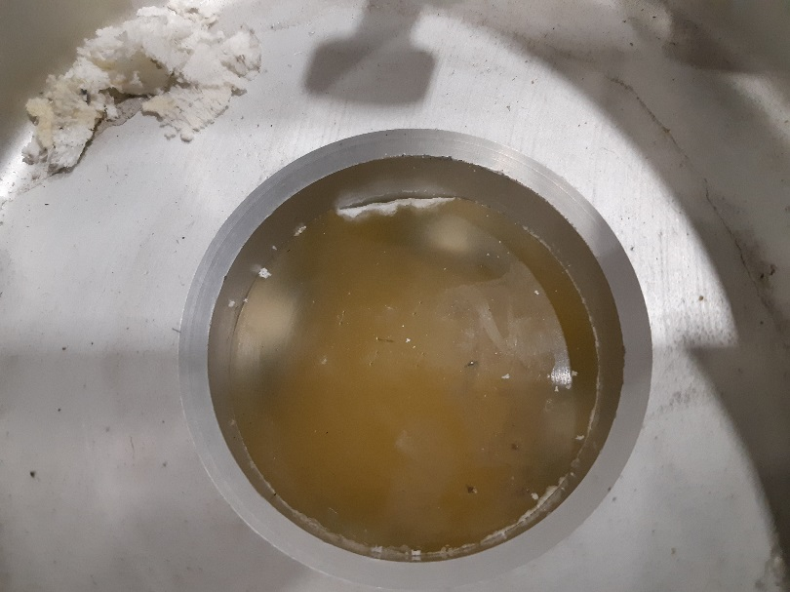
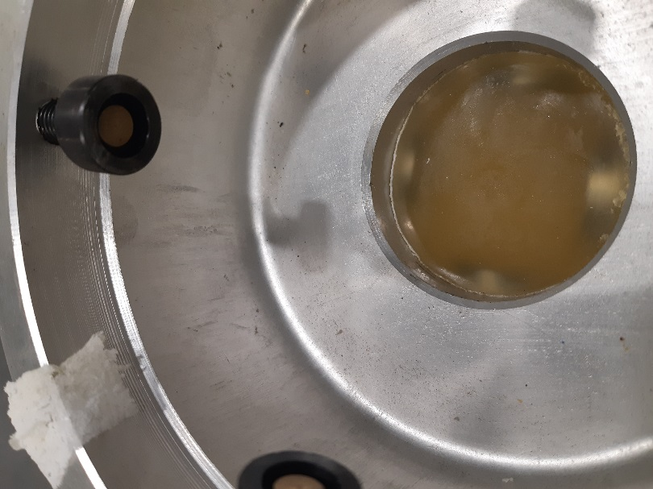
SPS Jack degradation
More failing jack in 2017 and 2018
9 more cases identified in 2019 which triggered an echange
Many more cases have been already affected
Severely damaged
Significantly damaged
Slightly damaged
PU chips

Slide 11
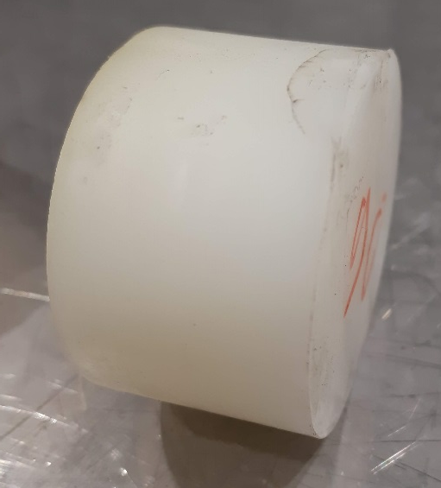
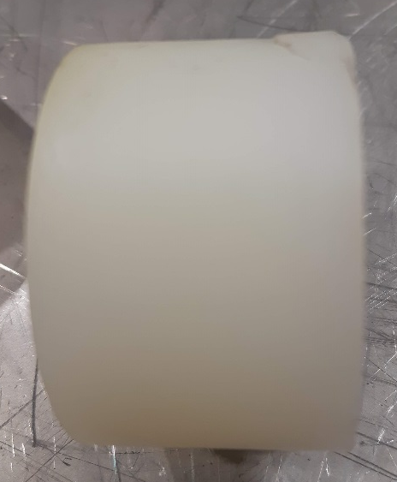
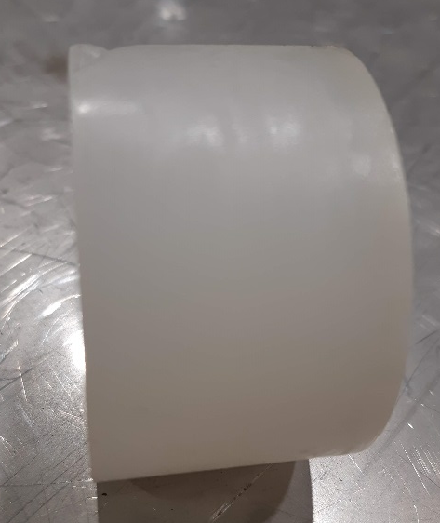
History
In 2000 all pads have been exchanged
Extensive study of polyurethane material and production process in 2003 → identified suitable formulation of PU for the SPS jacks: https://edms5.cern.ch/document/402303/2
Since then, all PU pads are ordered with that reference, and all batches tested at EN-MME material lab for resistance to punching, ShA hardness, resistance to compression and shape recovering
When restarting the refurbishment of jacks with pads from latest order (2017), non-conformities of shape and traces of cracks found on some of the pads
Cracks
Deformations

Slide 12
PU pad procurement
After investigation with the supplier (A+P) it turned out that the formulation of PU had changed since 2013 due to changes in the legislation of hazardous chemicals (use of Mercury forbidden) → CERN not informed of this change
In addition, the casting process and tooling had also been changed recently, what turned out to be the reason of the cracks (material sometimes slightly torn apart from surface during to demolding process)
The supplier proposed alternative PU formulations to avoid the cracks without success and finally stepped back to the initial casting process with the 2013 PU formulation
The latest samples were tested conform and all SPS Jack got replacement pads

Slide 13
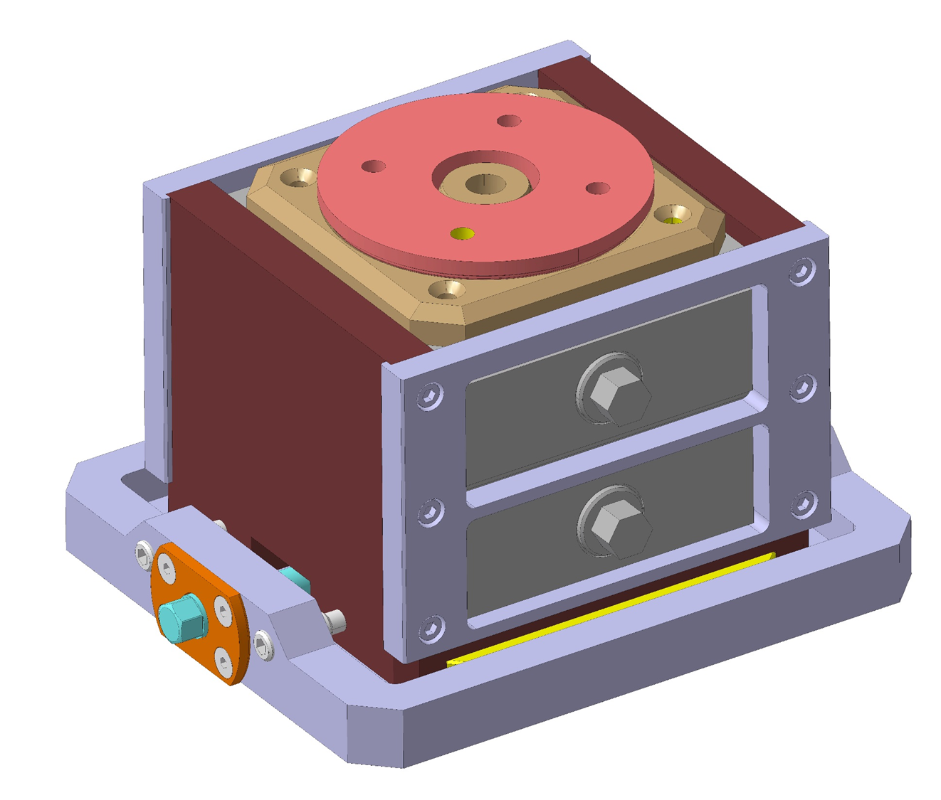
Mechanical jack replacement
Very difficult to combine ±10mm vertical stroke with ± 7mm horizontal stroke in an only 165mm high jack
Very complex and expensive solution
With risk of mechanical problems as well
It was decided to stick to the PU Jack solution if the problems can be fully understood and solved

Slide 14
Next steps
We need to understand the breakdown mechanism
Can we avoid this kind of breakdown?
If not, can we give a reliable lifetime?
The LHC Jacks show a different breakdown mechanism….
Many more magnets might be concerned…

