Slide 1
Motorized Adapters Polyurethane Pastils Issue
Mateusz Sosin on behalf of BE-GM-HPA Team
EMPA meeting, 9th May 2023

Slide 2
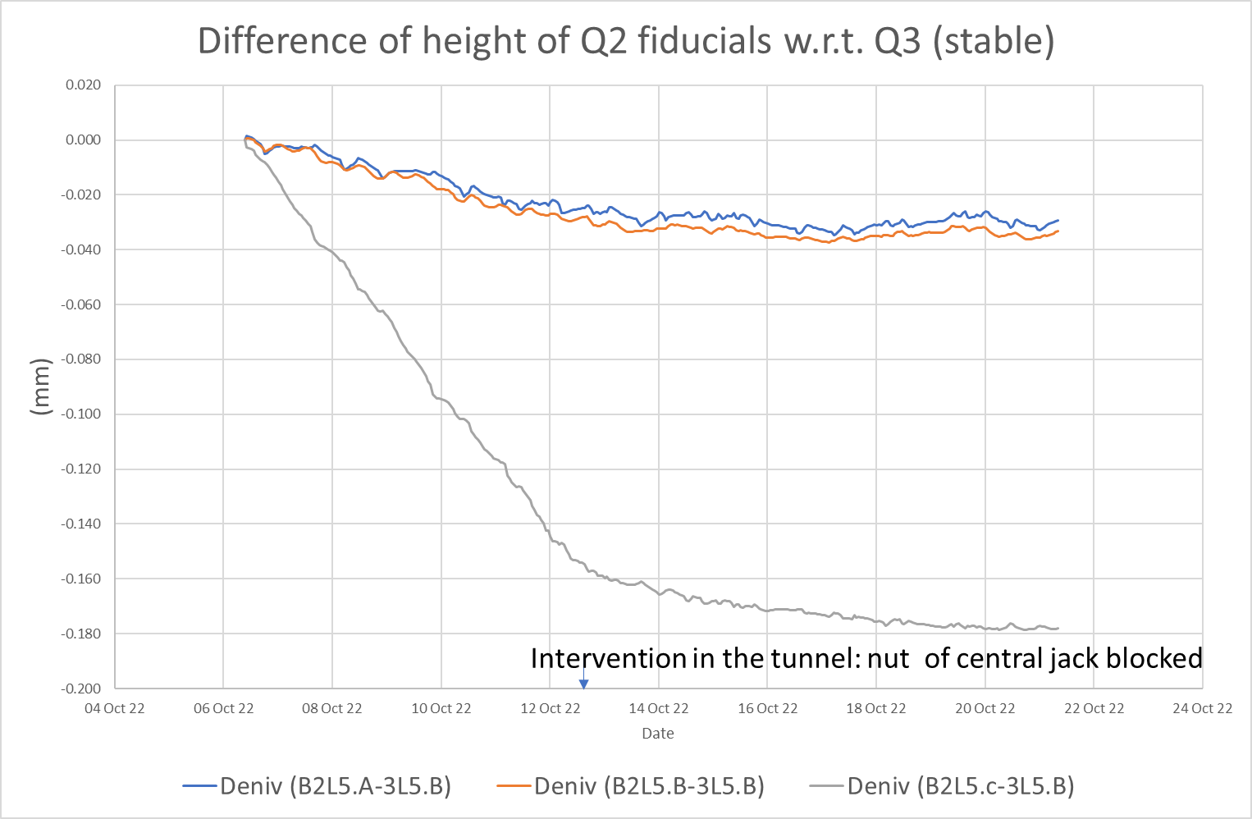
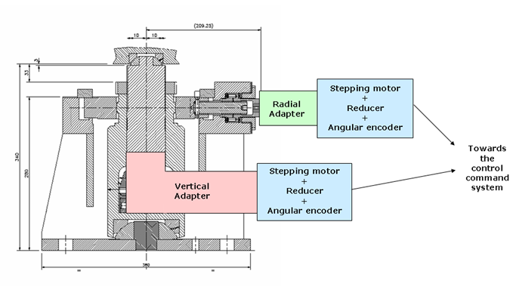
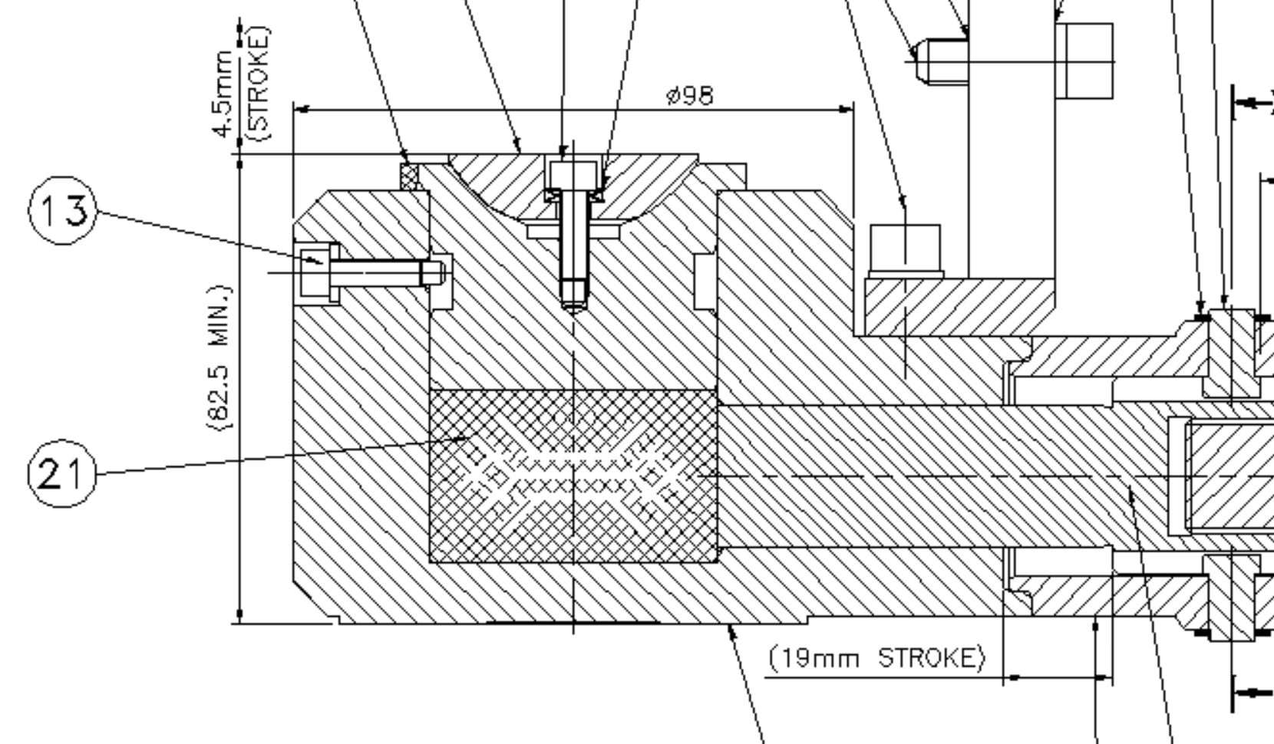
Observations on Q2L5, following 2022.10.13 intervention
Drift on the magent supporting jack observed
After an intervention in the tunnel to block the jack nut of Q2 5L central jack, drift stopped
Conclusion
  The issue comes from the vertical adapter
  The motorized adapter to be exchanged during technical stop
  An “autopsy” planned to be performed to understand why?
Intervention planned beginning of January 2023 due to high radiation level in the P5 triplet

Slide 3
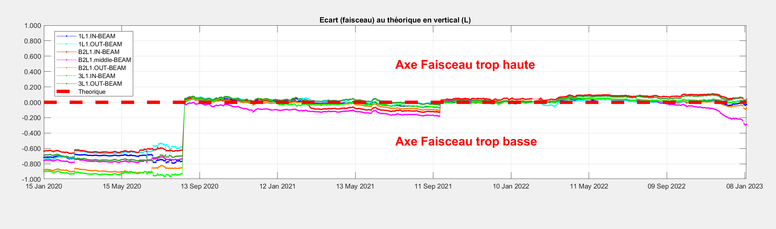
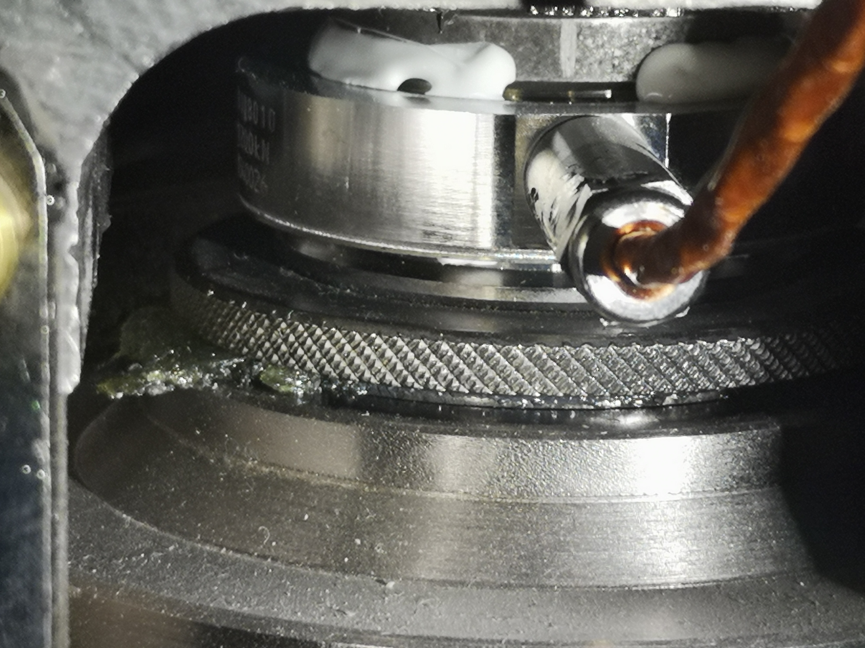
Q2L1 Issue
1L
Vertical
[mm]
Alignment
at warm
Alignment
at cold
V. Rude
Before the intervention in P5L, a similar drift behaviour was observed on other (Q2L1C) jack
An inspection of this motorized jack was performed 13th of January 2023, showing a polyurethane leak
The decison was taken, to launch an inspection of PU pastilles under triplet magnets (starting from the detailed inspection of P1 ones)

Slide 4
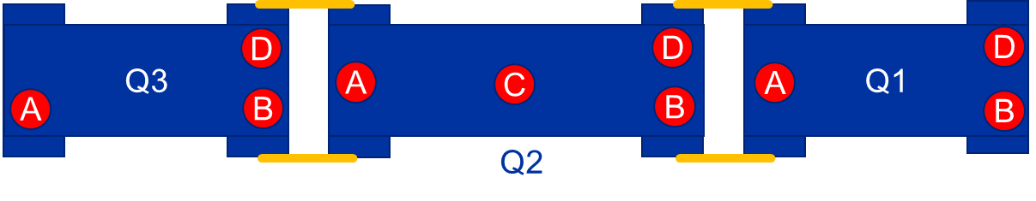
PU pastilles inspection in LHC
Series of interventions were executed between 16 – 31 January 2023:
All Q2C jacks adapters were opened, as PU pastilles in these locations were based on other recipe (soft pastilles, with hardness of 72..75 Sh – initial value in 2005)
  Most Q2C PU pastilles were degraded → ~0 Sh of pastille → Replaced to spare ones
  2 higher loaded central jacks (P1R, P2R) PU pastilles were ok (~70 Sh → hard 95 Sh (?) pastilles installed in 2005)
Remaining jacks A / B / D (containing hard pastilles – initially 95 Sh in 2005)
  All motorized adapters have been inspected visually (PU leak) and motion tests have been performed
  ~30% of adapters were open, pastilles hardness was measured and PU state was inspected
    For some adapters - a dissassembly in 927 RP Lab required due piston locking issue
  No particular issues detected, nevertheless hardness decreased from 95 to 70 Sh over 17 years

Slide 5
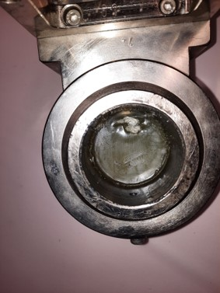
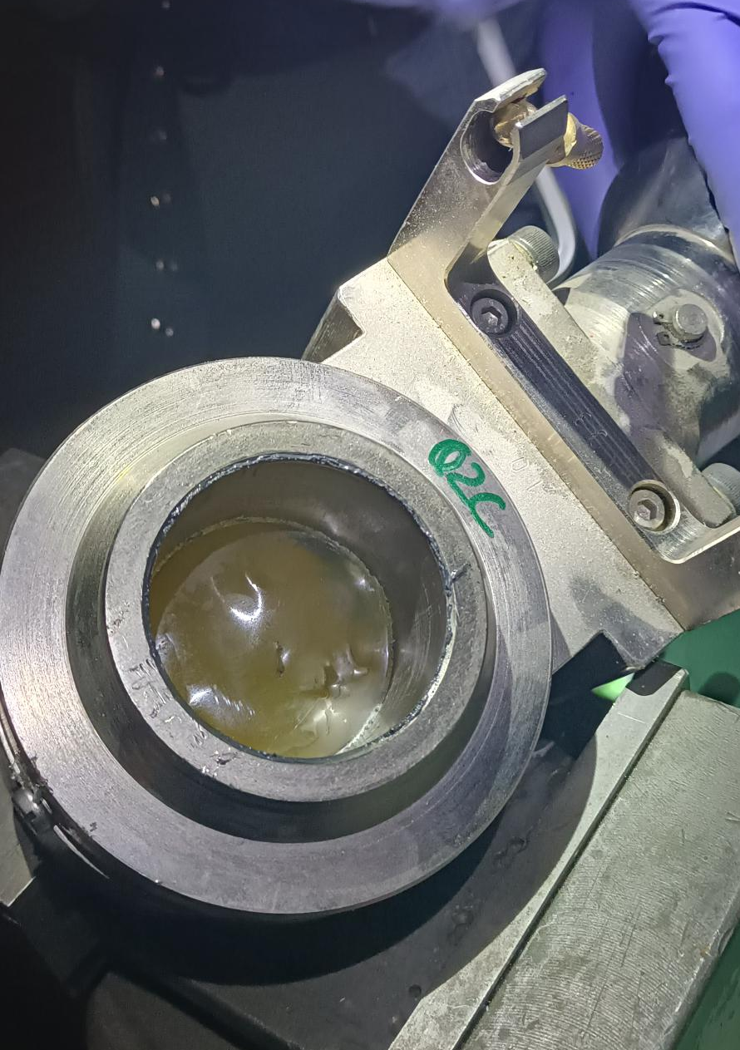
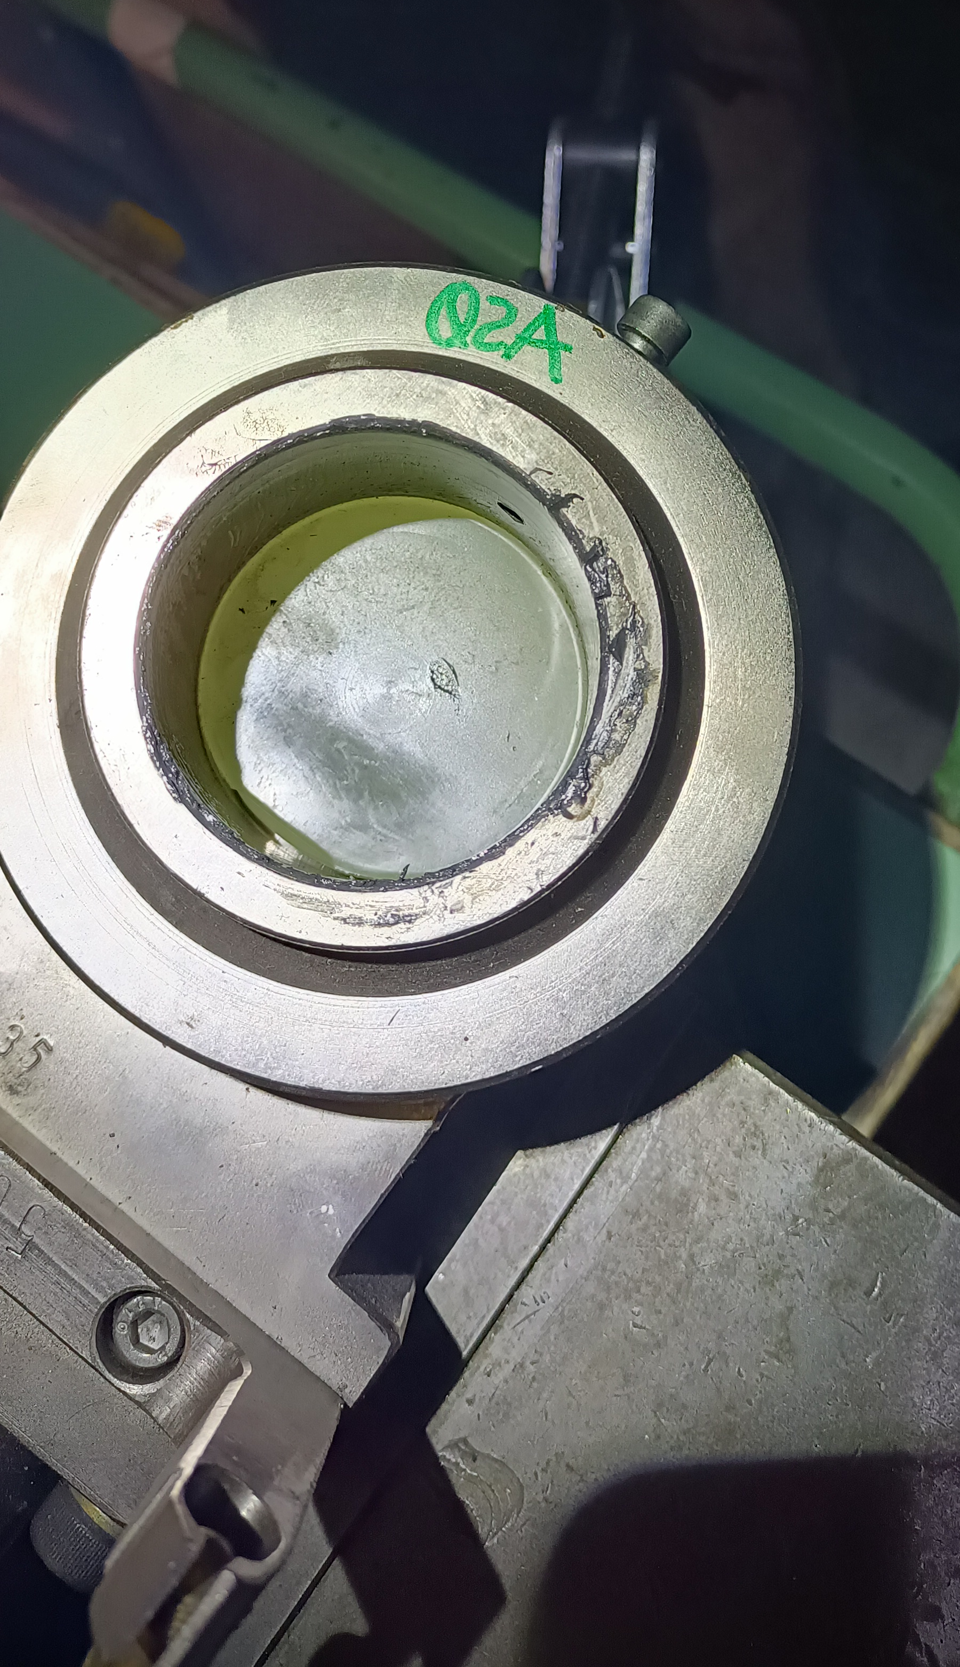
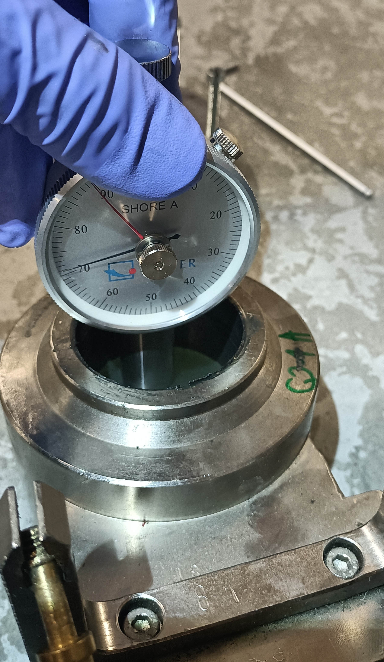
Phtos of pastilles (EDMS 2825814)
Soft pastilles
(degraded)
Hard pastilles
(hardness reduced, but fully functional)
Q2C R5
Q2A R5
Q2C L1
Q1A L5

Slide 6
Inspections summary
Replaced to compare with
damaged PU pastilles
Suspected to be soft one installed
(Q2C replaced with Q2D)
No clear correlation of damage with radiation or load:
  Soft pastilles under various load 1 .. 8 Tonnes; same degradation for P1/2/5/8, but different radiation levels
Soft pastilles affected. Hard pastilles hardness reduced, but not compromising their functionality
Grease impact ? Ageing ? (for SPS operation, the issues has been observed after 15 years of pastilles use)
Legend:

Slide 7
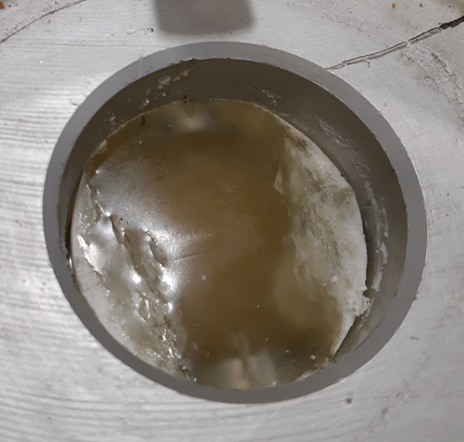
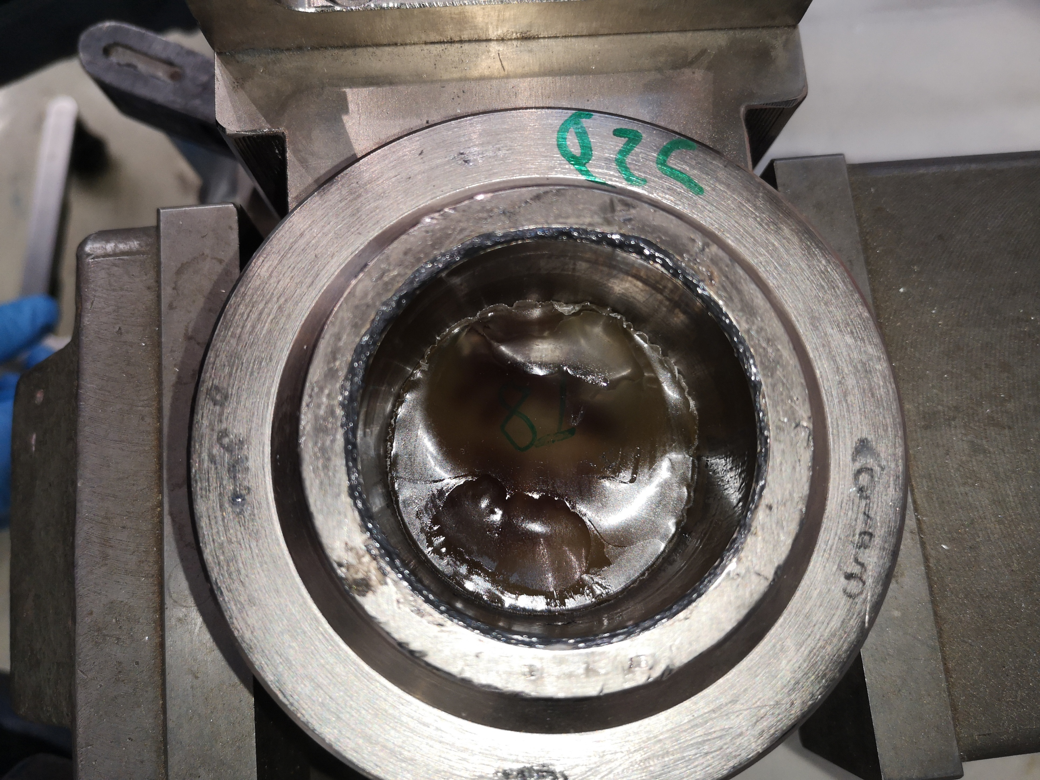
Initial observations, comparison with SPS PU pastilles issue
Different damage mechanism, than for the SPS pastilles:
Q2C L5
EN-MME-MM (S. Sgobba) contacted to help in identifying the issues source
Replaced (damaged) PU pastilles to be delivered for detailed tests, following RP measurements:
  Strongly and medium degraded + light softened pastilles
  Reference – spare ones
Chemical analysis foreseen to be conducted
LS2C committee 22.03.2019:
Chips and powder observed, expected due to environmental conditions
J. Bauche, P. Bestmann, J.-L. Grenard, C. Pasquino, Refurbishment of the SPS Quadrupole Jacks (https://indico.cern.ch/event/803501 )
Softening (for 95 Sh ones) / dissolution-like effect (for 75 Sh pastilles) observed
Different radiation levels (P1/5 vs. P2/8)
No or limited air access
Grease impact ?
Ageing ?

Slide 8
Action plan
Investigate issues with help of experts (EN-MME, contact EMPA)
  Perform analysis, to identify the source of issues (Grease? Load? Operation scenario? Radiation? Operation time limit? Combination of factors?). Several samples of the same serie of PU pastilles under irradiation for HL motorized adpaters solution ongoing
  Basing on detailed analysis and SPS experience – produce new series of pastilles compatible with LHC adapter needs (number of remaining spares is limited)
Prepare complementary inspection of the jacks during YETS 2023-24
Parallel to LHC investigations, extrapolate the investigation results to
HL-LHC motorized adapters design.
Re-analyse alternative options for the HL-LHC vertical adapter

Slide 9
LHC PU Pastilles
LHC PU pastilles procuction, followed extensive study of polyurethane material and production process in 2003, which identified suitable formulation of PU for the SPS jacks: https://edms5.cern.ch/document/402303/2
The LHC pastilles series procured in 2005, based on a study of the quality of the pads for the SPS polyurethane cylinders (https://edh.cern.ch/Document/SupplyChain/DAI/1907270)
  Series ordered form Angst + Pfister supplies pads polyurethane of sufficient quality (resistance to radiation, hardness). Report reference: "The SPS quadrupole jacks", technical note EST-SU-ME/2003/002, EDMS n° 402303. Testing procedure as in EDMS 499558

