Slide 1

Motorized Adapters Polyurethane Pastils Issue
Summary of material investigations
First conclusions
Visit EMPA - 2023-05-09
Stefano Sgobba based on material of Chemistry laboratory TE/VSC/SCC (Colette Charvet, Benoit Teissandier, Daria Ternova, Mauro Taborelli) and EN/MME/MM (Alice Moros)

Slide 2
Summary of material investigations
Samples received
FTIR analysis
TGA analysis
DSC analysis
XRD spectra
Conclusions
Perspectives

Slide 3
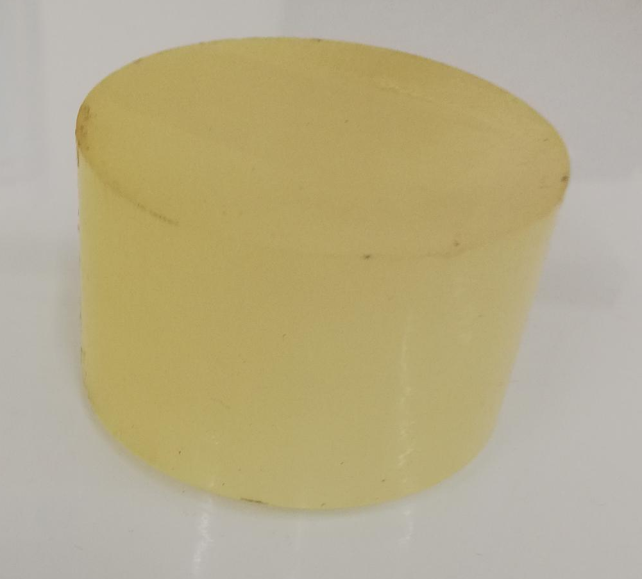
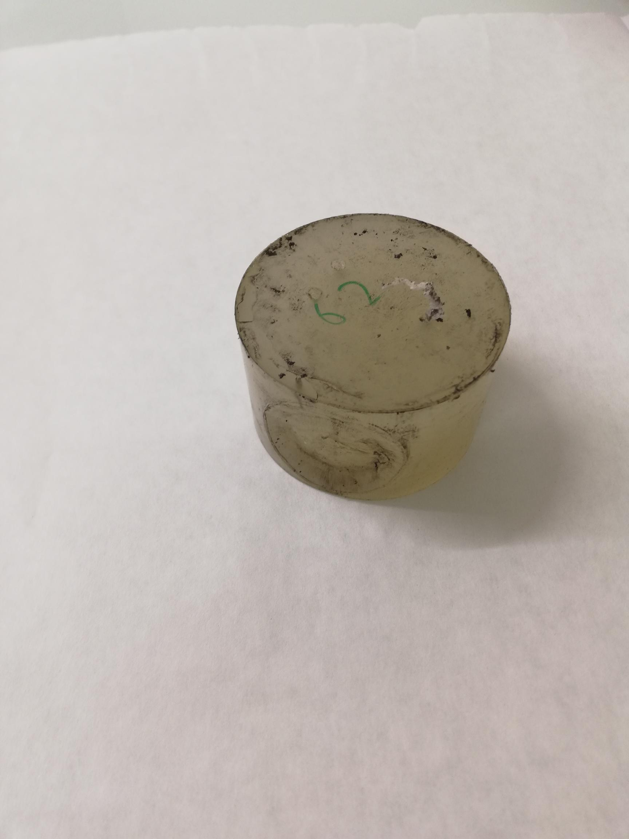
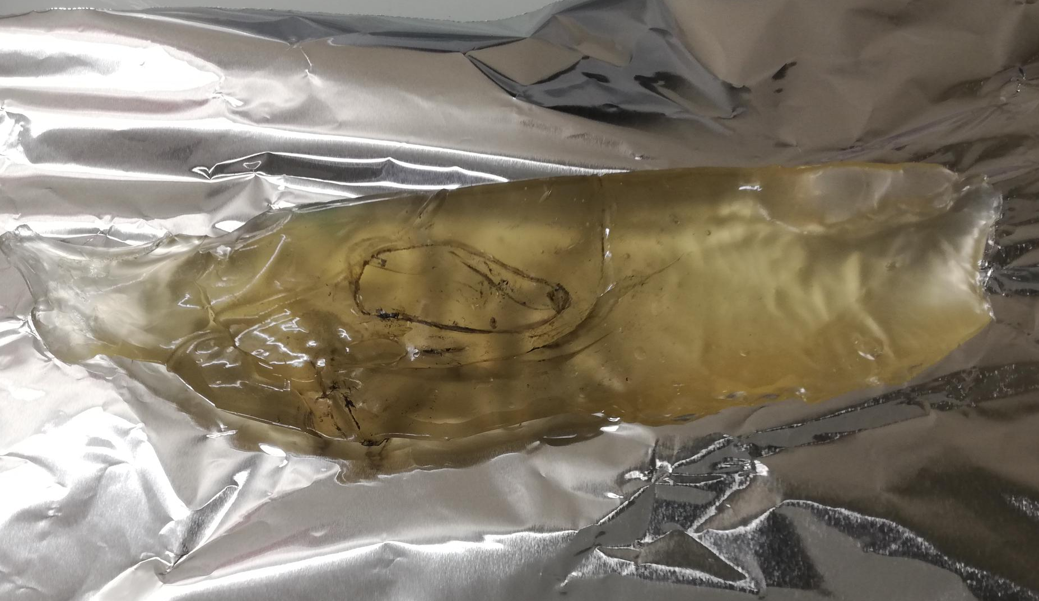
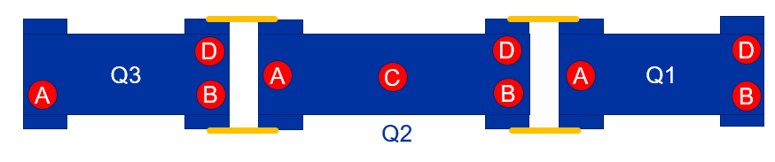
Summary of material investigations, samples
1 - Pastil 70 ShA
Unused
2 - Pastil used
Point 5 / LHC
3 - 2R Q2C 71 ShA
Degraded PU pastils seem to be mainly at the
Q2C position?

Slide 4
FTIR analysis : Spectral differences
1 – New pastil
3 – Degraded pastil
Bond 1703 cm⁻¹ disappeared: Hydrogen bonded Carbonyl group (C=O)
Bond 1730 cm⁻¹ increased: Free carbonyl group (C=O)
Bond 3333 cm⁻¹ decreased: Hydrogen bonded N-H group
Observation: absence of the OH band at 3600-3300 cm⁻¹ → absence of hydrolysis

Slide 5
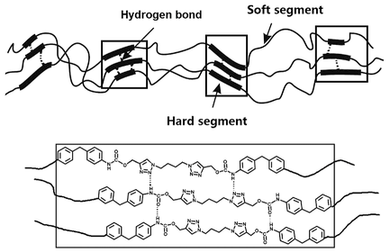
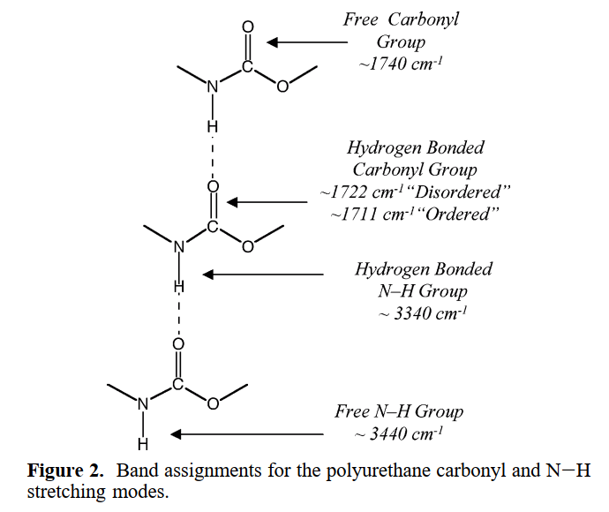
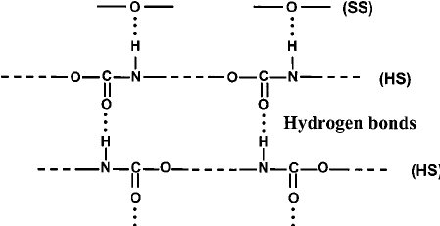
FTIR analysis : Hydrogen bonds
Bond 1703 cm⁻¹ disappeared: Hydrogen bonded Carbonyl group (C=O)
Bond 1730 cm⁻¹ increased: Free carbonyl group (C=O)
Bond 3333 cm⁻¹ decreased: Hydrogen bonded N-H group

Slide 6
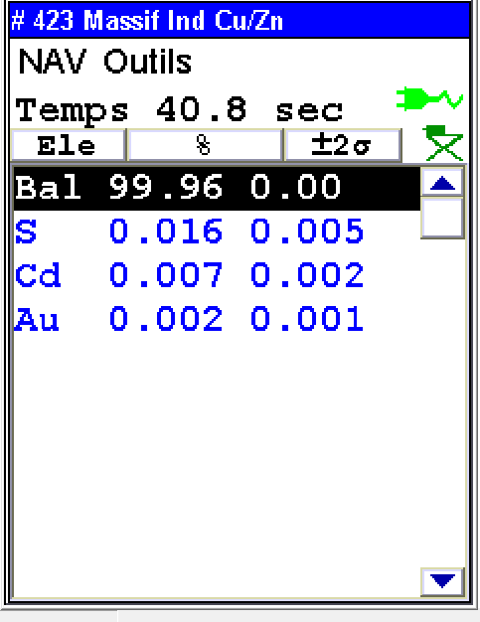
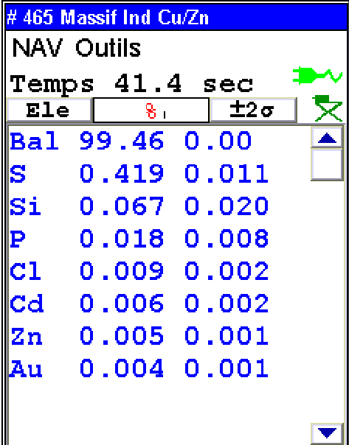
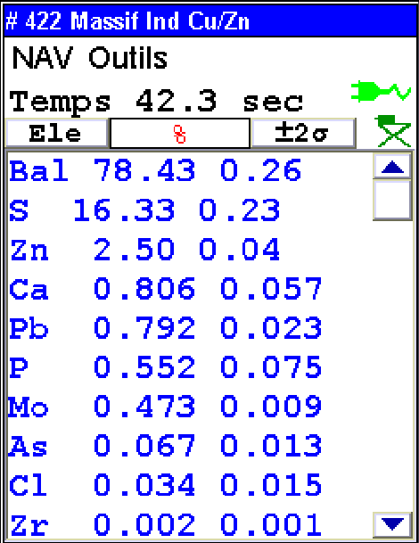
XRF analysis
New pastil
Degraded pastil
Molykote Grease BR2
The elements S, Zn and P detected in the degraded pastil must originate from the Molykote BR2 Grease
Presence of P may be a cause of PU degradation

Slide 7
TGA of PU samples (New et chewing gum)
Signal instability due to sample boiling
The TGA analysis do not show any significant difference between the unused sample and chewing gum sample which could explain the observable mechanical degradation

Slide 8
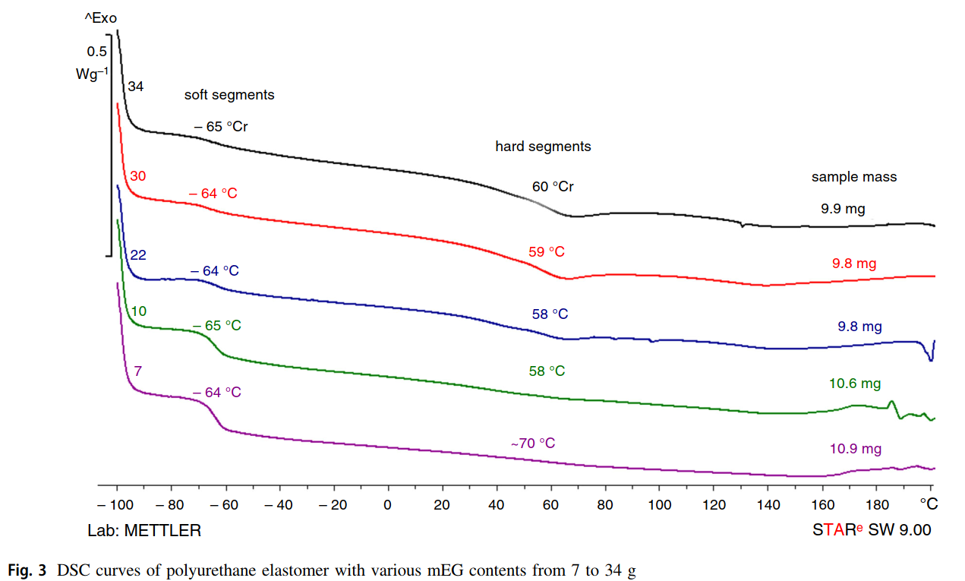
DSC example: Tg(soft segments) and Tg(hard segments)
Tg hard segments:
can be undetectable for some formulations of PU
Tg soft segments
Polyurethane elastomers (PUR) based on polypropylene glycol and 4,40-diphenylmethane diisocyanate were prepared with various monoethylene glycol (mEG) contents → chain extender

Slide 9
DSC results for PU pastils
Date | DSC code | Sample name | mass, mg | method | Tg1, °С
2023-03-15 | r0619 | PU sample new | 35.6 | Tg LN | -29.4
2023-03-16 | r0620 | PU sample 62 | 12.9 | Tg LN | -30.0
2023-03-16 | r0621 | PU sample slime-like | 23.1 | Tg LN | -33.6
∆Tg = 4°C
Tg soft segments

Slide 10
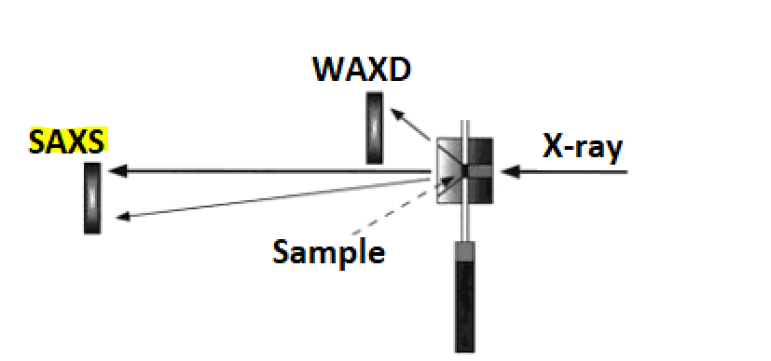
Polyurethane (PU) XRD Analysis
X-Ray Diffraction (XRD) is a non-destructive technique used to identify crystalline phases and orientation, as well as determine structural properties such as lattice parameters, strain, grain size, epitaxy, phase composition, and preferred orientation.
In this study, reference (solid) and damaged (viscous) PU samples have been analysed by XRD in Bragg-Brentano (BB) geometry to highlight potential differences in phase identification. In the XRD-BB configuration, the diffracted signal comes from a depth of a few micrometers within the inspected sample.
Our XRD system allows to explore Small-Angle X-ray Scattering (SAXS) as well, widely used in polymer laboratories. This technique complements XRD by detecting scattering from a few degrees down to a few hundredths of a degree between the X-ray beam and the sample surface. This enables investigation of the "nano" region, ranging from a few tens to several hundreds or thousands of angstroms with appropriate optics. SAXS patterns offer insights into the structural ordering of both crystalline and non-crystalline features, resulting from inhomogeneities in the distribution of electrons in the studied material. These differences may arise between inclusions and the surrounding matrix, between types of atoms in a chemical compound, or between individual molecules or molecular assemblies.

Slide 11
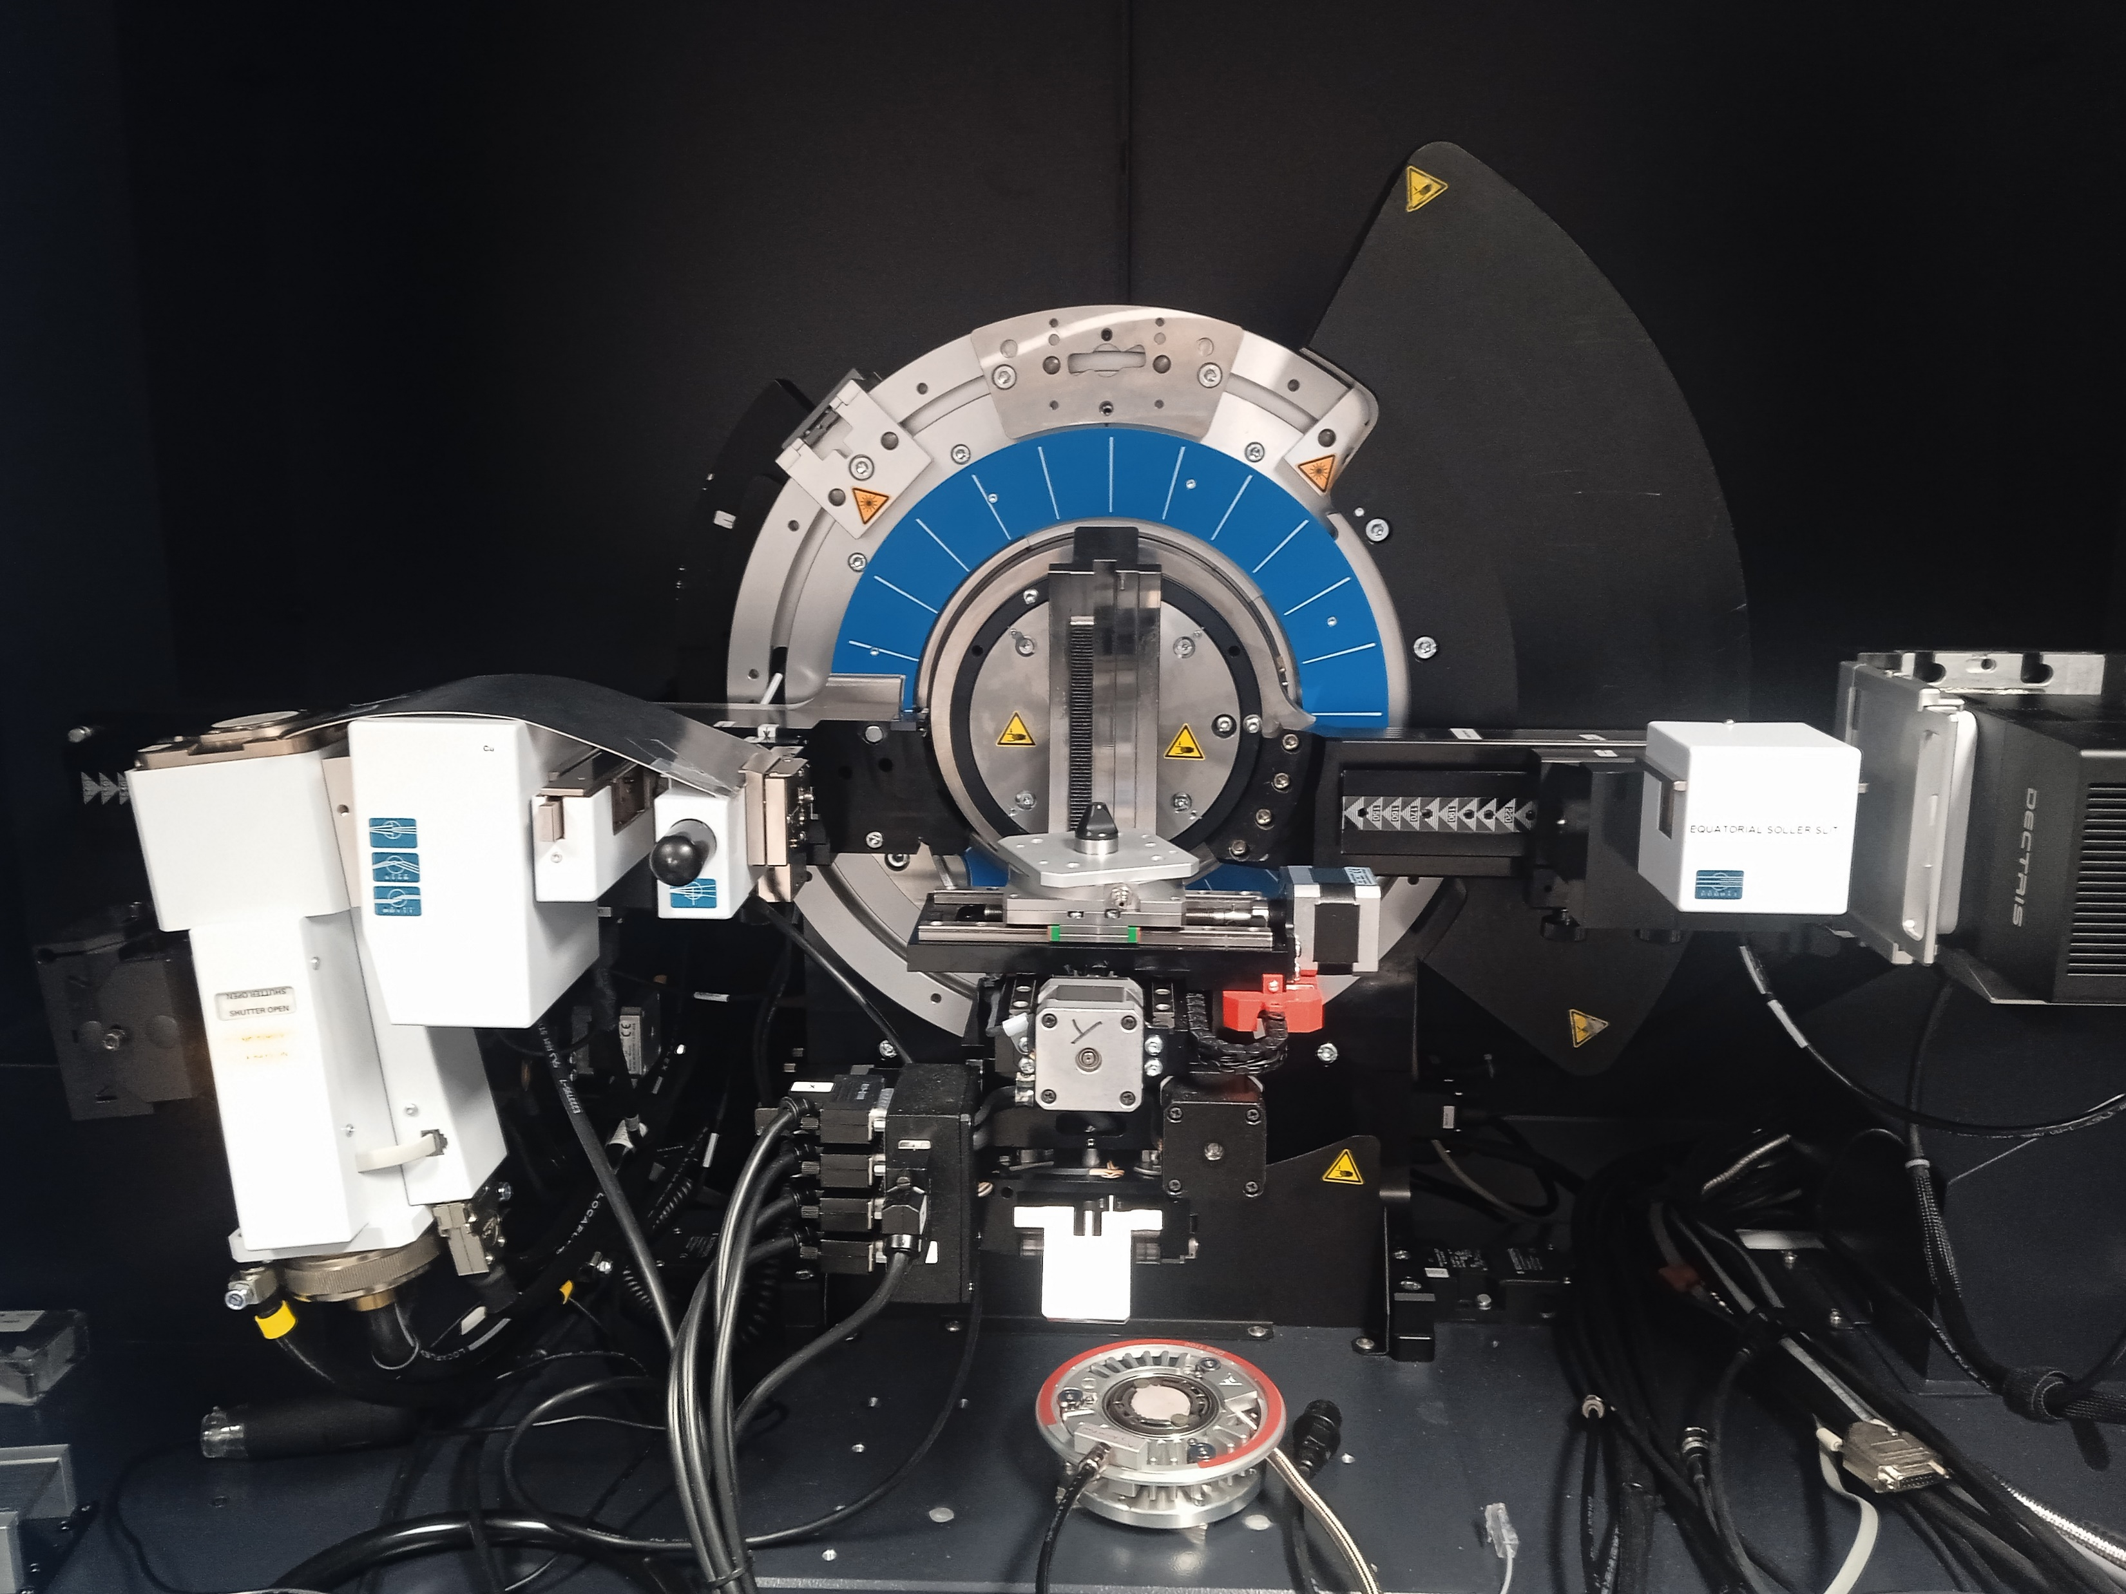
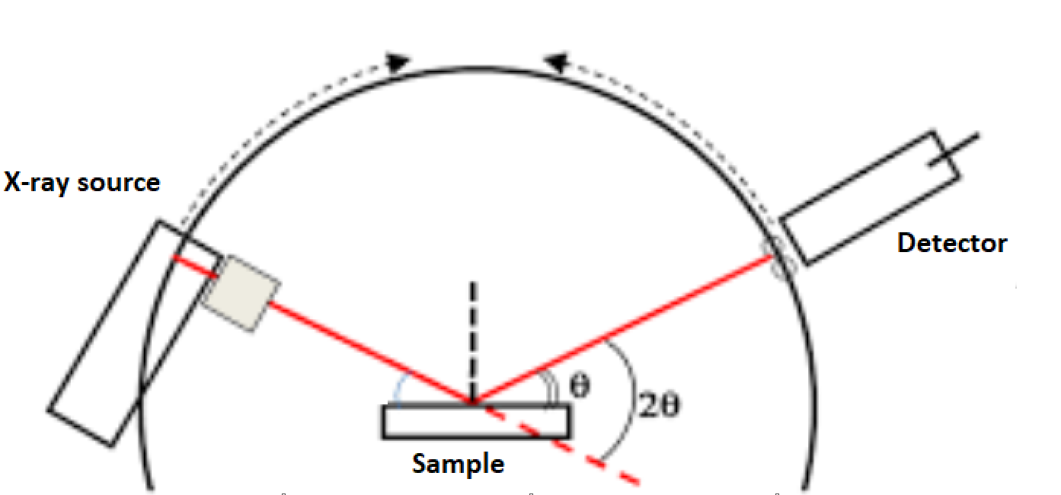
XRD-BB Analysis - System parameters
In the XRD-BB configuration, the X-Rays source and the detector move together in the so called “coupled Theta/2Theta” scan.
Configuration | X-ray source | Tube | V (kV) I (mA) | Detector Mode | Detector | Detector window (mm x mm) | Sample-Detector Distance (SDD in mm) | Optics
Bragg-Brentano | Cu line focus | Cu with 1.54 [Å] | 40 40 | 1D | γ-optimized | 74.9 x 35.4 | 355.2 | Motorized slit: OpeningDegree (0.30 °)
Filter | Scan type | 2Theta range (°) | Absorber | Time/step (s) | Increment (°) | Sample preparation | Software for cryst. phase and chem. composition identification
Ni0.02 | Coupled Theta/2Theta | 12-80 | 1 | 1 | 0.020 | Specimens were cut before analysis | EVA + PDF database

Slide 12
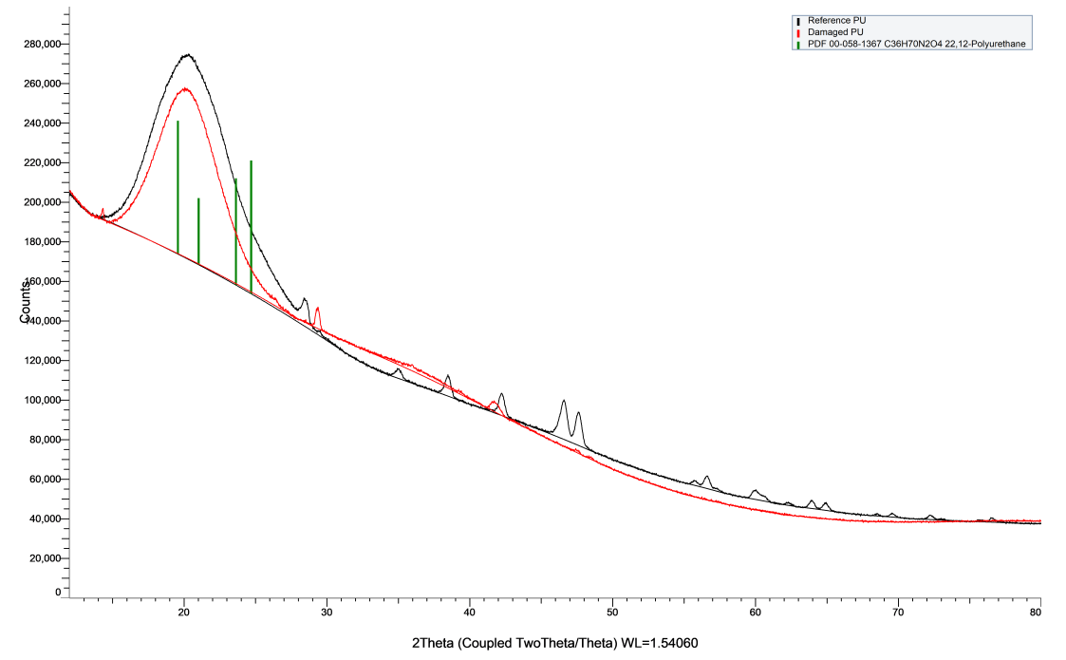
XRD-BB Results
The background signal in X-ray diffraction analysis can arise from various sources, such as the sample itself (e.g., amorphous phase), the instrument (e.g., sample holder), or air scattering.
Differences between two specimens could be attributed to the system alignment or the sample shape (in this case, the surface of the damaged PU was difficult to keep flat).
At present, no clear conclusions can be made, including for the difference in crystalline phases.
It is recommended to explore the SAXS technique for both new and used PU samples.

Slide 13
Conclusions
Polyurethane type Ester (FTIR)
No hydrolysis (FTIR)
No major chain rupture (TGA)
No big changes in the soft segments (DSC)
Damage of the hydrogen bonding seems to affect strongly the mechanical properties of polyurethanes (FTIR)
Presence of the Molykote grease (FTIR, XRF)
XRD: differences between two specimens could be attributed to the system alignment or the sample shape (the surface of the damaged PU was difficult to keep flat)
The cause of degradation remains unknown
The main hypothesis for the degradation is the conjunction of pressure, the Molykote grease and time → difficult to reproduce in the laboratory

Slide 14
Perspectives
Mechanical testing (creep in compression) to identify differences of strainrates in secondary creep regime between products of different hardness
Study the possible interaction of Molykote lubricant with the pastil → elemental and crystallographic analysis (XRF, XRD SAXS)
Study possible evolution of the crystallinity (XRD SAXS)
Identify products with a longer lifetime in operation conditions:
    unlubricated/lubricated
    SPS/LHC environment
Clarify the compatibility of specific lubricants with the selected product

