Slide 1
Polyurethane Pastilles analysis by CERN chemistry lab
Chemistry laboratory TE/VSC/SCC
10/R-015
08/05/2023

Slide 2
Outline
Samples received
FTIR analysis
TGA analysis
DSC analysis
Other tests
Conclusions
Questions

Slide 3
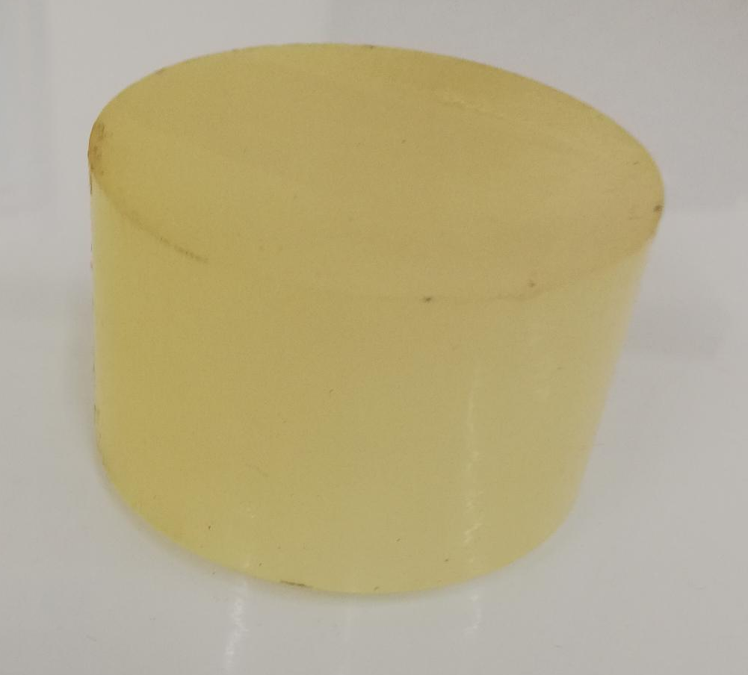
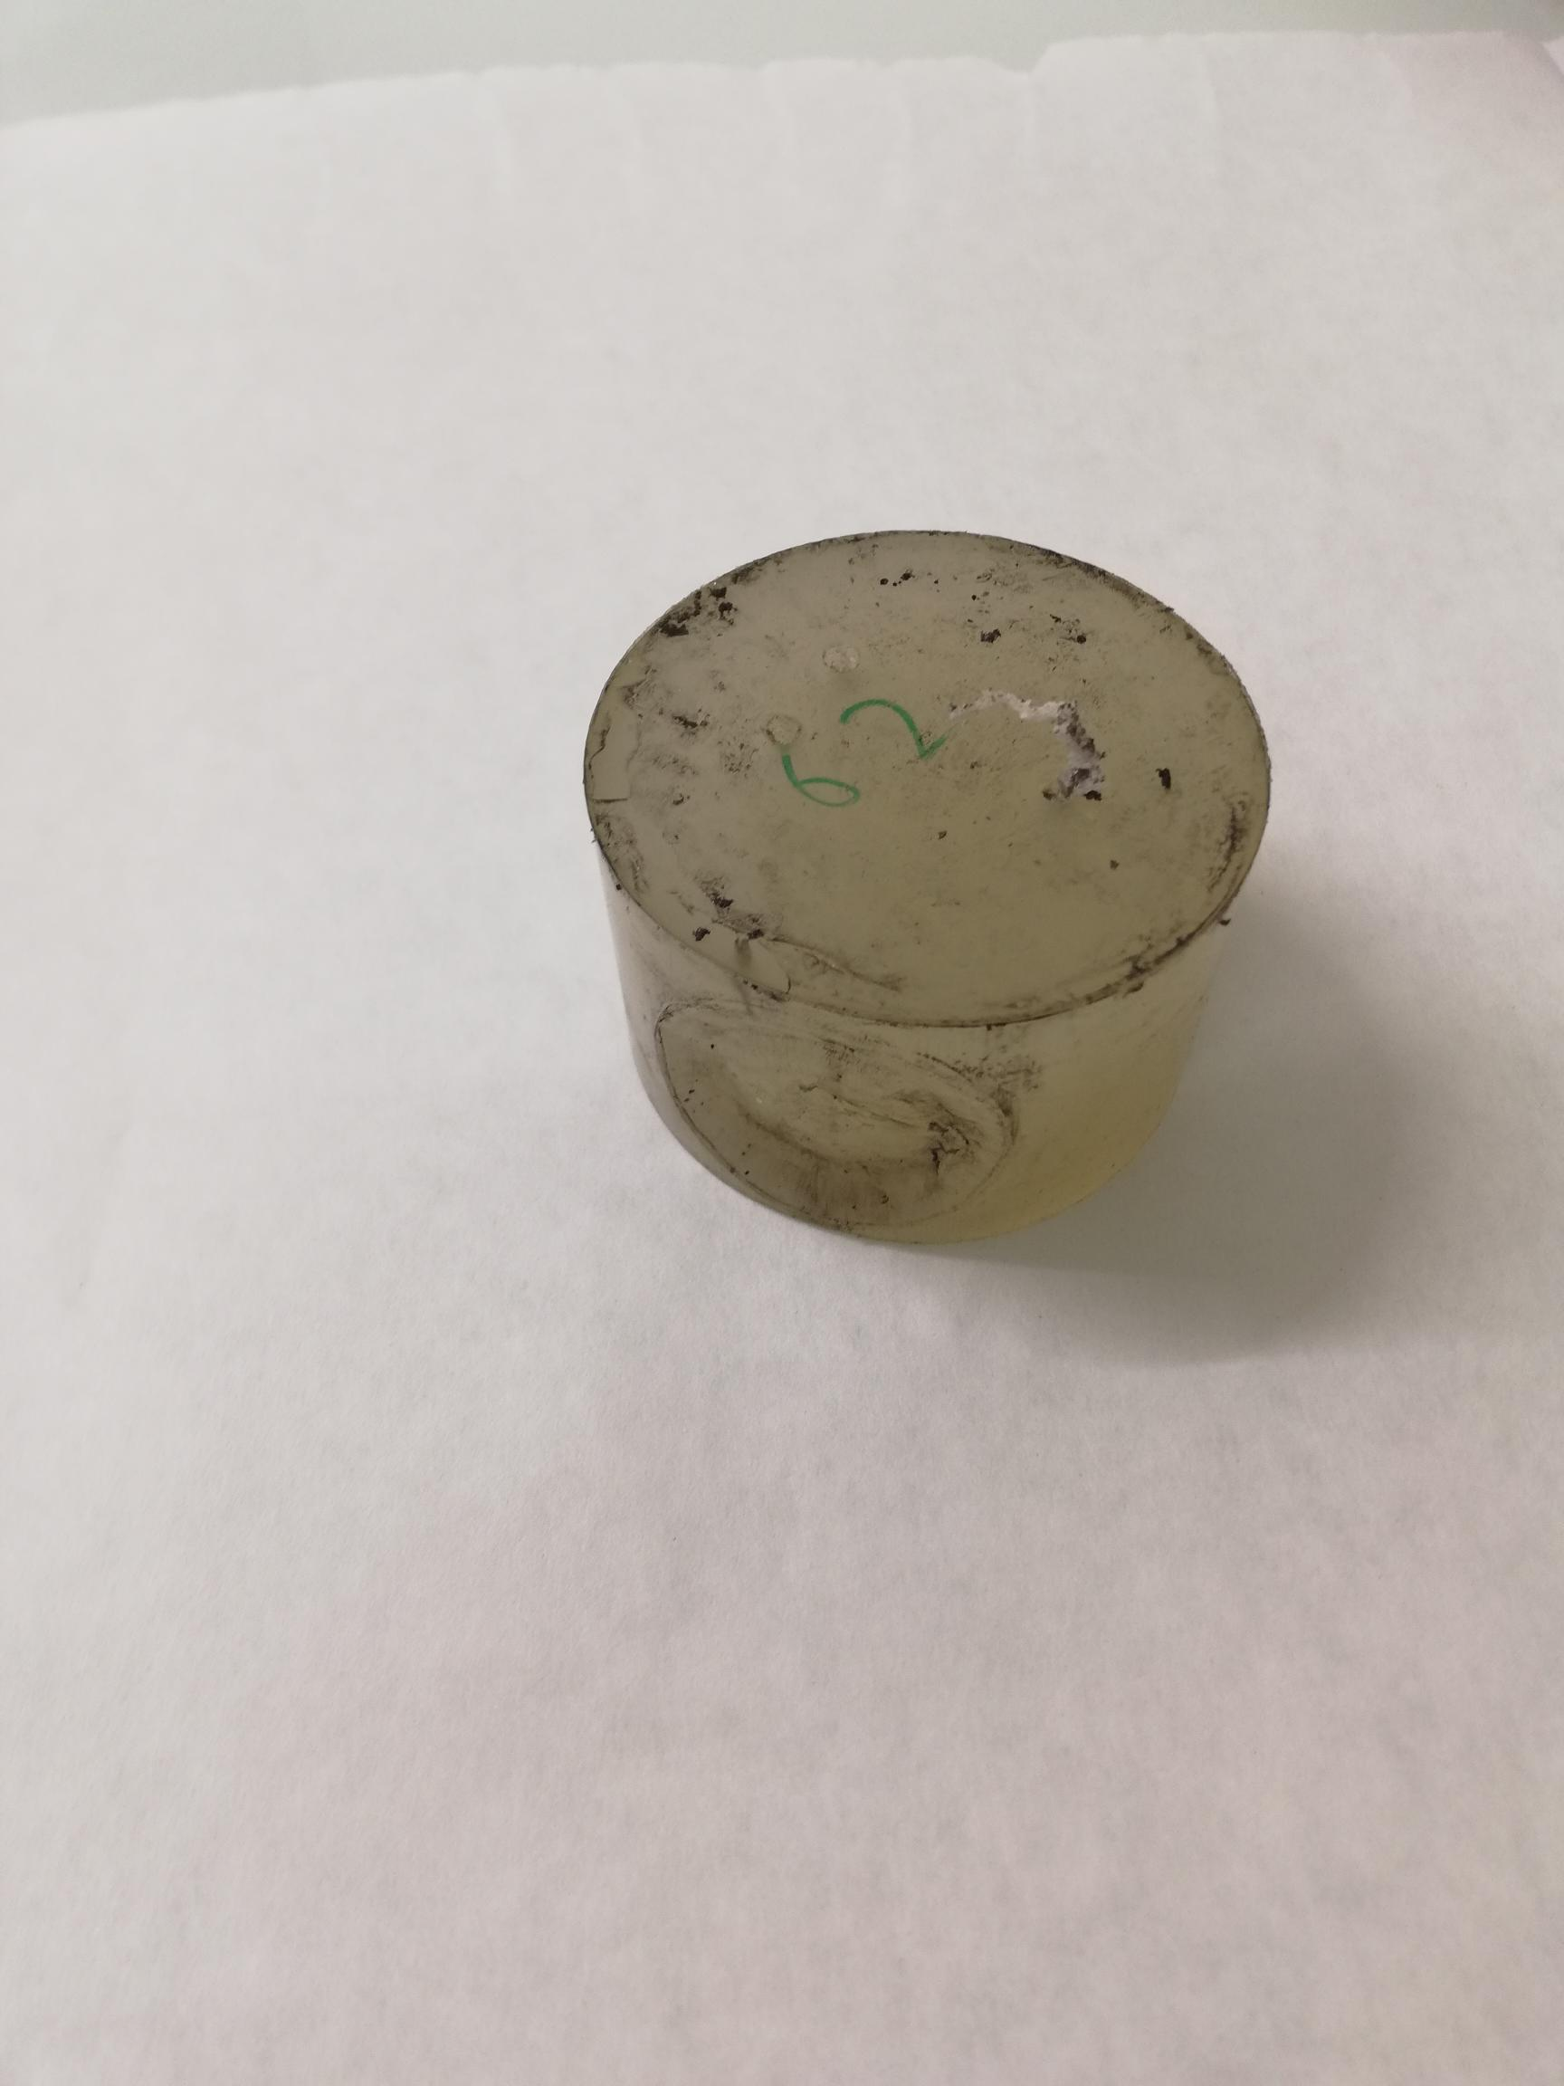
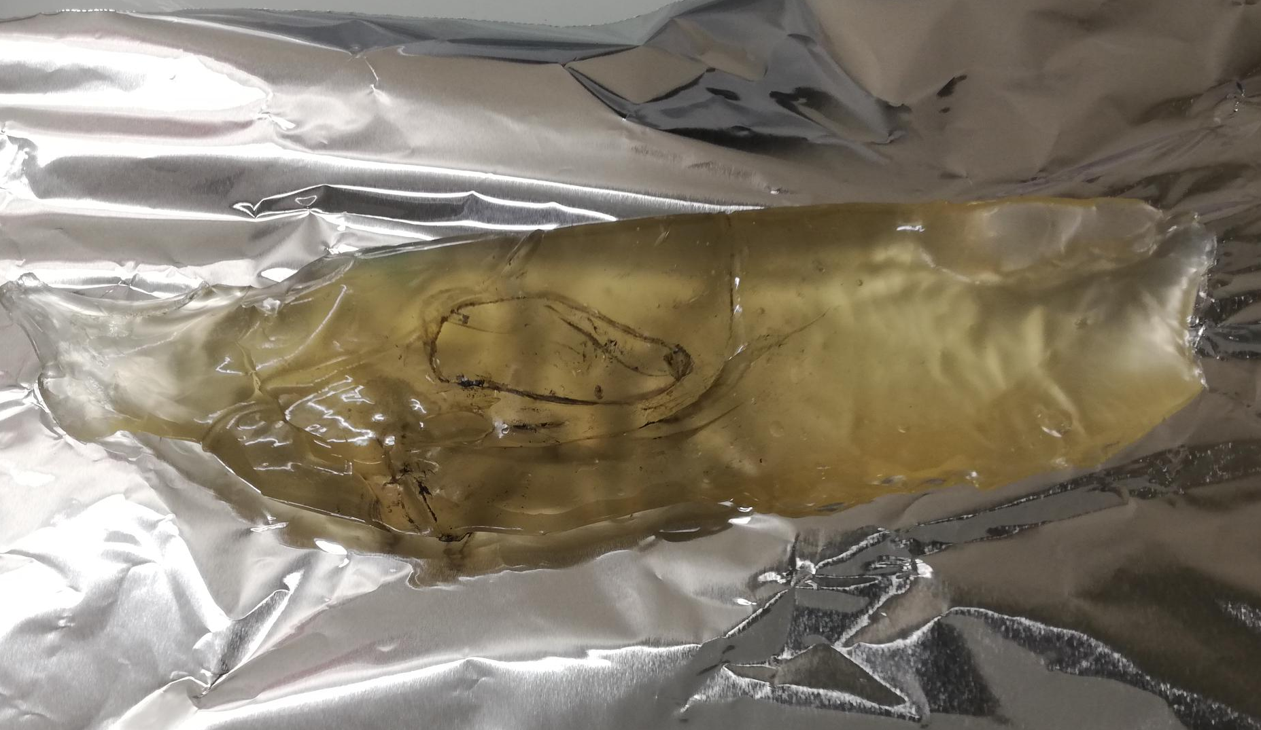
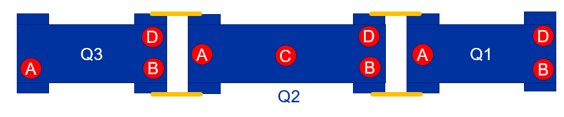
Samples: 3 Polyurethane pastilles
1 - Pastille 70 ShA
Non utilisée
2 - Pastille usagée
Point 5 / LHC
3 - 2R Q2C 71 ShA
Degraded PU pastilles seem to be mainly at the
Q2C position?

Slide 4
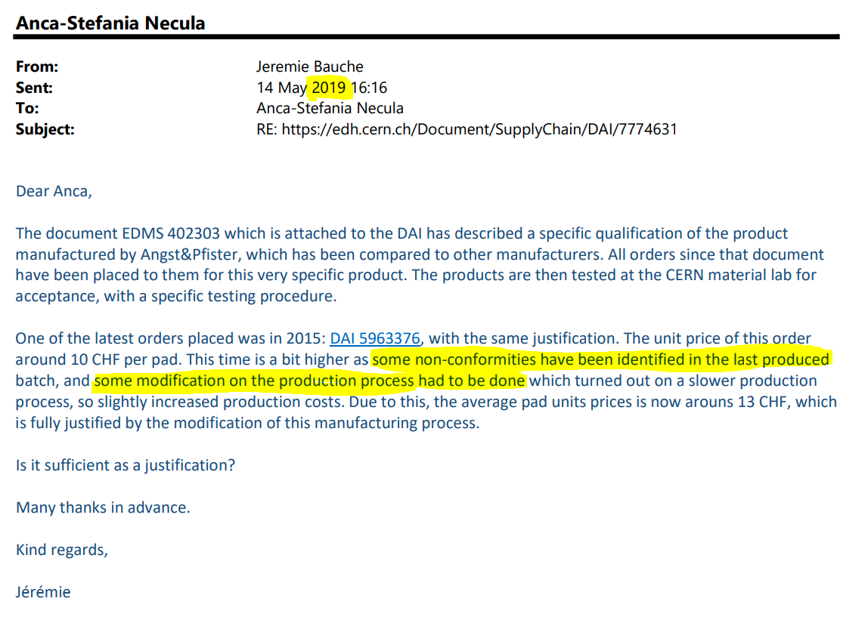
Historique des commandes et reference chez A&P

Slide 5
FTIR analysis

Slide 6
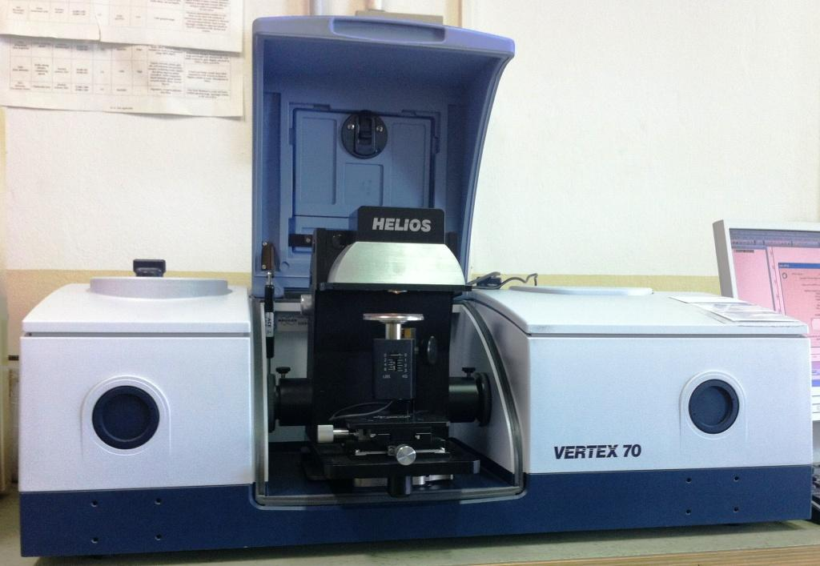
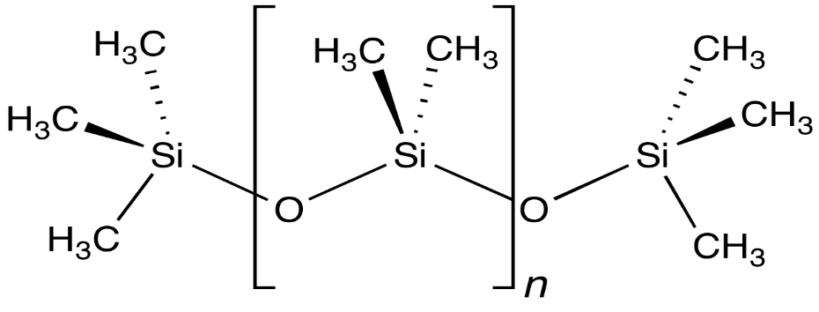


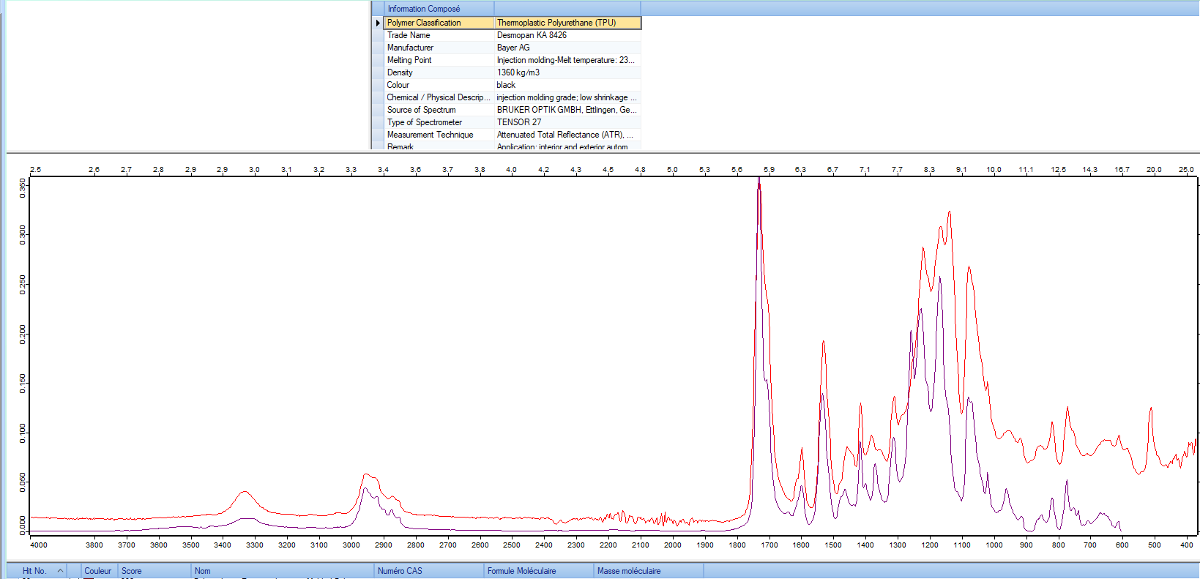
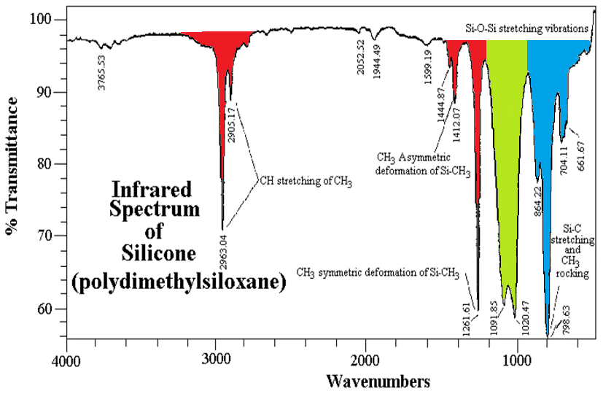
Instrument: Fourier-Transform Infrared spectroscopy (FTIR)
e.g.: Silicone oil
ZnS Window
Lab. Spectrometer : Bruker Vertex 70
Polychromatic IR light
Exemple: Polymers Identification

Slide 7
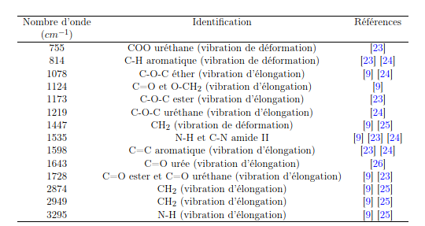
FTIR analysis : Identification of the polyurethane type
1 – New pastille
2 – Used pastille
3 – Degraded pastille
ATR FTIR bonds of a polyurethane ester
          3 samples are the same polyurethane type: POLYURETHANE ESTER
          This information doesn’t answer:
            Is it the same producer?
            Is it the same material (fillers, compounding..)?

Slide 8
FTIR analysis : Spectral observation
1 – New pastille
2 – Used pastille
3 – Degraded pastille
          Fact: Polyurethane ester are susceptible to hydrolysis
          Observation: absence of the OH band at 3600 -3300 cm⁻¹ →
No evidence for hydrolysis

Slide 9
FTIR analysis : Spectral differences
1 – New pastille
3 – Degraded pastille
Bond 1703 cm⁻¹ disappeared: Hydrogen bonded Carbonyl group (C=O)
Bond 1730 cm⁻¹ increased: Free carbonyl group (C=O)
Bond 3333 cm⁻¹ decreased: Hydrogen bonded N-H group

Slide 10
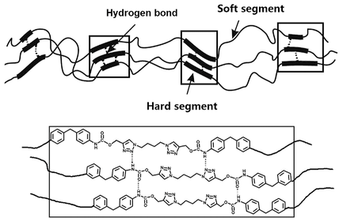
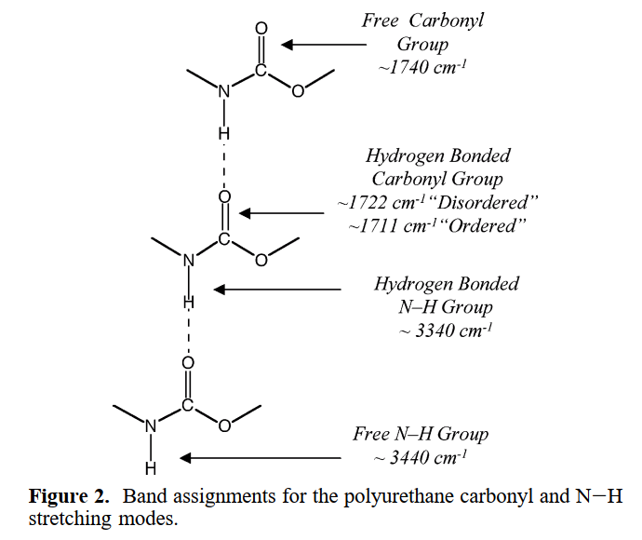
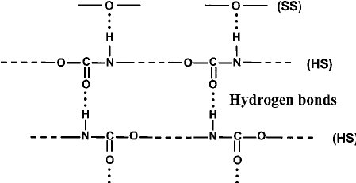
FTIR analysis : Hydrogen bonds
Bond 1703 cm⁻¹ disappeared: Hydrogen bonded Carbonyl group (C=O)
Bond 1730 cm⁻¹ increased: Free carbonyl group (C=O)
Bond 3333 cm⁻¹ decreased: Hydrogen bonded N-H group

Slide 11
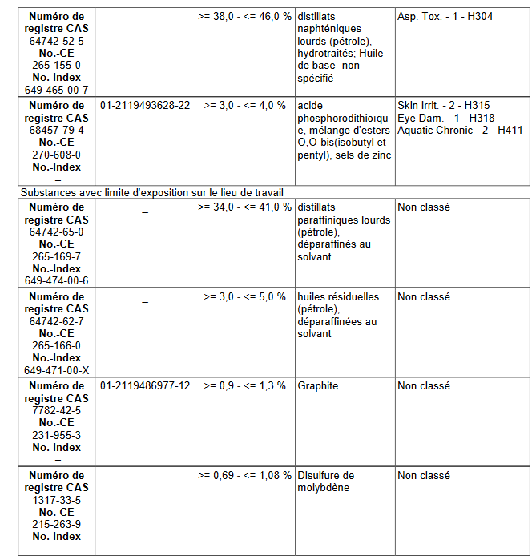
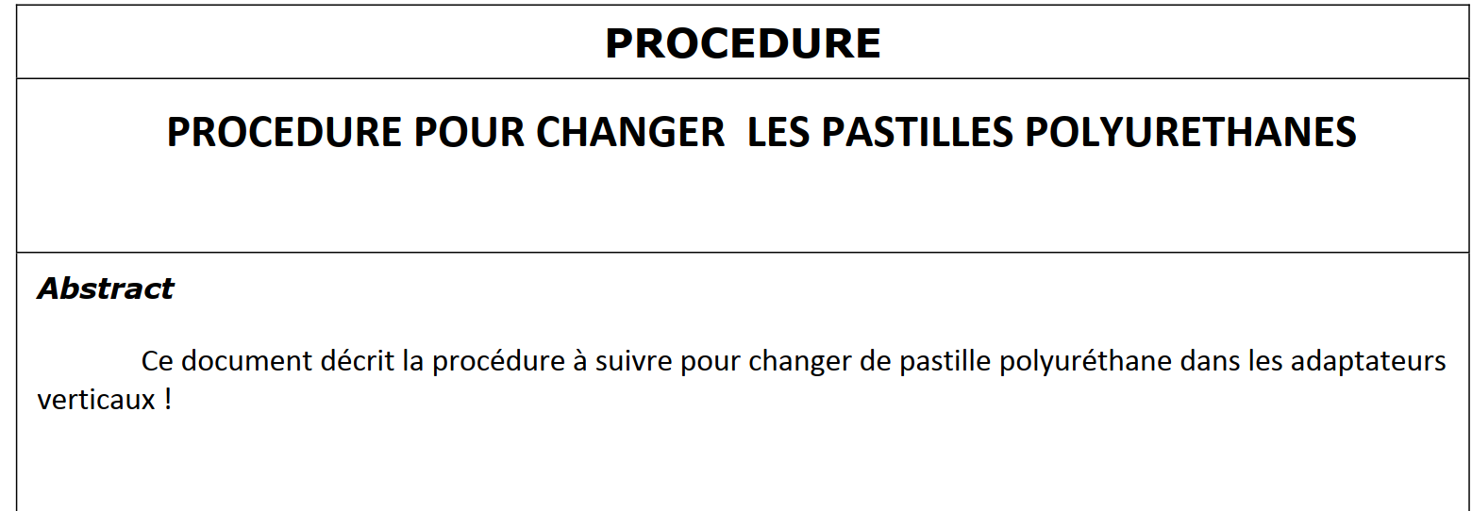
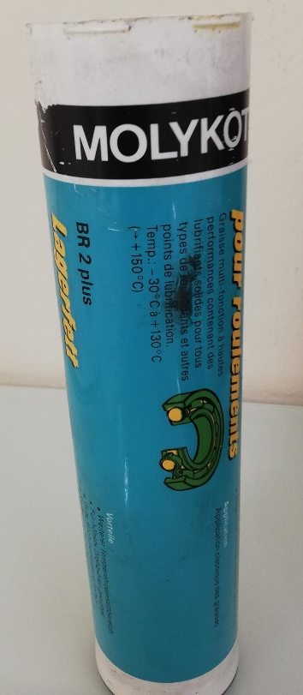
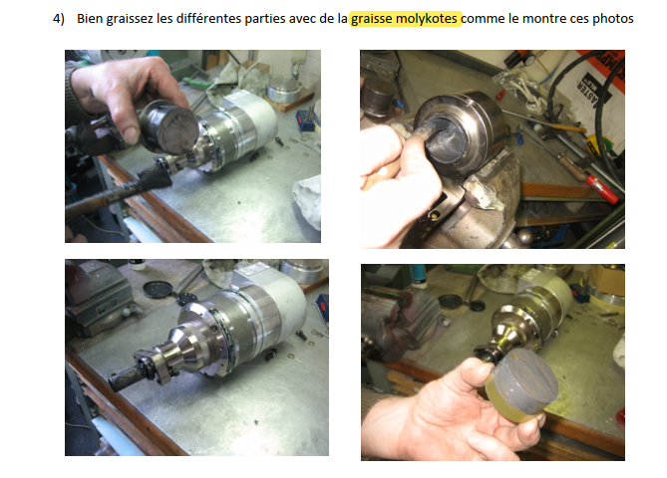
Presence of Molykote grease
MSDS Molykote BR2
New pastille
Degraded pastille
Molykote grease
Molykote BR 2
standard magasin
SCEM 57.75.10.250.9
?
https://edms.cern.ch/document/909627/1

Slide 12
XRF analysis

Slide 13

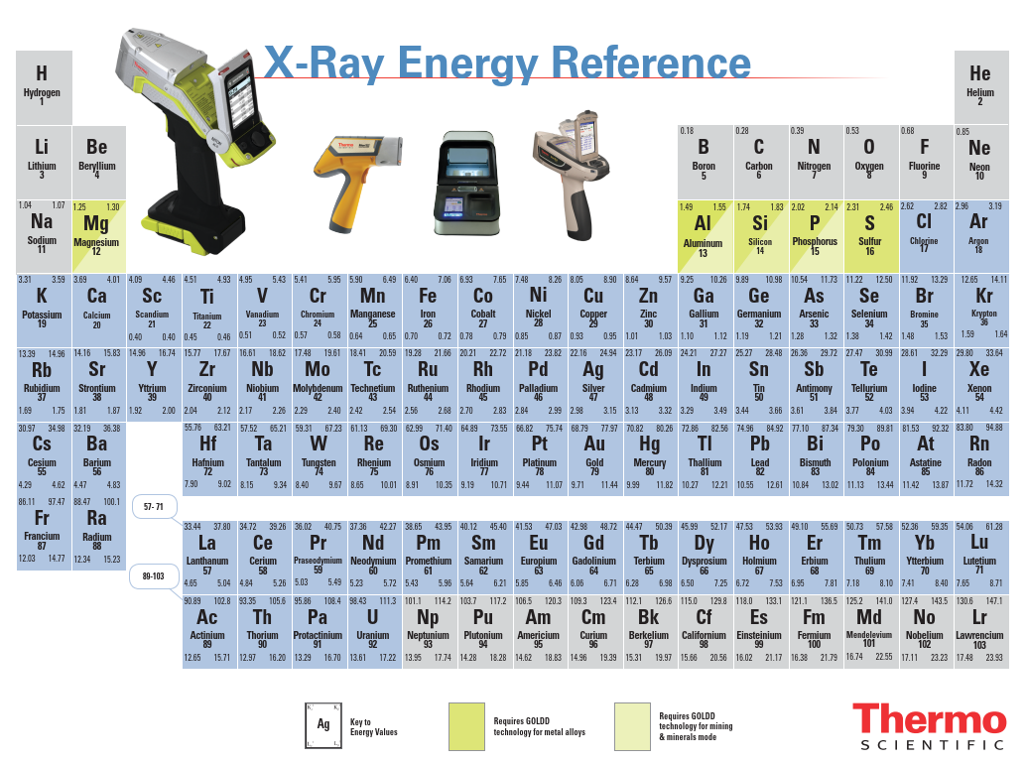
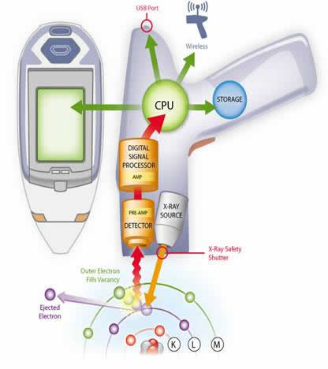
XRF spectroscopy
Niton XL3t GOLDD+

Slide 14
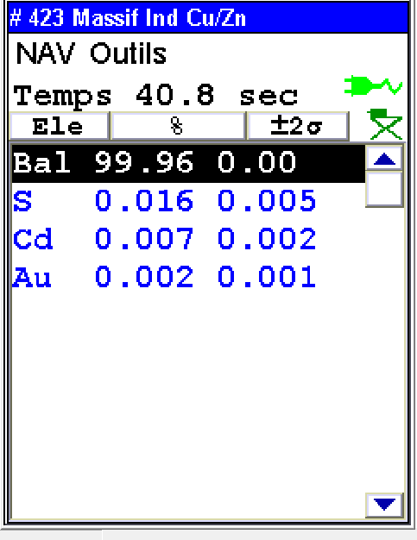
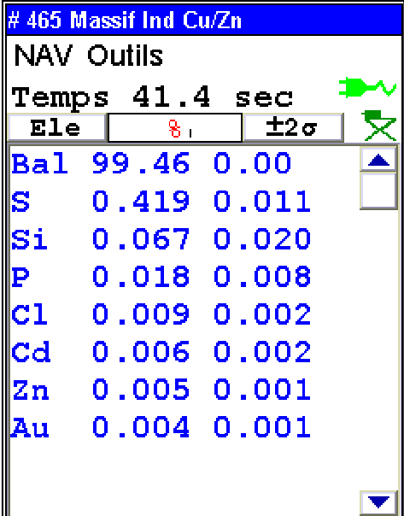
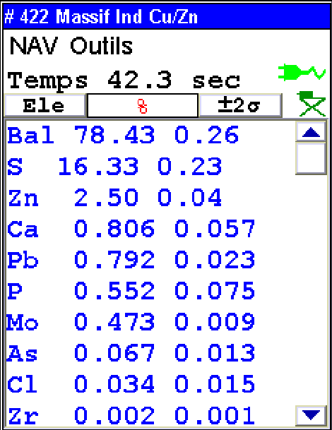
XRF analysis
New Pastille
Degraded pastille
Molykote Grease BR2
The elements S, Zn and P detected in the degraded pastille must originate from the Molykote BR2 Grease

Slide 15
TGA analysis

Slide 16
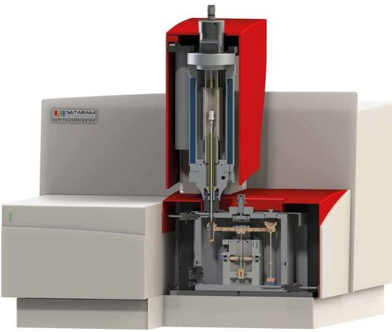
TGA analysis
(Setaram Labsys Evo)
Oven (1600°C max)
Sample
(20-100 ug)
Gas (Ar, Air, etc.)
Microbalance

Slide 17
Exemple of degradation : PTFE grease after irradiations

Slide 18
TGA of PU samples (New et chewing gum)
Signal instability due to sample boiling
The TGA analyzes do not show any significant difference between the New sample and and chewing gum which could explain the observable mechanical degradation

Slide 19
DSC analysis

Slide 20
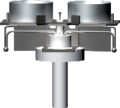
DSC technique
thermocouples
DSC measurement cell
Example of DSC thermogram
In DSC the difference in heat flow between a sample and a reference is measured as a function of time as both the sample and reference are subjected to a controlled temperature profile.

Slide 21
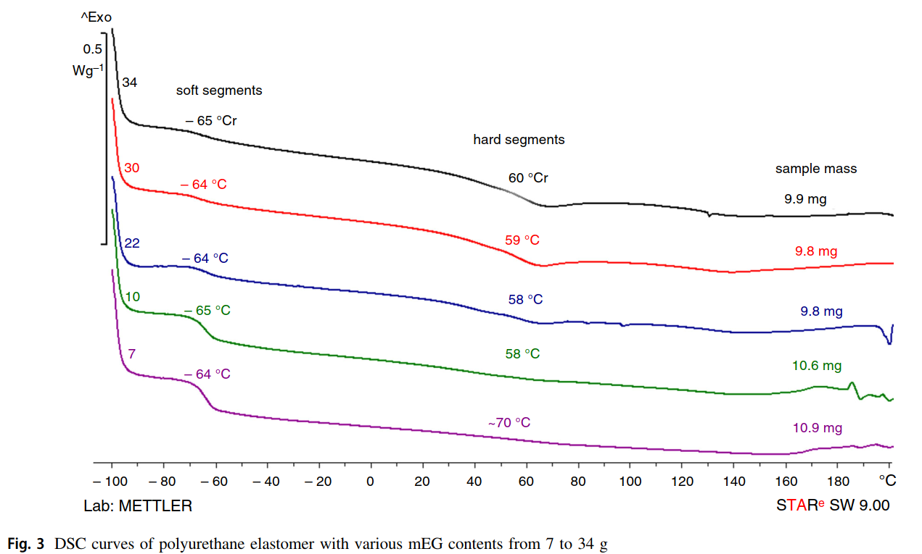
DSC example: Tg(soft segments) and Tg(hard segments)
Tg hard segments:
can be undetectable for some formulations of PU
Tg soft segments
Polyurethane elastomers (PUR) based on polypropylene glycol and 4,40-diphenylmethane diisocyanate were prepared with various monoethylene glycol (mEG) contents → chain extender

Slide 22
DSC results for PU pastilles
Date | DSC code | Sample name | mass, mg | method | Tg1, °С
2023-03-15 | r0619 | PU sample new | 35.6 | Tg LN | -29.4
2023-03-16 | r0620 | PU sample 62 | 12.9 | Tg LN | -30.0
2023-03-16 | r0621 | PU sample slime-like | 23.1 | Tg LN | -33.6
∆Tg = 4°C
Tg soft segments

Slide 23
Other tests

Slide 24
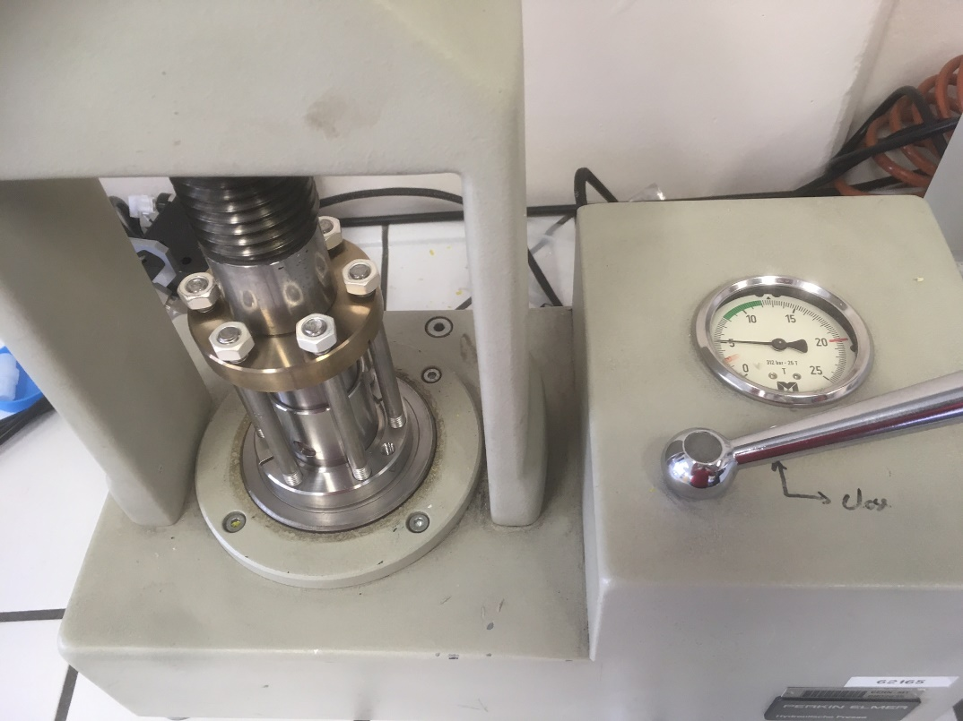
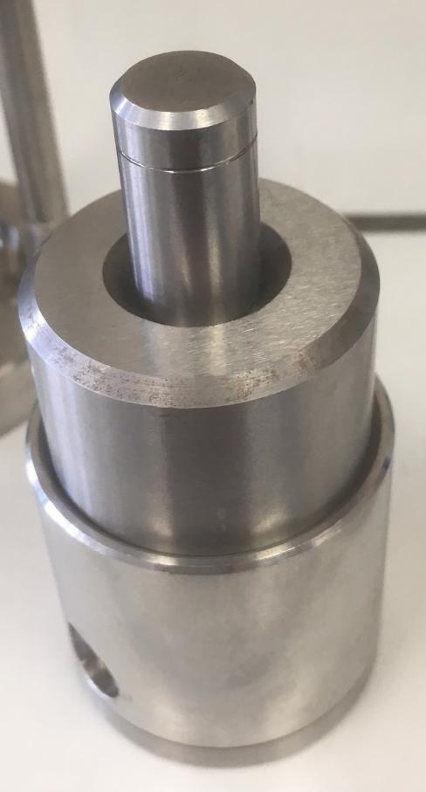
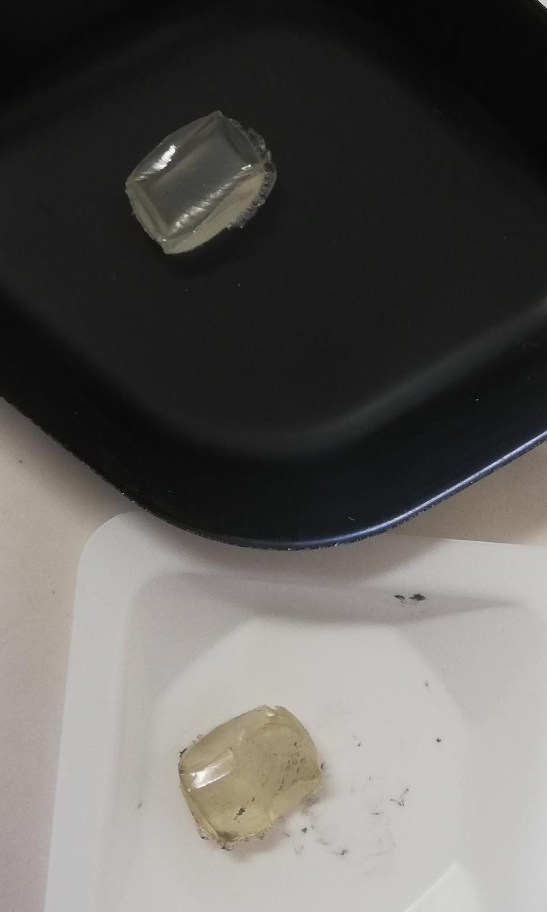
Compression test with Molykote
sample coated and not with Molykote grease under
  5 tons of pressure at 150°C, 1 day
  5 tons of pressure at 80°C, 1 day
→ No PU “gel” formation

Slide 25
Conclusions
Polyurethane type Ester (FTIR)
No hydrolysis (FTIR)
No major chain rupture (TGA)
No big changes in the soft segments (DSC)
Damage of the hydrogen bonding seems to affect strongly the mechanical properties of polyurethanes (FTIR)
Presence of the Molykote grease (FTIR, XRF)
The cause of degradation remains unknown
The main hypothesis for the degradation is the conjunction of pressure, the Molykote grease and time → difficult to reproduce in the laboratory

Slide 26
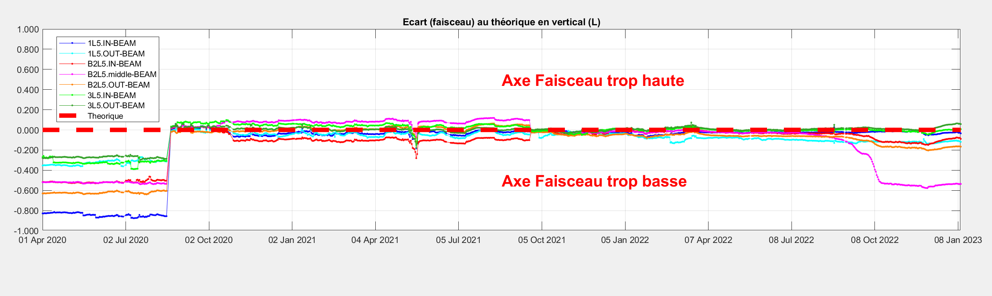
Questions
Why do degraded PU pastilles seem to be mainly at the Q2C position?
What is the peculiarity of the central jack at the Q2C position?
Traceability of the pastilles suppliers (company, PU composition, production process)
Traceability of the pastilles in the tunnel (batch, position)
Data on the strength applied as a function of the degradation observed

Slide 27
Backup-draft slides

Slide 28
General info about degradation of PURs
During degradation, PURs undergo both chain scissions and cross-linking
PUR esters are more sensitive to hydrolysis
PUR ethers are more sensitive to oxidation
https://doi.org/10.1016/j.polymdegradstab.2013.12.018

Slide 29
Starting materials for PURs
Polyols
Isocyanates
Chain extenders (amines, ..)
Vulcanizing agents (sulphur, peroxides)
prepolymers

Slide 30
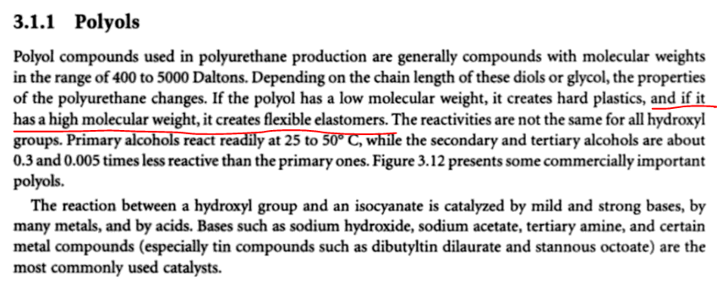
Polyols
Our case: flexible elastomer → a high molecular weight polyol
Info from the book:
https://books.google.ch/books?hl=en&lr=&id=g93wwhc0gr0C&oi=fnd&pg=PA1&ots=zz5w-g6dDk&sig=plvVWzCiCFtUBpRV5j6UFZSlAxM&redir_esc=y#v=onepage&q&f=false

Slide 31
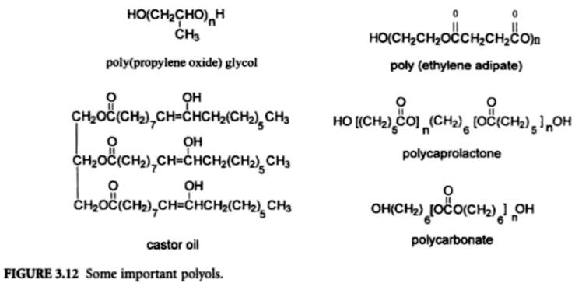
Polyols

Slide 32
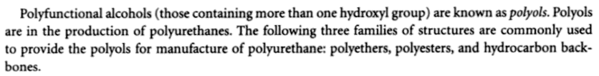
Polyols
NB! The ester or ether nature of a PUR originates from its polyol

Slide 33
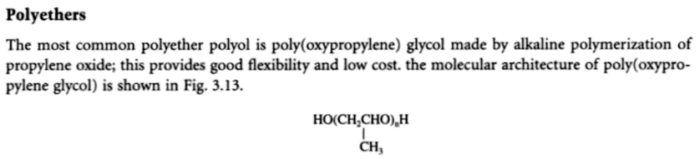
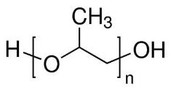
Polyols (polyethers)
Structural formula

Slide 34
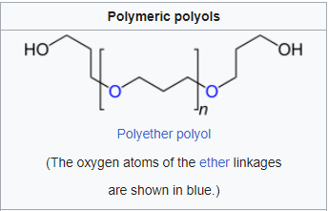
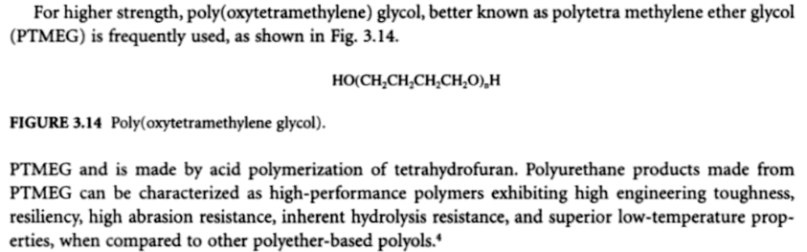
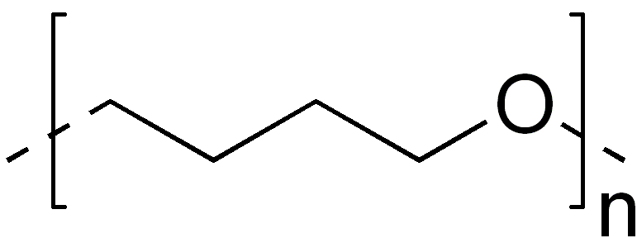
Polyols (polyethers)
Structural formula

Slide 35
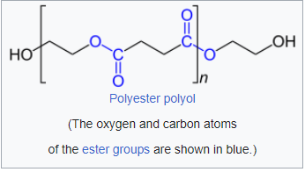
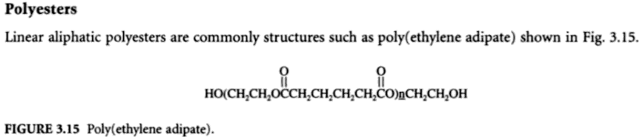
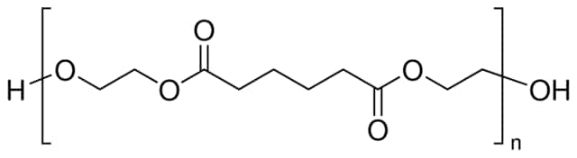
Polyols (polyesters)

Slide 36
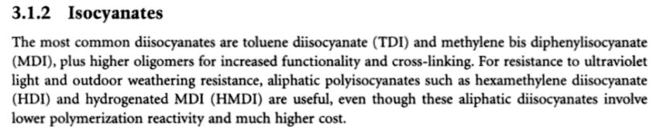
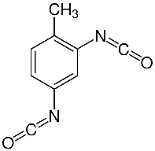

Diisocyanates
MDI
TDI

Slide 37
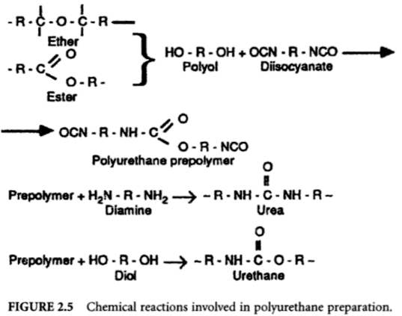
Chemical reactions of PU synthesis

Slide 38
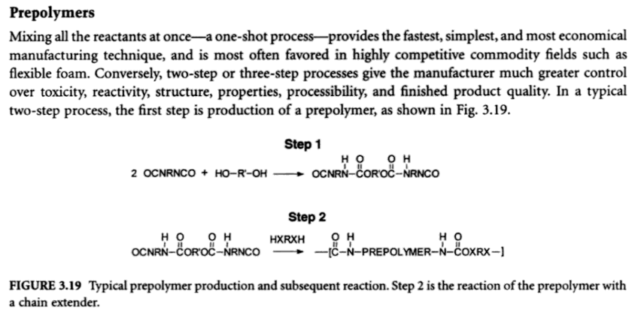

Prepolymers

Slide 39
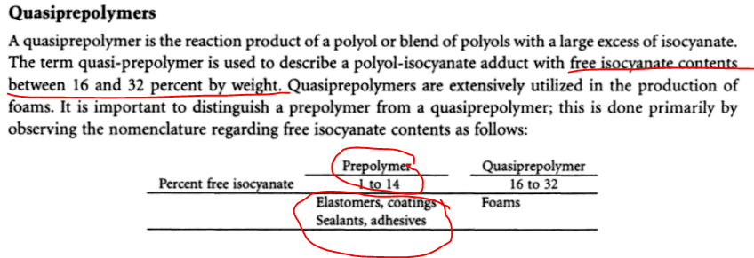
Prepolymers: free isocyanate contents

Slide 40
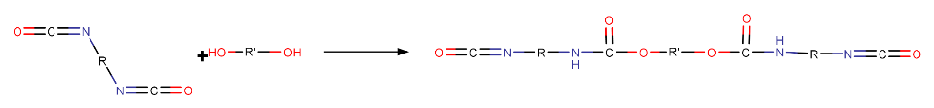

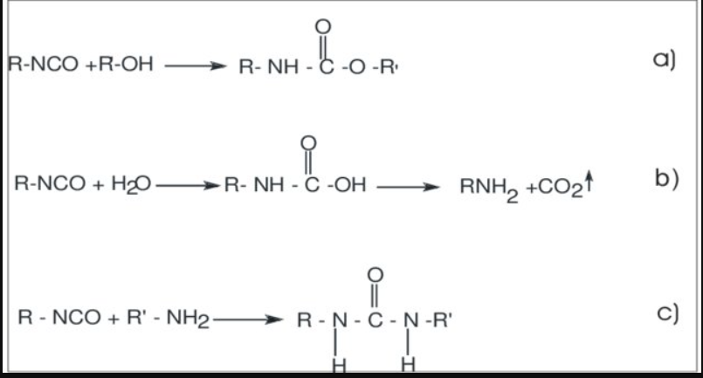
Chain extenders reactions

Slide 41
Soft and hard
“Polyurethanes (PUs) are a class of segmented copolymers composed of soft and hard segments. The soft segment is usually a polyether or polyester polyol while the hard segment is composed of a diisocyanate and chain extender. The soft segment provides elasticity, whereas the hard segment contributes strength and rigidity through physical cross-linking points.”
https://royalsocietypublishing.org/doi/10.1098/rsos.180536

Slide 42
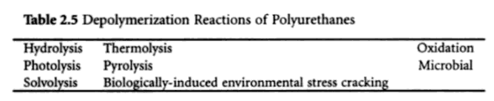
Paths of depolymerizaiton of PUR
From the book

Slide 43
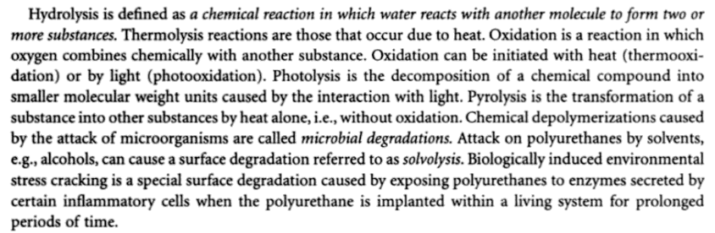
Paths of depolymerizaiton of PUR

Slide 44
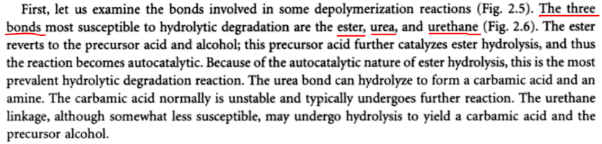







Hydrolysis of PURs
carbamic acid
carbamic acid
ester
urethane
urea

Slide 45


Hydrolysis of PU
Esters have a memorable pattern of three intense peaks at ~1700, ~1200, and ~1100 from the C=O and two C-O stretches, and hence follow what I call the “Rule of Three”
↓ ester [1210-1160] or [1310-1250]
↓ urethane [1540-1520]
↑ [OH]
In general, for saturated esters, this peak falls from 1210 to 1160, whereas for aromatic esters, it falls from 1310 to 1250.
Change in the bond between
carbonyl carbon --- ester oxygen
↓
carbonyl carbon --- hydroxyl oxygen

Slide 46


Additives to polyester PURs for better hydrolysis resistivity

Slide 47

Depolymerisation of PURs:
Chem. nature of the reactants influences hydrolytic stability:
Polycaprolactone glycol (PTMEG is the best)
Isocyanate (MDI > TDI)

Slide 48



FTIR: PURs wavenumbers
In our new sample, we have two C=O peaks!!!
Which became one C=O peak in the “chewing gum” sample
Apparently, there is some change in the neighbouring of the urethane carbonyl

Slide 49

FTIR: hydrogen bonds → amino group

Slide 50
FTIR: hydrogen bonds → amino group
Generally speaking, the N—H groups free from hydrogen bonding have a stretching vibration at 3450 cm-1
the groups involved in hydrogen bonding have much lower frequencies, ranging from 3300 to as low as 3200 cm-1.

Slide 51

FTIR: hydrogen bonds → C=O

Slide 52
FTIR: hydrogen bonds → C=O
The 1732-cm-1 component is assignable to the carbonyls free of hydrogen bonding, and the lower frequency component, at approximately 1703 cm-1, is associated with hydrogen-bonded carbonyls.

Slide 53


Slide 54



Primary, secondary and tertiary…
Primary urethane: if one carbon and two hydrogen atoms are attached to the nitrogen atom
Secondary urethane: if two carbon atoms and one hydrogen atom are attached to the nitrogen atom
Tertiary urethane: if three carbon atoms are attached to the nitrogen atom

Slide 55

FTIR of isocyanates
Diisocyanates: peak is at unusual region ~2277 cm⁻¹
Do PUs depolymerise to diisocyanates?
Do (and can) we observe a peak at 2277 cm⁻¹?

Slide 56

PURs resistance
The Vanderbilt Rubber Handbook: Robert O. Babbit

Slide 57

Paths of depolymerizaiton of PUR
From the article
Recycling of Polyurethane Foams. DOI: https://doi.org/10.1016/B978-0-323-51133-9.00006-1

Slide 58
Phosphorolysis

Slide 59

Degradation Hypothesis: Phosphorolysis
          Can the combined action of molykote grease and compression degrade PURs?
* http://wrap.warwick.ac.uk/112512/1/WRAP-degradation-stabilization-polyurethane-elastomers-Xie-2019.pdf

Slide 60

Phosphorolysis: the article Troev et al.
The exchange reactions proceeding between the ester groups during the synthesis of polyesters[10,11] and the exchange reaction between ester groups of phosphonic acid diesters [12,13] gave grounds for us to assume that the esters of phosphonic (I) and phosphoric (II) acids could also participate in the exchange reactions with ester {-OC(O)-} and urethane {-HN-C(O)-O-} groups.
The results achieved allow us to suggest that: (i) -- other diesters (alkyl and aryl) of phosphonic acid [(RO)2P(O)H, (ArO)2P(O)H], esters of alkyl(aryl)phosphonic acid [(RO)2 P(O)R, (RO)2 P(O)Ph] as well as alkyl (aryl) ester of phosphoric acid [(RO)3 P(O), (ArO)3 P(O)] may also participate in above mentioned reactions; (ii) – all of the above mentioned esters may also degrade polyesters [-C(O)-O-], polycarbonates [O-C(O)-O-] and phosphorylated polyamides [-C(O)-NH-].
We plan to investigate this assumption experimentally.
Zinc bis(O,O-diisobutyl) bis(dithiophosphate)
https://doi.org/10.1016/S0141-3910(99)00105-6
CAS 68457-79-4

Slide 61

Phosphorolysis
What is the FTIR signal for
[NR4]+ group??
(originally a neutral amine
group -NR₃- )
New functional groups formed
with ion bonds

Slide 62

Phosphorolysis
new functional groups in the polymer
with covalent bonding
What is the FTIR signal for
P(O)H(OR)2 group??
originally no P=O bonds in the polymer…

Slide 63
Alcoholysis/glycolysis of PURs

Slide 64

Alcoholysis/glycolysis of PURs
urethane linkages
(keeping the urethane linkages ➔ no many changes to FTIR)
Polymer → oligomers

Slide 65
Devulcanisation and Reclamation

Slide 66

Devulcanisation and Reclamation

Slide 67
Devulcanisation and Reclamation
“Vulcanized rubbers are infusible and insoluble materials with a 3D crosslinked structure (100% gel content), which are difficult to process and reprocess for further compound production. Therefore, these rubbers need to be partially soluble with lower crosslink density, which can be achieved by partially destroying the initial crosslinked structure, giving more chain mobility (molecular freedom). The soluble fraction can interact and bond with the polymer matrix chains. Thermomechanical, thermochemical, ultrasonic, and microwave are common techniques for partial breakup of the crosslinked structure of vulcanized rubbers. Regardless of the method used, there are two concepts related to the process of destroying the crosslinked structure of rubber including devulcanisation and reclamation. Reclamation is based on the scission of C–C bonds in the rubber backbone to reduce the MW and obtain some plasticity. On the other hand, devulcanisation is the specific cleavage of S–S and C–S bonds, partially destroying the 3D network to produce plasticity.
In an ideal devulcanisation process, the rubber backbone should not be damaged. However, selective breakup of the crosslinked structure inside vulcanized rubber is not possible without damaging some C–C bonds in the backbone. Table 3 reports the energy required for breaking the different bonds of crosslinked rubbers. In general, reclamation and devulcanisation might occur at the same time, making their differentiation difficult in a specific process (Figure 14) [1].“
Materials 2020, 13, 782; doi:10.3390/ma13030782
“Produce plasticity” !!! Our PUR sample also became more plastic!!

Slide 68

Thermolysis of PU

Slide 69

FTIR: hydrolysis
Fact: hydrolysis = OH buildup
C=O constant
Idea: should we also use the ratio C=O/OH?

