Slide 1
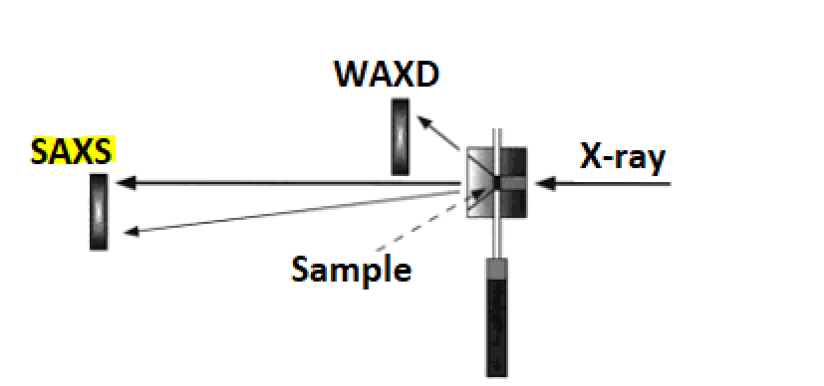
Polyurethane (PU) XRD Analysis
X-Ray Diffraction (XRD) is a non-destructive technique used to identify crystalline phases and orientation, as well as determine structural properties such as lattice parameters, strain, grain size, epitaxy, phase composition, and preferred orientation.
In this study, reference (solid) and damaged (viscous) PU samples have been analysed by XRD in Bragg-Brentano (BB) geometry to highlight potential differences in phase identification. In the XRD-BB configuration, the diffracted signal comes from a depth of a few micrometers within the inspected sample. The obtained XRD-BB diffractograms are shown in the following slides.
Our XRD system allows to explore Small-Angle X-ray Scattering (SAXS) as well, widely used in polymer laboratories. This technique complements XRD by detecting scattering from a few degrees down to a few hundredths of a degree between the X-ray beam and the sample surface. This enables investigation of the "nano" region, ranging from a few tens to several hundreds or thousands of angstroms with appropriate optics. SAXS patterns offer insights into the structural ordering of both crystalline and non-crystalline features, resulting from inhomogeneities in the distribution of electrons in the studied material. These differences may arise between inclusions and the surrounding matrix, between types of atoms in a chemical compound, or between individual molecules or molecular assemblies.

Slide 2
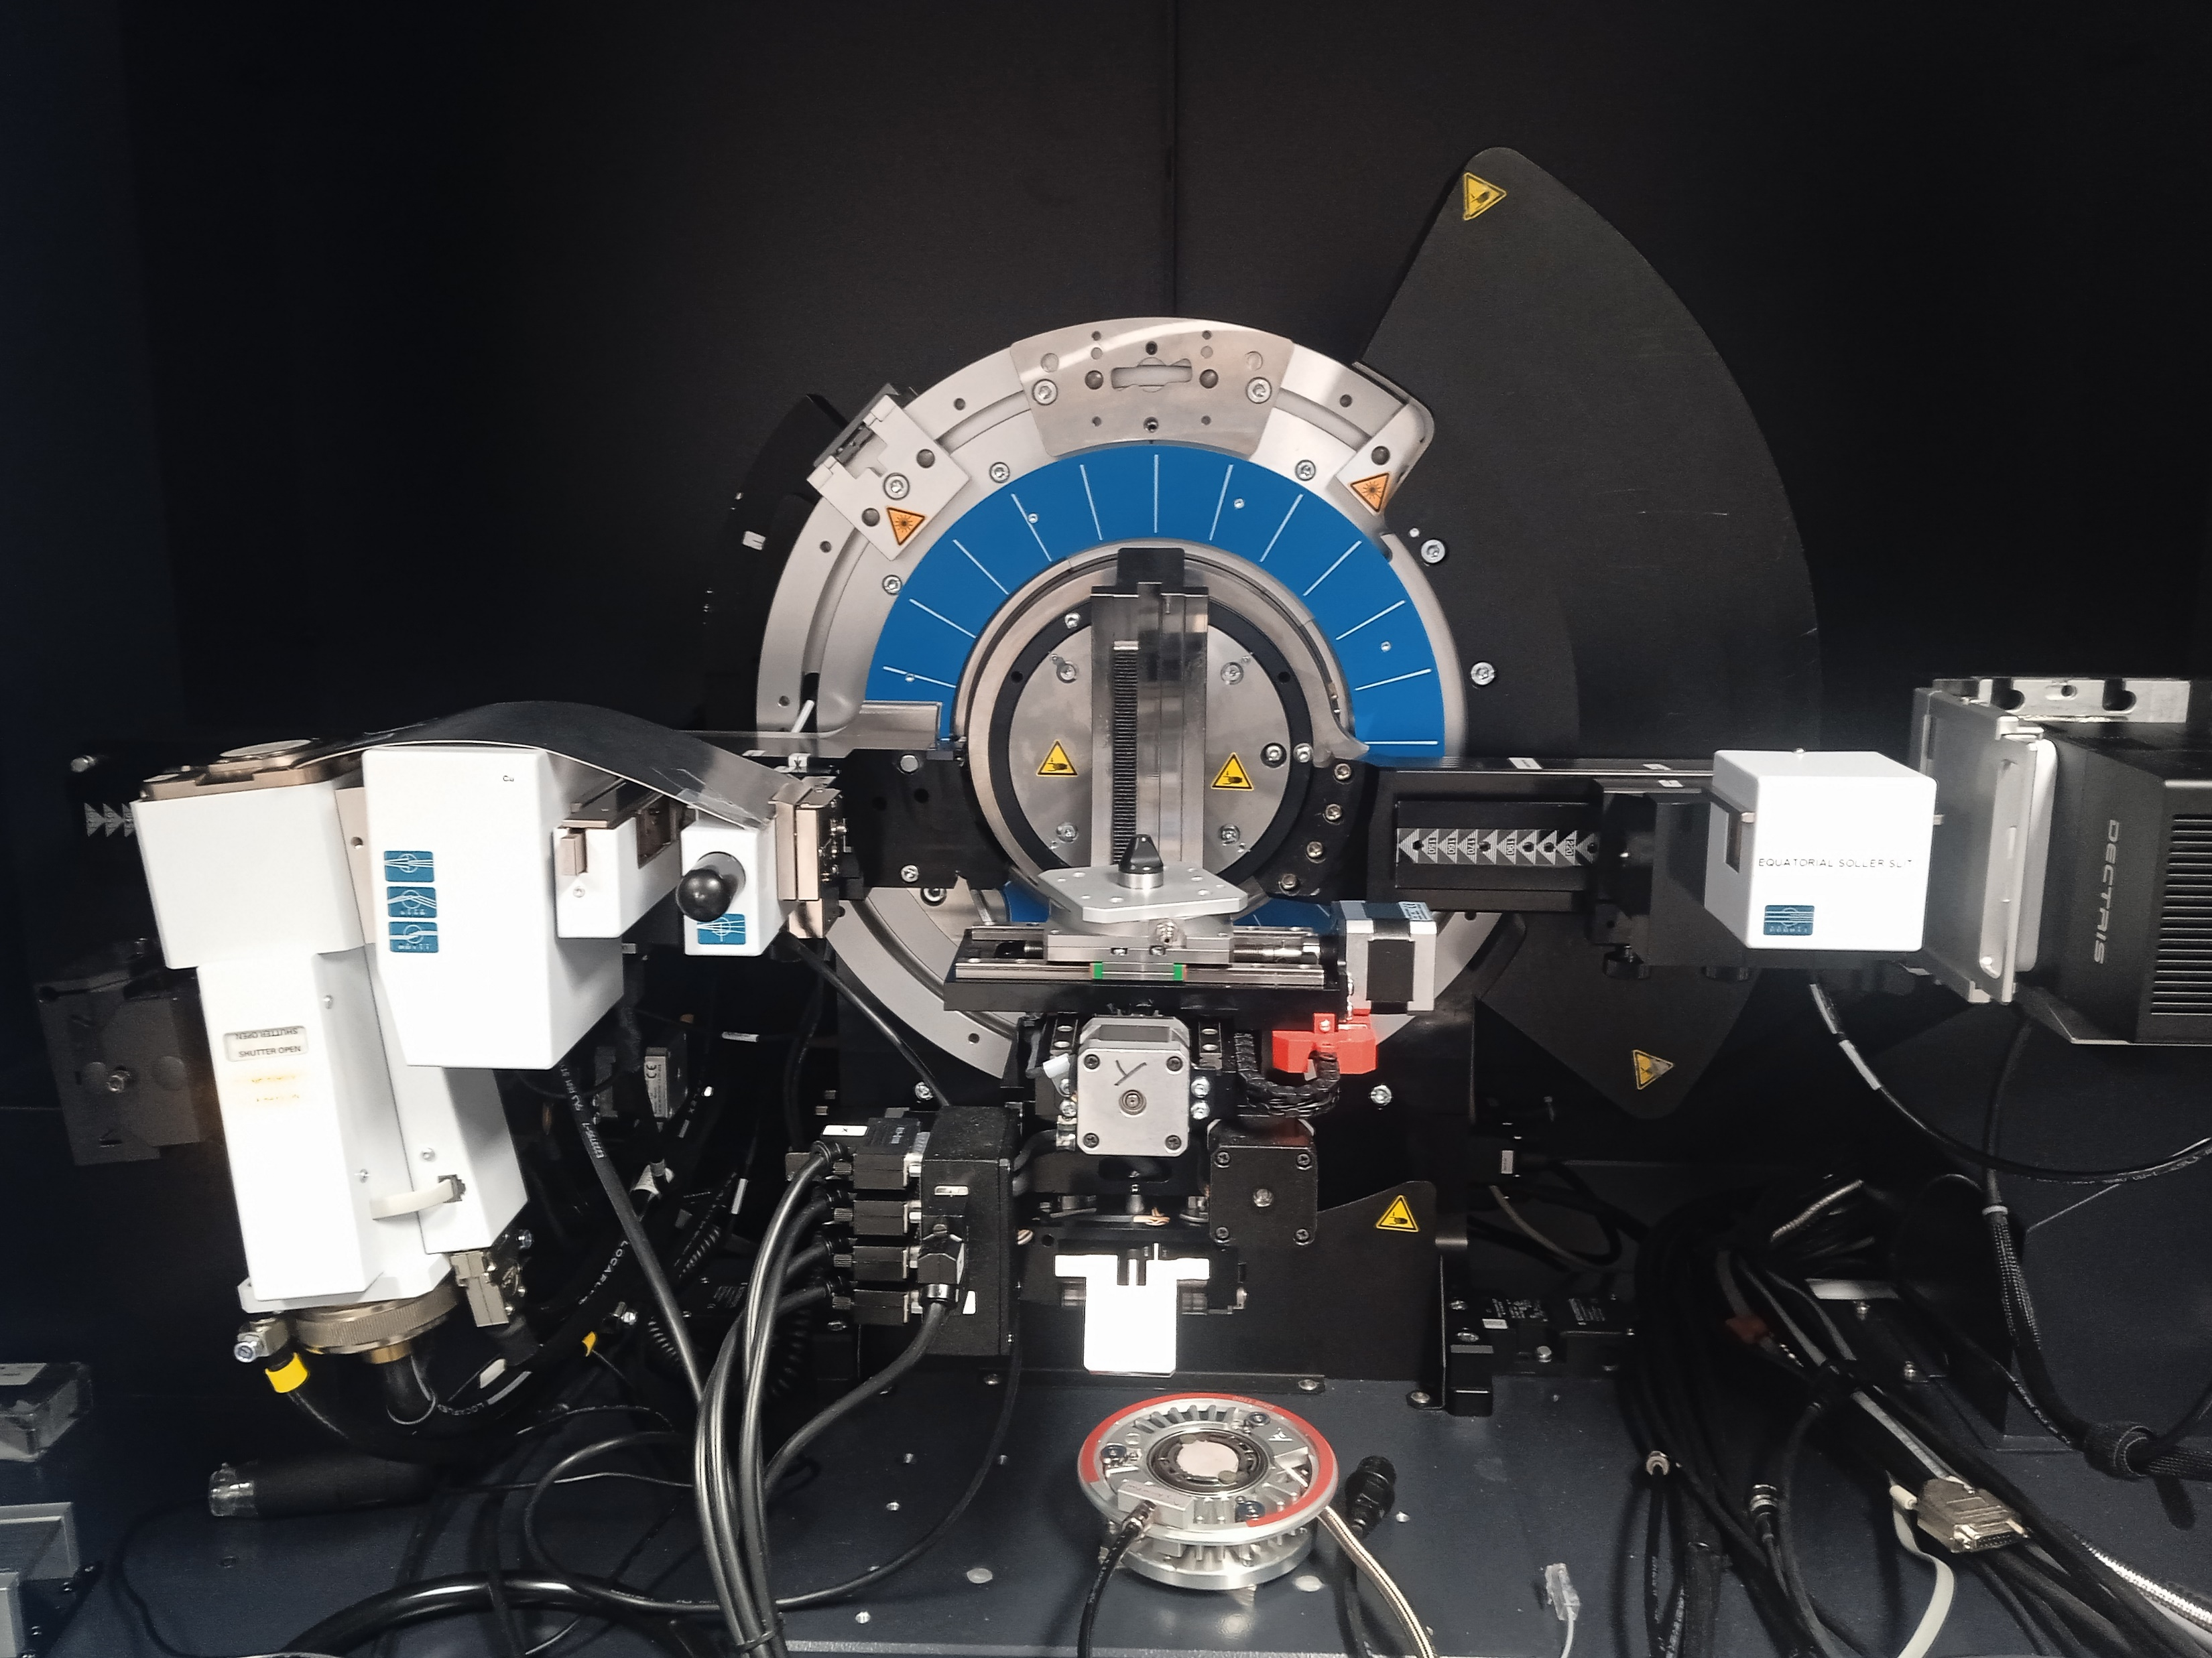
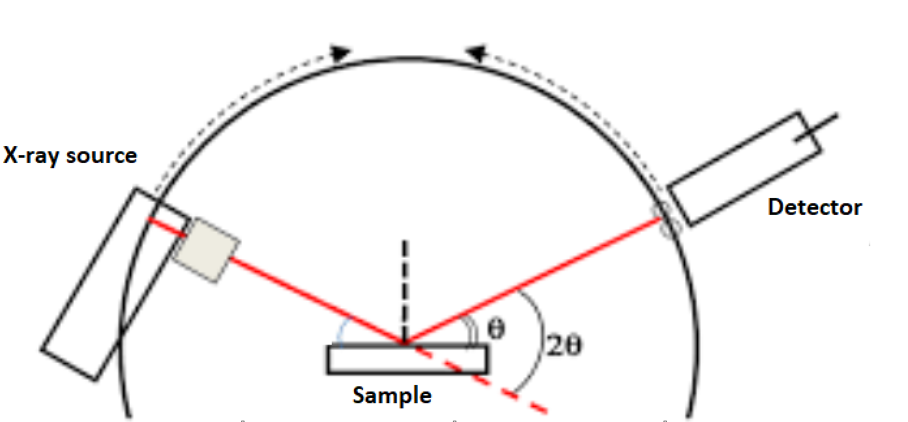
XRD-BB Analysis - System parameters
In the XRD-BB configuration, the X-Rays source and the detector move together in the so called “coupled Theta/2Theta” scan.
Configuration | X-ray source | Tube | V (kV) I (mA) | Detector Mode | Detector | Detector window (mm x mm) | Sample-Detector Distance (SDD in mm) | Optics
Bragg-Brentano | Cu line focus | Cu with 1.54 [Å] | 40 40 | 1D | γ-optimized | 74.9 x 35.4 | 355.2 | Motorized slit: OpeningDegree (0.30 °)
Filter | Scan type | 2Theta range (°) | Absorber | Time/step (s) | Increment (°) | Sample preparation | Software for cryst. phase and chem. composition identification
Ni0.02 | Coupled Theta/2Theta | 12-80 | 1 | 1 | 0.020 | Specimens were cut before analysis | EVA + PDF database

Slide 3
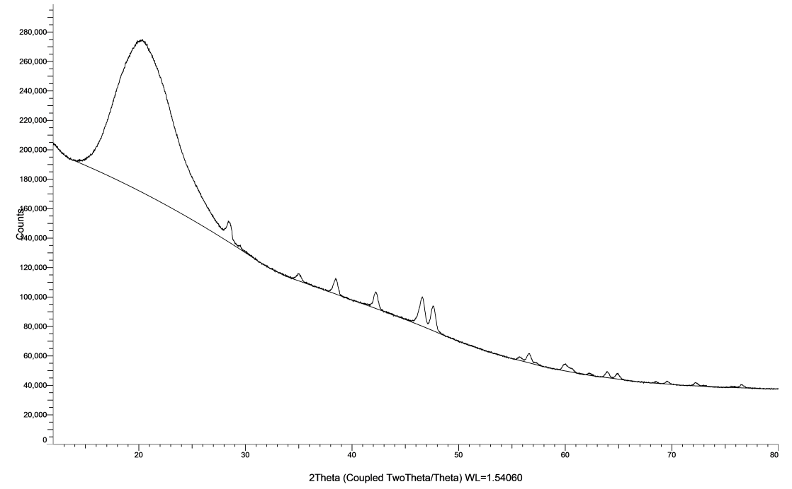
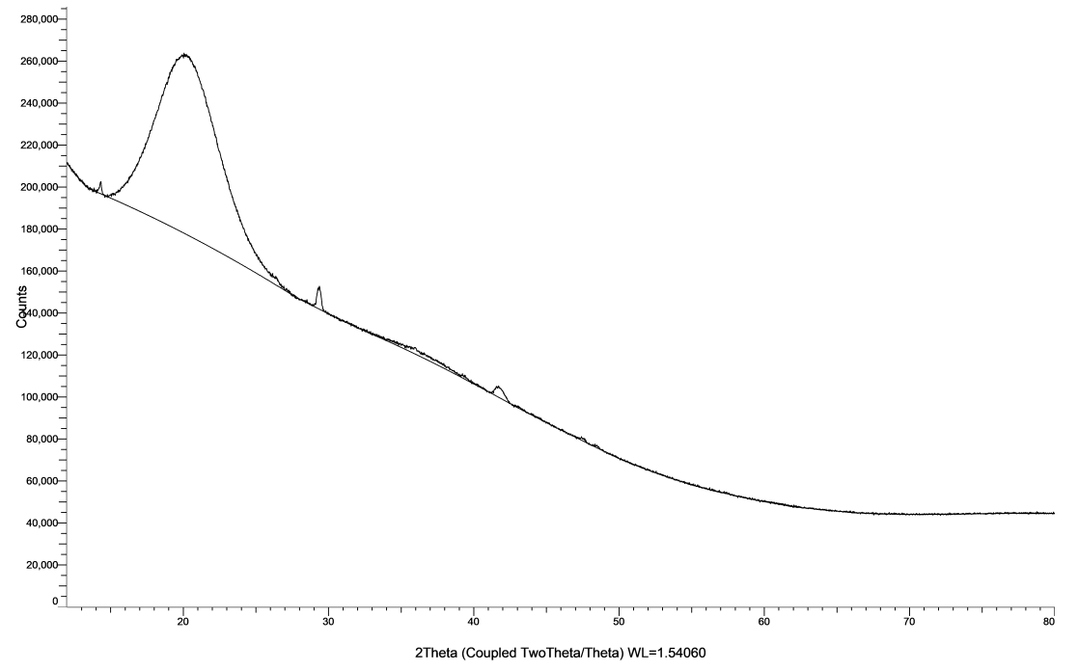
XRD-BB Results
PU - Reference
PU - Damaged
The performed XRD-BB measurements reveled similar diffractograms for both the reference and damaged PU - The initial large peak (2Theta between 15° and 30°), representing amorphous phase, is linked to the presence of PU material. Additional small peaks (2Theta from 25°) are of uncertain nature and likely related to the sample holder material and/or dirt in the specimen.

Slide 4
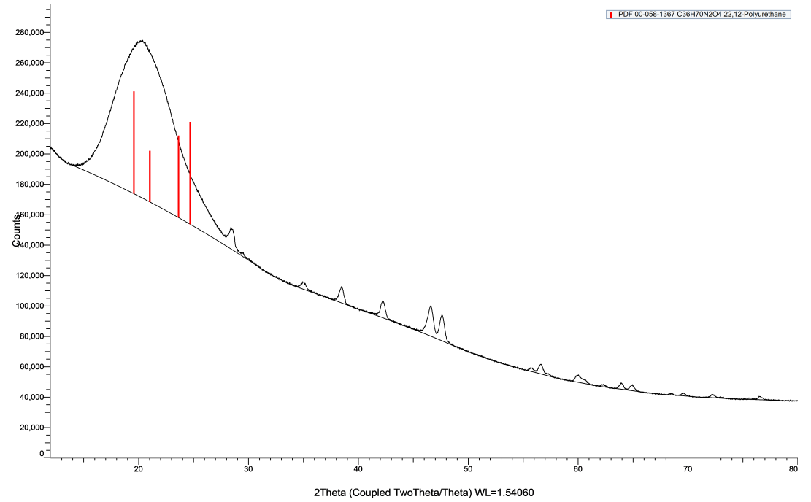
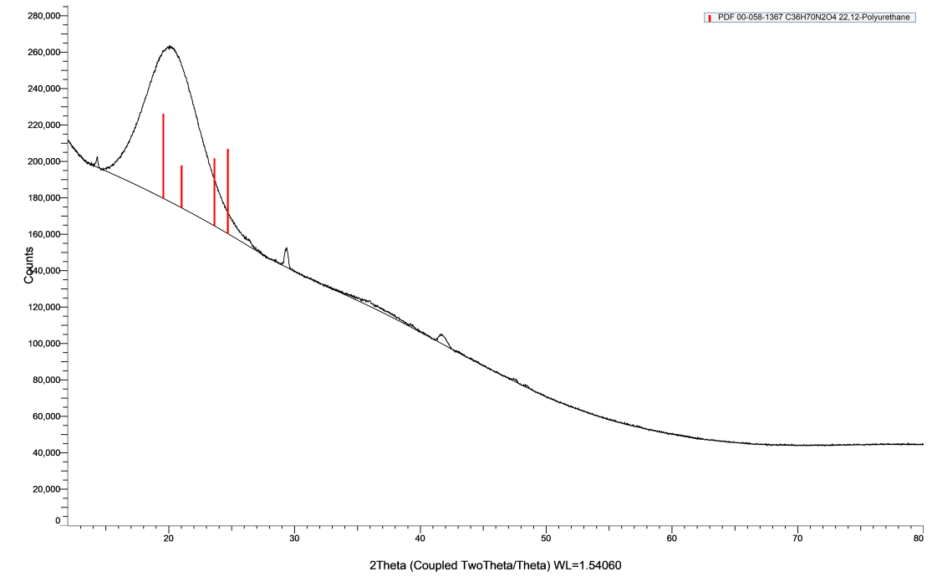
XRD-BB Results
PU - Reference
PU - Damaged
The performed XRD-BB measurements reveled similar diffractograms for both the reference and damaged PU - The initial large peak (2Theta between 15° and 30°), representing amorphous phase, is linked to the presence of PU material. Additional small peaks (2Theta from 25°) are of uncertain nature and likely related to the sample holder material and/or dirt in the specimen.

Slide 5
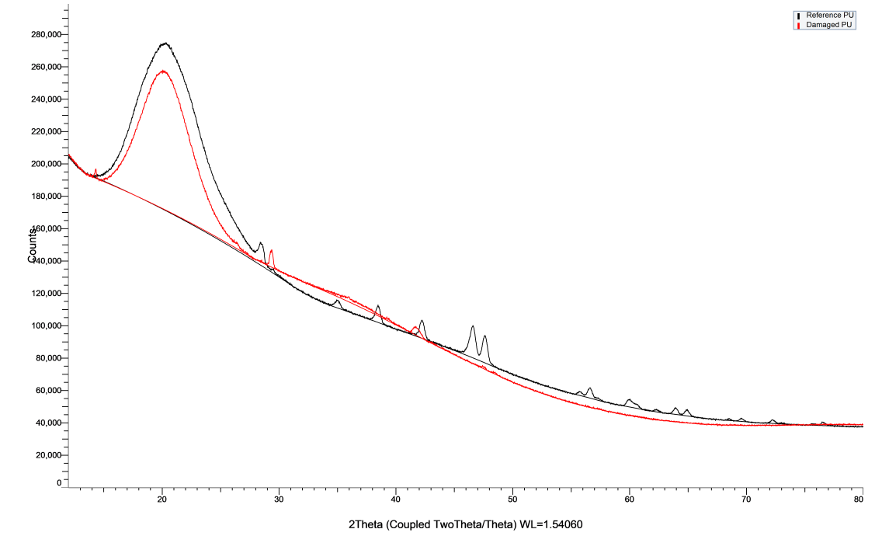
XRD-BB Results
The background signal in X-ray diffraction analysis can arise from various sources, such as the sample itself (e.g., amorphous phase), the instrument (e.g., sample holder), or air scattering.
Differences in the background signal between two specimens could be attributed to the system alignment or the sample shape (in this case, the surface of the damaged PU was difficult to keep flat).
At present, no clear conclusions can be made.
It is recommended to explore the SAXS technique for both new and used PU samples.

Slide 6
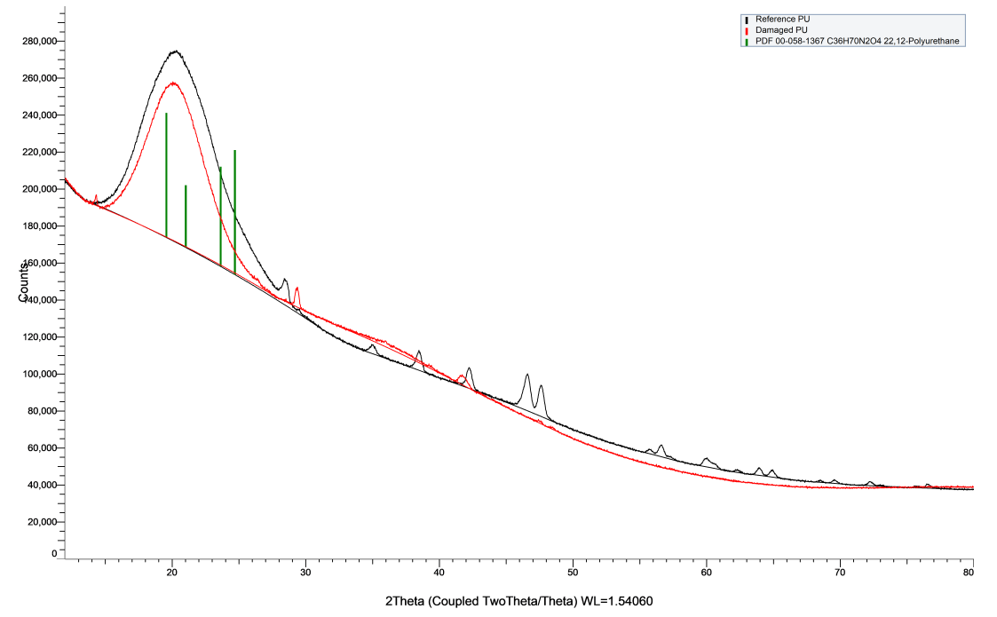
XRD-BB Results
The background signal in X-ray diffraction analysis can arise from various sources, such as the sample itself (e.g., amorphous phase), the instrument (e.g., sample holder), or air scattering.
Differences in the background signal between two specimens could be attributed to the system alignment or the sample shape (in this case, the surface of the damaged PU was difficult to keep flat).
At present, no clear conclusions can be made.
It is recommended to explore the SAXS technique for both new and used PU samples.

Slide 7
home.cern

Slide 8
