Slide 1

MTF Structures
EDMS: 2808678
Project Office – Procurement, Baseline Documentation, Quality & Risk Office
Lorcan Quain Solís
Procurement, Baseline Documentation, Quality & Risk Office

Slide 2
Summary
Equipment vs Batch;
Attaching children assets;
Detaching children assets;
Common errors;

Slide 3
Summary
Equipment vs Batch;
Attaching children assets;
Detaching children assets;
Common errors;

Slide 4

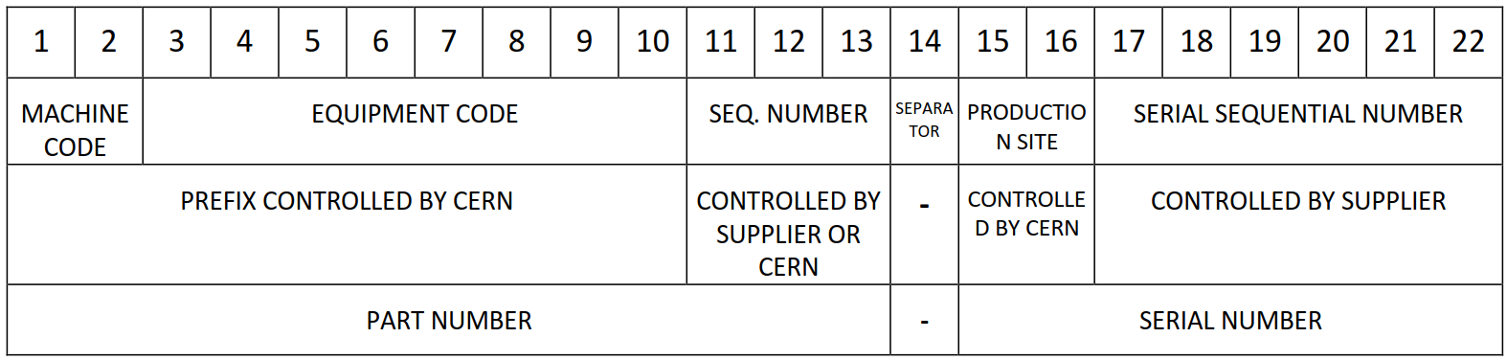
Assets
Assets represent the real pieces or assemblies that are being manufactured.
All the manufacturing documentation (metrological reports, material certificates, manufacturing reports…) are linked to the assets through the MTF interface.
They include a series of manufacturing steps to track the progress of the production.
Assets can be of two types: individual equipment or batches.
The code includes information about the item, the manufacturer, and a sequential number differentiating the assets with the same item and manufacturer:

Slide 5
Equipment vs batch
Individual equipment:
One unique asset code per unit, units traced individually
Specific documents and manufacturing steps for each piece / assembly
Usually for more complex pieces produced in low numbers
Can only be attached to 1 place (asset / batch / location)
Example: a coil (individual MIP, tests…) or an end plate with a specific dimensional control.
Batch:
A group of units share the same code, units traced as a lot
All the pieces in the batch have common documents and manufacturing steps
Usually for simple pieces that are manufactured in series
Can be attached in many places (different units used in different assemblies)
Example: a set of shims or a set of collars that share the same material certificate and have a single dimensional control report that includes all the units in the batch

Slide 6
Summary
Equipment vs Batch;
Attaching children assets;
Detaching children assets;
Common errors;

Slide 7
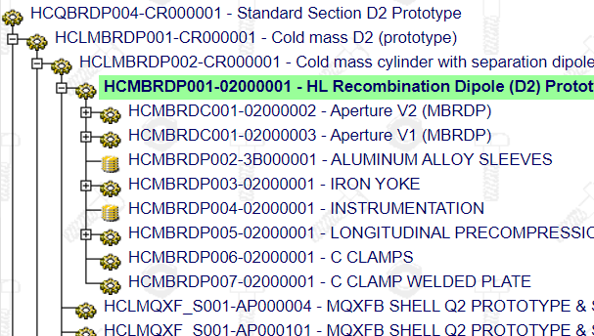
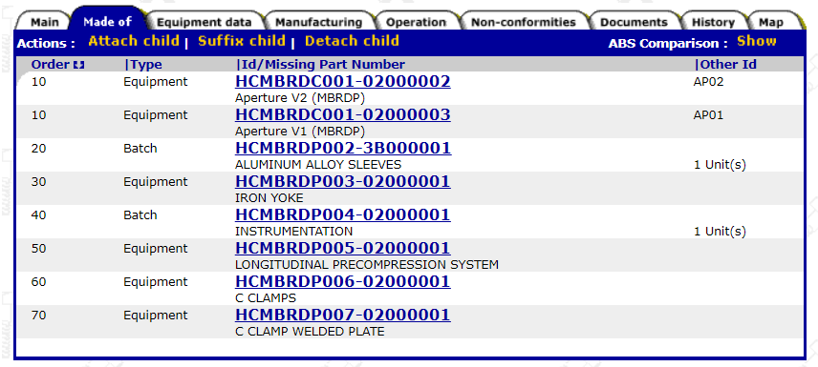
Assembly Breakdown Structure
Assembly Breakdown Structure (ABS)
The ABS is used to keep traceability of the components that are used to build an assembly. In MTF its is represented as a tree structure in which the different assets can have children assets.
The children assets of a particular asset can be found in the tab “Made of”:

Slide 8
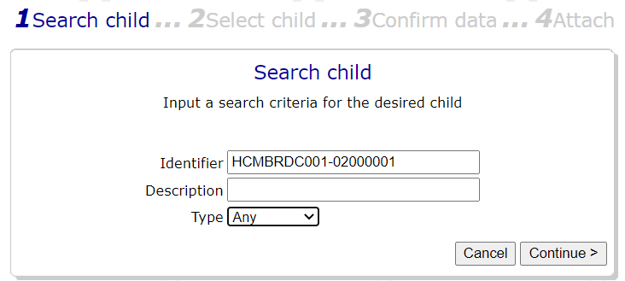
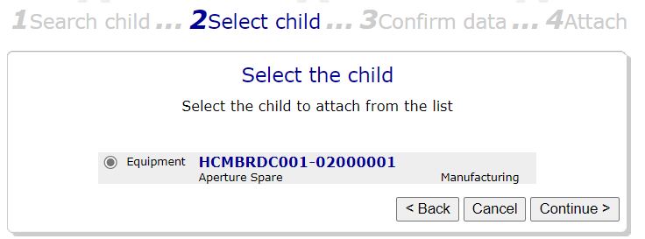
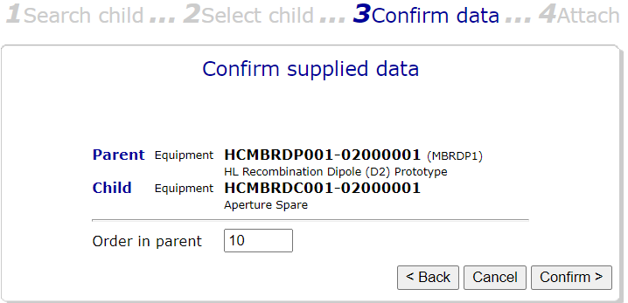
Attaching children assets I
Go to the parent asset
In “Made of” click on “Attach child”
Paste the code of the children asset in the “Identifier” field
Select the child asset that will be attached
2
3
4
Order of children in the MTF tree. Default taken from Item structure.

Slide 9
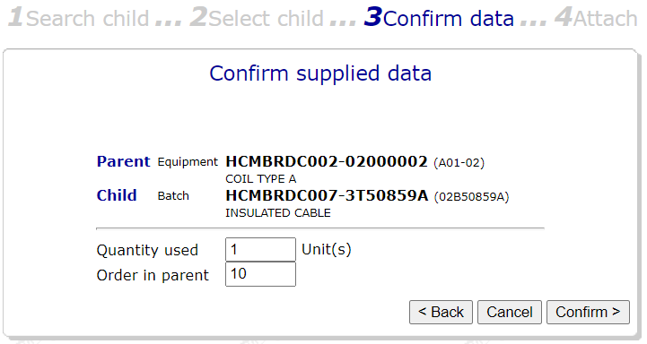
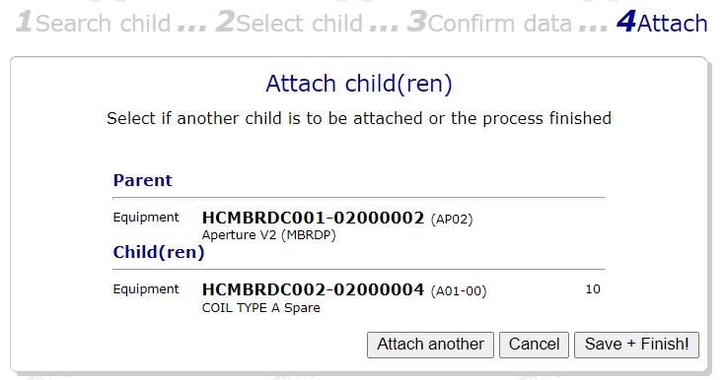

Attaching children assets II
“Save+Finish!” if finished or “Attach another” if more children assets have to be attached (back to step 1)
For children batches: number of units from the batch used for this parent asset (just for information, not used very often)
5
Check in detail the code and description of the parent asset! There is a bug in MTF that swaps the parent asset with other assets that you may have open in other browser tabs.
If this happens, cancel the attachment and start from scratch by searching for the parent asset again.

Slide 10
Summary
Equipment vs Batch;
Attaching children assets;
Detaching children assets;
Common errors;

Slide 11
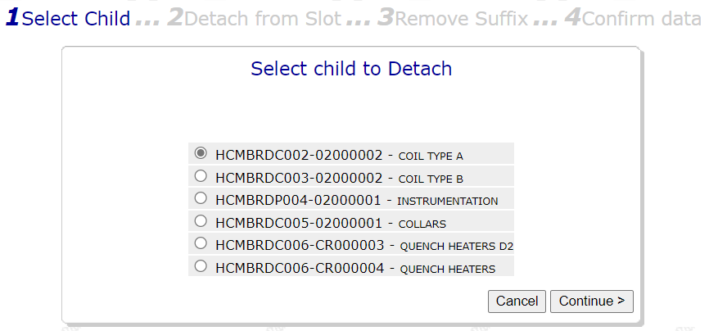

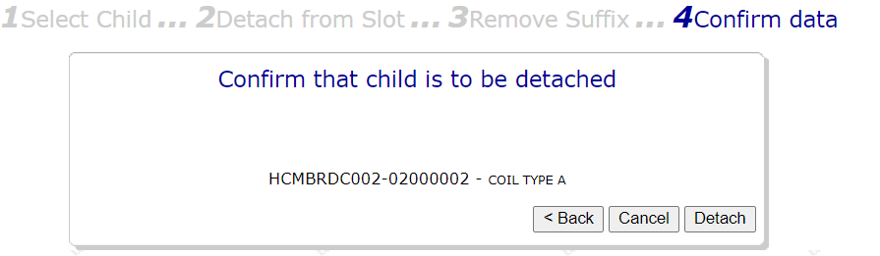
Detaching children assets I
Go to the parent asset
In “Made of” click on “Detach child”
Select the child asset to be detached
Click “Detach” to finalise the detachment
2
3
4

Slide 12
Summary
Equipment vs Batch;
Attaching children assets;
Detaching children assets;
Common errors;

Slide 13
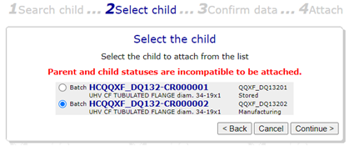
Incompatible status
If when trying to attach a child asset you get an error similar to the one in the screenshot below, it is probably due to the status of the parent or child asset. If the location of any of them is in a CERN store, you will see this error when trying to edit the MTF structure. If this happens, please get in contact will the HL-LHC quality team (hi-lumi-lhc-pdqr@cern.ch).
For any other error messages, please also get in contact with the Quality Team so that we can check each case.

Slide 14
Thanks

