Slide 1
Series production
HL-LHC PDQR Office
EDMS 2895509

Slide 2
Series production
We are now moving to Series production for cryomodules (for the Cavities, it was already the case)
The equipment will be installed in the LHC machine so we need to have proper traceability in terms of components and documentation
The approach is the the same as for the prototypes, but it will be more demanding as there will be several items built in parallel
Quality activities to go in line with production

Slide 3
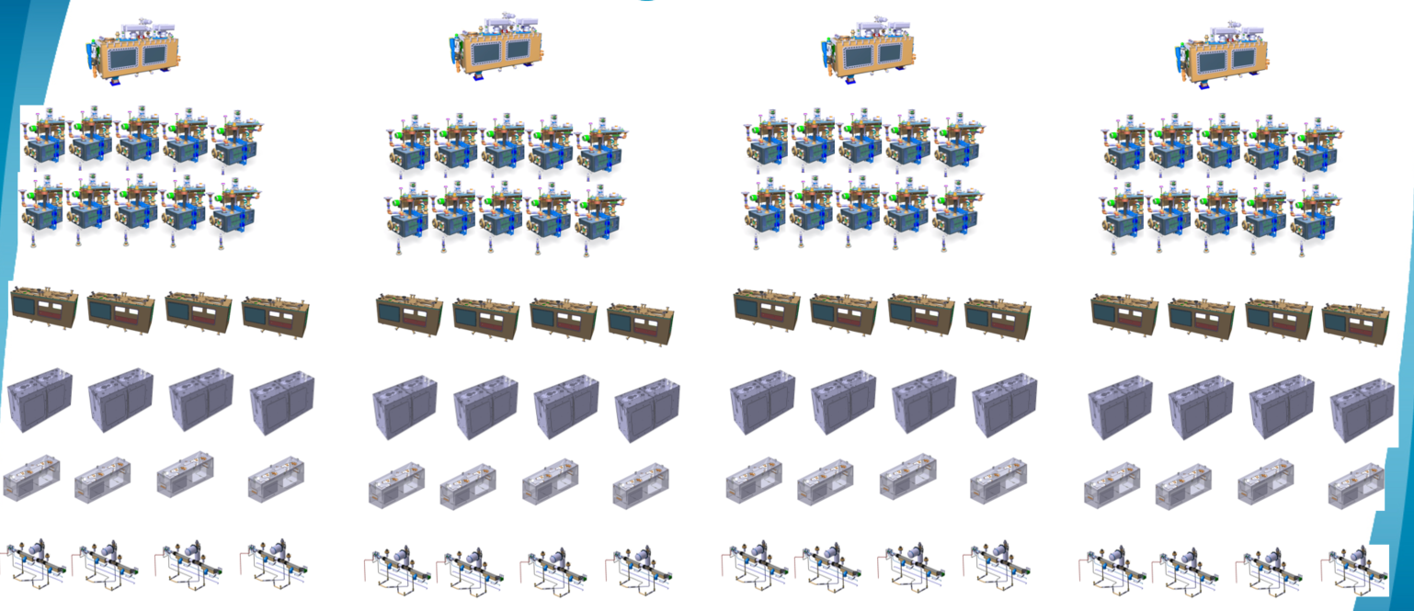
What goes where

Slide 4
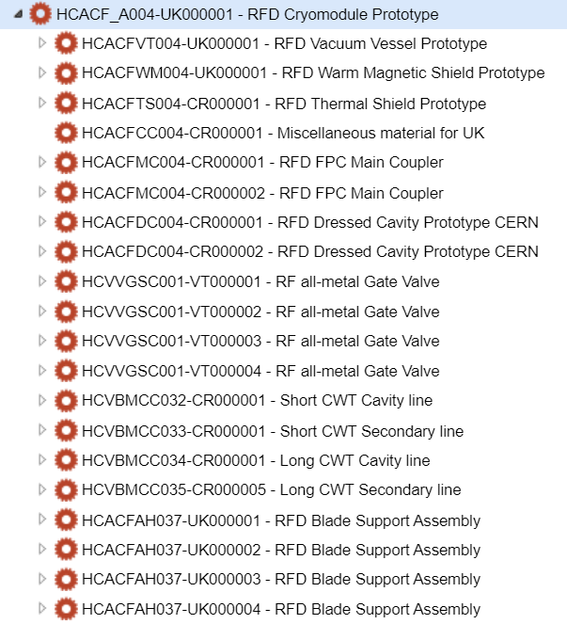
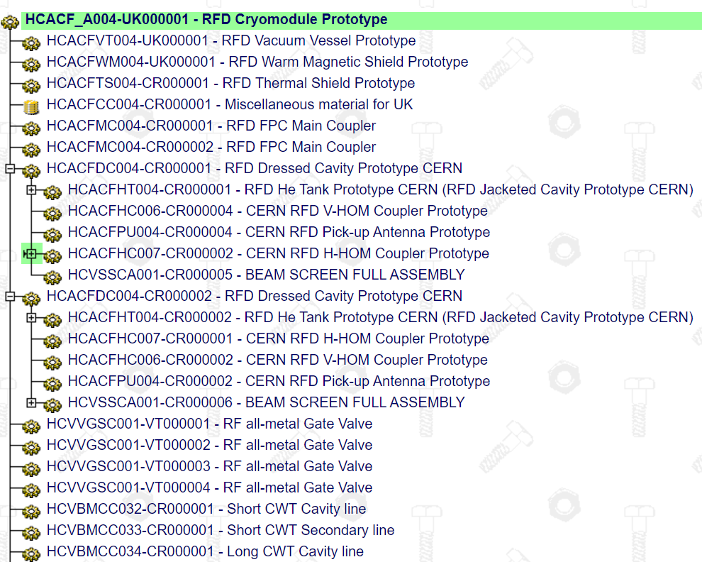
What goes where
MTF used to grant the traceability of the equipment and sub-equipment (Serial numbers)
People on site should provide the inputs in terms of components usability
Documentation to be attached to the step of the corresponding asset
Documentation/manufacturing data is to be provided on regular bases and not at the end of production

Slide 5
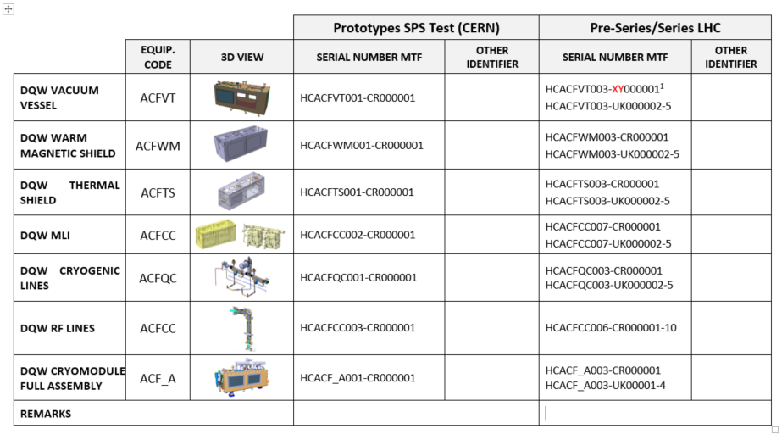
What we need from you to create the assets
In principle, the components to be traced will be similar to the RFD Cryomodule prototype
In addition to the ‘main’ cryomodule components, other ones can also be traced (supports for instance were also issued in MTF for the RFD Cryomodule) – This is to be defined in the BOM
Serial numbers (MTF identification) is already foreseen for Vacuum Vessels, WMS, Thermal Shield, MLI, Cryogenic Lines main assembly and Cryomodule Assembly)

Slide 6
What we need from you to create the assets
MTF assets are created by us (PDQR Office)
N° assets for main components is known
Serial numbers are foreseen
Access rights (EDMS Group) is by default HL-LHC-WP4-UK-MTF (we will make sure you all are inside and have the proper rights)
….so what we need from you?
  Production Workflow, which shall be based on an approved Manufacturing and Inspection Plan (MIP)

Slide 7
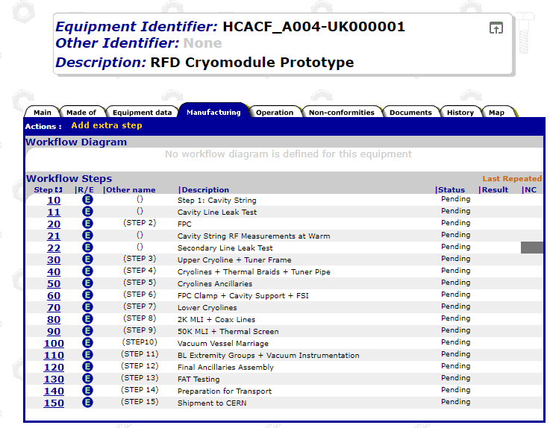
What we need from you to create the assets
The workflow is to be defined beforehand for proper implementation
This workflow is settled based on the Manufacturing and Inspection Plan and in agreement with WP4 colleagues
Steps to be implemented based on the production and inspection steps (normally there is a document to be provided)
Extra steps shall only be added for activities that were not foreseen or due to a NCR which requires to repeat step(s)

Slide 8
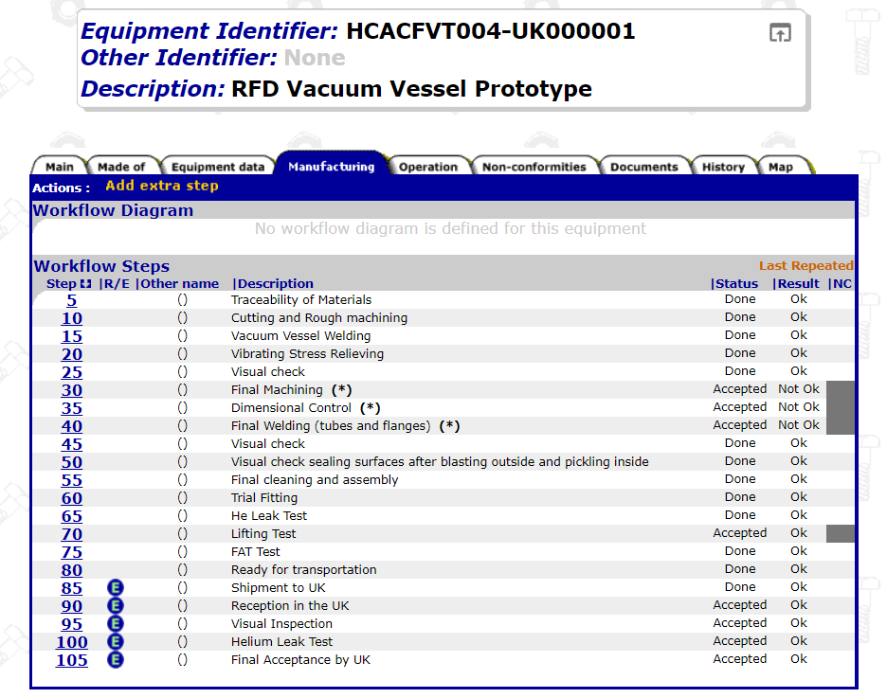
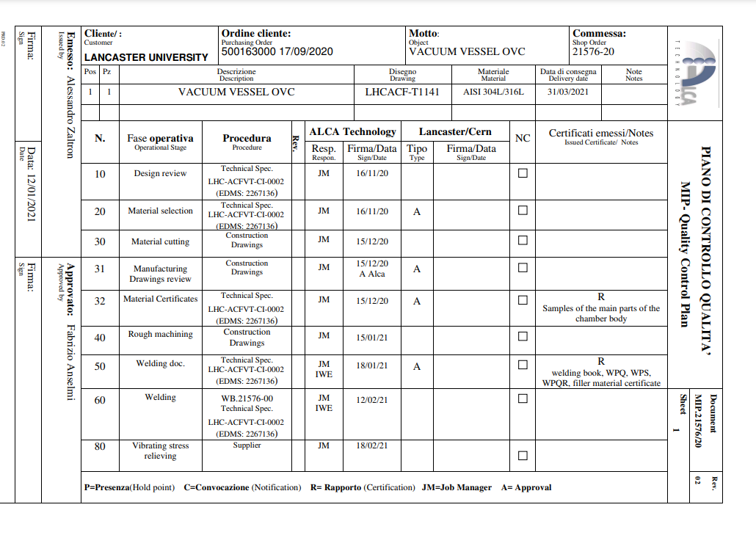
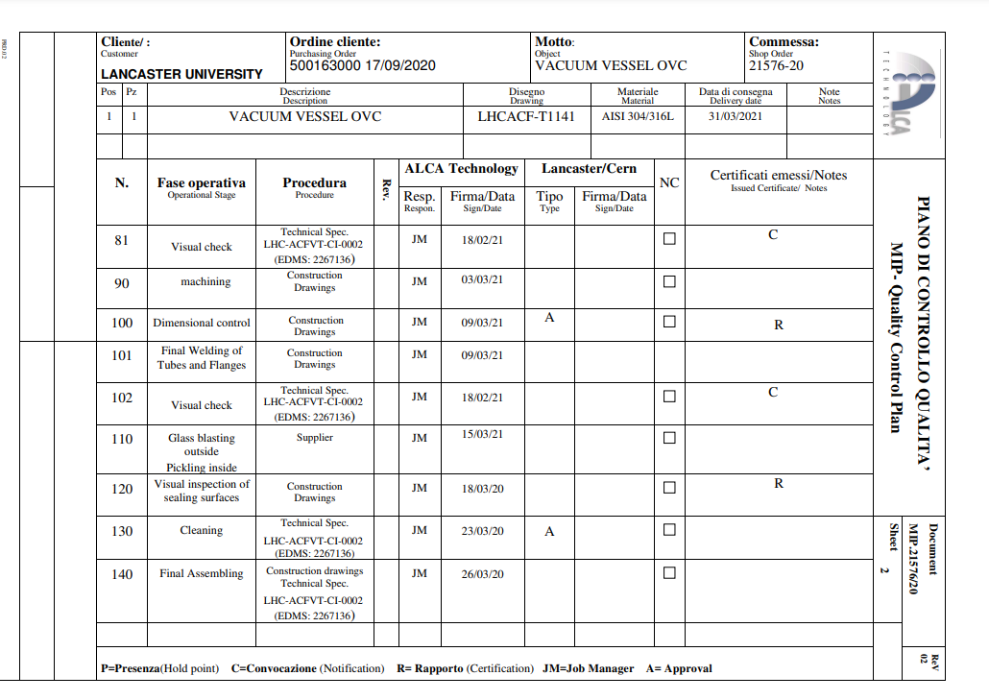
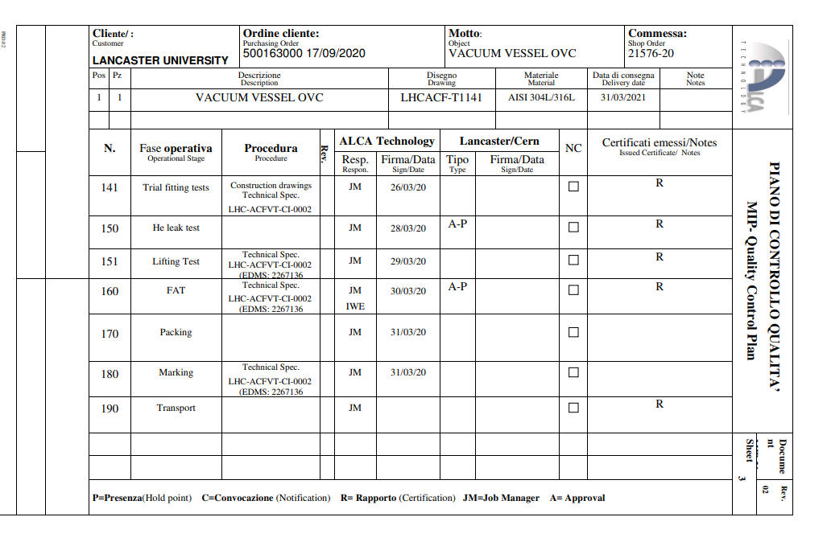
What we need from you to create the assets

Slide 9
Conclusions
We are moving to Series production, and we need to be even more attentive to the QA/QC activities (much more demanding that building just one cryomodule)
Proper traceability is a must – What goes where / What is the equipment made of
Regular reporting during production including NCRs (which should be taken as a learning process and improvement)
You are responsible to upload the documentation and close the steps unless a step is set as HOLD POINT. Then it is up to CERN to give clearance and close the step.

Slide 10

Thank you for your attention

