Slide 1

CERF
CERN-EU high-energy Reference Field facility
Robert FROESCHL, Fabio POZZI, Marco TISI
HSE/RP-AS
PS/SPS User Meetings · Indico (cern.ch) 11/05/2023

Slide 2
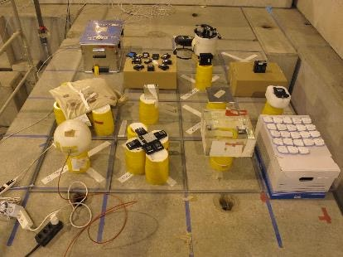
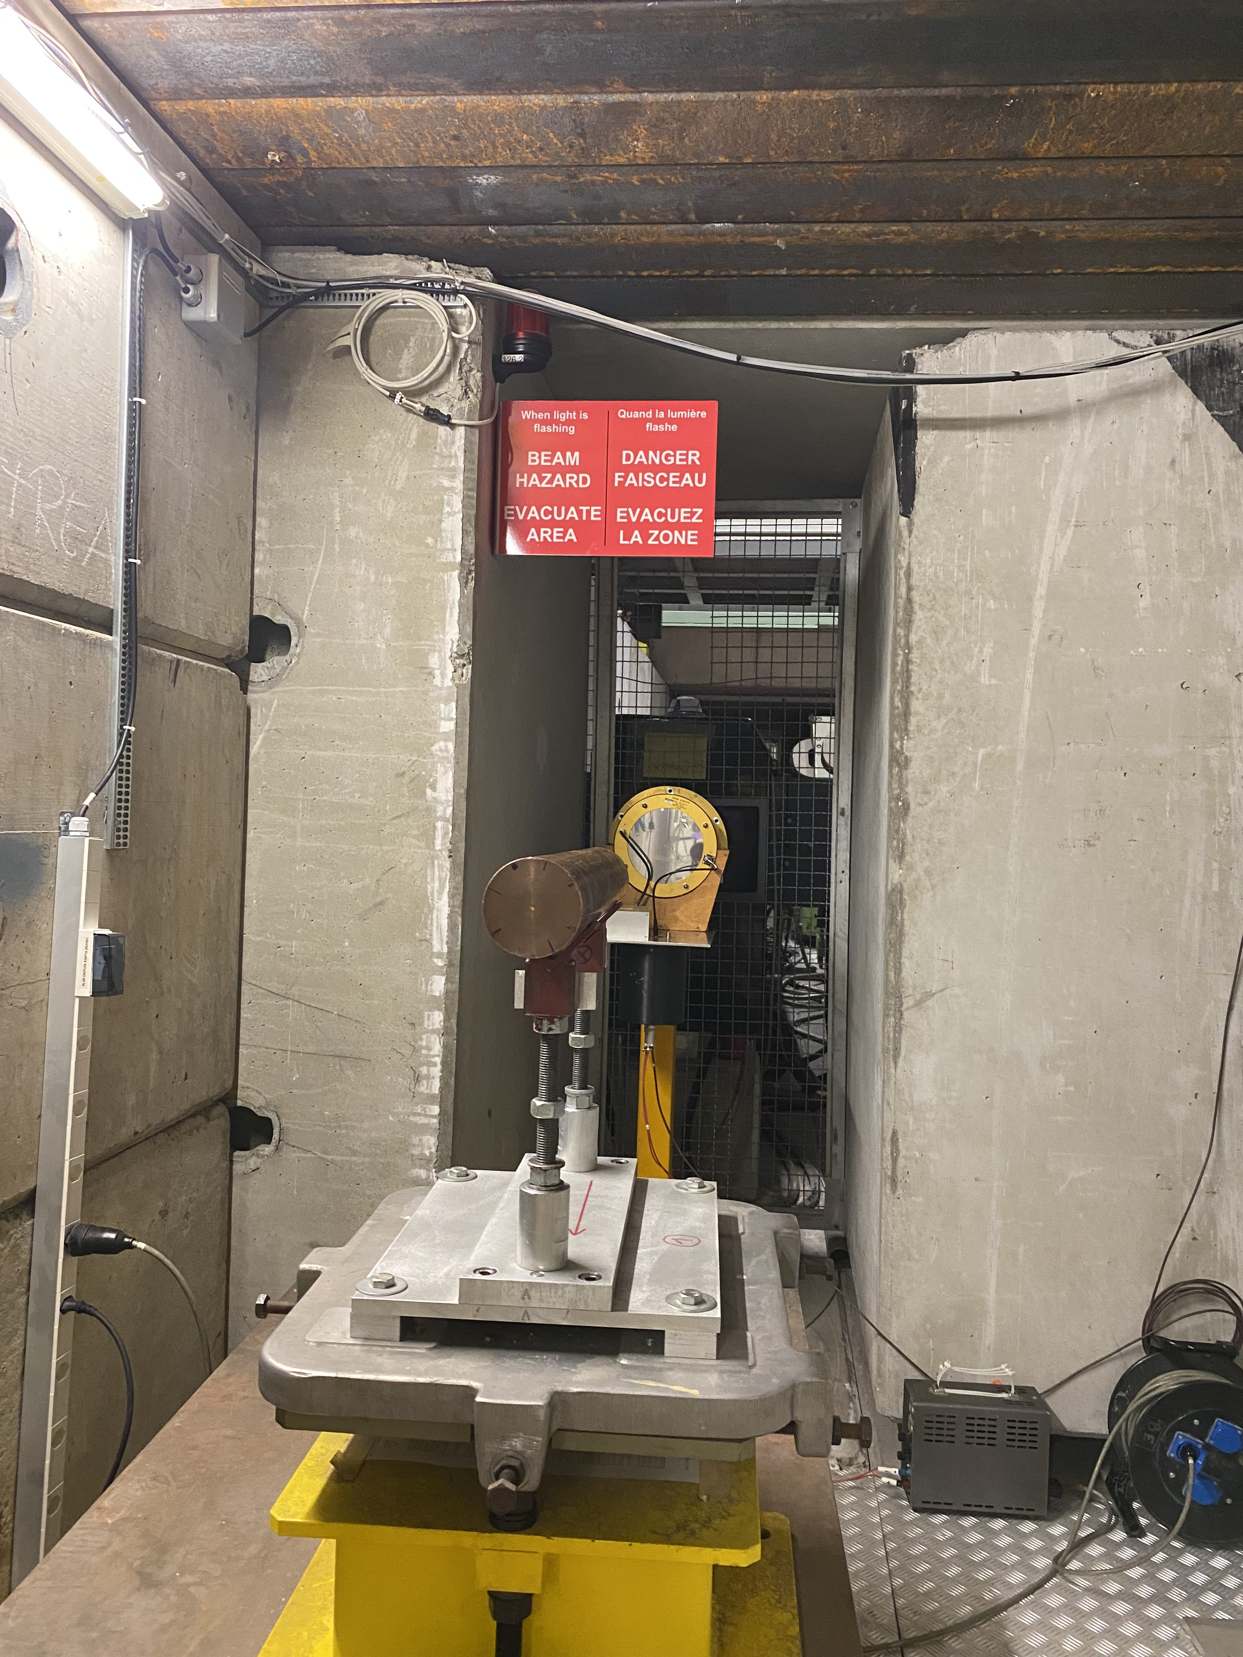
Physics goal
Unique field calibration facility for radiation protection instrumentation used at high-energy accelerators
Simulated workplace field to determine the response of detectors and dosimeters used around high-energy accelerators and for air-crew dosimetry
In the past years CERF had several users from universities, research centres, private companies and CERN groups

Slide 3
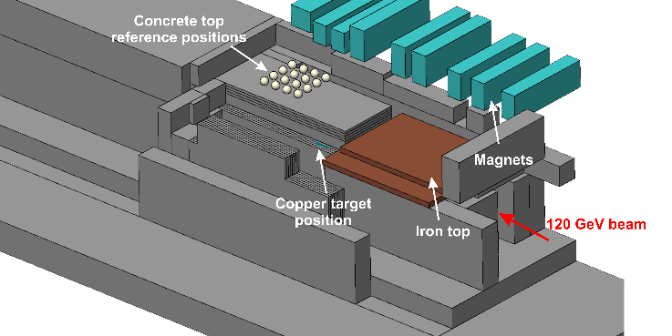

Installation and typical beam parameters
H6 (PPE126)
120 GeV/c positive hadron beam (2/3 pions + 1/3 protons)
Typical beam intensities: 10⁶-10⁸ particles per spill
Target:
  Diameter = 7 cm
  Length = 50 cm

Slide 4







Important info for H6 downstream users
CERF run 2023: from Wed 10/05 till Wed 17/05 (Week 19)
Tight time schedule: short irradiations – we have many external users from outside CERN
All H6 downstream experimental areas are interlocked during the CERF run period
PLEASE DO NOT ACCESS areas downstream CERF even WHEN the BEAM is OFF
(we frequently stop the beam for a short time to allow CERF users to access the irradiation positions, to change their detectors or start/stop measurements)
If you need short access, please call us and we will agree on the time of your access: Robert FROESCHL (160058), Fabio POZZI (166258) or Marco TISI (68713)

Slide 5
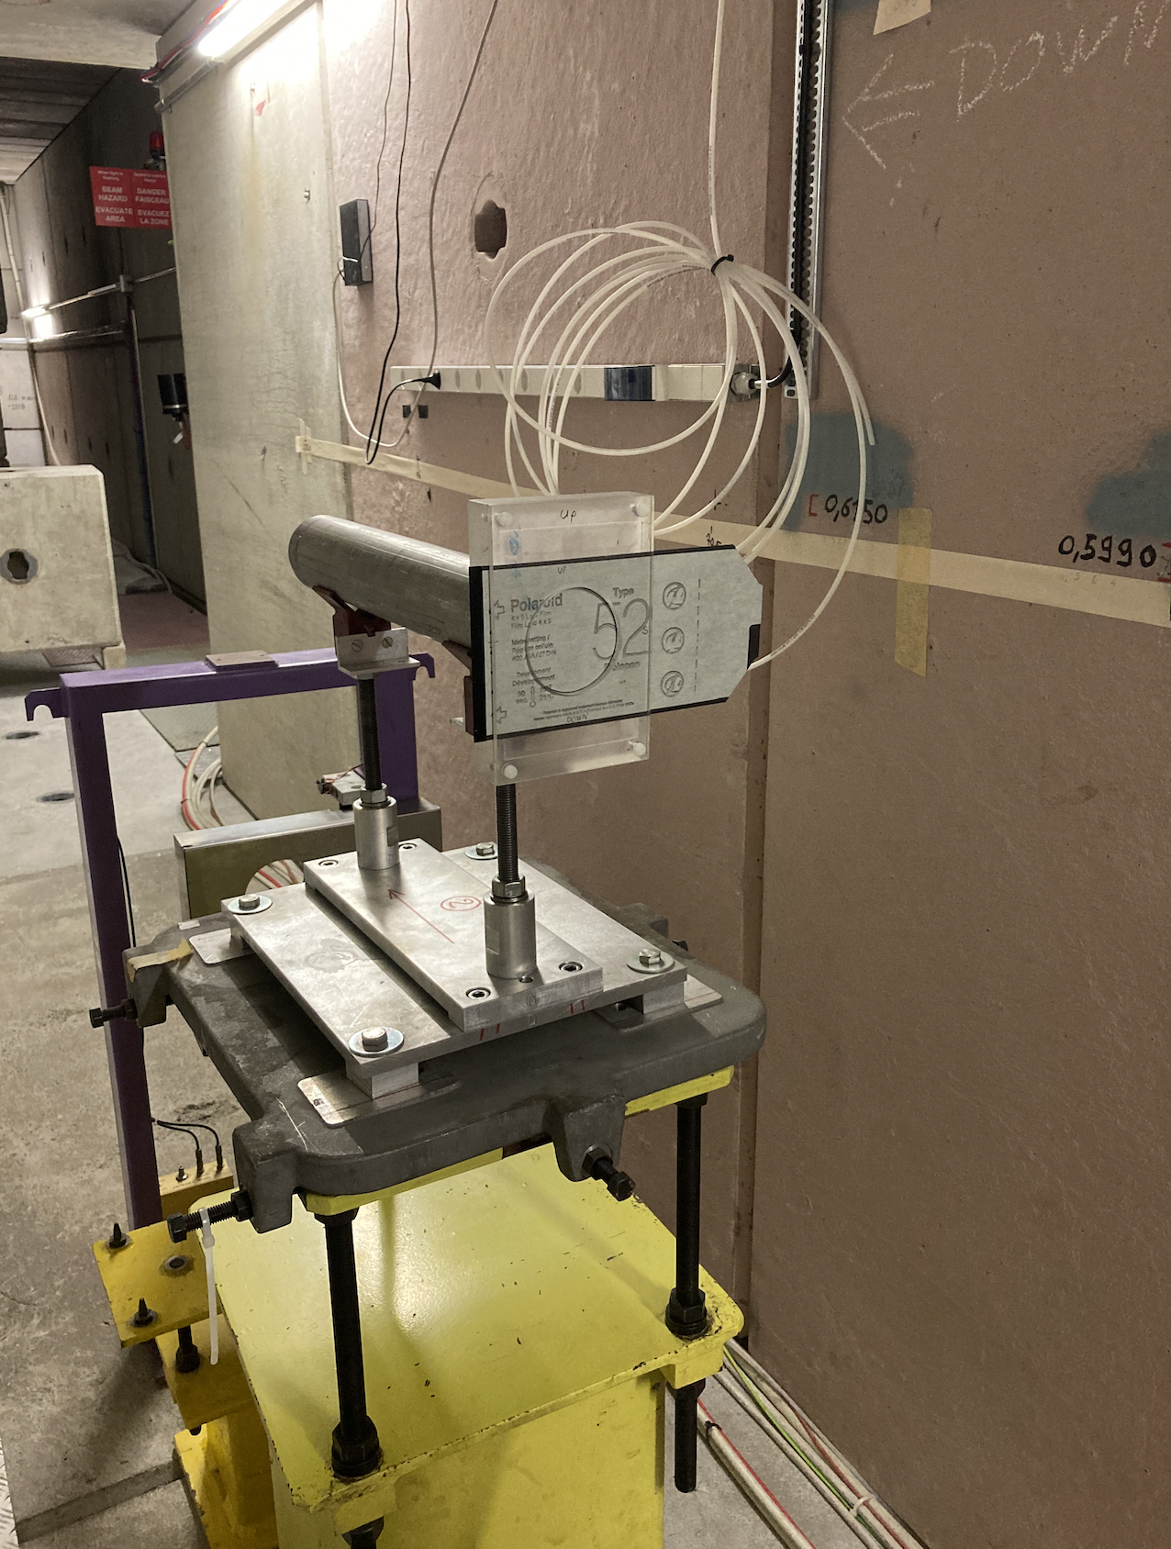
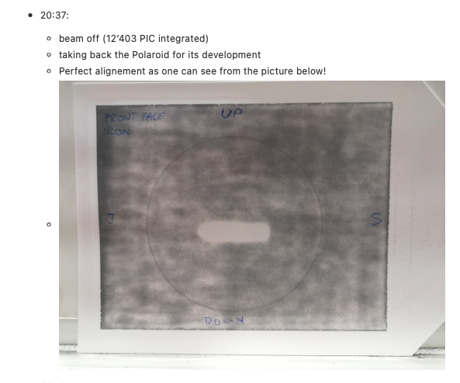
Highlights from yesterday
Beam smiling on our Polaroid!
(very well centred!)
Yesterday (Wed 10/05) dedicated to beam set-up, i.e. intensity scan and beam alignement
Around 11pm first irradiation started with passive dosimeters from PSI (Swtizerland)
This morning users from IRSN (France) and CAS (Czech Republic)
We wish to acknowledge the great support we received by Laurie and Dipanwita!
And thanks to BE-OP colleagues for the wonderful beam delivered so far!

